Slide 1
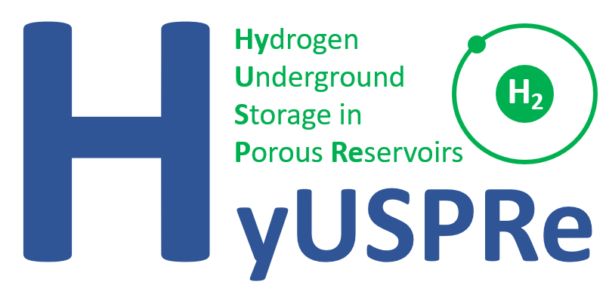







Hydrogen and Brine Displacement Processes in Clashach Sandstone: Relevance of Haine´s Jumps and Intermittent Flow
Eike M. Thaysen, Ian B. Butler, Damien Freitas, Aliakbar Hassanpouryouzband, Catherine Spurin, Roberto Rizzo, Fernando Alvarez Borges, Robert Atwood, Katriona Edlmann
Grant number EP/S027815/1

Slide 2
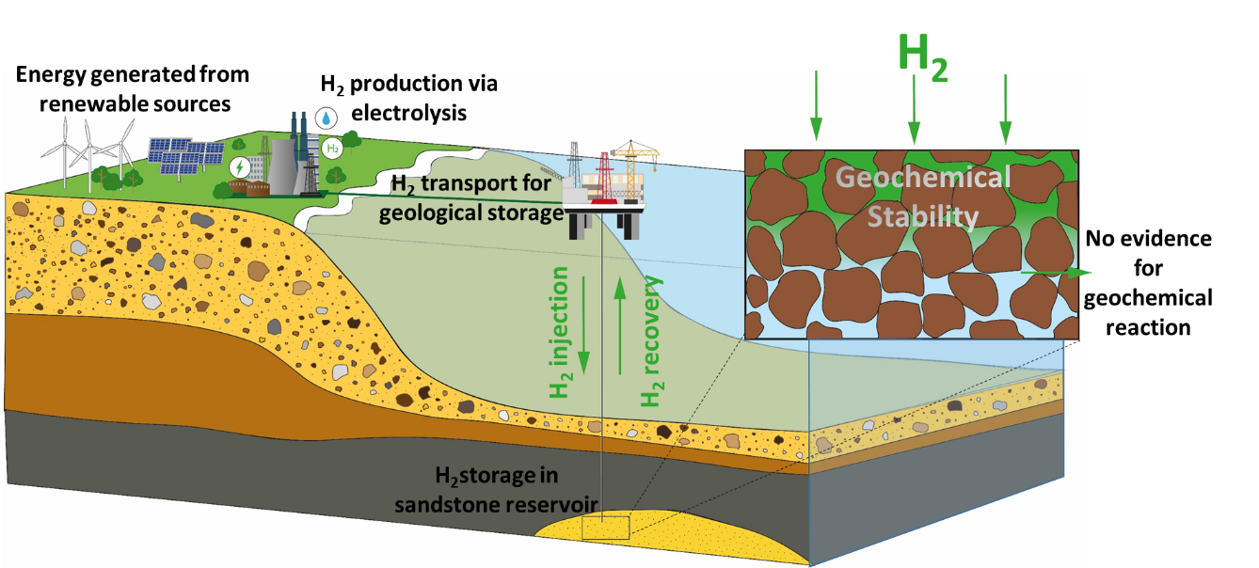
INTERSEASONAL POROUS MEDIA H₂ STORAGE- A TECHNOLOGY IN ITS INFANCY SHOES
H₂ fluid flow
injectivity
recoverability
Notes:
H2 storage in porous media could be a corner stone in our transition to a zero carbon society, providing H2 energy with the necessary large storage capacities. But several uncertainties are still connecting to H2 storage in porous media –one of them being the H2 fluid flow affecting the H2 injectivity and recoverability

Slide 3
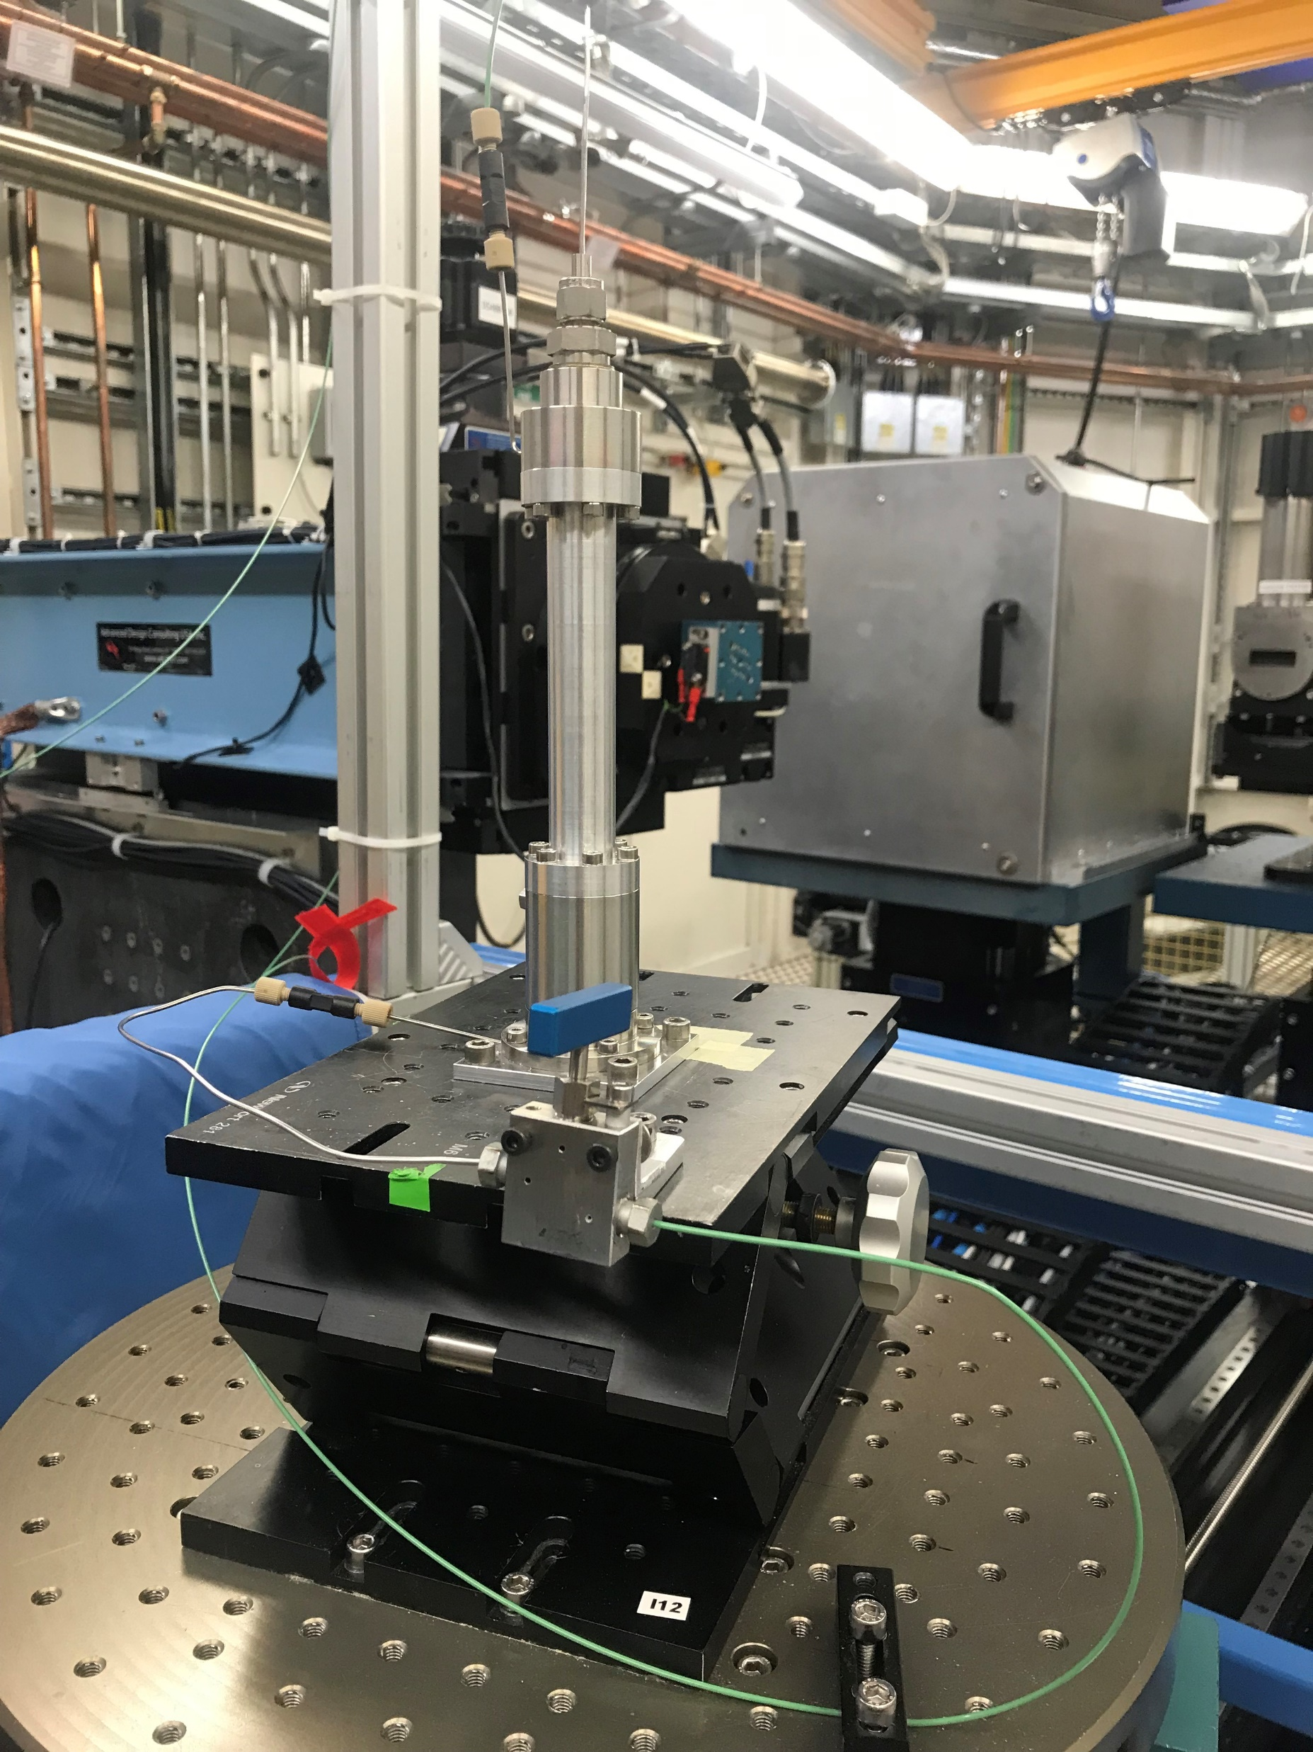
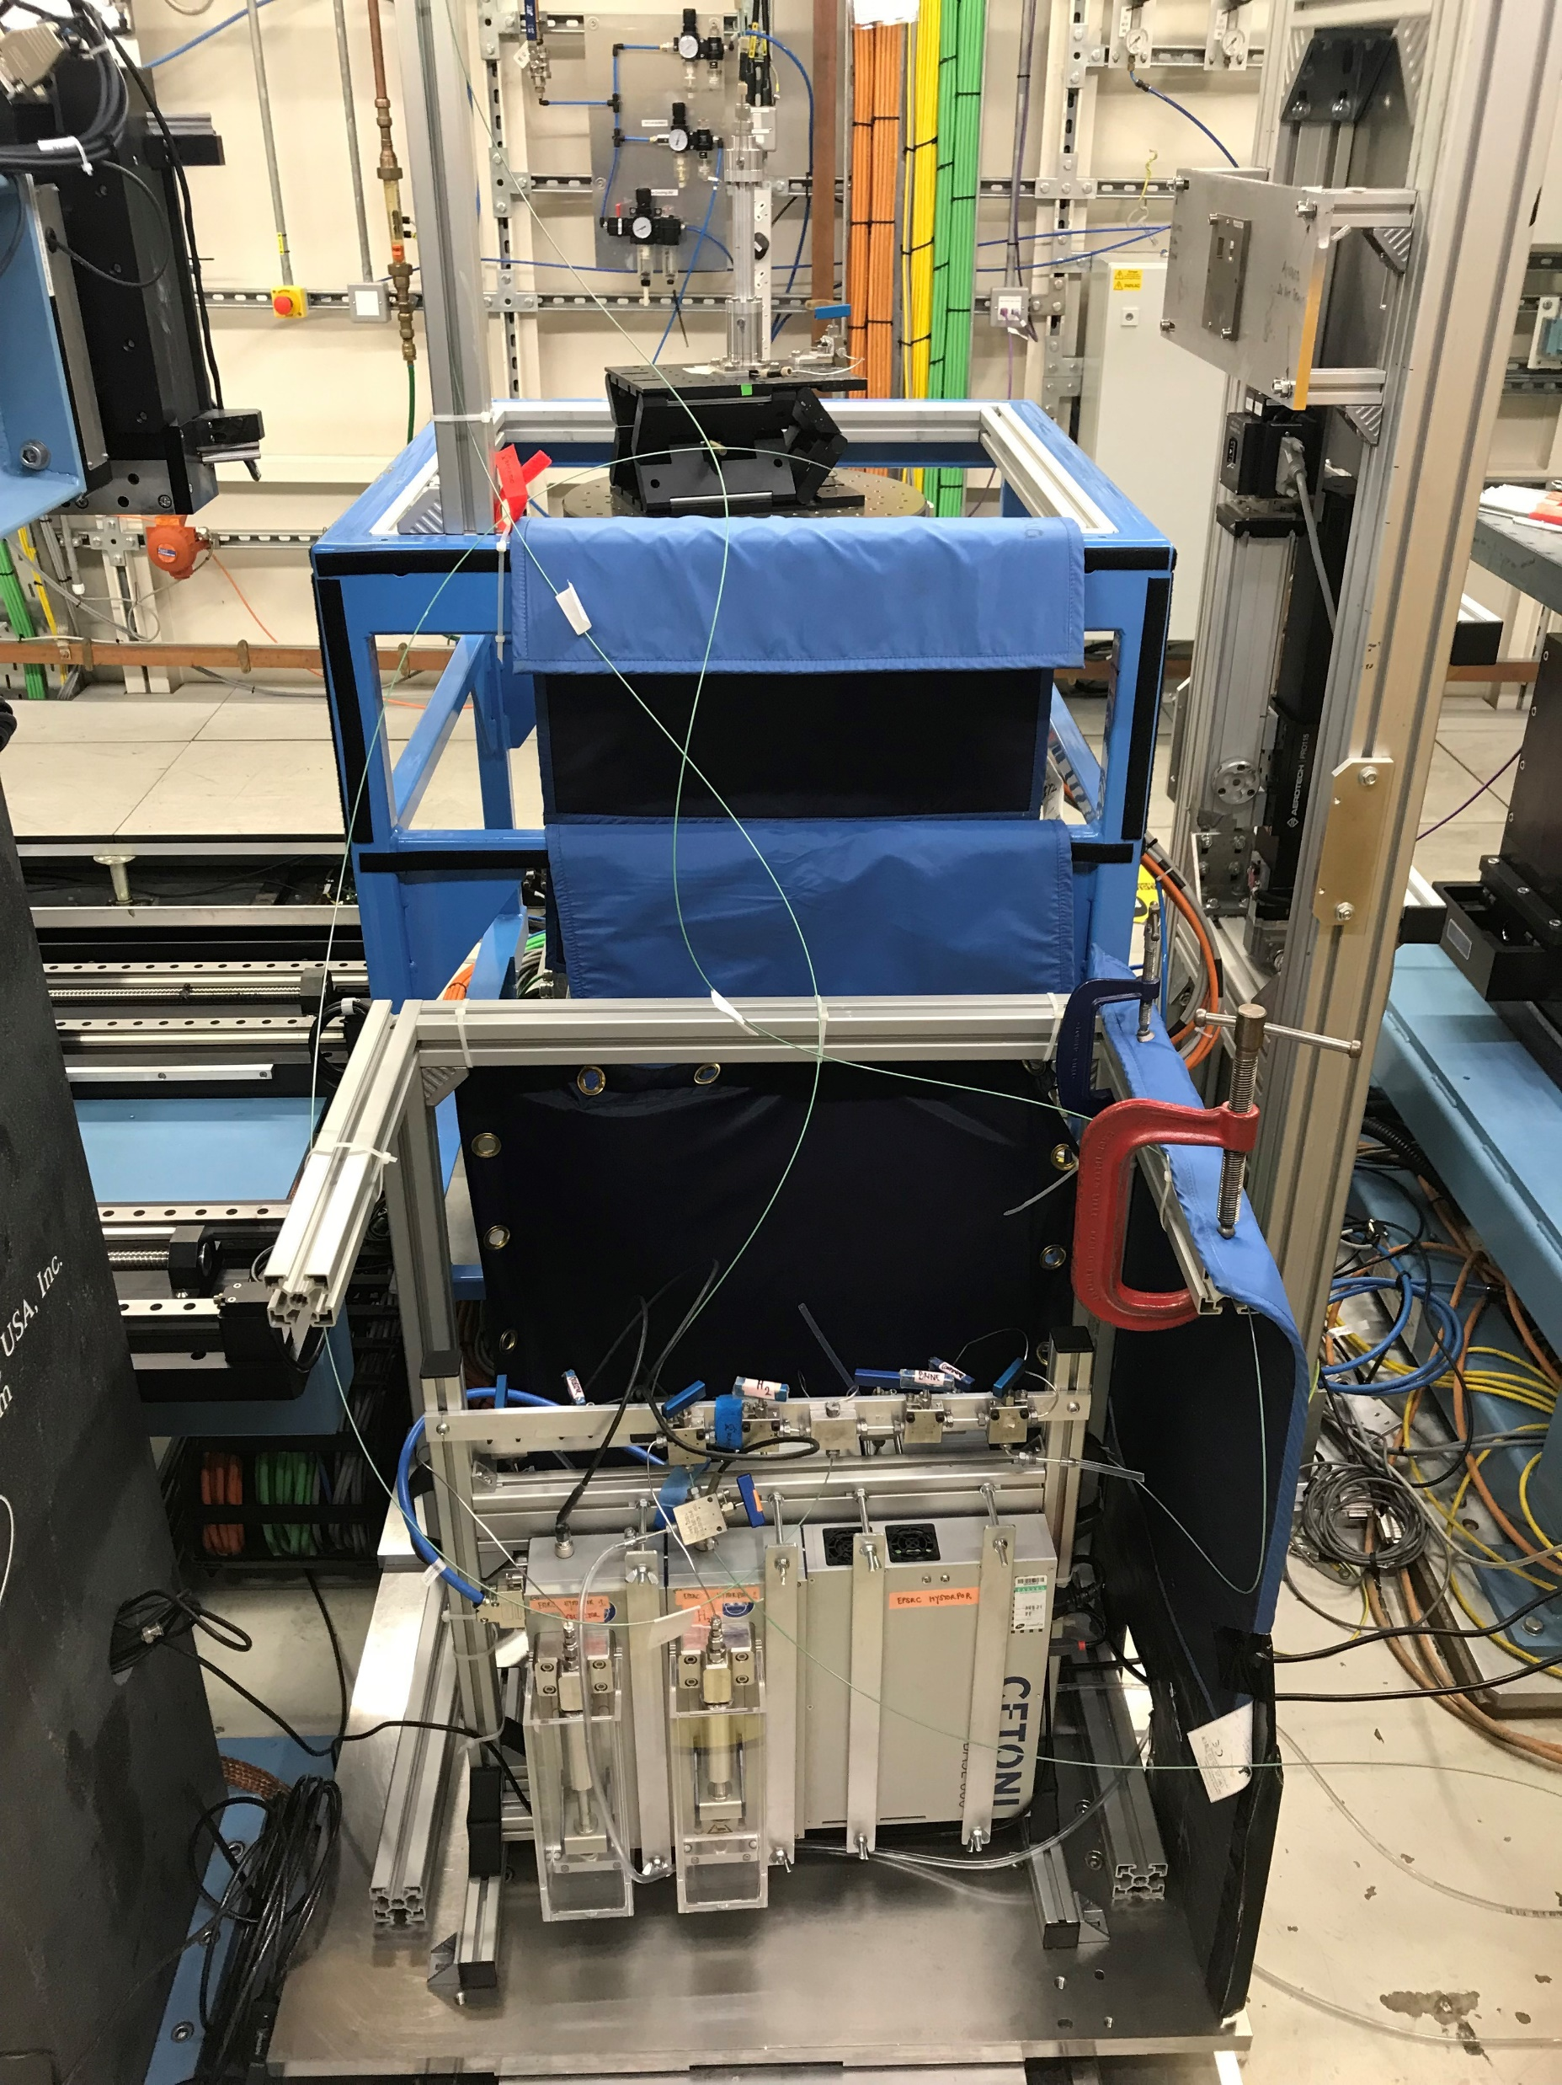
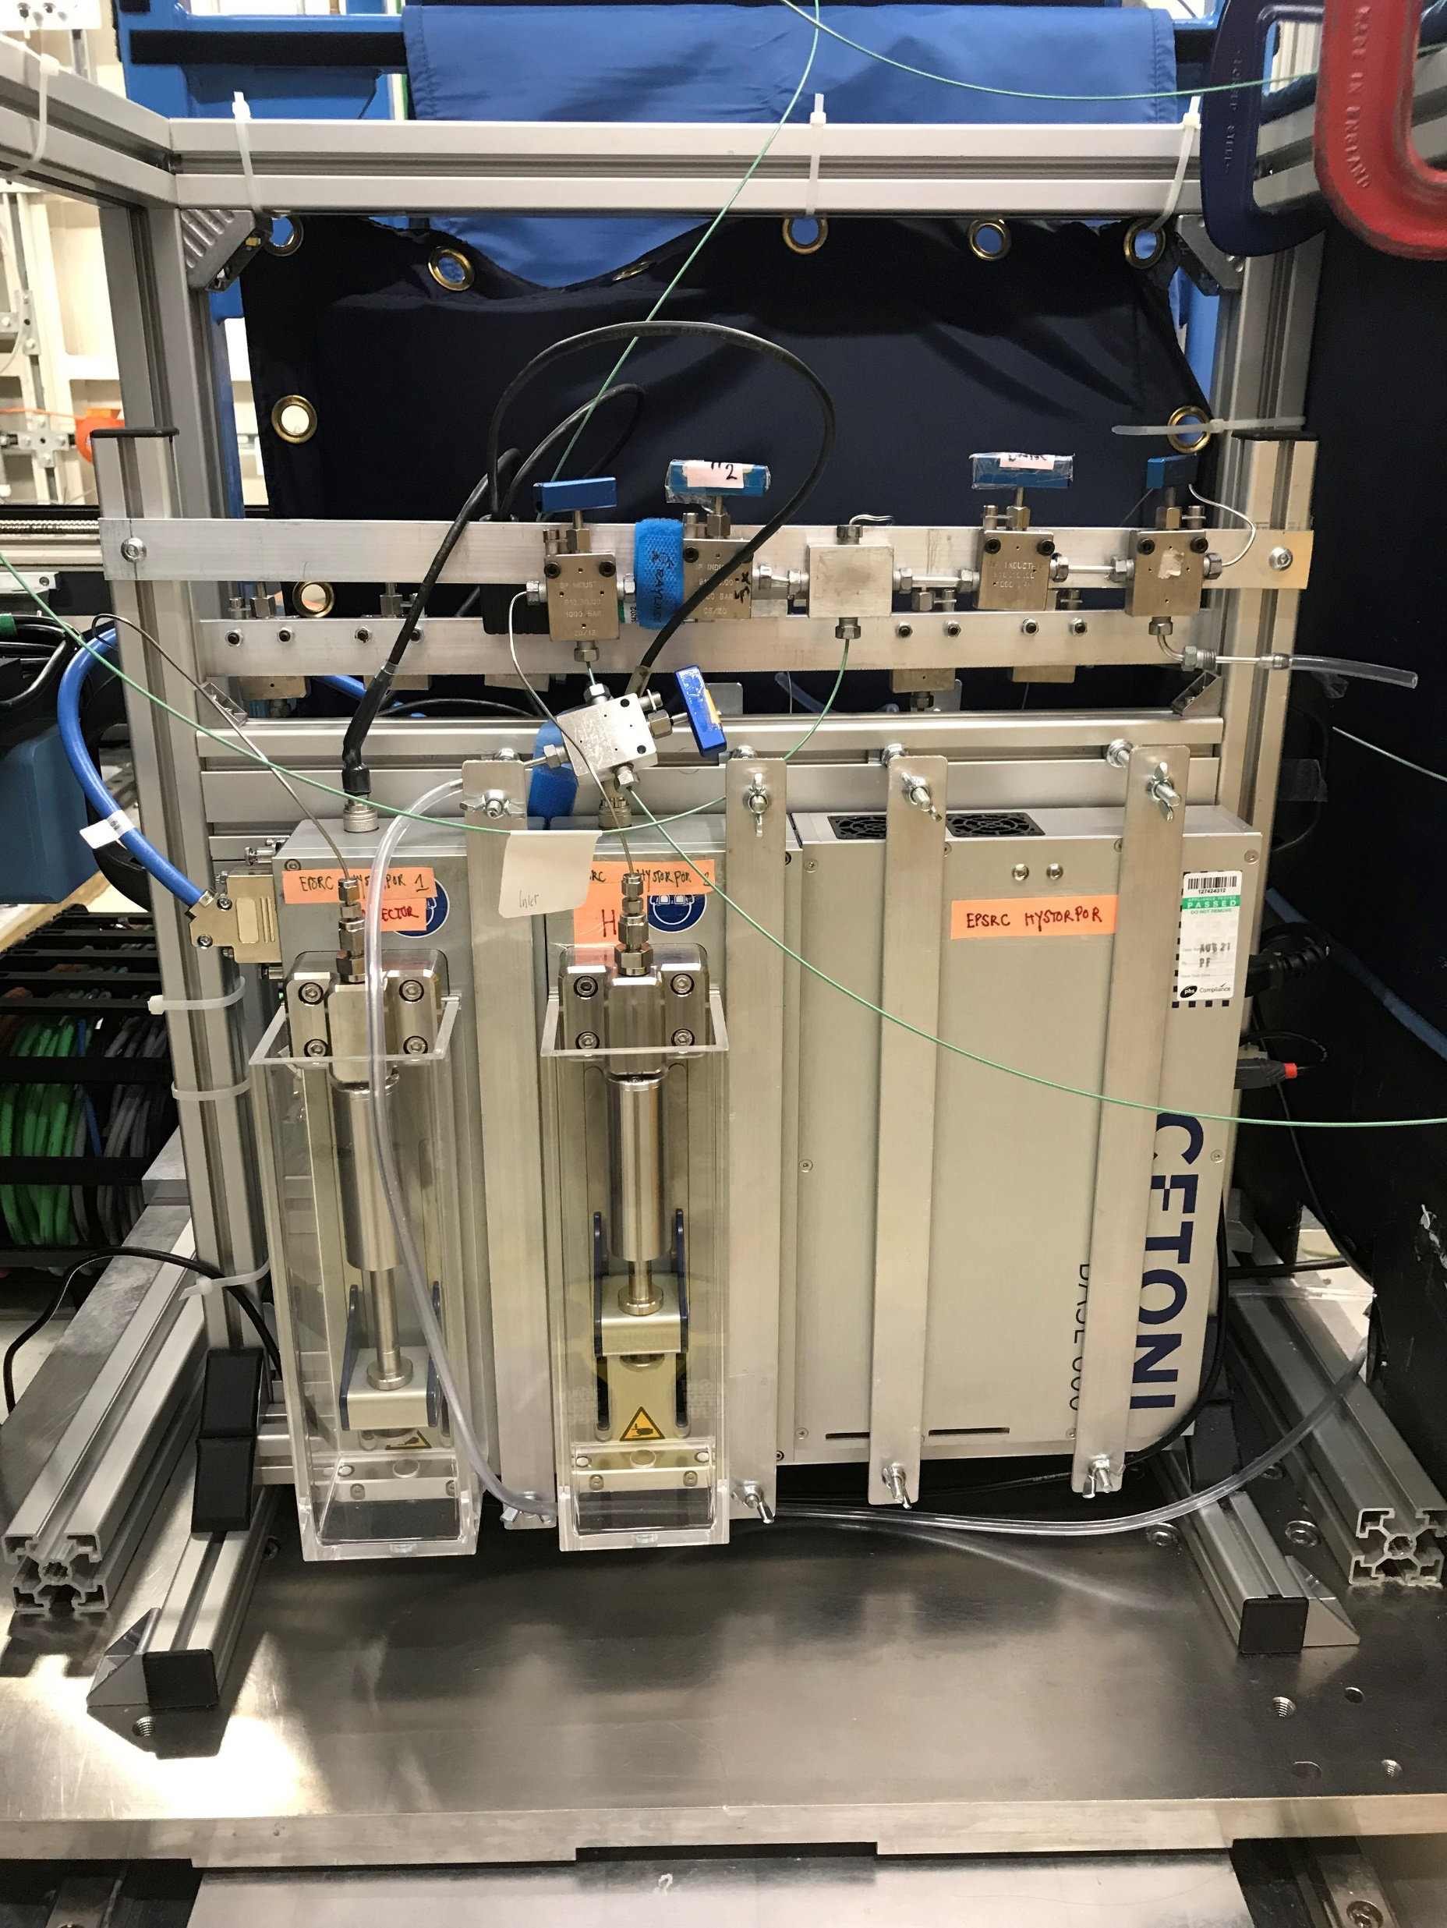
HIGH PRESSURE APPARATUS FOR VISUALIZING H₂ FLOW IN ROCKS
Rock sample inside X-ray transparent
pressure vessel
4 high pressure pumps for injecting H₂ and brine, for the confining pressure and for backpressure

Slide 4
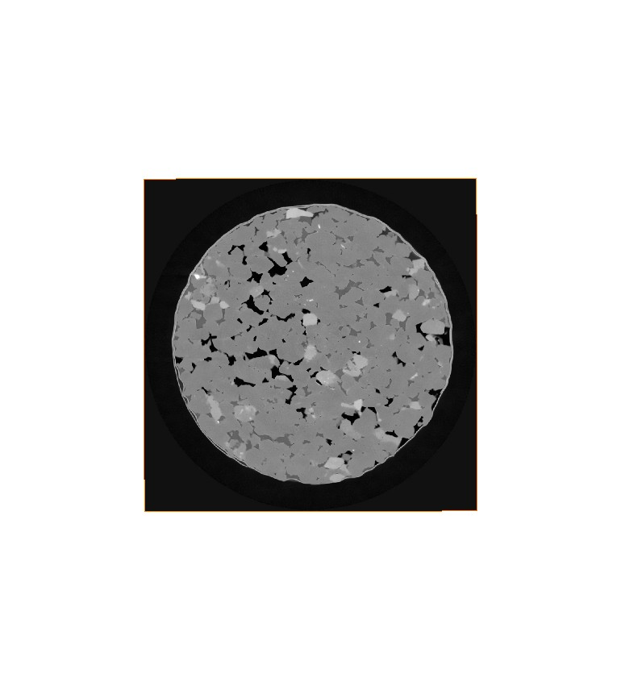
H₂ BEHAVES AS A NON-WETTING PHASE
(d)
brine
H₂ (black) fills the centre of the pores
Residual brine (dark grey) remains in corners, pore throats and in thin films around grains
H₂
H₂
rock
H₂
0.5 mm
Clashach sandstone after injection of 10 PV of brine (0.5 M CsCl) followed by 10 PV H₂
Thaysen et al., 2023, Int J Hydrogen Energy, 48 (8), 3091-3106
Notes:
Moving on to the results what you see here is a an image that was taken after saturation of the rock sample with 10 pore volumes of brine (where we used 0.5 molar Cesium chloride) and subsequent injection of 10 pore volumes of hydrogen. The rock is shown in different tones of light grey, the brine appears as dark grey and the hydrogen is black.
Looking more closely at the distribution of brine and hydrogen in the pore space we see that the hydrogen fills the centre of the pores with residual brine shown in the pore throats and corners, and as thin films around grains.
So clearly, hydrogen behaved as a nonwetting phase and brine as a wetting phase in our experiments.

Slide 5
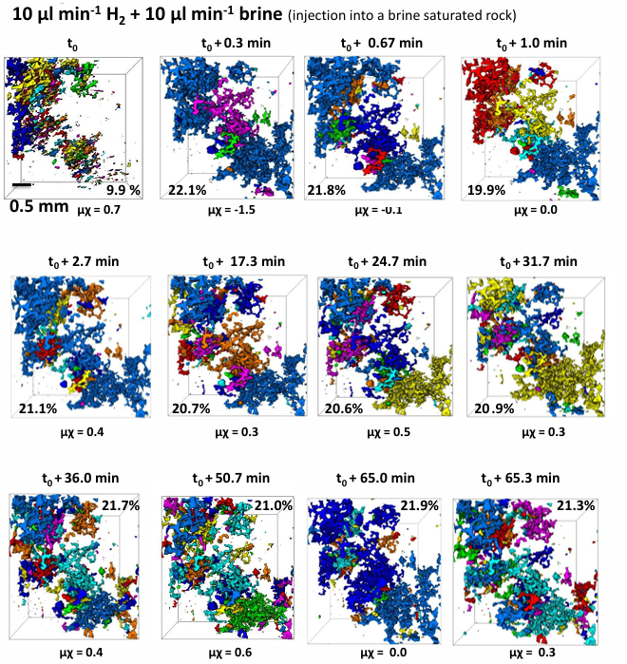
STEADY STATE INJECTIONS @ 1:1 INJECTION RATIO 20-22% H₂ SATURATION & WEAK CONNECTIVITY

Slide 6
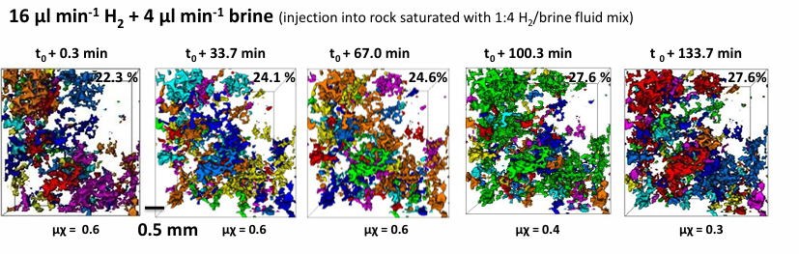
STEADY STATE INJECTIONS @ 4:1 INJECTION RATIO H₂ SATURATION INCREASES UP TO 28%. WEAK H₂ CONNECTIVITY
Miniminal influence of connectivity on pore space saturation
Thaysen et al., 2025, J Colloid Interface Sci, 694 (137704)

Slide 7
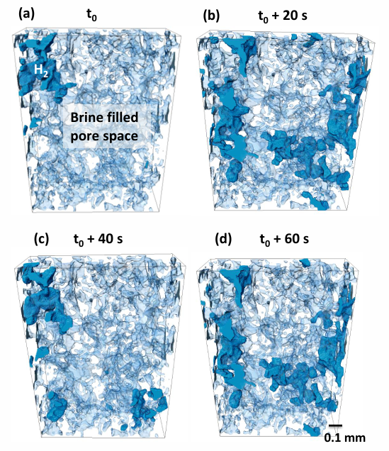
H₂ FILLING OF PORE SPACE: INTERMITTENT FLOW IN PARTS OF THE VOLUME
Darcy´s law, widely applied for reservoir
simulations, assumes continuous flow
Ca=4.7 ×10⁻⁹
Thaysen et al., 2025, J Colloid Interface Sci, 694 (137704)

Slide 8
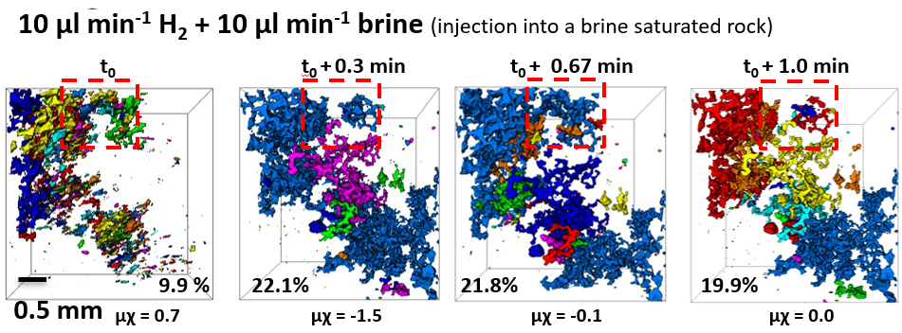
STEADY STATE INJECTIONS @ 1:1 INJECTION RATIO INTERMITTENT FLOW
volume of H₂ moving intermittendly is minor
Thaysen et al., 2025, J Colloid Interface Sci, 694 (137704)

Slide 9
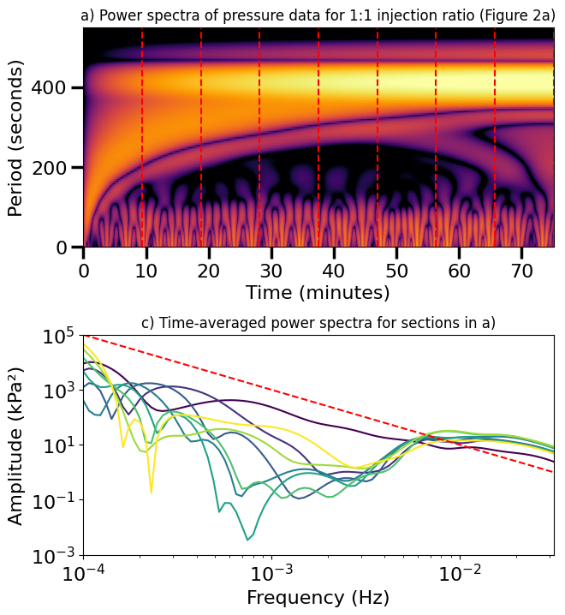
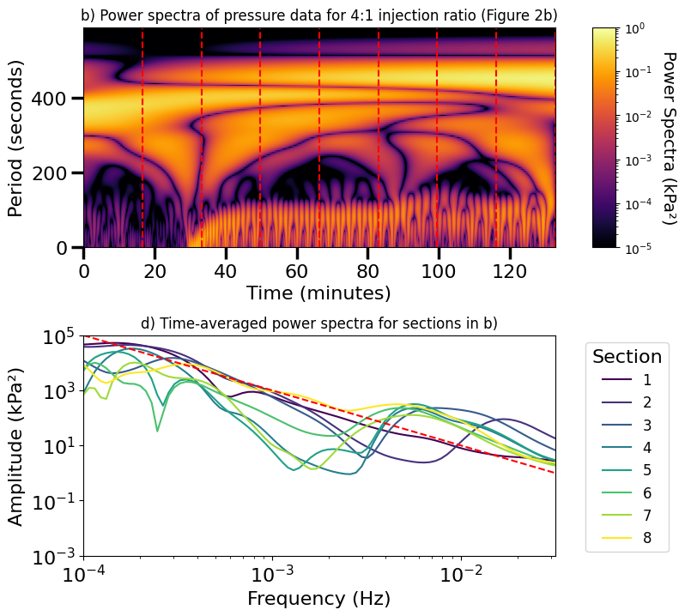
PRESSURE FLUCTUATIONS AT CORE OUTLET CONFIRM INTERMITTENT FLOW
injection ratio 1:1
injection ratio 4:1
red noise
Thaysen et al., 2025, J Colloid Interface Sci, 694 (137704)
Notes:
Power spectra: Transformation of the pressure data into the frequency domain using a continuous wavelet transformation
At both the 1:1 and 4:1 H₂/brine injection ratios, the pressure oscillations had intervals of 2-3 minutes (Fig. 9b and d; ´bumps at ̴ 10⁻²´). Both injection schemes were characteristic of red or Brownian noise, i.e. pressure signals produced by Brownian motion (shown by the red dashed lines in Fig. 9b and d). The pressure signal prior to gas arrival was characterized by white noise (random noise for frequencies > 10⁻³ Hz; SI Fig. S4).
Red noise indicates a stochastic process where pressure fluctuations are seen throughout the pore space, resulting in intermittent filling of pores over a wide range of time-scales, from seconds to minutes

Slide 10

H₂ RELATIVE PERMEABILITY ESTIMATION
LET MODEL
Lomeland, 2018
LET PARAMETERS
L_{w} = 8.0
L_{g} = 8.5
E_{w} = 0.06
E_{g} = 0.01
T_{w} = 2.0
T_{g} = 4.0
predictions of gas injectivity and recovery should be made with caution due to the neglection of the irreducible water saturation in fractional flow data
Flowrate: 20 µl min⁻¹ (N_{c}: ~2*10⁻⁸ for drainage; ~2*10⁻⁶ for imbibition), P_{c} = 80 Bar, temp = ambient
Notes:
Krevor et al. [59] observed similarly low CO₂ saturation ratios and relative permeabilities in Berea sandstone at 50 °C and 9 MPa injection pressure (Fig. 11). Compared to CO₂, H₂ is more wetting (Fig. 11), as shown previously [60].

Slide 11
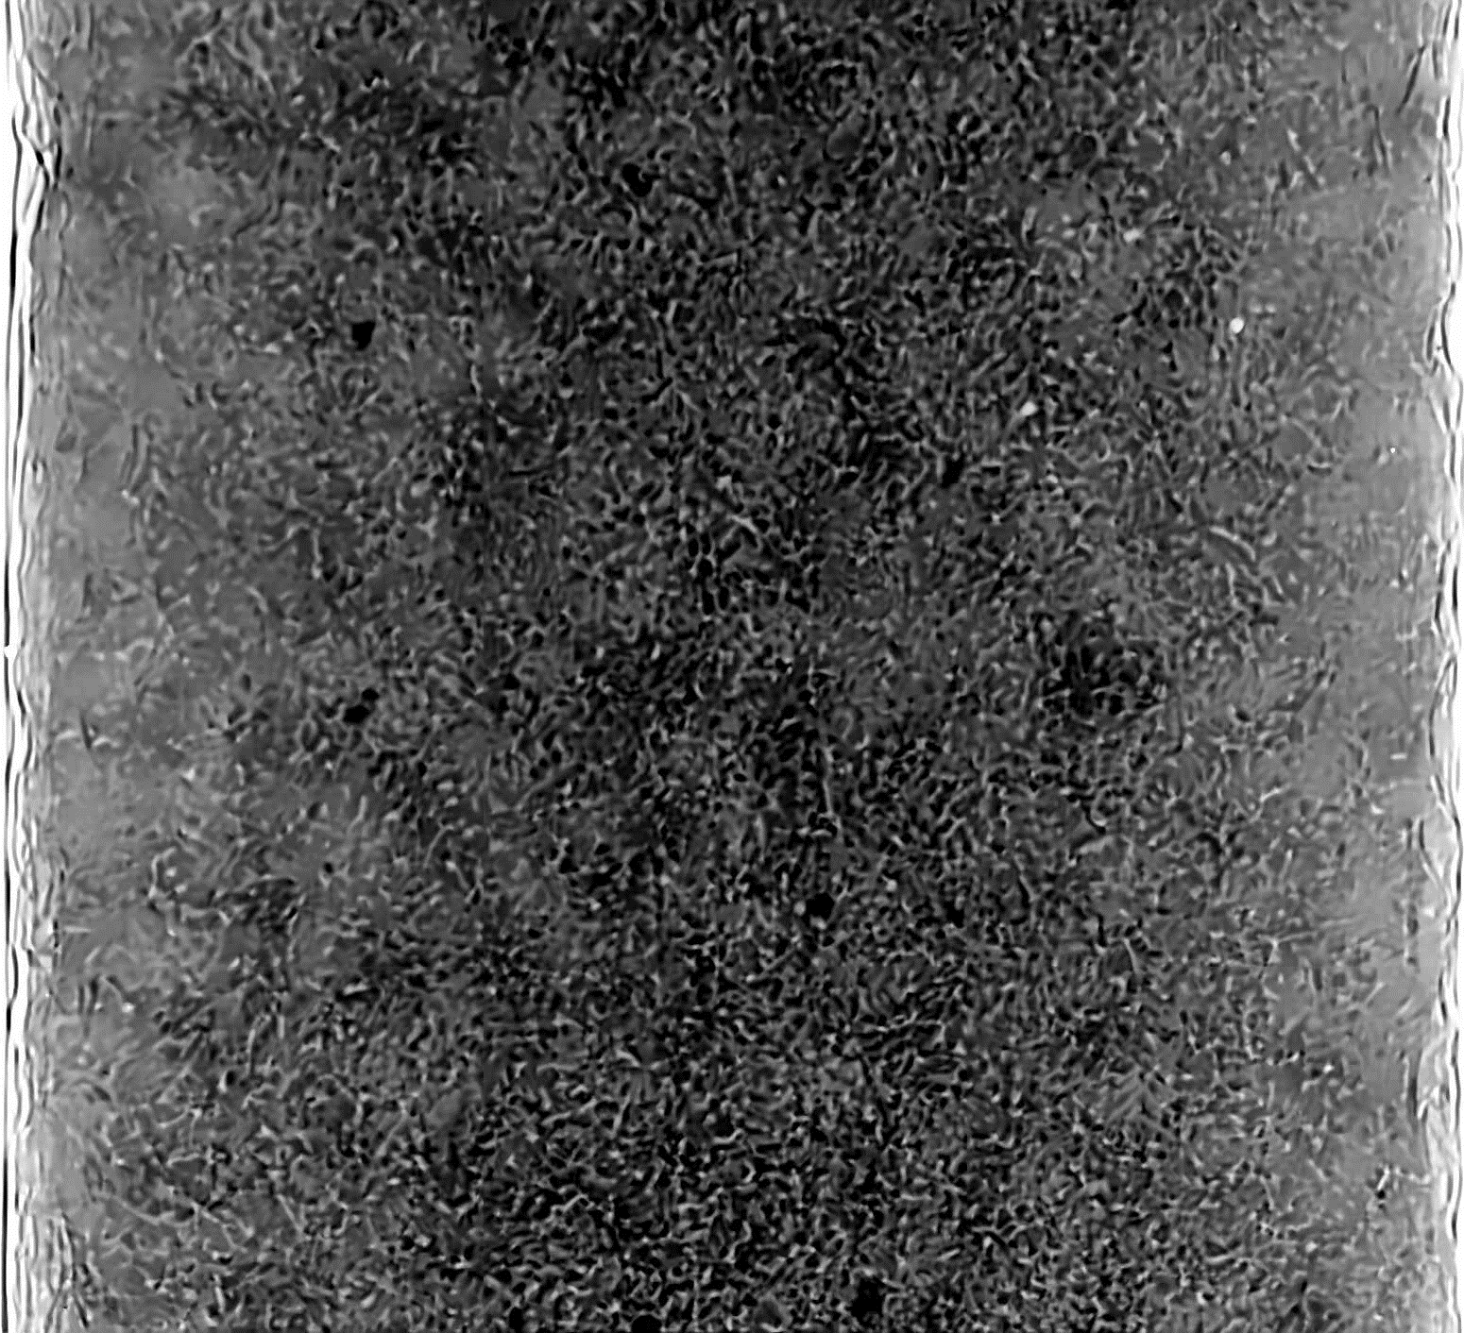
2D RADIOGRAPHS DURING
UNSTEADY STATE INJECTIONS:
HAINES JUMPS?
Haines jumps are important energy-dissipating pore-scale events that are key to understand multiphase fluid flow
2D radiography to provide insights on dynamic fluid processes that occur over timescales of 10s to 100s of milliseconds
Thaysen et al., 2025, J Colloid Interface Sci, 694 (137704)

Slide 12
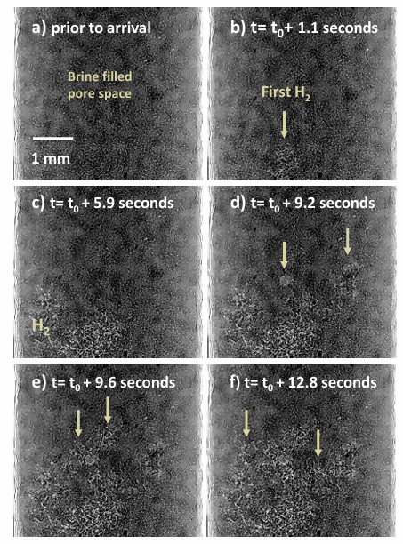
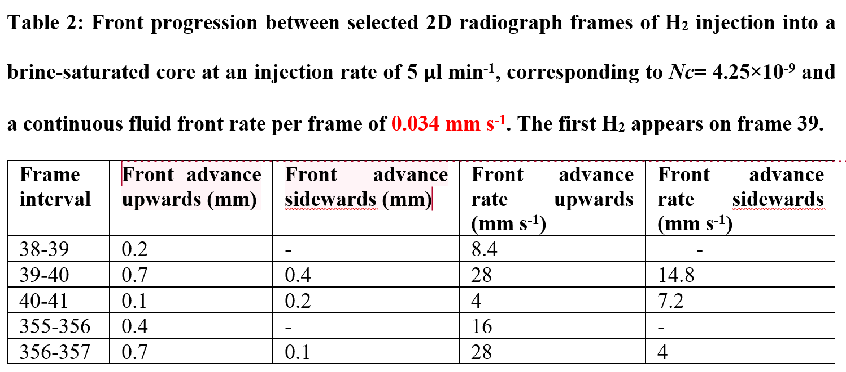
2D RADIOGRAPHS DURING
UNSTEADY STATE INJECTIONS :
HAINES JUMPS IN ACTION
mean pore diameter: 0.035 µm
Thaysen et al., 2025, J Colloid Interface Sci, 694 (137704)

Slide 13
CONCLUSIONS
Higher H₂ fractional flow increased H₂ saturation from 20-22% to 28%
lower H₂ storage capacity in aquifers with higher hydrodynamic flow
H₂ connectivity: weak and unchanged at different fractional flows
minimal influence of connectivity on H₂ saturation
low H₂ recovery in aquifers with hydrodynamic flow
Intermittent flow detected but limited volume of fluctuating H₂
applicability of Darcy´s law to describe the bulk H₂ and brine fluid flow not challenged
Geological models should include Haines jumps and intermittent flow to improve accuracy
Notes:
A higher H₂ fractional flow of 0.75 relative to 0.5 increased the H₂ saturation in the pore space from 20-22% to 28%, implying a lower H₂ storage capacity in aquifers with higher hydrodynamic flow.
Hydrogen connectivity was weak and remained similar across different H₂ fractional flows, indicating minimal influence of connectivity on pore space H₂ saturation, and suggesting low H₂ recovery in aquifers with hydrodynamic flow, which may adversely affect the economic feasibility of the storage operation.
Confirm at higher resolution
Intermittent flow was detected in parts of the rock during steady-state injections, but the volume of fluctuating H₂ was limited, indicating that the applicability of Darcy´s law to describe the bulk H₂ and brine fluid flow based on relative permeability and capillary pressure was not challenged

Slide 14
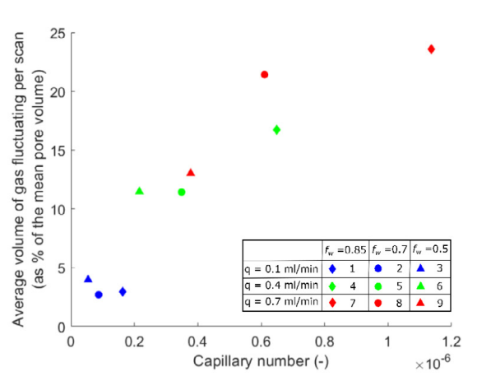
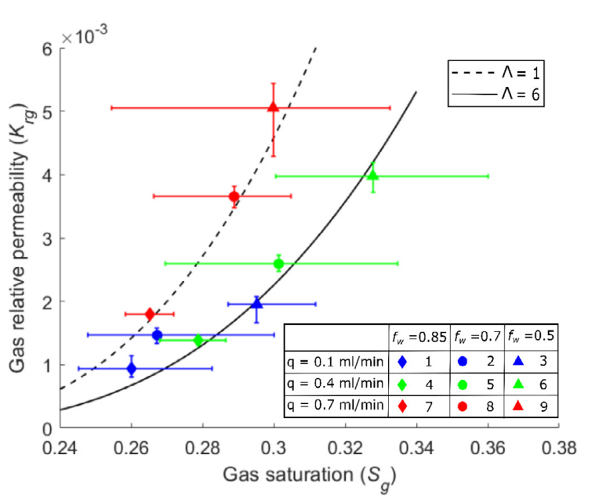
N₂ steady state experiments
FUTURE EXPERIMENTS
Confirm connectivity at higher resolution
Determine the capillary number at which intermittent flow will affect macroscale flow behaviour
lower viscosity ratio → relatively more intermittent flow can be expected for a given flow rate and shifts in the relative permeability can be expected at lower capillary number than for N₂.
Spurin et al. (2019): Adv Water Res 150 (103868),1-7
Notes:
The fraction of intermittent flow is likely to increase at flow rates corresponding to higher capillary numbers. To model intermittent flow alongside laminar flow, new reservoir models incorporating Navier-Stokes equations may have to be developed. Future experiments should quantify the volume of H₂ fluctuating intermittently as a function of capillary number and fractional flow to quantify the increase of intermittent flow with increasing capillary number and to determine the capillary number at which intermittent flow will affect macroscale flow behaviour such as the relative permeability.
Considering the lower viscosity ratio of the H₂-brine system compared to the N₂-brine system, relatively more intermittent flow can be expected for a given flow rate and shifts in the kr_{H2} can be expected at lower N_{c} than for N₂.

Slide 15
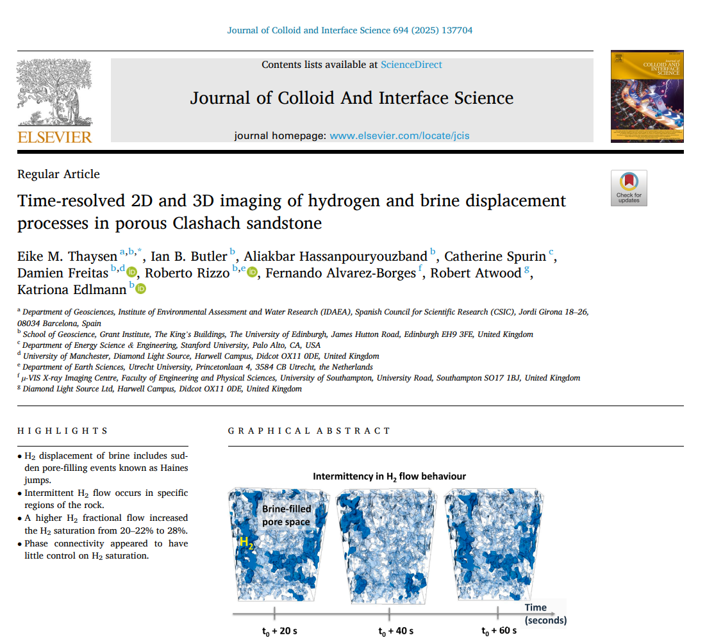
Thank you!
eike.thaysen@idaea.csic.es

Slide 16
H₂ RELATIVE PERMEABILITY ESTIMATION
LET MODEL
high permeability relative to previous studies in similar systems
predictions of gas injectivity and recovery should be made with caution due to the neglection of the irreducible water saturation in fractional flow data
LET PARAMETERS
L_{w} = 8.0
L_{g} = 8.5
E_{w} = 0.06
E_{g} = 0.01
T_{w} = 2.0
T_{g} = 4.0
Flowrate: 20 µl min⁻¹ (N_{c}: ~2*10⁻⁸ for drainage; ~2*10⁻⁶ for imbibition), P_{c} = 80 Bar, temp = ambient
Notes:
Krevor et al. [59] observed similarly low CO₂ saturation ratios and relative permeabilities in Berea sandstone at 50 °C and 9 MPa injection pressure (Fig. 11). Compared to CO₂, H₂ is more wetting (Fig. 11), as shown previously [60].

Slide 17
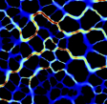
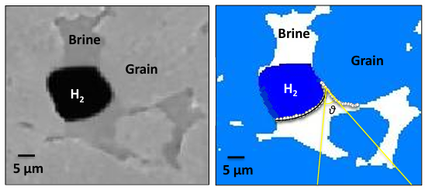
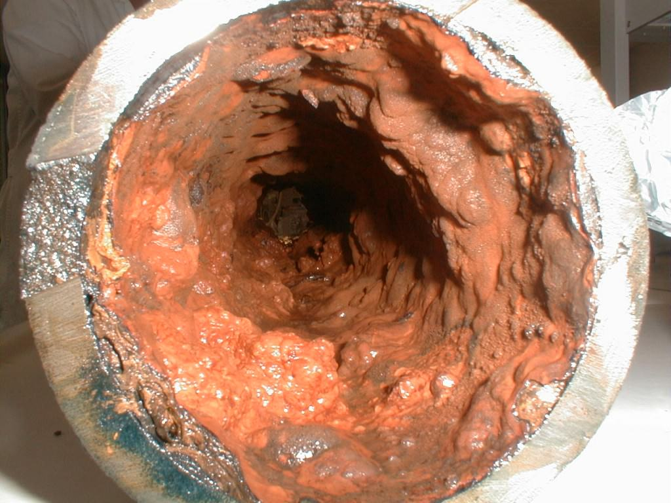
PARAMETERS THAT AFFECT H₂ INJECTIVITY & RECOVERY
Key parameters:
Pore network connectivity, relative permeability/capillary pressure relationships with varying fluid saturation, porosity
Other parameters:
Wettability (contact angle between H₂, brine and rock), tortuosity, absolute permeability
Cushion gas
Biofilm
Clogging of pores and pipes

Slide 18
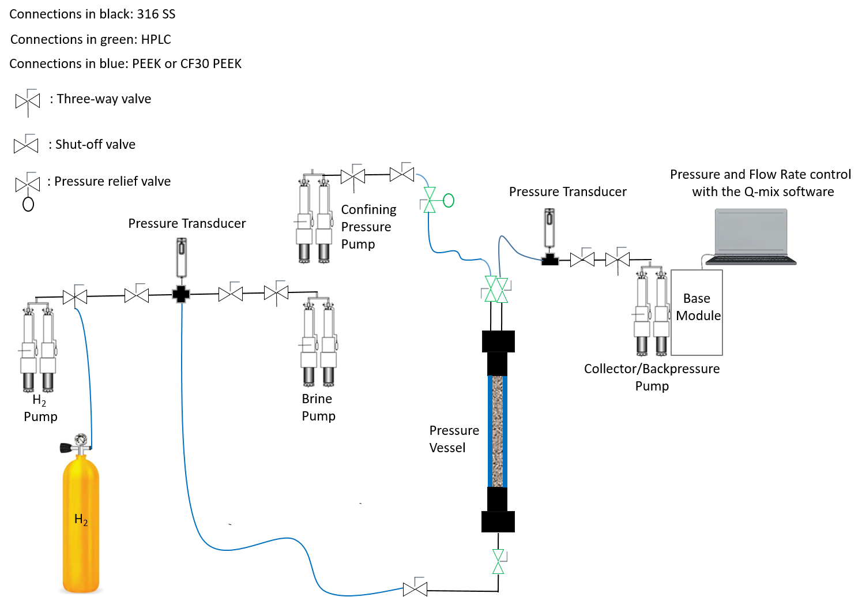
HIGH PRESSURE APPARATUS FOR VISUALIZING H₂ FLOW IN ROCKS
5 mm diameter Clashash sandstone
20-70 Bar

