Slide 1
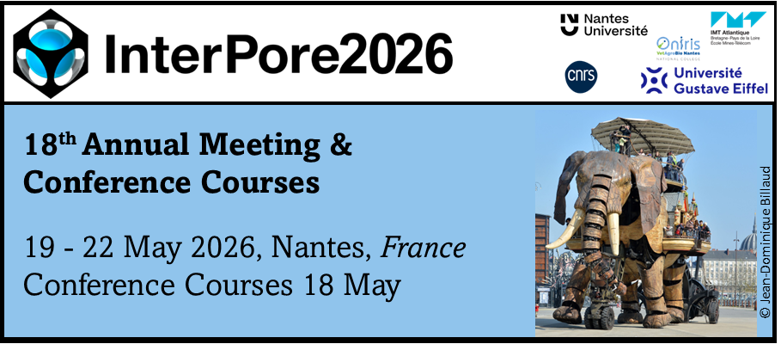


Interfacial Effects of an Anionic Surfactant on Evaporation in a Porous Medium
Ayomikun Bello, Abdolreza Kharaghani, Evangelos Tsotsas
Institute of Process Engineering, Otto von Guericke University, Magdeburg, Germany
Ayomikun Bello, Ph.D.,
Alexander von Humboldt Postdoctoral Fellow
18th Annual International Conference on Porous Media (InterPore 2026)
22nd May, 2026. Nantes, France

Slide 2
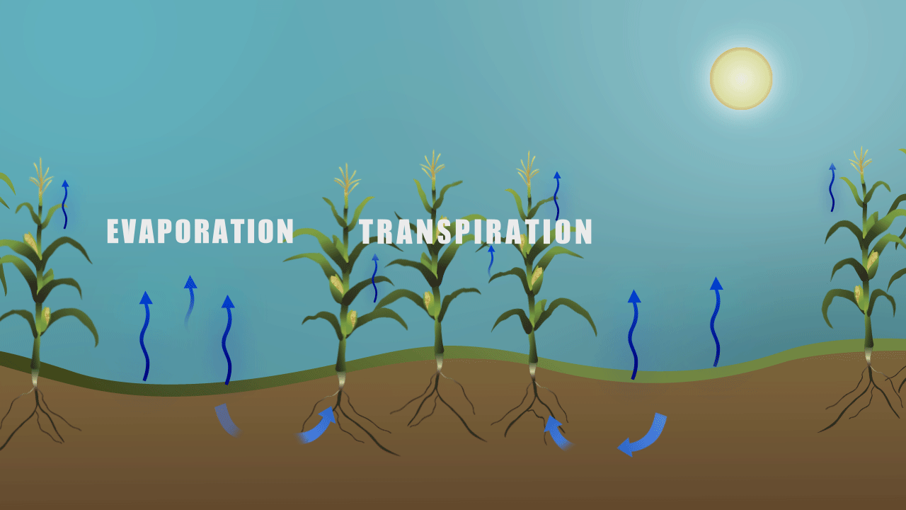
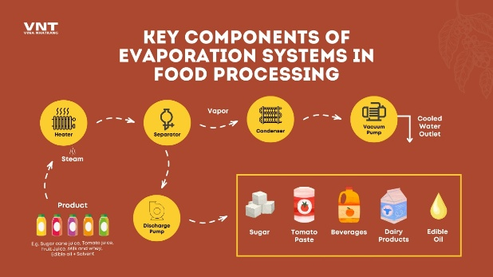
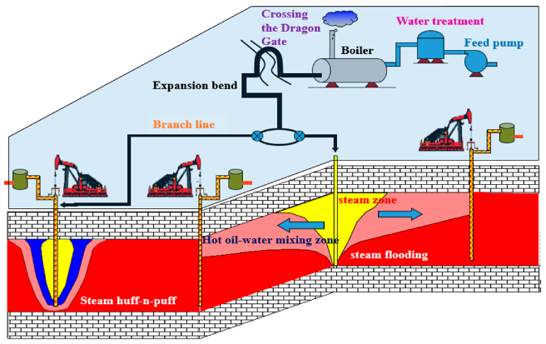
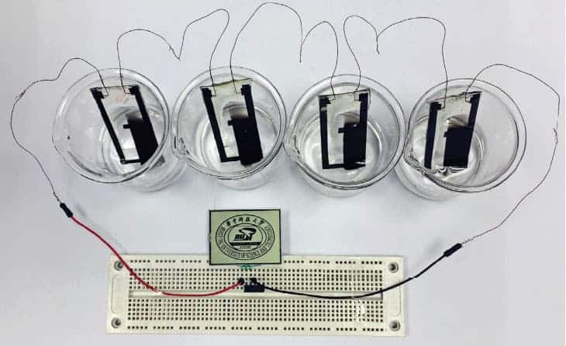
INTRODUCTION: Evaporation in porous media
Evaporation is the process by which molecules at the surface of a liquid gain enough energy to escape into the gas phase.
Evaporation is the process by which molecules at the surface of a liquid gain enough energy to escape into the gas phase.
What is evaporation in porous media?
The removal of liquid through phase change while air invades pore spaces
Controlled by capillary forces, pore geometry, surface tension, and wettability
Why it matters (applications):
Soil science & agriculture (irrigation efficiency, soil moisture management)
Energy & environment (fuel cells, CO₂ storage)
Industrial drying (food, pharmaceuticals)
Soil drying
Food processing
Enhanced oil recovery
Energy devices
Notes:
So let's start with the basics. Evaporation in porous media is the process by which a liquid is removed from a solid material through vaporization, as air progressively invades the pore spaces left behind. What makes this different from evaporation off an open surface is that it's controlled by capillary forces, the balance between surface tension and pore geometry. This makes it inherently complex and spatially variable. It is important in many applications, such as soil drying, agriculture, fuel cells, CO₂ storage, and industrial drying processes. So understanding the mechanisms behind evaporation is not only scientifically interesting but also very relevant for engineering applications.

Slide 3
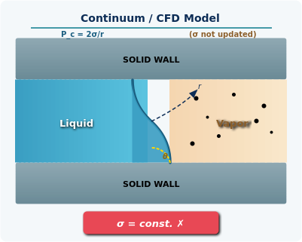
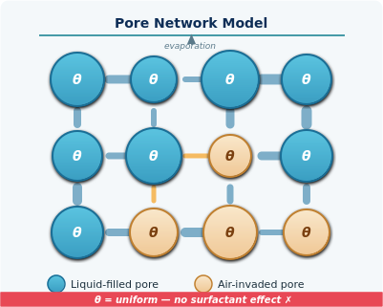
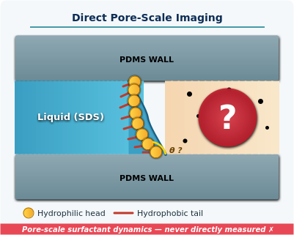
INTRODUCTION: Research gap
Continuum / CFD models
Pore network models
Direct pore-scale imaging
Treat σ as constant - surfactant effects on Laplace pressure not resolved
Assume uniform, static wettability θ - dynamic surfactant adsorption not captured
Surfactant redistribution, meniscus shape change & film dynamics at pore level never directly measured
Research Question: How does surfactant concentration, relative to the CMC, modify pore-scale meniscus dynamics, wettability, and evaporation kinetics?
Notes:
Many existing studies assume that surface tension remains constant and that wettability does not change during evaporation. However, when surfactants are present, this assumption is no longer valid. Surfactants can redistribute dynamically, change the contact angle, modify meniscus shape, and influence thin liquid films. Most previous work relies on continuum models, CFD, or pore network models. But the actual pore-scale mechanisms, such as meniscus evolution and surfactant effects, have rarely been directly observed experimentally. So our research question is: How does surfactant concentration, especially relative to the critical micelle concentration, modify pore-scale evaporation dynamics?

Slide 4
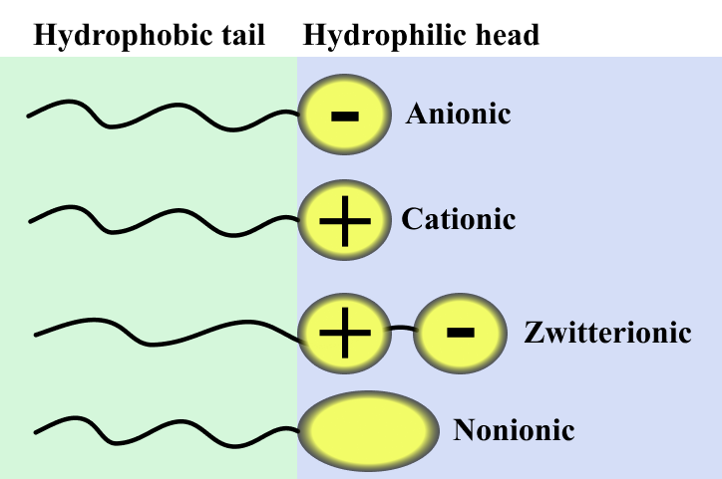
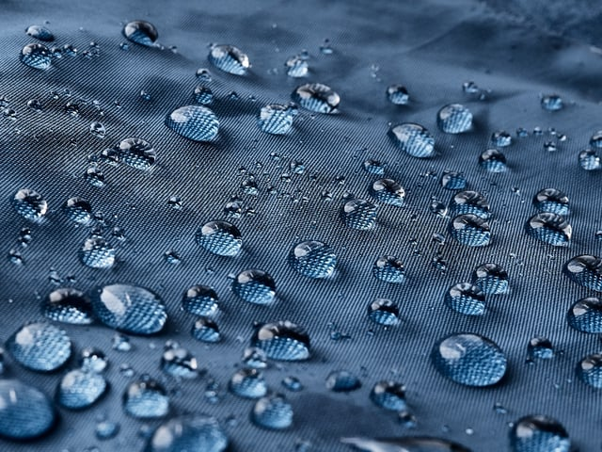
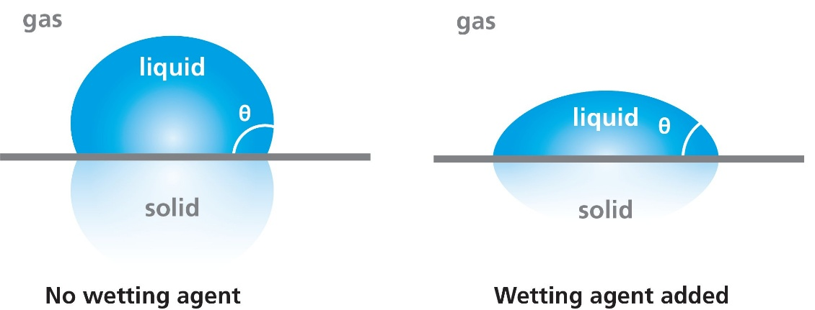
INTRODUCTION: Key concepts about surfactants and wettability
Wettability
Surfactant types
Wettability alteration
Surfactants → (1) reduce surface tension, (2) change contact angle, (3) drive Marangoni flows
Surface tension ↓ → more spreading → larger liquid–gas area
Marangoni flows: tangential interfacial flows from surface‑tension gradients
Notes:
Before getting into the results, I want to quickly cover the key physical concepts at play. Surfactants are molecules with a hydrophilic head and a hydrophobic tail. In water, they accumulate at the air-water interface. When enough of them are present, they form a layer that reduces the surface tension of the liquid. This reduction in surface tension has three main consequences for our system. First, it changes how much pressure is needed for air to invade a pore, this is the capillary entry pressure. Second, it affects the contact angle, which determines how well the liquid wets the solid surface. And third, concentration gradients of surfactant can drive what are called Marangoni flows, tangential flows along the interface driven by surface tension gradients. Lower surface tension means more spreading, and a larger liquid-gas interface. That's one of the routes through which evaporation can actually be enhanced.

Slide 5
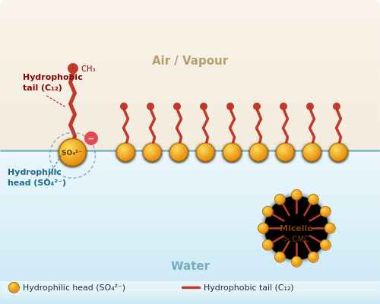
AIM AND OBJECTIVES
Aim:
To investigate how varying concentrations of sodium dodecyl sulfate (SDS) modify pore-scale evaporation dynamics in a PDMS microfluidic network, using direct optical imaging to quantify liquid saturation, meniscus and contact angle evolution.
Objectives:
Conduct evaporation experiments with pure water and SDS solutions below, at, and above CMC.
Quantify the evolution of liquid saturation over time using high-resolution pore-scale imaging and image analysis.
Characterize how surface tension reduction alters capillary entry pressure and air invasion patterns.
Measure advancing contact angles at the pore scale to link wettability changes to evaporation kinetics.
Notes:
The aim of this work is to investigate how different concentrations of surfactant influence pore-scale evaporation dynamics. We used a PDMS microfluidic pore network and direct optical imaging. Our main objectives were, to perform evaporation experiments with water and SDS at concentrations below, at, and above the critical micelle concentration; to quantify liquid saturation over time; to analyze invasion patterns and drainage behavior; and to measure contact angles to link wettability changes with evaporation kinetics

Slide 6
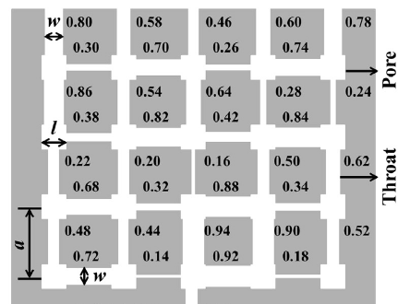
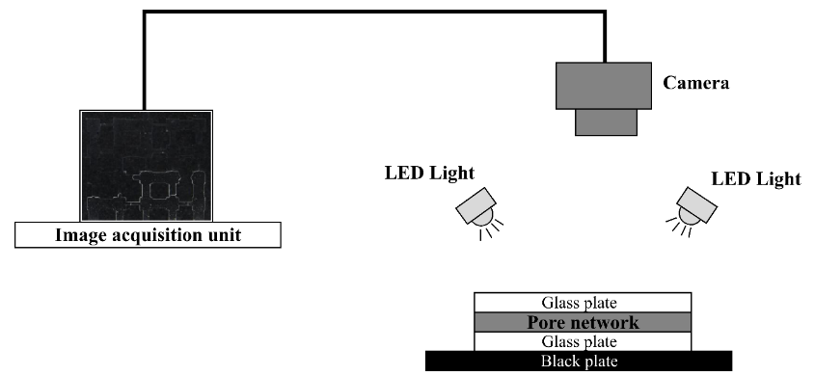
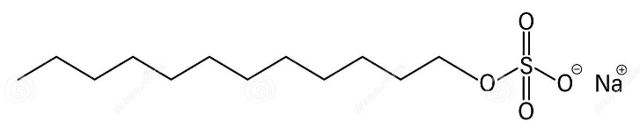
MATERIALS AND METHODS
PDMS Microfluidic Network
Experimental setup
5×5 array of square pores (1 mm side); throat widths 0.14 - 0.94 mm; uniform depth 0.1 mm
Imaging System
Nikon D810 DSLR + 105 mm macro lens; automated 1-minute intervals; 4-way LED illumination
Conditions
Temperature 25±2 °C · Relative humidity 22±2%
Image Analysis
Python + OpenCV for saturation tracking; ImageJ DropSnake for contact angle measurement
SDS Solutions Tested
Fluid | Conc. (wt.%) | σ (mN/m) | vs. CMC
Water | — | 72.0 | —
SDS-1 | 0.10 | 62.6 | Below
SDS-2 | 0.23 | 40.0 | AT CMC ★
SDS-3 | 0.30 | 36.8 | Above
SDS-4 | 0.50 | 32.2 | Above
Anionic surfactant – Sodium Dodecyl Sulfate (SDS)
Notes:
We used a PDMS microfluidic network consisting of a 5 by 5 array of square pores. Each pore is 1 millimeter wide, and the throats vary from 0.14 to 0.94 millimeters. We saturated the chip with each test fluid under vacuum to ensure complete filling, then placed it horizontally under controlled conditions: 25 degrees Celsius, 22% relative humidity. Evaporation was driven by exposure to the ambient environment on one side of the chip. Images were captured automatically every minute using a Nikon D810 with a 105mm macro lens. We then processed those images in Python using OpenCV to track liquid saturation over time, and used ImageJ with the DropSnake plugin for contact angle measurements. The five fluids we tested are listed in the table — pure water at 72 mN/m surface tension, and four SDS solutions ranging from below to well above the CMC of 0.23 wt%.

Slide 7
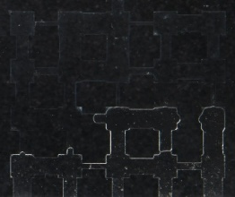
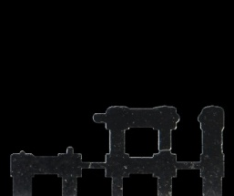



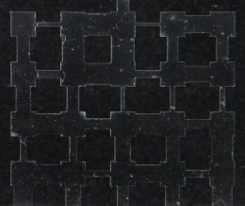
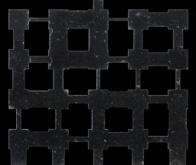
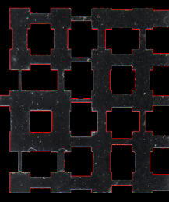

MATERIALS AND METHODS: Image analysis
 | RAW IMAGE | GRAYSCALE AND BG REMOVAL | CONTOUR DETECTION | FILLED BINARIZATION | OVERLAYING
During evaporation At the end of evaporation
(a)
(b)
(c)
(d)
(i)
(e)
(f)
(g)
(h)
AIR
LIQUID
SOLID
Image processing algorithm. (a) Raw image during evaporation; (b) grayscale image after background removal; (c) contour detection of pores; (d) positions of solid (black) and gas pixels (white) during evaporation; (e) raw image at the end of evaporation; (f) grayscale image after background removal; (g) contour detection of pores; (h) solid (black) and gas pixels (white) at the end of evaporation; (i) overlaid image on positions of solid (black), gas (white) and liquid (gray) pixels during evaporation.
Notes:
To quantify saturation, we developed an image processing workflow. First, we converted images to grayscale and removed the background. Then we detected pore contours and created binary masks. By overlaying intermediate images with the final dry image, we could distinguish liquid, air, and solid regions. This allowed us to calculate normalized saturation over time.

Slide 8
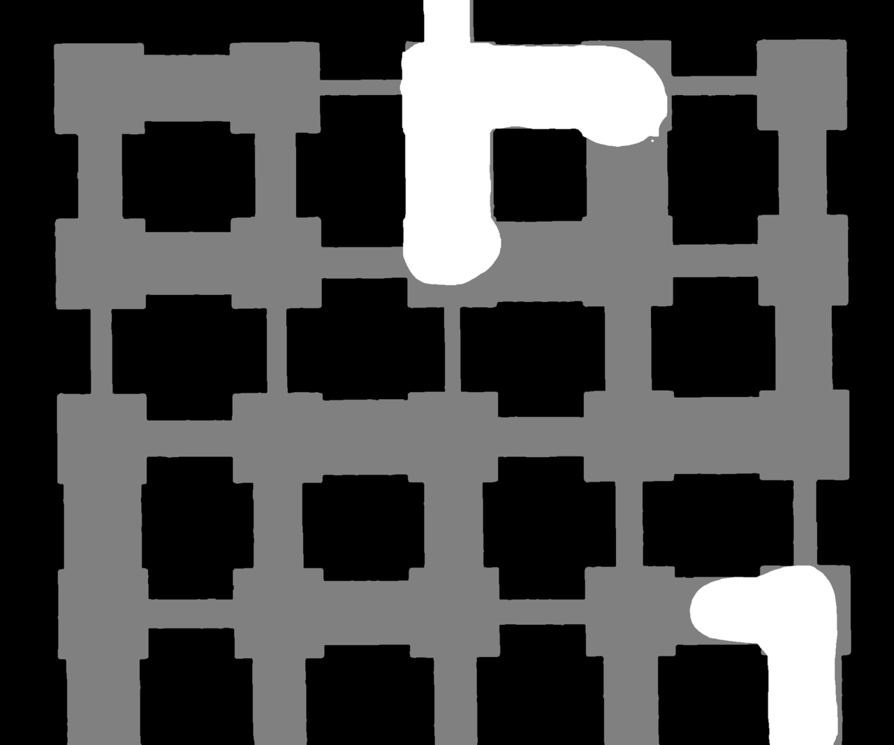

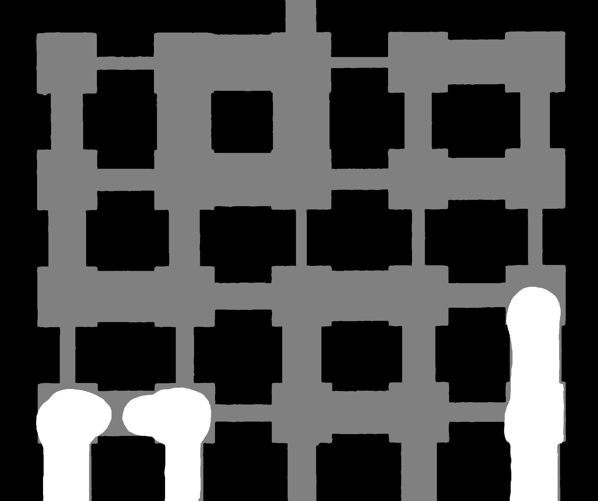
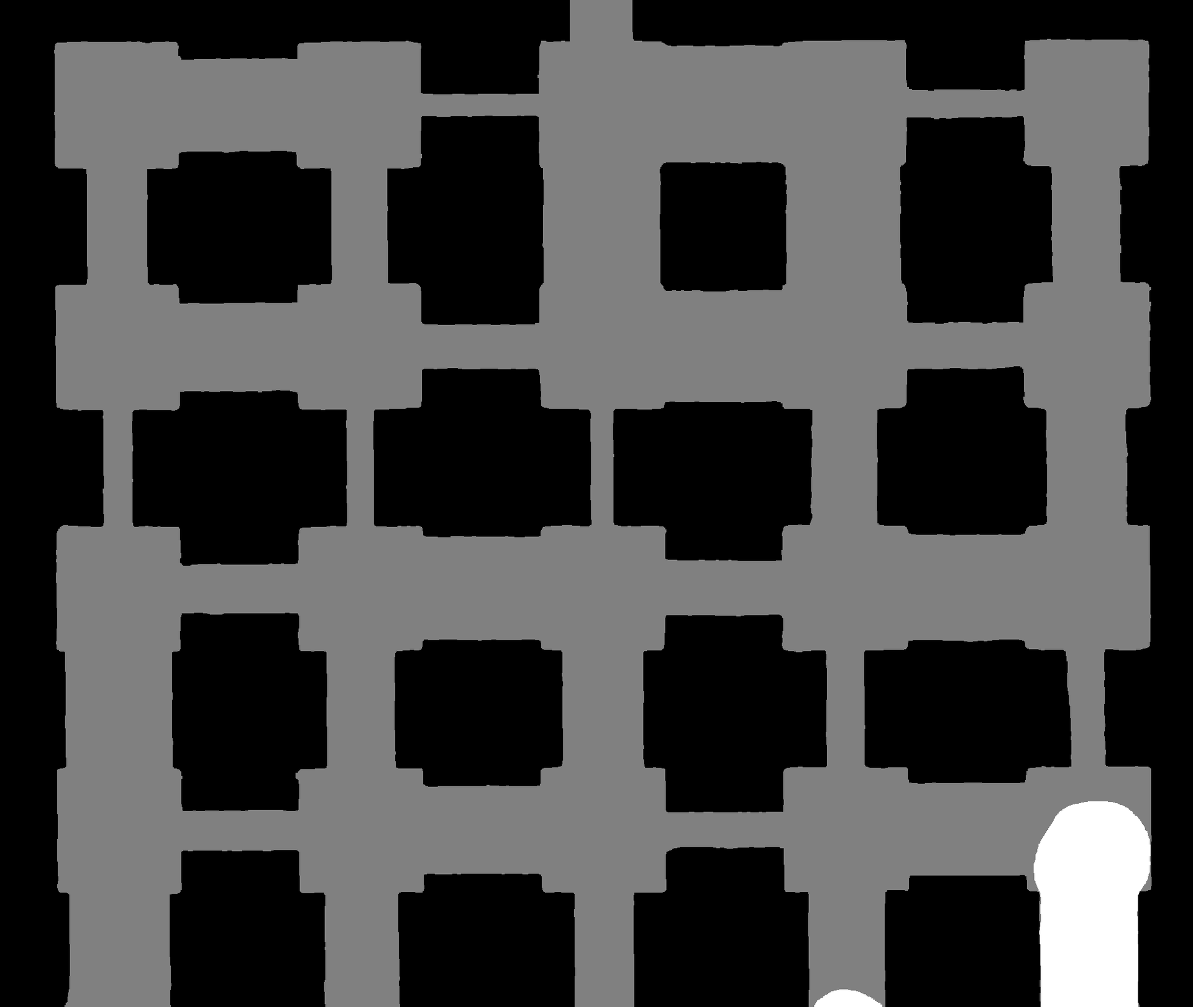
RESULTS AND DISCUSSION: Evaporation patterns for the fluids
Distilled water
0.1 wt.% Surfactant
0.23 wt.% Surfactant
0.3 wt.% Surfactant
0.5 wt.% Surfactant
Water
Below CMC
(0.1 wt.%)
At CMC
(0.23 wt.%)
Above CMC
(0.3 - 0.5 wt.%)
Fingering-dominated
Partial improvement
Optimal — cooperative drainage
Diminishing returns
High σ → large P_{c} → air fingers through widest throats. Air pockets, curved menisci in narrow throats, disconnected liquid islands.
Small σ (−13%). Air invades more pores early; fewer liquid islands at S_{norm}=0.5. Thin films persist, delaying complete drying.
σ drops to 40 mN/m. Broad, connected menisci. Percolating air paths. Smooth invasion front. Fastest complete evaporation.
σ and invasion patterns change little. Micelle formation may restrict vapor escape, slightly increasing total time.
Invasion evolves from fingering (water) → cooperative drainage (CMC) — confirmed by direct optical imaging of the PDMS pore network.
Notes:
Now moving to the results. For pure water, we observed a fingering-dominated invasion pattern. Because water has high surface tension, capillary pressure is large, so air mainly enters through the widest throats, creating isolated air pockets and disconnected liquid islands. When we added surfactant below the CMC, we saw partial improvement. Air invaded more pores earlier, and fewer liquid islands remained. At the CMC concentration, we observed the most significant change. The invasion became cooperative, with broad connected menisci and smooth air pathways across the network. This resulted in the fastest evaporation. Above the CMC, we saw diminishing returns. The invasion patterns looked similar to the CMC case, but evaporation became slightly slower, possibly due to micelle formation restricting vapor escape.

Slide 9
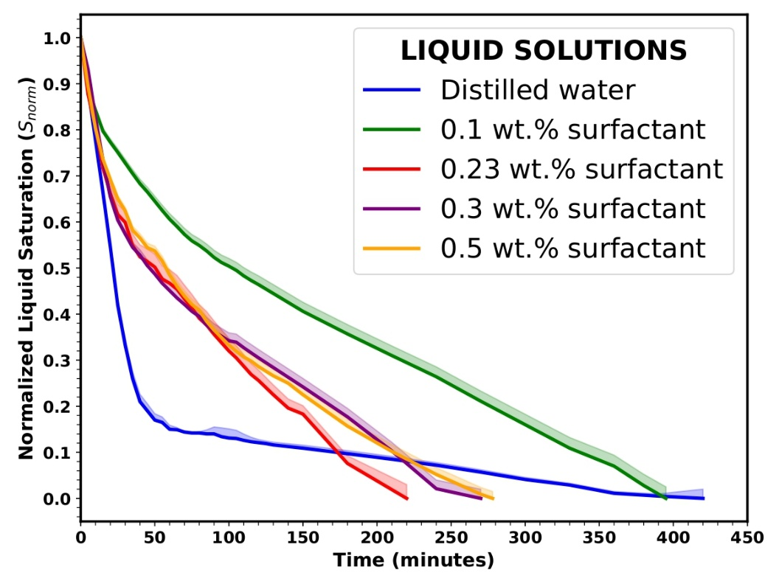
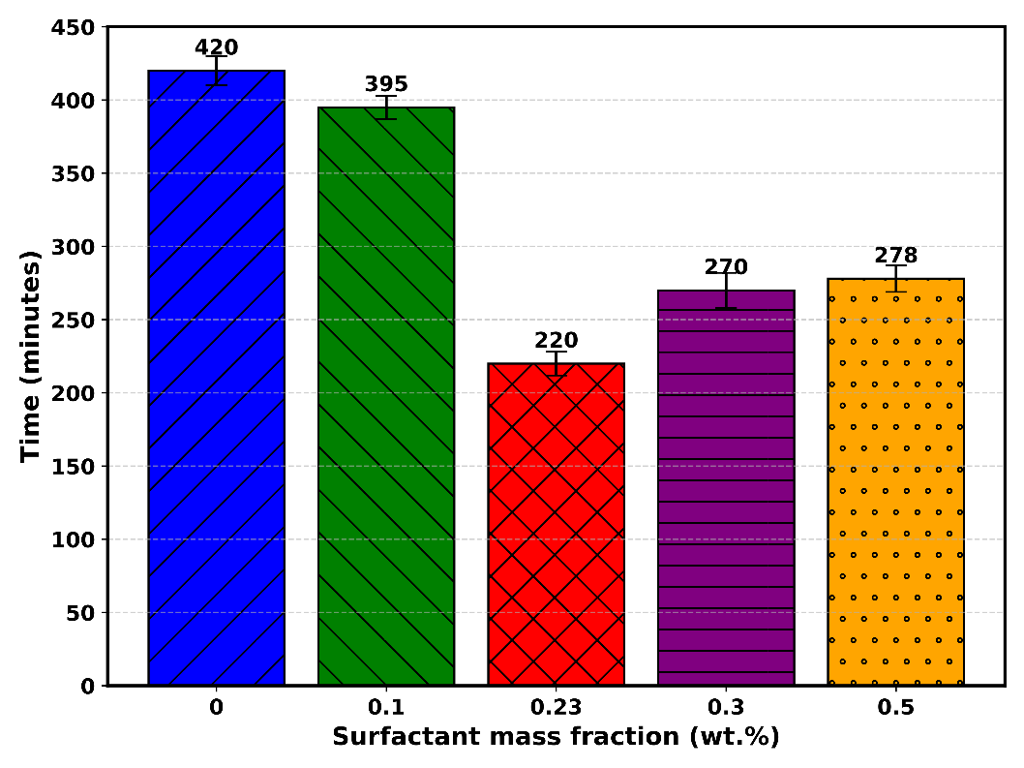
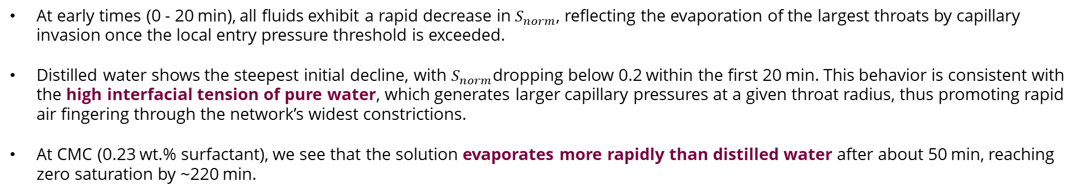
RESULTS AND DISCUSSION: Evaporation curves
−47%
faster at CMC vs. water
(220 vs 420 min)
−6%
faster below CMC
(395 min, partial effect)
Plateau
above CMC — negligible
additional benefit
Evaporation curves (normalized liquid saturation vs. time) for pure water and SDS solutions
Total evaporation time for water and SDS solutions at various mass fractions
At early times (0 - 20 min), all fluids exhibit a rapid decrease in${ S}_{norm}$, reflecting the evaporation of the largest throats by capillary invasion once the local entry pressure threshold is exceeded.
Distilled water shows the steepest initial decline, with $S_{norm}$dropping below 0.2 within the first 20 min. This behavior is consistent with the high interfacial tension of pure water, which generates larger capillary pressures at a given throat radius, thus promoting rapid air fingering through the network’s widest constrictions.
At CMC (0.23 wt.% surfactant), we see that the solution evaporates more rapidly than distilled water after about 50 min, reaching zero saturation by ~220 min.
Notes:
Here we show the saturation curves, which tell the same story quantitatively. At early times, all fluids show a rapid drop due to evaporation from large pores. The blue curve is pure water — and you can see it takes 420 minutes to reach complete evaporation. What's interesting is the shape: a very steep initial drop as the widest throats drain rapidly, followed by a long, slow tail as the remaining liquid gets trapped and connectivity breaks down. The green curve — 0.1 wt% surfactant — finishes slightly faster at 395 minutes, about 6% improvement. The thin film effect I mentioned is visible here in the extended tail. Now look at the red curve — 0.23 wt%, at the CMC. It starts more slowly than water in the first 20 minutes or so, because the reduced surface tension actually lowers the initial driving force for drainage. But after about 50 minutes, it overtakes everything else and reaches zero saturation by 220 minutes. That's a 47% reduction in total evaporation time compared to water. The purple and orange curves — above the CMC — sit between the CMC and below-CMC cases, finishing at around 270 and 278 minutes respectively. So there is a clear optimum at the CMC.

Slide 10
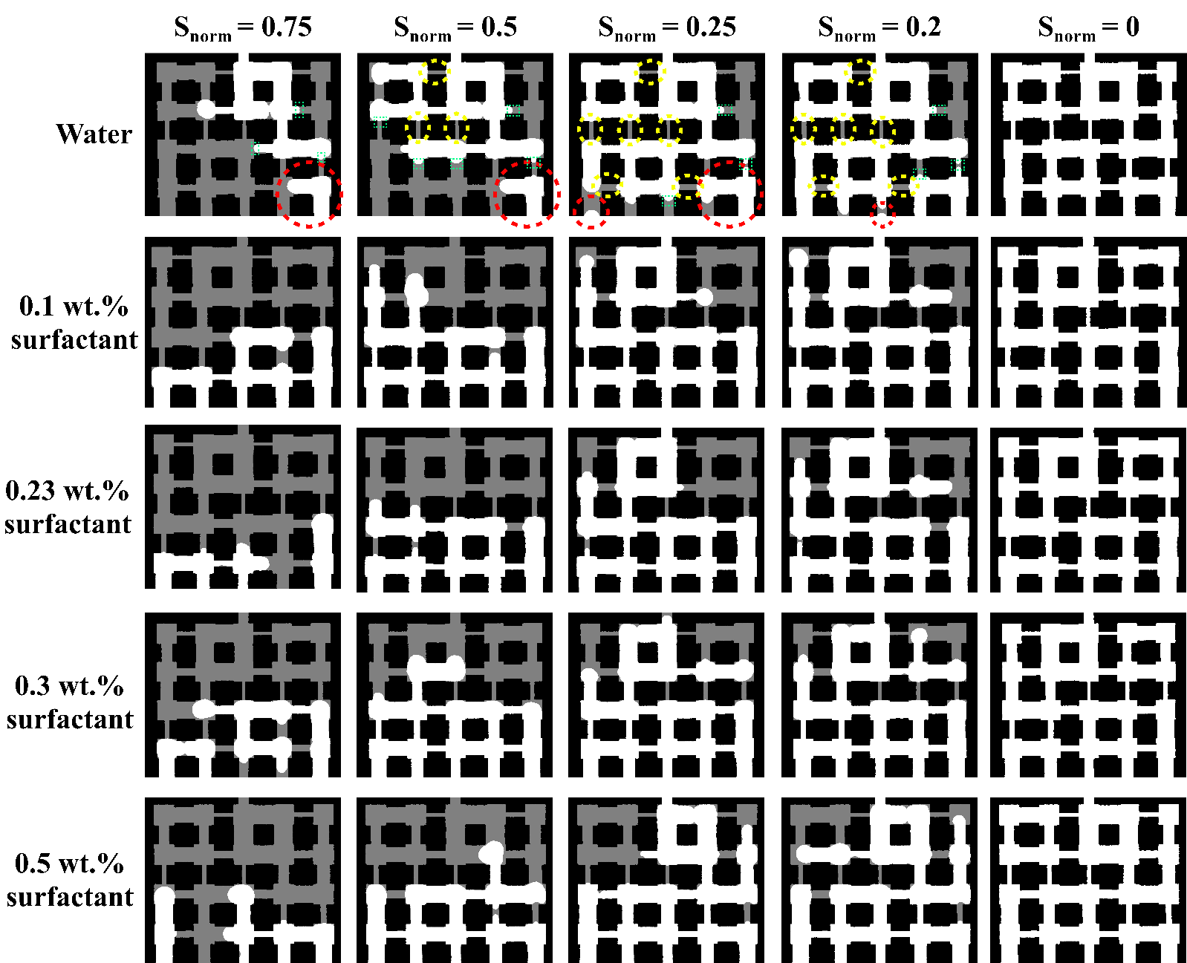
RESULTS AND DISCUSSION: Pore-scale saturation front images
An initial steep drop in saturation (within the first hour) earlier shown corresponds to rapid evaporation from surface pores; thereafter, deeper liquid films persist under strong capillary retention and limited connectivity. Air invades in isolated pockets, leaving most of the network bridged by liquid.
With 0.1 wt.% of surfactant (0.1 wt. %), at S_{norm} = 0.75, water’s larger throats allow widespread air entry and fragmentation into disconnected liquid islands, whereas the 0.1% surfactant solution retains thin films along pore walls, slowing desaturation.
An optimal balance is reached at 0.23 % surfactant, where surface tension reduction is sufficient to promote rapid, uniform air invasion without overly suppressing capillary transport. Pore images at S_{norm} = 0.5 show connected, extensive invasion pathways rather than clustered pockets.
Notes:
These images show the invasion front at different saturation levels. For water, we see isolated air pockets and disconnected liquid clusters, which indicate poor connectivity. With surfactant, especially at the CMC, the invasion pathways become more connected and uniform. This supports the idea that surfactants promote cooperative drainage instead of fingering behavior.

Slide 11
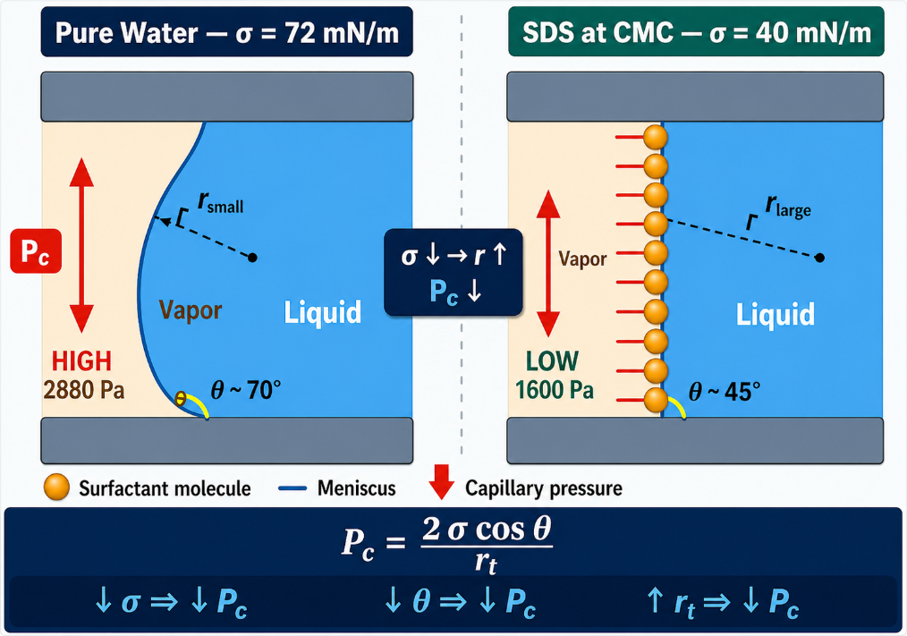
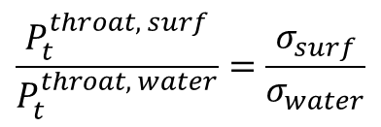
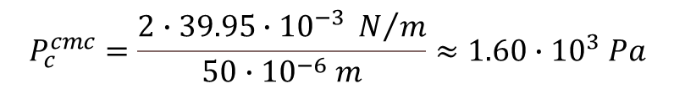

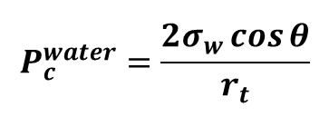
RESULTS AND DISCUSSION: How surfactants increase evaporation
SDS is non-volatile, and slightly depresses water’s vapor pressure by a colligative (Raoult’s-law) effect; its interfacial layer alters which water molecules can evaporate.
Surfactants could enhance evaporation by lowering threshold pressures.
Surface tension
Fluid | Conc. (wt.%) | σ (mN/m)
Water | 0 | 72.01
SDS-1 | 0.10 | 62.56
SDS-2 | 0.23 | 39.95
SDS-3 | 0.30 | 36.83
SDS-4 | 0.50 | 32.16
Reduced surface tension directly decreases P_{t} for throat and pore invasion
$$\frac{P_{t}^{throat, surf}}{P_{t}^{throat, water}}=\frac{σ_{surf}}{σ_{water}}$$
$$P_{c}^{water}=\frac{2∙72.01∙{10}^{−3} N/m}{50∙{10}^{−6} m}≈2.88∙{10}^{3} Pa$$
$$P_{c}^{water}=\frac{2σ_{w}\cos{θ}}{r_{t}}$$
$$P_{c}^{cmc}=\frac{2∙39.95∙{10}^{−3} N/m}{50∙{10}^{−6} m}≈1.60∙{10}^{3} Pa$$
Lower P_{c} facilitates earlier invasion of air. This means that pore water evaporates at lower pressures, accelerating evaporation.
Notes:
So mechanistically, what's going on? The key is the capillary entry pressure. The capillary pressure needed for air to invade a throat is governed by the Young-Laplace equation — it's directly proportional to surface tension and inversely proportional to pore size. For a throat 50 micrometres in radius, pure water requires a capillary pressure of around 2,880 Pascals. At the CMC, with surface tension reduced to 40 mN/m, that drops to about 1,600 Pascals. That's nearly a 45% reduction. What this means practically is that air can now invade pores that were previously blocked — not just the widest throats, but progressively smaller ones. The invasion front becomes broader and more connected. Pores start evaporating at lower driving pressures, and the whole process accelerates. It's worth noting that SDS is non-volatile, so it doesn't itself evaporate. It slightly depresses the vapour pressure of water through a colligative effect, but the dominant mechanism is structural — it lowers the barrier to air invasion.

Slide 12
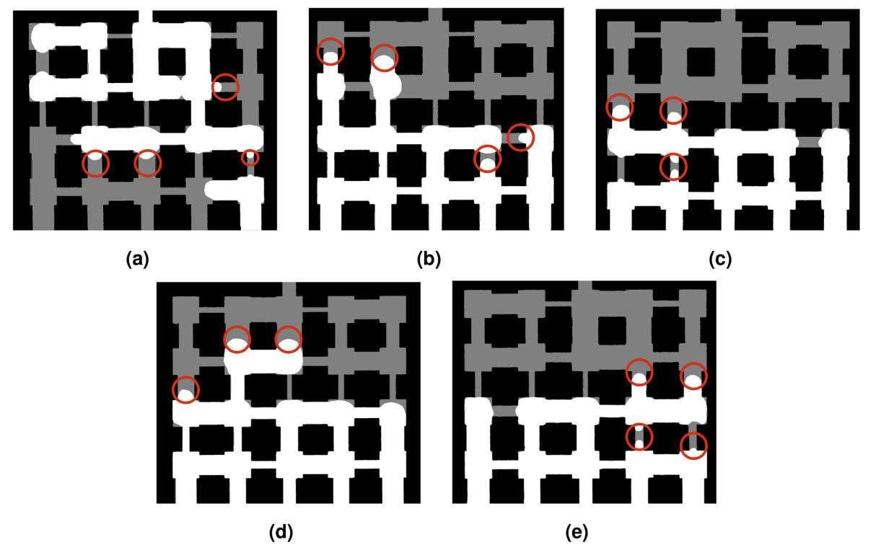
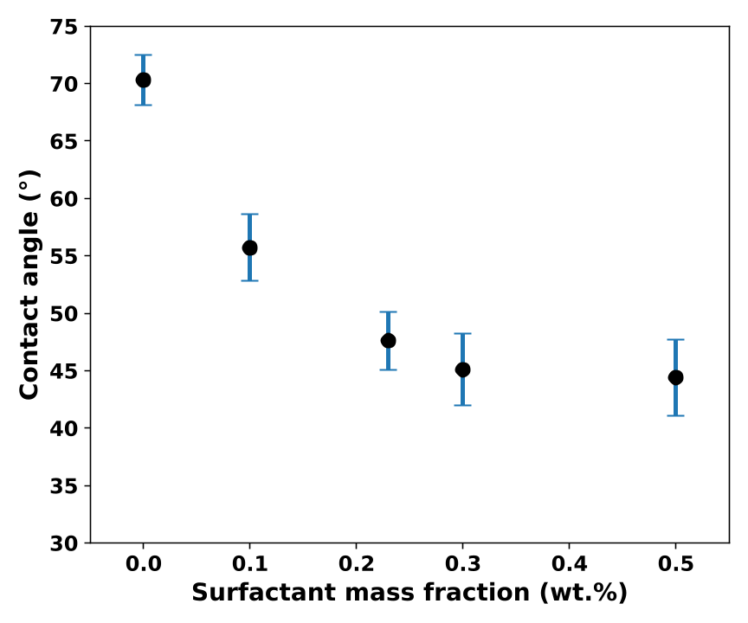
RESULTS AND DISCUSSION: Role of wettability (Contact angle measurement)
Advancing menisci used for contact angle measurements of at S_{norm} = 0.5. (a) Pure water; (b) 0.10 wt.% SDS; (c) 0.23 wt.% SDS; (d) 0.30 wt.% SDS; (e) 0.50 wt.% SDS.
Contact angle averaged over all the evaporation fronts in the meniscus and averaged over three measurement trials
~71°
~56°
~47°
~45°
Water
0.1 wt.%
At CMC
Above CMC
Poor wetting
Improved wetting
Well below 90°
Plateau
High CA minimize contact, preferring larger pores and spherical configurations to reduce surface area.
Smaller CA leads to more curved meniscus, resulting in higher Laplace pressure and an increase in equilibrium vapor pressure at the interface.
Notes:
The contact angle measurements give us complementary insight into what's happening at the pore walls. For pure water, the average contact angle at mid-evaporation is around 71 degrees. This reflects poor wetting of the PDMS surface, and it's consistent with the irregular, fingering-type invasion we observed. When we add 0.1% SDS, the contact angle drops to about 56 degrees — the surface is now more wettable, and the invasion front is smoother, though thin films still persist. At the CMC, the contact angle falls to around 47 degrees — well below 90 degrees. This is significant because below 90 degrees, the meniscus curves inward toward the air phase, which actually helps air enter small pores more smoothly. You get this cooperative drainage behaviour we saw in the images. Above the CMC, the contact angle plateaus at around 45 degrees. Further surfactant addition doesn't change the wettability meaningfully — consistent with the interface being saturated with SDS molecules.

Slide 13


CONCLUSIONS
At CMC, SDS achieves optimal balance between surface tension and wettability, enabling easier air entry and a smoother drying front, reducing evaporation time by almost half compared to water.
Surfactant lowers the contact angle, improving spreading and allowing air to move more uniformly through pores, accelerating evaporation compared to water.
Invasion dynamics shifts from fingering (pure water) to cooperative drainage with surfactant, promoting liquid redistribution and more uniform evaporation.
Capillary entry pressure decreases with surface tension up to the CMC, then comes to a plateau, indicating a saturation limit to surfactant effectiveness.
Bello, A., Kharaghani, A. & Tsotsas, E. Pore-scale influence of surfactants on evaporation in a porous medium. Sci Rep 16, 3272 (2026).https://doi.org/10.1038/s41598-025-29925-z
This study was conducted within the framework of the postdoctoral research fellowship awarded to Ayomikun Bello, PhD by the Alexander von Humboldt Foundation.
Notes:
So let me bring all of this together, to summarize, at the CMC, SDS provides an optimal balance between surface tension and wettability. Evaporation time was reduced by nearly half compared with pure water. The invasion regime shifted from fingering to cooperative drainage. Capillary entry pressure decreases with surface tension up to the CMC, after which further surfactant has limited effect.

Slide 14

Topics of interest include, but are not limited to, the following:
Modern computational fluid dynamics (CFD) and multiphysics modeling
Scientific Machine Learning and physics-informed neural networks for heat and mass transfer prediction and optimization
Innovations in drying, encapsulation, membrane processes, and porous media flow
Surfactant-assisted transport, wettability alteration, and interfacial heat and mass transfer
Process intensification and energy-efficient thermal processing
Novel experimental and validation techniques, such as PIV, thermal imaging, and advanced sensing methods, for complex flow systems
Digital twins and data-driven process optimization
Sustainable and green process engineering applications
Thanks for your attention
ayomikun.bello@ovgu.de
contactme@ayo-bello.com
Notes:
Before we open for questions, I'd also like to draw your attention to a Special Issue we are guest editing in the journal Processes, titled 'Heat and Mass Transfer in Process Engineering: Modern Approaches'. The submission deadline is 30 September 2026, and we welcome contributions across a wide range of topics, from CFD and machine learning to drying, membranes, and sustainable process engineering. Details are on the slide. Again, thank you, I'm happy to take questions.

Slide 15


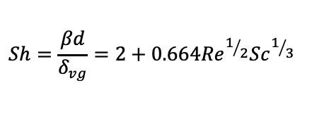
Contact Angle and Evaporation of Single Droplets
Experimental setup for evaporation experiments: (a) pendant droplets; (b) sessile droplets
Analytical model for validation
Image processing algorithm
Evaporation is modelled as diffusion-limited mass transfer from a sphere under forced convection:
$$d^{2}t=d_{0}^{2}−Kt$$
where the evaporation constant K is given by:
$$K=\frac{4ρ_{g}β}{ρ_{l}} (Y^{∗}−Y_{∞})$$
The mass transfer coefficient β is obtained from the Ranz–Marshall correlation:
(a) Raw captured image; (b) Binary conversion; (c) Cleaned binary mask after noise removal; (d) Isolated droplet with the filament section behind it removed for accurate area estimation.
$$Sh=\frac{βd}{δ_{vg}}=2+0.664{Re}^{1/2}{Sc}^{1/3}$$

Slide 16
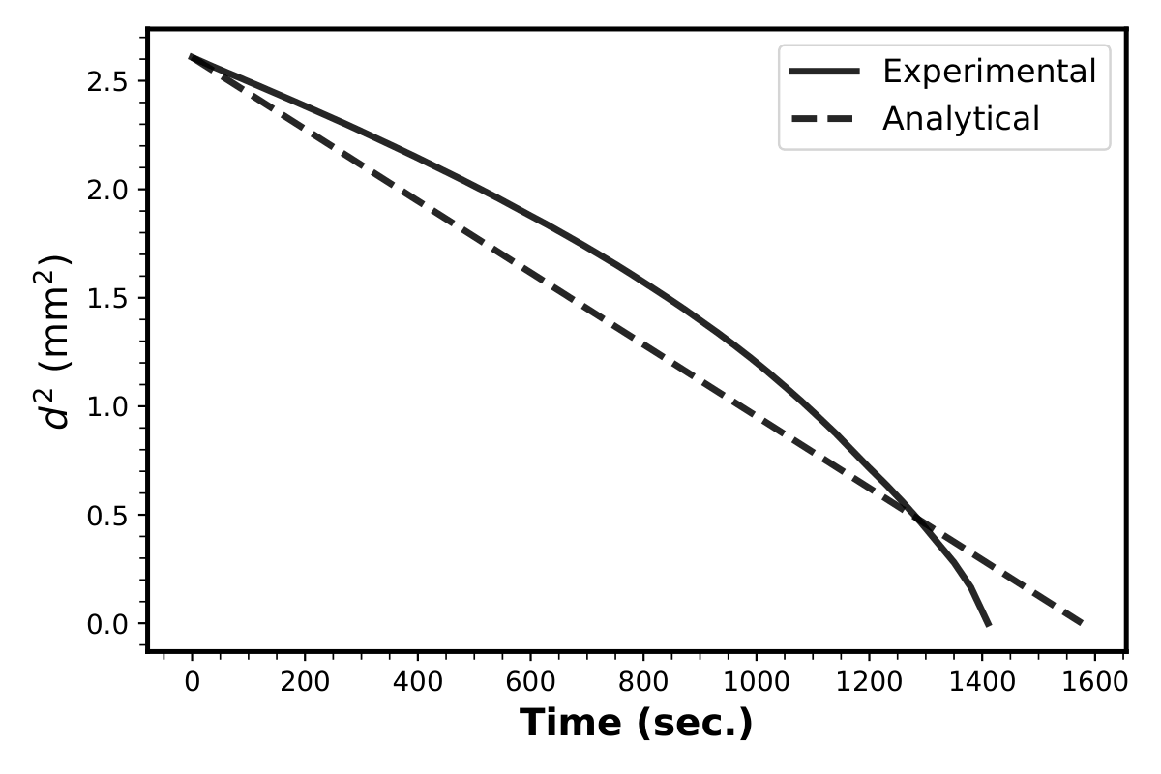
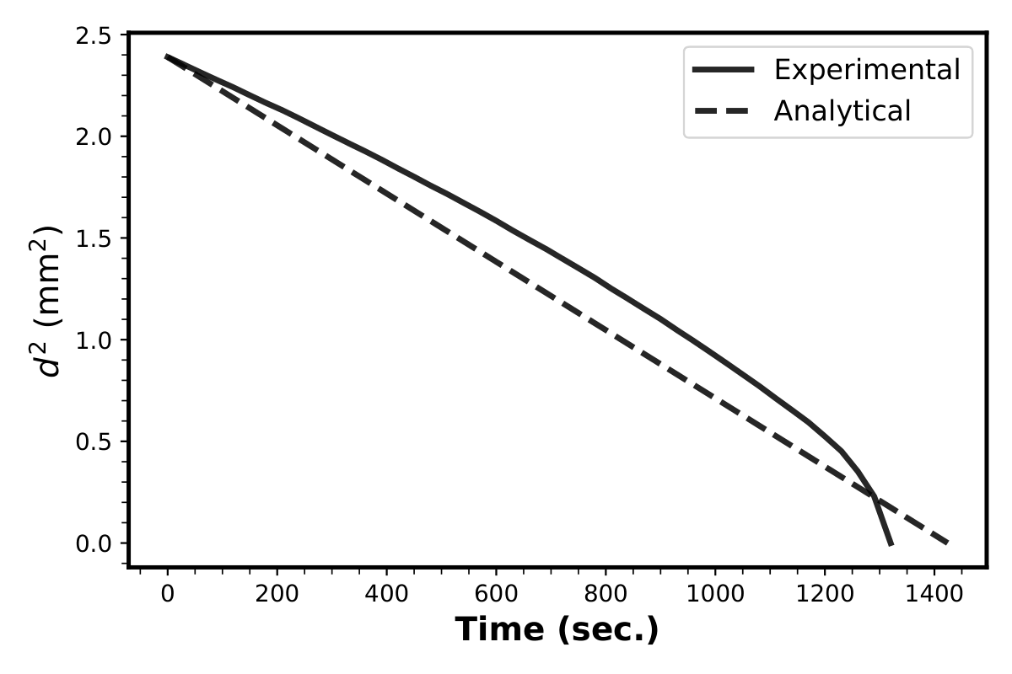

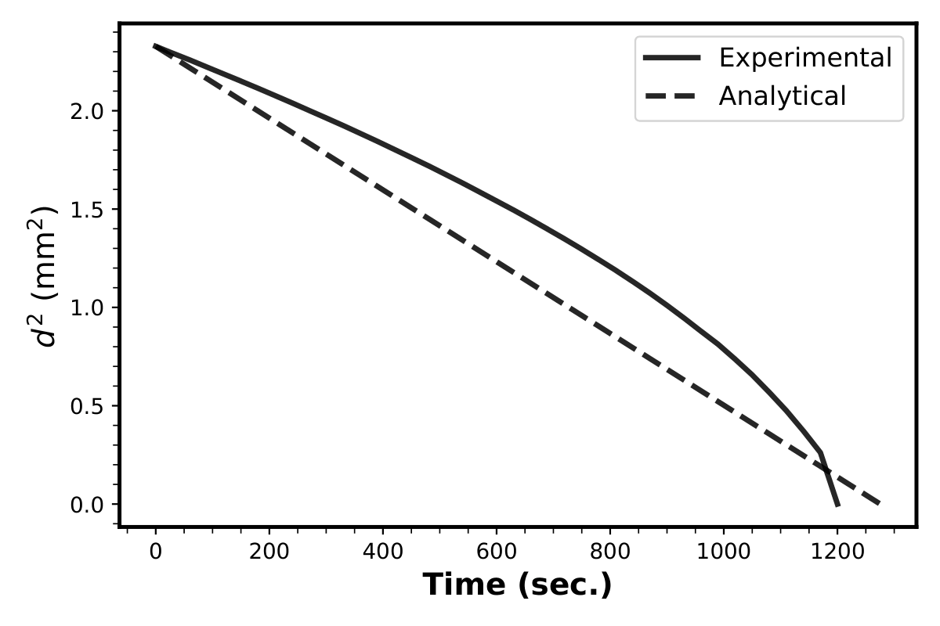
VALIDATION
d²-t curves for water under air flow (a) 1.03mm/s, 30⁰C; (b) 1.48mm/s, 30⁰C; (c) 2.4mm/s, 30⁰C; (d) 1.48mm/s, 45⁰C
(a)
(b)
(c)
(d)
Pure water droplets used as baseline to benchmark experimental setup against the classical d²-t diffusion-limited evaporation model.
Satisfactory agreement between experimental and analytical evaporation curves across all tested flow velocities and temperatures, with deviations in the range of 6-12%.
Deviations can be attributed to minor heat losses, filament hygroscopicity, and quasi-steady assumptions in the analytical model.

Slide 17
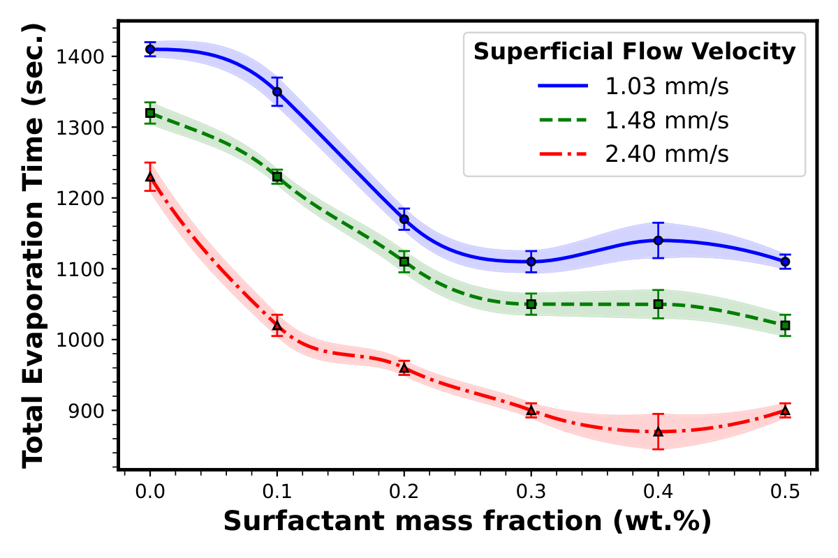
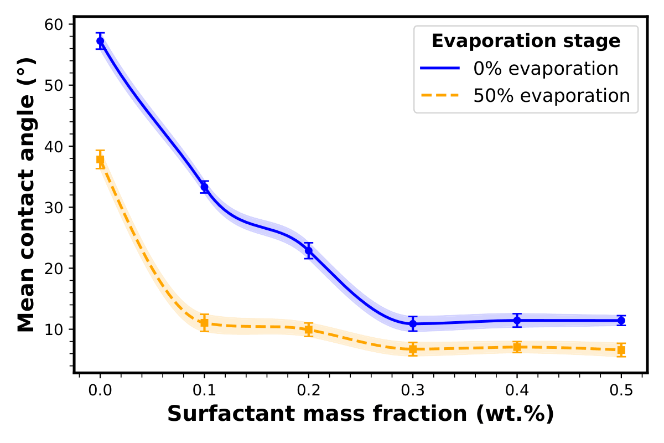
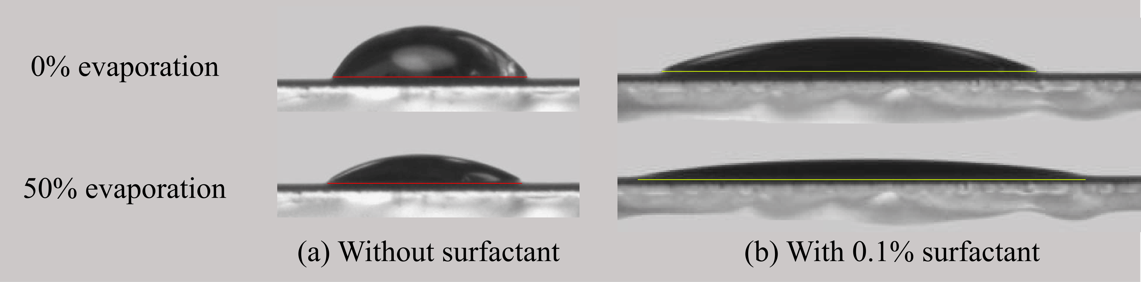
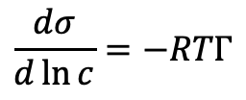
SOME RESULTS
Total evaporation time as a function of surfactant concentration for different flow velocities
Variation of mean contact angle with surfactant mass fraction at the start and mid evaporation
Total evaporation time decreases with increasing SDS mass fraction up to the CMC, explained by the Gibbs adsorption relation:
$$\frac{dσ}{d\ln{c}}=−RTΓ$$
Surfactant molecules disrupt the hydrogen-bonded water network at the liquid–air interface, reducing the energetic barrier for evaporation and allowing water molecules to escape more easily.
(a) Water droplet undergoing constant-radius evaporation with a pinned contact line; (b) Surfactant droplet showing earlier contact line motion due to reduced surface adhesion and lower surface tension.
Notes:
At concentrations ≥ 0.3 wt.%, droplets begin nearly completely flat (~10–11°) and remain so throughout evaporation, indicating full interface saturation with surfactant molecules.
At ≥ 0.3 wt.%, the nearly flat droplet geometry becomes the dominant driver of faster evaporation, redistributing liquid toward the contact line and sustaining high evaporation flux throughout the process.

