Slide 1


Flow Capacity Evolution in Water-Invaded Fracture Networks of Deep Shale Gas Reservoirs
Xianggang Duan, Yingying Xu, Wei Xiong, et al.
PetroChina Research Institute of Petroleum Exploration & Development
19-22 May 2026, Nantes, France

Slide 2
Contents
1. Background
2. Research Progress
3. Conclusions

Slide 3
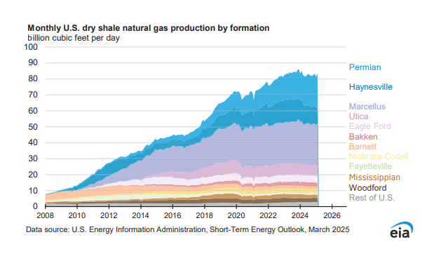
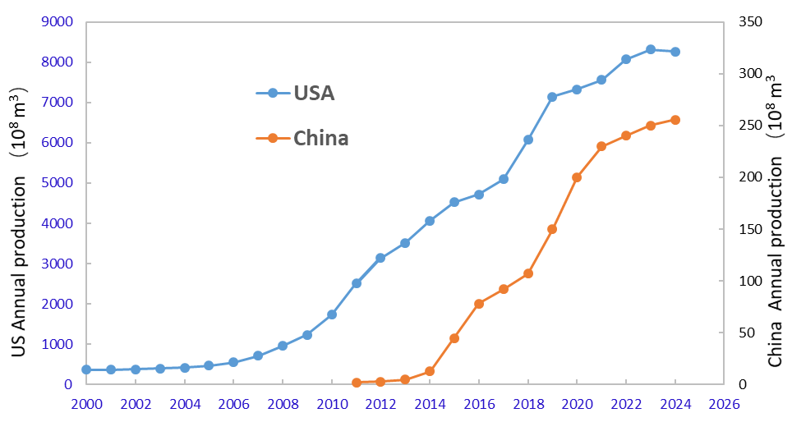
1. Background
Shale gas production has grown rapidly in both China and the United States.
Many technical challenges in deep shale gas development still need to be solved.
Notes:
Global technically recoverable shale gas resources are estimated at 243 trillion m³, with China accounting for 19.2 trillion m³ and ranking fifth worldwide. Since 2000, global shale gas production has grown at an average annual rate of 17%

Slide 4
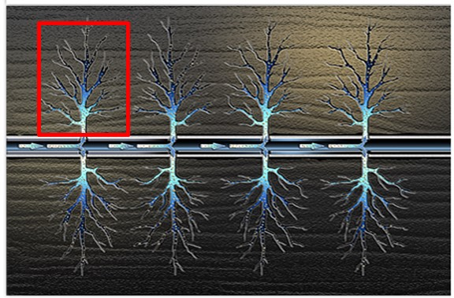
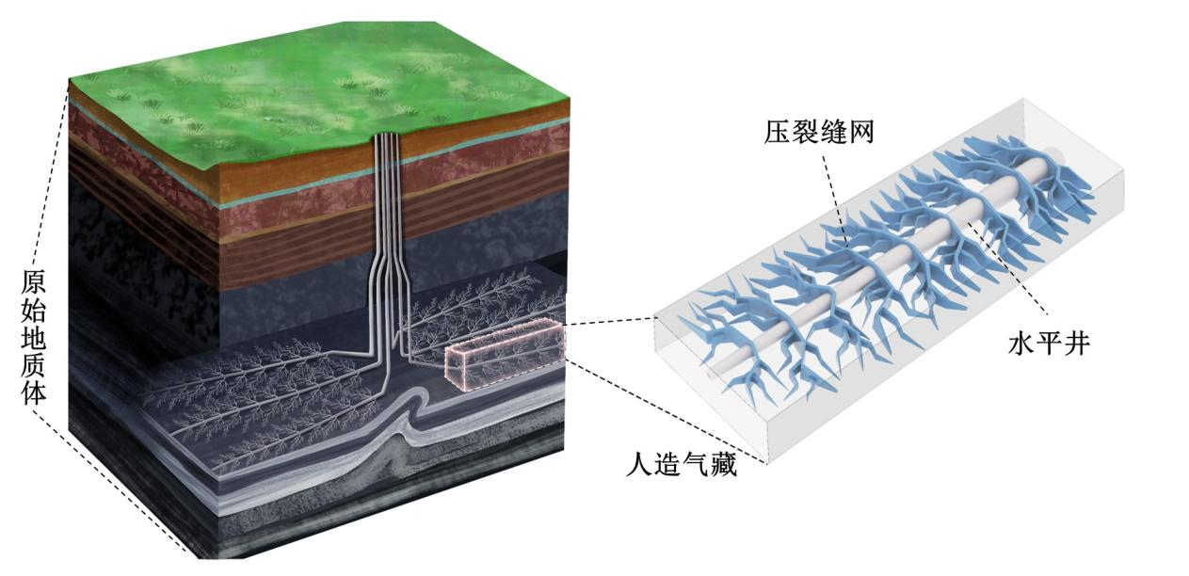
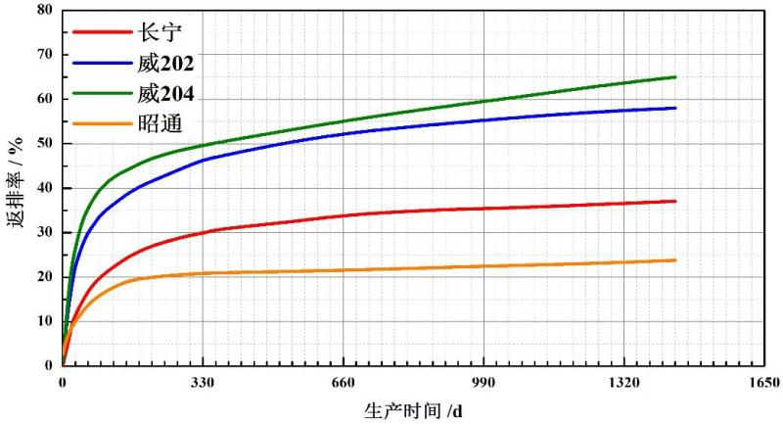
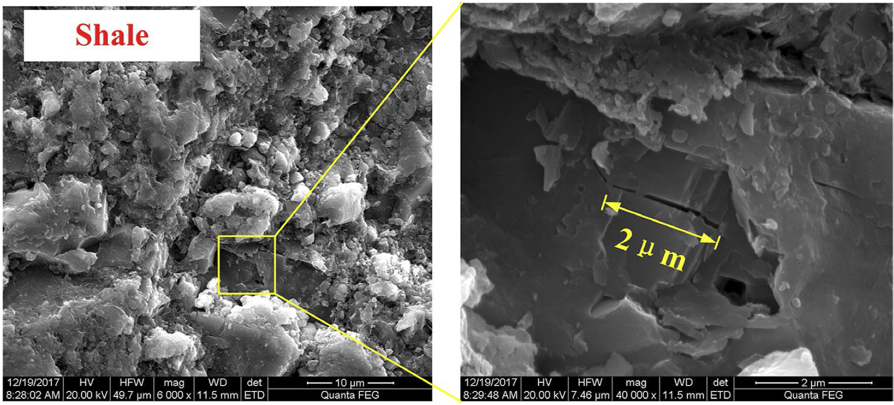
1. Background
40,000–60,000 m³ of fracturing fluid, while the flowback rate is commonly only 10%–50%
A large amount of water remains in fracture networks and nearby matrix.
how retained fracturing fluid affects fracture-network flow capacity.
N201
W202
W204
YS
Original stratum
Horizontal well multi-cluster fracturing wells
Shale
Schematic diagram of "artificial gas reservoir" of shale gas
Shale micro-nano pores
Notes:
Deep shale gas wells in China usually require 40,000–60,000 m³ of fracturing fluid, while the flowback rate is commonly only 10%–50%,
how retained fracturing fluid affects fracture-network flow capacity
As a result, a large amount of water remains in fracture networks and nearby matrix. However, its impact on flow capacity evolution is still not fully understood.

Slide 5
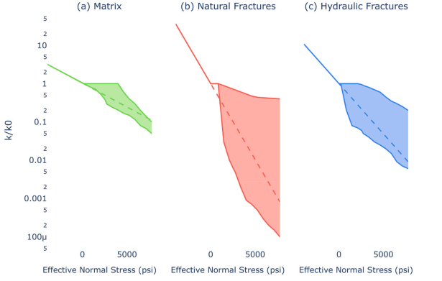
Key Questions
1. Can fracturing fluid invade the shale matrix?
2.How does water invasion affect fracture-network conductivity during production?
Propped fracture
Unpropped fracture
Damage
Matrix
Notes:
This study investigates the mechanisms and mathematical characterization of flow capacity in water-invaded fracture networks through advances in experimental methods and theoretical modeling.

Slide 6
Contents
1. Background
2. Research progress
3. Conclusions

Slide 7
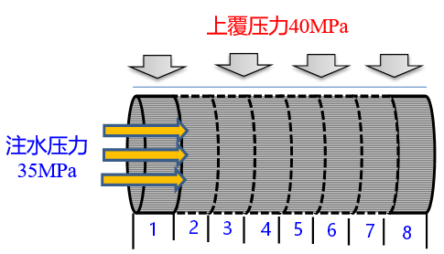
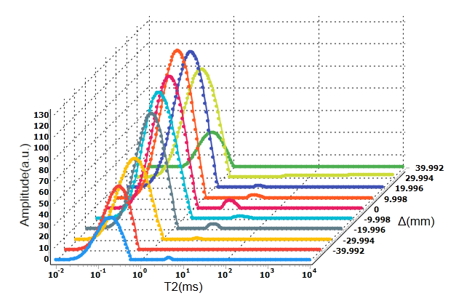

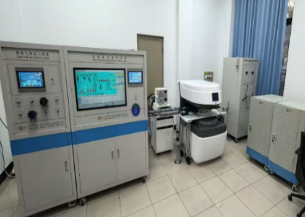
（1）Experimental method for evaluating water distribution
A layered NMR testing sequence (SFG-MSCPMG) was developed to characterize water distribution in shale cores
NMR scanning system
Confining pressure:40MPa
N
Outlet pressure transducer
Inlet pressure transducer
Back pressure valve
Water injection pressure:35MPa
Core holder
Water flow
Inlet valve
S
Back pressure
transducer
Confining pressure
transducer
direction
Confining
pressure
valve
Confining pressure pump
Data acquistion and analysis system
Back pressure pump
Displacement pump
NMR equipment
Water saturation distribution in the core
Notes:
for the stress sensitivity of matrix–unpropped water-bearing fractures
A new physical simulation method for high-pressure water invasion into the matrix was developed.

Slide 8
（2）Fracturing-fluid invasion depth reaches 4–6 cm
The invasion depth of fracturing fluid in shale generally ranges from 4 to 6 cm.
Water saturation and invasion depth increase with matrix permeability, injection pressure, and clay content, and both show a power-law increase with imbibition time.
waterlogging depth/cm
time/h
Time/h
Spatial distribution characteristics of water saturation within the core sample（0.0068 mD）
The variation of water invasion depth in shale with different matrix permeabilities

Slide 9
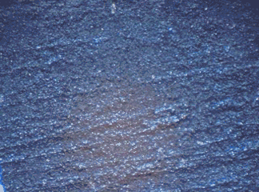
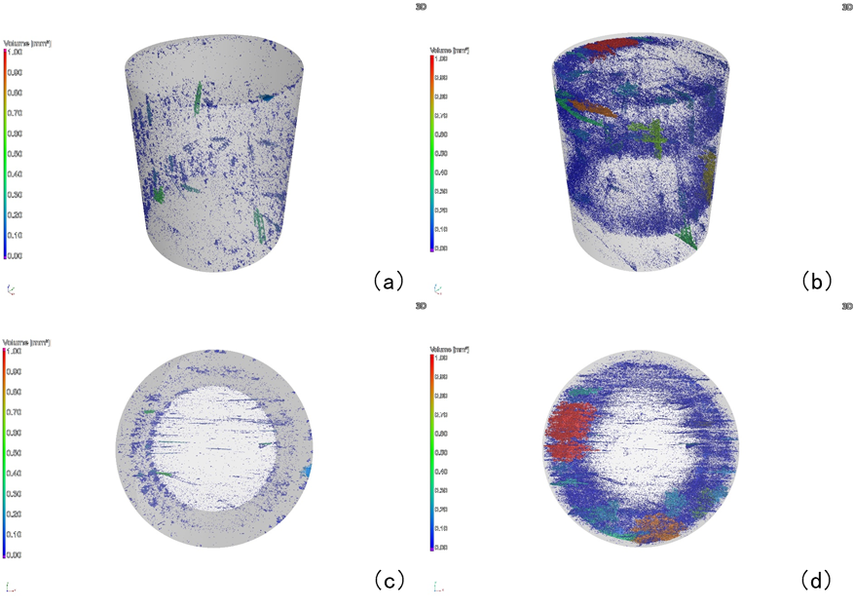
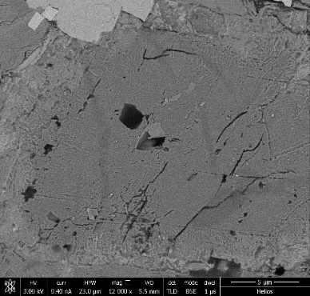
（3）Positive effects of fracturing-fluid invasion
Positive effect：Fracturing-fluid invasion can induce additional microfractures through hydration and imbibition.It can also promote adsorbed-gas release, with up to 40% displaced under the tested conditions
New crack
New crack
Millimeter scale
Microscopic observation of fracture connectivity in later stage
Micrometer scale
Characteristics of CT aperture structure before and after water rock interaction
Nanoscale
FIB-SEM scanning image after water invasion
Notes:
置换吸附气，增压，增渗

Slide 10
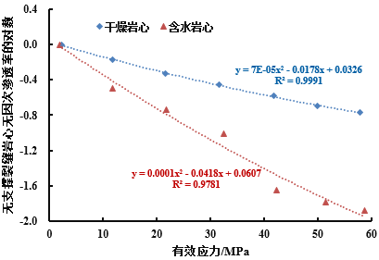
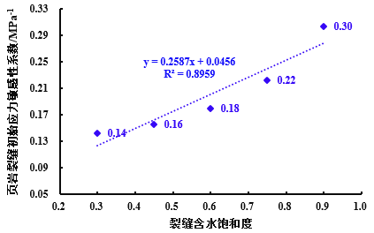
（4）Negative effects of fracturing-fluid invasion
After water–rock interaction, water-bearing unpropped fractures show much stronger stress sensitivity. Under high effective stress, permeability decreases by 2–4 orders of magnitude, and the stress-sensitivity coefficient increases by 2–4 times.
The stress-sensitivity coefficient increases with water saturation but decreases with effective stress.
Inverse dimensionless unpropped-fracture permeability
Inverse dimensionless unpropped-fracture permeability
Initial stress-sensitivity coefficient of shale fractures/MPa-1
Dry core
Water-bearing core
Dry core
Water-bearing core
Effective stress/MPa
Effective stress/MPa
Fracture water saturation
Dimensionless fracture permeability curves of Well Ning 217#11-4 before and after water invasion
Dimensionless fracture permeability curves of Well Wei 202H18-1#11 before and after water invasion
Correlation between shale fracture stress sensitivity and water saturation
Notes:
. Under low-stress conditions, fracture-surface asperities undergo weaker compression, resulting in stronger fracture flow capacity and the highest stress sensitivity.

Slide 11
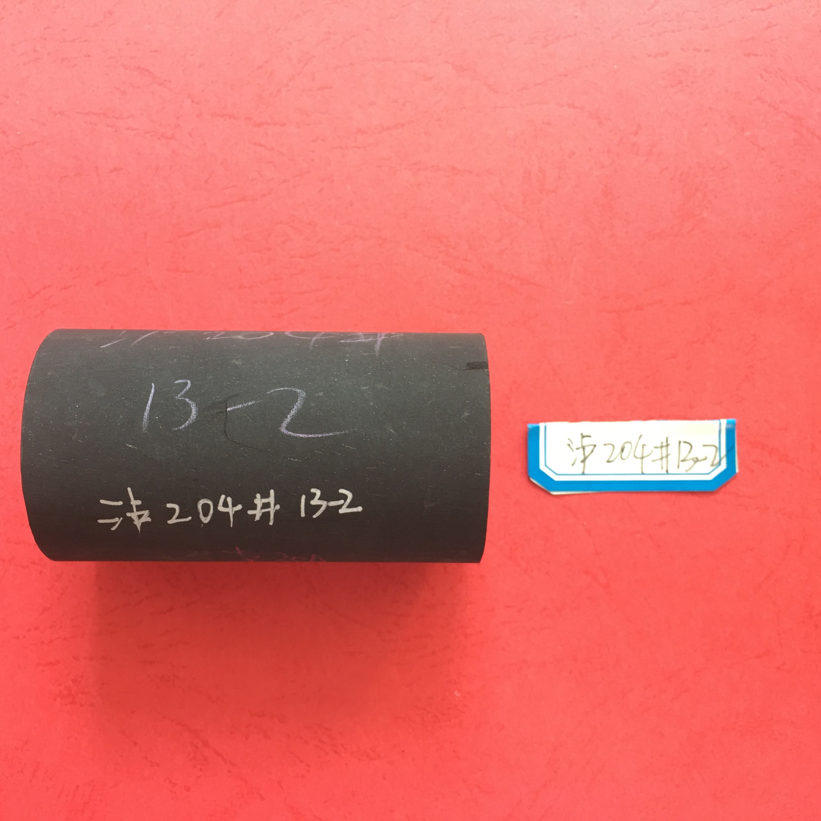

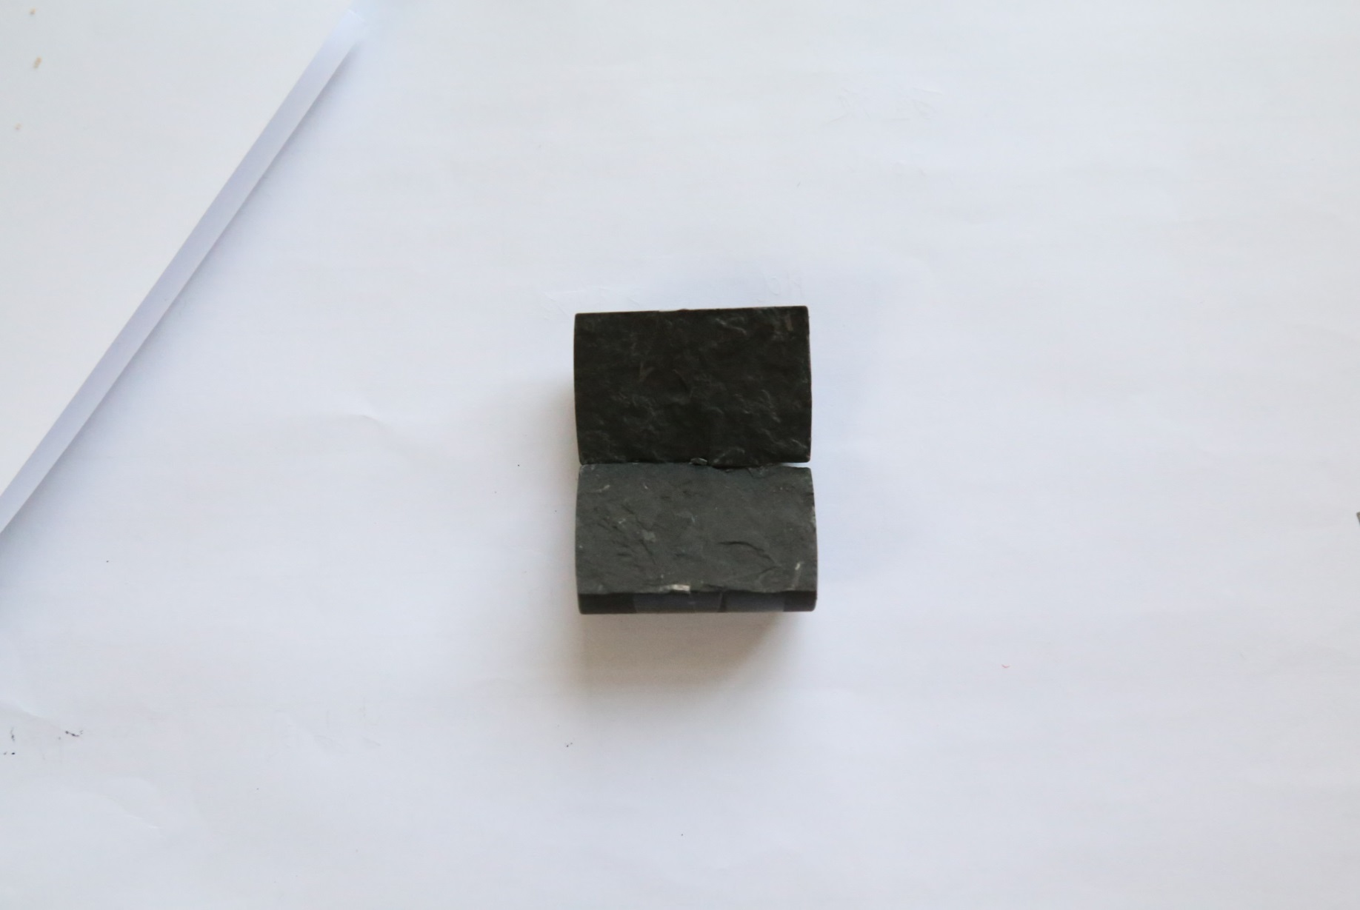

(5) Key regions controlling fracture-network conductivity
The fracture-network system can be divided into four flow regions: the propped-fracture zone, unpropped-fracture zone, stress-damaged zone, and matrix zone.
Among them, the unpropped-fracture zone and stress-damaged zone show the largest changes in flow capacity.
Effective / initial permeability
Effective / initial permeability
Permeability/mD
Propped fracture
Unpropped fracture
Damage
Matrix
Matrix effective stress/MPa
Fracture effective stress/MPa
Effective stress/MPa
Matrix stress-sensitivity curve and model
Stress-sensitivity curve and model for unpropped fractures
Relationship between effective stress and permeability in different regions
Notes:
首先我们开展了缝网体不同流动区域的流动应力敏感性流态实验，，发现无支撑区和损伤区的渗流能力对应力敏感性是最大的，因此在开发过程中，压裂改造区缝网题导能流能力也与米却相关

Slide 12










(6) A seepage model for matrix–fracture water invasion
A seepage model considering water invasion in both the matrix and fracture system is being developed to predict fluid retention and gas production.
Matrix governing equation
Adsorption desorption
Matrix
Gas water two phase
Governing equation of water invasion
water invasion layer
Crack
Crack control equation
Gas water two phase
Single phase flow
Gas water two phase

Slide 13
Contents
1. Background
2. Research progress
3. Conclusions

Slide 14
Conclusions
Fracturing fluid can invade the shale matrix to a depth of about 4–6 cm, even in ultra-low-permeability shale. It also changes local pore structure and mechanical properties.
The stress sensitivity of water-bearing unpropped fractures is not constant. It increases with water saturation and decreases with effective stress. Under 55 MPa effective stress, permeability may decrease by 2–4 orders of magnitude.
The water-invaded unpropped-fracture zone is a key region controlling the evolution of overall fracture-network conductivity during production.

Slide 15
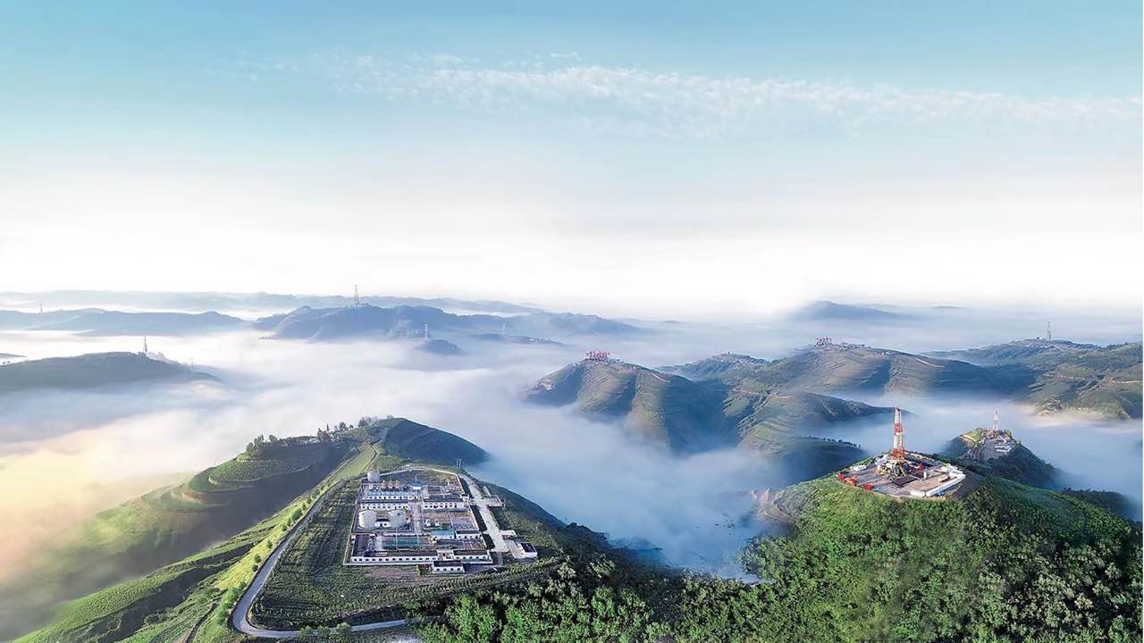
Thank you
for your attention!

