Slide 1

Special Session in Honor of Jun Yao
Limitations of Darcy’s Law in Modelling Fluid Flow in Porous Media
Wenhui Song¹, Yan Jin¹, Kangping Chen²
¹ China University of Petroleum (Beijing)
² University of Arizona

Slide 2
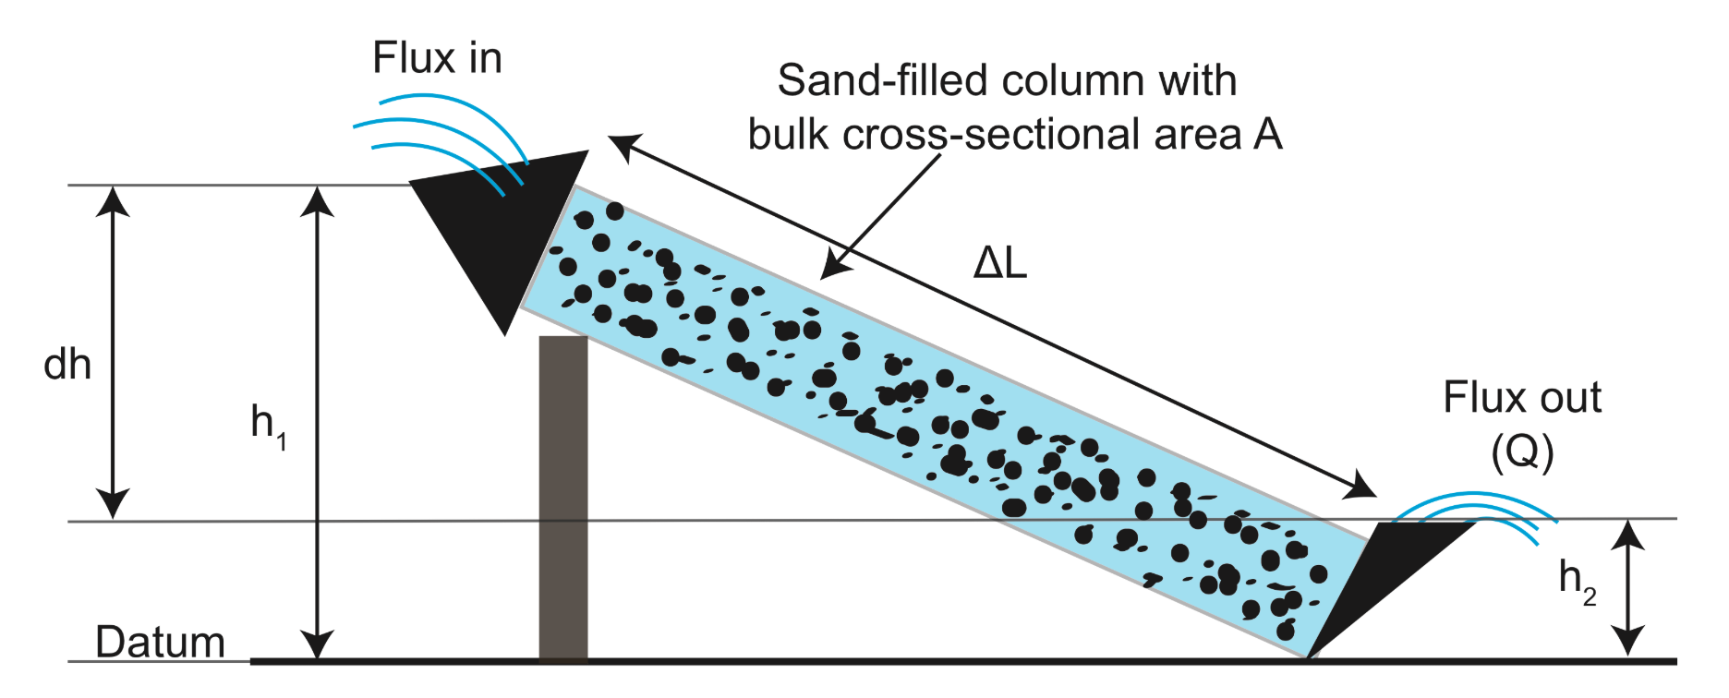




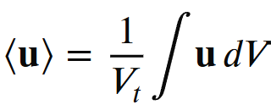
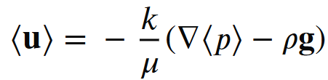
History of Darcy’s Law
Steady low-Re flow of an incompressible fluid in a rigid porous medium
Physical experiment
Theoretical derivation
Incompressible Navier-Stokes equation
Neglecting
inertial term
Steady state
Stokes equation
Volume averaging
(Henry Darcy, 1856)
Darcy’s Law
(Whitaker, 1986)
[1] H. Darcy, Les fontaines publiques de la ville de Dijon: Exposition et application des principes a suivre et des formules a employer dans les questions
de distribution d’eau (Victor Dalmont, 1856), Vol. 1
[2] Whitaker, Stephen. "Flow in porous media I: A theoretical derivation of Darcy's law." Transport in porous media 1.1 (1986): 3-25.

Slide 3
Is Darcy’s equation suitable for describing reservoir flow?
Henry Darcy’s experiments were conducted under open boundary conditions at both ends of the core. Reservoir porous media generally behave as semi-closed flow systems.
Continuity equation
High pressure
Low pressure
Integrate over the entire pore space
Outlet
mass flow rate at outlet/inlet
Integral form of continuity equation
Oil and gas flow in semi-closed porous media is controlled by fluid compressibility
mass flow rate at inlet

Slide 4
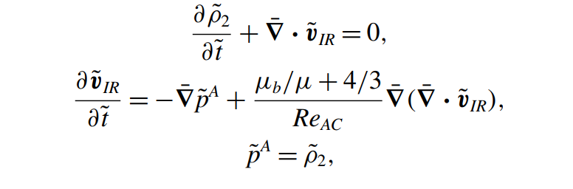
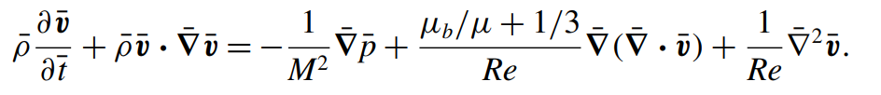
Gas flow equations from compressible Navier–Stokes equation
For gas flow, compressible N–S equations reduce to a damped wave equation
Volume averaging upscaling: damped wave → diffusion equation, not Darcy’s law
Compressible N–S equation
Irrotational flow (potential flow)
Volume averaging
μ: shear viscosity; μ_{b}: bulk viscosity
Mach-number non-dimensionalization
Damped wave equation
D_{m}: diffusion coefficient
C_{sf}: scaling factor
c: wave of speed
l_{min}: characteristic length
Helmholtz decomposition
D_{ρ}: self-diffusion coefficient;
ρ_{e}: gas density
How to derive the gas diffusion coefficient D_{m} expression in porous media?

Slide 5
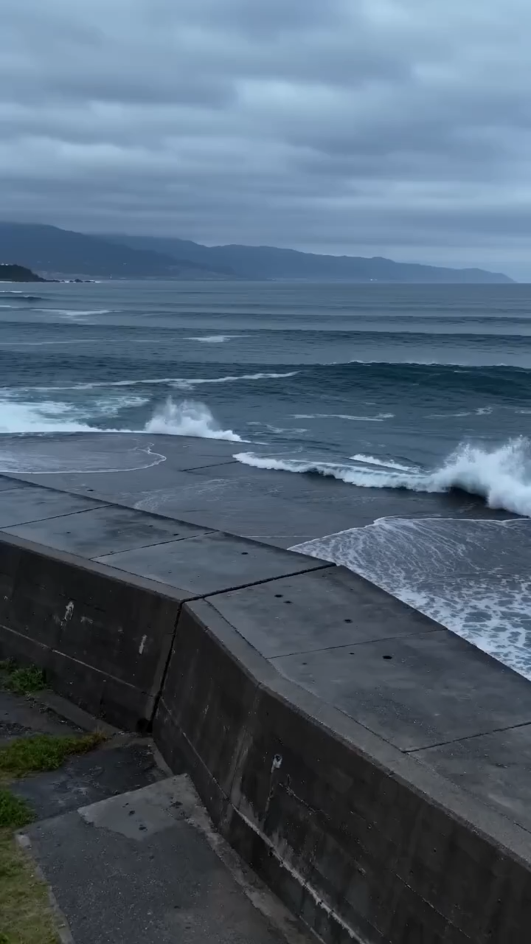
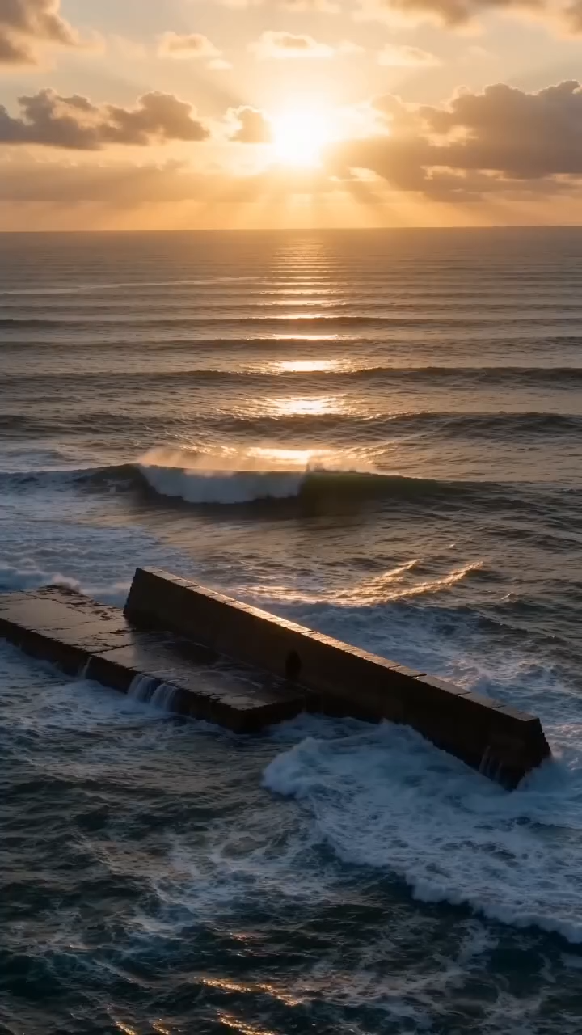
Physical model
Perfectly matched layer (PML) is to attenuate the oscillatory wave and mimic the fluid flow to hydraulic fracture or wellbore
ρ
ρ_{e}
PML
ρ: gas density
ρ_{e}: exit gas density
Closed boundary
PML boundary
Closed
boundary
Digital rock (black: pore; white: solid)
Duplicate
Pore network model

Slide 6
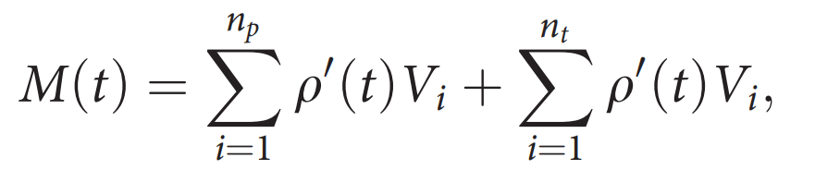
Solution of the gas diffusion coefficient​ in porous media
Pore scale
damped wave equation
Core scale
diffusion equation
Adjust D_{m} to
fit pore scale result
Scale factor C_{sf} expression
pore structure
Perturbed mass variation in inner region of PNMs

Slide 7
Physical models from various rock type
11 groups of digital cores with various rock type
1#
2#
3#
4#
5#
6#
7#
8#
9#
10#
11#

Slide 8
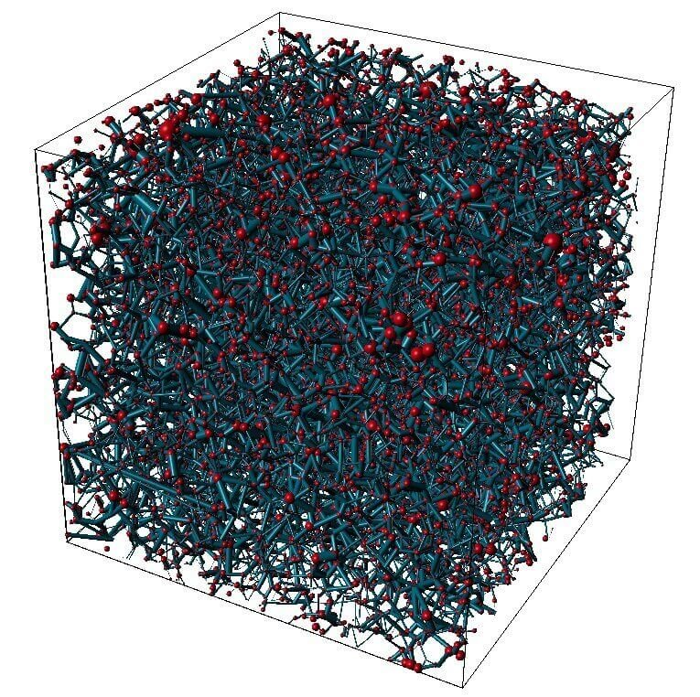
Pore-network discretization of the damped wave equation
Fully implicit scheme
j3
j33
Damped wave equation
i
L_{ij2}
L_{ij1}
j22
j11
j2
j1
Pore network basic unit
Initial condition
Poreunit
k+1 time step
k , k-1 time step
PML attenuation
Throat
unit
k+1 time step
k, k-1 time step

Slide 9
Pore-network gas flow via damped wave equation
Perturbed density variation on PNM #1 (P:40MPa T:400K dP/dx:0.5MPa/m)
t=0s
t=1.512×10⁻⁵s
t=2.268×10⁻⁵s
t=3.024×10⁻⁵s
t=4.5361×10⁻⁵s
t=9.0721×10⁻⁵s

Slide 10
Pore-network gas flow via damped wave equation
Perturbed mass variation in inner region of PNMs(P:40MPa T:400K dP/dx:0.5MPa/m)

Slide 11

Pore-network gas flow via damped wave equation
Correlation coefficient between pore structure parameters and C_{sf}
Macroscopic gas diffusion coefficient
1: r_{pmax}/r_{tmin}:
ratio of maximum pore size to minimum throat size
2: γ：mean pore throat size ratio
3: CN_{ave}：mean coordination number
4: CN_{std}：standard deviation of coordination number
5: Φ：porosiy
6: D_{ave}/L_{x}： ratio of average pore size to length
D_{m} depends on porosity, gas viscosity, coordination number, and pore size

Slide 12
Gas diffusion coefficient analysis under gas–water flow
Invasion-percolation simulation of fluid distribution during water imbibition
Gas–water distributions on PNM #1 during water spontaneous imbibition
1#
S_{w}=0.027
S_{w}=0.21
S_{w}=0.36
S_{w}=0.64
S_{w}=0.95
5#
S_{w}=0.03
S_{w}=0.15
S_{w}=0.32
S_{w}=0.77
S_{w}=0.85
Gas
Water

Slide 13
Analysis of gas diffusion coefficients under gas–water flow
Perturbed mass variation in inner region of PNMs at different water saturations
1#
D_{m}=4m²/s
D_{m}=6m²/s
S_{w}=0.21
S_{w}=0.36
5#
D_{m}=20m²/s
D_{m}=35m²/s
S_{w}=0.15
S_{w}=0.32

Slide 14
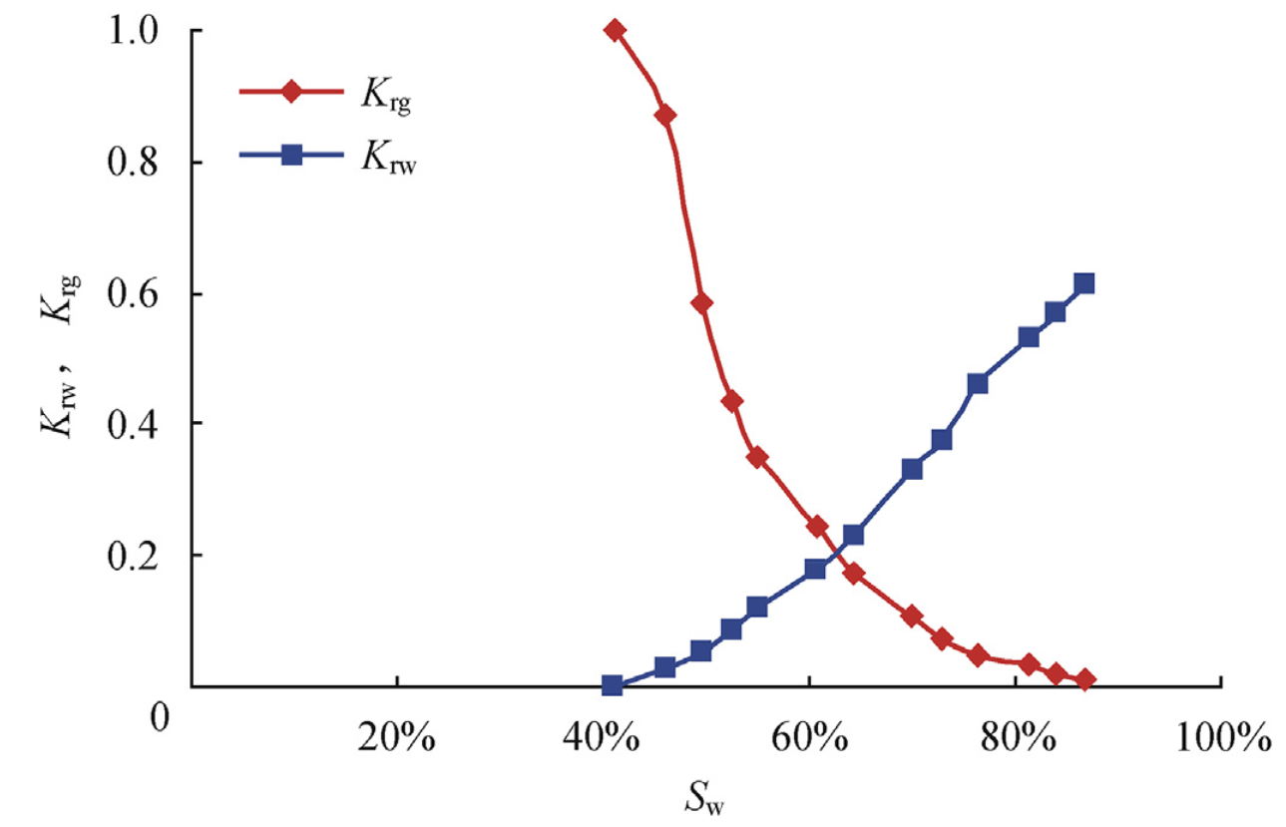
Analysis of gas diffusion coefficients under gas–water flow
PNM | S_{W} | CN_{ave} | D_{ave}/m | D_{m}/m²/s
#1 | 0.21 | 3.9 | 3.43×10⁻⁵ | 4
 | 0.36 | 4.27 | 3.74×10⁻⁵ | 6
#5 | 0.15 | 3.69 | 9.8×10⁻⁵ | 20
 | 0.32 | 3.72 | 1.11×10⁻⁴ | 35
Gas phase tends to occupy larger pores with higher connectivity as water saturation increases in a water-wet system
Conventional gas–water flow theory
Damped-wave gas–water flow theory
Water saturation increases
VS
Diffusion coefficient increases
Diffusion area decreases
Gas flow rate decreases
Increasing S_{w} reduces k_{rg} and gas flow rate

Slide 15

Construction of matrix–fracture network model
Induced fracture
Matrix
hydraulic fracture
Wellbore
Micro fracture area
black：pore，white：solid
Tight gas reservoir fracture network
Tight sandstone digital rock
Matrix–fracture digital rock
PML layer
hydraulic fracture
Initial high gas density in matrix
Initial low exit gas density in matrix
Matrix–fracture gas flow simulation
Matrix–fracture pore network

Slide 16
Damped-wave-based matrix–fracture gas flow simulation
Perturbed density variation on matrix–fracture network (P:30MPa T:400K dP/dx:0.5MPa/m)
t=1.52×10⁻⁹s
t=4.95×10⁻⁶s
t=8.99×10⁻⁶s
t=1.39×10⁻⁵s
t=1.9×10⁻⁵s
t=4.19×10⁻⁵s

Slide 17
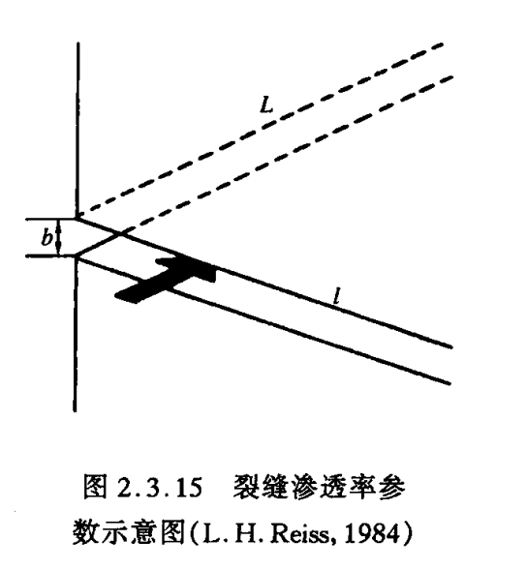
Damped-wave-based matrix–fracture gas flow simulation
Perturbed mass variations were calculated for the original and half-reduced apertures
Fracture permeability model
Perturbed mass variation in matrix
D_{m} remains constant
VS
k_{f}: fracture permeability
b: fracture aperture
Conventional theory : stress-sensitive aperture reduces production rate
This study: aperture variation has no impact on production.

Slide 18
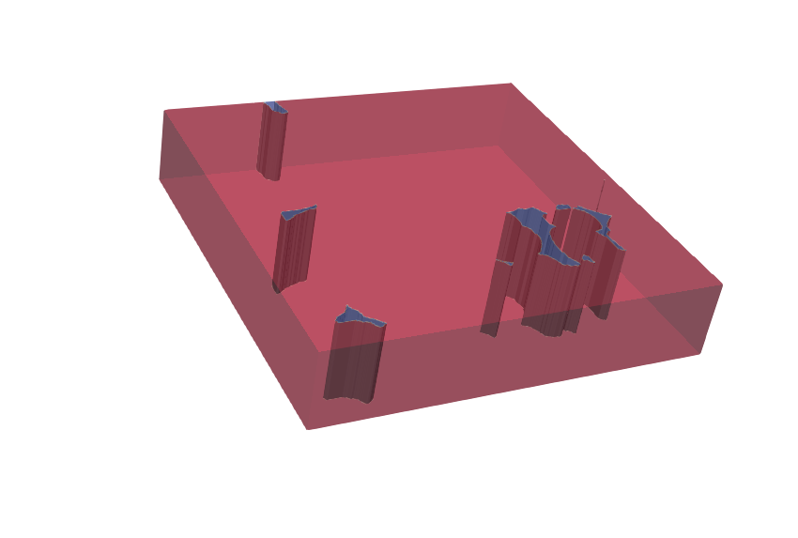
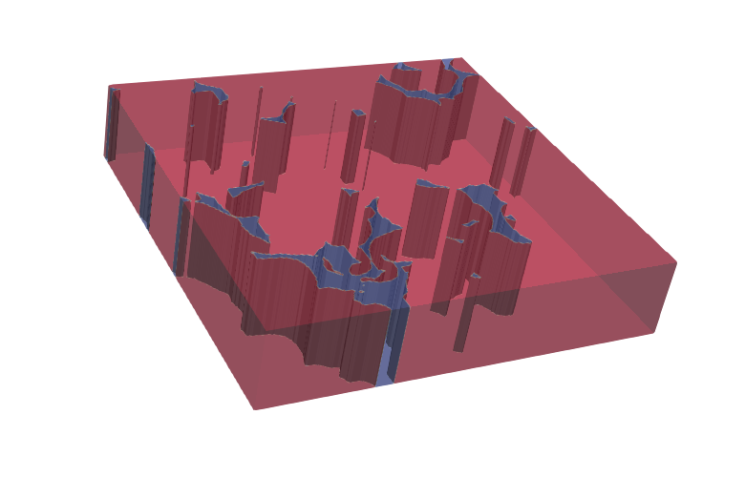
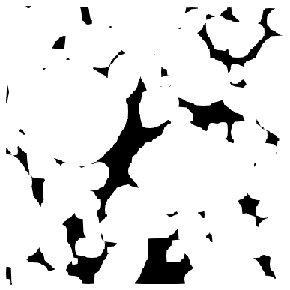
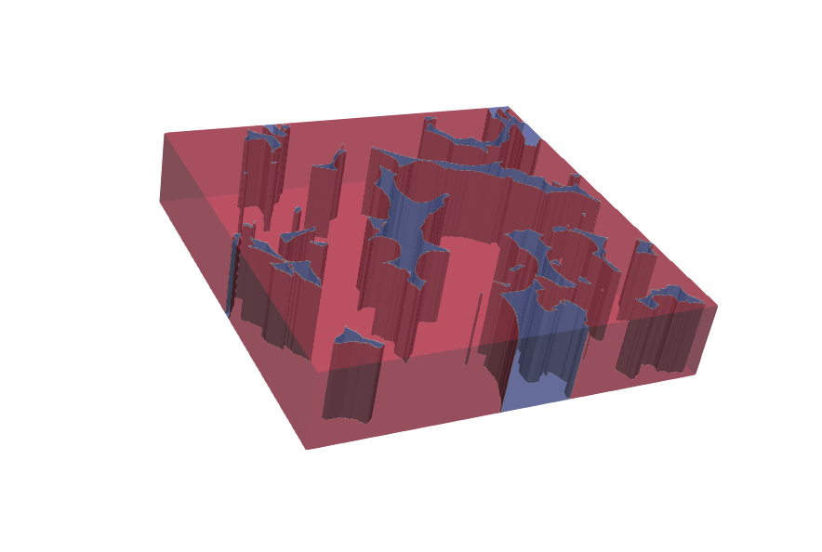
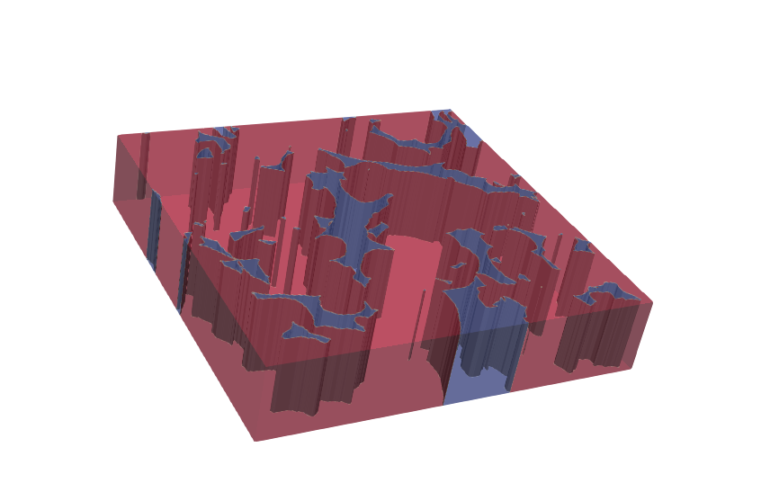
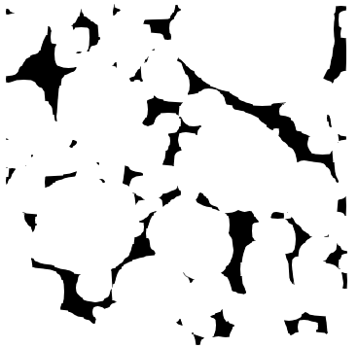
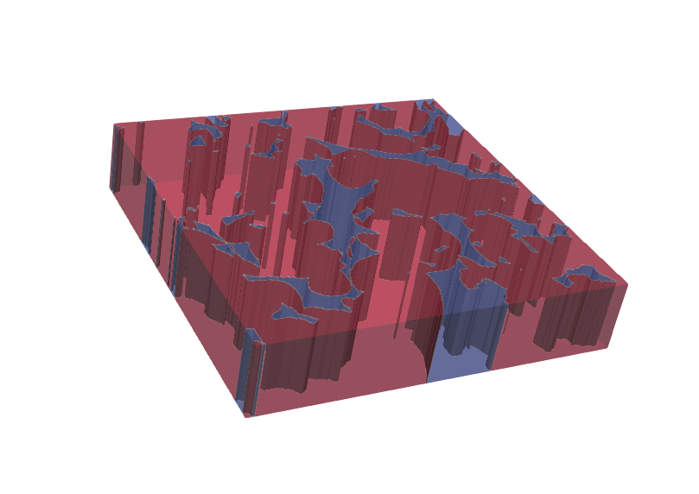
Damped-wave-based matrix–fracture gas flow simulation
Partial blockage of the matrix-fracture cross-section is applied under constant aperture
Matrix pore–fracture interface identification
Artificial blockage of pore–fracture cross-section
γ=0.096
γ=0.31
black: pore-fracture
interface
γ=0.59
γ=0.67
γ： block ratio
A_{b}: blocked pore area
A_{p}：total pore area
γ=0.75

Slide 19
Damped-wave-based matrix–fracture gas flow simulation
block ratio 0.096
block ratio 0.31
block ratio 0.59
block ratio 0.67
block ratio 0.75

Slide 20
Damped-wave-based matrix–fracture gas flow simulation
Perturbed mass variation in matrix at different block ratio with same aperture
No block
block ratio 0.096
block ratio 0.31
block ratio 0.59
block ratio 0.67
block ratio 0.75

Slide 21
New insights into gas reservoir development
Gas flow is governed not by fracture aperture variation, but by matrix pore–fracture
contact area variation
Diffusion coefficient change with block ratio
Conventional fracturing concept
Stimulated reservoir volume (SRV)
Enhancing permeability by creating wide fractures
New insights into fracturing
Stimulated reservoir area (SRA)
Enhancing fracture–matrix pore contact area by creating long fractures

Slide 22
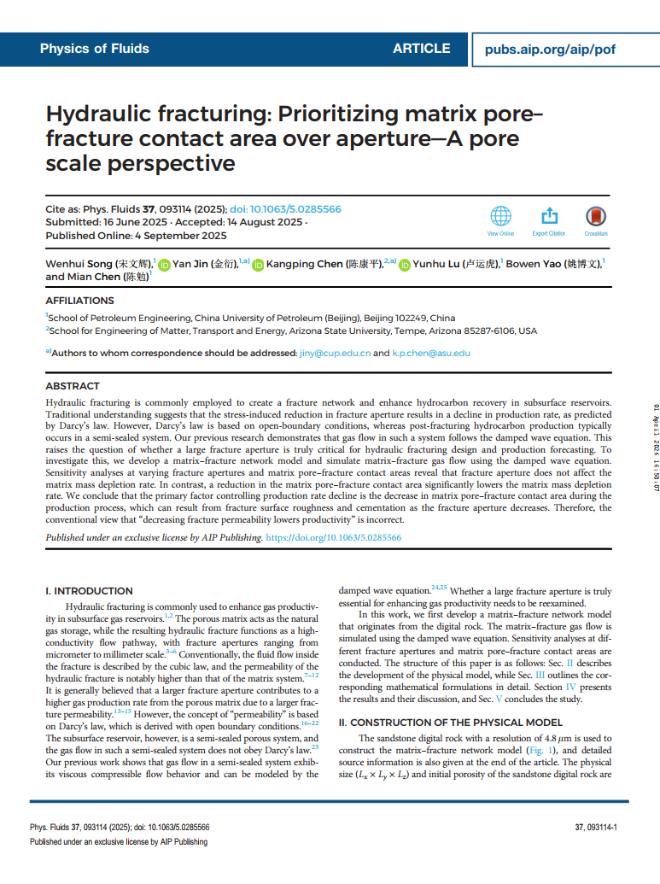
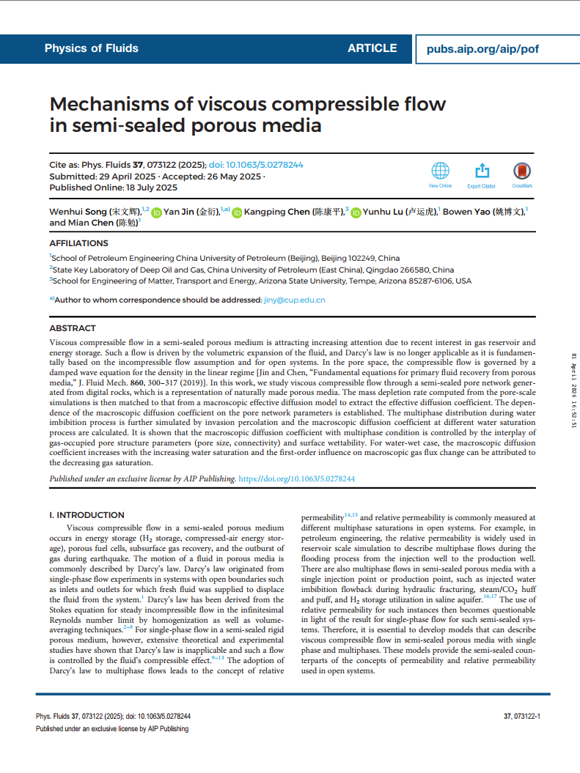
Relevant publications
[1] Song, W., Jin, Y., Chen, K., Lu, Y., Yao, B., & Chen, M. (2025). Hydraulic fracturing: Prioritizing matrix pore– fracture contact area over aperture—A pore scale perspective. Physics of Fluids, 37(9).
[2] Song, W., Jin, Y., Chen, K., Lu, Y., Yao, B., & Chen, M. (2025). Mechanisms of viscous compressible flow in semi-sealed porous media. Physics of Fluids, 37(7).

Slide 23


Special Session in Honor of Jun Yao
Thanks for your attention!
Tel: 18669408664
E-mail: song_wen_hui_upc@163.com
Wechat
ResearchGate

