Slide 1


Ostwald Ripening in Porous Media
A Decade of Exploration
Ke Xu, Peking University
& Many other researchers working on this topic since 2016
2026/05/20, Nantes, France

Slide 2
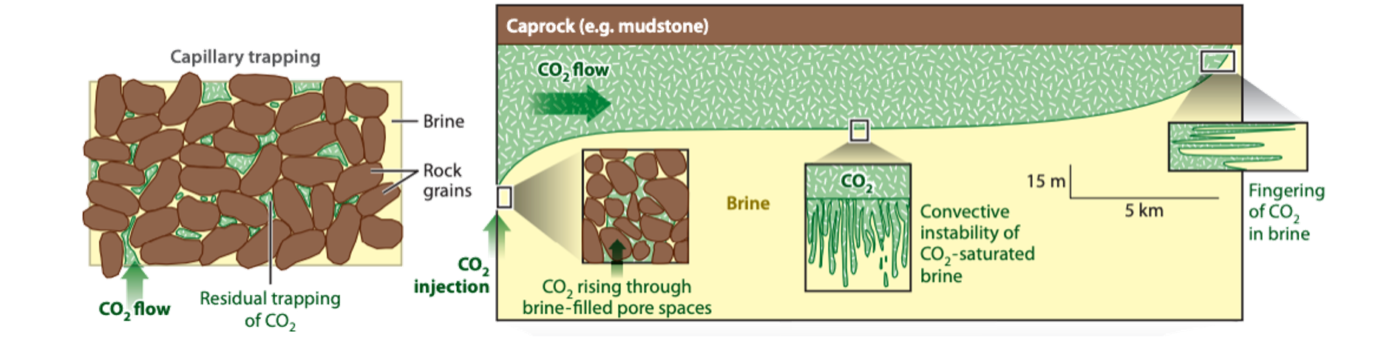
Major fluid mechanisms for geological carbon sequestration
Structural trapping: CO₂ trapped as gas cap
Capillary trapping：
CO₂ trapped as discrete bubbles
Dissolution trapping：
CO₂ trapped as aqueous/oleic solution
Mineral trapping：
CO₂ trapped as minerals, which is supposed to be permanent
Huppert, 2014

Slide 3
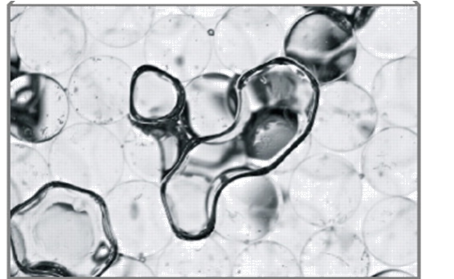
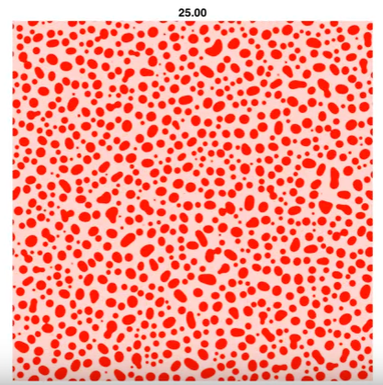
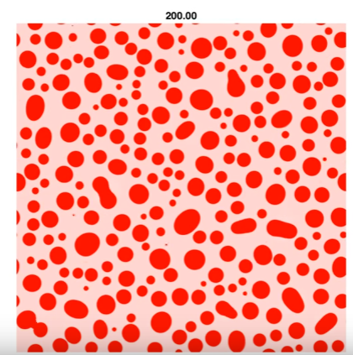
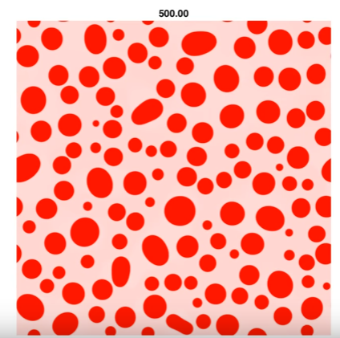
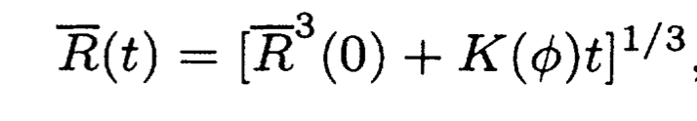
Capillary trapping and bubble coarsening
“The residual trapping of fluid within porous rock is one of the most effective methods for stably trapping CO₂ after injection”
---- Huppert et al.
Annual Review of Fluid Mechanics (2014)
CO₂ soluble in formation fluid => mass redistribution via diffusion (ripening)
LSW theory of Ostwald ripening
Bubbles coarsen in open space!
How about in Porous Media?
Fu et.al. Physical Review E, 2016

Slide 4
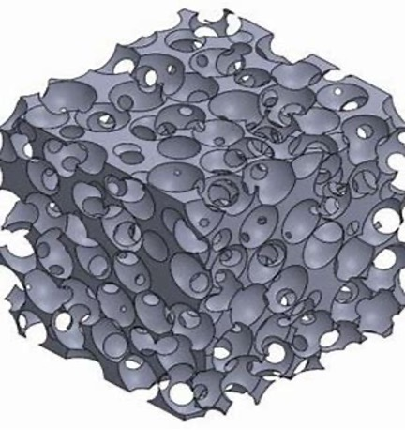
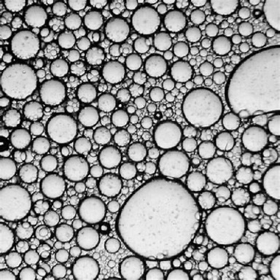
Bubbles in porous media: governing length scales
dispersed fluid systems
at least one dispersed phase
governed by bubble/droplet size
porous media
interconnected pore-network
governed by pore size
vs.
thermodynamic properties
coarsening kinetics and equilibrium
dissolution
…

Slide 5
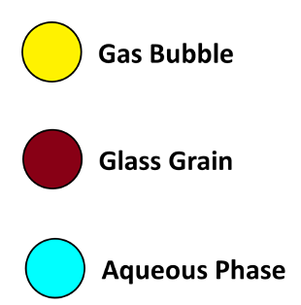
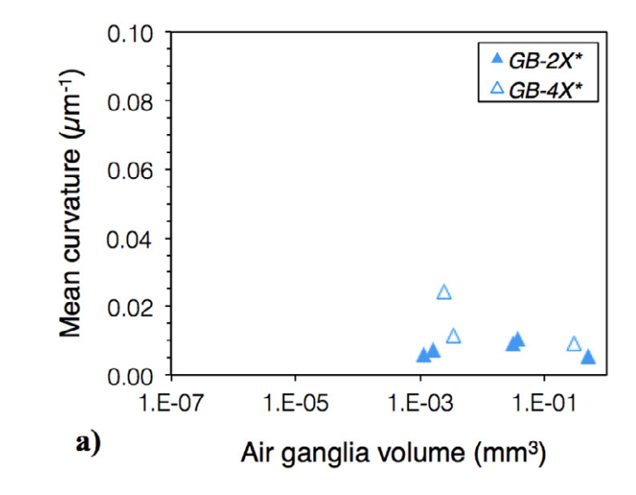
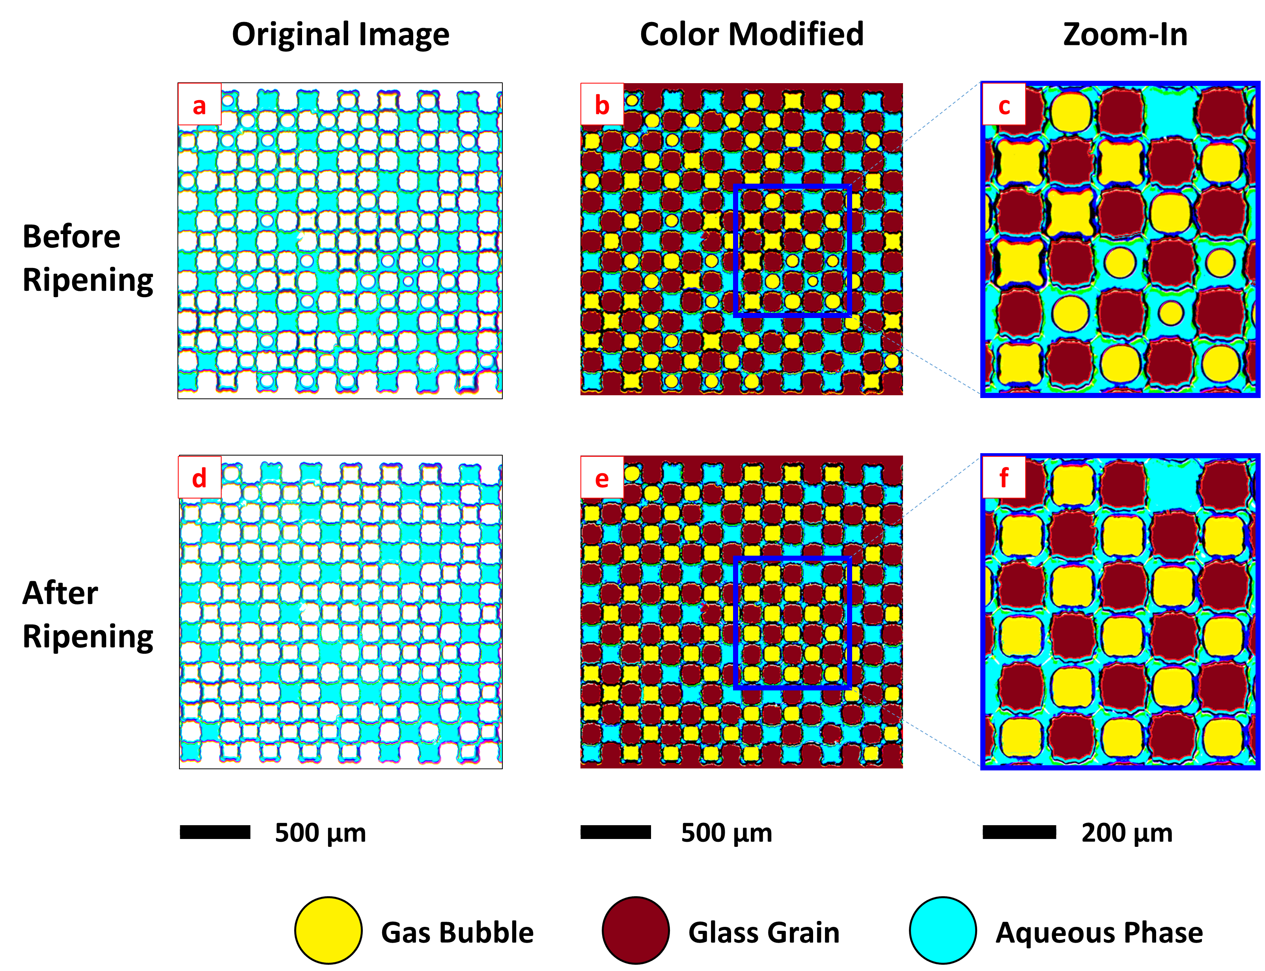
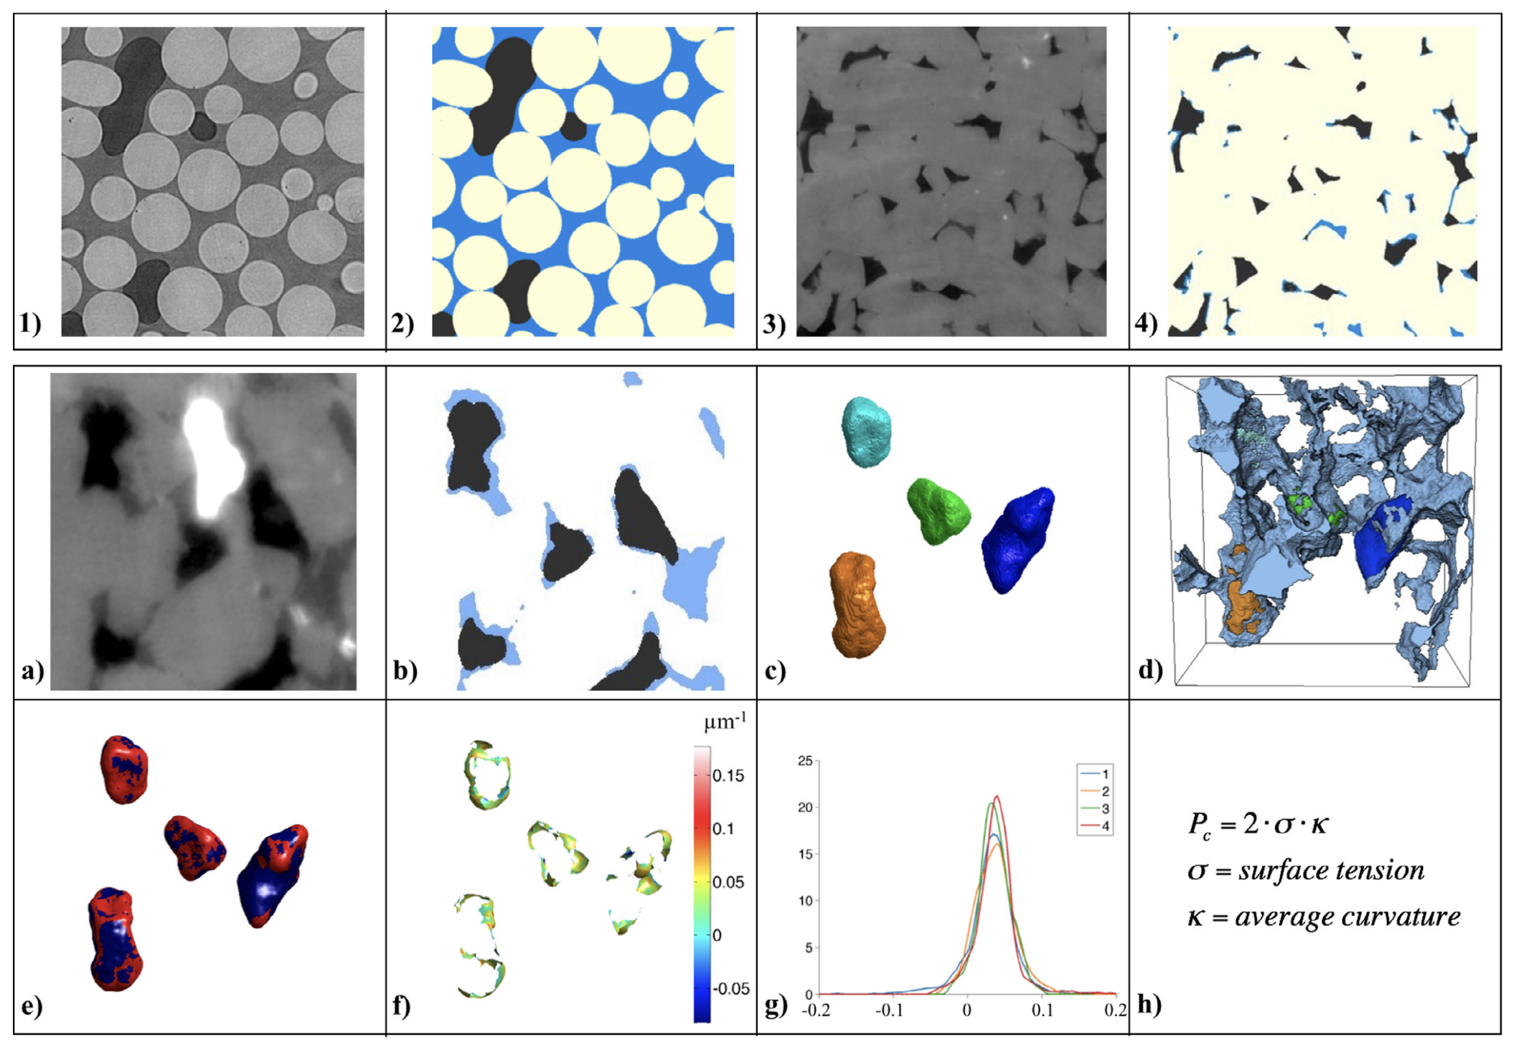
The Start: Pore-scale Experiments in UT-Austin & Stanford @ 2017
Observation: smaller bubbles grow at expanse of large bubbles
Stanford
UT-Austin
(120 hours)
Garing et al., AWR, 2017
Xu et al. PRL, 2017

Slide 6
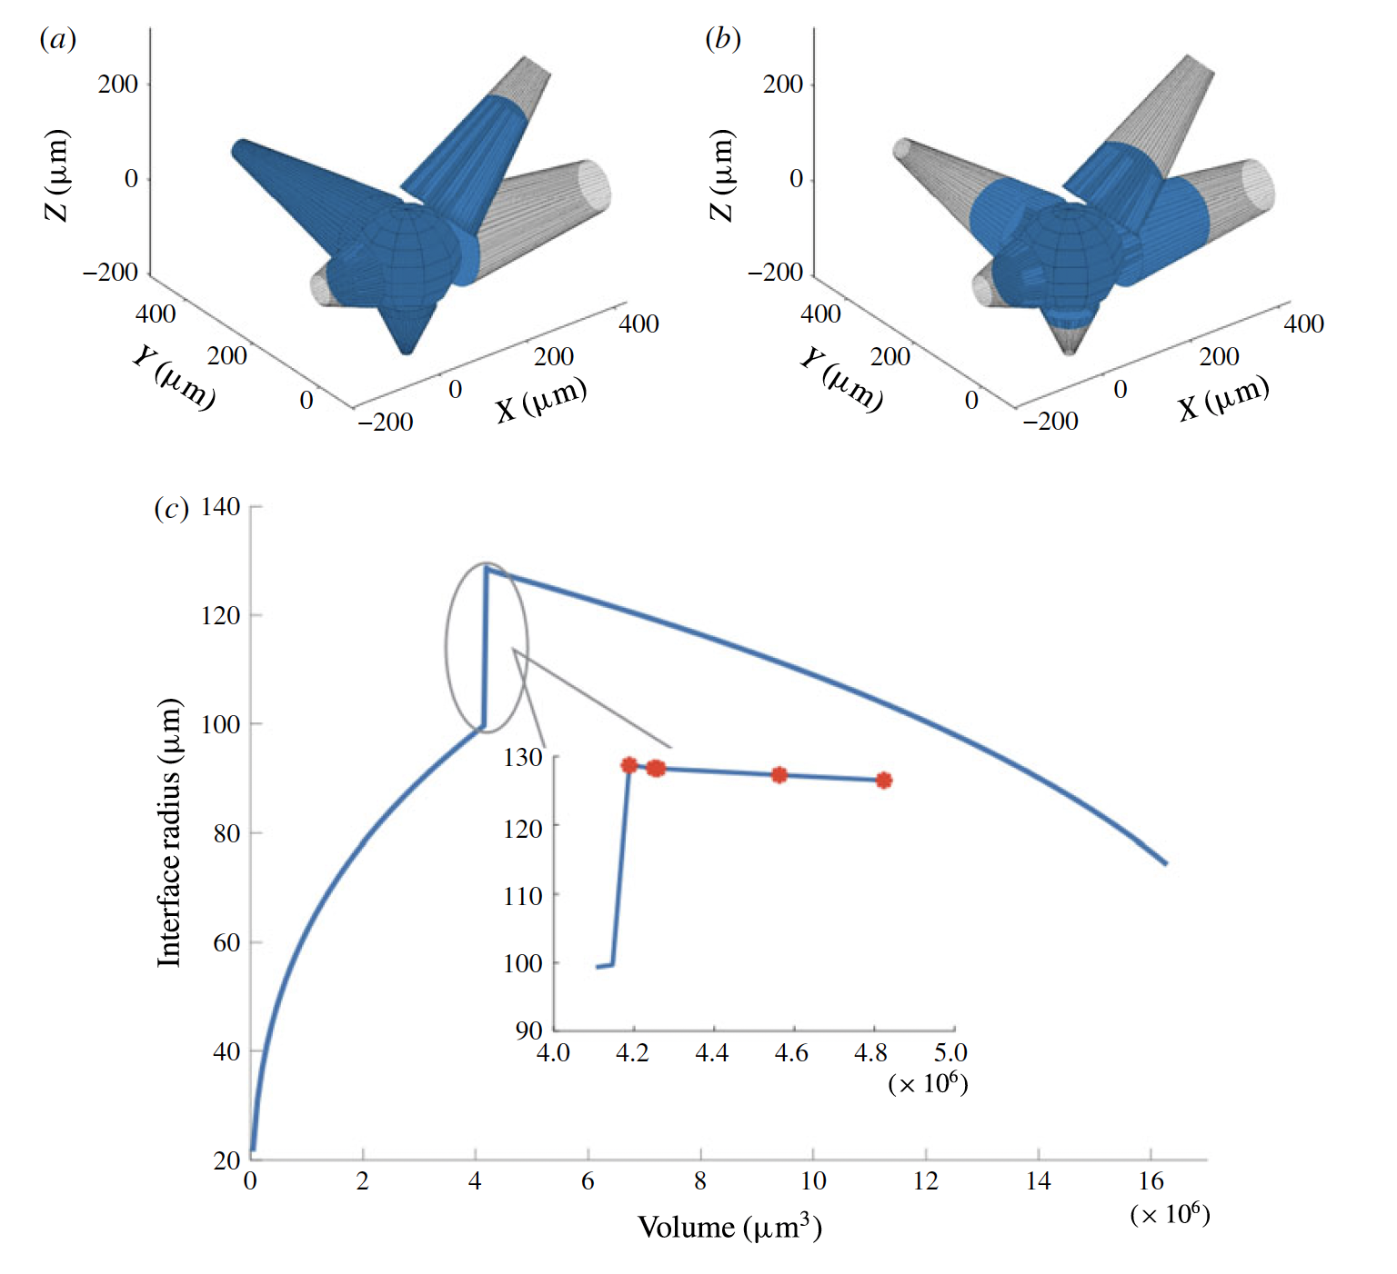
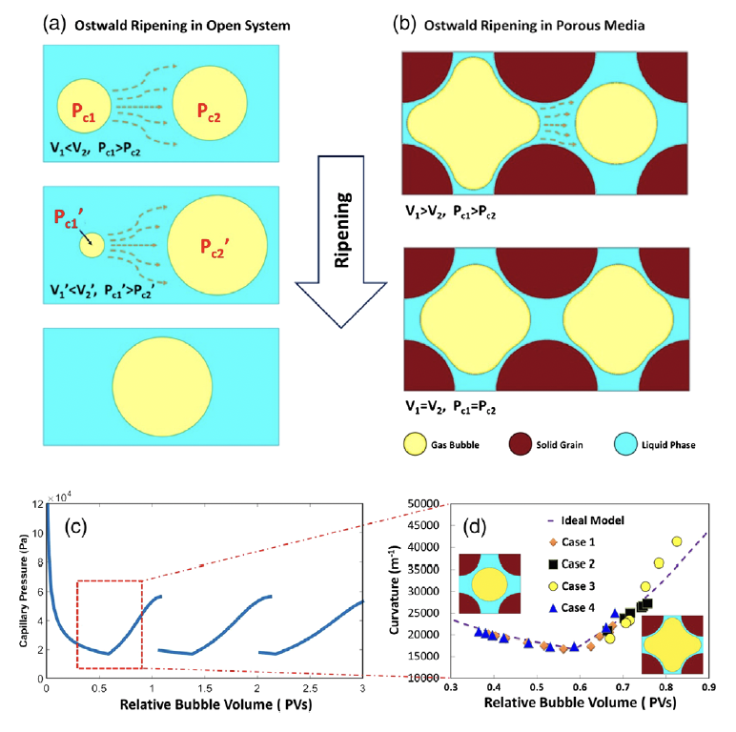
The Start: Pore-scale Experiments in UT-Austin & Stanford @ 2017
Physics: porous structure reverses Pc-V correlation
Stanford
UT-Austin
de Chalendar et al. JFM, 2017
Xu et al. PRL, 2017

Slide 7
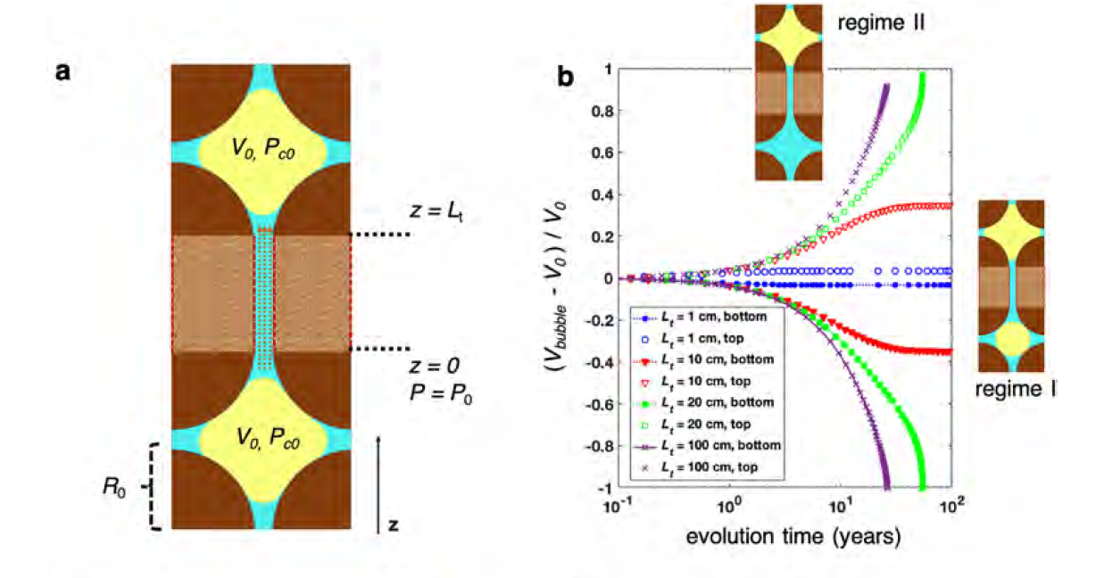
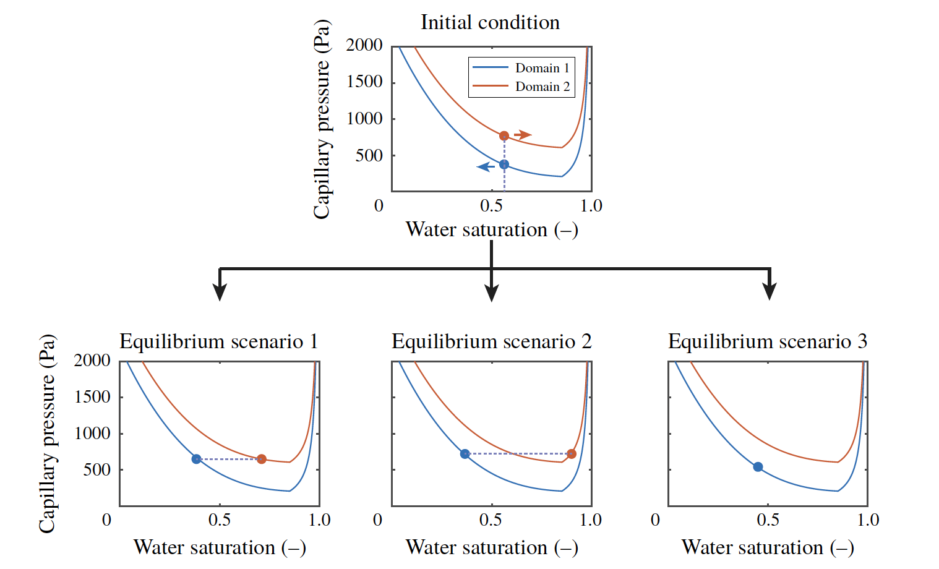
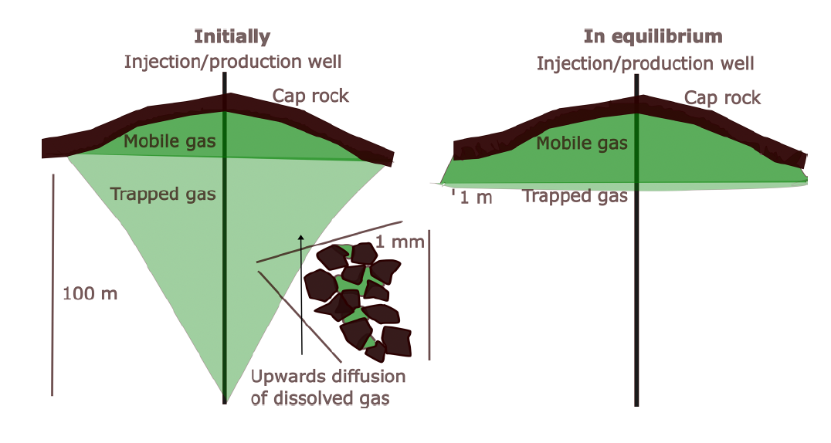
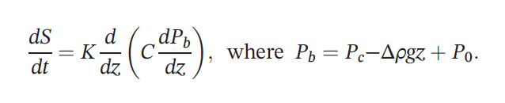
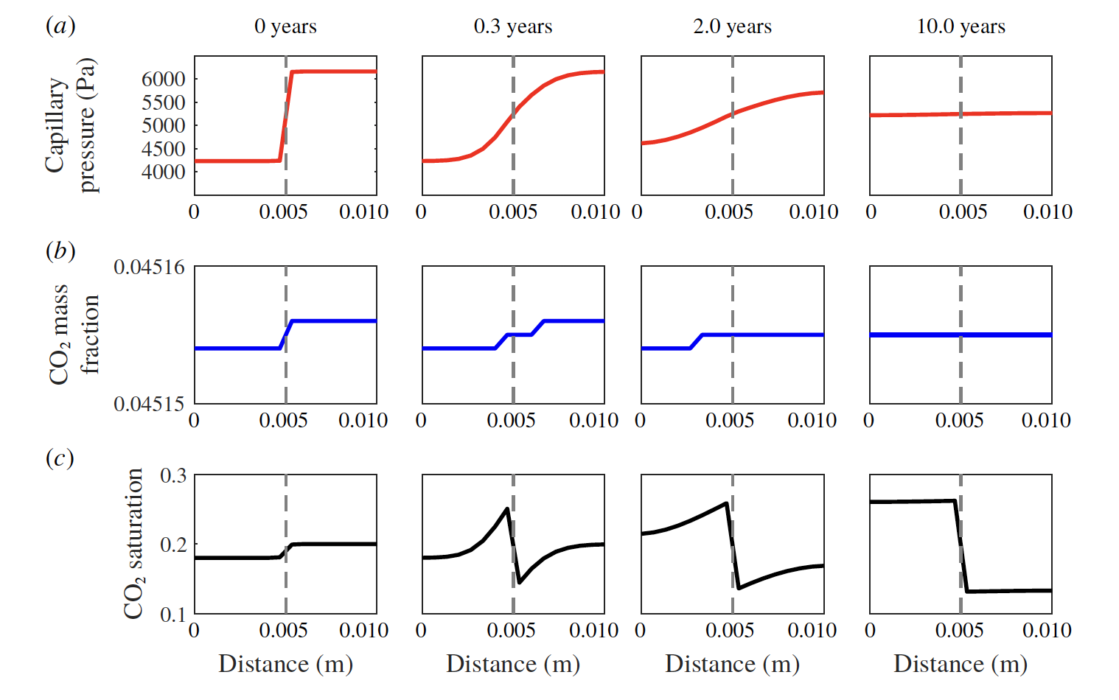
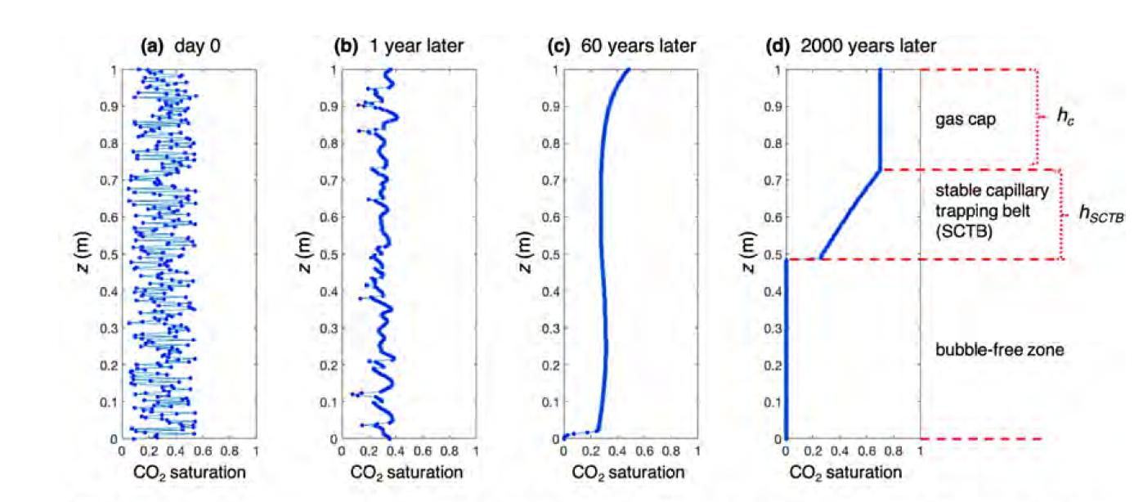
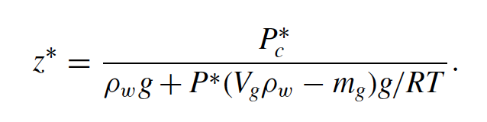
Step 2: Darcy-scale migration kinetics
MIT & Stanford & PKU
Stanford
Imperial College
Hight of transition zone
Xu&Mehmani et al., GRL, 2019
Feng et al., TiPM, 2022
Li et al., JFM, 2020
Li et al., TiPM, 2022
Blunt, PRE, 2022
Diffusive migration behaviors, with gravity vital at long term

Slide 8
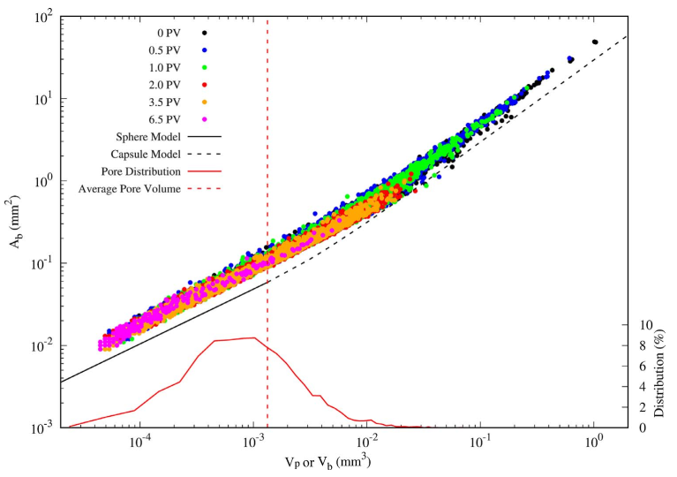
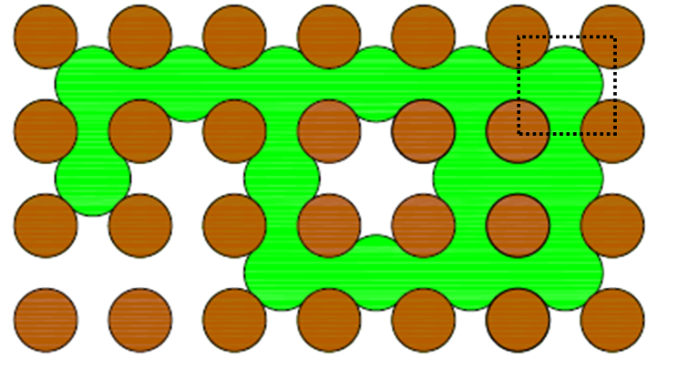

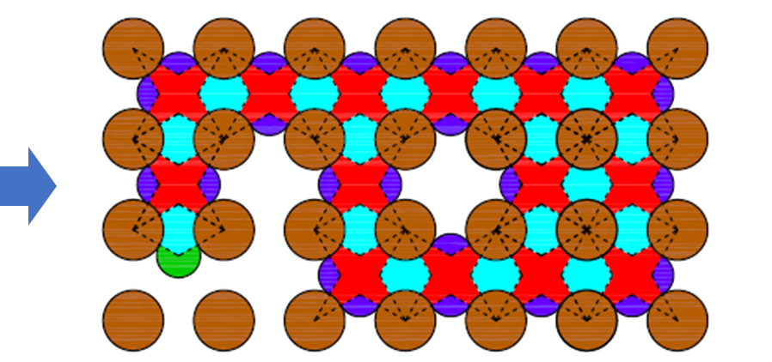
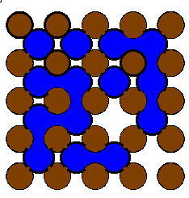

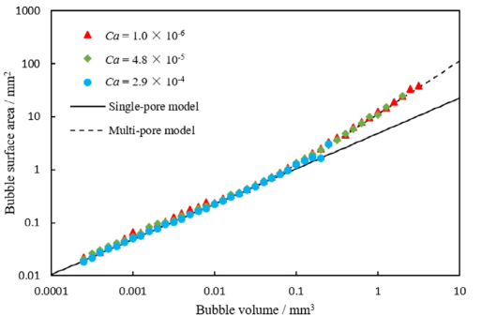


Step 3: Theoretical Approaches in Peking University
Thermodynamic origin – Wang et al., PNAS, 2021
A ~ a*V - b
$$V_{pore}$$
Patmonoaji & Suekane AWR, 2017
$$V_{pore}$$
Hu et al. IJHMT, 2020
Proportional F-V correlation erases driving force of infinite coarsening
Dispersed fluid can be thermodynamically stable in porous media!

Slide 9
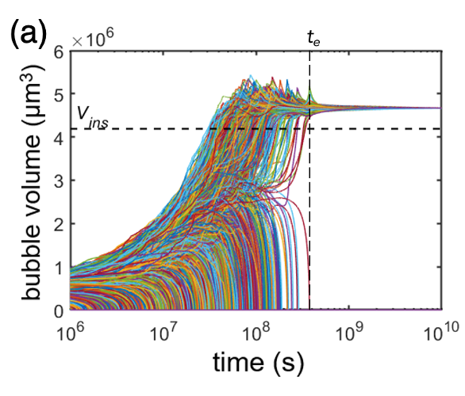

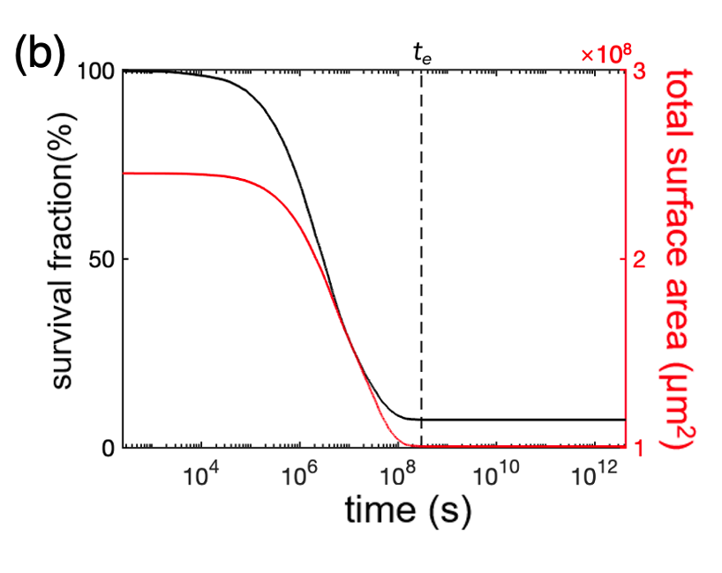
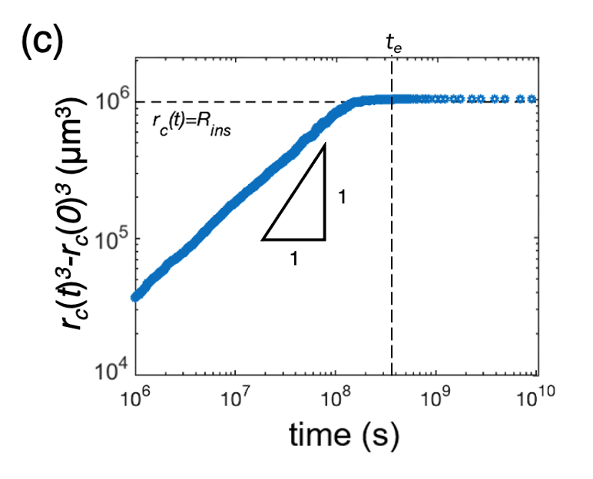
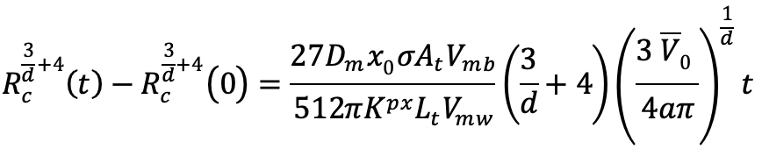
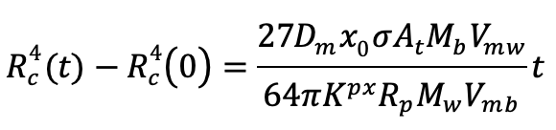

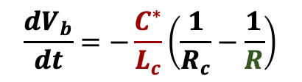
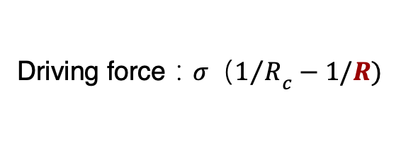
Step 3: Theoretical Approaches in Peking University
Coarsening Kinetics– Yu & Wang et al., GRL, 2023
In bulk fluid (LSW)：
Mass transfer length：R
$$\frac{dV}{dt}=C_{LSW}σR\left(\frac{1}{R_{c}}−\frac{1}{R}\right)$$
Driving force：${{σ（1}/R}_{c}−1/R)$
In pore-network
Bubble size (R) change => transfer length NOT changed
$$\frac{dV_{b}}{dt}=−\frac{C^{∗}}{L_{c}}\left(\frac{1}{R_{c}}−\frac{1}{R}\right)$$
Closely packed:
Sparsely packed:

Slide 10
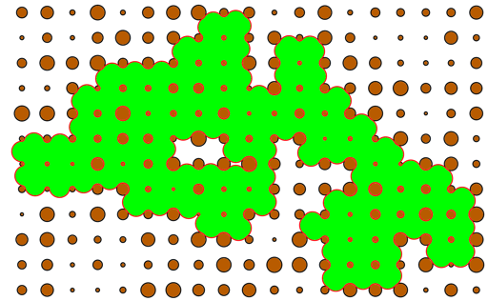
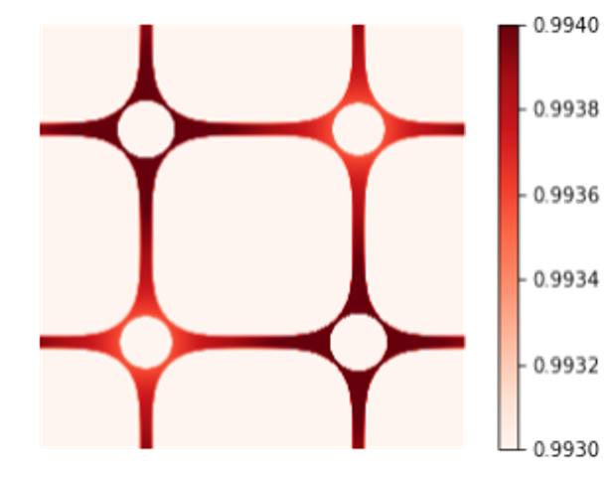
Step 3: Theoretical Approaches in Peking University
Interplay between critical length scales shapes bubbles’ behaviors, by：
—— regulating the free energy – volume correlation；
—— decoupling mass transfer length from bubble size.

Slide 11
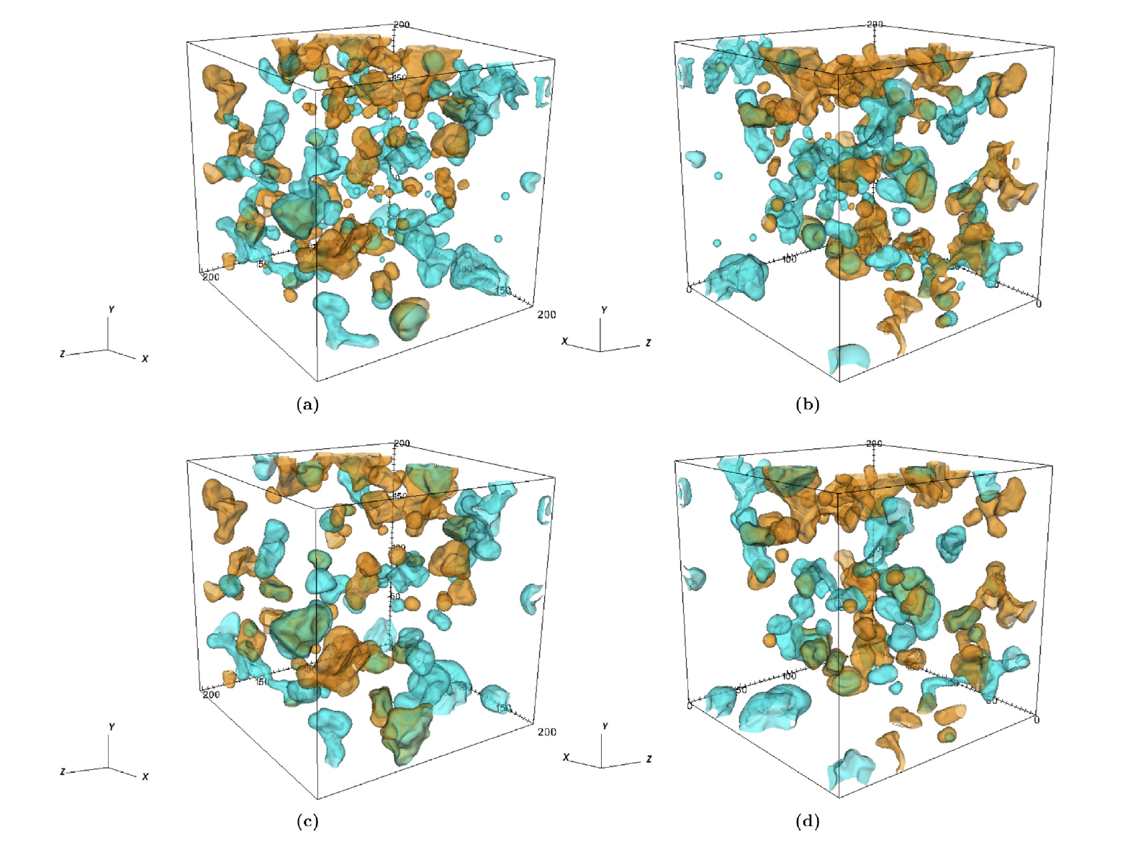
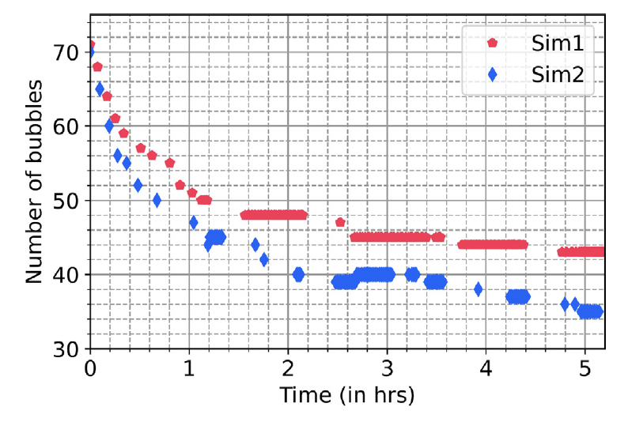
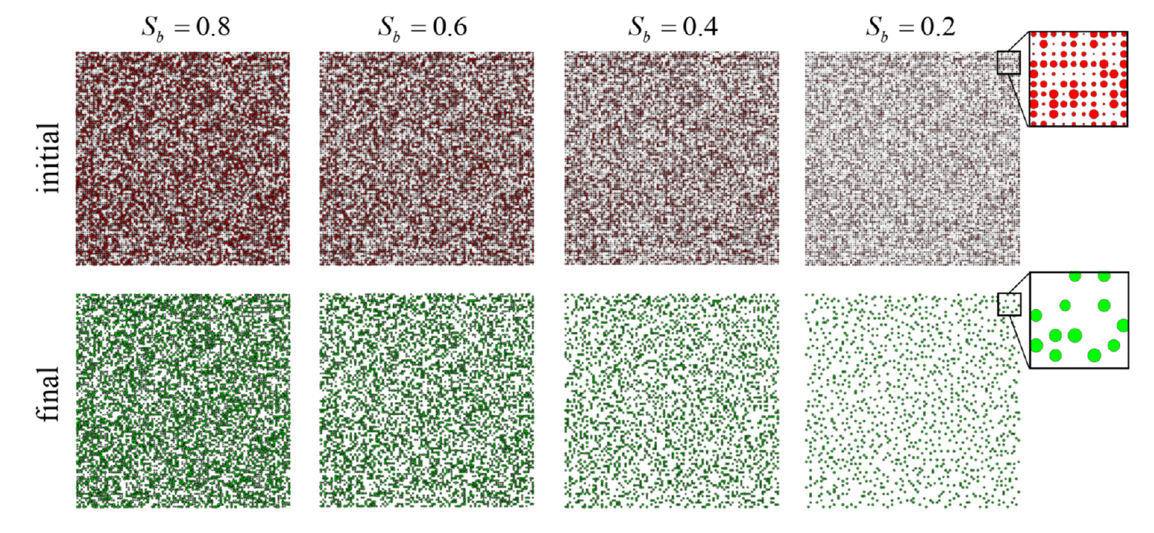
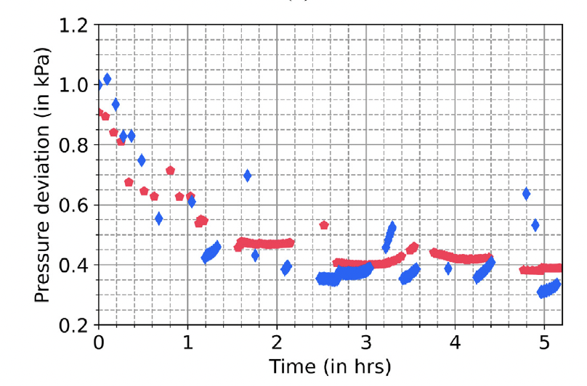
Diverse Approaches
Modeling at Pore scale – PNM, Phase Field, Levelset, etc.
Detailed and comprehensive studies on the effect of pore geometry, multi-components, heterogeneity, etc.
Porelab
Pennstate
Singh et al., AWR, 2024, levelset method
Mehnami & Xu, JCP, 2022, PNM

Slide 12
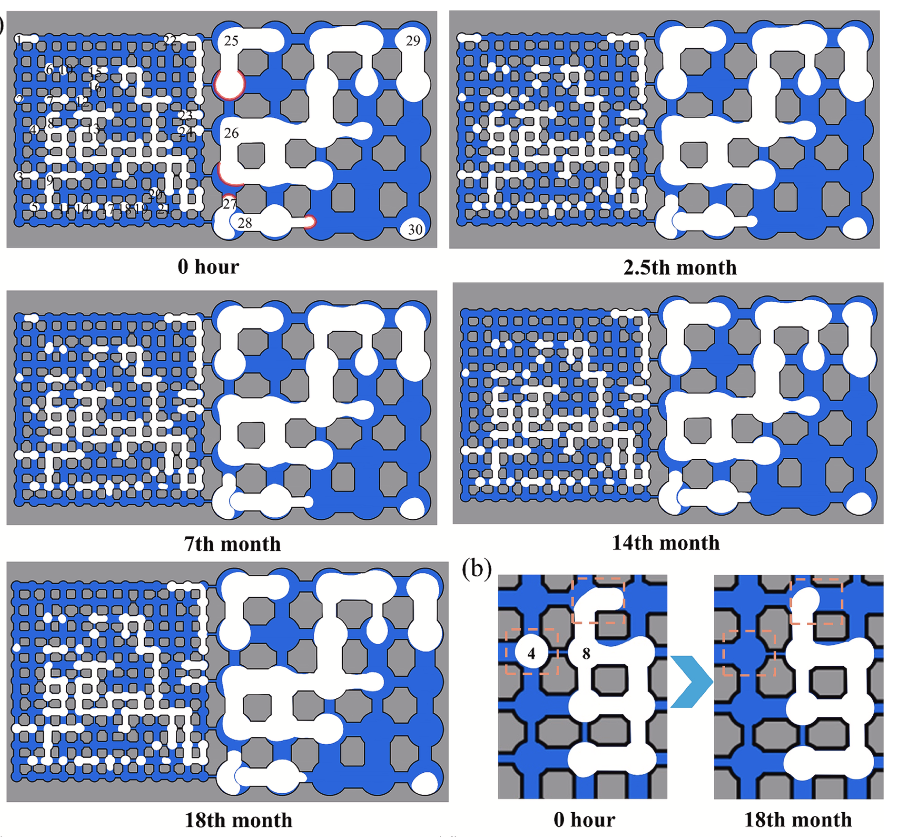
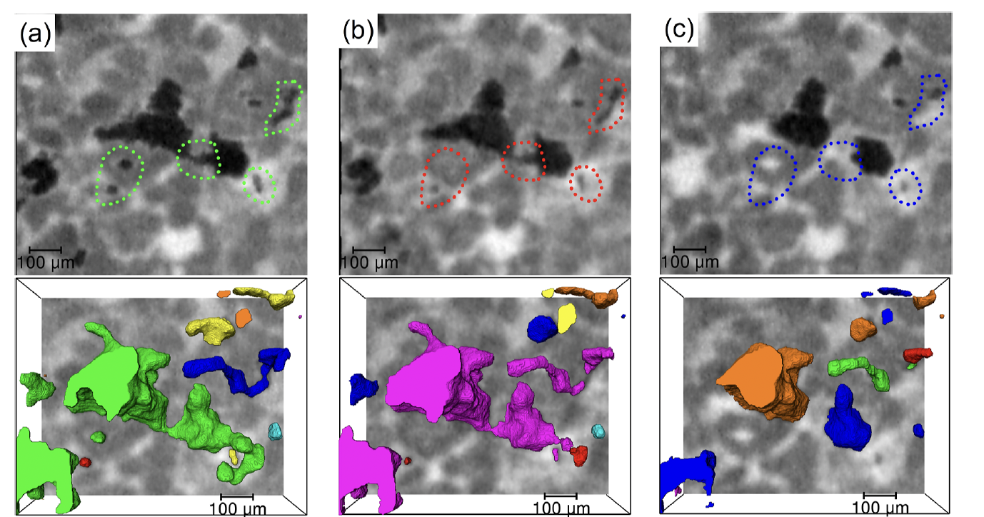
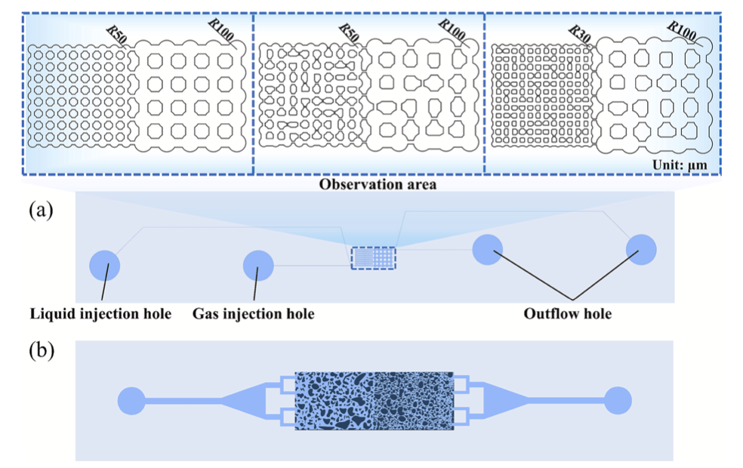
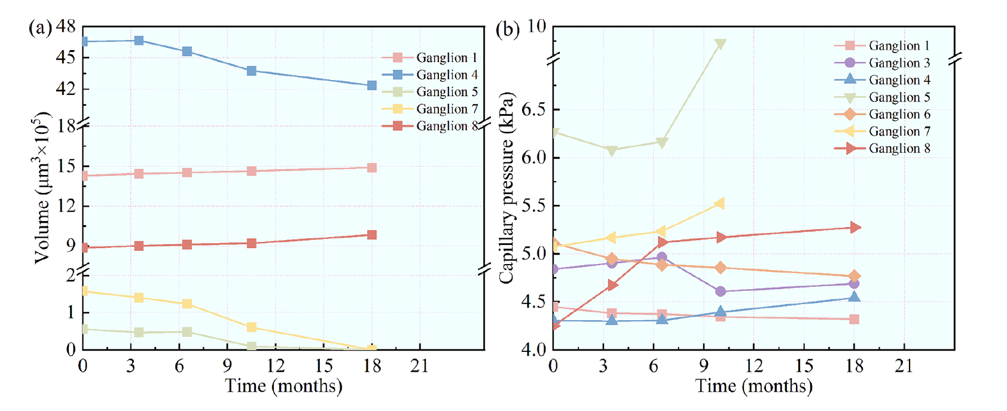
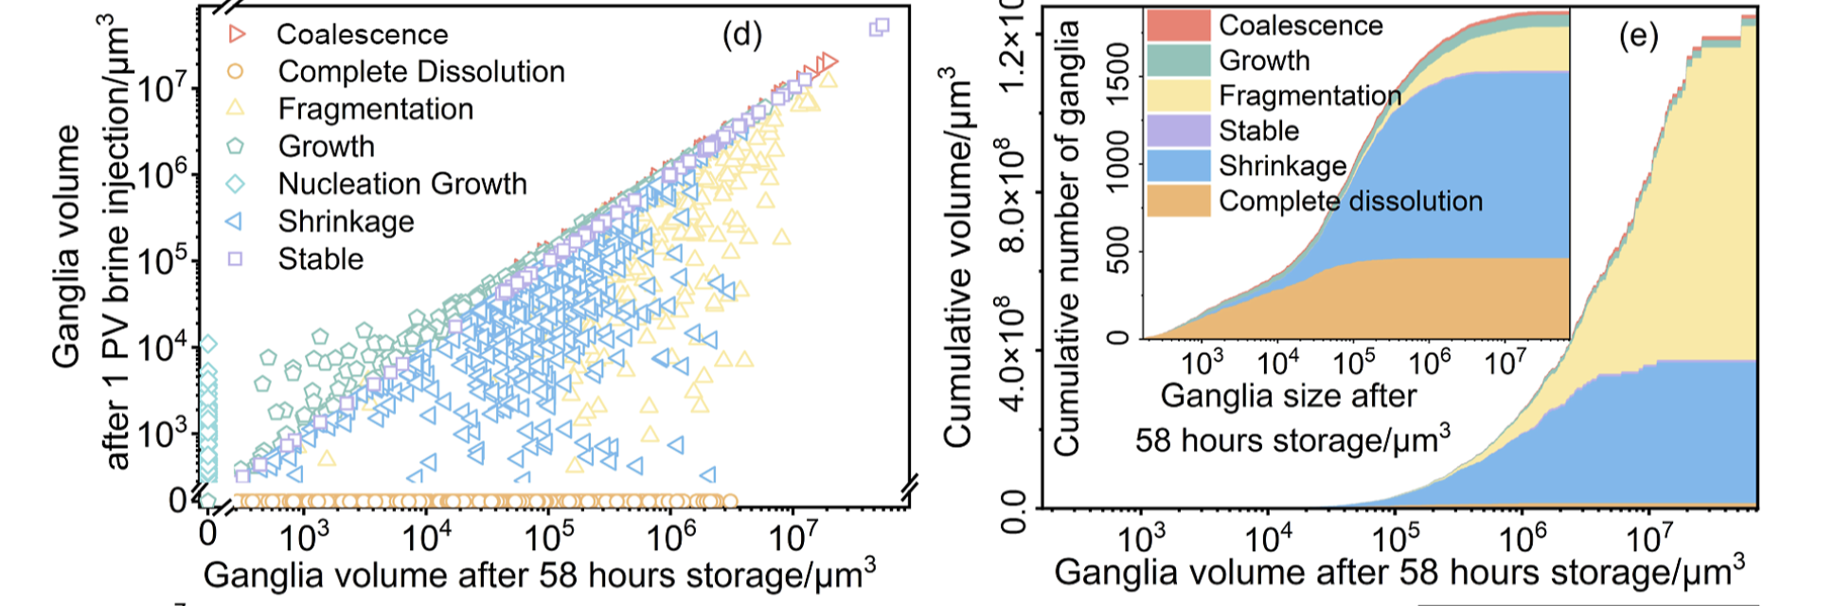
Experimental Validations
Core flood, microfluidics, etc.
Chai et al., EST, 2026
Feng et al., Experimental Thermal and Fluid Science, 2025

Slide 13
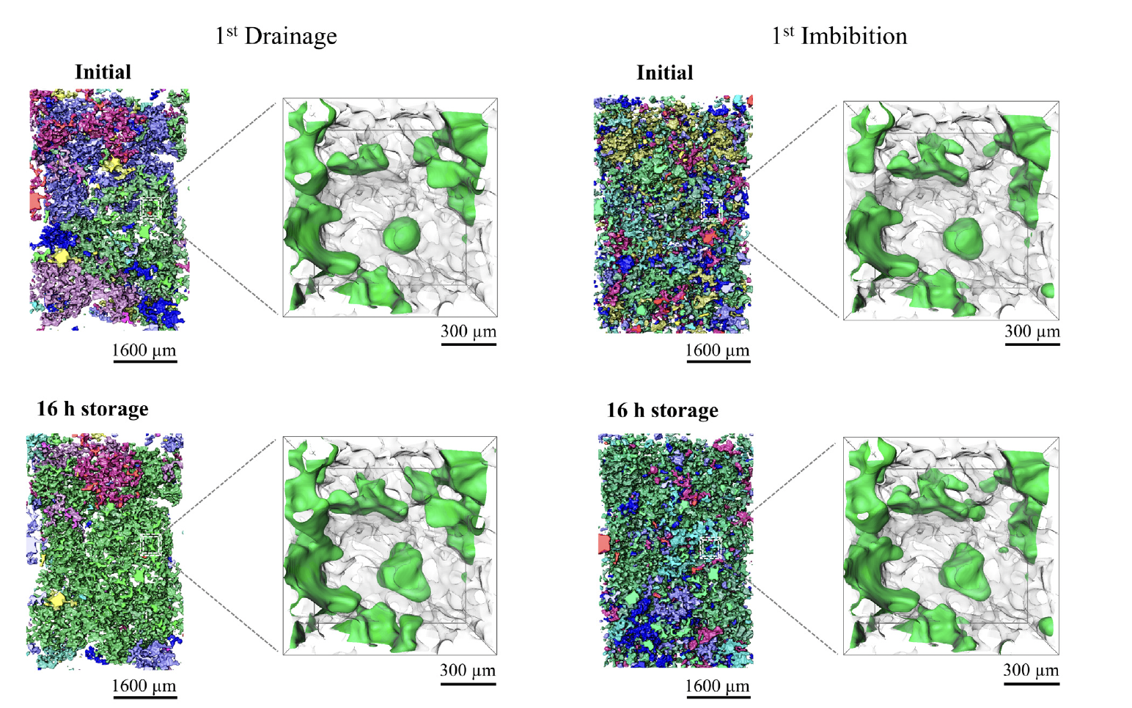
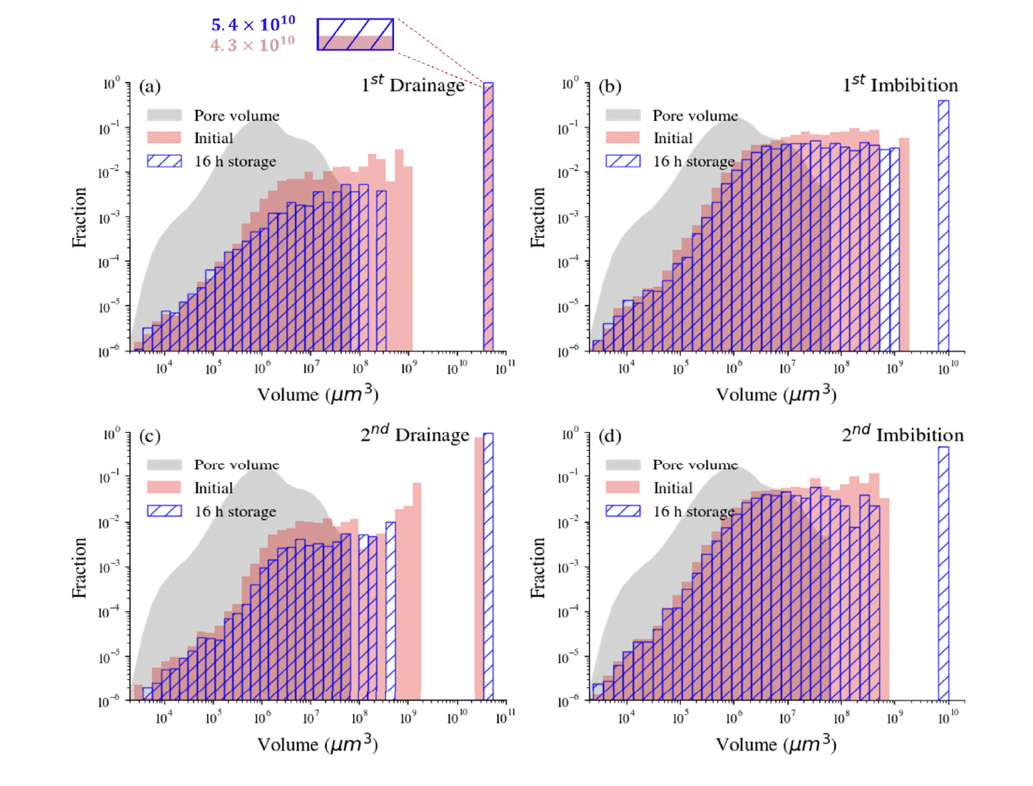
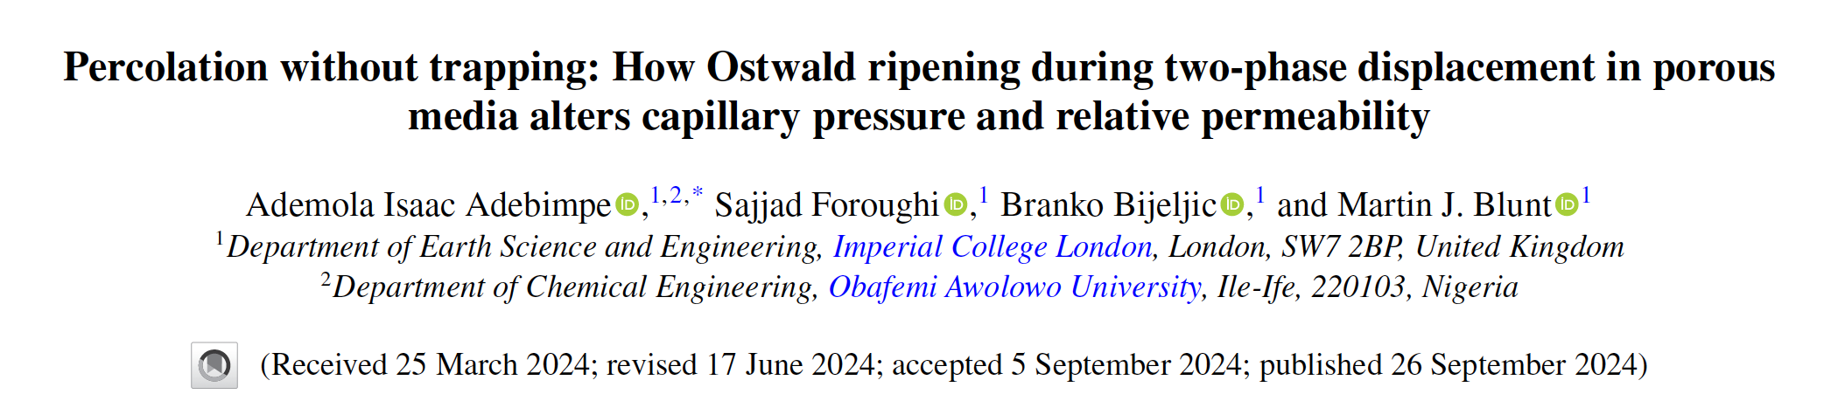
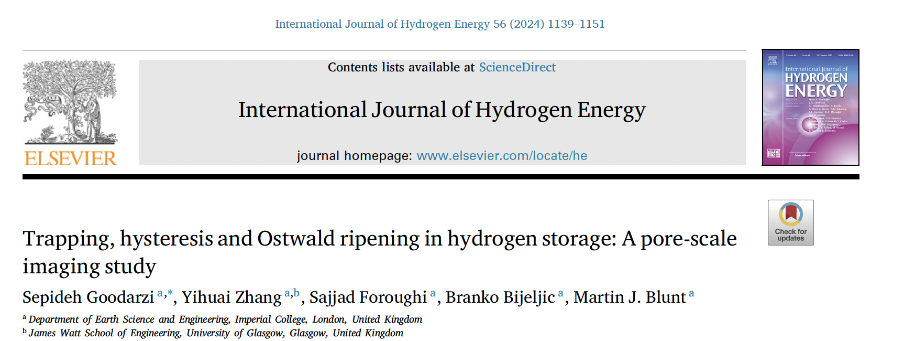
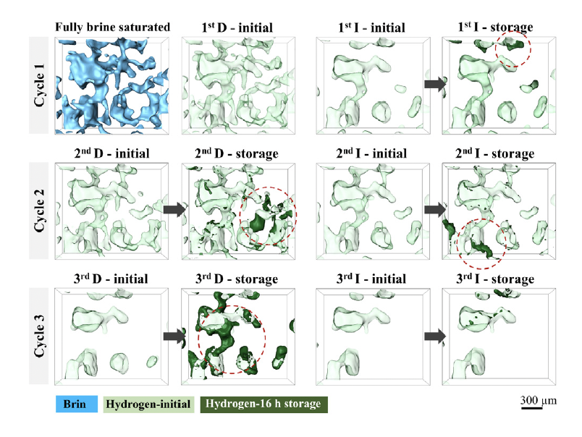
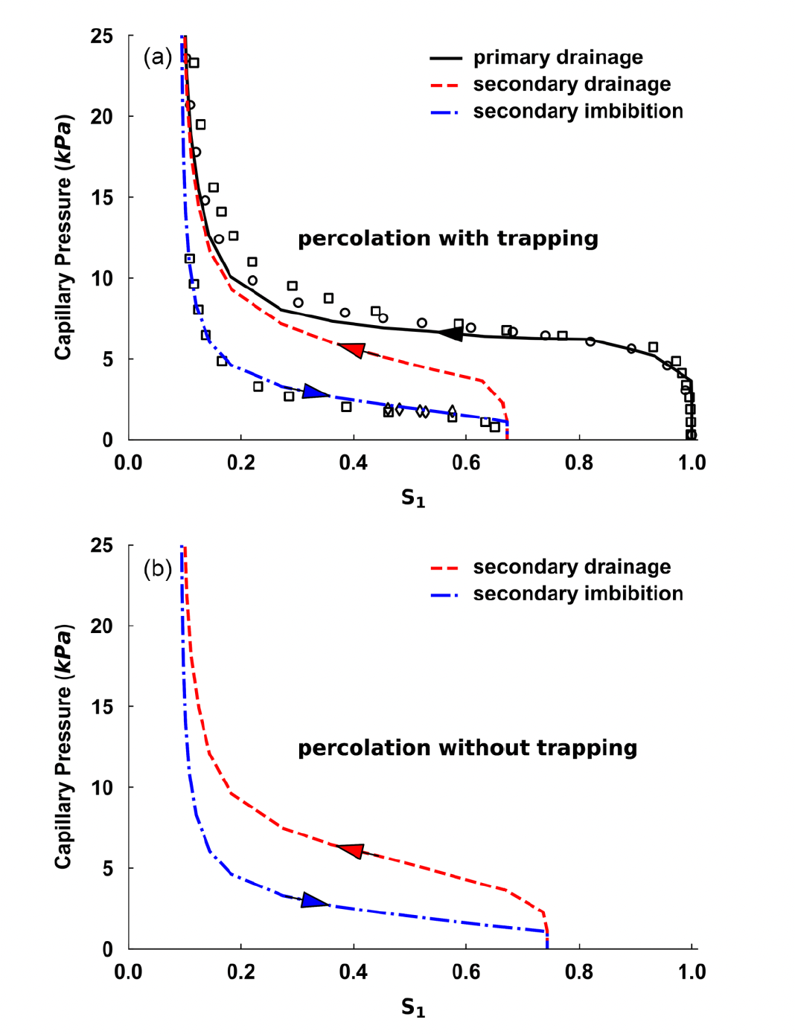


A Major Field-Scale Implication: Reduction of Hysteresis
Maily from Blunt Group
Ostwald ripening largely suppress the hysteresis effect!
Important for hydrogen storage, with multiple injection-retraction cycles

Slide 14


An Interesting Extension: Biological Systems
Sujit Datta & Rodney Priestley @ Princeton
Formation of functional unites in a cell is initiated by phase separation
Fibrillar networks stabilized ganglia and thus allows effective “functional rooms” in the cell!

Slide 15
Brief Summary
2016-2017: experimental observation, parrallel @ UT-Austin and @ Stanford.
2018-2022: theory on REV scale, , @MIT/PKU, @Stanford and @ Imperial College
2021- now : diverse approaches, inluding:
Theories on thermaldynamics and coarsening kinetics @ PKU and @ PennState
Pore-scale modeling @ PennState and @Porelab
Coreflood targeting on CCS and H₂ storage: @ Imperial College and @ Shell
Repeately confirmation by experiments at all scales
Acknowledgement
Sally Benson in corporative initiating this direction
Steffan Berg in promoting it across Europe
Martin Blunt in demonstrating its applications in future industry
Yashar Mehmani in supporting my ripening work since 2018

Slide 16

Comments are Welcome!
Ke Xu, Peking University
& Many other researchers working on this topic since 2016
2026/05/20, Nantes, France

