Slide 1


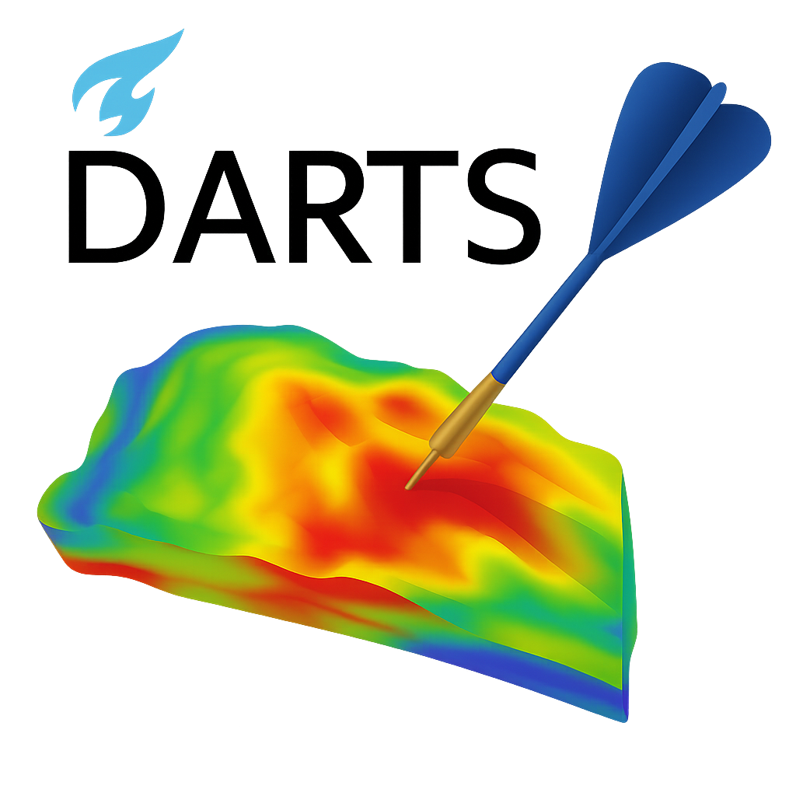
INTERPORE 2026 · ORAL PRESENTATION
Augmented Operator-Based Linearization
for Modeling of Hysteresis process
in CO₂ Sequestration
Jianxin Lu¹ · Aleksei Novikov¹ · Mengjie Zhao¹ · Lifei Yan¹ · Rouhi Farajzadeh¹ · Denis Voskov¹²
¹ Delft University of Technology, Netherlands ² Stanford University, USA
Department of Geoscience & Engineering
May 2026 · Nante, France
Notes:
Good afternoon, everyone. Thank you for being here. My name is Jianxin Lu, a PhD candidate at TU Delft. Today I would like to share our recent work on extending the operator-based linearization framework so that it can simulate history-dependent processes like hysteresis in CO₂ sequestration. Let us get started.

Slide 2
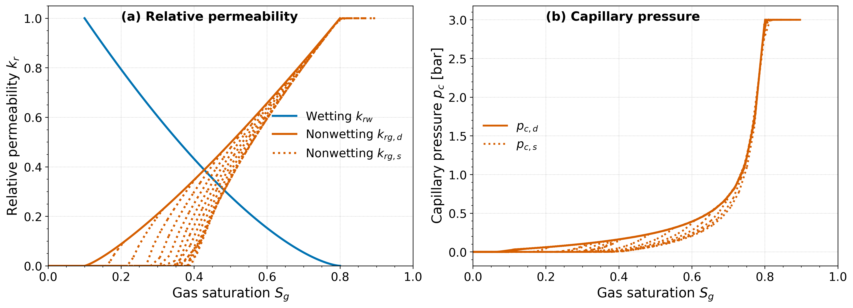
Why Hysteresis Matters in CO₂ Storage
History-dependent flow properties drive residual trapping & long-term storage security
Long-term CO₂ storage relies on trapping mechanisms
Structural, residual, dissolution and mineral trapping all act together — residual trapping is impacted by hysteretic flow properties.
k_{r} and p_{c} are path-dependent — drainage vs. imbibition yield very different values at the same saturation.
Ignoring hysteresis underestimates residual trapping and overestimates mobile CO₂, distorting storage forecasts.
Fig. 1 Bounding (solid) and scanning (dotted) curves for relative permeability and capillary pressure under drainage / imbibition.
Hysteresis impacts:
KEY CHALLENGE
• Residual gas saturation
• Plume migration & sweep efficiency
• Long-term CO₂ mass balance
A simulator for CO₂ storage must reproduce drainage–imbibition transitions consistently and at reservoir scale.
Jianxin Lu · InterPore 2026 · Delft University of Technology
2 / 10
Notes:
When we inject CO₂ into a deep saline aquifer, long-term storage relies on several trapping mechanisms acting together — structural, residual, dissolution and mineral trapping. Among these, residual trapping — where CO₂ is immobilized as disconnected droplets — is largely controlled by the hysteretic behavior of relative permeability and capillary pressure. What does that mean? Look at the figure on the right. The solid line is primary drainage and imbibition curve, if ignoring hysteresis, kr and pc will be calculated in this curve during whole simulation. But in fact, At the same gas saturation, in the same block, the relative permeability during imbibition can be very different from that during drainage. In other words, the rock has memory of its flow path. If we ignore hysteresis, we systematically underestimate how much CO₂ gets trapped. So the challenge is clear: a simulator for CO₂ storage has to reproduce the drainage–imbibition cycle, consistently, at reservoir scale, and at acceptable cost. That is what motivated this work.

Slide 3
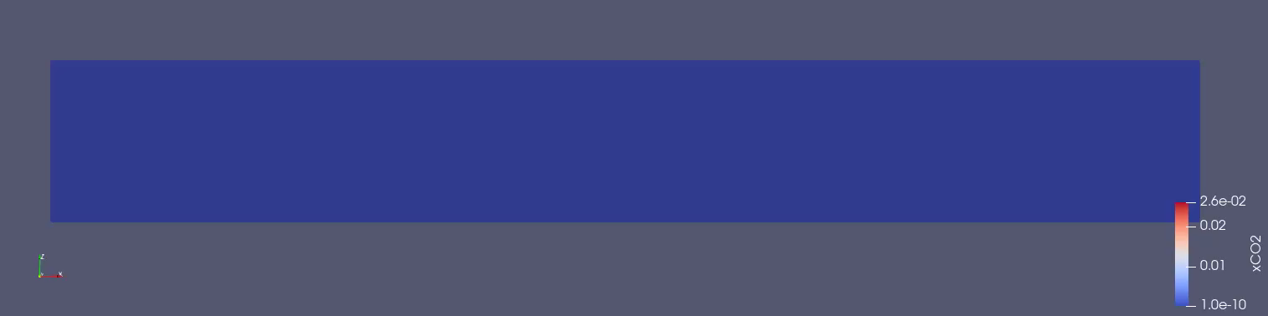
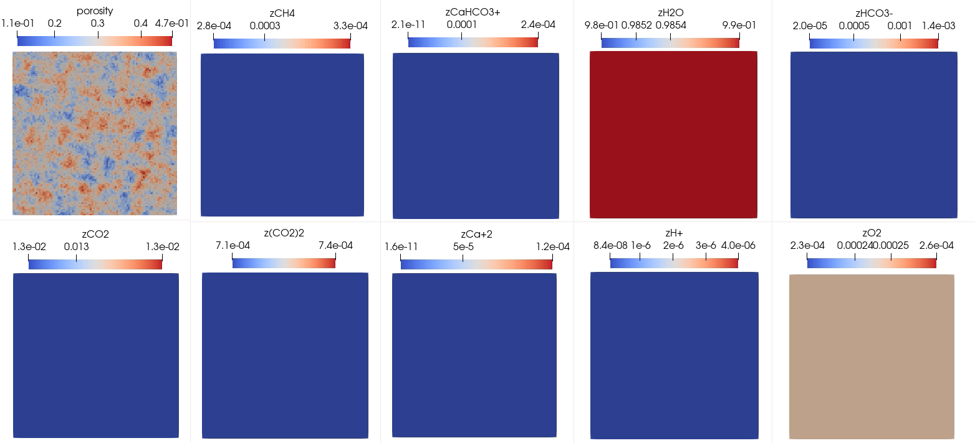
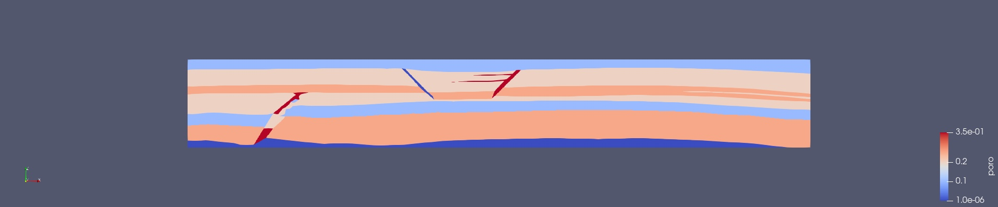
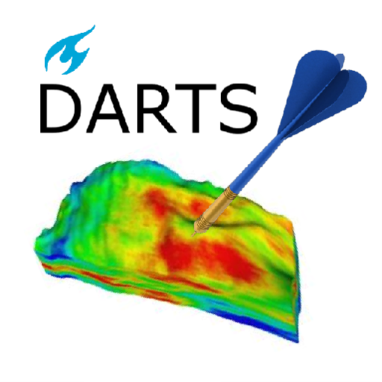
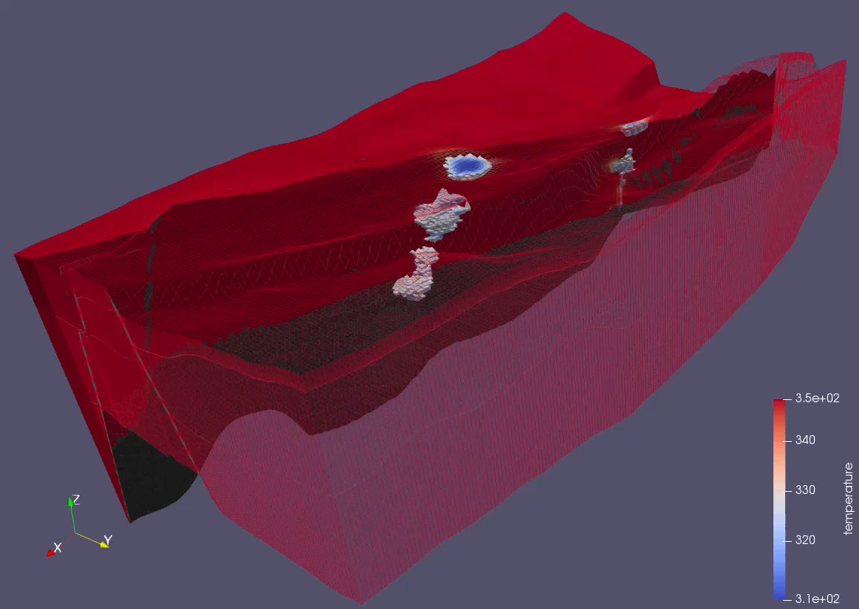
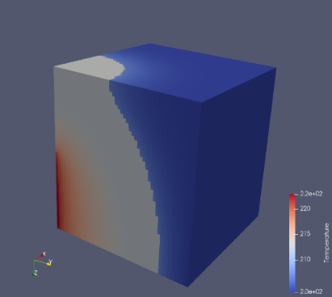
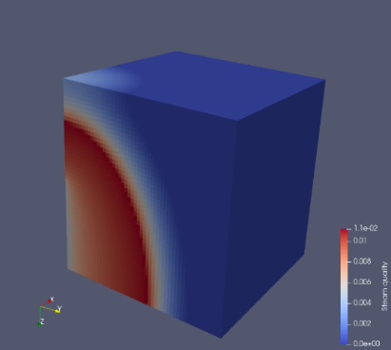
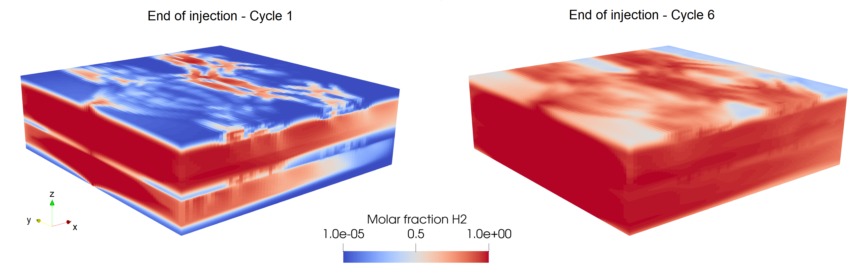
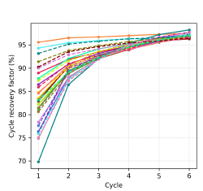
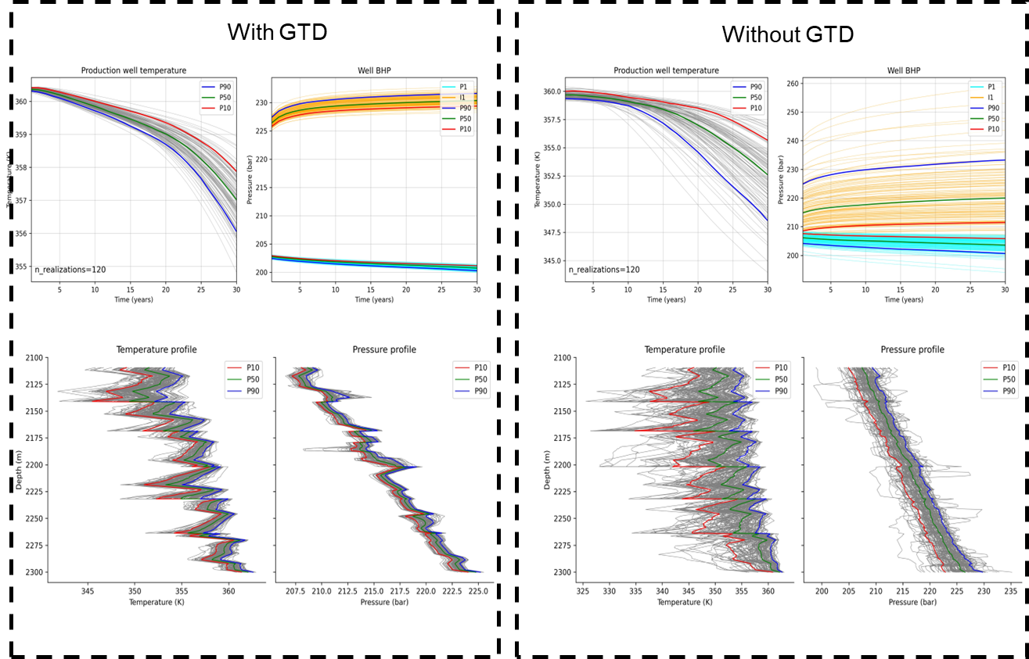
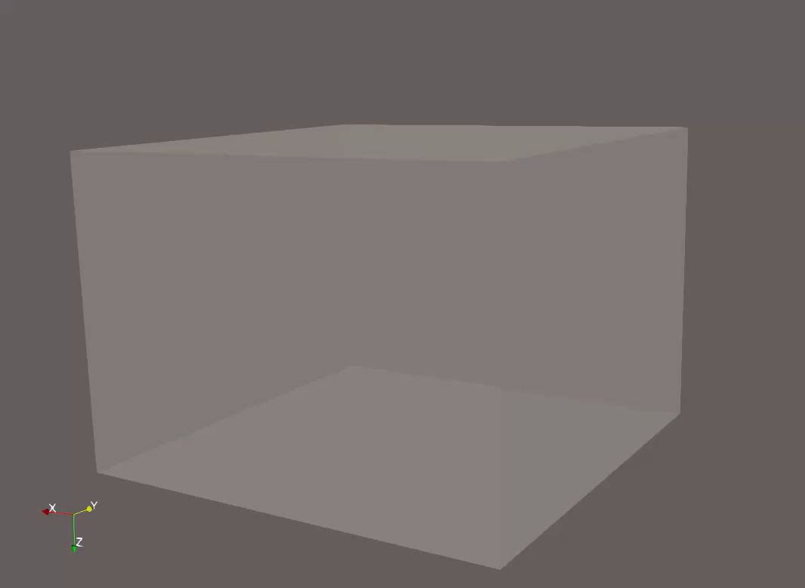
Delft Advanced Research Terra Simulator (DARTS)
Rock dissolution due to CO2 injection
SPE11 benchmark on CO2 sequestration
Hadjisotiriou et al., SPE 2025
Novikov and Voskov., SPE 2025
Extraction of water from moon
Modelling of geothermal production
Aldegheri, ESA 2025
open-source · Python + C++
Wang et al., AE 2020, RE 2021, GEOT 2023
Delft campus geothermal project
https://gitlab.com/open-darts
Geological controls of UHS in depleted fields
3
Chen at al., SGW 2025
Loyola at al., 2026
Jianxin Lu · InterPore 2026 · Delft University of Technology
3 / 10
Notes:
Before I introduce the method, let me briefly introduce the simulator we developed our work on. DARTS is an open-source reservoir simulator developed at TU Delft. It is designed for multi-physics problems. There are some works we are working on using DARTS. Including SPE11 benchmark, geothermal production, hydrogen storage in depleted fields, also a very interesting topic- Extraction of water from moon. Geochemistry study on rock dissolution duo to CO2 injection. Two design choices make it particularly useful for our work. First, the Python interface is very flexible, so we can develop new physics quickly. Second, the performance-critical kernel — including Jacobian asemble— is implemented in C++. But what really sets DARTS apart is its core linearization technique: Operator-Based Linearization, or OBL. This is what I want to focus on next.

Slide 4
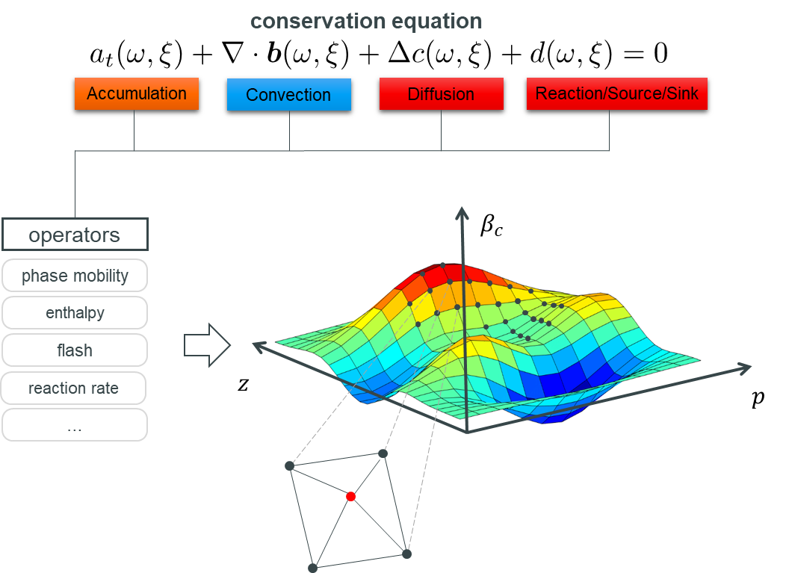
Operator-Based Linearization (OBL)
Core methodology in OpenDARTS: tabulated nonlinear physics in state space
Conservation equation
All nonlinear physics (flux, accumulation, source / sink, reaction) are grouped into state-dependent operators evaluated over a parameter space.
Parameter space
ω = { p, zᶜ }
operators are tabulated on a uniform grid and linearly interpolated during Newton iterations.
BENEFIT
Avoids expensive on-the-fly flash & property evaluation — ~10 vs ~100 CPU cycles per call.
Fig. 2 Nonlinear physics expressed as state-dependent operators over the parameter space {p, z}.
Jianxin Lu · InterPore 2026 · Delft University of Technology
4 / 10
Notes:
So what is OBL? In a conventional simulator, every Newton iteration requires evaluating complex nonlinear physics — flash calculations, equations of state, viscosities, reaction rates — together with all their derivatives. This is expensive. OBL takes a different route. The conservation equation, shown at the top, can be decomposed into four physical terms — accumulation, convection, diffusion, and source–sink. Each of these terms is rewritten as a product of two functions: one that depends on the thermodynamic state, and one that depends on the discretization. The state-dependent part is what we call an operator. It groups together all the nonlinear physics — phase mobility, enthalpy, flash, reaction rate — into a small set of smooth functions of the state. Now here is the key idea: instead of evaluating those operators on the fly every Newton step, we adaptively tabulate and cache them on a uniform grid in parameter space coordinated with primary variables pressure, composition, temperature. During simulation, we no longer call expensive thermodynamic routines. We just interpolate the operator value and its derivatives in this parameter space. In a short word, OBL replaces expensive on-the-fly physics with cheap interpolation in a state-dependent operator space.

Slide 5
Limitation of Standard OBL in hysteresis modelling
Operators depend only on instantaneous thermodynamic state — no memory of flow history
Works: reversible physics
Fails: history-dependent physics
• flash / phase equilibria
• density, viscosity, enthalpy
• monotonic relative permeability
• equilibrium chemical reactions
• capillary-pressure hysteresis
• relative-permeability hysteresis
• irreversible dissolution / mineral trapping
• any path-dependent process
Operators depend on instantaneous state only — interpolation in (p, z) is fully consistent.
Same (p, z) state can map to different operator values — standard OBL cannot represent this.
→ We need an extension of OBL that retains its efficiency while allowing path-dependent operators.
Jianxin Lu · InterPore 2026 · Delft University of Technology
5 / 10
Notes:
OBL works beautifully — as long as the physics is reversible. On the left, you can see the kinds of properties OBL handles naturally: flash, density, viscosity, monotonic relative permeability, equilibrium chemistry. For all of these, the operator value at a given thermodynamic state is unique. The same pressure and composition always give the same operator. But on the right, we have the physics: capillary-pressure hysteresis, relative-permeability hysteresis, irreversible dissolution. For these processes, two cells with the same instantaneous state can have completely different operator values, depending on what they experienced before. Standard OBL has no way to represent this — the operator table is indexed only by the instantaneous state. So we need to extend the framework — keep its efficiency, but allow path-dependent operators.

Slide 6



Augmented OBL — Adding a History Coordinate
Embed history variables into the operator parameter space, preserve the Jacobian structure
ω̂ = { ω , η } with η = S_{g, max}
Extended parameter space
Standard OBL — (p, z)
Augmented OBL — (p, z, η)
z
z
η = S_{g, max}
p
p
z
p
η is frozen within each Newton step — Jacobian sparsity and dimension are preserved.
Jianxin Lu · InterPore 2026 · Delft University of Technology
6 / 10
Notes:
This is the central idea of the work. We propose to embed history variables directly into the operator parameter space. Instead of indexing operators only by ω, we use an augmented parameter ω-hat, which contains the original state plus a history coordinate η. For hysteresis, the natural choice for η is the maximum gas saturation experienced by a cell, S_g,max. T On the left, standard OBL interpolates inside a 2D grid in (p, z). On the right, augmented OBL interpolates inside a 3D grid in (p, z, η). Now, the crucial design point — and this is what makes the method practical — is that η is treated as a local cell property, not as a primary unknown. It is frozen within each Newton iteration and only updated at the end of a converged step. What does that buy us? The Jacobian dimension does not change. The sparsity pattern does not change. Newton convergence is unaffected. A single extra dimension in the operator table captures the full hysteretic physics — at minimal computational overhead. That is the core message of this talk.

Slide 7
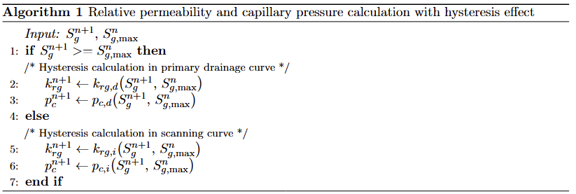
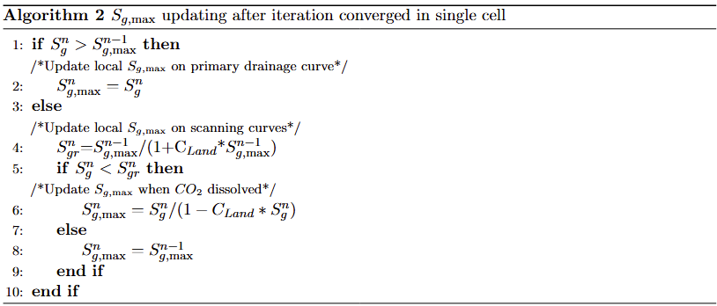
Hysteresis Algorithm
Killough model coupled with augmented OBL — maximum gas saturation as a local history variable
Algorithm 1 · k_{r} and p_{c} with hysteresis
Algorithm 2 · S_{g, max} update with dissolution feedback
Key features
Consistent linearization
Drainage ↔ imbibition
Dissolution feedback
Sg,max frozen during Newton iterations — Updated after iteration converged .
Algorithm switches between bounding and scanning curves cell-by-cell.
When CO₂ dissolves, Sg,max is rescaled so the hysteretic state stays consistent.
Jianxin Lu · InterPore 2026 · Delft University of Technology
7 / 10
Notes:
Let me now show how this works in practice. We use the well-known Killough hysteresis model, fully coupled with our augmented OBL. On the left is Algorithm 1. Given the current saturation and the local S_g,max, we decide which curve we are on. On the right is Algorithm 2: how we update S_g,max after each converged step. Three things to highlight. "k_r and p_c are evaluated through OBL interpolation in the augmented parameter space, primary unknowns enter the Jacobian consistently. Second, drainage and imbibition transitions are handled cell-by-cell, automatically. Third, dissolution feedback is built in — it is not a separate post-processing step.

Slide 8
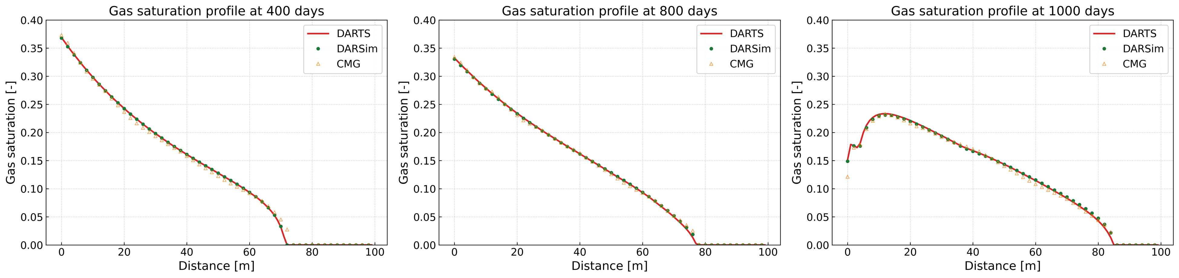
1D Benchmark — Cross-Simulator Validation
DARTS (augmented OBL) vs DARSim vs CMG · Killough hysteresis model
Setup
• 2-component binary system (CO₂ + H₂O), isothermal
• Day 0–400: CO₂ injection (drainage)
• Day 400–800: shut-in (no injection)
• Day 800–1000: water injection (imbibition)
• Adaptive parameterization, 1000 nodes / axis
Fig. 3 Gas saturation profiles at 400 / 800 / 1000 days — excellent agreement across simulators.
DARTS (augmented OBL)
DARSim
CMG
RESULT
Captures sharp gas front, residual saturation plateau and water-displacement leading edge — full drainage / imbibition cycle reproduced.
Three-way match across drainage, shut-in and imbibition stages — confirms correctness of our augmented OBL implementation.
Jianxin Lu · InterPore 2026 · Delft University of Technology
8 / 10
Notes:
To validate the implementation, we start with a one-dimensional benchmark. A two-component, isothermal system: CO₂ and water. The injection schedule is designed specifically to exercise hysteresis. We inject CO₂ from day 0 to day 400 — that is drainage. Then a long shut-in period from day 400 to 800 — to let dissolution act. And finally, water injection from day 800 to 1000 — that is imbibition. We compare DARTS, which uses our augmented OBL, against DARSim and against the commercial simulator CMG, both with the Killough hysteresis model. You can see the gas-saturation profiles at the three characteristic times. All three simulators agree across the full cycle — the sharp gas front during drainage, the residual plateau after shut-in, and the leading edge of the water displacement. This three-way agreement gives us confidence that the augmented OBL implementation reproduces the standard hysteresis physics correctly, and we can now move to realistic, reservoir-scale problems.

Slide 9
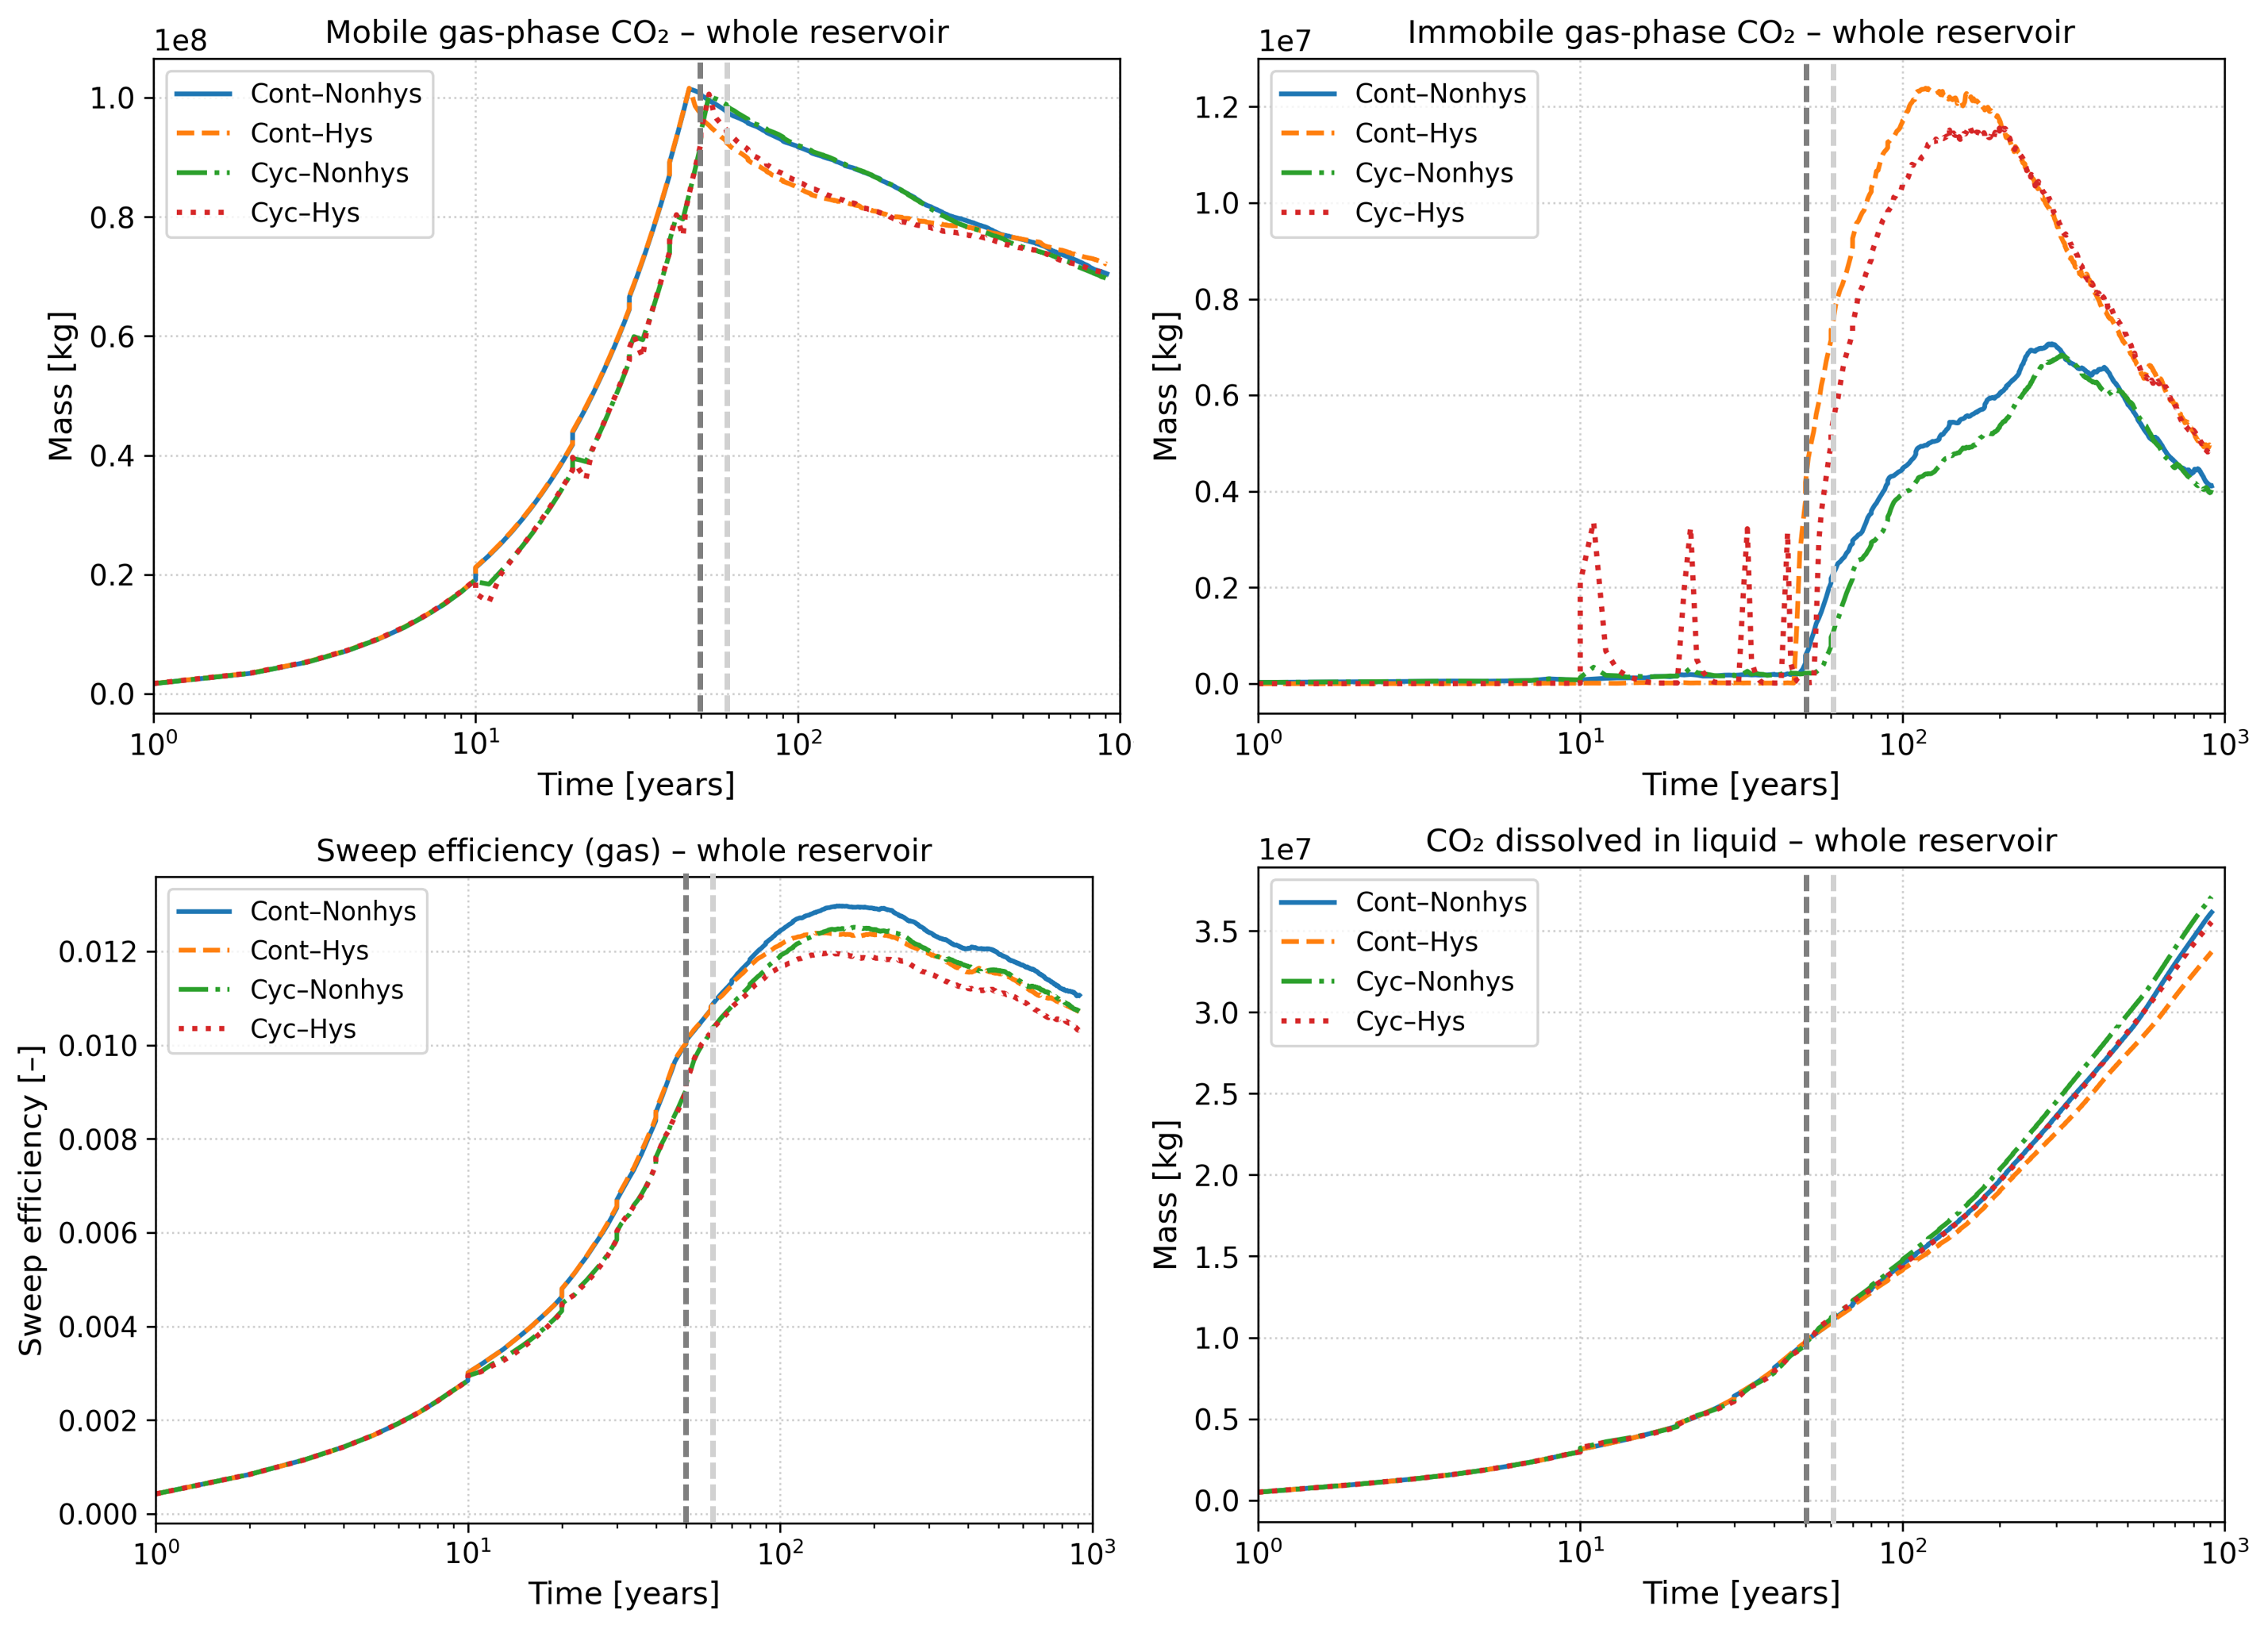
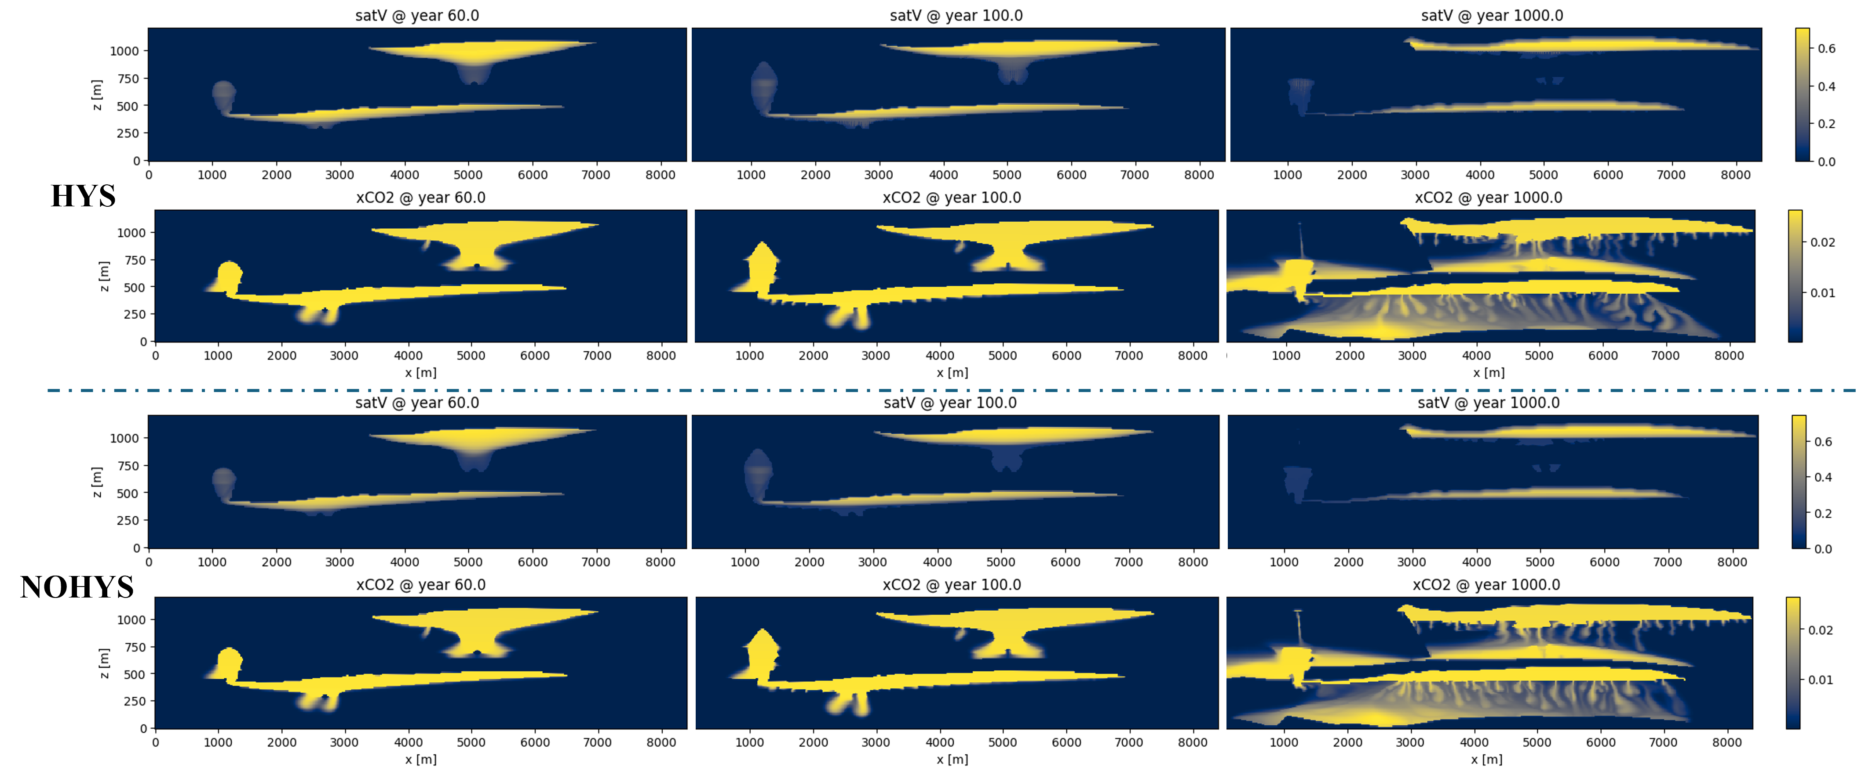
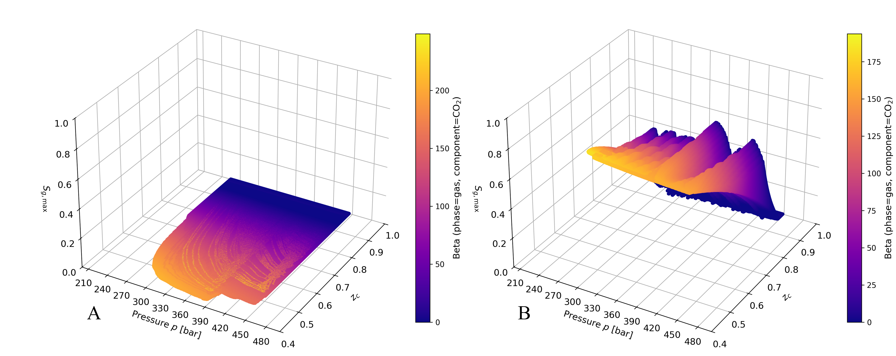
SPE11b — Reservoir-Scale Demonstration
840 × 120 grid · Norwegian Continental Shelf facies · 1000-year cyclic WAG injection
HYS (top) vs. NOHYS (bottom): saturation and dissolved CO₂ fields
Fig. 4 Mobile / immobile / dissolved CO₂ and sweep efficiency vs. time.
Operator generation points: HYS (right) vs NOHYS (left)
Cost overhead
Model | Newton iters | CPU (s)
HYS | 63 430 | 8 995
NOHYS | 63 852 | 7 322
Hysteresis enhances residual trapping at reservoir scale — only ~23% extra CPU cost.
Jianxin Lu · InterPore 2026 · Delft University of Technology
9 / 10
Notes:
Here we apply the same algorithm to the SPE11b benchmark — a heterogeneous 2D reservoir, simulated over 1000 years of cyclic water–CO₂ injection. In the upper panel you see the hysteretic run; in the lower panel, the non-hysteretic run. They look similar at first glance, but if you look carefully, the hysteretic case retains visibly more residual gas — especially during and after the water injection cycles. The curves on the right make this quantitative. The most important one is the immobile gas mass, top right. The hysteretic, cyclic case — the dotted red curve — accumulates substantially more trapped CO₂ than the non-hysteretic case. This is exactly the trapping enhancement we expect from physics, and it is now reproduced by the simulator. And what is the cost of all this physics? Look at the table. The hysteretic run took 63,430 Newton iterations versus 63,852 for the non-hysteretic case — essentially the same. CPU time increased by only about 23%. So for a one-dimensional augmentation of the parameter space, we capture a fundamentally important physical effect at a very modest cost. This is, in our view, what makes augmented OBL practical for reservoir-scale CCS simulations.

Slide 10

CONCLUSIONS & FUTURE WORK
All implementations are carried out in open source simulator-’’DARTS’’
✓ Conclusions
Augmented OBL embeds history variables into the operator parameter space — Jacobian structure preserved.
A new hysteresis algorithm uses S_{g,max} as a local history variable with CO₂ dissolution feedback.
Validated against DARSim & CMG; SPE11b reservoir-scale run captures hysteresis at ~23% extra CPU.
Thank you! Questions welcome.
jianxinlu@tudelft.nl · Delft University of Technology
Notes:
In conclusion, Augmented OBL embeds extra variable into the operator parameter space — extending OBL to path-dependent physics while preserving the Jacobian structure of the standard formulation. Built on this idea, a consistent hysteresis algorithm reproduces efficiently drainage–imbibition cycles at reservoir scale. All implementations are done in the ‘open-darts. If you are interested in our work, get into our repository.Thanks for your attention—I’d be happy to take questions.

