Slide 1
Microfluidics in Subsurface Energy Applications
From Proof of Concept to part of Subsurface Engineering Workflow
Zhenbang (Seven) Qi, Ph.D, P.Eng.
Interface Fluidics Ltd.
InterPore 2026
May 20th 2026

Slide 2
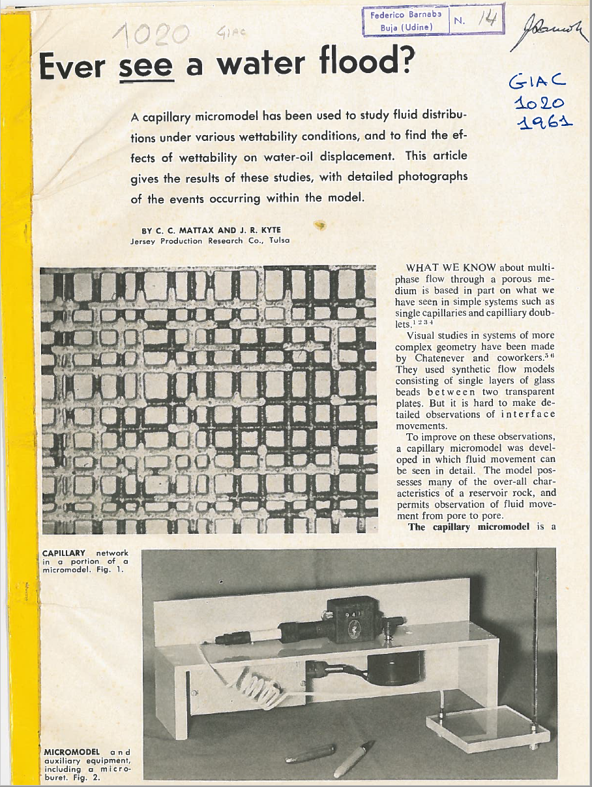
Intro to Microfluidics
What is it: Microfluidics is the study of fluid flow at the micrometer to nanometer – exactly what fluids experience in the reservoir
Why use it: Fluid interactions dominate the oil and gas industry. Fast, visual, and repeatable measurement of these interactions lets users make better decisions, faster.
History in oil and gas: One of the first applications explored using microfluidics was waterflooding in 1961.
Examples from daily life: COVID tests, diabetes test strips, inkjet printers, and pregnancy tests.

Slide 3
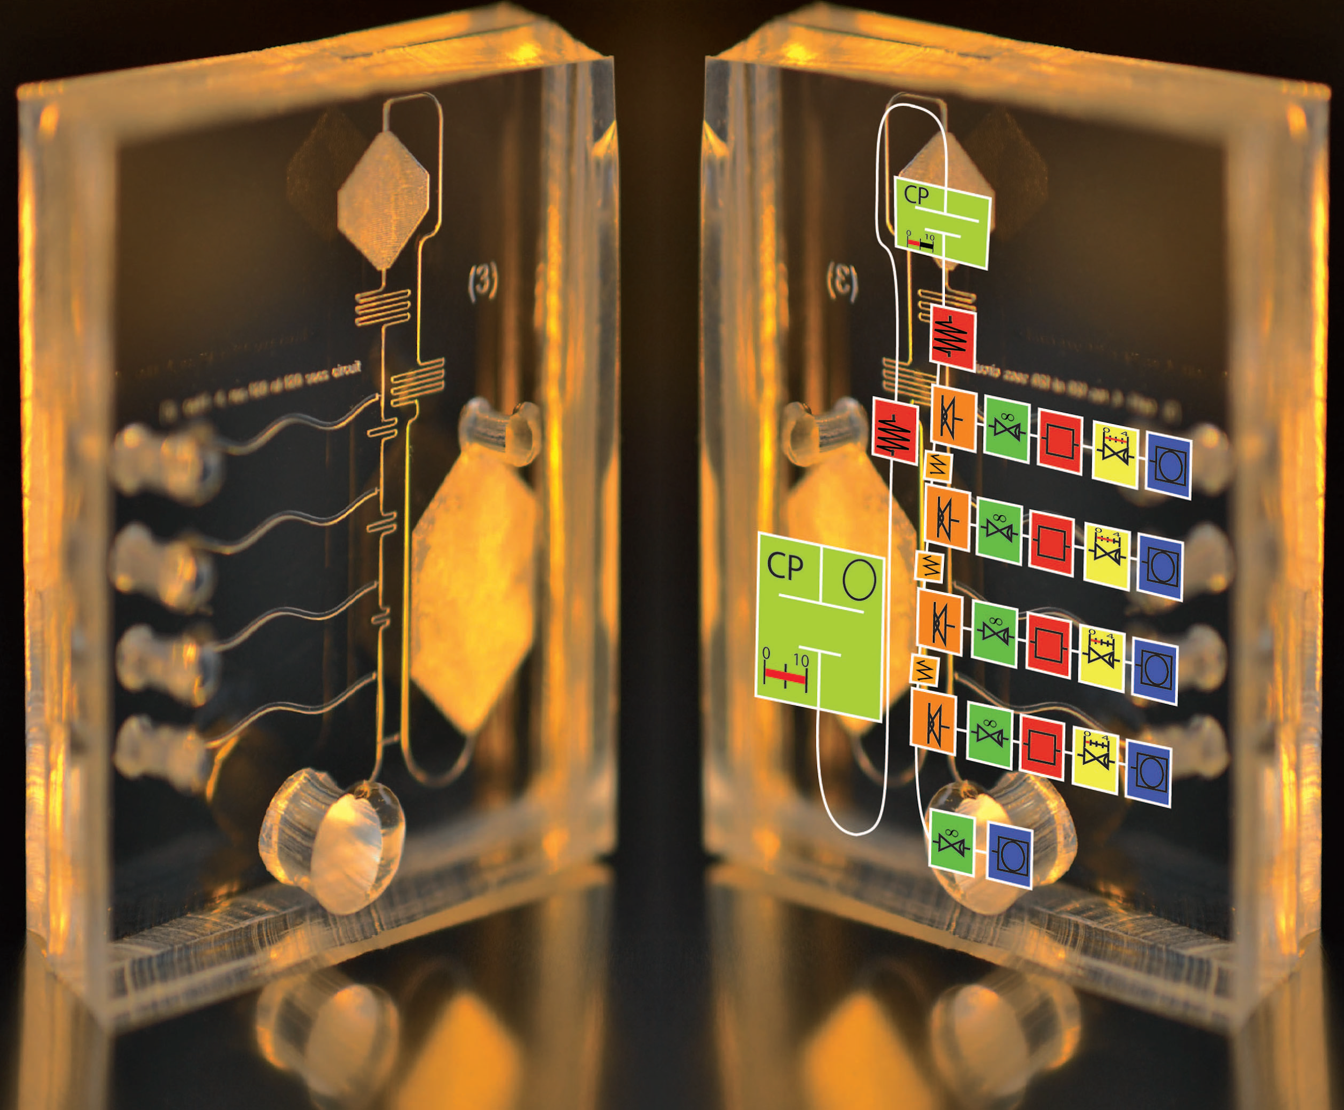
Why microfluidics/nanofluidics?
Real-time monitoring capabilities and visualization
Small sample volumes (μL, nL, pL, fL)
Enhanced mass and heat transfer (due to high surface-to-volume ratio)
Precise control over geometry
Precise control over the operating condition (temperature, pressure, concentration, pH, etc.)
Portability (small size)
Reproducibility
High-throughput screening and analysis
Multiplexing
Fast
R. Safavieh & D. Juncker, Lab Chip, 2013.

Slide 4
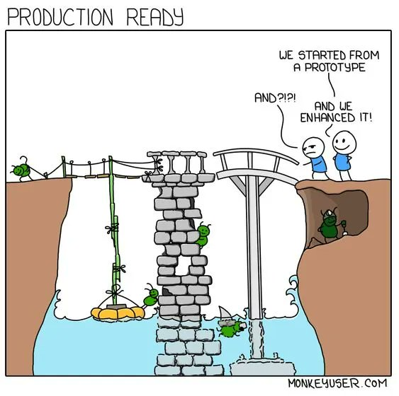
Proof of Concept (POC) ≠ Production

Slide 5
Why microfluidics/nanofluidics?
Real-time monitoring capabilities and visualization
Small sample volumes (μL, nL, pL, fL)
Enhanced mass and heat transfer (due to high surface-to-volume ratio)
Precise control over geometry
Precise control over the operating condition (temperature, pressure, concentration, pH, etc.)
Portability (small size)
Reproducibility
High-throughput screening and analysis
Multiplexing
Fast
Robust
Crude oil/field samples

Slide 6
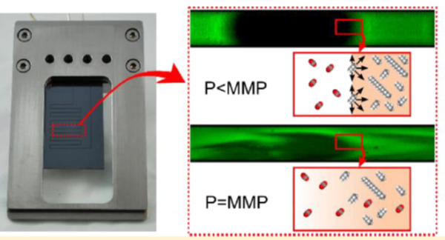
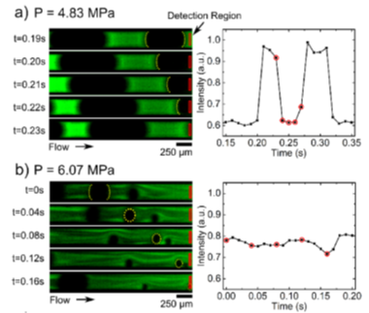
Minimum Miscibility Pressure Measurement - POC
Ph. Nguyen et al., Anal. Chem, 2015
“Miniature rising bubble apparatus”
Not multi-contact
Bubble train could be challenging to create with more viscous oil

Slide 7
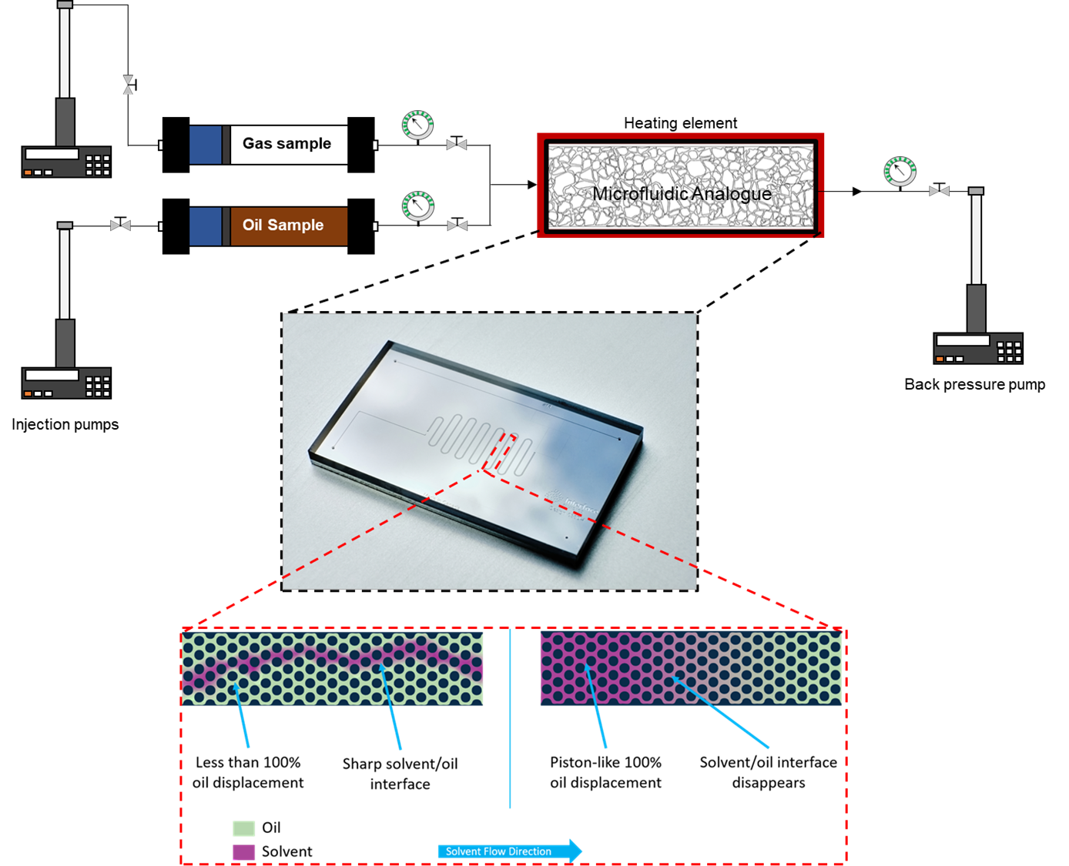
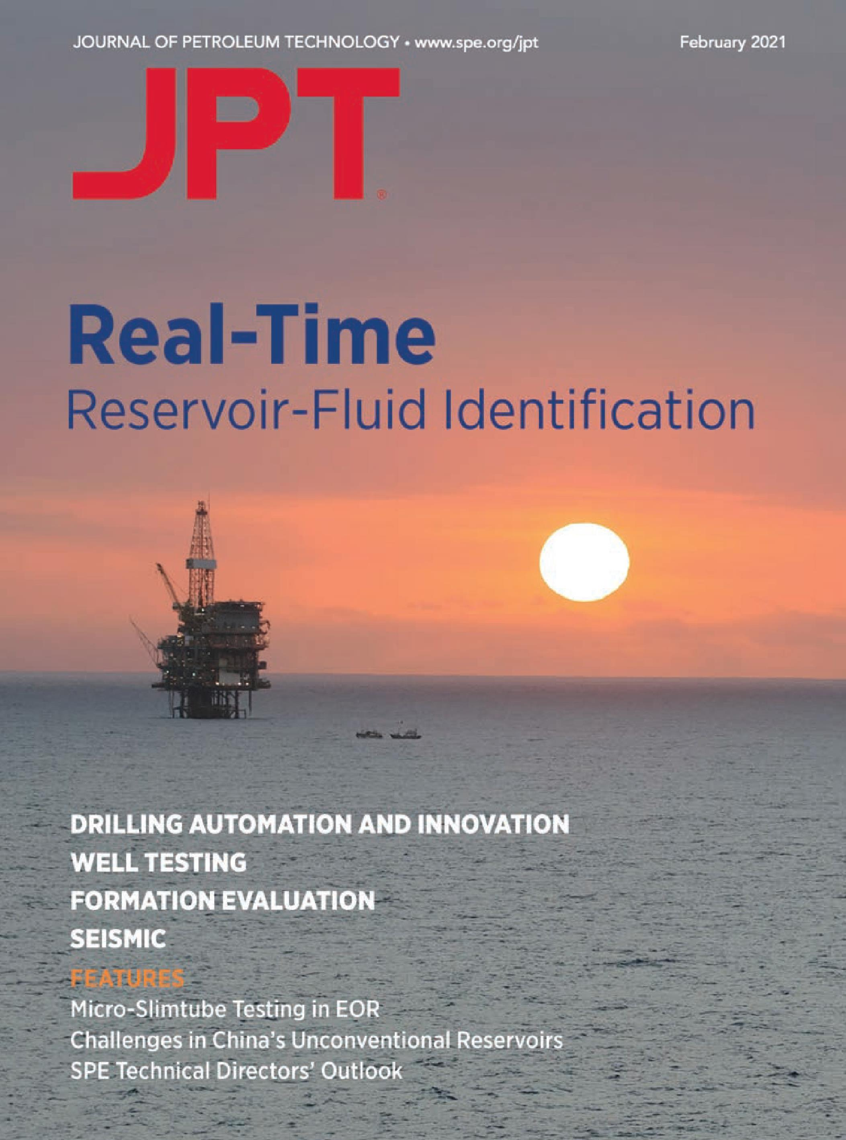
Minimum Miscibility Pressure Measurement
Technology
Interface’s slim-tube style MMP method
Advantages
MMP type: Multi-contact.
Time: 15 minutes per pressure datapoint.
Sample Quantity: < 0.1 mL per datapoint.
Measurement Quality: More data points mean tighter MMP error bars (±2.5 bar).
Visual Insights: Visual access to solvent-oil interaction in porous media (potentially miscibility mechanism).

Slide 8


Minimum Miscibility Pressure Measurement
Immiscible Case, P<MMP
Miscible Case, P>MMP

Slide 9
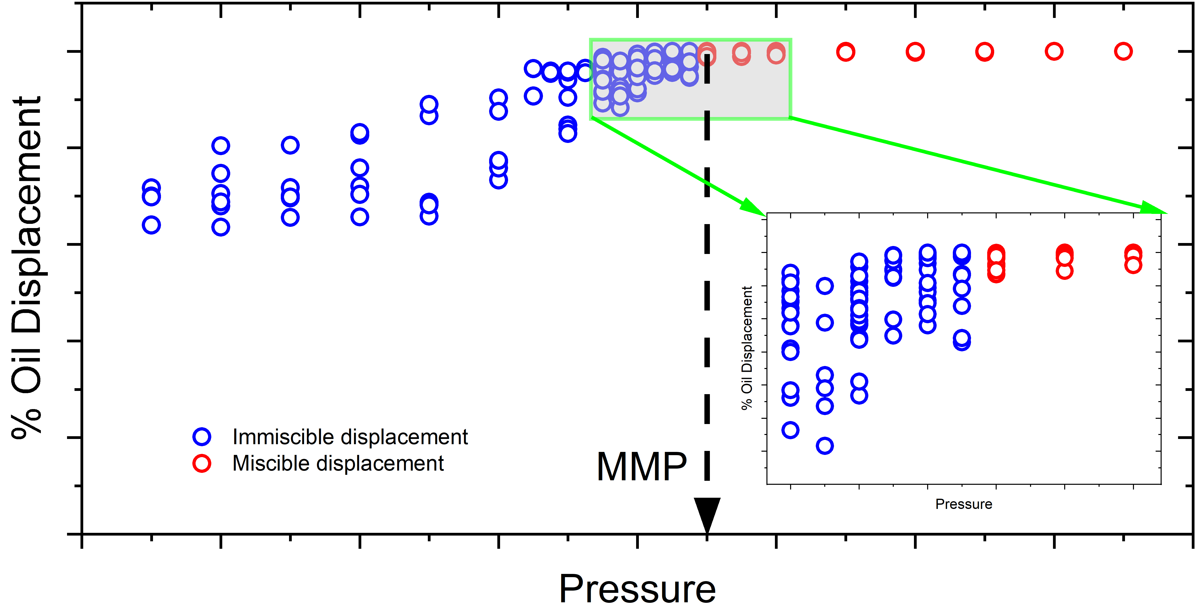
Rapid Measurements
Over 40 data points in less than 4 days!
Less than 5 mL live oil sample used for all data points.
Sharp change in oil displacement efficiency observed when miscibility condition reached.
Unlike slim-tube, no interpolation required.

Slide 10
Field Operations – CO2 MMP Sensitivity
Temperature (°C) | Injection Gas | Miscible/MMP (bara)
63 | CO₂ | Miscible at Reservoir P, 133 bara
 | 123 bara CO₂ | Miscible at 123 bara
 | 113 bara CO₂ | Miscible at 113 bara
63 | *Recycle gas | Miscible at Reservoir P, 133 bara
 | 123 bara Recycle gas | 125.0 ± 2.5
43 | 123 bara Recycle gas | Miscible at Reservoir P, 123 bara
63 | CO₂ with 5% CH₄ | Miscible at Reservoir P, 133 bara
 | CO₂ with 10% CH₄ | 142.5 ± 2.5
 | CO₂ with 15% CH₄ | 147.5 ± 2.5
63 | CO₂ with 2% H₂ | Miscible at Reservoir P, 133 bara
 | CO₂ with 2% N₂ | Miscible at Reservoir P, 133 bara
 | CO₂ with 2% Ar | 137.5 ± 2.5
63 | CO₂ with 7% CH₄, 2.5% H₂S | Miscible at Reservoir P, 133 bara
 | CO₂ with 15% CH₄, 5% H₂S | 147.5 ± 2.5
 | CO₂ with 7% CH₄, 1% H₂ | Miscible at Reservoir P, 133 bara
63 | CO₂ with 15% CH₄, 2% H₂ | 155.0 ± 2.5
 | CO₂ with 7% CH₄, 2.5% H₂S, 1% H₂ | Miscible at Reservoir P, 133 bara
 | CO₂ with 7% CH₄, 2.5% H₂S, 2% H₂ | Miscible at Reservoir P, 133 bara
Sensitivity of the CO₂ MMP as a function of different gas impurities for the specific reservoir studied in this work.
Overall, the miscibility of the CO₂ remains if the total gas impurity does not go beyond 5-7 mole%, assuming the reservoir pressure and temperature remains constant.
Completed within 4 weeks with over 100 data points in total. This would take years to accomplish using slim-tube!!!

Slide 11
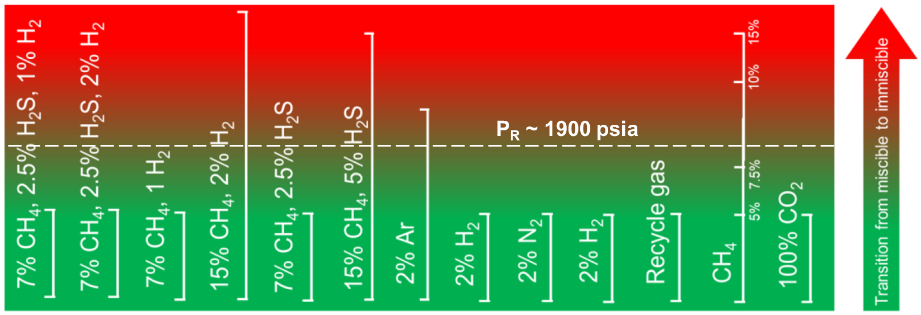
Field Operations – CO2 MMP Sensitivity
The microfluidic MMP platform has been used to perform a large-scale sensitivity analysis of the CO₂ MMP as a function of various gas impurities in different forms for a CO₂ injection field in Northern Alberta and can be implemented into routine workflow to frequently check the MMP of the CO₂ stream.

Slide 12
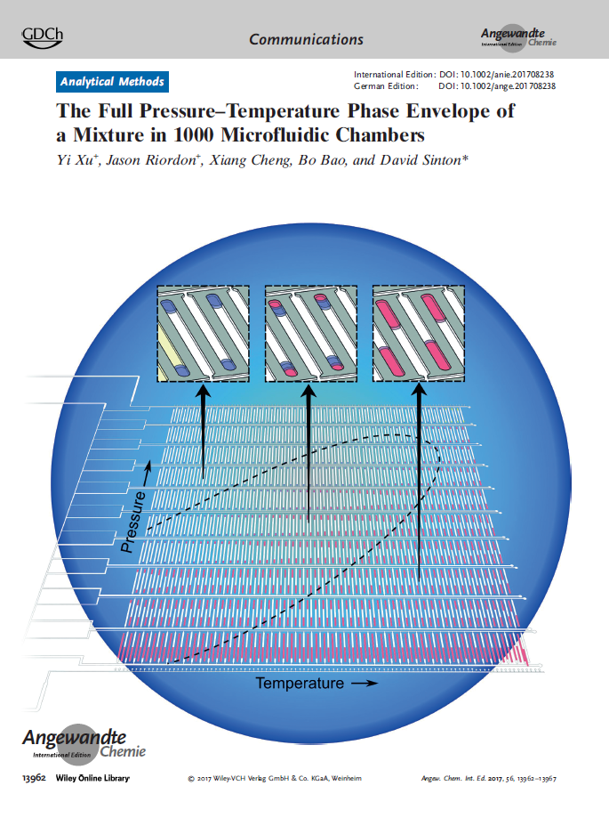
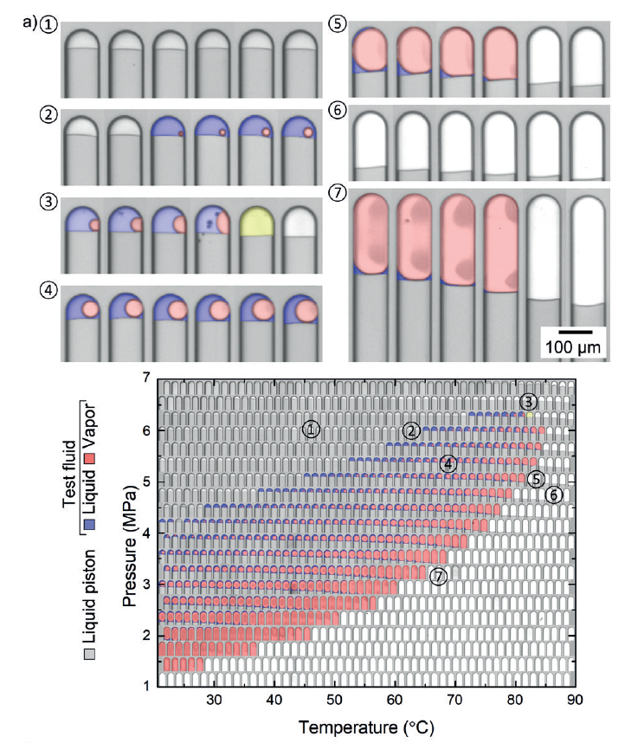
Phase behavior testing - POC
Xu et al, Angewandte Chemie, 2017
“phase envelop on a chip”
Very cool and satisfying to look at
Only two components ideal fluid
Communication between “wells”

Slide 13
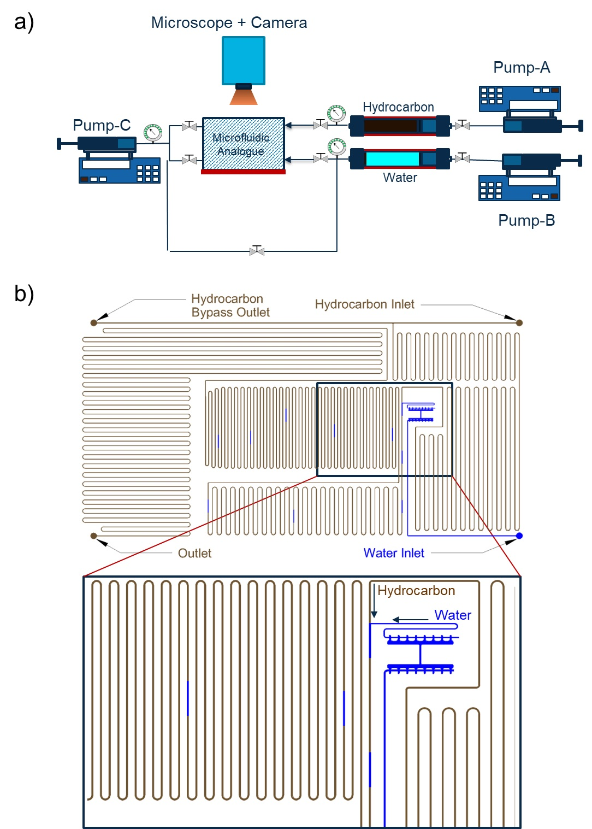
CCE-on-Chip
Multiple isolated hydrocarbon slugs are generated.
Slugs undergo multiple pressure steps to determine VLE data.

Slide 14
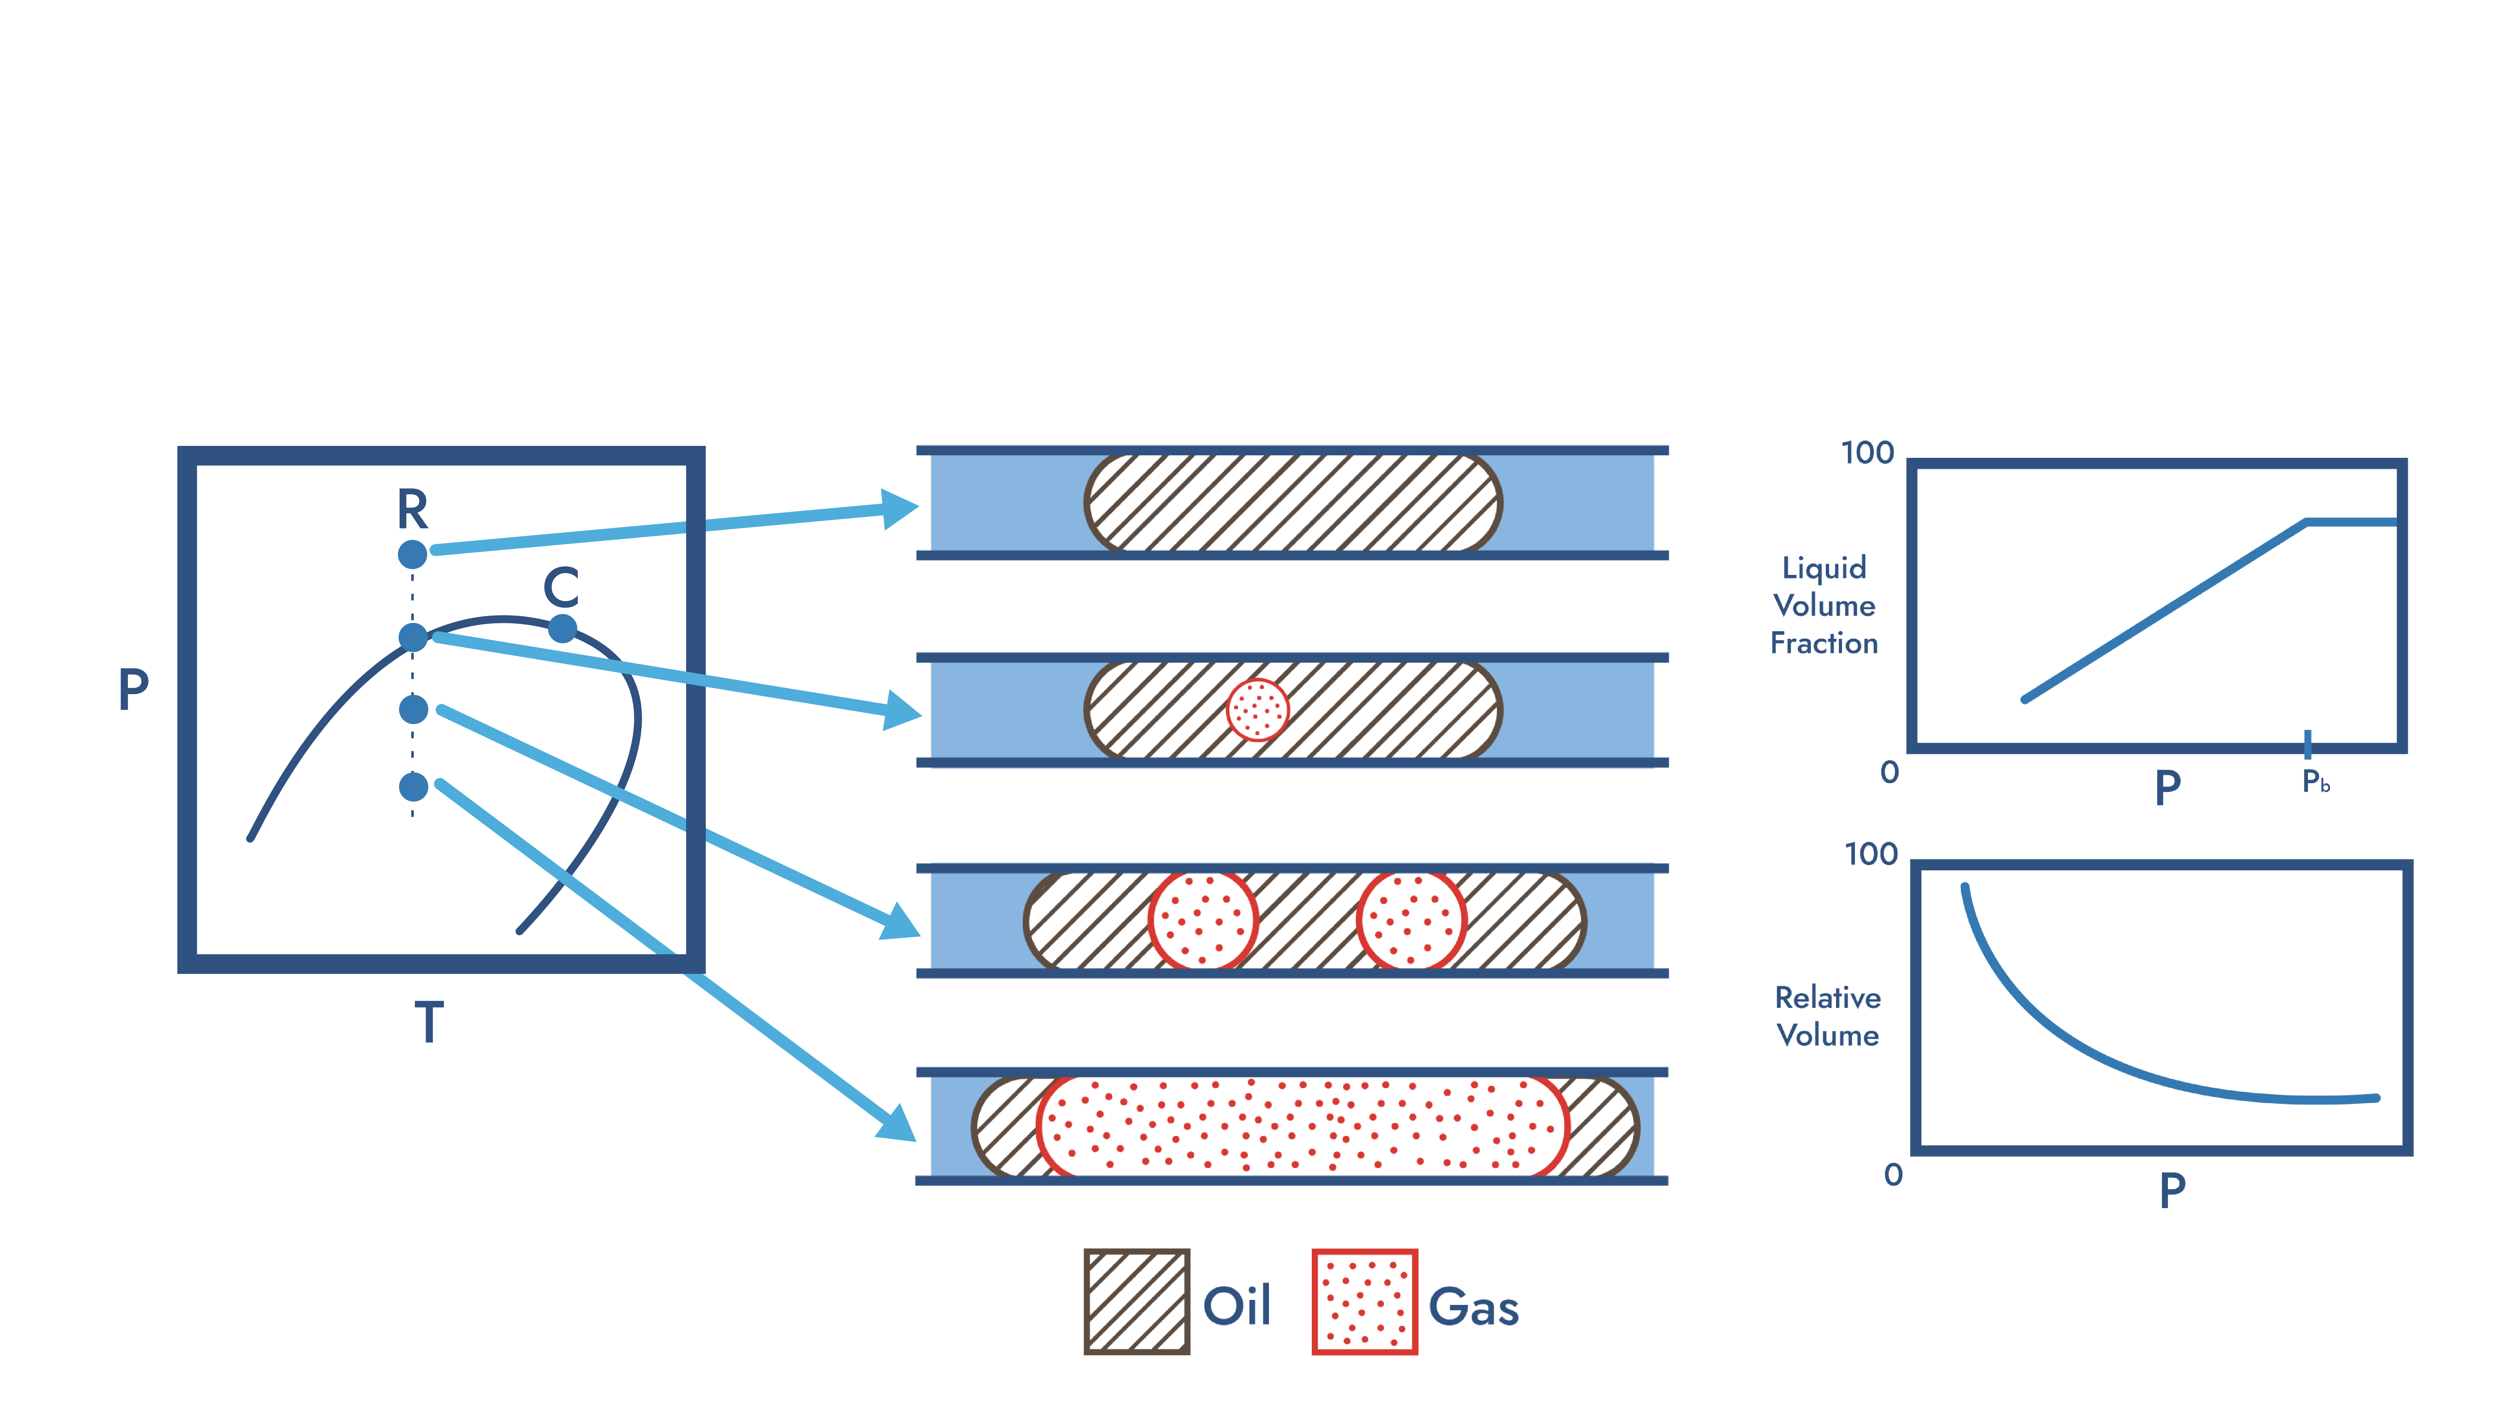
Black Oil CCE Method

Slide 15
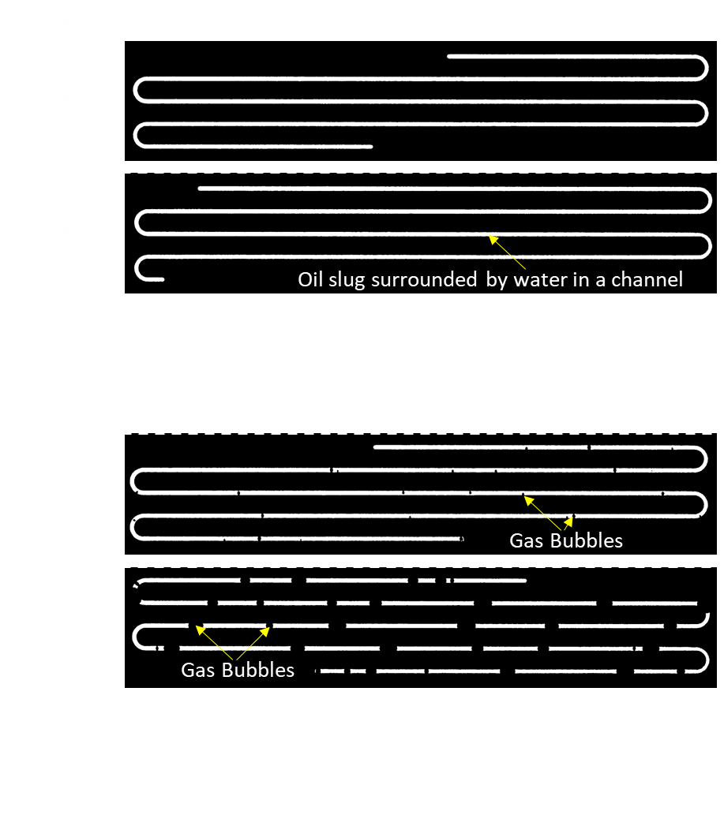

Example of Raw Video

Slide 16
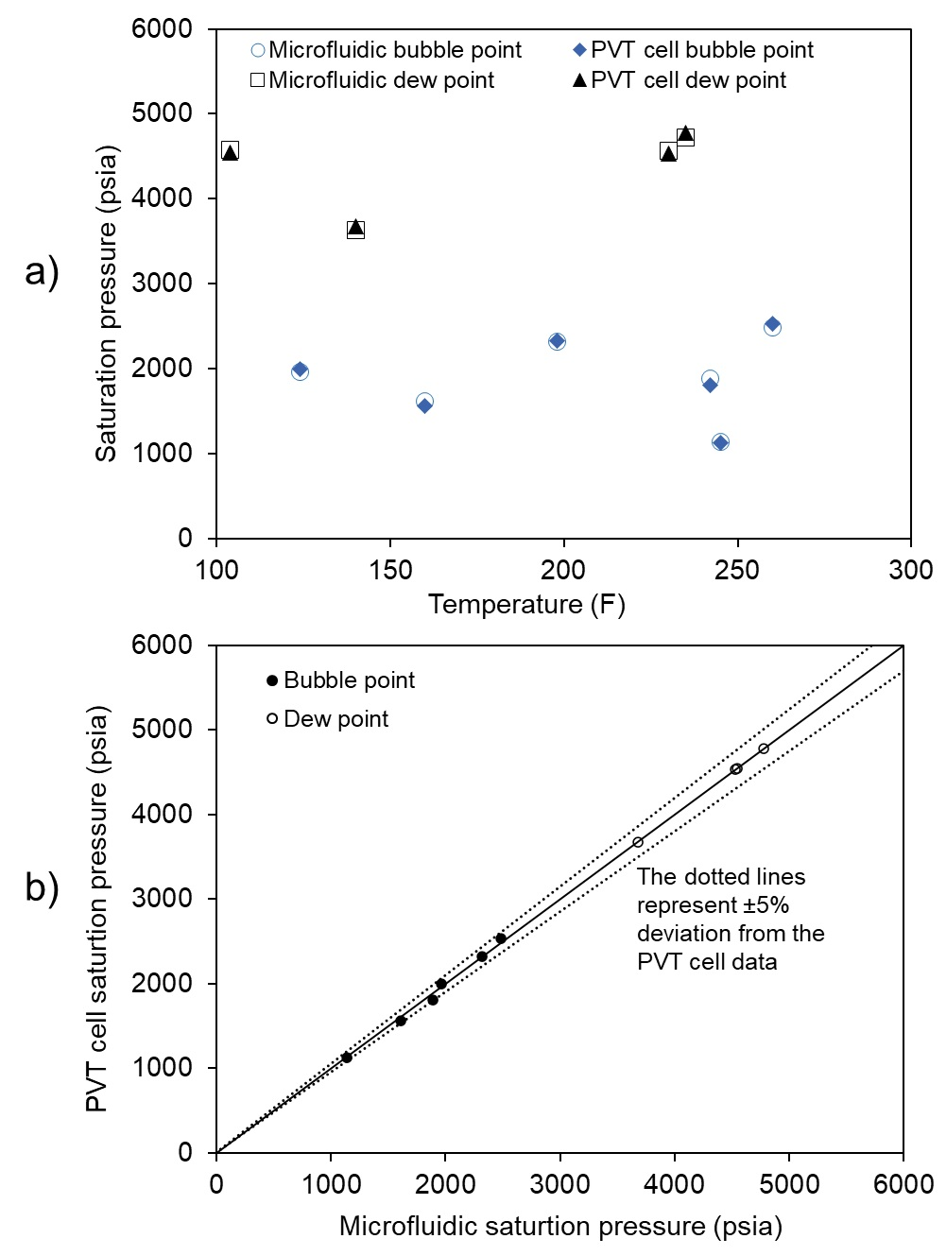
Saturation Pressure Data and Comparison
Microfluidic and traditional PVT cells were used to measure the behaviour of each fluid, and compared for agreement
In all cases, the microfluidic system agreed well within 5%.

Slide 17

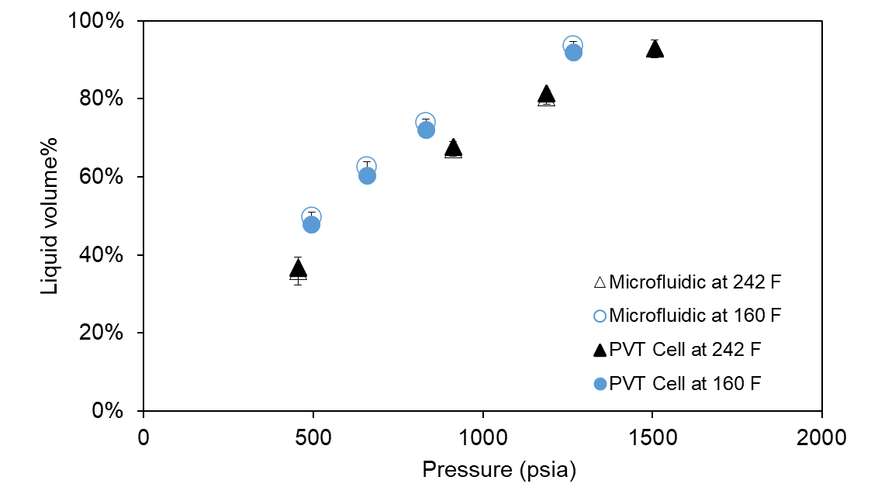
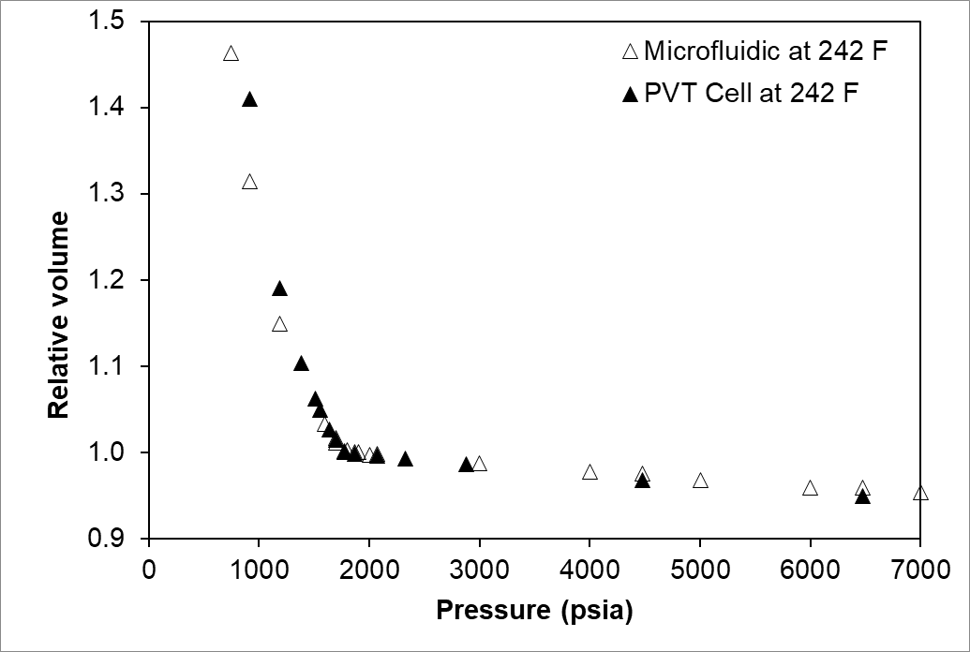
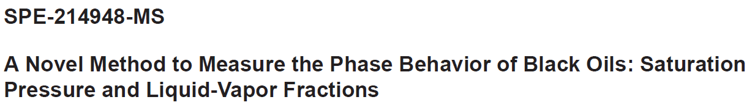
Liquid Volume %
 | Pressure (psia)
 | 1507 | 1188 | 912 | 455
Conventional | 92.9% | 81.4% | 67.8% | 36.8%
Microfluidic | 92.8% | 80.4% | 67.1% | 35.9%
Standard Deviation | 2.3% | 1.8% | 1.9% | 3.6%

Slide 18
Summary
Proof of Concept testing is fundamentally different from industry testing: the latter requires hardware and procedure that is robust, efficient, and provides repeatable results for routine subsurface engineering.
Microfluidic platforms move testing from years to weeks, enabling large-scale high throughput sensitivity analysis that was previously impossible.
Industry-ready devices are fully validated against industry standards (e.g. Slim tube tests and PVT tests) with multiple type of reservoir fluids, consistently matching traditional results within 5% while using 1000x less sample volume.
Microfluidics has the potential to be an essential component of the subsurface engineering workflow, enable more confident decision making.

Slide 19
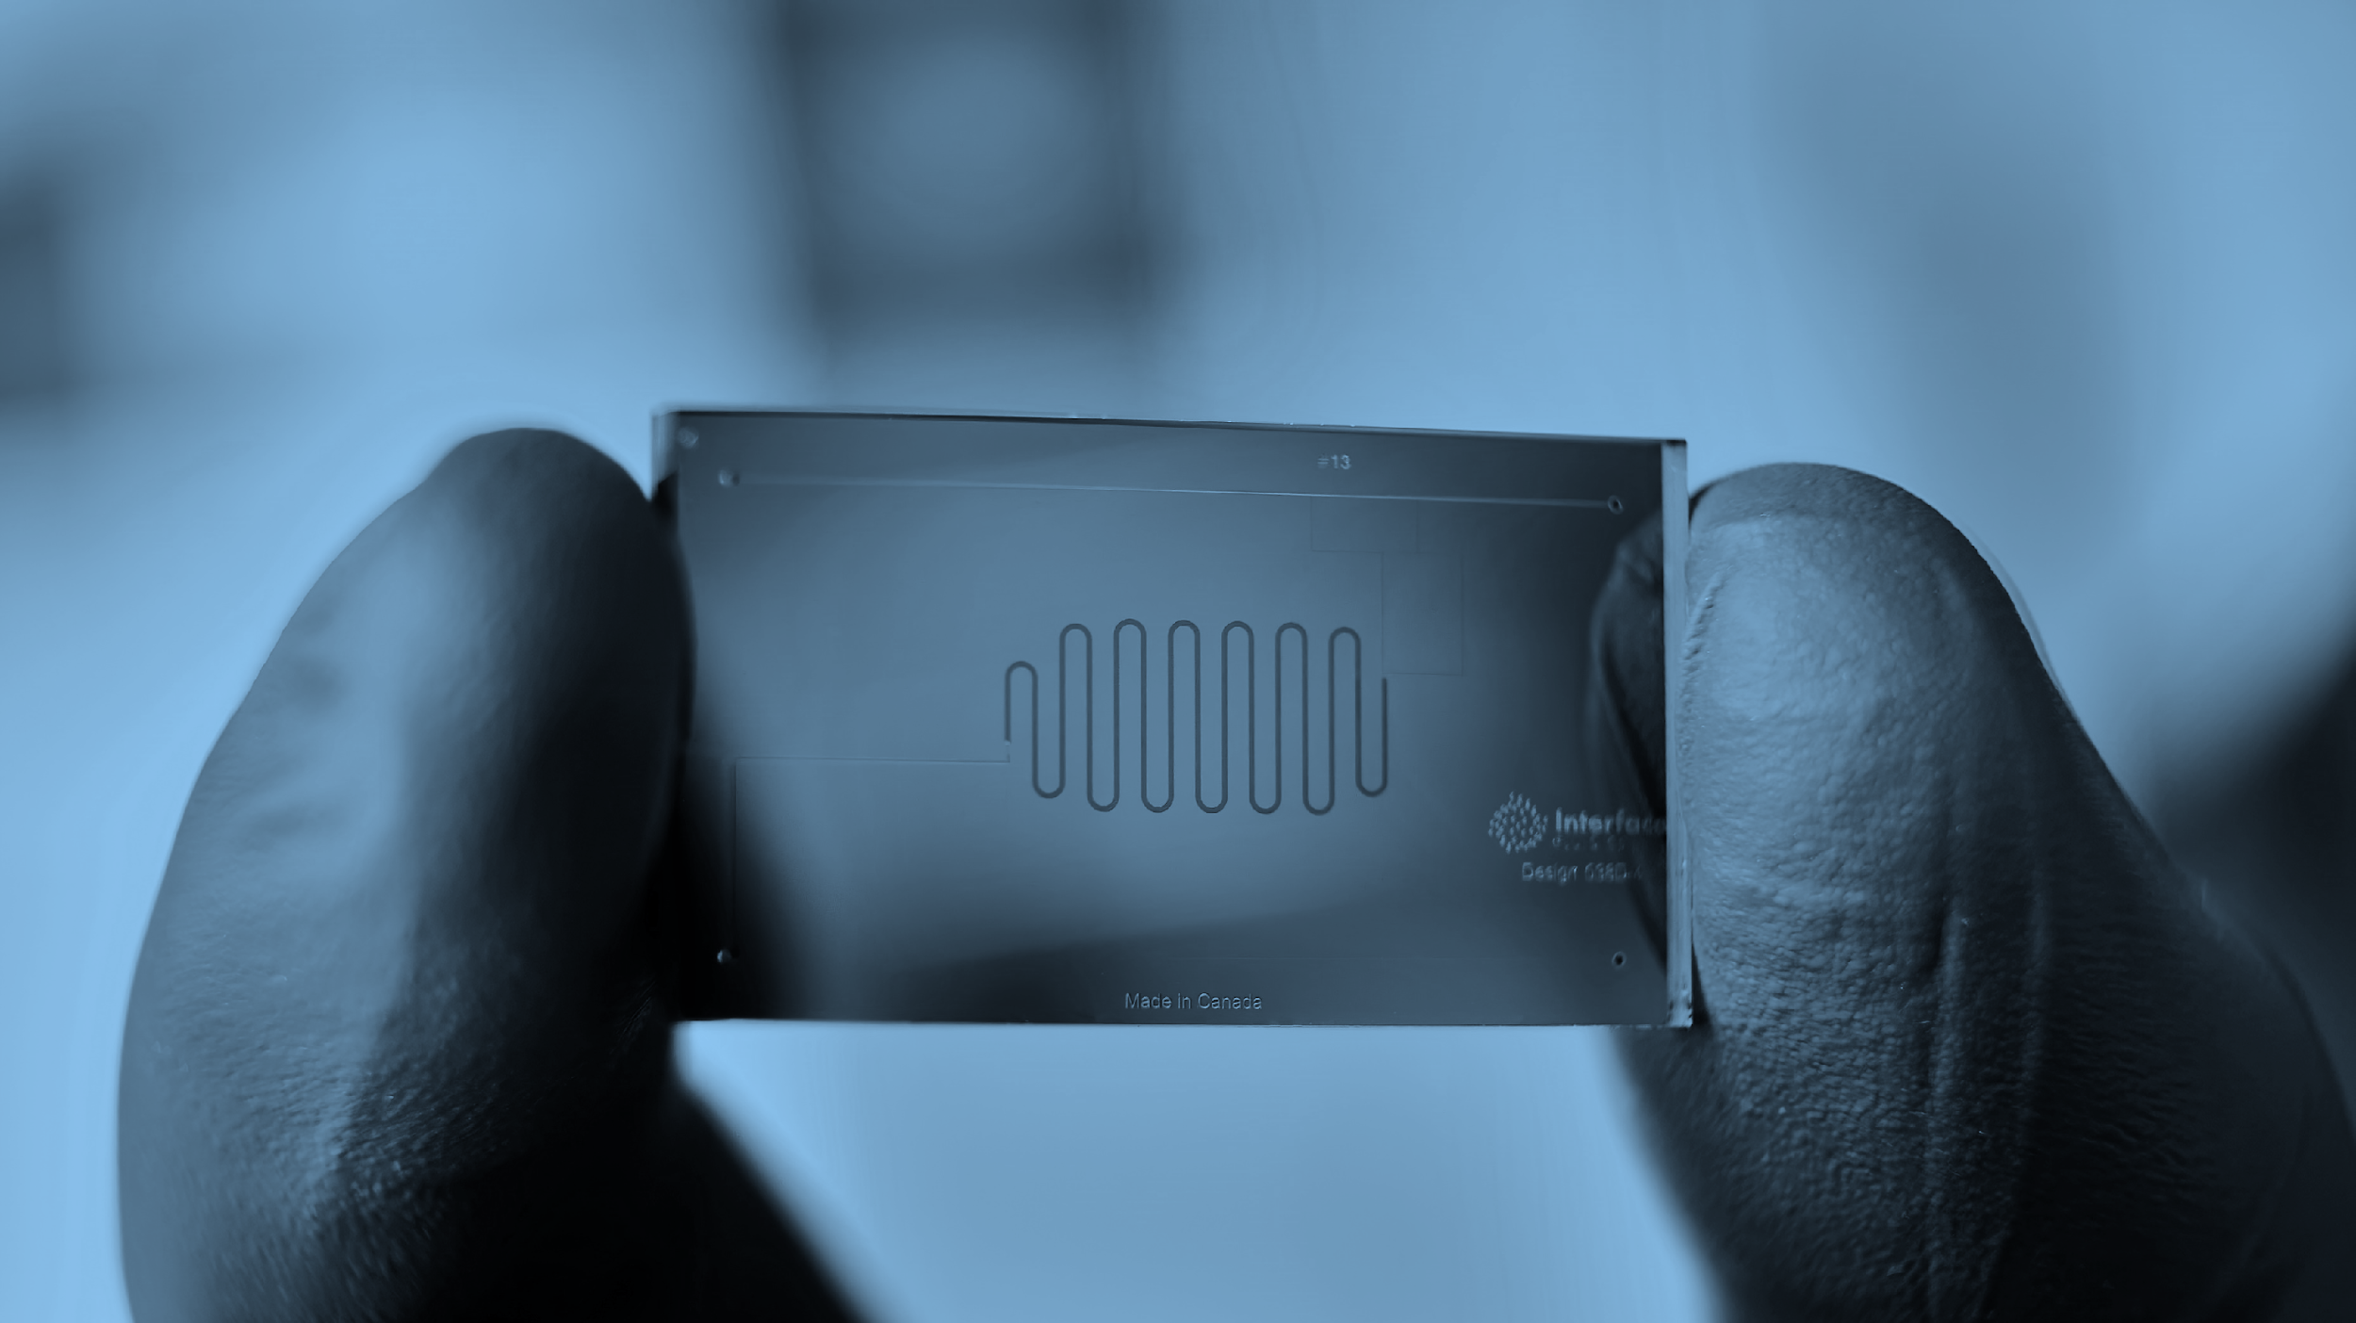





seven.q@interfacefluidics.com
nash.x@syniflow.com

