Slide 1

HTHP microfluidic platforms for In-situ
pore-scale studies of mineral reactions
Presenter: Ziyou Zhu (PhD candidate, Nanjing University)
Supervisor: Zhaoyang Ma
Date：22/05/2026
1
Notes:
Investigation of Pore-Scale Dynamics of Dissolution-Precipitation of Mineral Using Micromodel

Slide 2
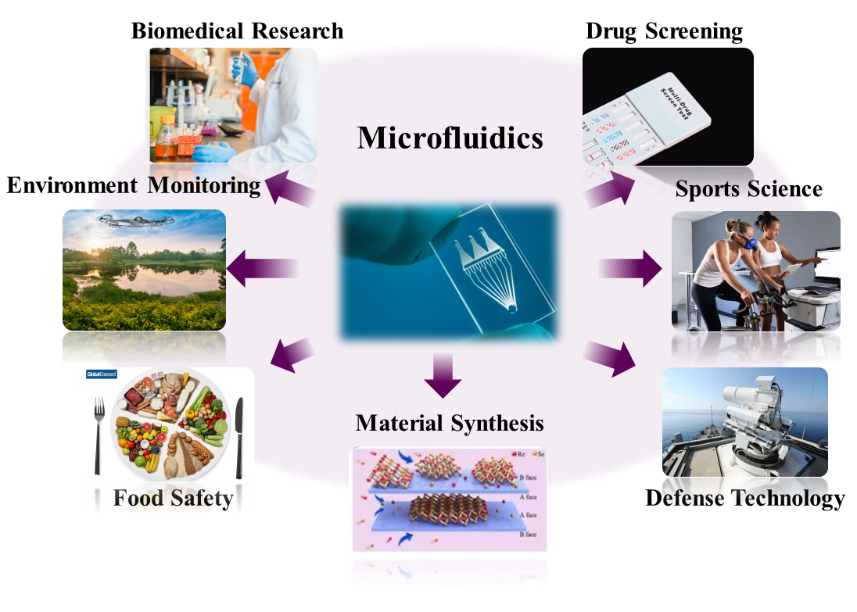
What is microfluidics
Microfluidics = precise control of fluids in micron-scale channels
Typical length scale: nm - μm
Flow regime: laminar (Re << 1)
Ultra-low reagent consumption: nL - μL
Enables direct visualization of process
Microfluidics is widely used across many fields
Minimal sample and reagent consumption
Precise fluidic control
Rapid analysis and high-throughput capability
Microfluidics let us see physics, chemistry and biology at the pore-cale
2

Slide 3
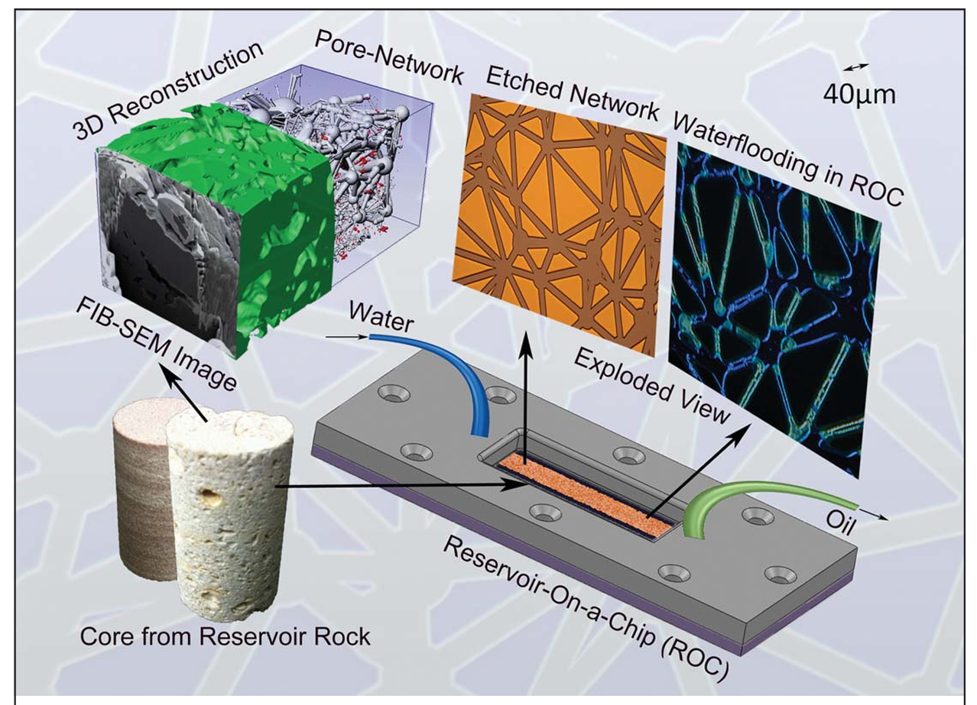
Micromodel for subsurface systems
Micromodel = microfluidic representation of porous media
Mimics pore-scale structure of real rocks
Geometry derived from
Real rock imaging (FIB-SEM, micro-CT)
Or idealized pore networks
Fabricated in glass/silicon/PDMS…
Enables direct visualization of flow, reactions, and microbes in porous media
Overview of the Reservoir-On-a-Chip (ROC) Workflow
(Naga Siva Kumar Gunda, et al., 2011)
Micromodels translate real reservoir structures into observable microfluidic systems
3

Slide 4
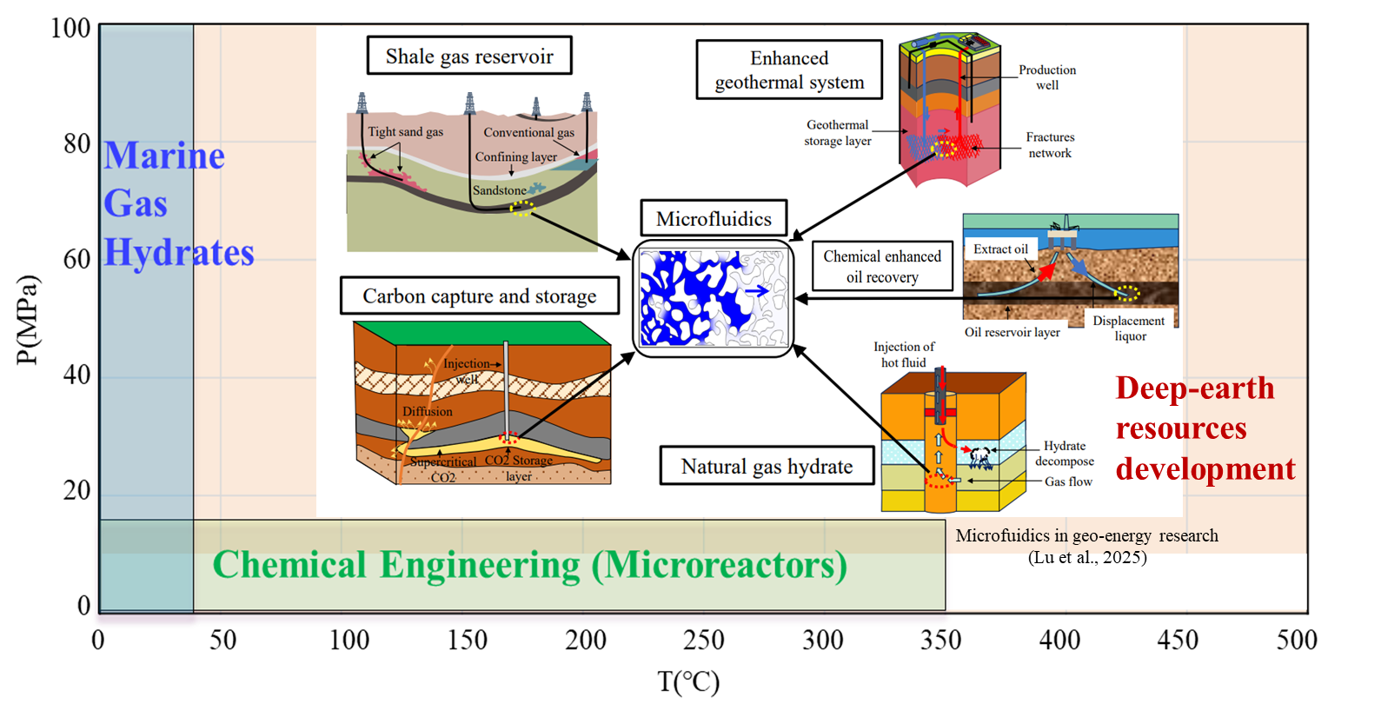
Microfluidics in geo-energy research
Conventional microfluidics cannot replicate the in-situ reservoir conditions
Developing HTHP microfluidics is essential & critical for deep-earth resources development
4

Slide 5
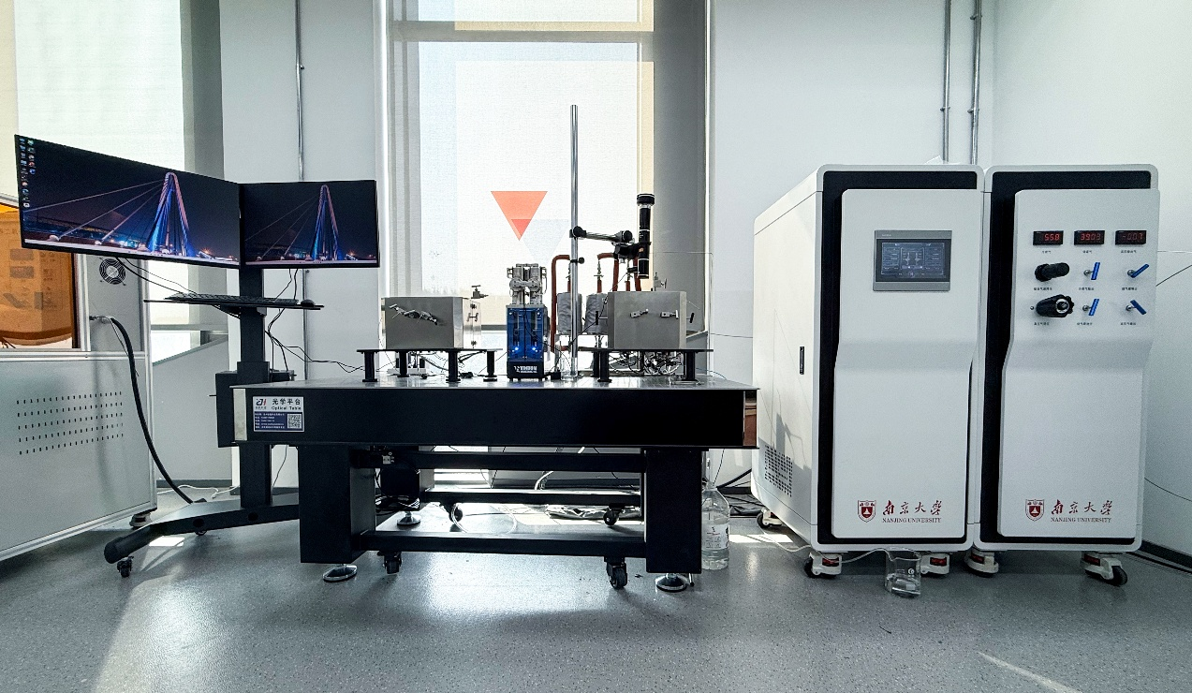
HTHP microfluidic experimental platform
Four parts
HTHP cabin
Displacement system
Data acquisition system
Microfluidic chips
Photographs of the developed equipment platform in Nanjing University.
Microfluidic platforms can simulate the conditions of subsurface resource exploitation
5

Slide 6
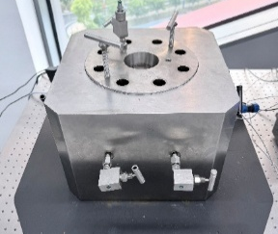
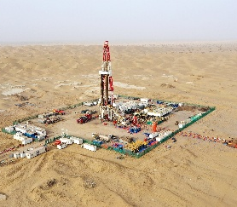
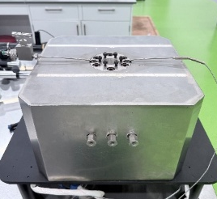
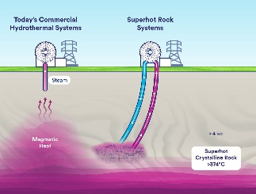
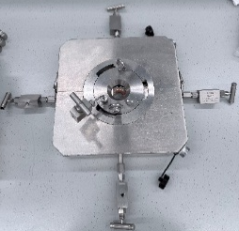
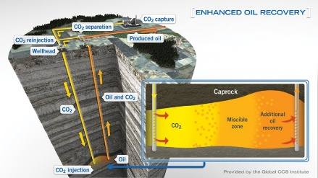
HTHP cabin
Micromodel holder 1（150℃ 70MPa）
Micromodel holder 2（300℃ 30MPa）
Ultra-deep Oil and Gas Development
Hot Dry Rock and Supercritical Geothermal
Adopt the “sealed cabin” design
Hastelloy and sapphire windows
Fluid-delivered (water) confining pressure
Independent, high - precision control of confining / pore pressure and temperature
Micromodel holder 3（100℃ 10MPa）
CCUS and EOR
Replicates deep subsurface reservoir conditions up to 70 MPa and 300 ℃
6

Slide 7
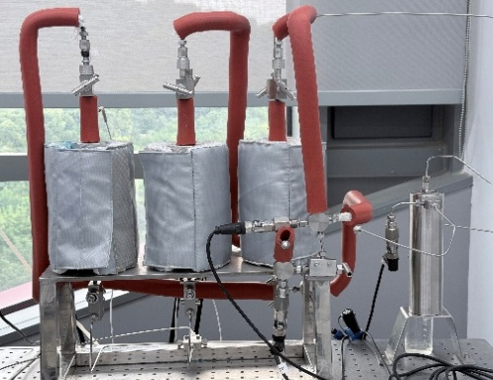
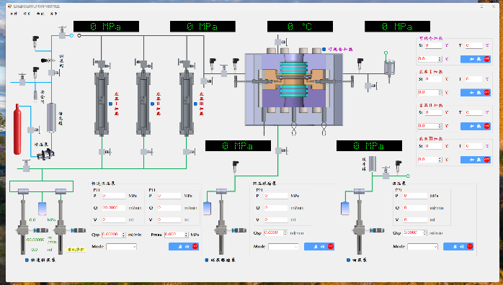
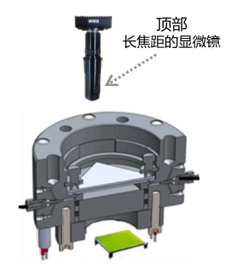
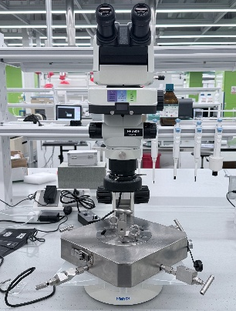
Displacement & Data acquisition system
Displacement system
Data acquisition system
Containers and
back pressure value
Integrated operating interface
Long-focal-length optical microscope
Fluorescence microscope
High-precision, highly stable flow rates (0.00001ml/min- 30ml/min)
Multiphase and multi-component injection (3 containers)
Integrated system controlling the flow rates, temperature and pressure.
Microscope + high-resolution camera to observe and capture the dynamic displacement process
Features an anti-vibration platform, enabling stable high-resolution imaging
7

Slide 8
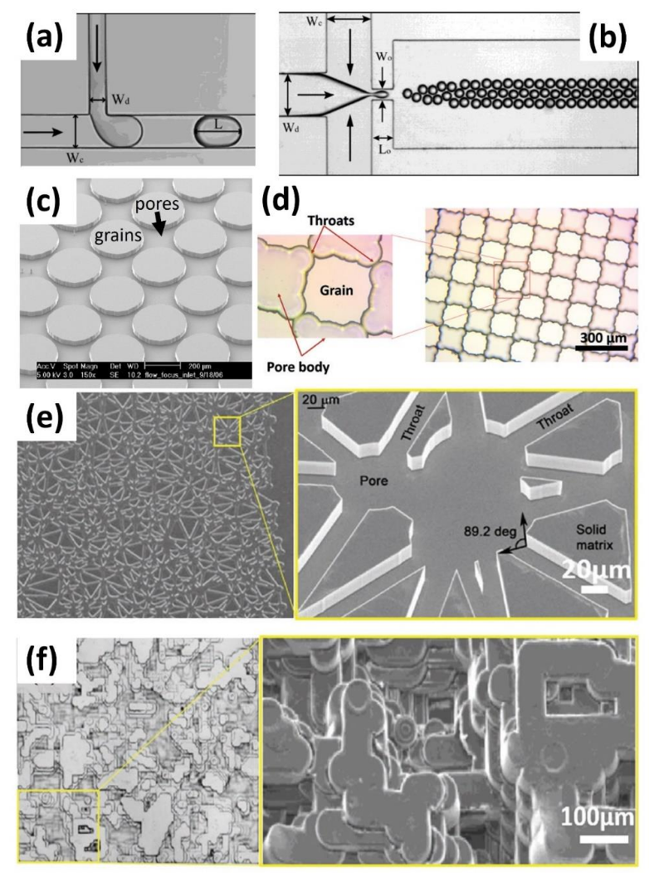
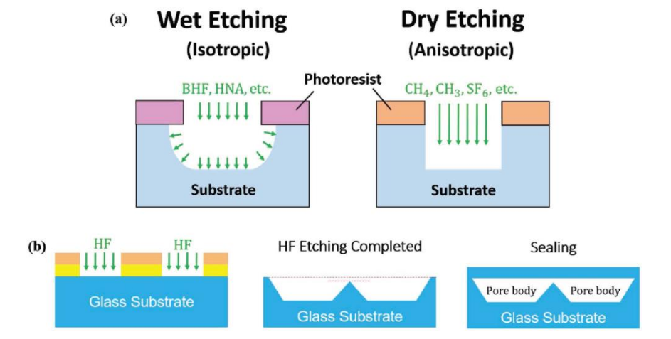
Microfluidic chips
Two important elements in the design and fabrication process
Geometry of the small volid space in the chip
Materials used to fabricate the chip (eg. silicon, glass)
(Gu et al., 2011)
(Gu et al., 2011)
(Willingham et al., 2008)
(Xu et al., 2017a)
Schematics for dry etch and wet etch (Anbari et al., 2018)
(Gunda et al., 2011; Anbari et al., 2018)
Microfluidic Chips are made for different research goals (multiphase flow, wettability, mineral reactions…) and rock structures.
(Park et al., 2012)
Examples of geometries of microfluidic void spaces
8

Slide 9
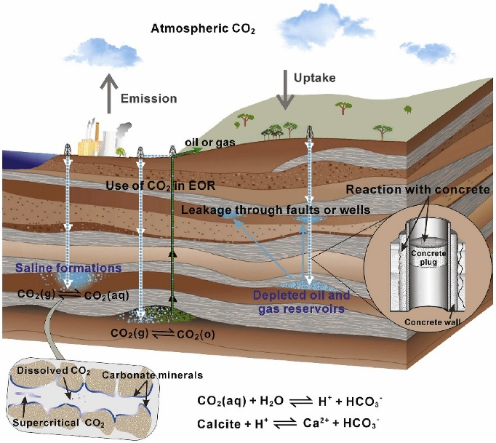
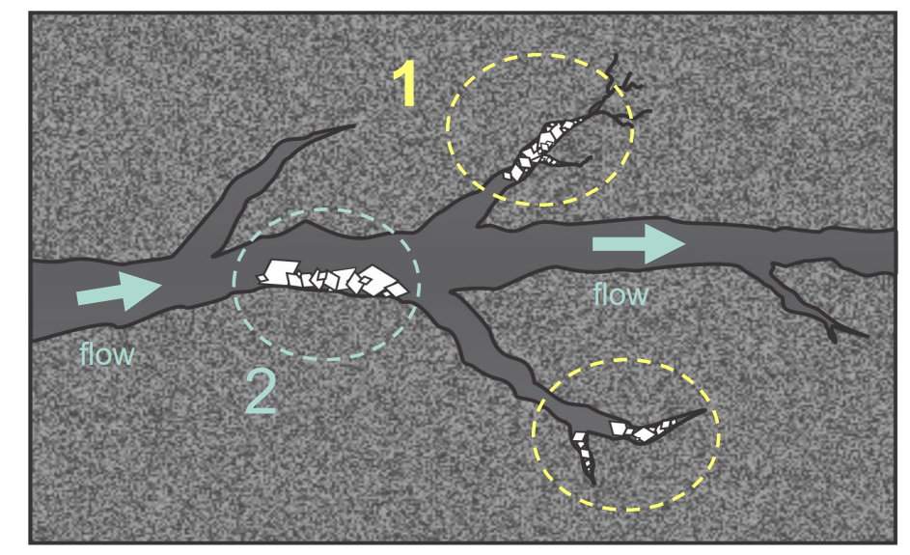
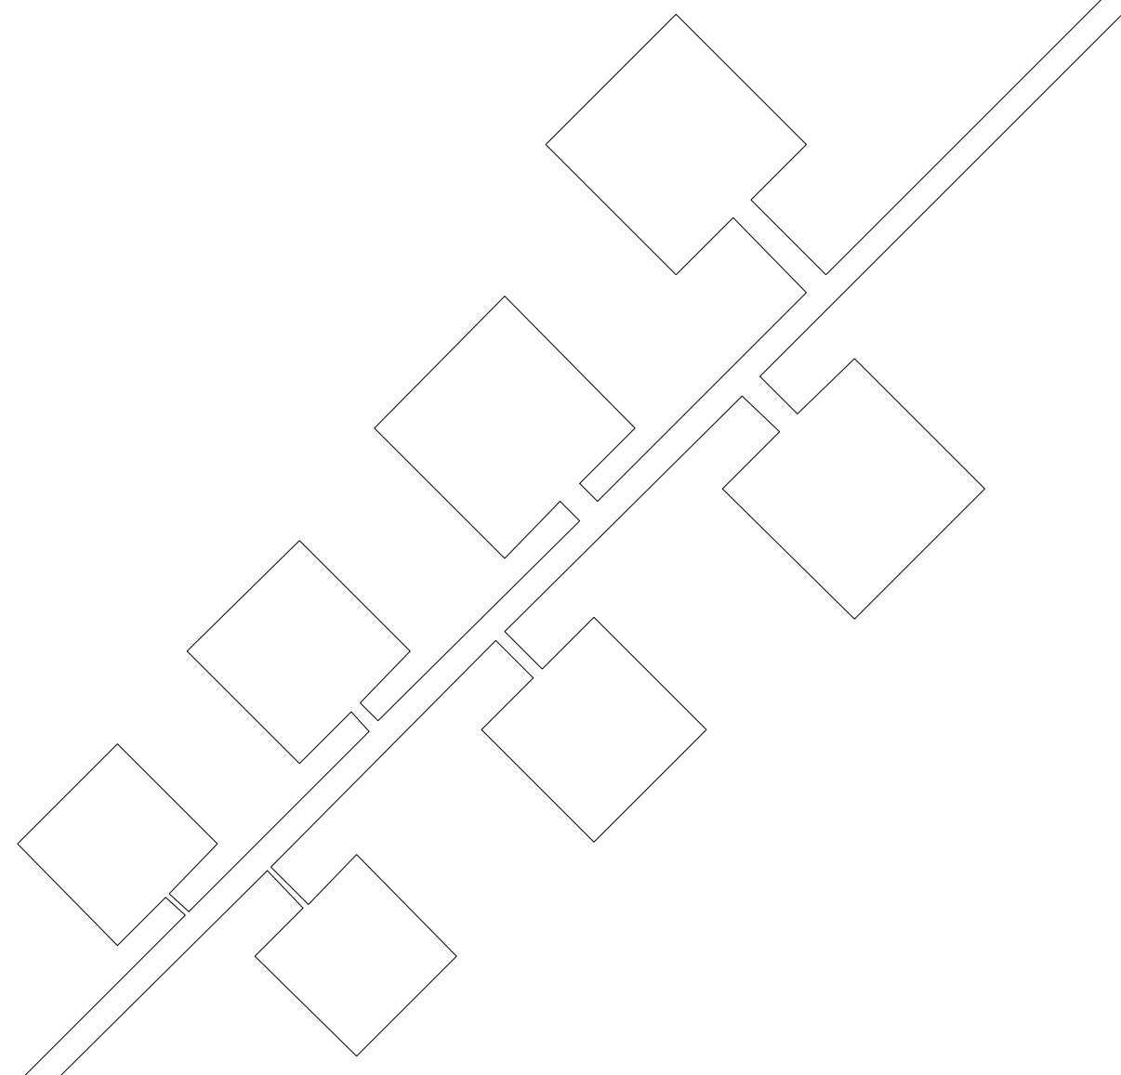
Geochemical processes in fractured system
Pore space is decomposed into two regions:
Dead-end fractures (immobile zone)
Diffusion-dominant reaction zone
No impact on primary flow channels
Flowing fractures (mobile zone)
Depends on ratio of flow to dissolution
Precipitation can cause clogging
Chemical reactions in GCS sites (Dai et al., 2020)
2
Formation of carbonic acid
Carbonate rocks dissolution
Formation of secondary precipitation
1
Investigating how fracture characteristics impact reactions using micromodel.
9

Slide 10
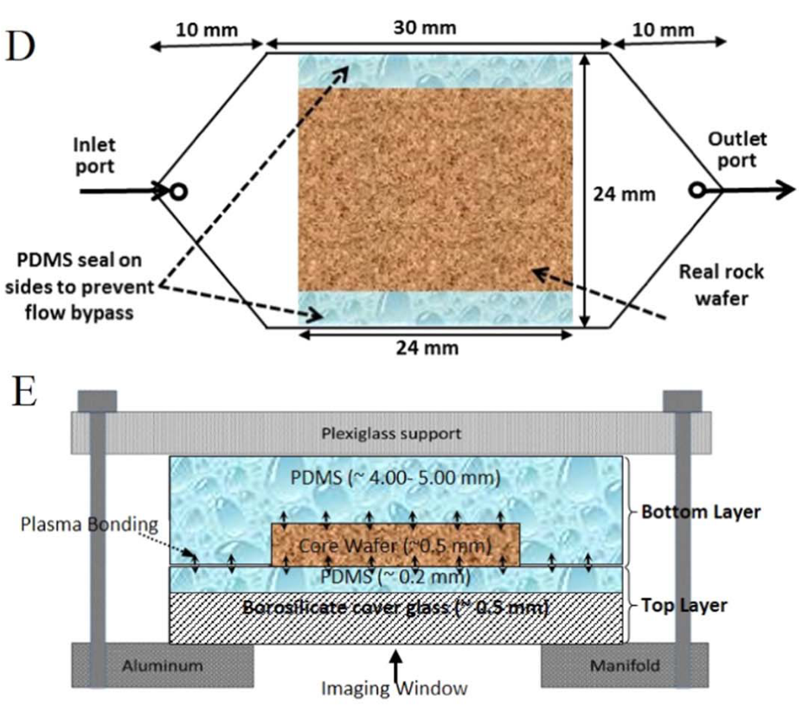
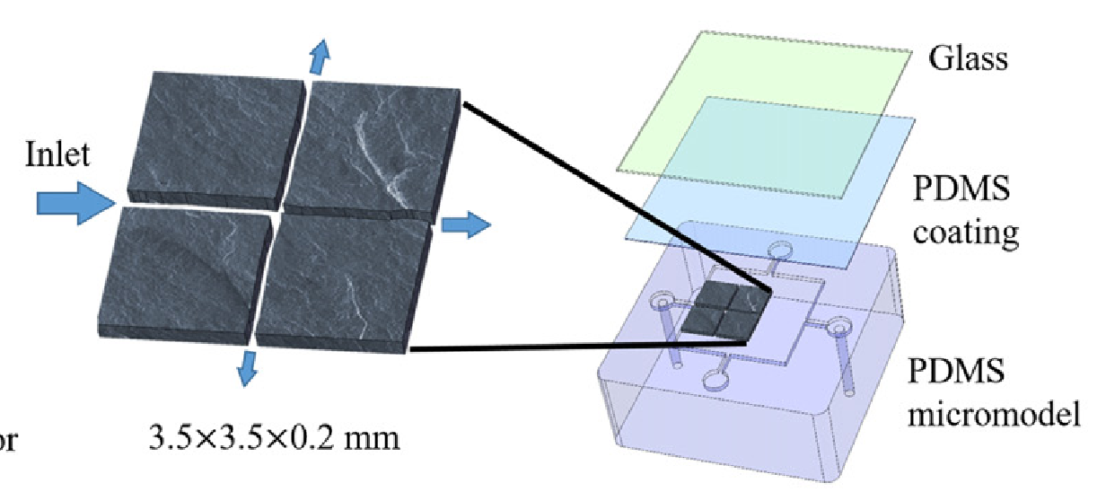
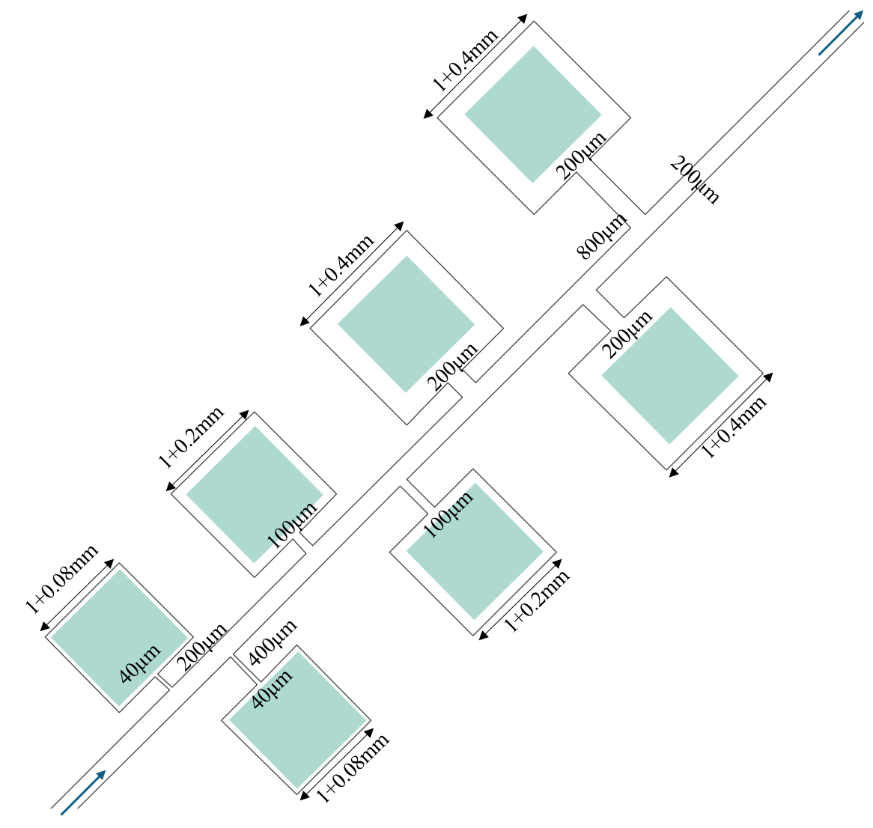
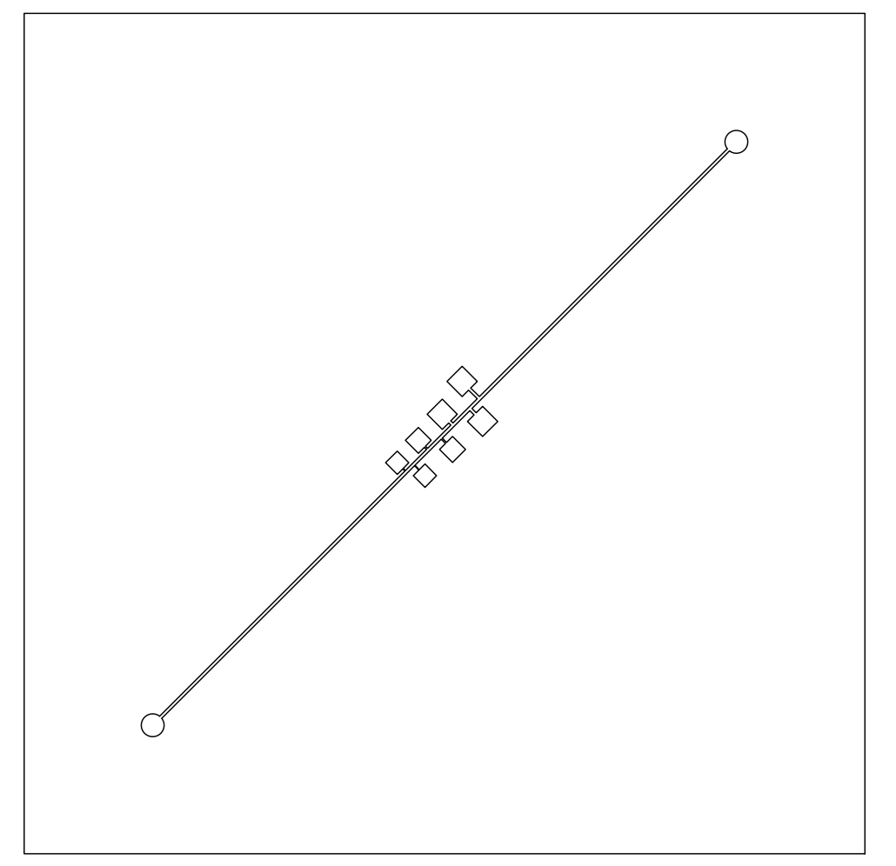
Micromodel design
Conventional microfluidic chips
Lack of real mineral composition and geochemical reactivity
Smooth surfaces, absence of natural pore surface roughness
Uniform and unstable wettability
Rock-on-a-chip
（Bowen Ling et al., 2021）
（Rajveer Singh et al., 2017）
Flow channel design
Micromodel with a main channel and lateral cavities
Main channel : 200μm
7 dead-end channels
DEP aspect ratio:1, 2, 4, 5, 10
Calcite grains were placed inside the cavity
Exploring how dead-end geometry affects mineral reactions.
55*55*0.2mm
-calcite
10

Slide 11
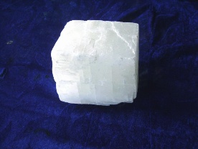
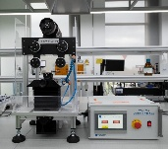
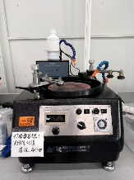
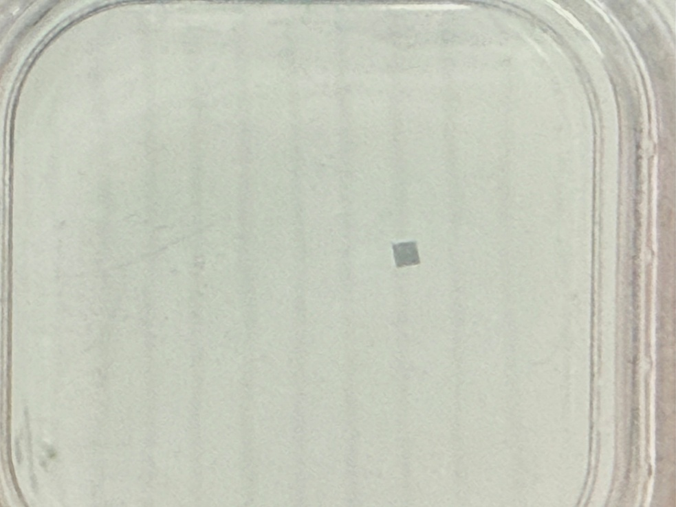
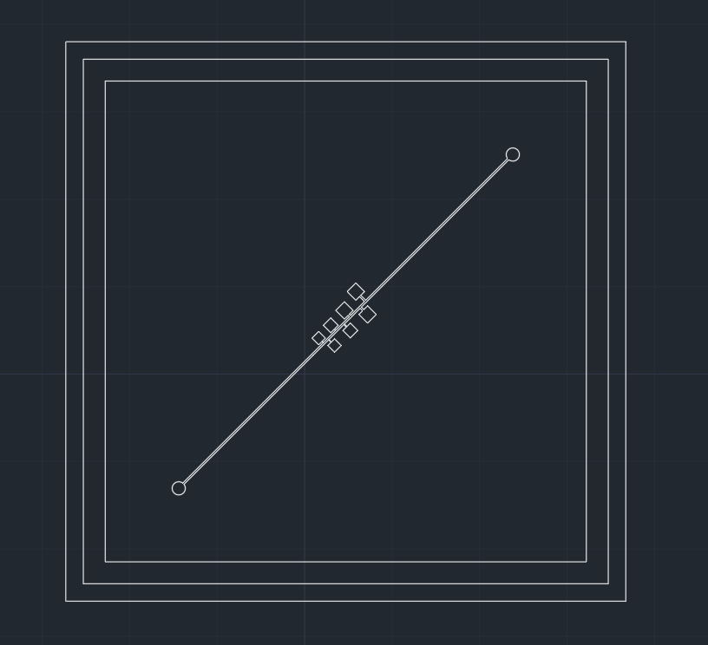
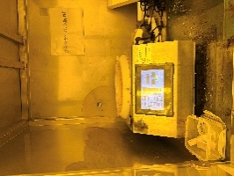
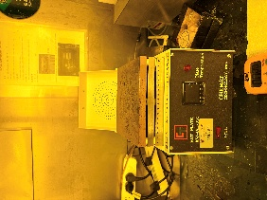
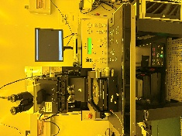
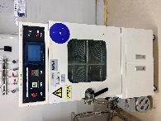
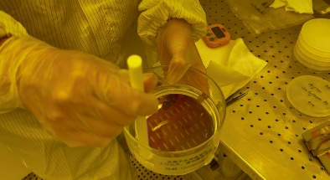
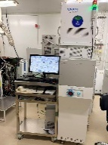
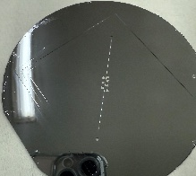
Micromodel Fabrications
Samples preparation
Calcite
Thin slices
Grind and polish
1*1*0.2mm
Fabrication workflow
Photomask preparation
Preprocessing
Photoresist deposition
Photolithography
Drilling for inlet/outlet holes
Loading the calcite samples into the cavity.
Anodic bonding to a cover glass plate.
Cutting for favorable chip size.
Development
Deep silicon etching
11
Notes:
In our laboratory, microfluidic chips are fabricated from glass. The fabrication follows standard photolithography and hydrofluoric acid etching procedures. The workflow includes seven main steps: 1) photomask preparation, 2) photoresist deposition, 3) photolithography (with photomasks that have the desired geometry patterns), 4) development, 5) HF etching, 6) glass cutting and drilling for favorable chip size and inlet/outlet holes, 7) thermal bonding to a plain cover glass plate. In the following sections we detail the steps of the workflow.

Slide 12
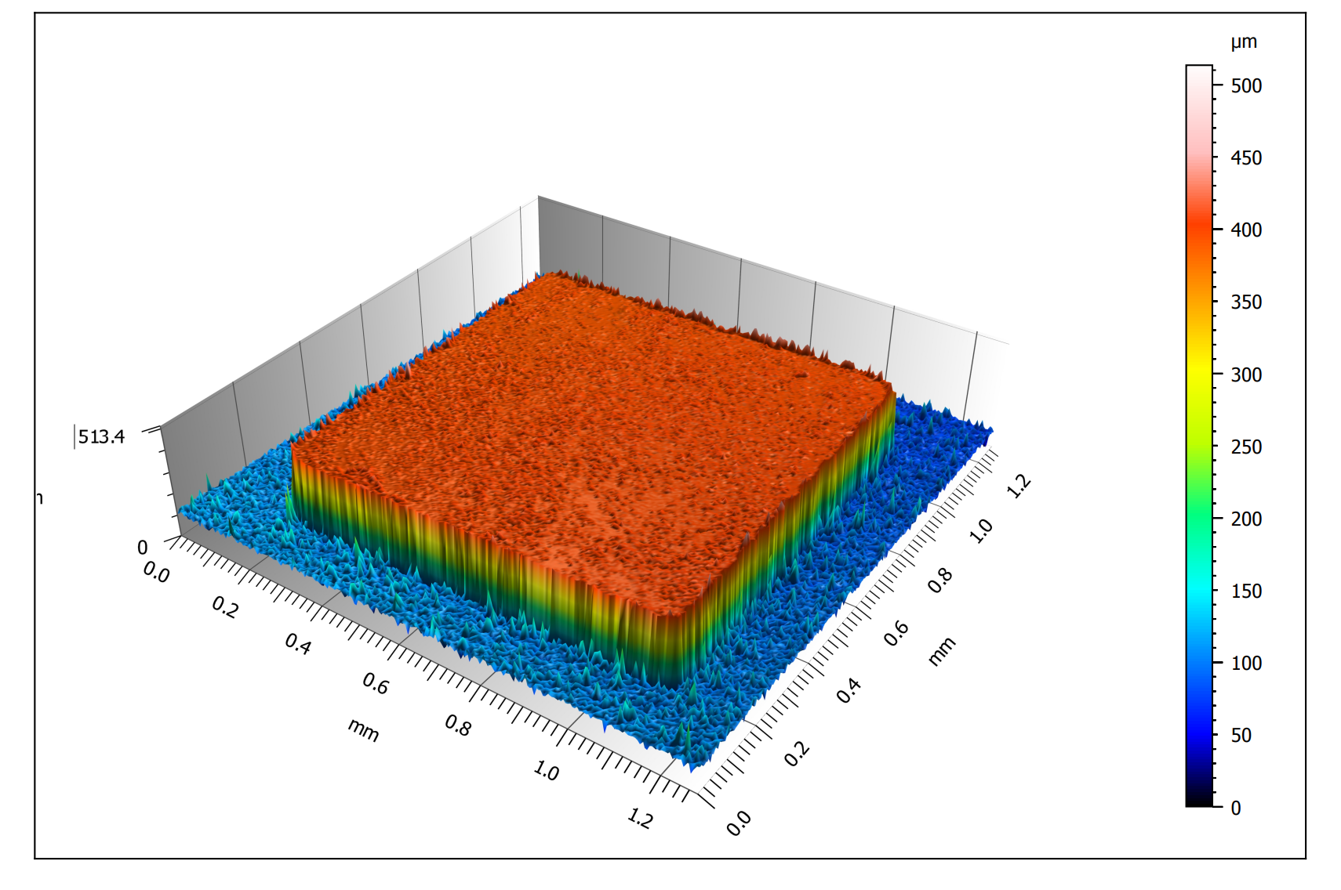
Experiments in dead-end fractures
Post-Experimental analyses
Experimental conditions
Confocal Laser Scanning Microscope
Scanning Electron Microscopy
(mineralogy)
T(℃) | P_{conf} | P_{back} | Flow Rates(μL/min)
50 | 9 | 8 | 0.1 or 1 or 10
Simulating authentic reservoir conditions
Different flow rates corresponding to varying Péclet numbers
Constant-flow injection
Future work
Conduct microfluidic experiments to visualize calcite dissolution (and subsequent reprecipitation inside dead-end pores at 50 ℃ and 8 MPa.
Study the correlation between micro-scale dissolution regimes and Péclet numbers in dead-end pores under confinement.
Quantitatively interpret the experimental phenomena using the lattice Boltzmann method (LBM).
12

Slide 13

Thank you for listening！
Email：
652025840006
@smail.nju.edu.cn
13

