Slide 1

1
Physics-constrained contact angle extraction
in 3D porous media
Zhenqi Guo, Feiyan Jin, Liang Lei*
22/05/ 2026
Notes:
Hello everyone, Today I will talk about our work on contact angle extraction in porous media. This work focuses on how to accurately measure contact angles from 3D images.

Slide 2
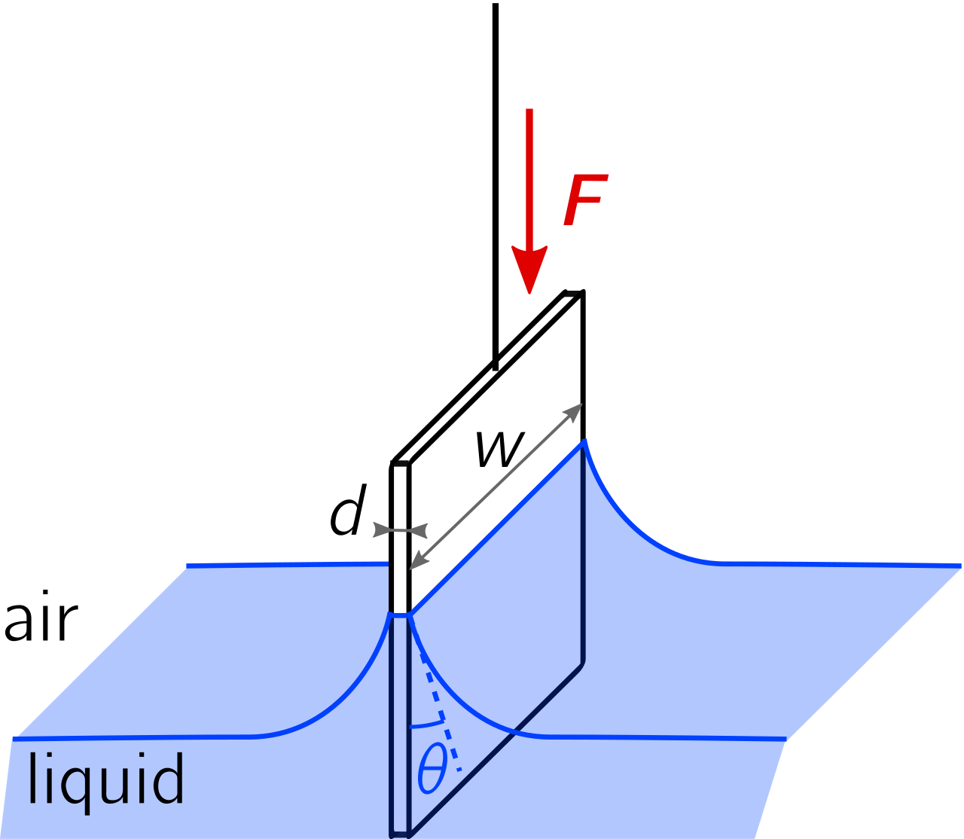
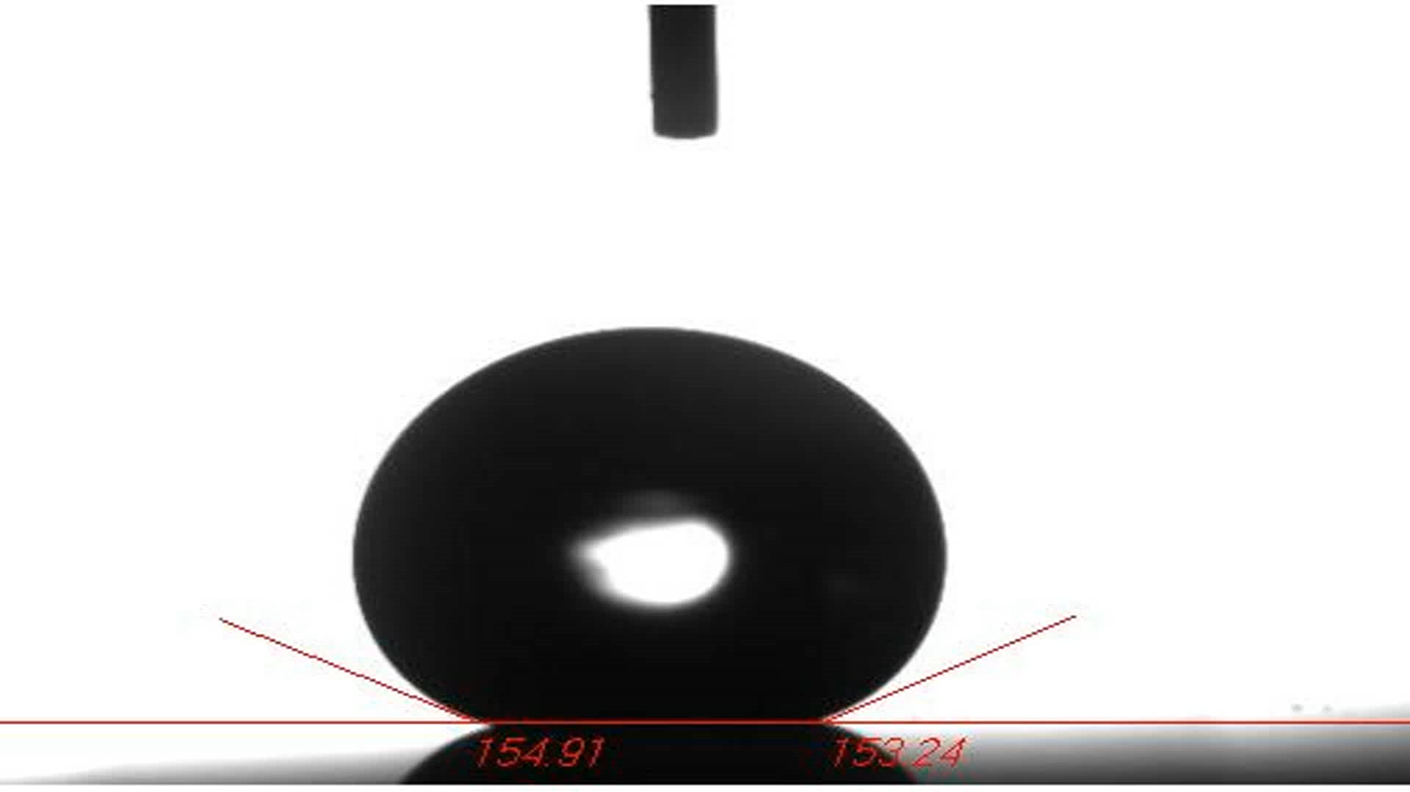

Contact angle measurement
2
Drop shape analysis
Wilhelmy Plate
Contact angle from droplet profile
Contact angle from wetting force
$$cosθ=\frac{F}{{Lγ}_{lg}}$$
Notes:
Contact angle is an important parameter in porous media. It strongly affects wettability, capillary behavior, and multiphase flow. Here are two common methods for contact angle measurement. On the left is the direct measurement method based on drop shape analysis. We can fit the droplet profile, easily obtain the contact angles. On the right, the contact angle is calculated from the wetting force and a known liquid surface tension. However, for complex porous media, it is difficult to measure the wetting force directly.

Slide 3
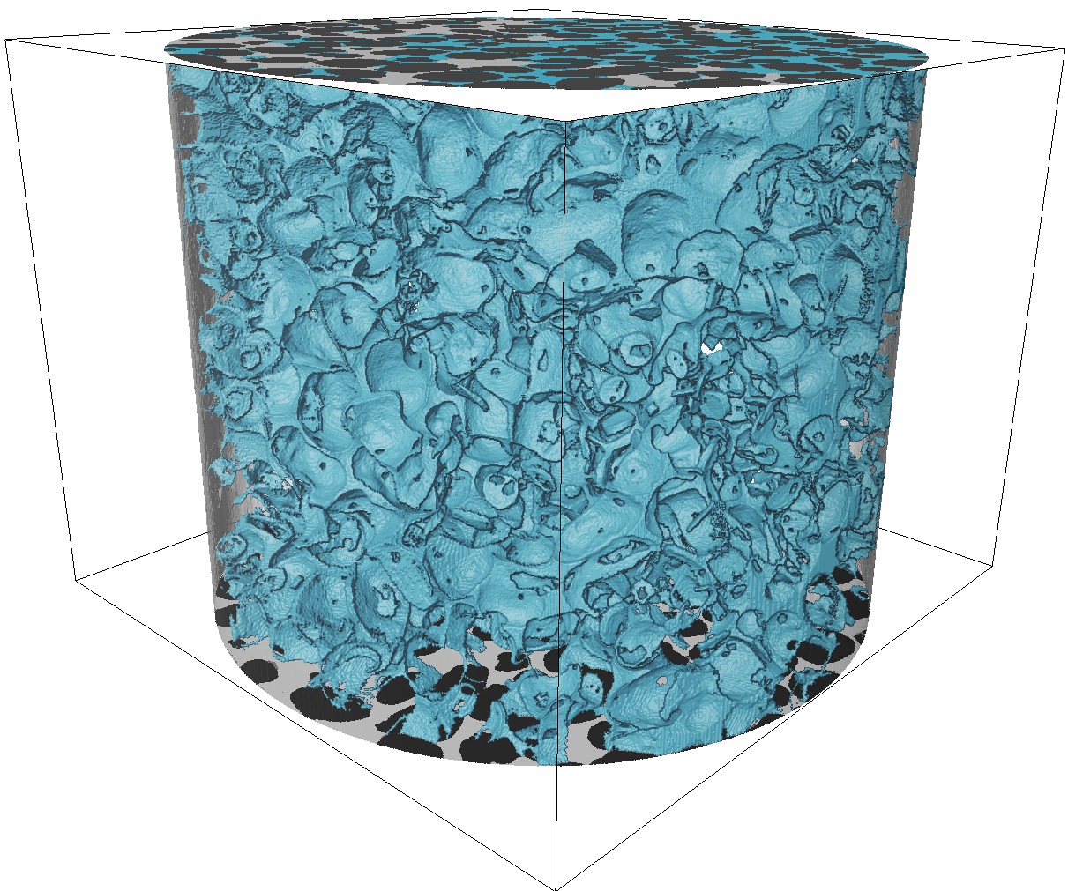
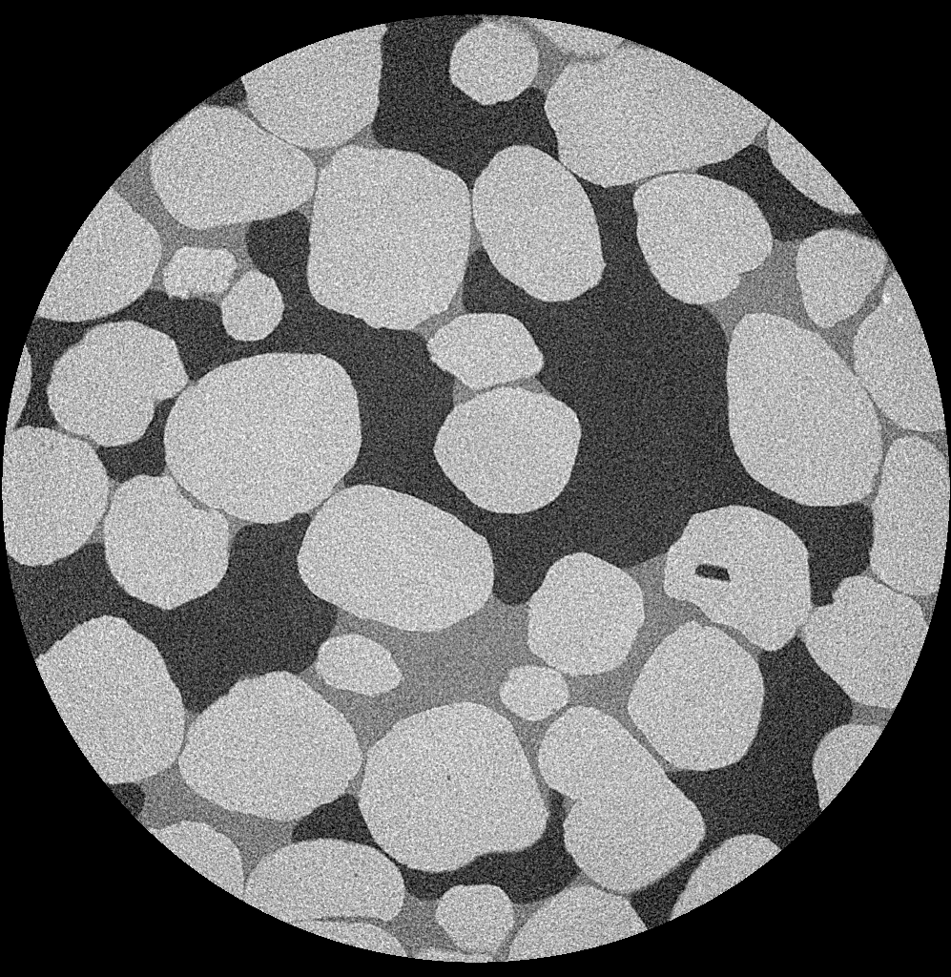

Contact angle measurement
3
Complex porous media
Drop shape analysis
Wilhemy Plate
Contact angle from droplet profile
Contact angle from wetting force
Gas
Sand
$$cosθ=\frac{F}{γ_{lg}}$$
Liquid
Figure Credit: Wikipedia
Notes:
Instead, through 3D CT images, the contact angle can be measured through geometric analysis.

Slide 4
Contact angle measurement
4
Interface extraction
Normal vector determination
Calculate angles
Complex porous media
n_{wg}
I_{wg}
I_{sg}
θ
n_{sw}
n_{sg}
I_{sw}
Sand
Gas
Liquid
A direct framework
Just geometry analysis
Notes:
Overall, the measurement is quite straightforward.
We first extract two interfaces, including the solid–liquid interfaces and the liquid–gas interfaces. Then, obtain corresponding normal vectors of these two interfaces. Calculate the contact angle using mathematical formulas.
Is a purely geometric analysis.

Slide 5
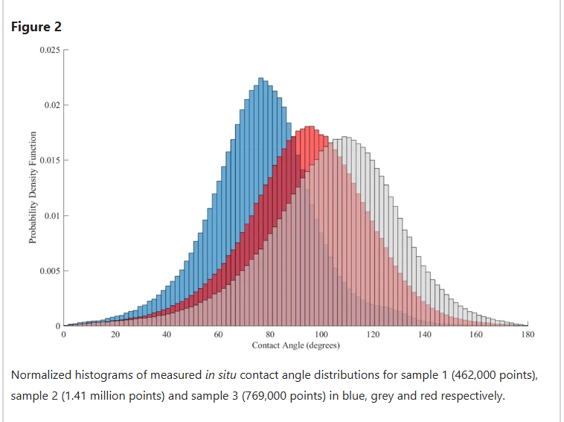
Contact angle measurement
5
Contact angle distribution
Interface extraction
Normal vector determination
Calculate angles
Complex porous media
n_{wg}
I_{wg}
I_{sg}
θ
n_{sw}
n_{sg}
I_{sw}
Sand
Gas
Robust measurement is difficult
A direct framework
Just geometry analysis
Liquid
Notes:
Following this straightforward framework, we obtained the contact angle distributions, as shown here.
In porous media, the contact angle is usually constrained by the local pore geometry, so it typically shows a wide distribution rather than a single value.
However, we can still observe some unrealistic contact angles, for example values close to 0 degrees.
In 3D CT images, image noise and limited resolution can lead to inaccurate local measurements.
To obtain reliable contact angle measurements, we need to remove nonphysical information from the digital images.

Slide 6
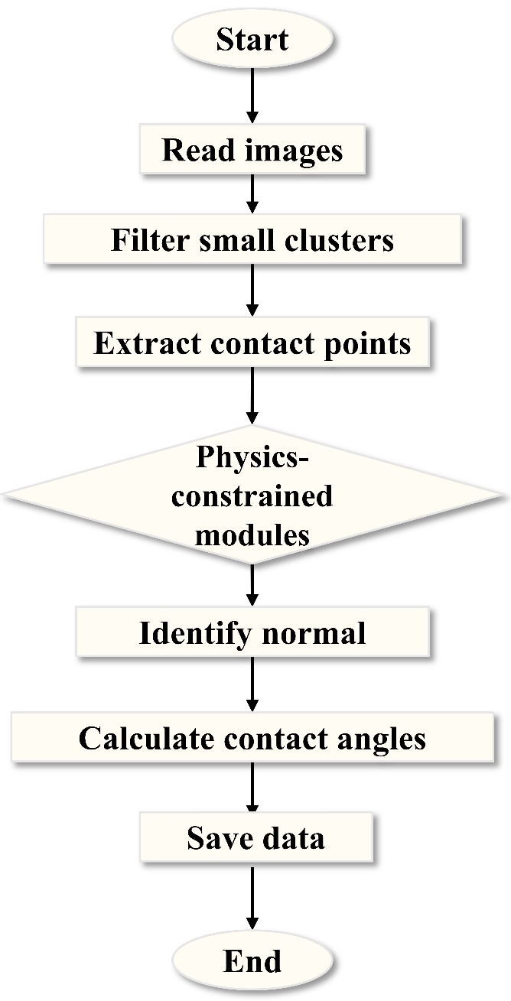
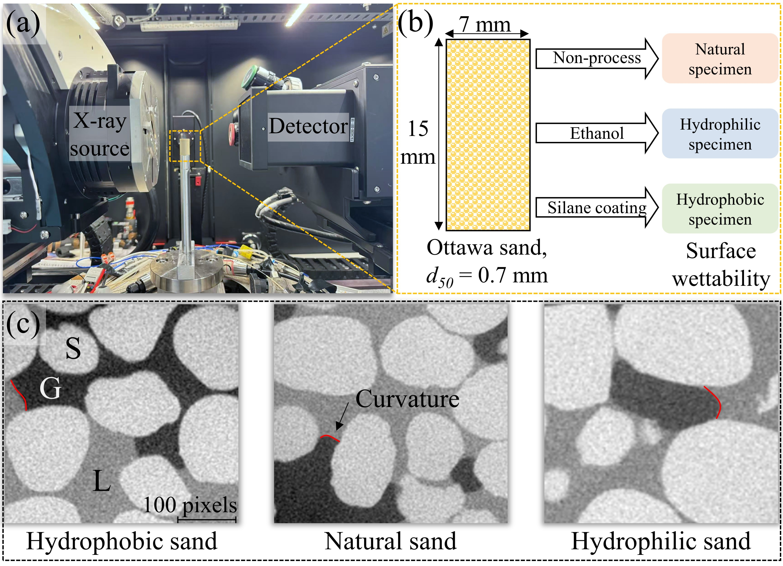
Workflow for 3D contact angle extraction
6
3D CT Image data
Notes:
This is the basic workflow of contact angle measurement. The focus is on the physics-constrained steps. Our data consists of 3D CT images containing samples with three different wettabilities.

Slide 7
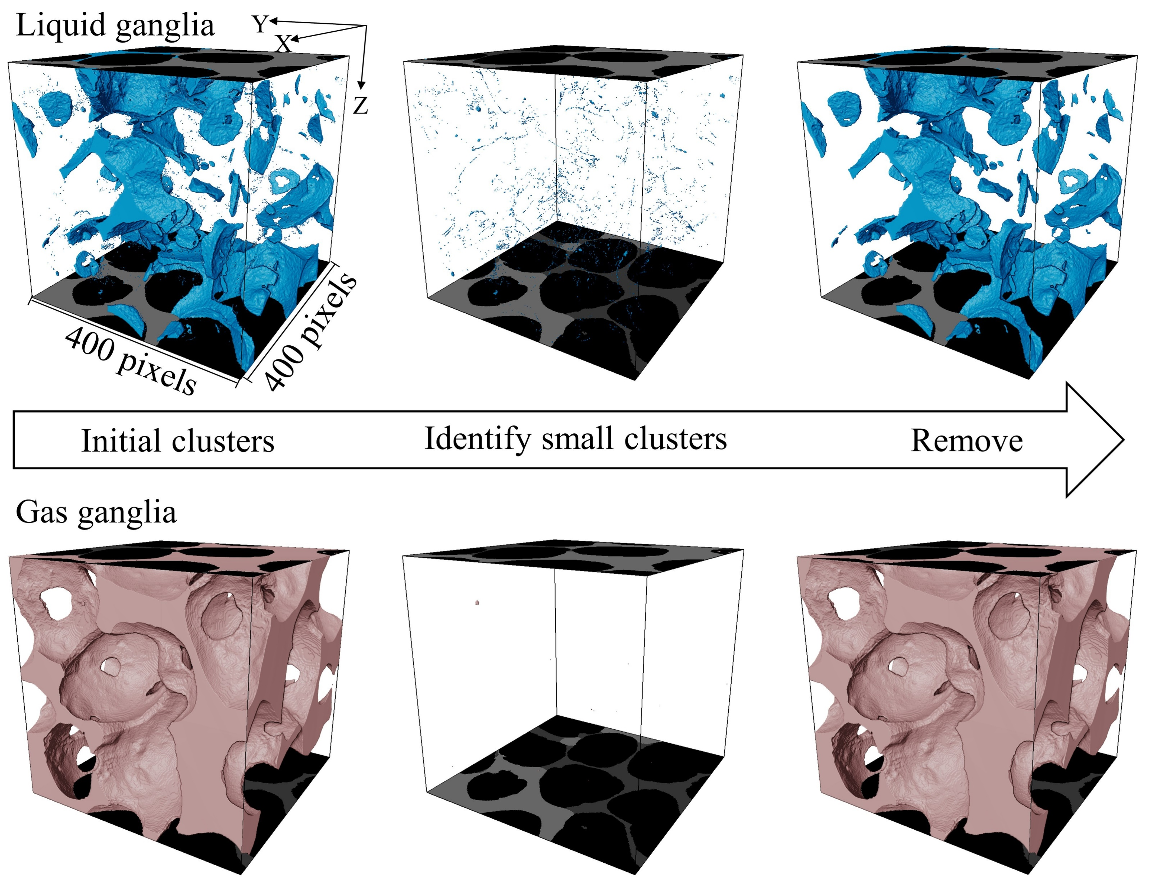
Remove small clusters
7
Interfaces with few voxels → unreliable measurement
Notes:
The first step is to remove image noise, as well as small liquid and gas clusters.
These clusters contain too few voxels, making the contact angle difficult to identify even visually.
Therefore, they are excluded from the subsequent measurements.

Slide 8
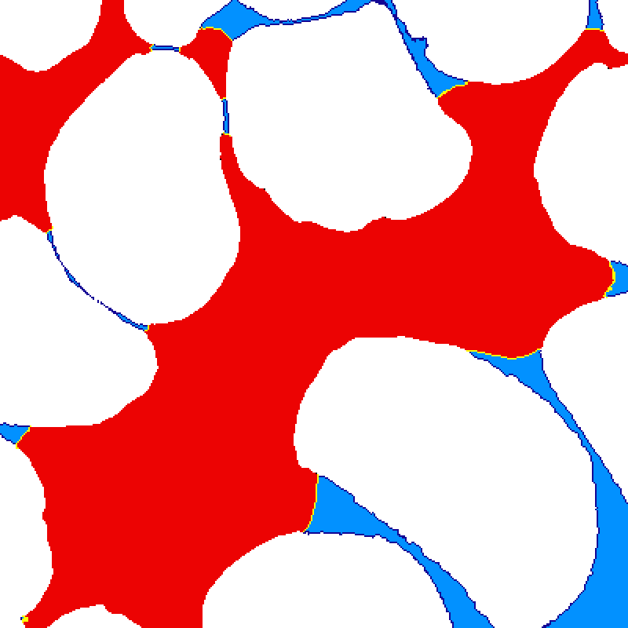
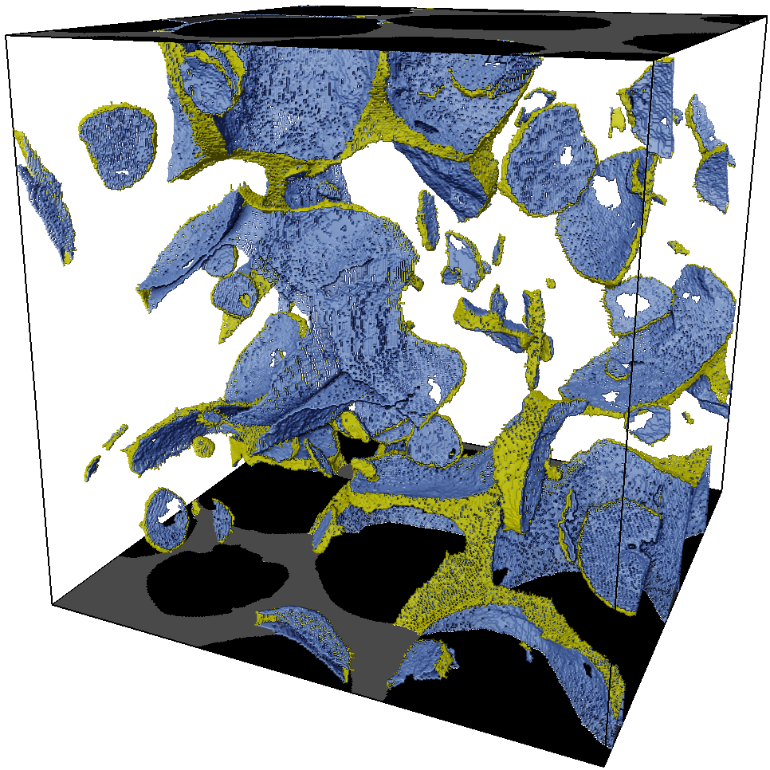
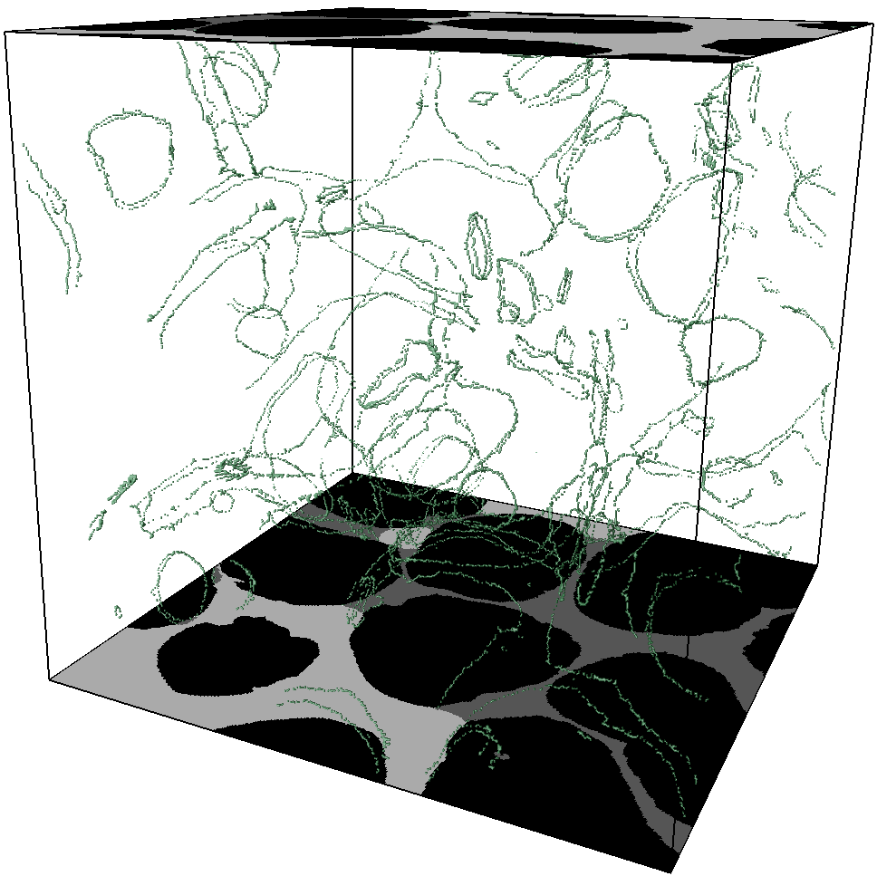
Extract interfaces and contact points
8
Extract solid-liquid interfaces, liquid-gas interfaces, and contact points
Y
X
Z
gas-liquid interface
gas
liquid
sand
solid-liquid interface
100 pixels
20 pixels
400 pixels
Contact line
gas-liquid interface
solid-liquid interface
Notes:
And then, we need to extract two interfaces, the liquid-gas interfaces and solid-liquid interfaces, and three-phase contact points. We identify two interfaces based on face contact.
Voxels belonging to both interfaces are considered as three-phase contact points. These points are then subjected to strict filtering.

Slide 9
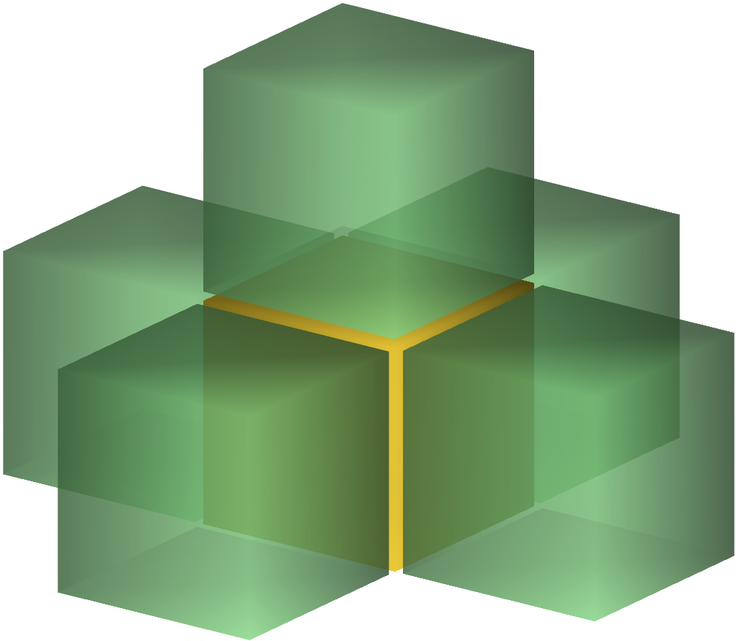
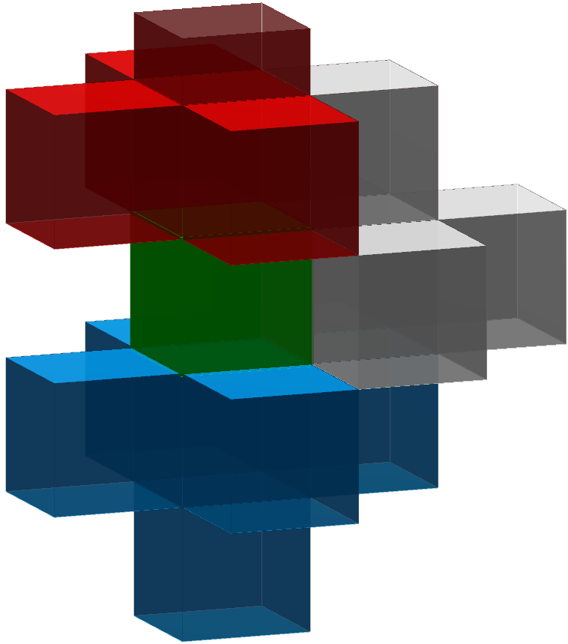
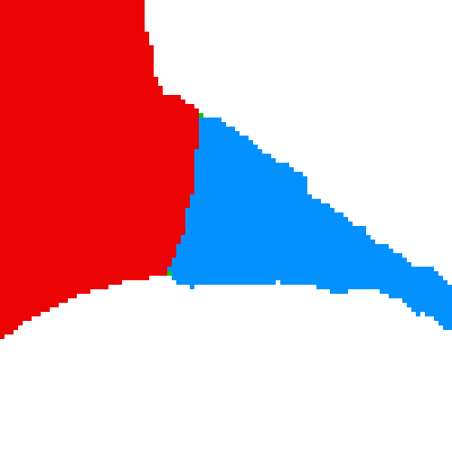
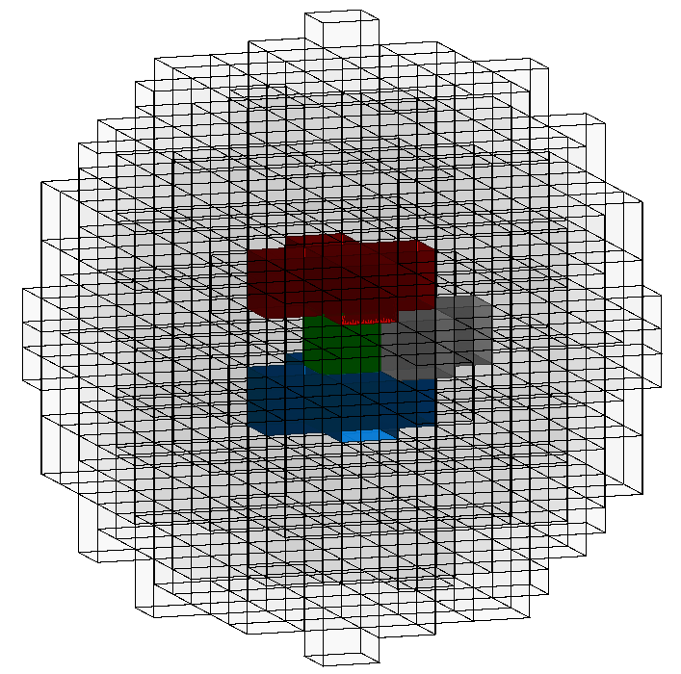
Geometrical and physical constrained steps
9
Constrained Step 1
Constrained Step 2
Solid voxel
Liquid voxel
Geometrical
compliance
Remove fake contact points
Gas voxel
Neighbor voxel>3
Contact voxel
Constrained Step 3
Sphere-based three phase ratio calculation
Select flat solid surface：
20%< Sand content < 80%
Solid
Gas
Physical
compliance
Liquid
R_{s} ∈[0.3, 0.7]
Contact point
(Sphere center)
Sphere field
Notes:
We apply three filtering steps to identify reliable three-phase contact points.
First, neighboring voxels must contain all three phases: solid, liquid, and gas.
Second, we further evaluate the local solid surface.
In theory, contact angles measured on relatively flat sand surfaces are more reliable.
Therefore, we construct a spherical neighborhood centered at each contact point and calculate the local solid fraction.
Contact points with excessively small or large solid fractions are excluded.
As illustrated on the right, these points are usually located near sharp edges or highly concave regions.
Essentially, these procedures evaluate the quality of the contact angle measurement and retain only reliable data points.
The method is simple, but very effective.

Slide 10
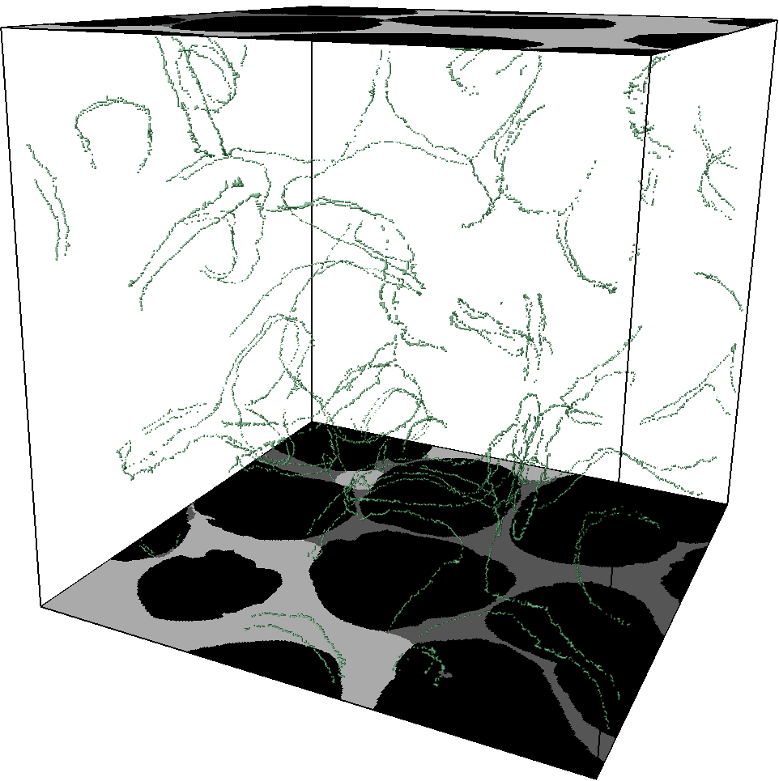
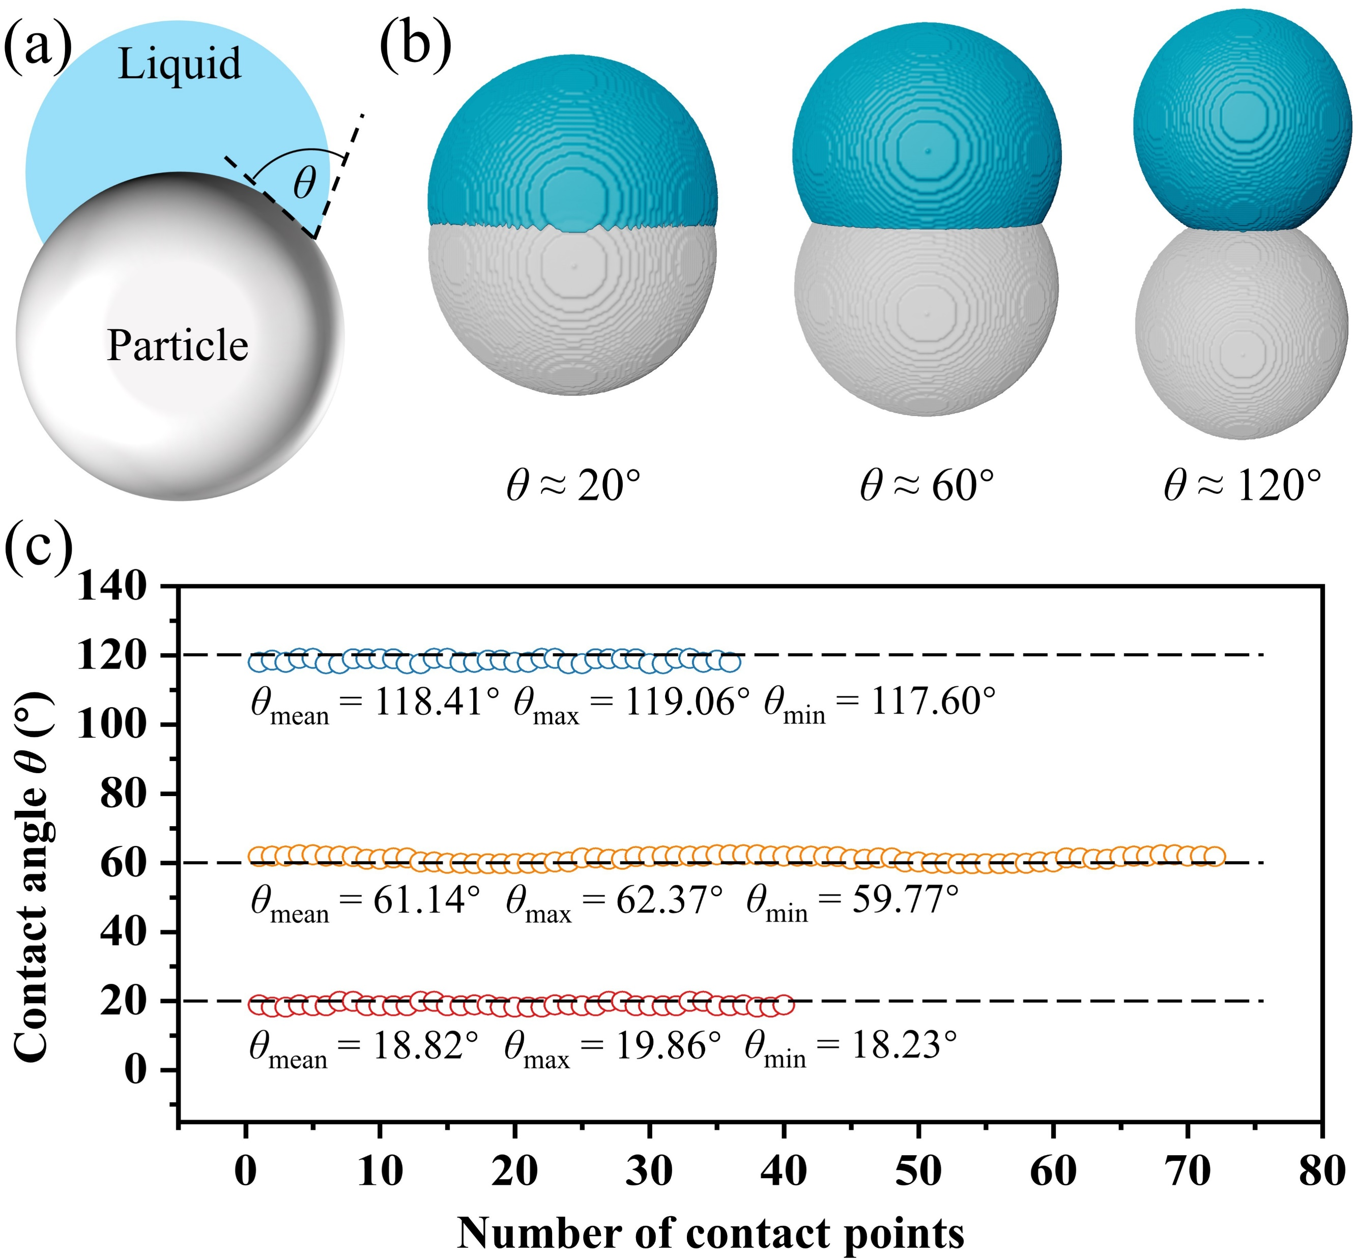
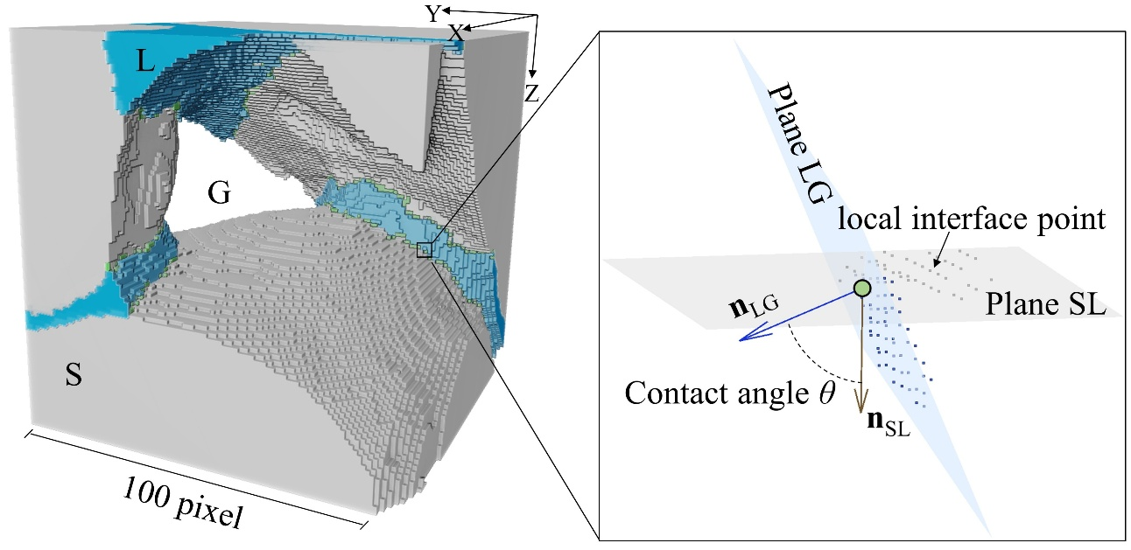
Result
10
Comparison
Verification of 3D contact angle measurement
Y
X
Z
400 pixels
Normal vector and plane
Notes:
Here we compare the contact points before and after filtering.
We can see that some isolated contact points are removed.
After that, the contact angle at each contact point can be measured, and the contact angle distribution is obtained.
To validate the method, we performed measurements on images with known contact angles.
The results show that the measured contact angles agree well with the known values.

Slide 11
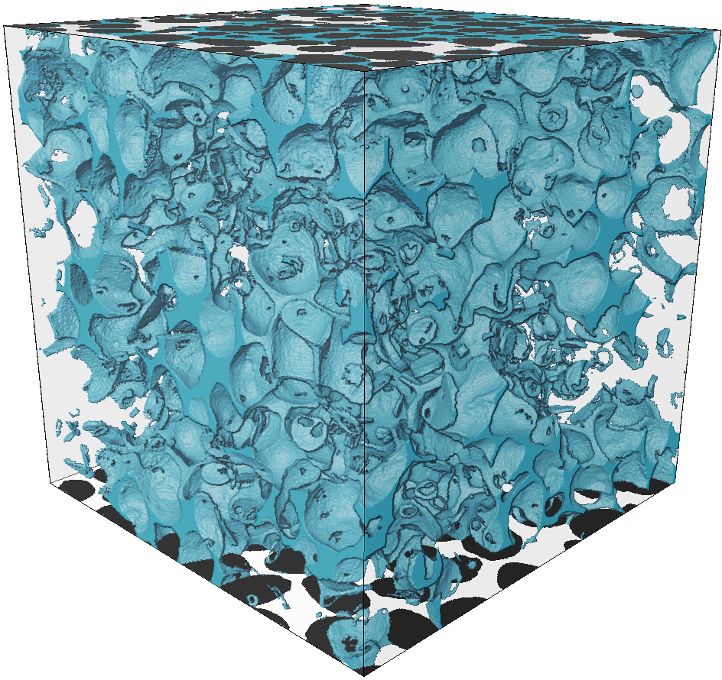
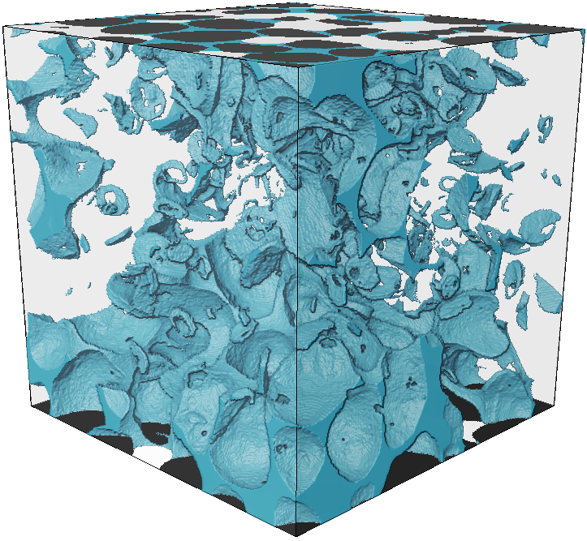
Result
11
The measurement results are quite reliable
Natural sand
Size 1
Size 2
Size 3
Normal distribution fitting
Y
X
Z
Hydrophilic sand
700
400
Relative frequency
700
700
400
400
Size 1
Size 2
Size 3
Hydrophobic sand
Contact angle θ (°)
Notes:
We also performed the measurements using different image sizes.
The results show only small fluctuations, indicating that our method is relatively robust.

Slide 12
Result
12
physical consistency
Natural sand
(Sun et al., 2020)
This work
(Wang et al., 2024)
Normal distribution fitting
(Alratrout et al., 2017)
Hydrophilic sand
Relative frequency
Hydrophobic sand
Contact angle θ (°)
Notes:
We also compared our method with several existing methods.
Overall, our results show a smoother contact angle distribution.
We do not observe unrealistic spikes within a narrow angle range, which seems more physically reasonable.
In summary, we developed a method for contact angle extraction in 3D porous media. The method reduces nonphysical measurements and produces smoother and more reasonable contact angle distributions. Thank you for your attention.

Slide 13
13
THANKS FOR LISTENING AND ATTENTION

