Slide 1

1
Physics-constrained contact angle extraction
in 3D porous media
Speaker: | Feiyan Jin
Supervisor: | Dr. Liang Lei
5/22/2026 | 01/09/2023

Slide 2
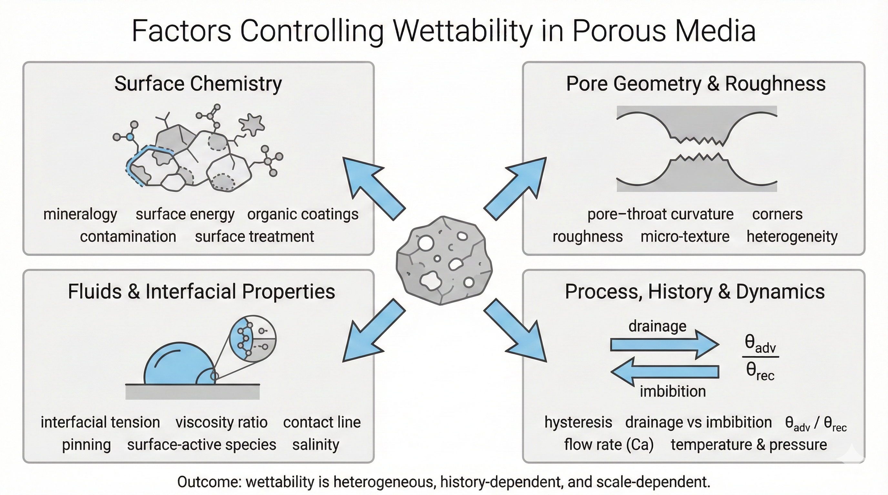

Wettability is not a single parameter in porous media
2
(Reza et.al., Advances in Colloid and Interface Science, IF19.5, 2025)

Slide 3
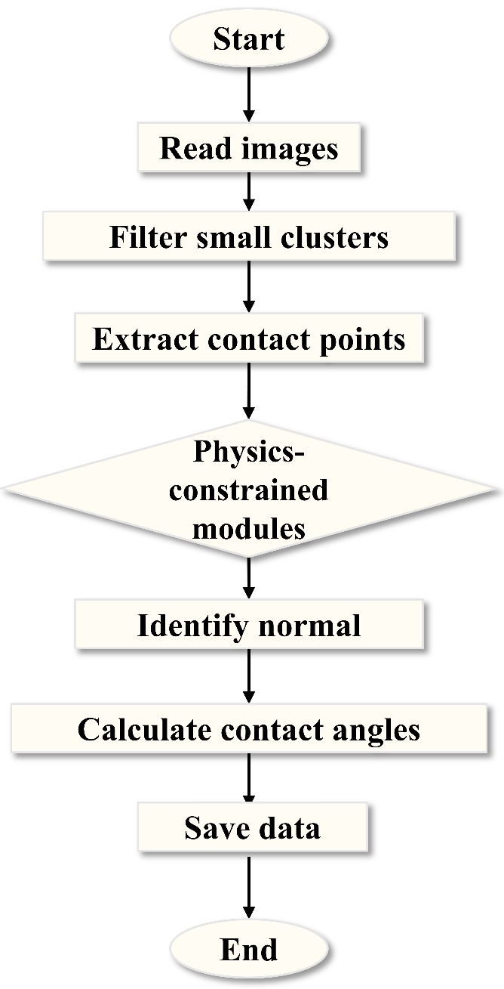
Workflow for 3D contact angle extraction
3

Slide 4
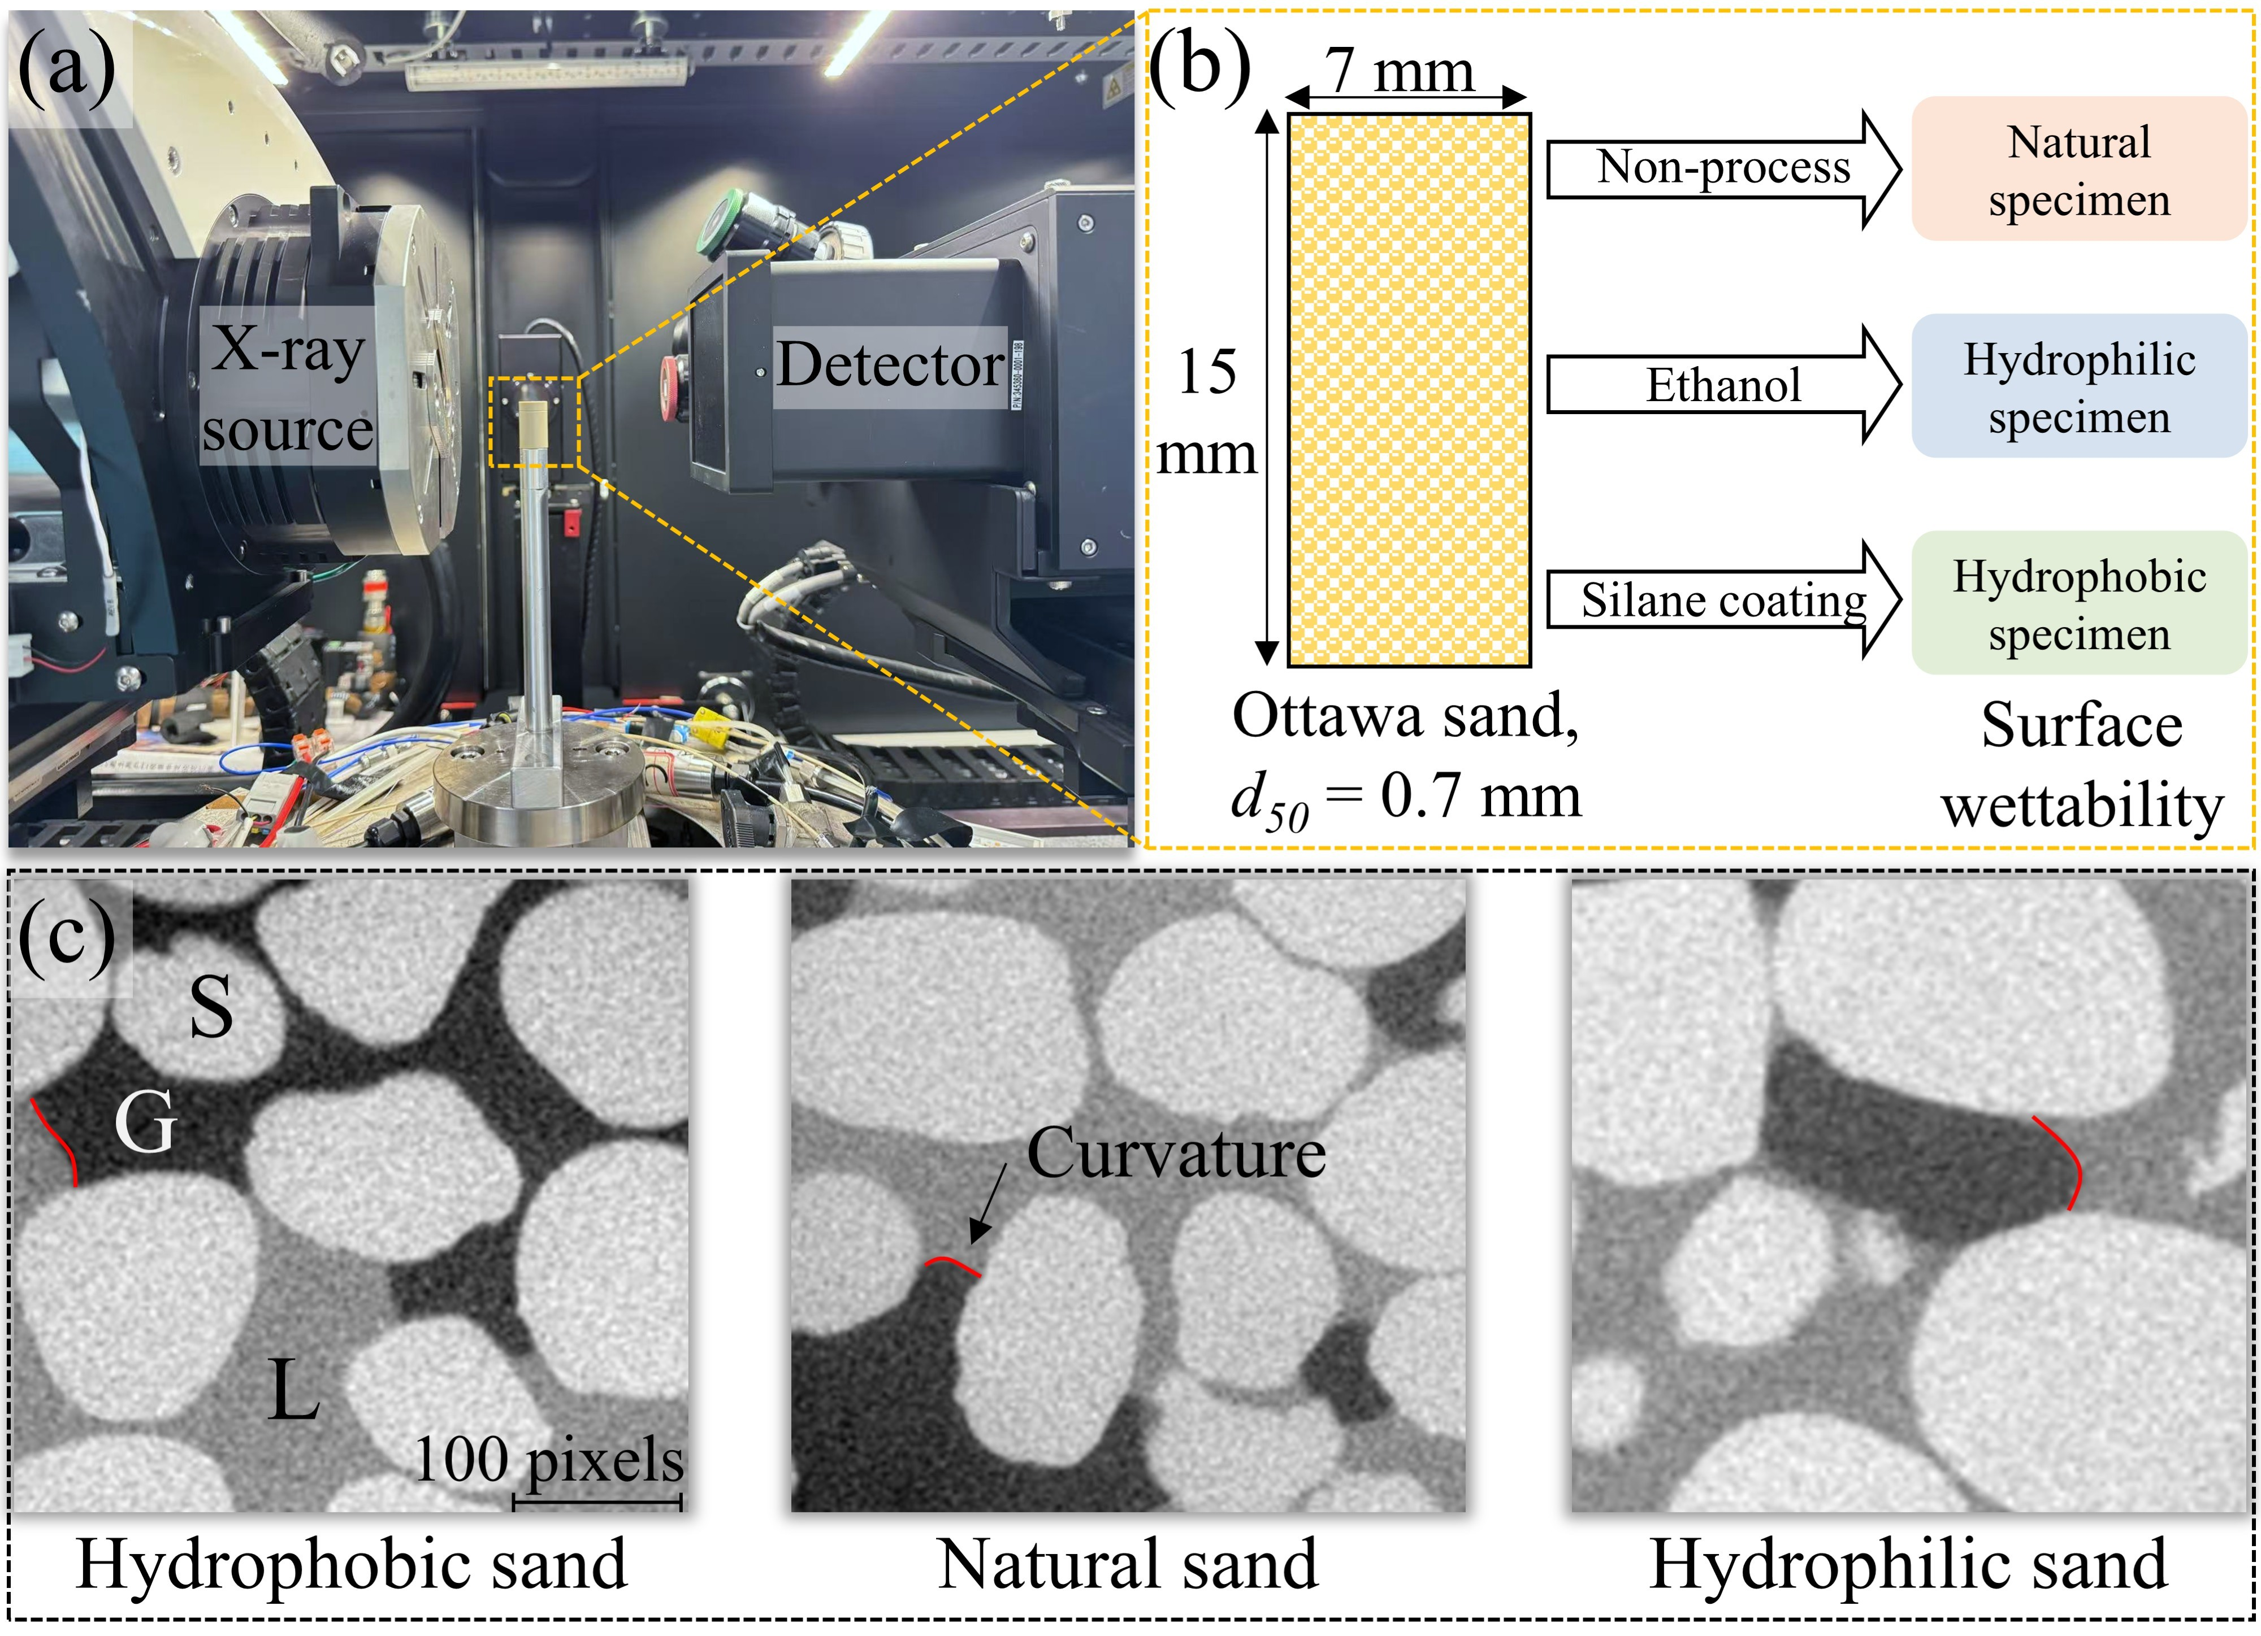
CT image data
4

Slide 5
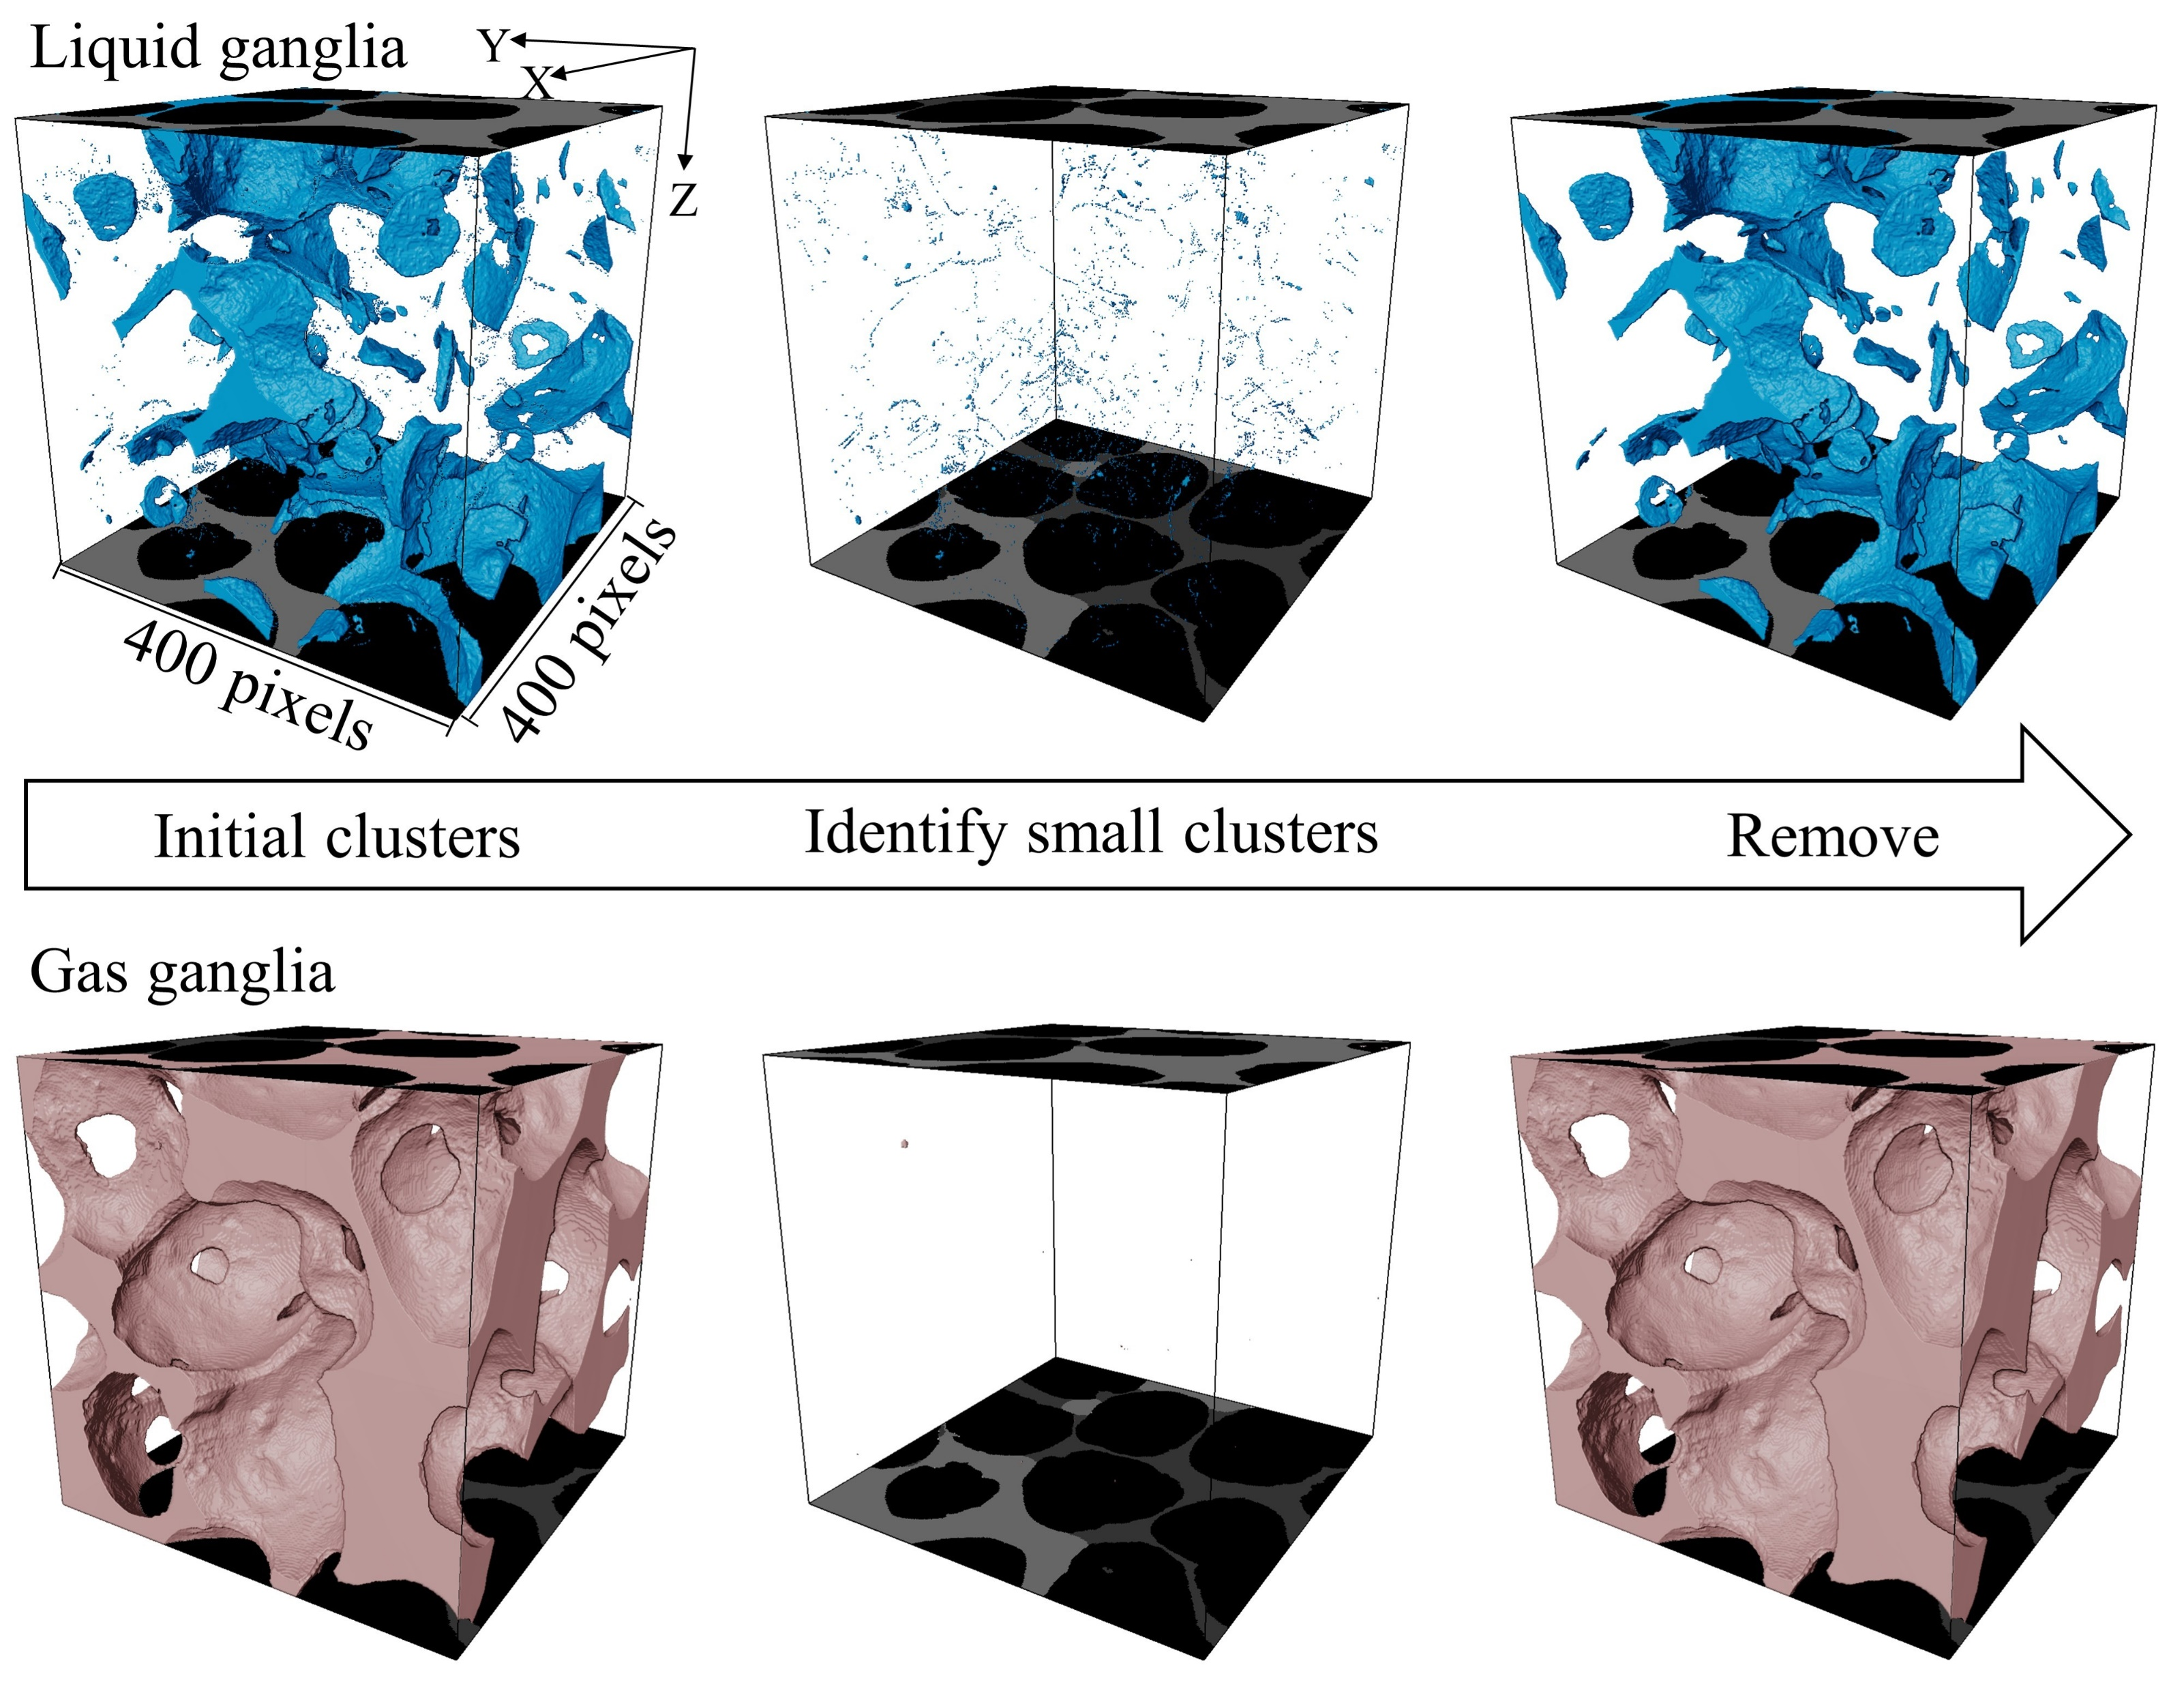
Small clusters out
5

Slide 6
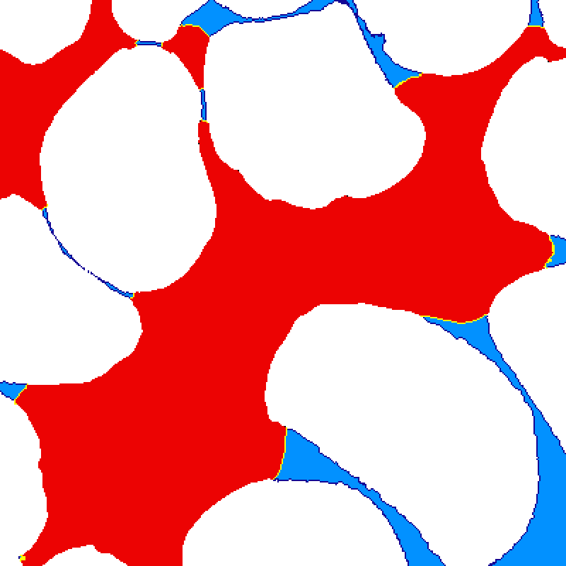
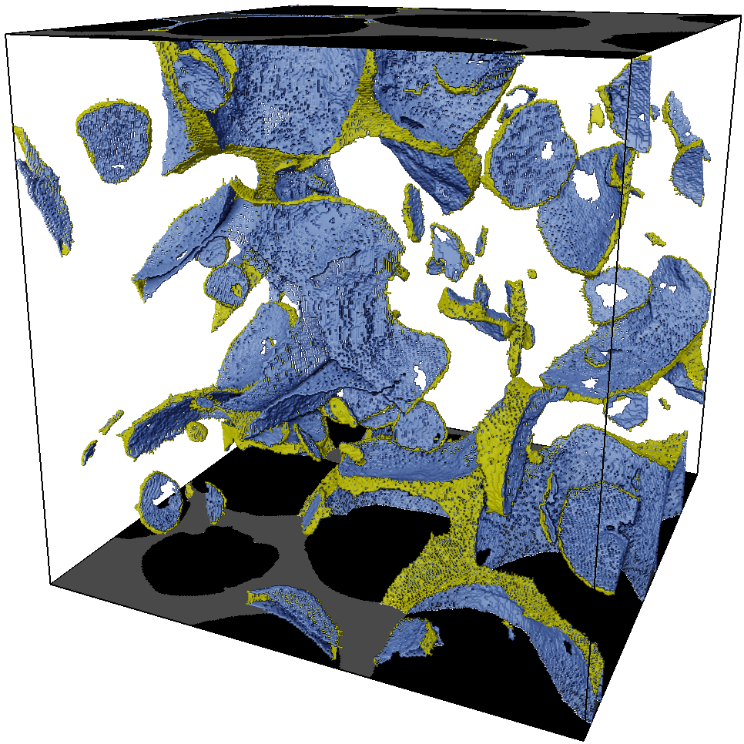
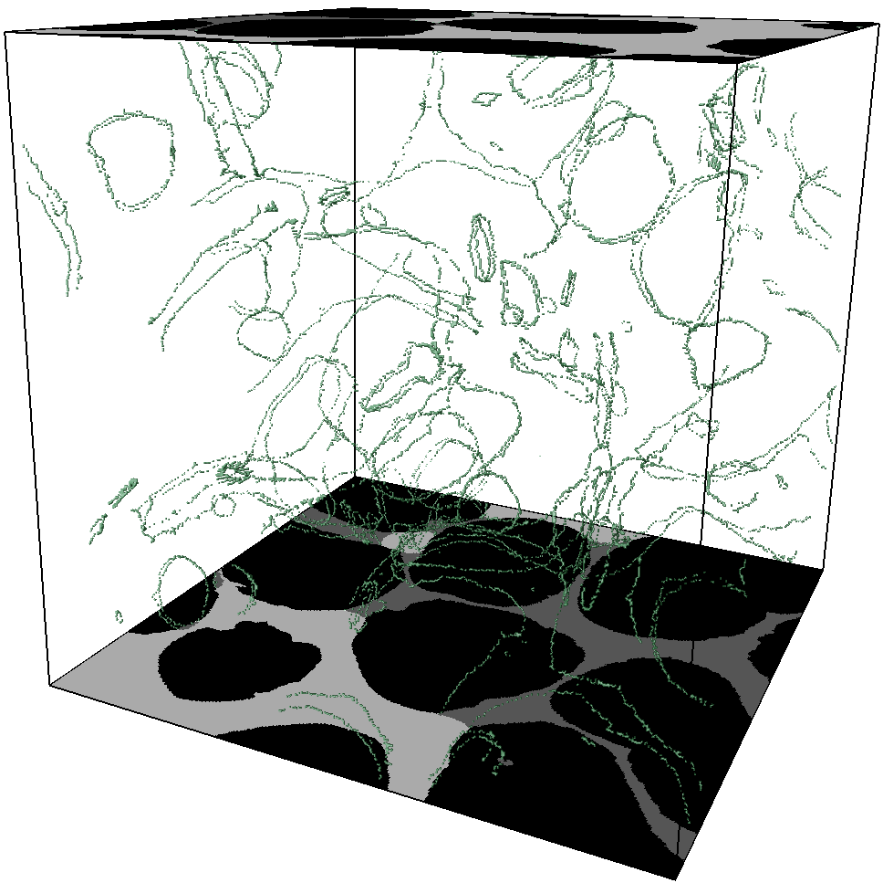
Interfaces and three contact points
6
Y
X
Z
gas-liquid interface
gas
liquid
sand
solid-liquid interface
100 pixels
20 pixels
400 pixels
Contact line
gas-liquid interface
solid-liquid interface

Slide 7
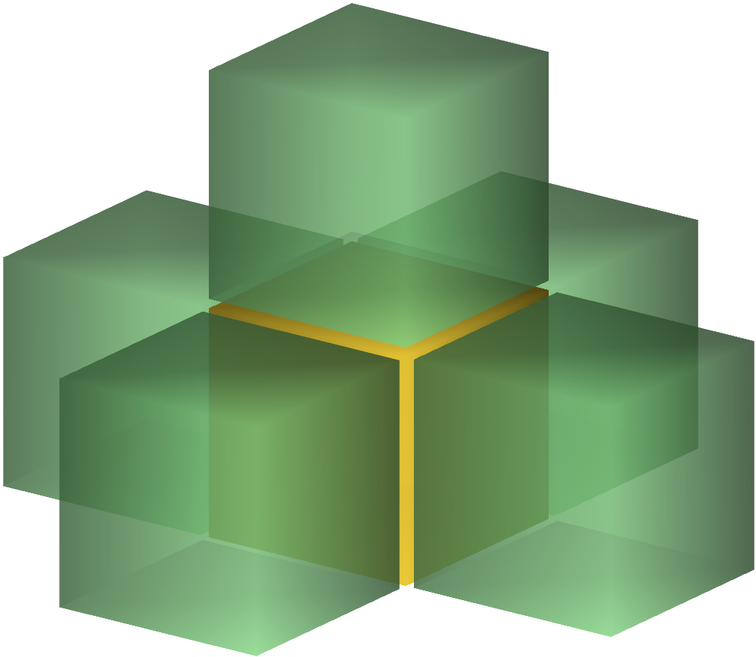
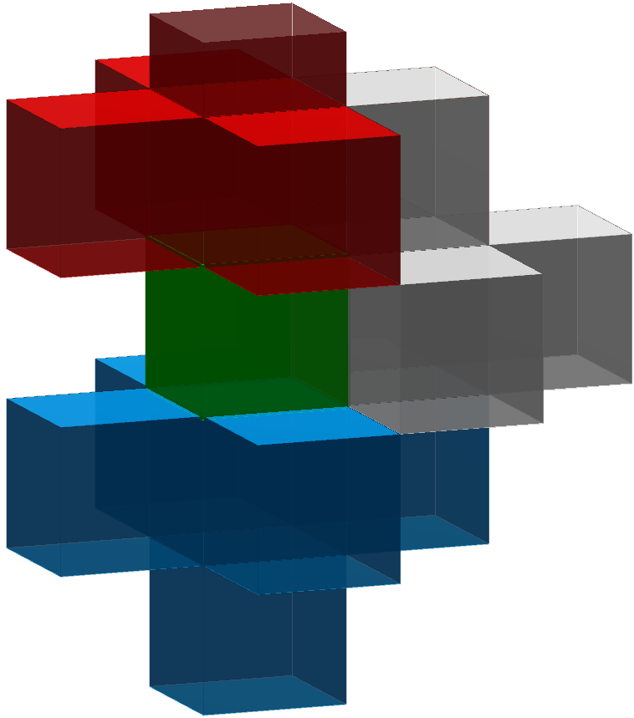
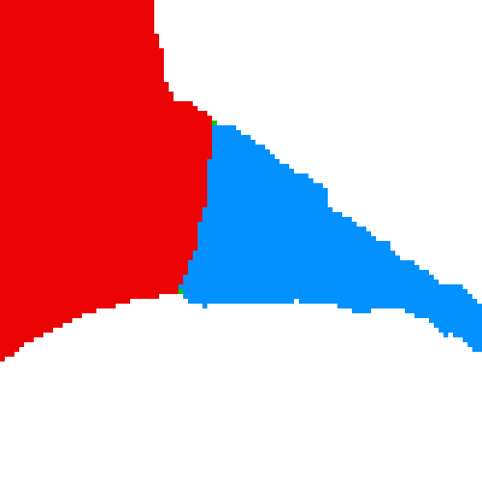
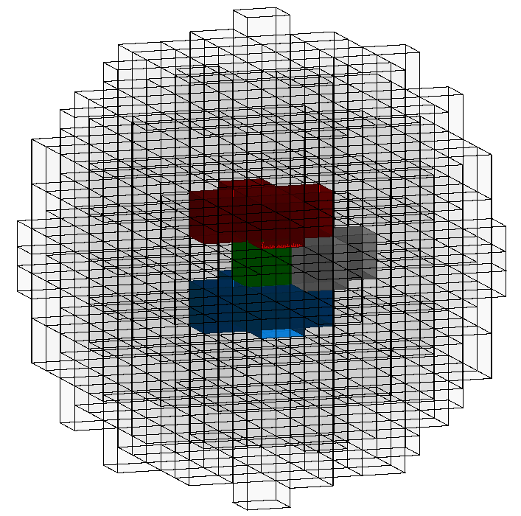
Geometrical and physical constrained steps
7
Constrained Step 1
Constrained Step 2
Solid voxel
Liquid voxel
Geometrical
compliance
Gas voxel
Neighbor voxel>3
Contact voxel
Constrained Step 3
Sphere-based three phase ratio calculation
Solid
Gas
Physical
compliance
Liquid
R_{s} ∈[0.3, 0.7]
Contact point
(Sphere center)
Sphere field

Slide 8
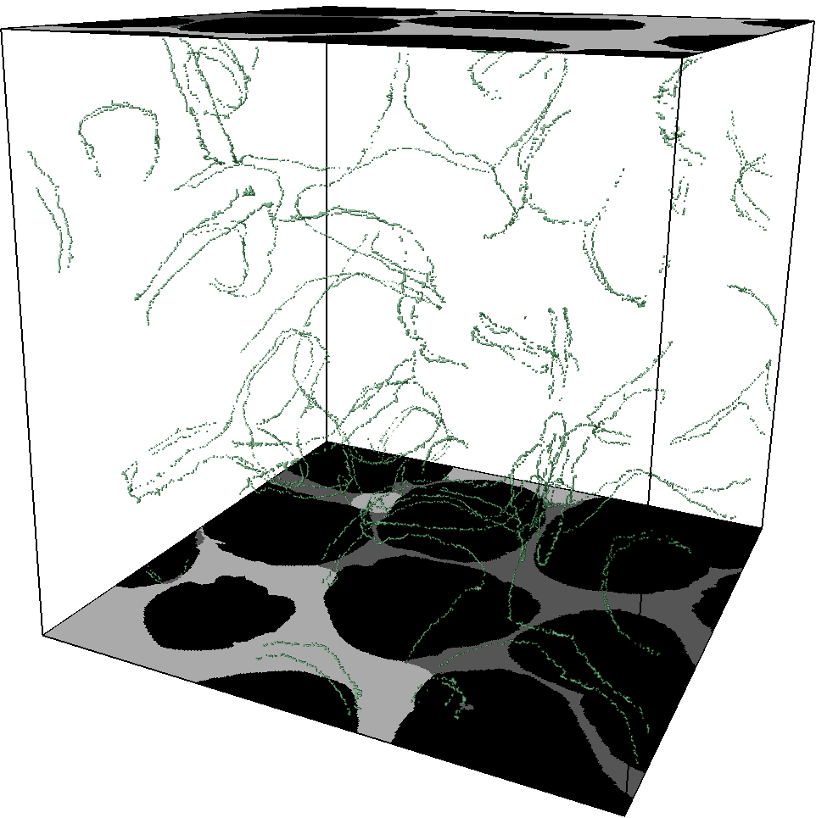
Comparison
8
Y
X
Z
400 pixels

Slide 9
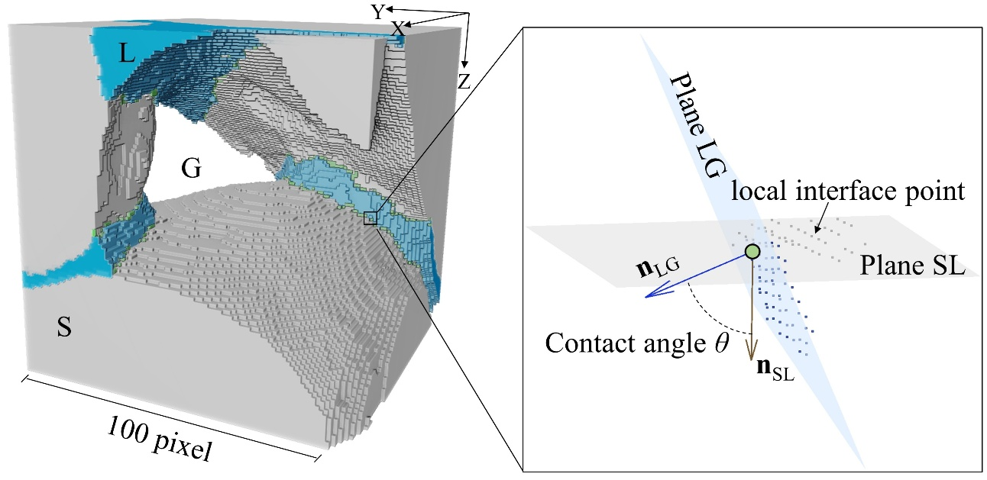
Normal vector and plane
9

Slide 10
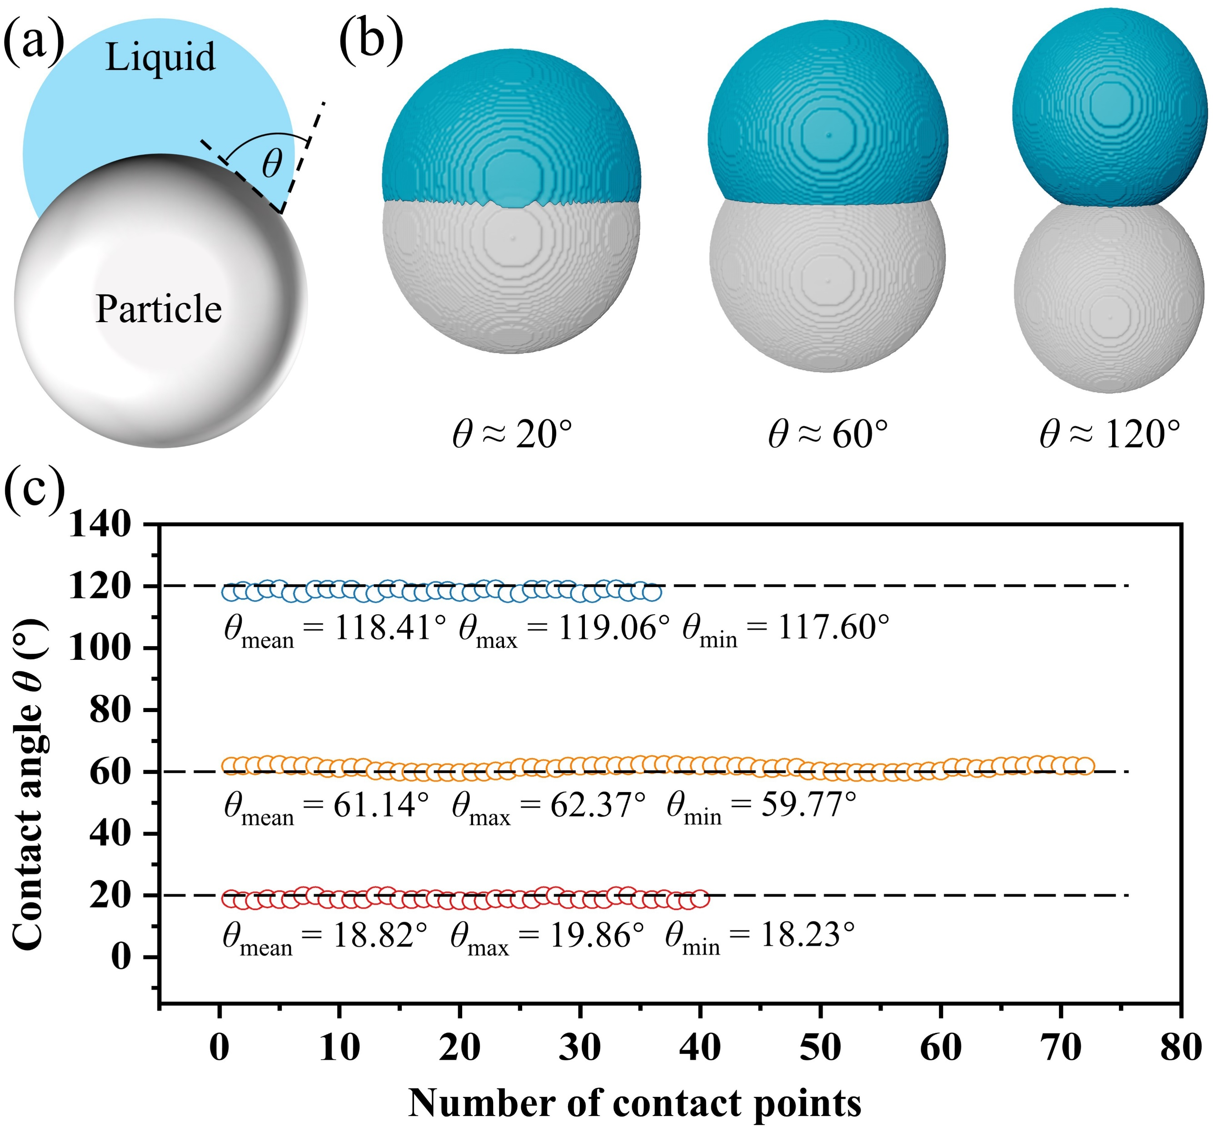
Verification
10

Slide 11
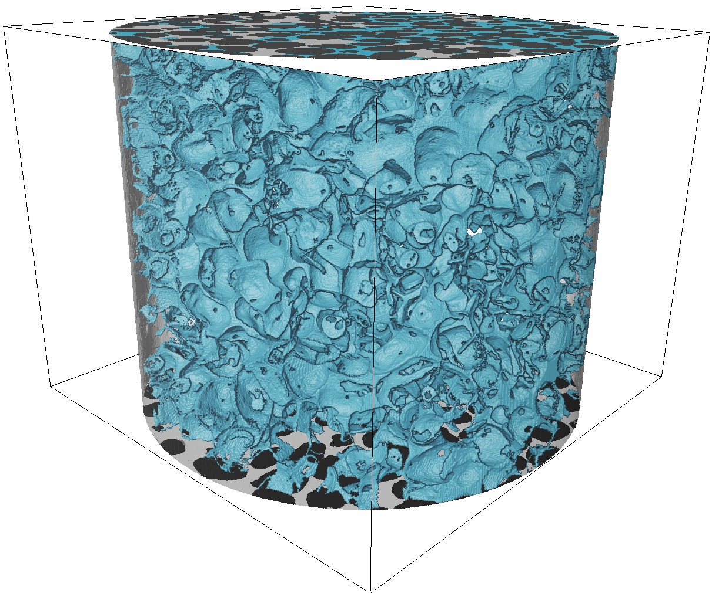
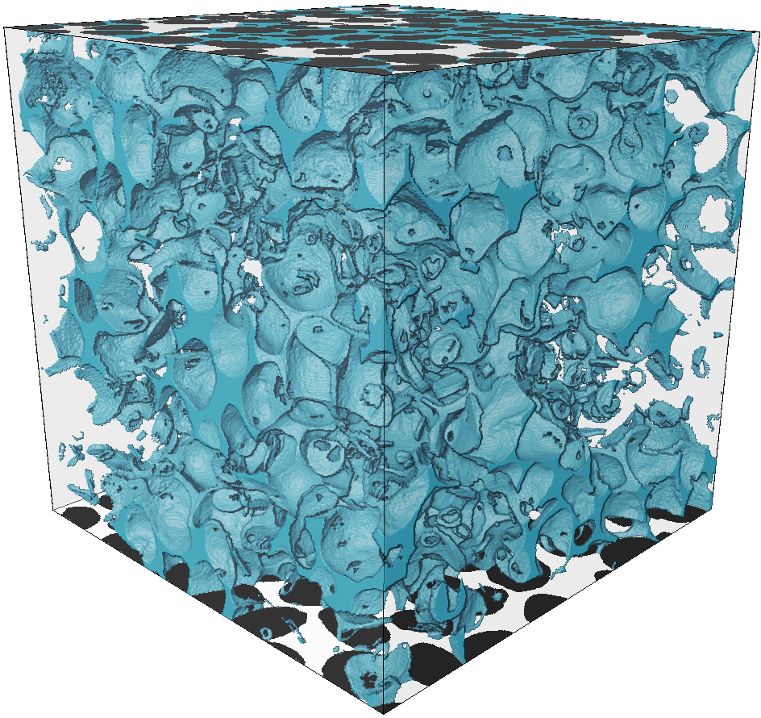
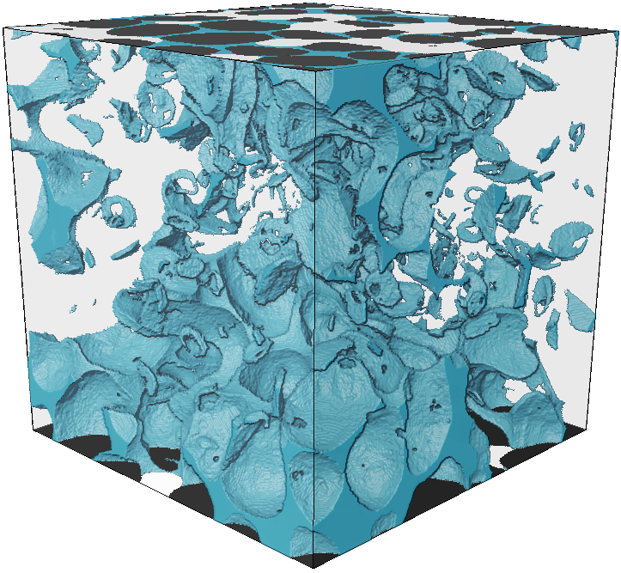
Result
11
Natural sand
Size 1
Size 2
Size 3
Normal distribution fitting
Y
X
Z
Hydrophilic sand
700
400
Relative frequency
700
700
400
400
Size 1
Size 2
Size 3
Hydrophobic sand
Contact angle θ (°)

Slide 12
Result
12
Natural sand
(Sun et al., 2020)
This work
(Wang et al., 2024)
Normal distribution fitting
(Alratrout et al., 2017)
Hydrophilic sand
Relative frequency
Hydrophobic sand
Contact angle θ (°)

Slide 13
Result
13
Z
Y
Natural sand
Hydrophilic sand
Hydrophobic sand
X
0
20
40
60
80
>100
<60
80
100
120
>140
Contact angle θ (°)
Z
Y
Evaporation
（49.1%）
684*684*600
Imbibition
（38.3%）
600*600*600
Mixing
（31.3%）
694*694*600
X
0
20
40
60
80
100
120
140
160
180
Contact angle θ (°)

Slide 14
14
THANKS FOR LISTENING AND ATTENTION

