Slide 1


InterPore2026: MS20—Special Session in Honor of Jun Yao
Reconstruction of digital rock based on discrete element method considering thermal-mechanical coupling effect
Chunqi Wang, Jun Yao
Research Center of Multiphase Flow in Porous Media
China University of Petroleum (East China)
19-22 May 2026, Nantes, France
Notes:
Good afternoon everyone, I'm Chunqi Wang. My report topic is “Reconstruction of digital rock based on discrete element method considering thermal-mechanical coupling effect.”

Slide 2
Contents
1. Introduction
2. Theory and Method
3. Results and Discussion
4. Conclusions and Outlooks
2/23
Notes:
There are four parts in my report. The first part is the “Introduction”.

Slide 3
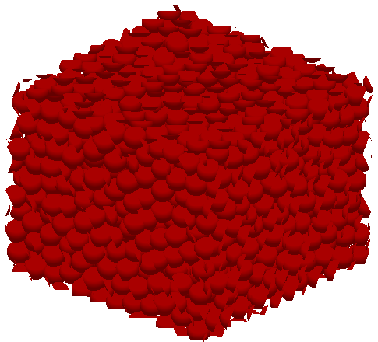
1. Introduction
1.1 Research Background
Deep & ultra-deep reservoirs: the main focus for increasing reserves and production in China.
Characteristic: High temperature, high pressure and high stress.
Motivation: Digital rock serve as an important platform for studying the microscopic flow behaviors. The existing digital rock reconstruction methods cannot consider the effects of thermal-mechanical coupling well.
Conventional oil & gas reservoirs
Deep & ultra-deep reservoirs
Proportion
Room temperature & pressure digital rock
Considering high temperature & high stress
High temperature & high stress digital rock
Annual newly discovered proven of deep & ultra-deep reservoirs
Research motivation in this study
3/23
Notes:
Deep & ultra-deep reservoirs become the main focus for increasing reserves and production in China. Their characteristics are high temperature, high pressure and high stress. Digital rock serve as an important platform for studying the microscopic flow behaviors. However, the existing digital rock reconstruction methods cannot consider the effects of thermal-mechanical coupling well.

Slide 4
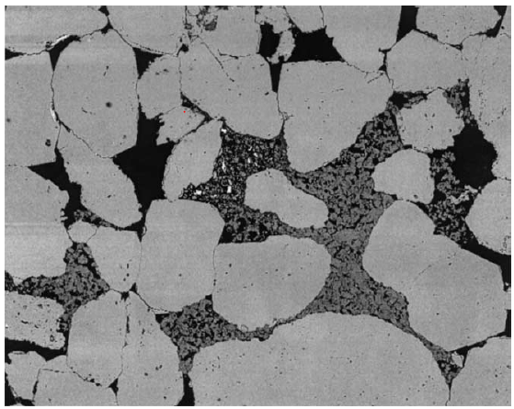
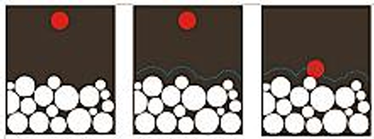
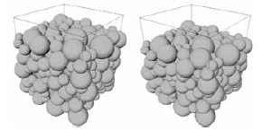
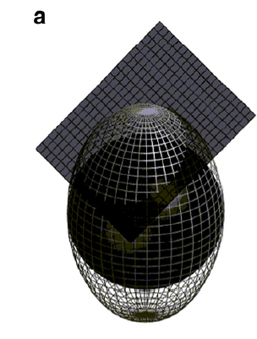
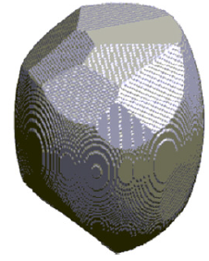
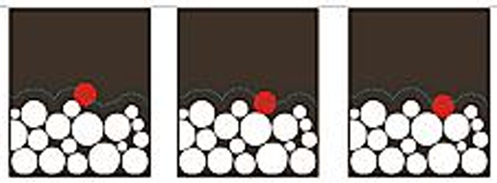
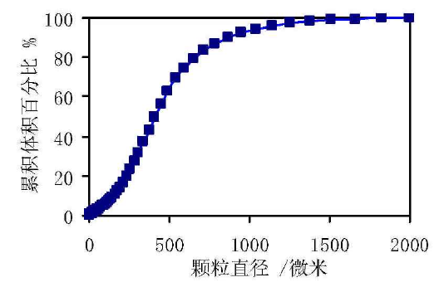
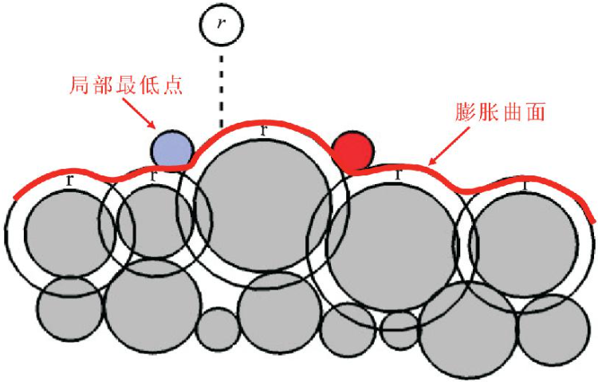
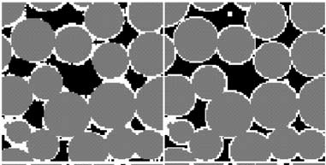
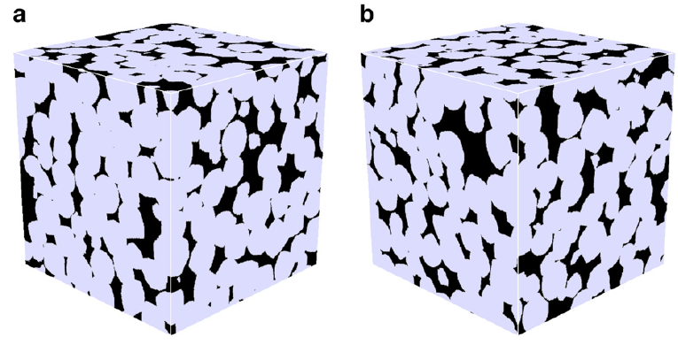
1. Introduction
1.2 Related Research: Traditional process-based method
The process-based reconstruction method is a possible solution. Bakke and Øren (2002) proposed this method, Jin et al. (2003) considered the mechanical parameters.
Steps: Image segmentation → Particle size composition analysis → deposition → compaction → digenesis;
Research gap: Can not simulate complex stress conditions. The mechanical parameters of the particles are not set up properly; and the multi-field coupling simulation cannot be carried out.
Øren, and Bakke, 2002
Zhu, et al., 2012
Local minimum
Surface of expansion
Frequency (%)
Zhao, 2009
Particle diameter (μm)
Luo, 2021
Øren, and Bakke, 2002
Particle size distribution analysis
Particle deposition
Compaction and digenesis
Irregular particle
4/23
Notes:
The process-based reconstruction method is a possible solution. The steps are: Image segmentation, Particle size composition analysis, deposition, compaction, and digenesis. However, the traditional process-based method can not simulate complex stress conditions. The mechanical parameters of the particles are not set up properly; and the multi-field coupling simulation cannot be carried out.

Slide 5
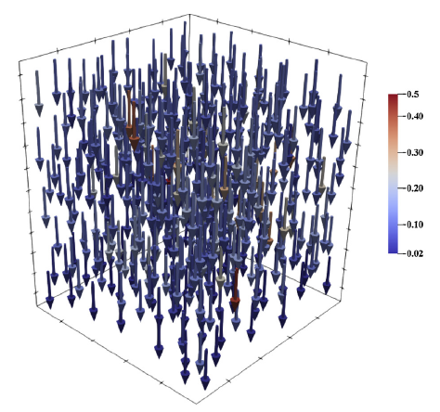
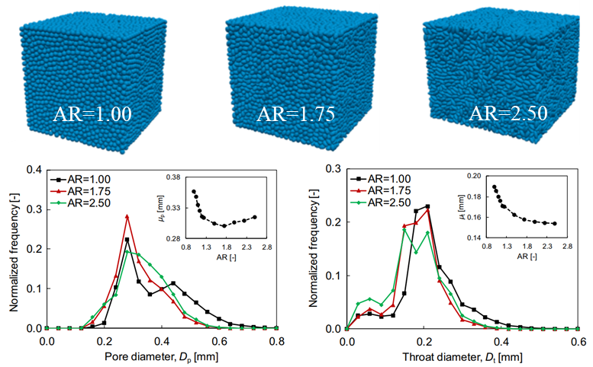
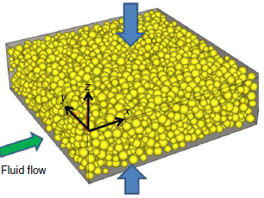
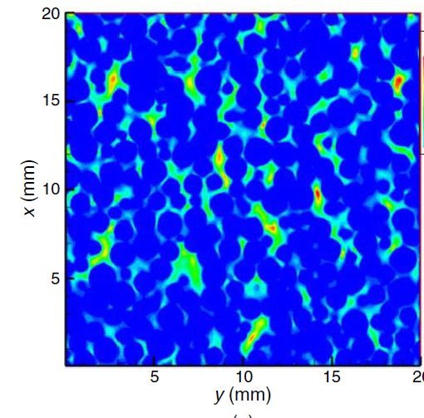
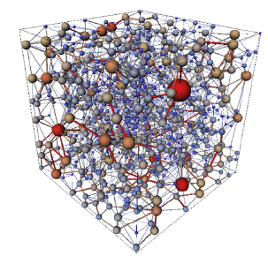
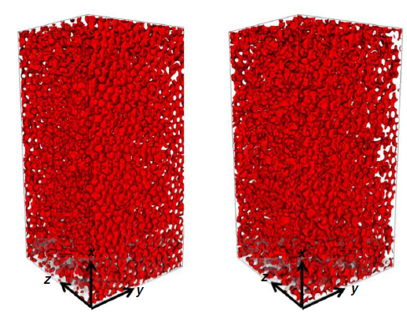
1. Introduction
1.2 Related Research: Discrete element method (DEM)
DEM for digital rock reconstruction: Fan et al. (2018) used discrete element method to simulate proppant pore structure deformation under closed stress, and used LBM to study the effect of stress on two-phase flow; Li et al. (2021) studied the effect of particle shape on the pore structure of the model.
Reconstruction process: DEM modeling of rock with room temperature & pressure → boundary conditions loading simulation → conversion to voxels (digital rock).
Stress loading simulation
Fan, et al., 2018
Li, et al., 2021
DEM modeling
Displacement field
Voxelization
LBM
PNM
Flow Simulation
Fan, et al., 2018
Flow simulation results
Digital rocks
Flowchart of digital rock reconstruction by DEM
Effect of particle shape on pore structure
5/23
Notes:
Discrete element method is another choice to realize the process-based reconstruction. Its process consists of DEM modeling of room temperature and pressure, boundary conditions loading simulation, and conversion to voxels.

Slide 6
1. Introduction
1.3 Research Gap
Current researches mostly used spherical particles to reconstruct digital core, resulting in triangular-shaped pores that cannot characterize the actual pore structure.
No reports have been published on use of actual-shaped particles and considering the effects of thermal-mechanical coupling for digital rock reconstruction based on DEM^{[1]}.
?
Triangular-shaped pores
Actual-shaped particles
DEM Model
Our previous research (JPM, 2024.)
Real-shaped particles DEM modeling (2-D for display)
[1] Zhu L, Zhang C, Zhang C, et al. Challenges and prospects of digital core-reconstruction research[J]. Geofluids, 2019, 2019: 1-29.
6/23
Notes:
However, there are no reports have been published on use of actual-shaped particles and considering the effects of thermal-mechanical coupling for digital rock reconstruction based on DEM.

Slide 7
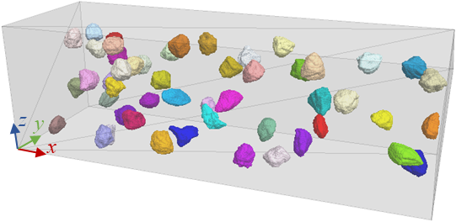
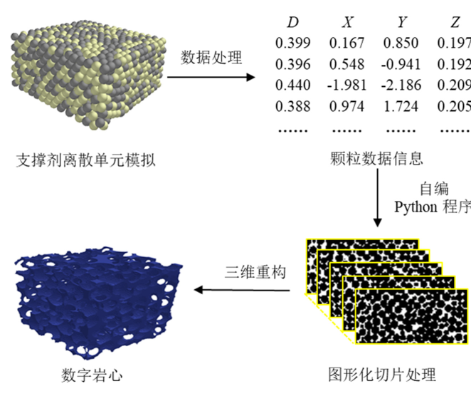
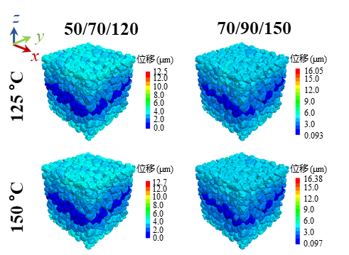
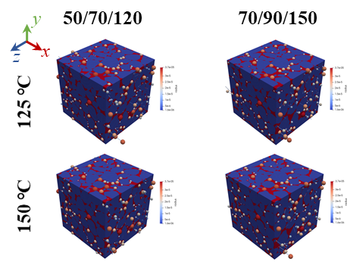
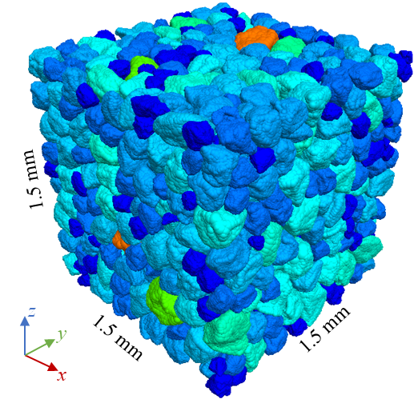
1. Introduction
1.4 Flowchart of Proposed Digital Rock Reconstruction Method
Room temperature & stress digital rock DEM modeling [threshold → watershed segmentation → rotation-invariant spherical harmonics (SH) analysis characterizing particle shapes → ODEC method establishing clump templates → DEM modeling] → High temperature and high stress loading simulation → Pore structure analysis & permeability calculation
Room temperature & stress digital rock
DEM modeling
High temperature and high stress
loading simulation
Pore structure analysis & permeability
calculation
Clump templates
Parameter calibration
Voxelization algorithm
Pore
Particle
DEM model
Reconstruction results
Pore network model (PNM)
7/23
Notes:
To fill this research gap, we have proposed a new framework for digital rock reconstruction. This is the flowchart: The first step is Room temperature & pressure digital rock DEM modeling, we first used the watershed method to segment the particles; Then, we used rotation-invariant spherical harmonic analysis to characterize the particle shape, and establish clump templates, Finally is DEM modeling. The second step is high temperature and high stress loading simulation. The third step is Pore structure analysis & permeability calculation.

Slide 8
Contents
1. Introduction
2. Theory and Method
3. Results and Discussion
4. Conclusions and Outlooks
8/23
Notes:
The second part is theory and method.

Slide 9
2. Theory and Method
2.1 Watershed Method
The basic principle: The watershed algorithm realizes image segmentation by simulating the immersion process of water in a catchment basin.
Modified: Over-segmentation when dealing with “peanut-shaped" particles. The over-segmentation problem in the watershed method was avoided by applying morphological reconstruction to the image^{[1]}.
Catchment basin
Watershed
Water level
Local minimum
Immersion process
Contact
Particle 1
Particle 2
Neck
Binary image
Distance field
Modified distance field
Segmentation result
[1] Zheng, J., Hryciw, R. D. Segmentation of contacting soil particles in images by modified watershed analysis[J]. Computers and Geotechnics, 2016, 73: 142-152.
9/23
Notes:
This is the flowchart of the watershed method. We used the morphological reconstruction to the image to avoid the over-segmentation.

Slide 10
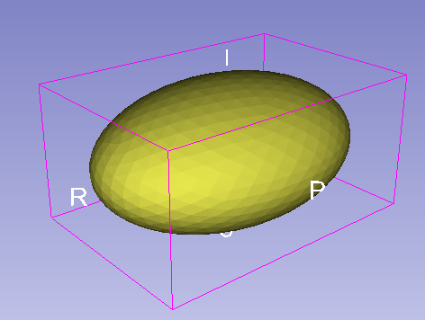
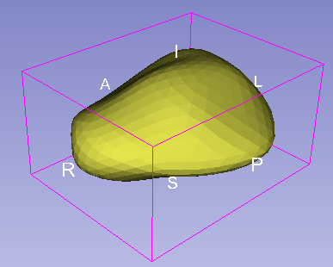
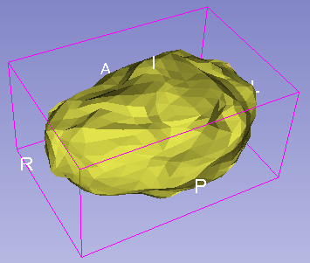
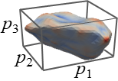
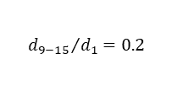
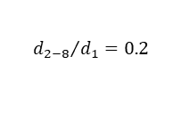
2. Theory and Method
2.2 Particle Shape Characterization with Rotation-Invariant SH Analysis
The basic principle: The principle involves characterizing particle shapes using a closed surface defined by a linear combination of spherical harmonic (SH) functions.
Construction SH coefficient matrix of actual rock particles：According to the relationship between d_{n} and n and the distribution of rotation-invariant SH factors.
Spherical harmonic expansion
Spatial descriptors PCA
Rotation-invariant SH analysis
SH expansion results of the actual particle
Relationship between d_{n} and n
The main contours of particles were constructed by I_{E} and I_{F}, Then use the d₂₋₈/d₁ and d₉₋₁₅/d₁ determine the mesoscopic characteristics of the particles.
n Degree
m Order
SH function and coefficient matrix
The relationship between the spherical descriptor and the degree, and the fitting results are used to construct the coefficient matrix.
EI = FI = 0.7
Coefficient matrix:
n↑
Rotation-invariant SH factors
Macroscopic
Microcosmic
$${d_{2−8}}/{d_{1}}=0.2$$
Spatial descriptors:
I_{F}= p₃/p₂
Normalization coefficient
I_{E} = p₂/p₁
Random number between 0 and 1
$${d_{9−15}}/{d_{1}}=0.2$$
10/23
Notes:
The rotation-invariant spherical harmonic analysis involves characterizing particle shapes using a closed surface defined by a linear combination of spherical harmonic (SH) functions. Firstly, the particle surface voxel points are mapped to a unit sphere, then solving the linear equations system to obtain coefficient matrix. Then, PCA is carried out on the coefficient matrix. Define spherical descriptor and rotation invariant SH factors; Calculate their distribution curves. Finally, according to the relationship between the spherical descriptor and the degree and the distribution of rotation invariant SH factors, construction SH coefficient matrix of actual rock particles.

Slide 11
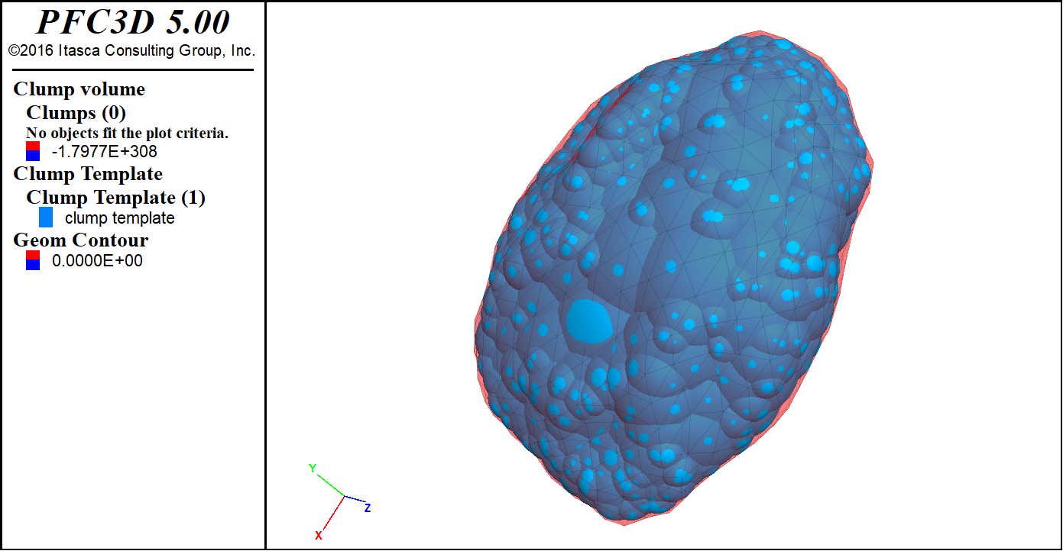
2. Theory and Method
2.3 Overlapping Discrete Element Cluster (ODEC) Method
Extract medial axis: The medial axis of the particle was extracted via morphological thinning to serve as the foundational skeleton for the subsequent generation of a directionally filled particle Clump.
Form clump: The particle contour was filled with spherical pebbles packed along its medial axis in order of decreasing radius to form a morphology-conforming Clump^{[1]}.
Particle
contour
Medial axis
Pebble
Contour
Pebble
Flowchart of the ODEC method (2-D for display only)
A clump example
[1] Taghavi, R., 2011. Automatic clump generation based on mid-surface. Paper presented at the Proceedings, 2nd international FLAC/DEM symposium, Melbourne.
11/23
Notes:
This is the flowchart of ODEC method. This algorithm can convert the particle contour into particles that can be used for the calculation of the DEM.

Slide 12

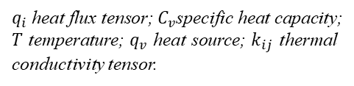


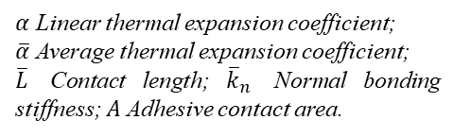
2. Theory and Method
2.4 DEM thermal-mechanical coupling algorithm
Heat transfer calculation principle: Heat pipes are placed at the contact points of the particles, and the heat is stored on the heat source and then conducted between the particles through the heat pipes.
Coupling: Particle thermal expansion alters the mechanical contact length, thereby affecting the contact forces; particle displacement changes the heat pipe length and thermal resistance, influencing heat transfer.
Governing equation
Equation discretization
Substitute into continuity equation:
$q_{i}$ heat flux tensor; $C_{v}$specific heat capacity; $T$ temperature; $q_{v}$ heat source; $k_{ij}$ thermal conductivity tensor.
Finite difference numerical solution
$V$ Particle volume.
Thermal strain and thermal stress
$Q^{(p)}$ Thermal power of heat pipe p;
$N$ Heat pipes number.
Heat pipe
$α$ Linear thermal expansion coefficient;
$\overline{α}$ Average thermal expansion coefficient;
$\overline{L}$ Contact length; ${\overline{k}}_{n}$ Normal bonding stiffness; $A$ Adhesive contact area.
Coupling simulation time step
$η$ Thermal resistance per unit length; $L$ Heat pipe length.
Heat source i
Heat source j
Physical model and mathematical model
Discretization and numerical solution
12/23
Notes:
This slide explains the principle of the DEM thermal-mechanical coupling algorithm. Heat pipes are placed at the contact points of the particles, and the heat is stored on the heat source and then conducted between the particles through the heat pipes. Particle thermal expansion alters the mechanical contact length, thereby affecting the interparticle contact forces; meanwhile, particle displacement changes the heat pipe length, influencing heat transfer.

Slide 13
Contents
1. Introduction
2. Theory and Method
3. Results and Discussion
4. Conclusions and Outlooks
13/23
Notes:
The third part is the Results and Discussion.

Slide 14
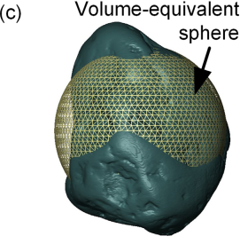
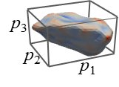
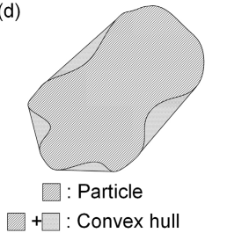
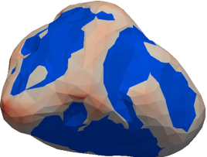
3. Results and Discussion
3.1 Particle Segmentation, Extraction, and Analysis
Segmentation & analysis: Bentheim sandstone images → watershed segmentation → rotation-invariant SH analysis → calculation of particle size and shape distribution;
Rotation-invariant SH analysis: Construct rotation-invariant SH factors and statistically analyze the distribution characteristics of the four rotation-invariant SH factors.
p₁ > p₂ > p₃
Distribution curves of particle geometric shape characteristics
Rotational invariant SH factor distribution curves
Digital rock data source: www.digitalrocksportal.org
14/23
Notes:
Taking Bentheim sandstone as an example, after watershed segmentation and rotation-invariant SH analysis, the particle size and shape distribution curves are calculated. There are the distribution characteristics of the four rotation-invariant SH factors.

Slide 15







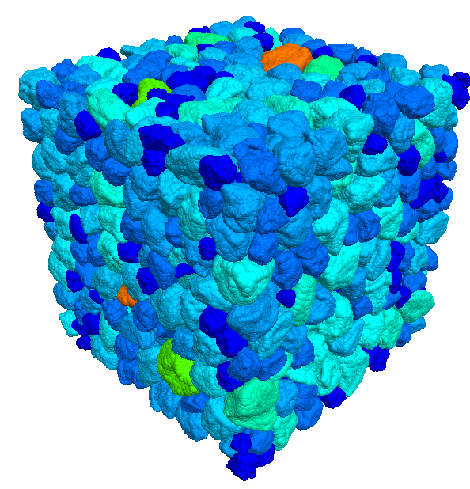








































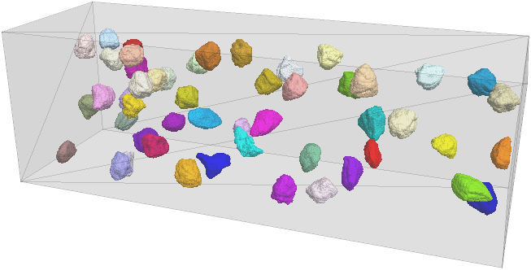
3. Results and Discussion
3.2 Room Temperature & Stress Digital Rock DEM Modeling
Clump template library: Based on the statistical results, a contour database (50 sets) is generated and then transformed into a clump template library for DEM simulation in PFC^{3D} using the ODEC algorithm.
DEM modeling: Selecting template randomly from the template library based on the particle size distribution and iteratively adjusting until the actual porosity is achieved.
1.5 mm
z
y
z
x
y
1.5 mm
1.5 mm
x
Relationship between d_{n} and n
Clump template library
Room T&S digital rock model
15/23
Notes:
Then, a Clump template library is generated based on the ODEC algorithm. Selecting template randomly from the template library based on the particle size distribution and iteratively adjusting until the actual porosity is achieved.

Slide 16
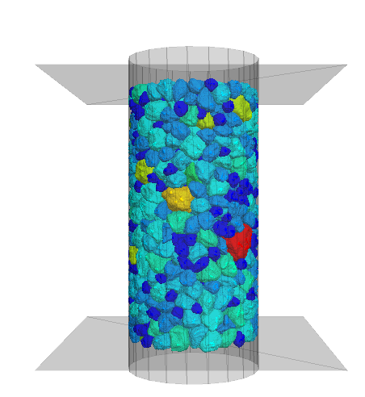
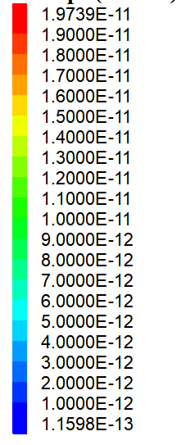
3. Results and Discussion
3.3 Mechanical and thermodynamic parameters calibration
Mechanical parameter calibration: The particle size was proportionally enlarged, and the micromechanical parameters of the intergranular contact constitutive model were calibrated based on the mechanical test^{[1].}
Thermodynamic parameters calibration: Based on the thermodynamic experimental results^{[2]} of Bentheim sandstone, the thermodynamic parameters for the particles in the DEM model were set.
200
Model parameters table
Particle radius (μm)
Parameters |  | Value
Microscopic contact model parameters | Effective modulus (Pa) | 1.30×10⁹
 | Bonding effective modulus (Pa) | 1.30×10⁹
 | Normal-to-shear stiffness ratio | 1.50
 | Bonding N-to-S stiffness ratio | 1.50
 | Tensile strength (MPa) | 0.70
 | Cohesion (MPa) | 0.50
 | Angle of internal friction (°) | 55.00
Thermodynamic parameters | Linear thermal expansion (℃⁻¹) | 2.00×10⁻⁵
 | Thermal resistance (℃·W⁻¹·m⁻¹) | 0.76
 | Specific heat capacity (J·kg⁻¹·℃⁻¹) | 1015.00
16.76
150
15.00
13.00
100
deviatoric stress (MPa)
11.00
9.00
50
7.00
Experimental data
5.00
Simulated result
z
0
y
3.02
0.0
0.5
1.0
1.5
x
Strain (%)
Parameters calibration model
Stress-strain curve
[1] Klein E, Baud P, Reuschlé T, et al. Mechanical behaviour and failure mode of Bentheim sandstone under triaxial compression[J]. Physics and Chemistry of the Earth, Part A: Solid Earth and Geodesy, 2001, 26(1-2): 21-25.
[2] Krishnaiah S, Singh D N, Jadhav G N. A methodology for determining thermal properties of rocks[J]. International Journal of Rock Mechanics and Mining Sciences, 2004, 41(5): 877-882.
16/23
Notes:
The mechanical parameters of the contact model between particles and thermodynamic parameters are corrected based on experimental results.

Slide 17
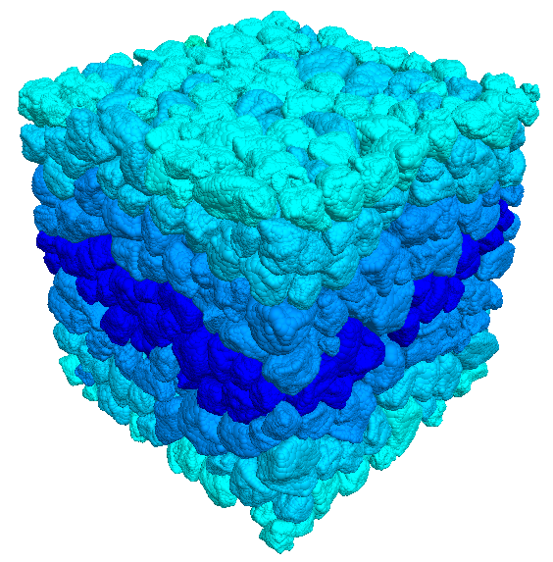
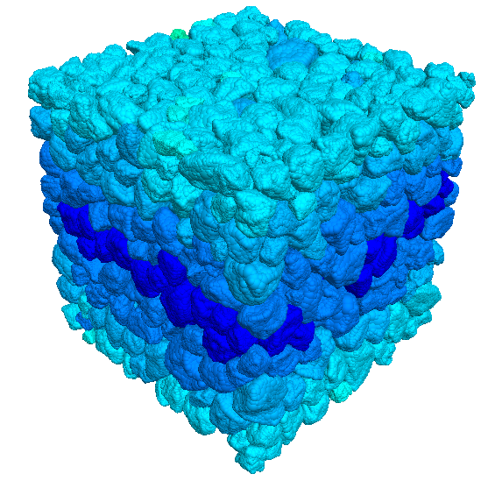
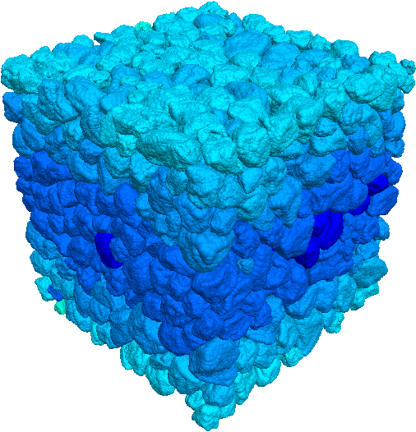
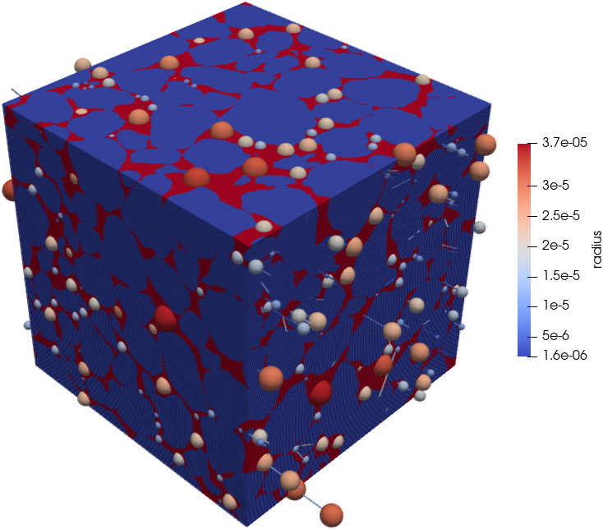
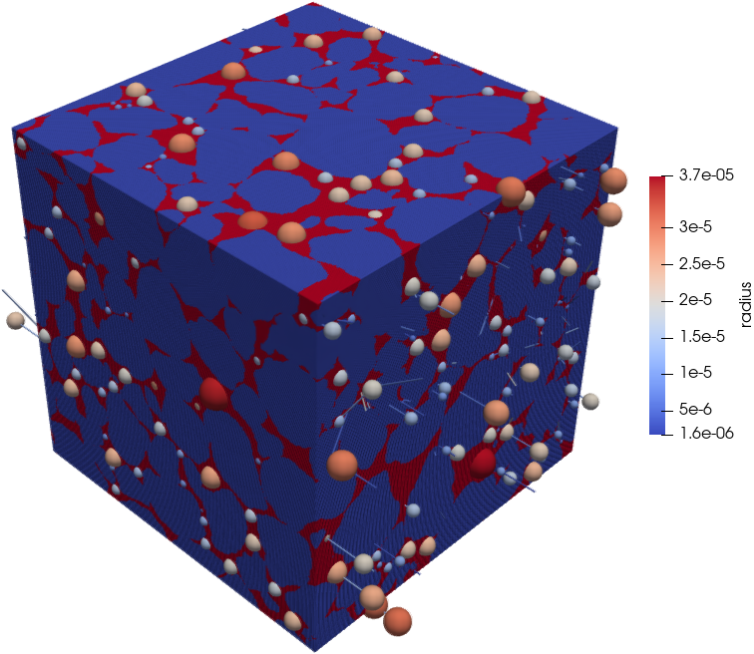
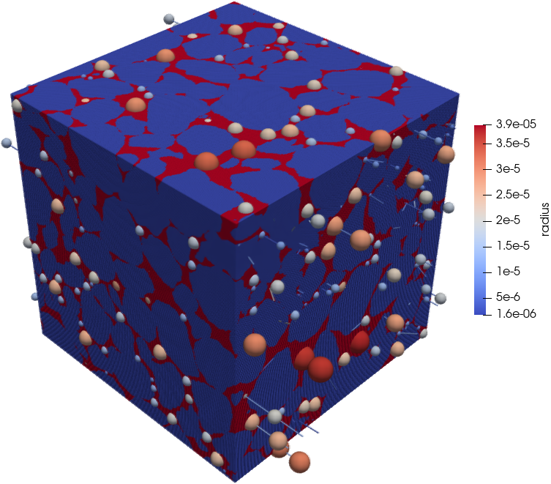
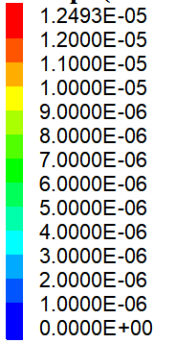
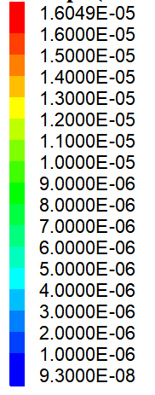
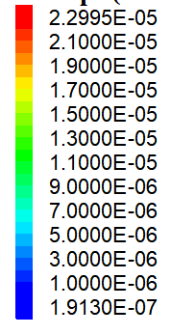
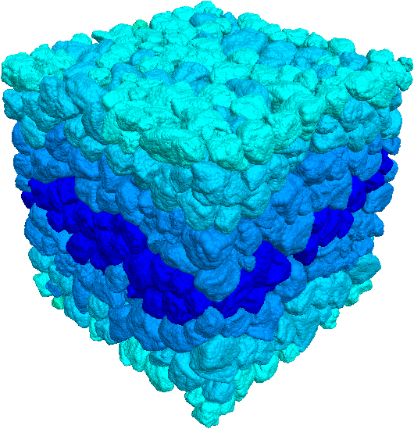
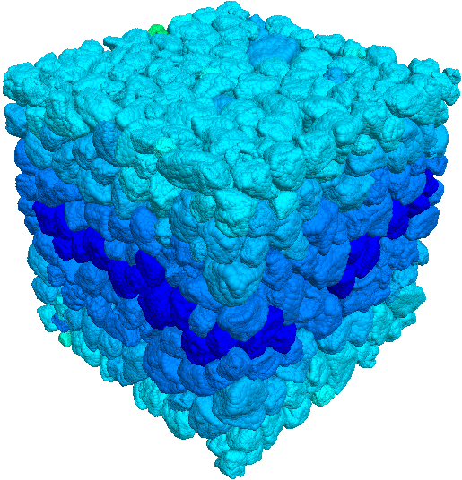
















3. Results and Discussion
3.4 Setting temperature and stress boundary conditions for numerical calculation
Set 4 temperature and 3 stress combinations to simulate 12 digital rocks under different temperatures and stresses. Then, convert the models into voxels and utilize the maximal ball method to extract the pore network models.
z
50/70/120
70/90/150
90/110/180
(MPa)
y
50/70/120
70/90/150
90/110/180
(MPa)
y
x
x
位移 (μm)
位移 (μm)
位移 (μm)
z
12.5
16.05
22.69
12.0
15.0
20.0
125 °C
10.0
12.0
16.0
8.0
9.0
14.0
125 ℃
6.0
12.0
4.0
6.0
8.0
2.0
3.0
0.0
0.093
4.0
0.191
位移 (μm)
位移 (μm)
位移 (μm)
12.7
16.38
22.99
12.0
15.0
20.0
Pore
150 °C
10.0
12.0
16.0
150 ℃
8.0
9.0
14.0
6.0
6.0
12.0
Voxelization
4.0
2.0
3.0
8.0
0.0
0.097
4.0
0.189
Particle
位移 (μm)
位移 (μm)
位移 (μm)
Maximal ball algorithm
12.8
16.40
24.39
12.0
15.0
20.0
175 °C
10.0
12.0
16.0
175 ℃
8.0
9.00
14.0
6.0
4.0
6.00
12.0
2.0
3.00
8.0
0.0
0.187
4.0
0.188
位移 (μm)
位移 (μm)
位移 (μm)
12.9
16.43
25.52
12.0
15.0
20.0
200 °C
10.0
12.0
16.0
200 ℃
8.0
9.00
14.0
6.0
12.0
4.0
6.00
2.0
3.00
8.0
0.0
0.183
4.0
0.180
DEM models under different T & S
Digital core and pore network models under different T & S
17/23
Notes:
We set 4 temperature and 3 stress combinations to simulate 12 digital rocks under different temperatures and stresses. Then, convert the models into voxels and utilize the maximal ball method to extract the pore network models.

Slide 18
3. Results and Discussion
3.5 Pore-throat geometric topology analysis: Geometric structure
Porosity: Porosity decreases with higher temperature and stress, with a maximum reduction of 9.42%.
Pore-throat geometry: As confining stress and temperature increase, both pore and throat radii decrease, manifested as the closure of small-radius pores/throats, the shrinkage of large ones, and an increase in throat length.
Different T
Porosity
Different S
Temperature
Stress (MPa)
Porosity of digital rocks under different T & S
Pore-throat geometric structure distribution curve under different T & S
18/23
Notes:
Porosity decreases with higher temperature and stress, with a maximum reduction of 9.42%. As confining stress and temperature increase, both pore and throat radii decrease, manifested as the closure of small-radius pores/throats, the shrinkage of large ones, and an increase in throat length.

Slide 19
3. Results and Discussion
3.5 Pore-throat geometric topology analysis: Topology structure
Coordination number: High temperatures and pressures reduce the proportion of 3-coordinated pores and increase 2- or 1-coordinated ones, lowering the overall pore coordination.
Connectivity: Increased temperature and stress reduce the x-axis intercept of the specific Euler characteristic curve, indicating poorer connectivity in the pore network.
Coordination number
Specific Euler number curves
19/23
Notes:
High temperatures and pressures reduce the proportion of 3-coordinated pores and increase 2- or 1-coordinated ones, lowering the overall pore coordination. Increased temperature and stress reduce the x-axis intercept of the specific Euler characteristic curve, indicating poorer connectivity in the pore network.

Slide 20
3. Results and Discussion
3.5 Pore-throat geometric topology analysis: Geometric structure
Permeability: High temperature and stress cause grain migration, deforming pore-throats, reducing radii, and degrading connectivity, leading to a permeability decrease of up to 24.98%.
Relative permeability: Higher temperature and stress shift permeability curves upward, affecting the non-wetting phase more strongly. The isoperm point moves toward the wetting phase, enhancing water-wetness.
Permeability
Relative permeability
20/23
Notes:
High temperature and stress cause grain migration, deforming pore-throats, reducing radii, and degrading connectivity, leading to a permeability decrease of up to 24.98%. Higher temperature and stress shift permeability curves upward, affecting the non-wetting phase more strongly. The isoperm point moves toward the wetting phase, enhancing water-wetness.

Slide 21
Contents
1. Introduction
2. Theory and Method
3. Results and Discussion
4. Conclusions and Outlooks
21/23
Notes:
The fourth part is Conclusions and Outlooks.

Slide 22
4. Conclusions and Outlooks
① High-Fidelity Digital Rock Modeling
Rotation-invariant spherical harmonicsenable accurate pore-throat reconstruction at ambient conditions.
② High temperature and stress driven pore-throat evolution
Stress causes significant pore-throat narrowing, elongation, and connectivity degradation.
Effects amplified by high temperature.
③ Permeability is far more sensitive than porosity
Permeability ↓24.98% (porosity ↓9.40%) under stress/temperature.
Nonlinear response from combined geometric and topological changes.
④ Relative permeability shifts under high temperature and stress
Compaction reduces throat size, lowers non-wetting flow resistance
Pore restructuring retains wetting phase.
Isoperm point shifts, residual non-wetting saturation ↑ (coupled structural & thermal-strain effects).
22/23
Notes:
In this study, we proposed a high-fidelity digital rock modeling method. Stress causes significant pore-throat narrowing, elongation, and connectivity degradation, effects amplified by high temperature. Permeability is far more sensitive than porosity to stress and temperature, because of nonlinear response from combined geometric and topological changes. And relative permeability shifts under high temperature and stress.

Slide 23








InterPore2026: MS20—Special Session in Honor of Jun Yao
Acknowledgement: This project was supported by the National Natural Science Foundation of China (No. 52034010, No. 52074336). Thanks for the data support provided by the Digital Porous Media Portal website.
This study can be cited as: Wang C, Huang Z, Yao J*, et al. Process-based reconstruction of digital rock based on discrete element method considering thermal-mechanical coupling effect and actual particle shape[J]. Geoenergy Science and Engineering, 2024, 243: 213326.
Thank you for your attention!
Find us:
rcogfr_upc@126.com
Notes:
That’s all, thank you for your attention!

