Slide 1


InterPore2026: MS20—Special Session in Honor of Jun Yao
Integrated thermo-hydro-mechanical coupling numerical simulation of hydraulic fracturing and production in tight oil reservoirs
Jinlong Li
Research Center of Multiphase Flow in Porous Media
China University of Petroleum (East China)
19-22 May 2026, Nantes, France
Notes:
Good morning, distinguished chairs, professors, and colleagues.
My name is Jinlong Li, from the Research Center of Multiphase Flow in Porous Media, China University of Petroleum, East China.
It is my great honor to present our work entitled “Integrated thermo-hydro-mechanical coupling numerical simulation of hydraulic fracturing and production in tight oil reservoirs.”

Slide 2
Outline
1. Research Background
2. Mathematical Model
3. Numerical Simulation Method
4. Results
5. Conclusion and Q&A
Notes:
My presentation includes five parts.

Slide 3
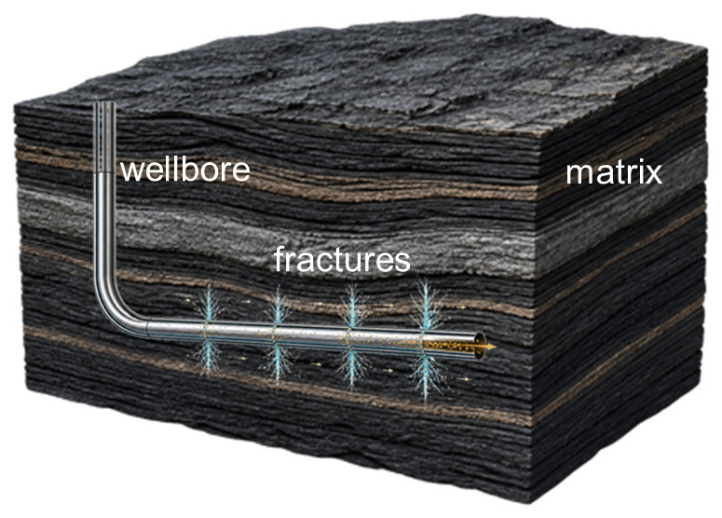
1. Research Background
Tight oil: abundant and have become an important area for the succession of oilfield resources
Hydraulic fracturing: the permeability of tight oil reservoirs is extremely low, and commercial development can only be achieved through hydraulic fracturing
The tight oil resources in the major basins of China
Hydraulic fracturing schematic diagram
Oil-bearing Basin | Permeability (mD) | Thickness (m) | Predicted Resources (10⁸ t)
Junggar Basin | <1 | 80-200 | 29
Santanghu Basin | 0.1-1 | 10-100 | 5.6
Ordos Basin | 0.01-1 | 20-80 | 19.9
Sichuan Basin | 0.0001-1 | 10-60 | 10.7
Songliao Basin | 0.6-1 | 5-30 | 19-21.3
Bohai Bay Basin | 0.2-1 | 100-200 | 3.8-4.5
Notes:
Tight oil resources are abundant and have become an important area for the succession of oilfield resources. As shown in this table, many major basins in China contain significant tight oil resources. However, due to the extremely low permeability, it is usually lower than 1 md or even can reach 0.0001 md，commercial development can only be achieved through hydraulic fracturing.
However, hydraulic fracturing is not only a stimulation process. It also changes the pressure field, water saturation, stress distribution, temperature distribution, and fracture conductivity. These changes will directly affect the following production performance.
Therefore, we must integrate the hydraulic fracturing and production for research.

Slide 4
1. Research Background
Key physical processes of hydraulic fracturing and production of tight oil:
(1)fracture propagation; (2)matrix-fracture flow; (3)matrix flow
Conventional workflows: a hydraulic fracturing simulation is conducted to obtain the fracture morphology. Then, this fracture morphology is used as the initial condition and embedded into the simulation of the production process
Production stage
Fracture propagation criterion
Production prediction
Reservoir model
Initial
distribution
of
pressure
fluid
stress
and
temperature
EDFM
Fracture propagation stage
Wellbore flow model
Pressure evolution
hydraulic fracturing fracture propagation model
Finite volume method
hydraulic fracturing fracture propagation numerical method
Fracture morphology
Fracture flow model
Numerical simulation method of reservoir production stage
Fluid distribution
Elastic mehcanics model
Distribution of
pressure,fluid,
stress and
temperature
Stress distribution
Displacement
discontinuity
method
Matrix flow model
Temperature distribution
Temperature model
short time steps and dynamic grid
Long time steps and fixed grid
Notes:
In conventional simulation workflows, hydraulic fracturing simulation and reservoir production simulation are often conducted separately. First, a hydraulic fracturing simulation is conducted to obtain the fracture morphology. Then, this fracture morphology is used as the initial condition and embedded into the simulation of the production process. The problem is that the final state after fracturing, including pressure, saturation, stress, temperature, and fracture conductivity, is exactly the initial condition for production. If these two stages are disconnected, important physical information may be lost.
Therefore, in this work, we develop an integrated simulation framework to connect hydraulic fracturing and production more consistently. We employed the same mathematical model and numerical methods. The fracturing process utilized short time steps and dynamic grids, while the production stage employed long time steps and fixed grids. An embedded discrete fracture model was used to characterize the fractures.

Slide 5
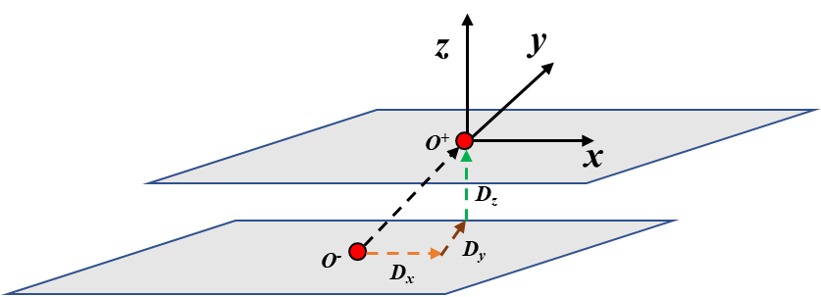
2. Mathematical Model
Establish a thermo-hydro-mechanical coupled mathematical model for the integrated hydraulic fracturing and production tight oil development
wellbore-fracture-matrix flow model
temperature and elastic mechanics model
temperature model
wellbore flow
fracure flow
elastic mechanics model
matrix flow
fracture propagation criterion
fracture-matrix crossflow

Slide 6
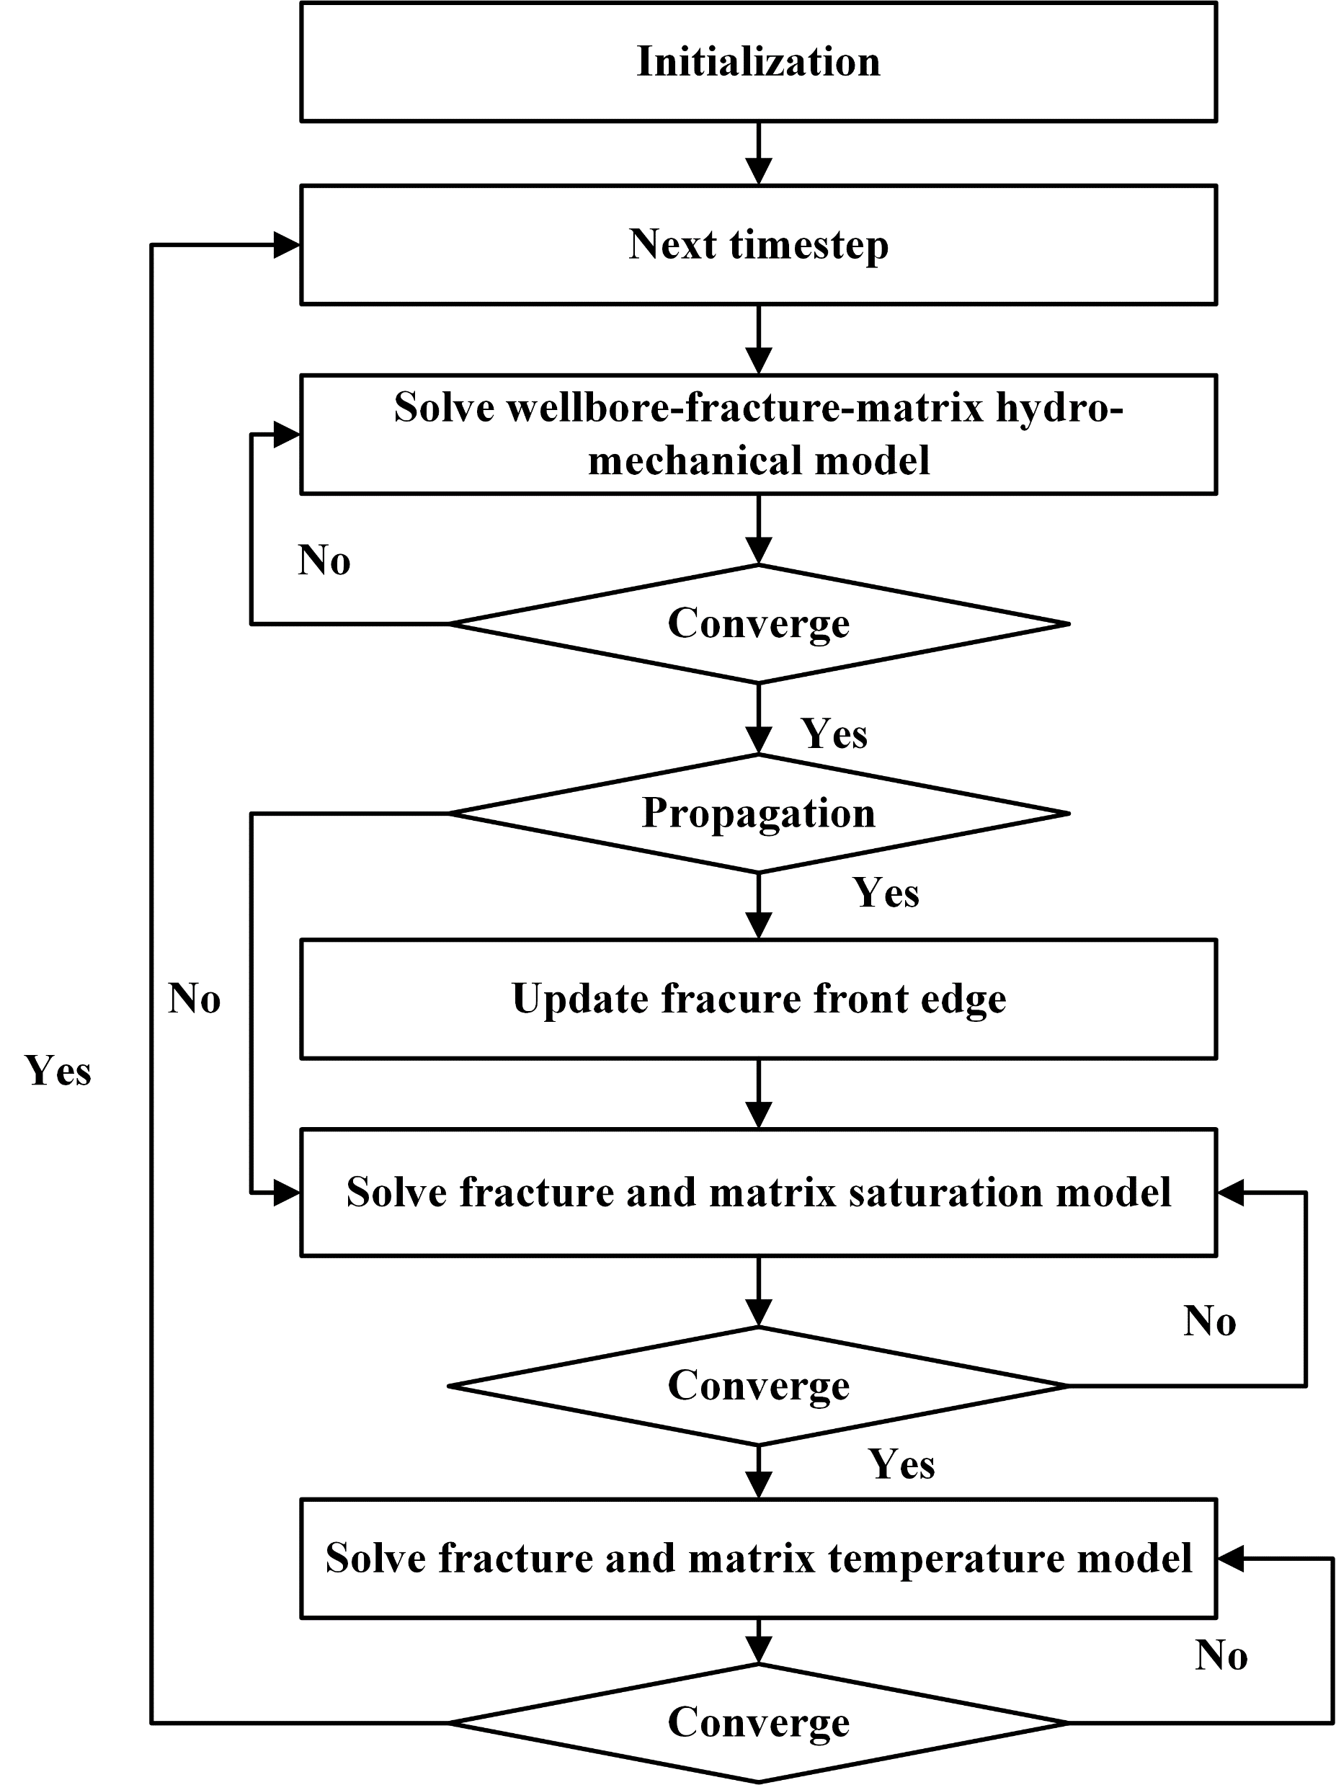
3. Numerical Simulation Method
The fracture elastic mechanics model is discretized based on the displacement discontinuity method(DDM), and the flow model and temperature model are discretized based on the finite volume method(FVM)
numerical discretization
elastic mechanics discretization
flow discretization
solution strategy
temperature discretization
Notes:
The coupled solution strategy can be summarized as follows.
In this way, the hydraulic fracturing stage and production stage are connected within one integrated numerical framework.

Slide 7
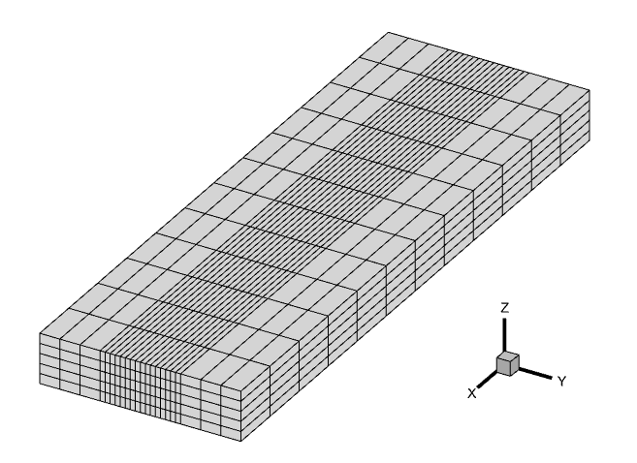
4. Results
Single fracture model
Input parameters
50m
600m
Parameters | Values
Matrix porosity | 0.05
Matrix permeability (10⁻³ μm²) | 0.001
Elastic Modulus (GPa) | 30
Poisson's ratio | 0.2
Fracturing fluid injection rate (m³/s) | 0.2
Proppant concentration (%) | 14
Injection volume (m³) | 150
Minimum principal stress (MPa) | 35
Initial formation pressure (MPa) | 20
Fracturing time (s) | 1000
inject point
200m
Physical model
Relative permeability curve
Capillary pressure curve
Notes:
After validation, we apply the model to a single-fracture tight oil reservoir case. In this section, we will present the differences and advantages of the numerical simulation framework established in this study compared to traditional methods.

Slide 8
4. Results
Impact of coupled matrix flow on production
Compared with the situation that fracturing not coupled with matrix flow:
Early stage: S_{w} rises → oil production decreases
Later stage: matrix pressure rises → oil production increases
Water production always higher due to combined effect of S_{w} and pressure rise
8.8%
15.9%
Comparison of cumulative oil production
Comparison of cumulative water production
Notes:
First, we will present the differences between our model and traditional methods in terms of predicting cumulative production. “Coupled matrix flow” is the result of our model, while “uncoupled matrix flow” is the result of the traditional approach that separates the fracturing process from the production process. For oil production, since our model takes into account the increase in matrix water saturation, in the early stages, the oil production will decrease, but in the later stages, considering the increase in matrix pressure, the cumulative oil production will increase. For water production, water production always higher due to combined effect of S_{w} and pressure rise.The differences in cumulative oil production and water production over the 10-year period were 8.8% and 15.9% respectively.

Slide 9
4. Results
Comparison of leakoff between our model and leakoff function
Traditional leakoff model:
Assumes single-phase flow in formation (ignores oil-water two-phase flow)
Assumes the pressure difference between the fracture and the formation is constant
Resulting in over estimating the leakoff volume
Schematic diagram of leakoff
Comprehensive leakoff rate
Comprehensive leakoff coefficient
Traditional Calculation Overestimates
Error Reaches 130%
Fracture
Invasion Zone
Formation
p_{f}
p_{I}
p_{m}
Pressure
Calculated according to the above formula:
Notes:
Next, we will compare the differences between our model and the traditional leakoff function model in terms of calculating the leakoff volume of the fracturing fluid. Using the model parameters mentioned earlier, we calculated the leakoff coefficient of the fracturing fluid, simulated the fracture propagation process with the same parameters, and counted the leakoff volume of the fracturing fluid. The results showed that the estimation of the fracturing fluid by the traditional leakoff function differed by 130% compared to our model's calculation results. We analyzed the reasons for this gap: leakoff function have two assumes:Assumes single-phase flow in formation (ignores oil-water two-phase flow);Assumes the pressure difference between the fracture and the formation is constant. Both these
two assumes resulting in over estimating the leakoff volume

Slide 10
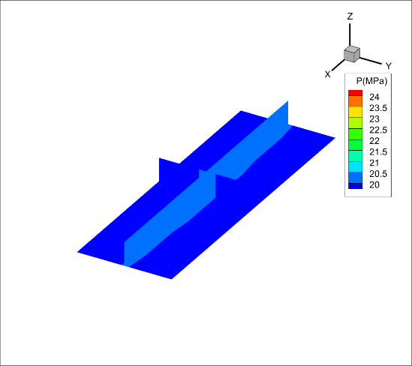

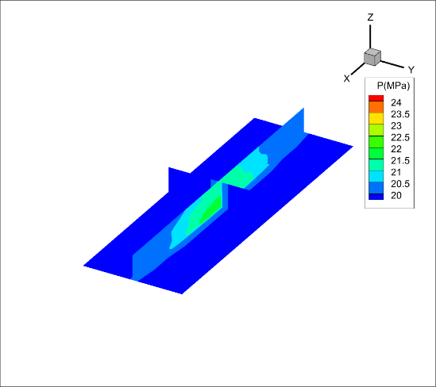
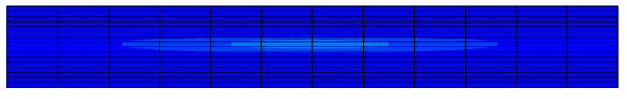

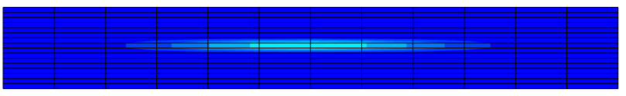
4. Results
Influence of initial matrix water saturation
Influence of P_{c}: initial S_{w} rises → P_{c} decreases → reducing the driving force for fracturing fluid to enter the formation → fluid leak-off decreases
Influence of K_{r}: initial S_{w} rises → K_{rw} increases → fluid leak-off increases
The influence of relative permeability is greater than that of capillary force
Water saturation 0.3
Water saturation 0.4
Water saturation 0.5
Fracture half-length at different water saturations
Post-fracturing matrix pressure distribution
Notes:
Then, we investigated the influence of the initial water saturation of the formation on the fracturing process and the subsequent production. We set the initial water saturation of the formation to 0.3, 0.4, and 0.5 respectively. We found that the higher the initial water saturation, the greater the increase in matrix pressure after fracturing, and the shorter the length of the fractures. This is the result of the combined effect of capillary force and relative permeability.

Slide 11
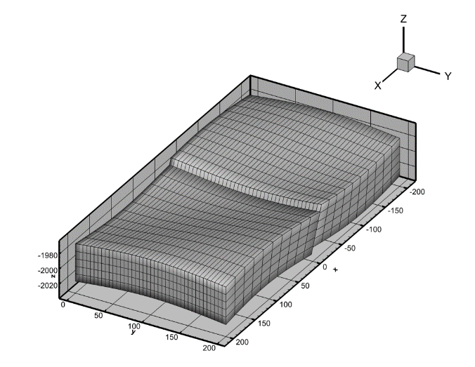
4. Results
Corner point grid example
Model setup
Input Parameters
Parameters | Values
Young's Modulus/GPa | 20
Poisson's ratio | 0.2
Fracture toughness/MPa·m^{0.5} | 2
Initial formation pressure/MPa | 20.0
Perforation depth/m | 2000
Matrix porosity | 0.05
Matrix permeability/10⁻³μm² | 0.001
Fracturing fluid viscosity/mPa·s | 1.0
Proppant volume fraction/% | 14
Injection fluid temperature/°C | 20
Reservoir temperature/°C | 60
Number of fractures/ | 5
Fracture spacing/m | 20
Injection volume/m³ | 150
Minimum horizontal principal stress/MPa | 35
Perforation point | Value
x/m | 0
y/m | 70,90,110,130,150
z/m | 2000
low stress layer
Matrix model
In-situ stress profile
Notes:
Finally, we know that we usually establish a geological model based on corner-point grids. In this section, we will demonstrate the applicability of this study on corner-point grids. The input parameters of the model are shown in the left table. The model has set five fractures to propagate simultaneously, and a vertical low stress layer has been set. Next, we will present the results of fracturing and production.

Slide 12
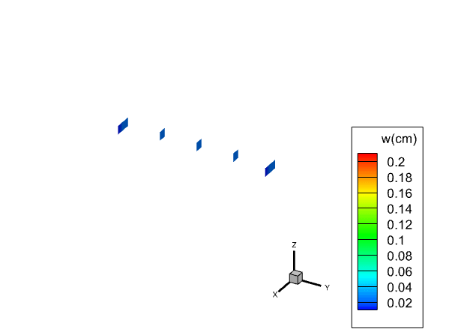
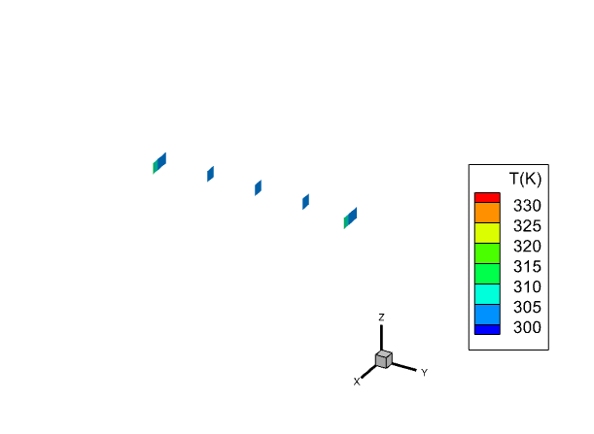
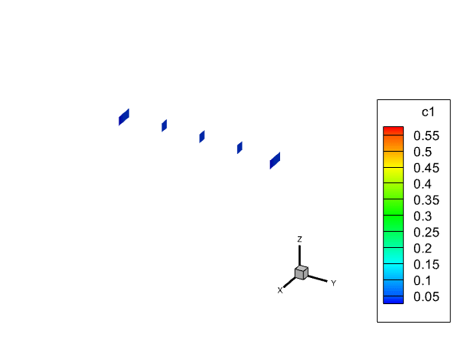
4. Results
Fracture morphology
Stress shadow: fractures confined to low-stress layer; max width at injection point
Temperature : lowest near injection point; rises along fracture length
Proppant: highest concentration near the injection point, and due to gravity, the proppant mainly settles at the lower part of the fracture
Fracture width distribution
Fracture temperature distribution
Fracture proppant volume fraction distribution
Notes:
Due to the stress contrast, the fractures are mainly confined within the low-stress layer. This indicates that the in-situ stress profile has a strong control on vertical fracture growth.
For fracture width, the maximum width appears near the injection point. This is reasonable because the fluid pressure is highest near the wellbore.
For temperature distribution, the lowest temperature is observed near the injection point because the injected fluid is colder than the reservoir. Along the fracture length, the temperature gradually increases due to heat exchange with the surrounding formation.
For proppant distribution, the proppant concentration is highest near the injection point. In addition, due to gravity, proppant tends to settle at the lower part of the fracture.
These results demonstrate that the proposed model can simultaneously describe fracture geometry, mechanical response, thermal field, and proppant transport.

Slide 13
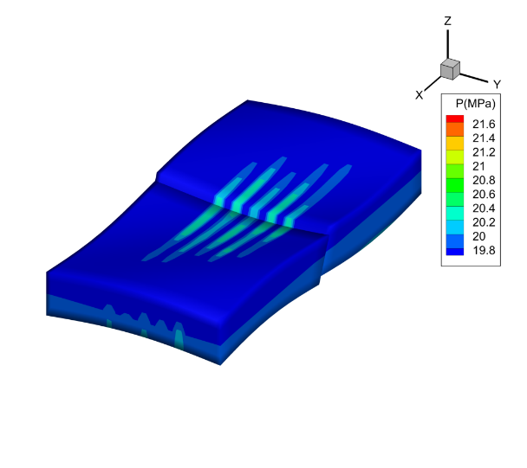
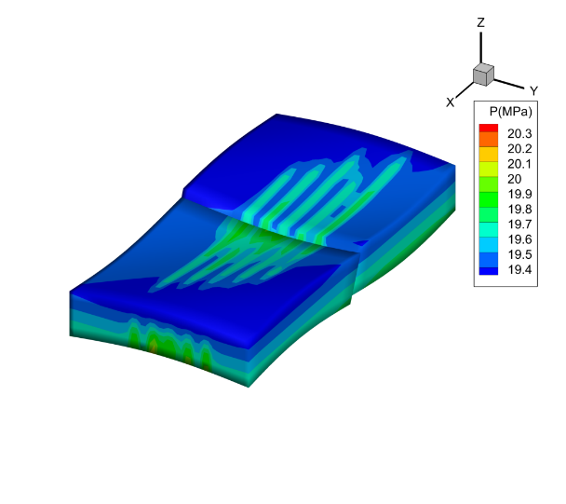
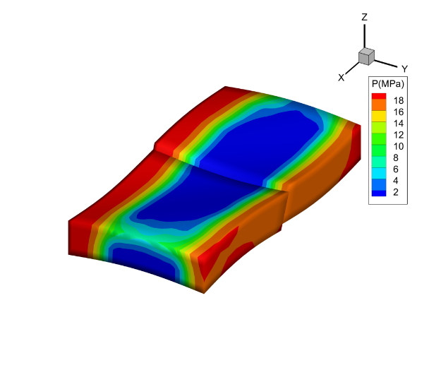
4. Results
Matrix pressure and production
fracturing → 30-day shut-in → 10-year depletion production(constant BHP 2MPa)
Early: high pressure → rapid production growth
Later: pressure drop → fracture closure → permeability decreases → production decline
Matrix pressure after fracturing,shut-in and production
Cumulative oil production over time
Notes:
After fracturing, the matrix pressure near the fracture is significantly increased due to fluid leakoff. During shut-in, pressure redistribution occurs between the fracture and the matrix. During production, the pressure gradually decreases as oil and water flow from the matrix into the fracture and then into the wellbore.
The production curve shows that oil production increases rapidly in the early stage because of high pressure support and high fracture conductivity.
However, in the later stage, pressure depletion becomes more significant. The decrease in pressure causes fracture closure, which reduces fracture permeability and leads to production decline.
This case shows that the integrated model can capture the connection between fracturing-induced pressure disturbance, fracture conductivity evolution, and long-term production behavior.

Slide 14
5. Conclusion and Q&A
  Conclusion
  After coupling matrix flow during fracturing, early oil production is suppressed by higher water saturation, but later production improves due to increased matrix pressure.
  Higher initial water saturation raises fracturing fluid leak-off via enhanced water relative permeability, reducing fracture half-length, and leading to lower cumulative oil recovery and higher water production.
  The proposed numerical method effectively simulates the fracturing-production process in tight oil reservoirs, serving as a quantitative tool for parameter optimization and production prediction, thereby supporting tight oil development
Contact Information
  Jinlong Li
  Research Center of Oil and Gas Flow
  State Key Laboratory of Deep Oil and Gas/China University of Petroleum (East China)
  Email: lijlong7@163.com

Slide 15
Thank You for Your Attention!
Notes:
Thank you very much for your attention. I would be happy to answer any questions

