Slide 1


InterPore2026: MS20—Special Session in Honor of Jun Yao
Insights from Monte Carlo Simulations for Phase Diagram Shift of n-Alkane Induced by Nanoconfinement in Shale Formations
Yifan Li
Research Center of Multiphase Flow in Porous Media
China University of Petroleum (East China)
19-22 May 2026, Nantes, France

Slide 2
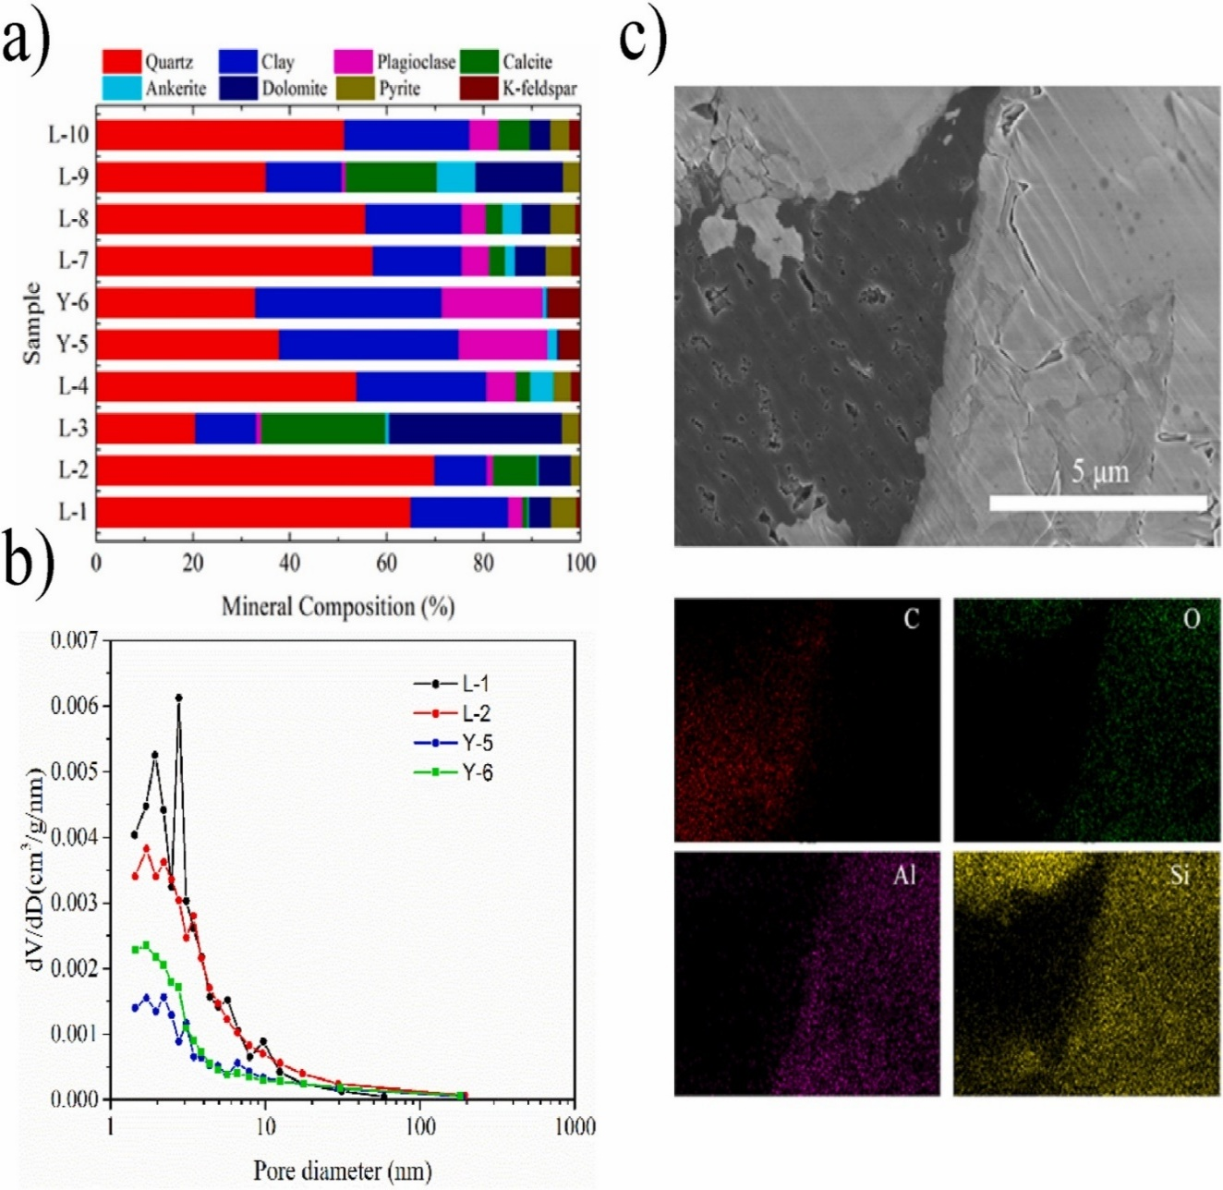
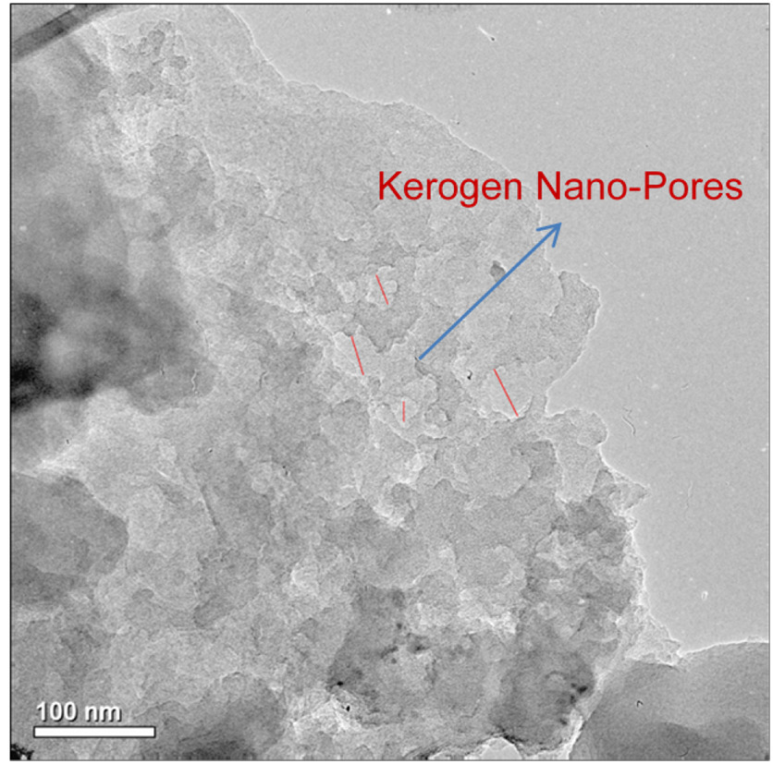
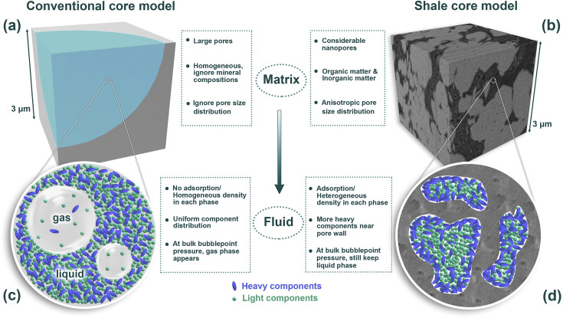
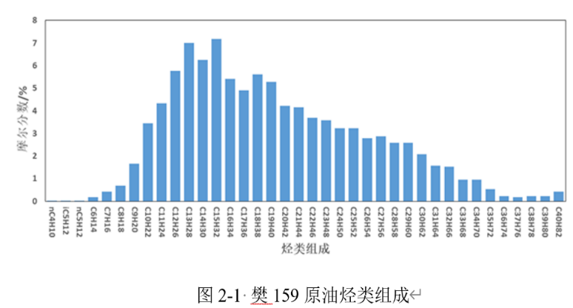
1. Research Background
Confinement effect on shale oil reservoir
Pore size distribution of shale formation
Molar fraction/%
Abnormal phenomena in nanopores
Alkane type
Shale oil composition
Exploration and development of unconventional reservoir
One of the key difference with conventional reservoir
Effects of Confinement cause Abnormal Hydrocarbon Properties

Slide 3
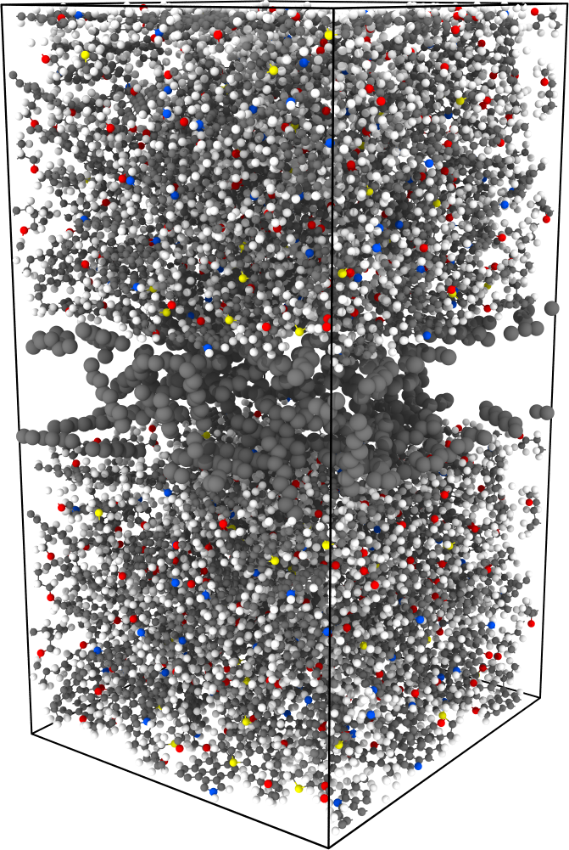
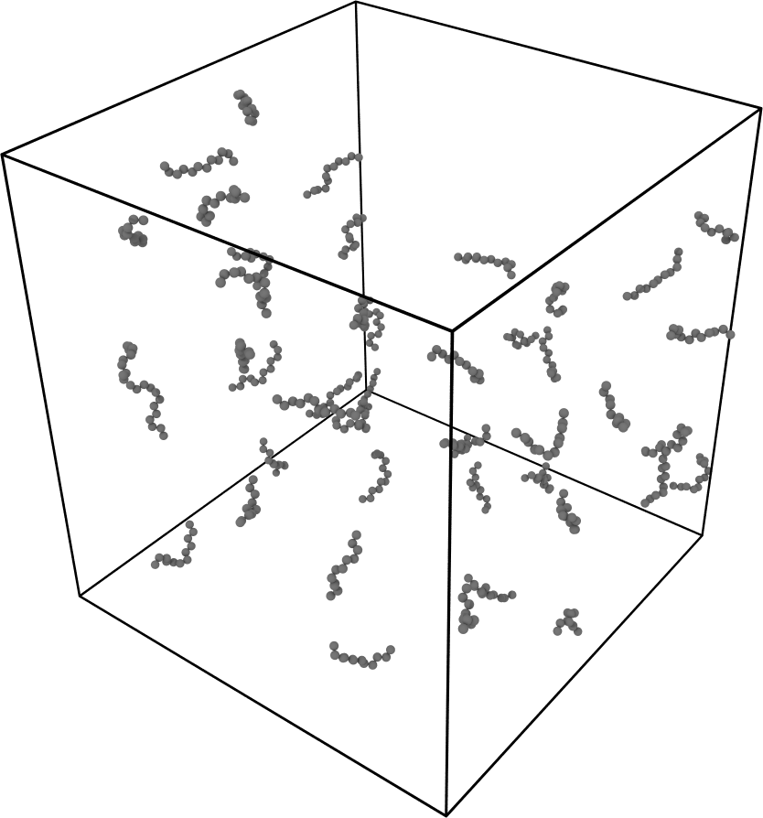
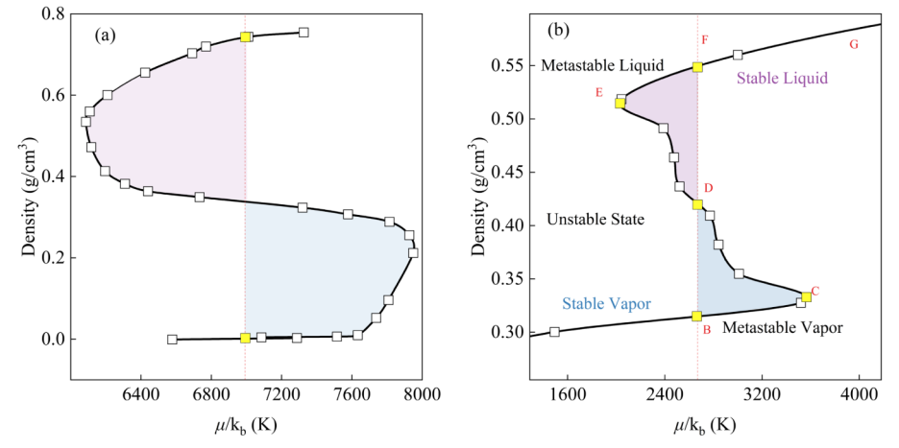
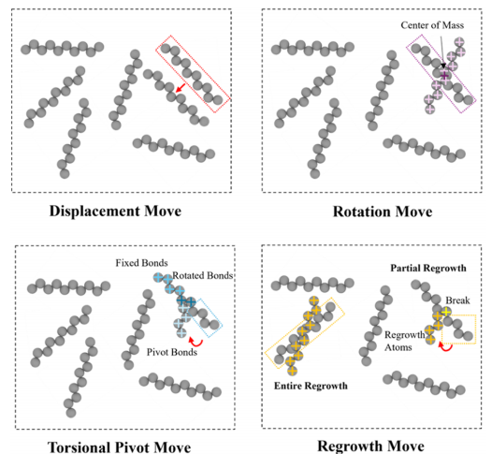
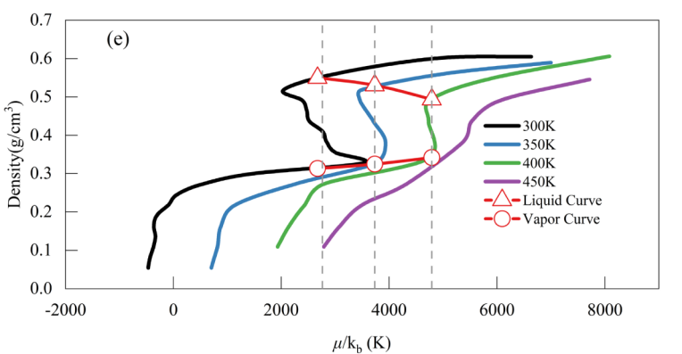
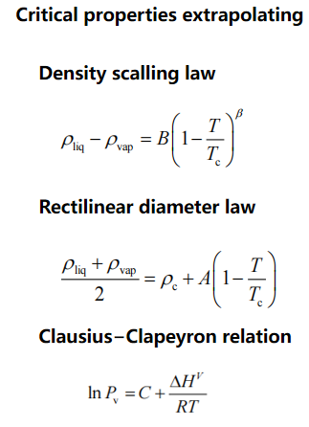
2. Research Methods
Gauge-Gibbs Ensemble Monte Carlo simulation, Gauge- GEMC
Equilibrium criteria
Swap
Temperature equality
Chemical potential equality
Phase
Change
point
Obtain V-L coexistence properties by Maxwell equal area rules
BOX1: Nanopore
BOX2: Bulk
Simulation box for V-L equilibrium properties
Determination of PC point
Monte Carlo Moves
Determination of Critical properties

Slide 4
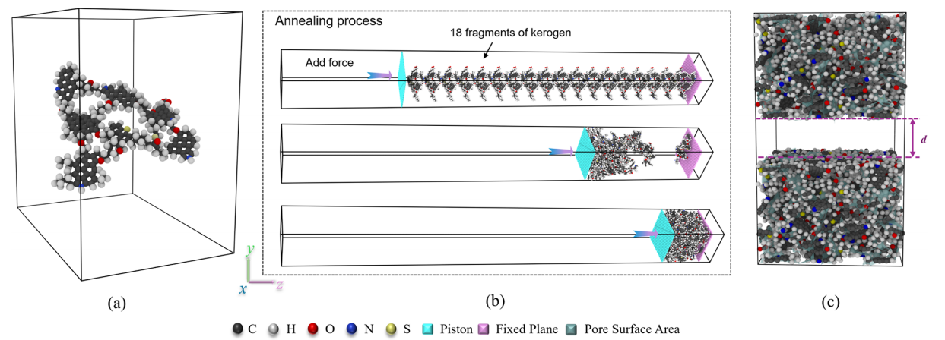
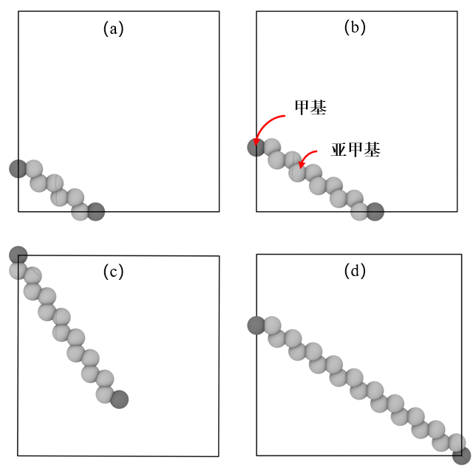
2. Research Methods
Molecular model of shale nanopores & alkanes
Type II kerogen
Type of alkane
n-octane n-dodecane n-pendecane n-eicosane

Slide 5
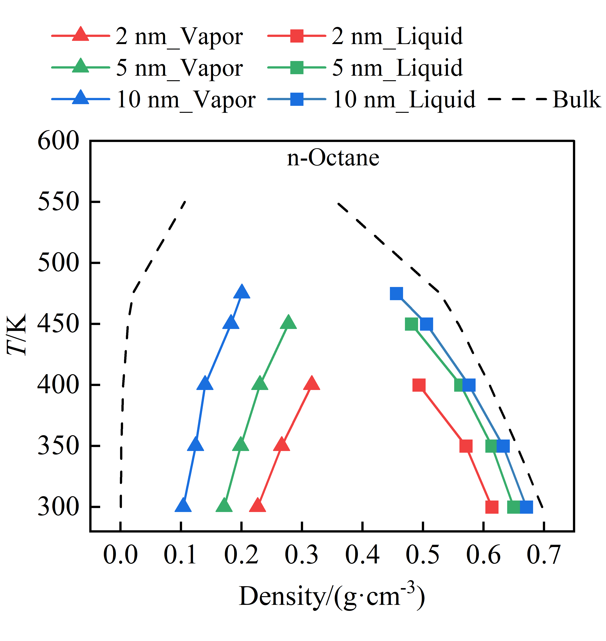
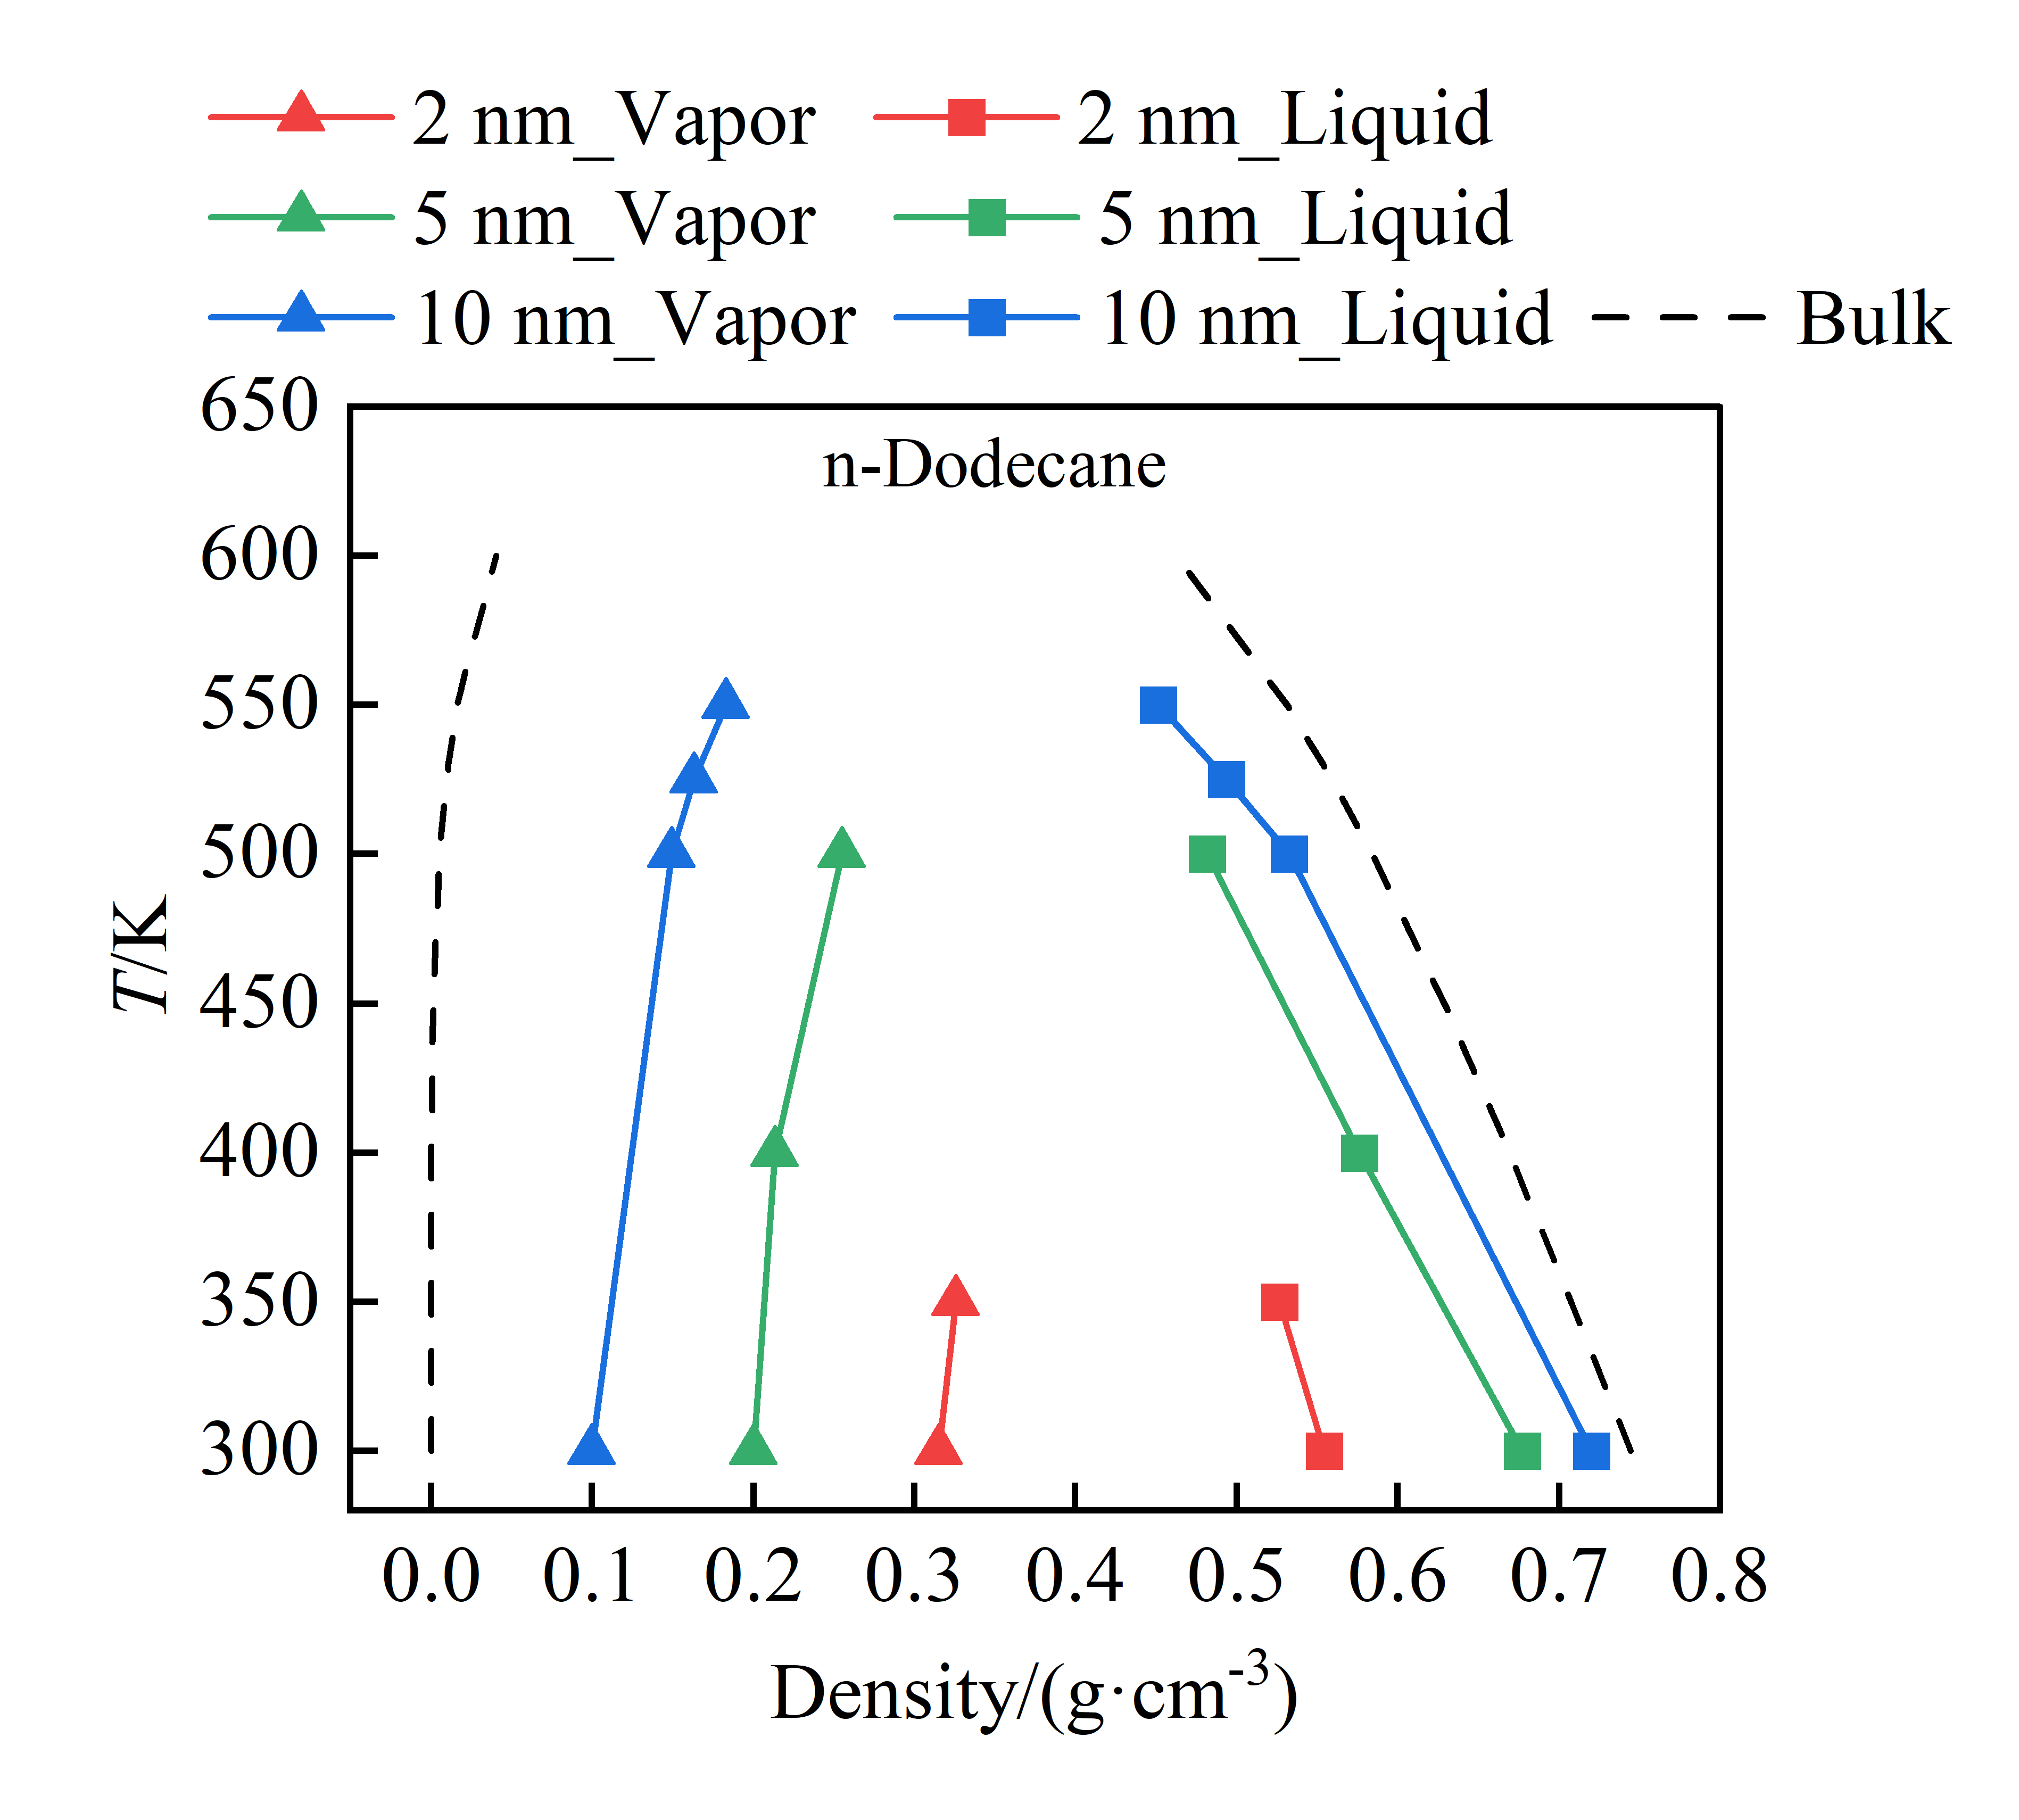
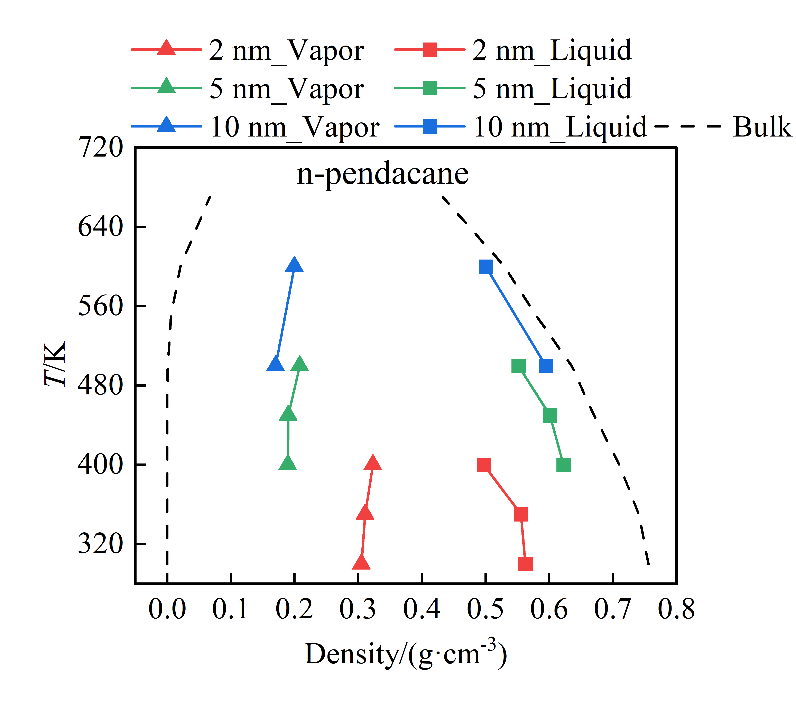
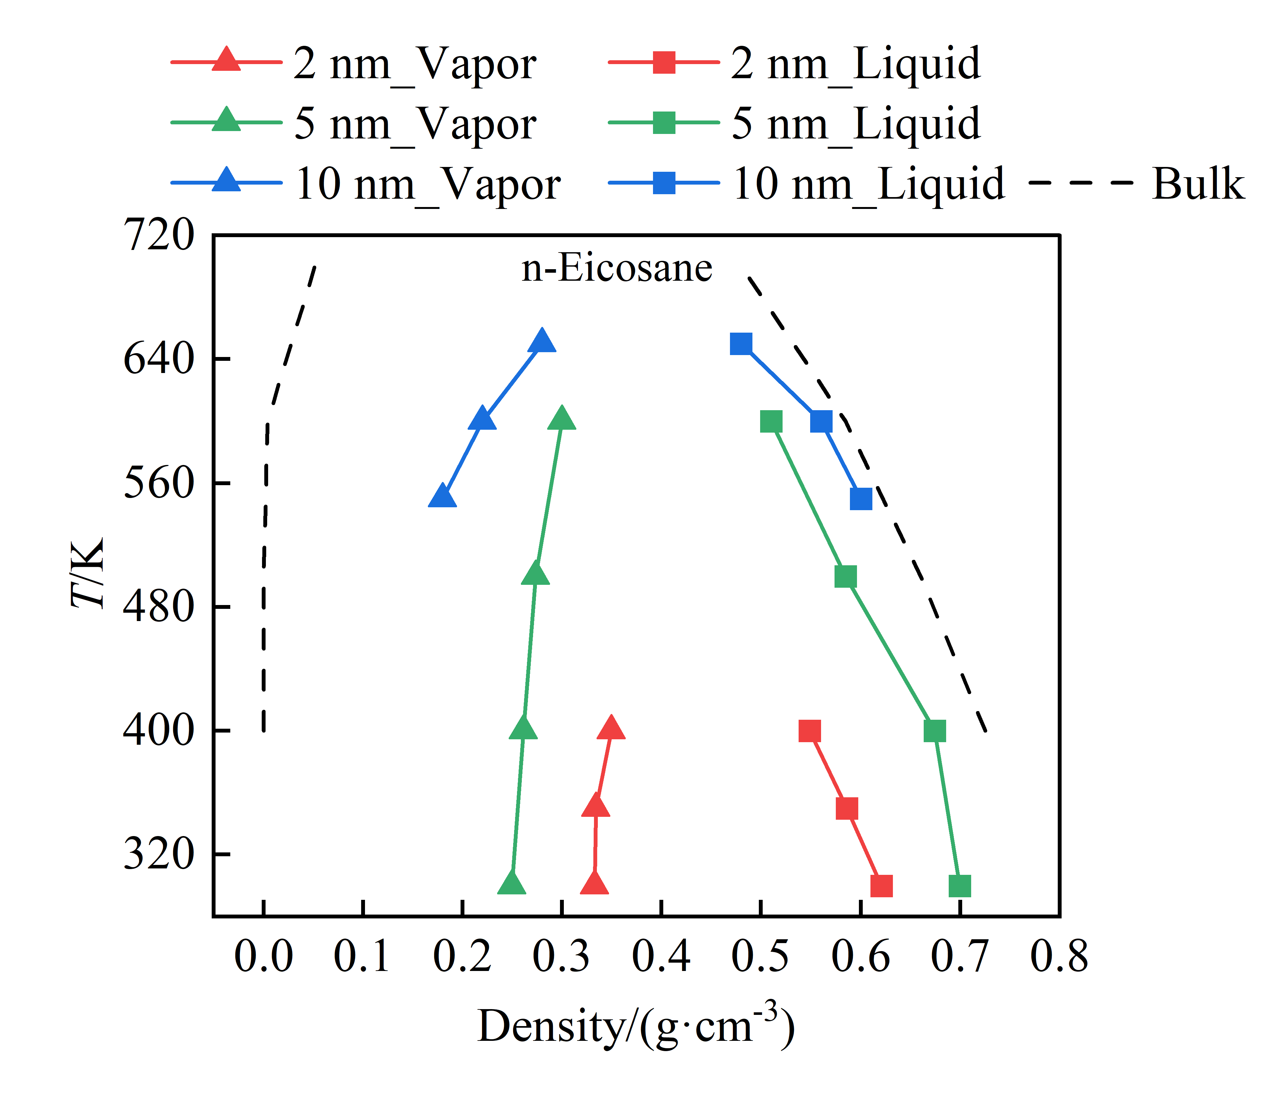
3. Research Results
V-L coexistence properties under confinement
Phase diagram of alkanes
The vapor-liquid phase envelope exhibits a noticeable shrinkage under confinement.

Slide 6
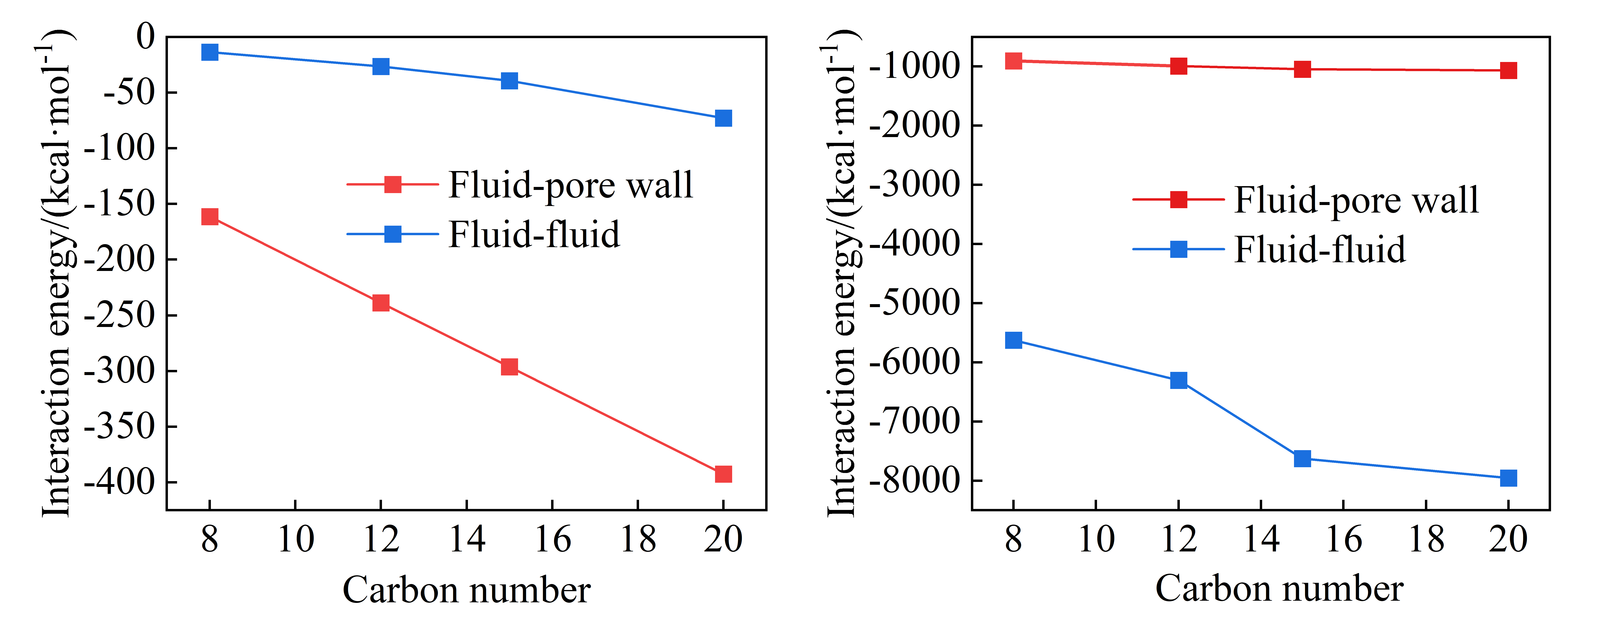
3. Research Results
Interaction forces analysis
Vapor Phase
Liquid Phase
The density deviation observed in nanopores is primarily governed by the underlying energy interactions.

Slide 7
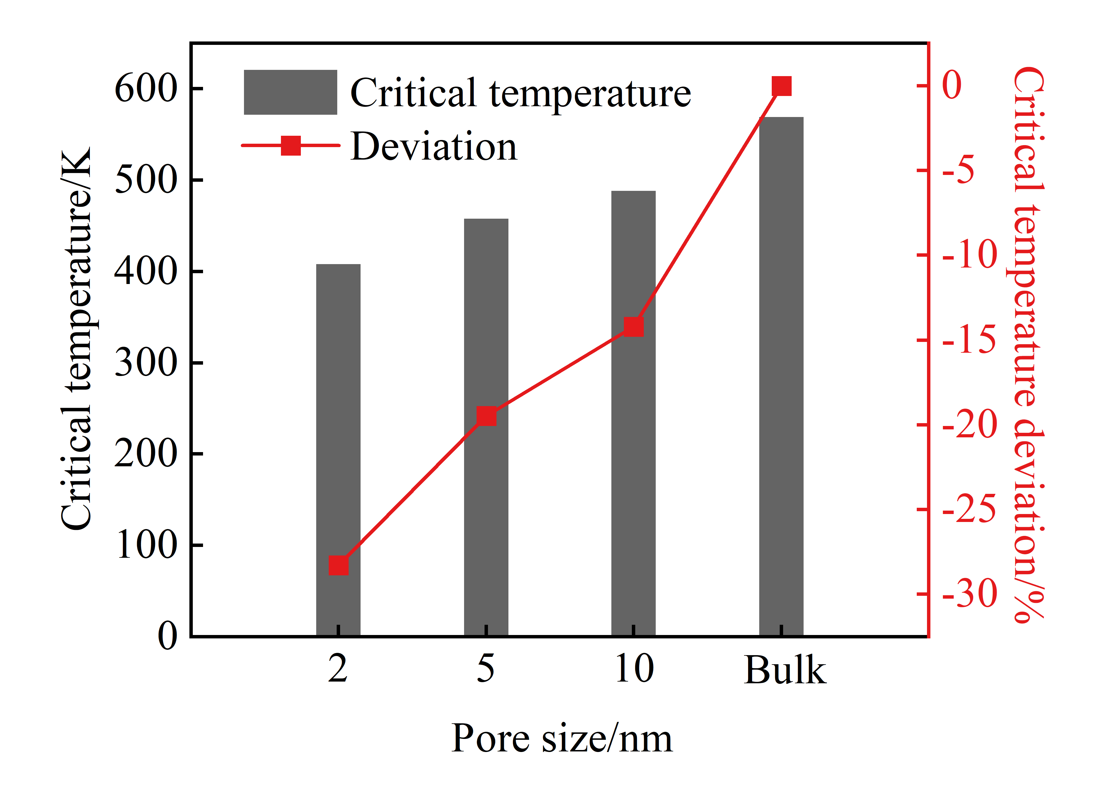
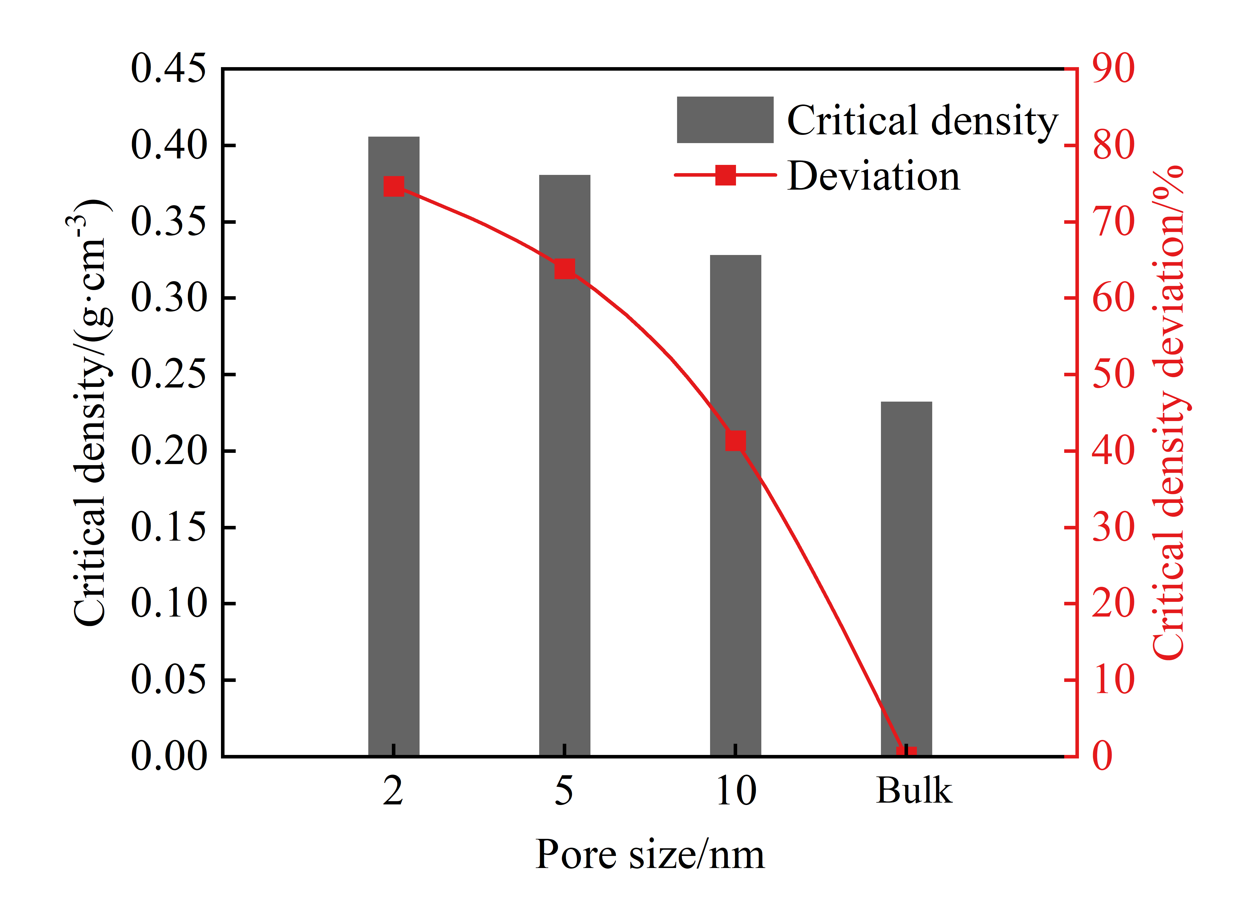
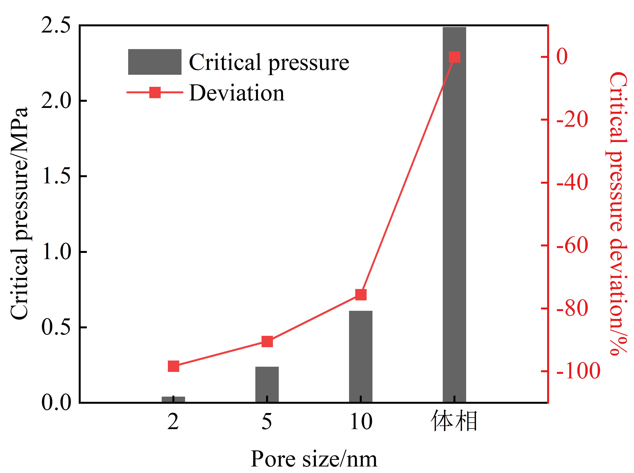
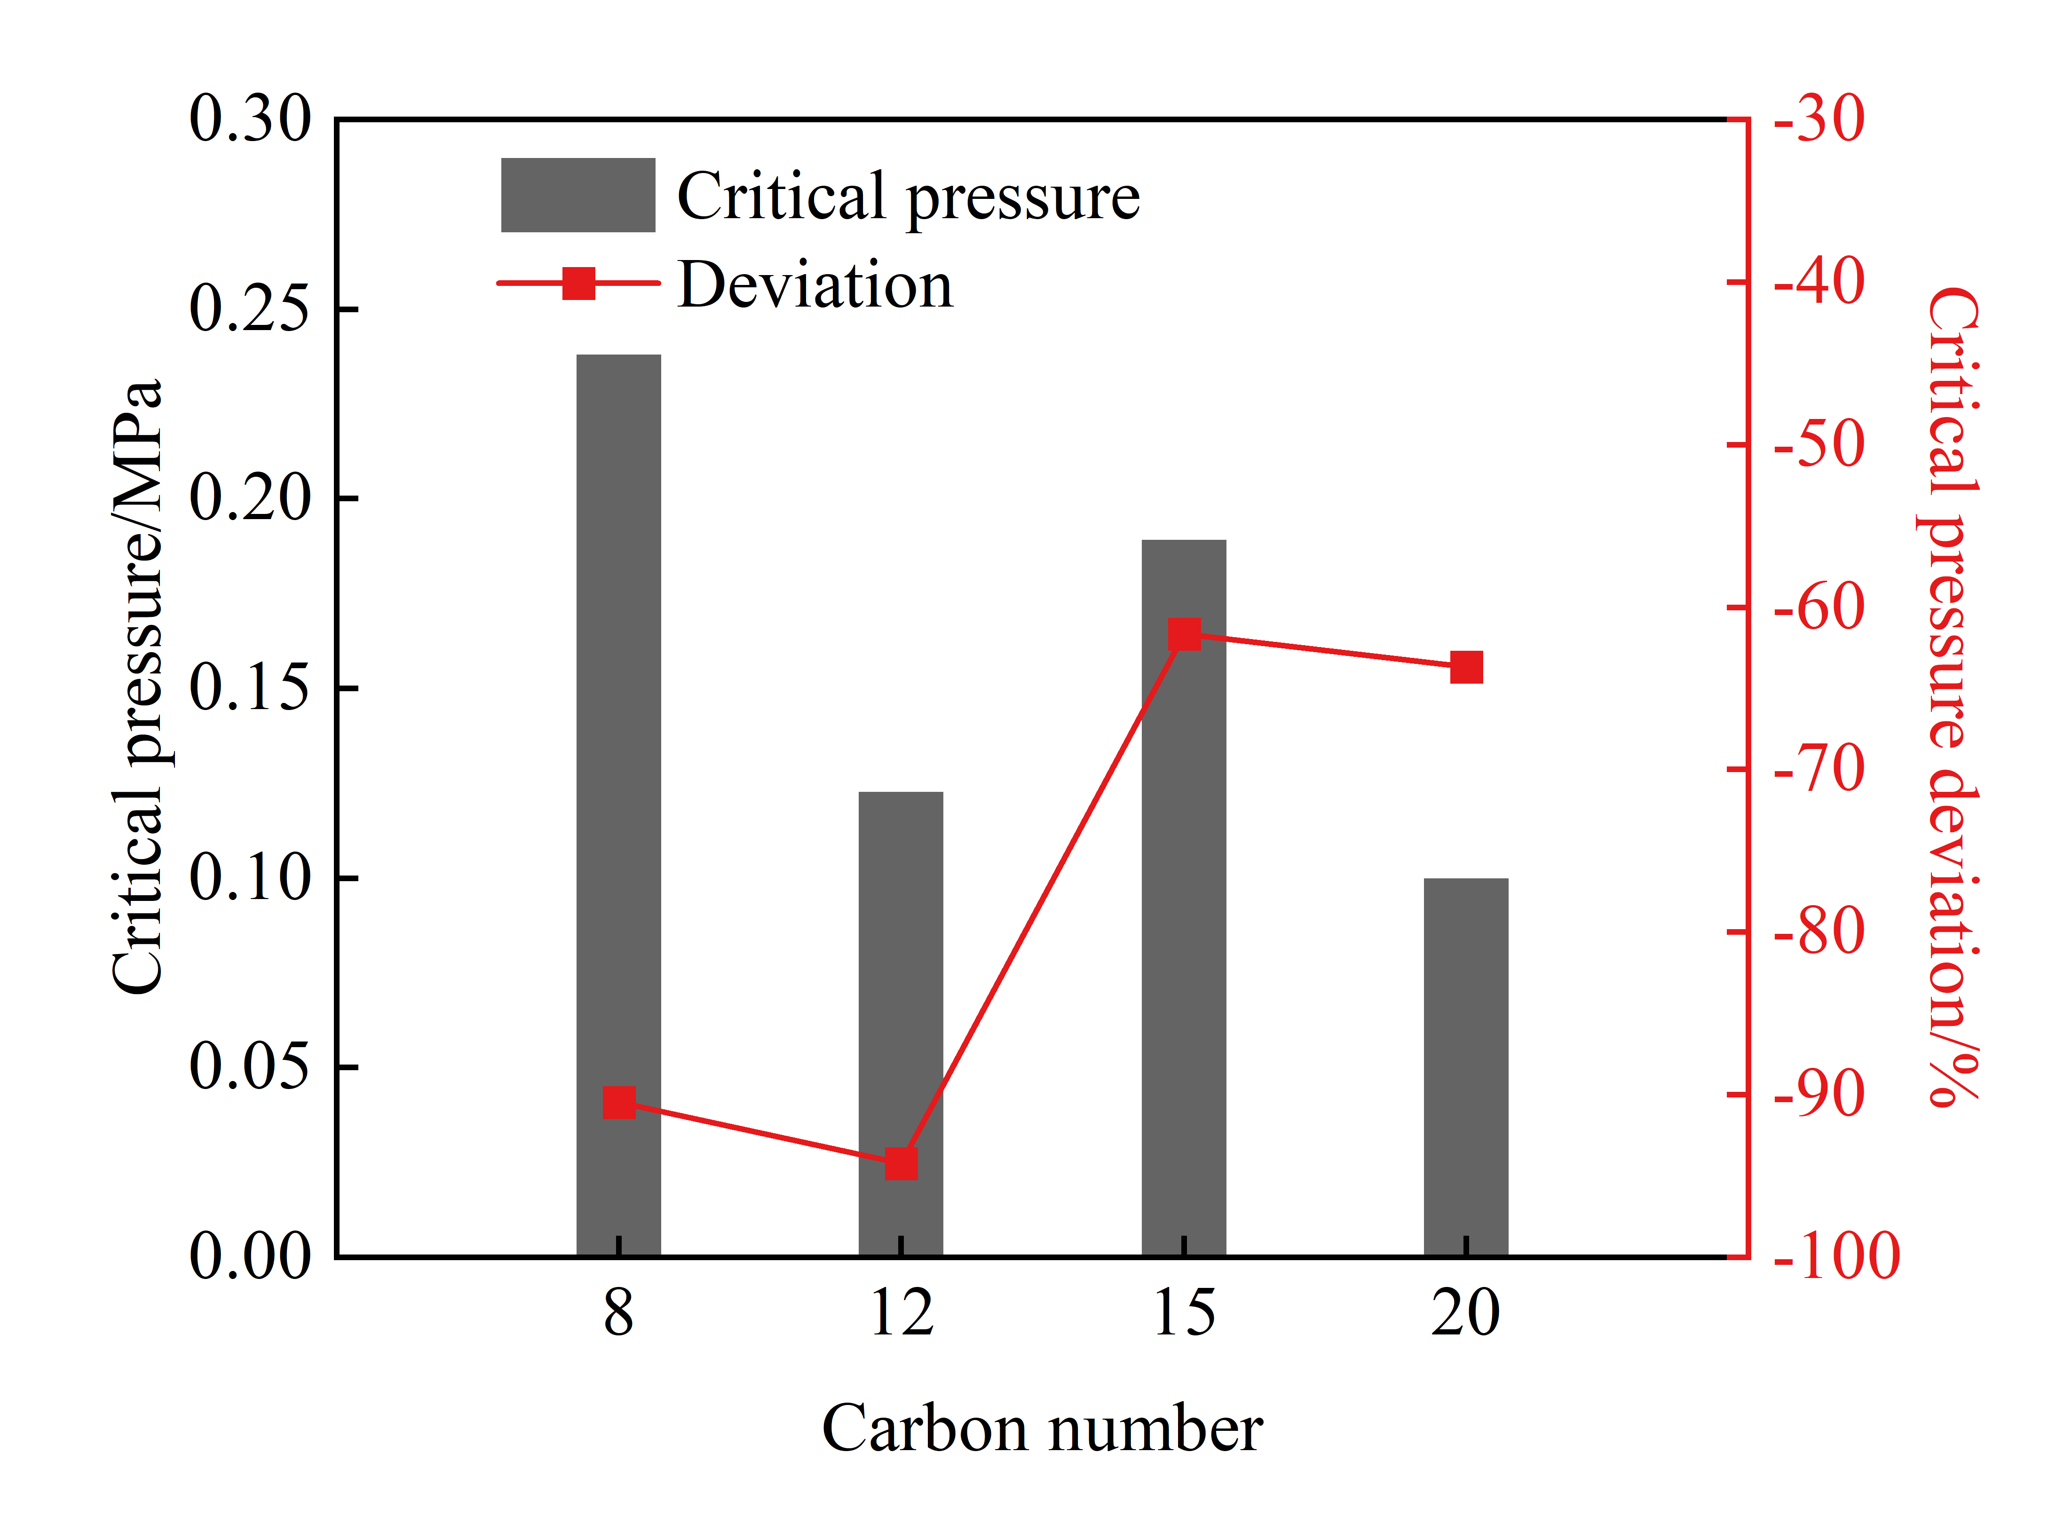
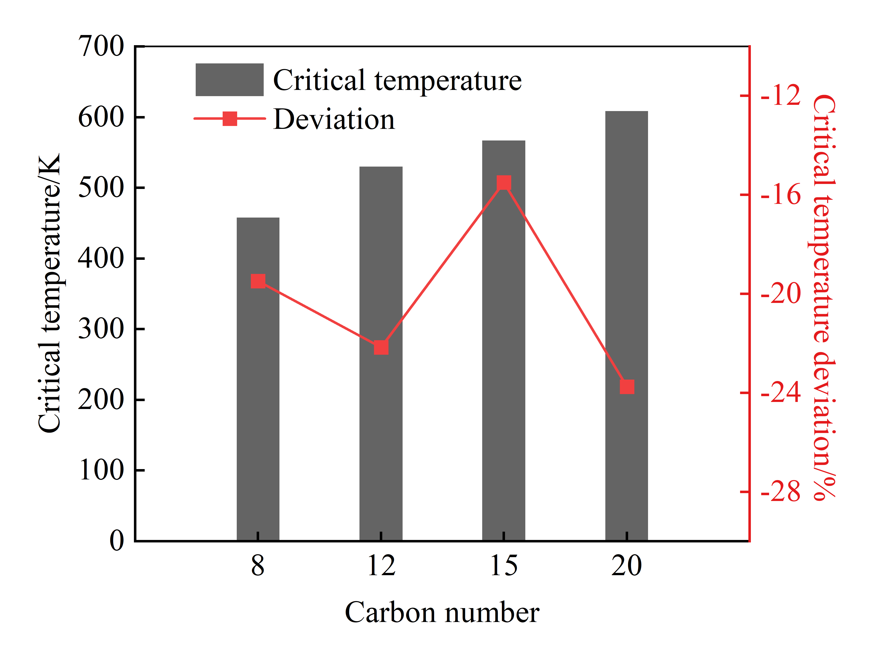
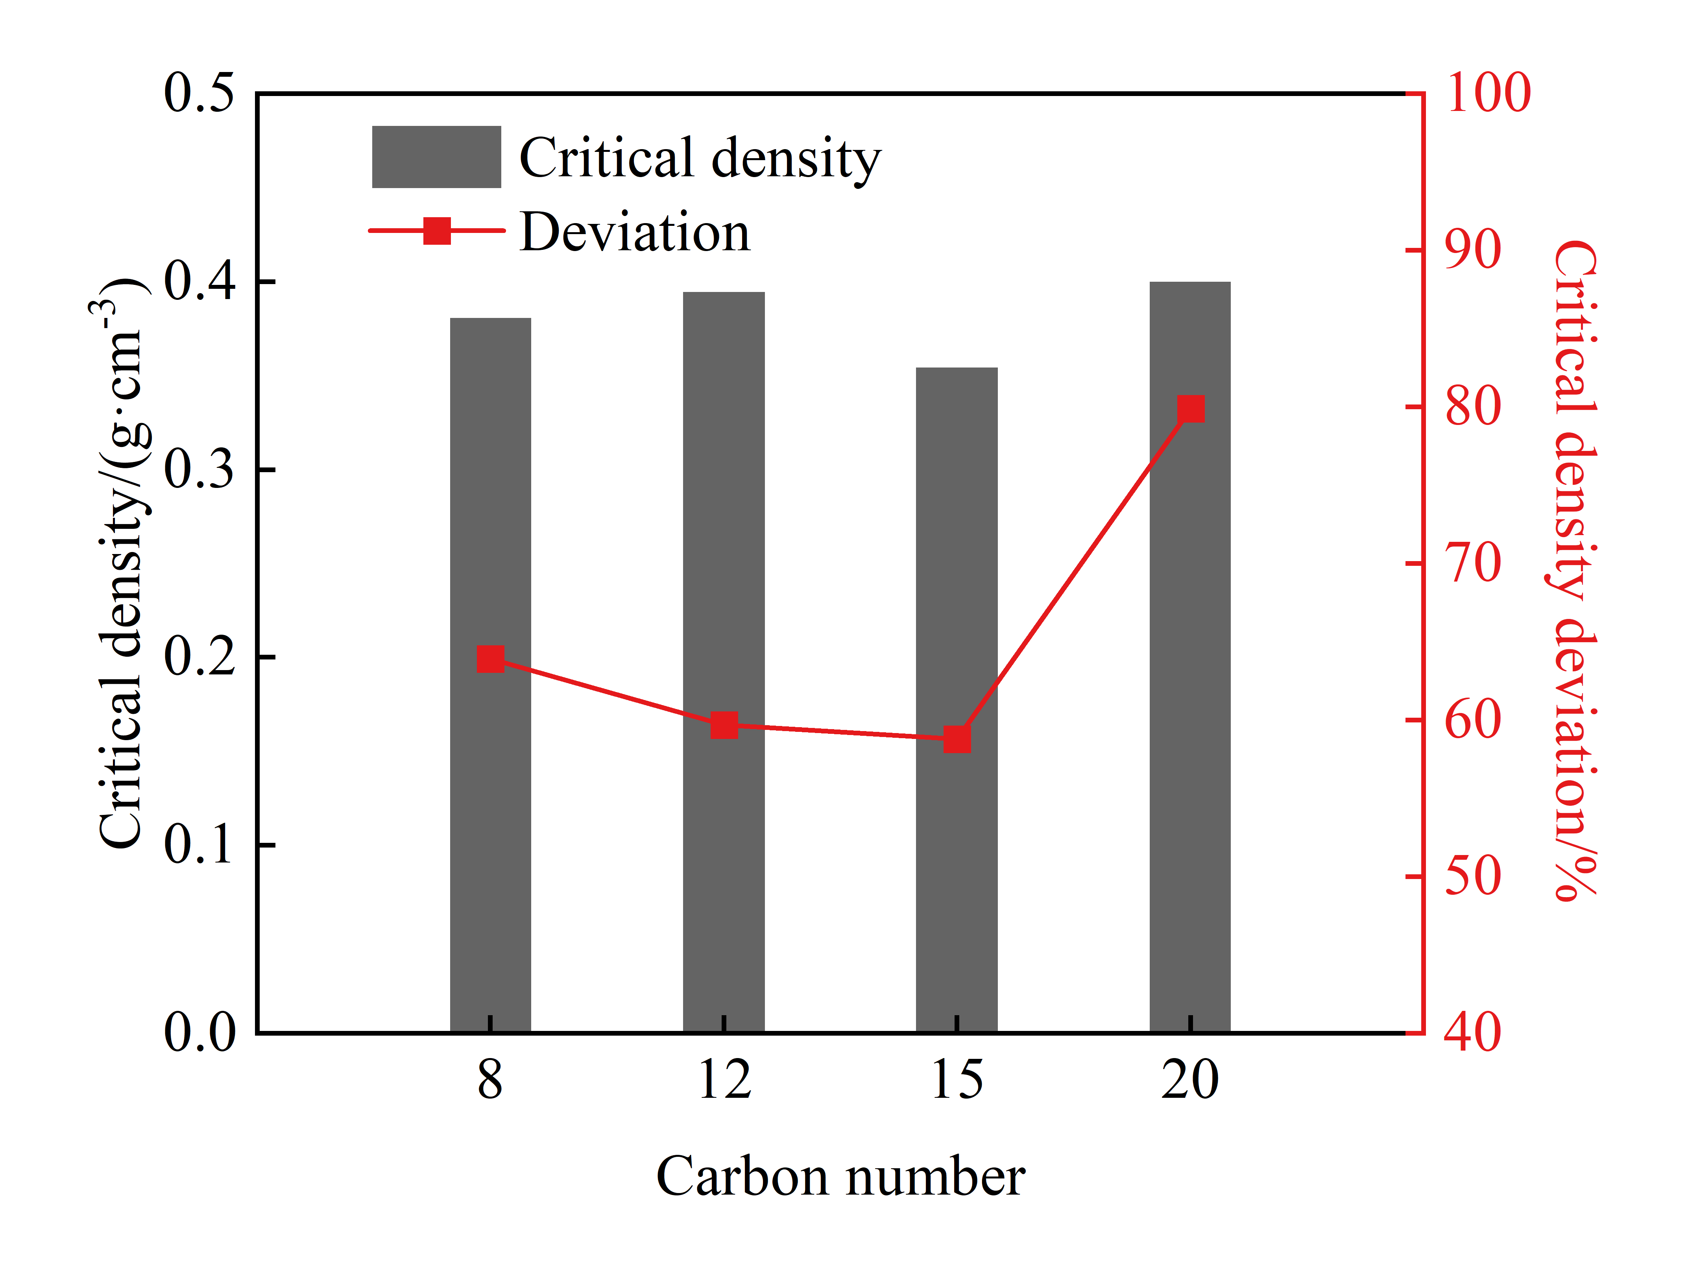
3. Research Results
Critical properties under confinement
Effect of pore size
Bulk
Effect of carbon chain length

Slide 8
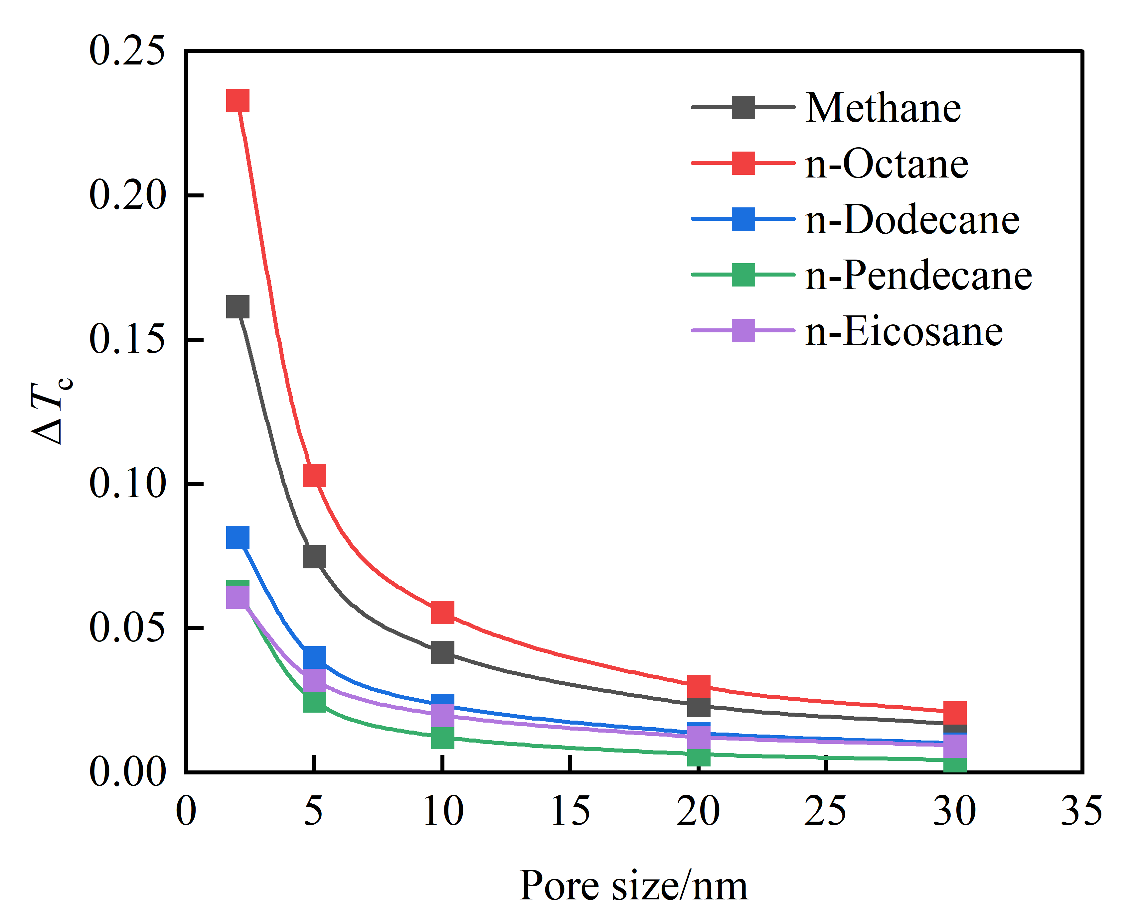
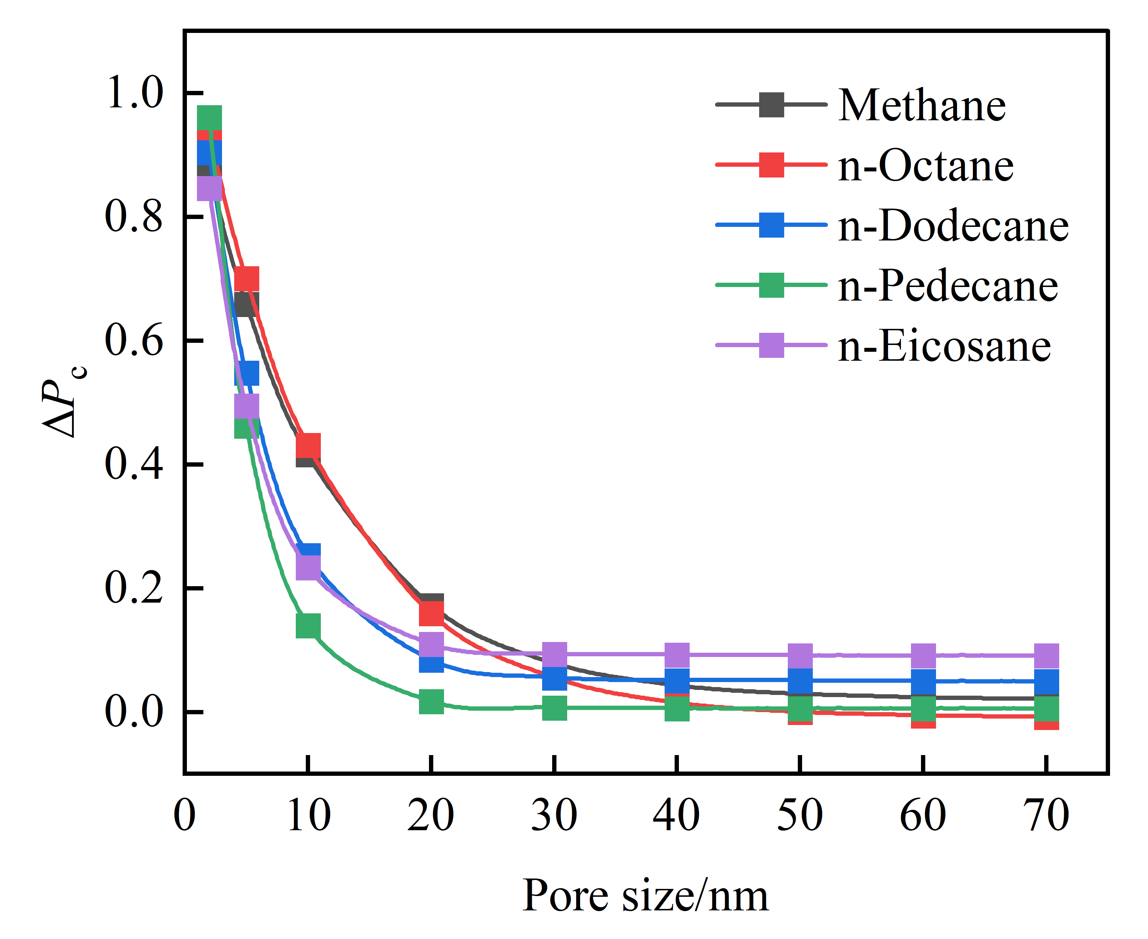
4. Research Highlights
Asymmetric Vapor-Liquid Phase Behavior under Nanoconfinement
Pore-Size-Dependent Shift of Critical Properties under Confinement
Application
Establish critical properties shift model for alkanes under confinement
Critical temperature
Critical pressure

Slide 9
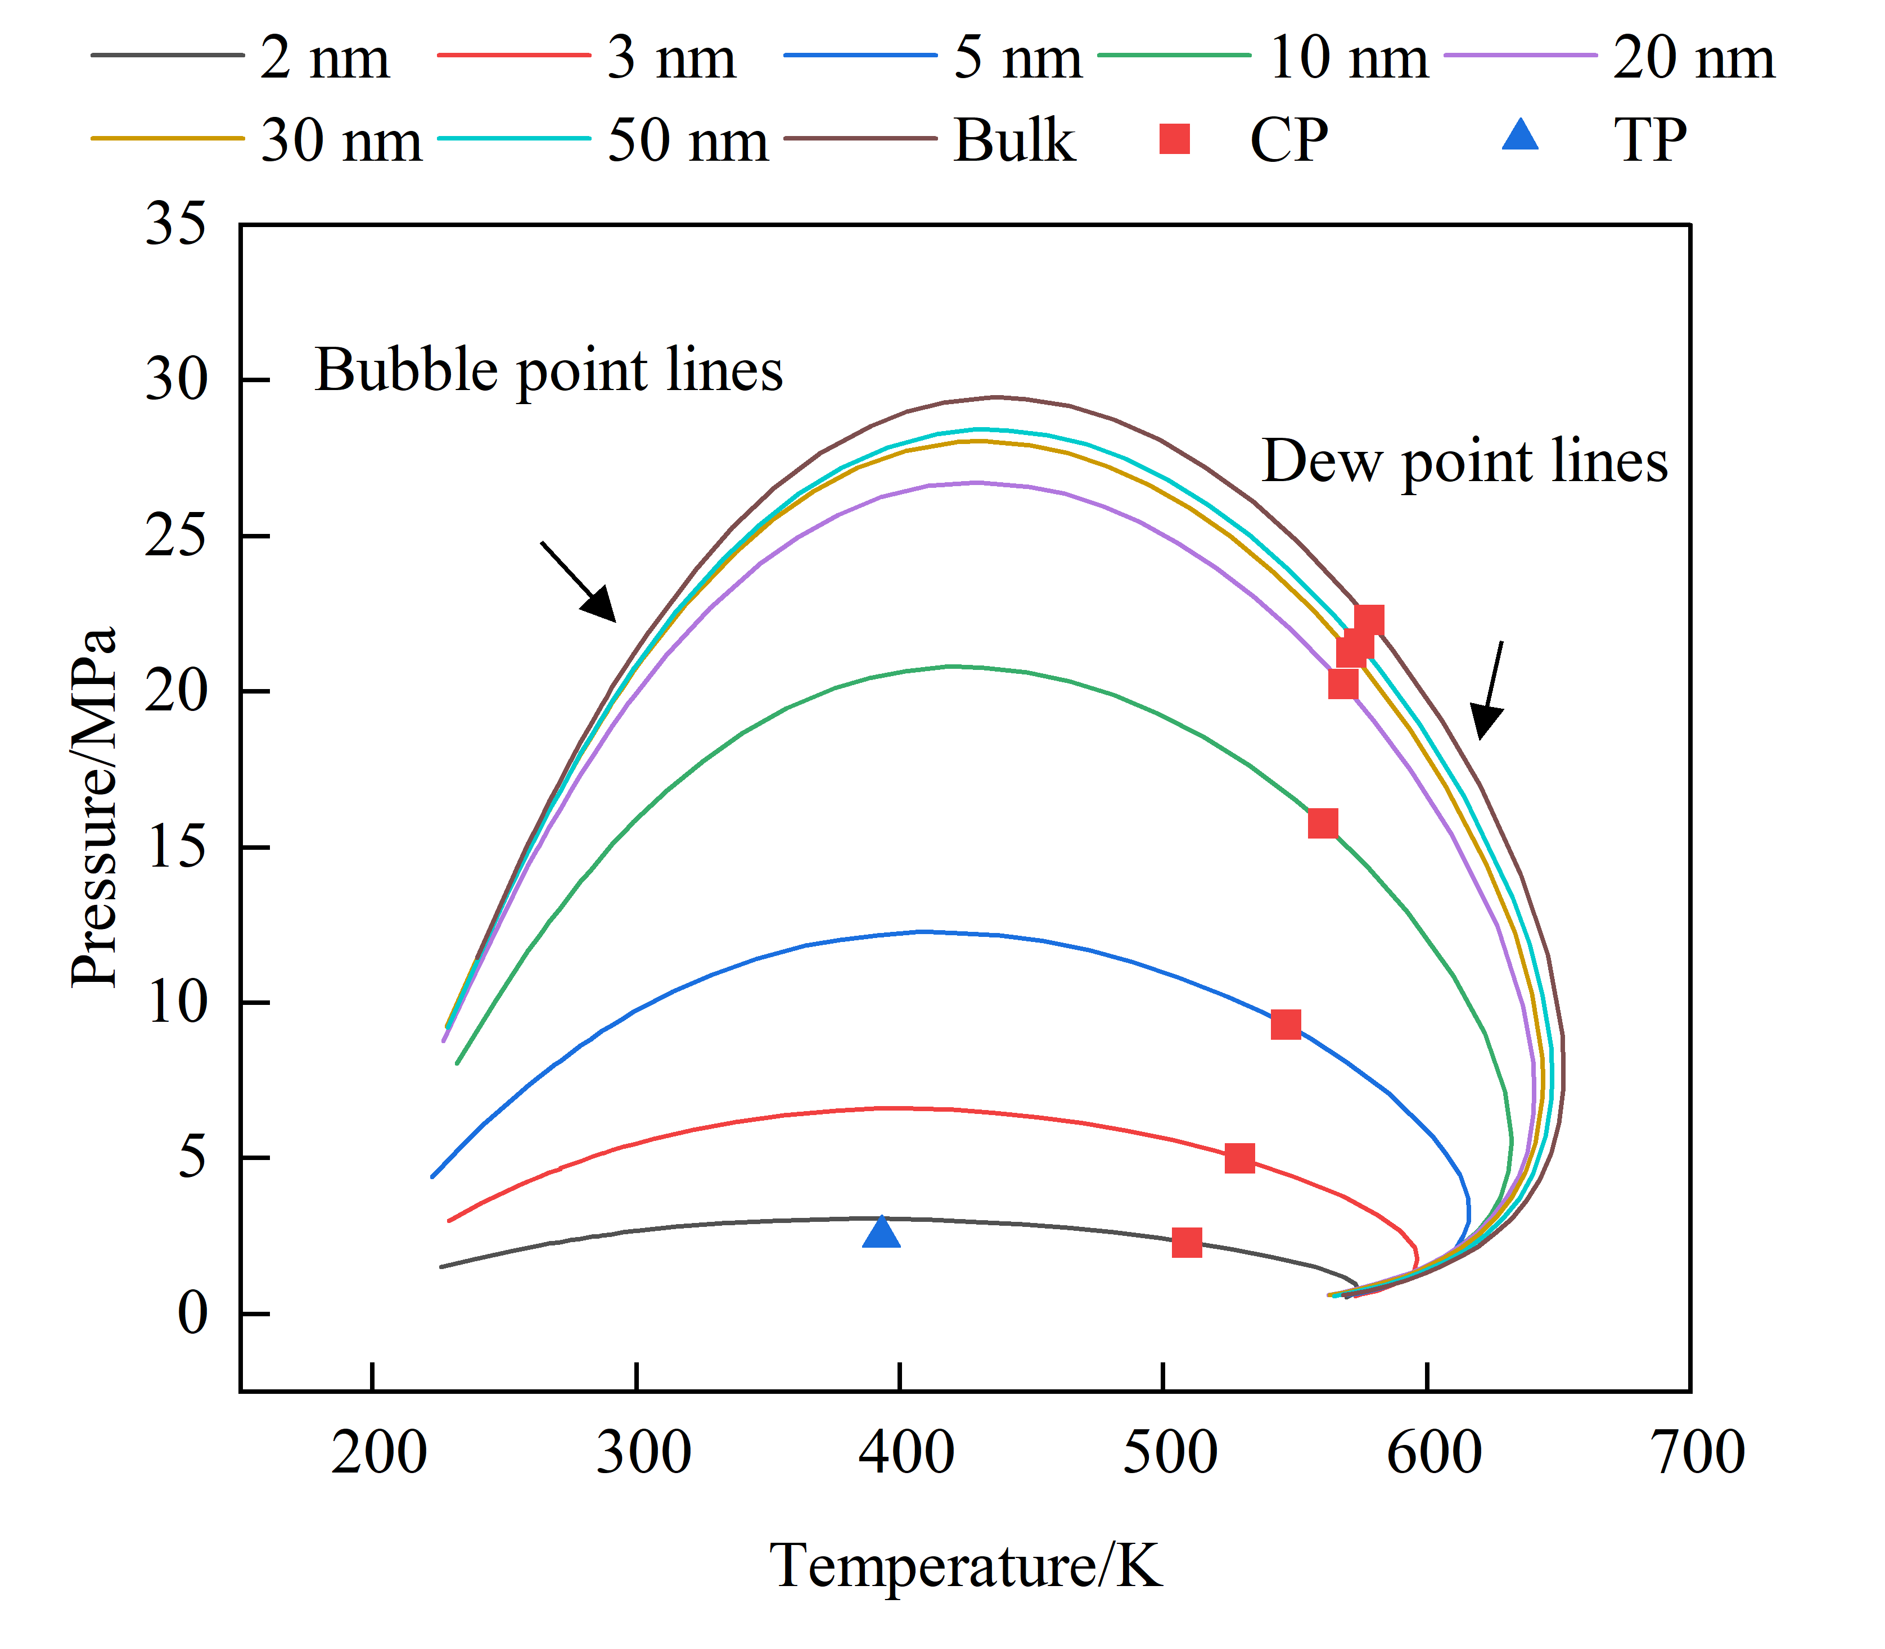
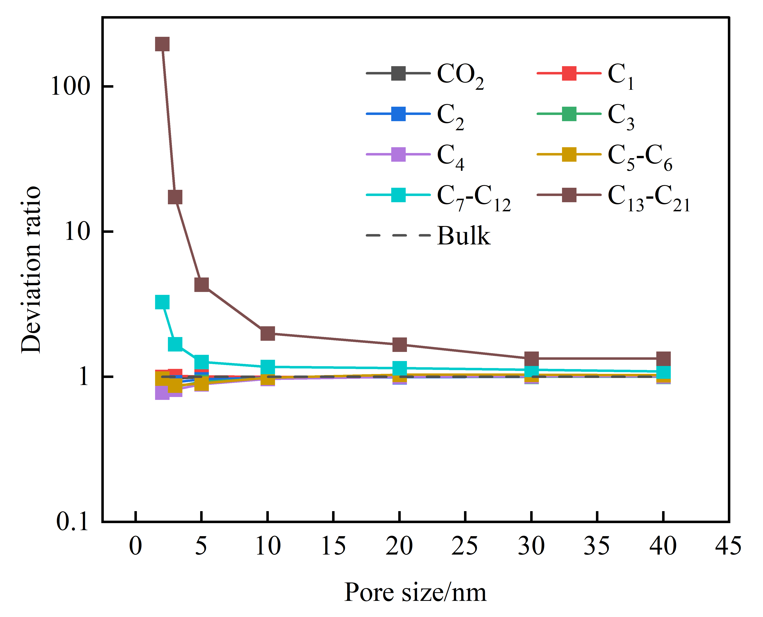
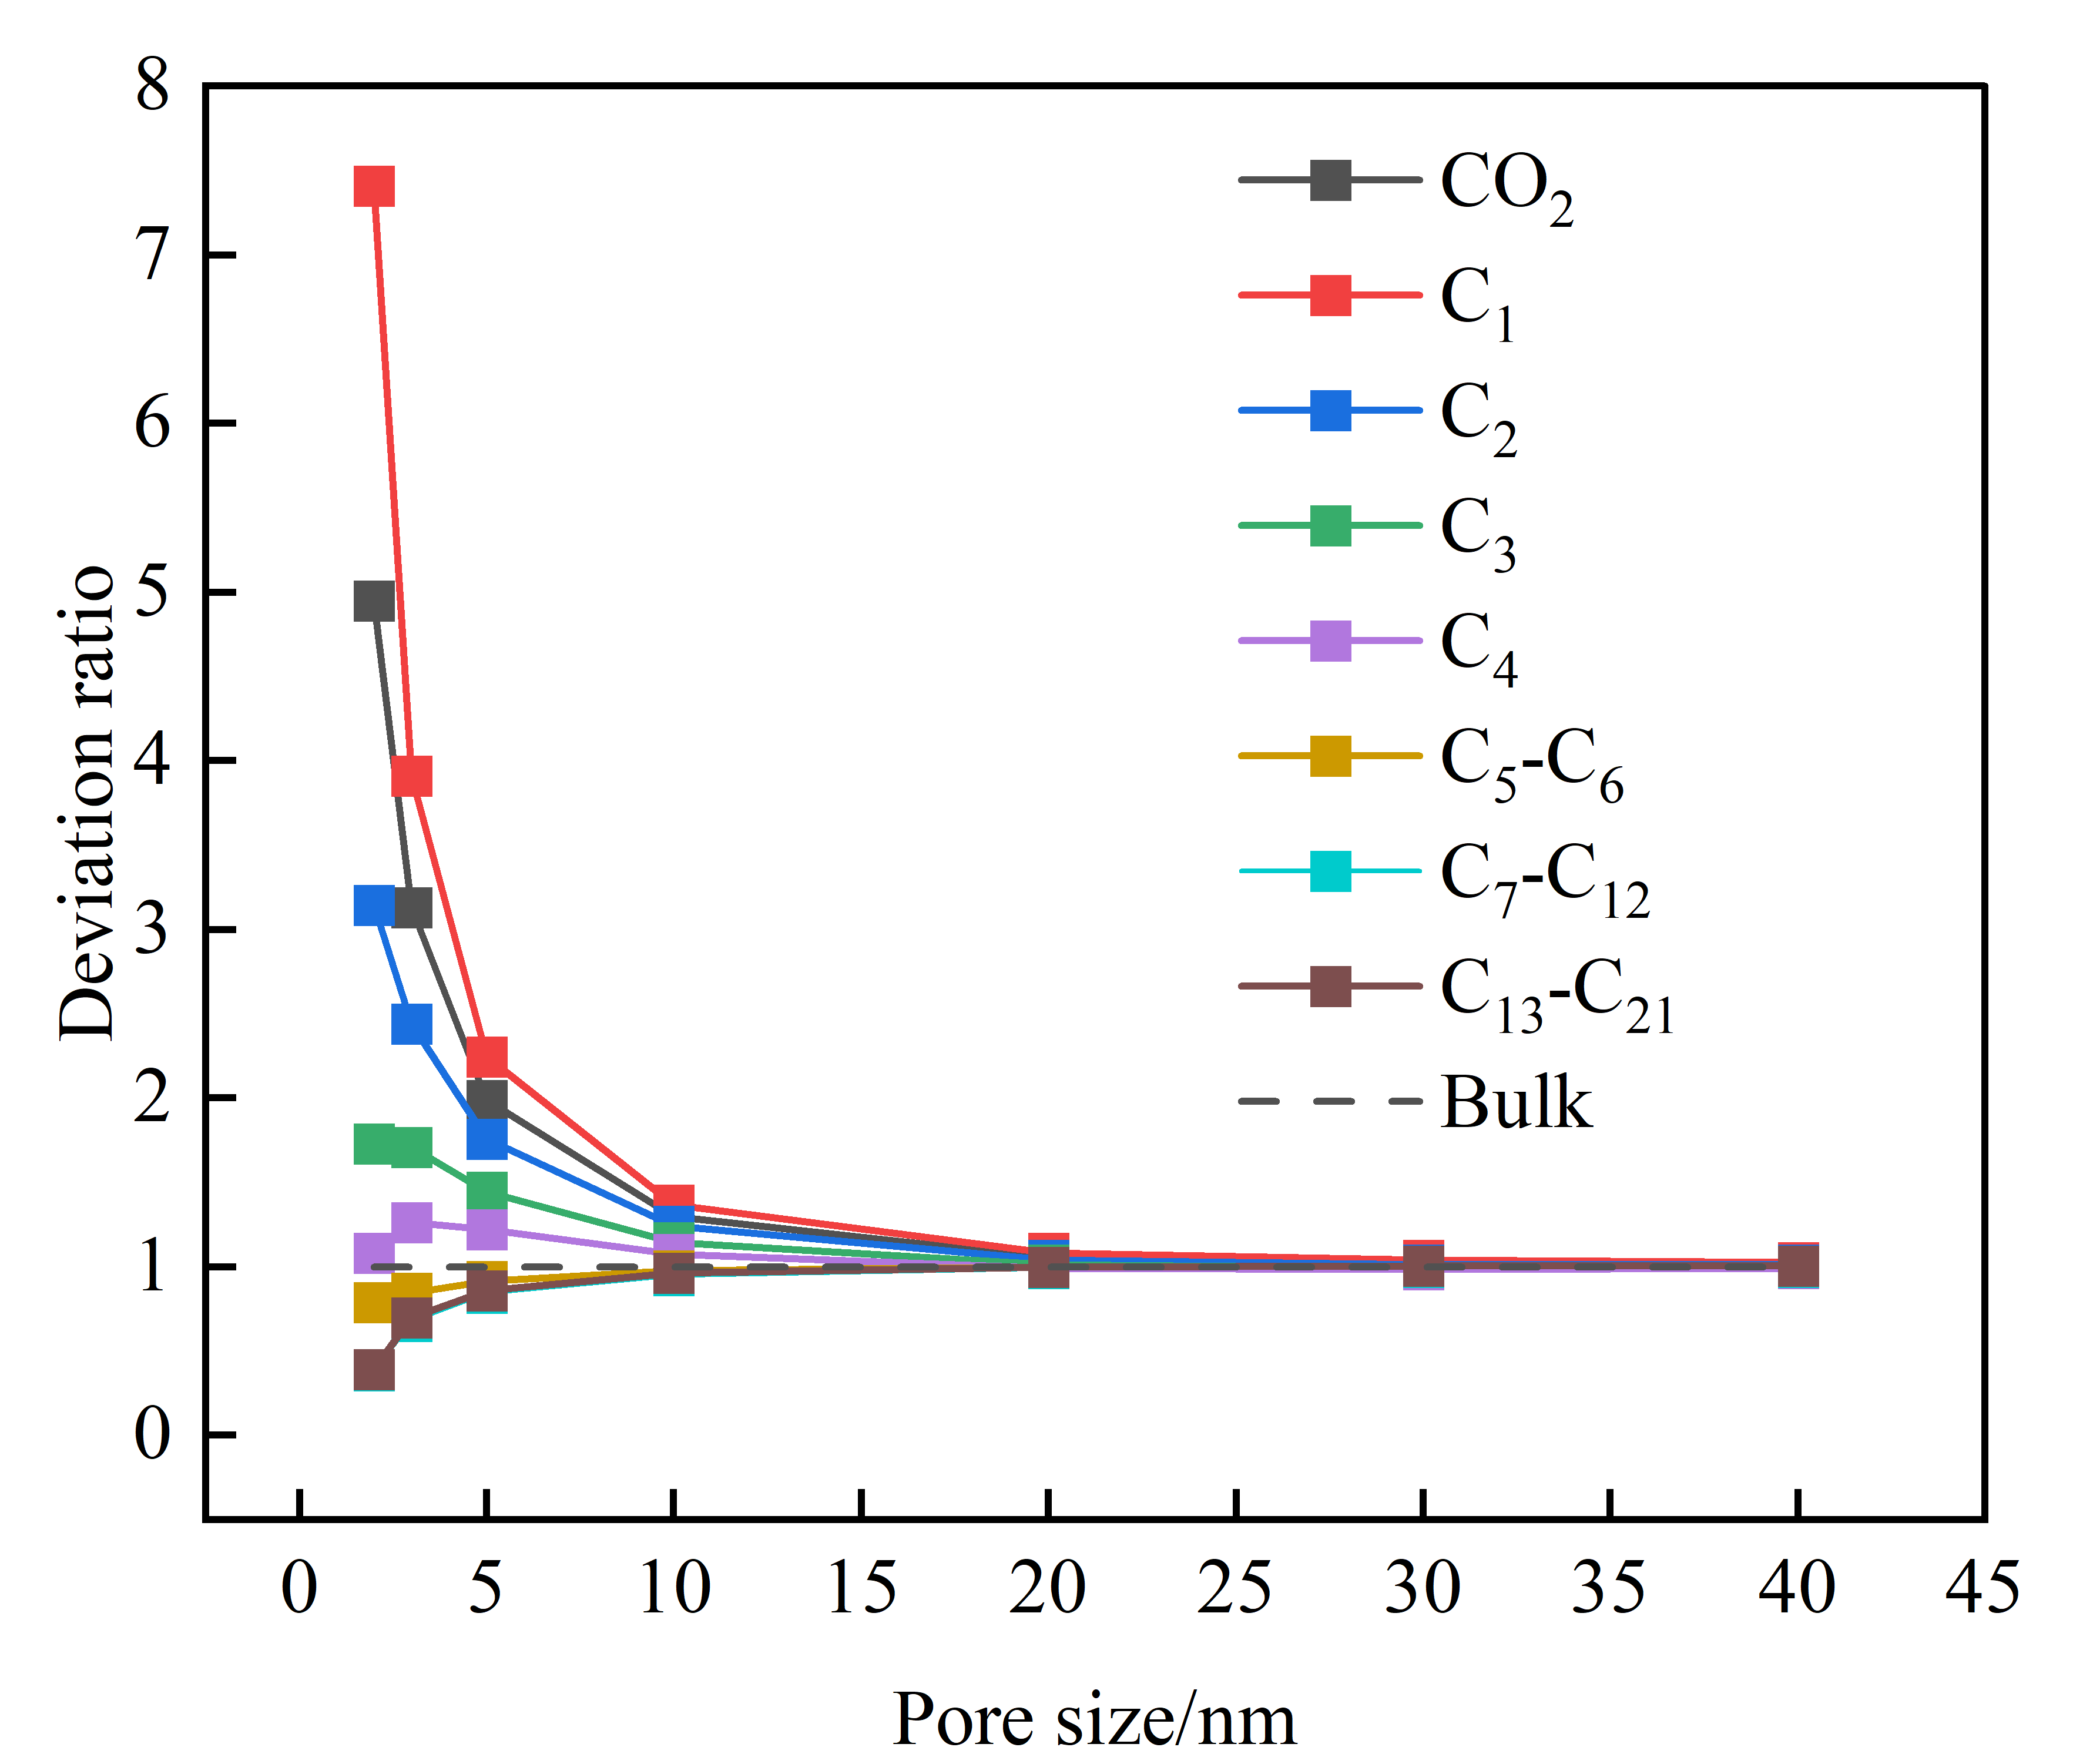
4. Research Highlights
Apply to numerical simulation of multi-component shale reservoir
P-T phase diagram
Variation of mole ratio deviation of shale oil components

Slide 10
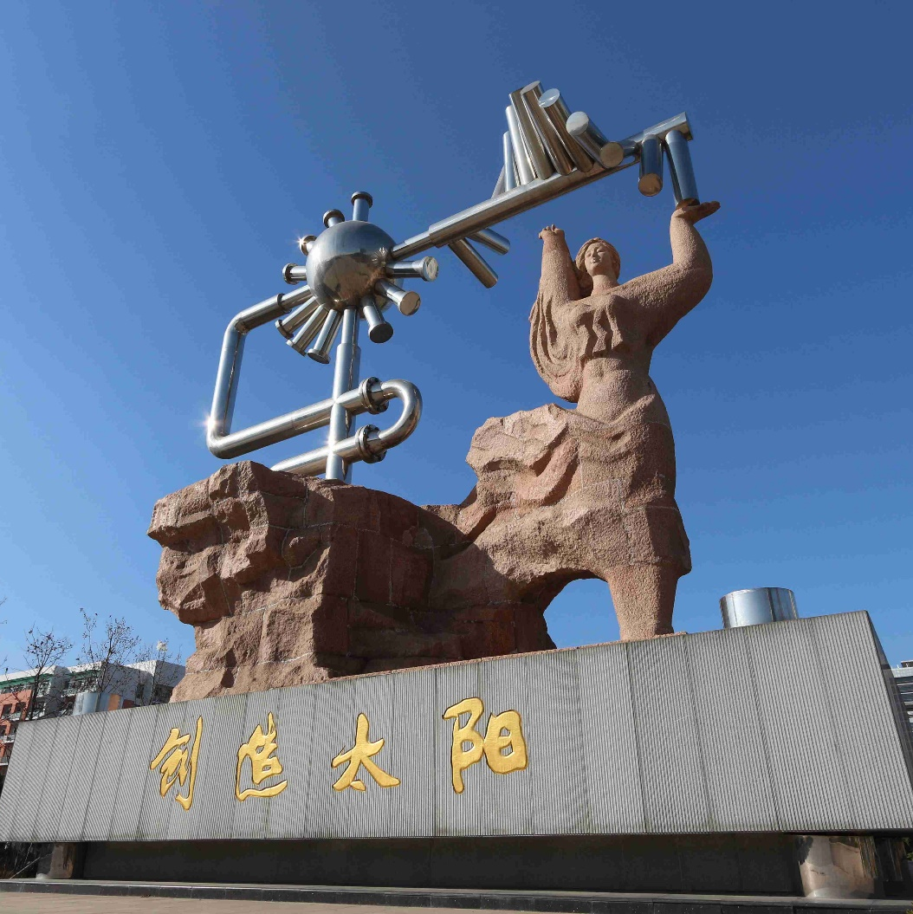
Thank you for watching
NAME：YIFAN LI
Email：b21020017@s.upc.edu.cn

