Slide 1


InterPore2026: MS20—Special Session in Honor of Jun Yao
A Variable-Dimension Evolutionary Transfer Optimization Framework for Well-Fracture Pattern Co-optimization of Fractured Horizontal Wells in Shale-Gas Reservoirs
Dali Zhao
Research Center of Multiphase Flow in Porous Media
China University of Petroleum (East China)
19-22 May 2026, Nantes, France

Slide 2
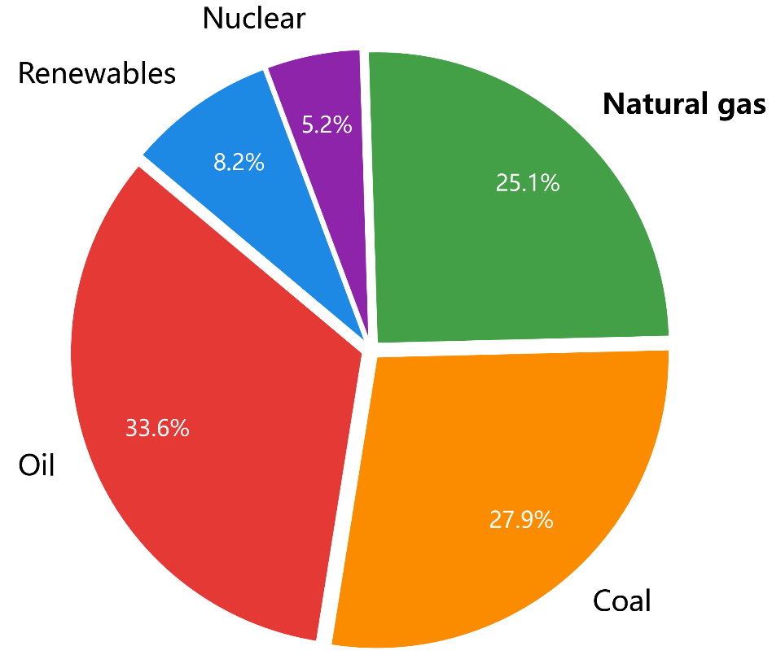
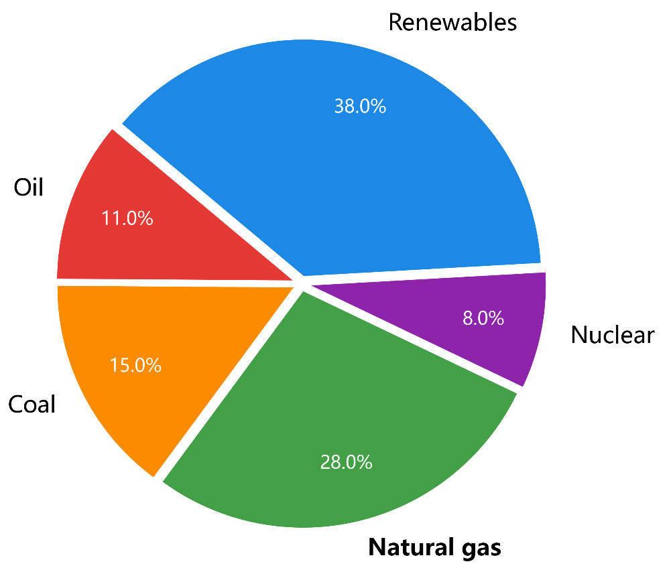
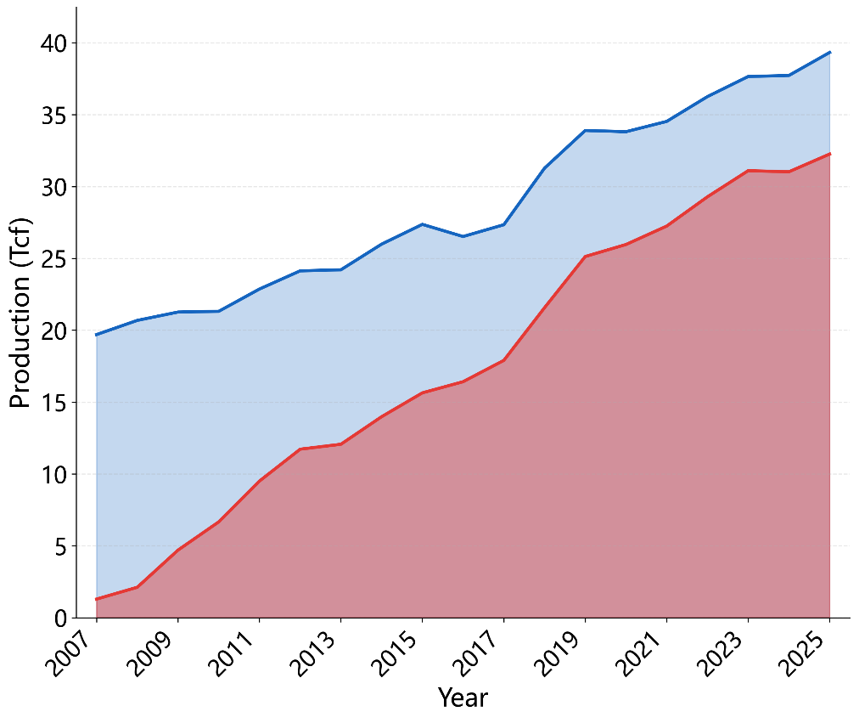
1. Background
Conventional natural gas
82%
shale gas
Global energy consumption shares, 2024
Global demand growth, 2024
U.S. shale gas vs. total natural gas
The data is sourced from EIA and is up to date as of 2024. The data for 2025 will be released in June 2026.
Natural gas is an important low-carbon and clean energy source, and shale gas serves as an important supplementary and replacement resource.
Notes:
First, let me briefly introduce the research background.
Natural gas is an important low-carbon and clean energy source. As of 2024, it accounts for about 25% of the global energy mix.
Shale gas is an important supplementary resource for natural gas supply. Taking the United States as an example, by 2025, shale gas accounts for about 82% of its total natural gas production.
Therefore, further research on shale gas development remains highly important.

Slide 3
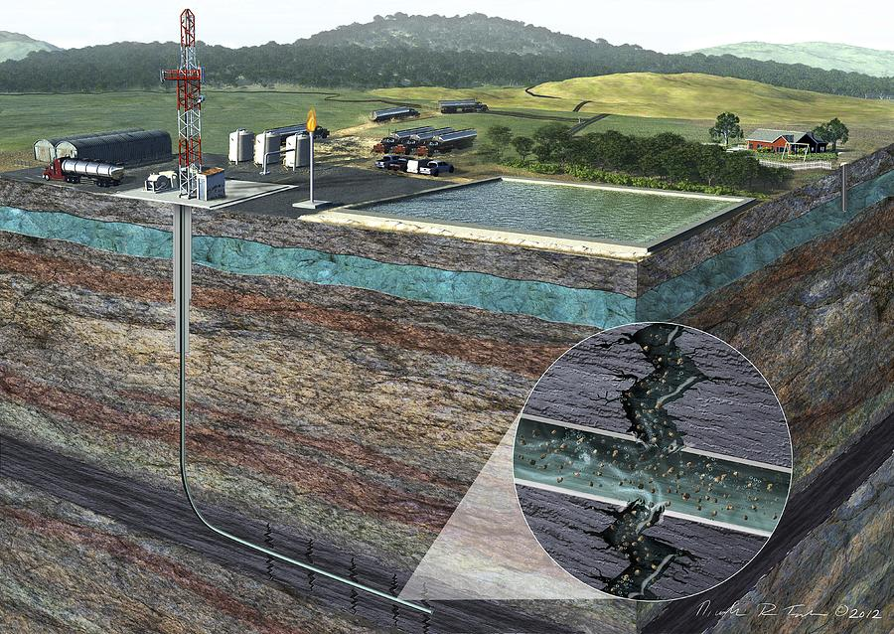
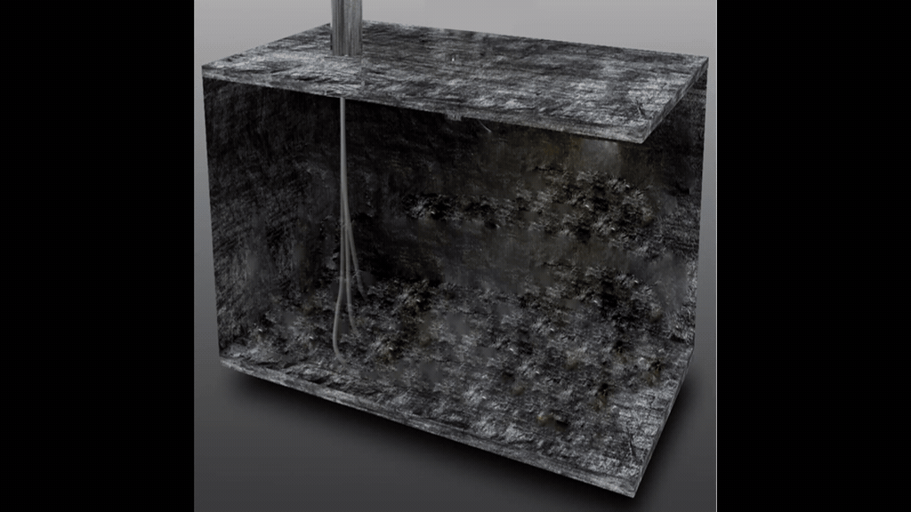
1. Background
Horizontal well hydraulic fracturing and three-dimensional development are key technologies for efficient shale gas development
Rational well placement and hydraulic fracturing design can significantly improve shale gas production performance.
Hydraulic fracturing. Credit: Oregon State University
3D development mode of shale gas
Notes:
Horizontal wells, hydraulic fracturing, and three-dimensional development have been widely used to improve shale gas production.
In this process, where to place the wells and how to design the fractures are two key factors that directly affect production performance.

Slide 4
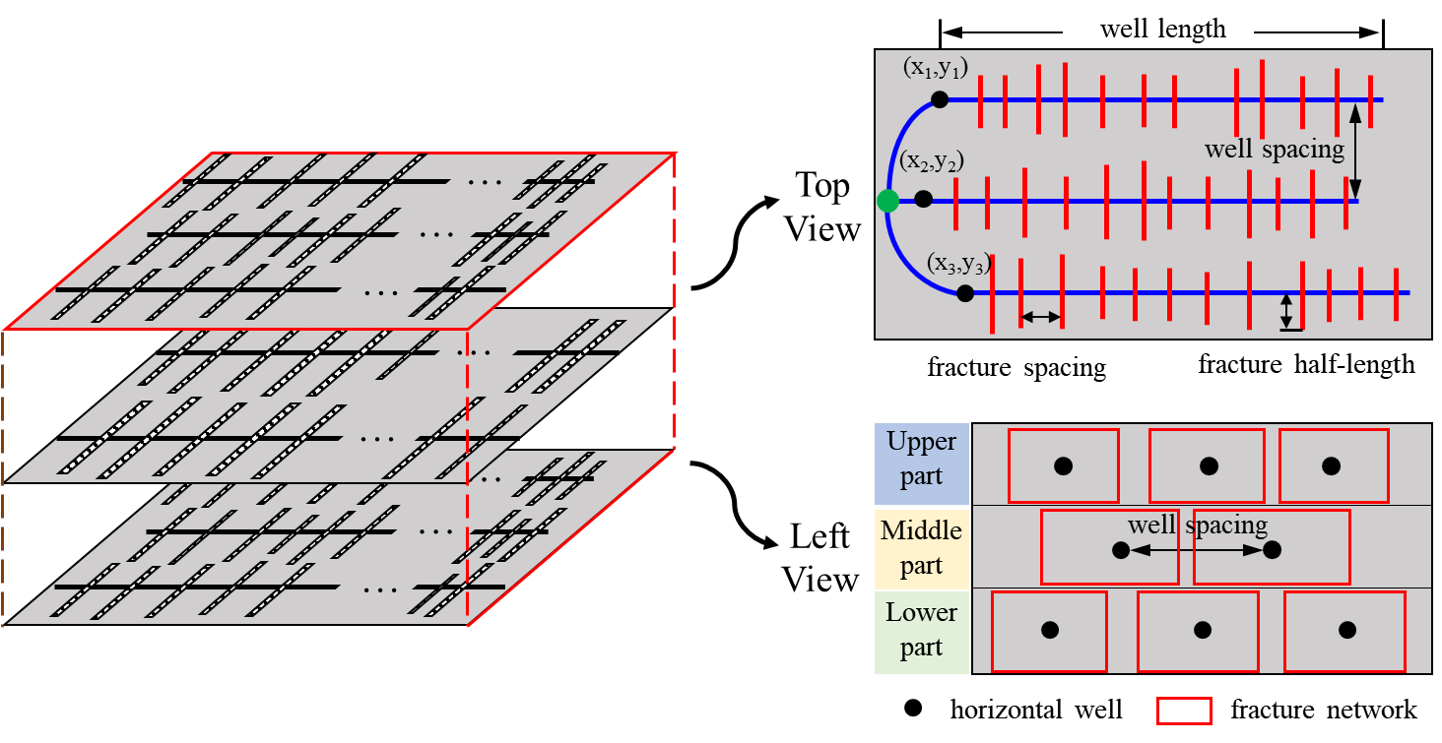
1. Background
In iterative optimization, the numbers of horizontal wells and hydraulic fractures may vary. The dimensionality of the optimization variables is variable.
The dimension of the variable is m * n, where both m and n are variables.
3D development model
Well–fracture optimization parameters
Transformed dimensional sample matrix
Variable-Dimensional Evolutionary Transfer Optimization(VDETO) framework
[1] Zhao, D., Yao, J., Huang, Z. et al. 2026. A Variable-Dimension Evolutionary Transfer Optimization Framework for Well-Fracture Pattern Cooptimization of Fractured Horizontal Wells in Shale-Gas Reservoirs. SPE J. SPE-233396-PA (in press; posted 17 April 2026). https://doi.org/10.2118/233396-PA
Notes:
For 3D shale gas development, we need to optimize the well locations and fracture parameters for each well. However, the optimal number of wells and fractures are not known in advance. candidate well–fracture scheme can be viewed as a m×n matrix, where m represents the number of wells and n represents the fracture-related parameters. both m and n are variable, different candidate schemes may have different dimensions. Traditional optimization methods usually assume a fixed solution dimension, so they cannot handle this problem effectively.

Slide 5
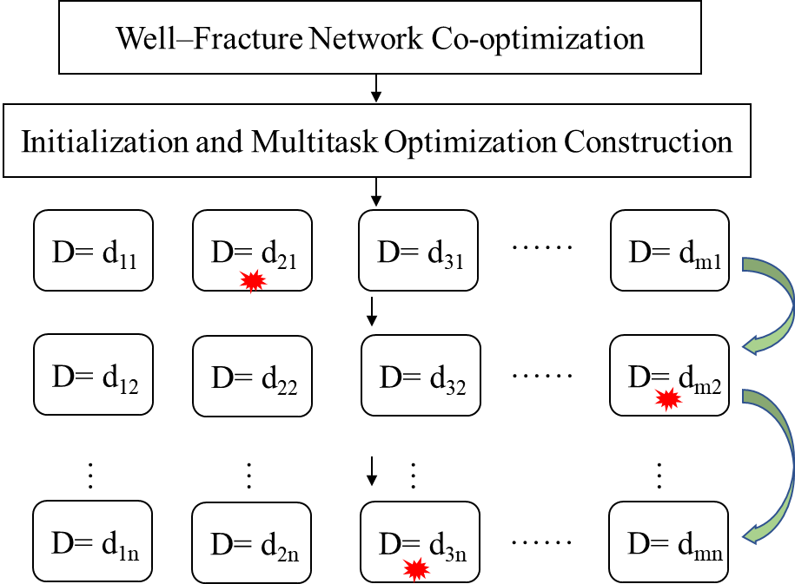
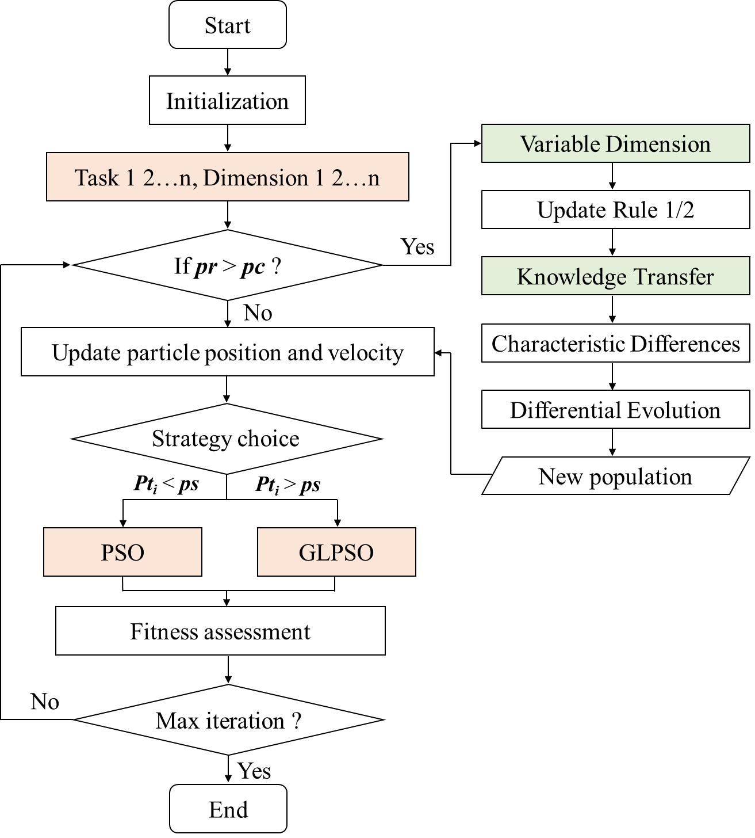
2. Optimization algorithm
①
③
Task repository containing the optimal well–fracture scheme
②
Adaptive adjustment of solution-vector dimensionality
Efficient information exchange among populations with different dimensions
Coordination between individual historical best solutions and global multidimensional decisions
Notes:
This is the framework of our method.
First, we transform the variable-dimensional optimization problem into a multitask optimization problem. Each task represents one specific dimensionality, and the task dimension can be adjusted during the optimization process.
After building this task library, we perform the optimization following the framework shown on the right. It mainly includes three parts

Slide 6
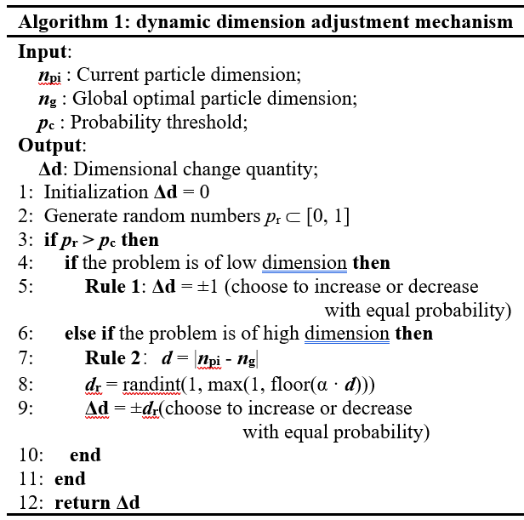
2. Optimization algorithm
1. Probability-Controlled Dimensional Adaptation
Under stochastic probability control, specific rules for dimension increase and decrease are defined for high and low dimensional problems, respectively, enabling the automatic optimization of the number of horizontal wells without the need to prescribe it in advance through sensitivity analysis.
Low dimensional tasks
increase if p_{r} > p_{c}
decrease if p_{r} > p_{c}
The variable dimensionality is 5 × m, where m is also a variable.
High dimensional tasks
Transformed dimensional sample matrix
Probability-controlled dimensional adaptation
Pseudo-code of dynamic dimension adjustment mechanism
Notes:
First, we propose a probability-controlled adaptive dimension mechanism.
Different dimension-changing rules are designed for different dimension tasks. For low dimension, It only allows for an increase or decrease of one dimension. For high dimension , it allows the dimension to vary within a certain range. To avoid premature convergence, dimension adjustment is triggered only when a random probability exceeds a predefined threshold during each iteration.

Slide 7
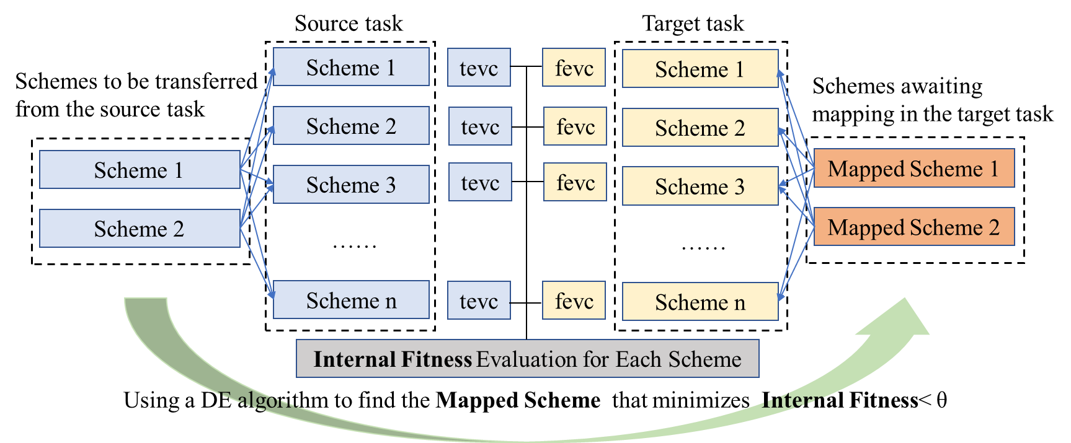
2. Optimization algorithm
2. Cross-Task Mapping Based on Population Feature Differences
Source task feature vector
Target task feature vector:：
Internal fitness function:
Cross-dimensional mapping optimization model:
A cross-dimensional mapping optimization model is established based on the characteristic differences among population individuals, and the internal fitness function is solved using the differential evolution algorithm
Notes:
Then, we propose a cross-task mapping mechanism based on population feature differences. As shown in the figure, the source task and target task have different dimensions. To transfer schemes from the source task to the target task, we first calculate their feature differences in the source task and then compare them with the assumed mapped schemes in the target task. After that, an internal fitness value is defined to measure the mapping quality. Finally, differential evolution is used to optimize the mapped schemes, and the schemes with the smallest internal fitness are selected as the final mapped scheme.

Slide 8
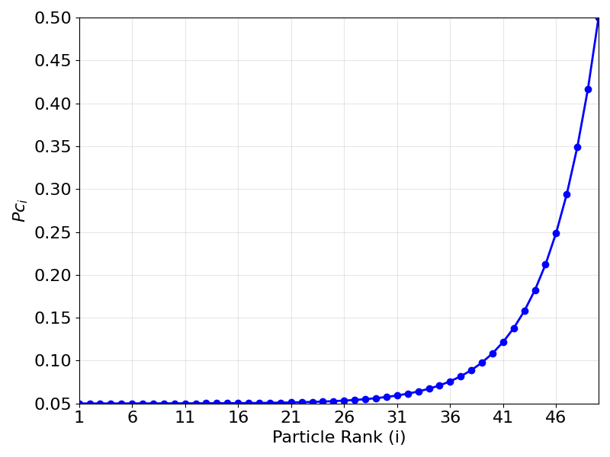
2. Optimization algorithm
3. Global-Local Particle Swarm Optimization Algorithm Based on Fitness Ranking
Global best direction across all tasks
GLPSO particle direction
Heterogeneous knowledge was globally shared among populations of different dimensionalities.
Inertia direction
Current-task global best direction
PSO particle direction
Resultant vector
Personal best direction
Particle
Particle Sorting Calculation Equation ：
PSO Velocity Update Equation(Ranking high) ：
GLPSO Velocity Update Equation(Ranking low):
Particle Position Update Equation ：
Ranking of Particle Fitness Values
Notes:
We develop a global-local particle swarm optimization strategy.
All particles are ranked by their fitness values. Particles with better performance update their velocities using the standard PSO rule, while poorly performing particles are updated using the GLPSO rule.
The key idea of GLPSO is to replace the current-task best solution with the global-task best solution. In this way, good particles continue searching in their current promising direction, while poor particles receive a global guidance to explore potentially better regions.

Slide 9
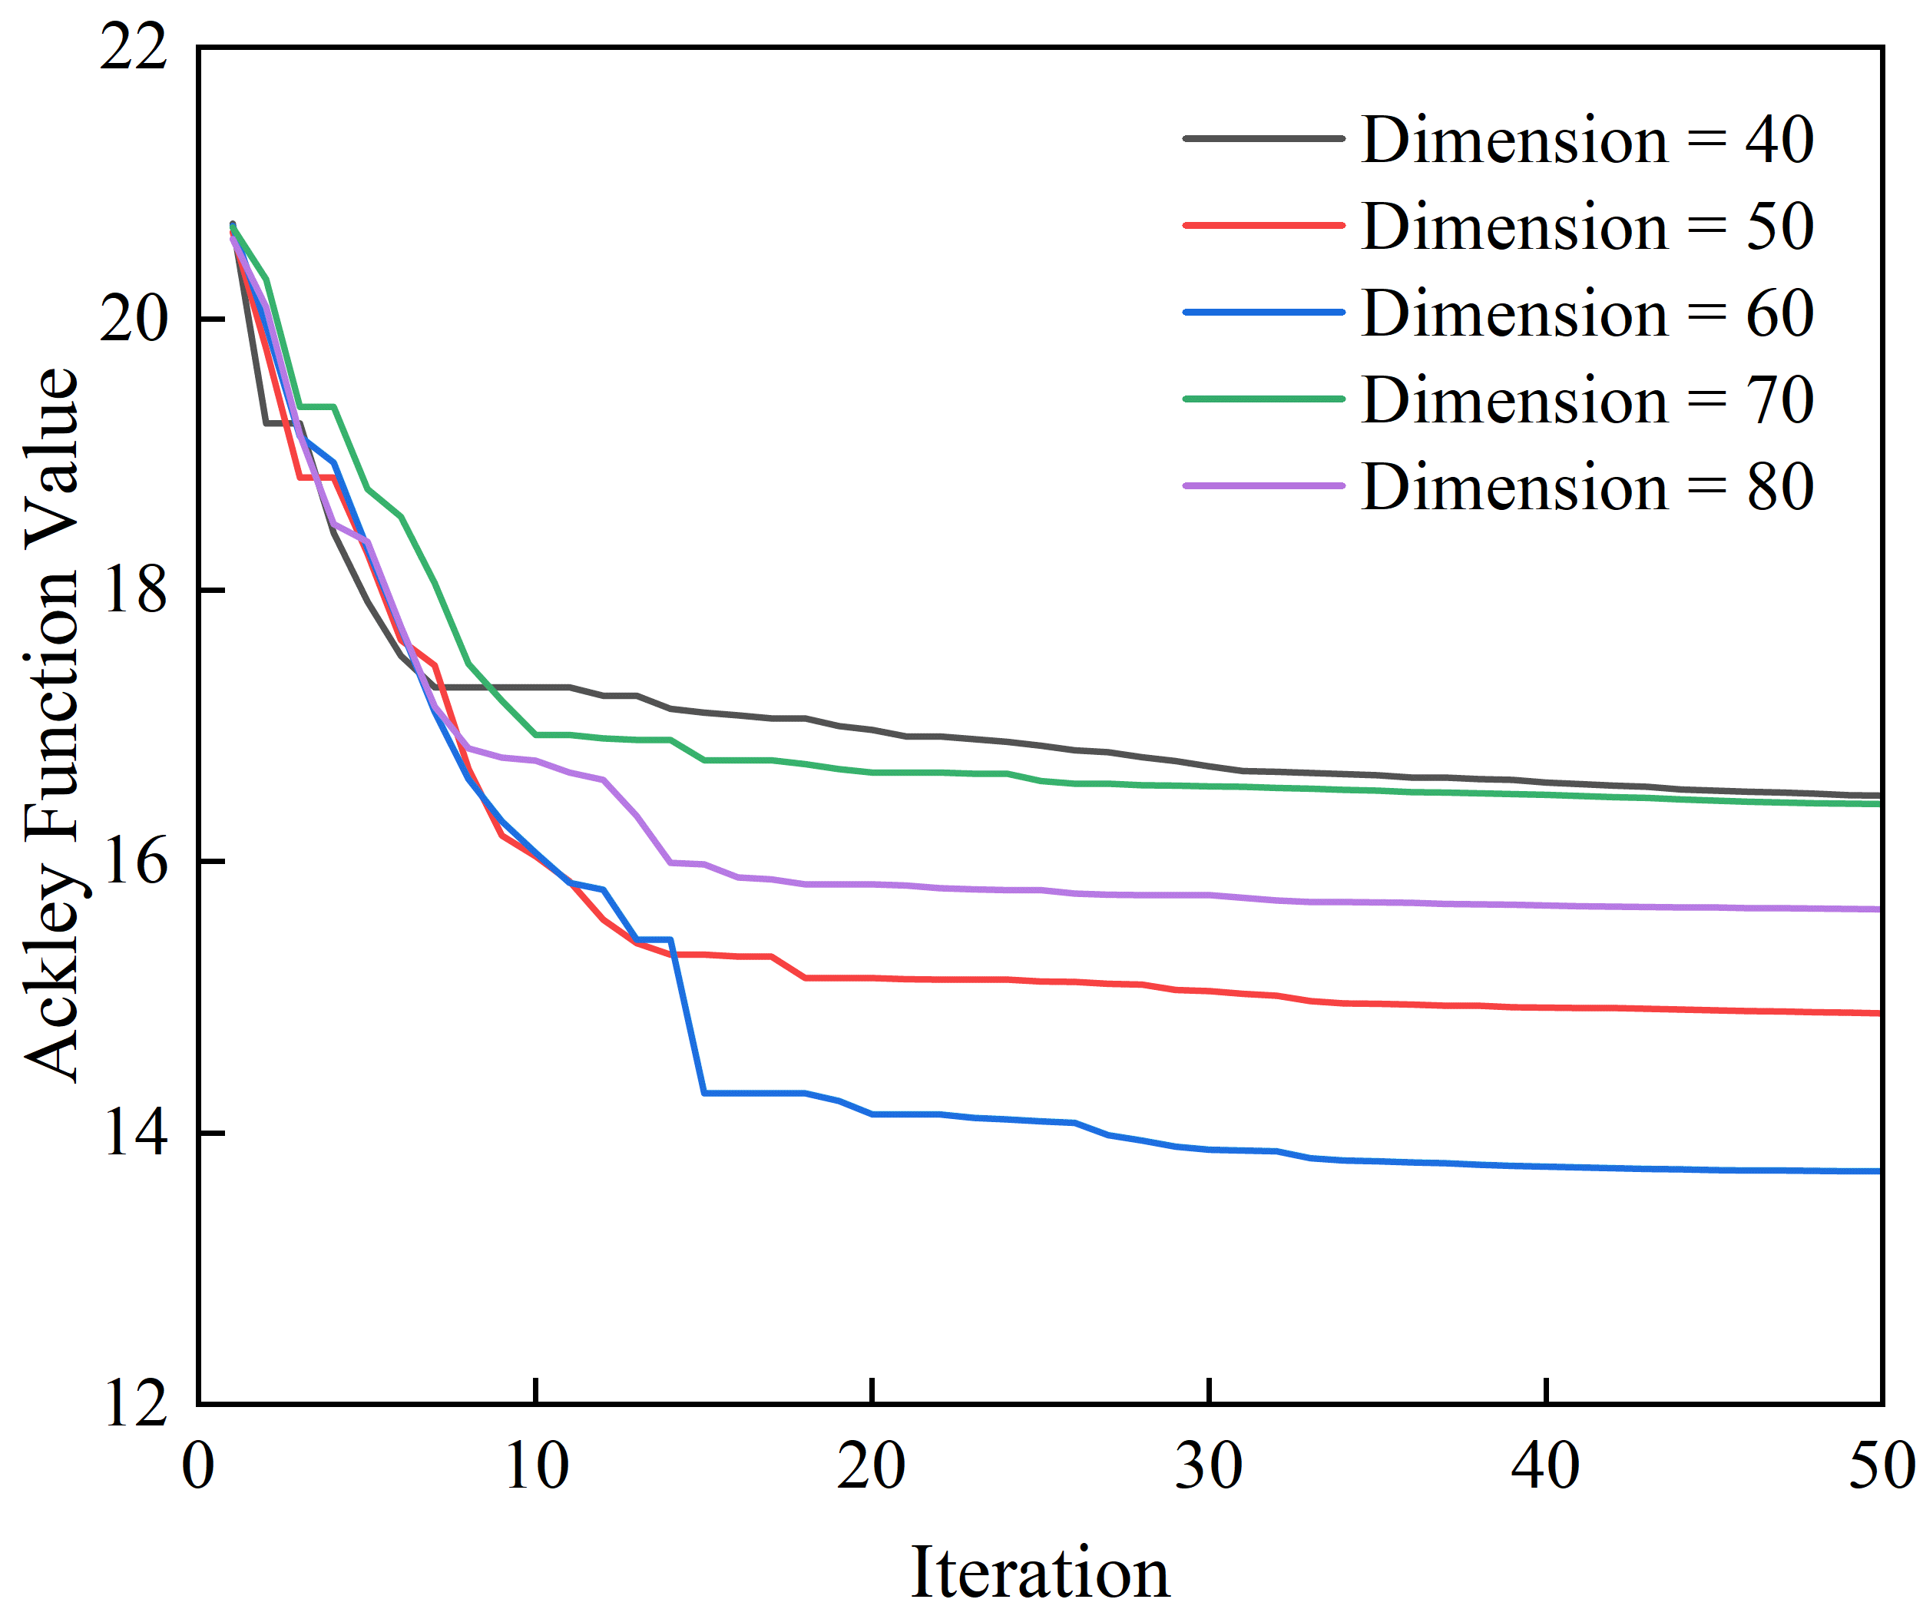
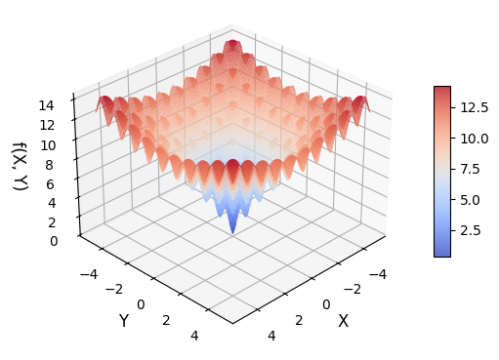
3. Algorithm Testing
Variable-Dimension Mathematical Problem
For the Ackley function over the dimension range of 40–80, the minimum value occurs around dimension 60, indicating the existence of an optimal dimension at which the function attains its minimum.
When a=20, b=0.5, and c=2π, the function plot is shown below
Optimization Results of the Ackley Function under Different Dimensions
2D Ackley Function Plot
Notes:
Next, we test the VDETO on a mathematical problem.
We use the Ackley function and search for its minimum with PSO over dimensions from 40 to 80. The results show that the minimum value does not change monotonically with dimension, but reaches the lowest value around 60 dimensions.

Slide 10
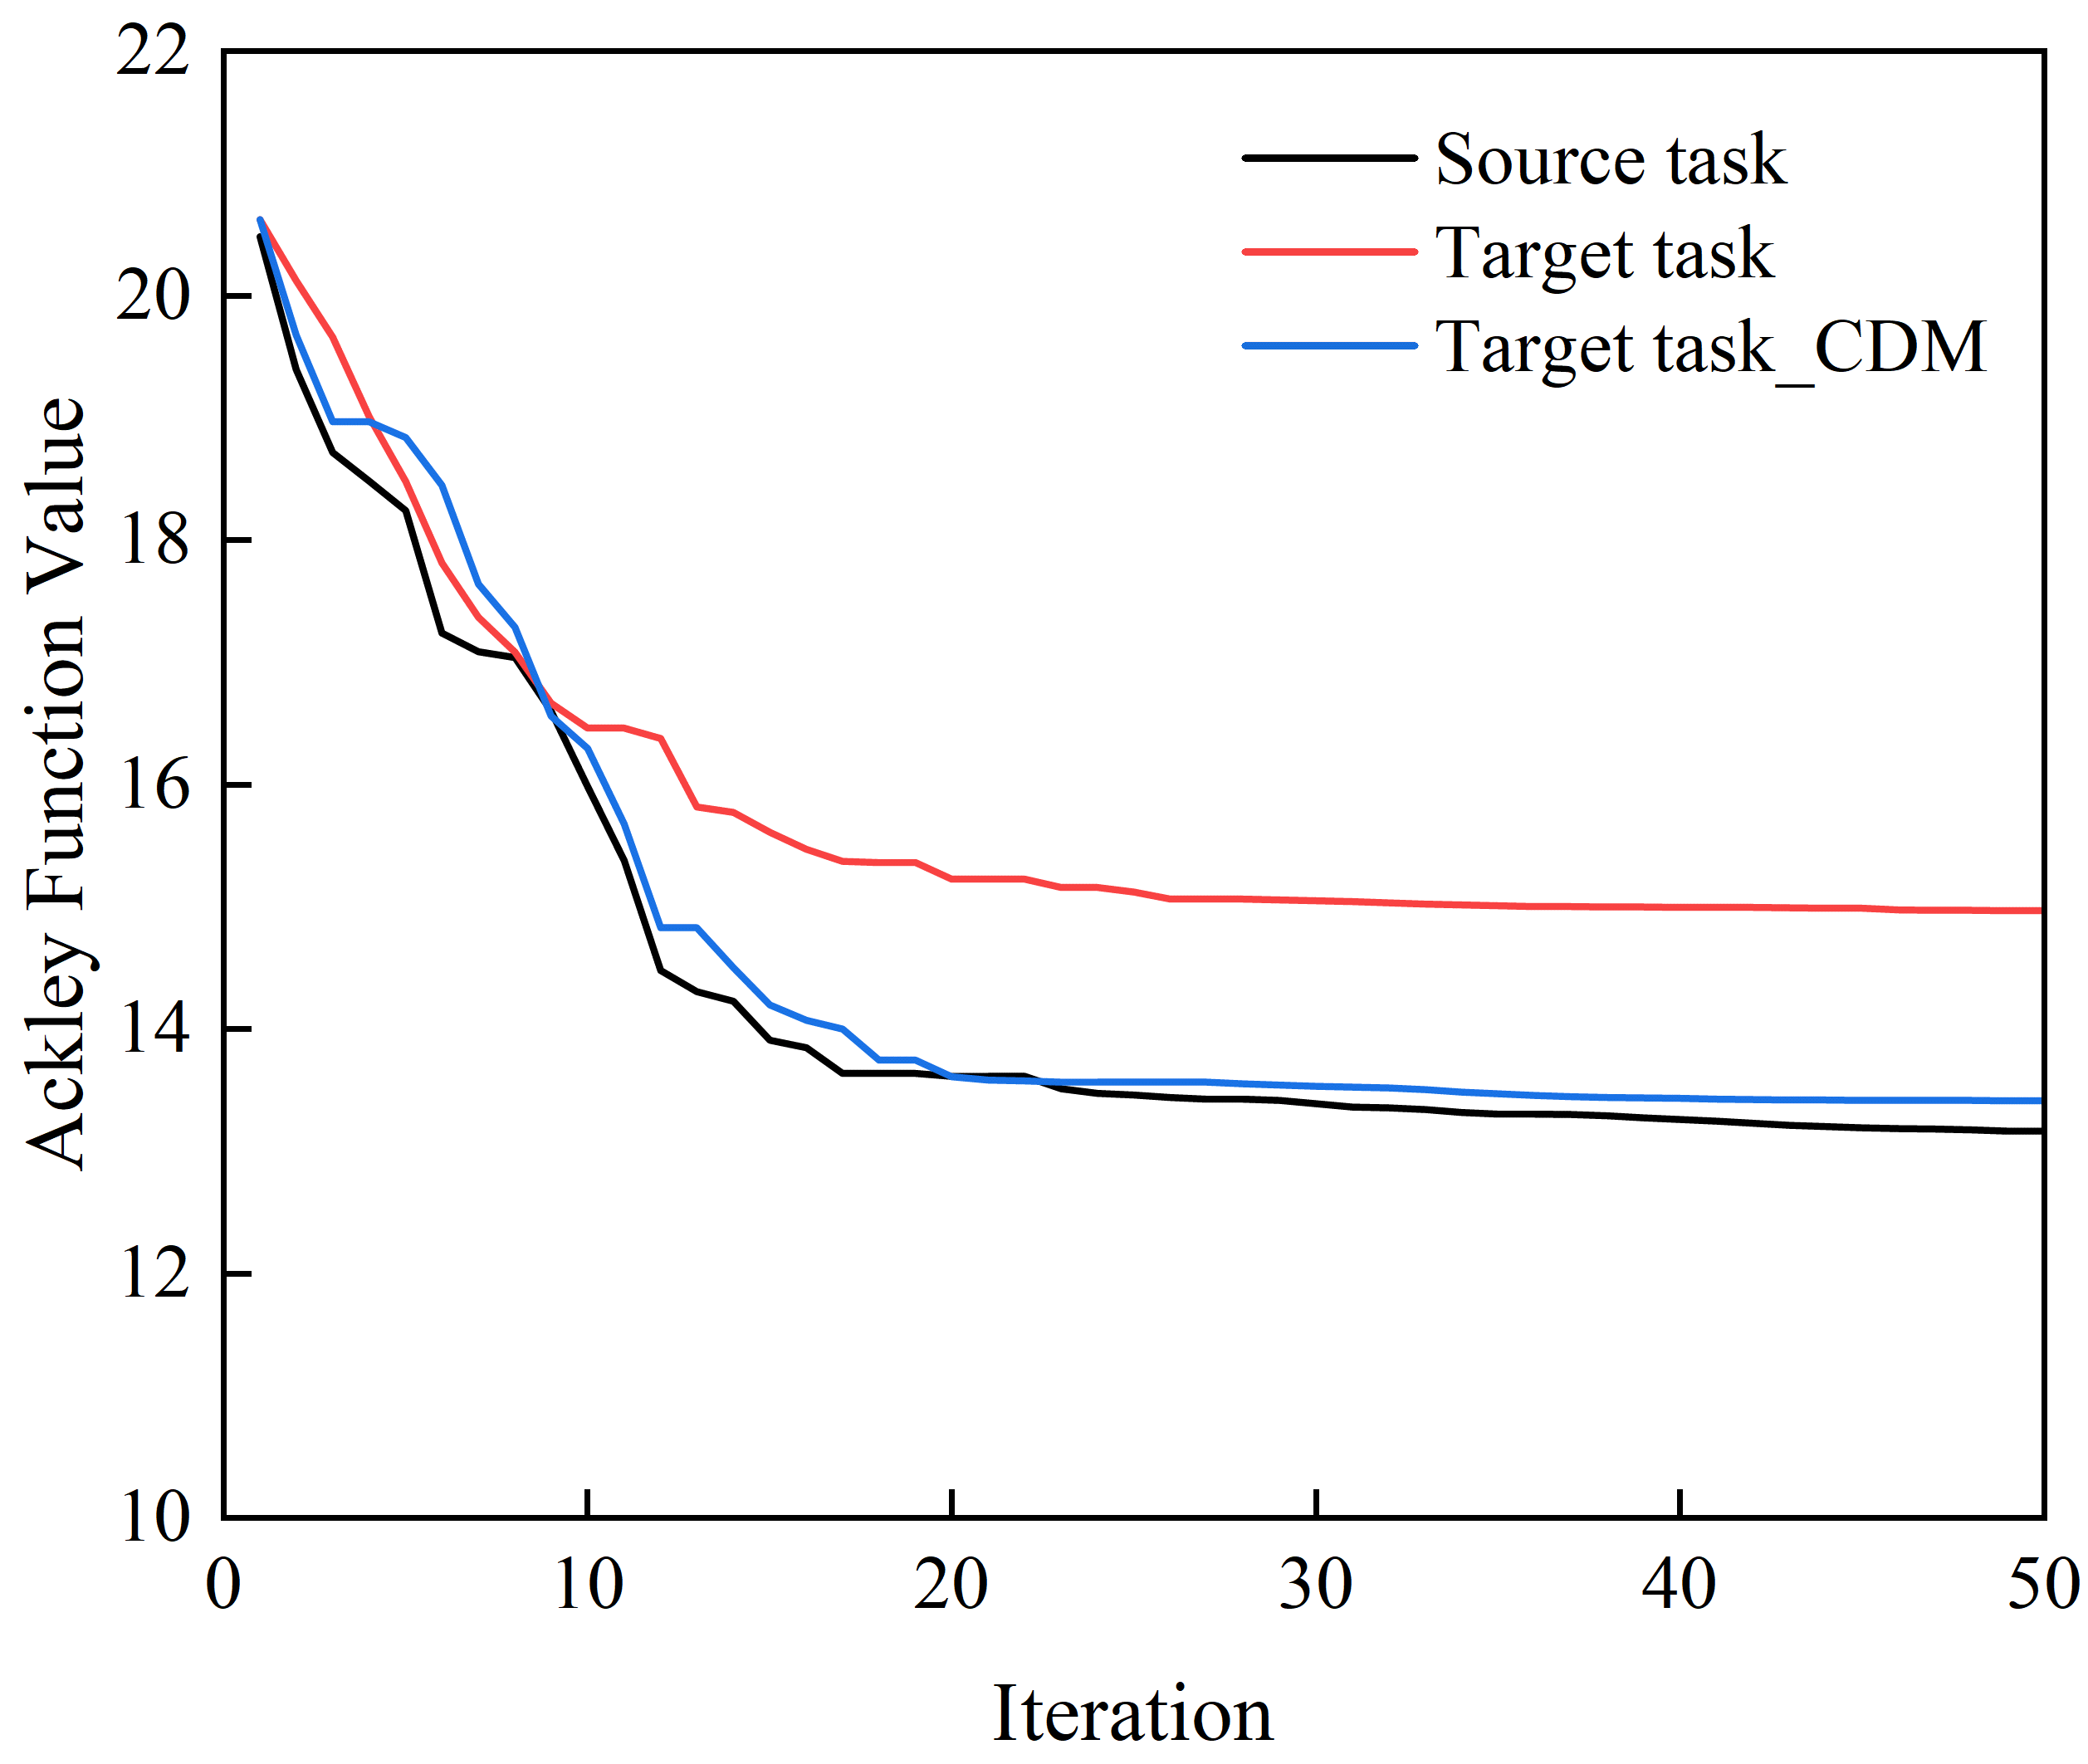
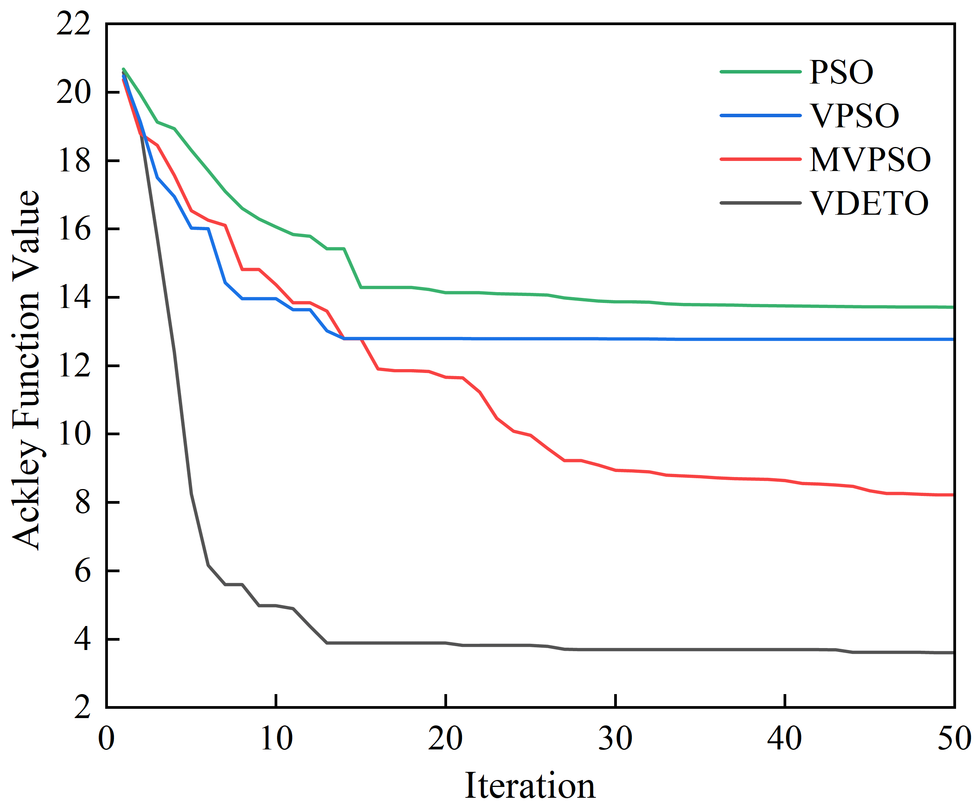
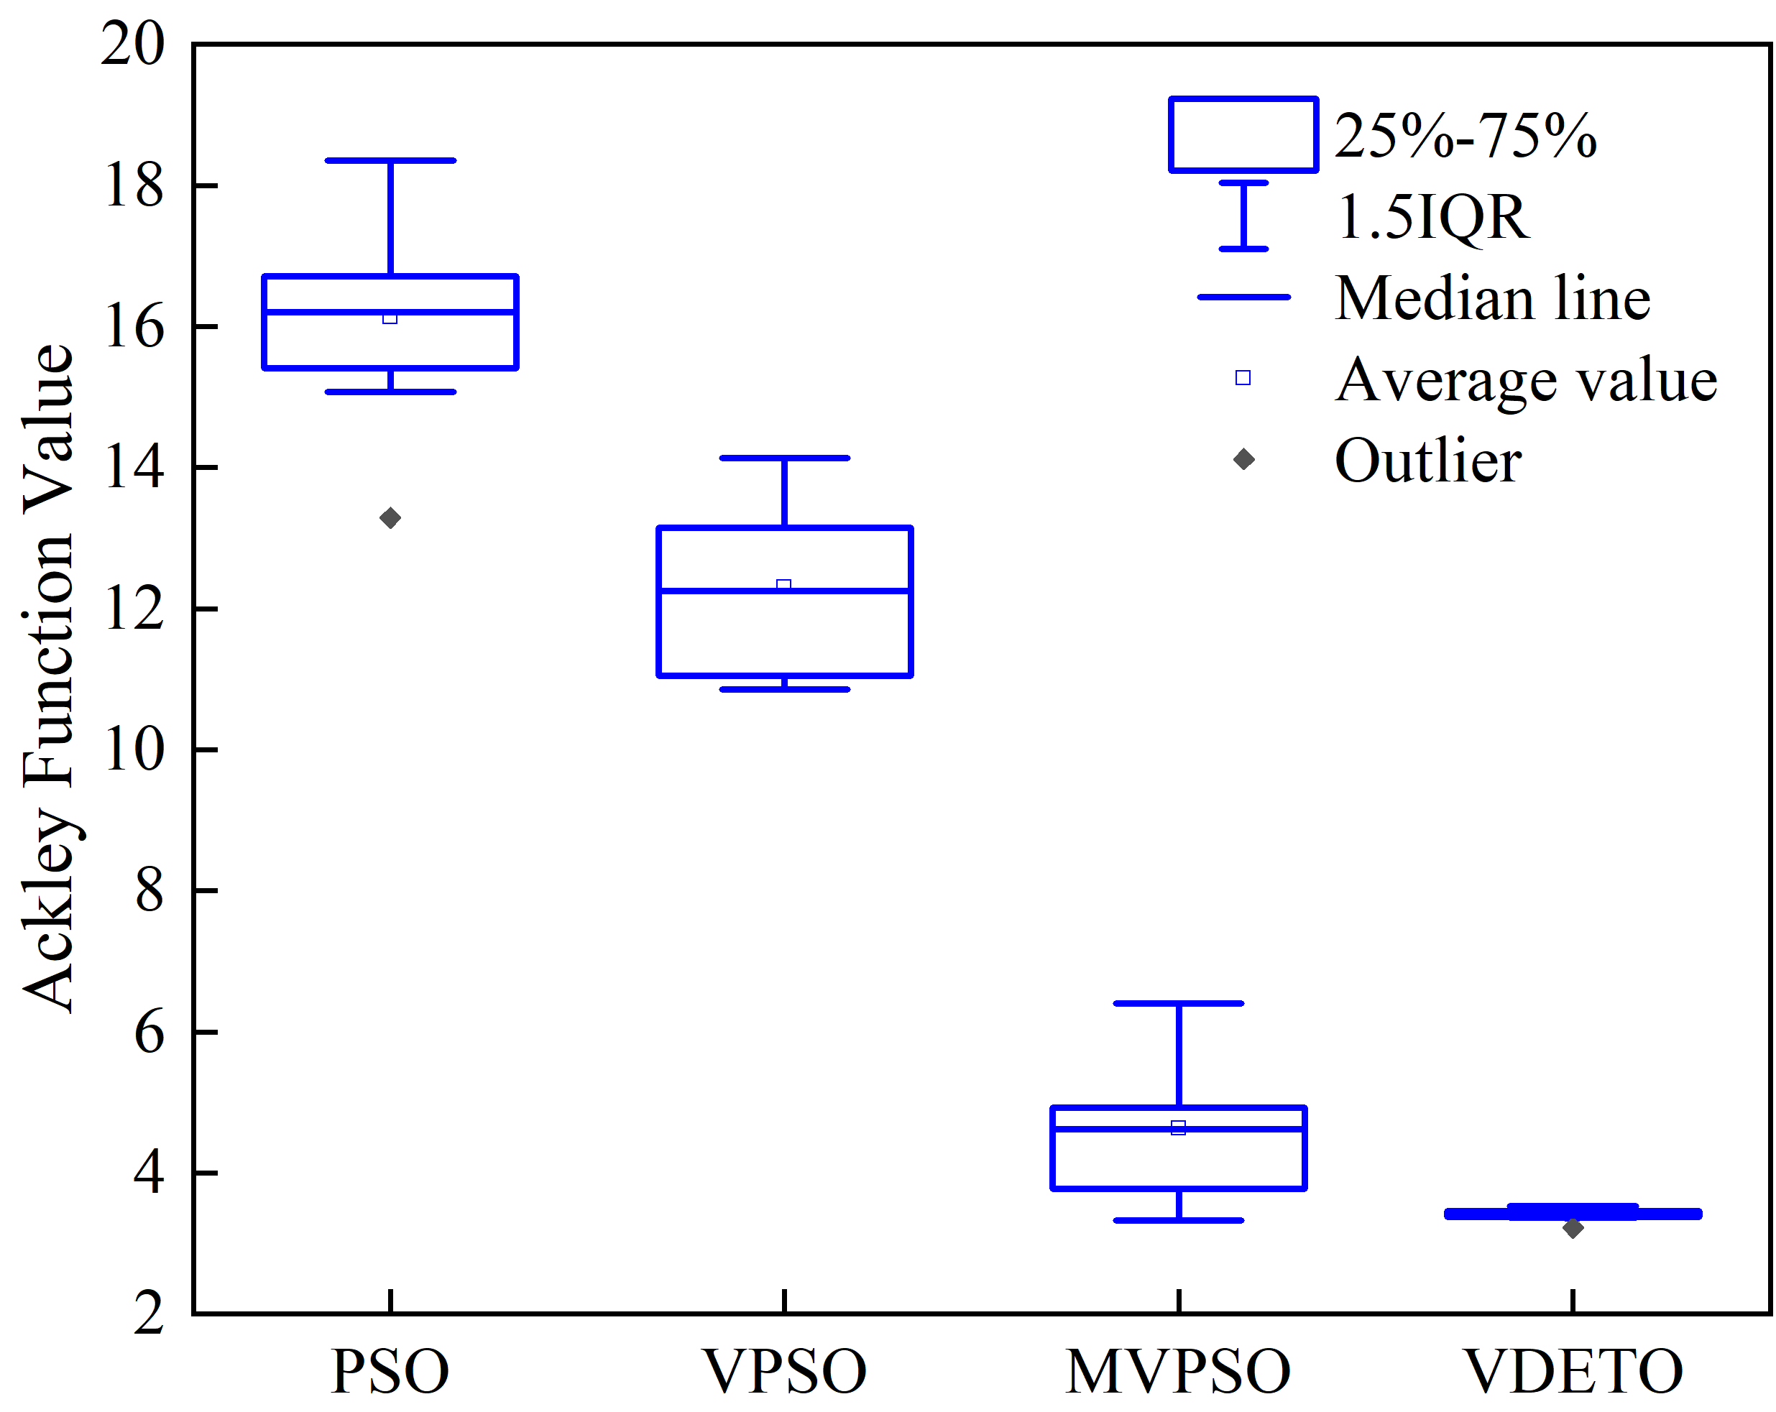
3. Algorithm Testing
Results of Mathematical Problem Testing
Evaluation of Knowledge Transfer Effectiveness, Optimization Performance, and Algorithm Stability
Optimization effect of cross-dimensional mapping transfer
Results of different algorithms on the variable-dimension Ackley function
Distribution of Ackley values from 10 independent runs of the four schemes
Knowledge transfer improves the optimization performance by 10.35%.
VDETO exhibits significantly better convergence speed, optimization ability, and robustness than the other methods.
Notes:
These are the optimization results.
The left figure tests the effectiveness of knowledge transfer. We transfer information from a 30-dimensional source task to a 40-dimensional target task. Compared with separate optimization, knowledge transfer improves the result by about 10.35%.
The middle figure shows the VDETO achieves the best performance. The right figure presents the statistical results of 10 repeated runs, showing that VDETO consistently performs best and has stronger robustness.

Slide 11
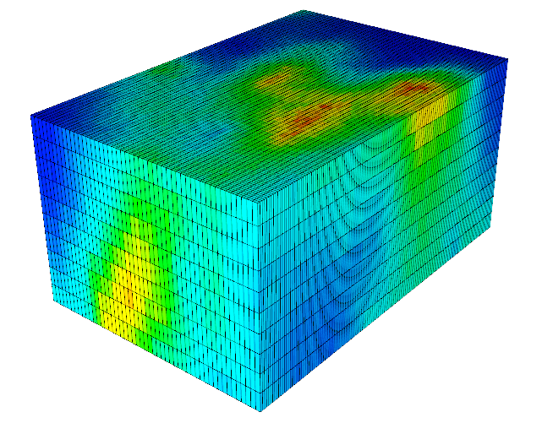
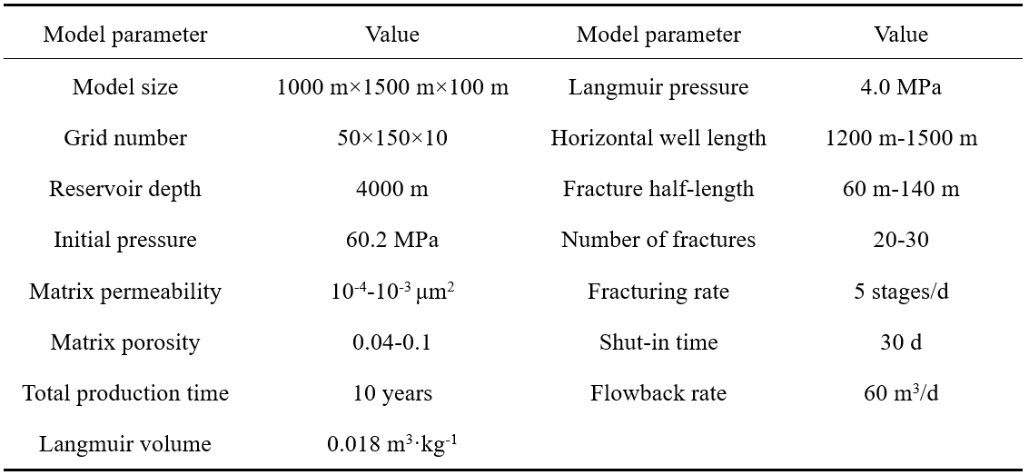
4. Practical Problems
Multi-Well Well Pattern and Fracture Network Optimization
Physical model settings
3D shale gas model :1000×1500×100 m, 50×150×10. Adopt three-layer development, with 2–3 wells in each layer. A gas–water two-phase flow model incorporating gas adsorption and Knudsen diffusion effects was implemented using CMG IMEX.
Shale gas reservoir mechanism model
Basic data of shale-gas reservoir
Notes:
Next, we apply VDETO to a practical case.
We build a 3D shale gas reservoir model .Adopt three-layer development, with 2–3 wells in each layer. the numerical simulation is performed using CMG IMEX.

Slide 12
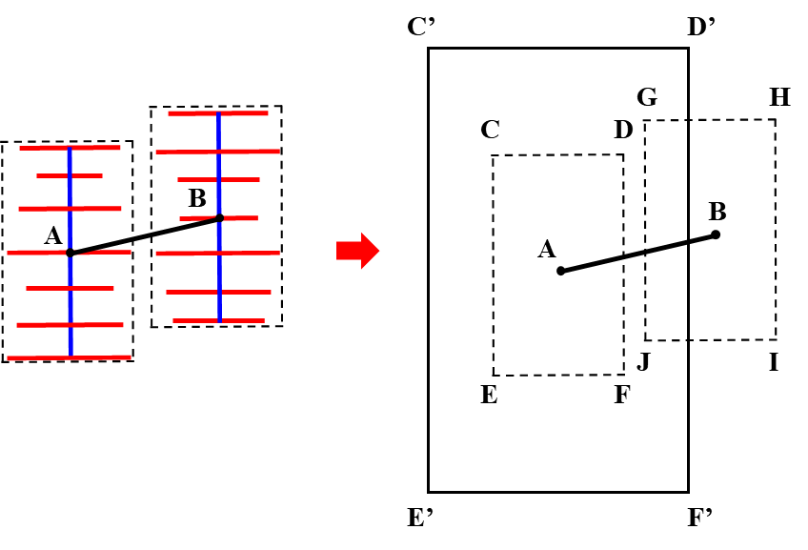
4. Practical Problems
Net present value model
Optimization variables: number of horizontal wells, well placement, half-length of horizontal wells, number of fractures, and fracture half-length.
Fracture Network Non-Intersection Model
Q_{g}​ and Q_{w} denote the gas production and water production, respectively, over the time step Δt. R_{g}​ and R_{w}​ denote the prices of natural gas and water, respectively. O denotes the operating cost. b denotes the discount rate. m denotes the number of horizontal wells. N_{f}​ denotes the number of fractures in each well. C_{well}​ denotes the cost of a horizontal well. C_{xf}​ denotes the relationship between the fracturing-stage cost and the fracture half-length.
Notes:
We build an optimization model with net present value (NPV) as the objective.
To avoid fracture interference, we build a Fracture Network Non-Intersection Model, where the spacing between two wells must be larger than the sum of their maximum fracture half-lengths.

Slide 13
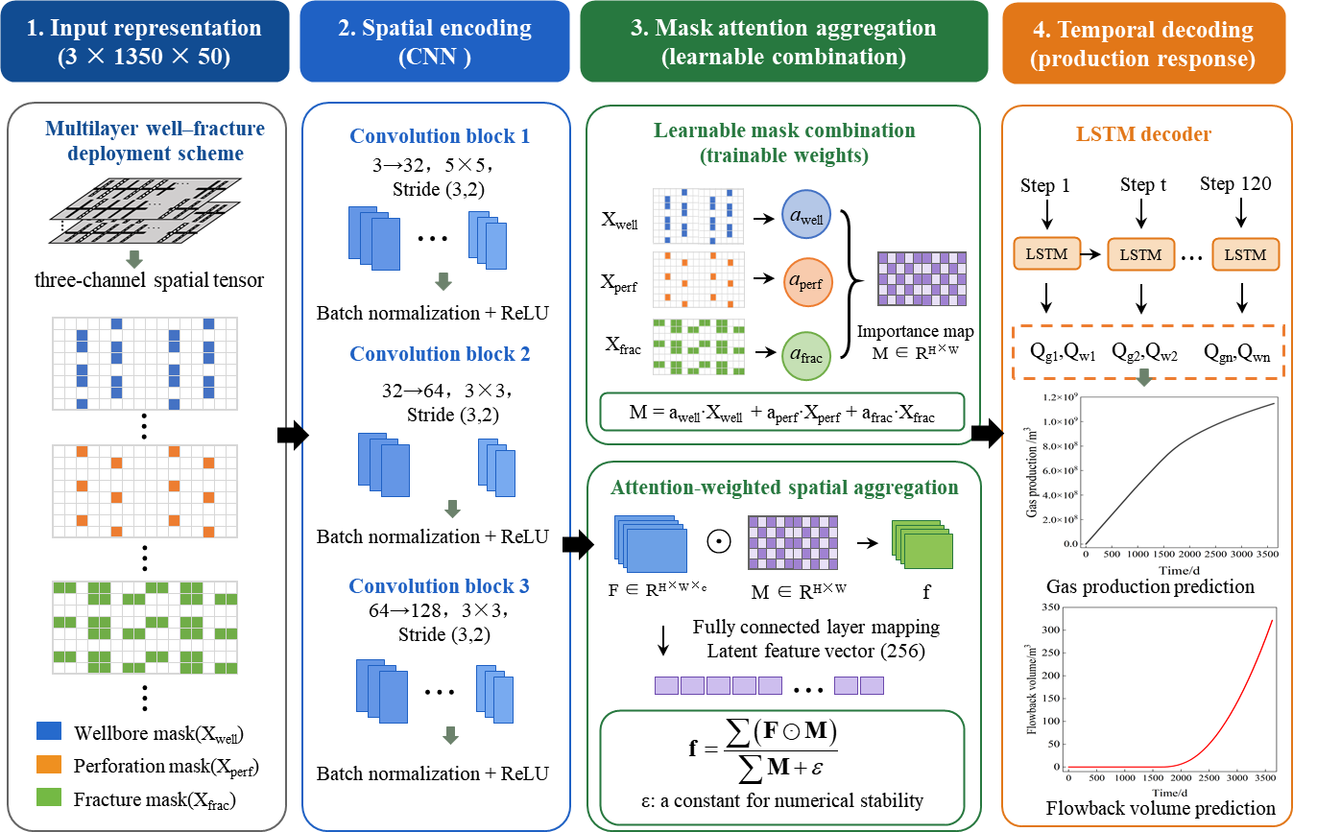
4. Practical Problems
Surrogate model to accelerate optimization process
1.CNN
CNN encoder extracts spatial features
2. Mask Attention Aggreation
Challenge: sparse well-fracture data make conventional CNNs insensitive to key spatial features.
Innovation: Learnable mask attention adaptively weights wellbore, perforation, and fracture masks to highlight production-critical sparse features.
3.LSTM
LSTM decoder predicts gas production and flowback volume over time
Notes:
To accelerate the optimization process, we build a CNN–LSTM surrogate model to replace part of the numerical simulations.
We encode the well–fracture network as digital inputs, but the well and fracture features are sparse compared with the reservoir matrix, making them difficult for CNN to capture. Therefore, we introduce Mask Attention to assign higher weights to these key features and these weights can be automatically learned and adjusted during model training.

Slide 14
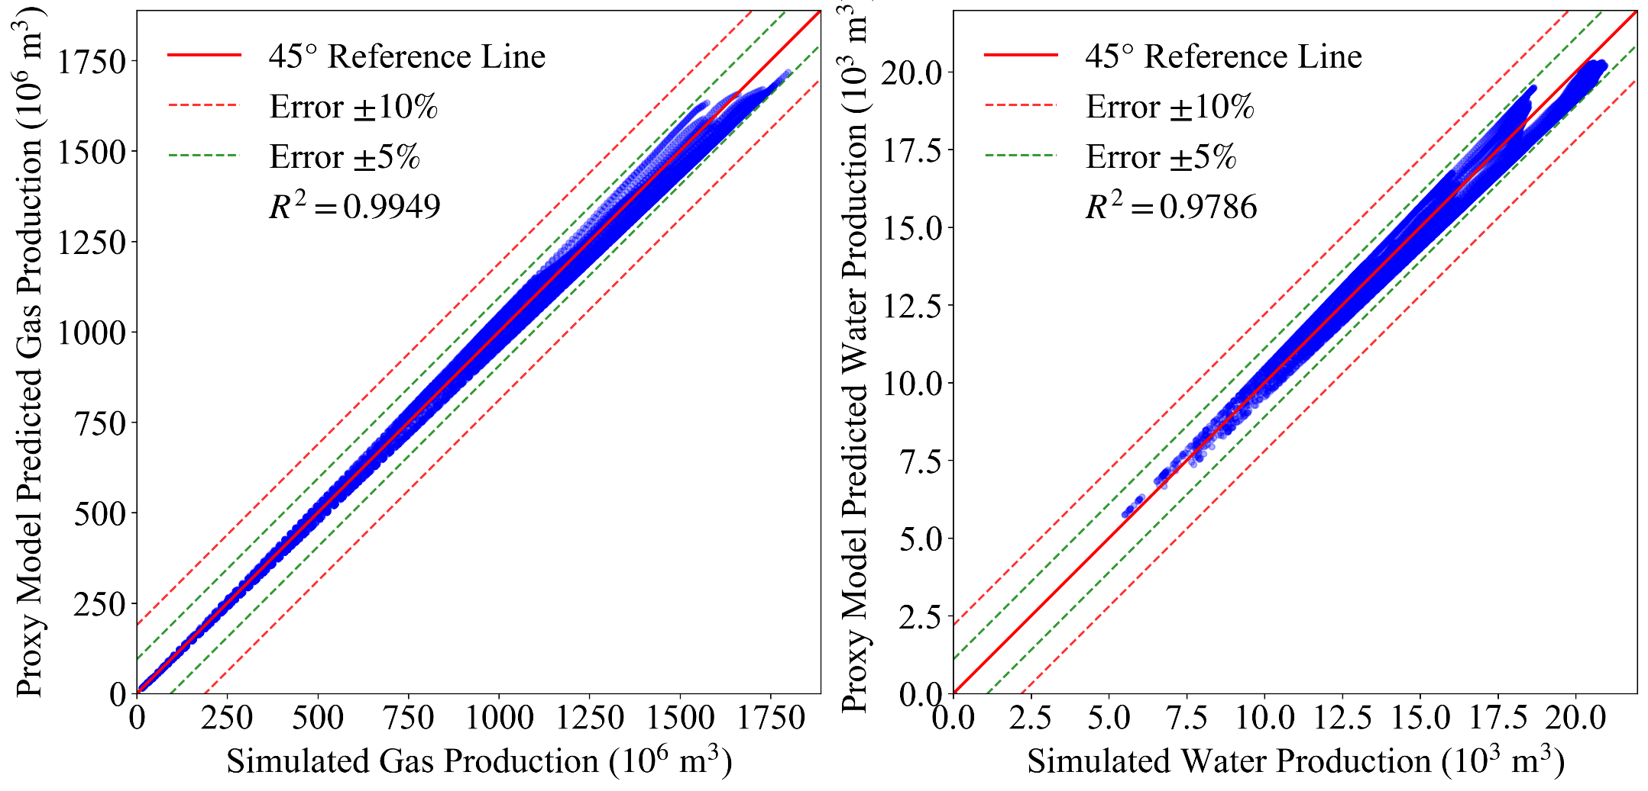
4. Practical Problems
Surrogate Model Validation
Comparison of gas production
Comparison of flowback volume
Full-time-step comparisons show that most prediction errors are within 5%. The R² values exceed 0.99 for gas production and 0.97 for flowback volume, demonstrating accurate dynamic prediction for subsequent optimization.
Notes:
This is the validation of the surrogate model.
Here, we compare the predictions over the full production period. Most prediction errors are within 5%. The R-squared is above 0.99 for gas production and above 0.97 for flowback volume, showing that the model can accurately predict production data

Slide 15
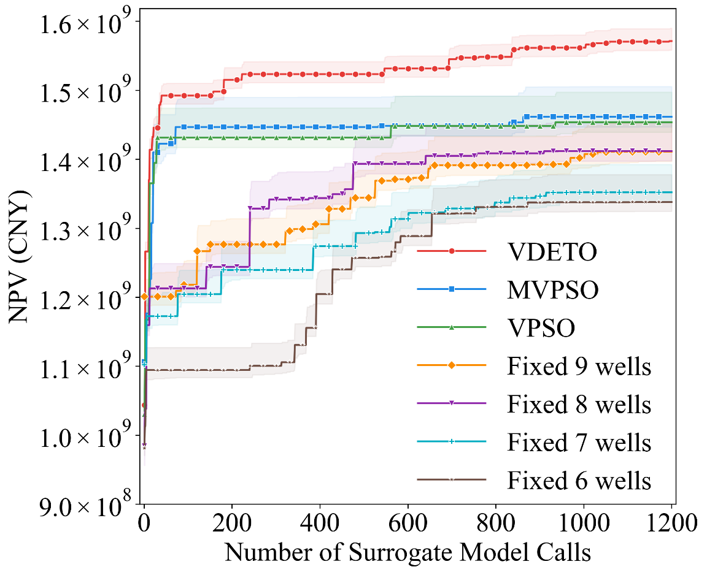
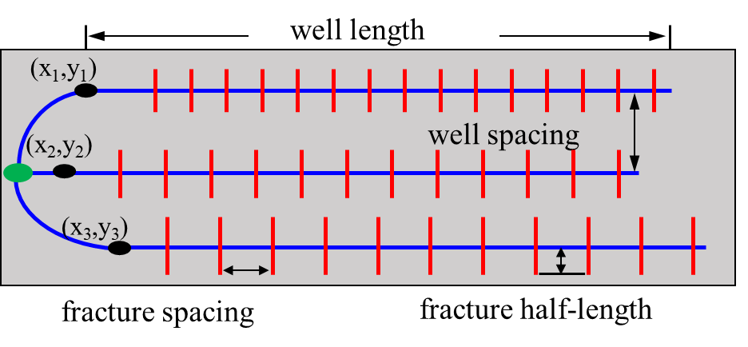
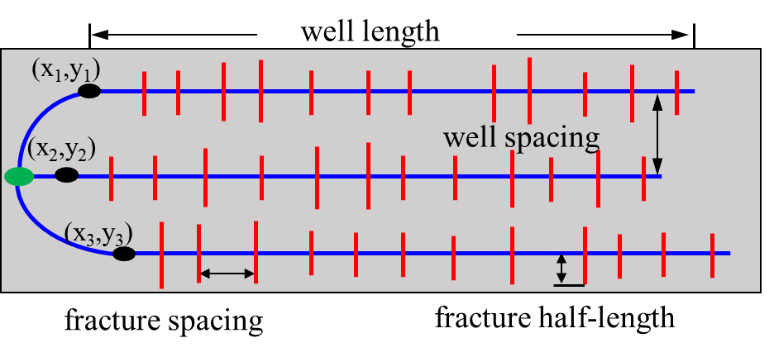
4. Practical Problems
Result
Baseline scheme
Variable-dimensional optimization scheme
Iteration curve
The VDETO achieves the highest NPV of 1.57 × 10⁹ CNY, improving it by 7.5% and 8.1% over MVPSO and VPSO, and by 11%–17% over the baseline scheme.
VDETO shows the narrowest confidence interval, indicating better stability and robustness
Notes:
These are the optimization results.
We compare VDETO with other variable-dimensional methods and baseline schemes, where the baseline uses equally spaced fractures with the same half-length for each well.
VDETO achieves the highest NPV, improving it by 7.5% and 8.1% over MVPSO and VPSO, and by 11%–17% over the baseline schemes. It also shows the narrowest confidence interval, indicating better robustness.

Slide 16
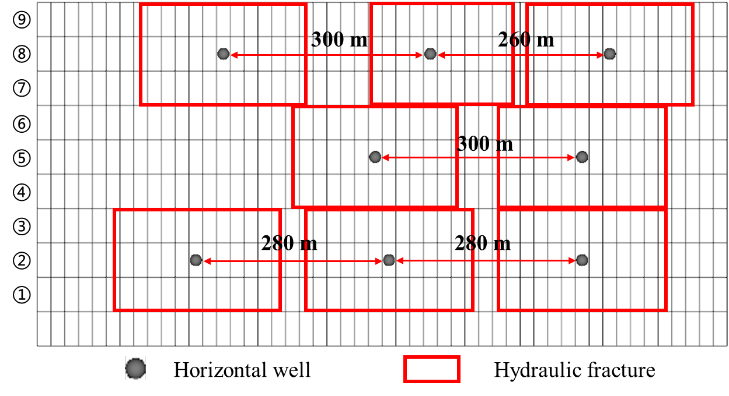
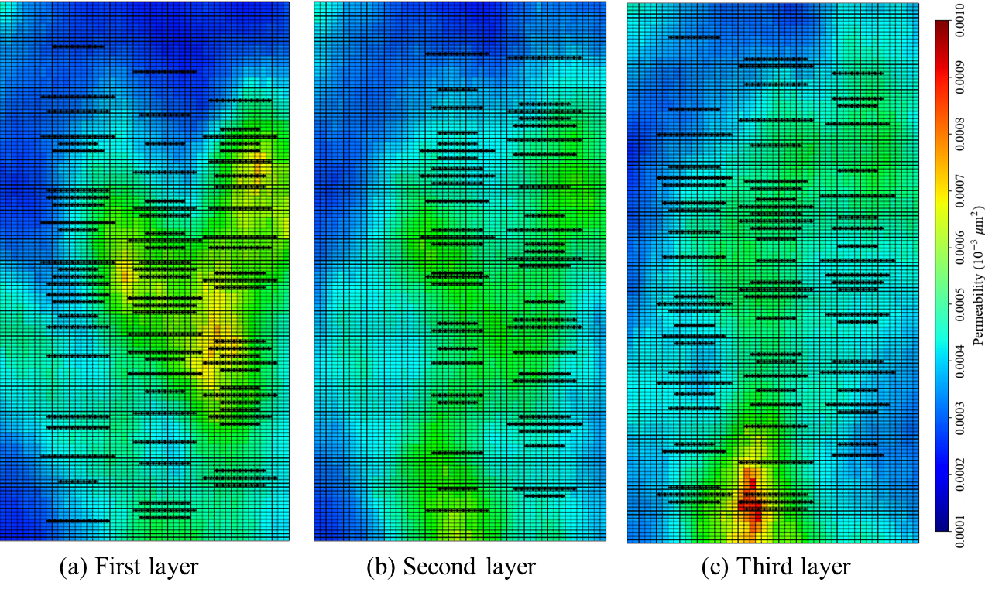
4. Practical Problems
Result
Optimal well placement
Optimal fracture layout
Well placement: VDETO result shows clear inter-layer adaptation: more wells are placed in Layers 1 and 3 with better flow conditions and fewer wells are placed in Layer 2.
Fracture layout: The optimized fractures adapt to reservoir heterogeneity and form an alternating spindle–dumbbell fracture pattern.
Notes:
The VDETO result shows clear inter-layer adaptation: more wells are placed in Layers 1 and 3 with better flow conditions, while fewer wells are placed in Layer 2.
For the fractures, longer fractures are mainly arranged in high-permeability areas, while shorter fractures are used in low-permeability areas, forming an alternating spindle–dumbbell fracture pattern.

Slide 17
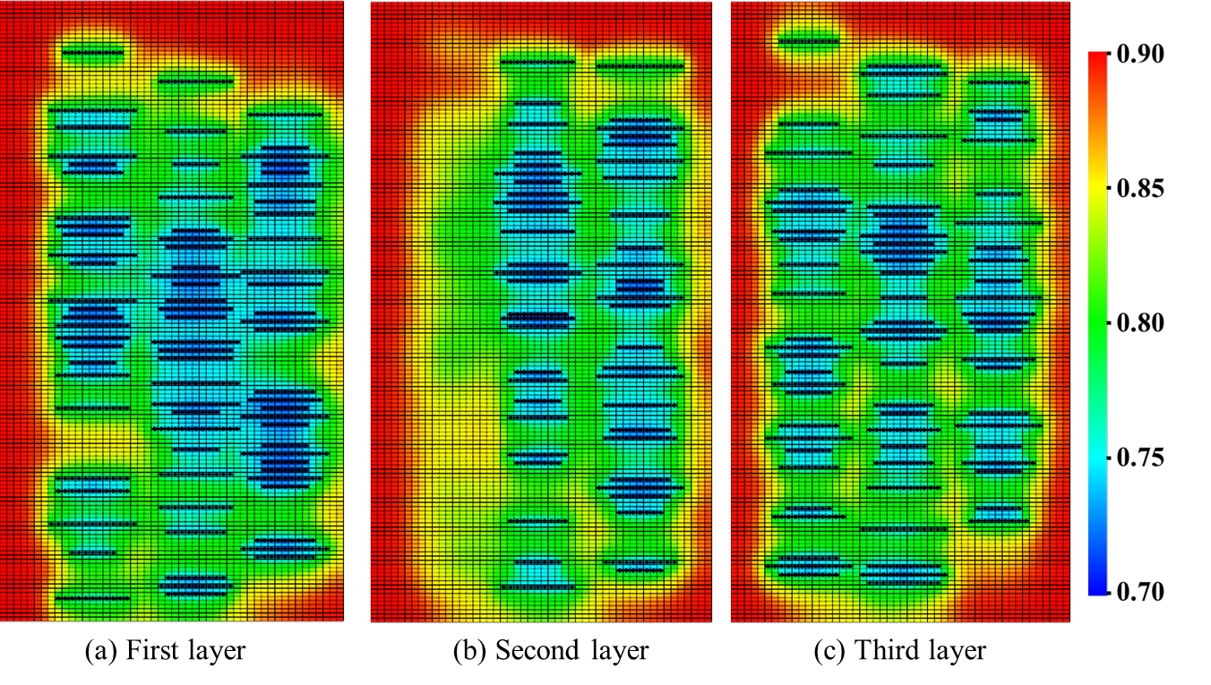
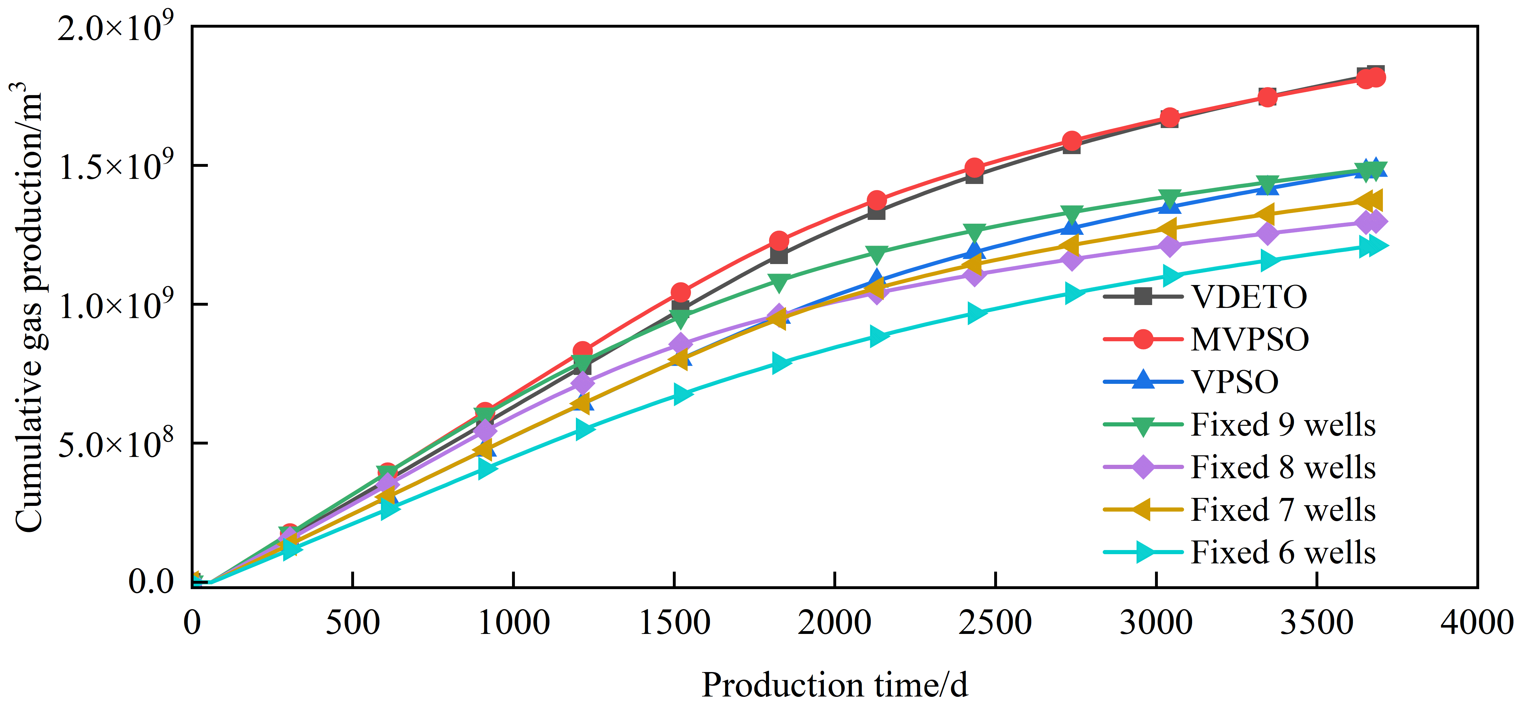
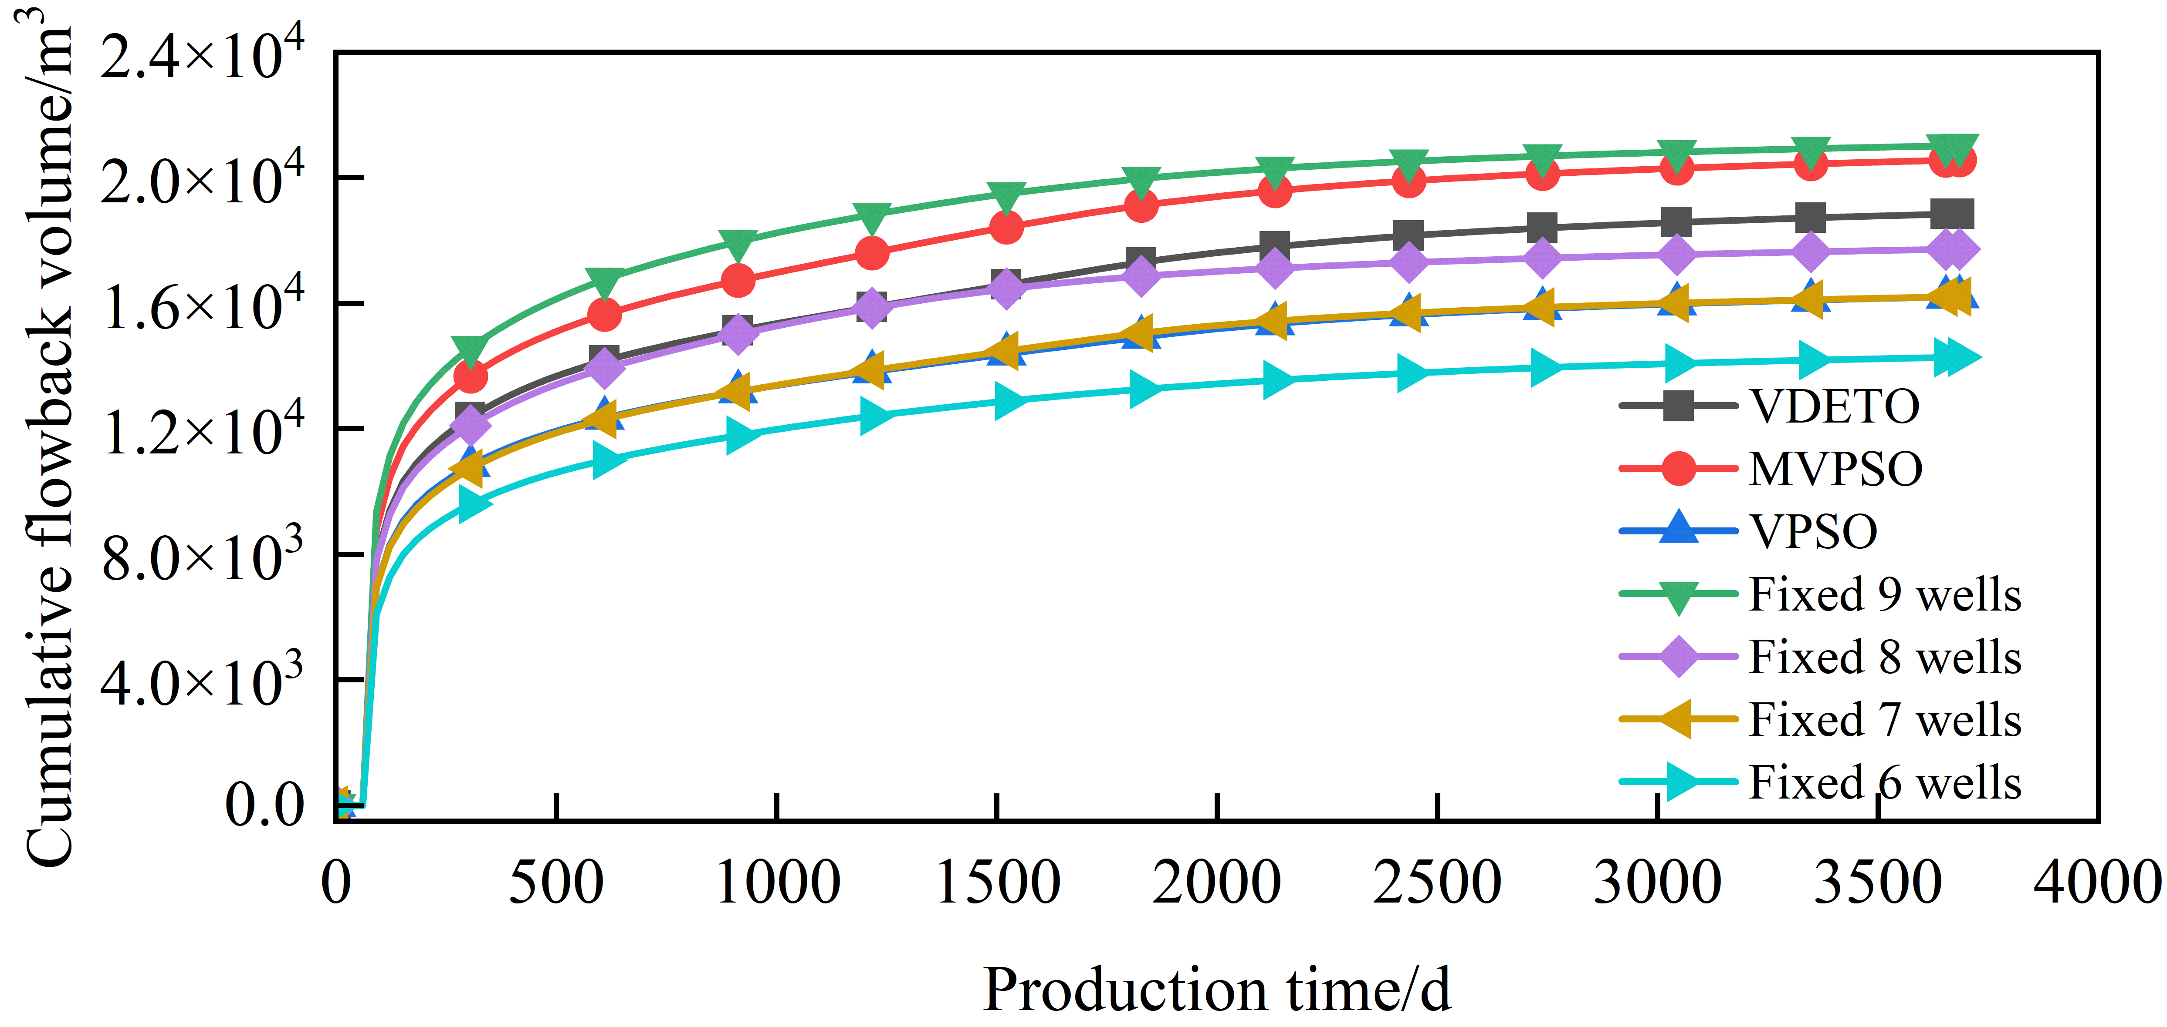
4. Practical Problems
Result
The non-uniform fracture scheme, especially VDETO, improves gas production and reduces flowback volume by better balancing well number, fracture scale, and stimulation intensity.
Gas Saturation after 10 Years of Production
Cumulative Gas Production and Flowback Volume
Notes:
Finally, we compare the 10-year production data of different schemes.
Compared with other methods, VDETO achieves higher gas production and lower flowback volume , leading to a higher NPV by better balancing well number, fracture scale.

Slide 18
Acknowledgements & Q&A
Acknowledgements
The author would like to sincerely acknowledge the guidance of Professor Jun Yao and the financial support from the Research Center of Oil and Gas Flow and the National Natural Science Foundation of China (Grant No. U24B6001).
Contact Information
Name: Zhaodali
Research Center of Oil and Gas Flow
State Key Laboratory of Deep Oil and Gas/China University of Petroleum (East China)
Email: zhaodaliupc@163.com
Thank You for Your Attention!
Notes:
Finally, I would like to thank Professor Jun Yao for his guidance on this work, and the National Natural Science Foundation of China for the financial support. Thank you for your attention.

