Slide 1
InterPore2026: MS20—Special Session in Honor of Jun Yao
Numerical simulation of reactive flow in fractured vuggy carbonate reservoirs considering hydro-mechanical-chemical coupling effects
Zhao-Qin Huangª, Cun-Qi Jia^{b}, Jun Yaoª, Yu-Shu Wu^{c}
ª Research Center of Multiphase Flow in Porous Media, China University of Petroleum (East China), China
^{b} Earth Systems Science and Engineering, King Abdullah University of Science and Technology, Saudi Arabia
^{c} Department of Petroleum Engineering, Colorado School of Mines, United States
19-22 May 2026, Nantes, France
Notes:
Good morning/afternoon, everyone. It is a great honor to be here at InterPore 2026, especially in this special session organized in honor of Professor Jun Yao. My name is [Your Name], from the Research Center of Multiphase Flow in Porous Media at the China University of Petroleum (East China). Today, I will be presenting our research on the "Numerical Simulation of Reactive Flow in Fractured Vuggy Carbonate Reservoirs."

Slide 2
Outline
1. Background and motivation
2. The hydro-mechanical-chemical model
3. Numerical scheme and examples
4. Remarks and future works
Notes:
My presentation is divided into four main parts. First, I’ll discuss the background and motivation behind this work. Then, I will introduce our theoretical model, the Discrete Fracture-Vug Network (DFVN). Next, I'll briefly cover the numerical scheme, followed by several numerical examples to validate the model and explore the coupling effects. Finally, I will conclude with some remarks and our plans for future work.

Slide 3
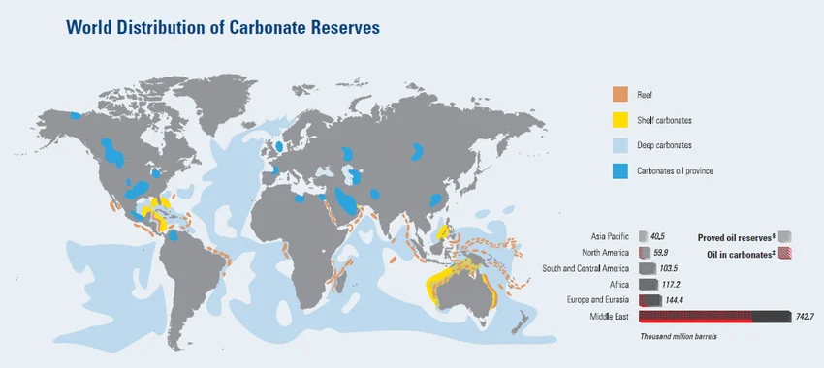
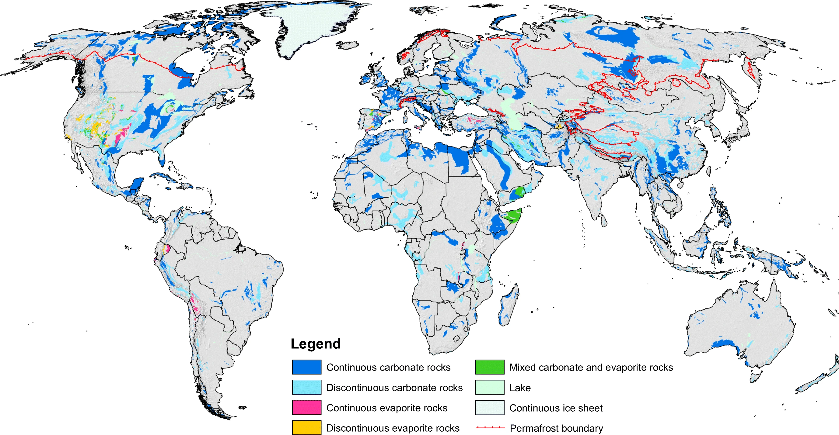
1.1 Background
Fractured vuggy carbonate reservoirs: more than 60% of the world's oil and 40% of the world's gas reserves are held in carbonate reservoirs, and fractured vuggy systems often host giant fields, especially important in Middle East, Mexico, West China, Brazil, ...
Karst aquifers: supply 10~25% of global drinking water in the world, especially important in Europe, China, Middle East, ...
The world distribution of carbonate reserves
The world karst aquifer map (WOKAM)
http://www.slb.com/~/media/Files/industry_challenges/carbonates
Nico Goldscheide, et al., Hydrogeol J (2020) 28:1661–1677
Notes:
Deep carbonate reservoirs are essential for increasing oil and gas reserves. However, they are characterized by extreme heterogeneity where matrix pores, tectonic fractures, and dissolution vugs coexist. This complex spatial connectivity leads to highly unpredictable flow paths and, unfortunately, low recovery efficiency.

Slide 4
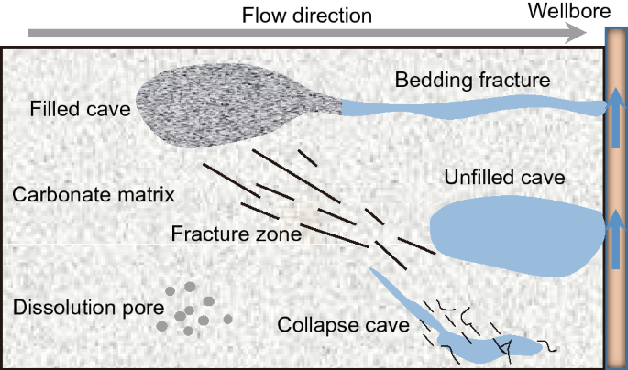
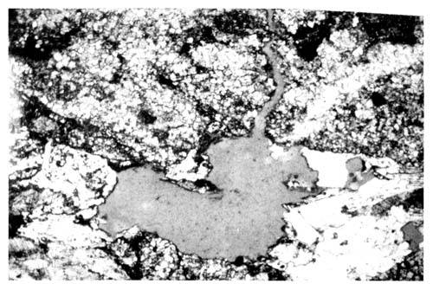
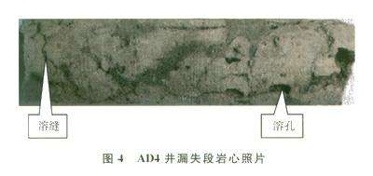
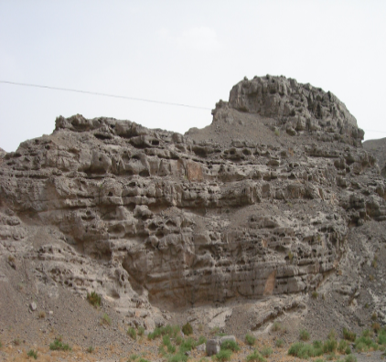
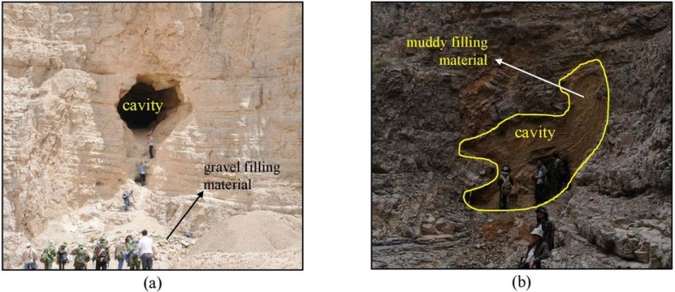
1.1 Background
The key characteristics: unlike typical porous media, karst systems have large conduits (cave-like channels), small fractures and fissures, and rock matrix with low permeability. The fluid flow and transport are the complex coupling process of porous media flow and free fluid flow.
Void spaces: pore, fractures, vugs, caves
Multi scales： from μm to m
Multi flow modes： porous + free flow
Multi physics：geomechanical + reactive flow
well
microscale fractures
millimeter vugs
centimeter small cavity
macroscale large cavity
fractures
vugs
Huang et al., Physics of Fluids, 2023, 35: 027116

Slide 5
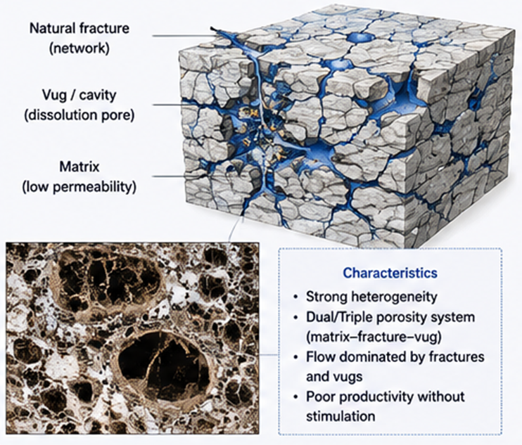
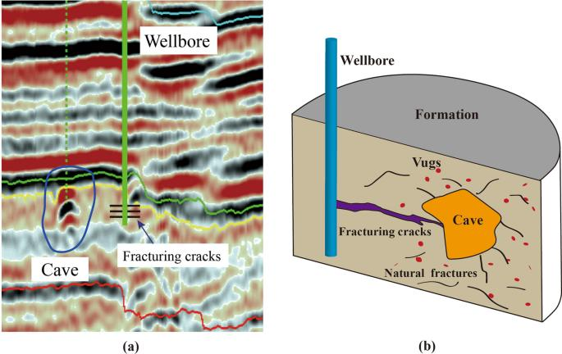
1.2 Acid fracturing stimulation
Why acid fracturing stimulation is needed?
Poor matrix permeability
Uneven connectivity between vugs and fractures
Strong channeling and bypassing
Low productivity
Rapid decline
Poor sweep efficiency
Acid fracking process:
Hydraulic fracking→ creates fractures
Acid reaction → etches fracture surfaces
The strong heterogeneity and anisotropy
Schematic of the geological model with acid fracturing well
(a) Seismic features of a karst cave
(b) Schematic of the geological model
Jianyi Liu, et al. Geomech. Geophys. Geo-energ. Geo-resour., 2024,10: 69

Slide 6
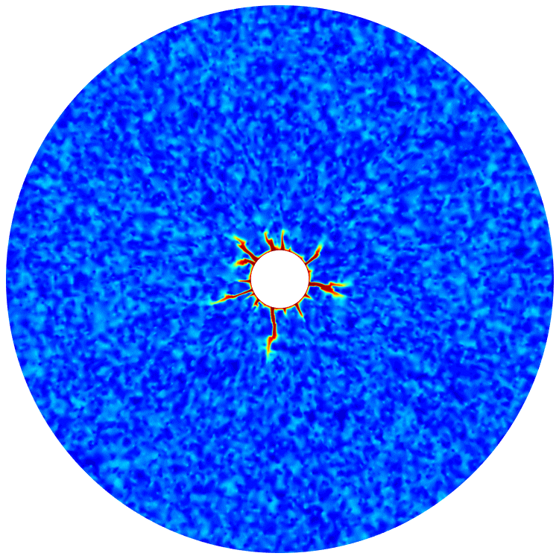
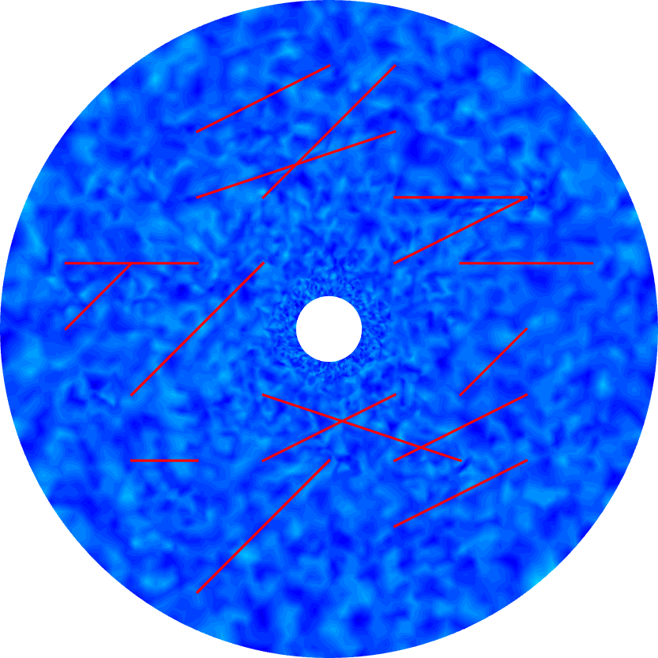
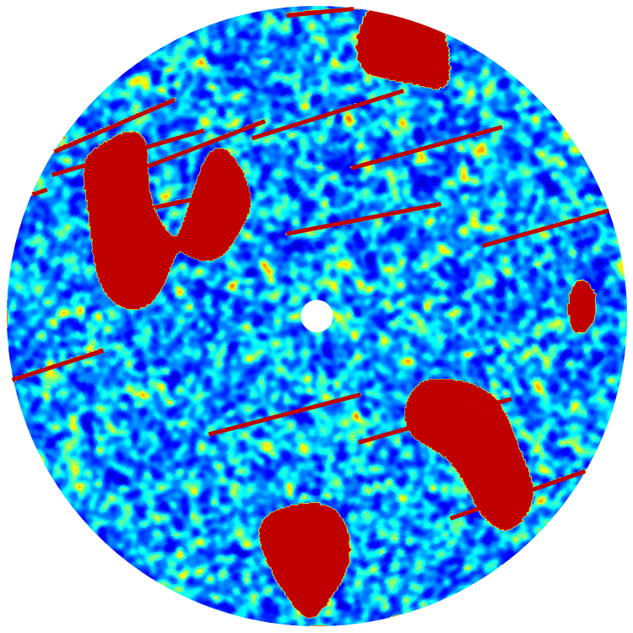
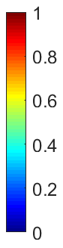
1.3 Previous works
Acid stimulation simulation in carbonate rocks: based on the classical two-scale continuum model developed by Panga et al. (2005), we have developed a new two-scale continuum model which considers mass conversion between liquid and solid phases.
The fluid flow models: the Darcy-scale model describes the reactive-transport process of acid and the evolution of the rock matrix and fractures. The Stokes model have been applied in vugs.
carbonate matrix rock
fractured carbonate rock
fractured vuggy carbonate rock
fractures
fractures
porosity
vug
matrix
matrix
matrix
Cunqi Jia, Kamy Sepehrnoori, Zhaoqin Huang, Jun Yao - SPE Journal, 2021
Cunqi Jia, Jun Yao, Kamy Sepehrnoori. Springer, 2025

Slide 7
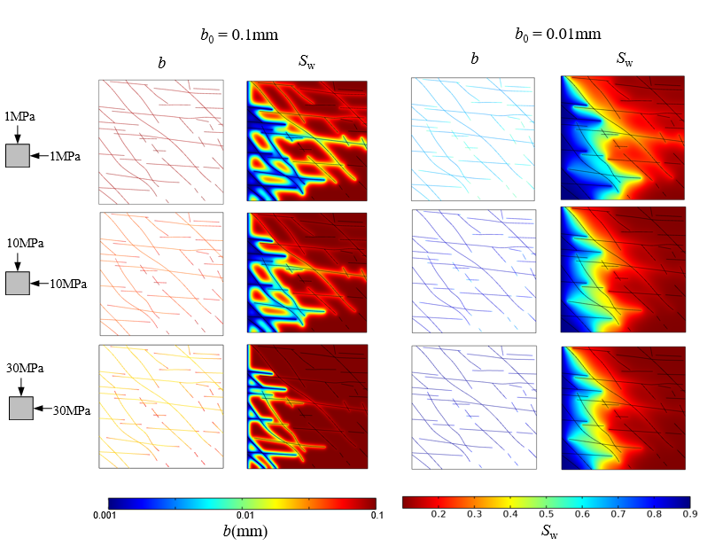
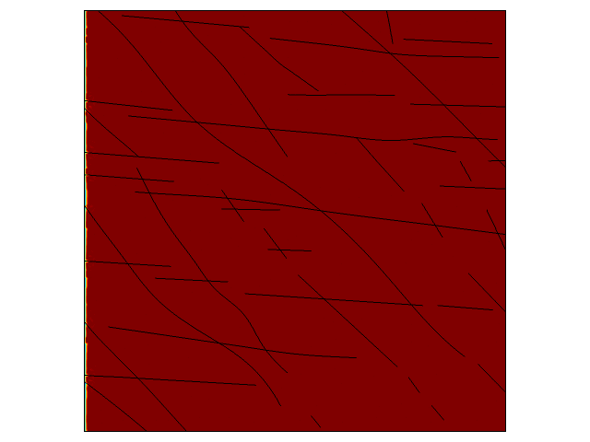
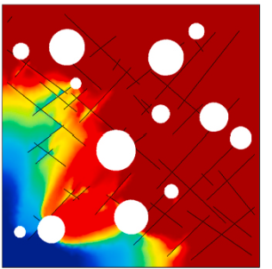

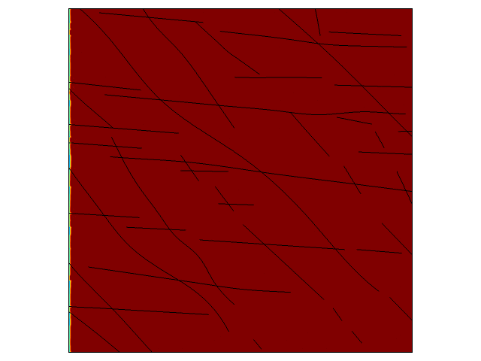
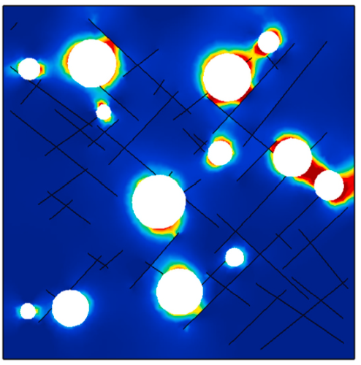
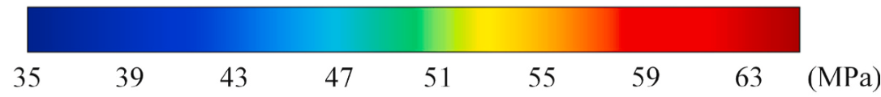
1.3 Previous works
Fluid flow: the coupling of porous media flow and free fluid flow, not only the Darcy equation
Hydro-mechanical: fractures will be open or closed, and the cavities will deform during production
What is the effect of hydro-mechanical behavior on the production of fractured vuggy carbonate reservoirs?
no hydro-mechanical
water saturation S_{w}
0MPa
without hydro-mechanical
0MPa
A
hydro-mechanical
the difference of S_{w} is 130%
Mises stress
10MPa
A
collapse
10MPa
hydro-mechanical
0.01 0.05 0.1
0.1 0.3 0.5 0.7 0.9
fracture apertures / mm
water saturation S_{w}
The water saturation S_{w} at point-A
fractured vuggy rock
Lijun Liu, Zhaoqin Huang, Jun Yao, et al., International Journal of Rock Mechanics & Mining Sciences 137 (2021) 104543

Slide 8
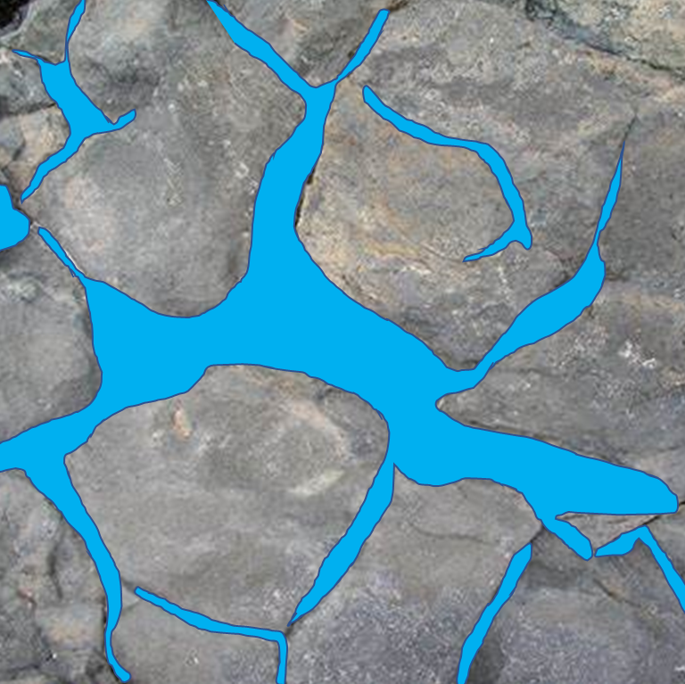
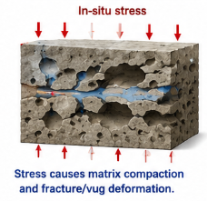
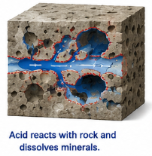
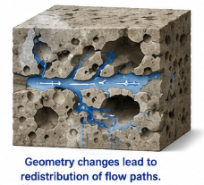
1.4 Hydro-Mechanical-Chemical coupling process
Is the HMC coupling effects important? acid dissolution enlarges flow channels, while in-situ stress causes compaction and fracture closure, which is a typical hydro-mechanical-chemical (HMC) coupling process. These feedbacks continuously alter permeability, aperture, and flow paths. How to simulate?
Hydro-Mechanical-Chemical coupling
Hydro-Mechanical-Chemical coupling
Heat
T
1. Rock dissolution
2. Deformation under geostress
3. Flow paths change
heat conduction
reaction rate
Hydro
Chemical
thermal stress
H
C
convective mass transfer
Acid injection
pH concentration
M
porosity
permeability
dissolution and precipitation
Acid reacts with rock and dissolves minerals
Matrix compaction and fracture/vug deformation
Geometry changes lead to redistribution of flow paths
Mechanical
Notes:
To improve connectivity, acidizing is commonly used to dissolve rock and connect isolated vugs. However, in deep reservoirs, we face a competition: while acid dissolution increases fracture aperture and vug geometry, high in-situ stress causes matrix compaction and fracture closure. Understanding this interaction between chemical dissolution and mechanical deformation is critical.

Slide 9
Outline
1. Background and motivation
2. The hydro-mechanical-chemical model
3. Numerical scheme and examples
4. Remarks and future works
Notes:
My presentation is divided into five main parts. First, I’ll discuss the background and motivation behind this work. Then, I will introduce our theoretical model, the Discrete Fracture-Vug Network (DFVN). Next, I'll briefly cover the numerical scheme, followed by several numerical examples to validate the model and explore the coupling effects. Finally, I will conclude with some remarks and our plans for future work.

Slide 10
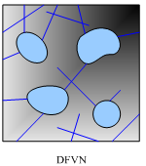
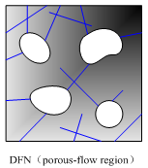
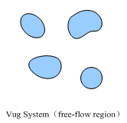
2.1 The fluid flow models in fractured vuggy rocks
The Discrete Fracture-Vug Network (DFVN) model
=
+
DFVN
DFN（porous-flow region）
Vug System（free-flow region）
Porous-flow region
Darcy equation
Coupling interface conditions
Free-flow region
Navier-Stokes equation
coupling Darcy-Stokes model
multi-scale characteristic
coupling porous-flow & free-flow characteristic
Yao and Huang, SPE & CiCP, 2010, 2011

Slide 11
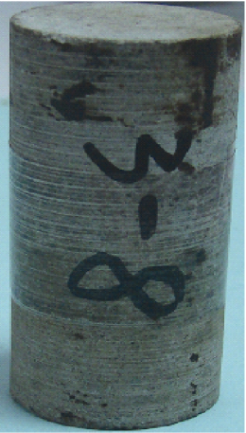
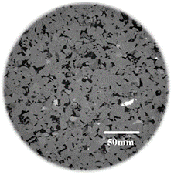
2.2 The chemical reaction and solute transport models
Porous media | Matrix | Fractures
Solute transport
Solute exchange
Chemical dissolution
hydrochloric acid (HCl) and calcite carbonate rock (CaCO₃)
Darcy scale
pore scale
Modified two-scale continuum model
Dimension-reduction fracture model
Notes:
Moving on to the theoretical model. We developed the Discrete Fracture-Vug Network (DFVN) model to simulate this complex system. In this framework, the matrix, fractures, and vugs are fully coupled, with fractures and vugs treated as lower-dimensional internal boundaries to significantly save computational cost.

Slide 12
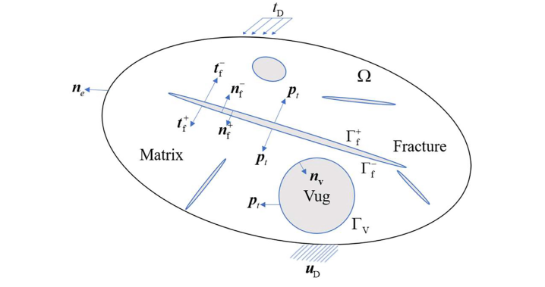
2.3 H-M-C coupling model of fractured vuggy rocks
outcrops
DFVN model
Hydro-mechanical model
Matrix: porosity
fracture: normal stress
fracture: stress compaction
1. Porous media：Biot equations
2. Vug：Stokes equations
3. Vug：Reactive acid transport
4. Interface：extended BJS conditions

Slide 13
Outline
1. Background and motivation
2. The hydro-mechanical-chemical model
3. Numerical scheme and examples
4. Remarks and future works
Notes:
My presentation is divided into five main parts. First, I’ll discuss the background and motivation behind this work. Then, I will introduce our theoretical model, the Discrete Fracture-Vug Network (DFVN). Next, I'll briefly cover the numerical scheme, followed by several numerical examples to validate the model and explore the coupling effects. Finally, I will conclude with some remarks and our plans for future work.

Slide 14
3.1 Numerical scheme
Fluid flow region: The FEM has been used to discretely solve the flow, solute transport and stress equations. Quadratic Taylor-Hood element is used for the velocity and linear elements for the pressure in the porous flow equations.
Reactive acid transport: Linear elements are used for the solute transport equations
Stress field: classical quadratic nodal elements are used in the displacement field.
(1) Fluid flow discretization
matrix
vug
fracture
(2) Acid transport and reaction discretization
matrix
fracture
vug
(3) Stress field discretization

Slide 15
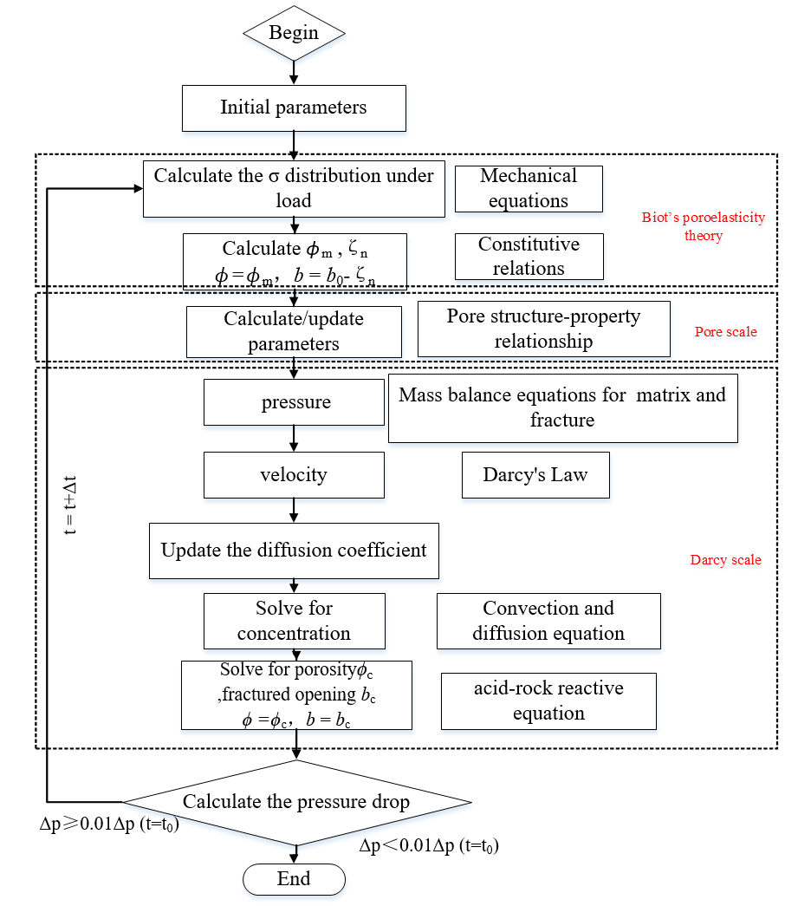
3.1 Numerical scheme
The real fractures: are some narrow high permeable regions with small width.
Simplified fracture model: we use the discrete fracture model, which is a dimension-reduction model, to reduce the number of local refined fracture mesh.
thin elastic
layer model

Slide 16
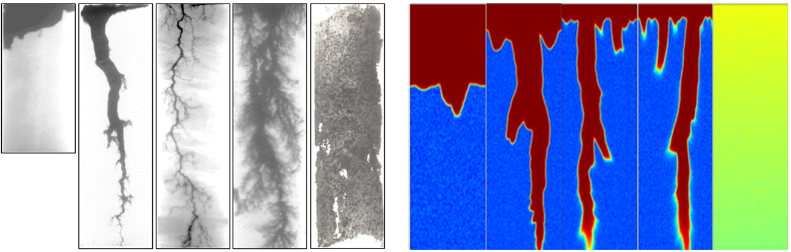
3.2 Model Validations
Comparison of dissolution patterns between physical experiment and numerical simulation results
The accuracy of the acid–rock reactive flow module was verified by comparing the simulation results with the core acidizing experiments of Hoefner and Fogler (1988).
parameter values used in the simulation
Experimental literature results
Numerical simulation results
Conical wormhole dissolution
Wormhole dissolution
Uniform dissolution
Face
dissolution
Conical wormhole dissolution
Wormhole dissolution
Uniform dissolution
 | Parameters | Values
ϕ₀ | Initial porosity | 0.2
Δϕ | Porosity variation | 0.15
N_{ac} | Acid capacity number | 0.1
Sh∞ | Asymptotic Sherwood number | 3
Sc | Schmidt number | 252.53
λ_{X} | Longitudinal pore structure coefficient | 0.5
λ_{T} | Transverse pore structure coefficient | 1
α_{os} | Pore structure efficient | 0.5
Face
dissolution
10.2 cm
10.2 cm
3.8 cm
3.8 cm
low
Injection rate
high
low
Injection rate
high
Notes:
First, we validated our reactive flow module against the classic experiments by Hoefner and Fogler. As shown here, our model successfully captures the transition from face dissolution at low injection rates to wormholing, and finally to uniform dissolution at high rates, matching experimental observations perfectly.

Slide 17
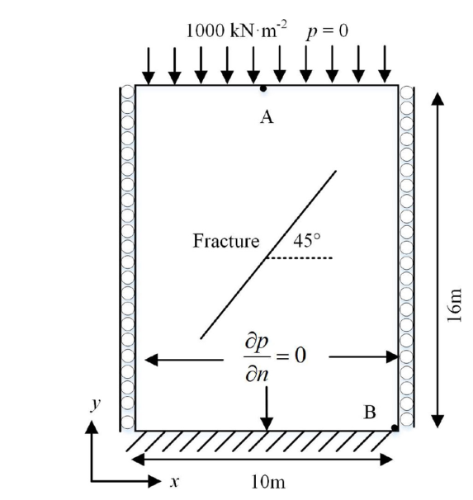
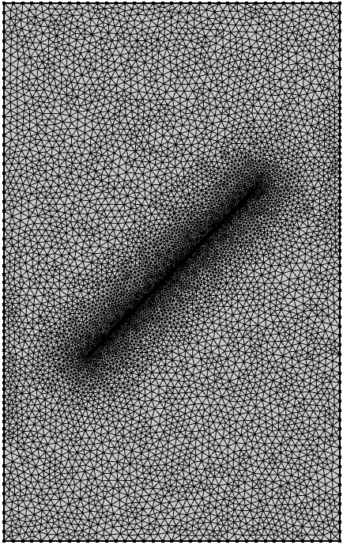
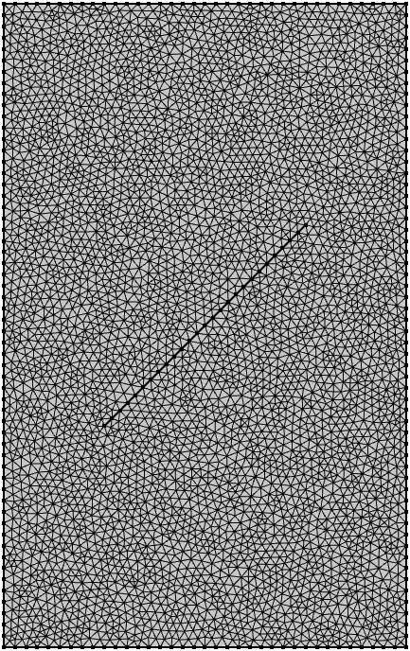
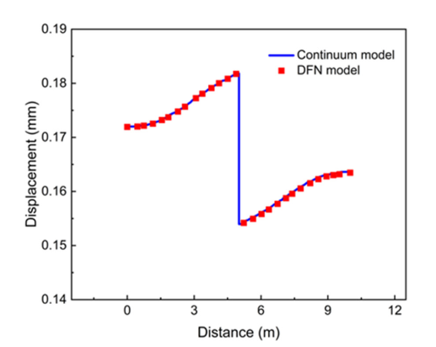
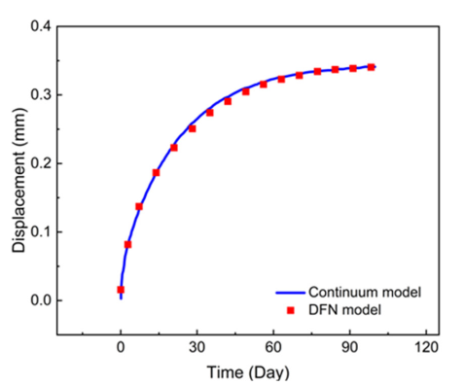
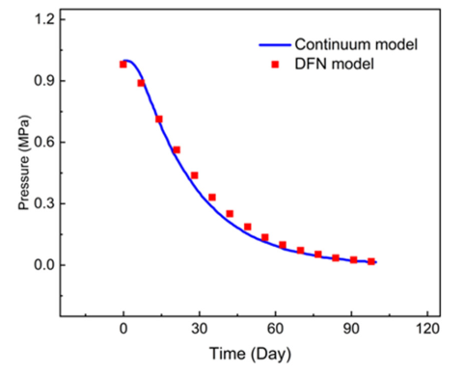
3.2 Model Validations
Comparison of the classical narrow fracture with real width and the d-1 discrete fracture model
In the continuum model, fractures are treated as mesh elements similar to the porou matrix. The highly refined mesh around the fractures guarantees accurately capturing the influence of fractures on fluid flow and mechanical behavior.
Parameters | Value | Parameters | Value
Young’s modulus of matrix E/GPa | 40 | Fracture aperture b/mm | 1
Matrix Poisson’s ratio ν | 0.25 | Normal stiffness K_{n}/GPa·m⁻¹ | 40.9
Matrix Poisson’s ratio E_{f}/GPa | 40 | Rock density ρ_{s}/kg·m⁻³ | 2600
Fracture Poisson’s ratio ν_{f} | 0.1 | Fracture storage coefficient S_{f}/Pa⁻¹ | 1.0×10⁻¹⁵
Porosity of matrix ϕ | 0.1 | Permeability of matrix k/m² | 1.0×10⁻¹⁸
Storage factor for matrix S/Pa⁻¹ | 1.0×10⁻¹⁴ | Permeability of fracture k_{f}/m² | 1.0×10⁻¹⁰
Benchmark model
Continuum model
Discrete fracture model
Comparison of parameter distributions calculated by continuum model
and discrete fracture model at 100 days
Comparison of parameter values calculated by continuum model
and discrete fracture (DFN) model at 100 days
Continuum
model
Discrete fracture
model
Continuum
model
Discrete fracture
model
Displacement on the
observation line
displacement at Point A
pore pressure at Point B
Displacement
pressure
Notes:
We also compared our Discrete Fracture Model (DFN) with conventional continuum models. The pressure and displacement distributions across the fracture at 100 days show that the DFM approach provides a more precise representation of the discontinuities while maintaining overall accuracy.

Slide 18
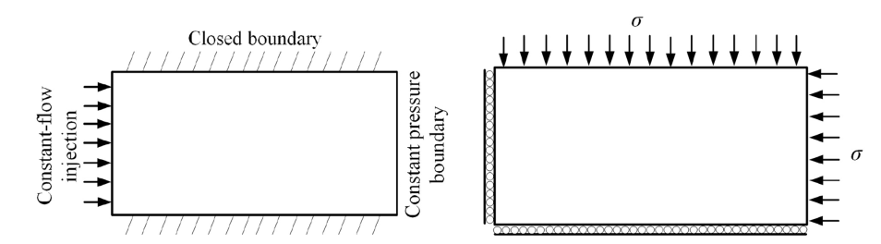
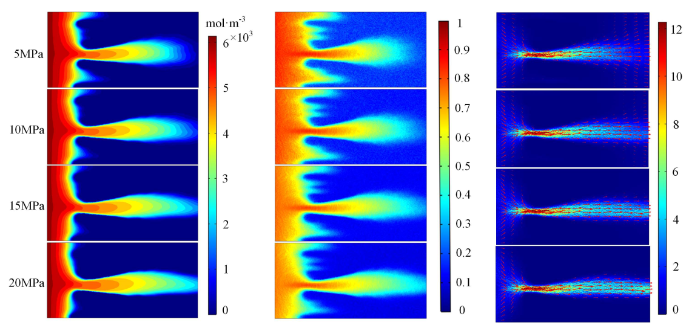
3.3 Numerical examples: carbonate rock matrix
Under higher stress conditions, the porosity of the target core sample after acid dissolution is lower compared to conditions without stress. In the absence of stress, a competitive balance between acid transport and reaction is achieved, leading to an optimal state.
When the mechanical process is coupled to the matrix acid stimulation process, the acid fluid has a greater effective stress load and receives a localized acceleration. The enhanced migration strength leads to a higher volume of acid fluids being ineffectively transported and increasing the acid breakthrough volume.
Damkohler number
=500
Flow boundary condition
Mechanical boundary condition
Concentration profile
Porosity profile
Velocity profile
Notes:
Visualizing the profiles, we see that higher stress promotes acid transport along dominant channels but limits overall matrix dissolution, which explains the lower utilization efficiency.

Slide 19
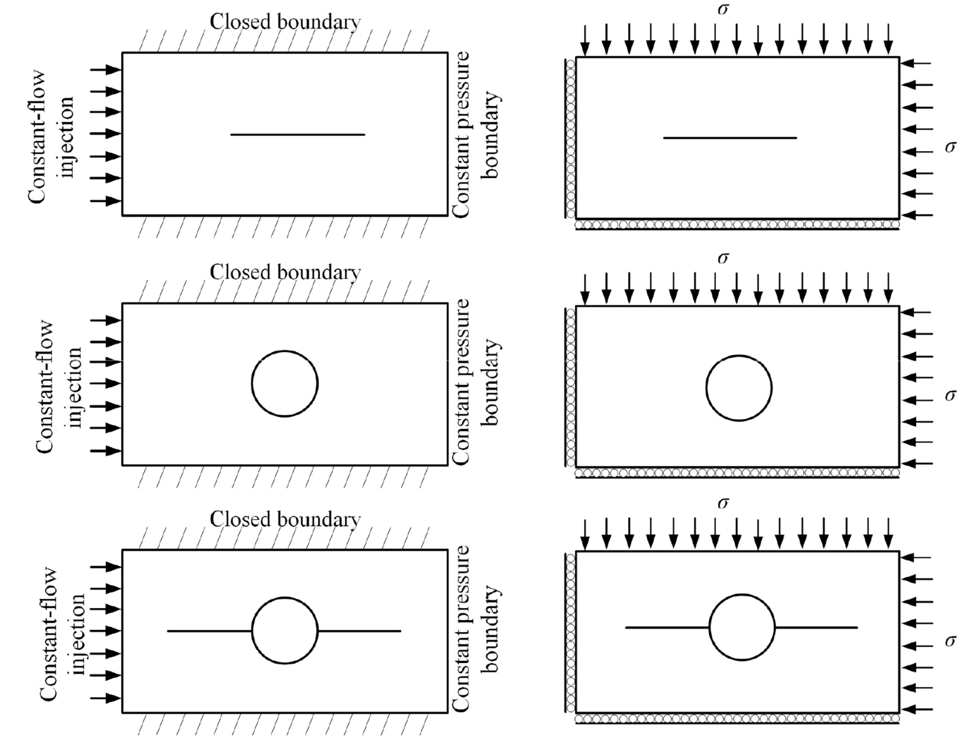
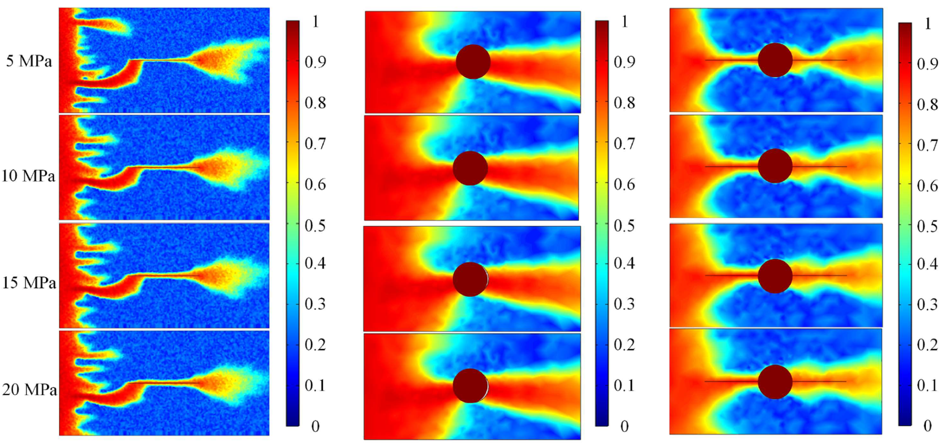
3.3 numerical examples: single fracture and vug cases
Stress plays a crucial role in influencing fracture aperture, particularly during the initial stages of stress application. In the early stages of stress application, substantial fracture closure occurs, which decreases the efficiency of acid transport along the fracture.
The reduction in fracture conductivity compels a greater volume of acid to flow into the surrounding matrix, thereby enhancing matrix dissolution and contributing to the increase in PVBT. In the single-vug model, stress-induced deformation is minimal. Although vug existence induces acid fluid flow, the impact of stress on flow paths is limited.
Damkohler number
=500
porosity
Flow B.C.
Mechanical B.C.
Single fracture
Single vug
Single fracture + vug
Notes:
Visualizing the profiles, we see that higher stress promotes acid transport along dominant channels but limits overall matrix dissolution, which explains the lower utilization efficiency.

Slide 20
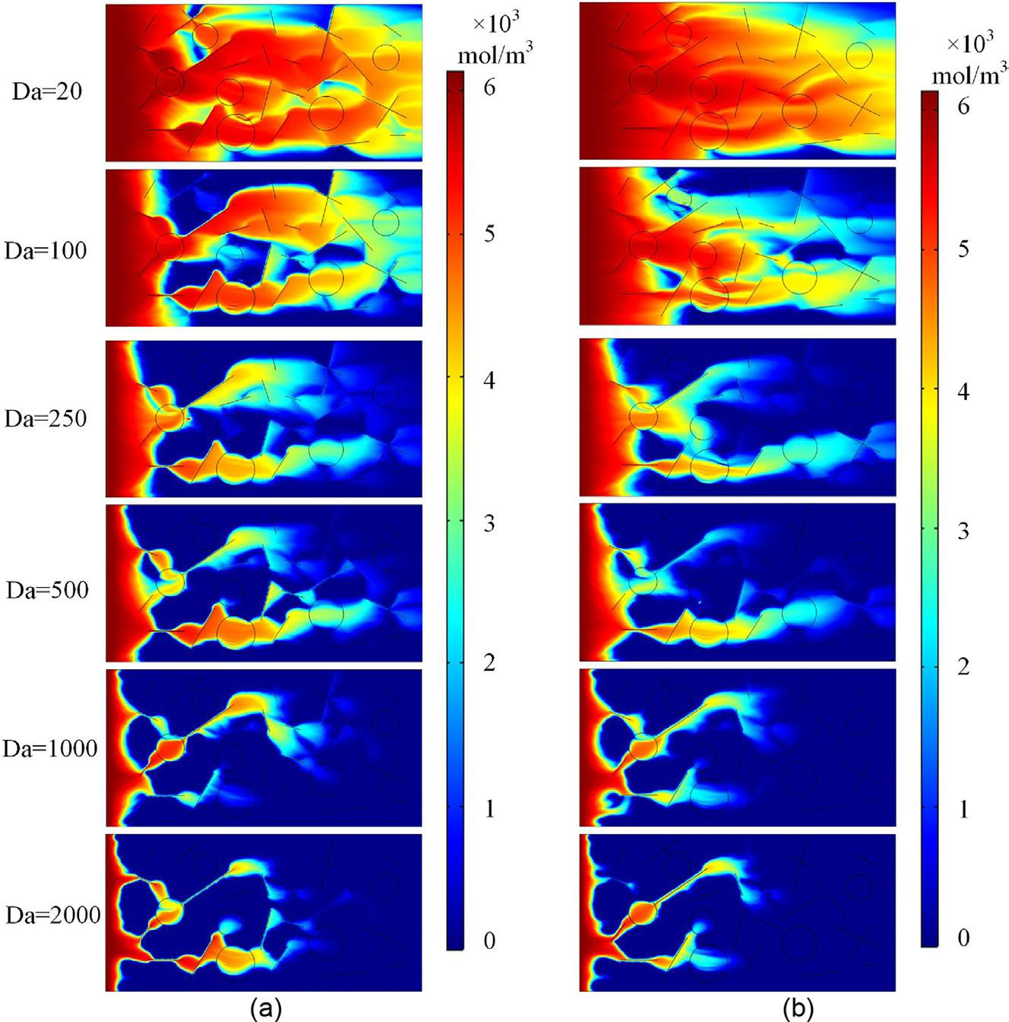
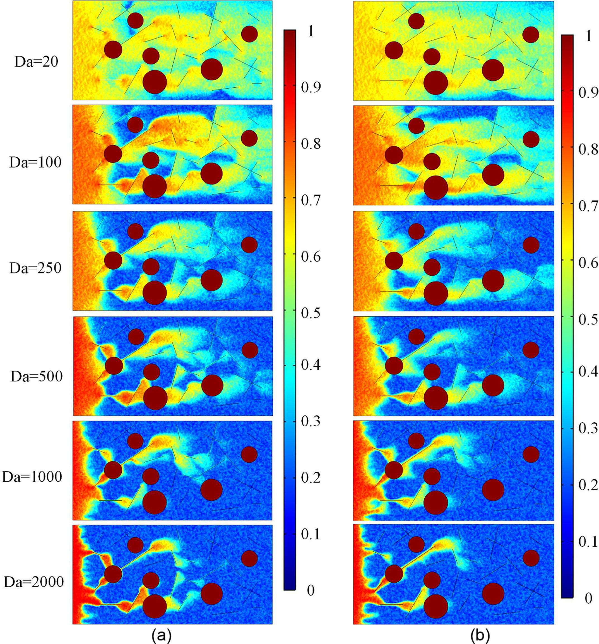
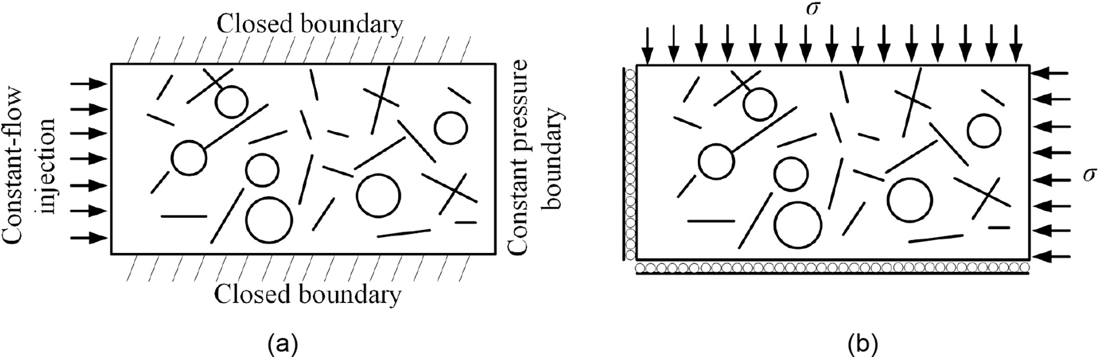
3.3 numerical examples: complex fractures and vugs case
At high injection rates: stress induction results in increased acid dissolution across broader areas.
At lower injection rates: the acid solution preferentially migrates into the vugs and the fracture networks. The interconnectivity between vugs and fractures progressively emerges as increasingly crucial in the acid stimulation.
Compared to the matrix region: fractures and vugs establish preferential pathways for acid migration. Less acid solution is needed to achieve a breakthrough. Stress diminishes the fluid flow capacity within these fractures, prompting enhanced dissolution in the adjacent matrix and increasing the PVBT.
concentration
porosity
Flow B.C.
Mechanical B.C.
with stress 20 MPa
without stress
with stress 20 MPa
without stress
Notes:
We also investigated the Damköhler number (Da), which represents the ratio of reaction rate to transport rate. In complex fracture-vug systems, the breakthrough volume increases as the reaction becomes more transport-limited (lower Da), and high stress further exacerbates this inefficiency.

Slide 21
Outline
1. Background and motivation
2. The hydro-mechanical-chemical model
3. Numerical scheme and examples
4. Remarks and future works
Notes:
My presentation is divided into five main parts. First, I’ll discuss the background and motivation behind this work. Then, I will introduce our theoretical model, the Discrete Fracture-Vug Network (DFVN). Next, I'll briefly cover the numerical scheme, followed by several numerical examples to validate the model and explore the coupling effects. Finally, I will conclude with some remarks and our plans for future work.

Slide 22
4.1 Conclusions
The presence of isolated fractures and vugs increases storage capacity but has a minimal effect on hydraulic conductivity. As the number of fractures and vugs increases, both core porosity and permeability also rise. However, the enhancement in core permeability remains relatively limited.
When the mechanical process is coupled to the matrix acid stimulation process, the acid fluid has a greater effective stress load and receives a localized acceleration. The enhanced migration strength leads to a higher volume of acid fluids being ineffectively transported and increasing the acid breakthrough volume.
Compared to the matrix region, fractures and vugs establish preferential pathways for acid migration. Less acid solution is needed to achieve a breakthrough. Stress diminishes the fluid flow capacity within these fractures, prompting enhanced dissolution in the adjacent matrix and increasing the PVBT. Within models incorporating vugs, stress has limited deformation effects.
Higher injection rates promote a more uniform dissolution pattern. Lower injection rates concentrate on dissolution in fractures and vugs. The acid does not fully saturate the vug spaces. Instead, the acid solution tends to dissolve the solid matrix and potentially connect with adjacent vugs or fractures.

Slide 23
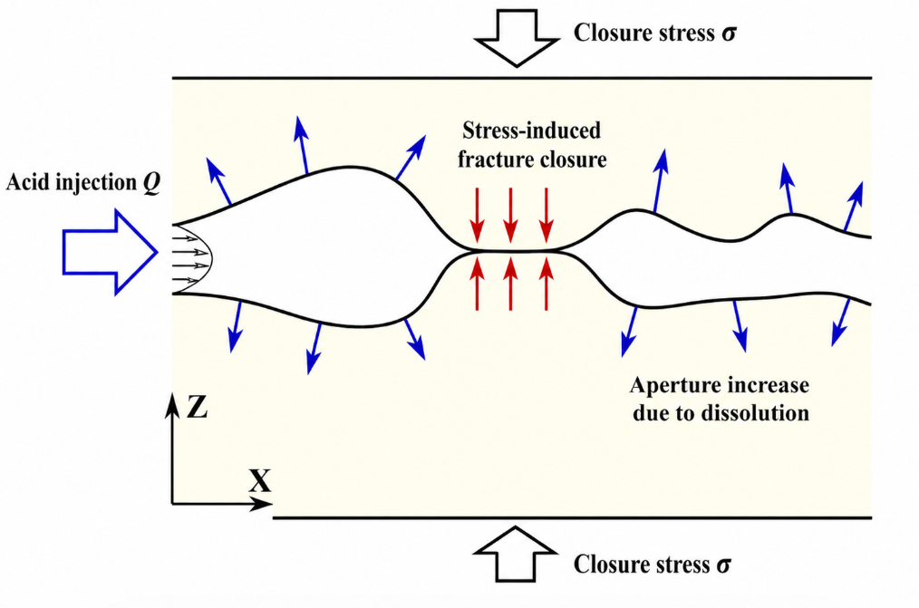
4.2 Future works
Experimental research: hydro-mechanical-chemical coupled acid-fracturing test
Build a visualized HMC experimental platform for single-fracture acidizing. Quantify the competition between acid etching and stress closure.
Identify dissolution patterns under different Pe-Da conditions. Quantify the real-time contribution of acid etching and stress closure. How the fracture’s permeability evolve under the HMC coupling process.
Notes:
Looking ahead, our future work will heavily focus on experimental validation. We are planning a new series of visualized Hydro-Mechanical-Chemical (HMC) experimental tests to better understand the coupling mechanisms in physical core samples.

Slide 24

The end
Thank You！
Notes:
That concludes my presentation. I would like to thank our team at the China University of Petroleum and our collaborators. Thank you all for your attention, and I am happy to take any questions.

