Slide 1
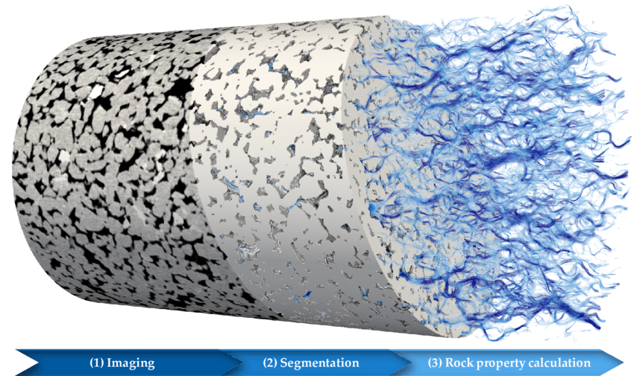


IN THE NAME OF GOD
Wetzel.m et al, 2021
Supervisor:
Adviser:
Improving the challenge of imaging resolution and field of view in permeability estimation by integrating multiscale imaging of carbonate rocks and Deep Learning
Student:
University:
Iman Nabipour, Jafar Qajar, Maysam Mohammadzadeh
Presentation Date:
Tehran University
September 2024

Slide 2
1
Introduction
Objectives
2
3
Methods
Discussion
4
5
Conclusion

Slide 3
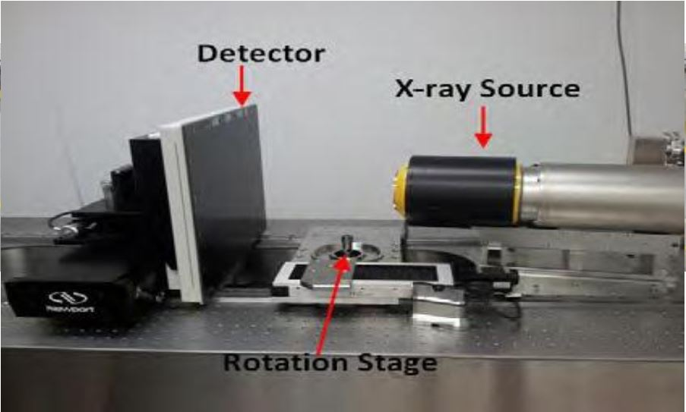
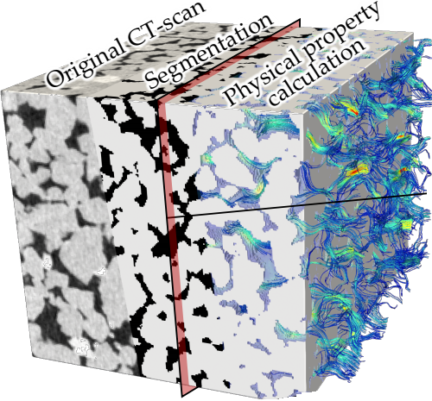

Introduction
Digital rock physics (DRP):
Stands at the forefront of porous media characterization.
Integrates cutting-edge tomographic imaging and advanced numerical simulations.
A complement to core-derived laboratory measurements.
Introduction
Literature
Methods
Discussion
Conclusion
Suggestions
A typical MCT setup
A typical DRP process
1
Bultreys et al 2016
Wetzel.m et al, 2021

Slide 4
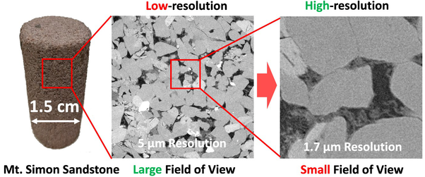

Research Objectives
The main objective
Exploring a novel solution to a critical gap in DRP:
The tradeoff between imaging resolution and field-of-view (FOV)
Introduction
Literature
1. Estimating transport properties and their correlation with pore morphology-topology
Yufu.N et al. 2020
Methods
2.Develop a workflow integrating DRP and machine learning
Discussion
3. A multiscale imaging for analyzing fluid flow in complex carbonates.
Conclusion
4. An efficient surrogate for Permeability from the low-resolutions images
Suggestions
2

Slide 5

Workflow Development
Introduction
Imaging and processing
1
Literature
Image Registration
2
Segmentation and REV analysis
3
Methods
Dataset Construction
4
Discussion
Conclusion
Model development
5
Suggestions
Model evaluation and validation
6
3

Slide 6
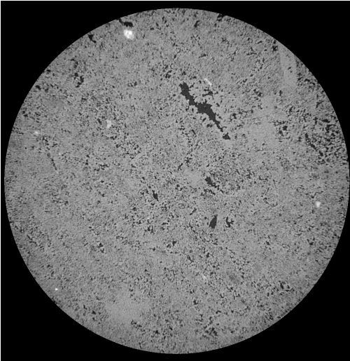
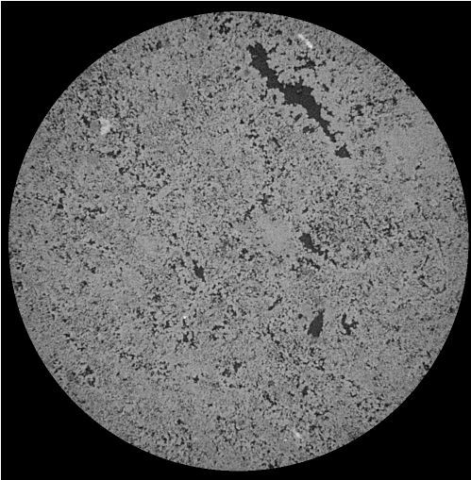
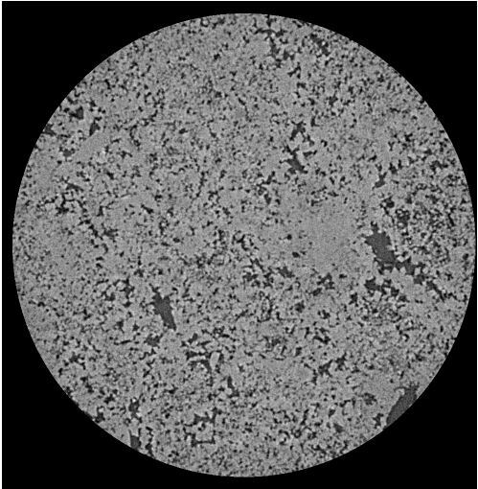
Multiscale/resolution Imaging
3 µm
2 µm
1 µm
Introduction
Literature
3.8 cm
Methods
Discussion
Conclusion
MIP test
Suggestions
XRD test: Dolomite
4

Slide 7
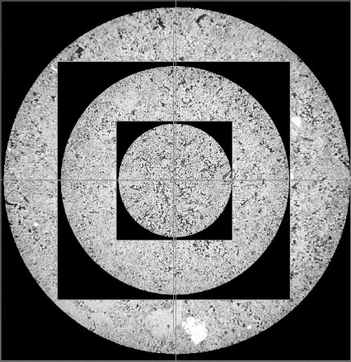
Image Processing: 3D Image Registration, Segmentation
Introduction
Literature
Align the multi-resolution images to locate the overlap region.
Methods
Statistical analysis
Porosity | 0.11
Eff. porosity | 0.90
Tortuosity | 2.15
Int.Mean.Curv | 2x10⁵
Euler | -1356
EqDiameter(um) | 180
Surf Area (um²) | 1.7x10⁶
Pore volume (um³) | 3.3x10⁶
PSD plot
Discussion
Step 1
Preprocessing
Conclusion
Step 2
Thresholding
Suggestions
Step 3
Post segmentation refinement
5

Slide 8
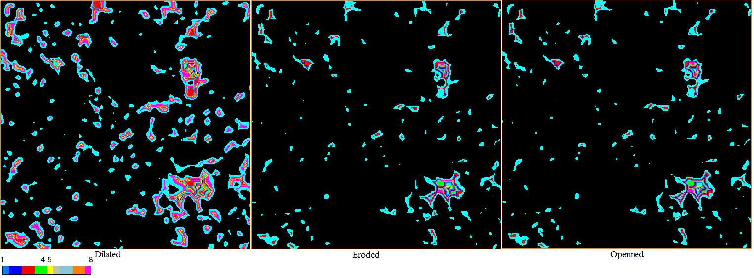
Dataset Construction
LBM (D3Q19) Velocity Field on HR REVs
Introduction
Direct pore scale flow simulation
Literature
Methods
Reference Permeability variations
Discussion
Conclusion
Suggestions
Data augmentation by morphological filters
6

Slide 9
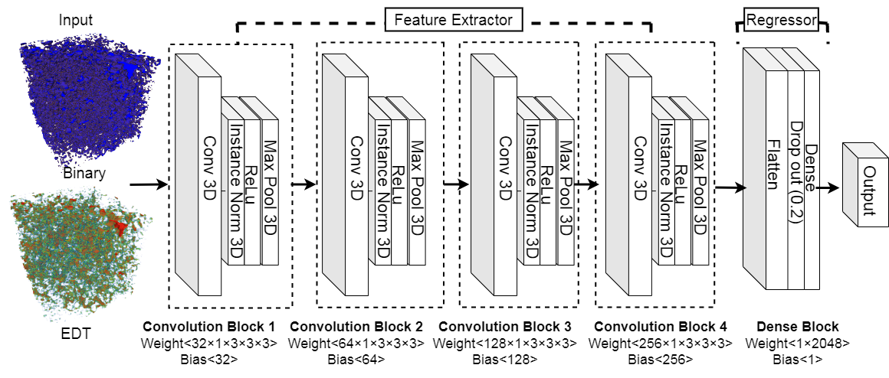
Model Development
Introduction
Literature
Methods
Discussion
Conclusion
Suggestions
The Designed Convolutional Neural Network (CNN) architecture
7

Slide 10
Model Development
Introduction
Hierarchical learning process across scales
Literature
Methods
Discussion
Conclusion
The multiscale resolution-aware network (MRAN) workflow
Suggestions
8

Slide 11
Results and Discussion
Calibration model: The model performance in the registered zone
Introduction
Literature
Methods
Discussion
Dykstra-Parson coefficient, Vĸ [-] | STD | Relative error (%) of Mean | Mean [mD] | Transport property
0.775 | 1.755 | 0 | 2.206 | K-LBM
0.765 | 1.765 | 4.54 | 2.307 | K-pred-HR
0.775 | 1.774 | 3.73 | 2.289 | K-pred-MR
0.779 | 1.772 | 3.04 | 2.274 | K-pred-LR
Conclusion
Suggestions
9

Slide 12
Results and Discussion
Calibration model: The model performance in the registered zone
Introduction
Residual analysis
Literature
Methods
Discussion
Conclusion
The model respects homoscedasticity
Model residuals should ideally exhibit a random distribution around zero, with no clustering
Suggestions
10

Slide 13
Results and Discussion
Test Data: Domains with different complexity in a wide variety of samples of the MR and LR images from the non-registered entire carbonate plug
Introduction
Q-Q plot: LR test data
Literature
Methods
Discussion
Conclusion
Test images | STD | Geometric mean [mD] | Relative Error [%] | Total data
MR | 0.725 | 1.754 | 16 | 102
LR | 0.705 | 1.612 | 7 | 102
Suggestions
11

Slide 14
Conclusion
Introduction
To resolve resolution-FOV tradeoff in DRP: Developing a multiscsle resolution aware network (MRAN):
Literature
Despite the complexities and limited size of the training data, the model achieves (R²≈0.96) across scales.
Methods
Residual analysis: homoscedasticity, unbiased nature, capable of handling the carbonate media.
Discussion
Conclusion
The transfer learning enhances the model's performance and generalization, particularly pre-training on 3D EDTs.
Suggestions
11

Slide 15

Thank’s for your attention

Slide 16
References
1. Wetzel, M., Pore space alterations and their impact on hydraulic and mechanical rock properties quantified by numerical simulations. 2021, Universität Potsdam.
2. Bultreys, T., W. De Boever, and V. Cnudde, Imaging and image-based fluid transport modeling at the pore scale in geological materials: A practical introduction to the current state-of-the-art. Earth-Science Reviews, 2016. 155: p. 93-128.
3. Niu, Y., et al., An innovative application of generative adversarial networks for physically accurate rock images with an unprecedented field of view. Geophysical Research Letters, 2020. 47(23): p. e2020GL089029.
4. Botha, P., Predicting Permeability and Capillary Pressure in Low-Resolution Micro-CT Images of Heterogeneous Laminated Sandstones. 2017, The Australian National University.
5. Rabbani, A., et al., DeePore: a deep learning workflow for rapid and comprehensive characterization of porous materials. Advances in Water Resources, 2020. 146: p. 103787.
6. Santos, J.E., et al., Computationally efficient multiscale neural networks applied to fluid flow in complex 3D porous media. Transport in porous media, 2021. 140(1): p. 241-272.
7. Tang, P., D. Zhang, and H. Li, Predicting permeability from 3D rock images based on CNN with physical information. Journal of Hydrology, 2022. 606: p. 127473.
8. Santos, J.E., et al., Learning a General Model of Single Phase Flow in Complex 3D Porous Media. arXiv preprint arXiv:2310.14298, 2023.
Introduction
Literature
Methods
Discussion
Conclusion
Suggestions
References
12

