Slide 1
Investigation on Enhanced Dispersion in multiphase flow in Porous Media
LI Zijing (D3)
Energy Course, Mechanical Engineering, Engineering Department
Tokyo Institute of Technology

Slide 2
CO₂ capture, utilization, and sequestration: CCUS
CO₂
CO₂
ScCO₂
CO₂
CO₂
CO₂ Resource
(e.g., Power Plant)
Enhanced Oil Recovery
Apply experiment-based models to a large-scale simulation for risk assessment and long-term monitoring
Oil
Onshore storage
Offshore storage
Cap Rock
Cap rock
Cap rock (e.g., mudstone)
Additional
oil
recovery
Miscible
zone
CO₂ Flow
CO₂
Brine
ScCO₂ exhibits as solvent, and dispersion happens under convection
Injection of ScCO₂ pushes residual oil.
CO₂, brine water and oil coexist.
1 km or more

Slide 3
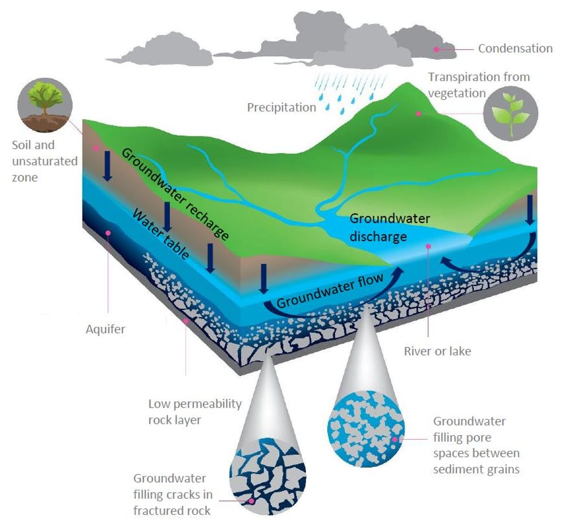
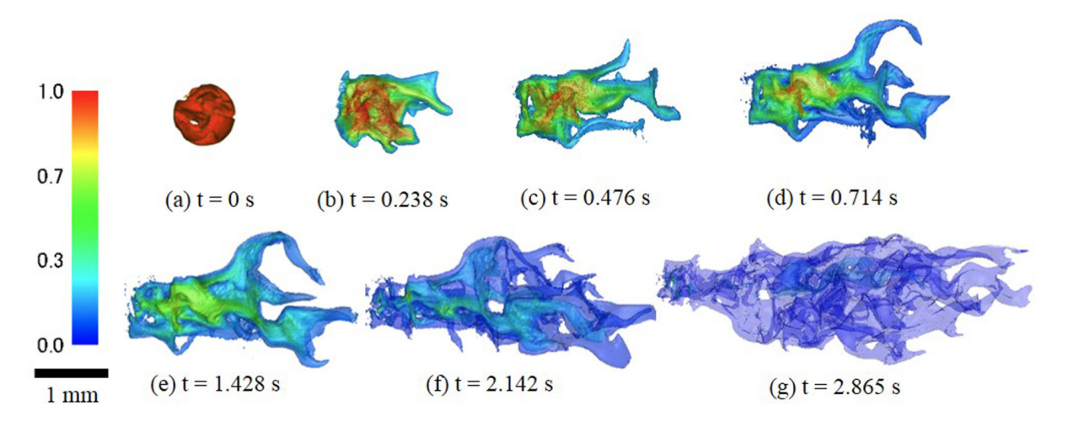
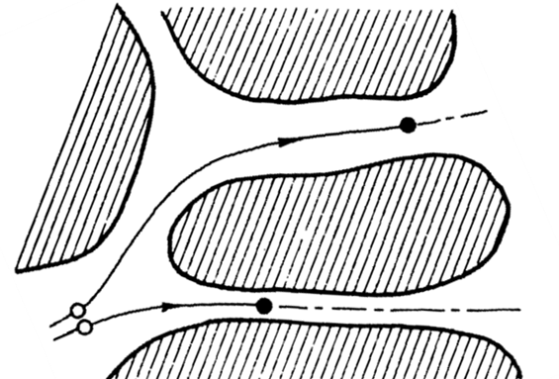
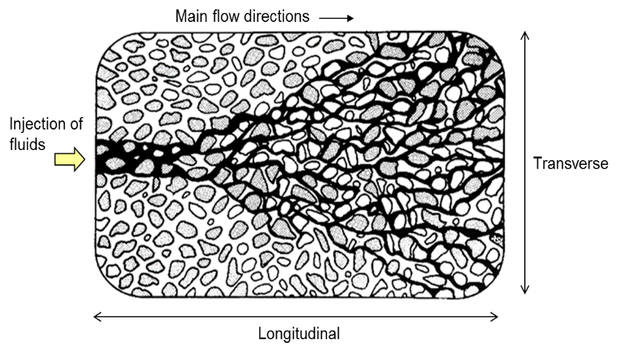
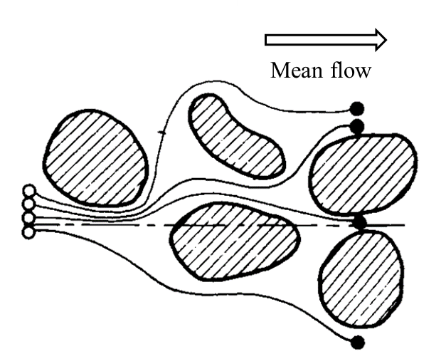
Dispersion and mixing in porous media
Diffusion
Solute Molecules
Random molecular motions
Microscopic (<< pore size)
Water Molecules
Dispersion
$$Pe=\frac{\text{advection} \text{transport} \text{rate}}{\text{molcular} \text{diffusion} \text{transport} \text{rate} }$$
Driven by forced convection
Molecular diffusion + solute movement
Groundwater fills pore spaces
Coarse sand:
Size arrange: 0.5–1 mm
Pore size: > 0.3 mm
Pore throat: > 0.2mm
Streamlines fluctuate
Discrepancies caused by variation of pore dimensions
Notes:
The phenomena as mentioned above happen in the underground geological formation shown in this figure. Groundwater fills cracks and pore spaces in fractured rock and sediment grains, this structure contains a lot of pores is called porous media. In this porous media, dispersion and diffusion always happen together. But we still need to distinguish the differences.→ Diffusion is the mixing process of particles due to random molecular motions, which happens in micro scale, while dispersion is a macroscopic phenomenon of the spreading of mass driven by advection. Since the diffusion rate is usually constant in a certain geological condition, here we define a characteristic number to evaluate dispersion phenomenon as the ratio of ~ and ~. And mixing, The process fundamentally due to molecular diffusion and stirring of porous media, was also studied in this topic.

Slide 4
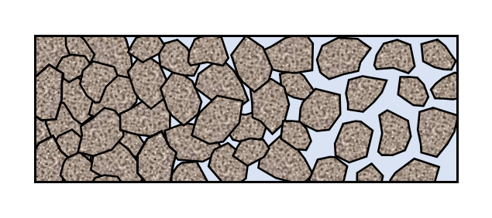
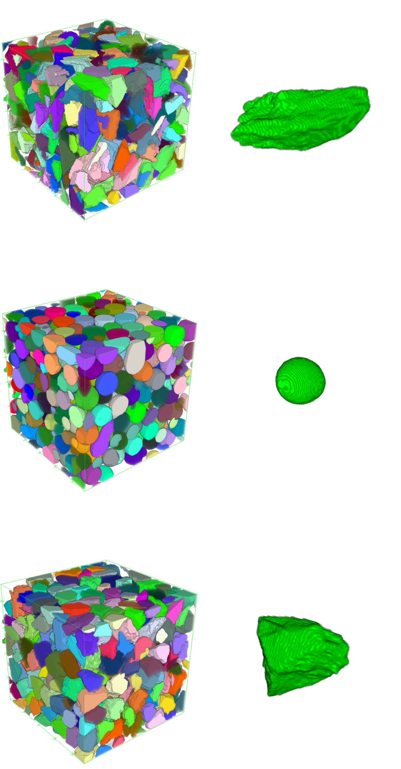
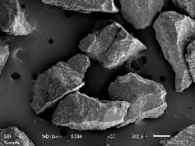
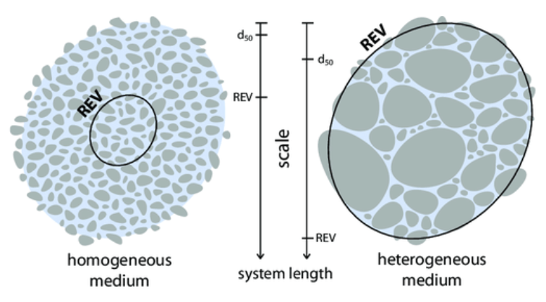
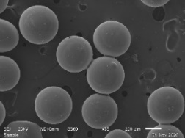
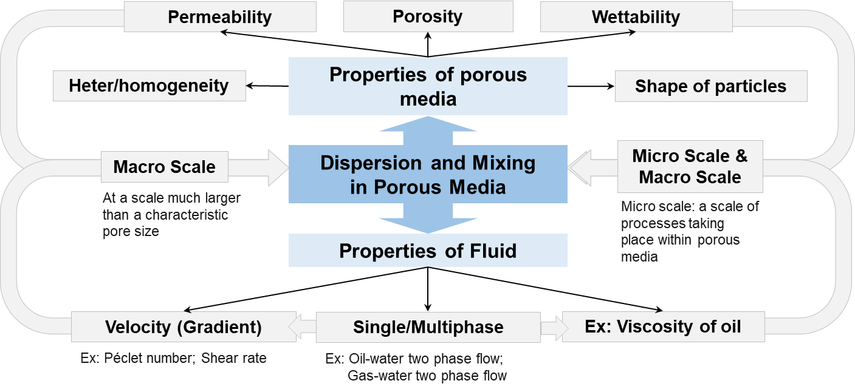
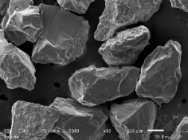
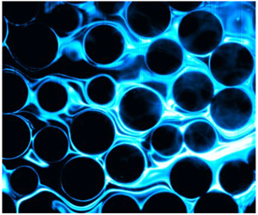
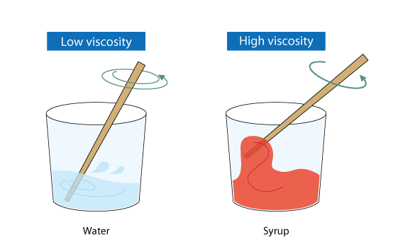
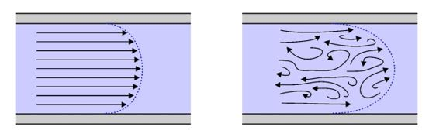
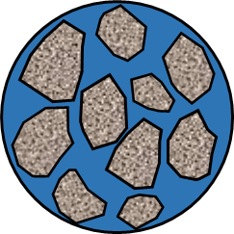
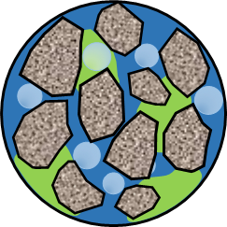
Properties that affect dispersion in porous media
no
pore spaces
unconnected pore spaces
connected pore spaces
Properties of porous media
Oil-wet
Limestone
non-porous
non-permeable
porous
non-permeable
porous
permeable
Water-wet
Glass beads
Sandstone
Interaction between phases and sand
Flow condition
Velocity distribution
Laminar flow
Turbulent flow
Single-phase
Multi-phase
Notes:
In the previous section, we introduced the enhancement on spreading process by these parameters, which describe the ~. In the next section. We will analyze the mixing state, which describe the combination of the tracer plume with the surrounding brine water from separated state. ~, ~, and ~ will be used to evaluate the mixing state.

Slide 5
X-ray tomography for dispersion study in porous media
Particle packed bed
Calibration curve
CT value
iodine ion concentration
Micro CT
Z axis
Distribution of the tracer concentration
X axis
Tracer experiment in uniform flow
Notes:
A tracer test is an effective way of measuring the dispersion coefficient in the laboratory. This is an experiment studying the dispersion under uniform flow →NaI is injected by point injection as tracer into the packed bed. By using a micro-CT scan, where the CT value has a linear relation with iodine ion concentration, therefore, we can obtain the concentration at each pixel. In this way, →we can observe how the tracer cloud disperses in the porous media via the changes of concentration distributions.

Slide 6
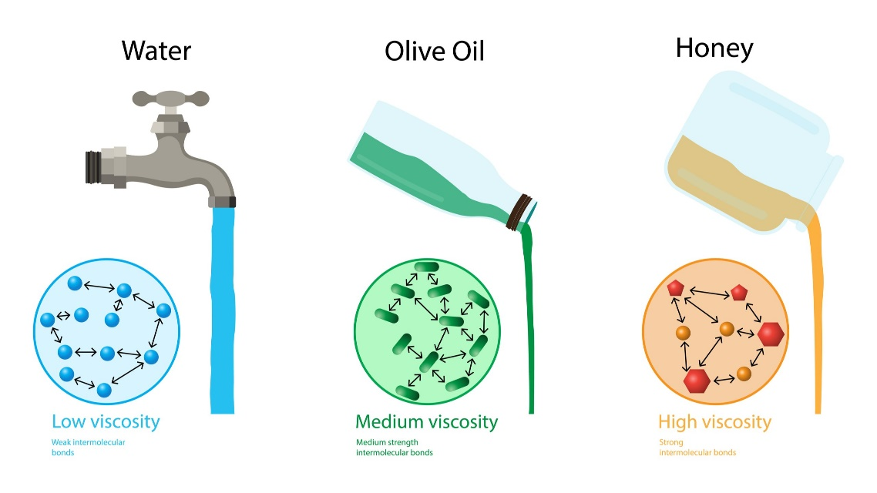
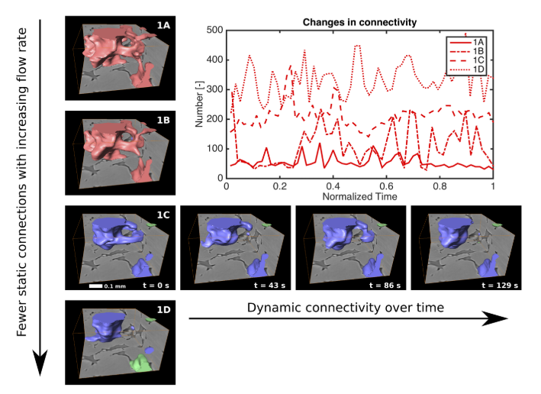
Impact of viscosity
Viscosity of fluid
Oil-water two phase system
(Chen, Z. et al., 2018)
Viscosity is the resistance of a fluid to change in shape or movement.
Inviscid
Viscous
(Singh, K et al., 2016).
(Reynolds, et al., 2017)
Viscosity affects the two-phase interaction
Laminar
Turbulent

Slide 7
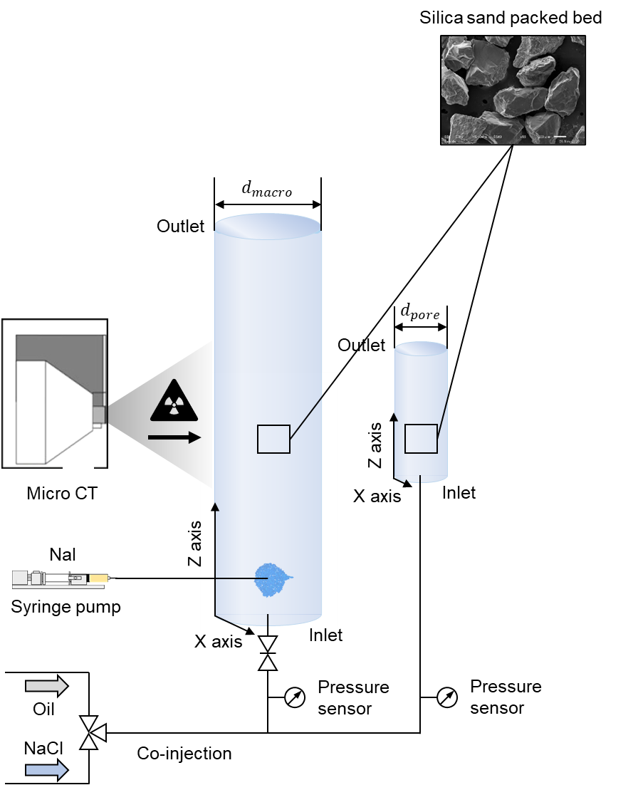
Device and materials
$M=\frac{μ_{nw}}{μ_{w}}=\frac{Viscosity of oil}{Viscosity of water}=0.65−500$
Experimental set-up
Fluid pairs
Packed bed: silica sand (wettability 60º)
Particle diameter$d=425μm \sim 500μm$
$d_{macro}=32 mm$, $d_{pore}=11 mm$
Porosity $φ=0.42$
Experimental novelties:
Co-injection
Oil
Homogeneous
Syringe pump
NaCl
Syringe pump
Combination of a macroscale dispersion process and pore-scale phase distribution
Initial
End
the scale involves the whole packed bed (~ mm, 95 um/pixel)
the scale of processes within pores (~ um, 5.2 um/pixel)

Slide 8
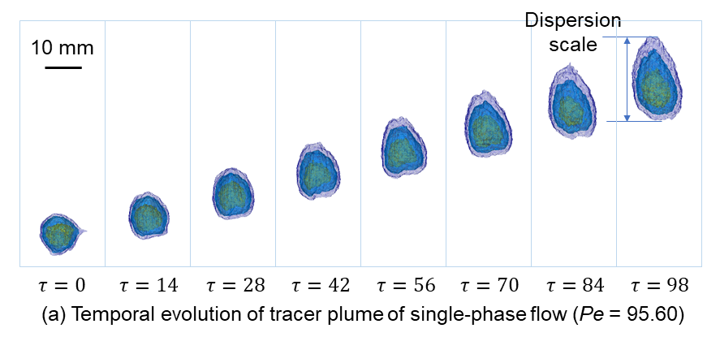
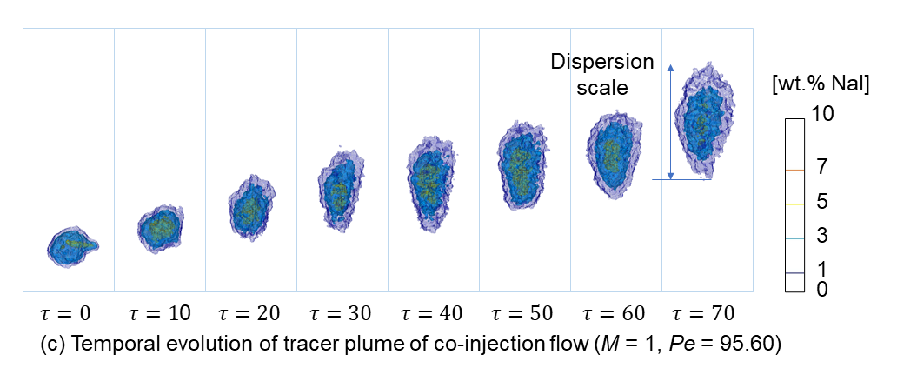
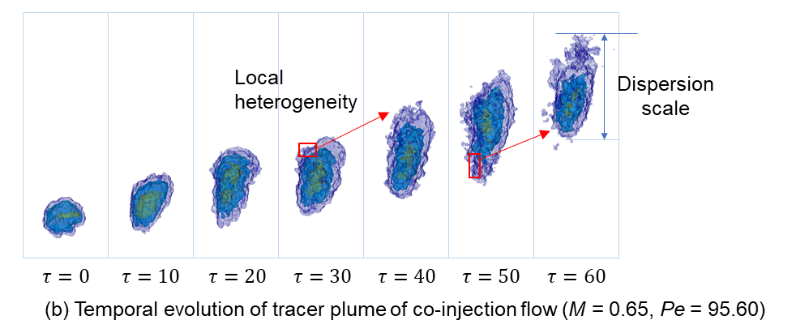
Visualization of solute spreading and mixing
When M ≈ 1, the solute transport and deformation were approximate to the single-phase case.
With the increasing of viscosity contrast, the dispersion scale on the flow direction drastically extended.
Notes:
In fully saturated porous media, the tracer deformed from a highly concentrated spherical solute plume to an ellipsoidal plume

Slide 9
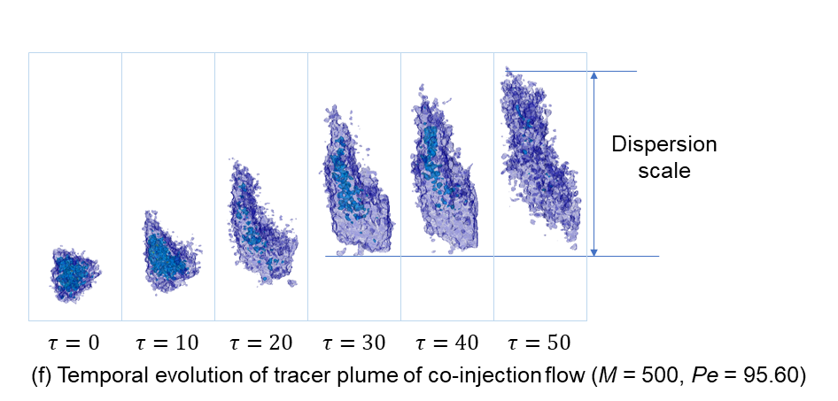
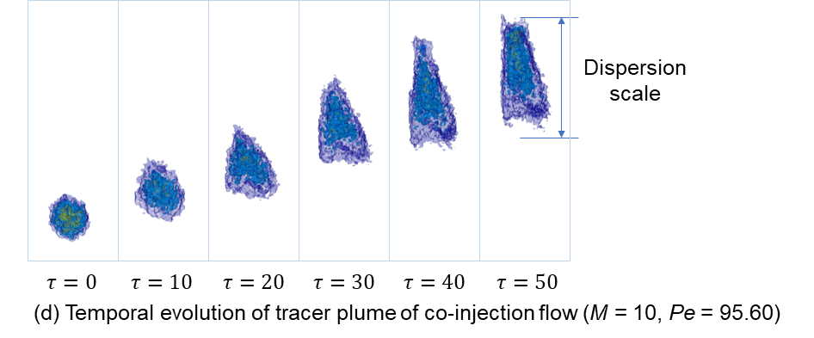
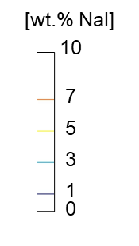
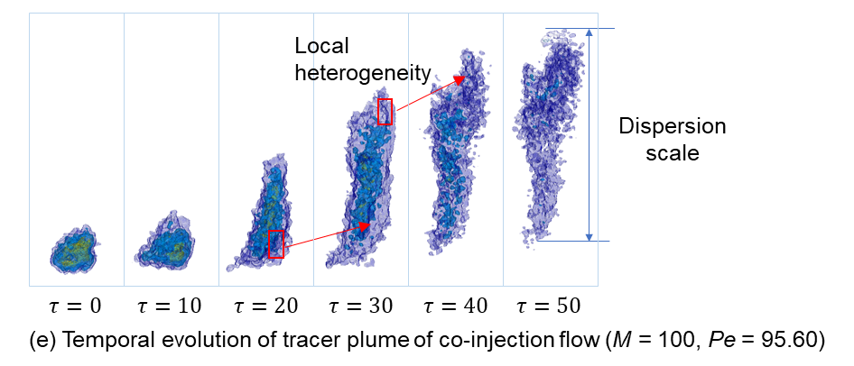
Visualization of solute spreading and mixing
When M >> 10, the movement of the tailing area was neglectable.
With M↑, heterogeneity of the aqueous phase increases.
The local heterogeneity causes solute distortions and increases the interfacial area.

Slide 10
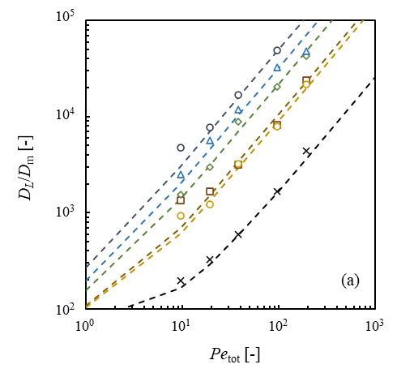
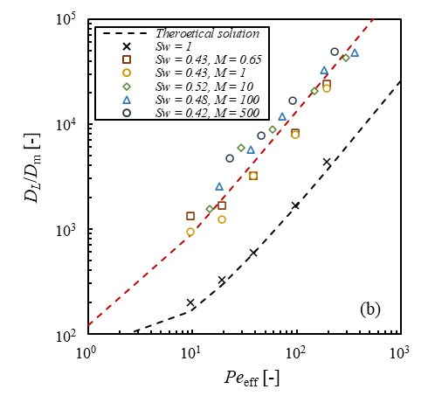
Dispersion coefficient & effective Péclect number
Péclect number: characterize the relative importance of advective and diffusive effects during transport
$$Pe=\frac{u_{av}L}{D_{m}}=\frac{\frac{Q}{A}∙d_{p}}{φD_{m}}$$
Effective Péclect number: characterize the magnitude of effective dispersion to diffusion during transport
$${Pe}_{eff}=\frac{t_{d}}{t_{a}}=\frac{\overline{v}a_{eff}^{2}}{λ_{eff}}$$
$a_{eff}$: effective average pore throat $a_{eff}=a×(1−ganglia trapping ratio)$
$λ_{eff}$: effective average pore size $λ_{eff}=λ×(1−ganglia trapping ratio)$
Trapped oil ganglia do not move with wetting phase → average pore throat narrows down
→ Pe_{water} > Pe_{total (oil+water)}
Trapped oil narrows down the pore throat
Oil
${Pe}_{eff}$can normalized a two-phase flow dispersion
Brine water

Slide 11
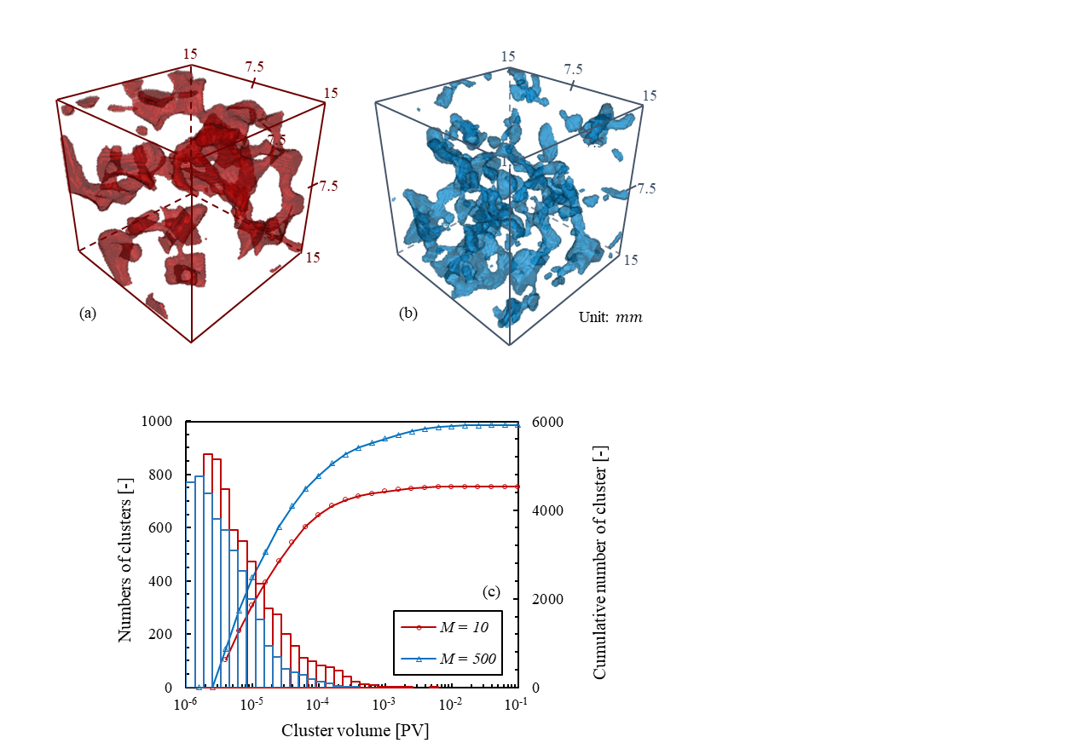
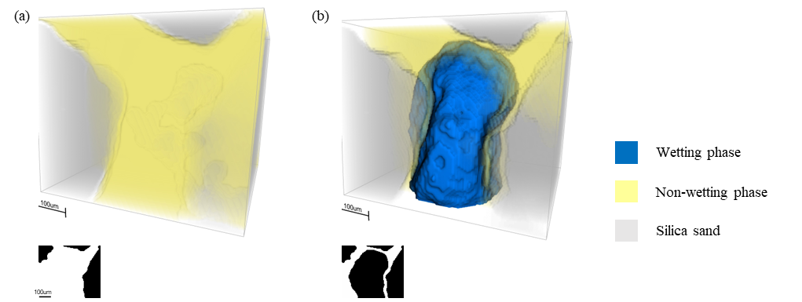
Pore-scale two phase distribution
(a-b) In the same pore, wetting phase displaced the pore which was firstly occupied by oil. The residual oil formed a film (Pe = 95.60, M = 100)
Cluster size variation and the formation of oil film increase the local heterogeneity and create preferential path and stagnation zones.
Spatial distribution of non-wetting phase at Pe = 95.60, (a) M = 10, (b) M = 500
Li, Z., Nasir, M., Wang, W., Kaito, K., Zhang, C., Suekane, T., & Matsushita, S. (2023). Impact of Oil Viscosity on Dispersion in the Aqueous Phase of an Immiscible Two‐Phase Flow in Porous Media: An X‐Ray Tomography Study. Water Resources Research, 59(10), e2023WR034849.

Slide 12
Thank You
for listening

