Slide 1
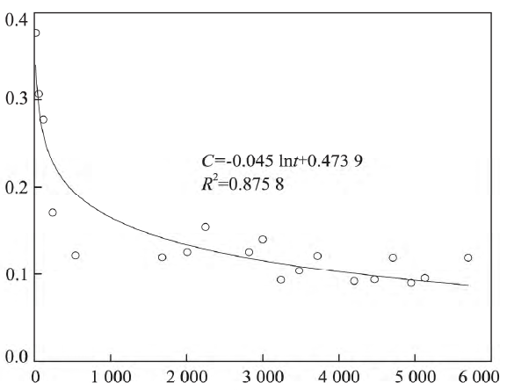
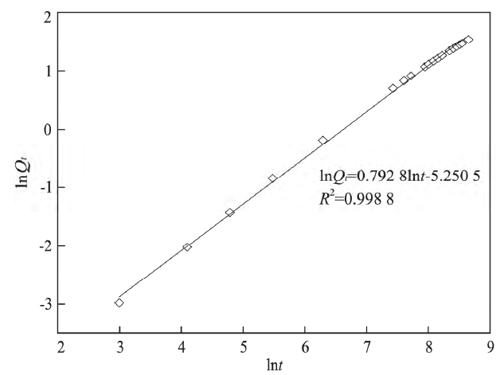
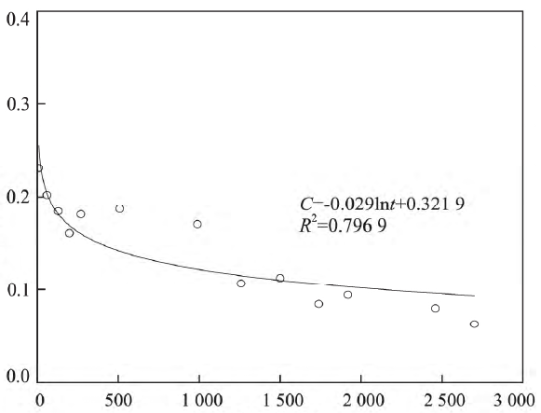
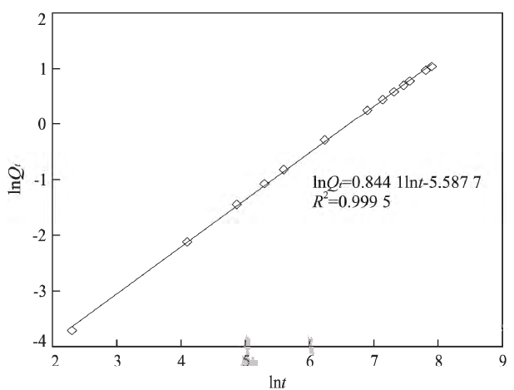
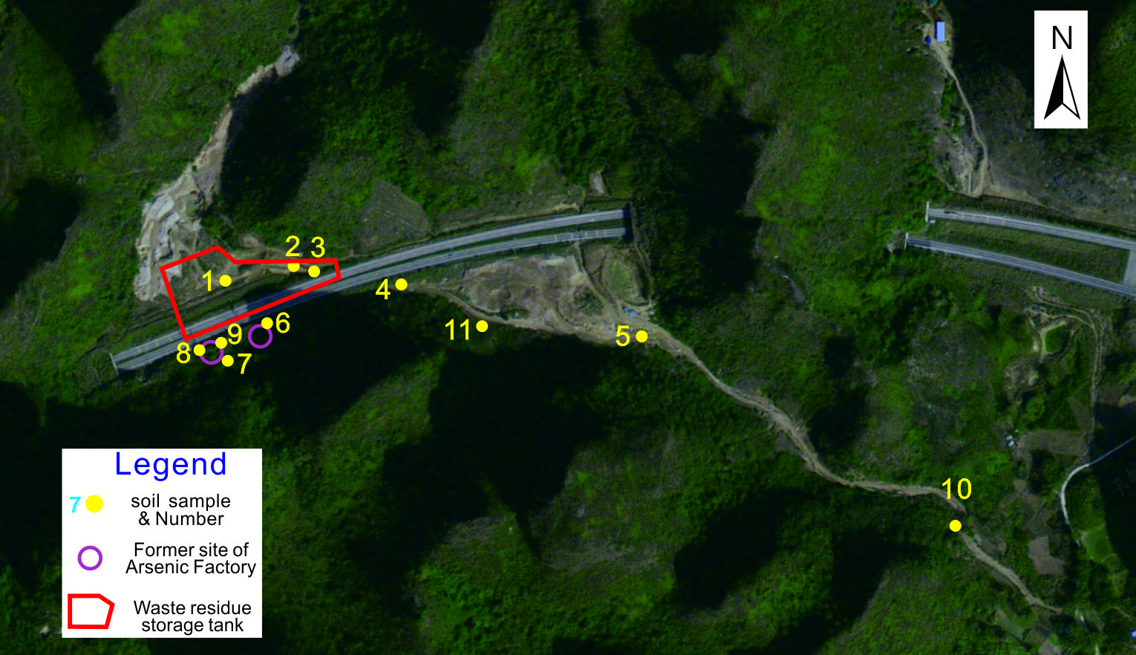
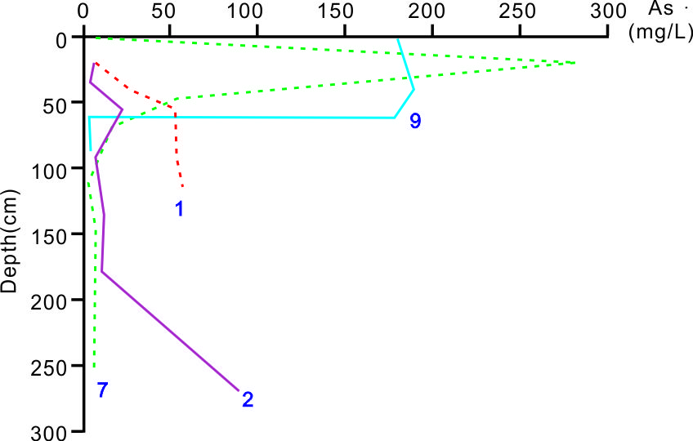
Simulation and Prediction of Natural Restoration for Arsenic-Contaminated Site
Shengzhang Zou ^{a,b,c}, Xaioqing WEI^{d}, Changsong Zhou ^{a,b,c}, Lianjie Fan ^{a,b,c}, Li Lu ^{a,b,c}, Yongsheng Lin ^{a,b,c}, Jia WANG^{a,b,c}
ª Institute of Karst Geology, CAGS/ Key Laboratory of Karst Dynamics, MNR & GZAR, Guilin 541004, China
^{b} International Research Center on Karst under the Auspices of UNESCO, National Center for International Research on Karst Dynamic System and Global Change, Guilin 541004, China
^{c} Guangxi Karst Resources and Environment Research Center of Engineering Technology, Guilin 541004, China
^{d} Yangzhou University, Yangzhou 225000, China
1. Introduction
As a non-invasive long-term management approach based on risk control over con-taminated sites, Monitored Natural Attenuation (MNA) turns out as an effective and economic strategy for soil and ground water pollution management with the potential for maximized cost-effectiveness. MNA is a widely used second-generation pollution site management and remediation method internationally. Based on the natural attenuation characteristics of pollutants, a comprehensive pollution prevention and control plan based on risk management is designed to reduce the remediation cost of polluted sites. In the United States, application of MNA in contaminated site remediation accounts for about 30%, and the cost is about several hundred thousand dollars.
Due to the difficulty, high cost, and poor effectiveness of soil and water pollution restoration in karst areas. At present, MNA mode is adopted in the study area, but in the past 30 years since the arsenic plant was polluted, As in the underground river water in Bapian still exceeds the standard during rainstorm. To comprehensively understand the attenuation rate of As in the site, accurately predict the time of MNA, and conduct sampling analysis on the soil in the polluted site. Thus, the spatial distribution characteristics of arsenic in soil were determined; And indoor soil arsenic desorption experiments were conducted under different conditions to obtain chemical kinetic parameters during the desorption process. Finally, based on the simulation results of Phreeqc, establish a model to understand the relationship between suction and time.
As (mg/L)
Time
(h)
Fig.3 Kinetic process fitting of As desorption process with deionized water(pH=7)
As (mg/L)
2. Background
The research area is located in the supply area at the source of the Bapian underground river sys-tem in Hechi City, Guangxi, and belongs to the peak cluster karst area in terms of topography. In 1995, due to the leakage of the arsenic factory wastewater treatment tank, the soil and underground water around the site were severely polluted. Then the arsenic factory was shut down, and its re-sidual waste was sealed in place using cement tanks; Later, due to the need for highway construc-tion, the waste was transferred to the cement tank on the south side for storage.
The research area is overlaid by the Quaternary strata, with underlying thick layers of Middle Carboniferous dolomite and limestone. The slope residual sandy clay of the Quaternary strata, with a thickness ranging from 1 to 10 meters; The lower part is a residual clay layer, and the upper part is a slope sand layer. The surface karst zone in the area is highly developed, which is conducive to atmospheric precipitation infiltration and forms underground runoff at the rock soil interface. As in the soil enters the underground river system with the underground runoff under the leaching effect of rainfall. Due to changes in hydrodynamic and environmental conditions, As deposits and accumulates in clay rich karst fractures and underground river pipelines, becoming a secondary source of pollution; When hydrodynamic and environmental conditions change, As enriched in clay will be reactivated, polluting groundwater.
Time
(h)
Fig.4 Kinetic process fitting of As desorption process with acidic solution(pH=4.6)
5. Prediction of Natural Purification Time for As Polluted Sites
Based on physical and chemical desorption tests (Fig.5), the unit desorption rate prediction models for arsenic under natural state and acid rain superimposed state were obtained (Formula 1 & Formula 2).
3. Spatial distribution characteristics of As in polluted sites
Ten soil sample collection points (1-10 #) and one soil environment control point (11 #) were set up along the direction of groundwater flow, around and downstream of the polluted site. Arsenic content was monitored at different depths in the vertical direction of collection points 1-8 # (Fig.1). The results showed that the arsenic content exceeded the standard between 60cm-130cm below the surface of the 1 # and 2 # waste disposal sites, and the arsenic content in the soil from the surface to the underground increased with depth (Fig.2).
Fig.5 Kinetic process fitting of As desorption process with acidic solution(pH=4.6)
y = 142.34x² + 556.87x - 16.994,（0.03≤x≤283）…….（1）
y = 113.93x² + 641.85x - 22.906,（0.035≤x≤283）…….（2）
Where y= decay time (min), x=As desorption capacity (mg/L)
The arsenic content in the polluted site is as high as 283 mg/kg, he arsenic content in the secondary standard of soil environmental quality is 40mg/kg. When the arsenic content in the soil leached by atmospheric precipitation drops to the second level soil environmental standard of 40mg/kg, it is considered that the site has been naturally restored. Therefore, the maximum value of the independent variable x in the model calculation is 283 mg/kg.
The model calculation shows that under ideal conditions of atmospheric precipitation with pH=7 and continuous leaching of arsenic containing soil at a unit area of 142.34 ml/h, it takes additional 16.25 years for the soil to meet the secondary standard requirements. And in acid rain with pH=4.6, it also takes 13.09 years.
Fig.1 Soil Sample Collection Points
Fig.2 Distribution of As Vertical Content in Soil Layer
Sampling points 1 # and 2 # are both located in low-lying areas of valleys, and soil arsenic content exceeds the standard only 300cm below the surface, with a multiple of 3.3 times the standard. The arsenic content in the soil also shows a pattern of increasing with depth. In low-lying areas of valleys, the water dynamics are strong, and As in the soil layer is continuously decreasing due to precipitation leaching, gradually moving deeper, resulting in an increase in the arsenic content in the lower soil layer due to continuous accumulation. Because the deep soil layer exhibits a reducing environment, As⁵⁺ is mostly converted into As³⁺ , and the migration ability of As³⁺ significantly decreases while continuously accumulating in the deep soil layer.
Different from points 1 # and 2 #, points 7 # and 9 # located around the waste residue storage tank area not only have the highest times of arsenic exceeding the standard in the soil layer, but also exhibit characteristics of high arsenic content in the shallow and low arsenic content in the deep. The arsenic content within 20cm below the surface reaches 283 mg/kg and 181 mg/kg, respectively, with exceeding multiples of 9.4 and 4.5 times. And high content arsenic pollutants are mainly concentrated within a depth of 60cm below the surface. This may be because the waste residue storage tank is located in a high slope area, with relatively weak hydrodynamic effects, and the migration rate of As is slow due to the leaching effect of rainfall.
The spatial distribution characteristics of As in different landforms can be eaten separately. Due to the leaching effect of rainfall, arsenic in the soil layer of the polluted site has entered a certain depth below the surface and accumulated to form a relatively stable secondary pollution source. Therefore, despite the removal of waste residue, arsenic pollutants trapped underground can still pose a pollution risk to groundwater.
6. Conclusions
The results indicate severe arsenic contamination in the original waste heap soil, with arsenic content reaching 181-283mg within 20cm below the surface in certain local areas. However, high concentrations of arsenic pollutants are mainly concentrated in the depth range of 30-60cm below the surface. This suggests that under the driving force of atmospheric precipitation, arsenic from the original waste heap infiltrates into the soil below the surface of 30-60cm.
Due to the transformation of the soil from an oxidizing environment to a reducing environment, arsenic continuously accumulates, forming a relatively stable secondary pollution source that still poses a risk of groundwater contamination. The results of desorption simulation experiments using local normal rainfall and acid rain (pH=4.6) show that normal atmospheric precipitation can only desorb approximately 40.7% of the arsenic in the soil. It would take an additional 16.25 years to bring the arsenic concentration in the contaminated site to the second-level standard limit of soil environmental quality. Under acid rain conditions, the dissolution rate of arsenic can reach 65.4%, and considering the local annual acid rain rate, the arsenic concentration in the contaminated site can meet the second-level standard limit of soil environmental quality within 13.09 years.
Acknowledgements
4. Natural attenuation dynamics experiment of As
The work was supported by Project Supported by the Guangxi Science and Technology Planning Project (GuiKe-AB18050026, GuiKe-AB22080070), and China Geological Survey Project (DD20221758, DD20230081). The authors wish to thank XIA R’yuan, ZHU Danni and YU Xiaoying for the support in the test.
Physical and chemical desorption experiments were conducted on the soil layer of the polluted site using deionized water with pH=7 and artificial acid rain with pH=4.6 as leaching solvents, respectively, to obtain the natural attenuation kinetic parameters of As in its natural state. The outlet flow rate of the desorption experiment is determined to be 142.34 ml/h based on the size of the experimental device, combined with local rainfall intensity and ground infiltration coefficient.
The dual constant model was used to fit the desorption kinetics of As, and the results showed that long-term stability can completely migrate As entering the experimental system soil. Physical desorption takes about 272 hours (Fig.3), while chemical desorption can shorten the time by about 17.3%, about 25 hours (Fig.4). This indicates that under natural conditions, the complete release of arsenic pollutants through atmospheric precipitation leaching will be very slow, but local acid rain can slightly accelerate the natural decay process.
References
Cheng Chun-fang. Research on Simulation Method of Natural Remediation of Heavy Metal Pollution in Soil Surface[J]. Chemical Engineering Design Communications, 2020,46(9):172-173.
Declercq I, Cappuyns V, Duclos Y. Monitored natural attenuation (MNA) of contaminated soils: State of the art in Europe—a critical evaluation[J]. Science of the Total Environment, 2012, 426(2): 393-405.
LI Yuan-jie, WANG Sen-jie, ZHANG Min, et al. Research progress of monitored natural attenuation remediation technology for soil and groundwater pollution[J]. China Environmental Science, 2018,38(3)：1185~1193.
MA Xin-cheng, XU Hong-xia, SUN Yuan-yuan, et al. Research progress on biotic natural attenuation for the remediation of chlorinated hydrocarbon-contaminated sites[J]. China Environmental Science, 2022,42(11): 5285~5298.
Yuan Haochen,Zhang Youkuan,Liang Xiuyu.Modelling of groundwater remediation using monitored natural attenuation at a contamination site in Guangzhou[J].Bulletin of Geological Science and Technology,2023,42(4):268-278.
Zeng Bin, Wei Xiaoqing, Zou Shengzhang, et al. Experiment and simulation on migration rule of As in soil of surface karst zone in Southwest China[J]. Earth Science, 2018,43(11): 4237-4245.

