Slide 1
PREDICTING ULTIMATE HYDROGEN PRODUCTION AND RESIDUAL VOLUME DURING CYCLIC UNDERGROUND HYDROGEN STORAGE IN POROUS MEDIA USING MACHINE LEARNING
Institutt for fysikk og teknolog- Universitet i Bergen
Raymond Mushabe
(CSSR-UiB)
Jean Donald Minougou , David Landa-Marbán , Birane Kane and Tor Harald Sandve
23rd 04 2024

Slide 2
Outline
Objectives and reasons for the study
Methodology
Key findings
Conclusions

Slide 3
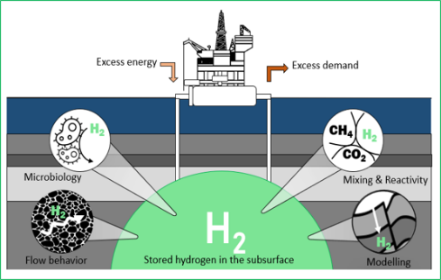
Objectives and reasons
Underground hydrogen storage (UHS) is seen as a technology that can be used to tackle the imbalance in renewable energy supply and demand chains.
Excess energy can be stored as gaseous hydrogen and reused when it is needed.
Hydrogen storage in geological reservoirs involves a lot of physica-chemical phenomena related to:
Reservoir dynamics, trapping mechanisms,
Potential reactions with minerals
Bio-geochemical reactions
Fast hydrogen injection and production while considering those physical constraints requires high computational power.
For a year of weekly operations, the number of possible combinations amounts to 3^52 (6.4610819E+24) scenarios
How do we predict the amount of stored hydrogen we are able to produce back under prevailing physics, operations, and economic limits?
Fig. 1 Source: CSSR-NORCE

Slide 4
Methodology- data creation
Data generation and treatment
Model validation and deployment
Geometries
Physics
Variable inputs:
Economic limits
Aquifer size
Python Scripts
Config. and mako files
Pyopmnearwell ensemble
OPM flow
Time series neural network
Hyperparameter tuning
First Predictions
Parameter tuning
2nd predictions
Outlook
Define case scenarios
ML Model: Train and test
4

Slide 5
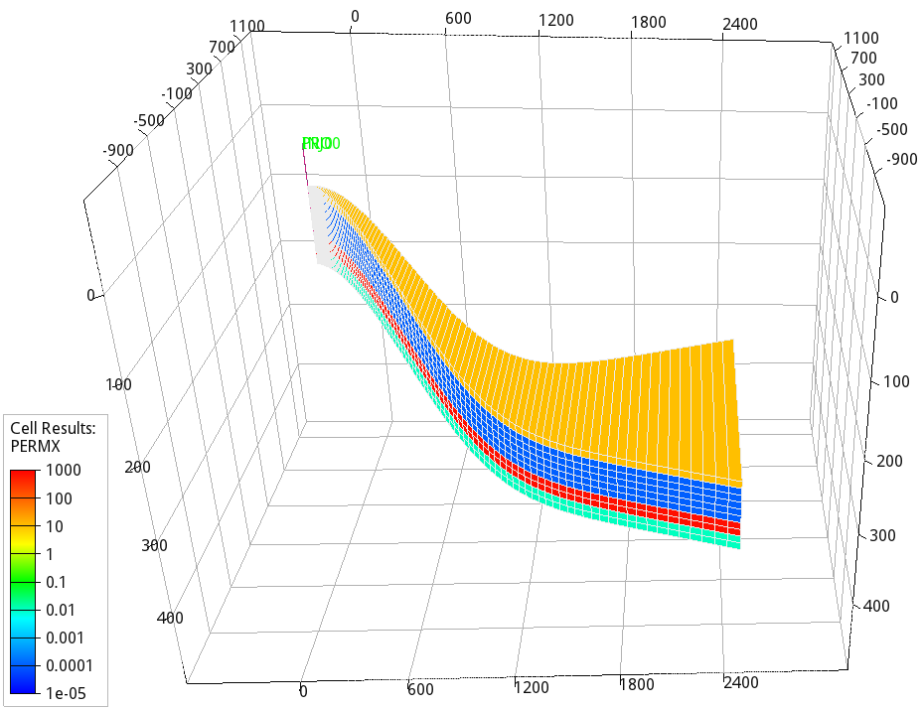
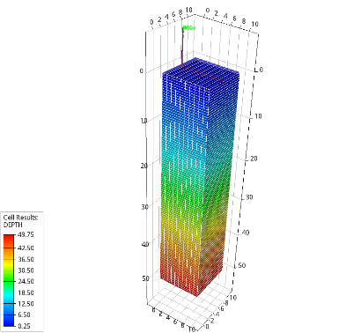
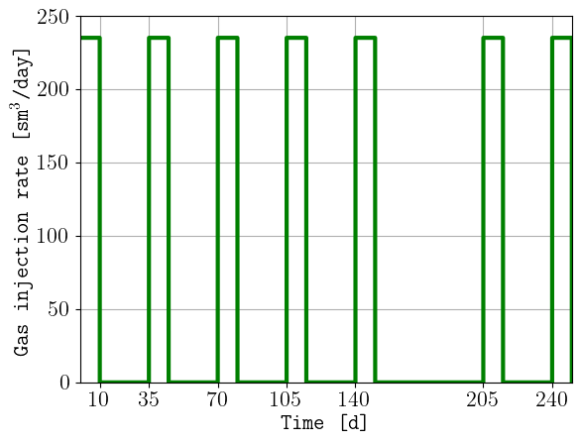
Methodology- Simulation end point
Fig. 2. Two published reservoir models (a) Okoroafor et al. (2023 and (b) Zhang et al.(2023) were used to depict two different reservoir geometries to simulate training datasets.
Fig 2. (c) The followed injection schedule inspired by Okoroafor et al. (2023).
The models were populated with physics driven laboratory data from our research group.
The economic constraint was set at 95% the defined production rate.
Residual hydrogen trapping (loss) was controlled by relative permeability hysteresis, capillary pressure, dissolution and reservoir geometry.

Slide 6
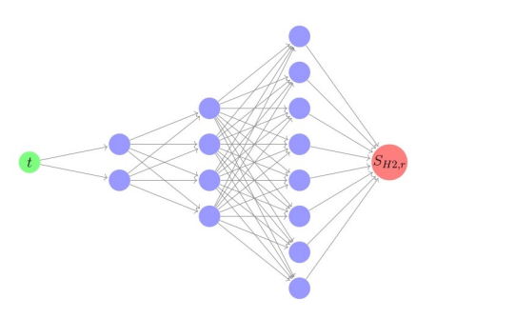
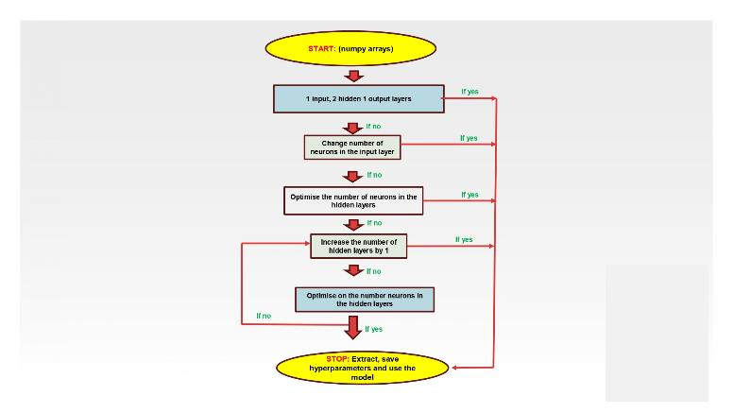
Methodology – Neural network model
Fig 3. (a) A keras time series neural network with a look back factor of 6 was used.
Fig 3. (b) A graphical illustration of the key optimization steps during hyperparameter tuning. The focus was on the number of hidden layers and neurons connecting them in the neural network.
The model was fed and trained on physics-rich:
Production data
Injection data
The model was trained to learn the temporal complexity in the dataset as each neuron is provided with a unique weight or bias.

Slide 7
Results- Key findings
Table 1. (a) A summary of the key ML results and the hyperparameter values in each case study.
Table 1. (b) Comparative results between simulation runs and ML model training and validation

Slide 8
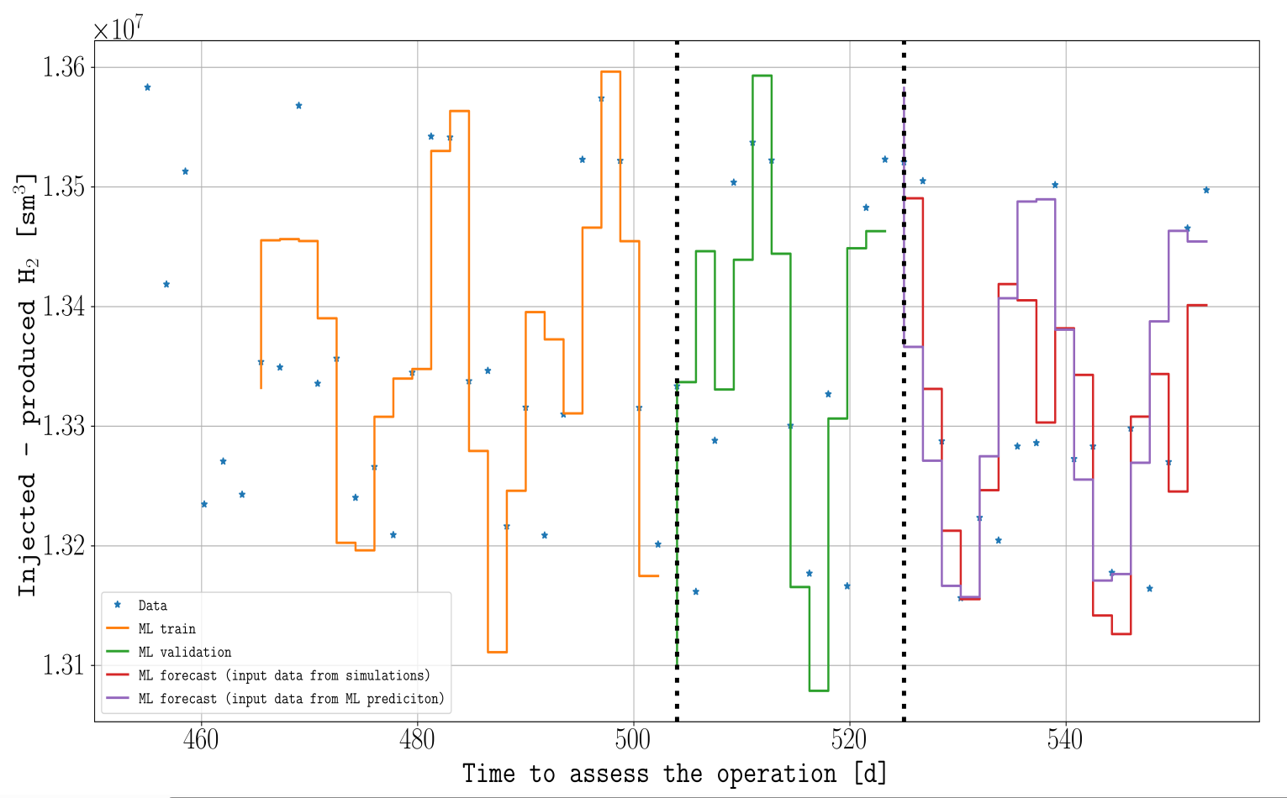
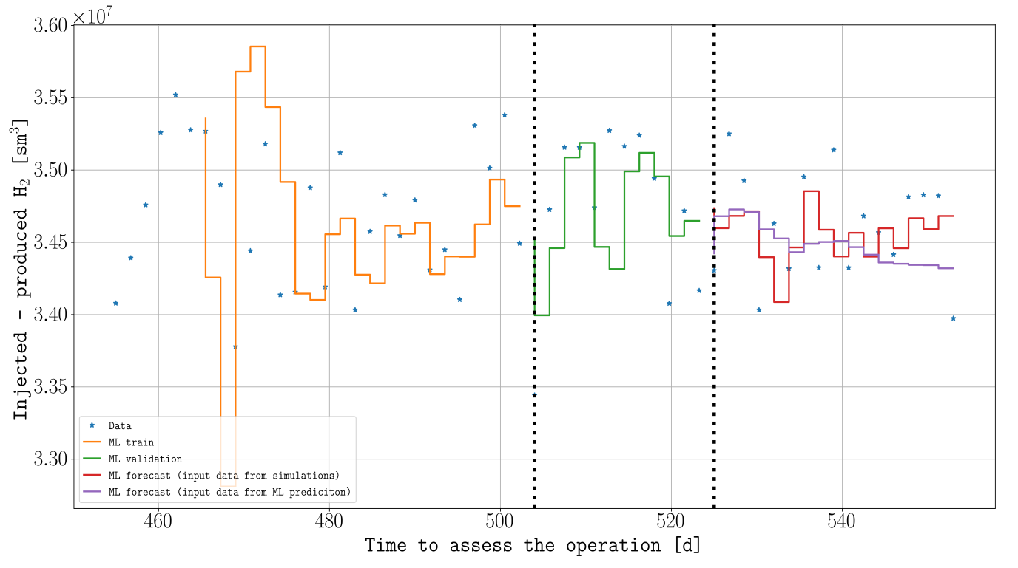
Results - Predictions on guassian model
(a)
(b)
Fig 4. Comparison on predictions on base case data sets (a) and target case 1 (b) with extended physics. (Injected volume in x10^8 sm3)
In both cases, the models well fitted the datasets during training and validation steps as seen win orange and green curves.
Subsequent predictions (red and purple curves) were also with acceptable ranges.
However, a slight mismatch was observed on both predictions for both production (not shown) and residual hydrogen volume forecasts for a physics enriched model (b).
The mismatch was associated with the physical complexity in the dataset.
Better data fitting was obtained after tuning a few hyperparameters in the developed model

Slide 9
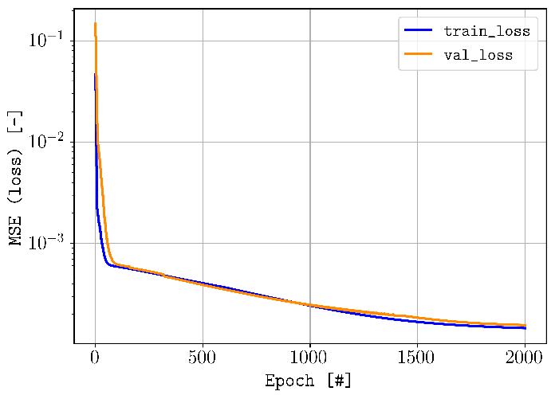
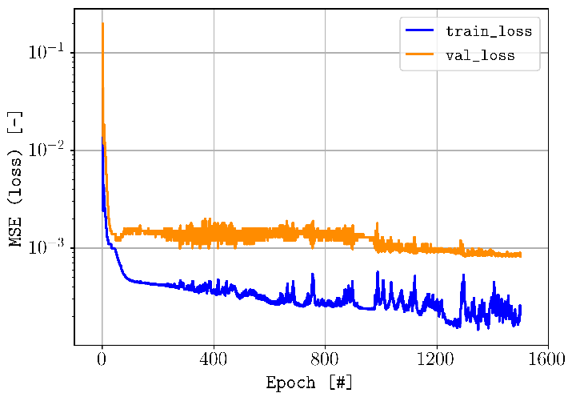
Results – evaluation of the loss functions
(a)
(b)
Fig 5 . The evolution behavior of the loss function (MSE) during the training and validation steps of the NN model trained on the dataset from base case 1 (a) and target scenario 1. (b)
In both scenarios, the loss functions were monotonically declining and reduced to an acceptable window.
The occurrence of the validation loss being greater than the training loss was also a positive observation since the dataset used in the validation was a small fraction of the whole training dataset

Slide 10
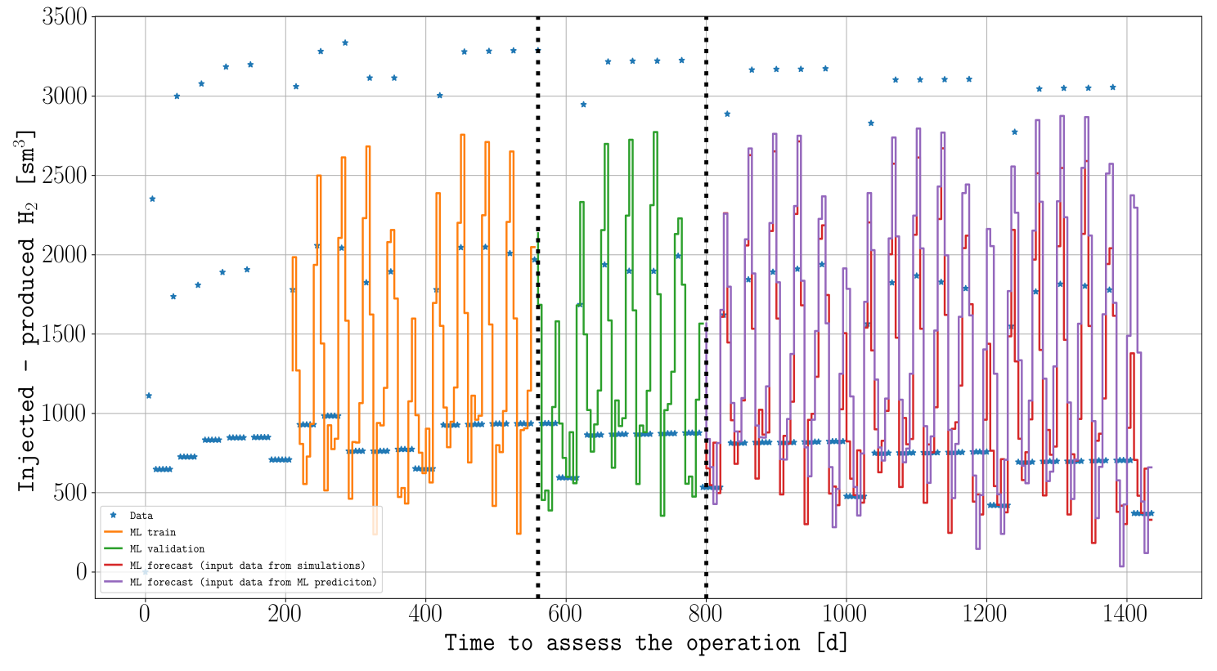
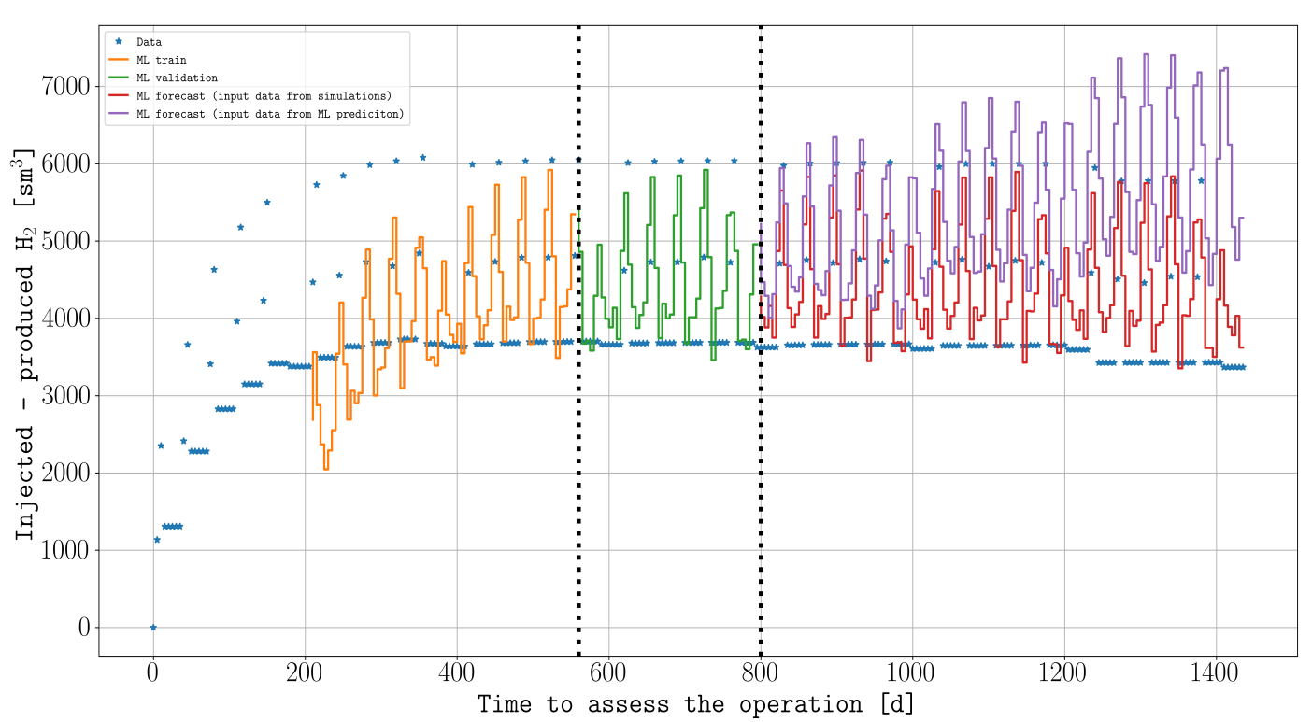
Results – Predictions on the horizontal well model
(a)
(b)
Fig 6. Predictions of residual hydrogen volume on the dataset generated on a horizontal well model inspired by Zhang et al.(2023).
The training and validation steps were good and the model captured the trends in the rerspective datasets.
However the overall performance of the model was guided by the location of of the dataset clusaters in both base case 2 (a) and target scenario 2 (b)

Slide 11
Conclusions
Based on this predictive modelling study on already published and open geological models, the following conclusions could be made
Machine-learned models can potentially be used to make production forecasts within acceptable accuracy levels.
The loss function values (the mean squared error (MSE) and mean absolute error (MAE)) support this conclusion.
The same models successfully predicted the residual hydrogen volumes when called upon. The predictions were in an acceptable accuracy window using the same performance metrics.
Predicting on the injection volumes seemed unnecessary because any neural network (NN) model used no matter its structure was able to make perfect predictions. In other words, the models perfectly matched the data sets.
This was expected as the injected amount injected into the reservoir is normally well known.
Computational costs in turns of run time from the machine-learned predictions were far much smaller in comparison with either a single or a collection of simulation runs. A multi-layer multi-physics scenario had 4 orders of magnitude difference. That was equivalent to 6773.5% percentage difference.
Predictions on the dataset generated on a complex UHS schedule using a one-layer reservoir model produced unique trends in the production data-sets. These trends were well captured by the learned neural network (NN) model and substantially reduced the computational cost for a 7-season scenario for in four years by 731.2%

Slide 12
Acknlogements

Slide 13
Last page
Department of Physics and Technology-University of Bergen
_____END____
UiB, CSSR, NORCE, EQUINOR, WINTERSHALL DEA, THE RESEARCH COUNCIL OF NORWAY, HAUKELAND UNIVERSITY HOSPITAL

