Slide 1
A Hybrid Multiscale Pore Network Modeling Method Applied to Complex Carbonate Rocks
Gwenole Tallec
May 2022

Slide 2
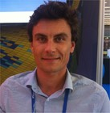
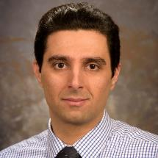
Co-authors
Viswasanthi Chandra
Research scientist, King Abdullah University of Science and Technology
Viswasanthi.Chandra@kaust.edu.sa
Gwenole Tallec
Product Expert, Thermo Fisher Scientific
Gwenole.Tallec@thermofisher.com
Arsalan Zolfaghari
Product Expert, Thermo Fisher Scientific
Arsalan.Zolfaghari@thermofisher.com

Slide 3
Outline
Context
1
Goals
2
Tools
3
Data processing
4
Results
5
Conclusion
6

Slide 4
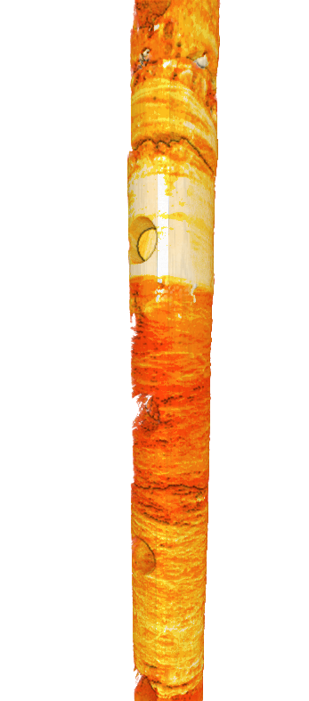
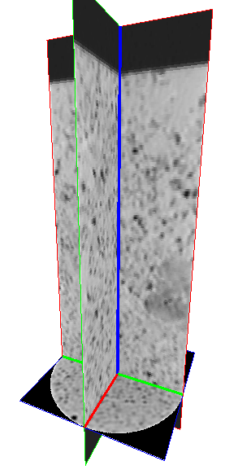
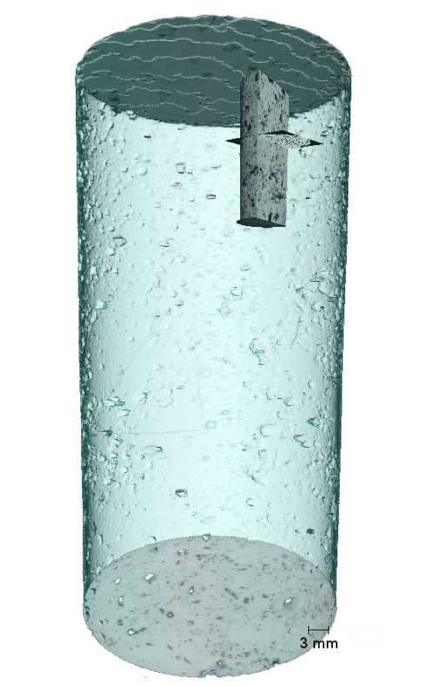
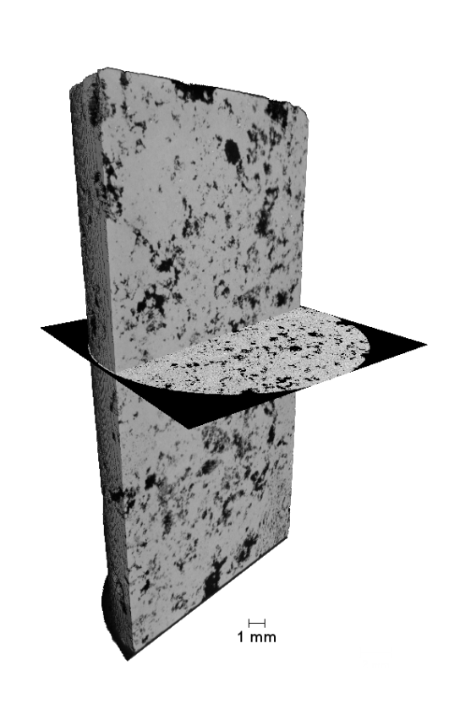
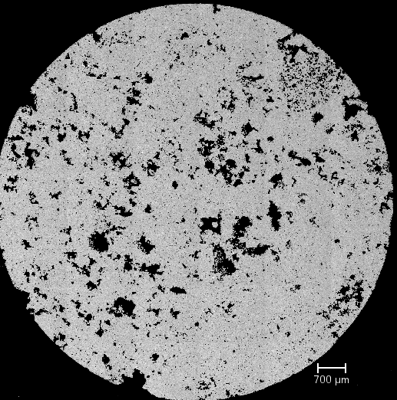
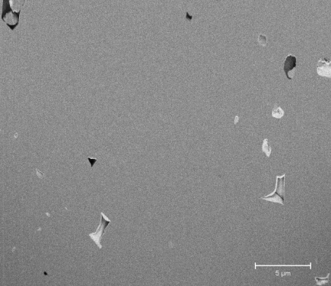
Multiscale imaging
Whole Core
CT
SEM/EDX
Mineralogy
CT
µCT
µCT
FIB/SEM
300 µm
50 µm
15 µm
1 µm
250 nm
1 nm
From Core to Pore
Notes:
Rajouter ROI + Fleches

Slide 5
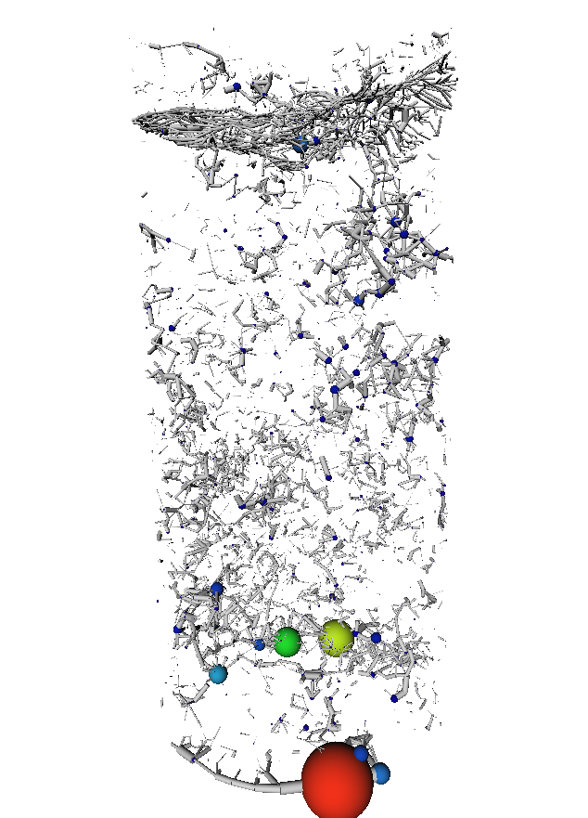
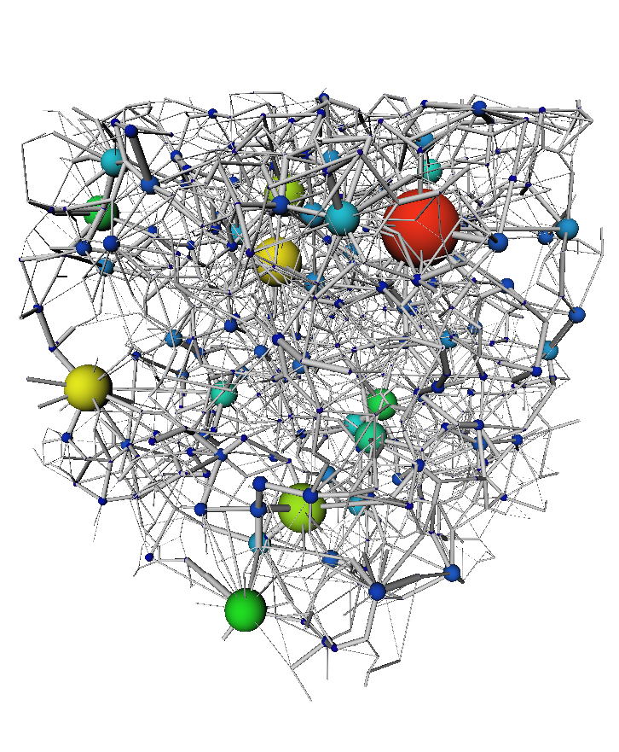
Context
Single scale imaging
Single scale simulation
1 sample – 1 resolution
1 scale Multiphase flow simulation
Multiscale imaging
Single scale simulation
N samples – N resolution
Upscaling the pore space
1 scale Multiphase flow simulation
Multiscale imaging
Multi scale simulation
N samples – N resolution
Multiscale Multiphase flow simulation

Slide 6
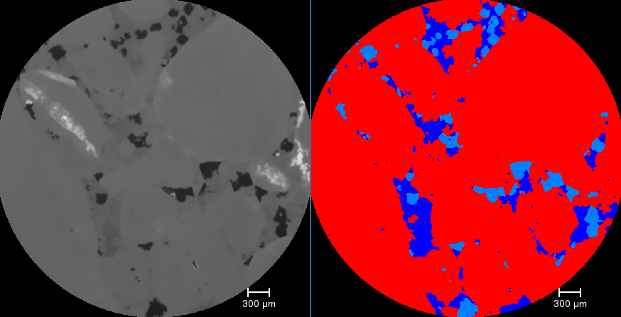
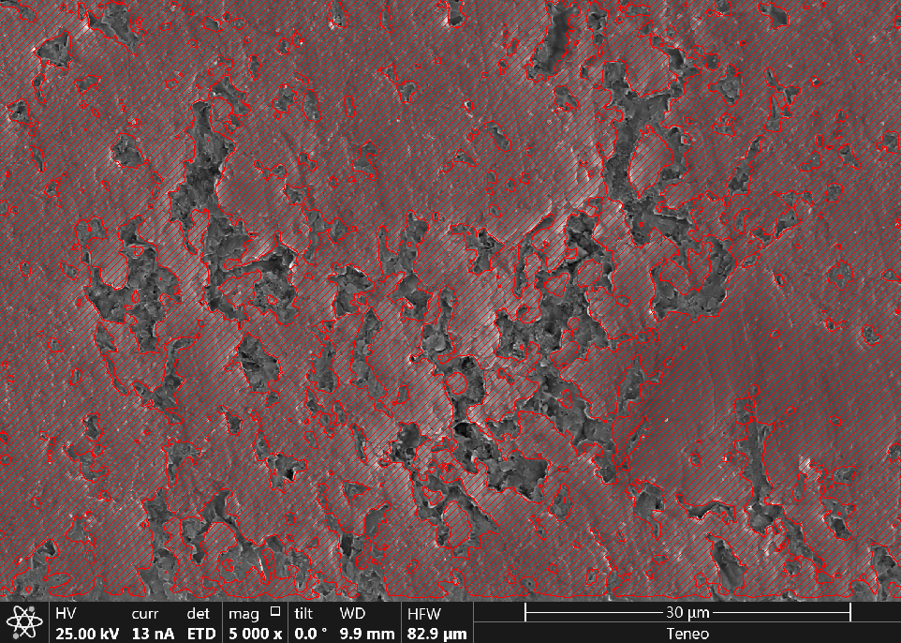
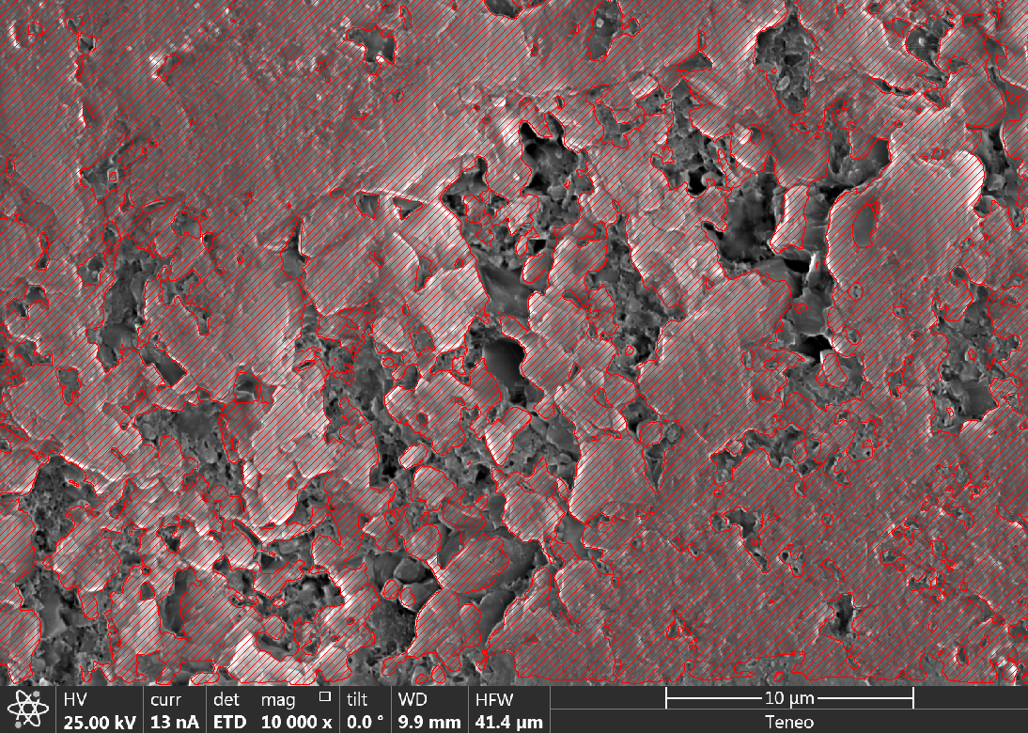
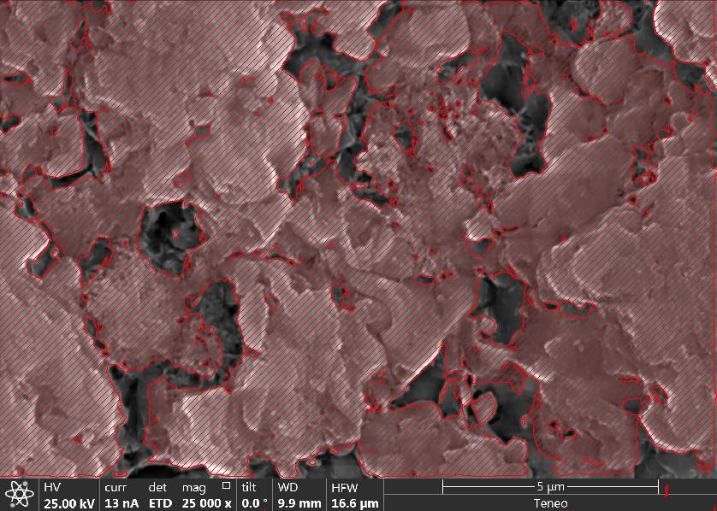
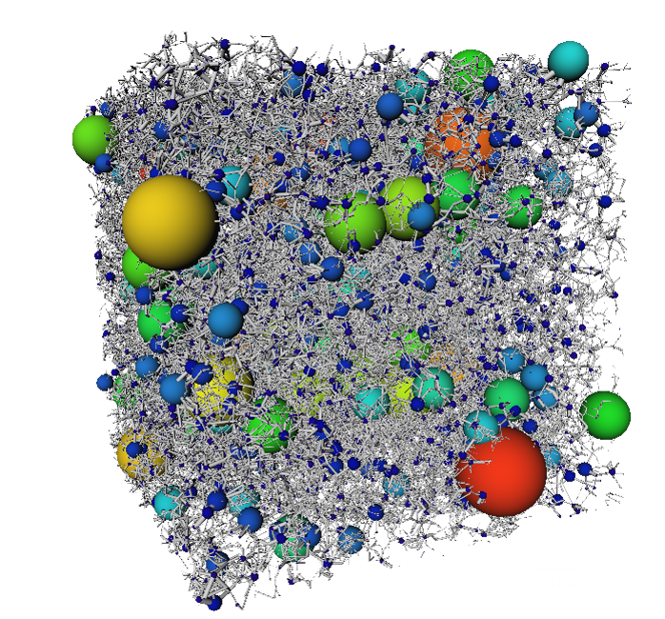
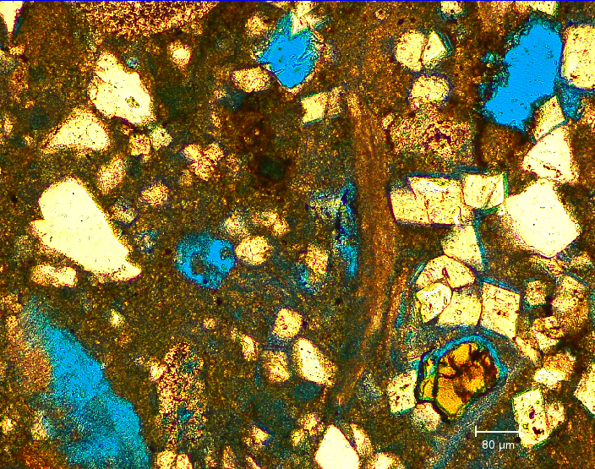
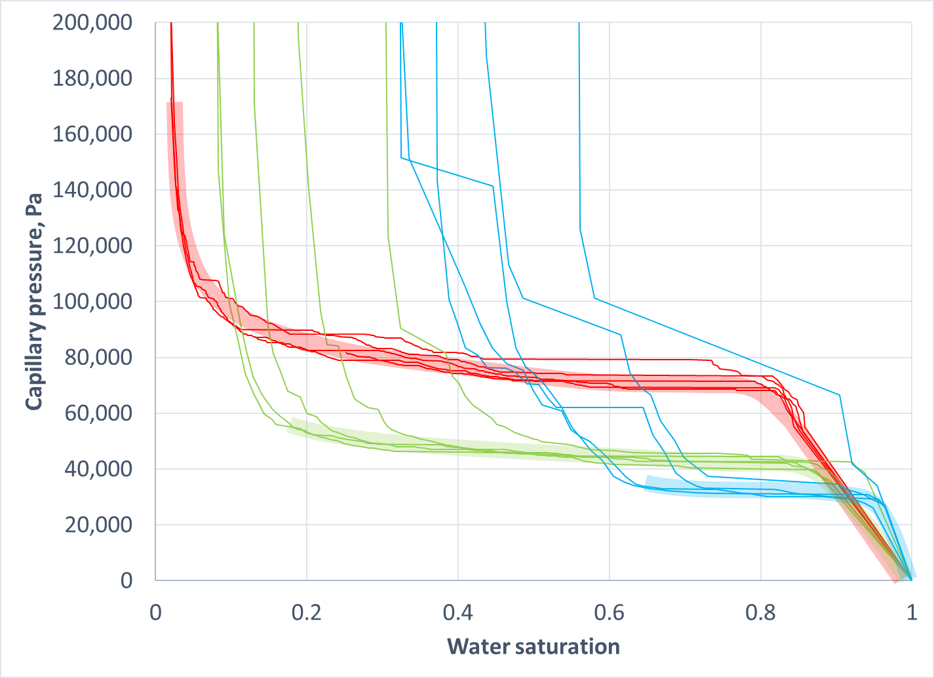
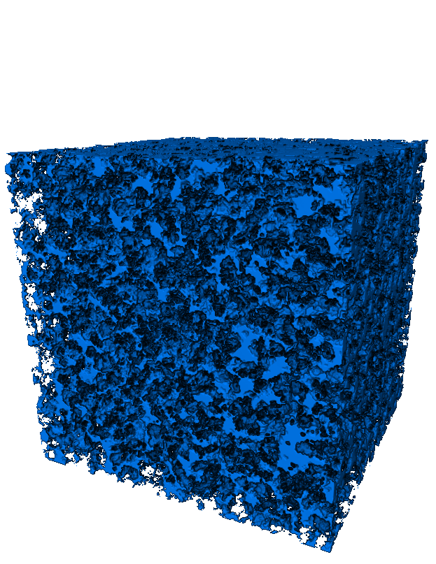
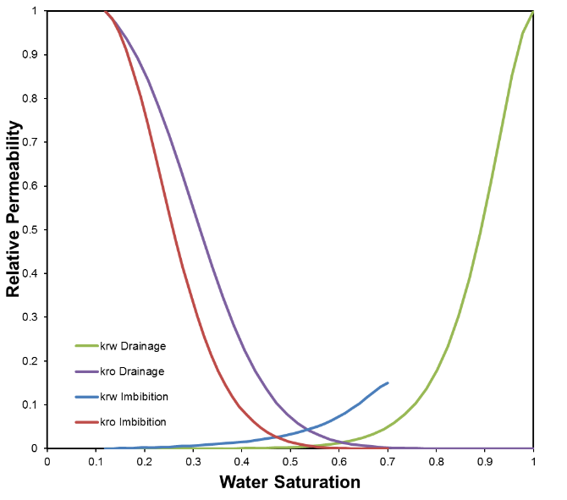
Goals
Intrinsic
Accurate modeling of carbonate rocks
Fast simulation of multi-phase flows
Useability
Define a workflow for further studies
Easily replicate the workflow

Slide 7
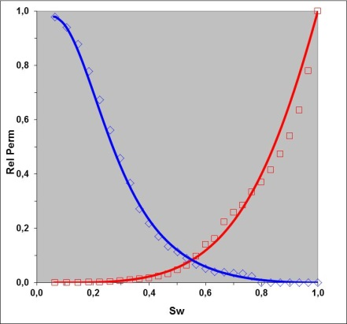
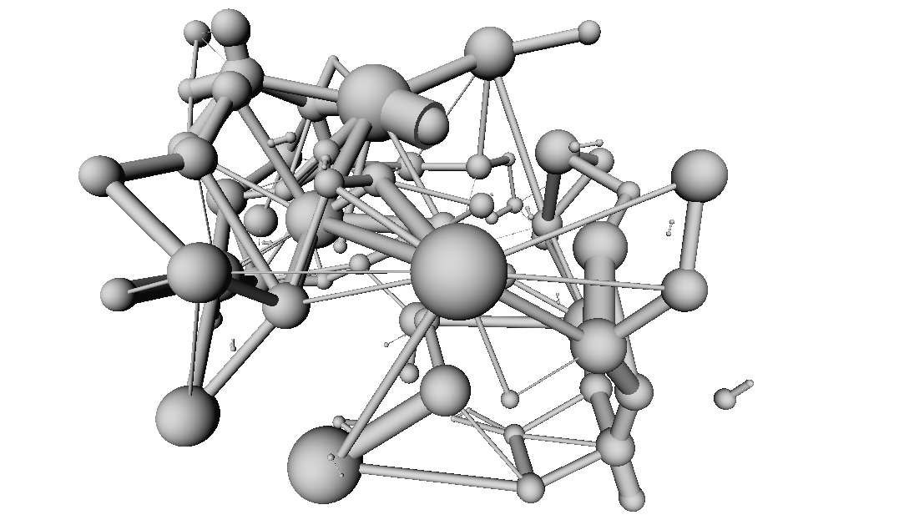
Tools
Image segmentation
Pore space definition at each scale
Applications
SEM : Deep Learning
mCT : Deep Learning
Replicability
Ground truth defined with Watershed or Machine Learning
Applicable to other models with U-net Deep Learning
Process Based Modelling
Create a 3D Pore structure from 2D images
Pore Network Model extraction
Dedicated extraction based on maximum inscribed spheres
One PNM for each rock type
2-Phase flow simulation
Primary Drainage / Water Flooding
Two-phase properties
Capillary Pressure
Relative Permeability
Resistivity Index
Residual Oil Saturation
Conditions
Assign wettability via contact angle distributions
Simulate trapping of non-wetting phase

Slide 8
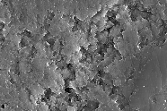
Tools : Image segmentation
Deep learning applied to 3D microCT
Define the Ground Truth on a subset
Training
Prediction on similar samples and larger scales
Deep learning applied to 2D SEM
Define the Ground Truth on one single image
Automatically tiled and sent to the trainer
Apply to other images

Slide 9
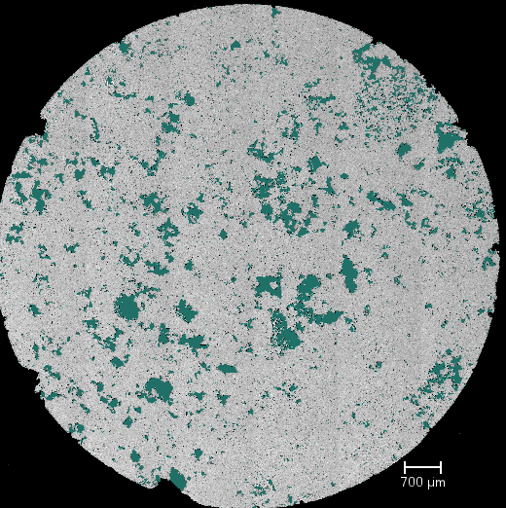
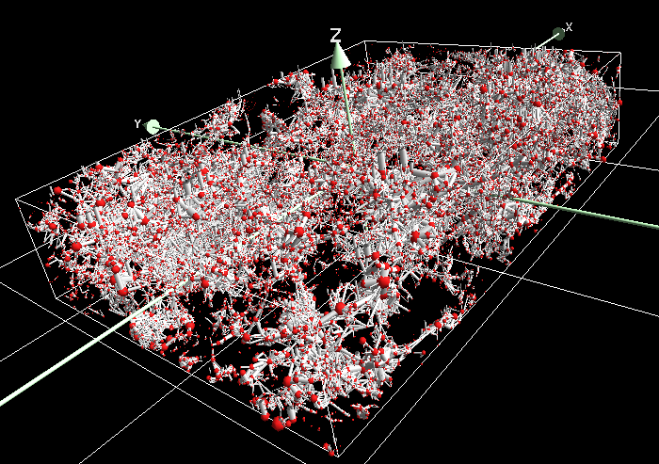
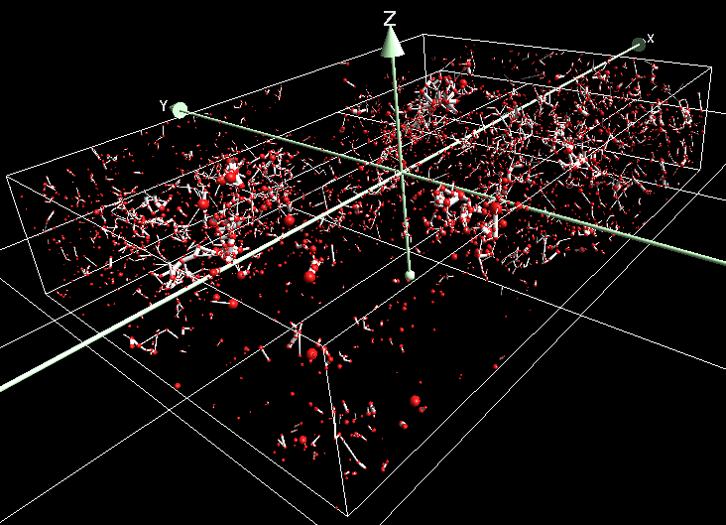
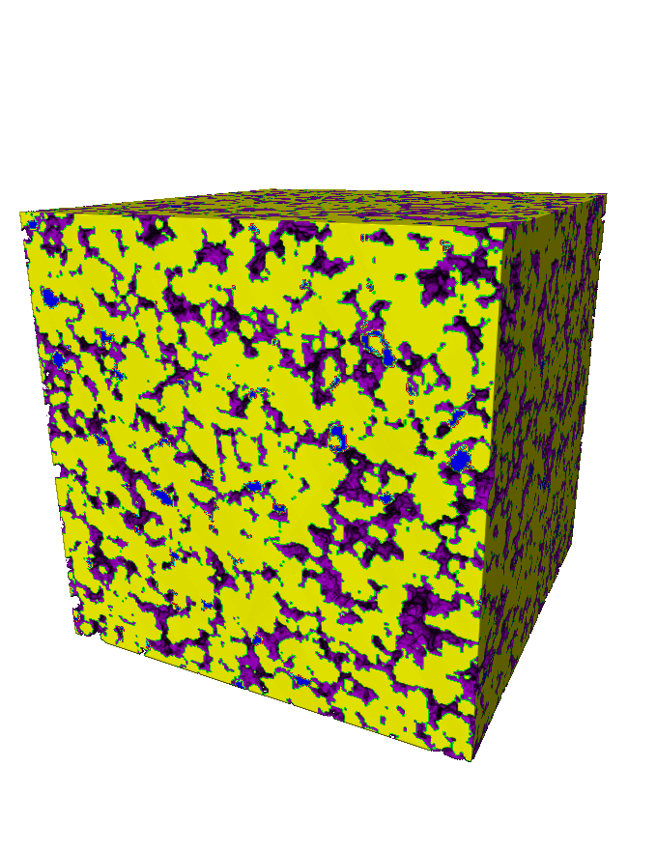
Tools : Image segmentation
Process Based Modelling
Motivation
Generate 3D pore space from 2D images
Multiscale Pore Network Model
Motivation
Take into account heterogeneities at different scales
Combine a continuum model of porous media with the PNM technique
Predict petrophysical properties at larger fields of view for carbonates
Applications
Simulate multiphase flow at several different scales
2µ pore space SEM
2µ pore space 3D
With multiscale PNM feature
No multiscale PNM feature
Thin Section
3D model
3D Pores

Slide 10
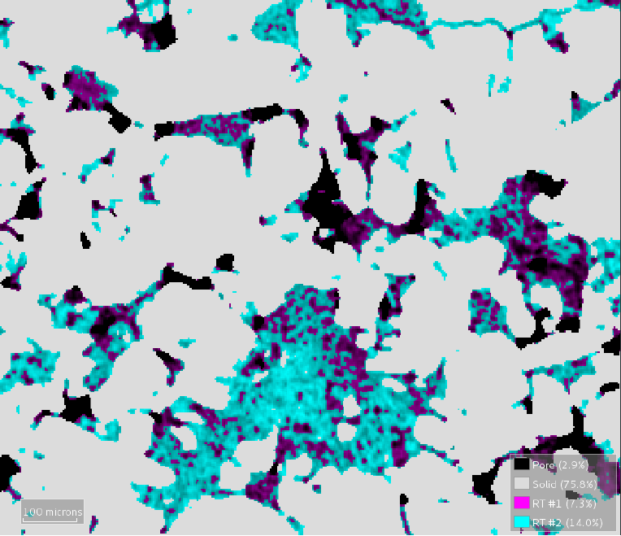
Tools : Multiscale Pore Network Model
▮Pores
Φ distribution
Φ-K relationship
Kx, Ky, & Kz
Cementation exponent in x, y, & z
Leveret-J function
Relative permeability
Resistivity index
▮Rock Type 1
▮Resolvable pores
▮Rock Type 1
▮Rock Type 2
Φ distribution
Φ-K relationship
Kx, Ky, & Kz
Cementation exponent in x, y, & z
Leveret-J function
Relative permeability
Resistivity index
▮Rock Type 2
1 PNM at each resolution
Used as input for Multiphase Flow Simulation

Slide 11
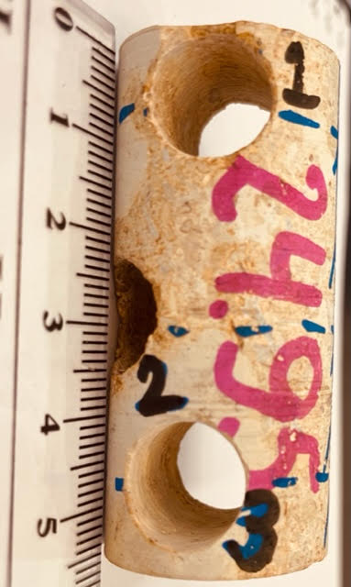
Data
Carbonate Plug from the Arab-D Formation of Saudi Arabia

Slide 12
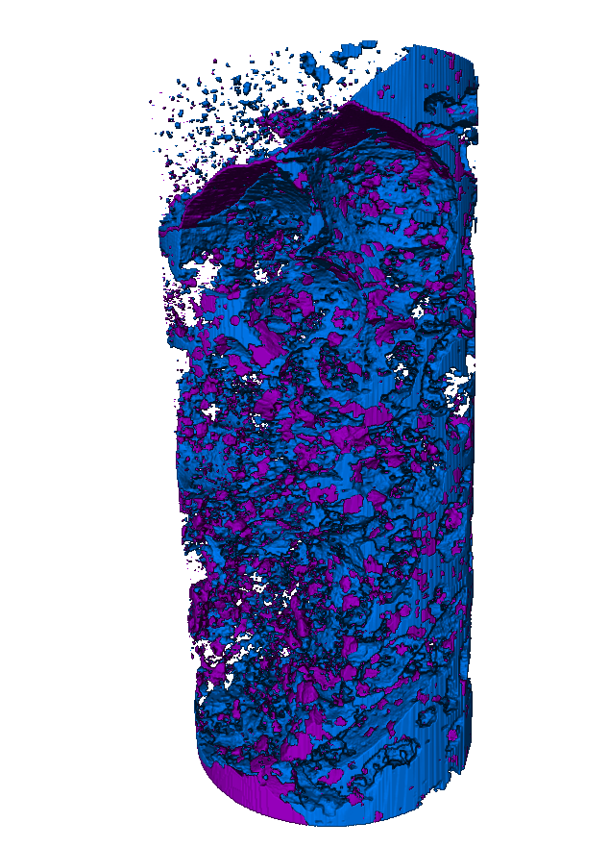
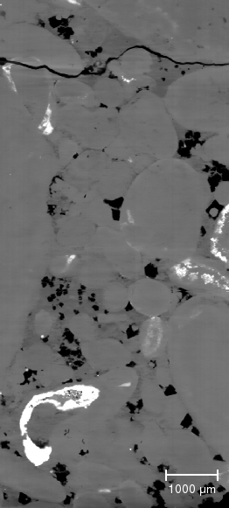
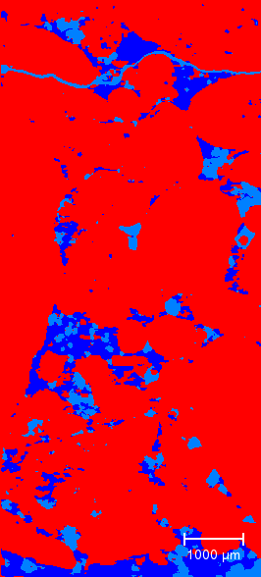
Data processing: microCT segmentation
Micro pores
13,8 %
Pores
5,5 %
Plug 2 scanned at 6µm
Denoised
Pore & Micro-pores
3D Pore & Micro-pores
InterPore 2022 | A Hybrid Multiscale Pore Network Modeling Method Applied to Complex Carbonate Rocks

Slide 13
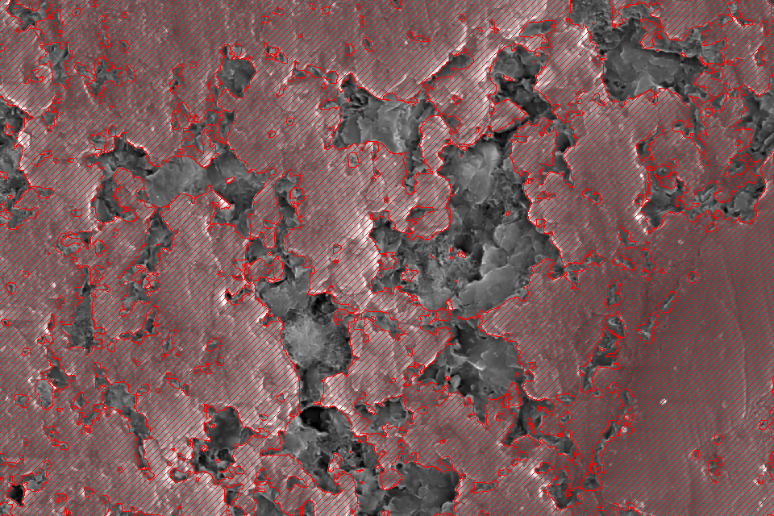
Data processing: SEM segmentation
Micro-pores scanned with SEM, pixel size 27 nm
Minerals highlighted in red
Deep Learning model applied to other samples to better characterize the micro-pores structure

Slide 14
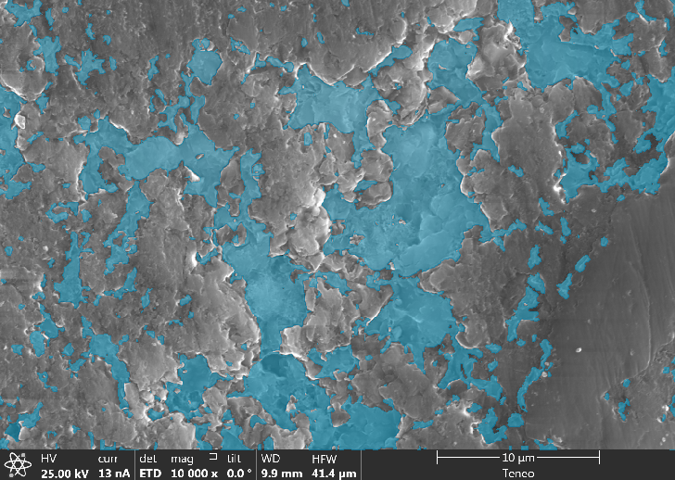
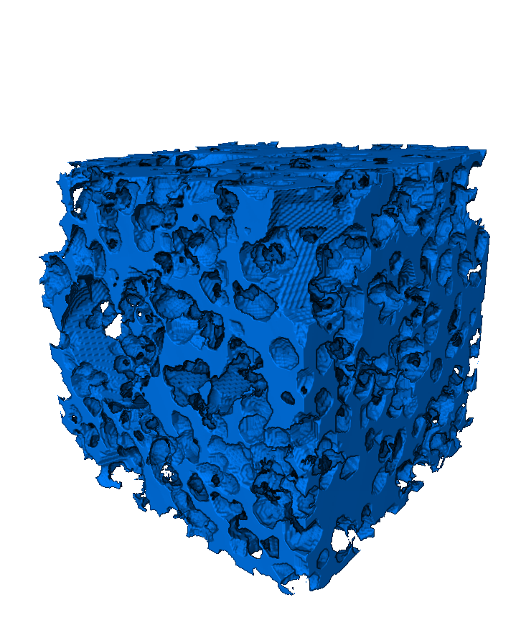
Data processing: generating 3D pore models from SEM
Process
Based
Modelling
Porosity : 34%
Pore Size distribution
Pore shape analysis
Grain Size distribution
Generated Pore Space
Derived PNM

Slide 15
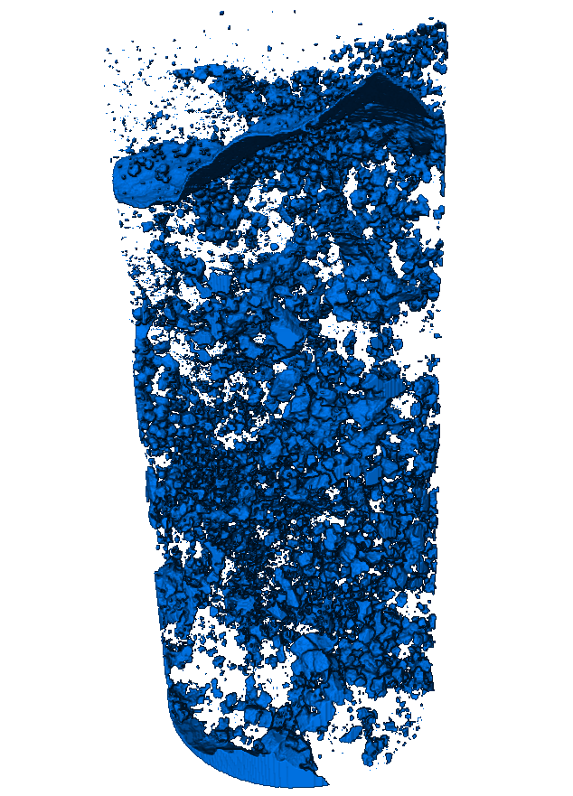
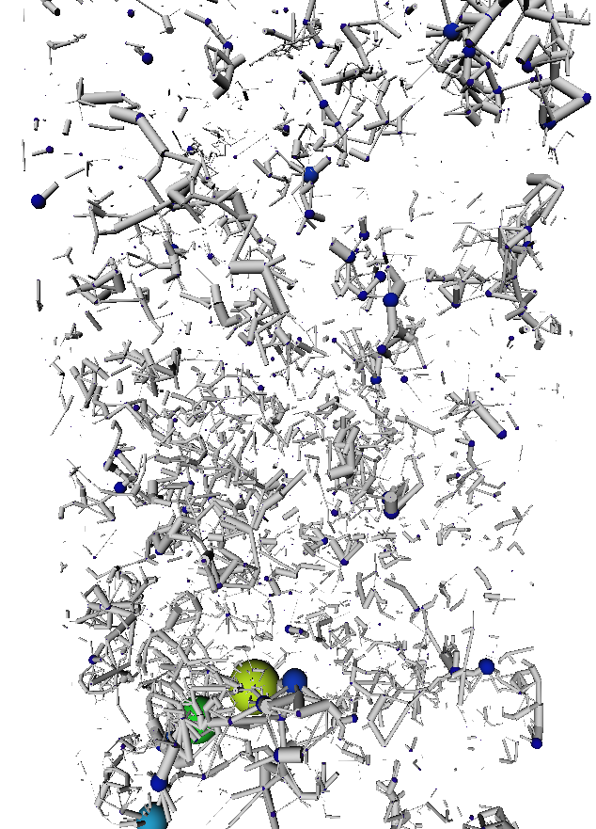
Data processing: rock types definition
3D pores model
3D PNM
Micro pores
PNM computed from the 3D models generated from the SEM images
Not equally distributed : use the greyscale intensity values to interpret the micro porosity In the Multiscale PNM
Pores
PNM computed from the microCT volume
Segmented XZ slice

Slide 16
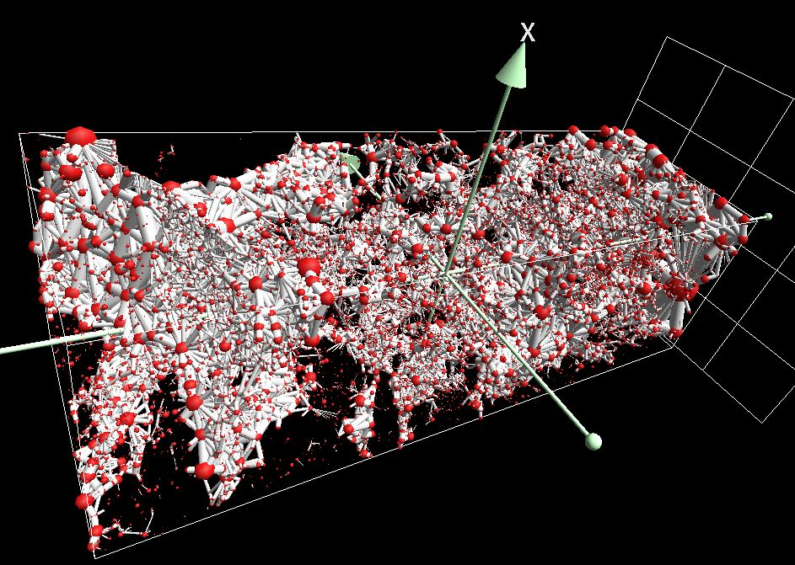
Data processing: Multiscale PNM
Micro pores not equally distributed :
Pore space defined once for the rock type
Global PNM defined with a porosity map
Porosity of the micropores defined in conjunction with the intensity values
Pores & micro-pores
Multiscale Pore Network Model

Slide 17
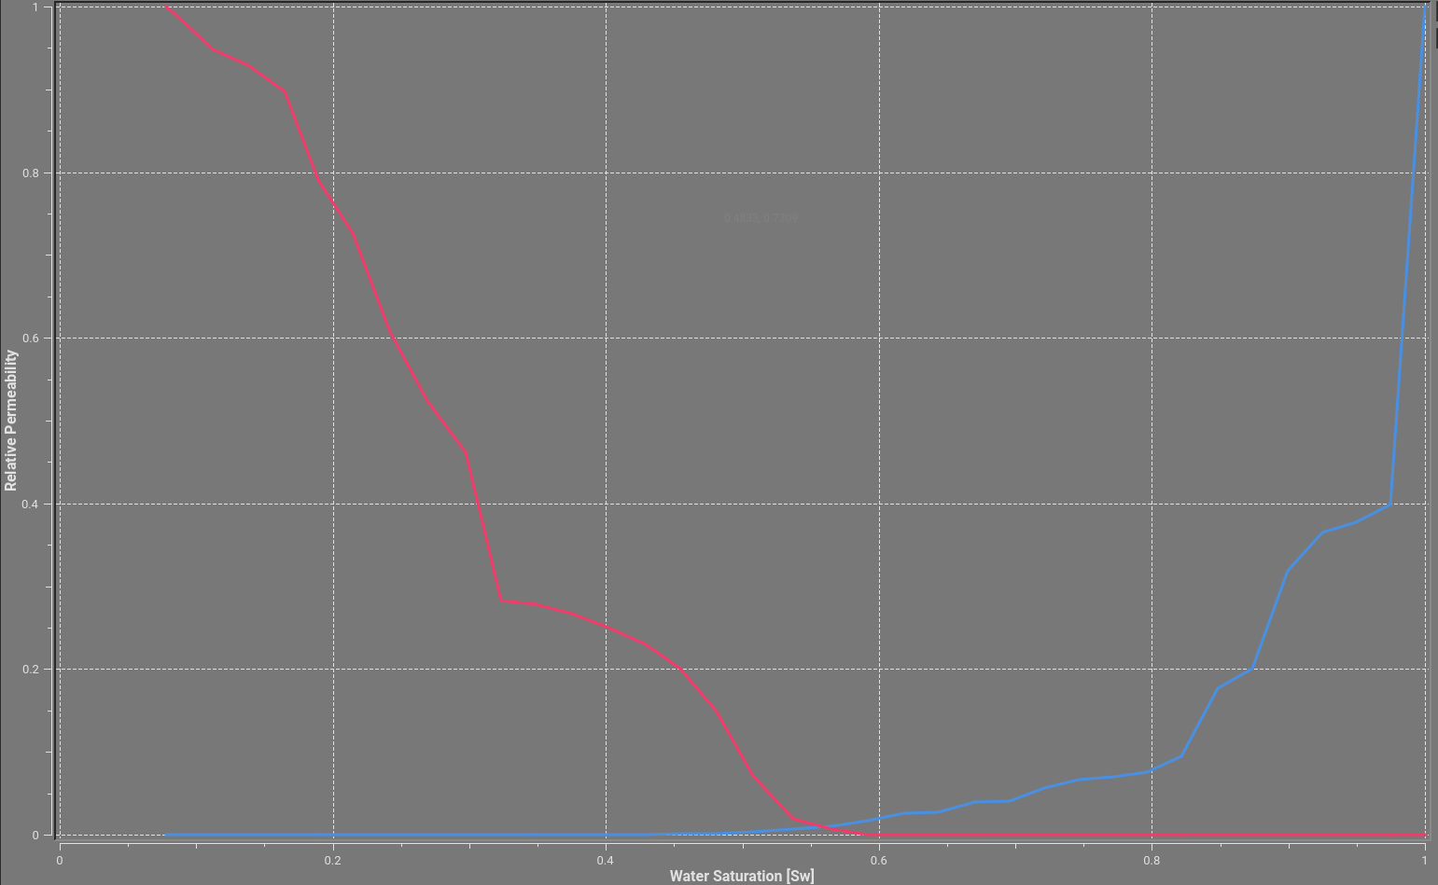
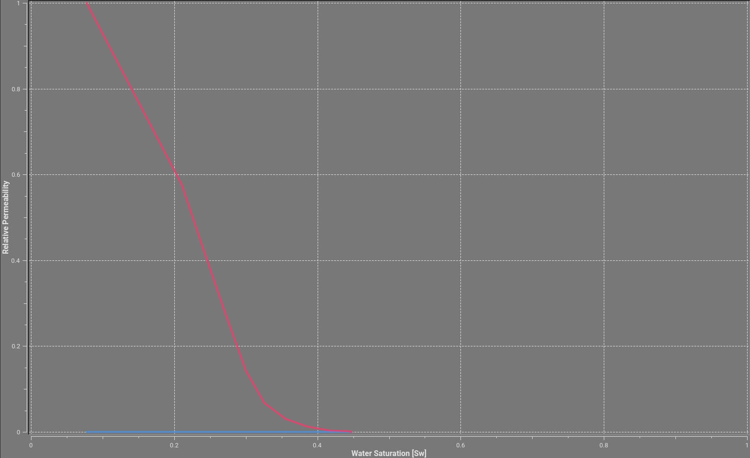
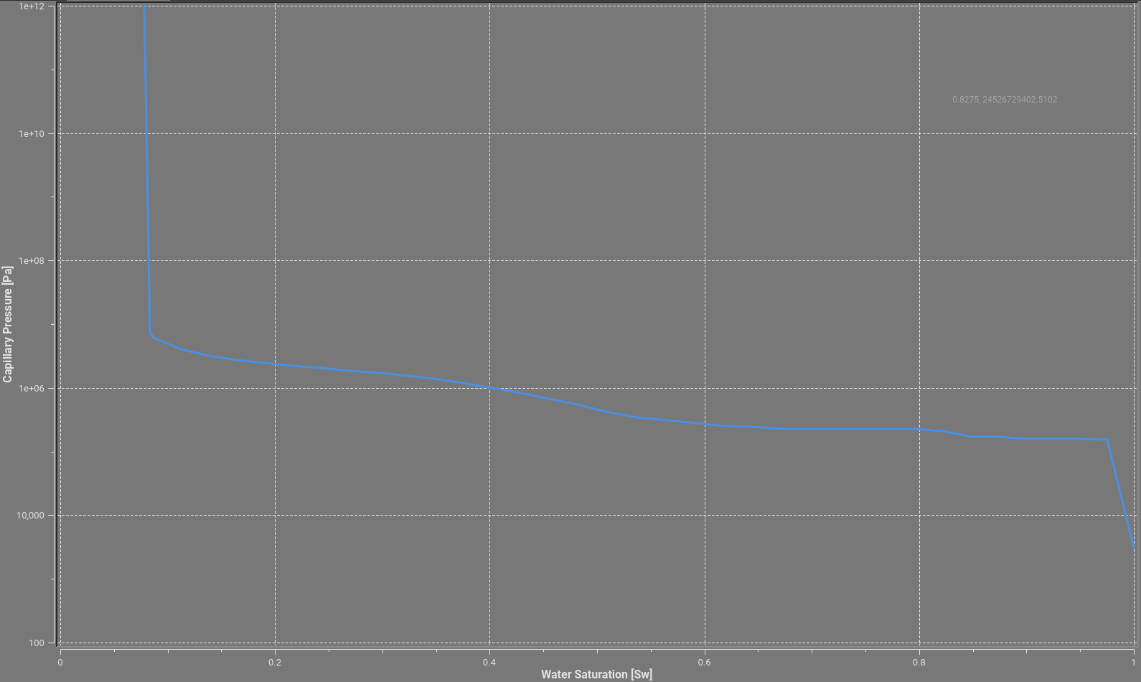
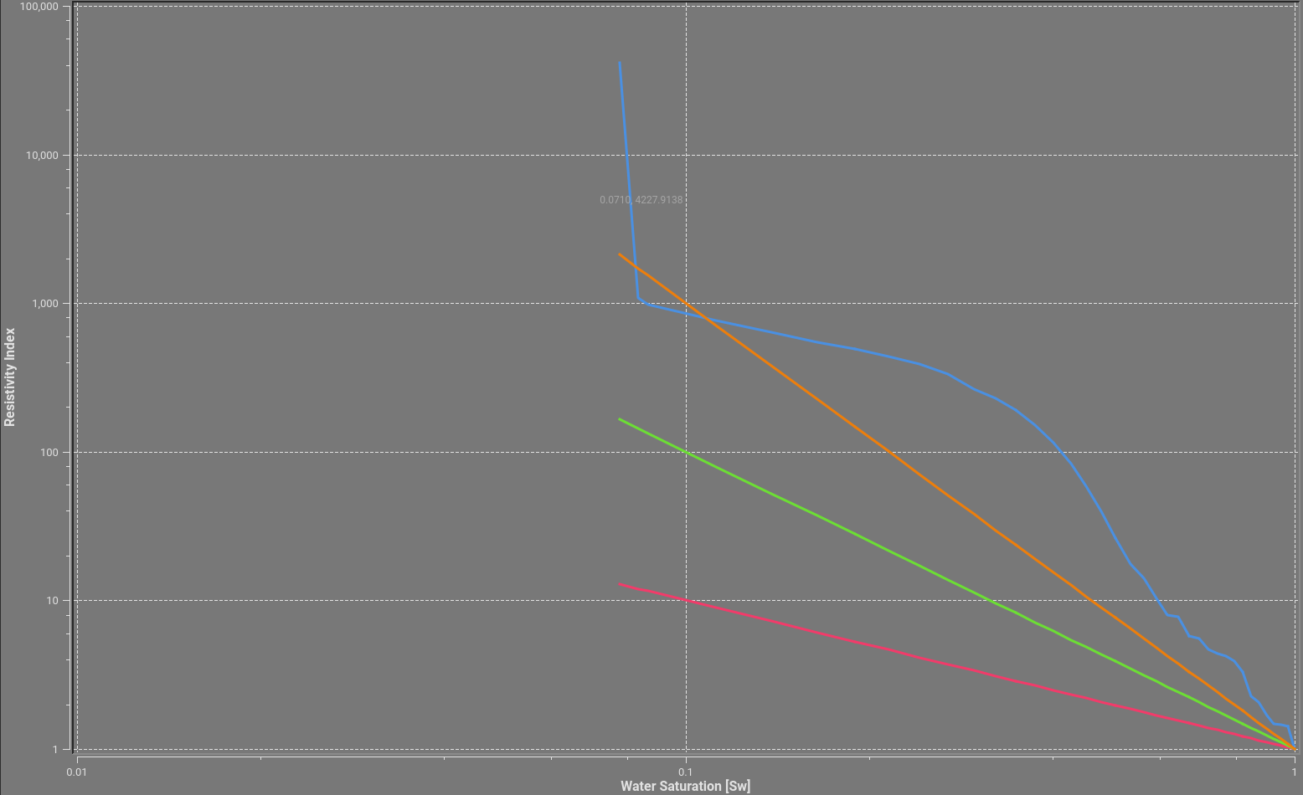
Multiscale flow simulation
Drainage kr
Water flooding kr
Drainage Pc
Drainage resistivity

Slide 18
Multiscale imaging
Whole Core
CT
SEM/EDX
Mineralogy
CT
µCT
µCT
FIB/SEM
300 µm
50 µm
15 µm
1 µm
250 nm
1 nm
From Core to Pore
Notes:
Rajouter ROI + Fleches

Slide 19
References
Questions
A Multi-Scale Imaging and Modeling Workflow for Tight Rocks, L. C. Ruspini, G. Lindkvist, S. Bakke, L. Alberts, A. M. Carnerup, and P. E. Øren, FEI Company
Relative permeability assessment in a giant carbonate reservoir using Digital Rock Physics Z. Kalam, S. Seraj, Z. Bhatti, A. Mock, P.E. Øren, V. Ravlo, O. Lopez Society of Core Analysts, SCA 2012-03
Investigation into the reliability of predictive pore-scale modeling for siliciclastic reservoir rocks Olivier Lopez1, Alexander Mock1, Jostein Skretting2, Egil Boye Petersen Jr. 2, Pal-Eric Oren1 , Alf Birger Rustad2 (1)NumericalRocks AS and (2)Statoil ASA
Pore-scale modeling of capillary trapping in water-wet porous media: A new cooperative pore-body filling model L.C. Ruspinia,1, R. Farokhpoora, P.E. Ørenb
SPE 2019: Digital Pore Space Study of a Middle-Eastern Carbonate Rock Sample, SPE-196653-MS Gwenolé Tallec, Thermo Fisher Scientific, Merignac, France
Find out more at booth #01

