Slide 1
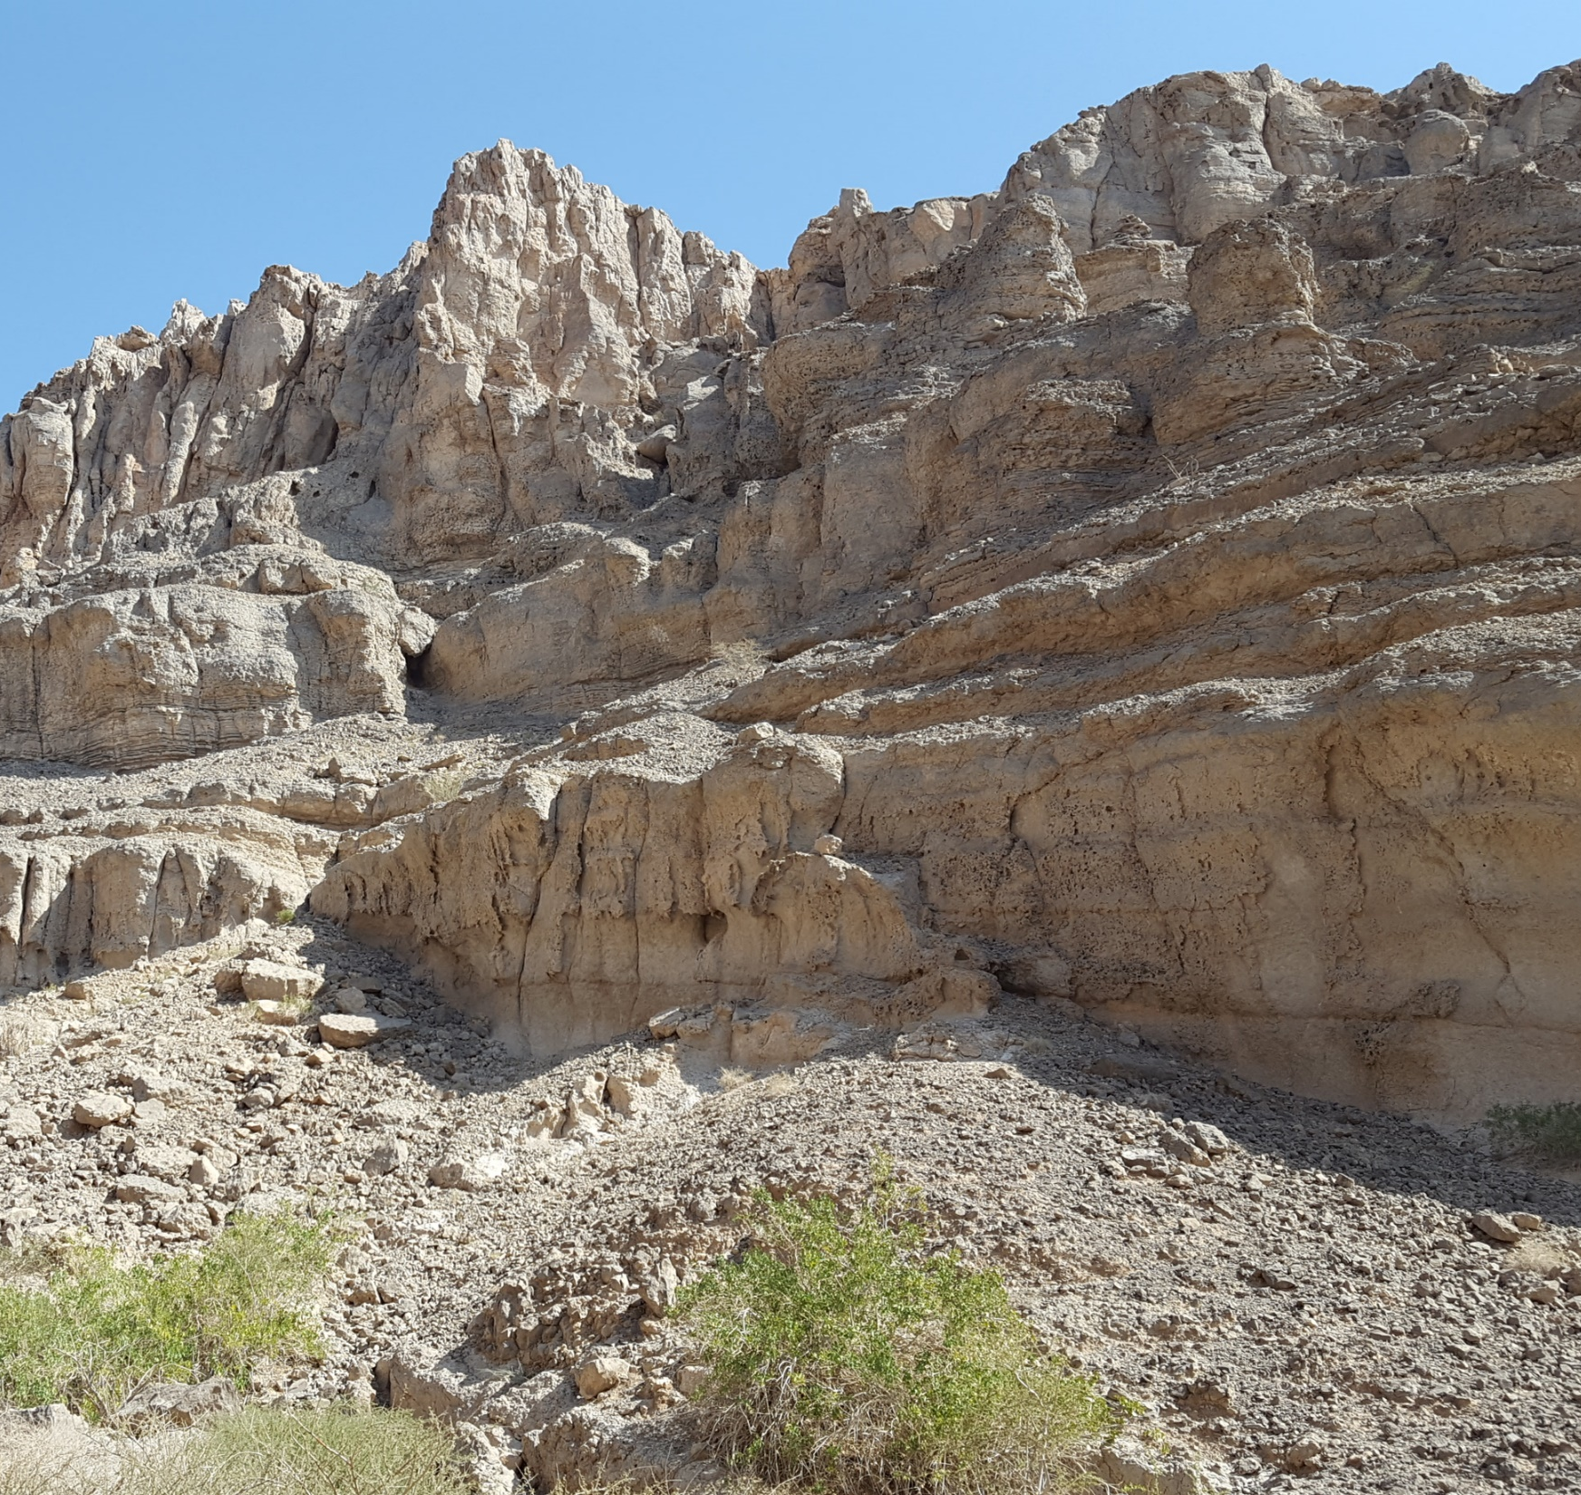
Characterising flow and transport in fractured geological media: 20 years later
Sebastian Geiger
Notes:
Thank you very much for inviting me to give this presentation to honour Brian’s InterPore Honorary Lifetime Membership Award. It is a great privilege to share some of my thoughts on flow and transport in fractured geological media with you, considering how much groundbreaking research Brian has done in this field for many decades

Slide 2
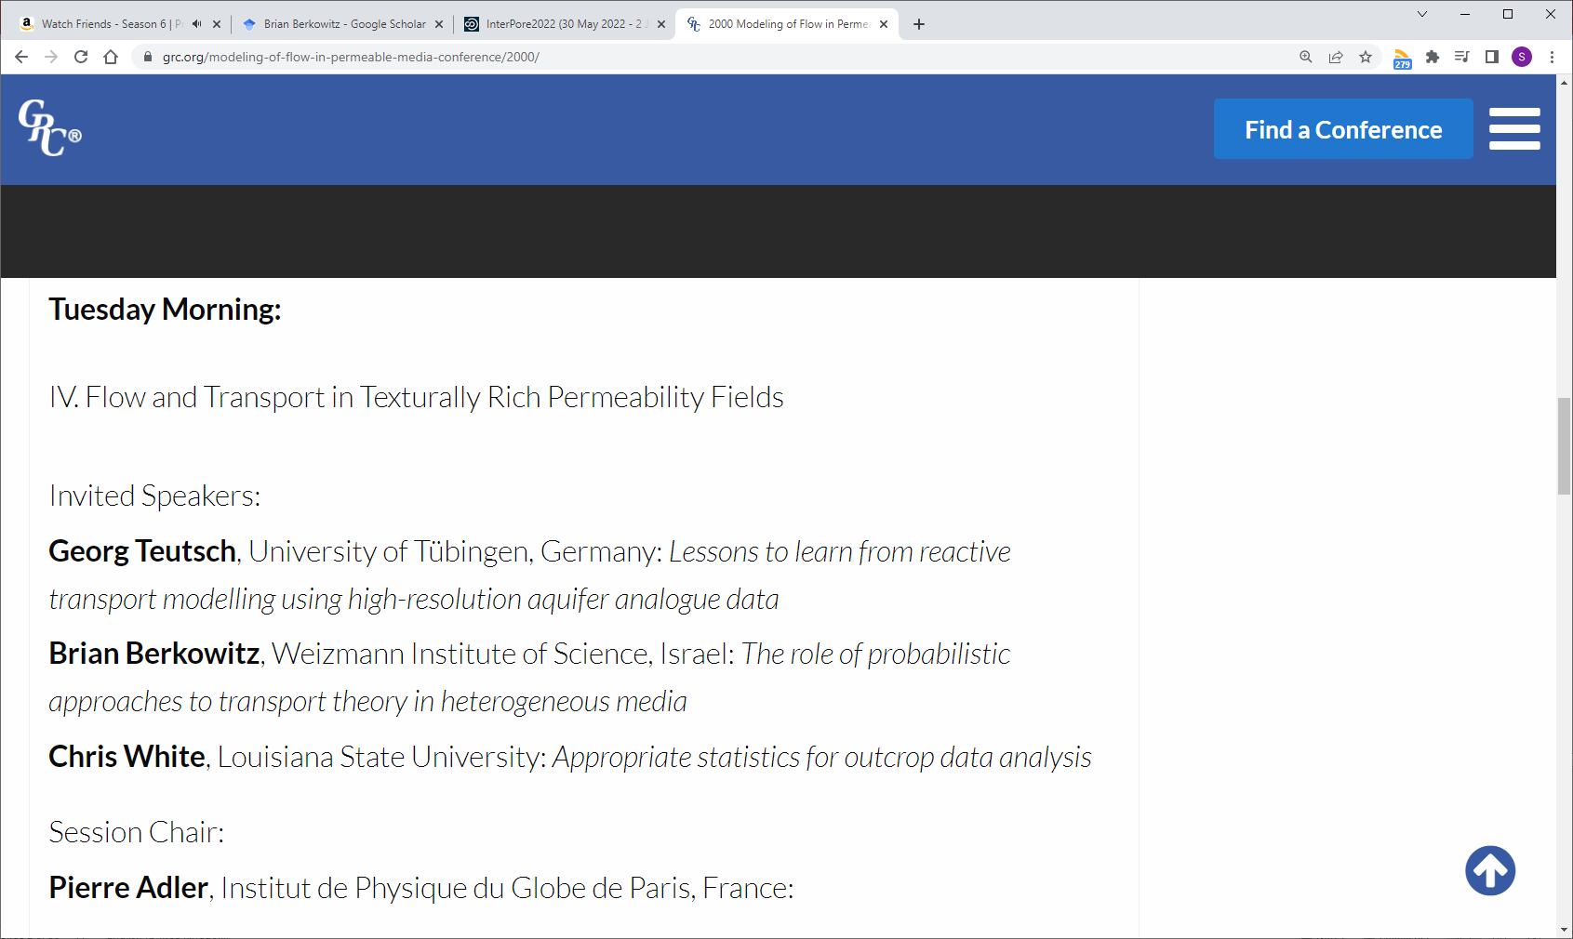
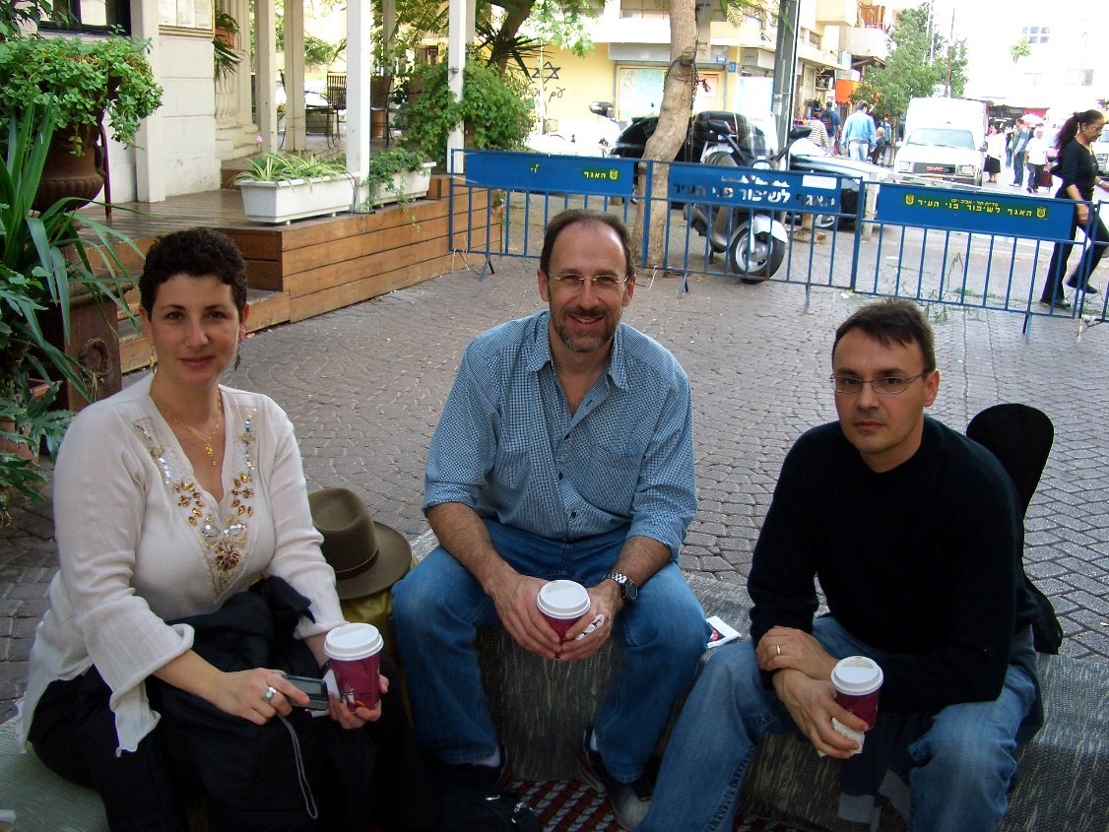
My first encounter with Brian: Gordon Conference 2000
Notes:
Before I start, I would like to take a moment to recall how I first met Brian – it was at the 2000 Gordon Conference for Flow and Transport in Permeable Media. I was a first-year PhD student and had heard about Brian’s work on Continuous Time Random Walks and spoken quite a bit with one of his PhD students, Peter Dijk, at an AGU conference a year earlier. It was very impressed that Brian took the time to sit down with me, a 1st year PhD student he has just met for the first time, for a couple of hours at a major international conference to explain the theory on Continuous Time Random Walks (CTRW) and elaborate how it compares to other models that try to explain the physical nature of anomalous transport in porous media and geological formations.
Now, I contacted Brian’s former PhD students and postdocs if they have pictures of Brian from that time. The earliest we could find is this one from 2006 with a very young Alberto Guadagnini, who supported Brian’s nomination for the award. Clearly, like his research, Brian has hardly aged over the years!

Slide 3
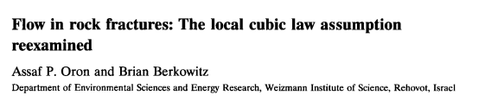
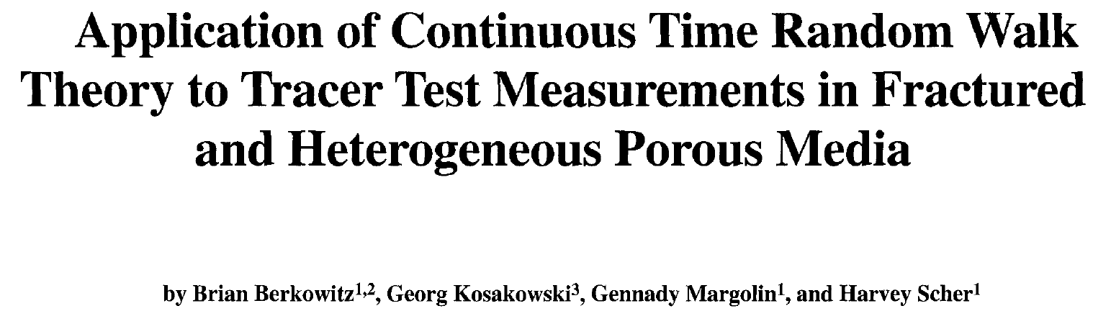
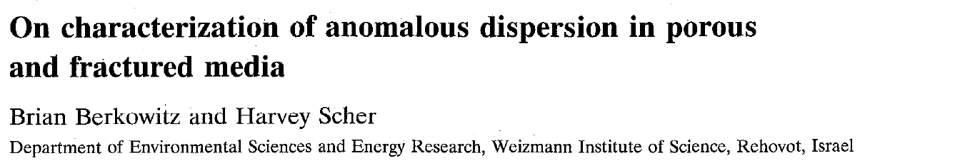
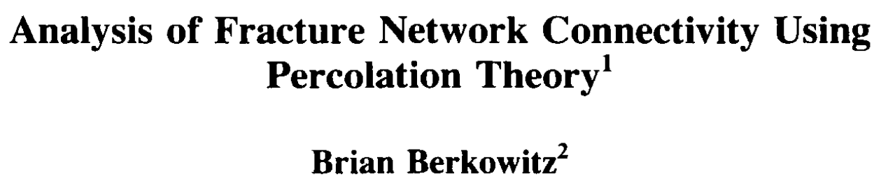
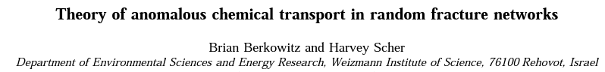
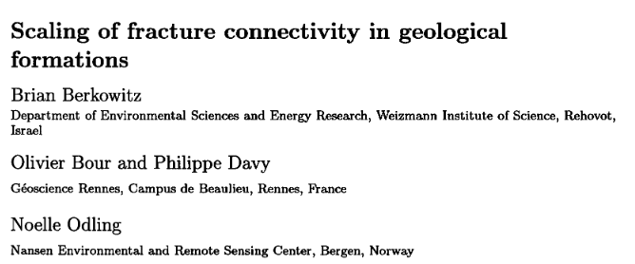
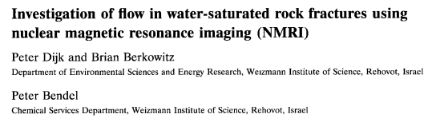
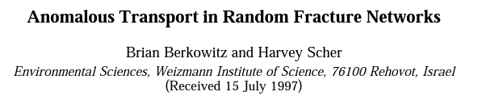
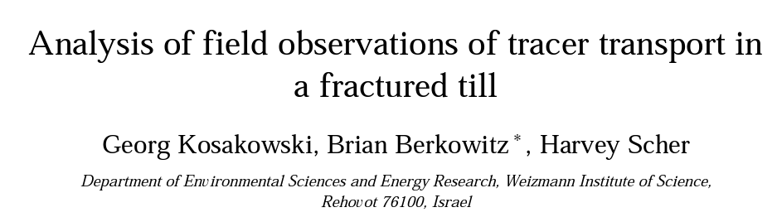
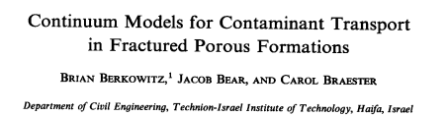
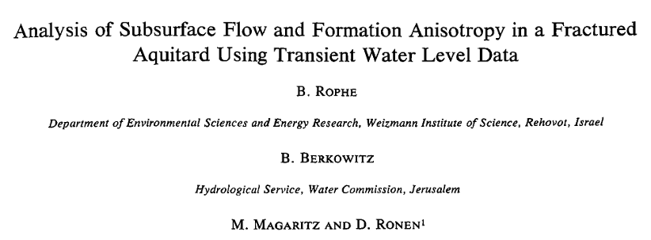
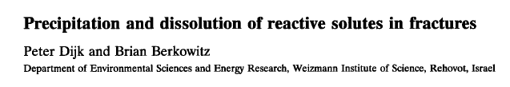
From fractures to anomalous transport
… and much, much more!
Notes:
But let me get to the actual presentation… Throughout the 1990ties, Brian has published an incredible amount of influential work on flow and transport in fractured rocks, from analysing the scaling behaviours of fracture networks to imaging flow in fractures, from revisiting the idea of the cubic law to analysing results field-scale experiments, and, most notably his work on developing better conceptual models that quantify flow and transport in fractured formations which of course includes CTRW.

Slide 4
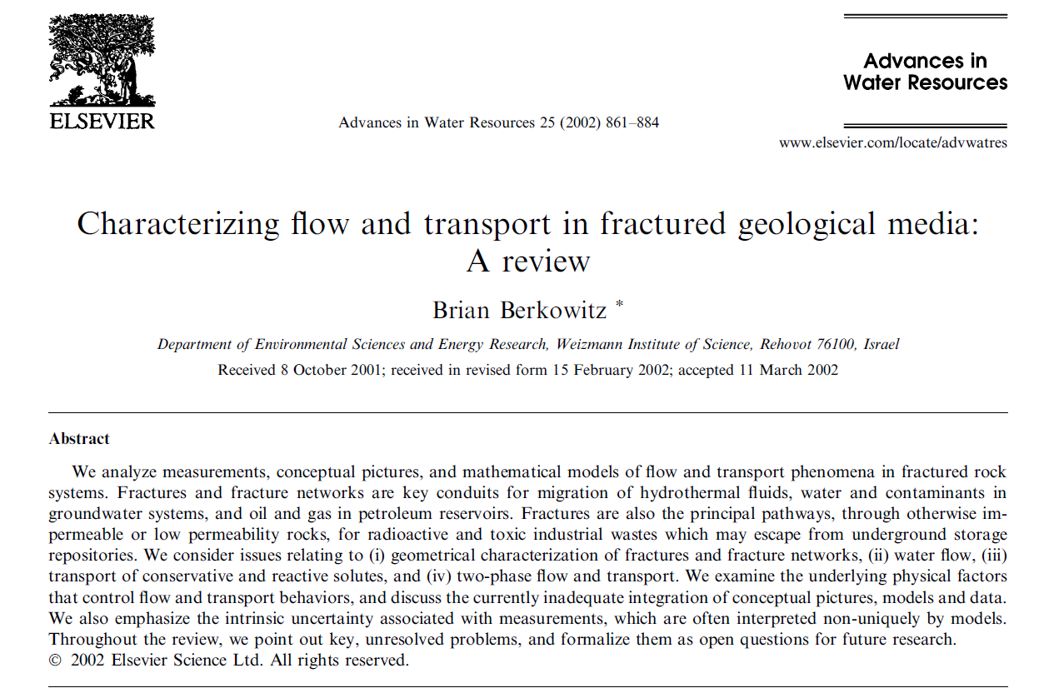
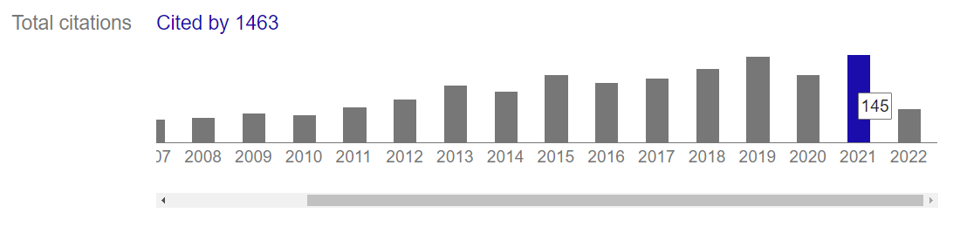
Notes:
This body of work was then summarised in this seminal paper which is the inspiration for my talk. The words “seminal paper” have seen quite an inflation in recent years, but Brian’s paper has been truly influential. Take last year for example: every 2.5 days a new paper was published that cited his review…

Slide 5
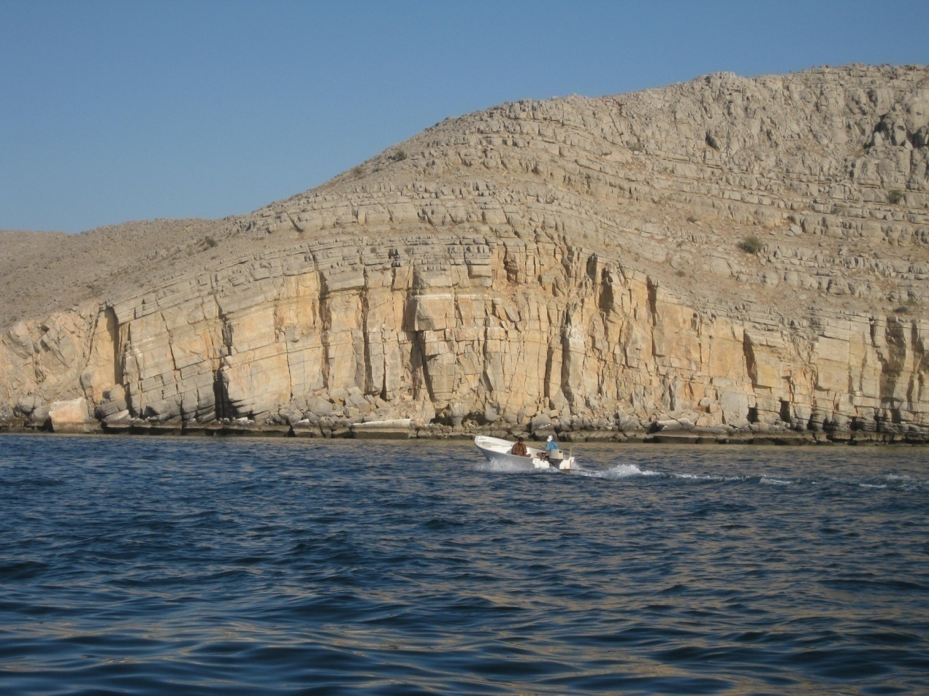
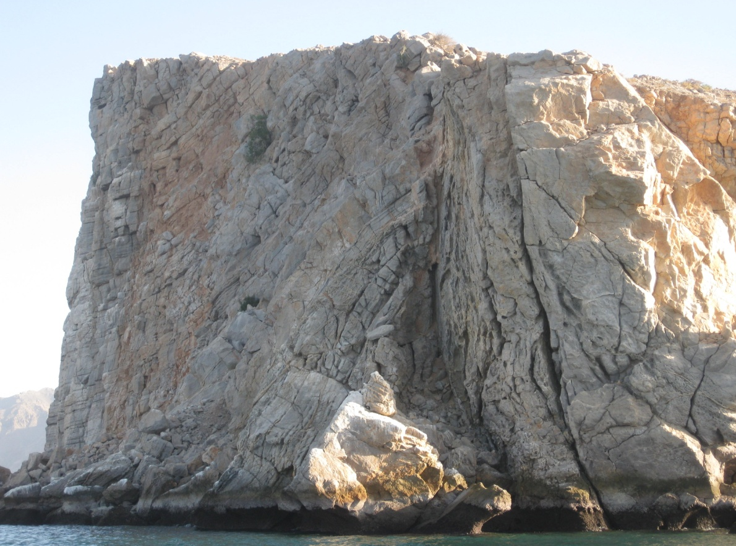
Why do we care about fractures?
Fractures are ubiquitous in subsurface reservoirs
Fractures can create preferential flow paths, causing early breakthrough and bypassing of large reservoir volumes
Fractures often “do not possess any homogenisation scale, so that, strictly speaking […] an REV cannot be defined”
What do we want to know?
Where and when do fractures impact flow?
What are the effective properties of the fractures (+ rock matrix) and how do we represent them in reservoir models?
How much energy (e.g. heat) is left in the rock matrix, how much fluids (e.g. CO₂) can we store in the rock matrix?
How can we engineer the reservoir to minimise risks?
Notes:
So, why do we care about fractures, why did Brian commit a significant part of his research to study flow and transport in fractured rocks?
Fractures are ubiquitous the subsurface, they oven provide preferential flow paths that cause early breakthrough and bypassing of large reservoir volumes, and – to quote Brian – fractures often do not possess any homogenisation scale, so that, strictly speaking an REV cannot be defined, which means it is very difficult to incorporate them into reservoir models because these models implicitly assume that an REV scale exists at the size of your chosen grid block
Because fractures can be found so often in the subsurface, we want to know when and where they impact flow, and what their effective properties are so that we can represent them in reservoir models. Since the rock matrix has a much larger volume than the fractures, we also want to how much energy is left in the rock matrix when we produce the reservoir, for example a geothermal reservoir, or how much fluids we can store in the rock matrix, for example in a CO2 storage site, and how fractures and matrix communicate with each other. Ultimately, because we cannot change the geology itself, we want to know how we can engineer our reservoir that contains fractures to minimize any risks during the production or storage of fluids.

Slide 6
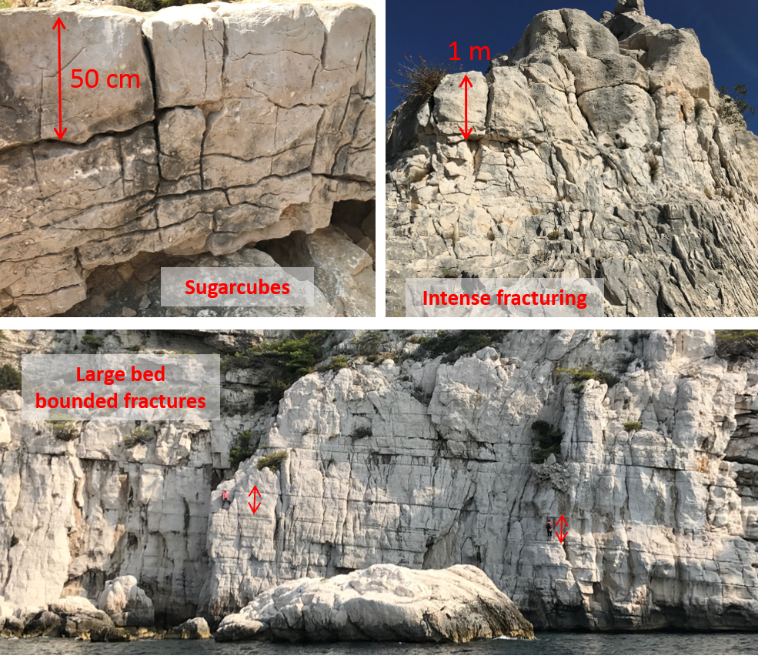
Trying to address (pragmatically) three open questions
Using numerical simulations, can connectivity properties be determined systematically from widely varying sets of fracture statistics?
How can we best integrate advantages of continuum and discrete fracture models?
How can we best develop quantitative modeling approaches that realistically capture immiscible two-phase flow [DNAPL migration] at the field scale?
Notes:
In his review paper, Brian posed a number of questions for future research, three of which we have been trying to address, perhaps in a somewhat pragmatic way. The questions are as follows:
Using numerical simulations, can connectivity properties be determined systematically from widely varying sets of fracture statistics?
How can we best integrate advantages of continuum and discrete fracture models?
How can we best develop quantitative modeling approaches that realistically capture immiscible two-phase flow [DNAPL migration] at the field scale?

Slide 7
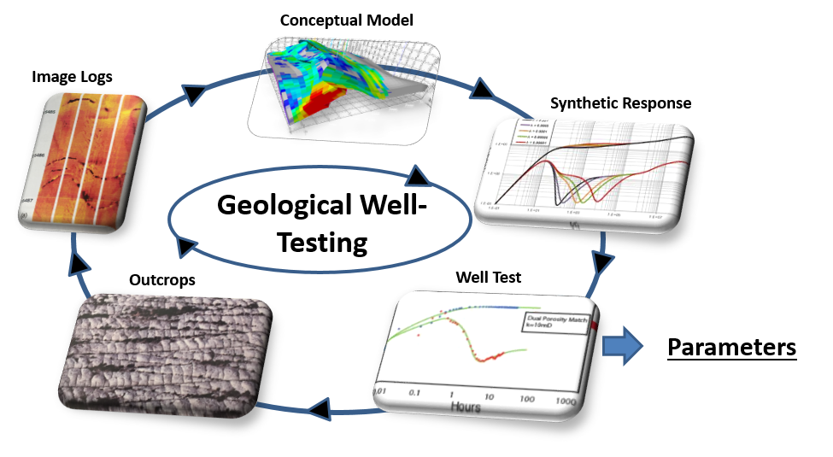
Using geological well-testing to determine fracture connectivity
Corbett et al., 2012
Egya et al., 2019a, 2019b, 2021
Freites et al., 2019, in review
High-conductivity fractures drained first
Initial recharge from high-permeability matrix, then from low-conductivity fractures and low-permeability matrix
Notes:
To understand the connectivity of fractures in the subsurface, we have looked at well test data. This is the work that I did together with Patrick Corbett and, most importantly, our PhD students David Egya and Alfredo Freites. Rather than relying on analytical solutions that idealise fracture flow, we have followed a geological well-testing approach where we use outcrop data and data from logs to build conceptual models of the reservoir in which the fractures are explicitly represented. We then simulate a well-test response for these models and see how this pressure response corresponds to the data observed in the field. If there is a mismatch, we re-evaluate our conceptual model until we get a good agreement between data and simulation, which eventually allows us to define properties such as average fracture conductivity or fracture connectivity.
This approach leads to some surprisingly unique results. For example, for a real subsurface reservoir David could show how a high-conductivity fracture network is depleted first and then successively recharged by the region of the rock matrix that has a higher permeability before additional recharge occurs from a second, less conductive fracture set and the part of the rock matrix that has a lower permeability.

Slide 8
Using geological well-testing to determine fracture connectivity
Corbett et al., 2012
Egya et al., 2019a, 2019b, 2021
Freites et al., 2019, in review
Spacing of high-conductivity fractures approximately 1 fracture per 8m
Low-conductivity fractures approximately 25 m away from well
Notes:
For the same reservoir we also had well-test data that sampled only a very small region around the well. Using this data, Alfredo could show that the average spacing of the high-conductivity fractures is approximately 1 fracture per 8 metres while the lower conductivity fractures are approximately 25m away from the well.

Slide 9
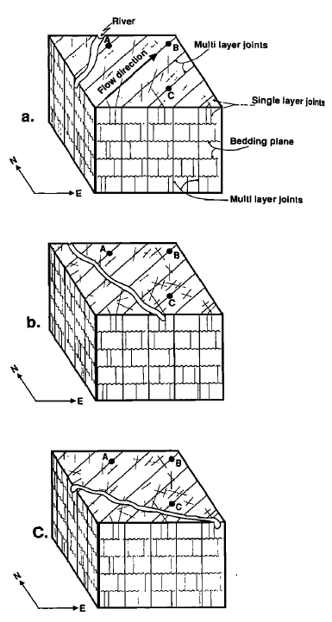
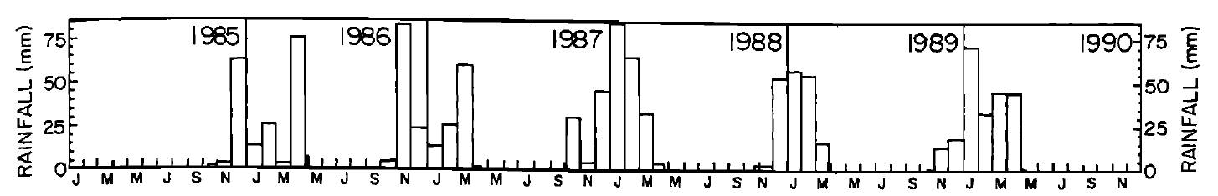
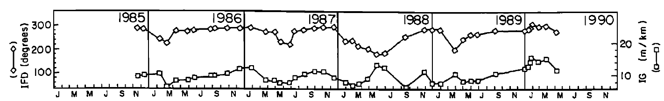
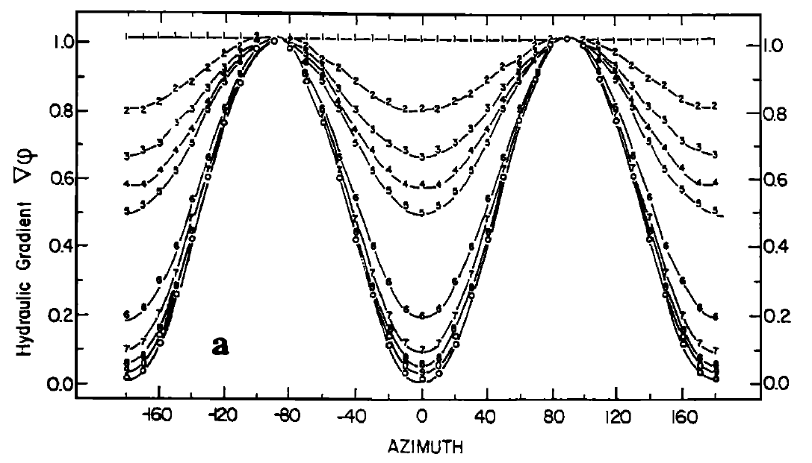
Geological well-testing idea not new…
Rophe et al., 1992
Notes:
The idea of “geological well-testing” is not new, however. Back in 1992, Brian published a paper where they used essentially the same concept, although relying on clever analytical solutions rather than numerical simulations, to estimate the fracture anisotropy in a fractured formation in Israel. For this formation, Brian and his co-authors developed a range of geological concept, shown on the right, and correlated the changes in the gradient of the hydraulic head and flow directions that were observed at wells as a response to annual variations in rainfall, shown on the top left, with analytical solutions that indicated how fracture anisotropy influences the gradient of the hydraulic head, shown on the bottom left to decipher the anisotropy pf the fracture network.

Slide 10
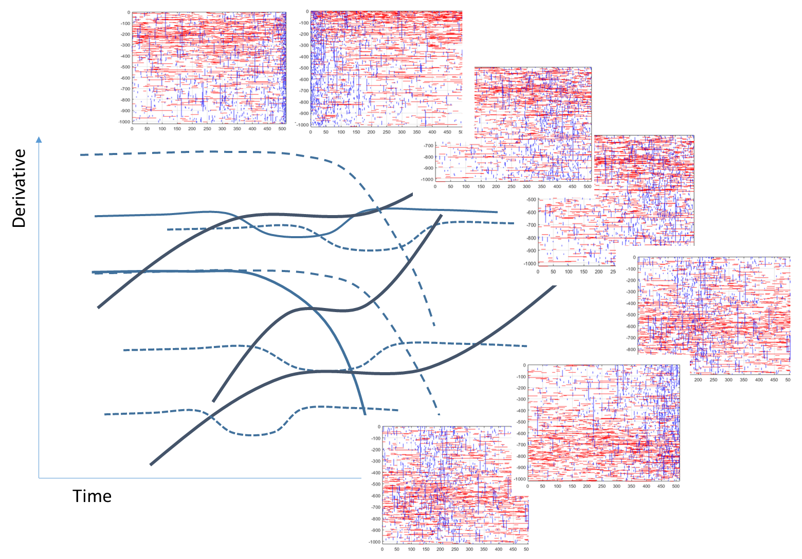
Using machine for systematic determination of connectivity
Dataset of over 2500 fracture geometries
Synthetic drawdown curve for each geometry
k-medoids clustering to group 1st derivative of drawdown curves
Dynamic time-warping as distance metric based on 2nd derivative of drawdown curves as input for clustering algorithm
Validated clustering approach using analytical solutions
Notes:
As I mentioned a couple of slides ago, the results that we obtained from the geological well-testing were surprisingly unique, which made us wonder if there is a more consistent relationship between fracture network properties and well-testing signals that can be revealed. To try and answer this question, Alfredo created a set of over 2500 stochastically generated fracture network geometries with geologically realistic but variable properties, some examples of these networks can be seen on your right. For each network we then created a synthetic well-test signal, that is we simulated a pressure drawdown curve.
Using k-medois clustering we grouped the 1st derivatives of the drawdown curves into clusters. This was easier said than done because k-medoids clustering normally works for static properties, not transient data, and the signals that we observed could vary in time quite substantially based on the fracture properties. After a lot of work, Alfredo found that dynamic time-warping, a technique that is normally used in speech recognition algorithms, is well places to essentially normalise the 2nd derivative of the drawdown curves, and use these as input for the distance metric in the clustering algorithm. Of course, Alfredo validated the approach thoroughly first, using drawdown curves that were created with analytical solutions and hence had well-defined input parameters.

Slide 11
Clustering results
Notes:
What Alfredo found that there are 12 unique clusters for the 1st derivative of the drawdown curve. You can see the variability of the mediod curves for each cluster on the right and the corresponding silhouette plot on the left.

Slide 12
Clusters and fracture properties
Much richer response than classical analytical methods
Consistent grouping and trends in fracture properties
Main control: Distance between well and closest fracture
Secondary control: Fracture intensity and connectivity
Average fracture aperture not important for ranges considered
Currently using PCA and MRA to identify ranking of properties for each cluster
Notes:
What Alfredo found is that his machine-learning based approach gave him a much richer insight into the links between fracture properties and well-test response than classical analytical methods. You can see the box plots for the key fracture parameters on your right, grouped by each cluster. There is a consistent grouping and trend between the fracture properties and clusters, with the main control being – somewhat surprisingly – the distance between the well and the closest fracture. A secondary control is the degree of fracture intensity and connectivity – the challenge Brian posed on his paper - while average fracture apertures are not important, at least for the ranges that we considered. Currently, Alfredo is using further machine learning techniques to work out the individual ranking of the fracture properties for each cluster.

Slide 13
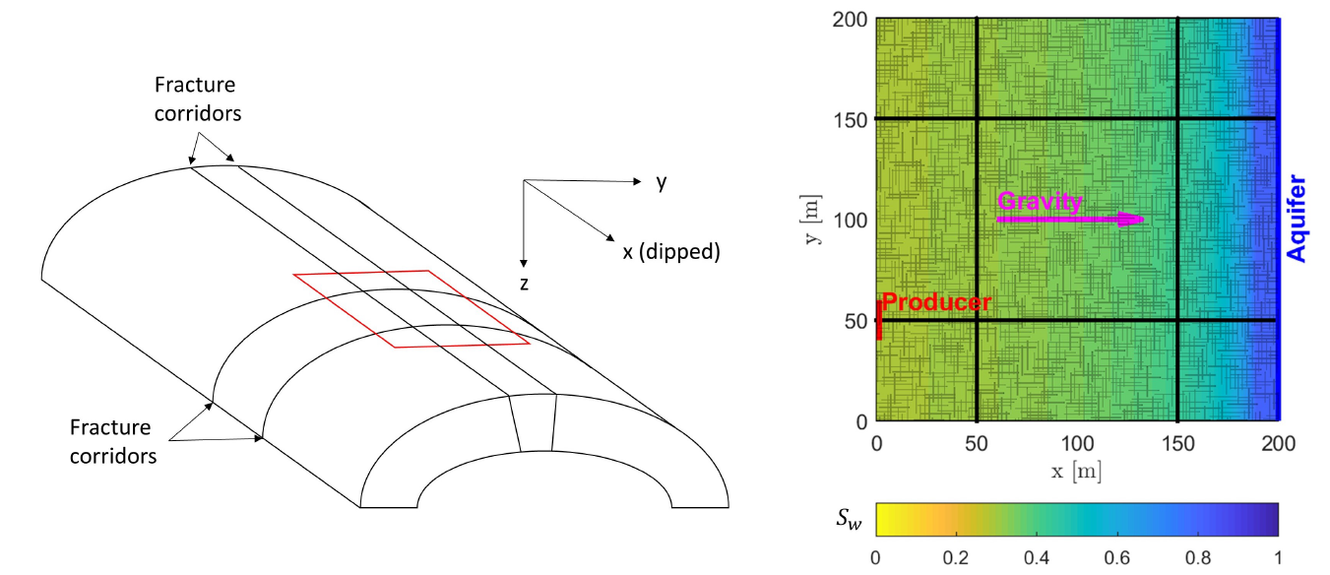
Integrating continuum and discrete fracture models for two-phase flow modelling at the field scale
Wong et al., 2020a, 2020b, 2021
Notes:
Geological well-testing allows us to identify if fractures are present in the subsurface and, at least to some degree, what the properties of the fracture network are. The question though remains is how we best incorporate fractures in reservoir models and when it is better to rely on conceptual models that represent each fracture explicitly, the discrete fracture models, or use fracture models that approximate the fracture network as an effective porous medium?
Florian Doster and I tried to look at this challenge together with our PhD student Daniel Wong. What you see here is an idealised conceptual model of a real gas reservoir located in an anticline. The reservoir contains fracture corridors that are well connected and a very large number of smaller, diffuse fractures. On the right hand side you see the map view f simulation result, showing the water saturation for a small part of the reservoir where all fractures and the fracture corridor, shown by the black lines, have been represented explicitly; gas is being produced at the left model boundary and water encroaches the reservoir from the aquifer.

Slide 14
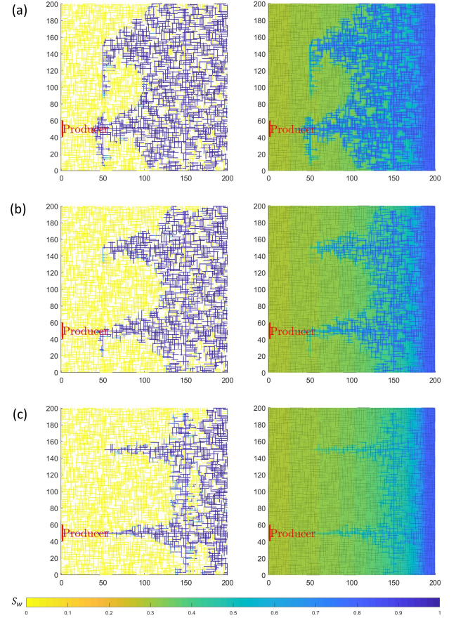
Investigation of flow behaviour
Fractures
Matrix
Reference simulations created using fully explicit representations of fractures in a small sub-sector
Fracture corridors and diffuse fractures have different flow behaviours and need to be modelled separately
Imbibition into the matrix occurs at interface between matrix and diffuse fractures, which cannot be represented by a single effective medium
If production stops, water redistributes in the fractures and matrix remains in transient state for long time, which needs to be captured in models
Gravity forces are negligibly small, so fracture-matrix transfer can be modelled by functions that account only for capillary forces
Increasing production rate
Notes:
Using a series of detailed reference simulations where fractures and fracture corridors are represented explicitly as shown here on the right for the water saturation in the fractures and matrix at increasing production rates, Daniel made the following observations.
Fracture corridors and diffuse fractures clearly have different flow behaviours and need to be modelled separately
Imbibition of water into the matrix occurs at interface between the matrix and diffuse fractures, which cannot be modelled accurately by a single effective medium
If production stops, water also redistributes in the fractures and matrix remains in transient state for long time, which needs to be captured in models
Gravity forces are negligibly small, so fracture-matrix transfer can be modelled by functions that account only for capillary forces
These processes need to be represented through the appropriate conceptual models, and it seems that neither a continuum model is not appropriate and, for the entire reservoir, it is also not possible to represent all fractures explicitly.

Slide 15
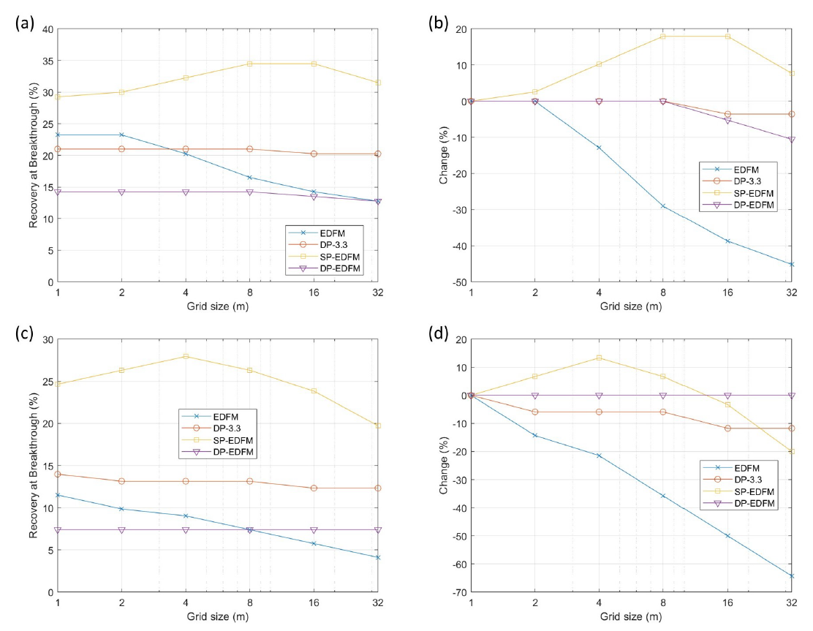
Error for different model concepts and grid resolutions
Difference in recovery
Error with respect to finest grid
Dual-continua models appear to have good agreement but yield incorrect saturation fields
Large errors when combining discrete fracture models for fracture corridors with a single effective medium for the diffusive fractures
Best approach to use discrete fracture models for fracture corridors and dual continua models for diffusive fractures (and transient transfer functions to capture redistribution in matrix)
But not just a matter of the right model concept, grid resolution also significant impact on results
Increasing production rate
Notes:
What you see here are the differences in gas recovery factors at the time of water breakthrough for different simulation approaches and different levels in grid resolution. The reference case where all fractures are represented explicitly is shown in blue, the results from a simulation where all fractures are represented by a dual continua model – separating the fast flowing fractures and stagnant matrix – are shown in orange, the results from a simulation where the fracture corridors are represented explicitly and the diffuse fractures by a single effective medium together with the rock matrix in yellow, and the results from a simulation where the fracture corridors are represented explicitly and the diffuse fractures by a dual continuum model in blue.
Dual continua models seem to work quite well at certain levels of grid refinement but the simulated saturation fields are wrong as they do not capture the dominating flow in the fracture corridors. When the fracture corridors are represented explicitly and the diffusive fractures and matrix are represented as an effective porous medium, the error is significant because for a large part of the reservoir the models to not capture the transient fluid exchange between fractures and matrix. The combination of discrete fracture models for the fracture corridors and a dual continua model that treats the diffuse fractures and rock matrix as two domains improves the results considerably, and we suspect that even better results can be achieved if we use better models that capture the transient, multi-rate exchange between rock matrix and fractures.
Unfortunately, there is no generalised rule which conceptual model to use when – the appropriate model choice depends on the fracture properties and the displacement mechanism, which need to be evaluated for each case.
Importantly though, getting good simulation results is not just a question of applying the appropriate model concept. Having the appropriate grid resolution is also very important, and it is indeed easy to get good agreement with reference solutions for the very wrong results because you have been unlucky enough to pick a poor grid resolution that cancels out the errors of a poor representation of the fracture model

Slide 16
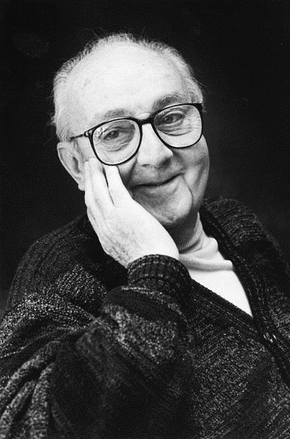

Closing points
Brian has made countless contributions to develop simple yet elegant models that are “less wrong” than existing ones, for fractured reservoirs and beyond, and that inspired generations of researchers
The endeavour to improve our understanding of flow and transport in fractured reservoirs is instrumental to provide secure and affordable access to energy and freshwater resources, and store waste products – key points that Brian has made 20 years ago
Essentially all models are wrong, but some are useful… (George Box)
Everything should be made as simple as possible but not simpler… (Albert Einstein)
Notes:
I want to close this presentations with the quotes from these two gentlemen.
Essentially all models are wrong, but some are useful… (George Box)
Everything should be made as simple as possible but not simpler… (Albert Einstein)
It is clear that Brian has made has made countless contributions to develop simple yet elegant models that are “less wrong” than the existing ones, for fractured reservoirs and beyond. These models have inspired the research of many generations of academics like myself. And our endeavour to improve our understanding of flow and transport in fractured reservoirs is instrumental to provide secure and affordable access to energy and freshwater resources, and store waste products – these are the very key points that Brian has made 20 years ago.
Thank you very much

