Slide 1
Sherwood number correlation for reverse osmosis membrane systems in turbulent regime
Siqin Yu, Bowen Ling, Yinuo Yao, Ilenia Battiato
06/01/2022

Slide 2
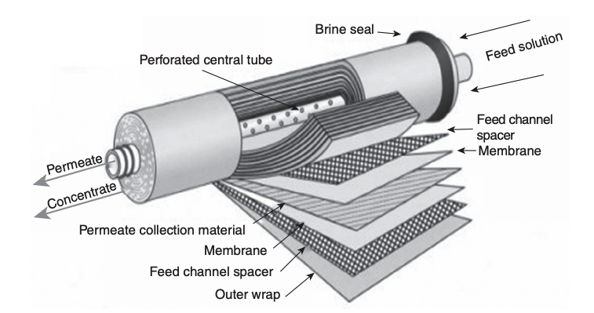
Introduction
Reverse osmosis membrane(ROM) system is important by providing new sources of clean water.
Schematic of ROM[1]
Desalination[2]
[1] Walker, J. H. (Ed.). (2019). Decontamination in Hospitals and Healthcare. Woodhead Publishing.
[2] https://www.filtnews.com/reverse-osmosis-for-desalination/

Slide 3
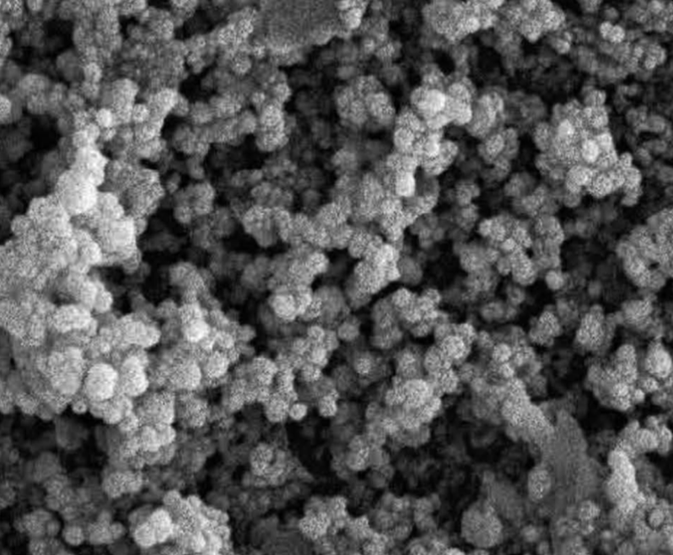
Multiphysics System
Membrane fouling
ROM system is a complex system
Foulant under SEM[1]
Flow
Mass transport
Foulant accumulation
Performance influenced by these physics
[1] Zhao, Y, Scientific reports, 6(1), 1-10.

Slide 4
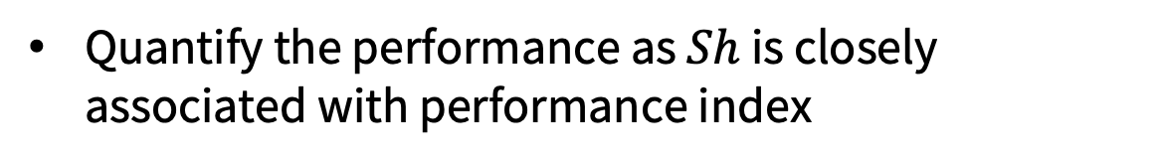
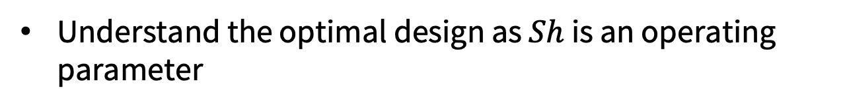

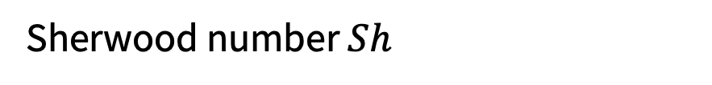
Sherwood Number Correlation
Sherwood number $Sh$
$$Sh\sim Re^{α}$$
Provide insights of mass transport mechanisms
Quantify the performance as $Sh$ is closely associated with performance index
Understand the optimal design as $Sh$ is an operating parameter

Slide 5
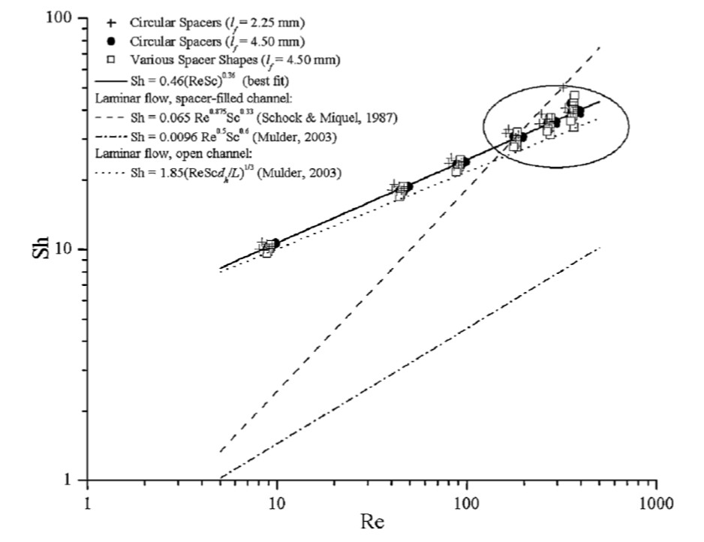
State-of-the-art
$Sh$ is largely impacted by $Re$ in laminar regime
Well-studied in laminar regime for different geometry
?
Knowledge gap
[1]
ROM system can work in turbulent regime ($Re=10000$)
[1] Guillen, G., & Hoek, Chemical Engineering Journal, 149(1-3), 221-231.

Slide 6
Governing Equations
flow
N-S equation
incompressible flow
solute
Fick law
fouling
Langmuir equation
We developed a solver called SUMembraneFoam [1] based on OpenFOAM.
In high Reynolds number, computational cost of direct numerical simulation of flow is too high
1. Ling, B., & Battiato, I. , Journal of Fluid Mechanics, 862, 753-780.

Slide 7
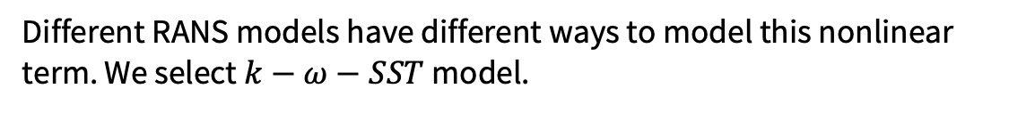
Governing Equations For Turbulent Flow
Reynolds-averaged Navier–Stokes equations(RANS)
Reynold decomposition
Nonlinear term
Different RANS models have different ways to model this nonlinear term. We select $k−ω−SST$ model.

Slide 8


Governing Equations For Turbulent Flow
With Reynold decomposition
Laminar
Turbulent
flow
N-S equation
$k−ω−SST$RANS
Turbulent mass transport equation
solute
Fick law
fouling
Langmuir equation
Langmuir equation

Slide 9
Validation For Turbulent Case
Introduce new governing equations for flow and mass transport
RANS model
2d turbulent flat plate
2d Mixing layer case
From NASA turbulence modelling website
RANS model for fully developed flow
3d Square duct case
Compare velocity profile with literature
Turbulent mass transport
mass transport in channel flow
Compare concentration profile with literature

Slide 10
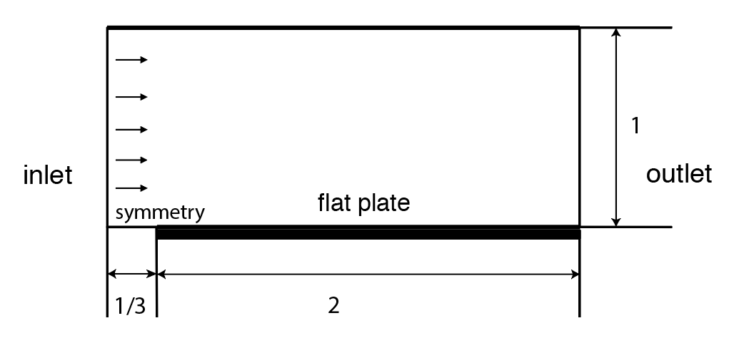
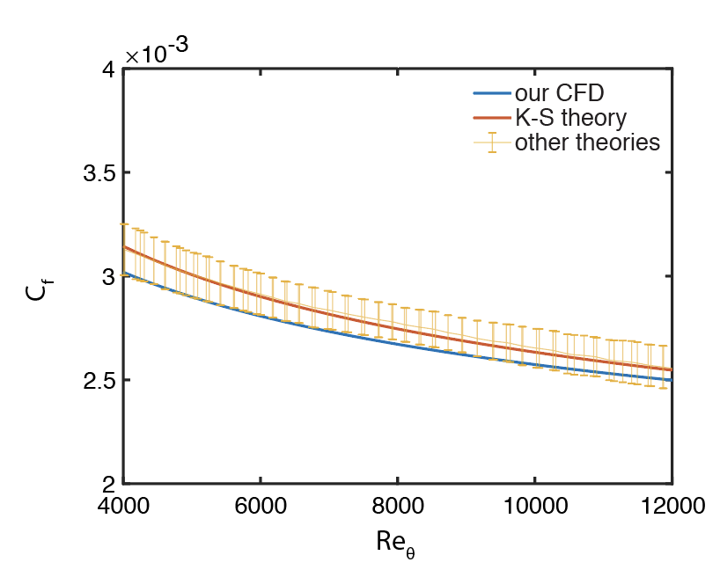
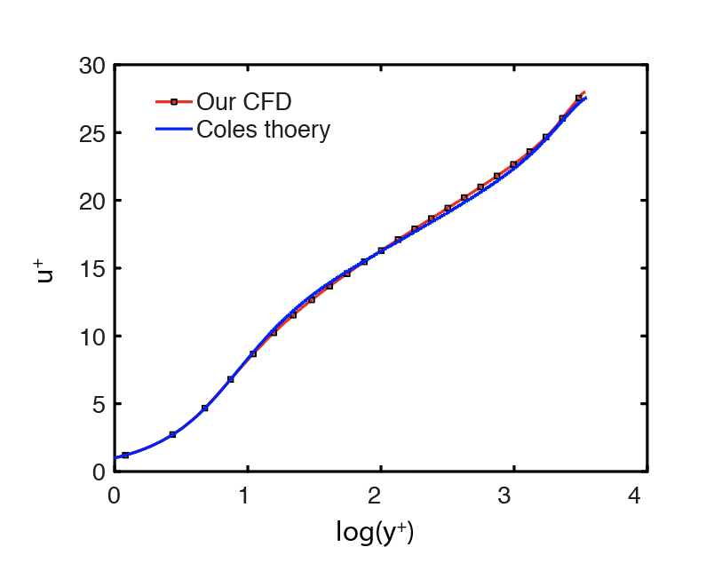
Validation Case1: Flat Plate
Skin factor
Normalized velocity profile

Slide 11
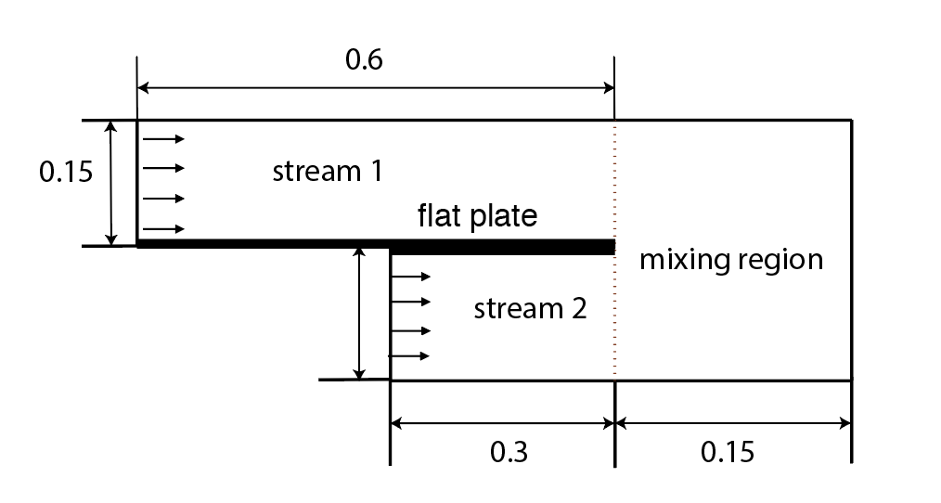
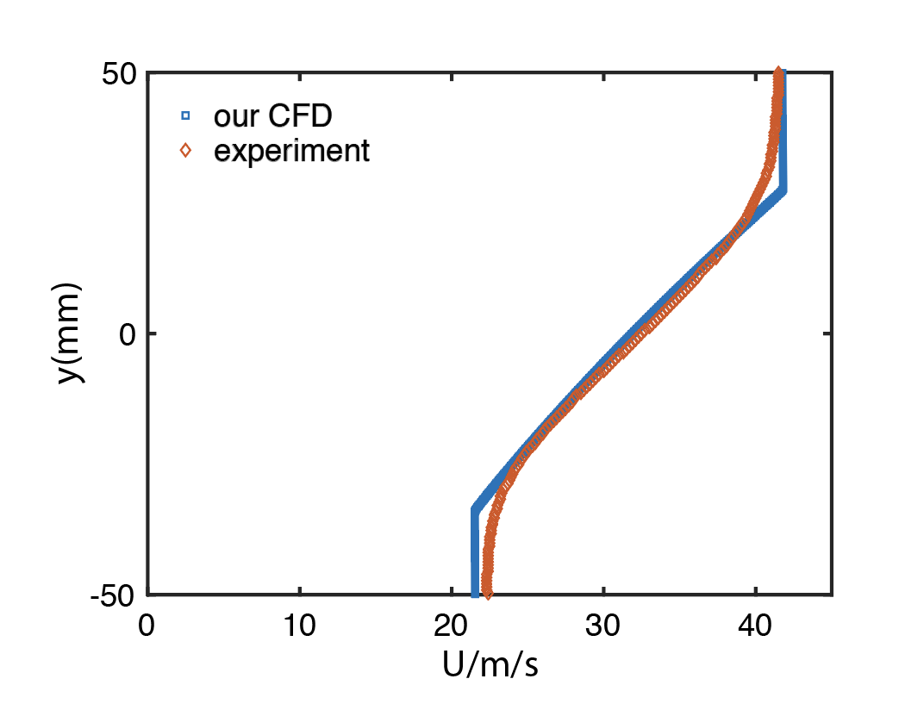
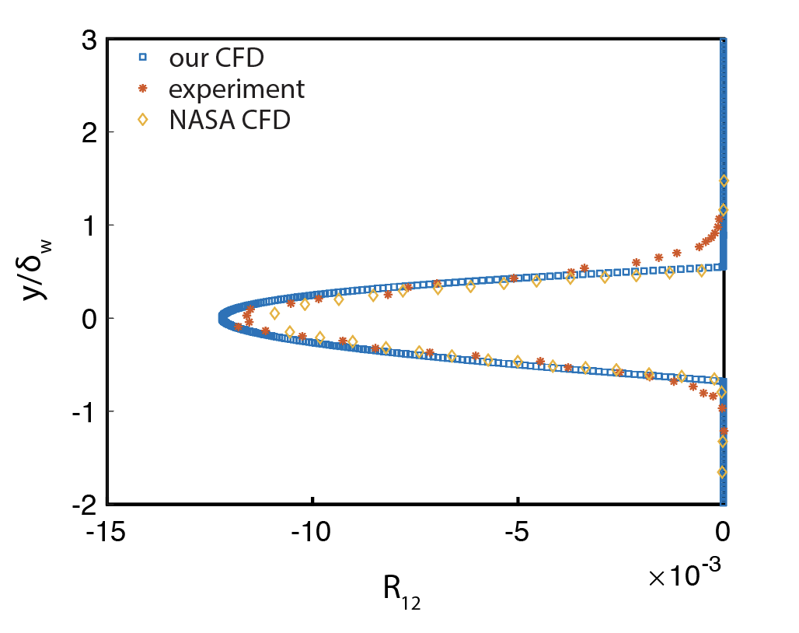
Validation Case 2: Mixing Layer
Velocity profile
Reynolds tensor profile

Slide 12
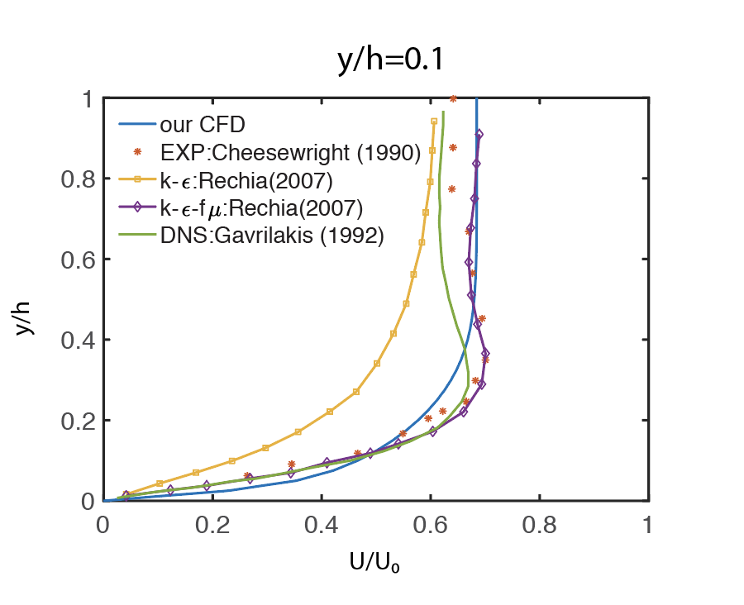
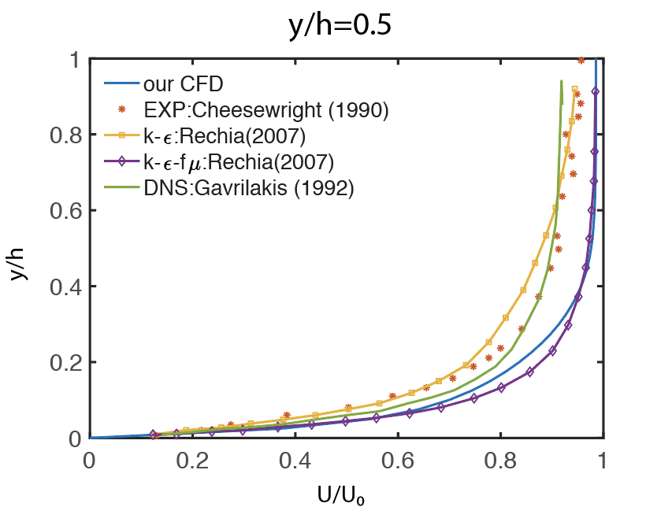
Validation Case 3: Square Duct

Slide 13
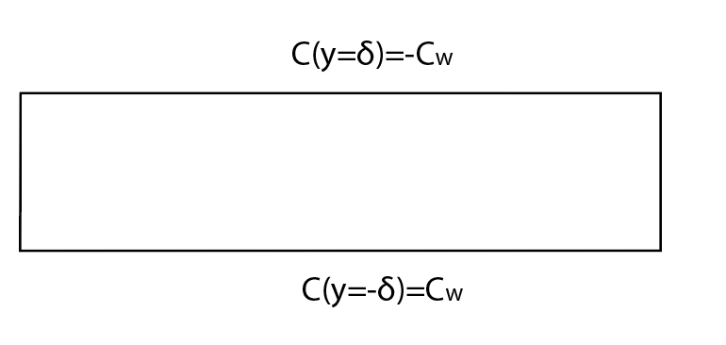
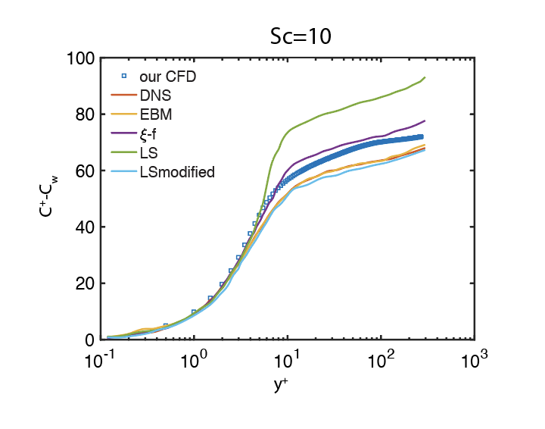
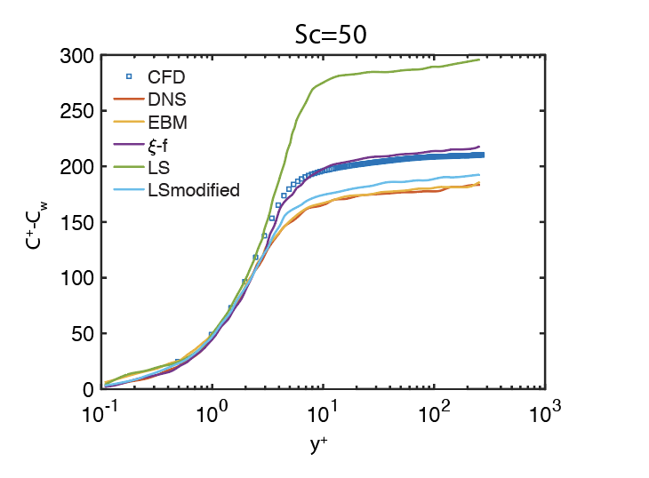
Validation Case 4: Mass Transport In Channel

Slide 14


Boundary conditions
$$U$$
$$U$$
solid
Porous media
No-slip boundary condition
?

Slide 15
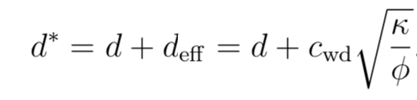
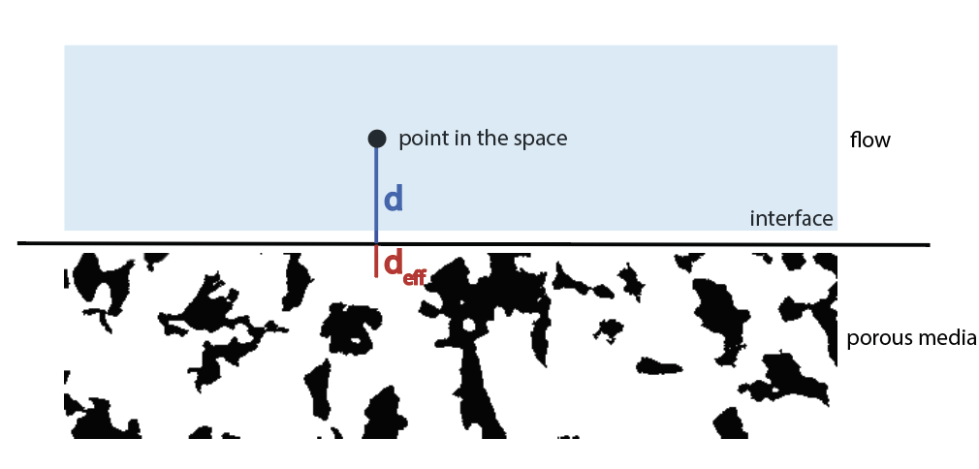


Boundary Conditions
For flow, effective distance is introduced here
With typical parameters of ROM
$$d_{eff}\sim 1×{10}^{−11}m$$
Same as solid boundary

Slide 16
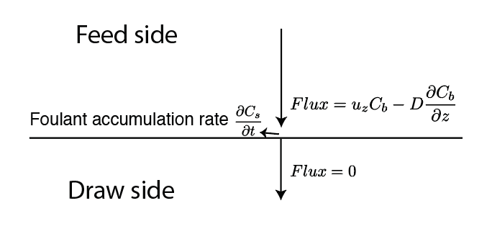
Boundary Conditions
For mass transport
Mass flux balance is satisfied on the membrane

Slide 17
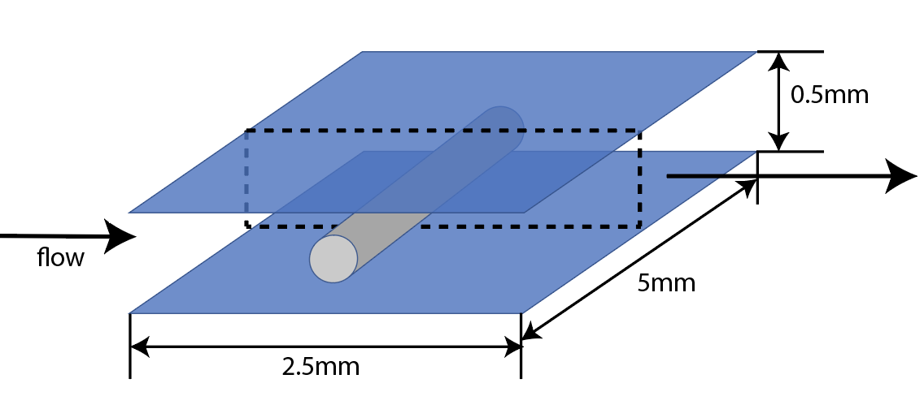
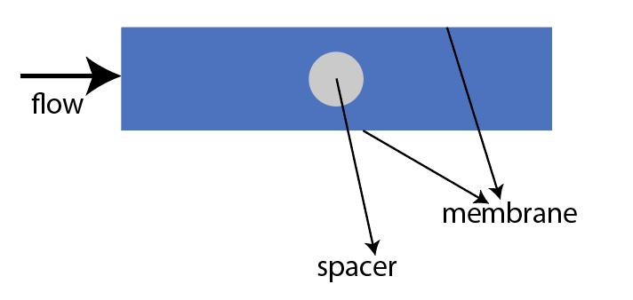
Spacer-filled Channel With Permeate Boundaries
Simulation of 4-cell system from $Re=5\sim 5000$

Slide 18
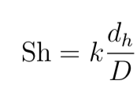

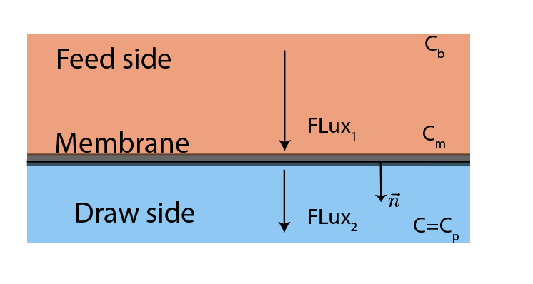
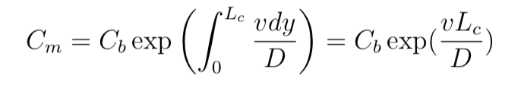


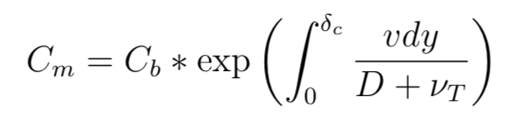


Theoretical Estimation
In Stokes flow regime
In turbulent flow regime

Slide 19
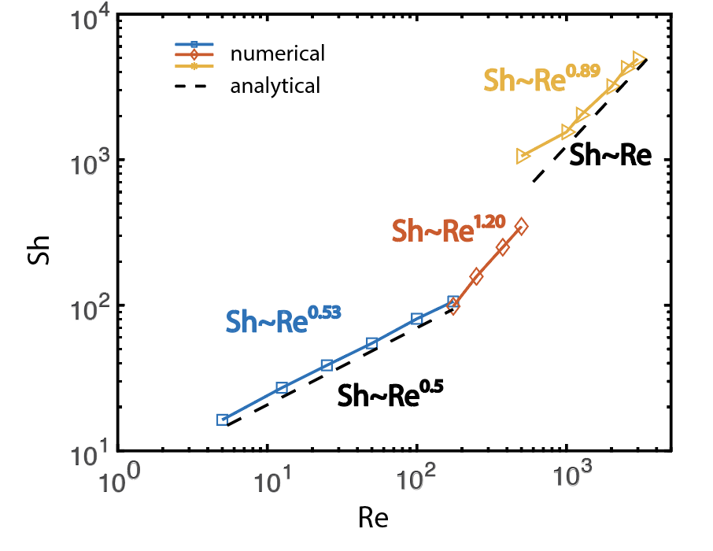
Extended Sherwood Number Plot
Sherwood number always increases with Reynolds number.
Two slope changes? Why?
[1]
Second slope change
First slope change
[1] S,Yu, B.Ling, Y.Yao, I. Battiato, Sherwood number correlation for reverse osmosis membrane systems in turbulent regime, to be submitted to J. Membrane Science

Slide 20
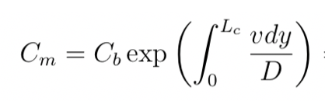
For Second Slope Change
Mass transport is enhanced because turbulent mass transport equation is the new governing equation
Power law is then changed
Turbulence promotes mass transport and reduces the boundary layer thickness.

Slide 21
For First Slope Change
Re=100
Re=250
At the slope change point, we observed vortex in the flow field.
Could the slope change be caused by vortex?

Slide 22
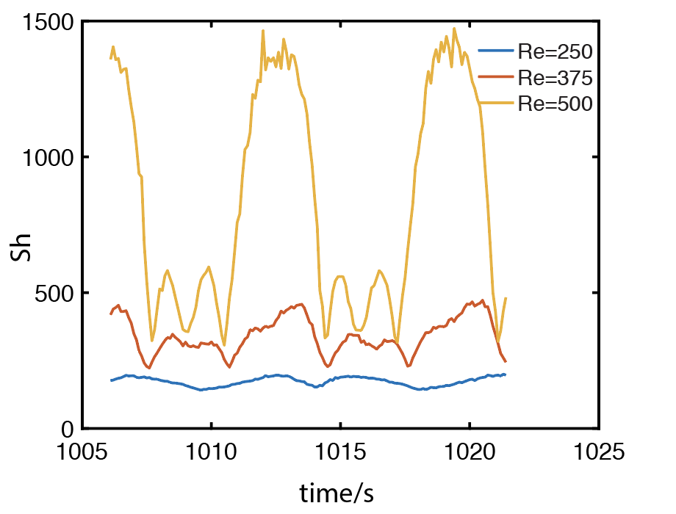
For First Slope Change
It periodically varies with time and has high peaks.

Slide 23
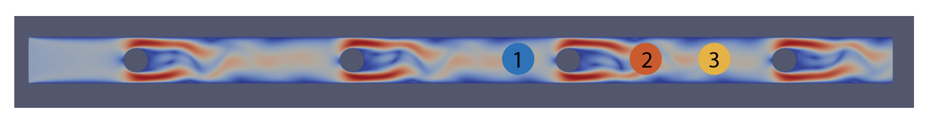
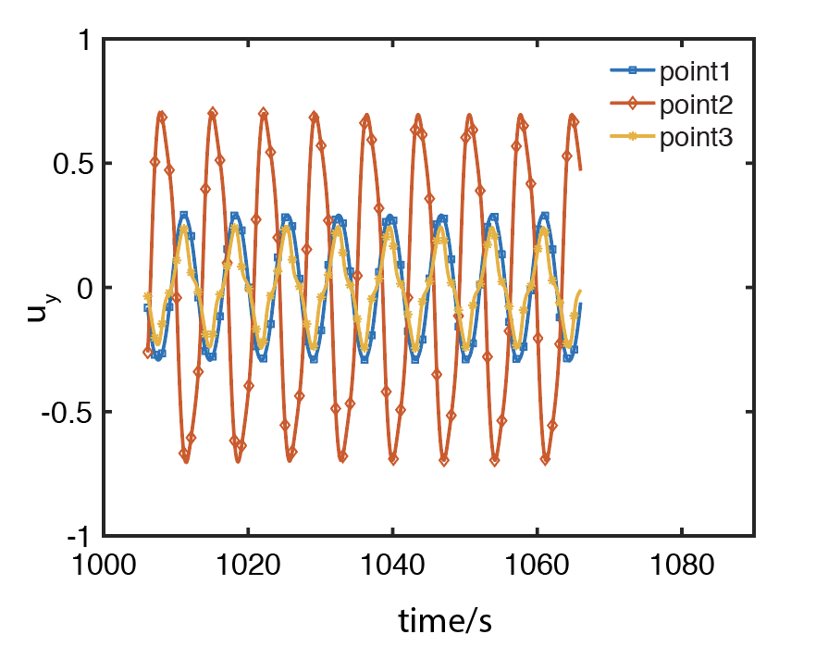
For First Slope Change
Vortex movement also leads to periodic velocity fluctuation.

Slide 24
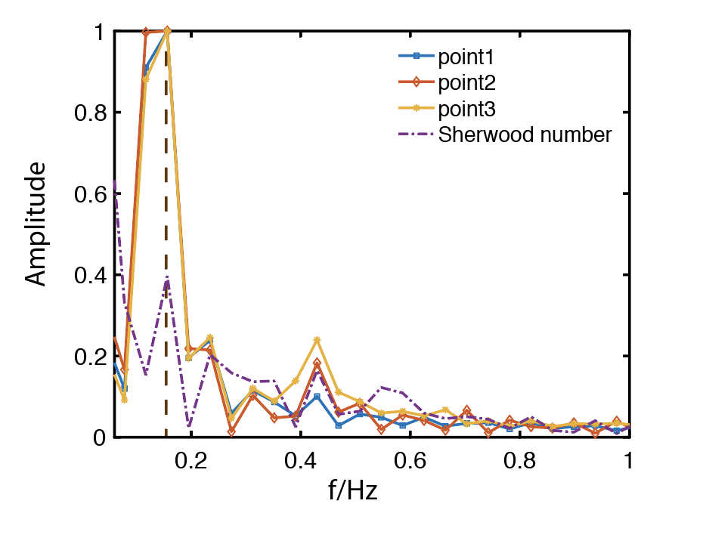
For First Slope Change
These two periods agree with each other.
First slope change is because of unsteady vortex movement.

Slide 25
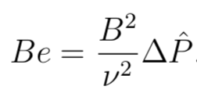
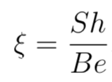
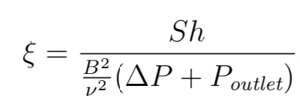
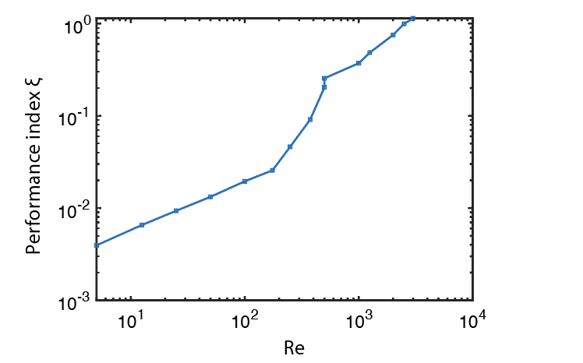
Performance Index
Old definition
Infinitely high performance index at Re=0
Taking draw side pressure into account
Performance index always increases with Reynolds number.
But super high Reynolds number may not be applicable in practice.

Slide 26
Conclusion
We developed our solver to make it applicable to turbulent regime with RANS
For the first time, Sherwood number correlation plot is extended to turbulent regime.
We observed two slope changes in the loglog plot and explained the underlying mechanism. The first is from vortex movement while the second is because of increase of effective diffusivity.
Performance index increases with Reynolds number in turbulent regime.

Slide 27
Acknowledgement
Ilenia Battiato
Bowen Ling
Yinuo Yao

Slide 28
Thanks !

