Slide 1

Impact of porous microstructure on performance of redox flow batteries: a modeling study
Javad Shokri, Daniel Niblett, Masoud Babaei, Vahid Niasar
Department of Chemical Engineering, University of Manchester, Oxford Road, Manchester, M13 9PL, United Kingdom
May 2022

Slide 2


Importance
~50 %
Intermittency
Unpredictability
Source:www.eia.gov/ieo
1

Slide 3
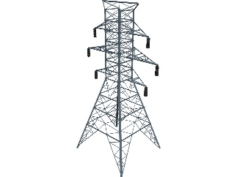
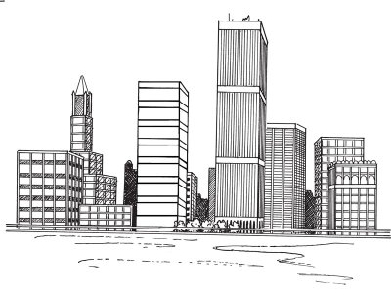

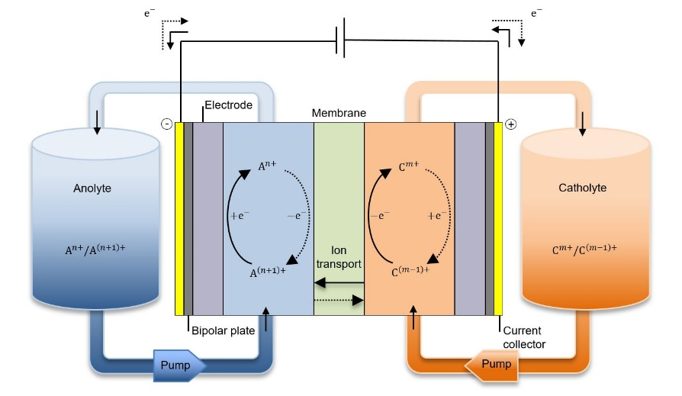
Excess power
Stabilize the supply rate
RFB
2

Slide 4
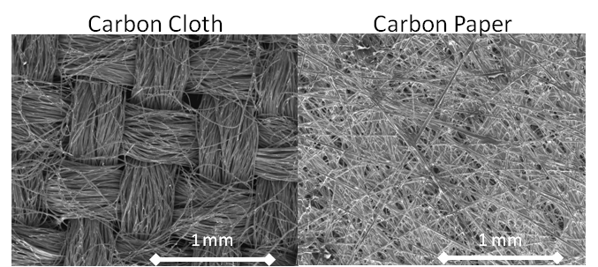

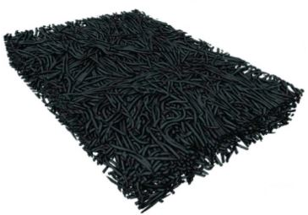
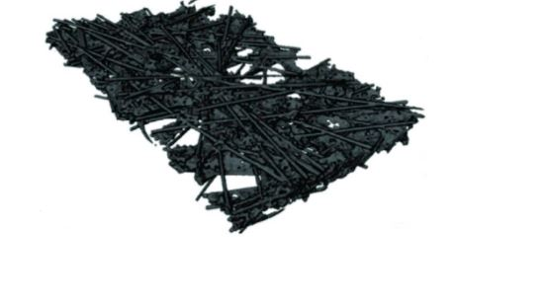
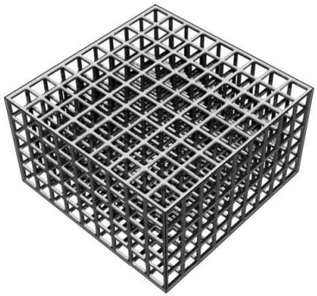
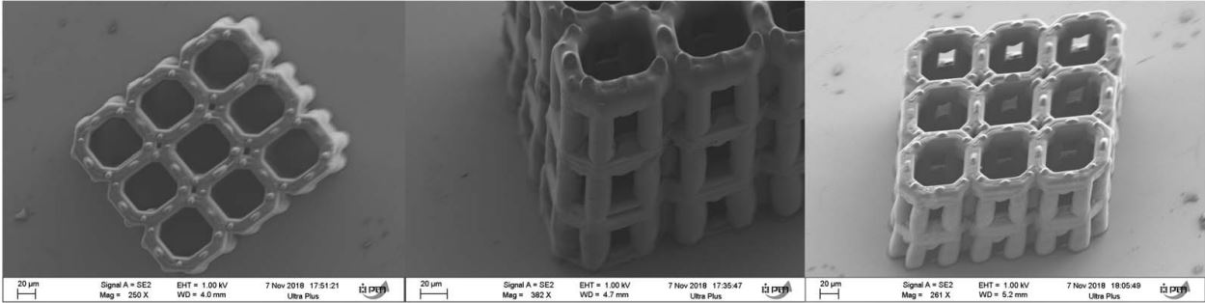
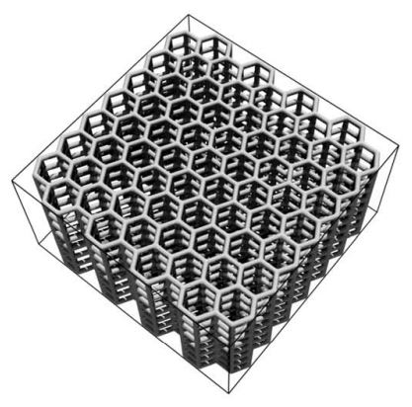
Commercial electrodes
Ordered microstructure
3

Slide 5
Research Objectives
Validating the pore network model against experimental data and comparing it to an equivalent ordered microstructure
Conducting a parametric study on ordered microstructure properties to identify the critical parameters controlling flow conditions
Outlining the improved microstructure for flow-through (FT) and interdigitated (ID) flow fields
4

Slide 6
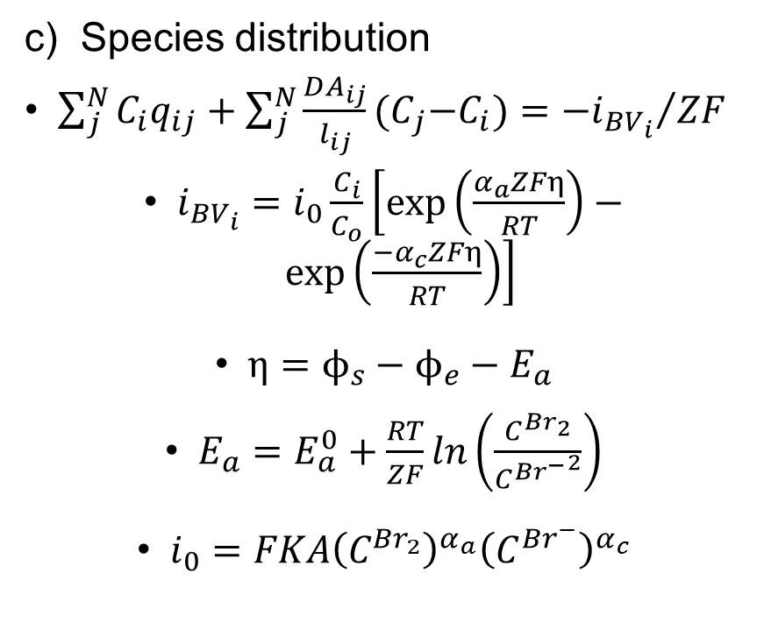
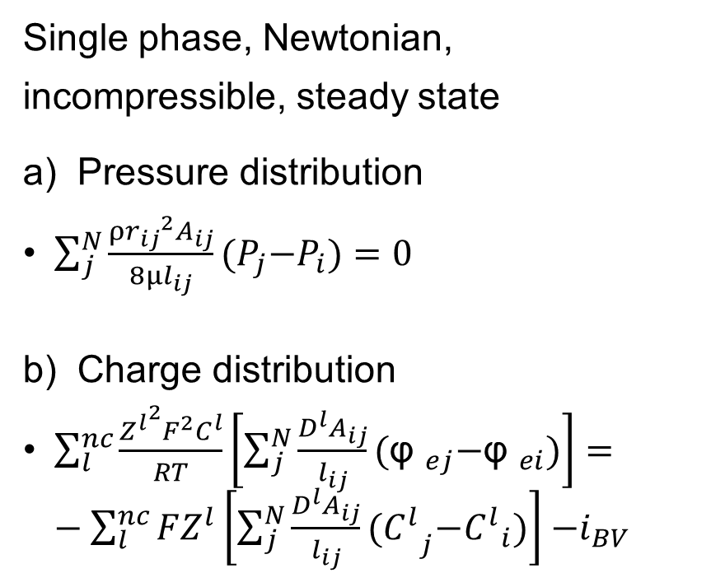
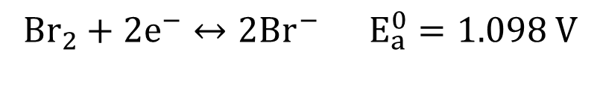
Methodology
$${Br}_{2}+2e^{−}↔2{Br}^{−} E_{a}^{0}=1.098 V$$
Single phase, Newtonian, incompressible, steady state
a) Pressure distribution
$\sum_{j}^{N}{\frac{{{ρr}_{ij}}^{2}A_{ij}}{8μl_{ij}}{(P}_{j}{−P}_{i})}=0$
b) Charge distribution
$\sum_{l}^{nc}{\frac{{Z^{l}}^{2}F^{2}C^{l}}{RT}\left[\sum_{j}^{N}{\frac{D^{l}A_{ij}}{l_{ij}}{(\text{φ} }_{ej}{−\text{φ} }_{ei})}\right]}=−\sum_{l}^{nc}{FZ^{l}\left[\sum_{j}^{N}{\frac{D^{l}A_{ij}}{l_{ij}}{(C^{l}}_{j}{−C^{l}}_{i})}\right]}{−i}_{BV}$
c) Species distribution
$\sum_{j}^{N}{C_{i}q_{ij}}+\sum_{j}^{N}{\frac{DA_{ij}}{l_{ij}}{(C}_{j}{−C}_{i})}={{−i}_{{BV}_{i}}}/{ZF}$
$i_{{BV}_{i}}=i_{0}\frac{C_{i}}{C_{o}}\left[\exp\left(\frac{α_{a}ZFη}{RT}\right)−\exp\left(\frac{{−α}_{c}ZFη}{RT}\right)\right]$
$η=ϕ_{s}−ϕ_{e}−E_{a}$
$E_{a}=E_{a}^{0}+\frac{RT}{ZF}ln\left(\frac{C^{{Br}_{2}}}{{C^{{Br}^{−}}}^{2}}\right)$
$i_{0}=FKA{\left(C^{{Br}_{2}}\right)}^{α_{a}}{\left(C^{{Br}^{−}}\right)}^{α_{c}}$
5

Slide 7
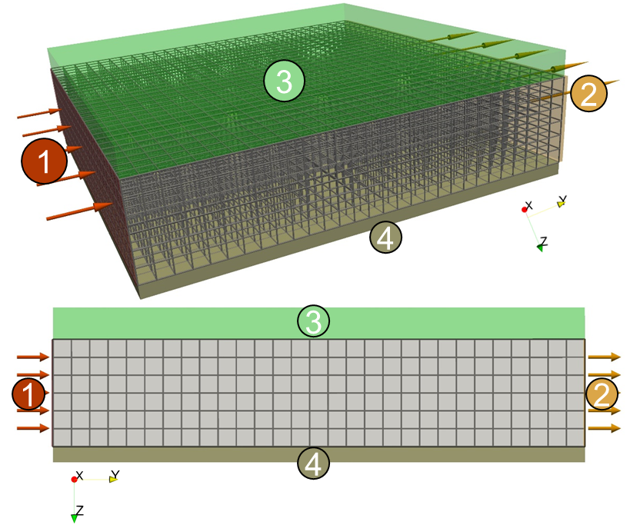
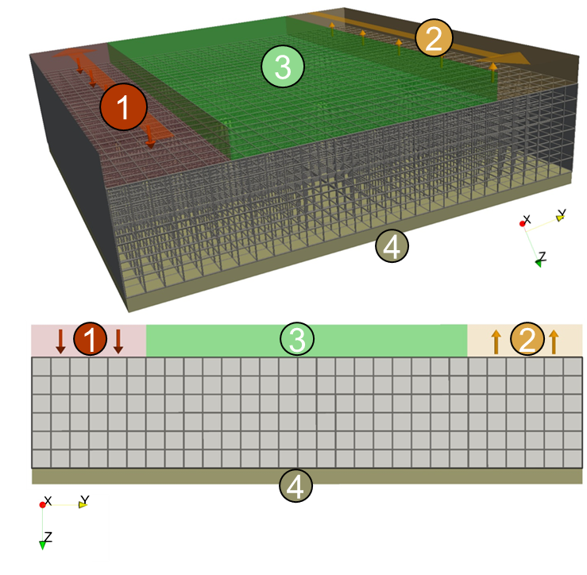
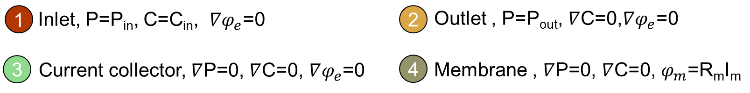
Boundary condition
Flow-through flow field
Interdigitated flow field
6

Slide 8
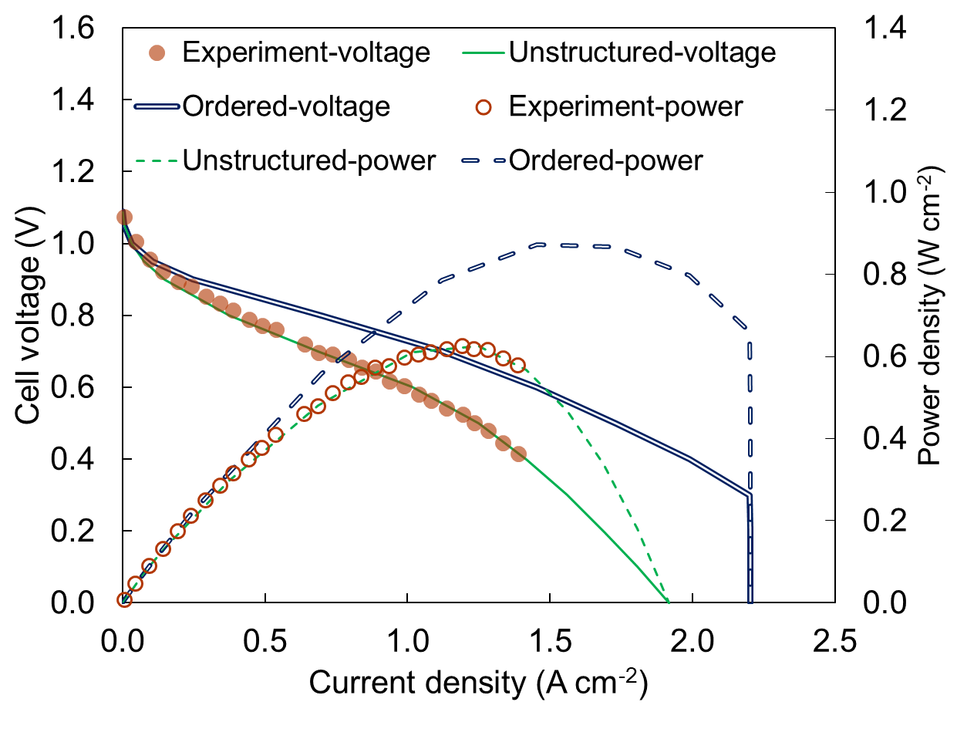
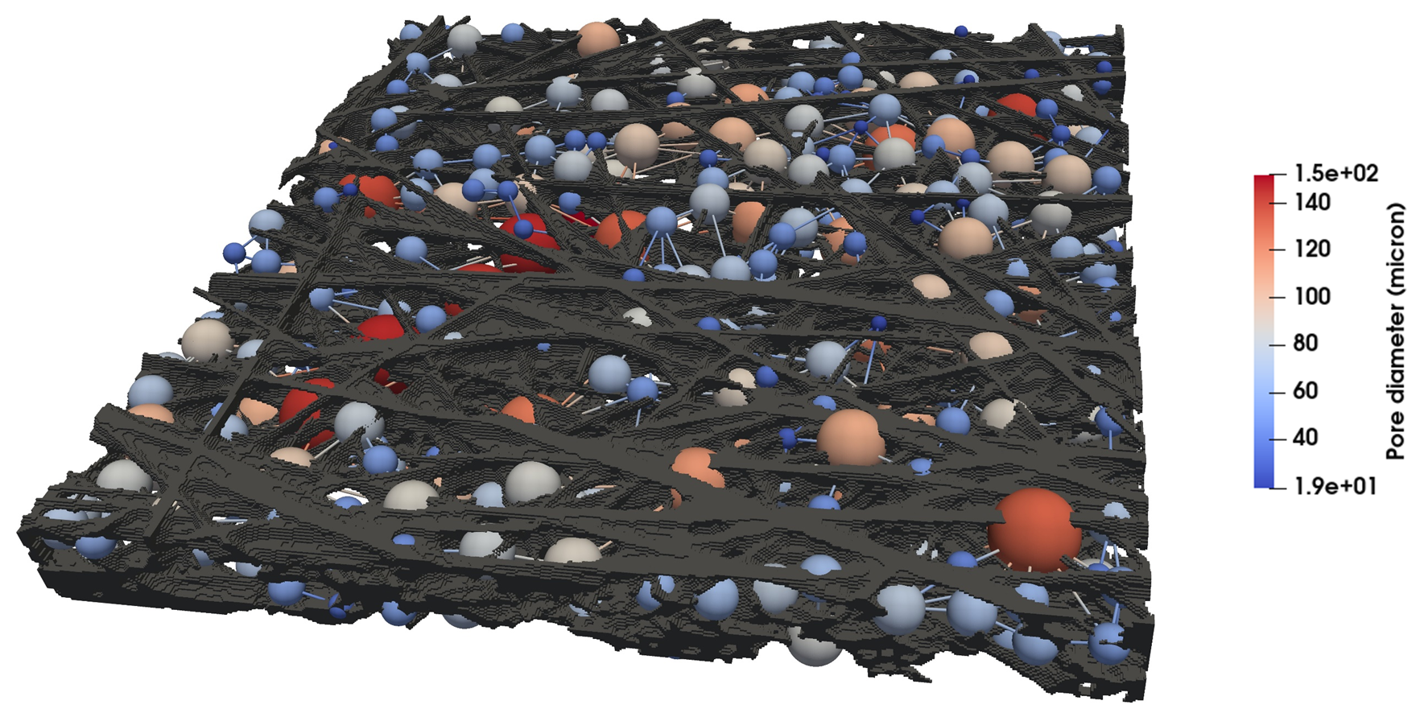
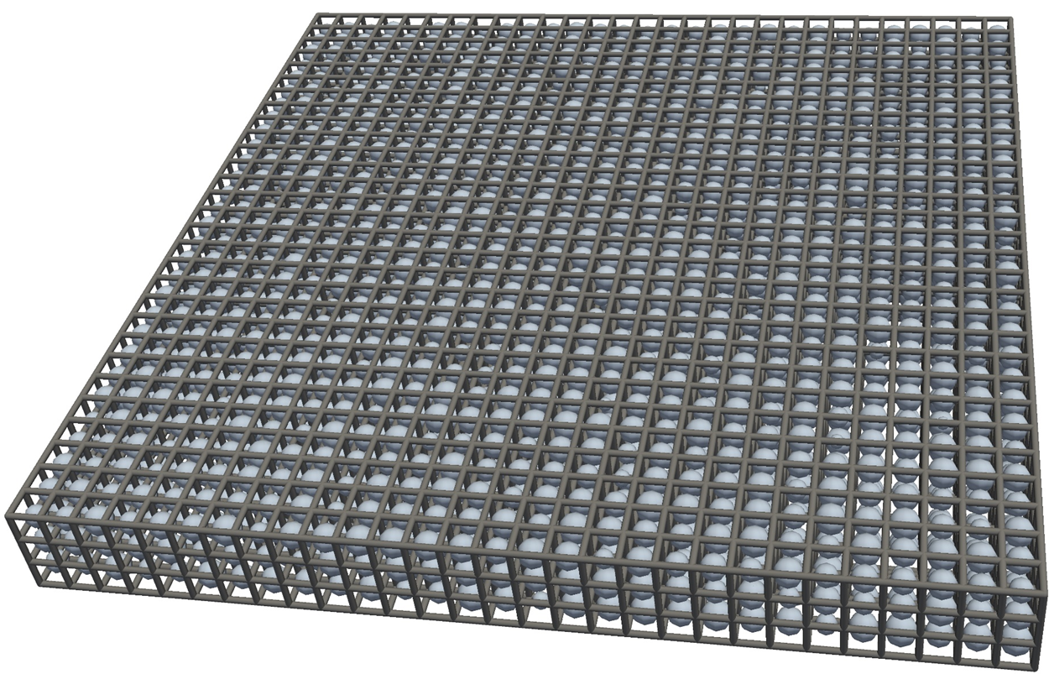
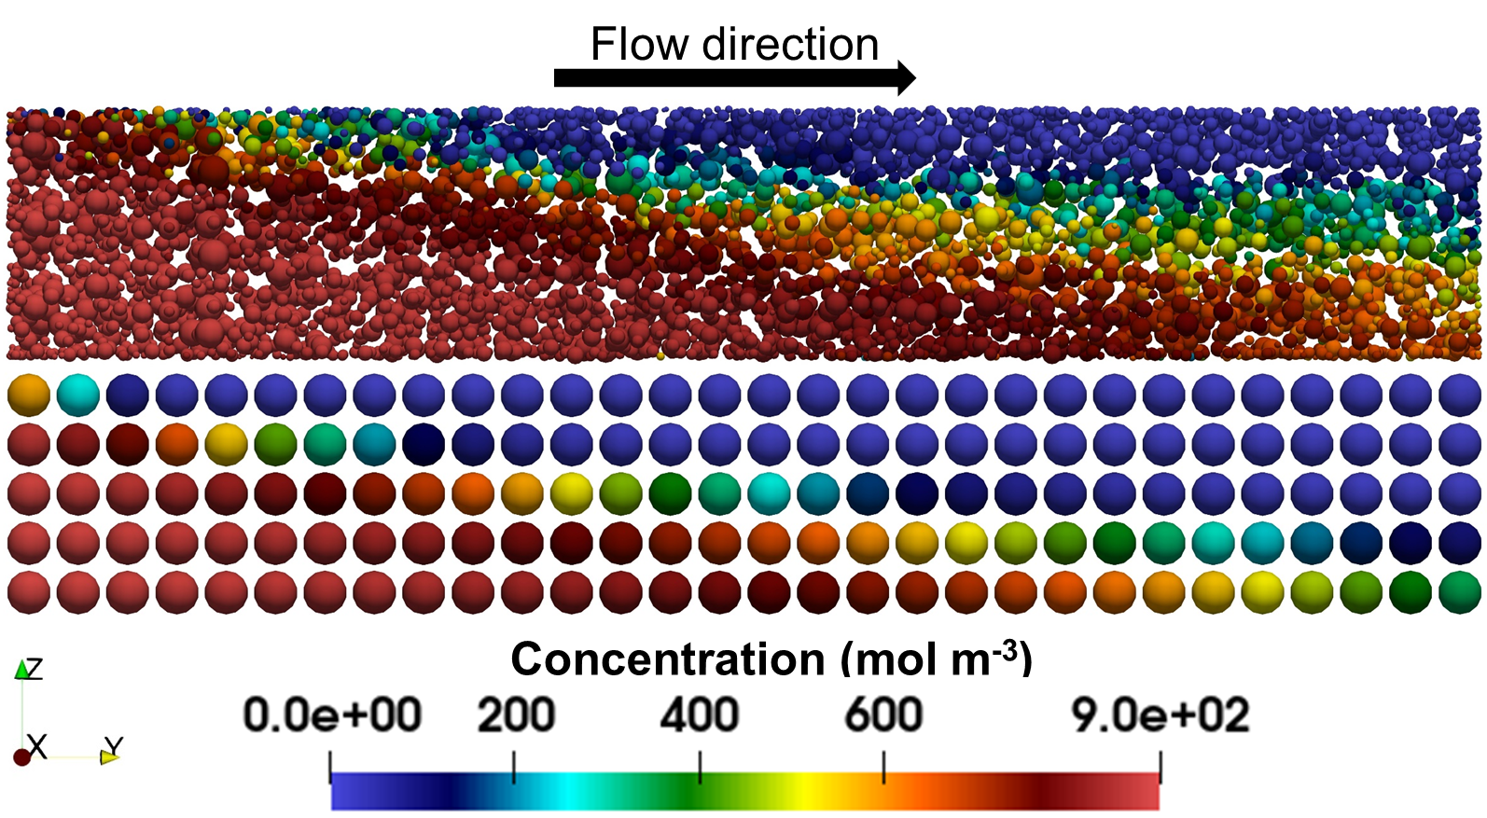
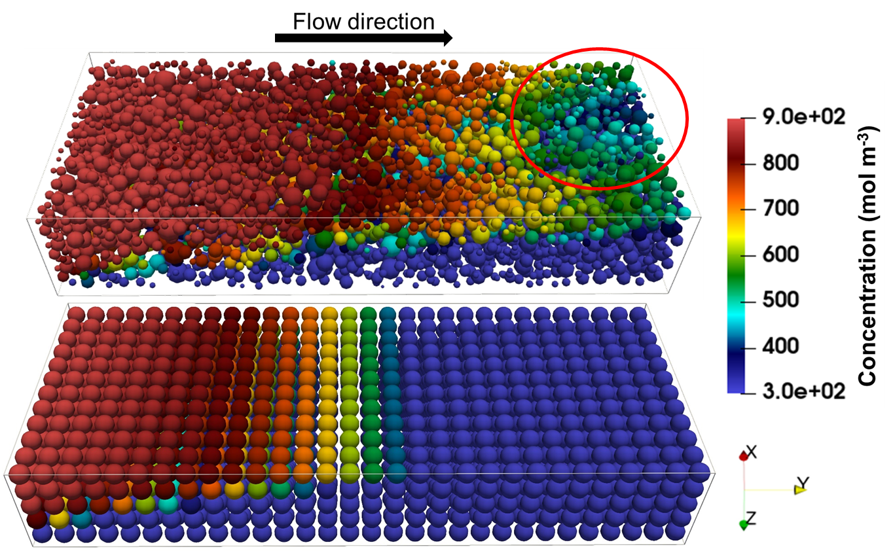
Experimental validation, Ordered Microstructure
Carbon paper
(unstructured network)
Cubic lattice
(ordered network)
0.87
0.63
a)
b)
The results show a good agreement between the experimental and the simulation
The homogeneous and non-tortuous microstructure, of the ordered cubic lattice, facilitates the mass transport in the ordered microstructure and improves the overall performance of the battery
c)
d)
e)
7

Slide 9
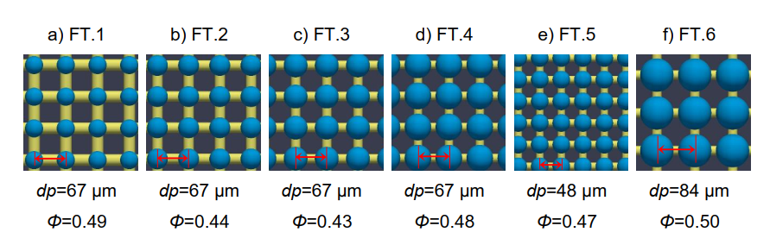
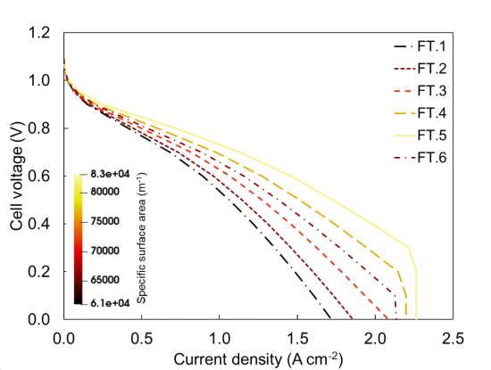
Effect of pore/throat size ratio and size of lattice units
Specific surface area
The permeability kept constant in all cases
The specific area plays an important role in the design in which by increasing the specific area, the performance of the battery was improved.
g)
8

Slide 10
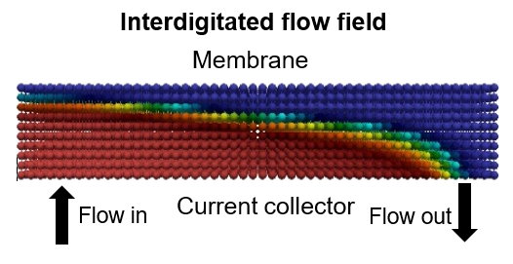
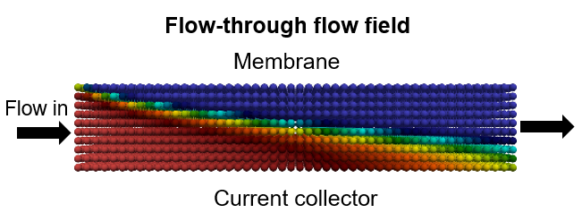
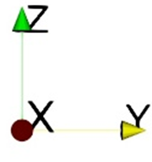
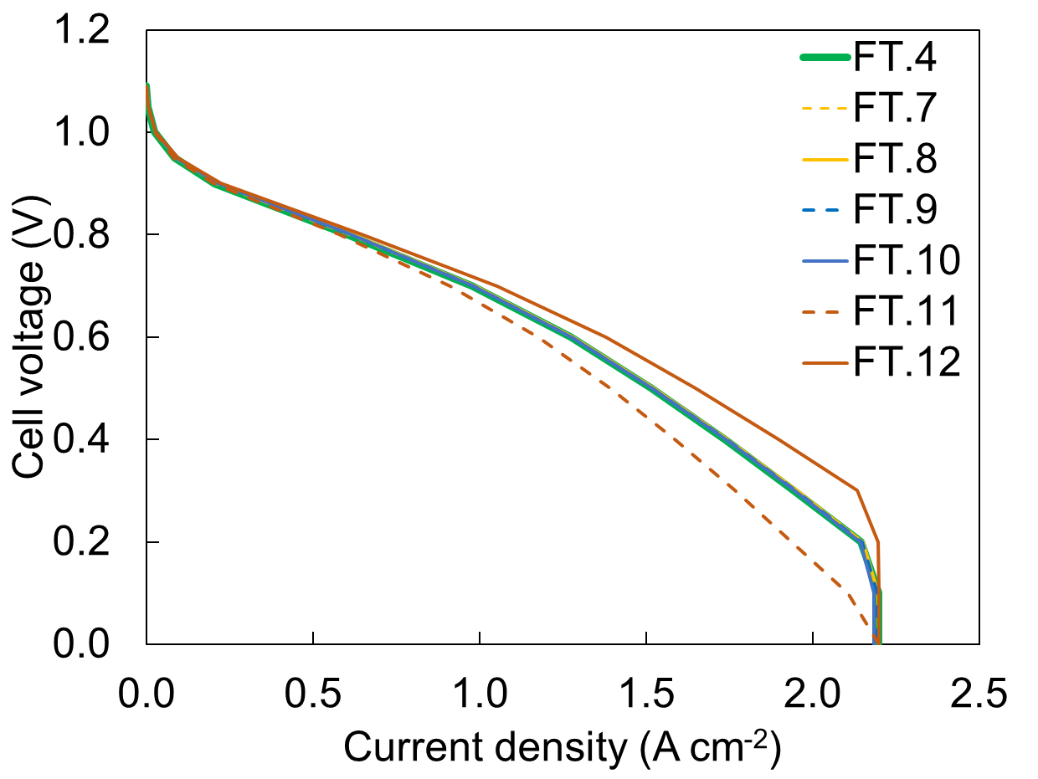
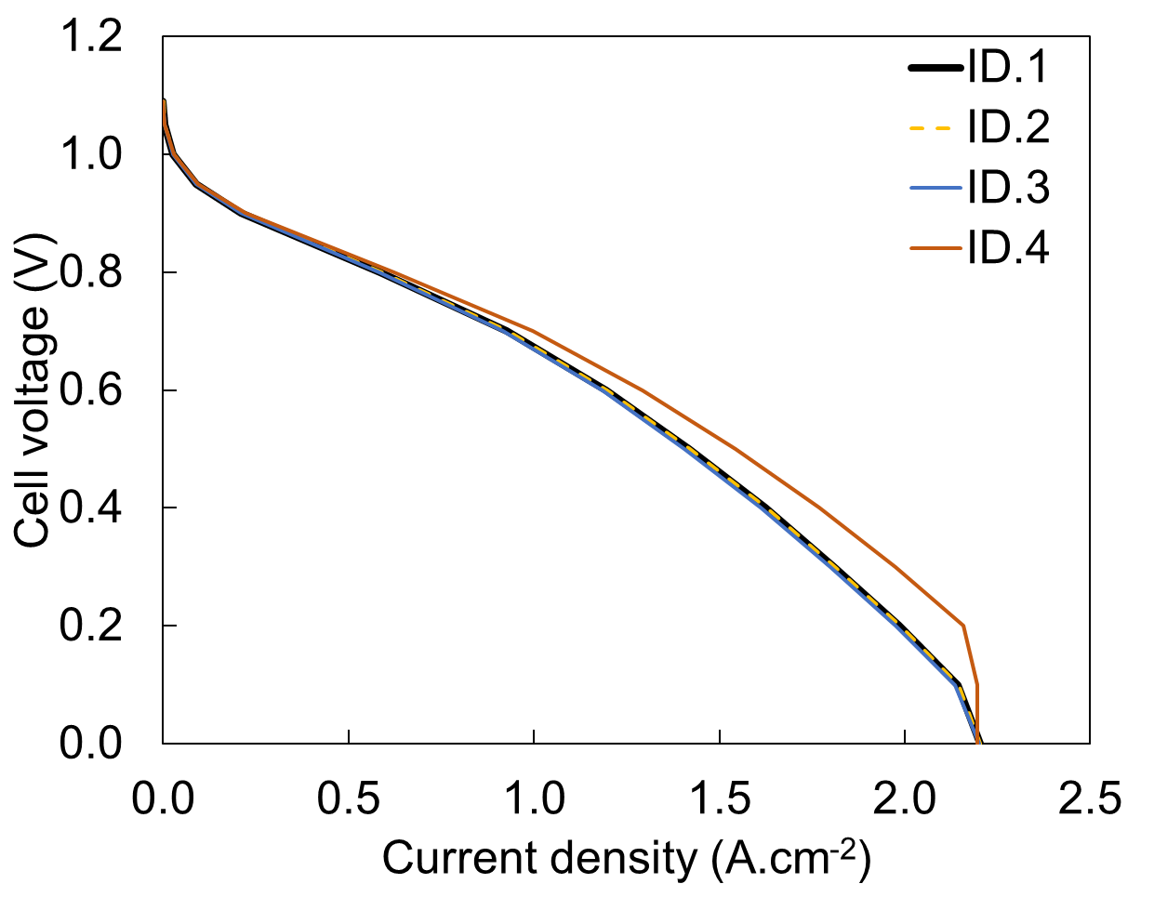
Through-plane and in-plane permeability anisotropy
Through-plane
In-plane
Constant flow rate condition
Permeability anisotropy in in-plane directions (x and y), have a minor influence on the performance of the battery (FT.7-10, ID.2 & 3)
Increasing the permeability in z direction, enhances the performance of the battery (FT.12 and ID.4)
Pumping power demand is affected by altering the permeability in y-direction. Increasing the permeability decreases the pumping demand by 30% and 26% in FT.10 and ID.3 compared to the base cases.
a)
b)
9

Slide 11
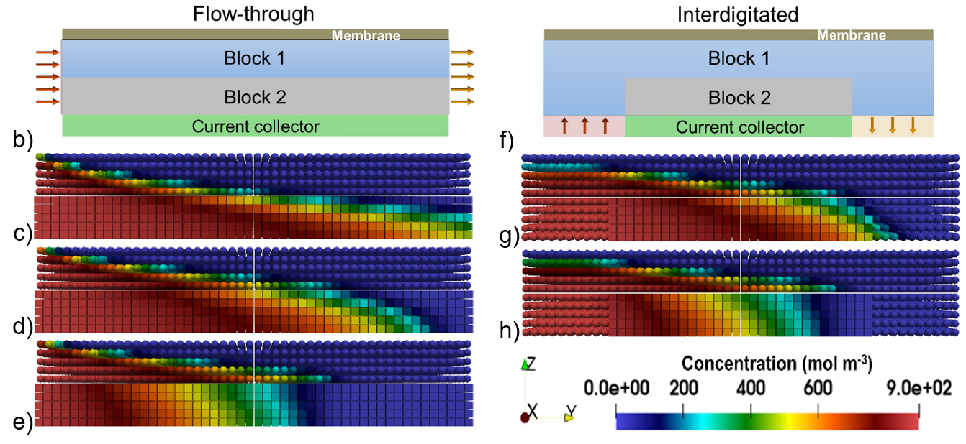
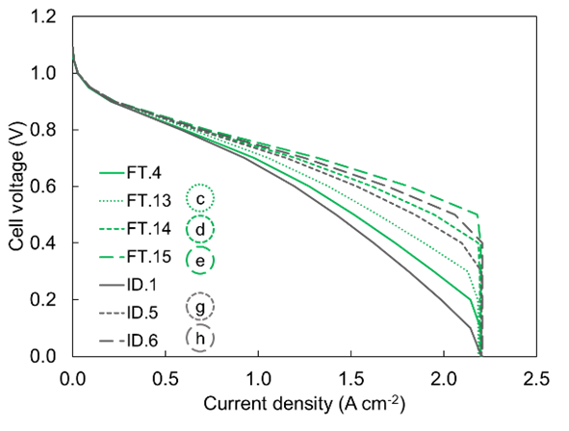
Microstructure improvement
a)
Bromine was mostly consumed in the proximity of the membrane and outlet of the battery for both of the flow fields
Network is divided into two sub-networks namely block 1 and block 2 with a higher and lower permeability in the y-direction, respectively
Macroscopic flow rate and the specific surface area are kept unchanged in different simulations
10

Slide 12
Conclusion
Ordered cubic lattice with the same permeability of the carbon paper, 35% increase in maximum power density
improved mass transport as a result of higher advection, diffusion, and lower tortuosity of the ordered lattice
Bigger pores and smaller throats, higher frequency of lattice units, higher specific surface
Permeability change in the x and y directions, no change in performance
The permeability variation in the through-plane (z) direction reinforced or hampered the diffusion and also the current generation.
At constant specific surface area, permeability, and flow rate results presented the superior performance of the improved microstructure in both flow fields.
Diverting the electrolyte main flow path, to the proximity of the membrane, where more reactions were taking place.
11

