Slide 1
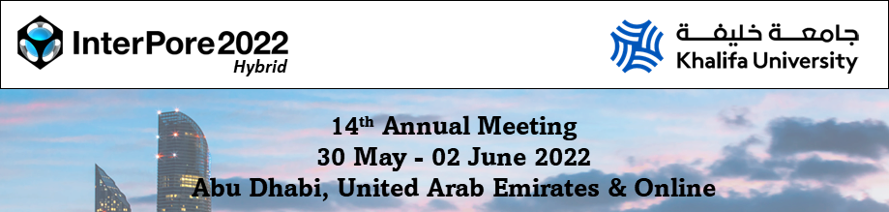
Regeneration of granular activated carbon by microwave (MW) irradiation and its application in a novel in situ regenerating permeable reactive barrier (PRB) approach (MW-PRB)
Pietro P. Falciglia^{1,2}, Erica Gagliano¹, Guido De Guidi^{3,4}, Stefano Romano^{2,5}, Paolo Roccaro¹, Federico G. A. Vagliasindi¹
¹Dipartimento di Ingegneria Civile e Architettura, Università di Catania, Catania, Italy;
²LNS – INFN, Catania, Italy;
³Dipartimento di Scienze Chimiche, Università di Catania, Catania, Italy;
⁴CRAM3RA, Università di, Catania, Italy;
⁵Dipartimento di Fisica e Astronomia, Università di Catania, Catania, Italy

Slide 2
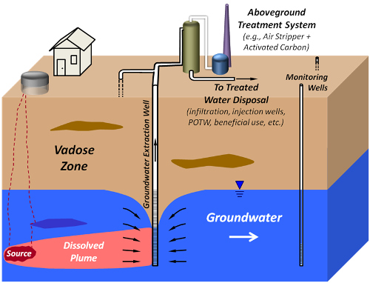
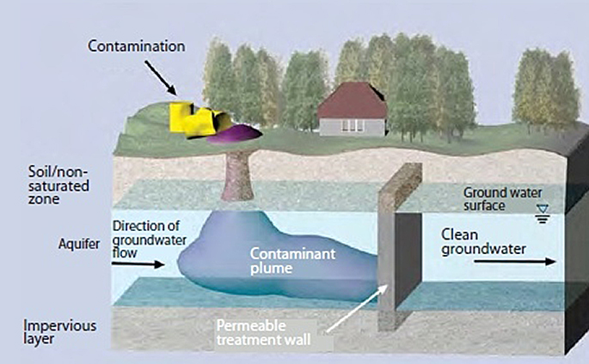
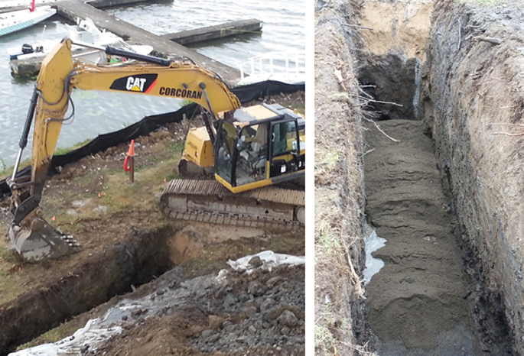
Introduction
INTERPORE 2022 - Pietro P. Falciglia, PhD
Pump and treat (P&T)
Permeable Reactive Barrier (PRB)
In situ passive groundwater treatment;
lower costs than P&T;
eco-friendly;
without groundwater flow alteration.
Source: Vertex
Environmental

Slide 3
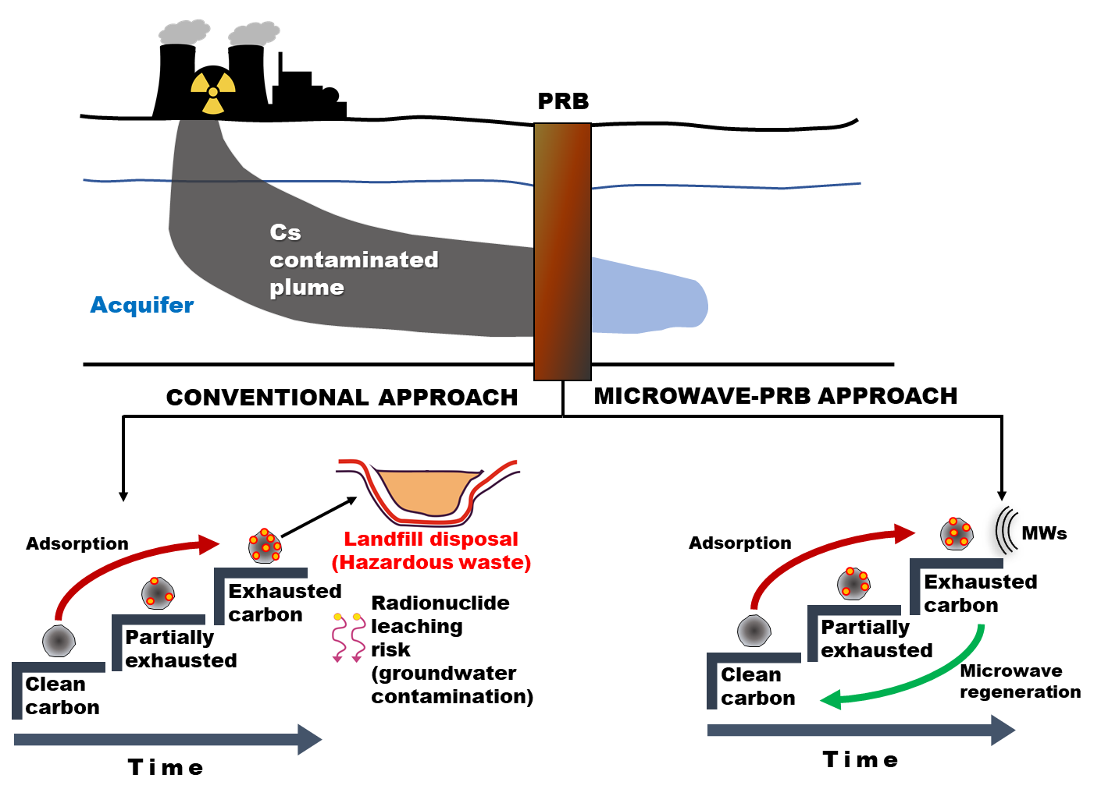
Reduced longevity of Permeable Reactive Barriers (PRBs) and in situ regeneration approach
  Reduced longevity due to a GAC saturation is the major problem affecting full-scale treatments (Ghaeminia and Mokhtarani, 2018).
  Exhausted AC incineration or landfill disposal are considered uneconomic and causes of secondary hazardous environmental contaminations.
  PRB in situ regeneration: very promising but challenging alternative (Ghaeminia and Mokhtarani, 2018).
  Coupling PRB with other regeneration processes (biological, electrokinetic) (Careghini et al., 2015; Ghaeminia and Mokhtarani, 2018) is considered a frontier research topic (Huang et al., 2017).
CONVENTIONAL PRB
INTERPORE 2022 - Pietro P. Falciglia, PhD
Elsevier
  However, studied approaches of PRBs coupled with biological, electrokinetic) (Careghini et al., 2015; Ghaeminia and Mokhtarani, 2018) are generally recognised as ineffective or uneconomical (Careghini et al., 2015).

Slide 4
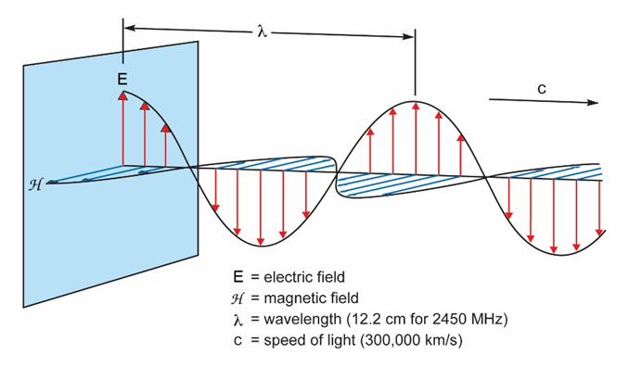
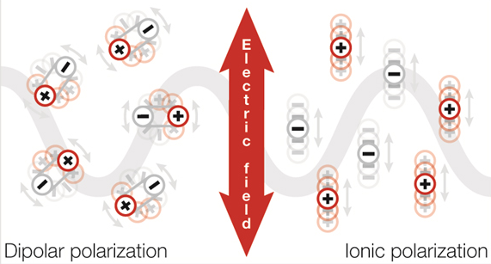
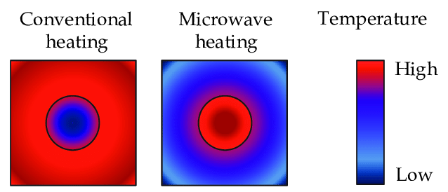
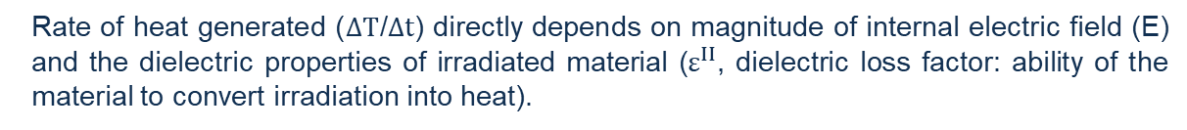
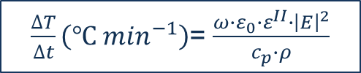
Microwave heating: innovative regeneration for saturated AC
Developed for communication, Microwave (MW) irradiation currently employed as cost-effective heating technology for several applications (mineral processing, remediation application, chemical synthesis).
Growing interest: passive ability of absorber materials (as ACs) to convert low irradiation energy into rapid temperature increase
Electromagnetic field → dipolar rotation and ionic conduction → heat generation.
MW heating over conventional for regenerating AC:
Temperature control
Volumetric heating (Uniformity)
Shorter regeneration time
Preservation of AC porous structure
Efficiency enhanced by AC dielectric nature and thermal resistance
INTERPORE 2022 - Pietro P. Falciglia, PhD
$\frac{∆T}{∆t}\left(℃ \min^{−1}\right)$= $\frac{ω∙ε_{0}∙ε^{II}∙{\left|E\right|}^{2}}{c_{p}∙ρ}$
Rate of heat generated ($∆T$/$∆t$) directly depends on magnitude of internal electric field (E) and the dielectric properties of irradiated material ($ε^{II}$, dielectric loss factor: ability of the material to convert irradiation into heat).
(Ao et al., 2018; Kostas et al., 2017; Falciglia et al., 2018; Sun et al., 2016)

Slide 5
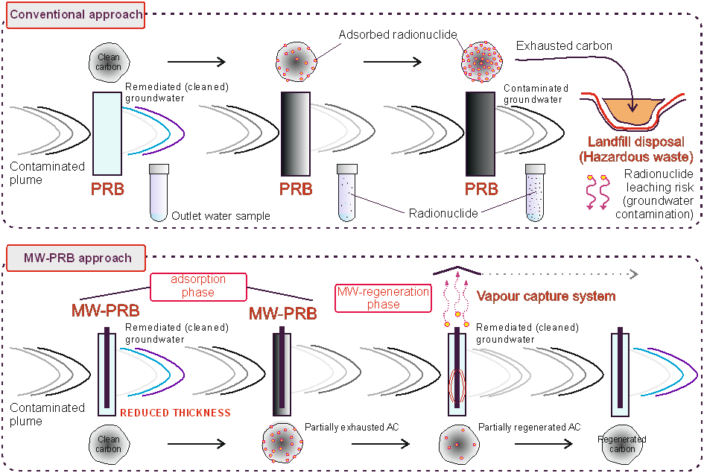
Novel MW based in situ regenerating PRB (MW-PRBs): Concept of proof
  Main advantages:
  Extension of PRB longevity;
  Reduction in PRB thickness and minimization of GAC final disposal to hazardous landfill.
  Significant reduction in both material costs and environment contamination risks.
INTERPORE 2022 - Pietro P. Falciglia, PhD
MW-PRB SYSTEM
Elsevier
Elsevier

Slide 6
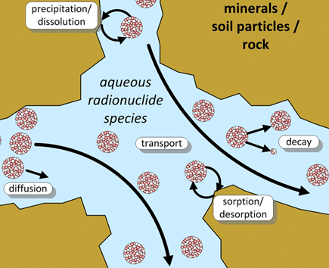
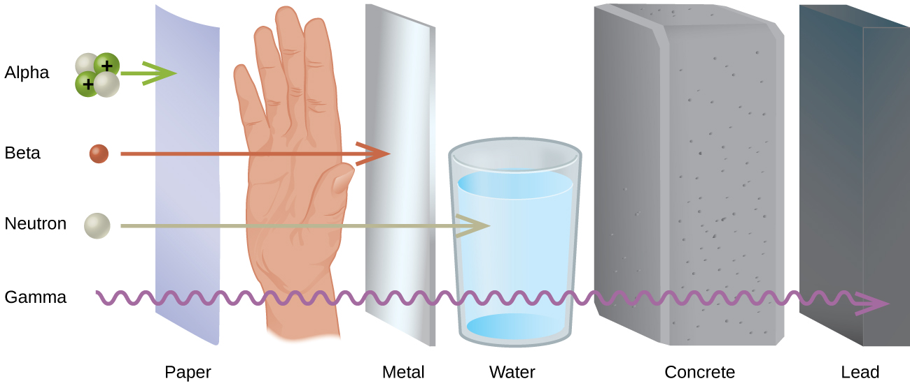
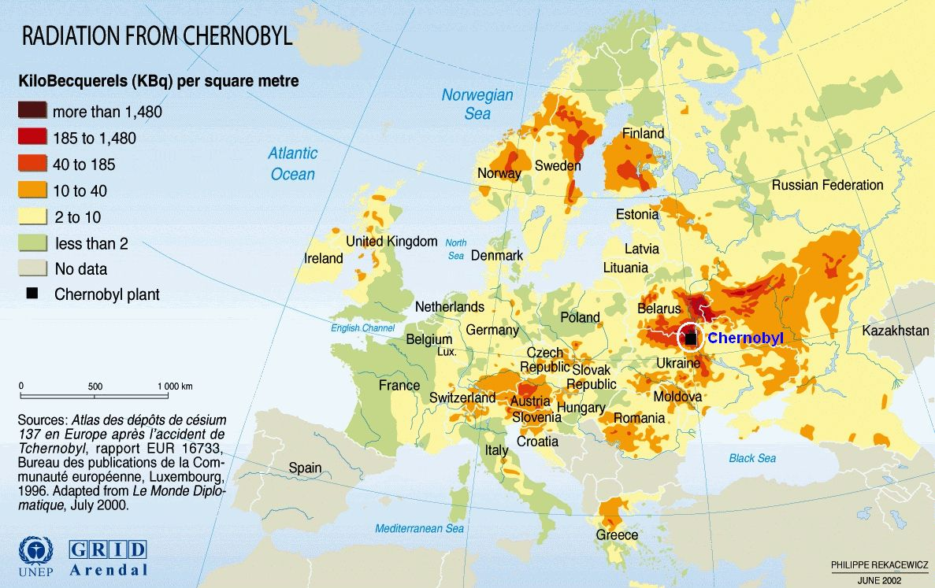
Radioactive cesium (¹³⁷Cs)
Anthropogenic activities (nuclear plants and medical facilities)
Cesium-137 major radionuclide in spent nuclear fuel processing
Important risk driver after nuclear accidents (Chernobyl - Fukushima)
High water solubility and bind to soil and mineral
Chemical composition similar to potassium and sodium
Detected at low concentrations
Water decontamination urgent and challenging task
Biological interactions: cardiovascular, immune and respiratory systems
Hazardous long-term radiological effects
Half-life 30.2 years
“Radionuclides emitting beta particles and gamma radiation”: 4 millirems x year in drinking water (EPA)
INTERPORE 2022 - Pietro P. Falciglia, PhD
PAPER
TISSUE
METAL
WATER
CONCRETE
LEAD
(Olatunji et al., 2018; Smith et al., 2001)

Slide 7


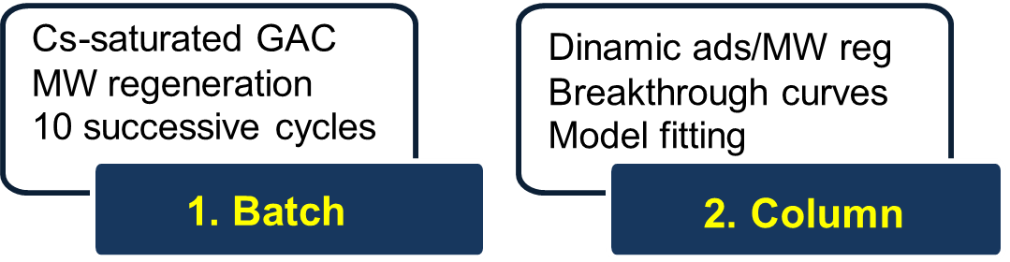
Objectives of the work
  GENERAL OBJECTIVE:
  To evaluate the feasibility of the MW based regenerating PRB system (MW-PRB) as combined treatment for Cs-impacted water.
INTERPORE 2022 - Pietro P. Falciglia, PhD
  SPECIFIC OBJECTIVES:

Slide 8
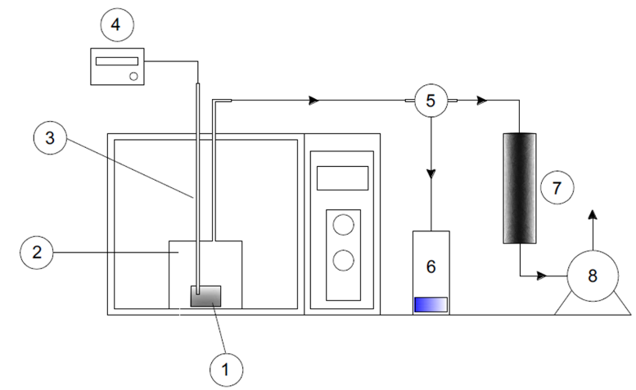
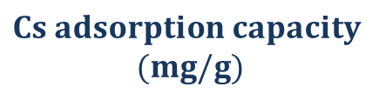



Materials and methods: batch tests
ADSORPTION – MW REGENERATION MULTIPLE CYCLES
133-Cs (isotope of ¹³⁷Cs) as CsCl in DI
133-Cs: chemico-physical properties of 137-Cs
Norit GAC 830 (S/L ratio 1:10)
[C₀]=250 mg/L
180 rpm for 24 h (20 °C)
ICP-MS analysis
  Best fitting (Langmuir e Freundlich)
Regeneration by MWs
15 g of Cs-saturated GAC
MW: Power=440 W, time = 3 min
INTERPORE 2022 - Pietro P. Falciglia, PhD
$$Cs adsorption capacity$$
$$(mg/g)$$
$q_{0}$ = $\frac{{V(C}_{0}−C_{f})}{m}$
Adsorption
1: GAC sample, 2: quartz reactor, 3: thermocouple, 4: analyzer, 5: condenser, 6: condensate, 7: filter, 8: vacuum pump
10 ADSORPTION – MW REGENERATION CYCLES
$RE(\%)$= $\frac{q_{i}}{q_{0}}$
$WL(\%)$= $\frac{W_{0}−W_{i}}{W_{0}}$
At the end of each cycle: Regeneration Efficiency Weight Loss
Temperature, Changes in GAC textural properties (BET area, SEM analysis)

Slide 9
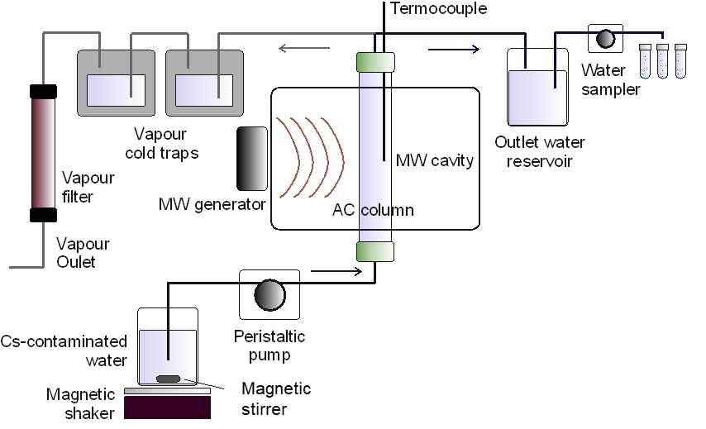
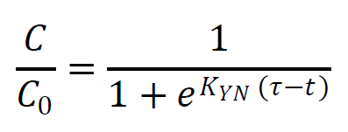
Materials and methods: column tests
ADSORPTION – DYNAMIC MW REGENERATION
MW-Column test setup
MW regeneration dynamic study
3 phases:
Adsorption in column.
MW regeneration of the material in column.
Next adsorption in columns.
INTERPORE 2022 - Pietro P. Falciglia, PhD
Norit GAC 830 (bed length=21 cm)
Column height = 50 cm
Flow rate 10 mL/min
[Cs] = 100 mg/L
MW regeneration at 300 W
Regeneration times = 5,10,15 min
Breakthrough curves for phases 1 and 3.
Several mathematical models to fix experimental data
Yoon-Nelson Model
Elsevier
The outlet section was split in two different hydraulic lines: (i) water line, working during the adsorption phases and (ii) vapour line, which collected the exhaust gas produced during the regeneration phase.

Slide 10
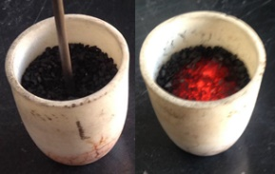
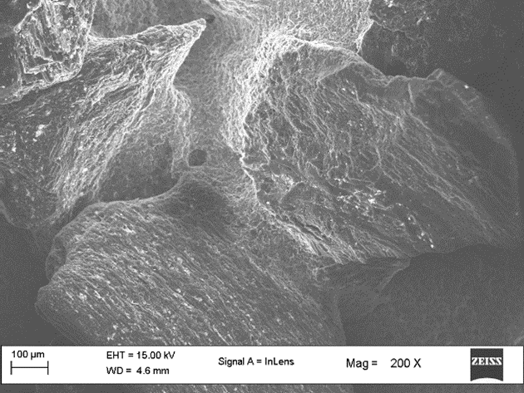
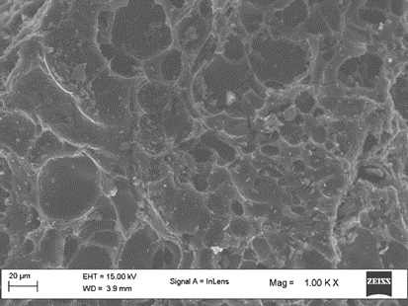
Results and discussion: batch tests
Preliminary tests: very rapid temperature increase (T_{max} 680 °C) due to GAC excellent dielectric properties [key factor in the whole regeneration process - Falciglia et al., 2018].
Max Cs removal of 81% [in agreement with previous findings, temperatures 400-700 °C are enough to effectively desorb Cs from solid materials - Honda et al., 2017; Liu et al., 2003].
INTERPORE 2022 - Pietro P. Falciglia, PhD
GACs
at 680 °C
SEM
Analysis
Elsevier
Virgin GAC
MW irradiated GAC
Highest BET area and pore volume at 5th cycle due to the increase in micropores (Mohamad Nor et al., 2016).
Further regeneration cycles (>5th) led to the partial destruction of some micropores previously formed and the decrease in BET area and pore volume.
Elsevier

Slide 11
Results and discussion: batch tests
ADSORPTION – MW REGENERATION MULTIPLE CYCLES
INTERPORE 2022 - Pietro P. Falciglia, PhD
Elsevier
Elsevier
A general increase in the removal efficiency was found up to the 5th cycle (highest value ~112%).
A linear increase in GAC weight loss percentage with MW regeneration cycles was observed. At the end of the 10th cycle, it was ~6.78%, much lower than that ascribed to conventional thermal regeneration (5-15% for each regeneration cycle) (Zanella et al., 2014). This evidence demonstrated that MWs preserve better the life span of GAC compared to conventional thermal regeneration (Ania et al., 2005).

Slide 12
Results and discussion: column tests
ADSORPTION – DYNAMIC MW REGENERATION
First adsorption phase: typical breakthrough curves.
Regeneration can take place even in dynamic condition with a permanent GAC water saturation.
Vapour steam → contaminant carrier
Increase in the Cs removal with irradiation time (maximum value of 80% @ 15 min-irradiation).
INTERPORE 2022 - Pietro P. Falciglia, PhD
Incresing irradiation time
Increasing regeneration effect
Elsevier
T1= 5 min; T2= 10 min; T3= 15 min; Applied Power 300 W
● Saturation plateau ~300 min
● Yoon-Nelson (R²=096)

Slide 13
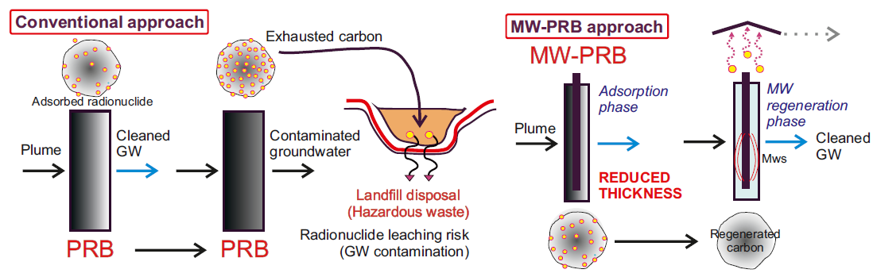
Conclusions and future perspectives
  Obtained finding demonstrated the feasibility of the proposed system.
  Data are essential to guide the scaling-up of the MW based regenerating permeable reactive barriers (MW-PRB).
INTERPORE 2022 - Pietro P. Falciglia, PhD
Elsevier
  Further techno-economic investigations are still needed.
  Experimental study + techno-economic analysis: MW-PRB feasibility and its PROs against conventional PRB
  Further investigations: co-existing contaminants and real groundwater conditions (variability).

Slide 14

THANK YOU!
My references
Pietro P. Falciglia
Dipartimento di Ingegneria Civile e Architettura
Università di Catania, Catania, Italy
E-mail: pietro.falciglia@unict.it

