Slide 1


A Review on Polymer Adsorption in Carbonate and Sandstone Reservoirs
Anoo Sebastian, Dr. Emad W. Al-Shalabi, and Dr. Waleed AlAmeri
Khalifa University

Slide 2
Overview
Introduction
Polymer Retention Concept
Polymer Retention Mechanisms
Factors Influencing Polymer Retention
Methods to Estimate Polymer Retention

Slide 3
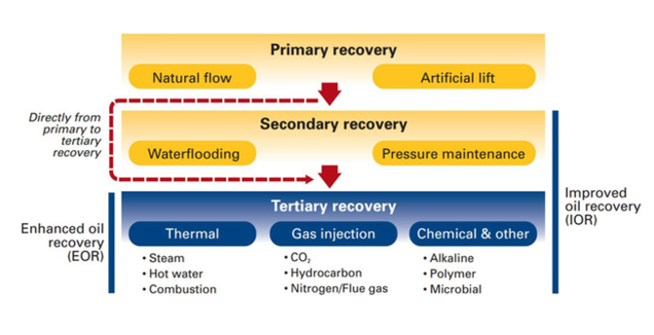
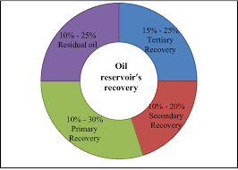
Introduction
Hydrocarbon continue to play a decisive role as an energy source
Enhanced oil recovery techniques
  Chemical EOR
  Polymer flooding
Oil reservoir’s recovery phases (Vesna et al., 2014)
Reservoir’s recovery factor (Vesna et al., 2014)

Slide 4
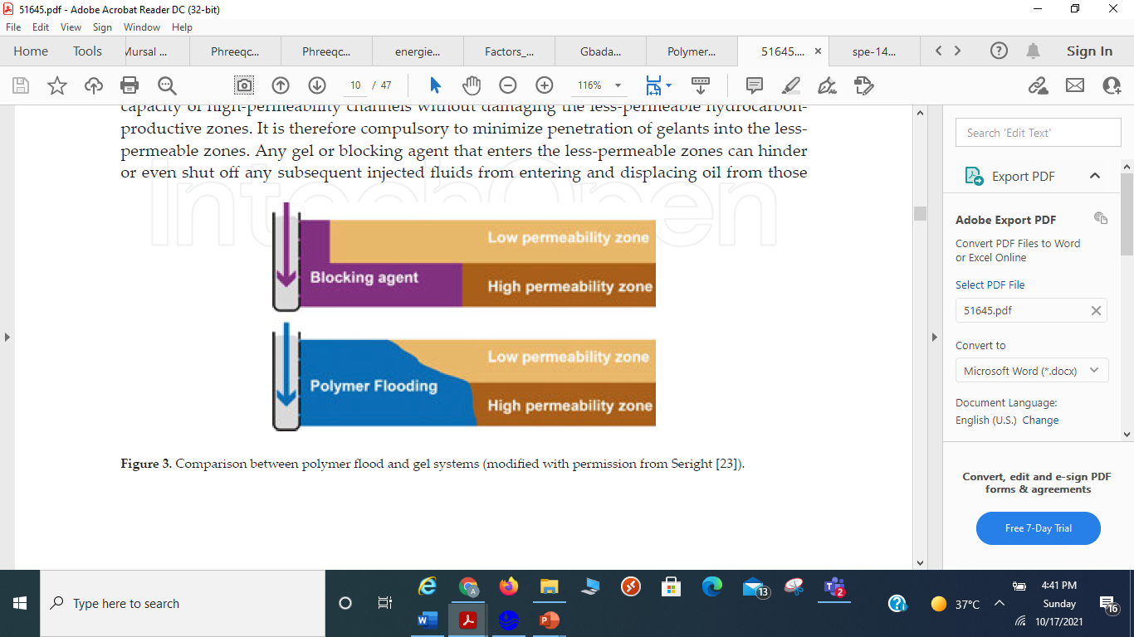
Introduction…
Mobility ratio
  M = λ_{w}/ λ_{o}; λ_{w} and λ_{o} are mobility of water and oil
Polymer flooding
  Mobility ratio less than 1
  Improve volumetric sweep efficiency
  Act as a conformance agent
Polymer flooding has shown limited applicability in carbonate reservoirs
Typical mobility ratio of (a) waterflooding process (M > 1.0),
(b) polymer flooding process (M ≤ 1.0) (Gbadamosi et al., 2019)
Polymer flooding to tackle reservoir heterogeneity (Seright et al., 2011)

Slide 5
Polymer Retention
Interactions between the transported polymer molecules and the porous medium
Delayed polymer propagation resulting delay in the oil displacement
Increased consumption of chemicals and increased injection period
Mechanisms
  Adsorption
  Mechanical entrapment
  Hydrodynamic retention
Polymer retention in porous media (Gbadamosi et al., 2019)

Slide 6
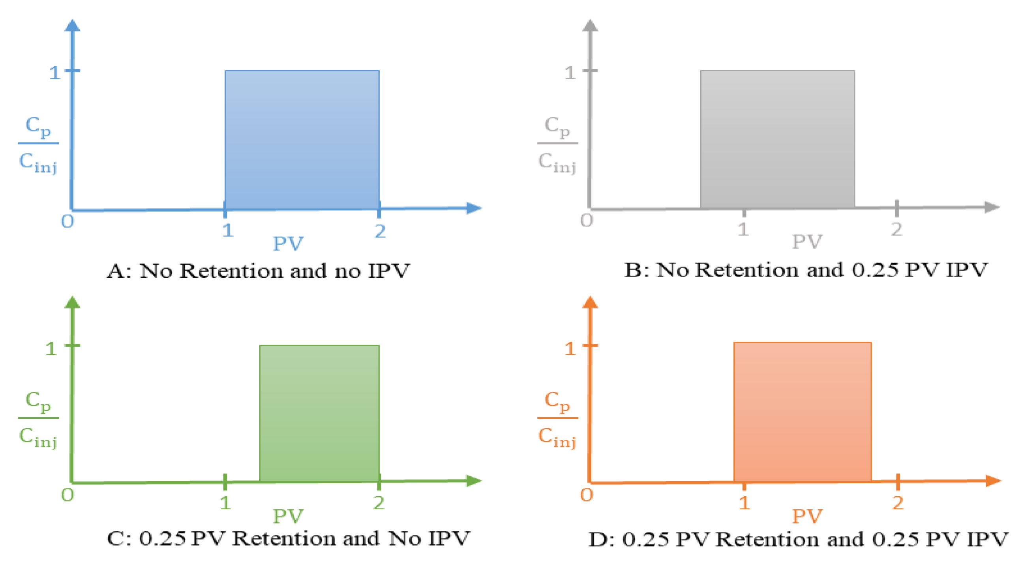
Inaccessible Pore Volume
Inaccessible pore volume
  Small pores which restricts the entry of large size polymer molecules
  It accelerates the polymer propagation through the porous medium
  Reduces the amount of polymer being contacted with the oil
Excluded pore volume
  Polymer molecules near the pore wall in the pore volume tend to move towards the central region
IPV (Ferreira et al., 2019)
Polymer breakout curves (Dawson and Lantz, 1972)

Slide 7
Factors Affecting Polymer Retention
Polymer Type
Polymer Concentration
Temperature
Presence of Oil
Water Salinity and Composition
Rock Surface

Slide 8
Factors Affecting Polymer Retention
Polymer Type
Biopolymers
  Xanthan Gum
  Scleroglucan
  Schizophyllan
Synthetic polymers
  HPAM (anionic)
  Sulfonated Polyacrylamide (AMPS and ATBS)
        AM/AMPS copolymer
        AM/ATBS/NVP terpolymer
HPAM: Partially Hydrolyzed Polyacrylamide; AM: Acrylamide; AMPS: 2-Acrylamido-2-MethylPropane-Sulfonate; ATBS: Acrylamide-Tertio-Butyl-Sulfonate; NVP: N-Vinyl-Pyrrolidone
Physical structure of HPAM polymer (Shakeel et al., 2020)

Slide 9
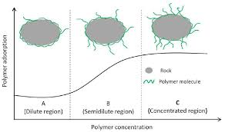
Factors Affecting Polymer Retention (Contd..)
Polymer Concentration Effect
  Adsorption increases with the increase in polymer concentration
  Polymer adsorption has a small dependency on polymer concentration in the dilute and concentrated regions, whereas a high dependency in semi dilute region
  In semi dilute region adsorption increases with increase in polymer concentration
Polymer adsorption in various concentration regimes (Guoyin Z. R., 2013)

Slide 10
Factors Affecting Polymer Retention (Contd..)
Temperature Effect
  Polymer adsorption decreases
  Weaker electrostatic interactions, Vander Waals forces
Presence of Oil
  Reduction in the total surface area (Wever et al., 2018; Wang et al., 2020)
  Oil desorption and polymer adsorption onto the oil layer (Broseta et al., 1995; Elmkies et al., 2001)
Water Salinity and Composition
  Higher adsorption at high salinity
Polymer adsorption in high-salinity water (Shakeel et al., 2020)

Slide 11
Polymer Retention Measurements
Static Adsorption Measurement
  A crushed Core is prepared, and a known concentration of polymer is added to the crushed core, then the polymer concentration is measured after separation of the polymer solution from the crushed core
Limitations:
  This method relies on two polymer concentration measurements, errors in these measurements have an essential impact on the adsorption value
  Crushed core used to have more surface area and minerals that might not be available in the main rock
  Mechanical entrapment cannot be measured

Slide 12
Polymer Retention Measurements (Contd..)
Dynamic Adsorption Measurement
  Injection of a slug of polymer solution into the core sample, followed by brine and performing a mass balance on the polymer. (retention = Polymer injected minus polymer produced)
Limitations
  Recovery of the polymer may require an extended period of brine injection
  Cumulative errors associated with measurements of low polymer concentrations in the produced fluid can introduce considerable uncertainty to the mass balance

Slide 13
Conclusion
The polymer retention is a critical parameter in the success of polymer flooding projects. Hence, the success of a polymer flood depends on determining the exact retention levels and designing the polymer flood accordingly.

Slide 14
References
Dawson, R., and Lantz, R. B., 1972. Inaccessible Pore Volume In Polymer Flooding. Journal of Society of Petroleum Engineers, 12: 448–452.
Ferreira, V. H. S., and Moreno, R. B. Z. L., 2019. Rheology-based method for calculating polymer inaccessible pore volume in coreflooding experiments. E3S Web of Conferences 89, 04001.
Gbadamosi, A. O., Junin, R., Manan, M. A., Agi, A., and Yusuff, A. S., 2019. An overview of chemical enhanced oil recovery: recent advances and prospects. International Nano Letters.
Guoyin, Z. R., 2013. Effect of Concentration on HPAM Retention in Porous Media. Paper SPE 166265, SPE Annual Technical Conference and Exhibition. New Orleans, Louisiana, USA.
Seright, R.S., Zhang, G., Akanni, O.O., and Wang, D., 2011. A Comparison of Polymer Flooding with In‐Depth Profile Modification. Paper SPE 146087, Canadian Unconventional Resources Conference, Calgary, Alberta, Canada,
Shakeel, M., Pourafshary, P., and Hashmet, M. R., 2020. Hybrid Engineered Water–Polymer Flooding in Carbonates: A Review of Mechanisms and Case Studies. Applied Sciences, 10, 6087.
Vesna, K. M., Branko, L., and Dusan, D., 2014. Factors Influencing Successful Implementation of Enhanced Oil Recovery Projects. Underground Mining Engineering, 025 41-50.

