Slide 1
Reduced order modeling with Barlow Twins self-supervised learning: Navigating the space between linear and nonlinear solution manifolds
T. Kadeethum and H. Yoon
Geomechanics Department, Sandia National Laboratories
Albuquerque, NM, USA
Collaborators: F Ballarin (CUSH), D. O'Malley (LANL),
Y. Choi (LLNL), N. Bouklas (Cornell)
Interpore 2022
This work was supported by the Laboratory Directed Research and Development program at Sandia National Laboratories and also DOE Office of Fossil Energy project -Science-informed Machine Learning to Accelerate Real Time (SMART) Decisions in Subsurface Applications.
SAND2022-6837 C

Slide 2
Why reduced order model?
Full order model (FOM) is computationally demanding
FOM is computationally very expensive for large-scale uncertainty quantification, optimization, or inverse modeling
This would take 1-2 hours^{1,2}
Imagine if you do 100,000 times of this
¹Kadeethum et al. (2022, Advances in Water Resources)
²Kadeethum et al. (2021, Computers & Geosciences)

Slide 3
Why non-intrusive approach?
FOMs
Flexibility
Or both
Schlumberger Eclipse Suite
Sierra Mechanics
non-intrusive ROM
proxy
measurement
experiments
onsite measurement

Slide 4
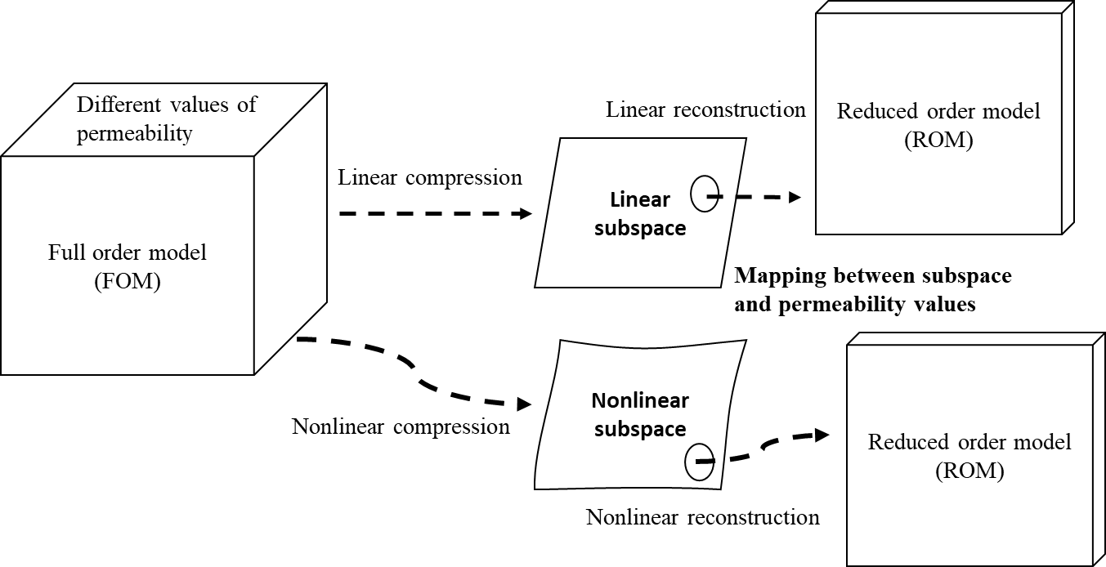
Motivation
ROM typically works on ‘parameterized PDEs’ and ‘reduced subspace’

Slide 5
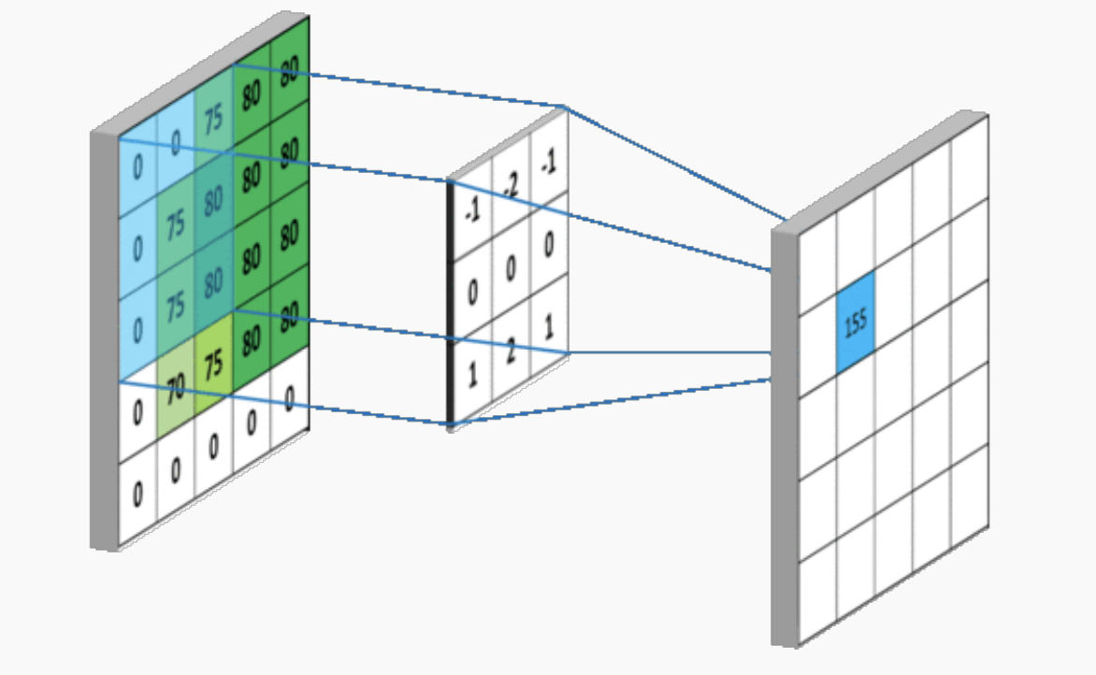
Motivation - continue
1. Unified framework that works well for both problems that lie within linear and nonlinear manifolds
(proper orthogonal decomposition (pod) yields optimal data compression for linear manifolds) [1]
2. Framework that does not rely on ‘convolutional layers,’ which makes our framework applicable to both structured and unstructured meshes [1, 2]
[3]
¹Kadeethum et al. (2022, Advances in Water Resources)
²Kadeethum et al. (2021, Nature Computational Science)
³https://towardsdatascience.com/simple-introduction-to-convolutional-neural-networks-cdf8d3077bac

Slide 6
Motivation - continue
1. We believe the key to develop a good ROM is to produce better reduced manifolds.
2. We extend Barlow Twins (BT) self-supervised learning [1], where BT maximizes the information content of the embedding with the latent space through a joint embedding architecture
The nonlinear manifolds are well structure
The nonlinear manifolds are not really well structure
¹Zbontar et al. (2021, arXiv:2103.03230)

Slide 7
Methodology
We first initialize training, validation, and testing sets.
These parameters could be material properties, boundary conditions, or parameterized geometry representation.

Slide 8
Methodology
We then build the training set through by querying full order model for each parameter.
*This is the major cost of building data-driven model.

Slide 9
Methodology
Data compression: training BT-AE model
The machine learning model has one encoder, decoder, and projector.
The main goal is to maximizes the information content of the embedding with the latent space through a joint embedding architecture.
Resulting in a better reduced manifolds

Slide 10
Methodology
We then map our parameters to reduced manifolds using ANN.
*We note that we could use other regressors such as GP or RBF.

Slide 11
Methodology
During the online or prediction phase, we approximate our quantities of interest through the trained ANN and trained decoder.

Slide 12
Physical problems that we test
Fluid density is a function of its concentration and temperature, impacting fluid flow behavior
Examples: geothermal energy recovery, seawater intrusion, storage of nuclear and radioactive waste, contaminant transport among others.
Depending on system Rayleigh number and the formation heterogeneity, convective mixing can greatly accelerate CO2 dissolution during geologic carbon storage.

Slide 13
Physical problems that we test - continue
velocity (1st Brezzi-Douglas-Marini element)
locally mass conservative
pressure (piecewise constant)
$$\begin{aligned}&∇⋅u=0 \\ &u+∇p=zTRa \\ &\frac{∂T}{∂t}+u⋅∇T=∇^{2}T,\end{aligned}$$
$$Ra=\frac{gαkΔT^{∗}H}{μκ}$$
temperature (1st enriched Galerkin)
time (4th backward differentiation formula)
Kadeethum et al. (2021, Computers & Geosciences)

Slide 14
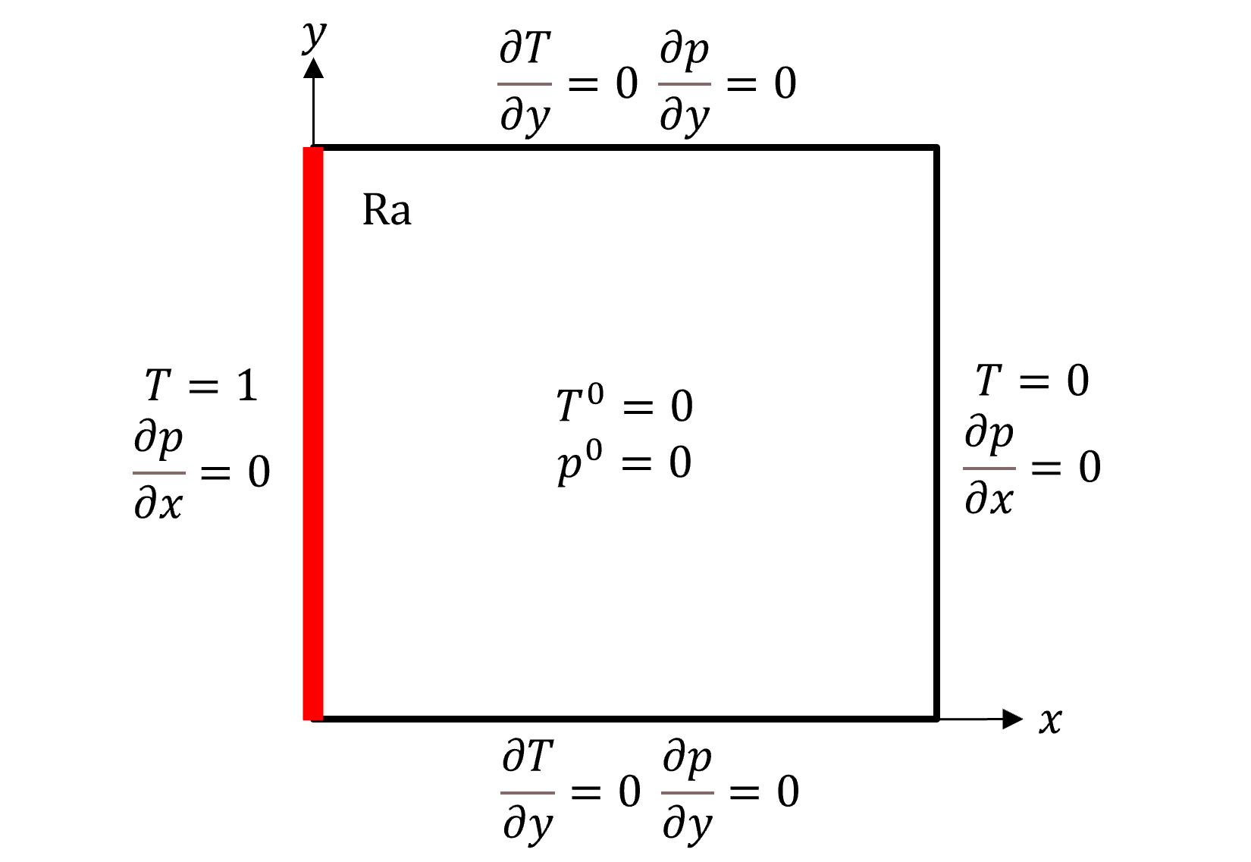
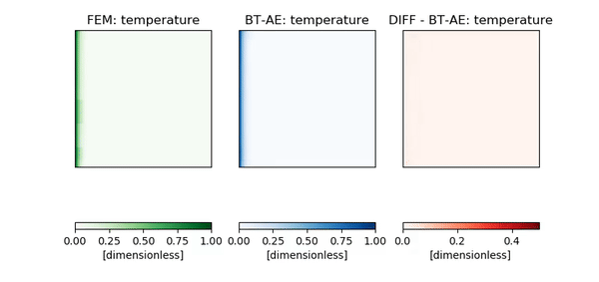
Results – Heated from side (HFS)
We test our model using heated from side problem [Zhang et al. (2016, Comput. & Geosci)]
The flow is driven by the change of temperature on the left side
Parameters
$$Ra_{1}=[40, 80]$$
Training: 40
Testing: 10

Slide 15
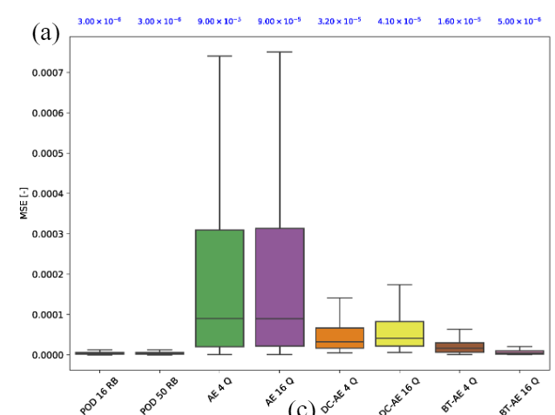
Results – HFS - continue
We can see that BT model provide almost similar performance as POD model, but much better than AE and deep convolutional AE (i.e., problem lies within linear manifolds)
AE
DC-AE
POD
Proposed model

Slide 16
Results – HFS - continue
We can see that the BT model (dashed) has a lower data compression loss (step 3), and it has a much lower mapping loss (step 4)
The nonlinear manifolds are not really well structure
The nonlinear manifolds are well structure

Slide 17
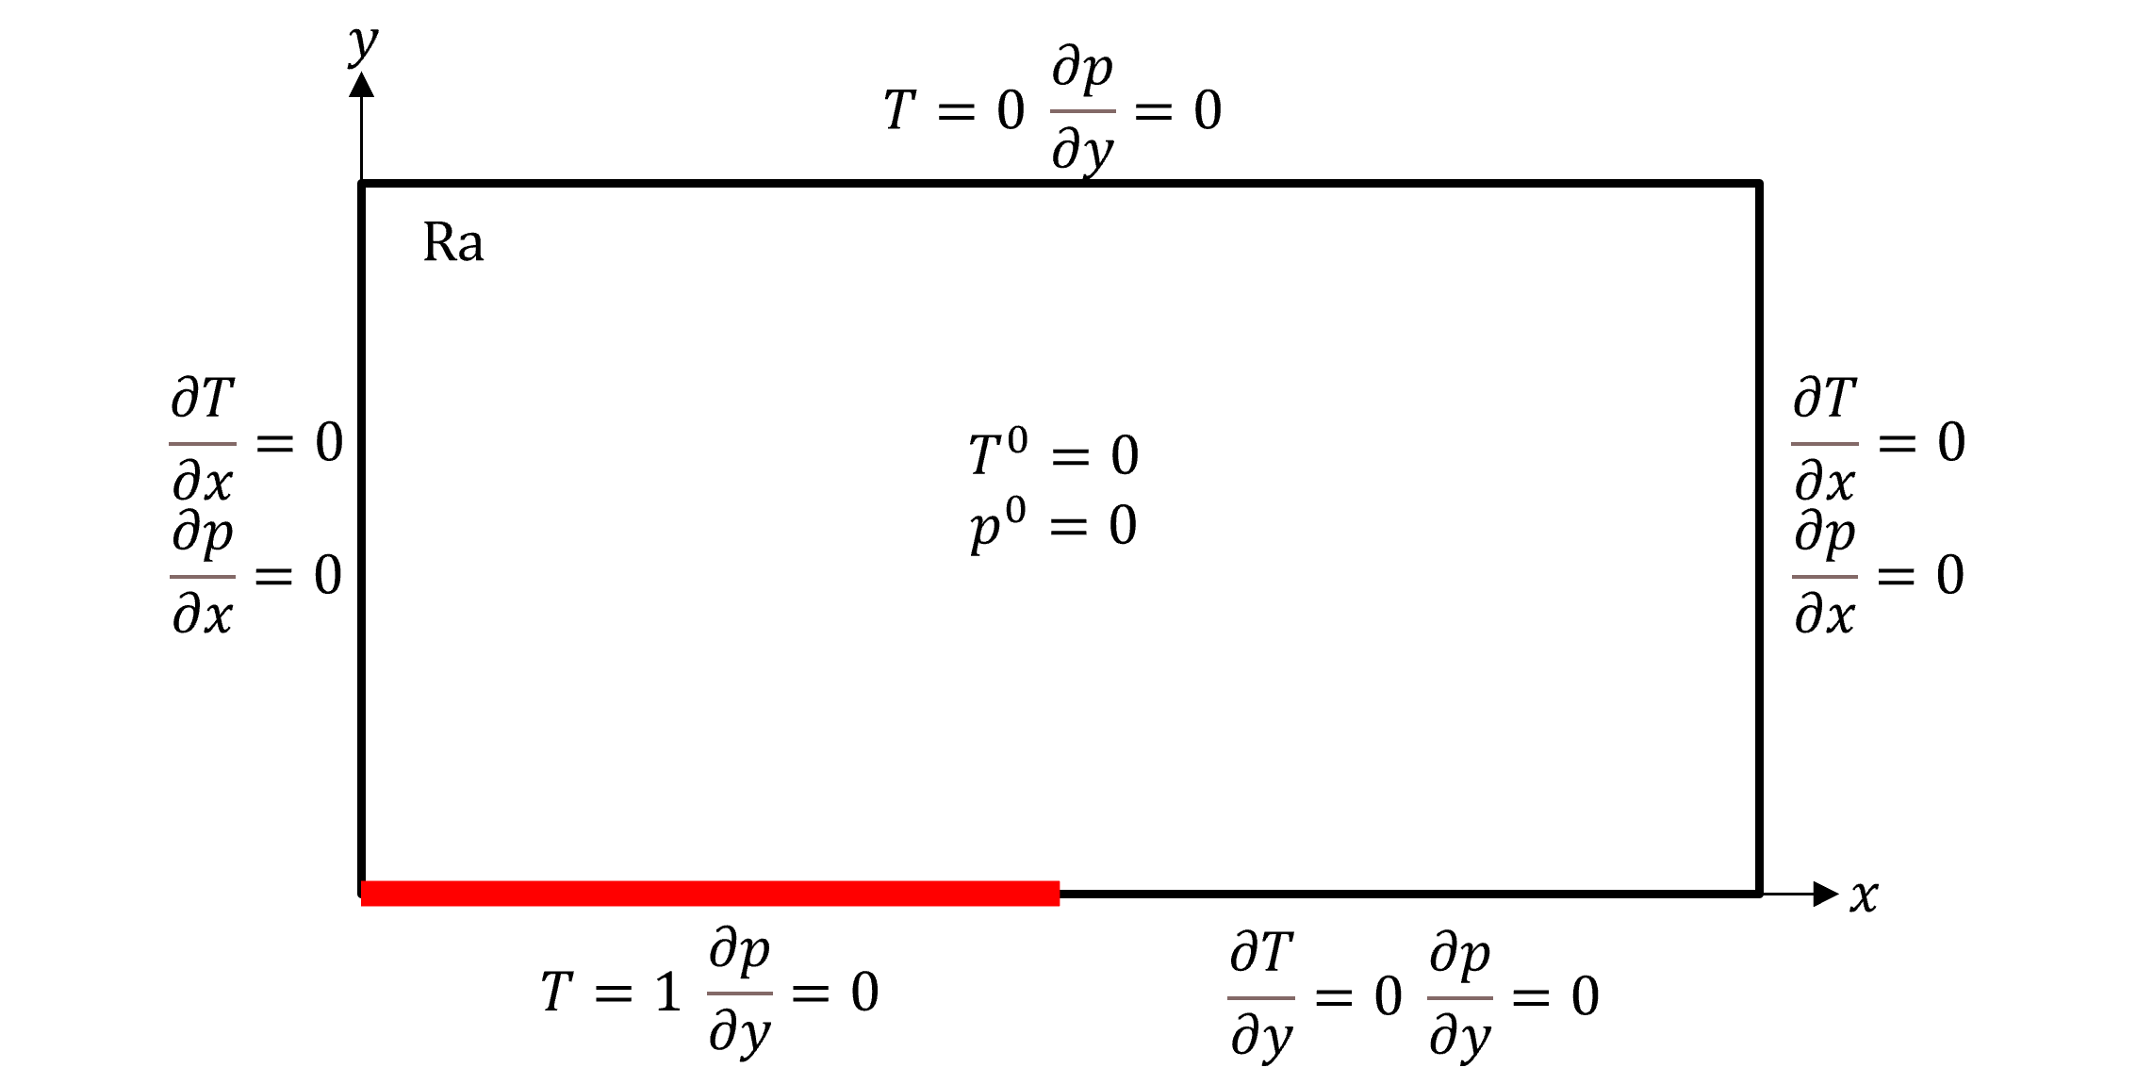
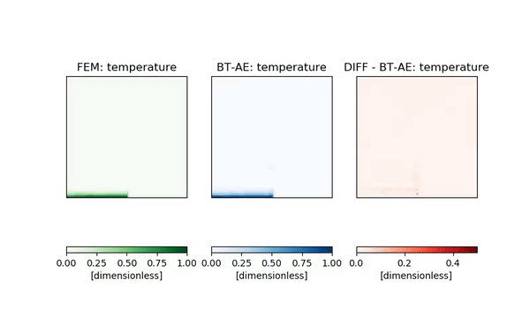
Results - Elder
We test our model using Elder problem
[Elder et al. (2017, Fluids)
The flow is driven by the change of temperature at the bottom
Parameters
$$Ra_{1}=[350, 450]$$
Training: 40
Testing: 10

Slide 18
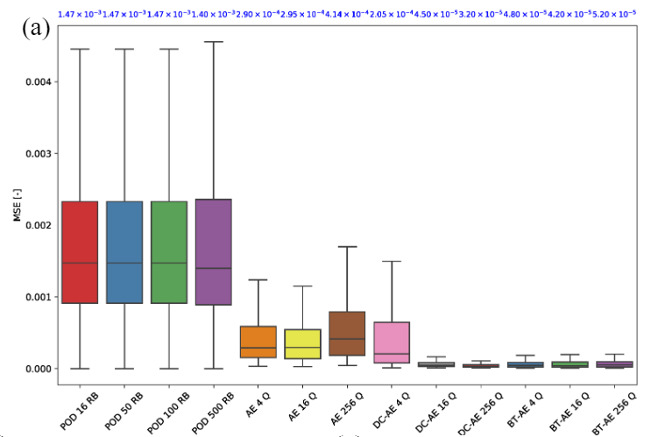
Results – Elder - continue
We can see that BT model provide almost similar performance as deep convolutional AE (as well as be able to achieve a very good accuracy with only 4 nonlinear manifolds)
POD
AE
DC-AE
Proposed model

Slide 19
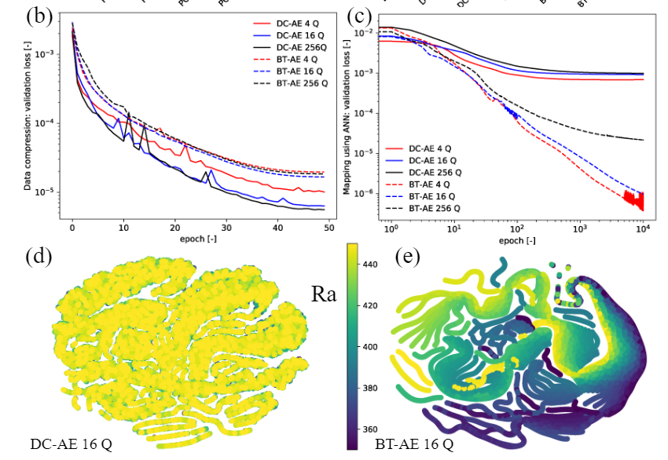
Results – Elder - continue
We can see that the BT model (dashed) has a higher data compression loss (step 3), but it has a much lower mapping loss (step 4)
The nonlinear manifolds are not really well structure
The nonlinear manifolds are well structure

Slide 20
Conclusions
1. A ROM framework that works in an optimal way for both linear and nonlinear manifolds
2. A ROM framework that can be applied to both structured and unstructured meshes
3. Uncertainty-aware BT-ROM is in progress to achieve uncertainty quantification.

