Slide 1
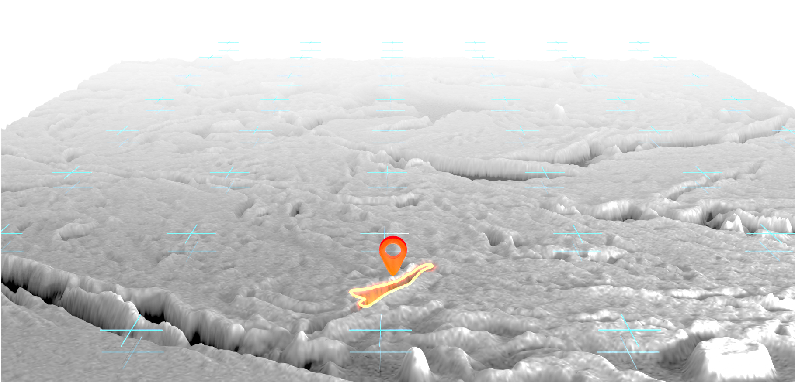
Towards Pore Super Segmentation on Artificially Enhanced SEM Images of Opalinus Clay by Voting Classification
2022
​M.Brysch¹, B.Laurich¹, C.Schettler¹, M.Sester²
¹ Federal Institute for Geosciences and Natural Resources, Hannover ² Gottfried Wilhelm Leibniz University, Hannover

Slide 2
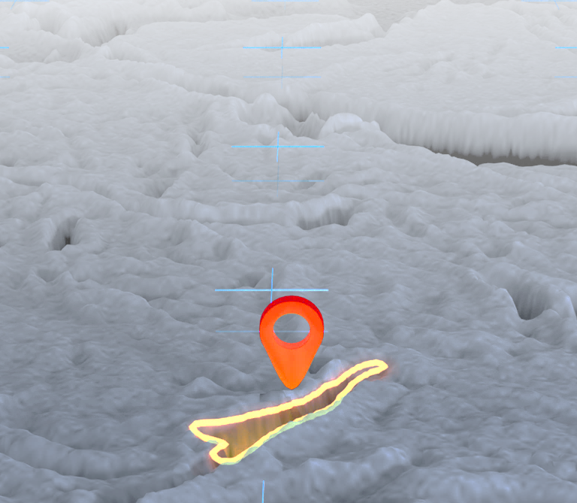
Overview
1.
Machine learning
on pore segmentation
pore
segmentation
3. Super
segmentation
2.
Super resolution
on BIB-SEM images

Slide 3
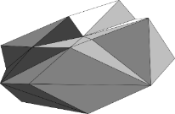
Motivation
Host rock
Requirements:
Large numerical models
Need accurate material parameter
Methodology for automatic pore segmentation
Processing of large amounts of data
Ability to detect smaller pores
Reduction of the truncation limit
Rock samples
Scanning electron microscopy (SEM)

Slide 4
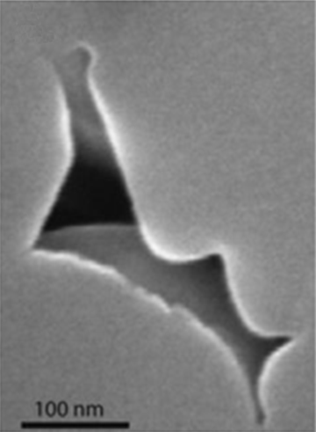
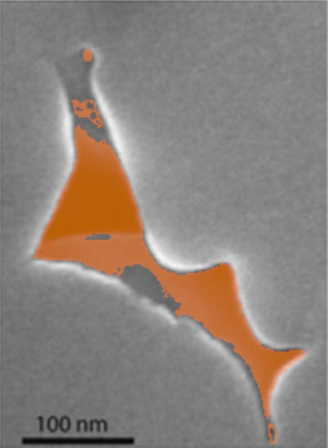
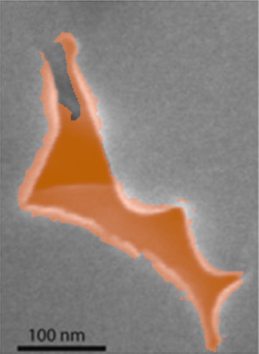
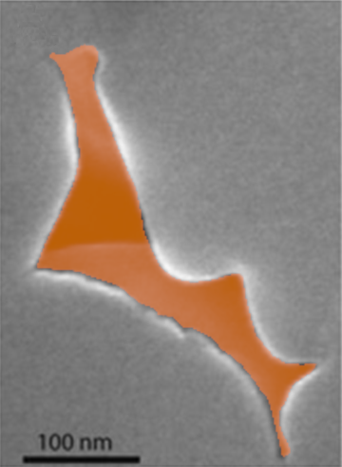
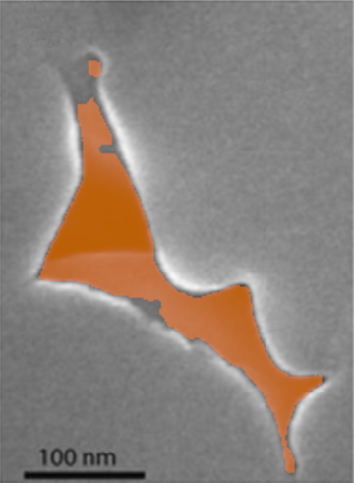
Task: Segmentation of Broad Ion Beam (BIB)-SEM images [1]
Houben, 2013 [2]
Pixel threshold
Watershed
[1] Klaver, J., et al. "BIB-SEM study of the pore space morphology in early mature Posidonia Shale from the Hils area, Germany." International Journal of Coal Geology 103 (2012): 12-25.
[2] Houben, M. E., and János U. In situ characterization of the microstructure and porosity of Opalinus Clay (Mont Terri Rock Laboratory, Switzerland). Diss. Hochschulbibliothek der Rheinisch-Westfälischen Technischen Hochschule Aachen, 2013.
manual segmentation
Pixel threshold + edge detection

Slide 5
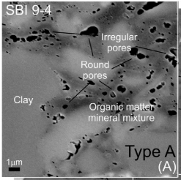
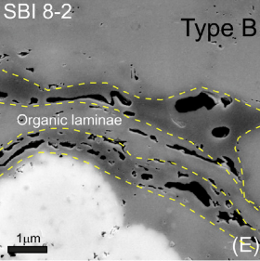
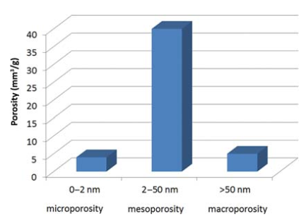
Goals
Automated analysis of rock samples
Pore segmentation
Material classification
Statistical evaluation (material parameters)
Holistic processing/viewing of data
DataMining + Machine Learning + Expert Knowledge
Understanding multi-causal relationships
Finished:
Prototype statistical analysis
9-ML classifier (MLC)
Super-resolution ESRGAN (Wang, 2018 [5]).
(Klaver 2015 [3])
[3] Klaver, Jop, et al. "BIB-SEM characterization of pore space morphology and distribution in postmature to overmature samples from the Haynesville and Bossier Shales." Marine and petroleum Geology 59 (2015): 451-466.
[4] Kaufhold, Stephan, et al. "Comparison of methods for the determination of the pore system of a potential German gas shale." Filling the Gaps: from Microscopic Pore Structures to Transport Properties in Shales. Vol. 21. The Clay Minerals Society, 2016. 163-190.
[5] Wang, X., et al. "Esrgan: Enhanced super-resolution generative adversarial networks." Proceedings of the European conference on computer vision (ECCV) workshops. 2018.
(Kaufhold 2016 [4])
Notes:
Materialeigenschaften

Slide 6
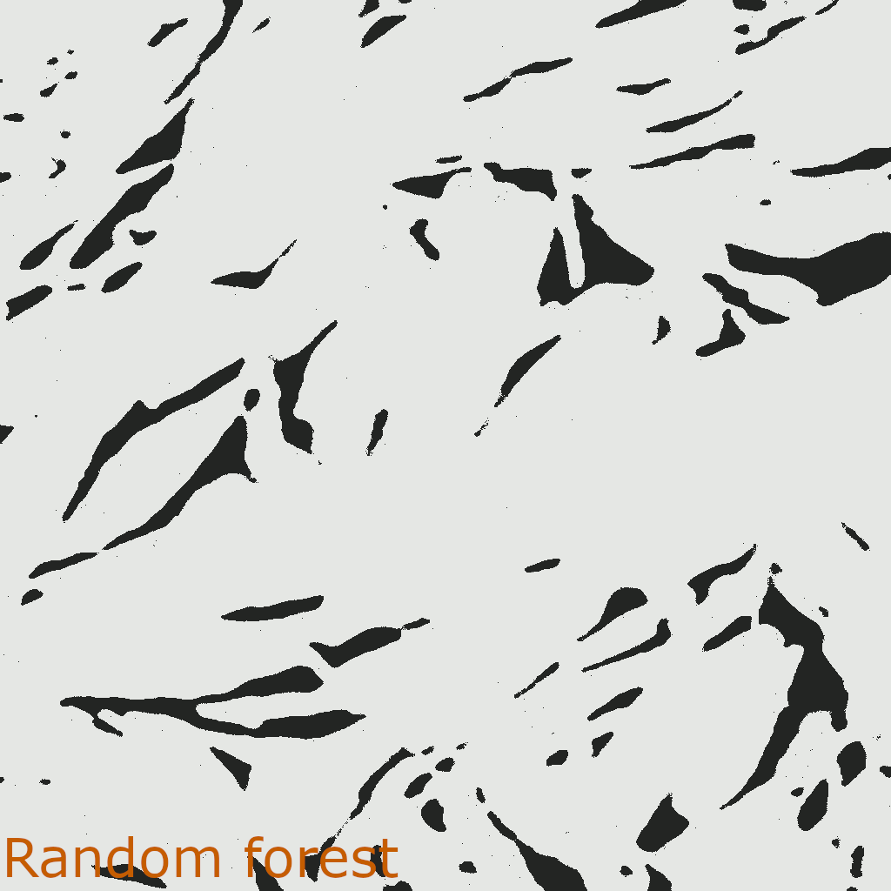
Machine learning results
$$500 nm$$

Slide 7
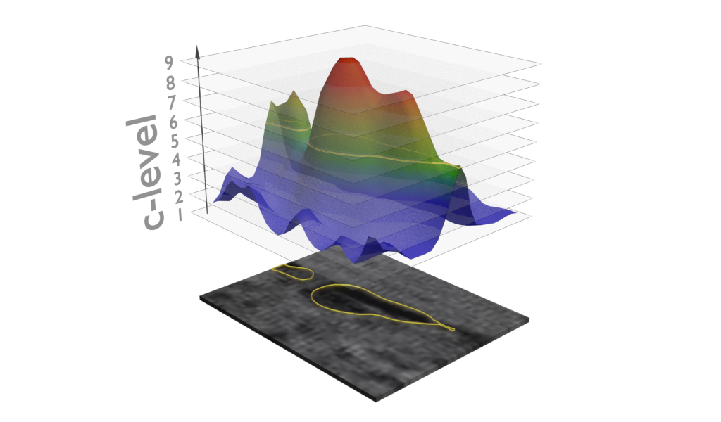
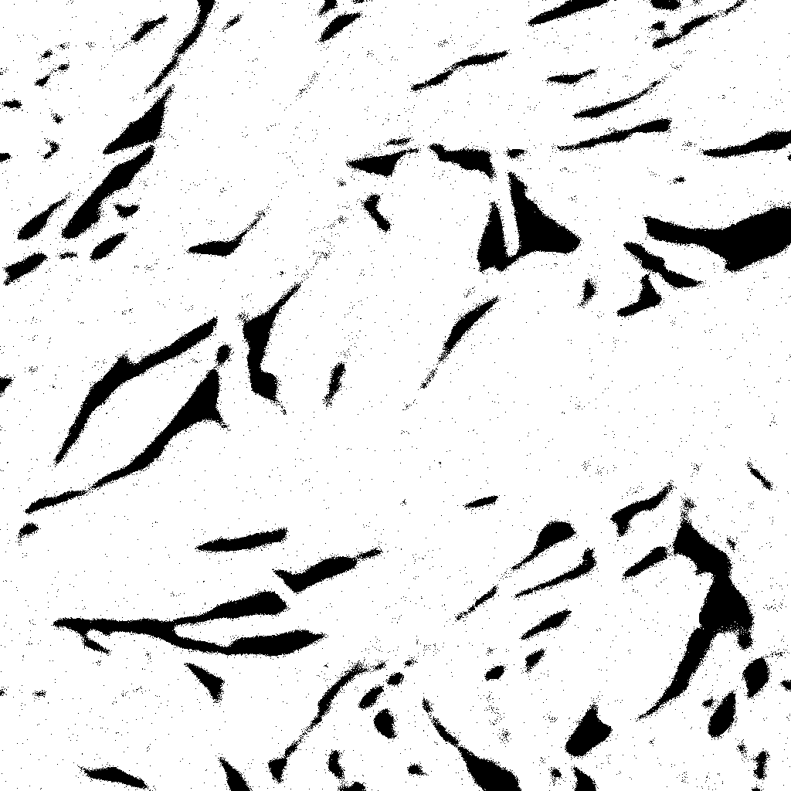
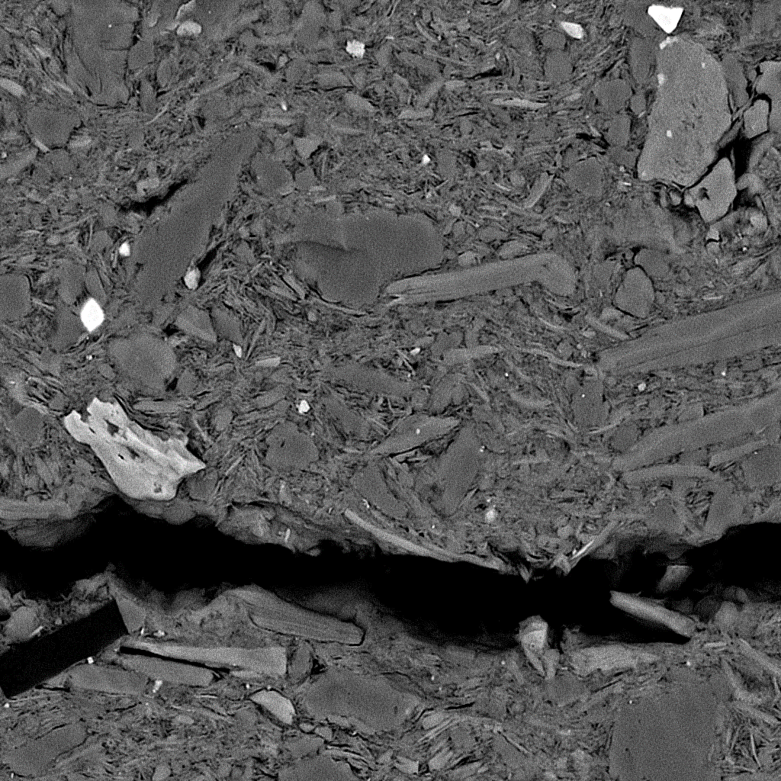
Ensemble/Voting classifier
9 machine learning classifiers have been implemented and trained
No ML classifier alone provides satisfactory results at the current state of research
Decision Tree Classifier
Extra Tree Classifier
Linear Support Vector Machine
Logistic Regression
Multilayer Perceptron
Passive Agressive Classifier
Quadratic Discriminant Analysis
Stochastic Gradient Descent Classifier
Random Forest Classifier
Probability Field & Voting Classifier
Machine Learning Classifier

Slide 8
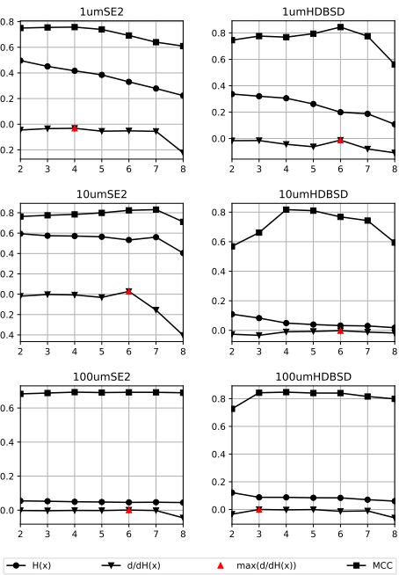
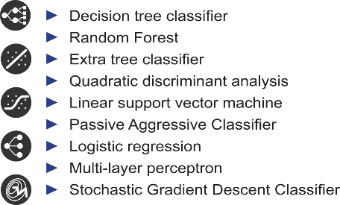
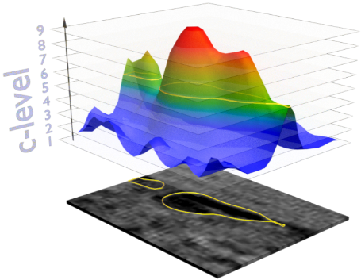
C-level Estimation
Ensemble method & voting classification
$$f(c)=\frac{1}{|M|}\sum_{m∈M}{f_{m}(y|x)}$$
Shannon entropy:
$$H\left(f\left(c\right)\right)=−\sum_{i=1}^{N}{f_{i}\left(c\right)\log\left(f_{i}\left(c\right)\right)}$$
$$\{c|c∈ℕ, c<10\}$$
$$\frac{dH(f(c))}{dc}=−\sum_{i=1}^{N}{\log\left(f_{i}\left(c\right)+1\right) }$$

Slide 9
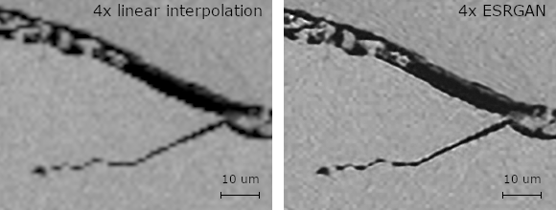
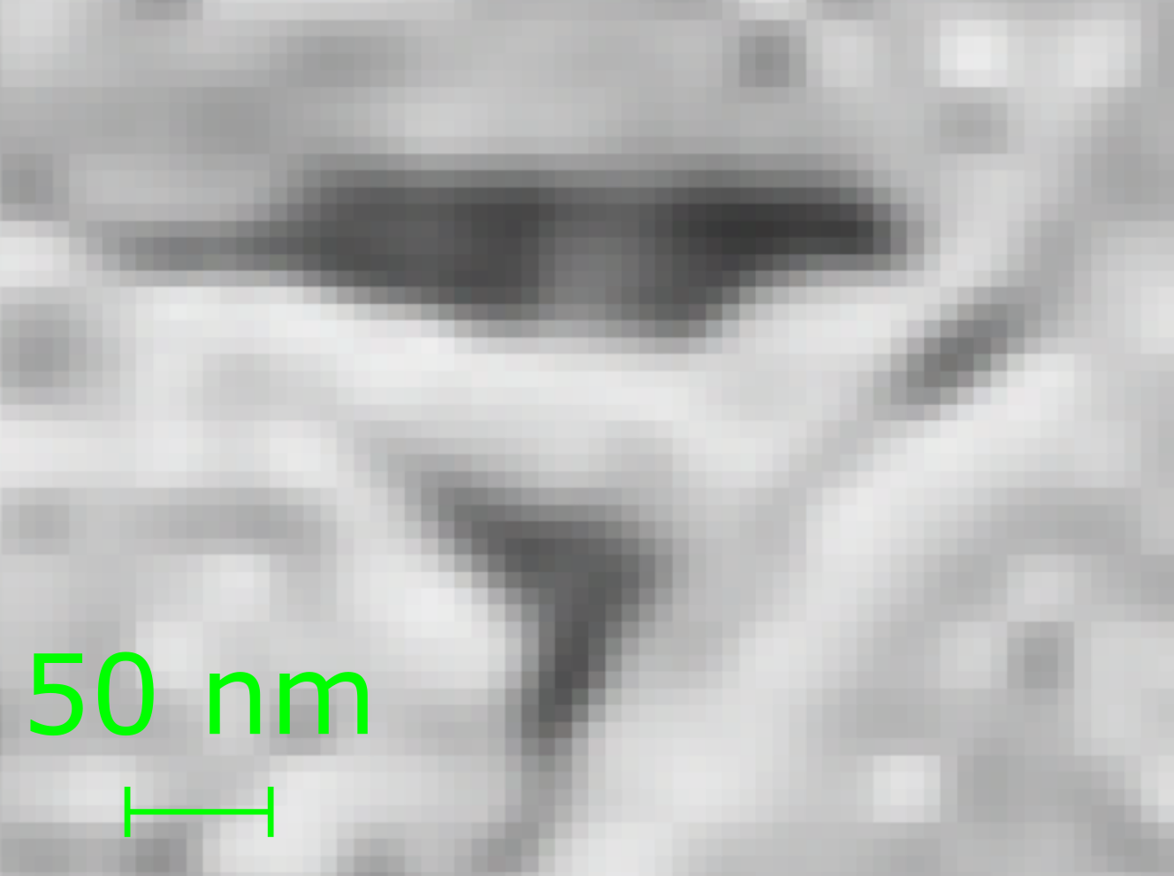
Super Resolution of BIB-SEM images
Resolution upsampling with Enhanced Super-Resolution Generative Adversarial Networks (ESRGAN)
32 Residual in Residual Dense Blocks (RRDB)
ResNet50 discriminator
4x linear extrapolation
Initial image
Linear extrapolation (4x)
ESRGAN (4x)

Slide 10
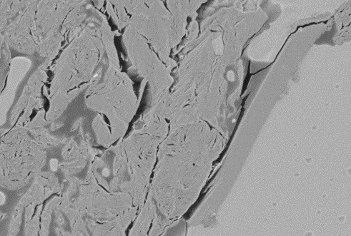
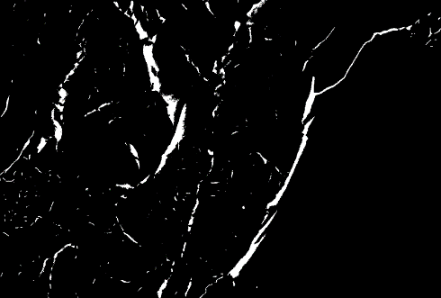
Summary
ESRGA Network
$$1μm$$
$$1μm$$
BIB-SEM imaging
Artificial enhancement of SEM images
Ensemble learning and calculation of the probability field
Final pore segmentation mask
Notes:
entwicklung eines kI gestüTzten vErfahrens zuR Automatisierten deTektion vOn poRen in gesteinen

Slide 11
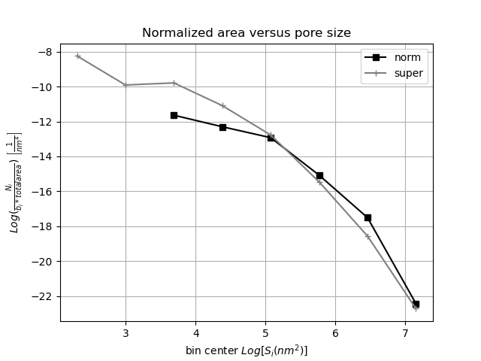
Conclusion
Smaller pores are better detected
Reduction of the truncation limit
The ESRGAN seems to create reasonable information's in SEM-images
smaller pores
larger pores

