Slide 1



Molecular Transport in Nanoporous Gold Thin Films for Drug Delivery Applications
Erkin Şeker
Associate Professor, Electrical & Computer Engineering
Co-Director, Center for Neuroengineering & Medicine
Graduate Groups: ECEGP, CHMS, BME, MAE, Biophysics
Designated Emphasis: Biotechnology, BioPhotonics

Slide 2
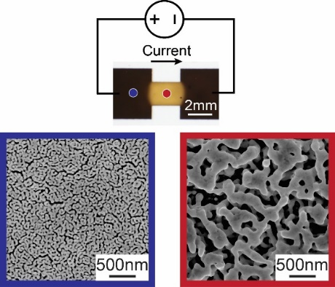
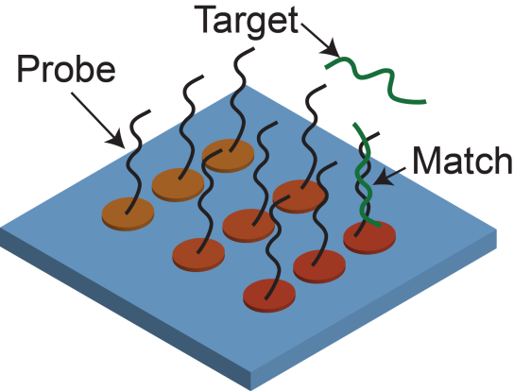
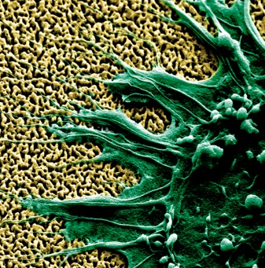
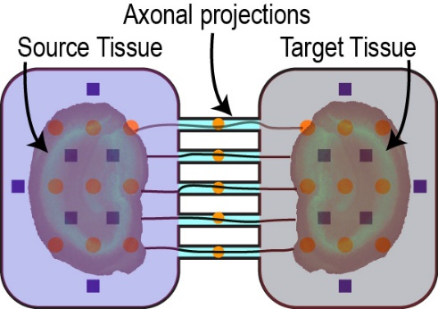
Şeker Lab – Multifunctional Nanoporous Metals
Morphology Modification
Nucleic Acid Sensors
Neural Interfaces
Tissue Chips
Notes:
2

Slide 3
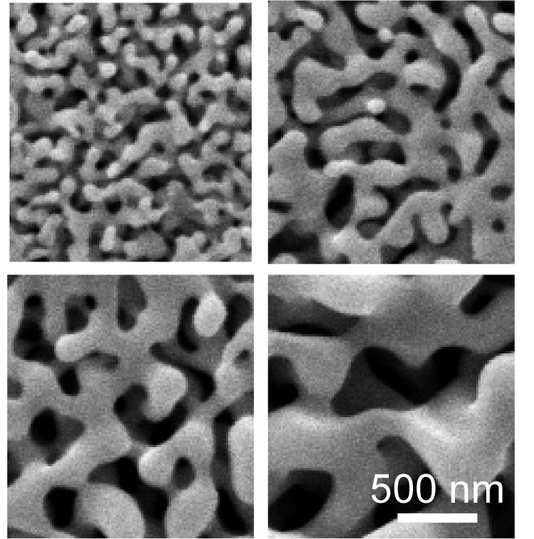
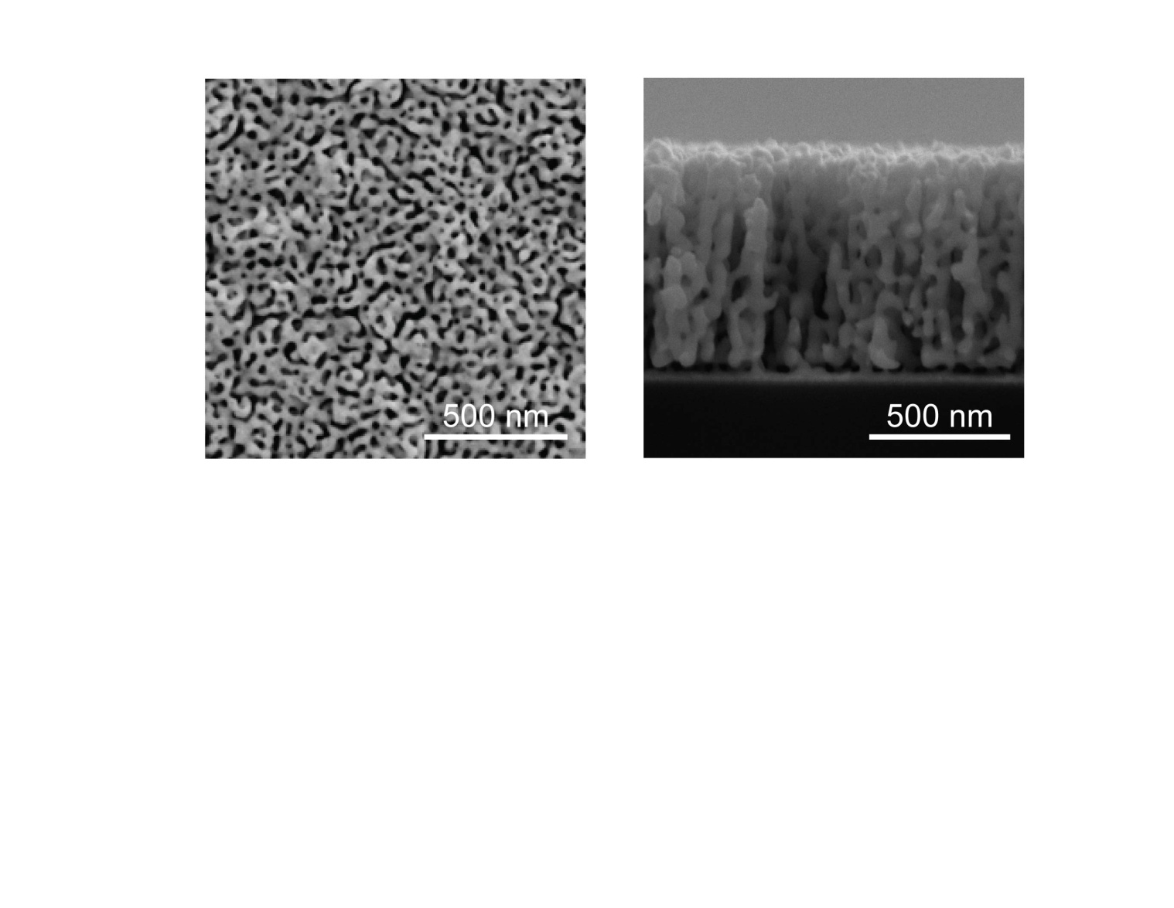
Nanoporous Gold
Nanoporous Gold Features
Self-assembly process
Microfabrication compatibility
Controllable morphology
Surface functionalization
Electrical conductivity
Main interest in np-Au’s catalytic properties and fundamental studies
Potential as a multifunctional biointerface material is underexplored
Notes:
3
Nanoporous gold is one such material that possesses numerous properties to address the requirements of multi-functional devices. These include a large array of medical devices, but also high-capacity capacitors, fuel cells, etc..
Self assembly: When a gold-silver alloy is placed in a strong acid solution, silver dissolves while gold atoms rearrange into an open-pore sponge structure. Dealloying is the selective removal of a less noble element from an alloy. Dealloyed metals have an enormous surface area, as much as 8 m2/g – this delloying method can be applied to other materials…
Drug release: high porosity – increased molecular storage can be used for drug release
Controllable morphology: morphology can be easily changed to make it suitable for different applications, control drug release and mechanical properties
Surface functionalization: the ability to functionalize the surface with well-established gold-surface chemistry enables its use for a variety of sensors and more biomimetic surfaces
Mechanical properties: morphological changes and elemental composition have a direct effect on mechanical properties, which can be precisely tuned
electrical properties: gold is a good electrical conductor, which makes it highly useful for electrodes.
optical properties: finally, it exhibits enhanced raman-effects due to the nano-structure, creating another dimension for sensors
Microfab integration: An important aspect is that the material can be deposited with various methods: sputtering, evaporation, electroplating… these make it amenable to integration with microtechnology..
The resulting material has reduced elastic modulus, increased surface area, corrosion resistance, and electrical conductivity, which are important features for sensors. Unique optical properties.. Industrial interest in using it for biomedical applications due to its desirable attributes.
DISCUSS: how this is transferrable to different metal systems, give examples, what are the design considerations for an alloy to be turned into a porous metal.

Slide 4
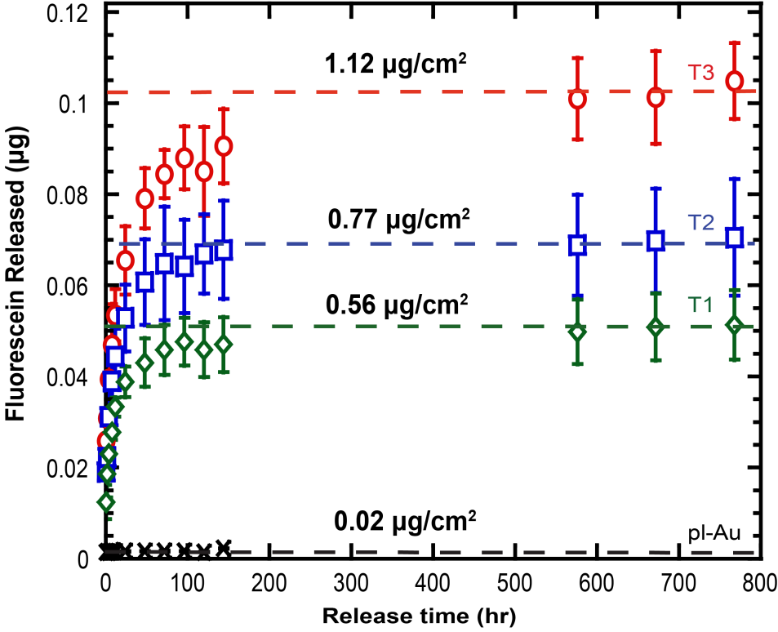
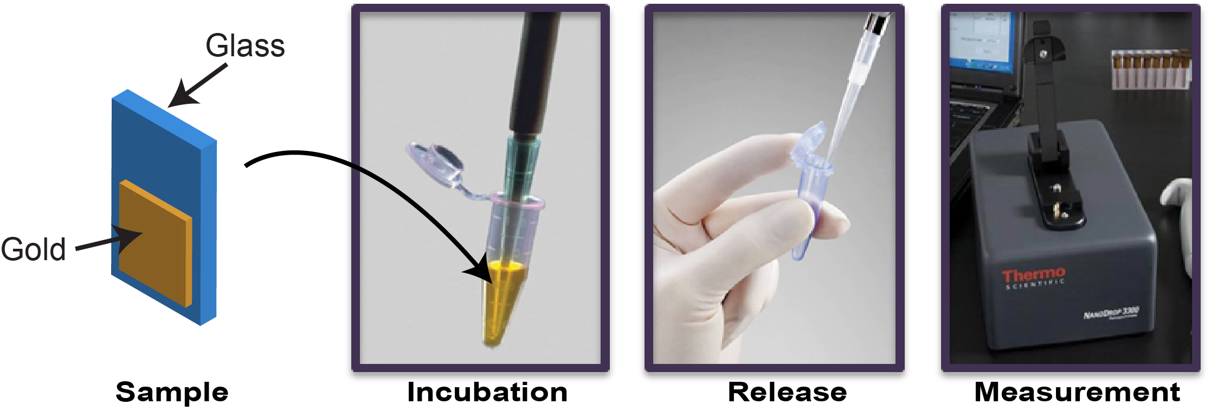
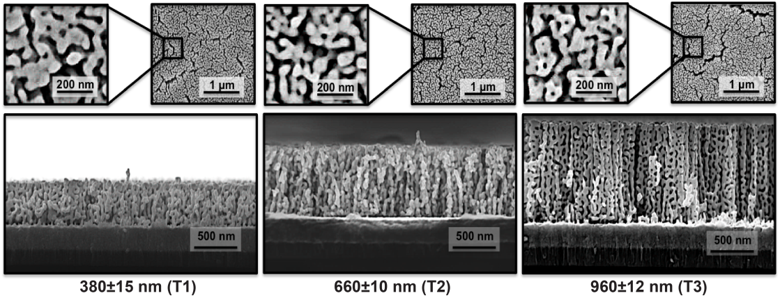
Loading Capacity of np-Au Thin Films
Experimental Procedure
Sample SEM Images
Nanoporous gold thin films can retain and release small molecules
Kurtulus, O. Daggumati, P., Seker, E. Nanoscale 6:7062, 2014
Notes:
4
In order to demonstrate the potential of np-Au films for delivery of pharmaceuticals, we infused 3 x 4 mm np-Au films patterned on silicon chips with 10 mM fluorescein in deionized water overnight
Then, the chips were rinsed in deionized water and placed in microcentrifuge tubes with 250 uL DI water, 5 uL samples were taken from tubes at specific time points, and the fluorescence was determined by fluorospectrometer
With increasing film thickness, the amount of fluorescein eluted increases.
Not shown here, control samples with planar gold patterns or no gold patterns stopped exhibiting fluorescein elution within the first few hours after starting the elution, suggesting that the np-Au films indeed can retain small molecules.
Also, not shown here, we have preliminary studies demonstrating continuous fluorescein elution over a period of 2 weeks.

Slide 5
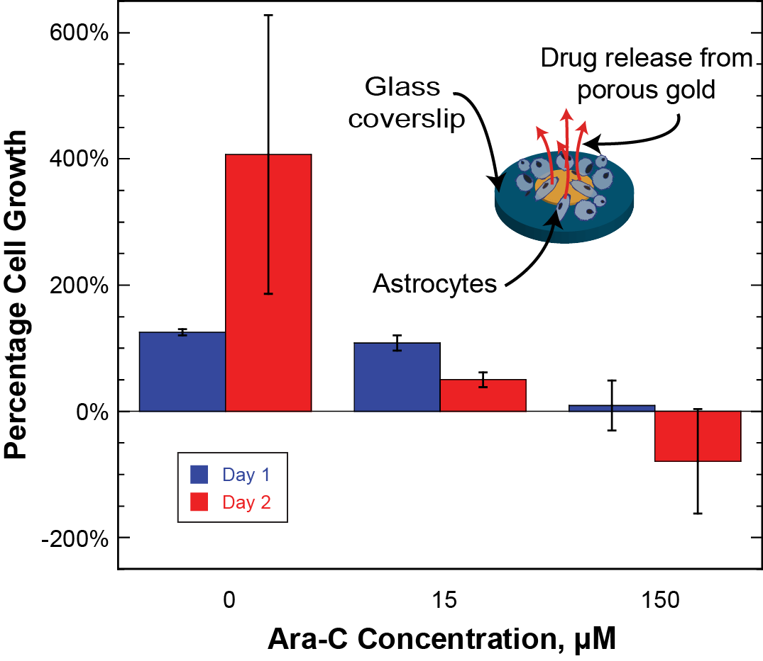
Drug Release & Cell Proliferation
Seker, E. et al. Advanced Healthcare Materials 1:133, 2012
Notes:
5
In order to test whether biologically-relevant amounts of drug molecules can be loaded into the nanoporous thin films, we used a small-molecule drug, arabino furinoside that suppresses cell division. …

Slide 6
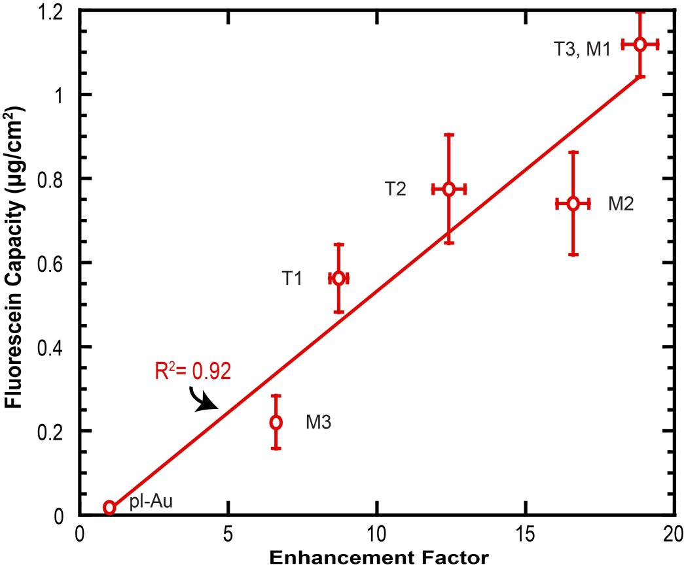
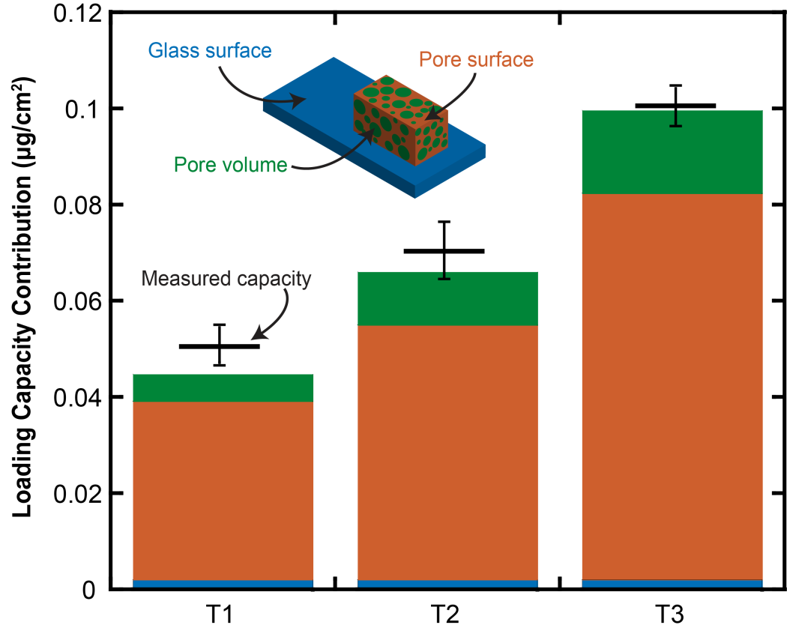
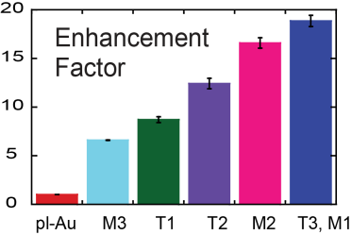
Deconstructing Loading Capacity
Electrochemical Quantification of Surface Area
Contributions to Total Loading Capacity
Surface area of np-Au thin films largely dictates the loading capacity and provides paths to control molecular release via surface modification
Notes:
6
The effective surface areas of different samples were electrochemically determined, using a potentiostat (Gamry Reference 600) with a homemade Teflon electrochemical cell, platinum counter electrode, and Ag/AgCl reference electrode. Cyclic voltammograms (CV) in 0.05 M sulfuric acid with a scan rate of 50 mV/s were obtained and the electrical charge under the gold oxide reduction peak between potentials of 720 mV and 970 mV was calculated. All calculated charge values were converted to the effective surface area by using 450 μC/cm² as specific charge of a gold surface^{29, 30}. The ratio of the effective surface areas of different np-Au samples to the effective surface area of control planar-Au sample was defined as “enhancement factor”.
Surface area (calculated via gold atomic weight, porosity, etc - converting the cyclic voltammetry-based effective surface enhancement to surface area per mass of np-Au) = 2.4m^{^2}/g.
Hydrodynamic radius of fluorescein molecules was calculated as 0.58 nm by Stokes-Einstein equation by taking diffusion coefficient of sodium fluorescein as 4.2 x10⁻⁶ cm²/s in water at room temperature

Slide 7
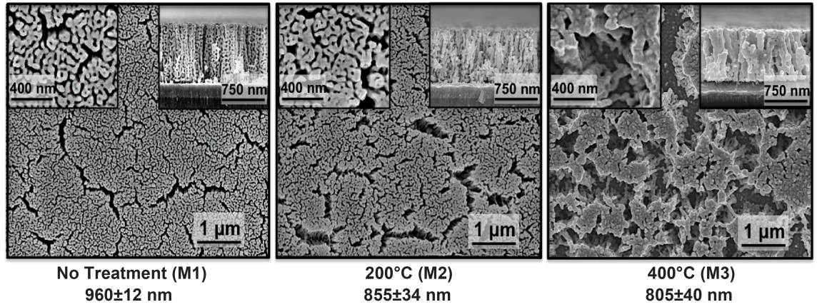
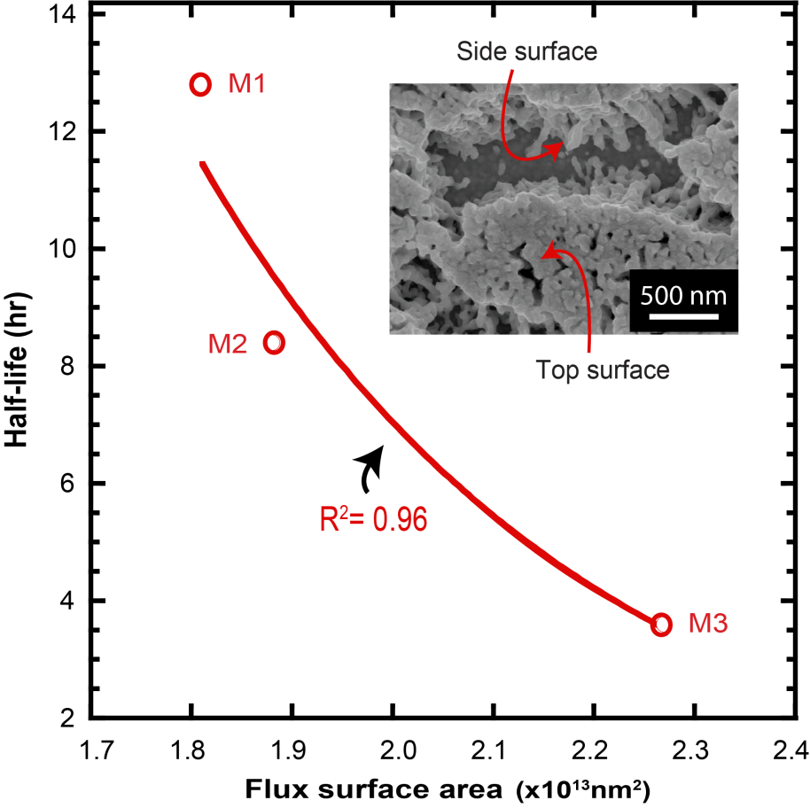
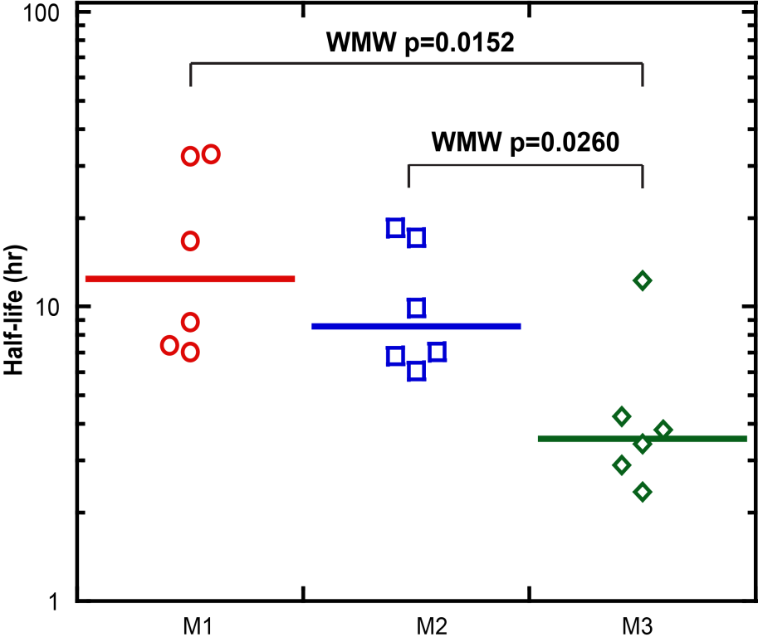
Tuning Molecular Release Rate
Micro- and nano-scale morphological features can be used for tuning molecular release rate
Notes:
7
Next, we investigated whether it is possible to control molecular release rate by modifying the morphological features. We use thermal annealing to modify the morphology where initial cracks in the thin film lead to generation of large voids, which create additional surfaces (aside from just the top surface) to release small molecules. As an indicator of release rate, we used half-life calculations, which is the amount of time it takes for half of the loaded molecules to be released. As seen in the figure, introducing cracks and resulted in monotonously decreasing half-lives.
We attribute this to the increased flux surface area, which inversely affects the half life, that is more flux surfaces results in higher release rates hence reduced half lives.

Slide 8
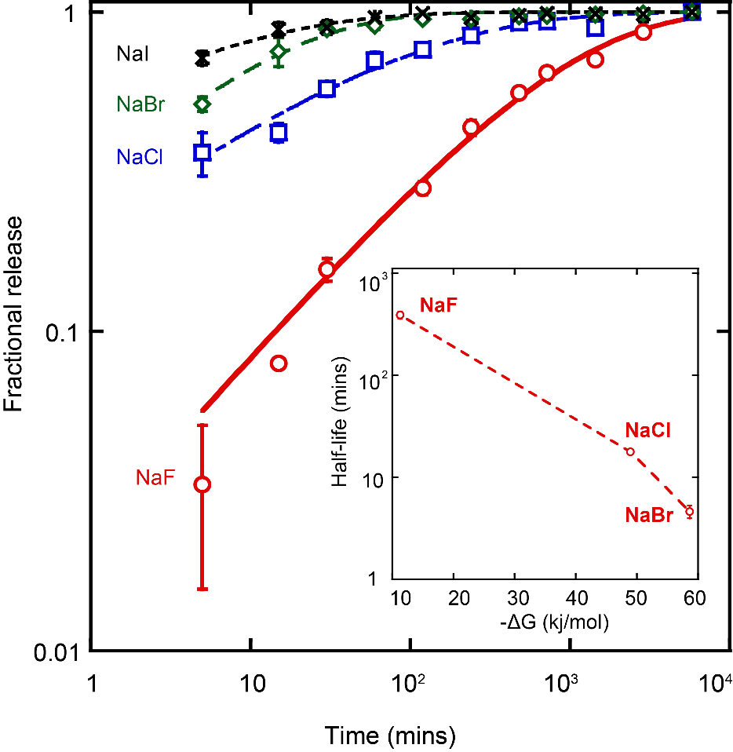
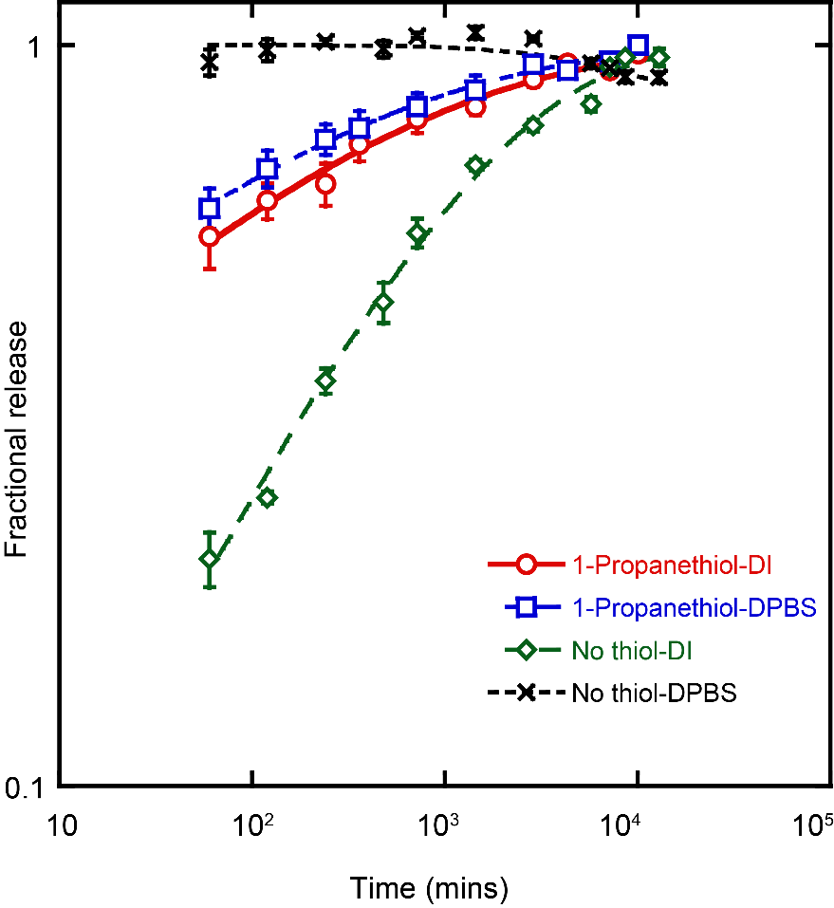
Halide-Gated Release
Effect of Halide Type on Release Profile
Thiol Modification for Reducing Halide Sensitivity
Surface-molecule interactions dictate molecular release and this can be tuned by functionalizing surfaces via thiol-chemistry
Polat, O. & Seker, E. Journal of Physical Chemistry C 119:24812 , 2015
Polat, O. & Seker, E. Journal of Physical Chemistry C 120:19189 , 2016
Notes:
8
While testing molecular release in biologically-relevant liquids, such phosphate buffered saline, we noticed a burst release of molecules reducing the release half-lives to order of minutes. We attributed this to competitive displacement of loosely-adsorbed fluorescein molecules by chloride molecules that have higher affinity to gold surface. We studies the release rate in the presence of different halides. As seen on the left figure, the release rate increased from fluoride-containing solutions to iodide-containing solutions.
For providing further insight into the relationship between the spontaneity of halide adsorption onto gold surface and the resultant release rate, we used free energy (ΔG) of adsorption of halides onto gold electrode obtained by theoretical calculations by Bodé et al. ⁵⁰ (Figure 4 inset). The monotonic trend shows that halide adsorption becomes more favorable in the order of F⁻<Cl⁻<Br^{-50, 51} with a corresponding decrease in the half-life of the release.
While this is an interesting way to immediately release the drug cargo, it is not desirable in a biological application. Since the release rate

Slide 9
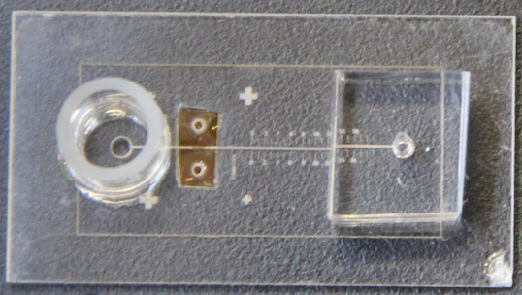
Voltage-Gated Molecular Release
reservoir
np-Au
glass
PDMS
Li, Z. & Seker, E. Advanced Functional Materials 28:1801292 (2018)
Np-Au electrode allows for electrically controlling the delivery of small-molecules at arbitrary time-varying doses
PDMS
reservoir
flow
glass
np-Au
Li, Z. & Seker, E. Lab on a Chip 17:3331 (2017)
Notes:
ELECTROPHORETIC RELEASE
I mentioned the need to modulate tissue response on demand. One way of doing this is by electrical stimulation. However, electrical stimulation is not as specific and is excitory. It is desirable to release neuromodulators that can modulate tissue response. For example, in the case of epilepsy, we can release anti-epileptic drugs before a seizure occurs. I demonstrated this with a proof-of-concept experiment. I made a 0.6% agarose gel, which mimics the diffusive and mechanical properties of brain tissue. I patterned gold and np-au strips over a glass cover slip, loaded np-Au with fluorescein. Placed the gel over the np-au and au interface. The control fluorescence release from a planar electrode is shown as well. both electrodes were immersed in fluorescein solution, np-au did not retain any fluorescence.
Can we modify pores in such a way that the molecules are favorably kept inside unless triggered to be released?
There is also need to prolong the drug release.. It can be done by increasing the thickness… can there be other methods?

Slide 10
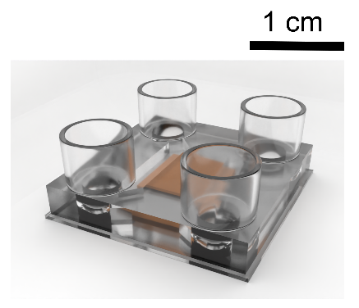

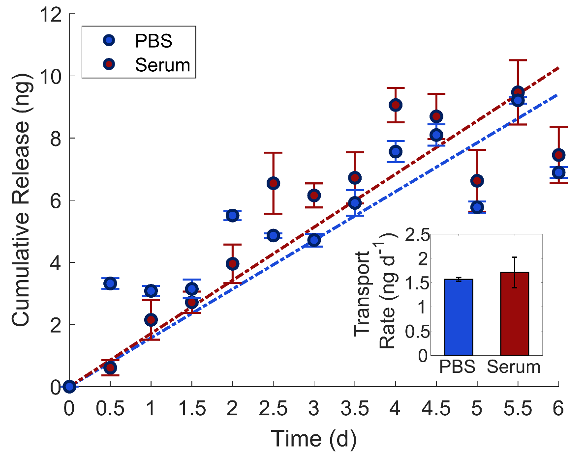
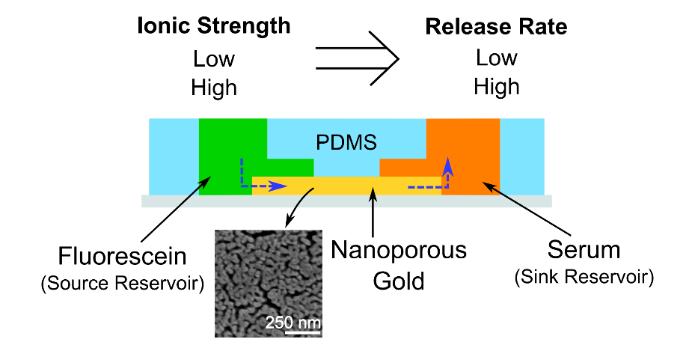
Sustained Molecular Transport
Nanoporous gold thin films allow for in-plane transport to sustain molecular release in biofouling conditions
Palanisamy, B., Goshi, N., Seker, E. Nanomaterials 11:498 (2021)
Notes:
10% fetal bovine serum

Slide 11
Summary
Molecular release from nanoporous gold thin films is largely dictated by surface-molecule interactions
Modulating surface-molecule interactions via chemical and electrical gating allows for controlling molecular release rate
Nanoporous films act as intrinsic sieves against large biomolecules and sustain molecular release in biofouling conditions
Nanoporous gold thin films can be readily integrated into devices using conventional microfabrication techniques

Slide 12
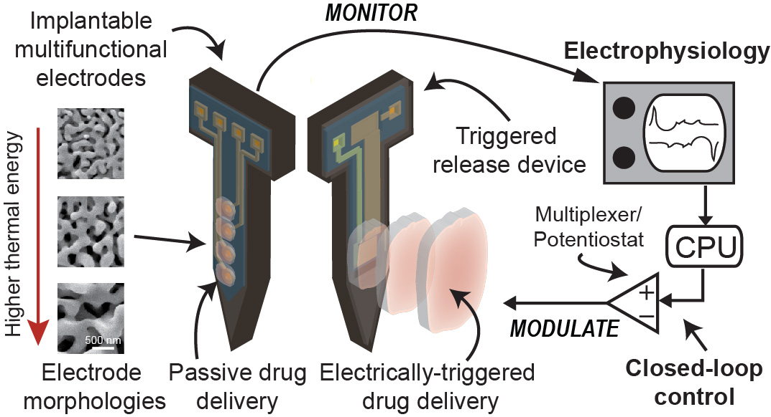
Future Directions

Slide 13












Şeker Lab – Multifunctional Nanoporous Metals
Doctoral Students
Masters Students
Alumni
Dr. Jovana Veselinovic (PhD ChemE, 2020, Becton Dickinson)
Dr. Zidong Li (PhD BME, 2018, Google Verily Life Sciences)
Dr. Chris Chapman (PhD BME, 2017, Imperial College London)
Dr. Tatiana Dorofeeva (PhD ECE, 2016, Cisco)
Dr. Özge Polat (PhD ChemE, 2016, Intel)
Dr. Pallavi Daggumati (PhD ECE, 2016, Genentech)
Barath Palanisamy (BS BME, 2021, UCLA)
Sachit Nagella (BS ChemE, 2021, UCSB)
Swathi Sundar (MS ECE, 2020, Nokia)
Madison Crain (BS+MS ECE, 2019; Intel)
Alex Hampe (MS BME, 2018, PowerSchool LLC)
Josh Garrison (BS+MS ECE,2 016, Micron)
Dr. Zimple Matharu (Postdoc, 2017, Bristol-Myers Squibb)
Dr. Patricia Losada-Perez (Postdoc, 2016, University of Brussels)
Dr. Ling Wang (Postdoc, 2016)
Dr. Juan Manuel Artés Vivancos (Postdoc, 2015, UMass, Lowell)
Noah Goshi
(BME)
Greg Girardi
(BME)
Alex Gardner
(ECE)
Hyehyun Kim
(BME)
Sadi Md Shahriar
(MSE)
Darius Rudominer
(ECE)
Collaborators
Prof. Pamela Lein, UC Davis
Prof. Helen Raybould, UC Davis
Prof. Jeremy Mason, UC Davis
Prof. Maria Marco, UC Davis
Prof. Karen Moxon, UC Davis
Prof. Josh Hihath, UC Davis
Dr. Monika Biener, LLNL
Dr. Jürgen Biener, LLNL
Dr. Ibo Matthews, LLNL
Funding
NSF CAREER, Nano-Biosensing, MMN
NIH NIBIB Trailblazer Award
NIH R21 – Gut-Brain Axis
NIH R03 – Neuroinflammation & Alzheimer’s
UC Davis Comprehensive Cancer Center
UC Davis Microbiome Program
UC Lab Fees Research Program
UC Davis RISE Grant
MGH Fund for Medical Discovery Award

Slide 14
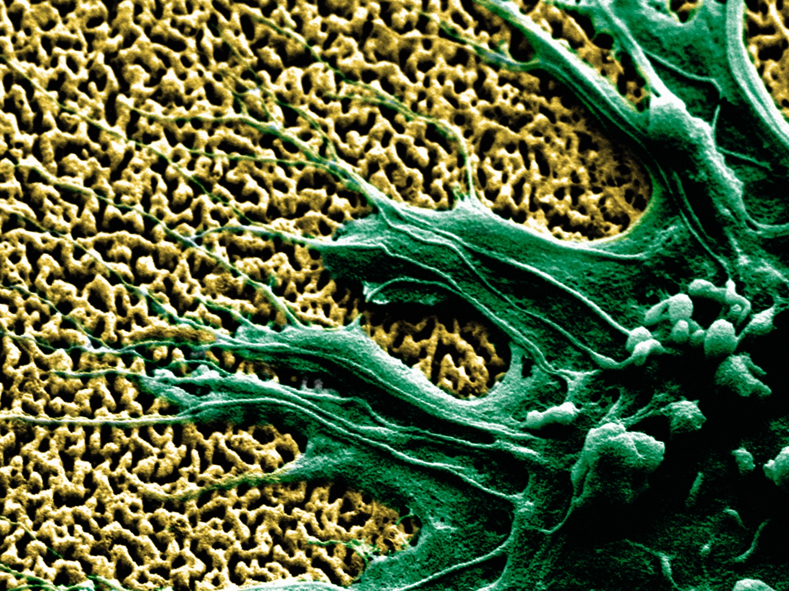
Thank You
Erkin Şeker
eseker@ucdavis.edu

