Slide 1
Nanoparticle-based suspensions and emulsions for enhanced oil recovery
A. Strekla ^{1,2}, Ch. Ntente ^{1,3}, M. Theodoropoulou ¹ and Ch. Tsakiroglou^{1,*}
¹ Foundation for Research and Technology Hellas, Institute of Chemical Engineering Sciences (FORTH/ICE-HT), 26504 Patras, Greece
² University of Patras, Department of Physics, 26504 Patras, Greece
³ University of Patras, Department of Chemistry, 26504 Patras, Greece
* ctsakir@iceht.forth.gr

Slide 2
Contents of presentation
Introduction
Overview
Synthesis of Fe NPs and characterization
Tests of enhanced oil recovery in porous media models
Conclusions

Slide 3
Introduction
Energy consumption worldwide is expected to increase by 50% relative to current levels by the end of 2030.
This growth is unlikely to be met by renewable resources, and thus there is a strong and growing demand for oil as a predominant energy resource.
Problem
Globally the overall oil recovery factors for primary and secondary recovery range from 35% to 45%.
A tertiary recovery method can enhance the recovery factor by 10-30%, which could contribute to energy supply
The use of nanoparticles in enhanced oil recovery (EOR) processes comprises an emerging and well-promising approach.
Objectives

Slide 4
Overview
polyphenols from parsley leaves
FeCl₃
Synthesis of Fe NPs
Density , Contact angle
Surface – Interfacial tension
Size , z-potential
Rheology of emulsion
Characterization of Fe NPs properties
Experiments into porous media
transparent glass-etched pore networks

Slide 5
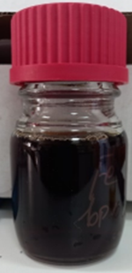
Synthesis of Fe NPs
Polyphenols
(parsley leaves)
FeCl₃ 0.1M
Measurements of Fe NPs suspension
pH | 6,02
Eh (mV) | 499,1
Surface Tension(mN/m) | Wilhelmy plate 53.84 | DuNouy Ring 55.12
Interfacial Tension (mN/m) | 19.41 (with n-C12)
Size (nm) | 132,43
Z-potential (mV) | -25,5
Image : Solution of FeNPs

Slide 6
Properties of FeNPs
fluids | Density d (g/mL)
Paraffin oil | 0.829
NaCl 0.25M | 1.002
Fe NPs 0.25(g/L) | 0.9931
Fe NPs 0.25 (g/L) – NaCl 0.25M | 0.9814
Fe NPs 0.25 (g/L) – NaCl 0.25M (Emulsion) | 0.833
Density:
Measurement ST and IT of suspensions:
suspension | Surface tension (mN/m) | Interfacial tension (mN/m)
NaCl 0.25M | 66.42 | 30.59
Fe NPs 0.25(g/L) | 52.87 | 27.93
Fe NPs 0.25 (g/L) – NaCl 0.25M | 50.03 | 20.72
The static surface/interfacial tension of aqueous phase/air and aqueous phase/oil was measured by using a tensiometer with DuNouy Ring.

Slide 7
Contact angles:
Solutions | CA (°)/air | image | CA (°) / paraffin | Image
NaCl 0.25M | 53.85 |  | 54.45
Fe NPs 0.25 g/L | 53.05 |  | 39.2
Fe NPs 0.25 g/L – NaCl 0.25M | 55.0 |  | 43.95

Slide 8
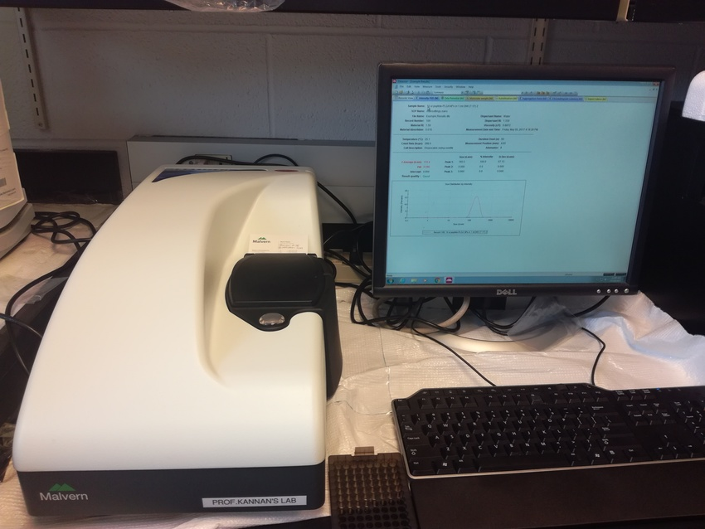
The suspended nanoparticle size distribution was determined with dynamic light scattering (DLS), while the stability of the nano-colloids was confirmed by measuring the ζ-potential.
Size and z-potential:
solutions | Size (nm)
Fe NPs 0.25 (g/L) | 36.39
Fe NPs 0.25(g/L) – NaCl 0.25M | 35.26
Fe NPs 0.25(g/L) – NaCl 0.25M (Emulsion) | 220.2
Image : Dynamic light scattering
Zeta potential of FeNPs 0.25 (g/L) is -22.1 mV.

Slide 9
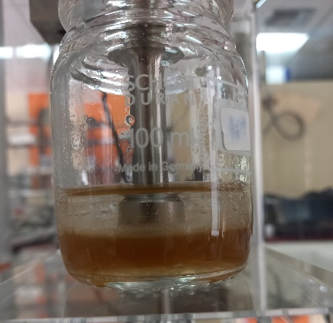
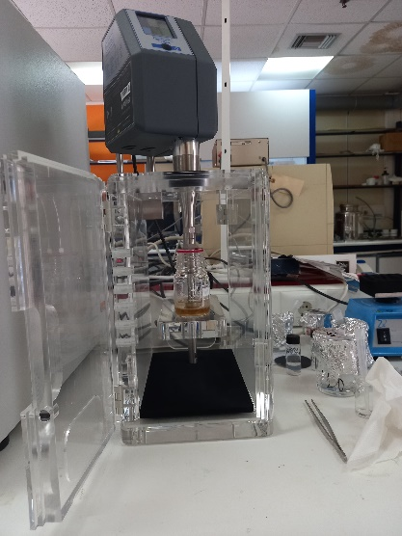
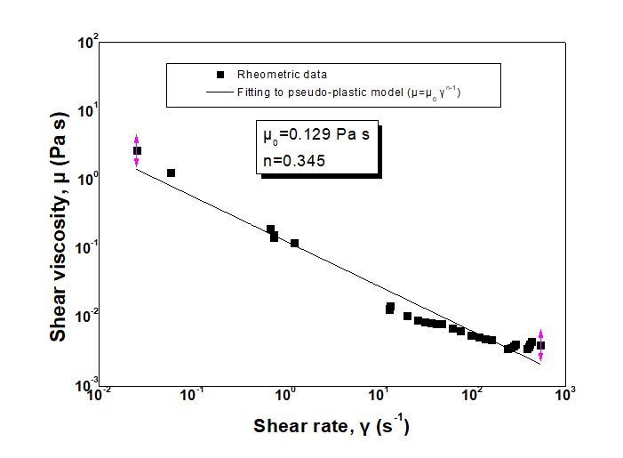
Pickering Emulsion
Pickering emulsion
Suspension of FeNPs - oil (n-decane) Volume ratio 1:1
Ultrasound probe
With the aid of an ultrasound probe, the nano-colloids were mixed with oil (n-decane) to prepare Pickering emulsion of FeNPs 0.25g/L -NaCl 0.25M .

Slide 10
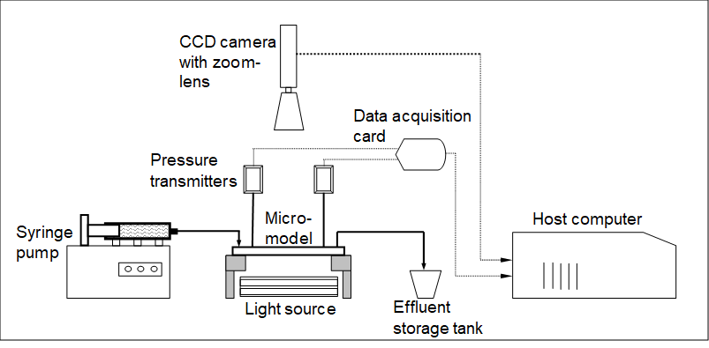
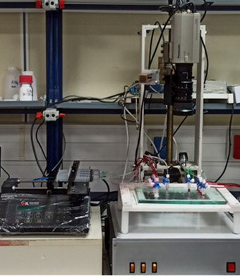
Experimental setup of visualization tests on transparent pore networks

Slide 11
Values of Ca and κ
fluid | Flow rate(10⁻⁶/60) m3/s | U ( 10 ⁻⁵ m/s) | μ (Pa s) | ΙΤ (mN/m) | Ca (10⁻⁶) | κ
paraffin | 0.08 | 0.94 | 0.026 | 30.5 | 8.0 | 26.0
NaCl 0.25M | 0.2 | 2.35 | 0.001 | 25.0 | 0.94 | 0.038
FeNPs 0.25 g/L | 0.2 | 2.35 | 0.001 | 25.0 | 0.94 | 0.038
FeNps 0.25 g/L – NaCl 0.25M | 0.2 | 2.35 | 0.001 | 25.0 | 0.94 | 0.038
FeNps 0.25 g/L – NaCl 0.25M (emulsion) | 0.2 | 2.35 | 0.01246 | 25.0 | 1.17 | 0.48
Capillary number $Ca=\frac{μ_{displacing U}}{IT}$
Viscosity ratio
$$κ=\frac{μ_{displacing}}{μ_{displaced}}$$
$μ_{emulsion}$ = 0.01246 Pa s
$μ_{paraffin}$ = 0.026 Pa s
$μ_{water}$ = 0.001 Pa s
Ca pore scale -> Ca_{L1}=Ca*factor
Ca network scale -> Ca_{LN}=Ca_{L1}*L_{N}/L_{p}
Drainage: Ca_{L1}=0.0324, Ca_{LN}=3.2
Imbibition: Ca_{L1}=0.0038, Ca_{LN}=0.38
Tsakiroglou et al., AIChE J. 49(10), 2472 (2003)

Slide 12
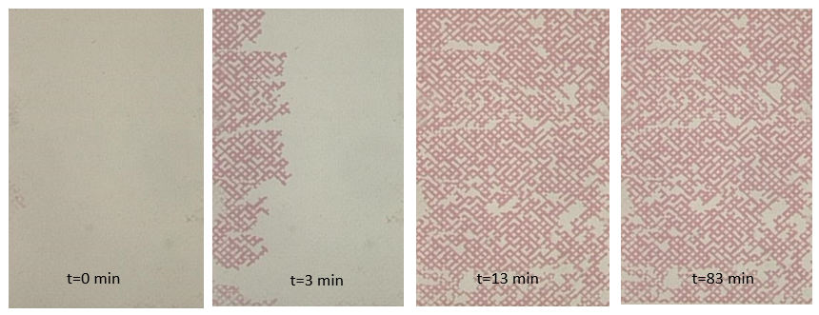
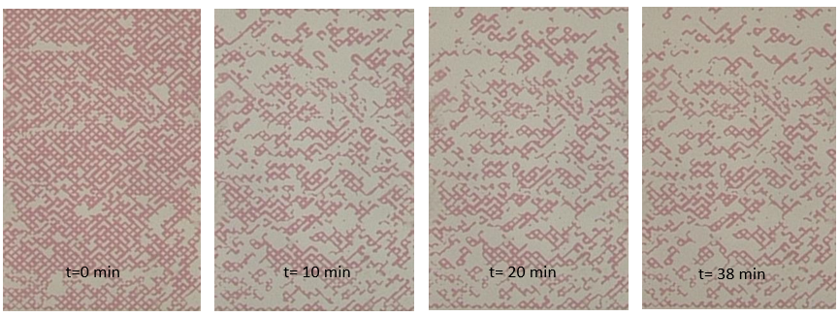
Transient two-phase flow patterns
Primary Drainage
Displacement NaCl 0.25M by paraffin oil (red- colored)
κ= 26.0
Ca = 8x${10}^{−6}$
Primary Imbibition
NaCl 0.25M
κ = 0.038
Ca = 0.94x10⁻⁶

Slide 13
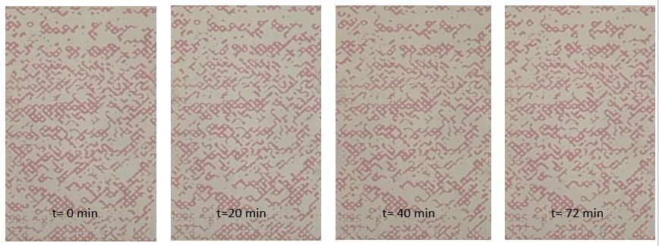
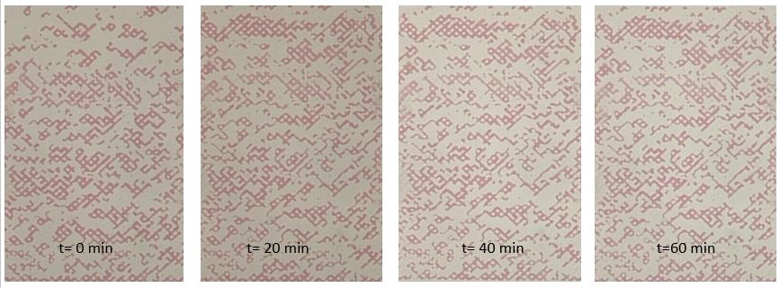
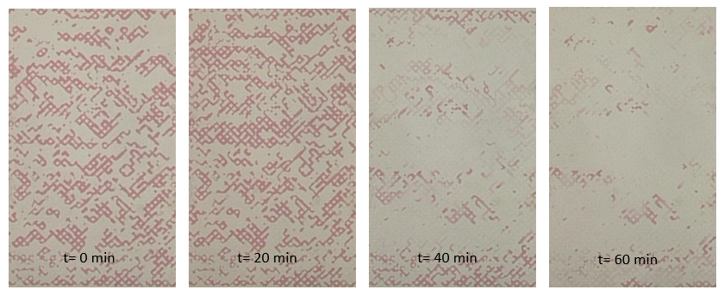
Transient two-phase flow patterns
Secondary
Imbibition
FeNPs 0.25 g/L
κ≈ 0.038
Ca = 0.94x10⁻⁶
FeNPs 0.25 g/L – NaCl 0.25M
κ≈ 0.038
Ca = 0.94x10⁻⁶
$$κ=\frac{μ_{displacing}}{μ_{displaced}}$$
FeNPs 0.25 g/L – NaCl 0.25M
Emulsion
κ=0.48
Ca = 1.17x10⁻⁶
Tsakiroglou et al., J. Coll. & Interface Sci. 267, 217-232 (2003)
Tsakiroglou, J. Non-Newt. Fluid Mech. 117, 1–23 (2004)

Slide 14
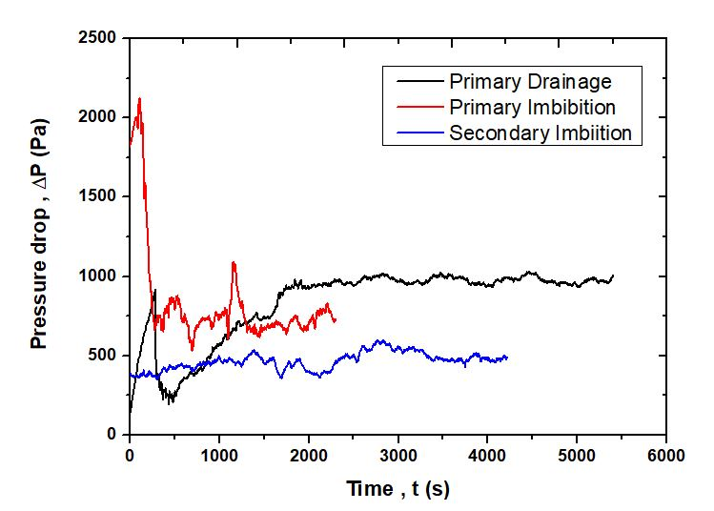
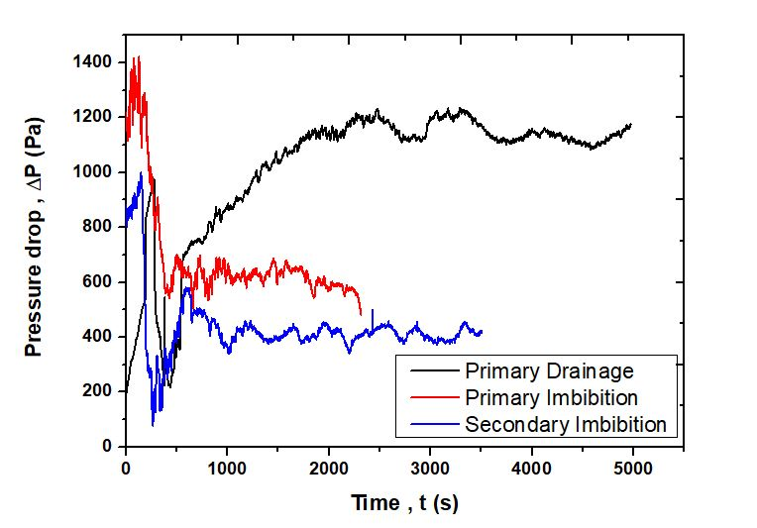
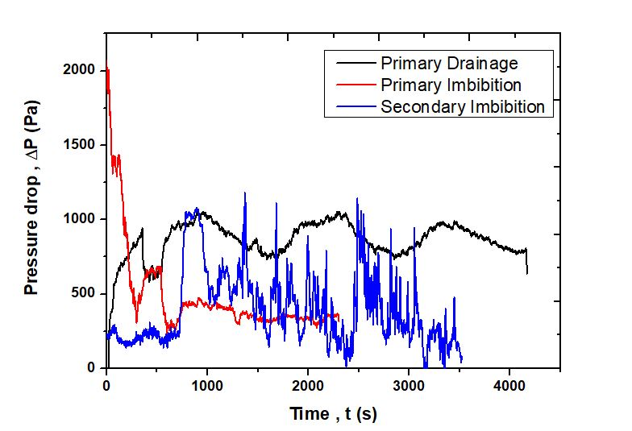
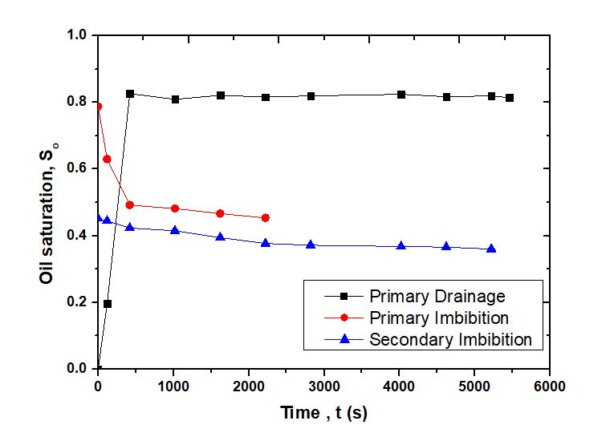
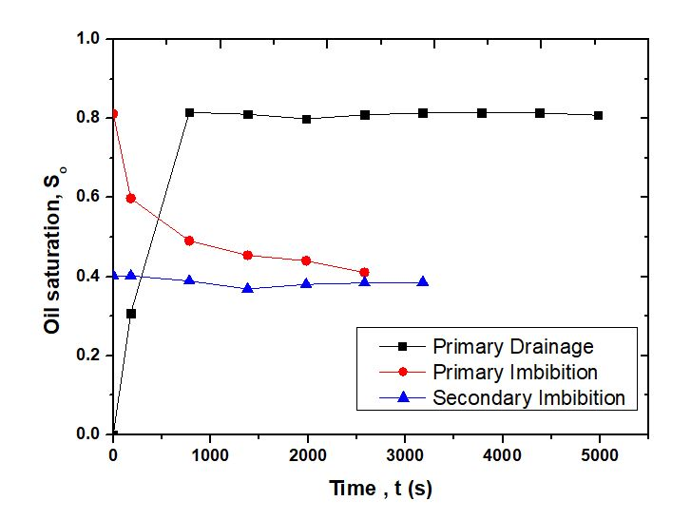
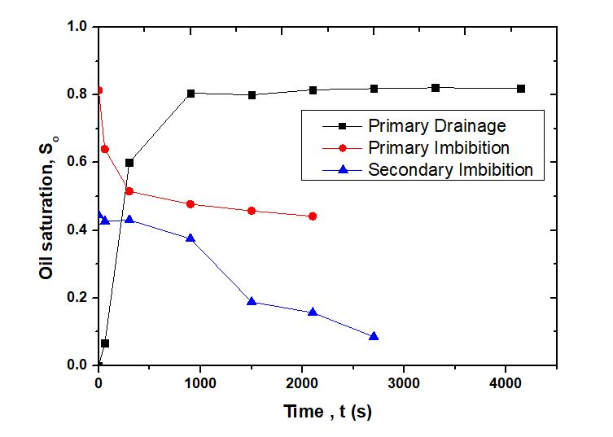
Plots of tests for EOR
Fe NPs 0.25 (g/L) – NaCl 0.25M Emulsion
Fe NPs 0.25 (g/L)
Fe NPs 0.25 (g/L) – NaCl 0.25M

Slide 15
Results
Type of displacement | Displaced fluid | Displacing fluid | Flow rate (mL/min) | Injected volume (mL) | Oil saturation | Oil removal efficiency (%)
Drainage | NaCl 0.25M | Paraffin oil | 0.08 | 8.0 | 0.82 | -
Prim. Imbib. | Resid. paraffin oil | NaCl 0.25M | 0.2 | 8.0 | 0.45 | 46.25
Sec. Imbib. | Resid. paraffin oil | FeNPs 0.25 (g/L)-water suspension | 0.2 | 14.4 | 0.36 | 20.0
Drainage | NaCl 0.25M | Paraffin oil | 0.08 | 8.0 | 0.82 | -
Prim. Imbib. | Resid. paraffin oil | NaCl 0.25M | 0.2 | 8.0 | 0.41 | 50.0
Sec. Imbib. | Resid. paraffin oil | FeNPs 0.25 (g/L)-NaCl 0.25M suspension | 0.2 | 14.0 | 0.39 | 4.88
Drainage | NaCl 0.25M | Paraffin oil | 0.08 | 8.0 | 0.82 | -
Prim. Imbib. | Resid. paraffin oil | NaCl 0.25M | 0.2 | 8.0 | 0.44 | 46.34
Sec. Imbib. | Resid. paraffin oil | Emulsion | 0.2 | 12.0 | 0.09 | 79.55

Slide 16
Conclusions
The potential to increase the residual oil recovery efficiency by injecting suspensions of iron oxide nanoparticles synthesized and stabilized by the polyphenols of parsley extracts is investigated with visualization tests on a glass-etched pore network.
The nanoparticles mobilize trapped oil by transferring it from upstream to downstream through a mechanism of successive steps of drainage (local increase of oil saturation) / imbibition (local decrease of oil saturation).
It seems that the oil recovery efficiency of secondary imbibition tests is favored when using low iron concentration Fe NPs suspension without the presence of NaCl . On the other hand, the oil recovery efficiency increases respectably when using Pickering emulsions stabilized by FeNP with NaCl.

Slide 17
Acknowledgement

