Slide 1
Impact of Displacement Direction Relative to Heterogeneity on Averaged Capillary Pressure-Saturation Curves
Javad Shokri , Omar E. Godinez-Brizuela , Hamidreza Erfani , Yongqiang Chen, Masoud Babaei , Brian Berkowitz , and Vahid Niasar
InterPore2022, May 2022

Slide 2
Introduction
Immiscible two-phase flow
Relative permeability and capillary pressure curves
Monotonically increases
Residual wetting saturation
Residual non-wetting saturation
$$P_{c}=P_{nw}−P_{w}$$
1
Notes:
Immiscible two-phase flow in porous media can be easily found in nature and various industrial applications such as geological carbon storage, oil recovery, and treatment of non-aqueous phase liquid (NAPL) contamination. Modeling two-phase flow in porous media at the continuum-scale usually relies on Darcy’s law, amended with three key empirical constitutive relations which are defined as a function of saturation. Relative permeability and capillary pressure.
These functions are nonlinearly dependant on saturation and defined within a range of saturation referred to as residual wetting and non-wetting saturations. Capillary pressure which is generally defined as the pressure difference between the non-wetting phase and the wetting, has a monotonic relation with the wetting phase saturation.

Slide 3
Introduction
Factors affecting capillary pressure
Pore morphology, solid surface properties, non-equilibrium effects, heterogeneity and etc.
Heterogeneity affects the fluid phase distribution and the dynamics of two-phase flow
2
Notes:
Heterogeneity, affects the fluid phase distribution and the dynamics of two-phase flow at different spatial and time scales. For instance, at the field scale, water saturation can change across the geological layers; in reservoir engineering, the remaining oil saturation in low-permeability regions will be larger than the high-permeability regions.

Slide 4
Knowledge gap and research question
Effect of heterogeneity interface and flow direction on the capillary pressure and saturation distribution
The effect of heterogeneity interface on capillary pressure has not been assessed
Heterogeneity interface: a surface normal to the flow direction across which the porous medium undergoes a sharp change in pore size distribution
3
Notes:
1. The aforementioned experimental and modeling studies provide valuable information on the impact of small-scale heterogeneity on saturation profile and internal capillary pressure. However, variation of internal capillary pressure, and saturation distribution as a function of flow direction with respect to the heterogeneity interface has not been assessed.
2. The heterogeneity interface is a surface perpendicular to the flow direction across which the porous medium undergoes a sharp change in pore size distribution and consequently capillary pressure and permeability variation .
3- The current study focuses on assessing the validity of capillary pressure-saturation relation near the heterogeneity interface

Slide 5
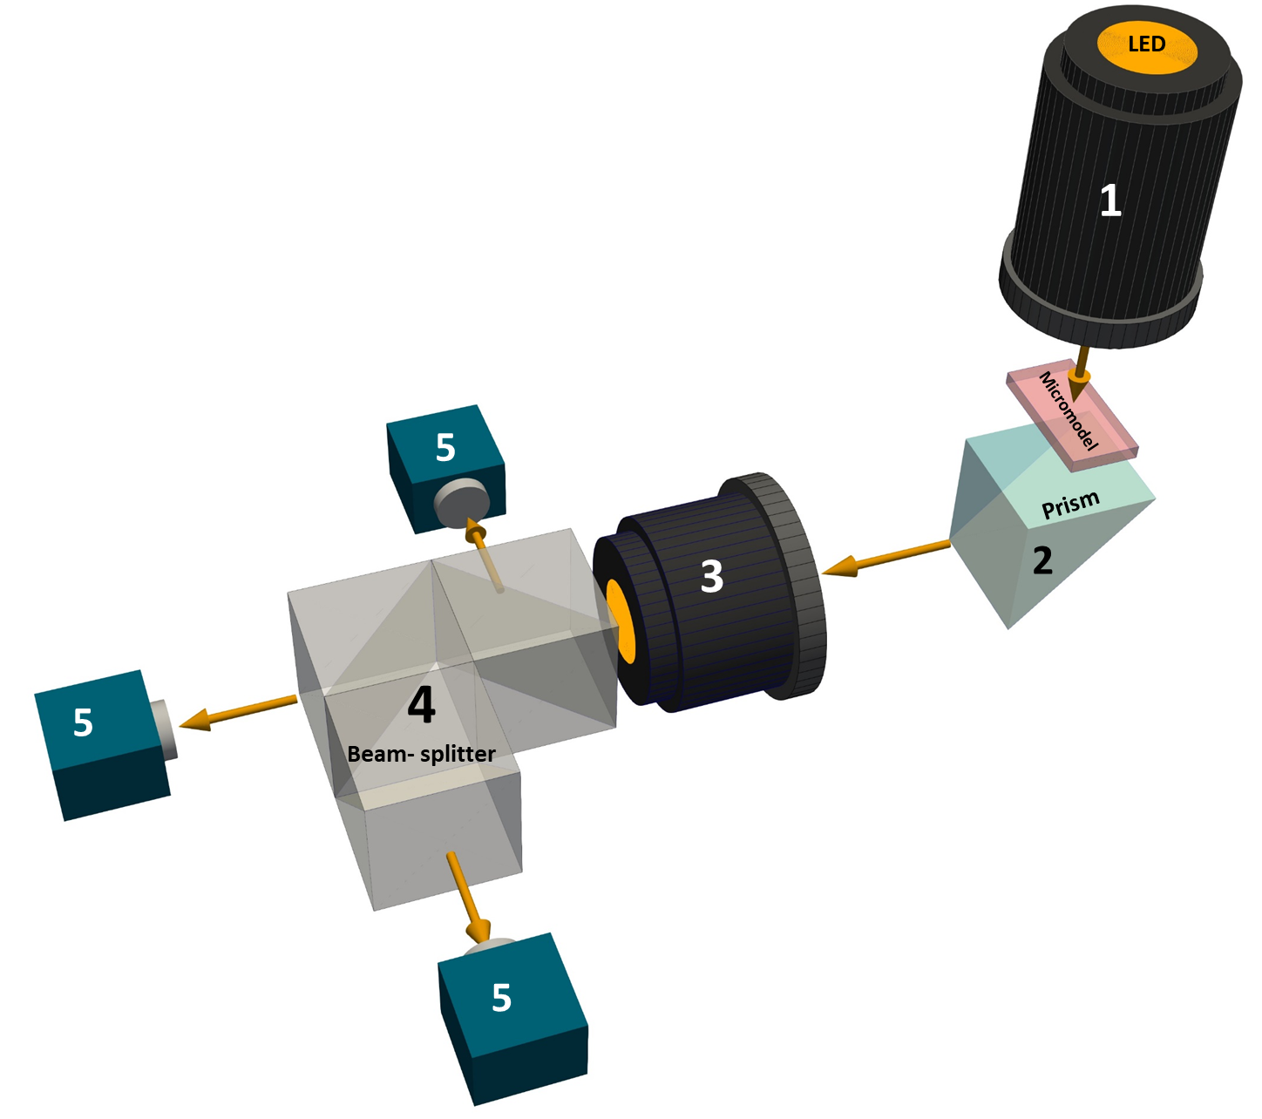
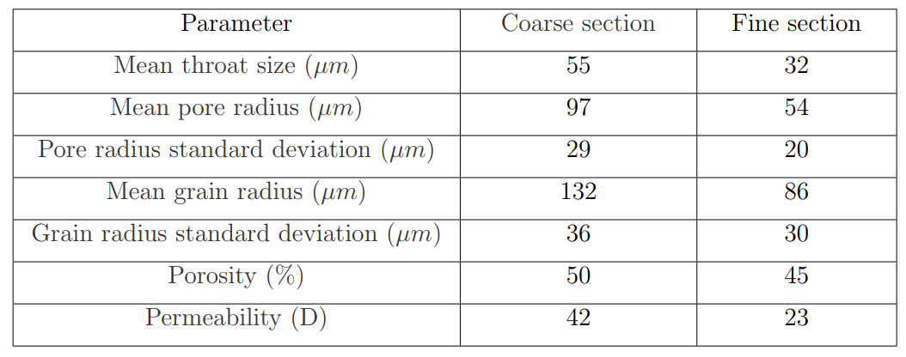
Micromodel and experimental setup
a collimated LED light source
a prism
a magnifying lens
a box of three beam-splitters
three 12-Megapixel monochrome cameras
a high-precision syringe pump (not shown)
PDMS elastomer
Treated with a silane-ethanol mixture to become uniformly Oil-wet
6 × 30 mm², with a depth of 60 µm
4
Notes:
The micromodel was prepared by a soft lithography method using PDMS, an elastomeric material. It was treated with a mixture of 2.5 µL silane to 1 mL ethanol to make the micromodel uniformly and stably hydrophobic.
The overall dimensions of the flow network were 6 × 30 mm2, with a uniform depth of 60 µm.
The figure shows the micromodel composed of two distinct sections, referred to as coarse and fine sections, with identical dimensions. The coarse and fine section permeabilities were 42 and 23 Darcy, respectively. The flow network is shown in white. The red rectangle shows the field of view used in the analyses.

Slide 6
Experimental design and procedure
No | Flow rate (mL/hr) | Displacement direction
1 | 0.001 | CtF
2 | 0.01 | CtF
3 | 0.1 | CtF
4 | 1 | CtF
5 | 0.001 | FtC
6 | 0.01 | FtC
7 | 0.1 | FtC
8 | 1 | FtC
Saturate with the wetting phase (oil phase-Fluorinert)
Inject 10 PV of the wetting phase
Inject the non-wetting phase -distilled water dyed with ink (water-based blue, Ecoline, 1/1 vol/vol)- with a constant rate (drainage process), and the injection was continued for 5 PV.
Experiments were carried out at 25 ◦C
The wetting and non-wetting phase viscosities were 4.7 and 0.9 mPa.s, respectively (unfavorable viscosity ratio).
Four different injection rates of 0.001, 0.01, 0.1 and 1 mL/hr corresponding to capillary numbers of 2.52 × 10⁻⁸ to 2.52 × 10⁻⁵ were employed.
FtC: Fine to coarse direction
CtF: Coarse to fine direction
5

Slide 7
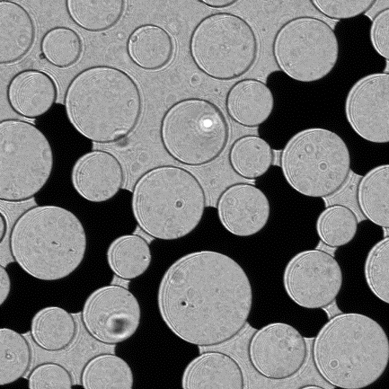
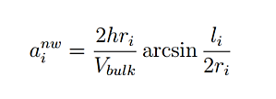
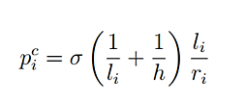
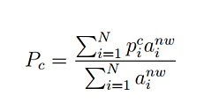
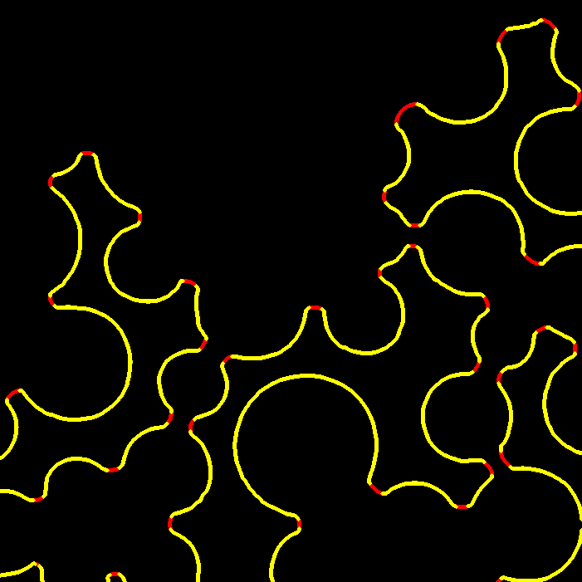
Image analysis
Fluid saturation
Mask: an actual image from the fully saturated micromodel with oil
Modified mask: The mask image converted to grey-scale with two levels for the porous, and solid regions.
Upscaled capillary pressure
r_{i} : planar radius of curvature
l_{i}: chord between the ends of the contact line
6
Notes:
Fluid saturation: Each image was subtracted from the mask to cancel out the non-porous zones and the porous zones occupied with the wetting phase. As a result, the non-wetting fluid could be identified. Then, by using a threshold value identified by Otsu’s method [22, 37], the image was transformed into a black and white image. Finally, by counting the white pixels of the resulting image, the amount of the nonwetting phase and by dividing this number by the total void space (counted from the modified mask), non-wetting phase saturation was calculated.
Capillary pressure:
To detect the fluid-fluid interface, each image was subtracted from the mask, then using the Canny edge detection method [38] the edge of the non-wetting fluid was determined. This contact line was composed of fluid-fluid and solid-fluid contact lines. Differentiating the fluid-fluid interface from the solid-fluid interface was carried out by inspecting every individual pixel of the contact line and its surrounding.
specific fluid-fluid interfacial area which was determined for the ith interface using the first equation.
Local capillary pressure was calculated using modified Laplace the middle equation
the upscaled capillary pressure was obtained by averaging all internal microscale capillary pressures weighted by their fluid-fluid interfacial area

Slide 8
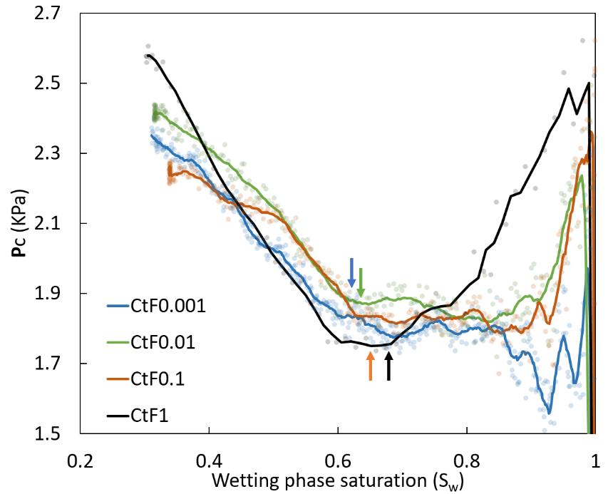
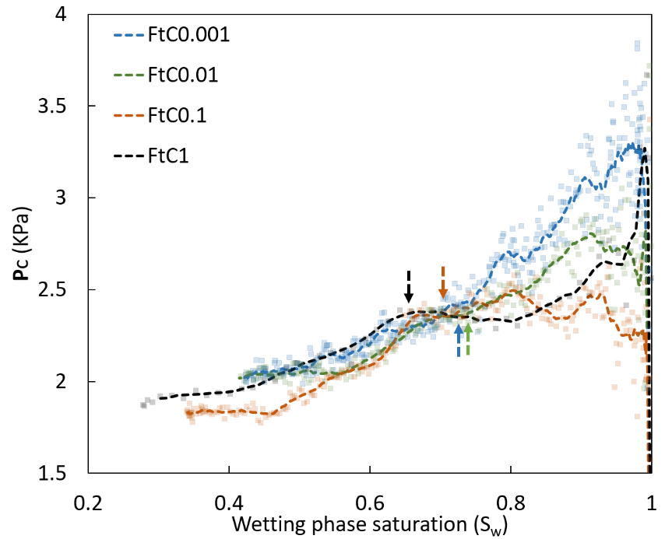
Results & Discussion
Upscaled dynamic capillary pressure shape
Traditional
Coarse to Fine
Fine to Coarse
7
Notes:
In the classical definition of the Pc-Sw relationship, the capillary pressure is measured when the rate of saturation change is zero. Data points measured under equilibrium conditions show monotonic relation between capillary pressure and saturation.
While figures for these experiments evidently show that the trend of the upscaled dynamic capillary pressure-saturation curve is different from the traditional shape of Pc-Sw curve.
This could be due to the fact that the pore size distribution in the entire porous medium controls the equilibrium capillary pressure. Whilst, only pores that are occupied by both wetting and non-wetting phases contribute in the dynamic capillary pressure calculation. Therefore, the local advancement of the non-wetting fluid in the porous medium determines the dynamic capillary pressure behavior.

Slide 9
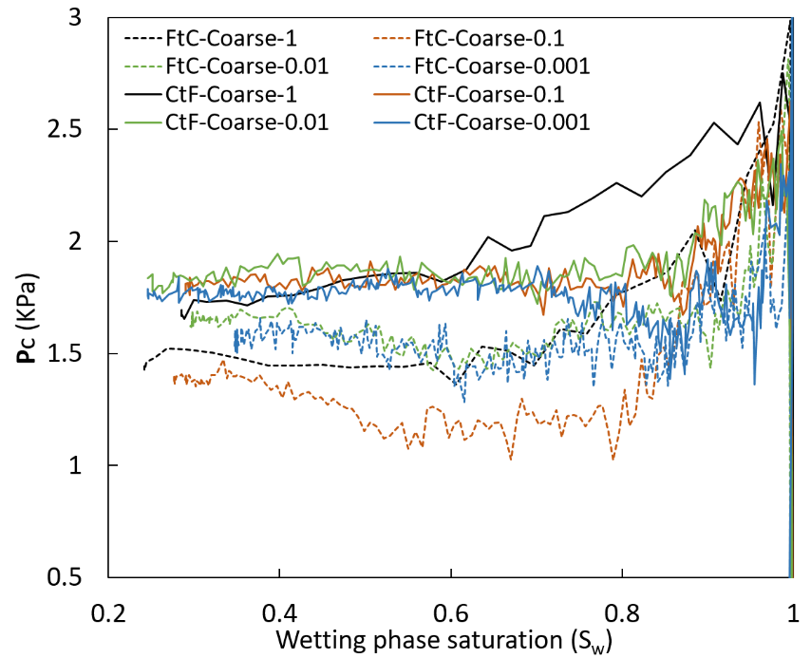
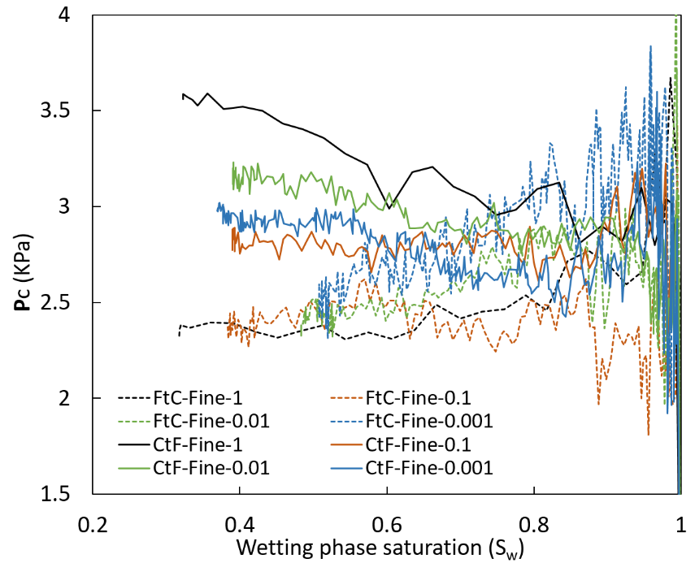
Results & Discussion
Capillary pressure curves are flow rate dependant.
CtF direction has a convex shape.
FtC direction is mostly decreasing.
Non-unique capillary pressure curve
Direction dependency of coarse and fine section
Fine to Coarse
Coarse to Fine
Fine section
Coarse section
Vertical arrows show the moment that the non-wetting fluid reaches the interface
8
Notes:
1- The Pc-Sw curves show a flow rate dependency, especially in early times before the non-wetting fluid crosses over the interface. In the CtF direction, the dynamic capillary pressure increases in higher flow rates as the rate of saturation change over time soars. This observation is in agreement with previous studies [16, 20, 23].
2- The Pc-Sw has a convex shape in the CtF direction. capillary pressure decreases as the non-wetting fluid moves toward the interface. Due to the lower mean pore size (higher entry capillary pressure) of the fine section, the non-wetting phase cannot cross over the heterogeneity interface. The capillary pressure builds up in the coarse section until it reaches the entry capillary pressure of the fine section. Then, the non-wetting phase invades the fine section, and consequently the dynamic capillary pressure increases.
3- The trend of the Pc-Sw curve is completely different in the FtC direction (Figure 1.4d). The capillary pressure is mostly decreasing as the non-wetting fluid moves forward. It appears that the capillary pressure drops faster when the advancing non-wetting fluid passes through the heterogeneity interface. The lower entry capillary pressure in the coarse section relaxes the capillary pressure, and the difference between the non-wetting phase and the wetting phase (Pc) declines gradually until the breakthrough time.
4- Figures 1.4a-b show the upscaled internal capillary pressure for the coarse section and fine section, respectively. These figures reveal that the upscaled capillary pressure in both fine and coarse sections is higher in CtF direction compared to the FtC direction. 5- after arrows the contrast between different Pc-Sw curves is decreased. However, there is still a noticeable difference between non-equilibrium Pc-Sw curves and a unique Pc-Sw curve cannot be deduced from transient experiments

Slide 10
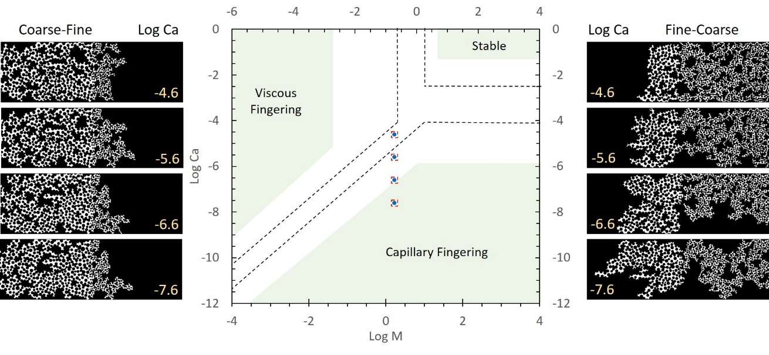
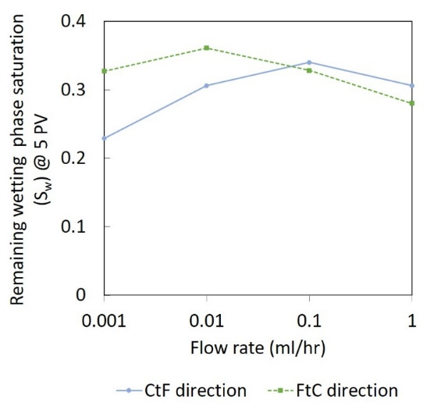
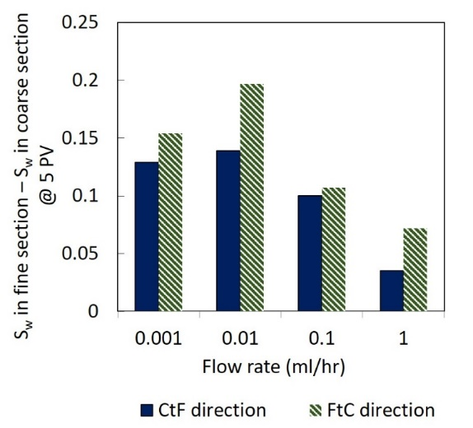
Results & Discussion
Non-monotonic behaviour due to trade-off between capillary and viscous forces
Remaining wetting phase saturation
Saturation difference between coarse and fine section
Phase diagram for immiscible displacement
9
Notes:
1- Non monotonic behaviour for the remaining wetting phase saturation and saturation difference between coarse and fine section (the trade-off between capillary and viscous forces was recognized as the underlying mechanism for this behaviour). The reason is that by increasing the capillary number (ratio of the viscous force to capillary forces), the viscous forces become more important and the displacement behavior changes from capillary fingering to viscous fingering.
Figure 1.7 shows the classical phase diagram proposed by Lenormand et al. [44] for immiscible displacement. Depending on capillary number and viscosity ratio, stable displacement, viscous fingering, or capillary fingering may take place.
Zhang et al. [2] found that the cross-over zone (transition from capillary fingering to viscous fingering or stable displacement) was narrower than in the study of Lenormand [44], which was controlled by the mean and standard deviation of pore size distribution. Hence in this study, the cross-over zone could be slightly different from previous studies due to the presence of the heterogeneity interface and different pore size distribution of the micromode It can be seen that capillary forces are dominant at the lowest flow rate, while viscous forces control the displacement at the highest flow rate. Moreover, capillary and viscous forces competed to dominate at two intermediate flow rates. As Figure 1.7 shows small capillary numbers, when viscous forces are negligible, capillary fingering grows independent of the flow direction [1]. Capillary fingers are noticeable especially in the lower capillary numbers for both displacement directions. By increasing the flow rate, the number of fingers decreases, and the invasion front becomes more stable in both flow directions.
b. The middle figure shows that under high injection rates, the least saturation variation between fine and coarse sections was observed. The highest saturation difference was observed at 0.01 mL/h where the effect of both capillary and viscous forces coexisted. It can be concluded that the competition between these forces not only caused the non-monotonic trend but also, resulted in the most discrepancy in saturation in the micromodel.

Slide 11
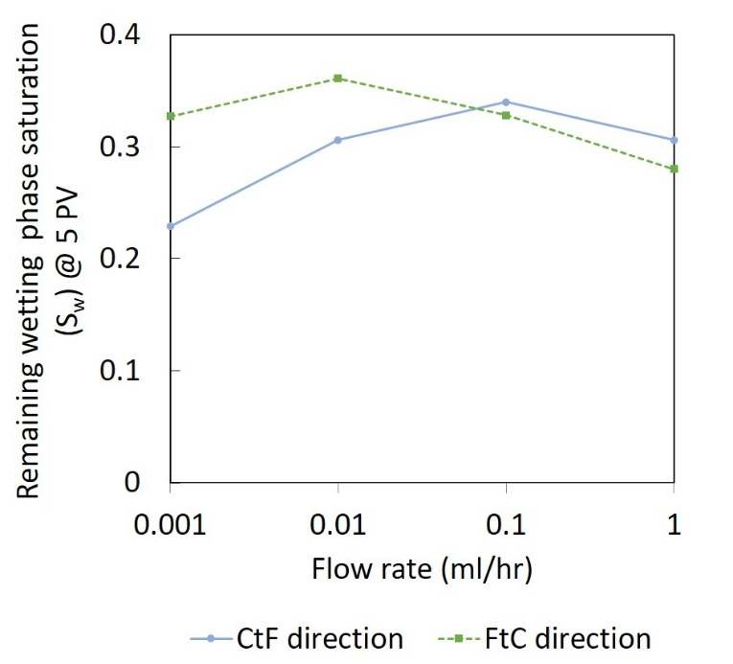
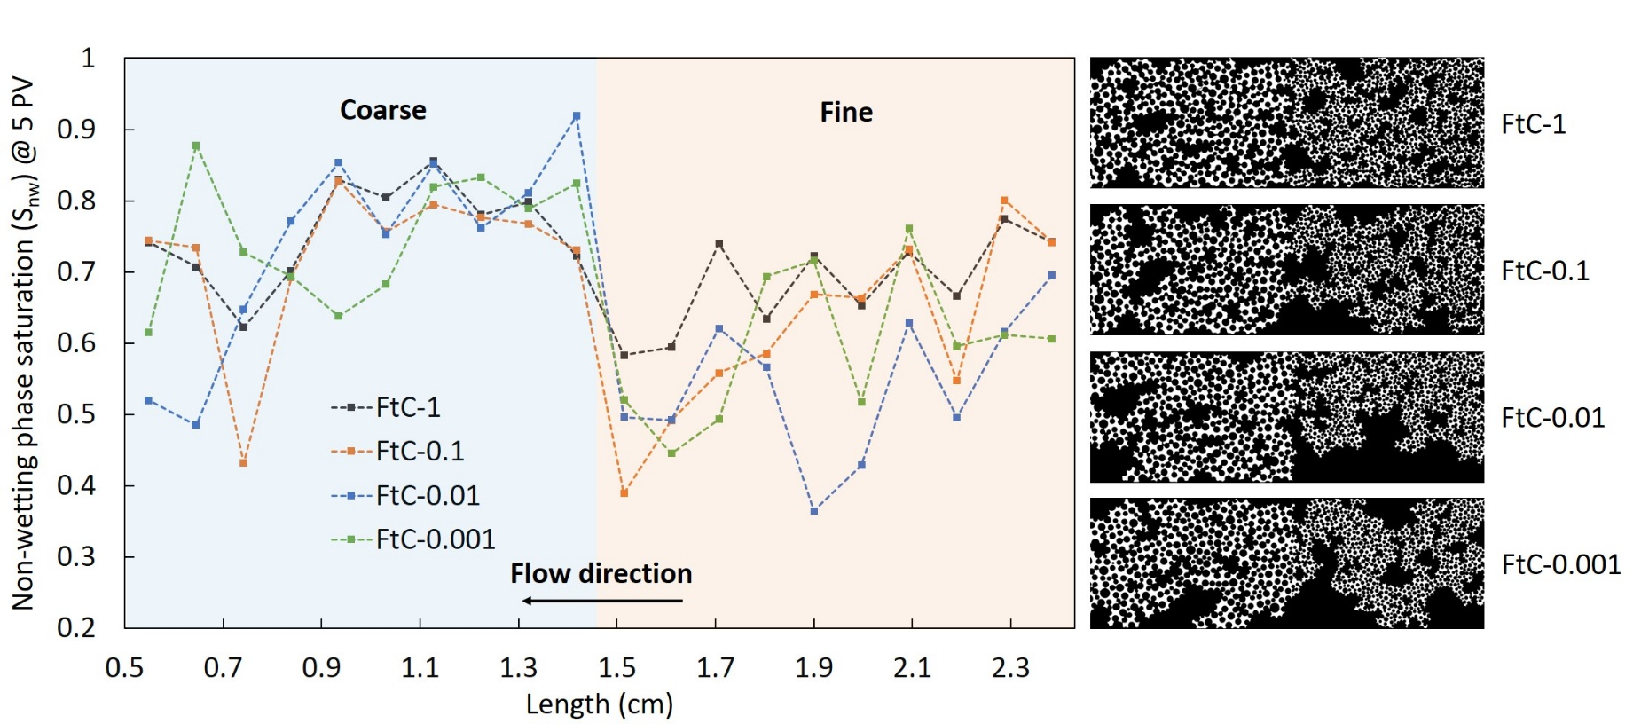
Results & Discussion
FtC direction: Highest flow rate $→$Highest S_{nw}
10
Notes:
the highest non-wetting phase saturation for FtC direction was obtained by the highest injection rate. The reason behind this observation is the presence of the heterogeneity interface in the micromodel.
In the FtC direction, when the non-wetting phase approaches the interface, due to the higher permeability in the coarse section, the interface accelerates and triggers preferential flow paths to reach the coarse section [3]. This phenomenon is similar to the capillary end effect where capillary pressure plunges to zero at the outlet boundary of porous media, which can be minimized by increasing the injection flow rate as viscous forces prevail over capillary forces [45]. Similarly in these experiments, increasing the flow rate stabilized the fluid front, restricted capillary fingers, lowered the effect of capillary end effect. Thus, a more even sweep was observed in the fine section. As a result, the average non-wetting phase saturation increased in the fine section in higher flow rates.
Figure illustrates the non-wetting phase saturation profile along the micromodel for FtC direction. It clearly shows the non-wetting phase saturation dropped near the interface, which is in line with numerical results [3, 12]. Furthermore, it depicts that the highest flow rate resulted in a more uniform saturation profile and larger average saturation due to suppression of capillary forces

Slide 12
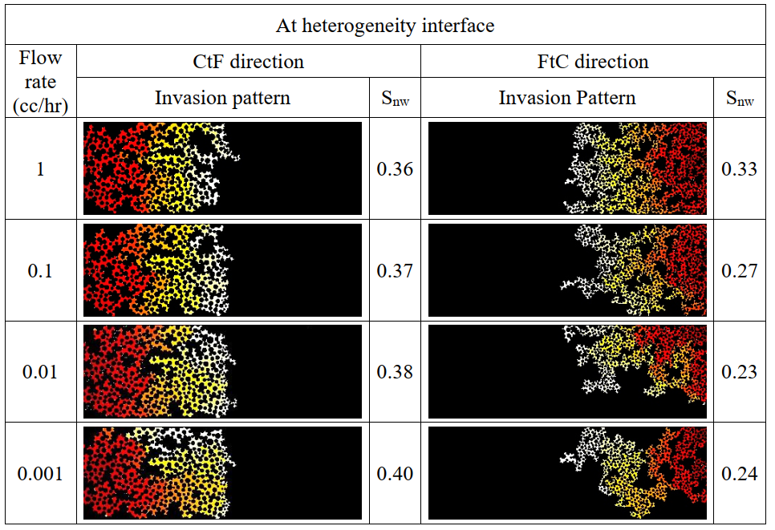
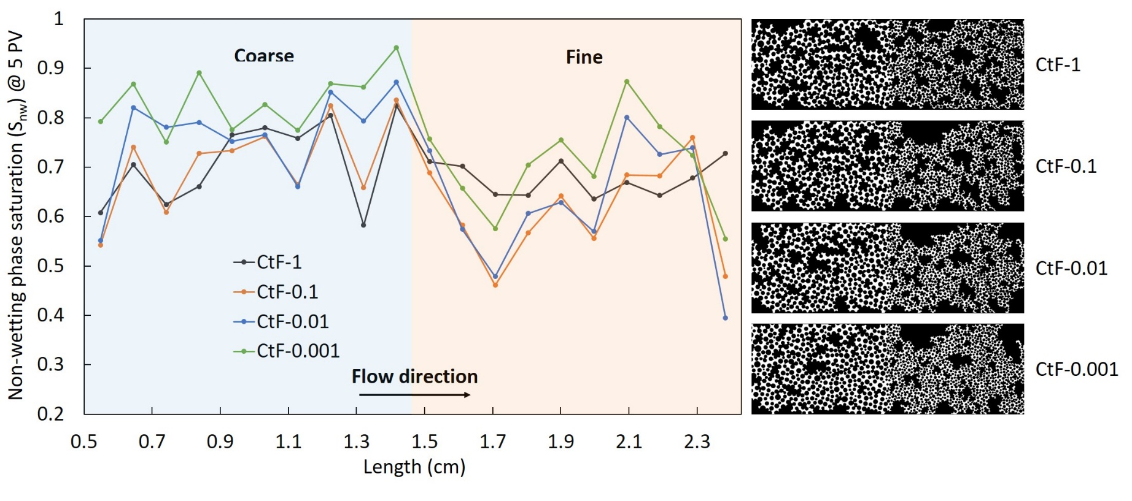
Results & Discussion
CtF direction: Lowest flow rate $→$Highest S_{nw}
Remaining wetting phase saturation
11
Notes:
In the CtF direction, because the capillary pressure jumps at the heterogeneity interface, non-wetting fluid was held behind the interface until entry capillary pressure was reached. This phenomenon suppressed capillary fingers at the interface until the rest of the coarse section was swept by the non-wetting phase (Figure 1.9, click).
Under such conditions, in which capillary pressure was controlling the immiscible displacement process, capillary forces became more important and dominated the process [46]. Therefore, the lower the capillary number, the better the non-wetting phase could displace the wetting phase. As can be seen in Figure 1.9, the lowest flow rate which the effect of capillary forces was more important, attained the highest non-wetting fluid saturation. Click
Furthermore, Figure 1.8a illustrates the non-wetting phase saturation profile along the micromodel for CtF direction; it is observed that, approaching the interface, the saturation of the non-wetting phase increased in lower capillary numbers.

Slide 13
Conclusion
The upscaled dynamic capillary pressure-saturation curve does not follow the classical shape of the P_{c}-S_{w} curves and show a non-monotonic and direction dependant behaviour.
A non-monotonic relationship between the remaining S_{w} and capillary number was observed. Capillary fingers were present in the lower injection rates where they gradually disappeared in higher capillary numbers.
The results demonstrate that the flow direction with respect to the heterogeneity significantly influences the trend of the averaged capillary pressure curves, as well as, the remaining saturation. Given that the micromodel had constant depth in both fine and coarse sections, the heterogeneity was mild compared to natural porous materials. Thus, it can be expected that the impact of flow direction on upscaled capillary pressure in the presence of heterogeneity will be more pronounced in natural 3D systems.
12
Notes:
1-
The upscaled dynamic capillary pressure-saturation curve does not follow the classical shape of the Pc-Sw curves.
this study demonstrates that flow direction with respect to the heterogeneity can even lead to non-monotonic Pc-Sw curves.
Significant differences between the Pc-Sw curves obtained from coarse and fine sections, depending on the flow direction, were observed.
The upscaled Pc-Sw curve for the entire domain for the coarse-to-fine direction showed a non-monotonic trend
2-
A non-monotonic relationship between the remaining Sw and capillary number was observed due mainly to the competition between capillary and viscous forces in the middle capillary numbers during the transition from capillary fingering to viscous fingering regime.
Capillary fingers were observed in the lower injection rates where they gradually disappeared in higher capillary numbers and the invasion front became less unstable.
3-
The highest Snw for the coarse-to-fine direction (0.77) was achieved at the lowest flow rate, while the highest flow rate caused the largest Snw for fine-to-coarse direction (0.72).
The saturation difference between coarse and fine sections is lower for the coarse-to-fine direction compared to the fine-to-coarse direction, due to capillary build up behind the heterogeneity interface.
Increasing the flow rate from 0.01 to 1 mL/h decreased the saturation difference by 65% and 75% for fine-to-coarse and coarse-to-fine directions, respectively.

Slide 14
