Slide 1
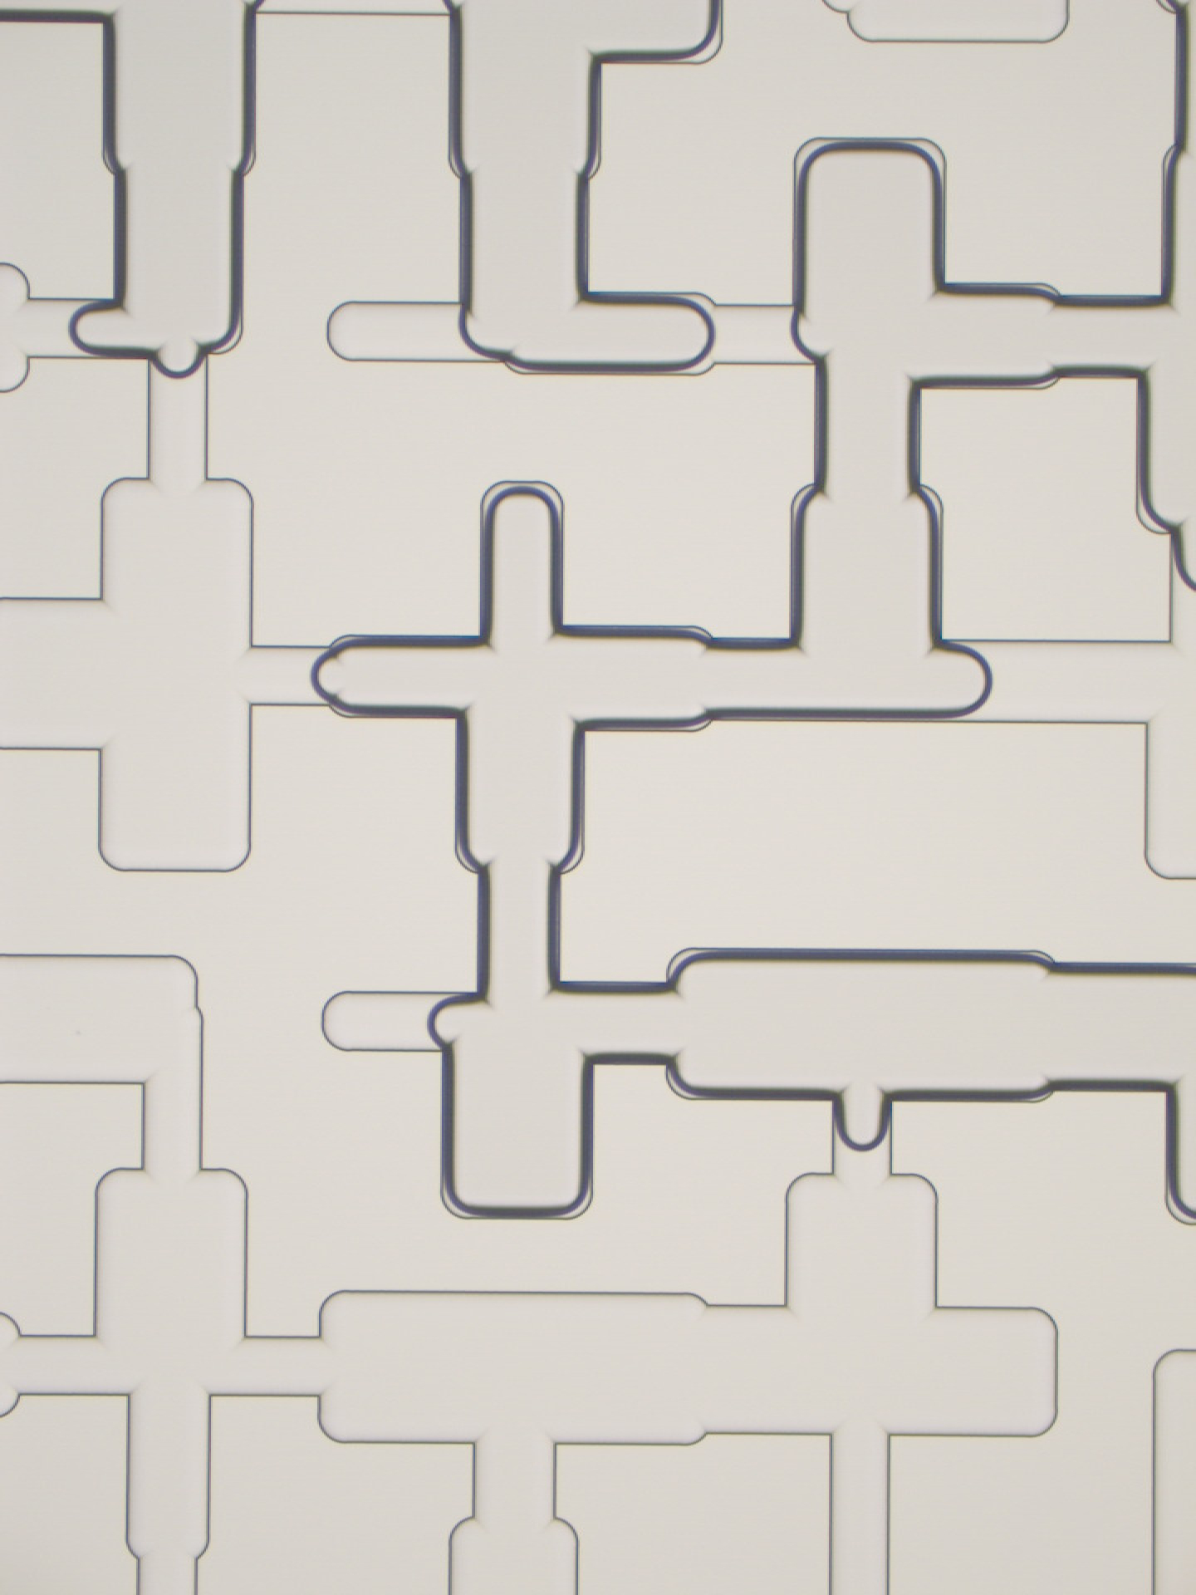
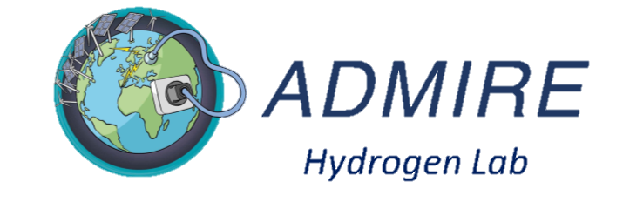
Microfluidics-based analyses of underground H₂ storage:
dynamic contact angles
Van Rooijen et al., AWR, 2022
Willemijn van Rooijen
Leila Hashemi, Maartje Boon
Rouhi Farajzadeh, Hadi Hajibeygi
W.A.vanRooijen@tudelft.nl
Interpore 2022
May 30th 2022

Slide 2
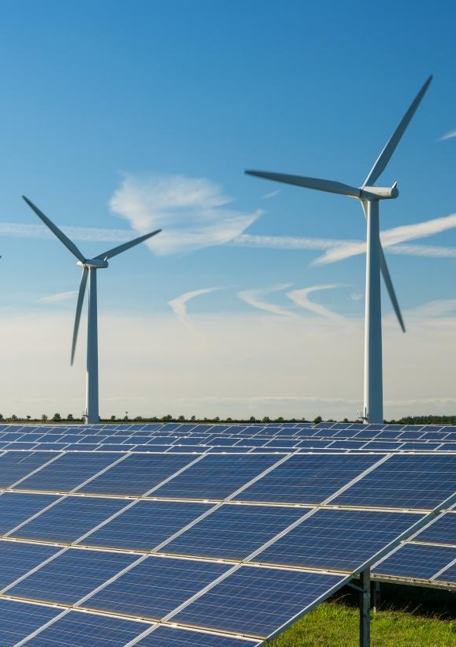
Why Underground Hydrogen Storage?
Scaling up storage is as crucial as scaling up production!
2

Slide 3
Why Underground Hydrogen Storage?
Scaling up storage is as crucial as scaling up production!
H₂ if stored in giant reservoirs allows for TWh storage!
3

Slide 4
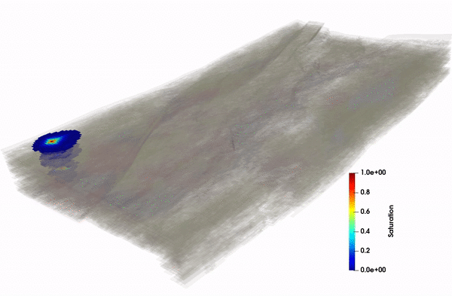
Enabling UHS needs pore-scale physics
Reservoir simulation
4

Slide 5
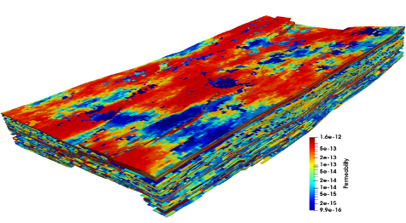
Enabling UHS needs pore-scale physics
Geological Characterization
Reservoir simulation
5

Slide 6
Enabling UHS needs pore-scale physics
Geological Characterization
Upscaled
Functions
Reservoir simulation
6

Slide 7
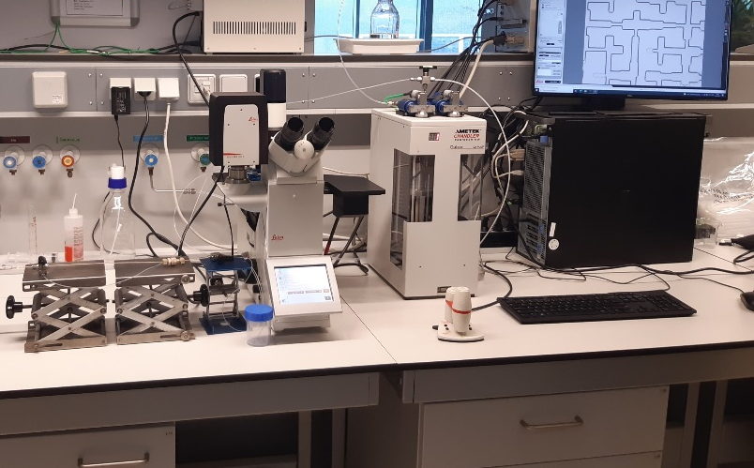
Enabling UHS needs pore-scale physics
Geological Characterization
Pore-scale Physics:
Contact angles, …
Upscaled
Functions
Reservoir simulation
7

Slide 8
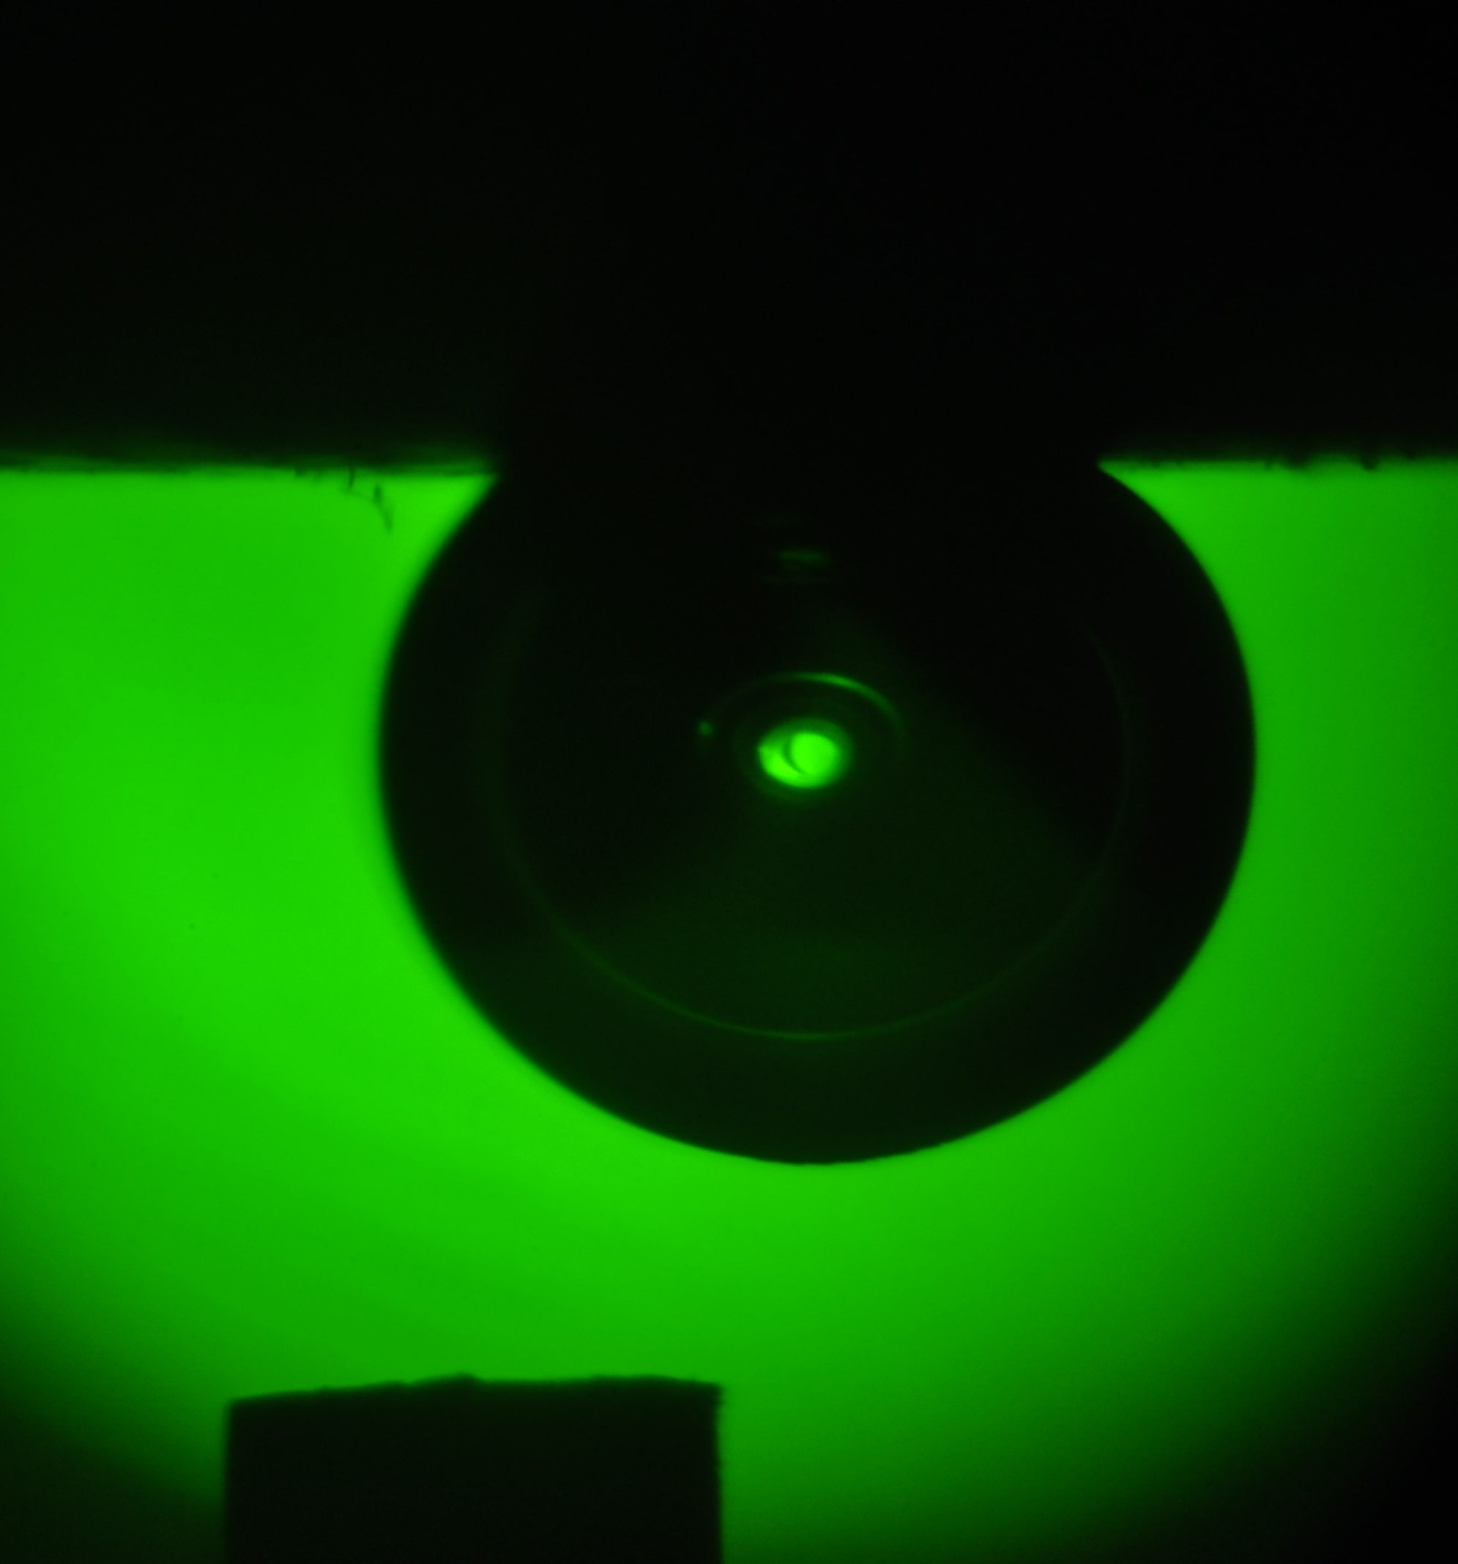
What do we know already?
Coreflood test (CF) [Yekta et al., 2018]
  Receding contact angle (RCA): 22 ° & 35 °
Captive Bubble Cell (CBC) [Hashemi et al., 2021]
  Intrinsic contact angle: 25 – 45 °
Tilted Plate Method (TPM) [Iglauer et al., 2021]
  Receding & Advancing contact angles: 7 - 44 ° & 8 – 48 °
Hashemi et al. (2021)
8

Slide 9
Influence of Pore size is missing!
Step by step approach:
From bundle-of-tube systems towards real cores
9

Slide 10
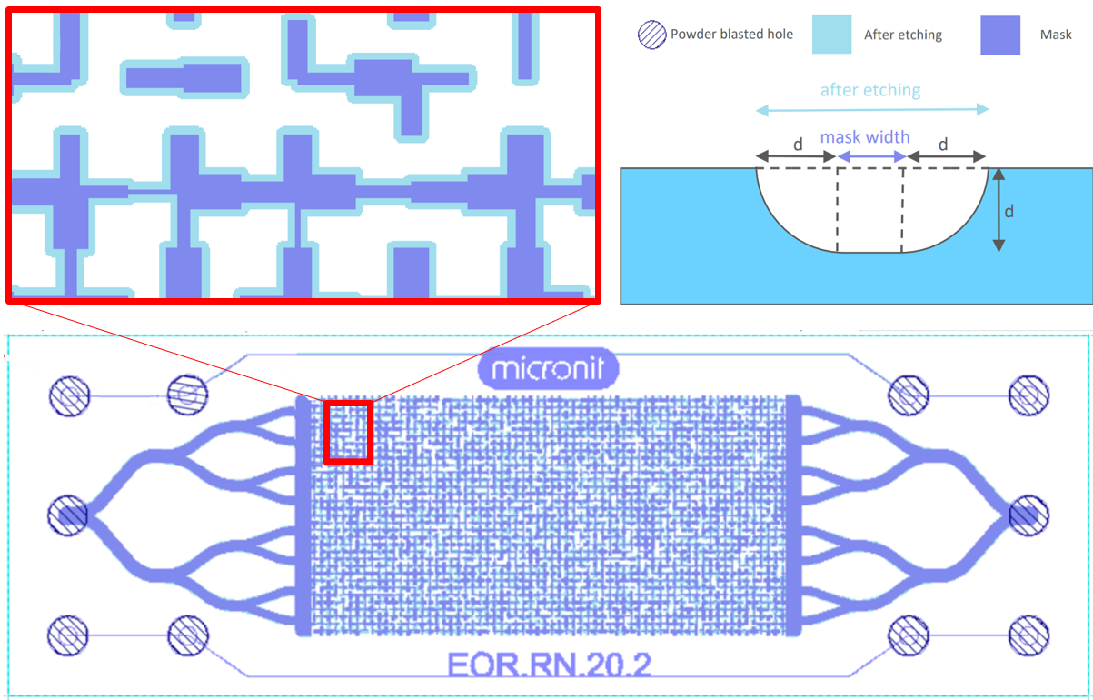
We designed & measured dynamic contact angles in micro chips!
Borosilicate glass microchips (Channels 50 – 130 μm)
10

Slide 11



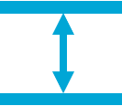

Measurements (10 bar, 20 ºC)
Advancing Contact angle
Receding Contact angle
Hysteresis
Channel width dependency
H_{2,} CO₂ and N₂
11

Slide 12
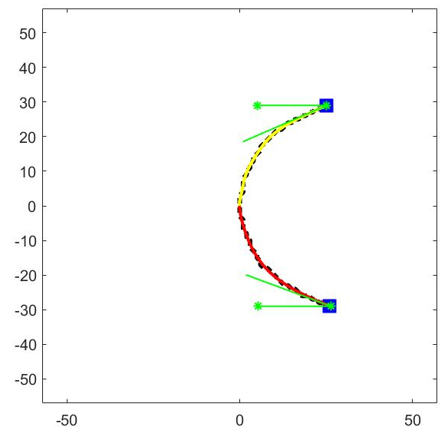
Image analysis: In-house MATLAB code
24º
gas
water
20º
12

Slide 13
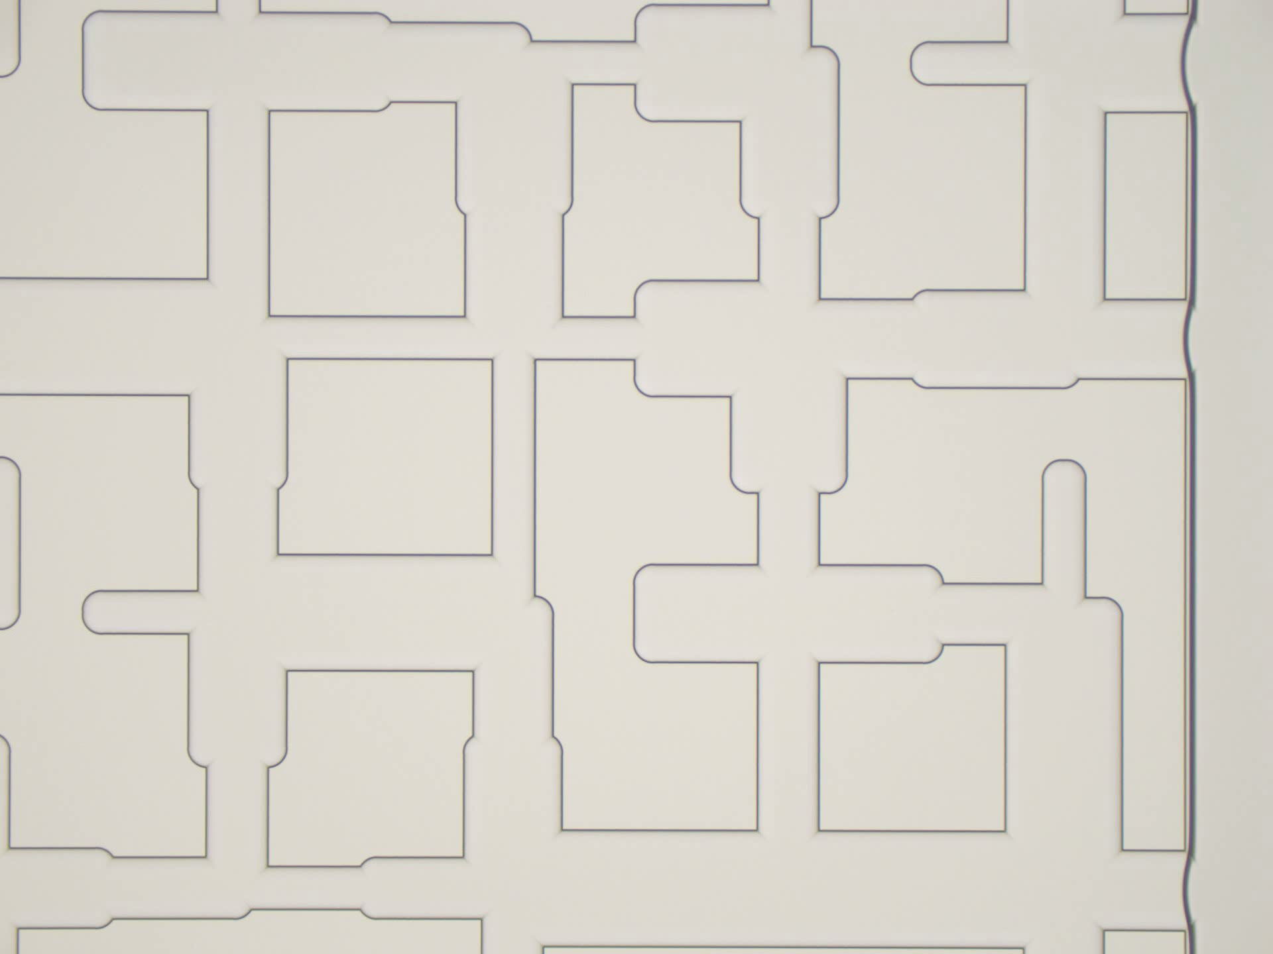


09-10-2020

Slide 14
Results and discussion
    Validation (Jafari and Jung, 2017)
14

Slide 15
Results and discussion
    Validation (Jafari and Jung, 2017)
      Sensitivity to contamination
15

Slide 16
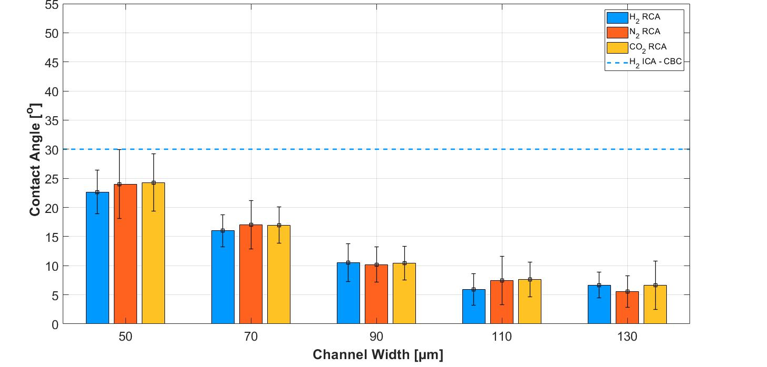
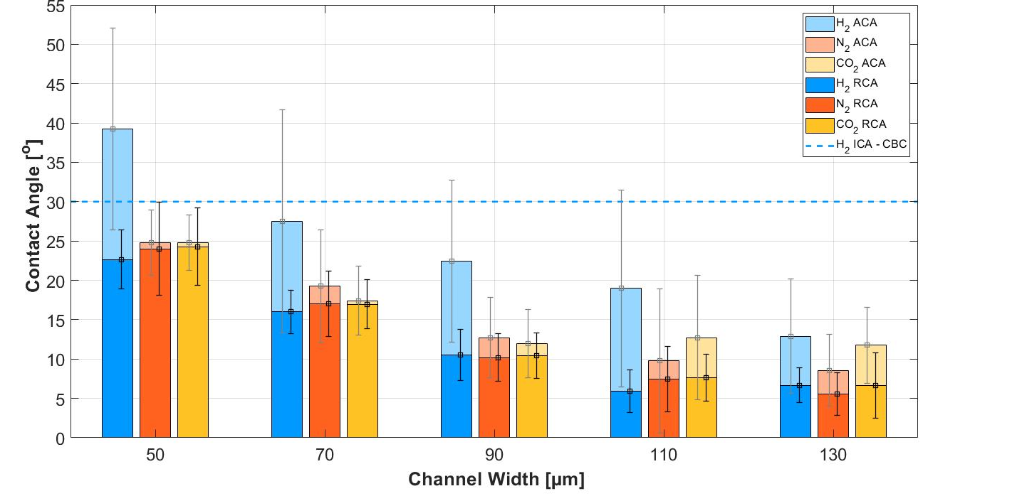
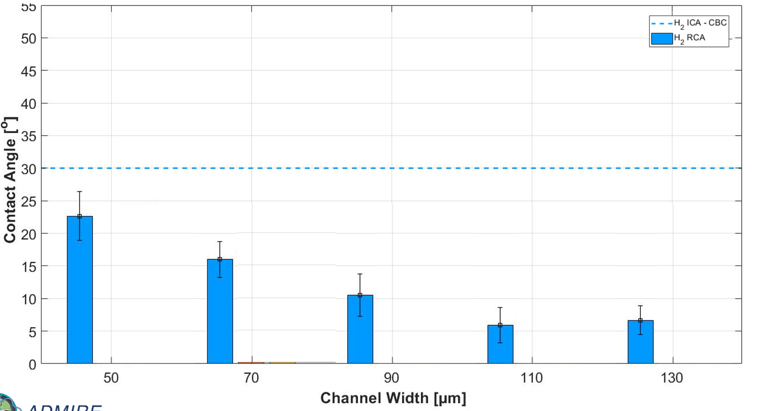

Results
      Strong water-wet
      Channel width-dependency
16

Slide 17
Results
      Strong water-wet
      Channel width-dependency
      CO₂ and N₂ similar to H₂
17

Slide 18
Results
      Strong water-wet
      Channel width-dependency
      CO₂ and N₂ similar to H₂
      Little hysteresis
18

Slide 19
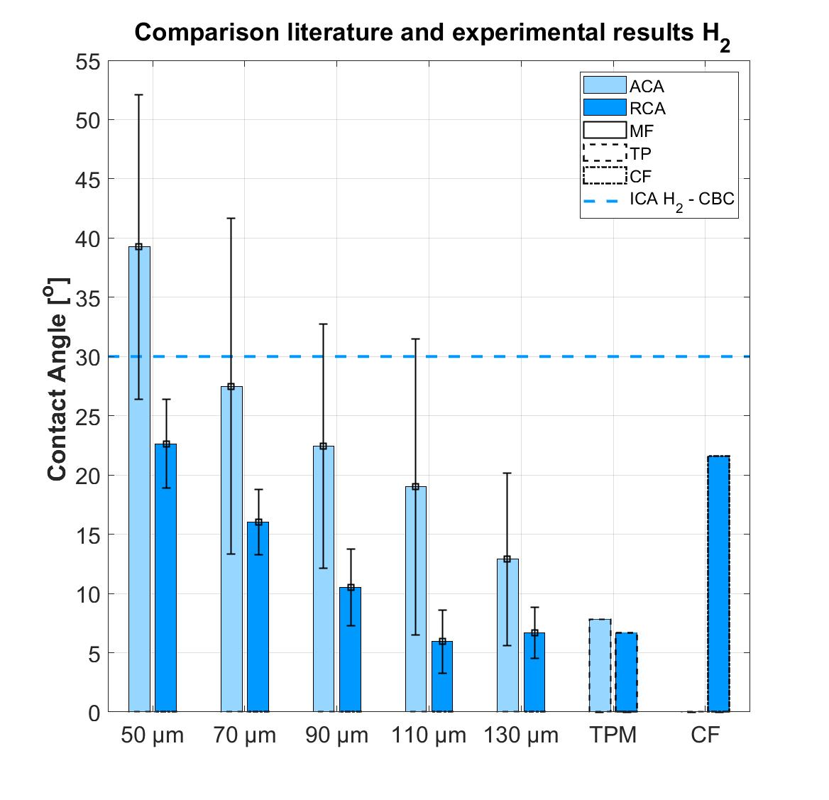
Comparison with literature
      Core-flood results - 50 µm
      Tilted Plate Method -130 µm
19

Slide 20
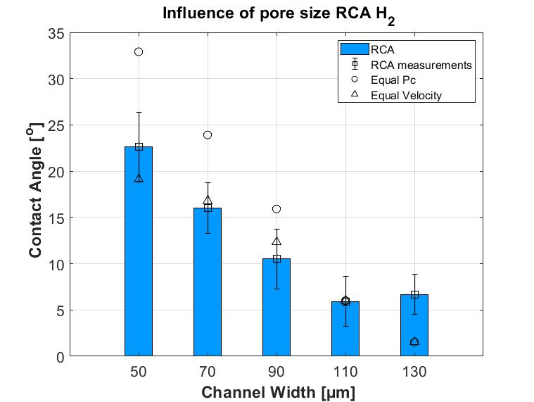
Influence of Pore Size: Theoretical backbround
Flow regime:
      Pc constant vs U constant!
20

Slide 21
Conclusions
H₂/water ACA: 13 – 39°
H₂/water RCA: 6 – 32°
21

Slide 22
Conclusions
H₂/water ACA: 13 – 39°
H₂/water RCA: 6 – 32°
Little hysteresis
22

Slide 23
Conclusions
H₂/water ACA: 13 – 39°
H₂/water RCA: 6 – 32°
Little hysteresis
Channel width dependency
23

Slide 24
Conclusions
H₂/water ACA: 13 – 39°
H₂/water RCA: 6 – 32°
Little hysteresis
Channel width dependency
CO₂/water and N₂/water systems similar to H₂/water systems
24

Slide 25
Conclusions
H₂/water ACA: 13 – 39°
H₂/water RCA: 6 – 32°
Little hysteresis
Channel width dependency
CO₂/water and N₂/water systems similar to H₂/water systems
25

Slide 26
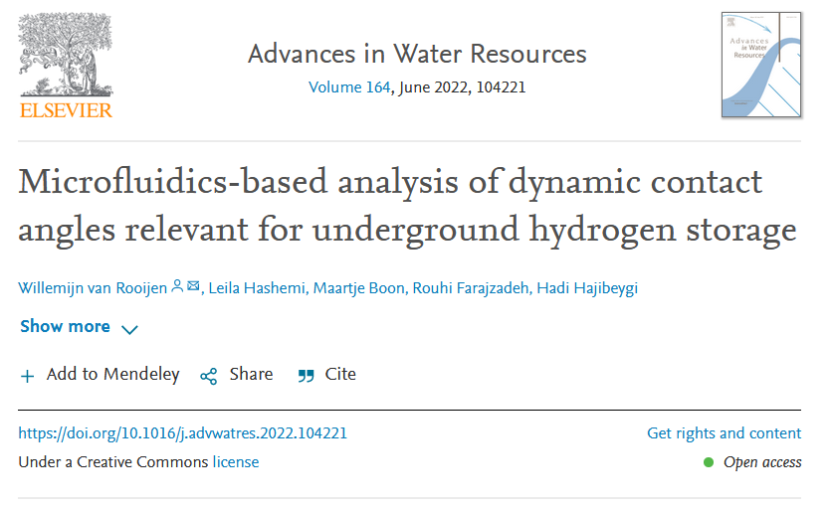
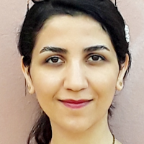
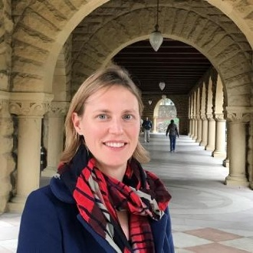

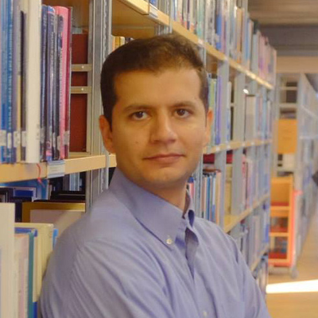
Thank you!
26

Slide 27
Microfluidics-based analyses of underground H₂ storage:
dynamic contact angles
Van Rooijen et al., AWR, 2022
Willemijn van Rooijen
Leila Hashemi, Maartje Boon
Rouhi Farajzadeh, Hadi Hajibeygi
W.A.vanRooijen@tudelft.nl
Interpore 2022
May 30th 2022

Slide 28
Extra slides

Slide 29
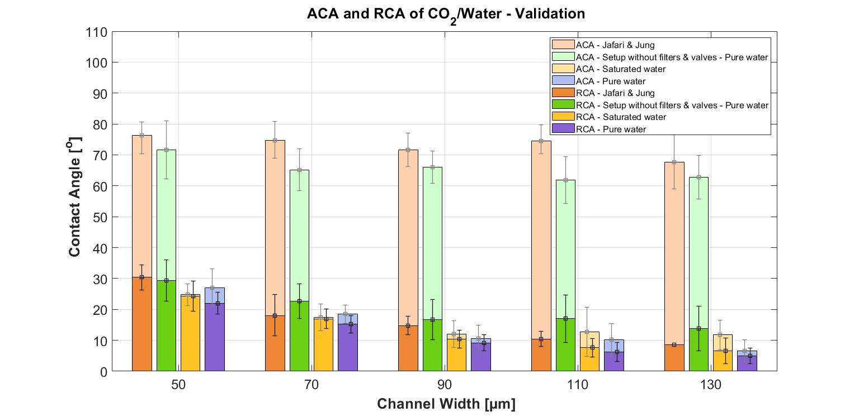

Slide 30
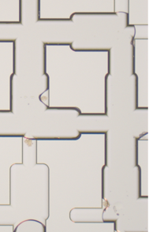
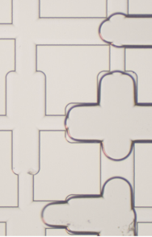
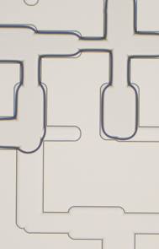
Chip 1, 2 and 3
Chip 4
Chip 5

Slide 31
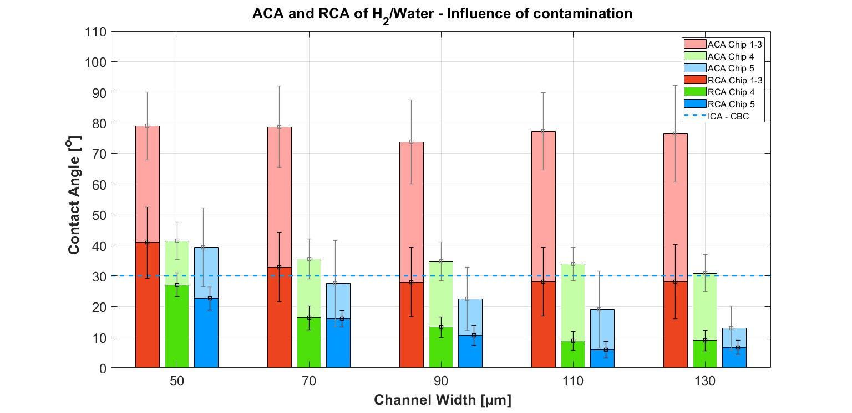

Slide 32
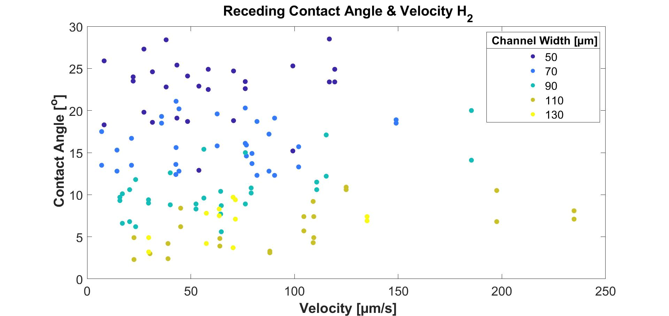

Slide 33
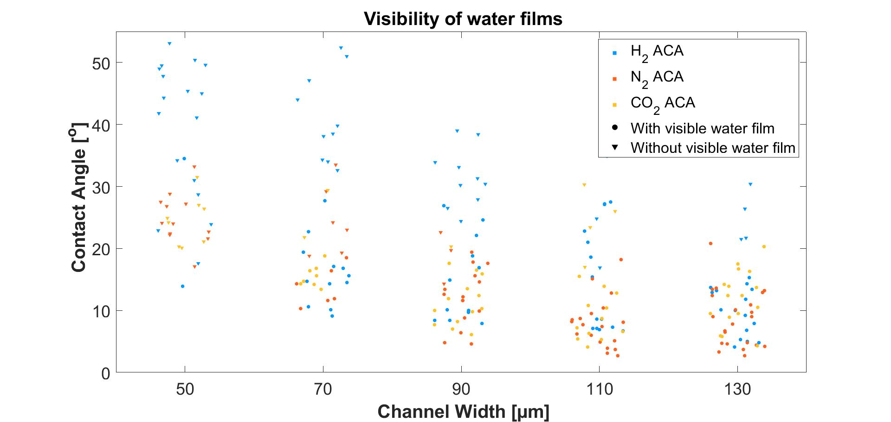

Slide 34
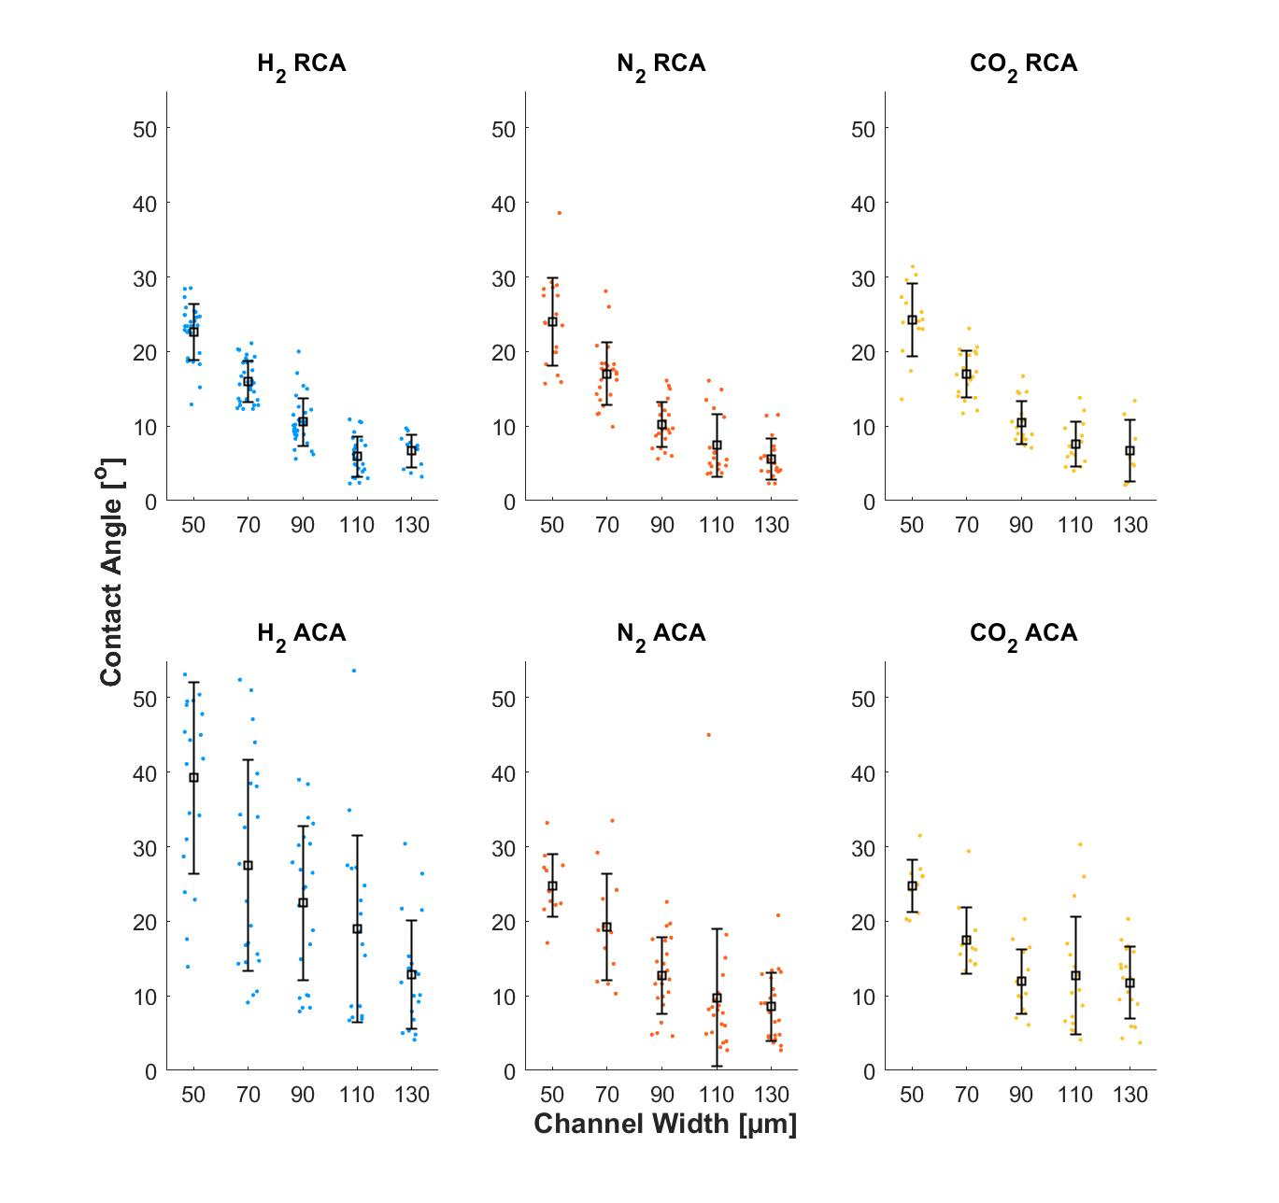

Slide 35
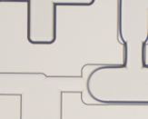
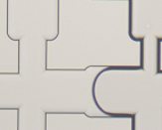
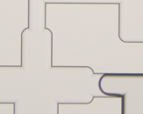
Results and discussion
    Validation (Jafari and Jung, 2017)
    Three types of interfaces
        With visible water films on both sides (top)
09-10-2020
35
35

Slide 36
Results and discussion
    Validation (Jafari and Jung, 2017)
    Three types of interfaces
        With visible water films on both sides (top)
        No visible water films (middle)
09-10-2020
36
36

Slide 37
Results and discussion
    Validation (Jafari and Jung, 2017)
    Three types of interfaces
        With visible water films on both sides (top)
        No visible water films (middle)
        One visible water film (bottom)
09-10-2020
37
37

