Slide 1
Digital Rock Characterization of Glacial Deposits to Refine Pore Systems
Ivan S Deshenenkov*, Paul J Tarabbia & Aqeel M Khalifa
Saudi Aramco, Dhahran, Saudi Arabia
2 June 2022
© Saudi Arabian Oil Company: Public, 2022

Slide 2
Agenda:
1. Glacial Flour
2. Digital Rock Physics Technology
3. Vugular Porosity from Dissolved Clasts
4. Pore Size Distributions
5. Conclusions

Slide 3
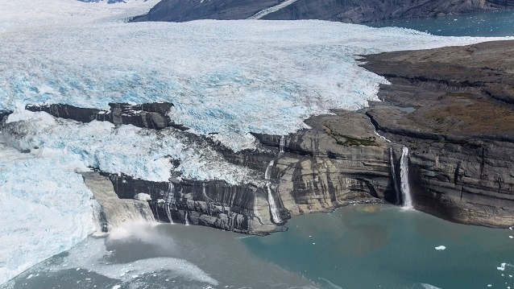
Glacial Rock Flour
Grey wash rich in Glacial flour
US National Park Service

Slide 4
Type Sample of Glacial Flour
Petrographic thin-sections illustrating possible glacial flour

Slide 5
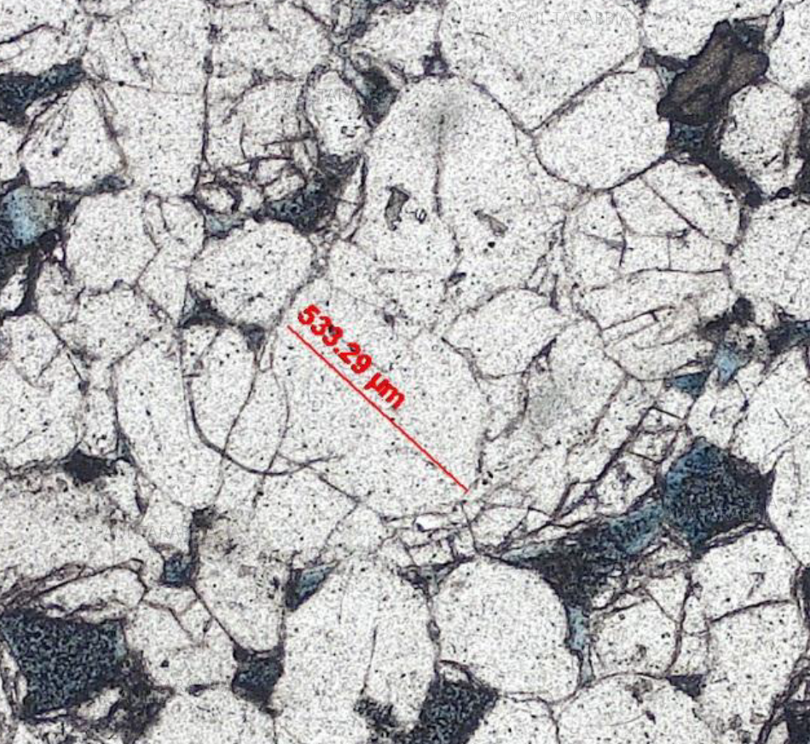
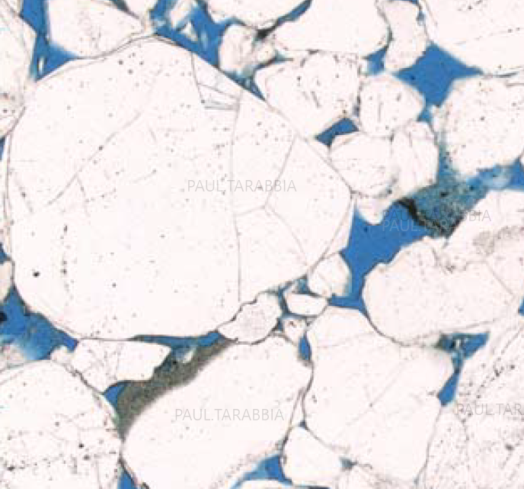
Petrographic Thin-Sections
Glacial grain crushing, abrasion and grain fracturing (Haldorsen, 1981):
Very high overburden and shear stresses in subglacial sediments > brittle and ductile deformations
Hard to tell if grains fractured near the surface due to glaciation or with increased burial due to compaction effects.
Petrographic thin-sections illustrating grain fracturing

Slide 6
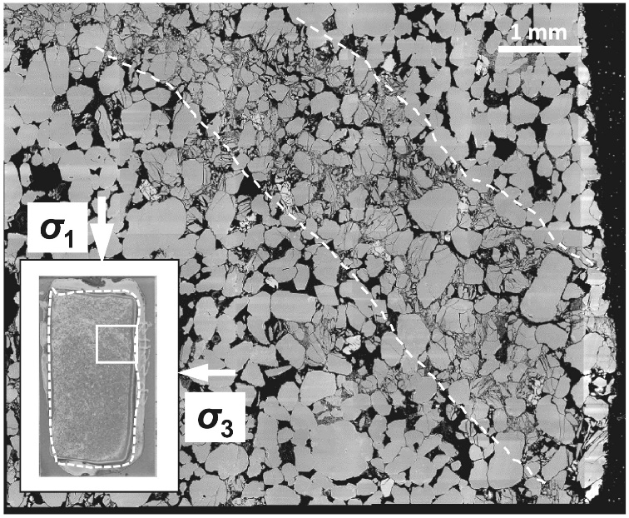
After Ma & Haimson, 2016
Grain Fracturing
Geomechanical Tests
Note the coexistence of fractured grains near non-fractured grains.
3D X-ray microscopy

Slide 7
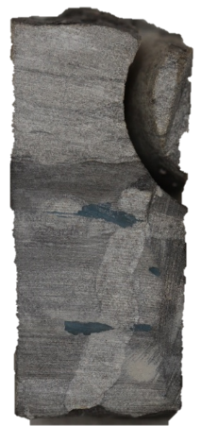
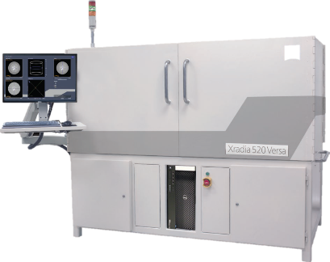
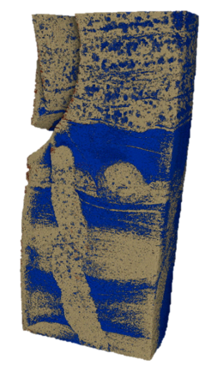
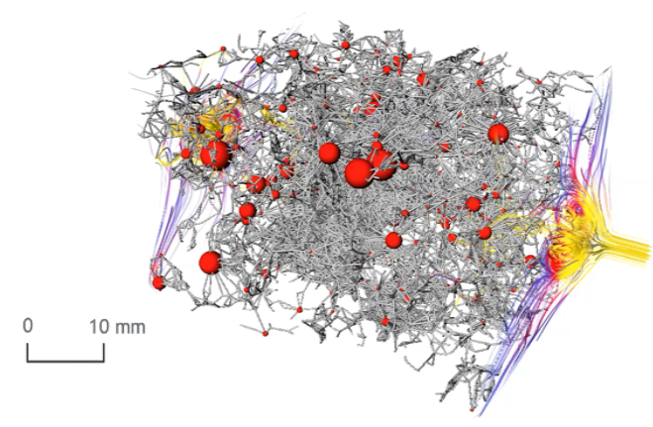
Workflow and Applications
WORKFLOW
Advanced analytical lab analysis of rock material to support Exploration drilling campaign
Non-destructive technique to examine 3D rock fabric and properties at micron scale
Using X-rays to evaluate reservoir quality
Generate fundamental Rock Physics data
Reduce budget & turn-around time of obtaining petrophysical information
Select the core sample
Image the core plug with X-rays
Evaluate rock structure
Model reservoir
quality

Slide 8
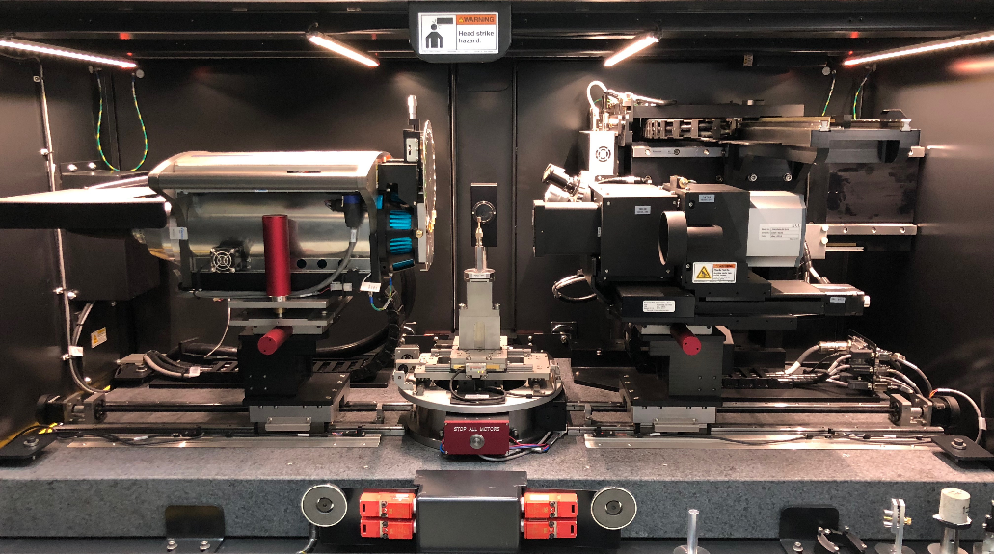
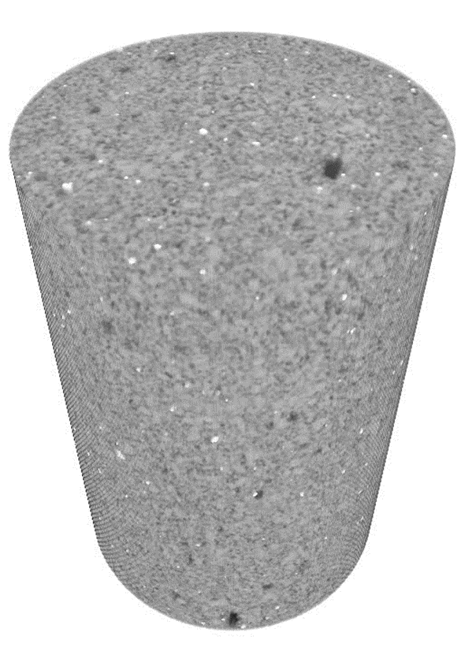
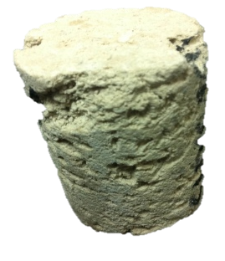
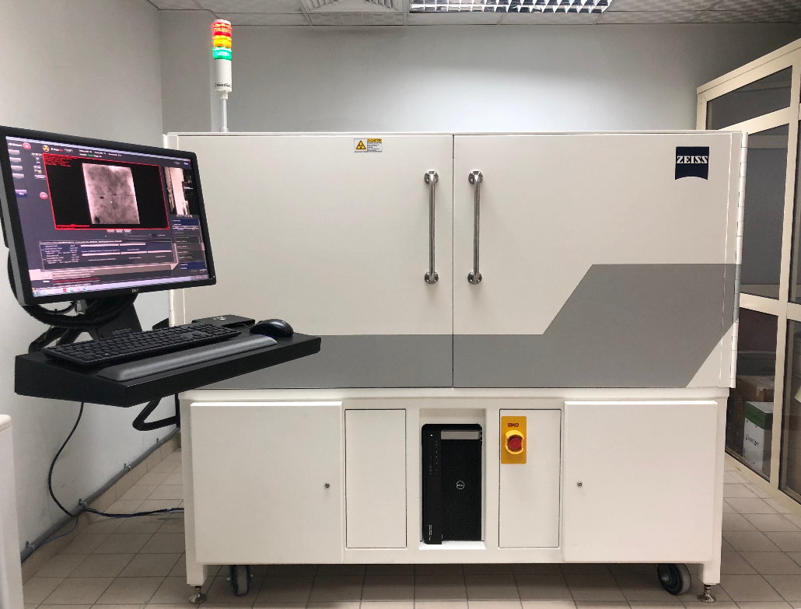
Digital Rock Physics Technology Outline
X-ray machine and imaging physics
sample
rotates
3D XRM render Voxel size 20μm
X-rays
High-resolution 3D X-ray Microscope was used to generate digital tomographies of the target samples with macro and 0.4x magnification (5-20 microns resolution) for the standard 1.5” plugs and 4x and 20x magnification (0.1-5 microns resolution) for the smaller sub-samples.

Slide 9
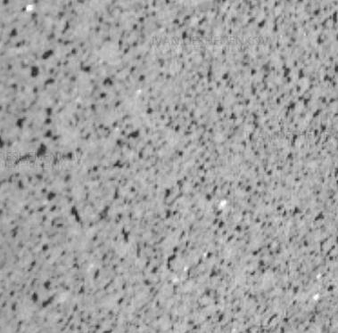
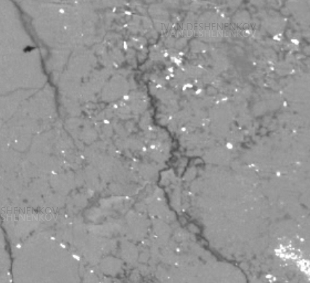
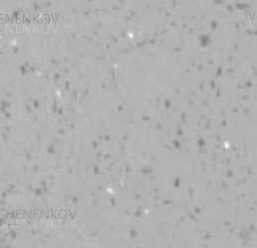
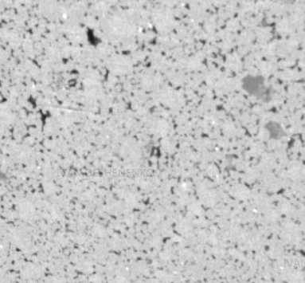
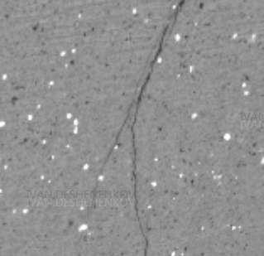
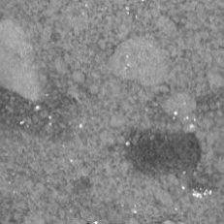
Digital Imaging Rock Morphology
Macroporous sandstone
Fractured tight sandstone
Microporous sandstone
Vugular porosity sandstone
Fractured microporous sandstone
Multi-rock type

Slide 10
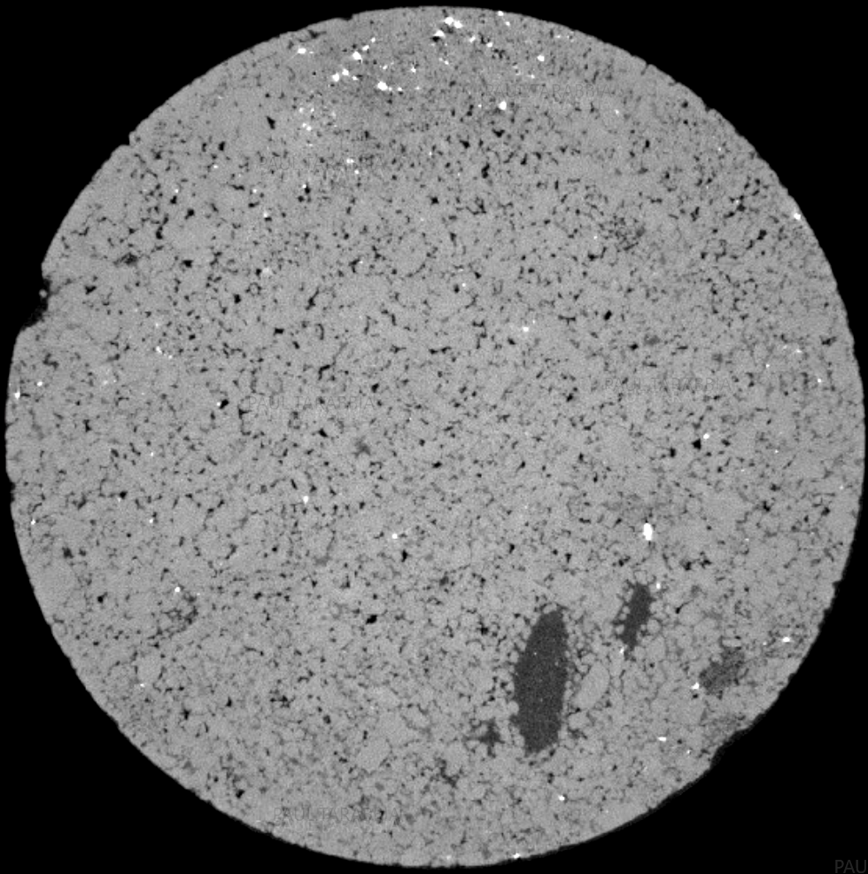
Vugular Porosity from Dissolved Clasts
3D X-ray Microscopy Example, 20um voxel size
Vugs were fairly common in the bulk of the plugs. A lot of them appear flattened or deformed but display well formed edges of the precursor clasts. This suggests induration of sediment before dissolution of clasts.
3mm wide
7mm long
quartz grains
heavy minerals
pores

Slide 11
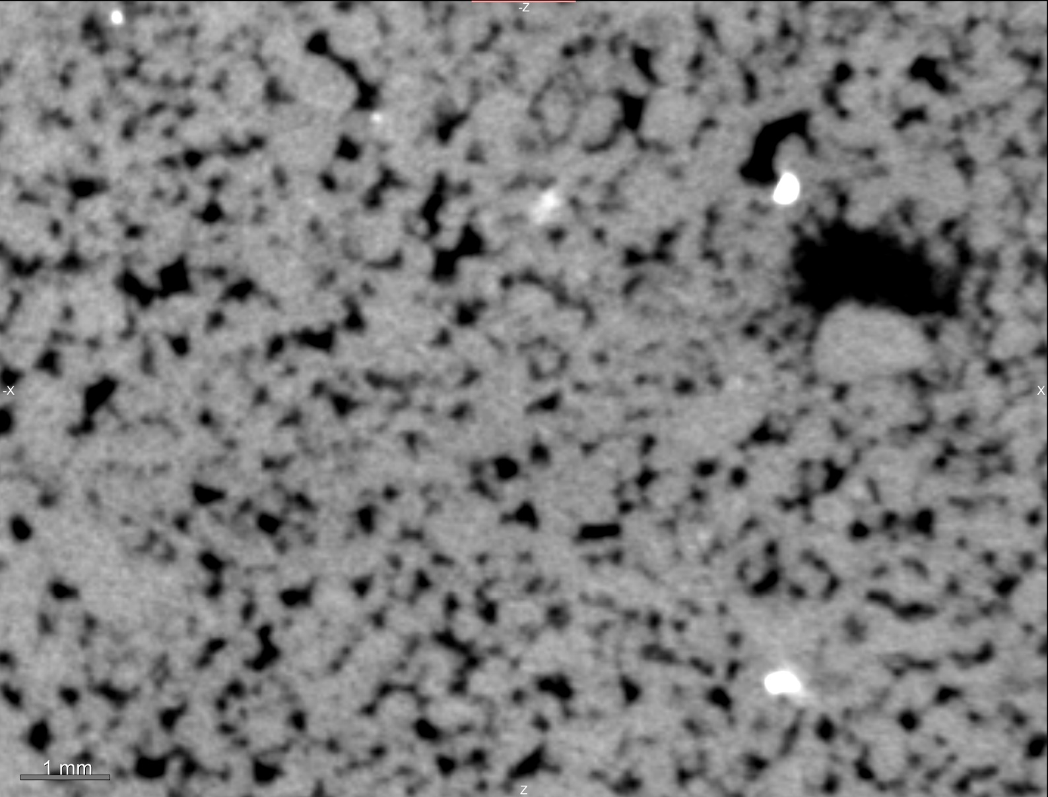
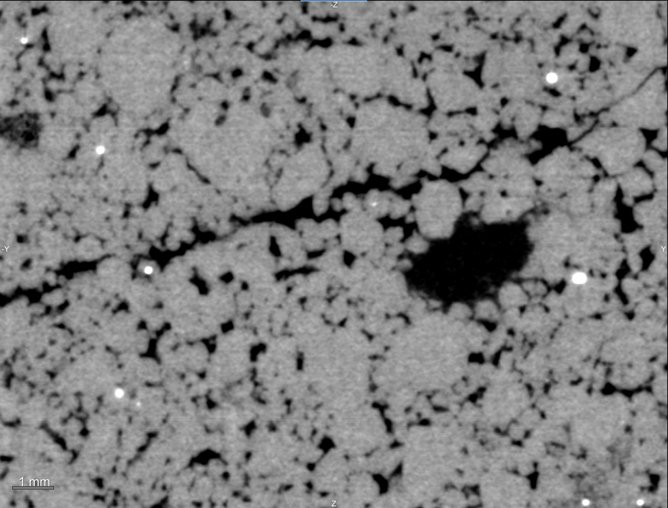
Vugular Porosity from Dissolved Clasts
3D X-ray Microscopy Example, 20um voxel size
Vugs observed in the plugs have well defined clast shapes and range in size from 1 to 7 mm.
Coring induced fractures were observed.
Heavy mineral distribution (bright white patches on the images) is important due to REE’s found in their composition, including Gadolinium that is a neutron absorber.
XRM horizontal slices of core plugs 3D X-ray tomograms. Note several large vugs on lower right edge of the plug that have a well-defined clast shape and the rim is made up of much smaller sized sand particles. White grains in these XRM images are heavy minerals.

Slide 12
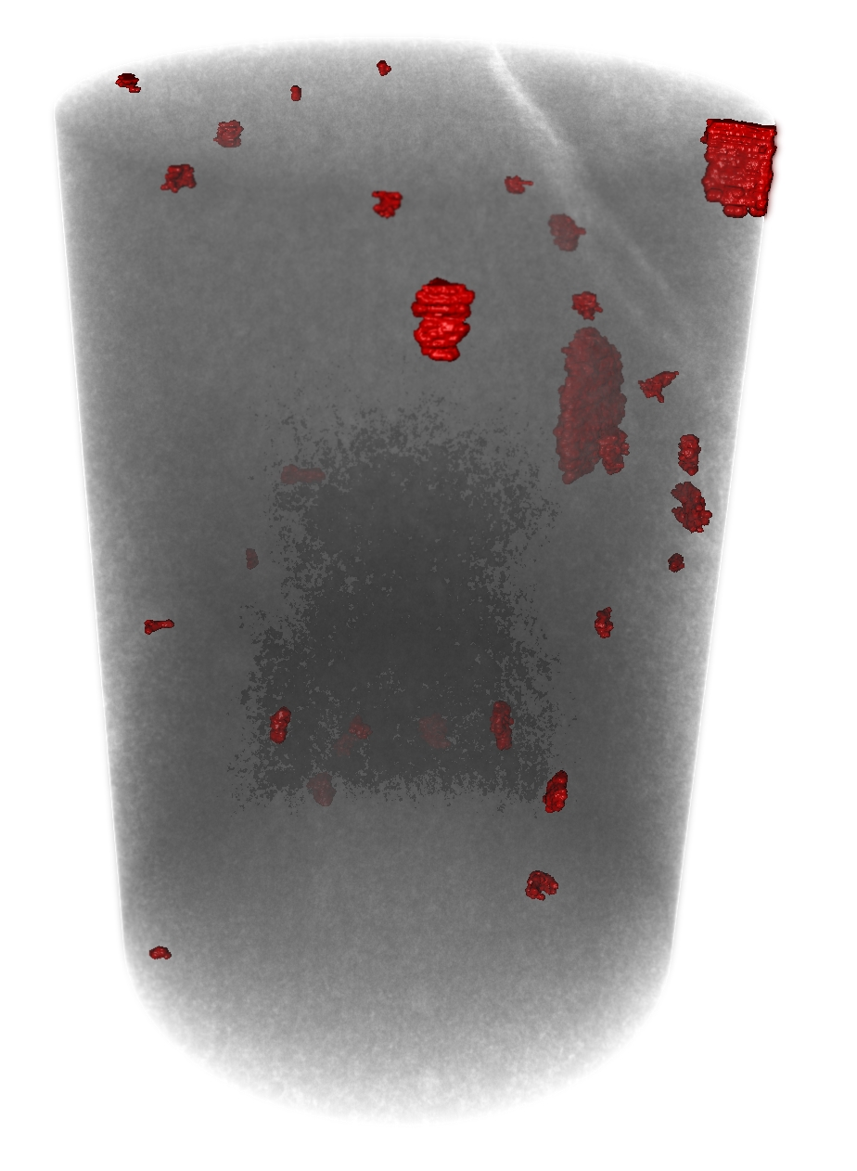
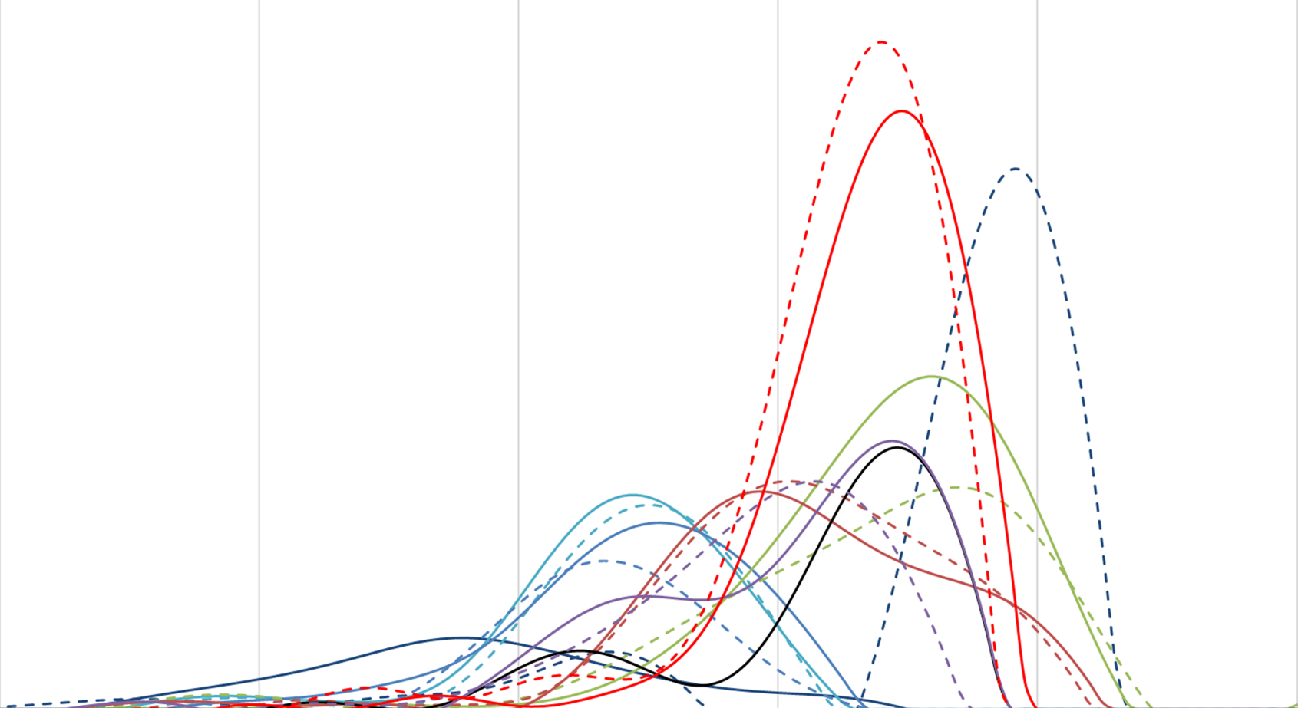
Pore Size Distributions
3D X-ray Microscopy and Nuclear Magnetic Resonance
Total porosity
←low high→
0.1
1
10
100
1,000
10,000
T2, ms
3D render of vugs from X-ray microscopy
Nuclear Magnetic Resonance T2 Distribution (2MHz)

Slide 13
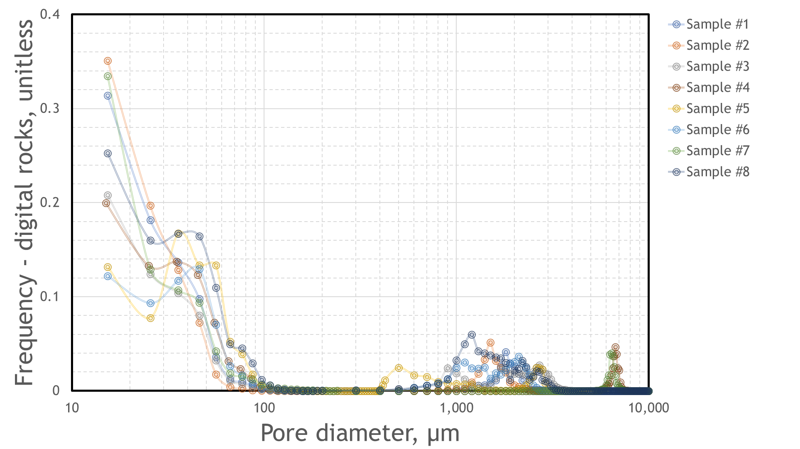
Pore Size Distributions
X-ray Microscopy and Nuclear Magnetic Resonance
Grain fracturing
Glacial flour
Vugs
Vugs
←low high→
Total porosity
0.1
1
10
100
1,000
10,000
T2, ms
Pore size distribution and NMR T2 with the presence of silt-sized pores (10-100 µm) in addition to the vugs (>1 mm).

Slide 14
Conclusions
The study is able to confirm bi/tri-modal pore size distributions, showing how the stratigraphy could be resolved using XRM. It unlocks future efforts for basin-scale pore-size characterization and modeling.
As the glacial flour is made up of fine particles, these particles may be mobile when a well is put on production, which may reduce permeability and cause productivity issues.
Identification of the glacial flour helps to refine well testing and production mechanisms.
As yielded by digital rock physics, vugs associated with studied rocks may also be a way of distinguishing glacial sediments, and impact storage capacity of the formation.

