Slide 1


How does the presence of an oil phase influence the non-Fickian salt transport during low salinity waterflooding EOR?
Arman Darvish Sarvestani ª, Behzad Rostami ª, Hassan Mahani ^{b}
Institute of Petroleum Engineering, University of Tehran, Iran.
(b) Department of Chemical & Petroleum Engineering, Sharif University of Technology, Iran.
University of
TEHRAN
arman7d@gmail.com, brostami@ut.ac.ir, hmahani@sharif.edu

Slide 2

Outline
Introduction
Problem Statement
Research Method
Results & Discussion
Conclusions
2

Slide 3
Low Salinity Waterflooding (LSWF)
High-Salinity Waterflooding
Low Salinity Waterflooding
Time
3
Reference: [Mahani et al (2015)]

Slide 4
Physical Dispersion/Mixing
Normalized
Salinity
t₁
t₂
t₃
4
Time
Reference: [Green & Willhite (1998)]

Slide 5
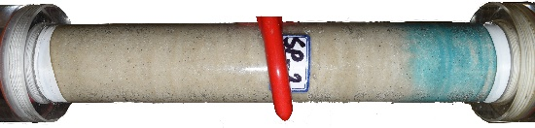
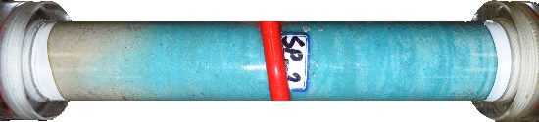
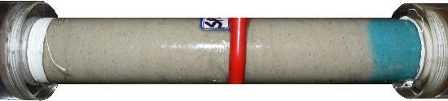
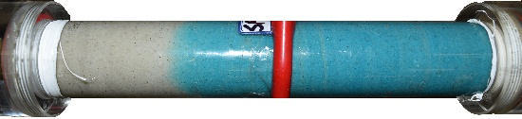
Polymer-Enhanced Low Salinity Waterflooding
(PELS)
After 0.14 PV
After 0.72 PV
LS
(0 ppm HPAM)
Dispersivity = 0.0069 ft
PELS
(200 ppm HPAM)
Dispersivity = 0.0018 ft
Flow Direction
Flow Direction
5
Reference: [Darvish et al (2021)]

Slide 6
Problem Statement
Previous studies showed that:
salt transport through porous media is affected by HPAM concentration, injection rate and salinity difference.
How does the presence of the second phase (such as oil) impact the salt dispersion during PELS?
6

Slide 7
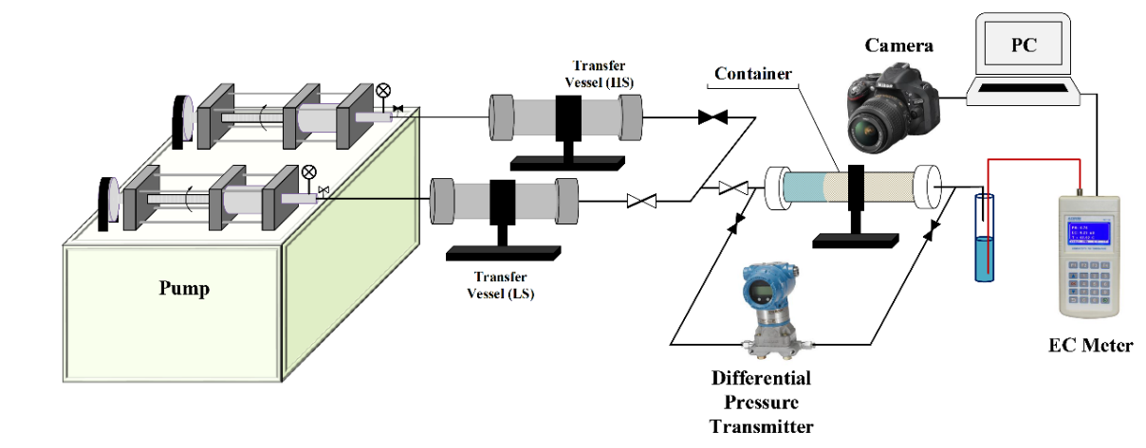
Research Method
Salinity
3 cm
Time (Injected PV)
25 cm
7

Slide 8
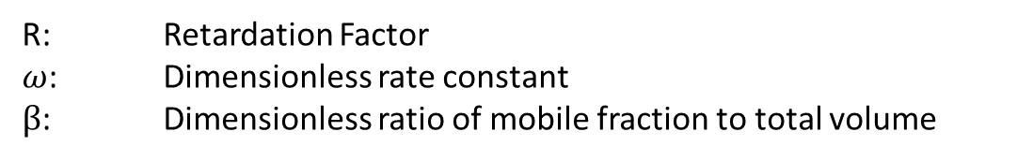
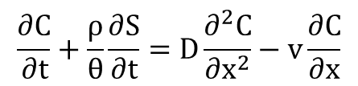



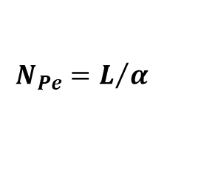
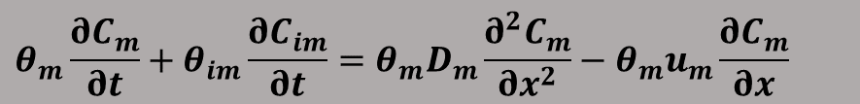

Mobile-Immobile Model (MIM)
Non-Fickian Dispersion
$$\frac{∂C}{∂t}+\frac{ρ}{θ}\frac{∂S}{∂t}=D\frac{∂^{2}C}{∂x^{2}}−v\frac{∂C}{∂x}$$
Mobile-Immobile Model (MIM)
Assumptions:
Negligible adsorption
Dispersion occurs only through aqueous phase
$$θ_{m}\frac{∂C_{m}}{∂t}+θ_{im}\frac{∂C_{im}}{∂t}=θ_{m}D_{m}\frac{∂^{2}C_{m}}{∂x^{2}}−{θ_{m}u}_{m}\frac{∂C_{m}}{∂x}$$
$$β=\frac{θ_{m}+ρk}{θ+ρk}$$
STANMOD is used for dispersivity analysis
$$R=1+\frac{ρk}{θ}$$
Negligible Adsorption (k ≈ 0)
$$β=1, R=1,ω=0$$
Dispersivity only depends on Peclet number (N_{Pe})
$$ω=\frac{α(1−F)ρk}{q}$$
$$N_{Pe}=L/α$$
R: Retardation Factor
$ω$: Dimensionless rate constant
$β$: Dimensionless ratio of mobile fraction to total volume
8

Slide 9
HS: 100,000 ppm
PELS: 2,000 ppm NaCl + 200 ppm HPAM
Presence of the 2nd phase
Higher salt dispersivity
9

Slide 10
HS: 40,000 ppm
PELS: 6,000 ppm NaCl + 200 ppm HPAM
10

Slide 11
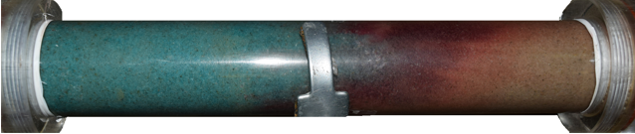
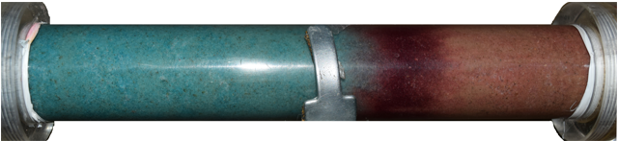
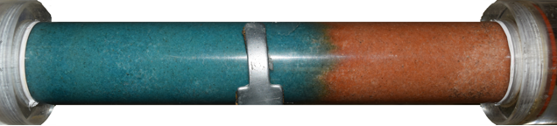
Results & Discussion
0
ppm
200
ppm
1,000
ppm
11

Slide 12
Conclusions
Single-Phase
200 ppm
Two-Phase
400 ppm
12

Slide 13
  Thanks for your kind attention
13

