Slide 1
Flow heterogeneity impact on dissolution processes in geologic porous media
Z. Kanavas¹, J. Jimenez-Martinez^{2,3}, J. Nimmo⁴, V.L. Morales¹
¹University of California, Davis
²ETH, Zürich, Switzerland
³Eawag, Dübendorf, Switzerland
⁴United States Geological Survey
Notes:
Today I will be presenting my project: Flow heterogeneity impact on dissolution processes in geologic porous media
Before jumping in I want to thank my advisor and collaborators for the immense help on this work and I also want to acknowledge the funding source, the National Science Foundation and Petroleum Research Fund

Slide 2
Geologic carbon storage has security concerns
Injected CO₂ acidifies host brine
Local reactions at injection may compromise integrity of well seal
Dissolution pattern can alter the mechanical integrity of the formation
Injection
Well
Caprock
Stored CO₂
Brine Formation
Caprock
Notes:
A novel approach to achieve net-zero emissions is the process of capturing and storing atmospheric carbon dioxide.
One method to do so is geologic carbon storage where we inject supercritical CO2 into a confined brine formation in the subsurface.
The injected CO2 will acidify the host brine influent and then dissolve any carbonate present in the reservoir.
Local reactions at the injection site make compromise the integrity of the well seal, potentially allowing CO2 to escape the confining caprock.
Also, the resulting dissolution pattern can an alter the mechanical integrity of the formation.
This motivates us to better understand and model the impact of fluid flow on solid dissolution in these brine-rock systems.

Slide 3
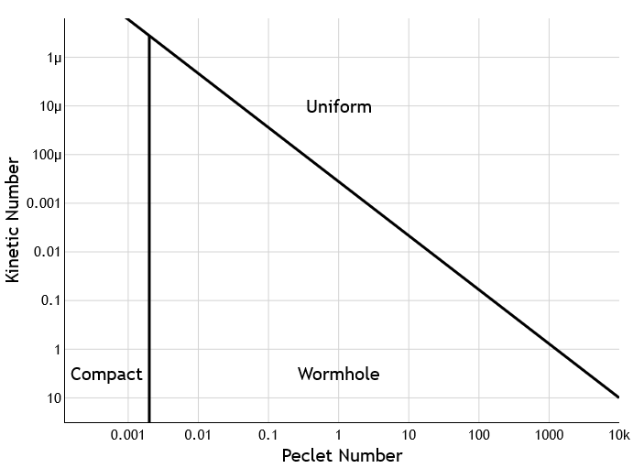
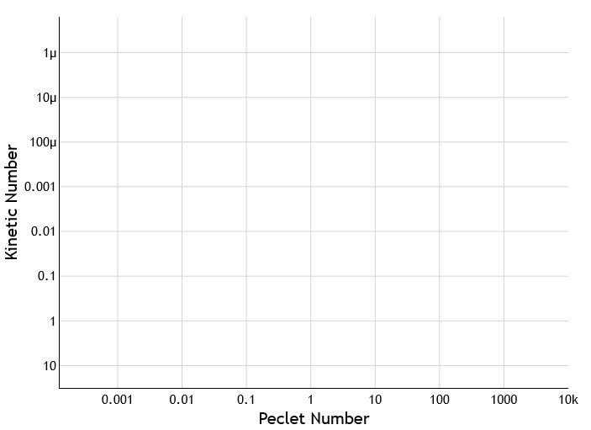
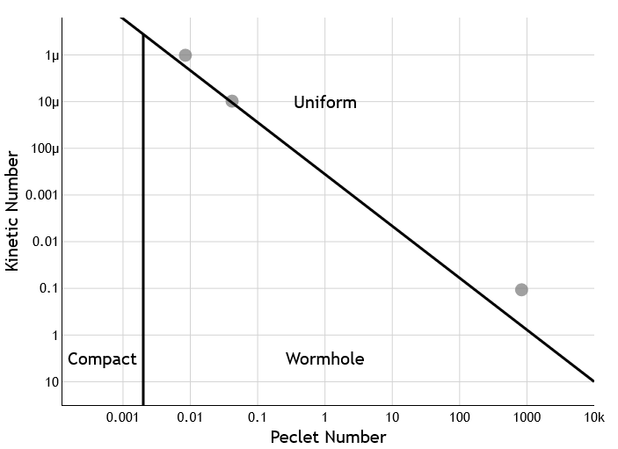
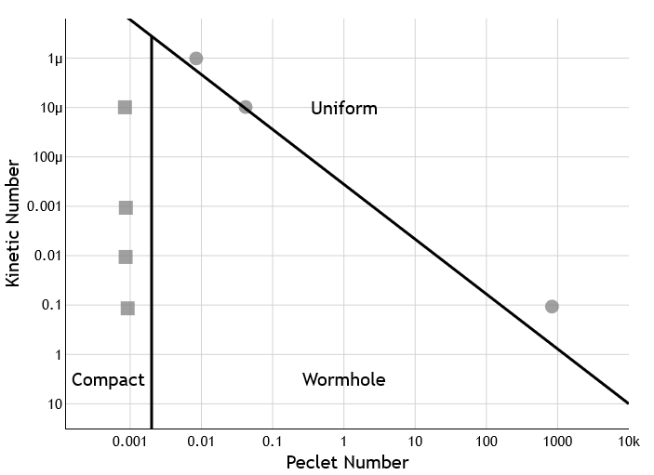
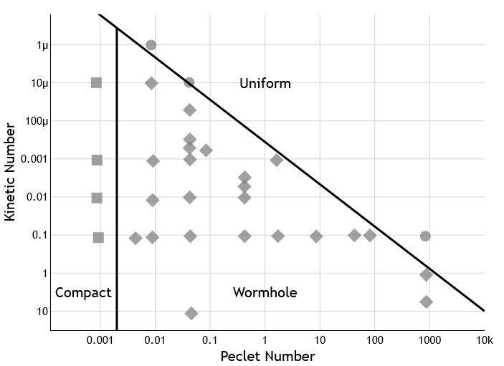
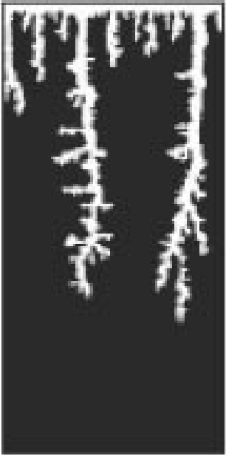
Conventionally, dissolution behavior is predicted using dimensionless transport & reaction metrics
Uniform
Compact
Wormhole
Uniform
Golfier 2002 Compact
Wormhole
Porosity
0.4
0.5
0.6
0.7
(Golfier et al., 2002)
Reaction-dominate
Granular salt dissolution
Uniform structure results in homogeneous flow
0.8
Diffusion-dominate
Diffusion-dominate
Advection-dominate
0.9
1.0
Notes:
Conventionally dissolution behavior is predicted using the dimensionless transport & reaction metrics in the form of a phase diagram, namely the Peclet and Kinetic numbers, where the Peclet number compares the advective to diffusion transport rate and the kinetic number compares the diffusive to reaction rate.
The most cited dissolution diagram from Golfier and coauthors studied the dissolution of granular salt samples and observed the following trends:
When the transport and reaction timescales are well matched, we expect to see a uniform dissolution pattern, where fresh reactant is carried away from the inlet, and reaction spreads throughout the sample.
At very low Peclet numbers, we expect compact dissolution where the porous medium is mostly dissolved where injection occurs.
With greater Kinetic and Peclet numbers, we expect wormhole dissolution where highly conductive channels are etched through the rock, where all the reaction occurs.
To reiterate, this diagram was developed from observations of granular salt sample dissolution. The uniformity of the samples’ structure will result in a homogeneous flow field.

Slide 4
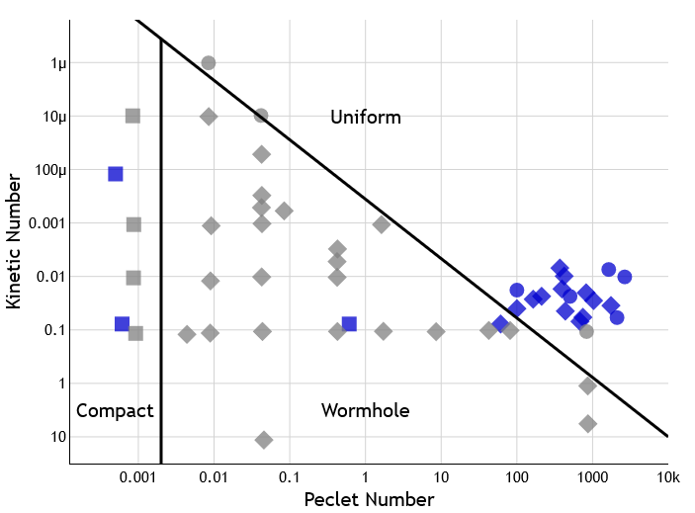
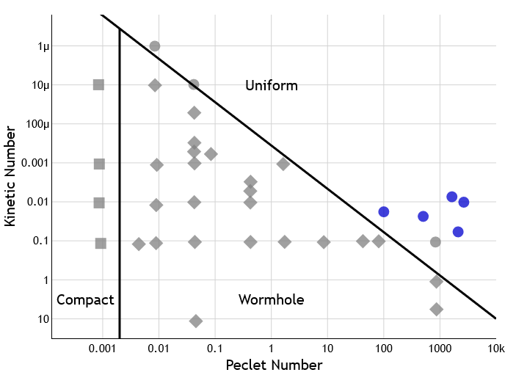
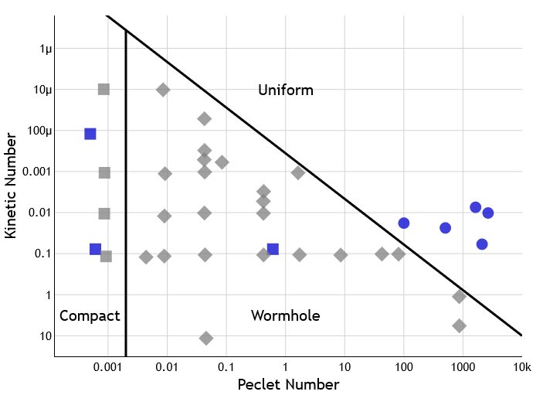
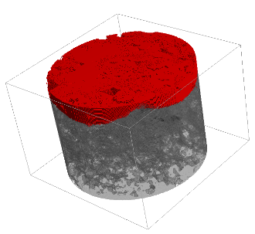
For complex structures, there are apparent misclassifications
Uniform
Compact
Wormhole
Uniform
Golfier 2002 Compact
Wormhole
Uniform
Golfier 2002 Compact
Wormhole
Uniform
Other Work¹⁻⁷ Compact
Wormhole
1
2
1
Reacted surface
Unreacted surface
¹Pereira-Nunes et al., 2016 ²Kanavas et al., In Prep
³Menke et al., 2015 ⁴Menke et al., 2017
⁵Al-Khulafi et al., 2018 ⁶Al-Khulafi et al., 2019
⁷Hinz et al. 2019
Complex structures can induce heterogeneous flow
Cause of misclassification?
Notes:
However, real rock samples are rarely homogenous.
Let’s plug some data of variably heterogeneous samples into Golfier’s model, I’ll show these points in blue.
First, we plot the samples where we observe uniform dissolution, as blue circles, all of these samples correctly fall into the uniform regime defined by Golfier’s diagram. Note, I am showing the post-dissolution structure, where red is the reacted surface and gray is the unreacted surface.
Next we plot samples exhibiting compact dissolution as blue squares… and wormhole dissolution as blue diamonds, and we see apparent misclassifications.
The complexity of these sample’s structures can induce heterogeneous flow and is a possible cause for this misclassification.

Slide 5
Research Aims
Goal: Understand what controls dissolution processes in structurally complex media.
Propose models to predict reaction ratio and dissolution behaviors.
Investigate the feedback process of flow heterogeneity on dissolution behavior.
1
2
Notes:
Through this project we sought to better understand what controls dissolution processes in structurally complex media.
To do so, we first Proposed models to predict reaction ratio and dissolution behaviors,
And then, we Investigated the feedback process of flow heterogeneity on dissolution behavior.

Slide 6
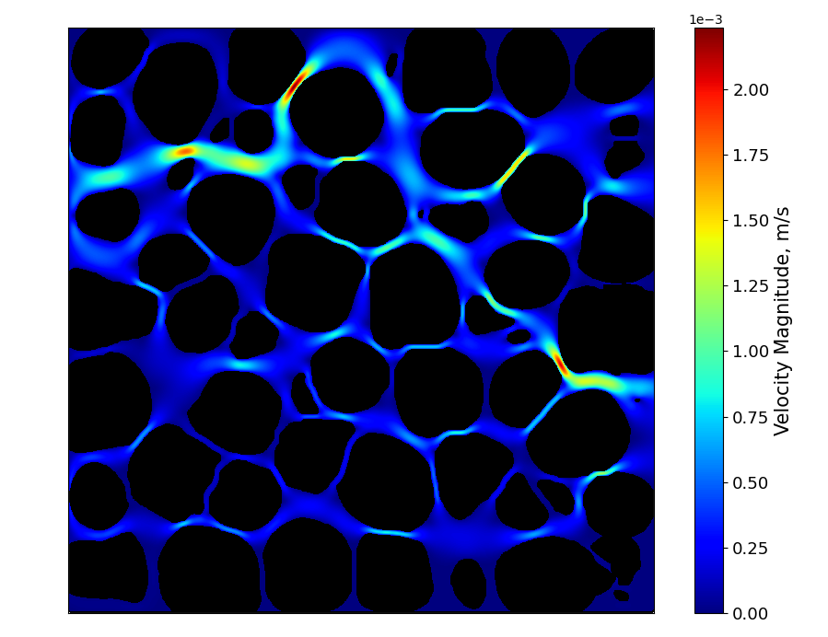
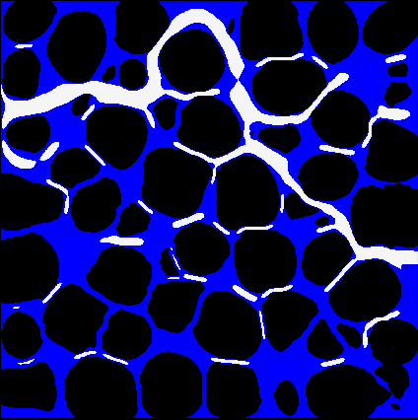
Quantifying flow heterogeneity: percolation threshold
1e-3
2
Immobile Region
$$u/{\left\langle u\right\rangle }<p_{c}$$
Mobile Region
$$u/{\left\langle u\right\rangle }≥p_{c}$$
Velocity Magnitude, m/s
1
(Kanavas et al., 2021)
0
Divides the flow field into mobile and immobile regions
$p_{c}→0$ homogenous flow
$p_{c}≫1$ heterogeneous flow
Interpore 2022 | zkanavas@ucdavis.edu
6
Notes:
We can determine the Eulerain flow field via direct numerical simulations. There is no agreed upon metric to quantify the heterogeneity of this field, so we proposed one in our publication last year.
We propose to quantify flow heterogeneity using the percolation threshold.
The percolation threshold is a measure of flow channelization and divides the flow field into mobile and immobile regions
Mathematically defined as the ratio between the minimum velocity in the mobile region relative to the average velocity of the sample. This velocity threshold is set as the first established path that connects inlet to outlet (i.e., percolation path). Velocities lower than this threshold are in the immobile region and velocities greater than this threshold are in the mobile region
A small percolation threshold indicates that the first breakthrough particle speed is similar to the average and indicates a homogeneous flow field.
A large percolation threshold indicates that the first breakthrough particle will exit the medium much faster to the average exit time and indicates a heterogeneous flow field.

Slide 7
Flow heterogeneity → incomplete mixing → reaction hotspots
Reaction ratio = $r_{e}/r_{b}$
1e-3
2
Velocity Magnitude, m/s
1
Where reactions occur!
0
Mobile region
Immobile region
Dissolved CO₂
Notes:
Our hypothesis of why flow heterogeneity is key to explain dissolution can be best explained with this pore-scale schematic.
Here is a zoomed view into the pore-scale of a 2d velocity field. Once the flow field is determined, we can find the streamlines that show the direction a particle will travel.
Flow heterogeneity can be also conceptualized as a division of the flow field into “mobile” and “immobile” flow regions, in white and blue respectively.
When CO2 is injected into the rock (here the pink particles), the bulk of the injected fluid will travel through the mobile region.
Here, CO2 particles are most likely to come into contact with the host rock at the interface between the mobile and immobile regions.
At this interface (shown in red) the acidified brine locally “mixes” with the rock and reacts to dissolve it.
Since acidified brine is not equally distributed in the void space, mixing of reactants is incomplete. This is in stark contrast to batch dissolution, where solution in a beaker and the rock are forcefully well mixed by a stir bar.
To gauge how incompletely mixed and under-reacted a system is, it is typical to quantify a porous medium’s reaction ratio: the reaction rate ratio of the effective to batch.

Slide 8
Incorporating flow heterogeneity into phase diagram
Uniform
Compact
Wormhole
Uniform
Compact
Wormhole
Compact
Wormhole
Uniform
Notes:
Returning to the apparent misclassification by Golfier’s diagram, we see the blue samples require the percolation threshold as the third dimension to be correctly classified.
Here, we have arbitrarily drawn cutoffs between the three behaviors.
We can see there is a relationship between the Peclet Number and the Percolation threshold, we can quantitatively confirm that with the following model.

Slide 9
Quantitatively predicting reaction ratio: $r_{e}/r_{b}$
Generalized Linear Model (GLM)
All possible combinations are ranked by their AIC to identify the best statistical model.
Mineral
heterogeneity
$$g\left(E\left({r_{e}}/{r_{b}}\right)\right)=β_{0}+\sum_{j=1}^{N}{β_{j}x_{j}}+\sum_{j=1}^{N}{\sum_{k=1}^{N}{β_{jk}x_{j}x_{k}}}$$
$$j,k∈\left\{Pe, K, {Da,p}_{c},MH,…\right\}$$
$$j≠k$$
Flow
heterogeneity
Reaction
ratio
Notes:
To statistically determine the best combination of the available metrics, we used a Generalized Linear Model, which produces a flexible linear equation that will predict the expected value of the reaction ratio as a function of some combination of the Peclet, Kinetic, and Damkohler number, as well as our flow heterogeneity term: percolation threshold, and other metrics like mineral heterogeneity as additive independent and/or interactive terms.
The various formulation combinations tested are ranked by their AIC (overparametrization penalty and goodness-of-fit) to identify the “best” statistical model.

Slide 10
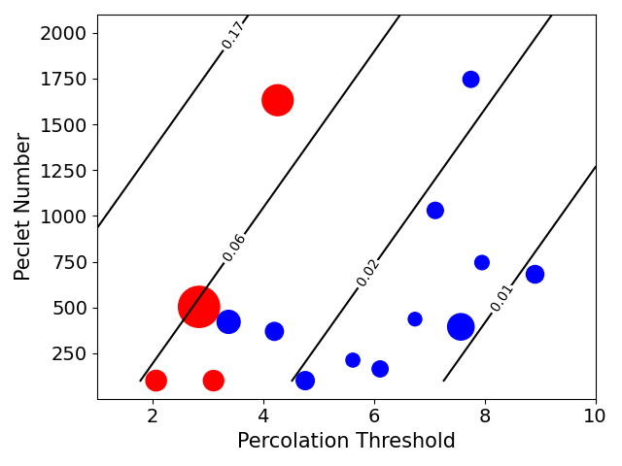
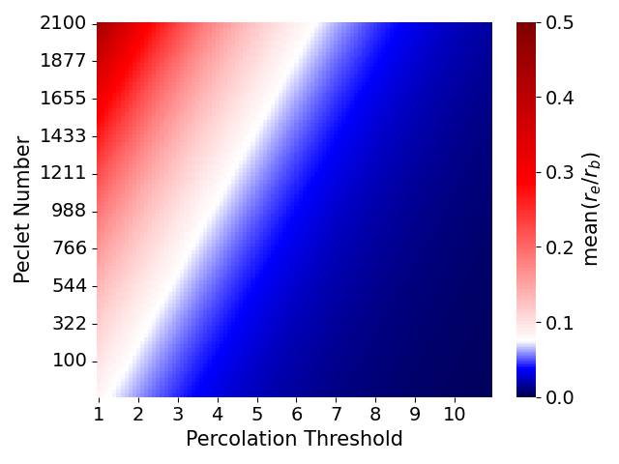
Quantitatively predicting reaction ratio: $r_{e}/r_{b}$
$$g\left(E\left({r_{e}}/{r_{b}}\right)\right)=β_{0}+β_{p_{c}}x_{p_{c}}+β_{Pe}x_{Pe}$$
Observed
$$r_{e}/r_{b}$$
Uniform
Wormhole
Predicted
This model explicitly predicts the reaction ratio ($r_{e}/r_{b}$) and hints at the expected dissolution behavior.
Notes:
The best model we found so far is the linear combination of percolation threshold and the Peclet number.
Here shown are the results of the predicted space for the range of Pe and pc that we have been working with.
Blue is lower reaction ratio, red is higher reaction ratio.
On the plot to the left we can appreciate that this does a pretty decent job at capturing the reaction ratios for heterogeneous structures. The marker size indicates the magnitude of reaction ratio and the marker color indicates the observed dissolution behavior.
Immediately we can see the relationship between reaction ratio and dissolution behavior where larger reaction ratios are associated with uniform dissolution and smaller reaction ratios are associated with wormhole dissolution.
So while This model explicitly predicts the reaction ratio ($r_{e}/r_{b}$) and it also hints at the expected dissolution behavior.

Slide 11
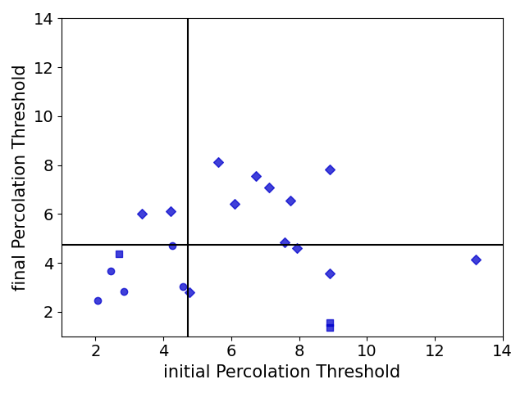
Flow heterogeneity → dissolution positive feedback
Uniform
Compact
Wormhole
Reinforcing (+)
Regulating (-)
Initial homogenous flow perpetuates uniform dissolution
Initial heterogenous flow perpetuates wormholing
However, some switch regimes during dissolution
→ Why?
Homogenous flow Heterogeneous flow
Homogenous flow Heterogeneous flow
Notes:
Because we have the structural evolution of our samples, we got interested in looking at how flow was arranged as dissolution progressed.
Here is a plot of the initial (x) and the final (y) metric for flow heterogeneity. Low values = uniform flow, high values = channelized flow.
From this we generally see that initial homogeneous flow perpetuates uniform dissolution and Initial heterogeneous flow perpetuates wormholing
However, some switch regimes during dissolution, we suspect a distinct structural shift happens during dissolution, though we are unsure of what it is.

Slide 12
Research Outcomes
Key Insight: Dissolution reactions are controlled by transport & reaction timescales, but their baseline hinges on flow heterogeneity.
Must account for flow heterogeneity in addition to transport and reaction timescales to predict dissolution behavior.
We can predict reaction ratio as a function of the Peclet number and percolation threshold.
Generally, there is a positive feedback process between flow heterogeneity and dissolution pattern.
1
2
3
Notes:
The key insight from this work is that dissolution reactions are controlled by transport & reaction timescales, but their baseline hinges on flow heterogeneity and we determined that, for complex structures,
1. We must account for flow heterogeneity in addition to transport and reaction timescales to predict dissolution behavior
2. We can predict reaction ratio as a function of the Peclet number and percolation threshold, and
3. We, generally, see a positive feedback process between flow heterogeneity and resulting dissolution pattern.

