Slide 1
Emergence of non-Fickian transport in truncated pluri-Gaussian permeability fields
Authors:
PhD candidate, Eugenio Pescimoro
Prof. Matteo Icardi
Prof. Giovanni Porta
Dr. Marco Bianchi

Slide 2
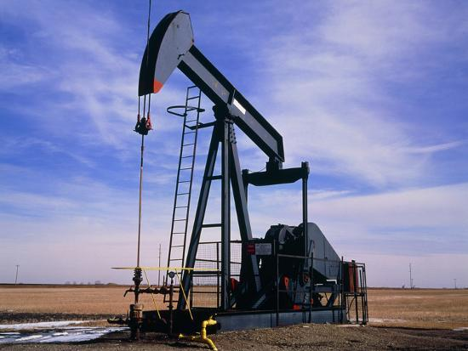
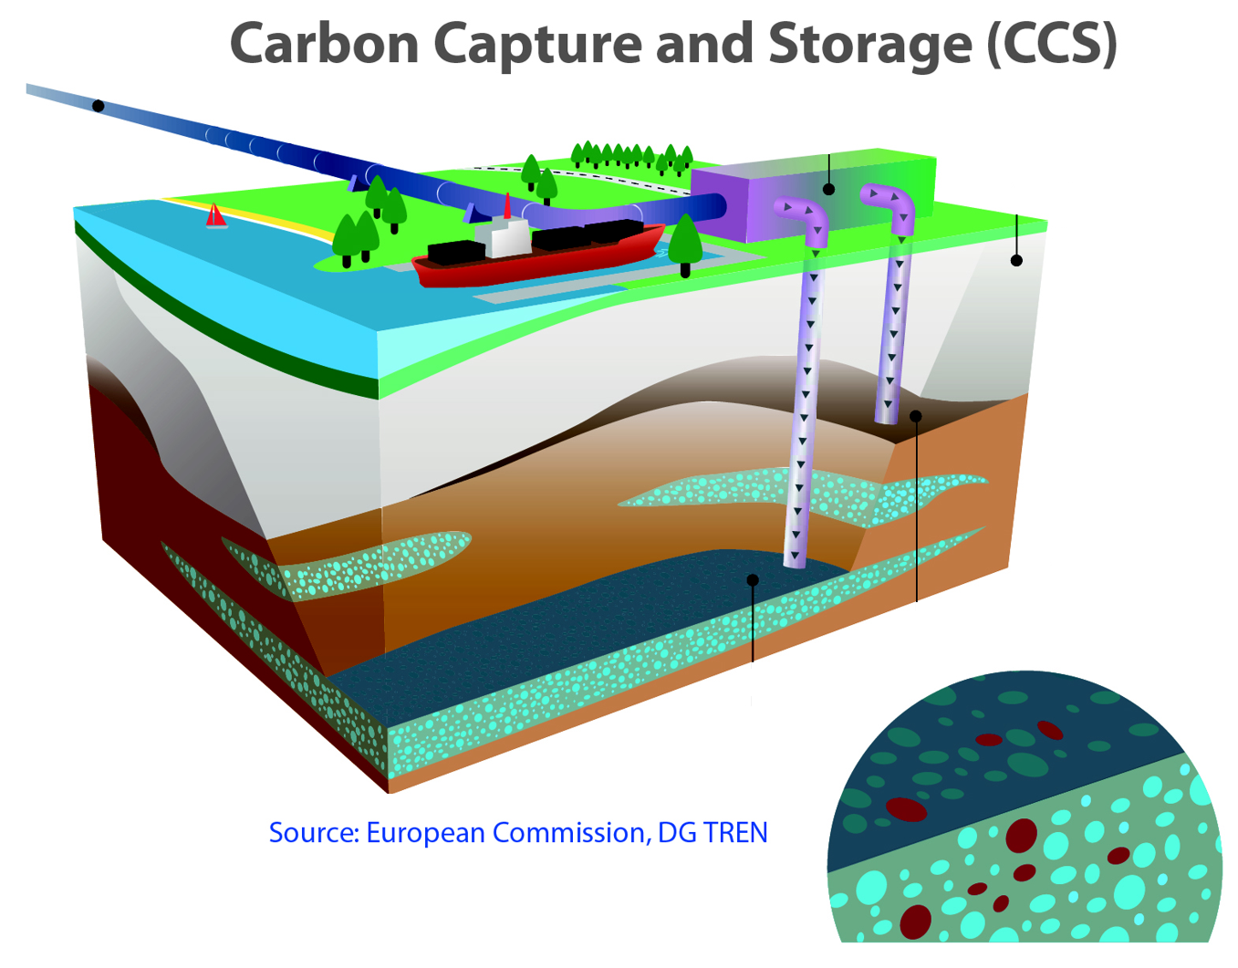
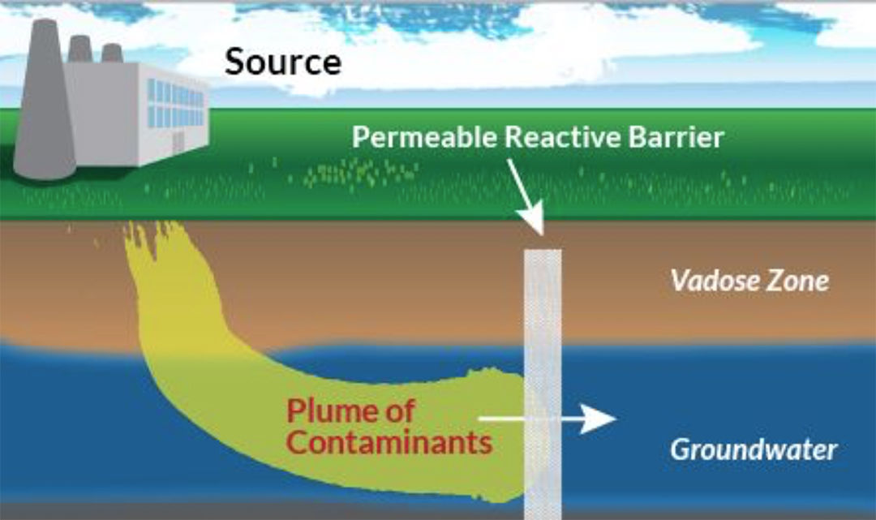
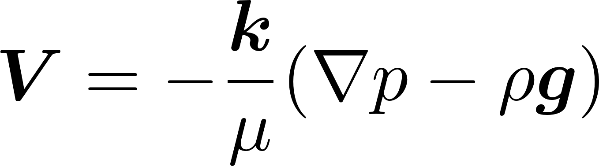
The problem
Existing macro scale transport models struggle to capture early and late arrivals solute plumes through highly heterogeneous sediments.
Pore (micro) scale: Navier-Stokes
Heterogeneity (meso) scale: Darcy & ADE
Field (macro) scale:
Macrodispersion? MRMT? CTRW?

Slide 3
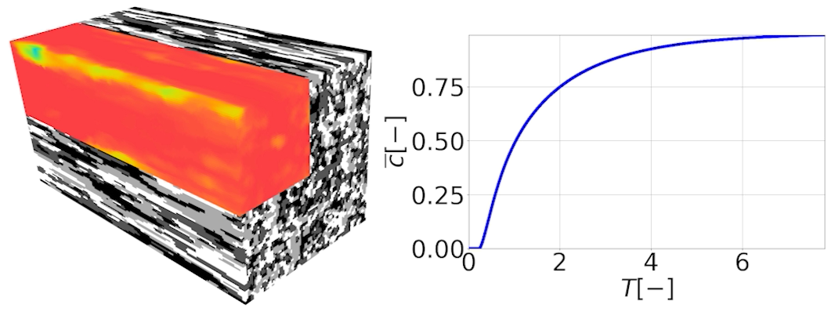
Research question
Under which conditions the Macrodispersion model can be successfully applied?
Macrodispersion model
CDF of the Inverse Gaussian distribution

Slide 4
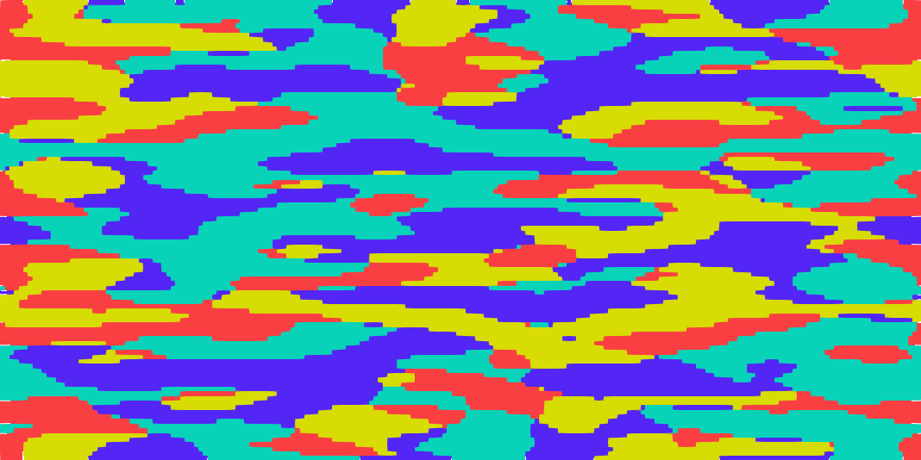
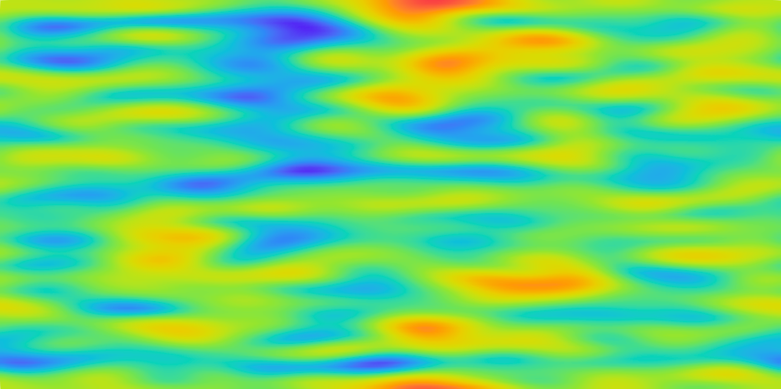
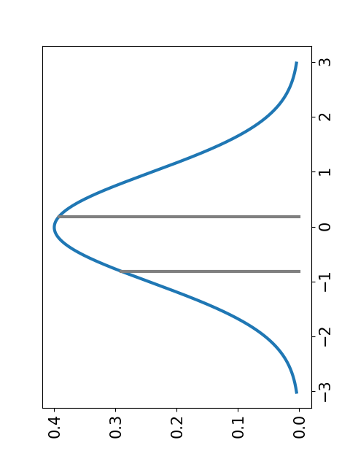
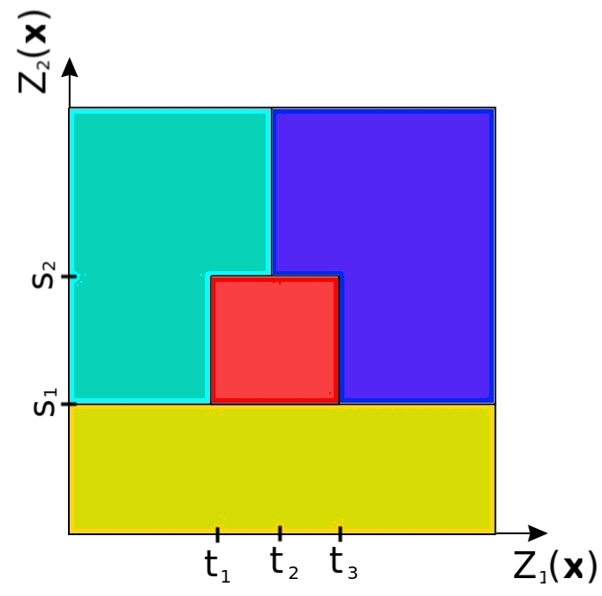
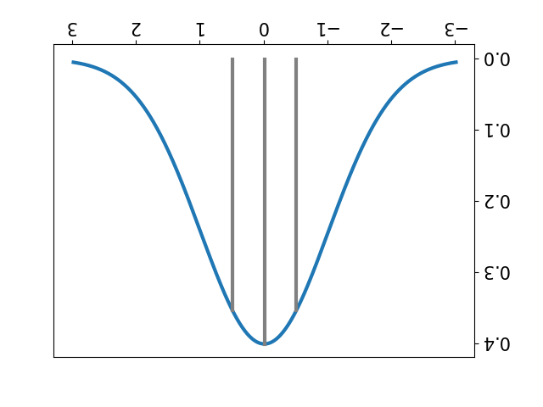
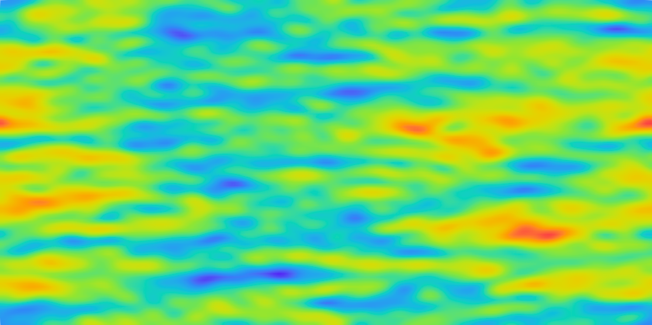
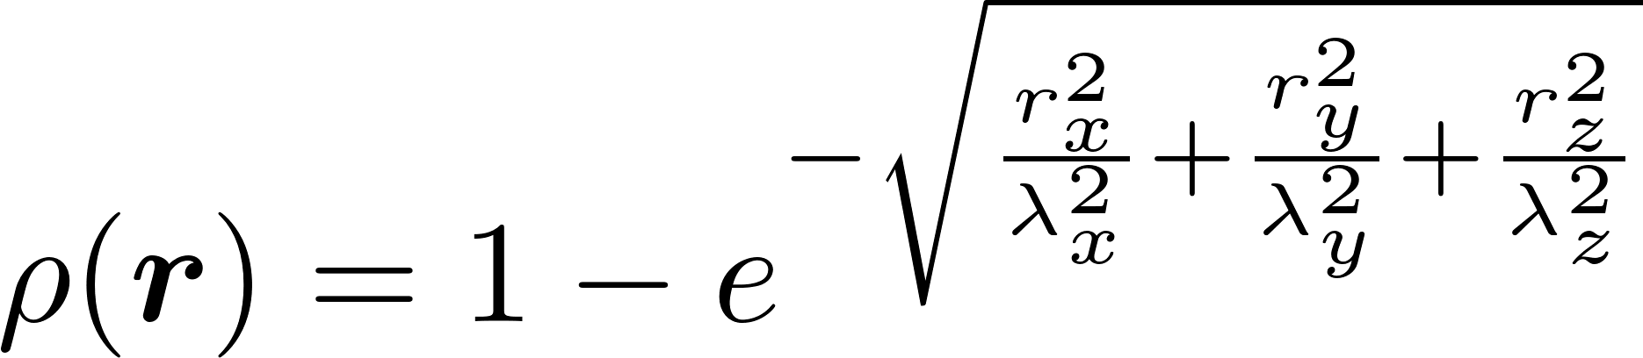
Step 3 to 5
Z₁(x)
Exponential correlation function
Z₂(x)
Notes:
PGS are generated by taking the values of two GRF Z1 and Z2 at the same spatial position and using them as coordinates to enter the corresponding truncation rule. The value corresponding to these coordinates in the truncation rule will determine the facies at the same spatial coordinates on the final PGS. This is the end of the geostatistic part.

Slide 5
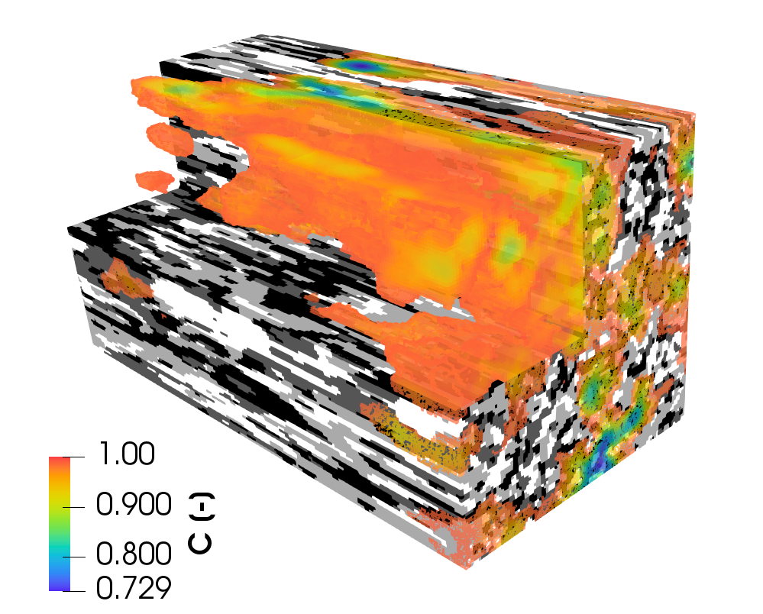
Experiment set-up
∇c = 0 m⁻¹
2m
p = 100 Pa
∇p = 0 Pa/m
c = 1
Inlet
1m
Outlet
∇p = 0 Pa
∇c = 0 m⁻¹
∇c = 0
∇p = 0 Pa/m
1m

Slide 6
Influence of k, λ and Pe on transport
Low permeability contrast | High permeability contrast
k [m²] = 10⁻¹⁰, 10⁻¹¹, 10⁻¹², 10⁻¹³ λ_{x} [m] = 0.8 D_{mol} [m²/s] = 10⁻¹⁰ | k [m²] = 10⁻⁹, 10⁻¹¹, 10⁻¹³, 10⁻¹⁵ λ_{x} [m] = 0.8 D_{mol} [m²/s] = 10⁻¹⁰
k [m²] = 10⁻¹⁰, 10⁻¹¹, 10⁻¹², 10⁻¹³ λ_{x} [m] = [0.4, 0.6, 0.8, 1.0] D_{mol} [m²/s] = 10⁻¹⁰ | k [m²] = 10⁻⁹, 10⁻¹¹, 10⁻¹³, 10⁻¹⁵ λ_{x} [m] = [0.4, 0.6, 0.8, 1.0] D_{mol} [m²/s] = 10⁻¹⁰
k [m²] = 10⁻¹⁰, 10⁻¹¹, 10⁻¹², 10⁻¹³ λ_{x} [m] = 0.8 D_{mol} [m²/s] = [10⁻⁹, 10⁻¹⁰, 10⁻¹¹] | k [m²] = 10⁻⁹, 10⁻¹¹, 10⁻¹³, 10⁻¹⁵ λ_{x} [m] = 0.8 D_{mol} [m²/s] = [10⁻⁹, 10⁻¹⁰, 10⁻¹¹]

Slide 7
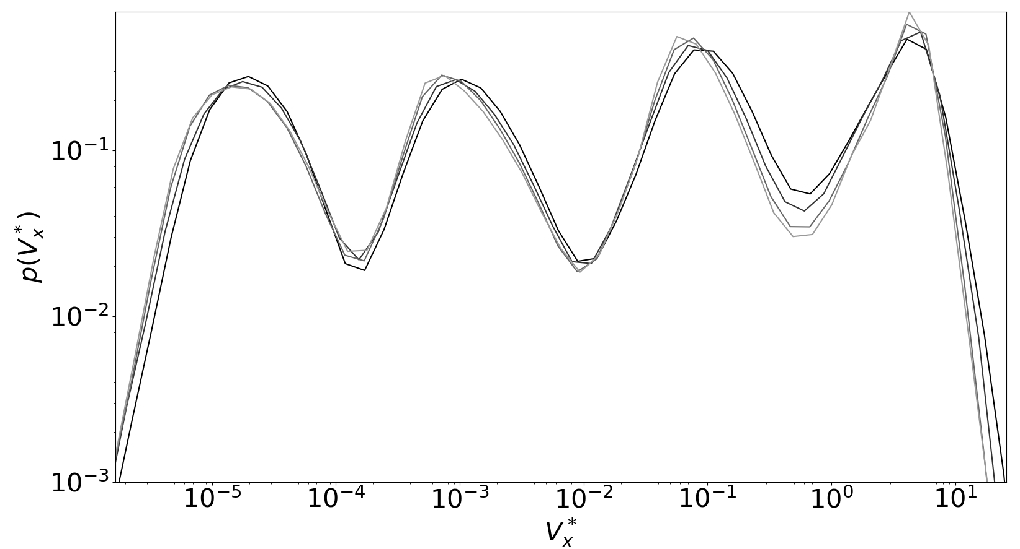
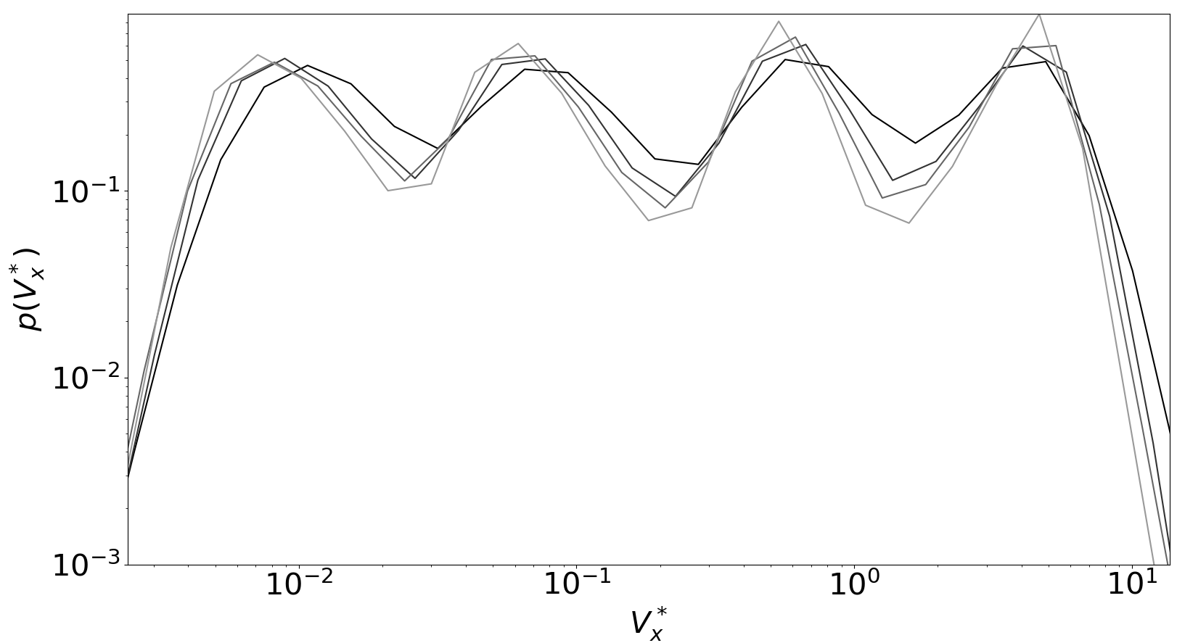
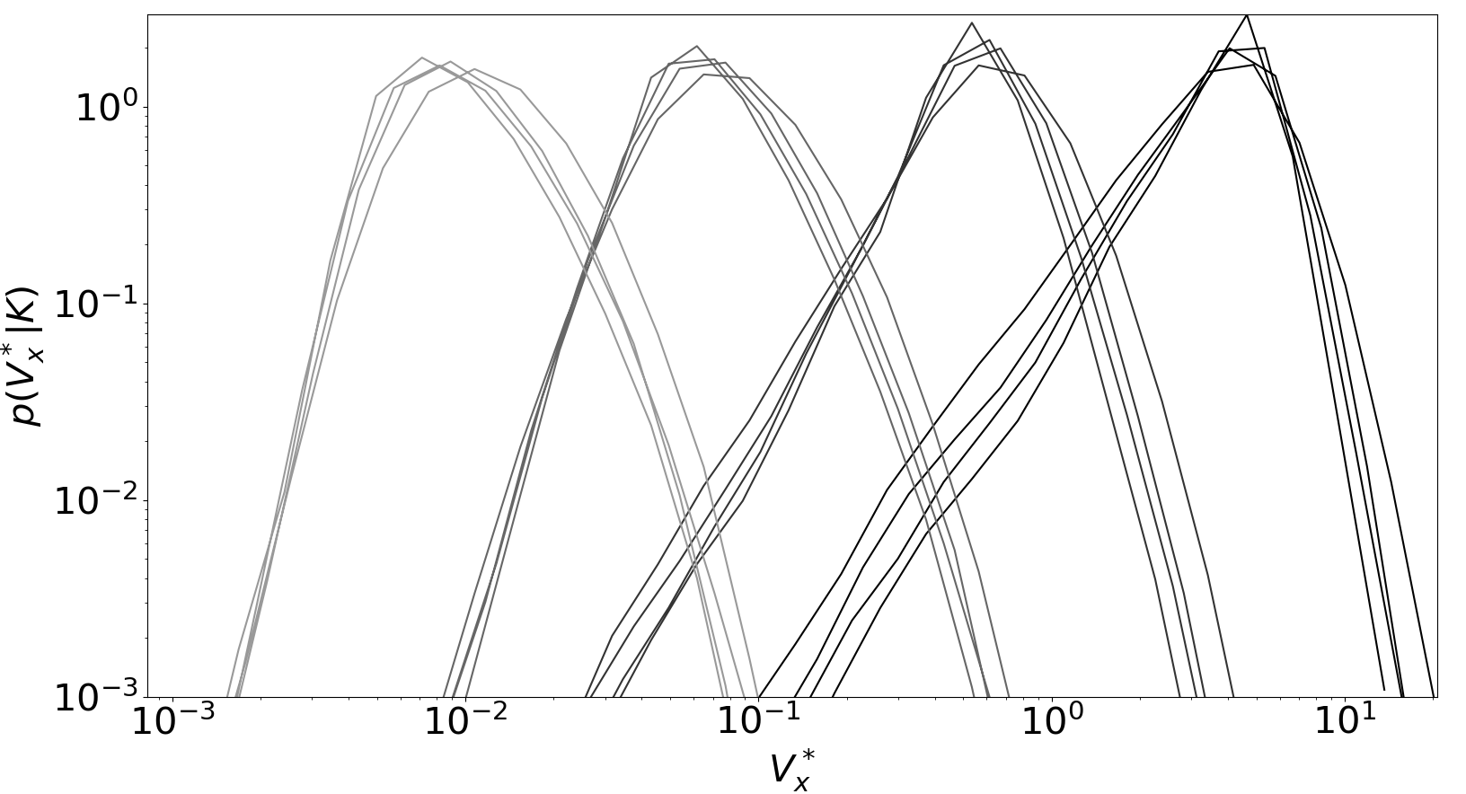
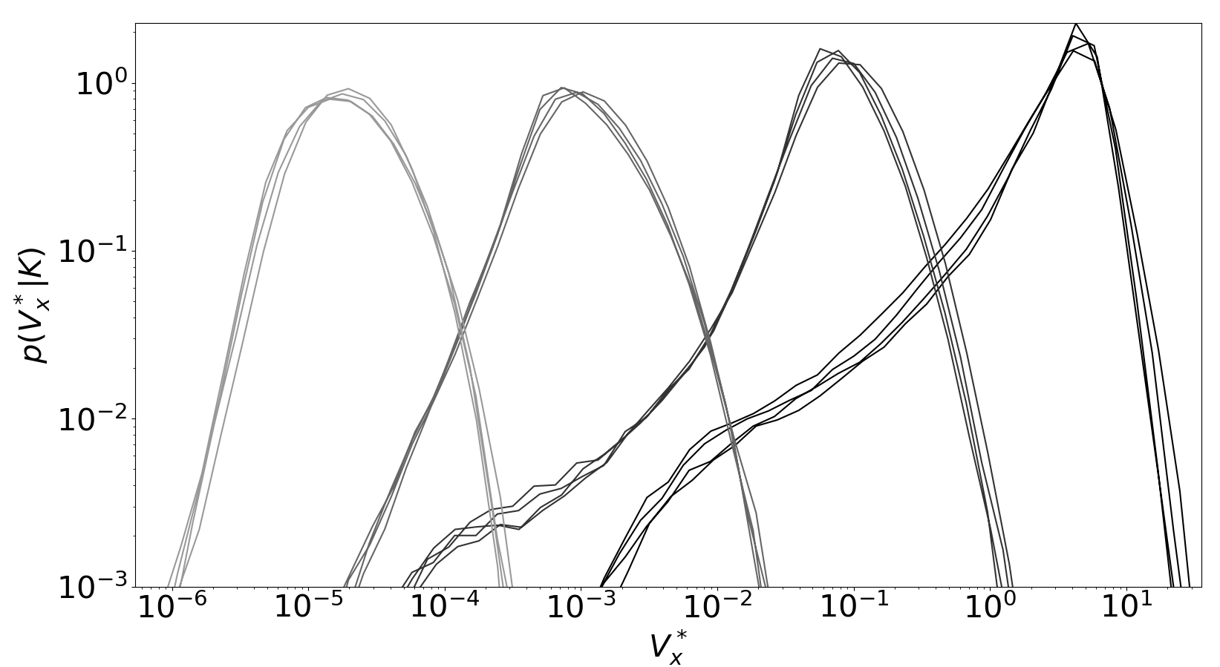
Joint and conditional velocity distributions in low vs high k
Low k vs high k

Slide 8
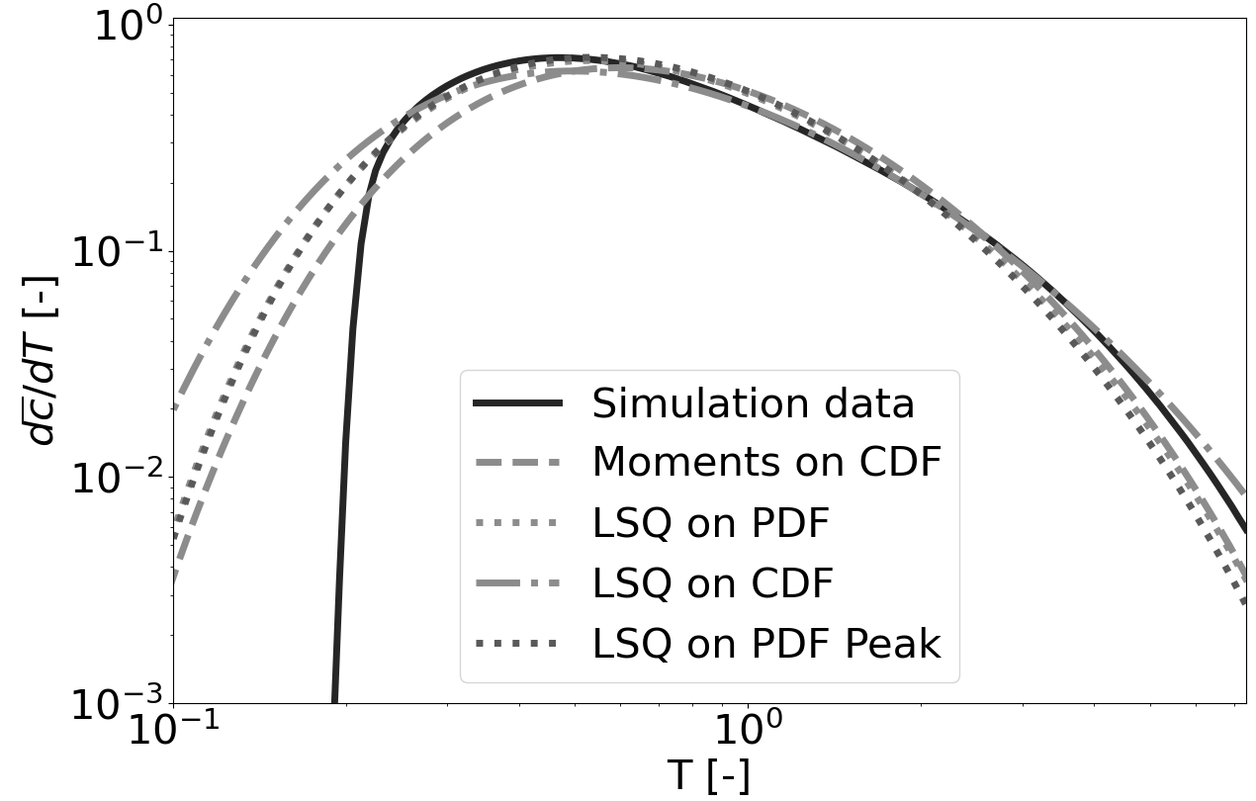
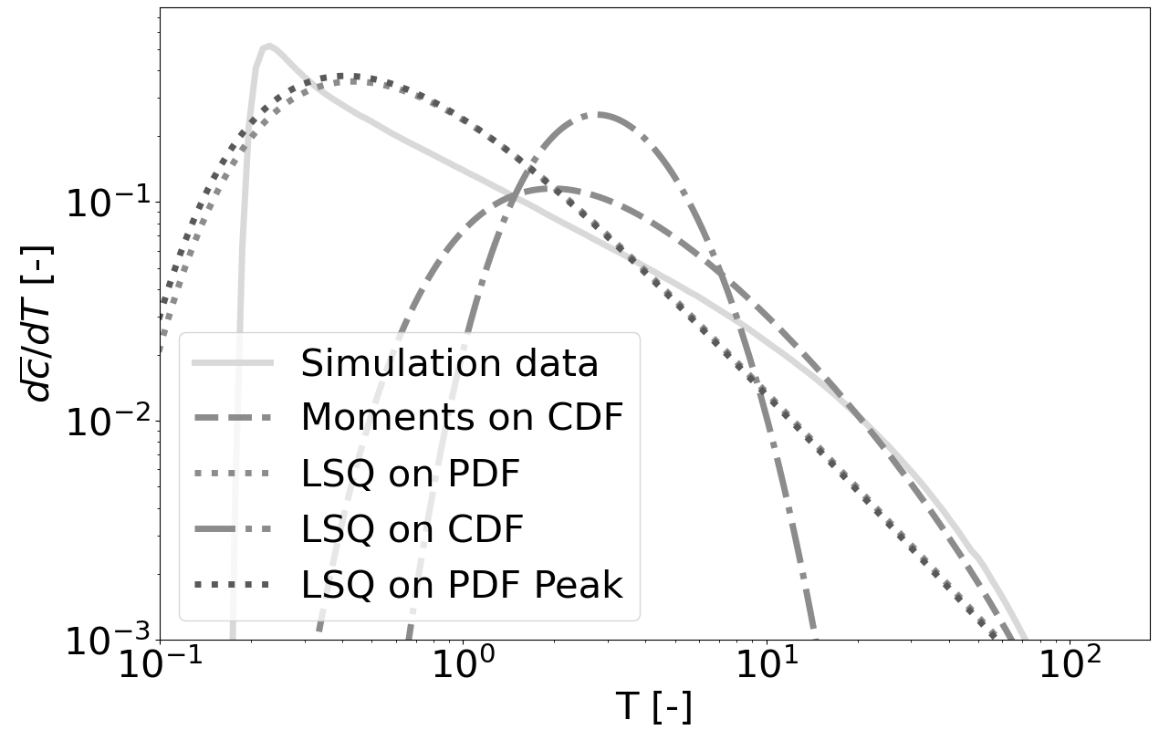
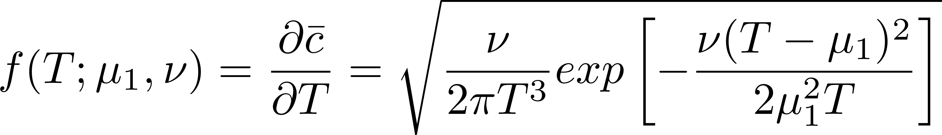
BTCs interpolation in low vs high permeability contrast
Low k vs high k
Inverse Gaussian distribution
Notes:
The Inverse Gaussian can accurately fit only BTC obtained for low permeability contrast fields at late times.

Slide 9
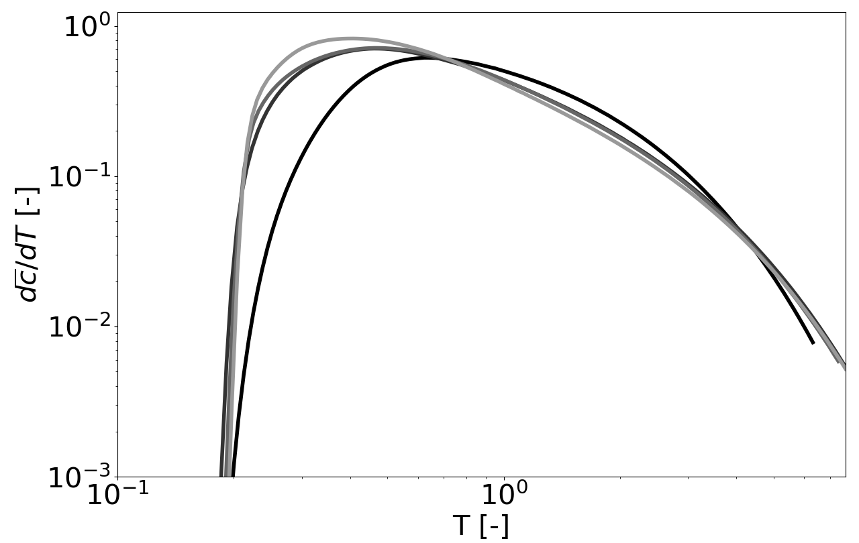
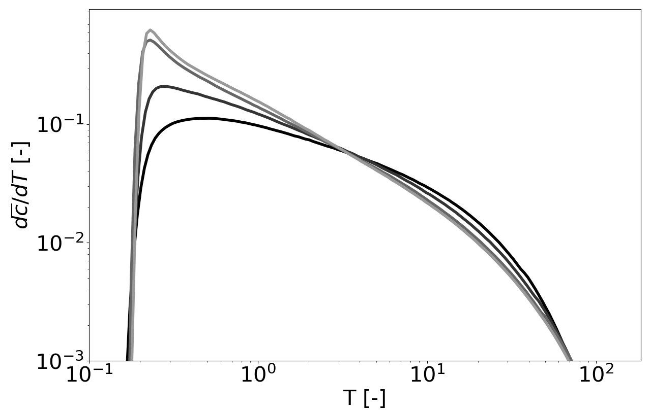
Correlation length and permeability contrast effect on BTC in low vs high k
λ = 1 meter λ = 0.8 meter λ = 0.6 meter λ = 0.4 meter
Low k vs high k
Notes:
Early arrivals: as the domain connectivity increases, the initial concentration peak raises and shifts toward earlier arrival times.
Central times: power law response (straight line) as the domain connectivity increases.
Late times: all the BTCs tend to the exponential law (curved line) after the solute has experienced enough heterogeneities.

Slide 10
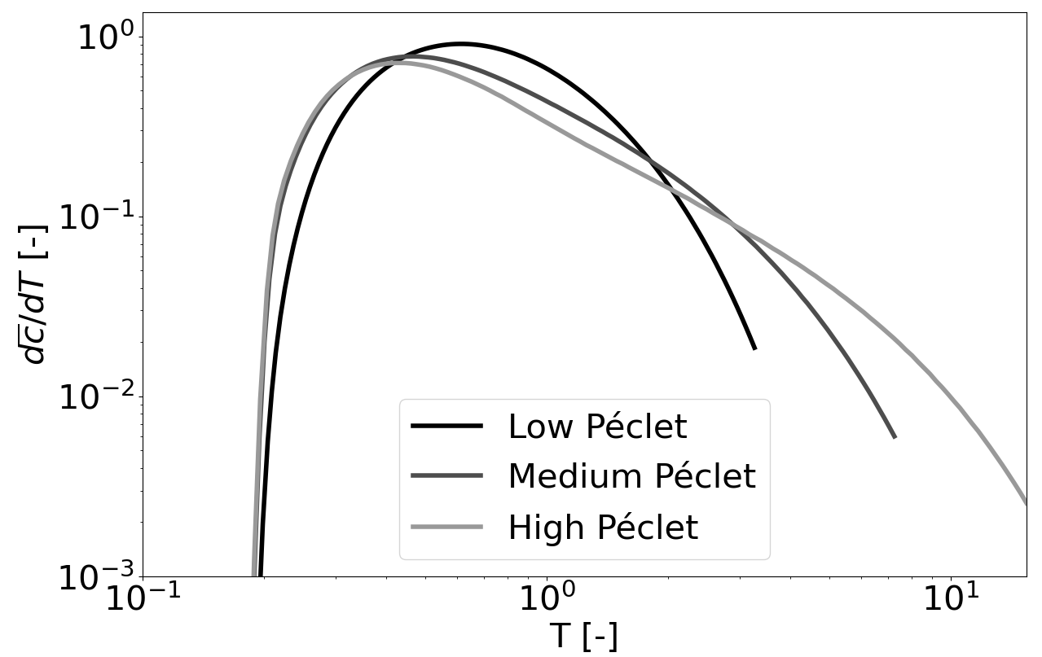
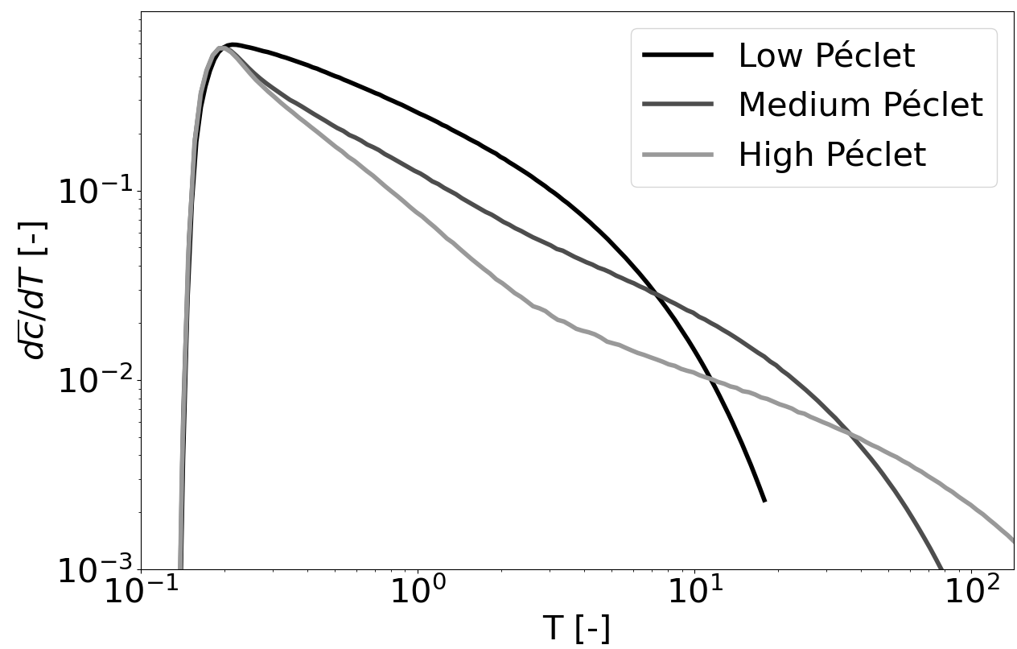
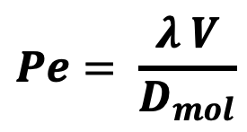
Péclet influence on BTC in low and high permeability scenarios
$$Pe= \frac{λ V}{D_{mol}}$$
6x10³
6x10⁴
6x10⁵
8x10²
8x10³
8x10⁴
Low k vs high k
Notes:
For low molecular diffusion fluids (high Péclet) the advection prevails on dispersion (peaky BTC followed by the power law).
For the high molecular diffusion fluids (low Péclet) the dispersion smooth the peak and the BTC tail follows an exponential trend.

Slide 11
Conclusions & future works
Take home message:
Permeability contrast plays a primary role in determining the fate of the solute, while correlation length and Péclet number can be both considered secondary non-Fickian transport triggering factors;
Future works:
realistic injection scenarios;
variable density and hydrodynamic dispersion models;
impact of different lithotype rules;
test sophsiticated non-local macro transport models.

Slide 12
End
Thank you for the attention!
Notes:
In broad terms, this long introduction to Darcy flow and transport summarises the main results from my second year of phd whose purpose has been enabling realistic subsurface setup preparatory to transport study. We now have an OpenFOAM library called setRandomField that generate PGS. Thanks to that, it is now possible to run flow and transport simulations in realistic heterogeneous porous media.

Slide 13
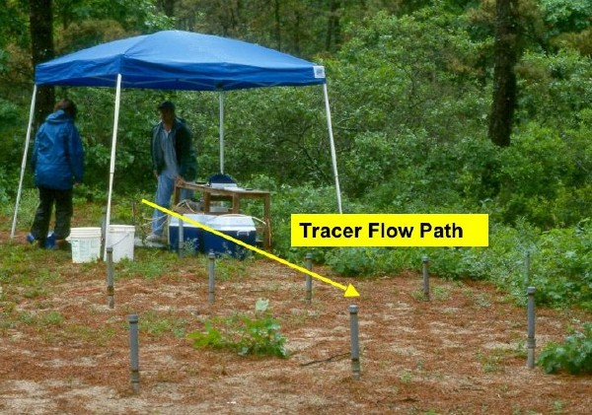

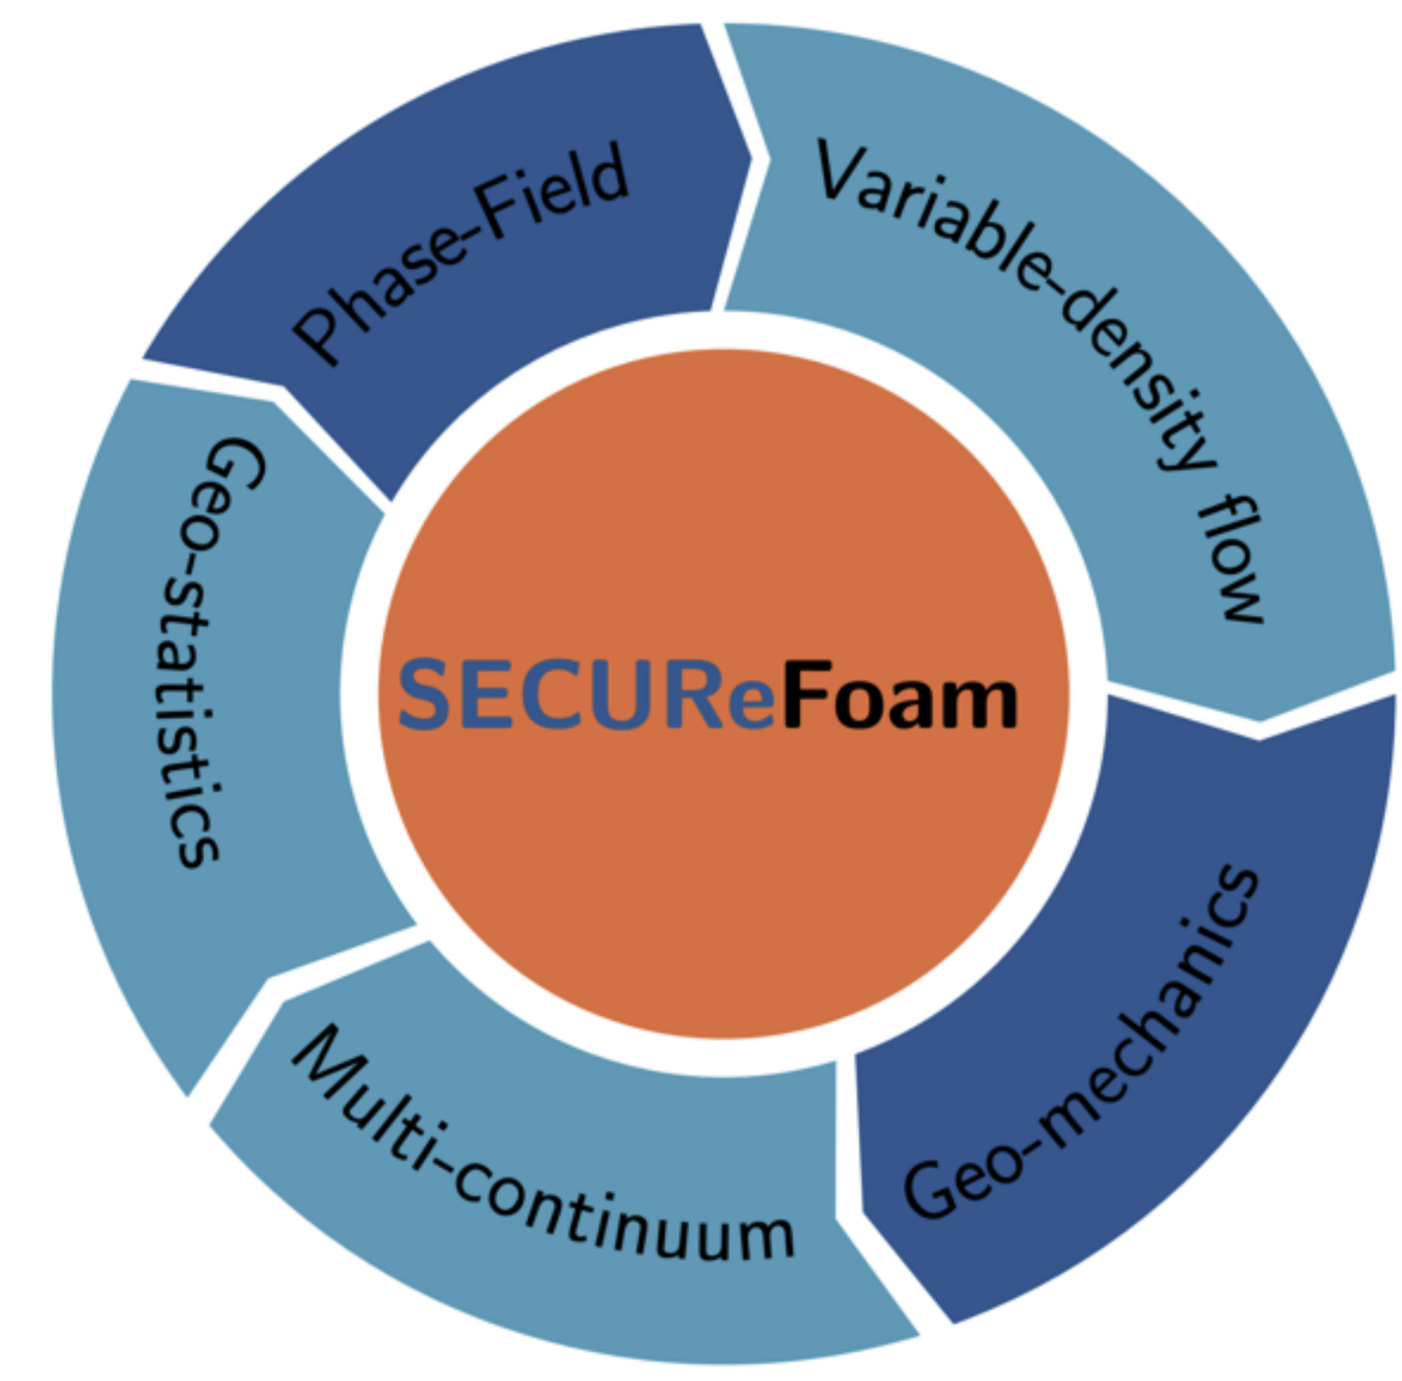
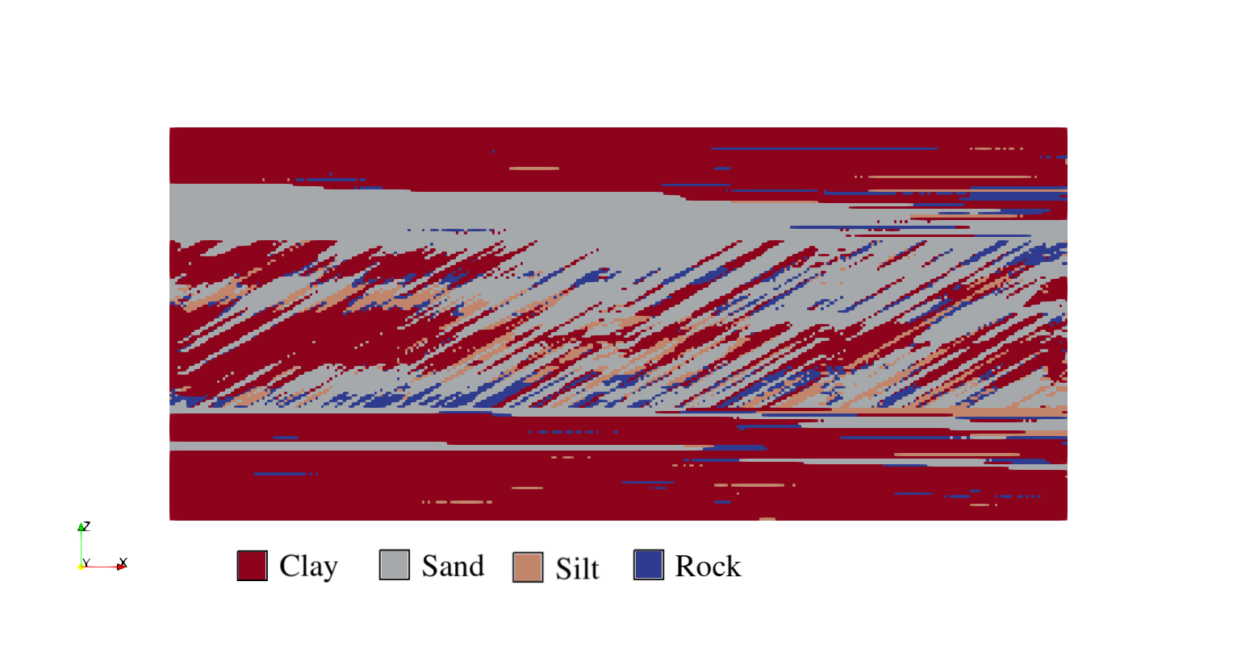

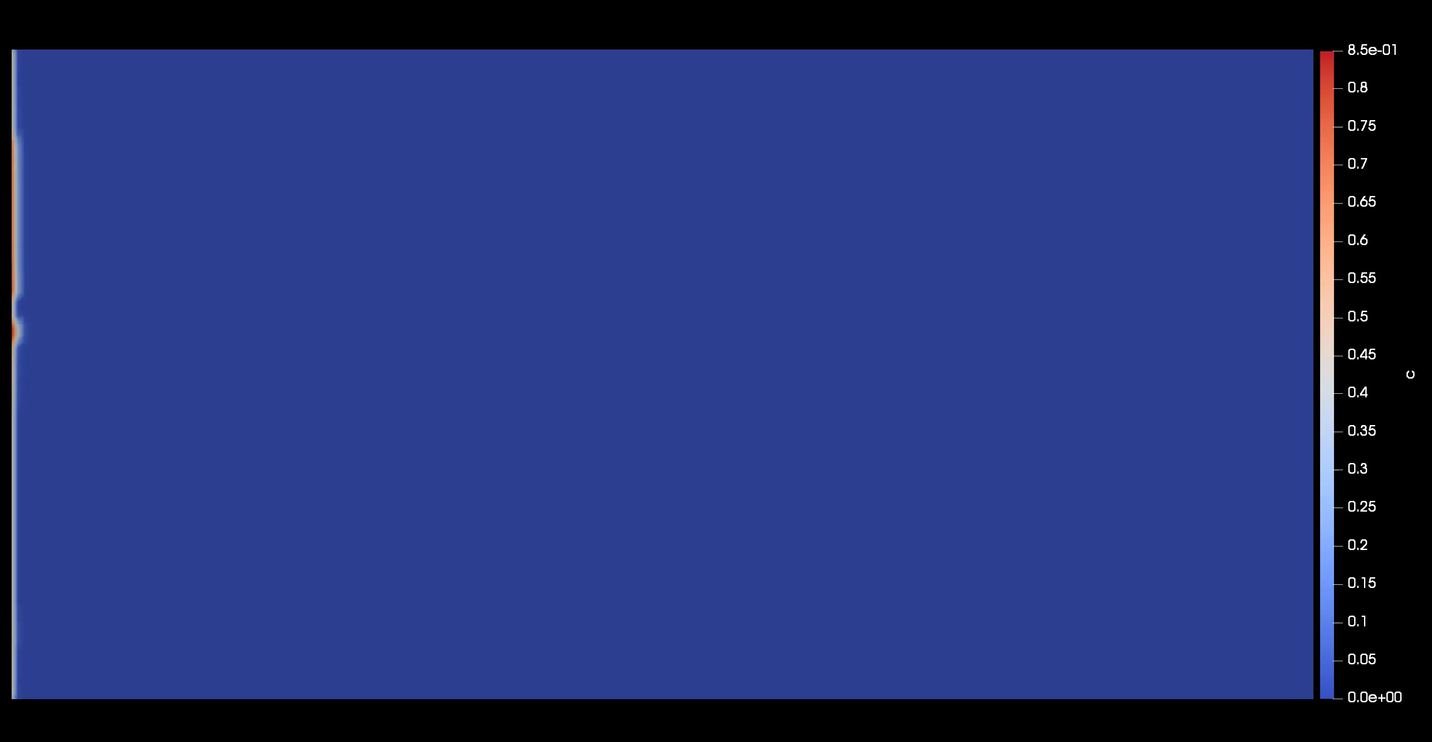
Geostatistics and hydrogeology with OpenFOAM
The open source, fully parallelizable, OpenFOAM library available at
provides integrated and customizable geostatistical, flow and transport solvers. The libraries can be split between utilities and solvers.
setRandomField utility: generates random heterogeneous porous media
subsurface geostatistical modelling methods
continuous spatial random fields generation
Truncated Gaussian Simulation (TGS)
Pluri-truncated Gaussian Simulation (PGS)
simpleDarcyFoam+adaptiveScalarTransportFoam solvers: flow and transport
Darcy’s law and groundwater flow equation
Single-phase transport mechanisms
Estimation of macrodispersion properties
Post-processing: Breakthrough Curve (BTC) and moment analysis
https://github.com/multiform-UoN/SECUReFOAM
Notes:
In this short talk I will outline the main capabilities of our open-source OpenFOAM library available at the link in this slide. While the library is currently under active development, a first version has already been released within the SECURe project and a new extended version will be available soon. This tool is designed to ease the simulation and analysis of solute transport in porous media. The pre-processing utility setRandomField provides a wide range of choice in the selection of the porous media heterogeneities, such as continuous, truncated or pluri-truncated gaussian random fields. On the right you can see an example of a PGS field generated, in collaboration with Ephesia. The flow and transport part relies on classical OpenFOAM PDE solver capabilities, in an Eulerian framework. A great advantage of using OpenFOAM library is that all our solvers and utilities come fully parallelised out-of-the-box. The main objective behind the implementation of this toolbox are to integrate geostatistics, flow, complex transport processes and postprocessing which links to the objective of my PhD that is, the study of the limitations of Fickian transport models in capturing the anomalous solute behaviour which arises in highly heterogeneous media.

Slide 14
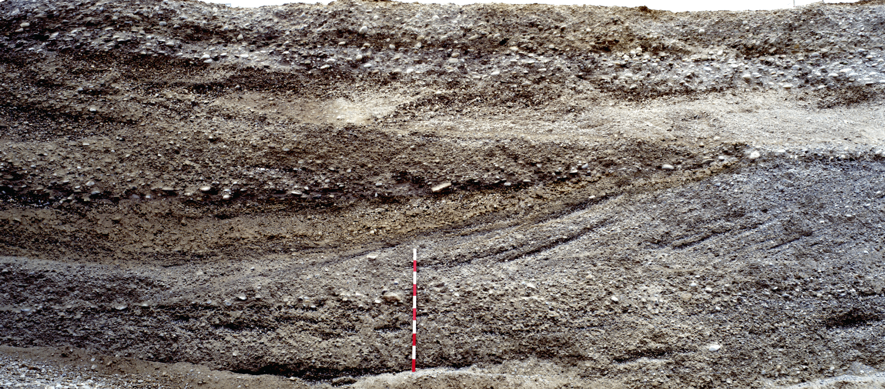
From the geological reality to the geostatistical model
Peter Bayer, Alessandro Comunian, Dominik Höyng, and Gregoire Mariethoz. High resolution multi-facies realizations of sedimentary reservoir and aquifer analogs. Scientific data, 2(1):1–10, 2015.
?
Notes:
inaccessible -> limited info
Geostatistics is the aswer
Geostatistical analysis aims to estimate the statistical parameters that determine the spatial distribution of the relevant variables. These parameters are used to estimate (interpolate) the variables at desired spatial locations where no measurements are available.
Subsurface is mostly inaccessible hence sparsity and uncertainty related to direct (like cores or samples) or indirect (like seismic) data limit deterministic hydrogeological modeling approaches. Geostatistical analysis aims to estimate the statistical parameters that determine the spatial distribution of the relevant variables. These parameters are used to estimate (interpolate) the variables at desired spatial locations where no measurements are available.

Slide 15
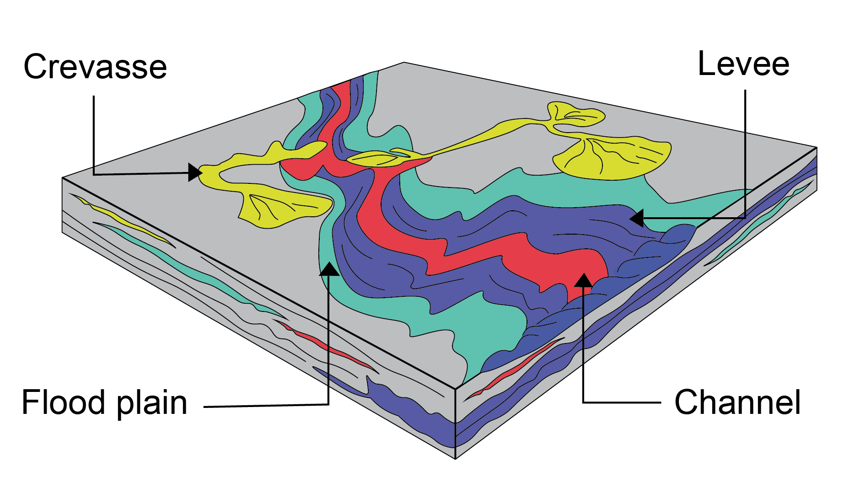
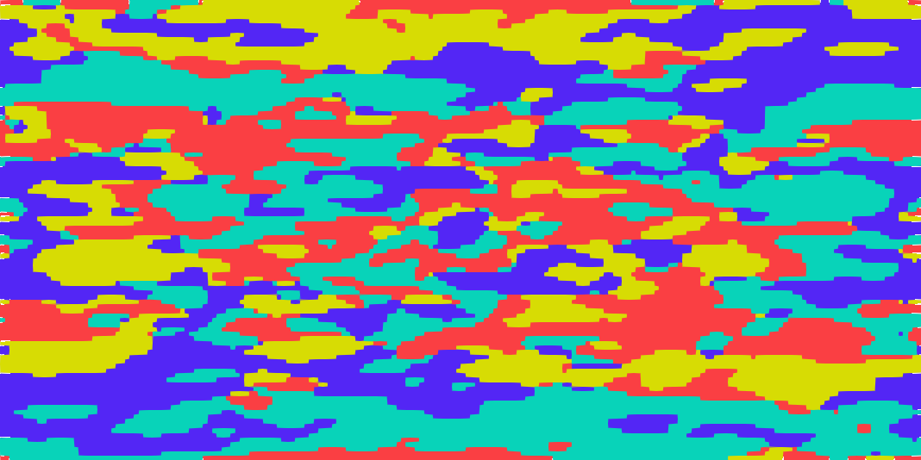
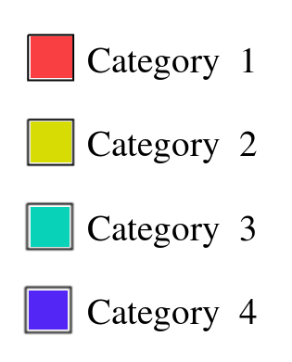
Pluri Gaussian Simulation (PGS) conceptual steps
Step 2
Step 1
Step 3
PGS
Step 5
Step 4
Notes:
Spatial and temporal scales of subsurface processes
-1 quantify hydrogeological properties
-2 conceptualization of the geological structure to highlight relevant properties
-4 let’s focus on random field generation
The PGS method can be subdivided into five main steps. Unfortunately the most intuitive way of explaining it does not follow its natural development. The first two steps (click) consist of geological analysis and conceptualization of the geological structure to highlight relevant properties needed as inputs for the following steps. For example, the contact between facies identified in step 2 fulfils a role of pivotal importance in the truncation rule draft at step 3. However, an intuitive idea of steps 1 and 2 is enough for our mathematical modeling purposes while steps 3, 4 and 5 require more attention. Let’s focus on random field generation (click).

Slide 16
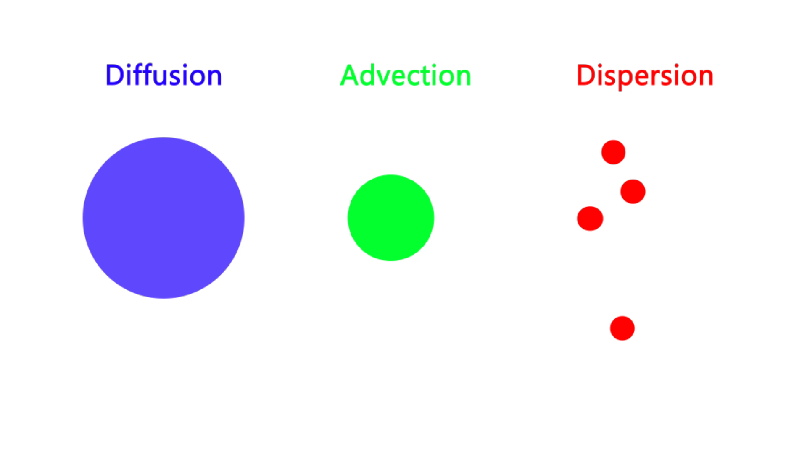
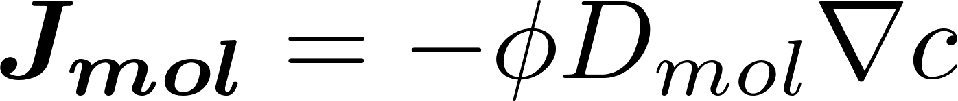
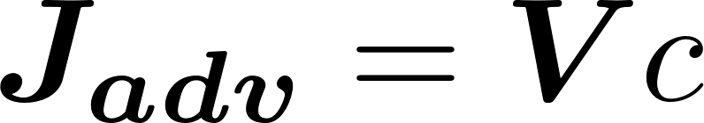
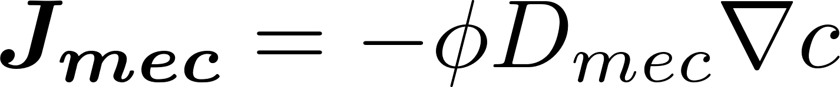
Porous media transport mechanisms
Notes:
Jmol Jadv Jmec fluxes per unit area of solute concentration c
Dmol Dmec molecular diffusion and mechanical dispersion coefficient
phi porosity
(1) Transport in porous media at Darcy scale can be typically ascribed to the simultaneous contribution of three main physical mechanisms: molecular diffusion, advection and mechanical dispersion. Molecular diffusion is originated by the random collisions of molecules while dispersion is caused by the advection velocity which makes the solute tracking through the porous structure of the medium which is basically a complex channel system. With J we indicate the fluxes per unit area of solute concentration c. Dmol and Dmec are molecular disffusion and mechanical dispersion respectively. Phi is the porosity of the porous matrix.

Slide 17
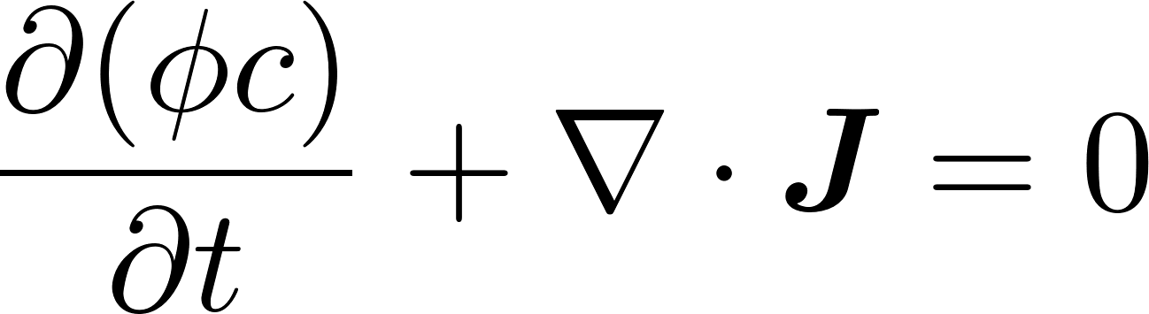
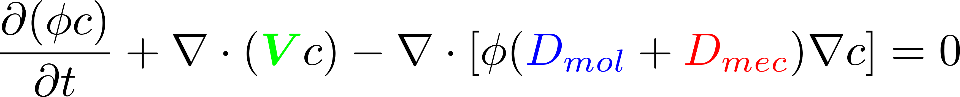
Advection-Dispersion Equation (ADE)
Net flux per unit area
Continuity equation
Advection-Dispersion Equation
Notes:
Summing all the flux contributions we obtain the net flux per unit area J. The sum of D_{mol} and D_{mec} gives the hydrodynamic dispersion coefficient D. Considering the classical continuity equation and substituting the concentration c to the density rho and the net flux per unit area J to the Darcy flux (rho V) we obtain the Advection Dispersion equation for the case of no source/sink terms within the domain.

Slide 18
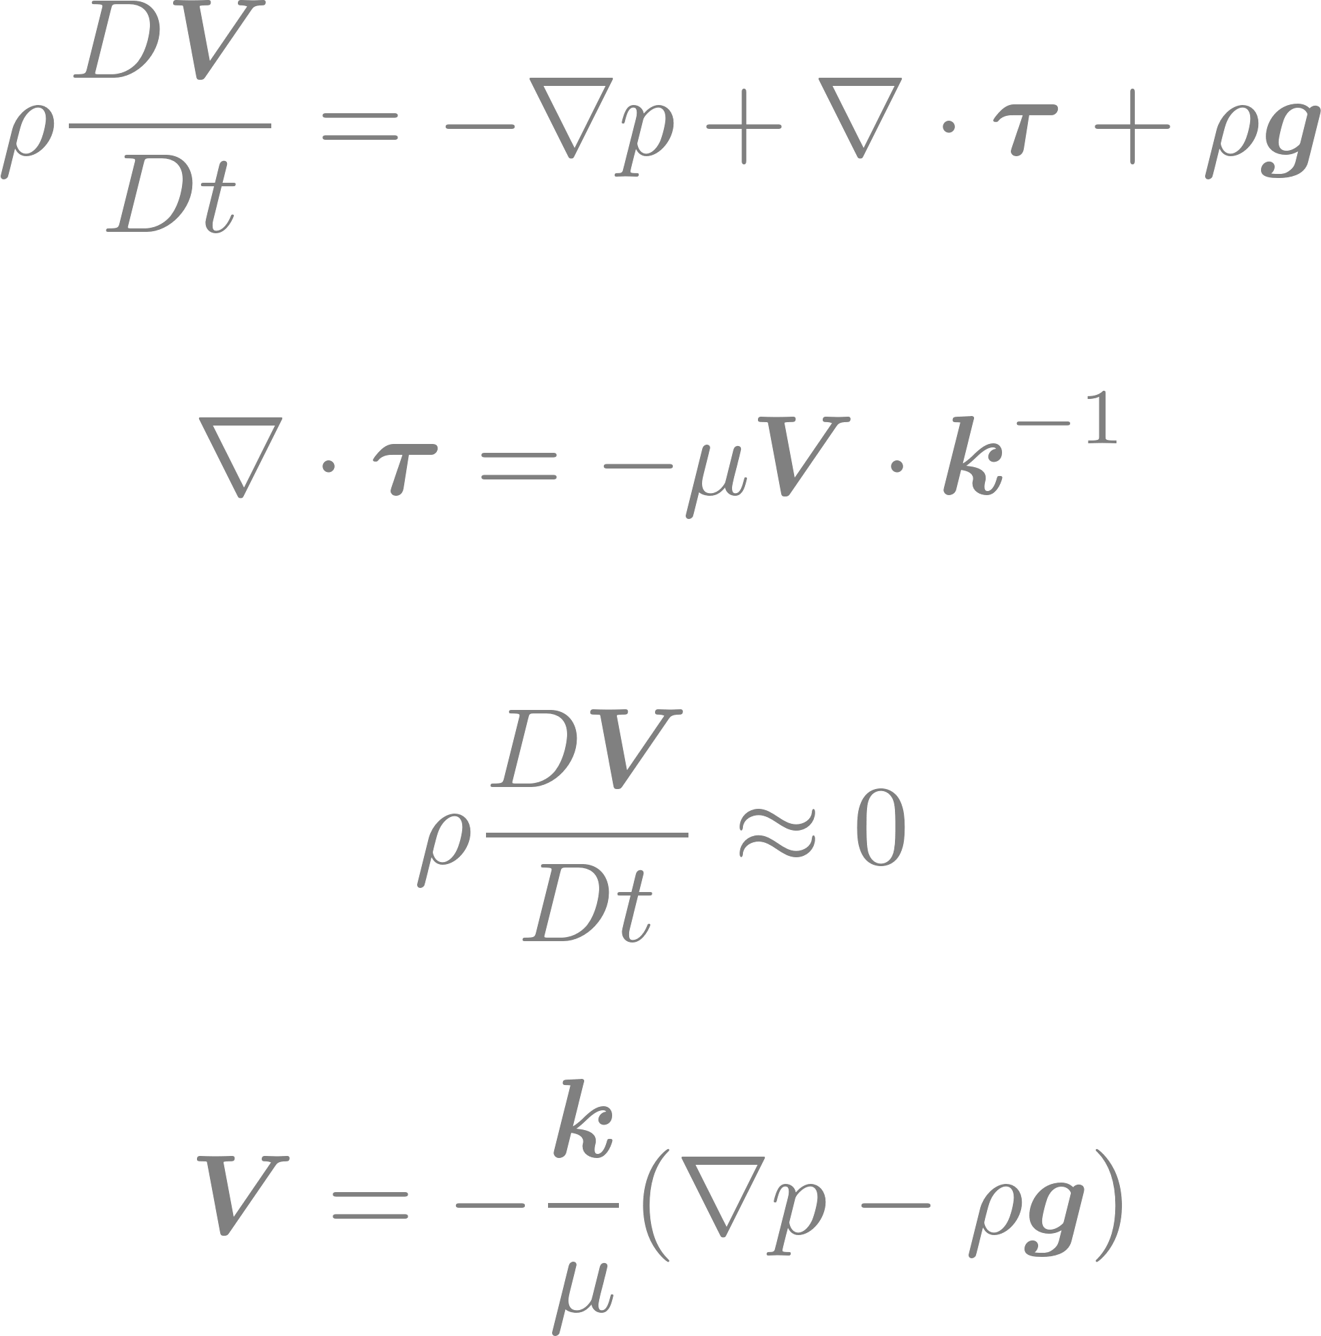

Darcy’s law & Groundwater flow equation
Darcy equation
Darcy equation intuitive derivation
Incompressibility condition
Groundwater flow equation
Notes:
To solve the ADE equation a velocity field V is needed. The constitutive equation for porous media flow is the Darcy equation that, together with the incompressibility condition, form a system of four equations in four unknowns (density rho is constant) that is known as the groundwater flow equation. (1) Darcy equation can be intuitively derived from Navier-Stokes equation by neglecting the inertial term due to low groundwater flow velocities. If we note also that viscous forces are similar to resistive forces like friction or drag we get an expression similar to Darcy’s law.

Slide 19
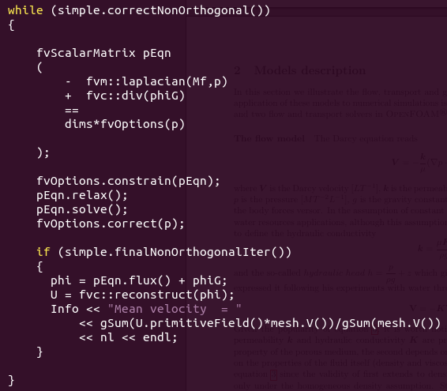
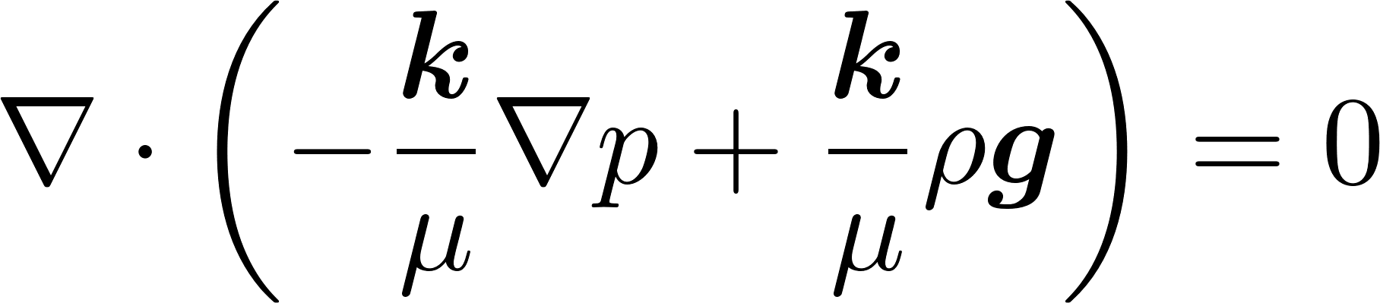
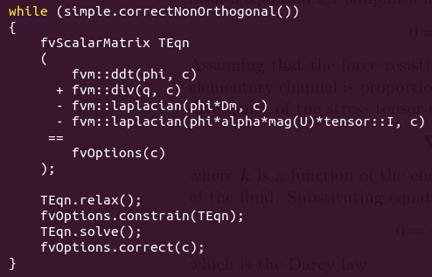
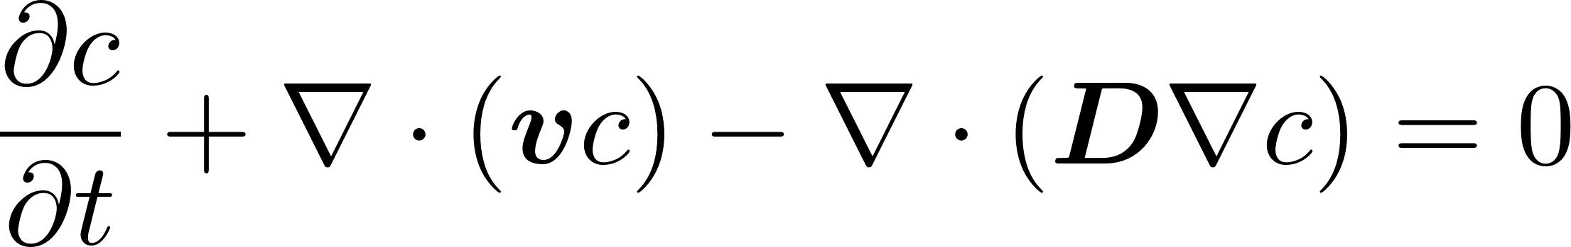
Mathematical models: flow
The pressure field p is solved implicitly by a diffusion equation
The velocity vector V is reconstructed by summing the fluxes induced by the pressure and by the gravity

Slide 20
Hierarchy of the libraries
Generates random heterogeneous porous media
- multivariate continuous Gaussian random fields
- exponential, Matérn and Gaussian correlation functions
- truncated and pluri-truncated Gaussian algorithm
setRandomField
setRandomField.C
setupGRF.H
tGRF.H
URF.H
corrLength.H
dtGRF.H
GRF.H
lGRF.H
computeRandomField.H
simpleDarcyFoam
simpleDarcyFoam.C
createFields.H
/opt/openfoamVersion#
applications
tutorials
bin
doc
solvers
test
utilities
src
finiteVolume
OpenFOAM
transportModels
turbulenceModels
etc
platforms
wmake
simpleDarcyFoam
adaptiveScalarTransportFoam
setRandomField
Flow simulation library
- Darcy’s law and incompressibility condition
Transport simulation library
- Single-phase transport mechanisms
- Estimation of macrodispersion properties

Slide 21
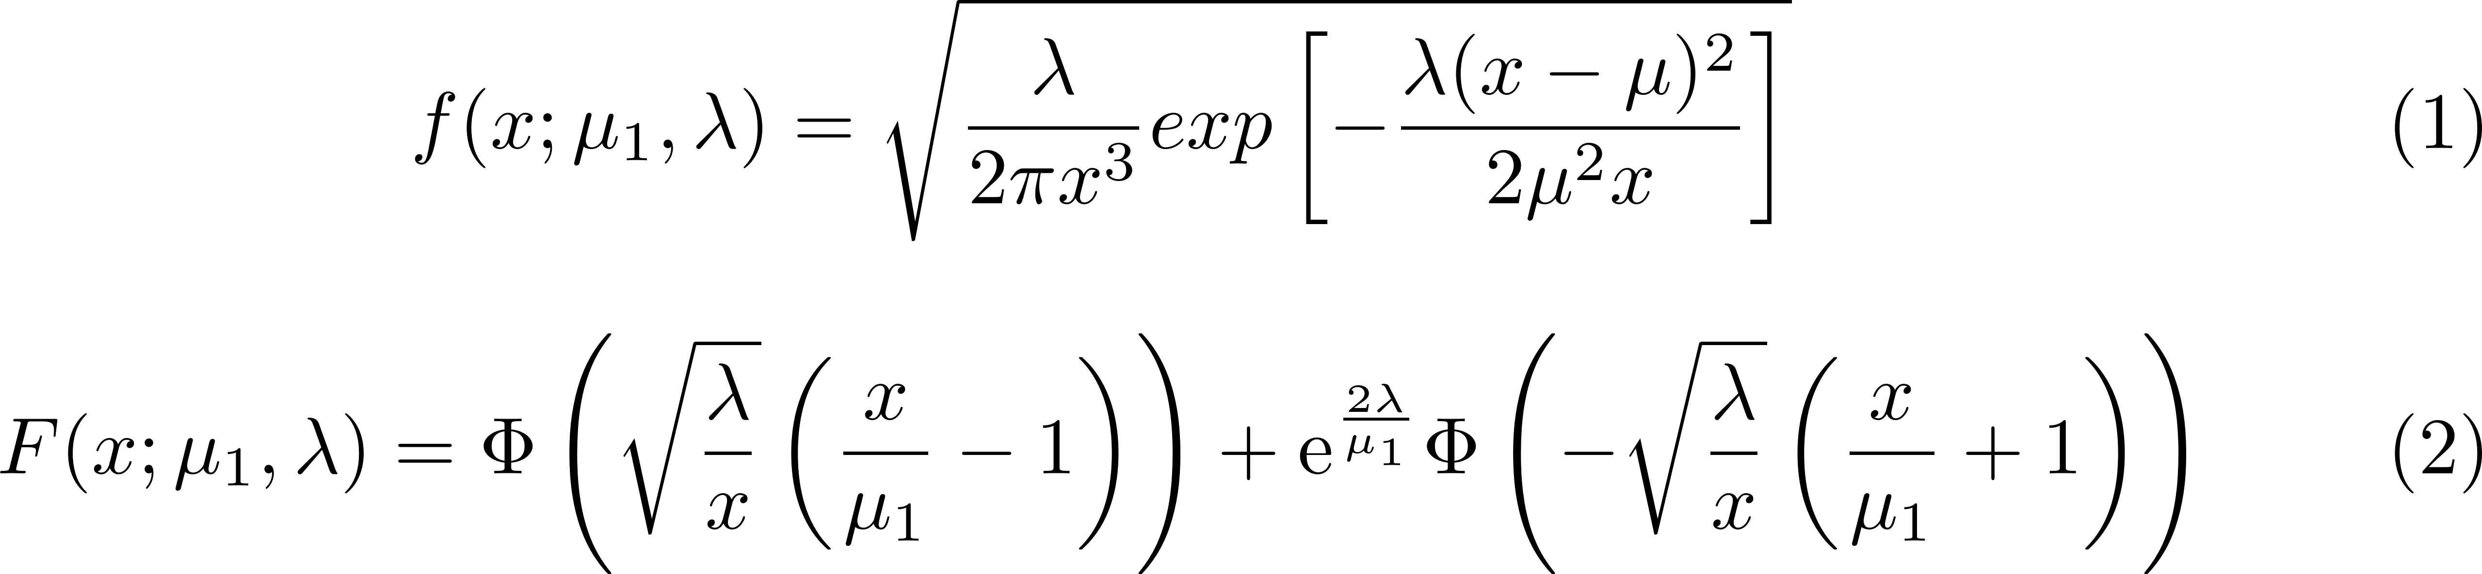
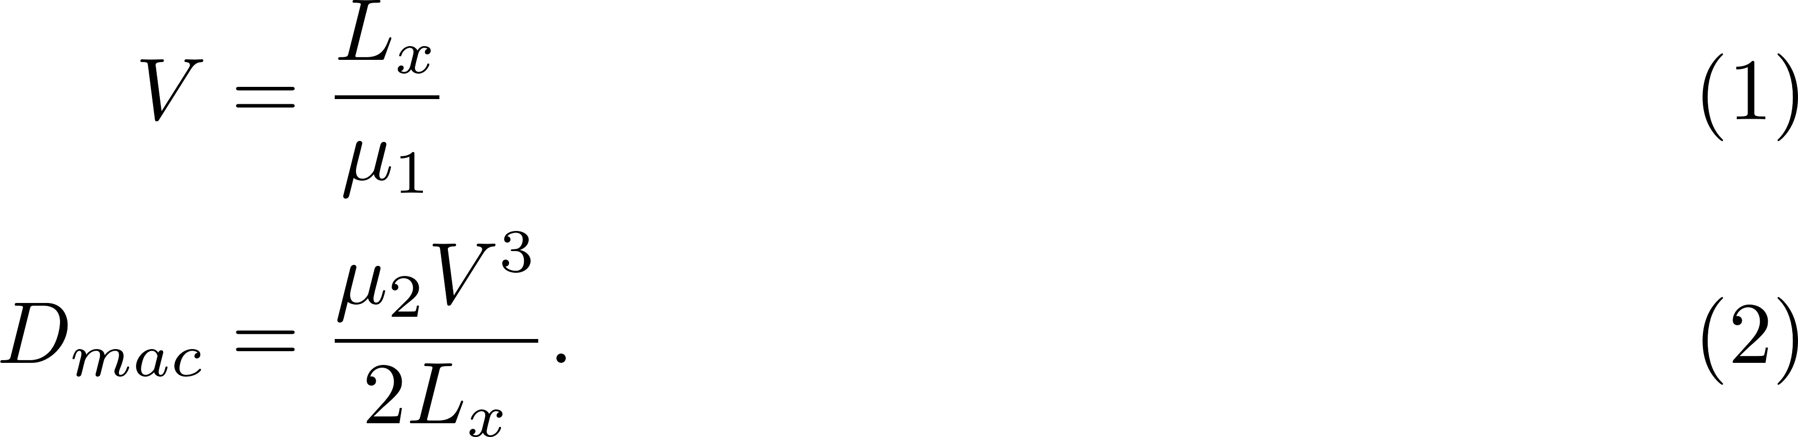
Numerical experiments: Moments and Least Squares Methods
Inverse (1) and Cumulative Inverse (2) Gaussian distribution:
Moments method: from equation (2) it is possible to retrieve the statistical moments which Yu et al. 1999 used to derive the expressions for the velocity and the macrodispersion:
Least squares method: it minimizes the sum of the squares of the difference between observed values and the fitted values provided by the models (e.g. eq. 1 or 2). The calculations are performed using the Python lmfit library.

