Slide 1



Simulating Supercritical-Liquid-Gas-Solid Phase Changes in CO2 during GCS Leakage
Pramod Bhuvankar
Abdullah Cihan
Jens T Birkholzer

Slide 2
Background: Need to model well blowouts
Motivation:
CO₂ well blowouts can be hazardous with tremendous expansion of the released CO₂ (Skinner 2003).
The expansion may lead to rapid cooling near CO₂’s triple-point and the formation of dry-ice crystals.
Sheep mountain blowout (1981), ~ 13,200 tons CO₂/day with chunks of dry ice hundreds of feet into the air.
Objectives:
To model compressible flow & phase transitions (supercritical-gas-liquid-solid) of CO₂ inside wellbore.
To study the impact of well parameters like depth, casing, & cement on the CO₂ leakage rate.

Slide 3
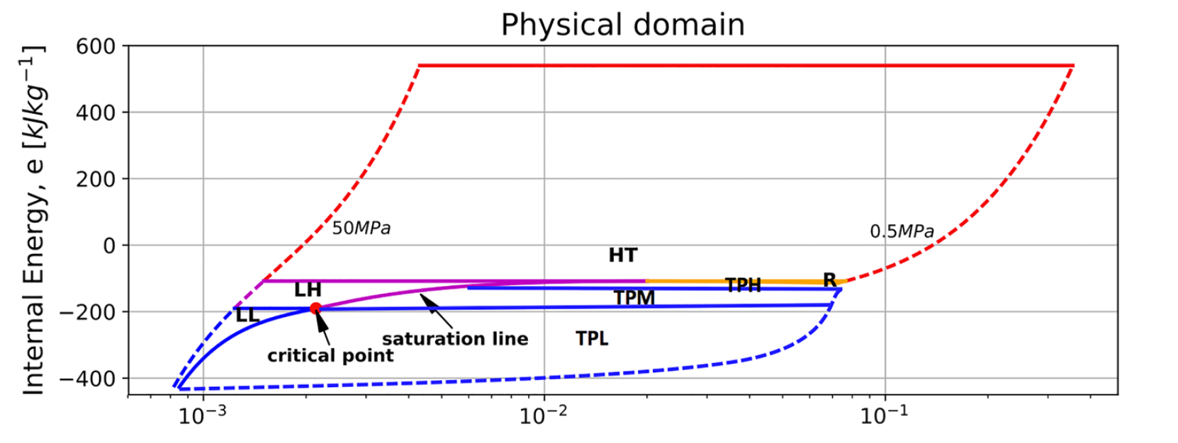




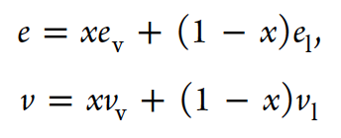



Methodology: CFD + Homogeneous Equilibrium Model
For flow inside circular cross-section conduits
Homogeneous Equilibrium Model
Fang et al., Ind. & Eng. Chem. Res. (2018)
E = e + 506.79 kJ/kg
1st order Godunov Riemann-solver based shock-capturing scheme (Toro 1994)

Slide 4
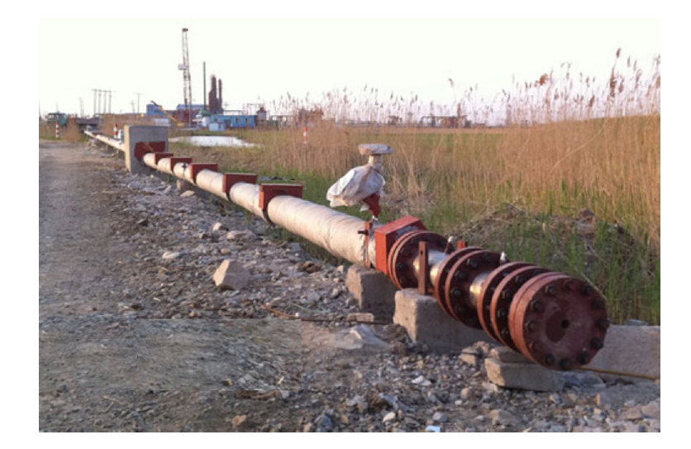
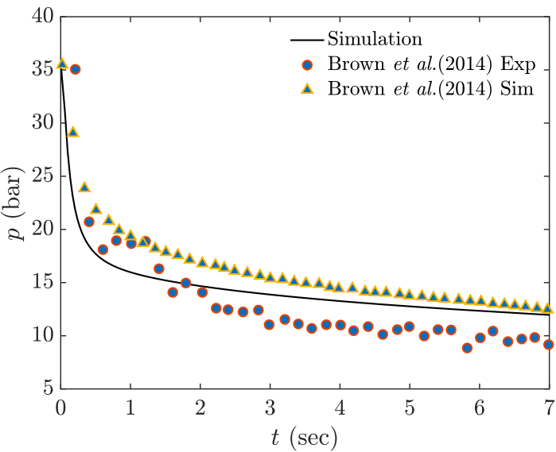
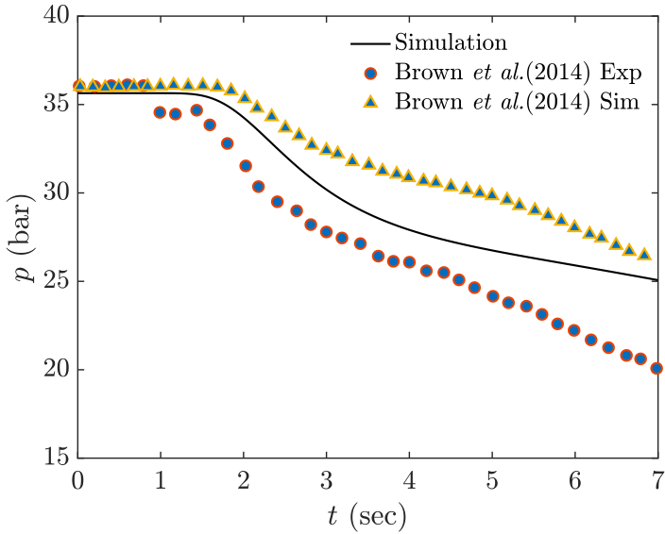
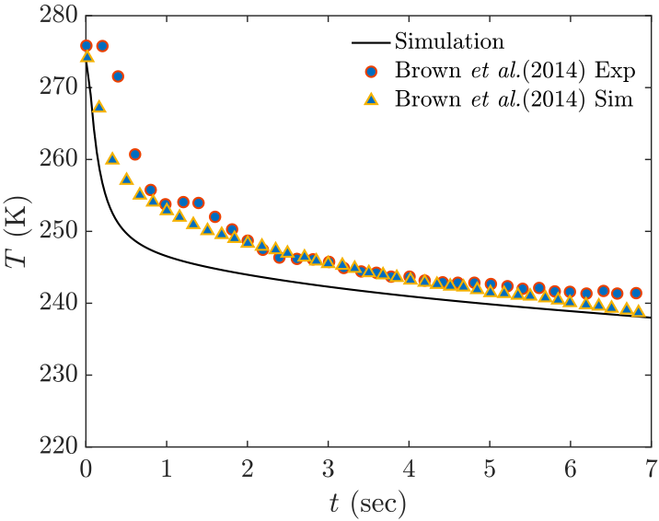
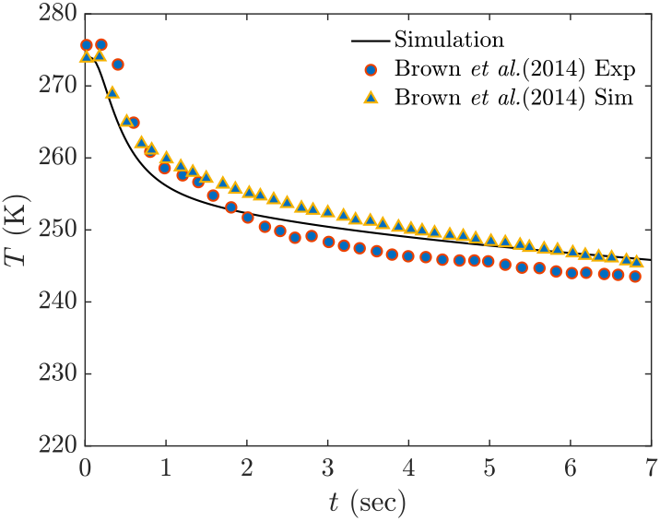
Testing the Code: Comparison with Experiment 1
Case 1: Brown et al. (2014)
L = 256 m, d = 233 mm.
Choked flow outflow boundary condition.
Ambient temperature of 298 K.
Insulated pipe.
P₀ = 36 bar, T₀ = 273 K
x = 6.4 m
x = 139 m
x = 6.4 m
x = 18.3 m

Slide 5
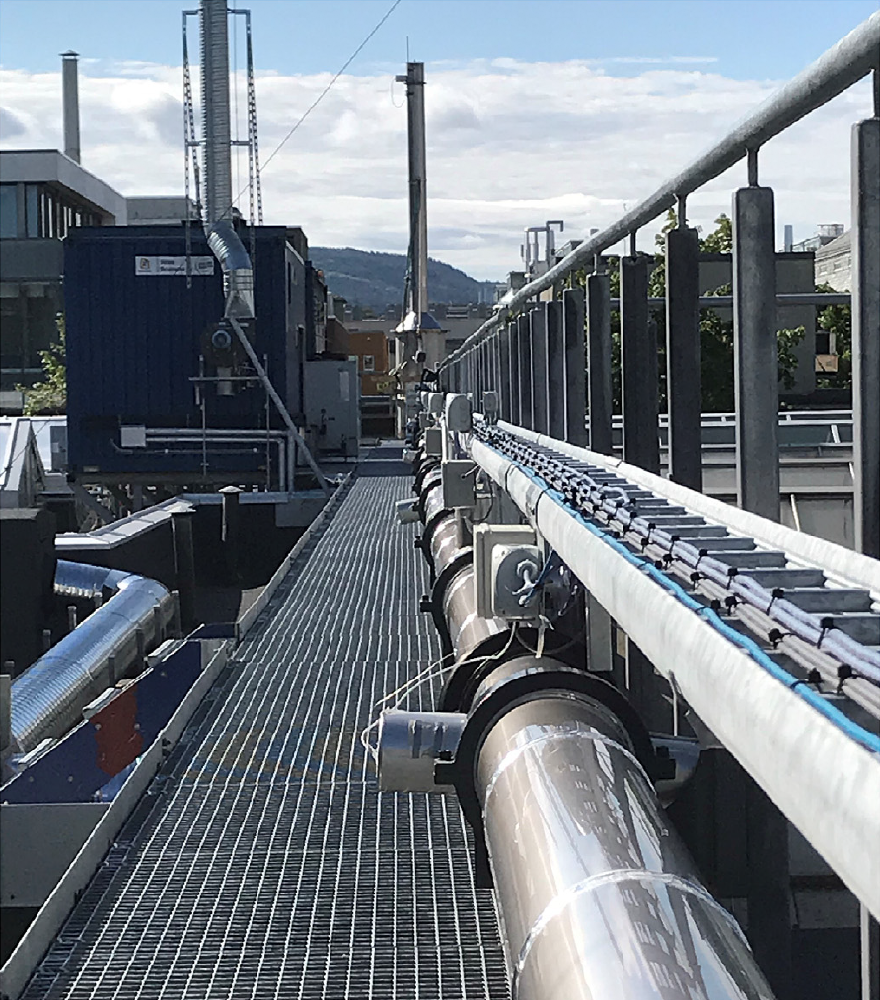
Testing the Code: Comparison with Experiment 2
Case 2: Munkejord et al. (2020)
L = 61.67 m, d_{i} = 40.8 mm.
Choked flow outflow boundary condition.
Ambient temperature of 9ºC.
Steel pipe (heat transfer modeled).
P₀ = 12.2 MPa, T₀ = 24.6ºC
x = 0.08 m
Pressure at initial times
x = 61.3 m

Slide 6
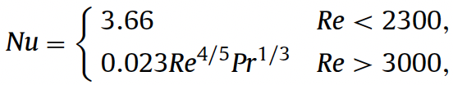
Problem Setup: Well Blowout
To simulate a CO2 blowout in a plugged well.
Inner diameter = 0.18m.
Cement to Rock: Conduction
h = 4 W/m-K
CO₂ to Casing: Turbulent internal convection
At t = 0: Cement plug rupture
Casing to Cement: Conduction
Long term integrity of CO2 storage- well abandonment (2009)

Slide 7
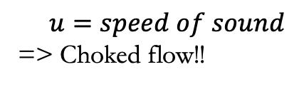


Key Results 1: H = 1160 m
Reservoir temperature = 54º C (Geothermal gradient)
Reservoir pressure = 11.46 MPa, k_{R} = 1000 mD.
$$\dot{m}≈230kgs^{−1}=19,872\frac{tonnes}{day}$$
$$u=speed of sound$$
=> Choked flow!!
$$T ≈−{20}^{o}C$$

Slide 8
Key Results: Effect of Well Height
Temperatures > geothermal temperature

Slide 9
Cases with dry ice formation
Reservoir temperature = 35º C
Reservoir pressure = 9.9 MPa, k_{R} = 100 mD.
Depth: H = 1000 m. L_{R} = 15 m.

Slide 10
Conclusions and Future work
The proposed method is effective in predicting choked leakage of CO₂ with phase transitions.
Modeling heat transfer in the surrounding conduit is important.
Well blowout simulations indicate leakage rate of CO₂ is on average 210 kg/s.
Intermittent ejection of dry-ice into the atmosphere observed for reservoir temperatures below 40º C.
Future work:
Study the effect of reservoir permeability on leak rate.
Incorporate hydrate formation models into current code.
Contact info: pbhuvankar@lbl.gov

