Slide 1
Numerical Simulation of Multi-phase Flow in Porous Media with a Phase-field Method
Lukas Maier, Dr. Manuel Hopp-Hirschler, Prof. Ulrich Nieken
06/02/2022
Notes:
Hello my name is Lukas Maier and I am from the Institute of Chemical Engineering at the University of Stuttgart. Today I want to talk about modeling multiphase flow in porous with a phase field method. Why is this important to calculate multiphase flows in porous media?

Slide 2
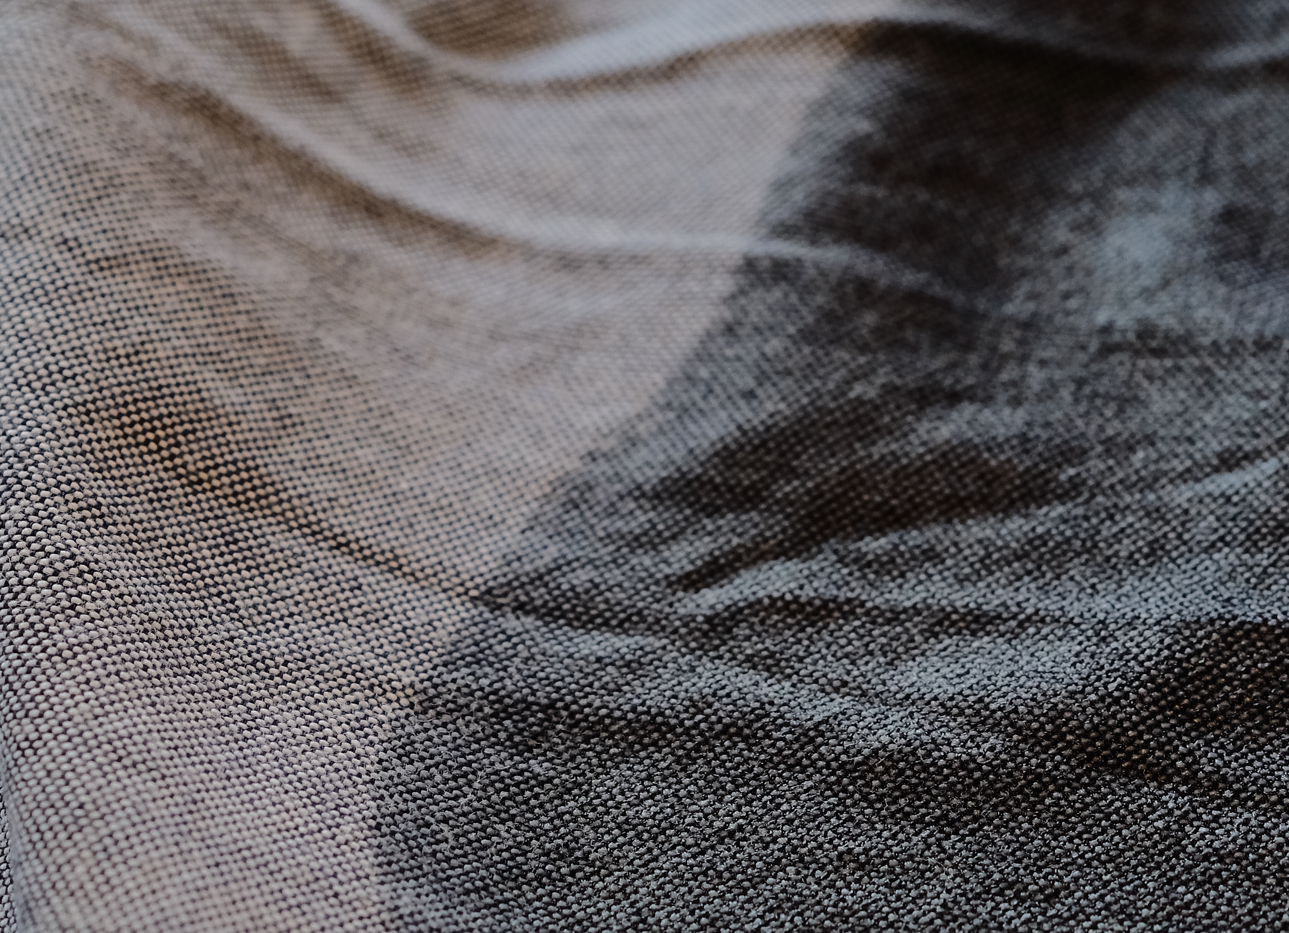
Motivation
Moisture transport in textiles
Gas diffusion electrodes
﻿Kunz et al. , Transport in Porous Media 132 (2020)
Multiphase flow in porous media
Notes:
Most likely, you already came into contact with multiphase flows in porous media this morning when you used a towel to dry off after showering.
Or you have already walked over a PVC floor today. The chlorine in the PVC was most likely obtained by electrolysis. In this process, gas and liquid are in contact in a porous electrode.
Numerical simulations can be very helpful in understanding these mechanisms better and thus improving the processes and materials for the respective application.

Slide 3
Outline
Theory
Modelling and Validation
Outlook
Theory
Modelling and Validation
Outlook
Notes:
I would like to continuo my talk with an introduction to the theory of the phase field method, then I would like to go into the modeling and at the same time show examples for validation. I would like to end my presentation with an outlook.

Slide 4
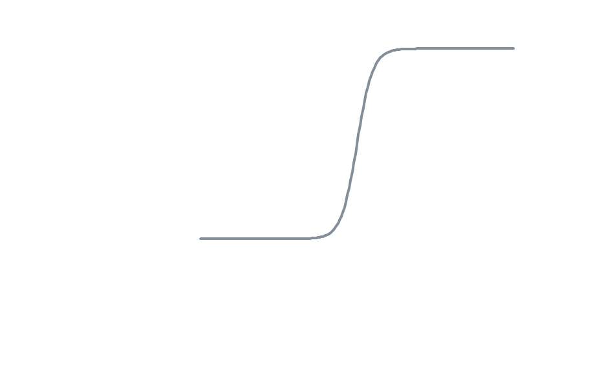
Diffusive Interface
Macroscale
Microscale
$$ρ_{nw}$$
$$ρ_{nw}$$
Non-wetting fluid
$$ρ$$
$$ρ$$
$$ρ_{nw}$$
$$ρ_{w}$$
$$x_{2}$$
$$y_{2}$$
$$y_{2}$$
$$y_{1}$$
Introducing a macroscopic diffusive interface.
Smooth transition of physical properties across the interface
Conceptual Advantage
Macroscale
1
$$φ$$
wetting fluid
-1
$$x_{2}$$
$$x_{2}$$
$$x_{1}$$
Theory
Modelling and Validation
Outlook
Notes:
At the beginning I would like to introduce the term diffuse interface, since this is very central in the phase field method. For this, I would like to look at the simplest case of multiphase flow in porous media. A capillary filled with a non-wetting fluid and a wetting fluid.
If we plot a density profile along the axis, we clearly see a sharp jump in density at the interface. That is, on the macroscopic scale, we have a sharp interface. If we zoom in and look at the density profile on the microscale, we see a tangens hyperbolicus profile of the density. we have a smooth transition of the density across the interface . this is called a diffusive interface.
What one does with the phase field method is we map the diffusive interface to the macroscale. One widens artificially the interface. Thereby, we obtains a smooth transition in the physical properties of the.

Slide 5
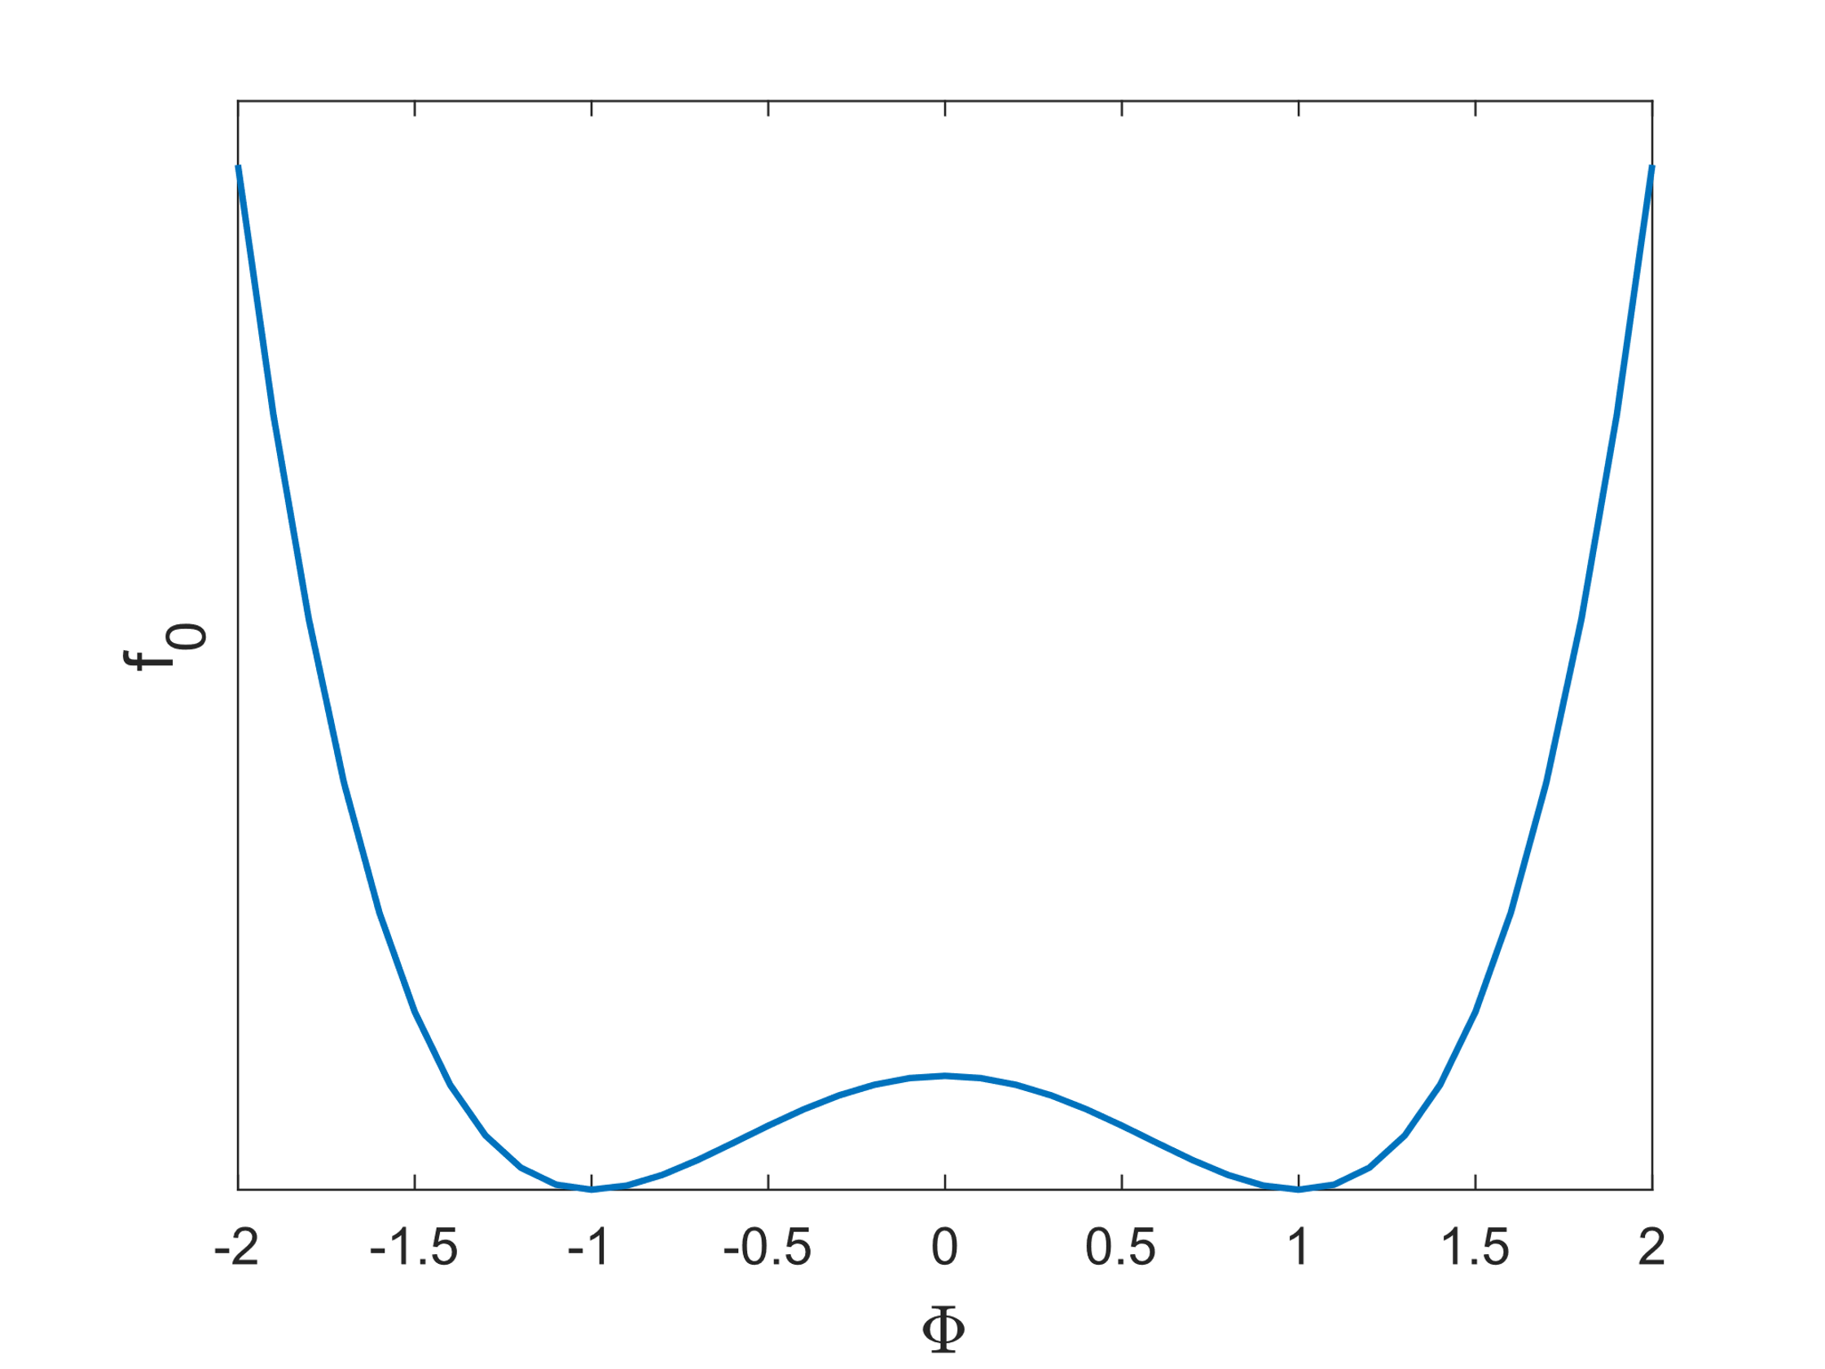
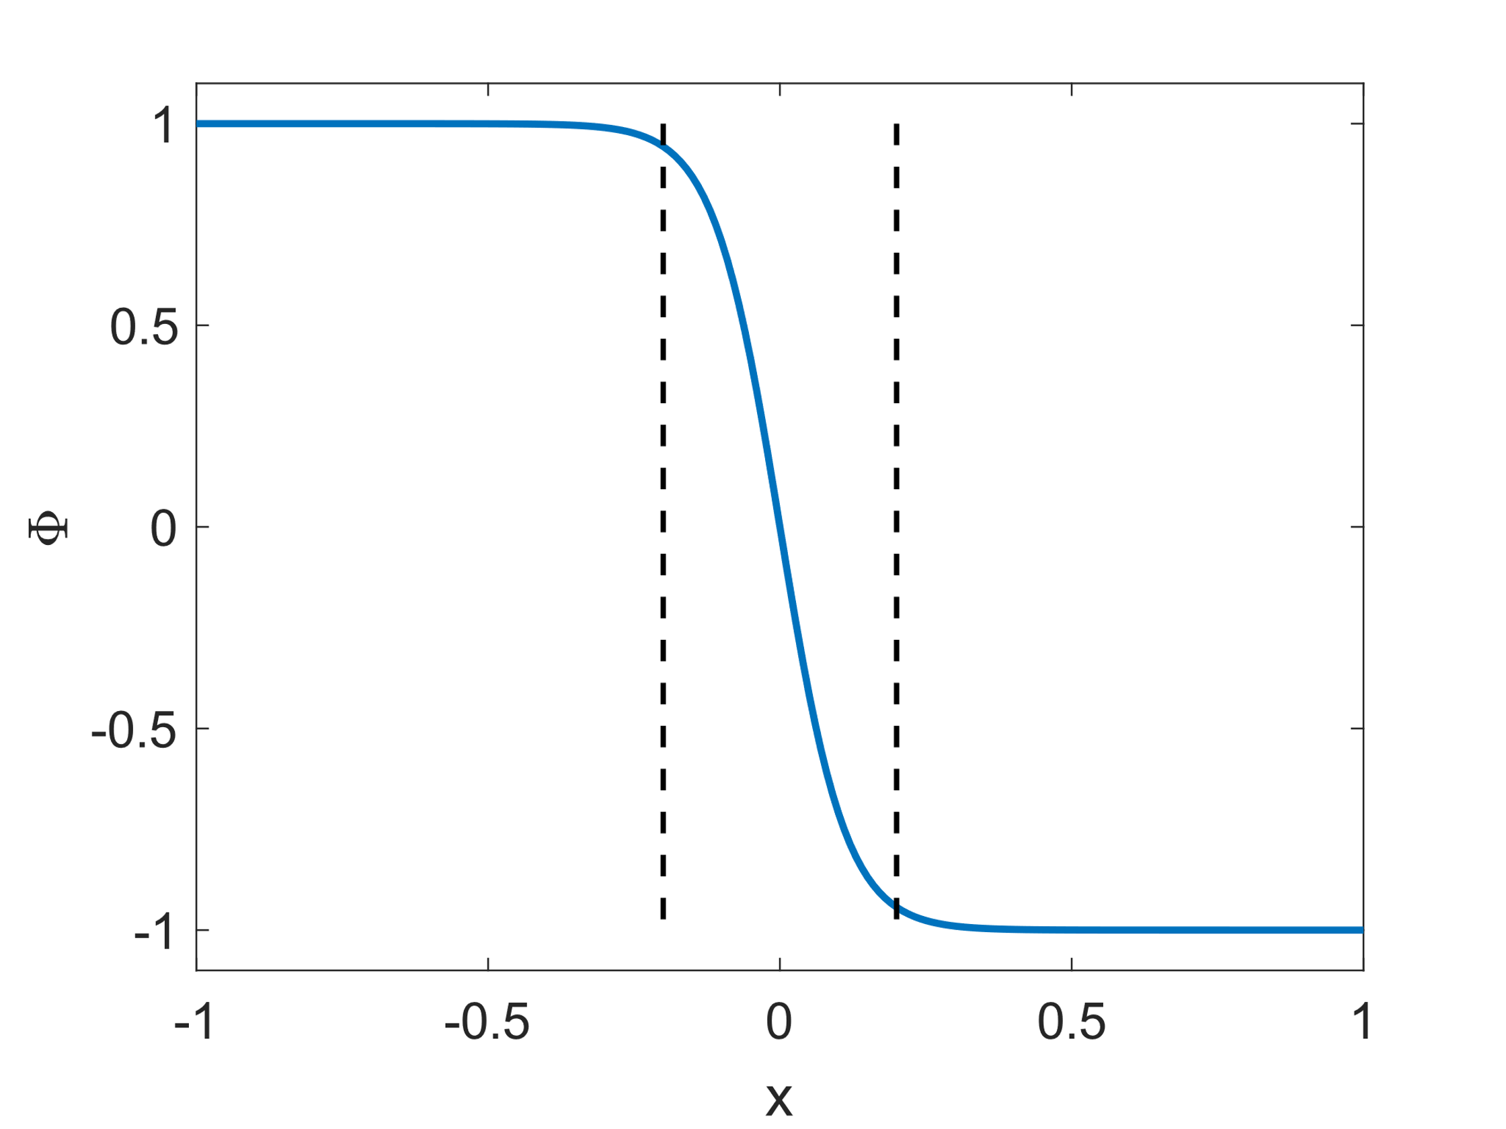
Cahn-Hilliard Equation
Double-Well Potential
Density of the free energy of immiscible two phase mixture:
$$f_{m}=f_{local}+f_{nonlocal}=\frac{λ}{4ε^{2}}{\left(φ^{2}−1\right)}^{2}+\frac{λ}{2}∇φ^{2}$$
$$F_{m}=\int_{V}{f}dV$$
$$f_{local}$$
Fluid 1
Fluid 2
Chemical Potential: $μ=\frac{δF}{δΦ}=λε^{−2}φ\left(φ^{2}−1\right)−λ∇^{2}φ$
$$−1$$
$$φ$$
$$1$$
$$L_{inter}=4.164ε$$
Cahn-Hilliard Equation:
$$∂_{t}φ+∇∙\left(uφ\right)=∇∙\left(M∇μ\right)$$
$$μ=λε^{−2}φ\left(φ^{2}−1\right)−λ∇^{2}φ$$
$$1$$
$$φ$$
Fluid 2
$$φ$$
Fluid 1
Interfacial tension: $σ=\frac{\sqrt{8}}{3}\frac{λ}{ε}$
$$−1$$
$$x$$
Theory
Modelling and Validation
Outlook
Notes:
The pioneers of the phase field theory started with the free energy, because this determines the thermodynamic state of a system. Because a system always strives to the state where the free energy is lowest. For a two phase system, which is not miscible, the following form of the density of the free energy can be postulated.
This is composed of a local and a non-local part. The local part has a minimum when the so-called phase field varibal is 1 or -1. This means that the density is replaced by a so-called phase field variable which indicates where the pphase is located. The influence of the interface, i.e. the non-local term, is taken into account by the second derivative of the phase field variable.
If we integrate the density of the free energy over the domain we get the free energy.
By forming the functional derivative to phi we get the chemical potential of the system.
Cahn Hilliard put this chemical potential into a convection diffusion equation and were able to determine the phase distribution.
If the cahn hilliard equation is solved in 1 d, a tangent hyperbolic profile is obtained, as in the previous slide, where the thickness of the interface can be adjusted by choosing epsilon.
The ratio of lambda and epsilon takes into account the influence of the surface tension on the free energy of the system. Therefore, with knowledge of the surface tension and the following relationship, lambda can be determined.

Slide 6
Surface tension force
﻿Single field Navier-Stokes equations for two incompressible newtonian fluids:
Non-wetting fluid
$∂_{t}φ+∇∙\left(uφ\right)=∇∙\left(M∇μ\right)$; $μ=λε^{−2}φ\left(φ^{2}−1\right)−λ∇^{2}φ$
$$ρ \left(∂_{t}u+\left(u∙∇\right)u\right)=−∇p+\left(η\left(∇u+{\left(∇u\right)}^{T}\right)\right)−μ∇φ \\ ∇∙u=0$$
$ρ=\frac{1+φ}{2} ρ_{nw}+ \frac{1−φ}{2} ρ_{w}; η=\frac{1+φ}{2}$ $η_{nm}+$ $\frac{1−φ}{2}$ $η_{w}$
Velocity $u$
Curved interface
$$ρ_{W}=1000 kg⋅m^{−3}$$
Phase Field $φ$
Pressure $p$
Velocity $u$
$$D=0.5⋅{10}^{−3}m$$
$$ρ_{FI}=1800 kg⋅m^{−3}$$
wetting fluid
$$η_{FI}=0.0047 Pas$$
$$η_{W}=0.001 Pas$$
La-Place Jump
Spurious currents
∼ ${10}^{−6} m⋅s^{−1}$
Theory
Modelling and Validation
Outlook
Notes:
If we turn again to our example of the capillary and want to describe the rise of the wetting fluid, we need a momentum balance. Therefore we solve the Navier Stokes equation. By arithmetic interpolation of the density and viscosity with the phase field variable we can couple the equations. As it is obvious, there is a curvature of the interface resulting in a surface force. The surface tension force is modeled in the potential form according to jaquim. It is remarkable that the curvature does not have to be calculated explicitly, but only the chemical potential and the gradient of phi. This set of equations is now implemented in a FEM framework. To check the implementation a very simple case is simulated. A drop of fluorine inert with 500mu in water. This material system will be used in all further examples. If we simulate the case we can see the phase distribution and the diffuse interface. Then we can see the pressure jump, which fits perfectly to the analytical solution. What is remarkable is the velocity field. Since we are in equilibrium, no velocity should be visible. This is SC, due to poor discretization of the SF. But these are very small compared to other methods.

Slide 7
Wetting
Wetting boundary condition: $∇φ∙n_{R}=\frac{\sqrt{2}}{2}\frac{cosθ}{ε}\left(1−φ^{2}\right)$
Zero gradient of chemical potential: $∇μ∙n_{R}=0$
Non-wetting fluid
$$θ=45°$$
Non-wetting fluid
$$n_{R}$$
$$θ$$
wetting fluid
Phase Field $φ$
Pressure $p$
wetting fluid
Theory
Modelling and Validation
Outlook
Notes:
Another important point in the modeling of multiphase flows is the contact angle , i.e. the contact angle that occurs at the three-phase boundary. This is implemented with the following boundary condition, derived from the free energy of the wall.
Again we want to simple one droplet propagation. It is again a droplet fluorinert with a radius of 250 micrometers. The contact angle is 45 degrees.

Slide 8
Wetting
Wetting boundary condition: $∇φ∙n_{R}=\frac{\sqrt{2}}{2}\frac{cosθ}{ε}\left(1−φ^{2}\right)$
Zero gradient of chemical potential: $∇μ∙n_{R}=0$
Non-wetting fluid
$$θ=45°$$
$$n_{R}$$
$$θ$$
Phase Field $φ$
Pressure $p$
Velocity $u$
wetting fluid
Theory
Modelling and Validation
Outlook
Notes:
If we simulate the droplet spreading, we get the following picture: The curvature decreases and therefore the Laplace pressure jump. For this case there is also an analytical solution.

Slide 9
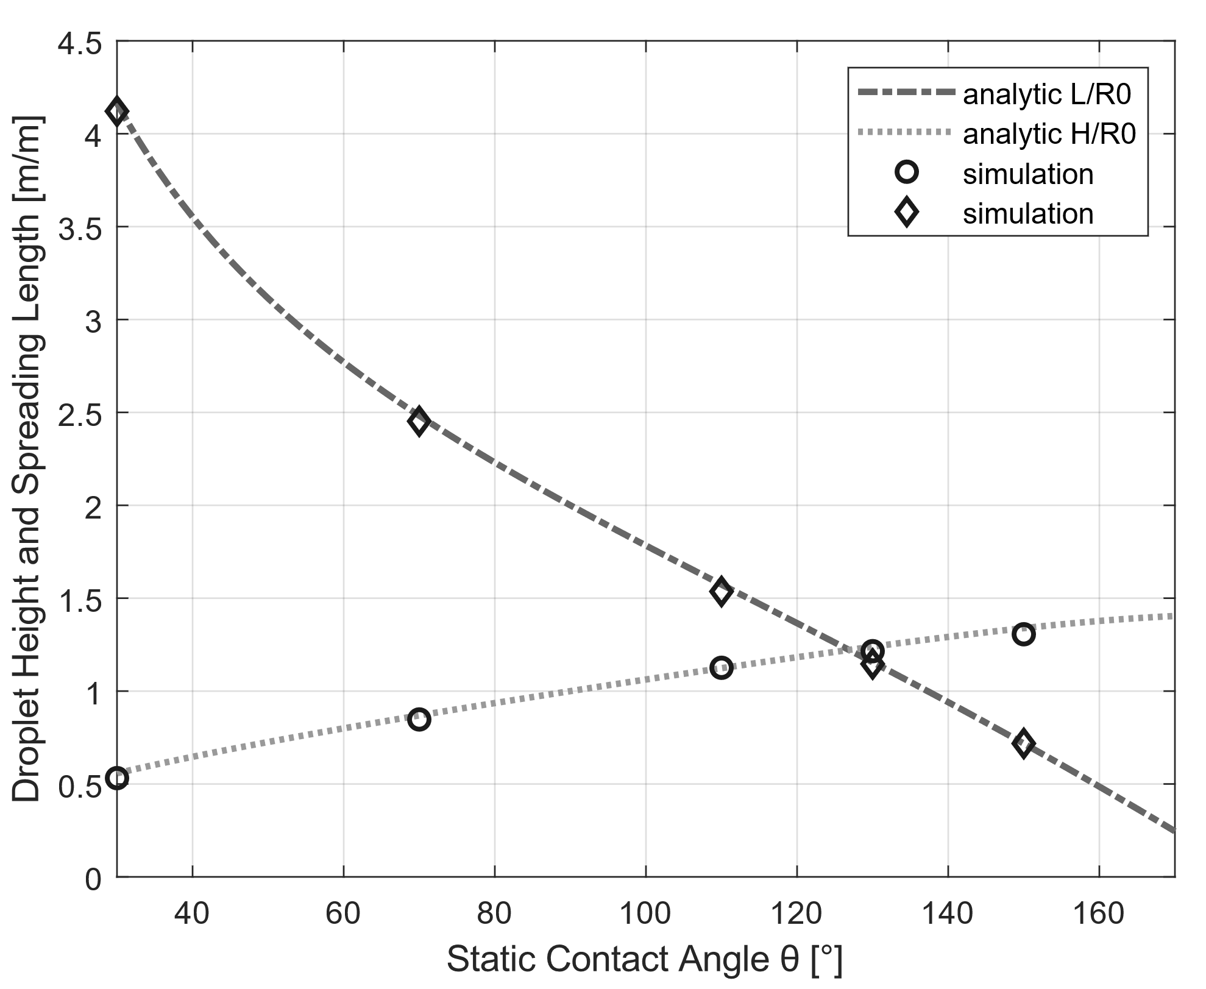
Wetting
Initial droplet
Non-wetting fluid
5
Stationary droplet
1
4
2
3
$$n_{R}$$
3
$$θ$$
2
1
4
4
3
1
5
5
wetting fluid
Theory
Modelling and Validation
Outlook
Notes:
This line represents the analytical solution for the propagation length of the droplet, this for the height in the relaxed state. The circles and prisms represent the simulative solution. We see that the numerical solution agrees with the analytical one.

Slide 10
Modelling Two Phase Flow in Porous Media
Dynamic drainage of a fluorinert saturated PDMS Micro-Modell
$$p_{in,exp}=1.86 kPa$$
$$p_{out}=0$$
﻿Kunz et al. , Transport in Porous Media 114(2) (2016)
Model reduction from 3D to 2D:
Additional friction term: $\frac{dv_{red}}{dt}=\frac{dv}{dt}−\frac{12 η v_{i}}{ρ∗d^{2}}$
Curvature: $p_{c}=σκ→κ=\frac{1}{r_{c}}=\left(\frac{2}{a}+\frac{2}{b}\right)\cos\left(Θ\right)→p_{c,z}=778Pa$ ﻿
Theory
Modelling and Validation
Outlook
Notes:
Now we want to compare our simulation with an experiment. For this we use an experiment that was conducted at the University of Utrecht. It is a micromodel made of PDMS initially filled with fluorinert. By applying a constant pressure, water is forced into the model.
In order to simulate the experiment in 2D, the friction at the lid and at the bottom must be taken into account, and this is taken into account with the following friction term.
In addition, the curvature in the 3rd dimension must be taken into account. For this purpose, the contribution of the capillary pressure is calculated from the 3rd dimension and subtracted from the inlet. A constant contact angle of 45 degrees is assumed.

Slide 11
Modelling Two Phase Flow in Porous Media
Dynamic drainage of a fluorinert saturated PDMS Micro-Modell
$$p_{in,sim}=1.08 kPa$$
$$p_{out}=0$$
Model reduction from 3D to 2D
Additional friction term: $\frac{dv_{red}}{dt}=\frac{dv}{dt}−\frac{12 η v_{i}}{ρ∗d^{2}}$
Curvature: $p_{c}=σκ→κ=\frac{1}{r_{c}}=\left(\frac{2}{a}+\frac{2}{b}\right)\cos\left(Θ\right)→p_{c,z}=778Pa$ ﻿
Theory
Modelling and Validation
Outlook
Notes:
If we simulate the drainage we can observe capillary finger very nicely.

Slide 12
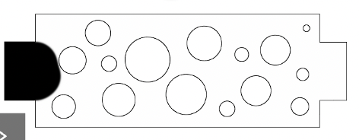
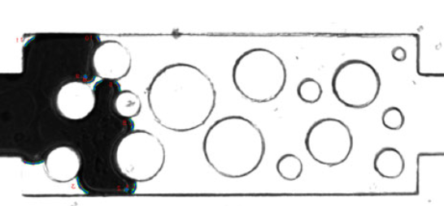
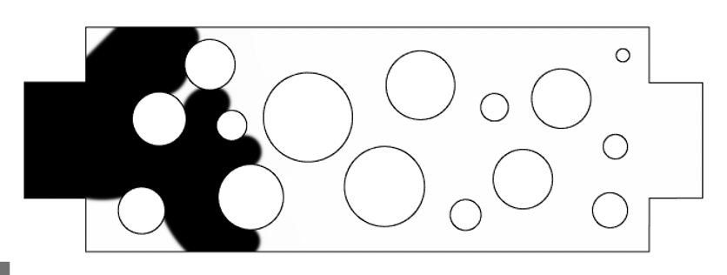
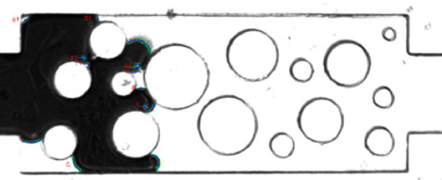
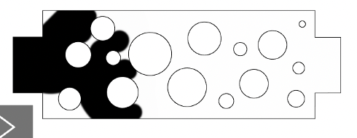
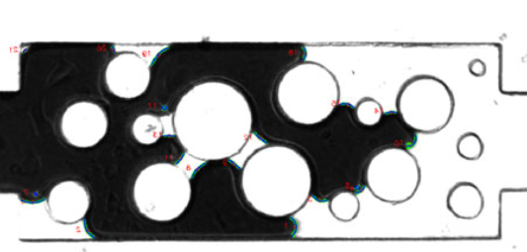
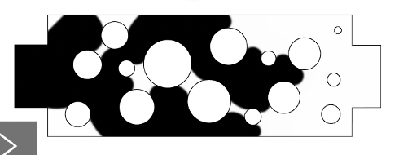
Comparison of simulation to experiment
Experiment
Simulation
$$S_{w}=0.82, t=0 s$$
$$S_{w}=0.82, t=0 s$$
Capillary Fingering
Good agreement of flow pattern between experiment and simulation
No agreement in the dynamics
$$S_{w}=0.67, t=0.8 s$$
$$S_{w}=0.67, t=0.025 s$$
$$S_{w}=0.64, t=1.2 s$$
$$S_{w}=0.65, t=0.036 s$$
$$S_{w}=0.43, t=1.4 s$$
$$S_{w}=0.4 , t=0.072 s$$
﻿Kunz et al. , Transport in Porous Media 114(2) (2016)
21/05/2022
Theory
Modelling and Validation
Outlook
Notes:
If you compare the experiment on the left side, you can see a good match in the flow pattern. Only in the last image you can see a small deviation. The dynamics, on the other hand, unfortunately do not fit. This may be due to the roughness of the micromodel or to the so-called stick slip behavior.
In summary, one can say that the characteristic behavior of multiphase flows in porous media can be simulated very well with the phase field method.

Slide 13
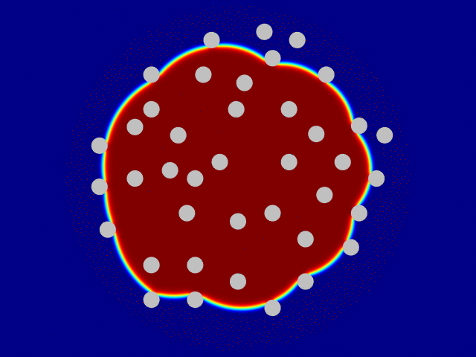
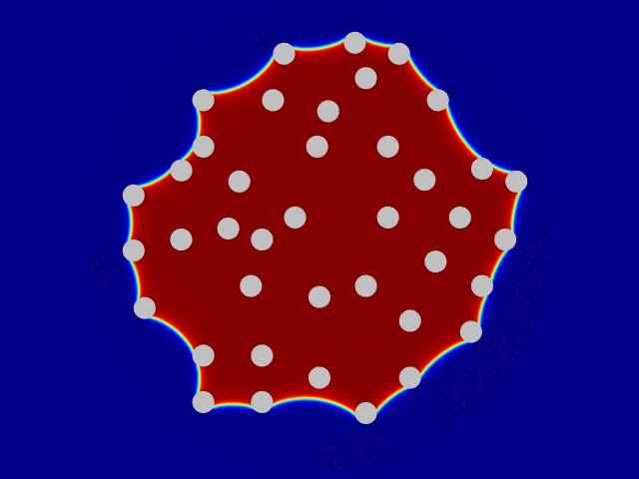
Outlook: Phase Change
Modelling evaporation in porous media
Fibers
Moisture transport in textiles
Crossection of yarn
Hydrophobic fibers
Hydrophilic fibers
Theory
Modelling and Validation
Outlook
Notes:
I would like to end my presentation with an outlook. At the moment we are working on the calculation of evaporation processes in yarns with the phase field method. Our goal is to find out which structure parameters

Slide 14
Thank you for your attention!
Lukas Maier
Lukas.Maier@icvt.uni-stuttgart.de
85180
Special thanks to: Magnus Gaehr, Dr. Manuel Hopp-Hirschler, Prof. Dr. Ulrich Nieken
Institute of Chemical Process Engineering
Böblinger Straße 78
70199 Stuttgart

