Slide 1
Effect of nanoparticles on water-soluble polymers flow in porous media
Dr. Mohsen Mirzaie Yegane | Dr. Fatemeh Hashemi
Frank Vercauteren | Nicole Meulendijks
Prof. Ridha Gharbi | Dr. Pouyan Boukany
Prof. Pacelli Zitha
31 May 2022, Abu Dhabi, UAE

Slide 2
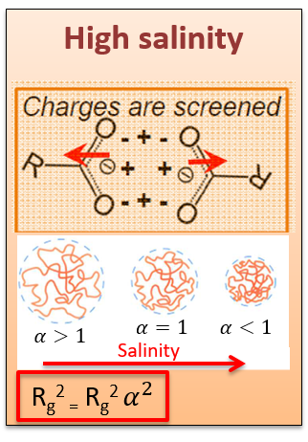
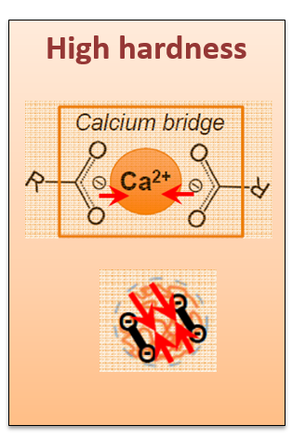
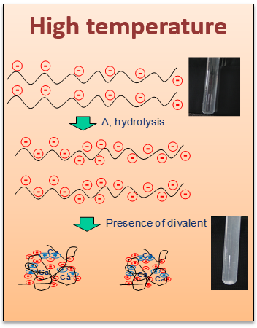
A novel polymer–nanoparticles hybrid for porous media applications
Motivation
Degradation of conventional polymers used for mobility control in porous media at harsh conditions
Hypothesis
A hybrid of modified polyacrylamide and silica nanoparticles capable of improving mobility control in high salinity, hardness, and temperature reservoirs
Objective
Develop a polymer–nanoparticles hybrid with improved viscosity and enhanced stability at harsh conditions
Investigate the polymer–nanoparticles hybrid flow in porous media
Target salinity: TDS = 20 wt%, 1.5 wt% Ca²⁺
Target temperature: 70 ºC
Notes:
In the presence of the divalent cations, polyion– metal complexes can be formed and the polymer chains can be bridged by the cations.
This bridging leads to polymer precipitation due to the complexing ability of the HPAM carboxylate groups.

Slide 3
Development of a hybrid system (molecular scale)
Step 1: Hydrophobic modification of silica nanoparticles (NPs)
Surface modification by a low molecular weight organic ligand
The surface becomes hydrophobic
Ensure colloidal stability by providing steric stabilization
Step 2: Hydrophobic modification of polyacrylamide (HMPAM)
98 mol% acrylamide, 2 mol% t-butyl acrylamide (hydrophobic)
Step 3: Bridging between HMPAM chains by NPs through hydrophobic-hydrophobic interactions
Rheological response at various concentrations to study the bridging effect

Slide 4
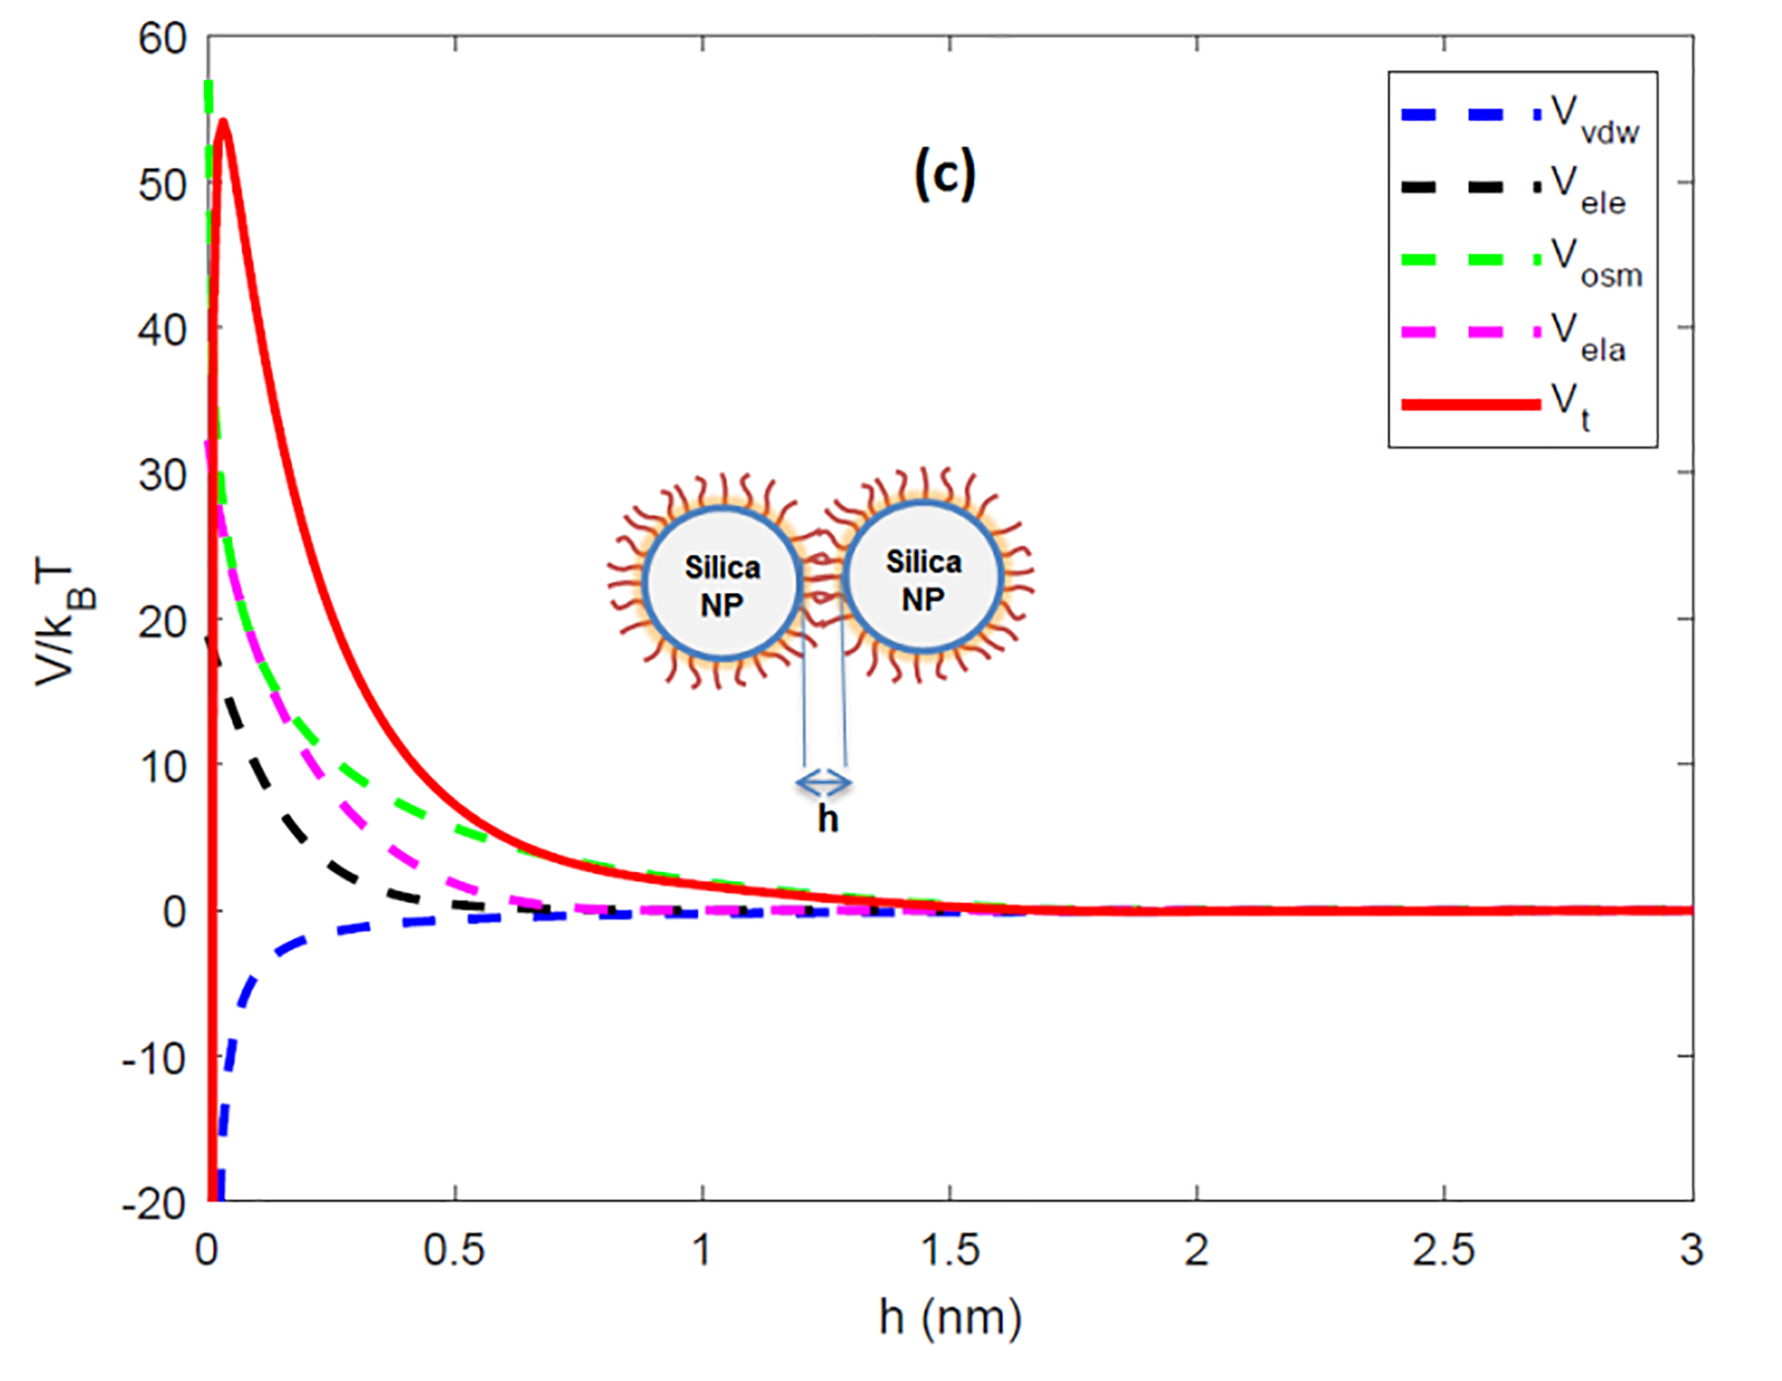
Colloidal stability of dispersed NPs
DLVO theory:
NPs without surface modification
NPs with hydrophobic surface modification
Van der waals attraction
Electrostatic repulsion
Steric potential
Bare NPs in Brine:
Hydrophobically-modified NPs in Brine:
Prevents aggregation of NPs
Mirzaie Yegane et. al., Soft Matter 2020
Notes:
In order to study the impact of the hydrophobic modification on the prevention of aggregation of silica NPs, on bare and hydrophobically silica NPs with approximately identical particle diameters.
When bare NPs were dispersed in Brine2015 most of them adhered to one another and large aggregates were formed.
This is an indication of the flocculation of small silica NPs into particulate networks, resulting in sedimentation.
Even though a few slightly larger agglomerates were formed, a majority of the NPs remained separated from each other. This shows that grafting low molecular weight ligands to the surface of NPs can prevent their aggregation.

Slide 5
Rheology of the hybrid at high salinity and temperature
Dilute
Semi-dilute
The effect of critical NPs concentration in the semi-dilute regime
Critical NPs concentration
Notes:
The viscosity improvement was more pronounced for HMPAM in the semi- dilute regime. Apparently, the HMPAM chains in the semi-dilute regime overlap, and therefore they can be bridged by NPs more easily. For a given HMPAM concentration, in the semi-dilute regime, there was a critical concentration of NPs above which the bridging of HMPAM chains by NPs happened more easily resulting in a significant increase in viscosity.

Slide 6
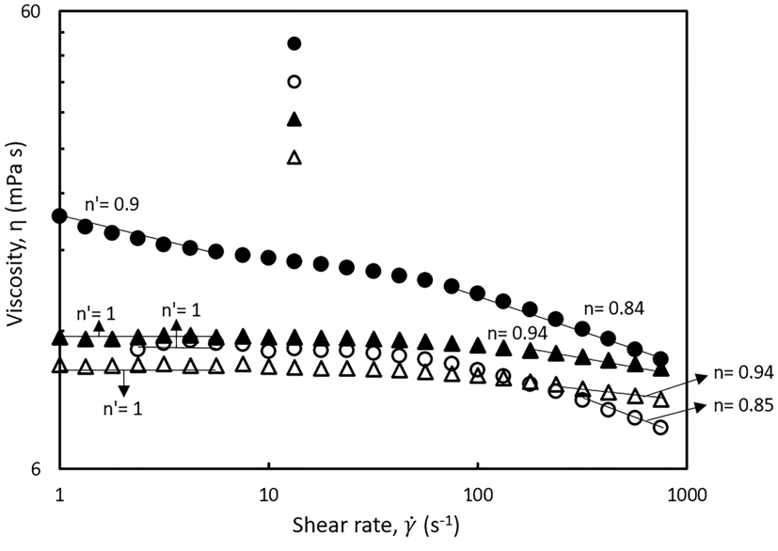
Shear rate dependency of the hybrid viscosity
The effect of hydrophobic-hydrophobic interactions
The hybrid viscosity considerably higher than the viscosity of HMPAM
Two shear-thinning regimes both in low shear rates (< 10 s¹ ) and high shear rates (> 100 s¹ ) for HMPAM–NPs hybrid
No synergic effect for the hybrid of unmodified polymer and NPs
Hydrophobically modified polymer with NPs
Hydrophobically modified polymer
Unmodified polymer with NPs
Unmodified polymer
Notes:
Particularly interesting → bridging between chains because of H-H interactions
Mu vs. shear rate → No effect of same NPs and unmodified Pol
Two shear-thinning regime → weak and strong intaractions

Slide 7
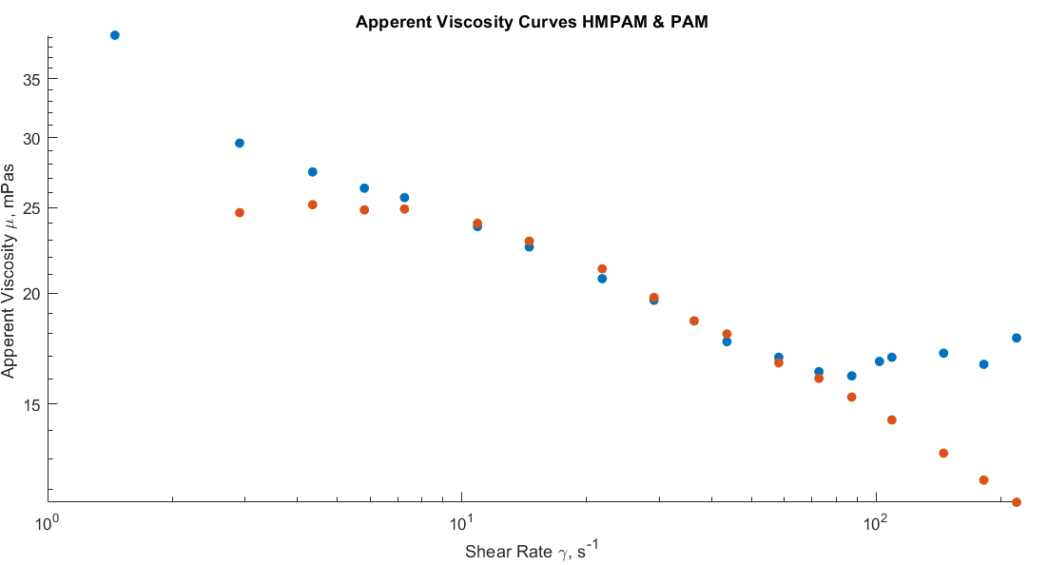
Transport in pore-scale
Elastic flow instabilities
Shear-thinning regime at low shear rates for the HMPAM–NPs hybrid
Shear-thickening behaviour for the HMPAM–NPs hybrid
No shear-thickening behaviour for the un-modified polymer and NPs
Hydrophobically modified polymer with NPs
Unmodified polymer with NPs
No Elastic flow instabilities
Notes:
the flow was visualised using fluorescent tracer particles and recorded with a high speed camera
the flow the HMPAM sample is observed to become noticeably unstable after a shear rate of 145 /s, indicating that this unstable flow might indeed be causing in the shear thickening behaviour of the sample.
Mach number of 1

Slide 8
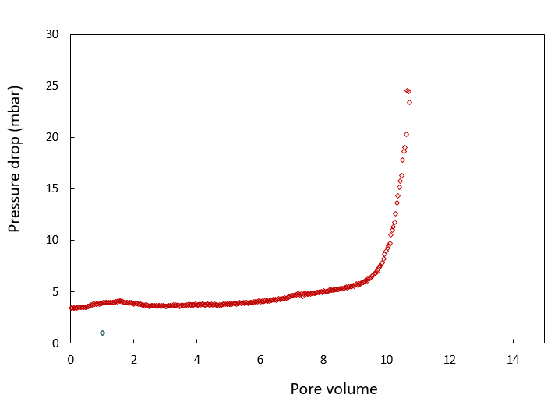
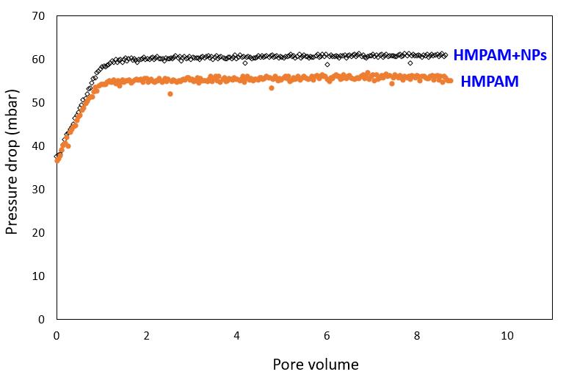
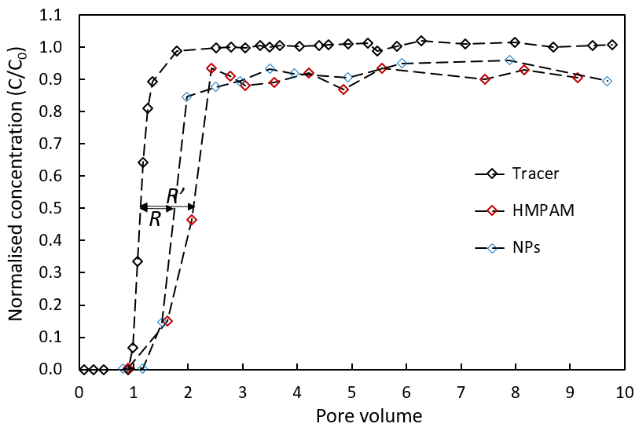
Transport in core-scale
NPs
Polymer and nanoparticles retention
Significant external and internal filtration of nanoparticle aggregates
Possible opening of the epoxy functional groups of the organic ligand at high temperature at larger time scale
Preventing significant external and internal filtration of nanoparticle aggregates, excellent injectivity
Due to the hydrophobic–hydrophobic interactions between the HMPAM and NPs, they were transported through the porous media in unison
Notes:
Transport of NPs in porous media is of concern
Even though till 8 PV → Significant external and internal filtration
Possible opening of the epoxy functional groups of the organic ligand at high temperature at larger time scale
Different behaviour when HMPAM – NPs
Due to the hydrophobic–hydrophobic interactions, they were transported through the porous media in unison, no significant retardation
hydrophobic–hydrophobic interactions prevents filtration of nanoparticle aggregates, excellent injectivity
Classis polymer bahaviour but higher resistance

Slide 9
Conclusions
The hydrophobic modification of the surface of NPs ensured the colloidal stability at high salinity
Hybridization of HMPAM and NPs exhibited enhanced stability at high salinity and hardness and improved the rheological properties of HMPAM at elevated temperatures
Elastic flow instability for the hybrid of HMPAM and NPs
Injection of NPs alone led to a substantial increase in the pressure drop due to external and internal filtration of nanoparticle aggregates
The injection of the HMPAM–NPs hybrid into a porous medium prevented such filtration and led to a higher resistance factor, as compared to that of the HMPAM solution

Slide 10
Acknowledgments
TNO
TU Delft
Dr. Filip Neele
Michiel Slob
Abdulaziz Fattah
Leen Sandifort
Jacco Eversdijk
Jelle Rohlfs
Dr. Bas van Ravensteijn
Maurice Mourad
Daniel Turkenburg

Slide 11
Thank you for your attention.

