Slide 1
Dynamic Mode Decomposition (DMD) for Analyzing Dynamics in Multiphase Flow in Porous Media
Catherine Spurin, Steffen Berg, James McClure, Ryan Armstrong

Slide 2
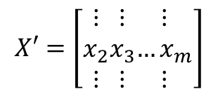
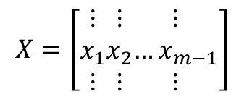

What is Dynamic Mode Decomposition?
DMD aims to extract the relevant dynamics for the flow:
DMD: Eigenvalues, Eigenmodes
(the superposition of modes describes the fluid flow)
Experiment with spatio-temporal data:
Time t
modes
x_{m}
$$X=\left[\begin{matrix}⋮ \\ x_{1} \\ ⋮\end{matrix}\begin{matrix}⋮ \\ x_{2} \\ ⋮\end{matrix}\begin{matrix}⋮ \\ …x_{m−1} \\ ⋮\end{matrix}\right]$$
Space x
x₂
$$X′=\left[\begin{matrix}⋮ \\ x_{2} \\ ⋮\end{matrix}\begin{matrix}⋮ \\ x_{3} \\ ⋮\end{matrix}\begin{matrix}⋮ \\ …x_{m} \\ ⋮\end{matrix}\right]$$
dynamics
$$A=X^{′}X^{T}$$
write
into
matrix
x₁
Time t
Position x in space
Diagnostics
Future state prediction

Slide 3


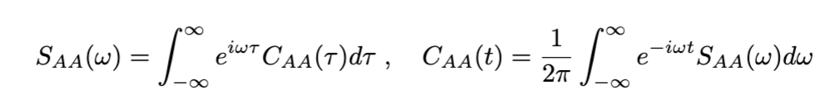
What can we learn?
Noise in the system is related to transport coefficients based on time correlation functions:
This means that if we can characterize the noise associated with the observable signal we can also characterize the dissipation.
A spectral representation of the time correlation function is obtained by Fourier transform:
The spatial and temporal dynamics are linked to the Pollicott-Ruelle resonances, which can be identified from the spectral signal. The eigenvalues are linked to the Lyapunov exponents, which characterize the relaxation dynamics of the system.

Slide 4
Application to 2-phase flow experiments
We perform DMD on 2 data sets already published:
Core flooding: flow front instabilities
https://www.frontiersin.org/articles/10.3389/frwa.2021.671399/full
(2) Micro-CT experiments: intermittent flow pathways
https://www.sciencedirect.com/science/article/pii/S0309170821000233
We have 2 main objective:
(1) Can DMD reproduce the data?
(2) What can we learn about the dynamics from DMD?

Slide 5
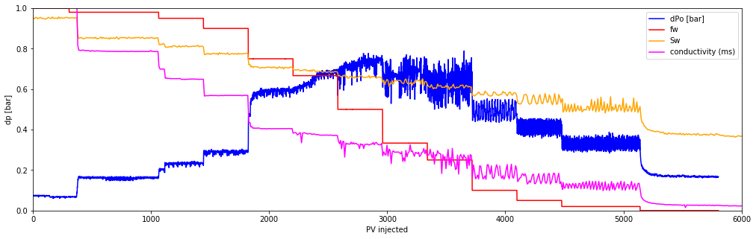
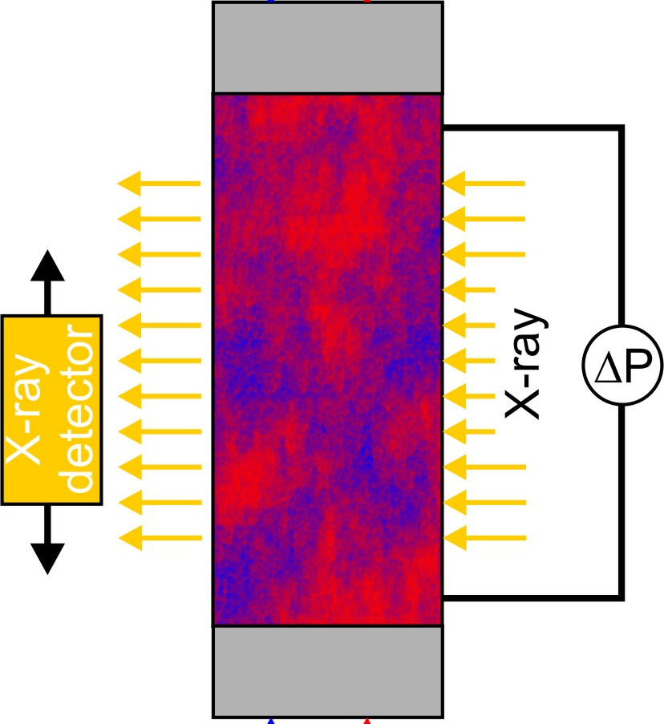






(1) Core flooding, 1D saturation profile
separator
Time data
$$f_{w}$$
fluid recirculation
pressure
oil
saturation
brine
$p$=10-30 bar
Pressure, saturation
$$q_{oil}$$
$$q_{brine}$$
end piece
time
S_{w}
core
Space data
saturation
24
points
2.54 cm
$$f_{w}$$
end piece
Fractional flow
$$f_{w}=\frac{q_{brine}}{q_{brine}+q_{oil}}$$
space

Slide 6
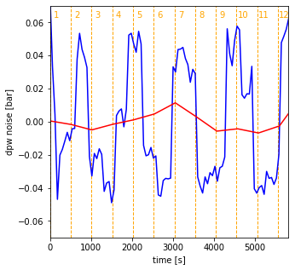
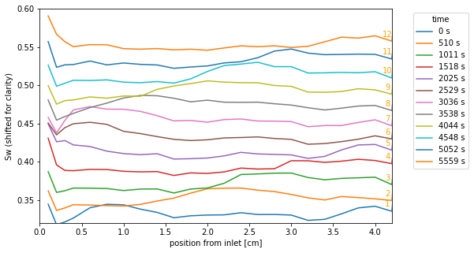
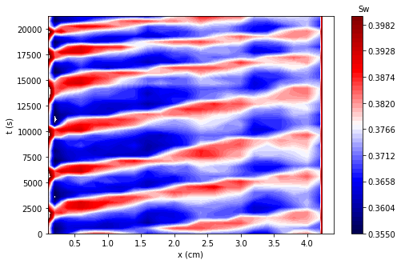
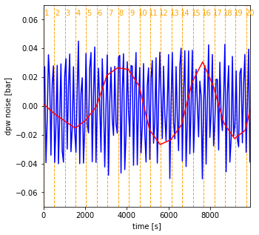
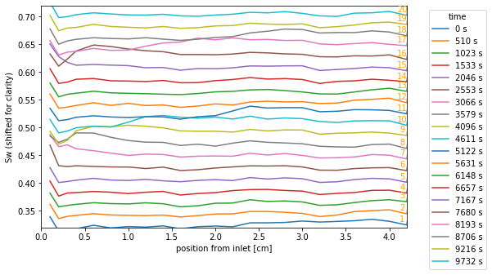
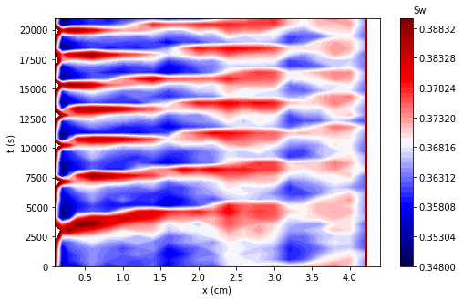


A
B
wave
C
time
$$f_{w}=0.10$$
peak
inlet
outlet
D
E
F
$f_{w}=0.0$5

Slide 7
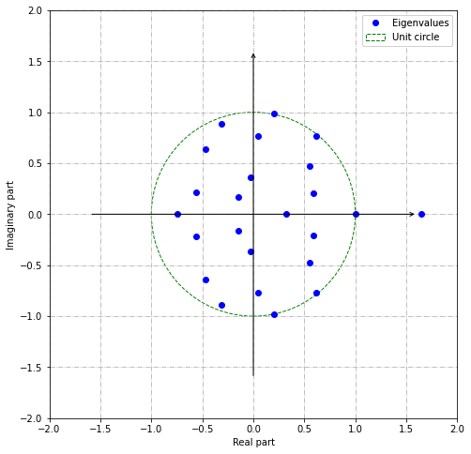
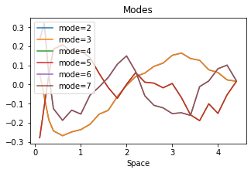
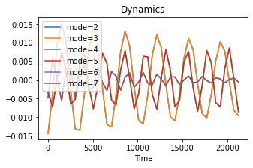
The superposition of modes will reconstruct the data
Eigenvalues
#6
#4
#2
#1
#0
#3
#7
#5

Slide 8
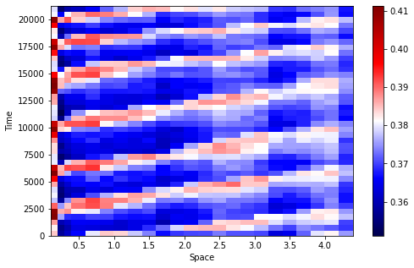
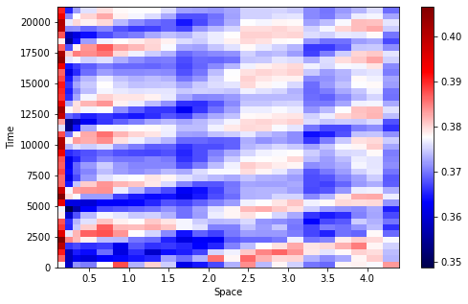
DMD reconstructs data well
Original
DMD reconstruction
(svd_rank=-1, tlsq_rank=6, exact=True, opt=True)

Slide 9
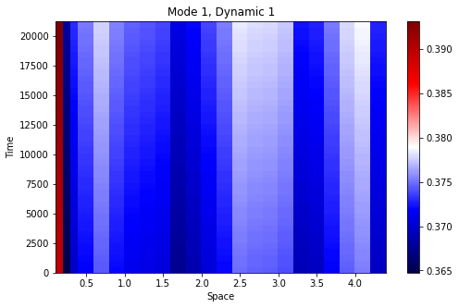
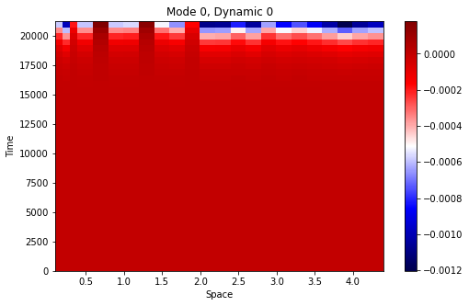
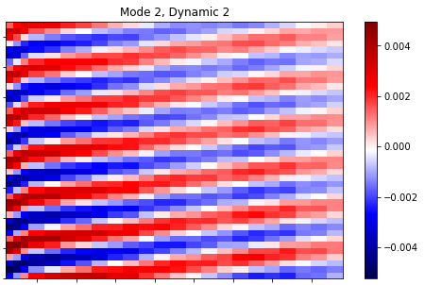

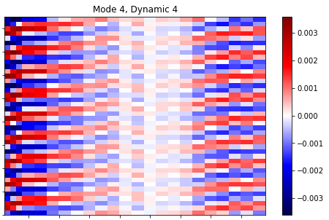

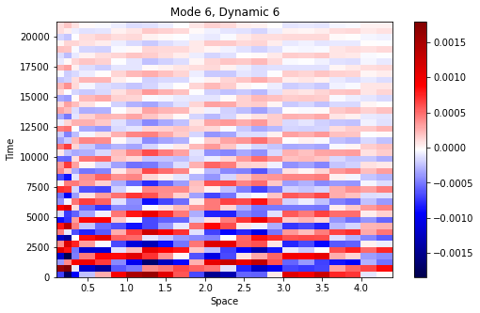

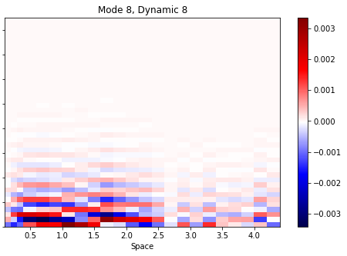
A
B
C
D
E
F
G
H
I

Slide 10
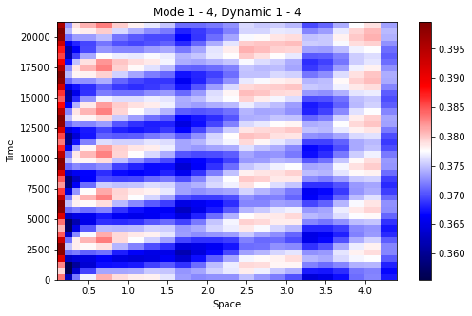
Not all modes needed to reconstruct data
Original
DMD full reconstruction
DMD – 4 modes + 4 dynamics
A
B
C
4 modes + 4 dynamics sufficient to reproduce the data

Slide 11
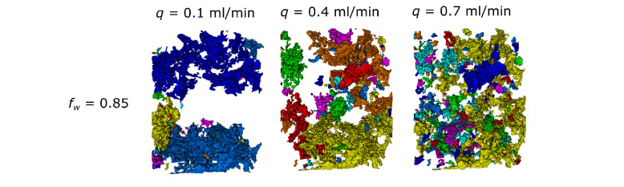
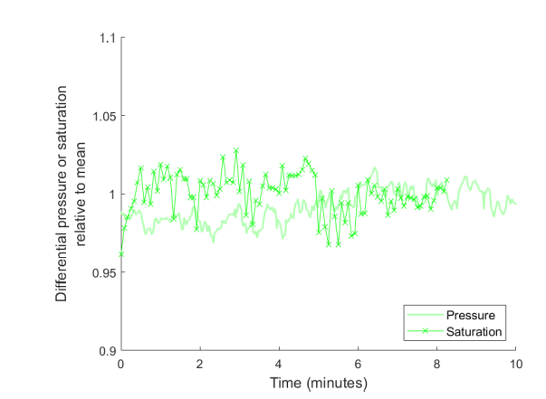
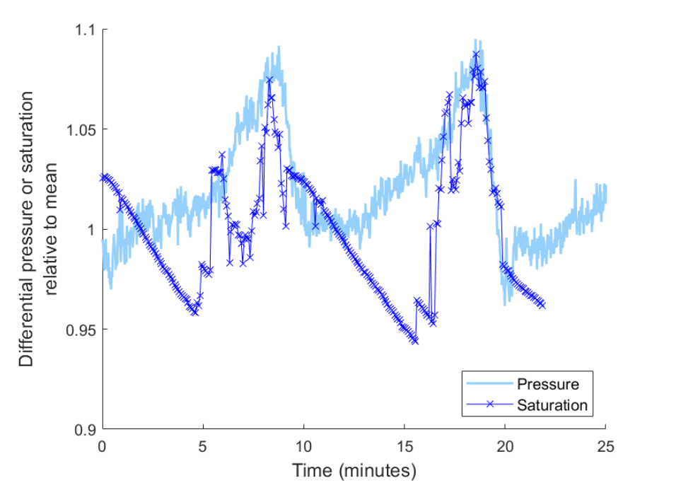
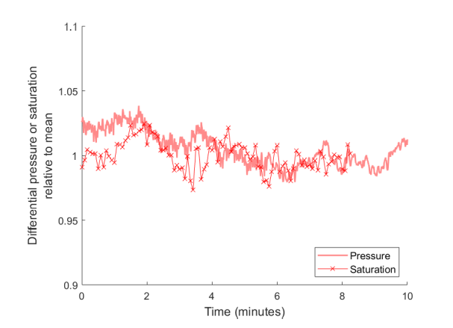
(2) Synchrotron experiments with intermittency

Slide 12
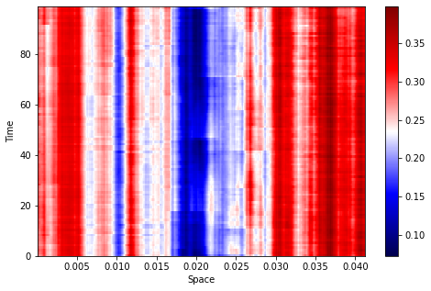
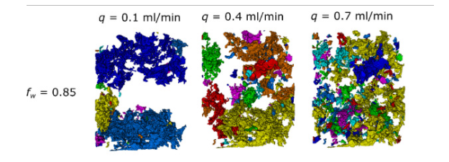
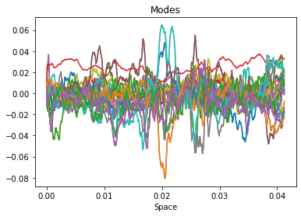
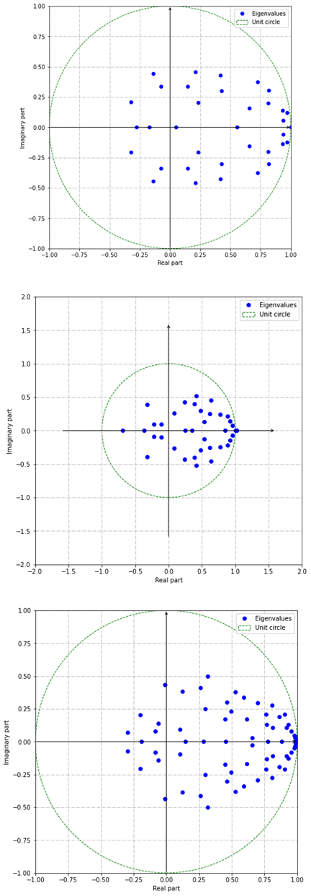
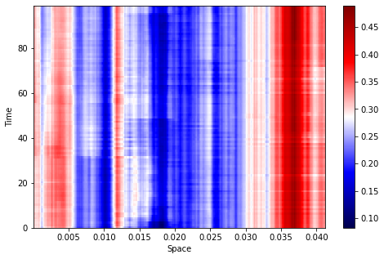
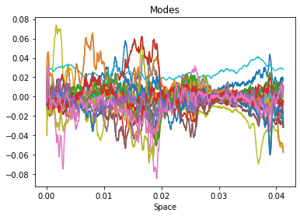
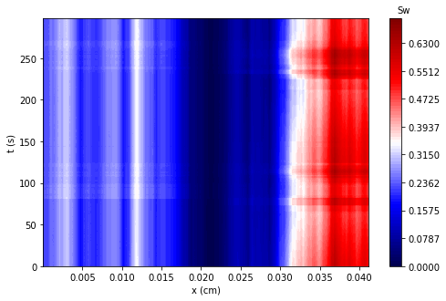
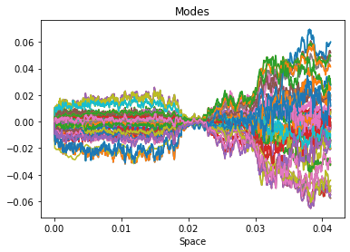
Experimental Data
fw=0.85
DMD Modes
DMD Eigenvalues
Increase in flow rate and capillary number
Increase in intermittency
Injection

Slide 13
Picks up dynamics that aren’t obvious to the naked eye

Slide 14
Conclusions
We used DMD to analyze dynamics for multiphase flow in porous media.
We show that DMD is able to reproduce the data.
With only a few modes, we were able to reconstruct the data
Modes show dynamics that aren’t easy to spot by eye
Future work to see if saturation DMD could be linked with pressure data -> Fourier analysis or power spectra

