Slide 1
Visualizing biofilms within porous media using contrast-enhancing staining agents
Laurenz Schröer, Tim De Kock, Tim Balcaen, Greet Kerckhofs, Karel Folens, Nico Boon and Veerle Cnudde - 31/05/2022

Slide 2
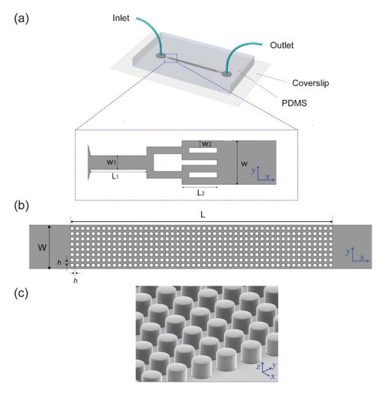
Biofilms colonize the pore space affecting the material properties and water transport
Biofilms induce:
Bioclogging
Microbially induced precipitation
Gas formation
Dissolution
Etc.
Their effect is often indirectly determined
or studied in 2D using microfluidics
Schematic example of a microfluidic setup
Valiei et al. 2012

Slide 3
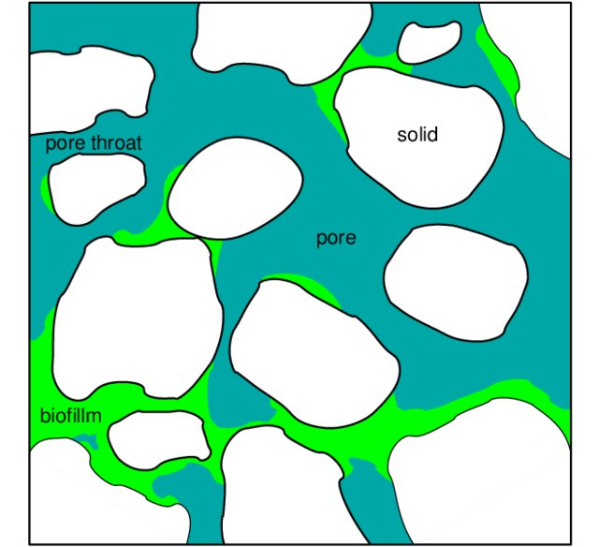
µCT can visualize the interior of opaque materials, but cannot distinguish biofilms from water
Biofilm = 99% water
Positive contrast agents
BaSO₄
silver-coated microspheres
1-chloronaphtalene
Drawbacks:
Alters fluid properties
Heterogeneous distribution
Sedimentation
Aim: Identify other negative contrast agents to visualize biofilms in 3D with µCT.
Schematic model biofilm
in porous medium
µCT cross-section
solid
Water/Biofim?
Water
Anozie Ebigbo, 2009

Slide 4
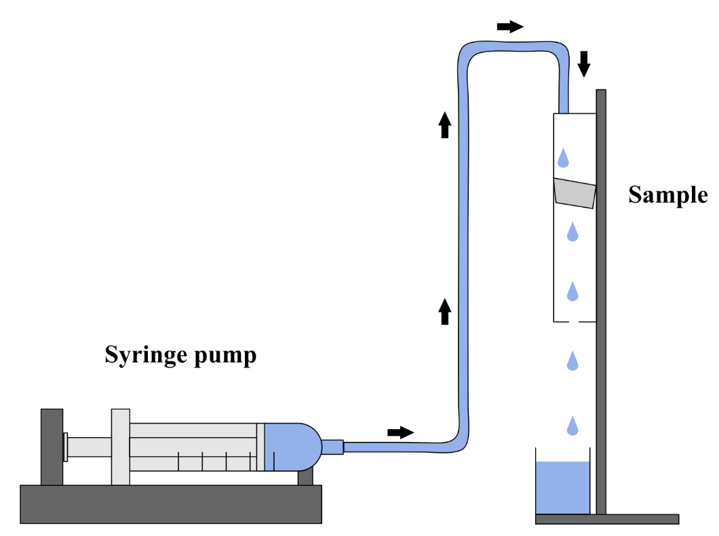
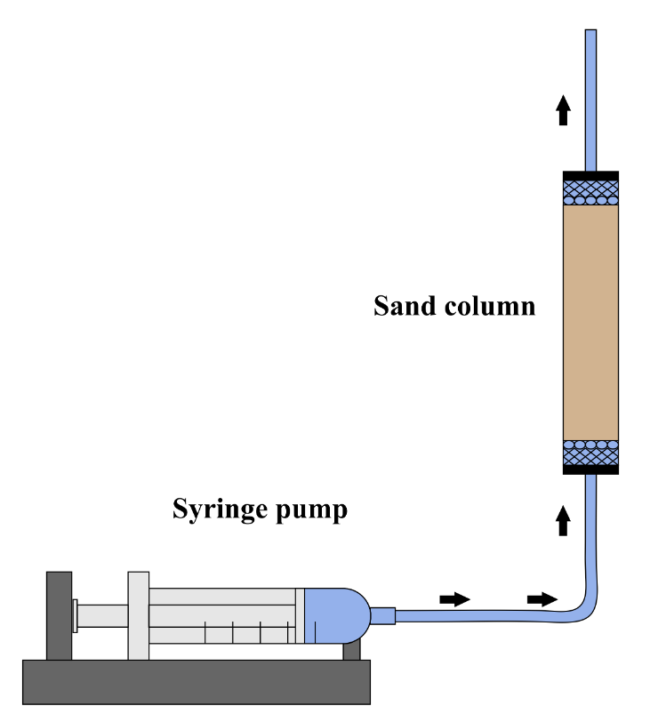
Biofilms were cultured on stones and within a sand column
Dripflow - Visualization “big” biofilms on stones
Flow - Visualization biofilms within pores
General workflow
Cultivate the biofilm
Add the contrast agent
Remove non-attached contrast agent with PBS
µCT scan

Slide 5
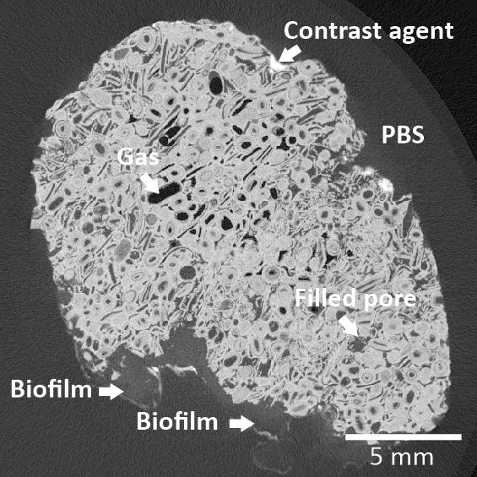
Numerous contrast agent were tested and mono-WD POM Gave promising results
Mono-WD POM: Dripflow experiment
Tested, but less promising
KI
KBr
Iron-oxidation
Ba-absorption
PTA

Slide 6
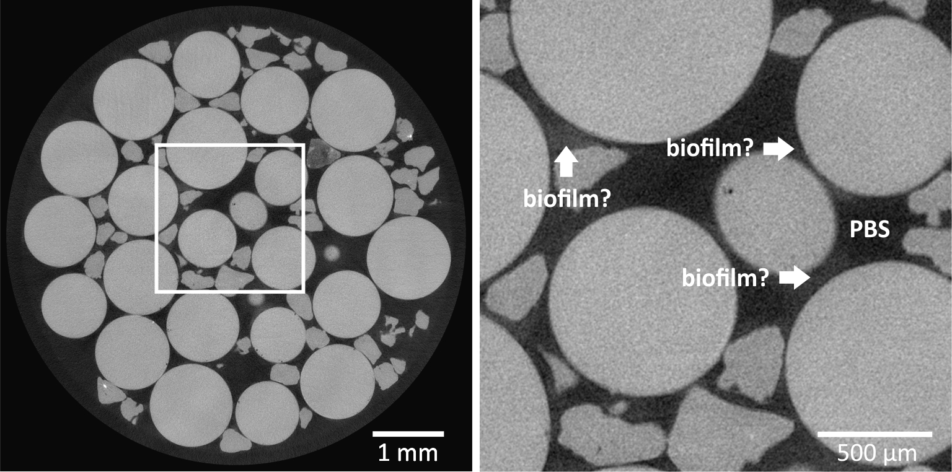
Visualizing biofilms inside the flow cell remains challenging

Slide 7
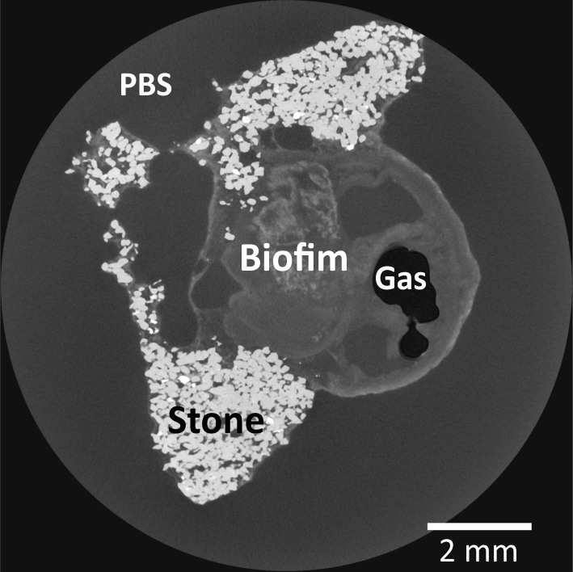
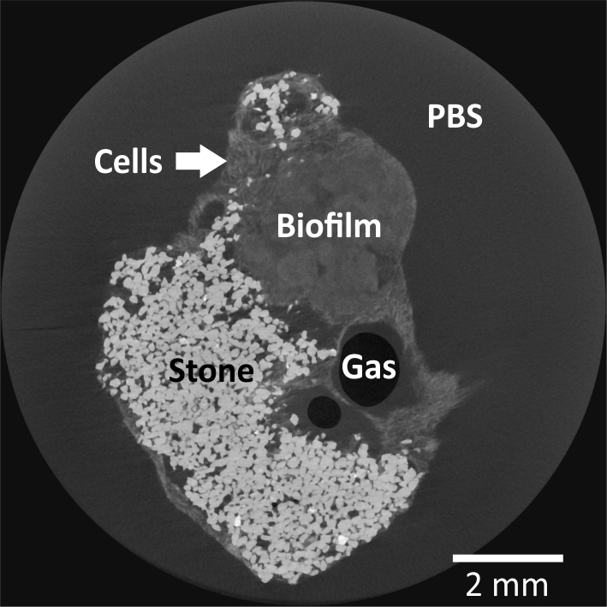
five contrast agents were compared Isotonic lugol and Hf-WD POM were promising
Hf-WD POM
Isotonic lugol

Slide 8
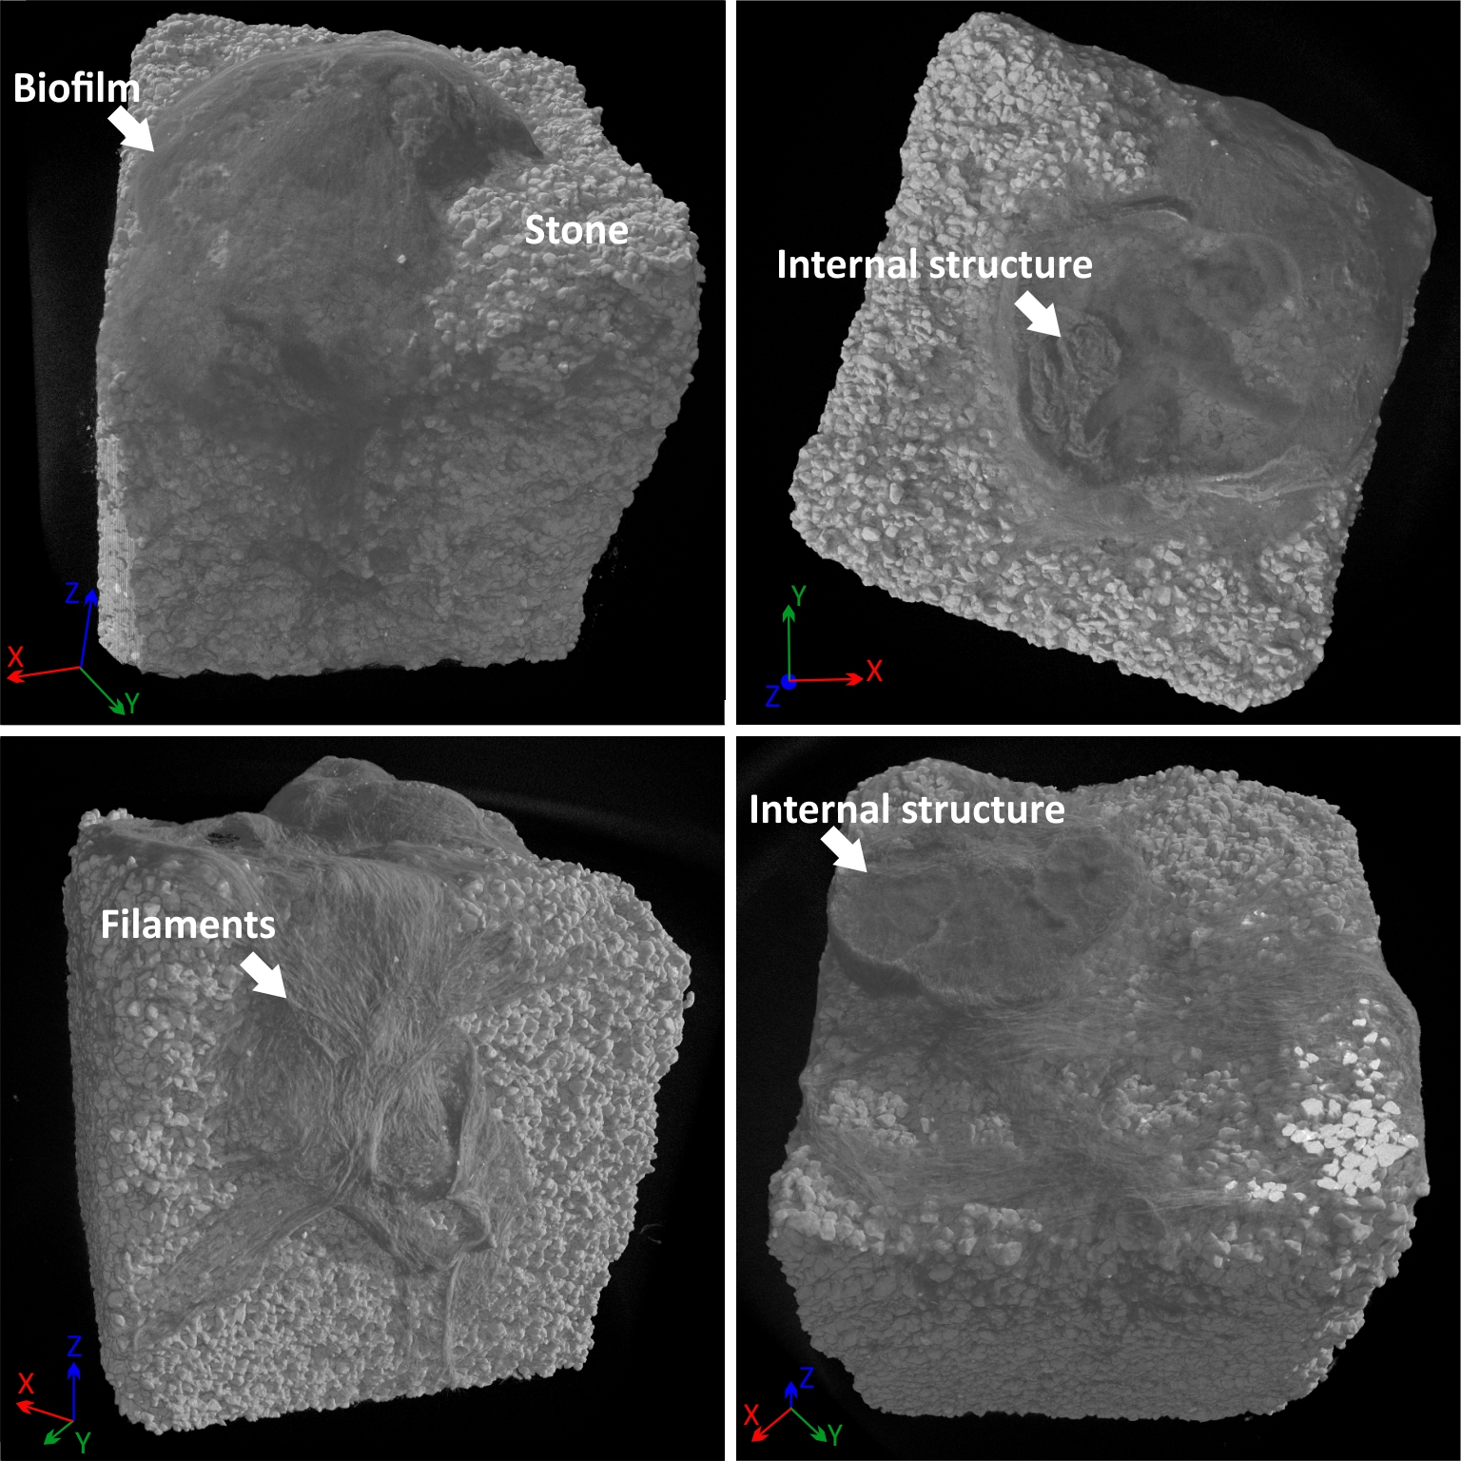
3D visualization of the biofilm structure
Hf-WD POM
Both contrast agents can be used complementary
Isotonic lugol

Slide 9
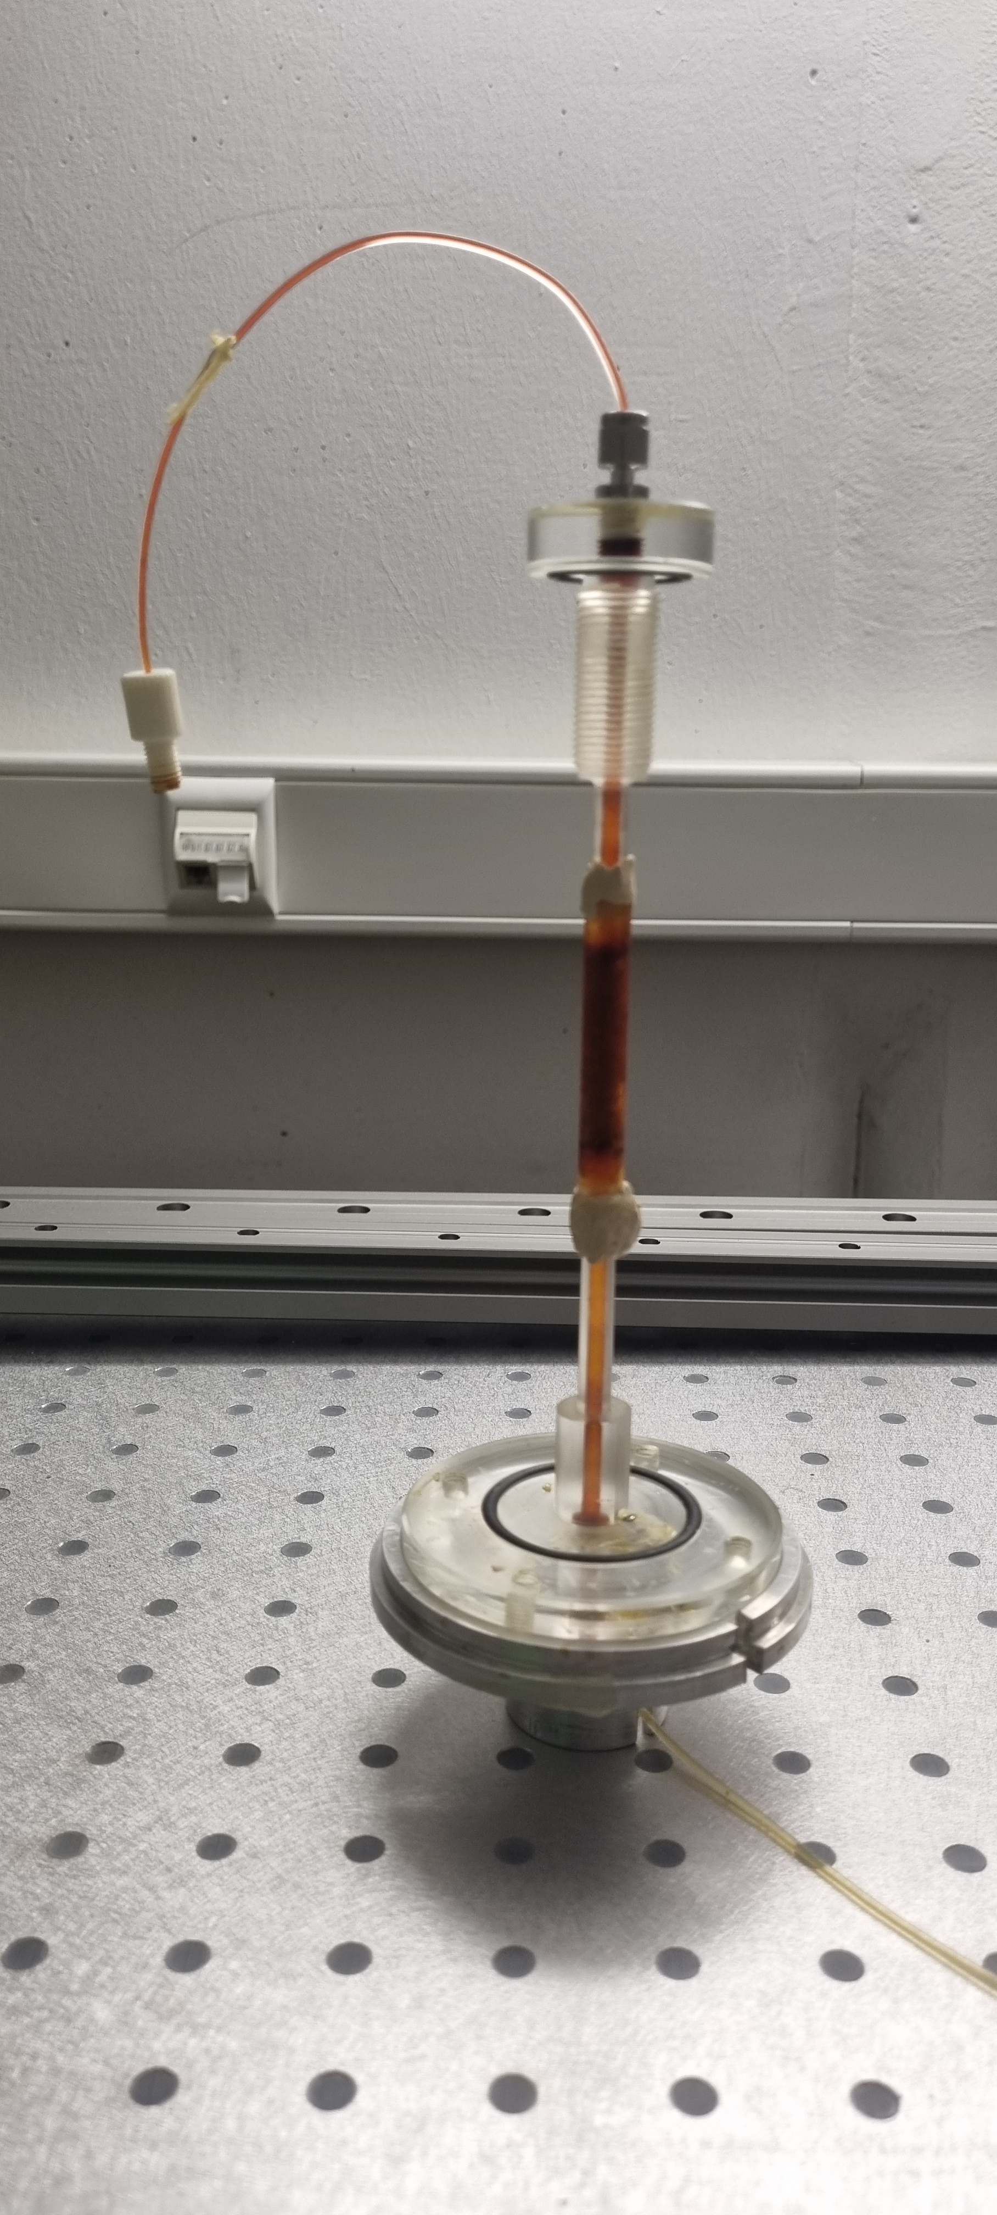
Isotonic lugol visualizes potential biofilms inside porous media but segmentation remains difficult

Slide 10
Conclusions and future research
Negative contrast agents are able to stain biofilms allowing visualization with µCT
Hf-WD POM, Mono-WD POM and isotonic lugol are the most promising contrast agents
Visualization of biofilms inside porous media remains challenging
Future research should focus on how these contrast agents interact with the biofilm and how we can enhance absorption

Slide 11
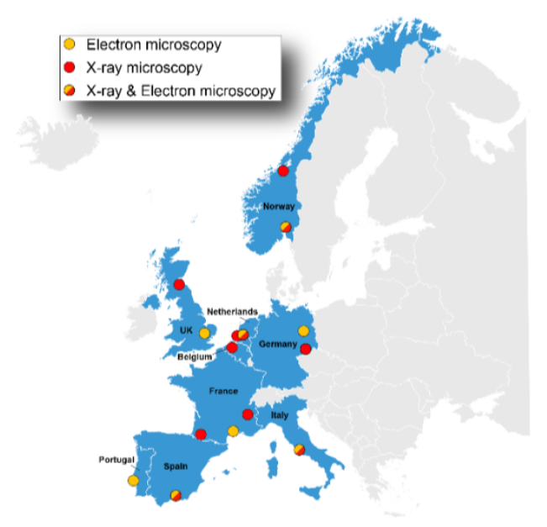
15 Institutions
9 Countries
Facilities:
11 Electron microscopy
14 X-ray Microscopy
Transnational access, joint research activities,
industry events, workshops, etc.
https://excite-network.eu/

Slide 12
Laurenz Schröer Postdoctoral researcher and Facility manager for EXCITE Department of geology - pprogress E Laurenz.Schroer@ugent.be T +32 9 264 46 33 www.ugent.be
@GeologieUGent @ProgressU
UGCT

