Slide 1
Abstract ID 285 Optimization of injection strategies for field-scale leakage remediation using microbially induced calcite precipitation
Svenn Tveit and David Landa-Marbán
NORCE Norwegian Research Centre

Slide 2
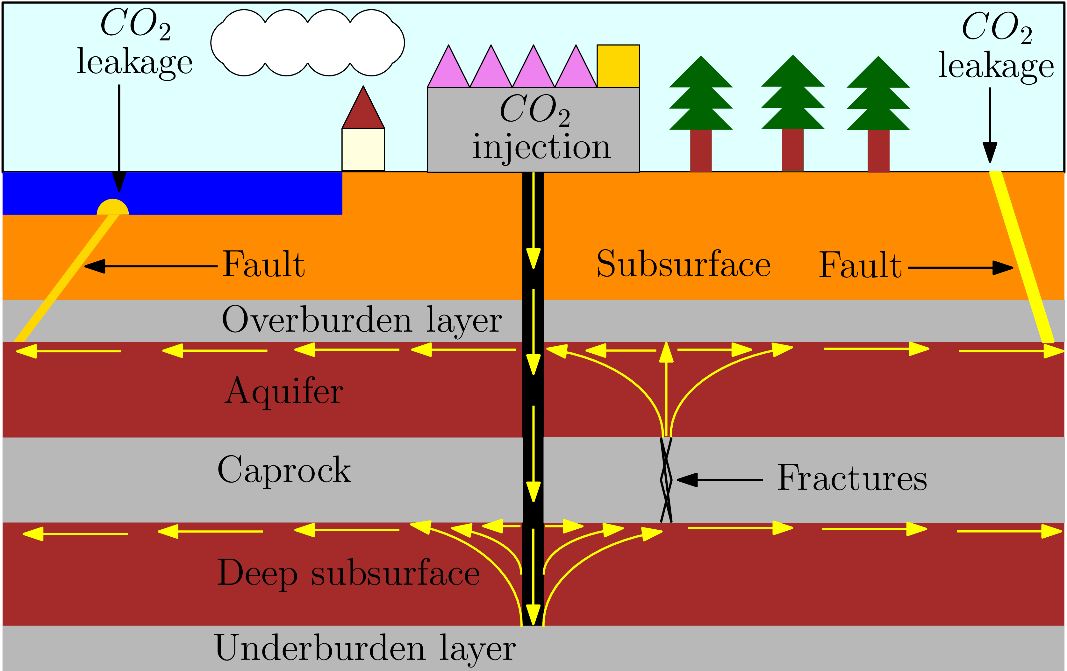
CO₂ storage
Saline aquifers or depleted hydrocarbon reservoirs have large volumetric storage potential
High injection rate can lead to hazardous pressure build-up
Fractures and/or fault reactivation can occur → CO₂ leakage
Sealing technology must be efficient and reliable

Slide 3
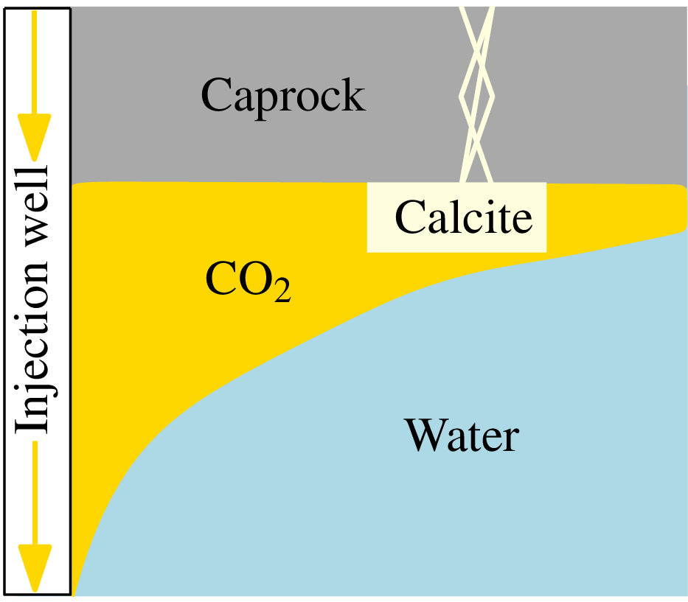
Field-scale application of MICP
Goal: Seal leakage paths potentially tens-of-meters away from the injection well
Injection components:
Microbial solution
Growth solution
Cementation solution
MICP model implemented in Open Porous Media (OPM) Flow simulator (www.opm-project.org)
→ suspended microbes
→ oxygen
→ urea

Slide 4
Injection strategy
$ms$ = microbial solution
$gs$ = growth solution
$cs$ = cementation solution
$w$ = water injection

Slide 5
Optimization
Goal:
Maximizing sealing of leakage paths and minimize total injection and no-flow periods
Objective function
$$J\left(x\right)=\sum_{p}^{N_{p}}{{\left\|φ_{c}^{leak} (t_{3}^{p})\right\|}_{∞}−γ\sum_{i}^{N_{t}}{x_{i}}}$$
$φ_{c}^{leak}$ = volume fraction of calcite at leakage path
$t_{3}^{p}$ = end of phase $p$
$γ$ = regularization parameter
$x$ are injection and no-flow periods, which are the control variables
Optimization problem solved with EnOPT steepest ascent method:
Gradient approximated by sample covariance matrix → no derivatives needed!
$N_{p}$ = number of phases
$N_{t}$ = number of injection and no-flow periods

Slide 6
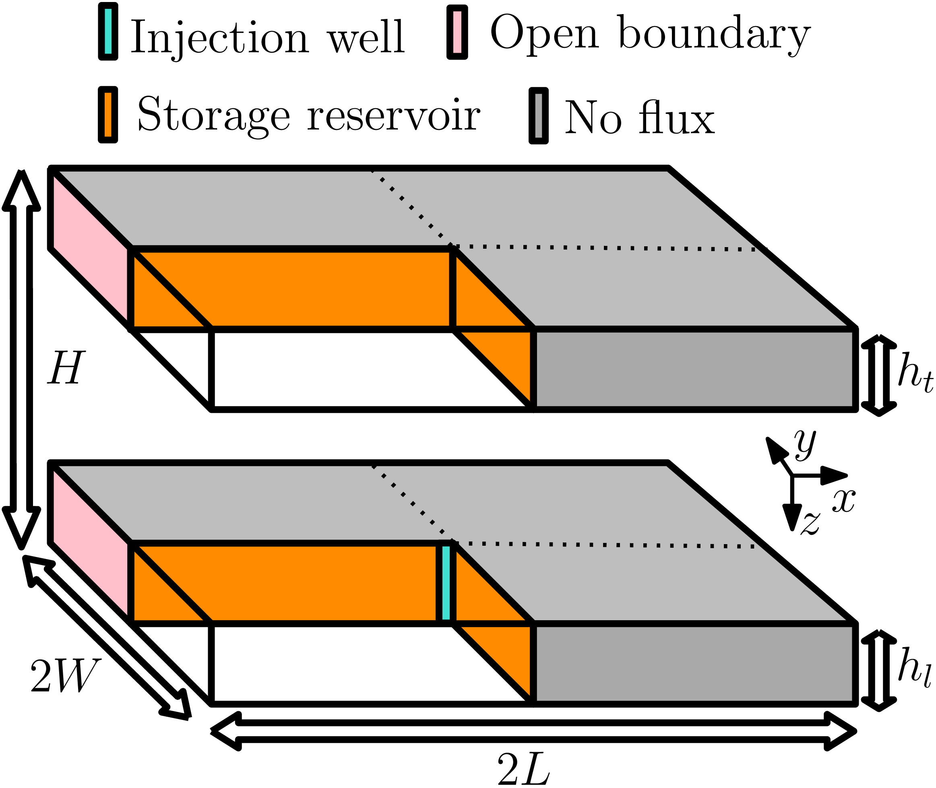
Numerical setup
Two aquifers separated by a caprock (not shown explicitly)
Simulate quarter of the domain (shown with dotted lines)
5 phases of injection and no-flow periods
Leakage path permeability twice the aquifer permeability
Assessed leakage by simulating CO₂ injection before and after optimized MICP treatment
$H$ = 30m
$W$= $L$ = 100m
$h_{l}$ = $h_{t}$ = 5m

Slide 7
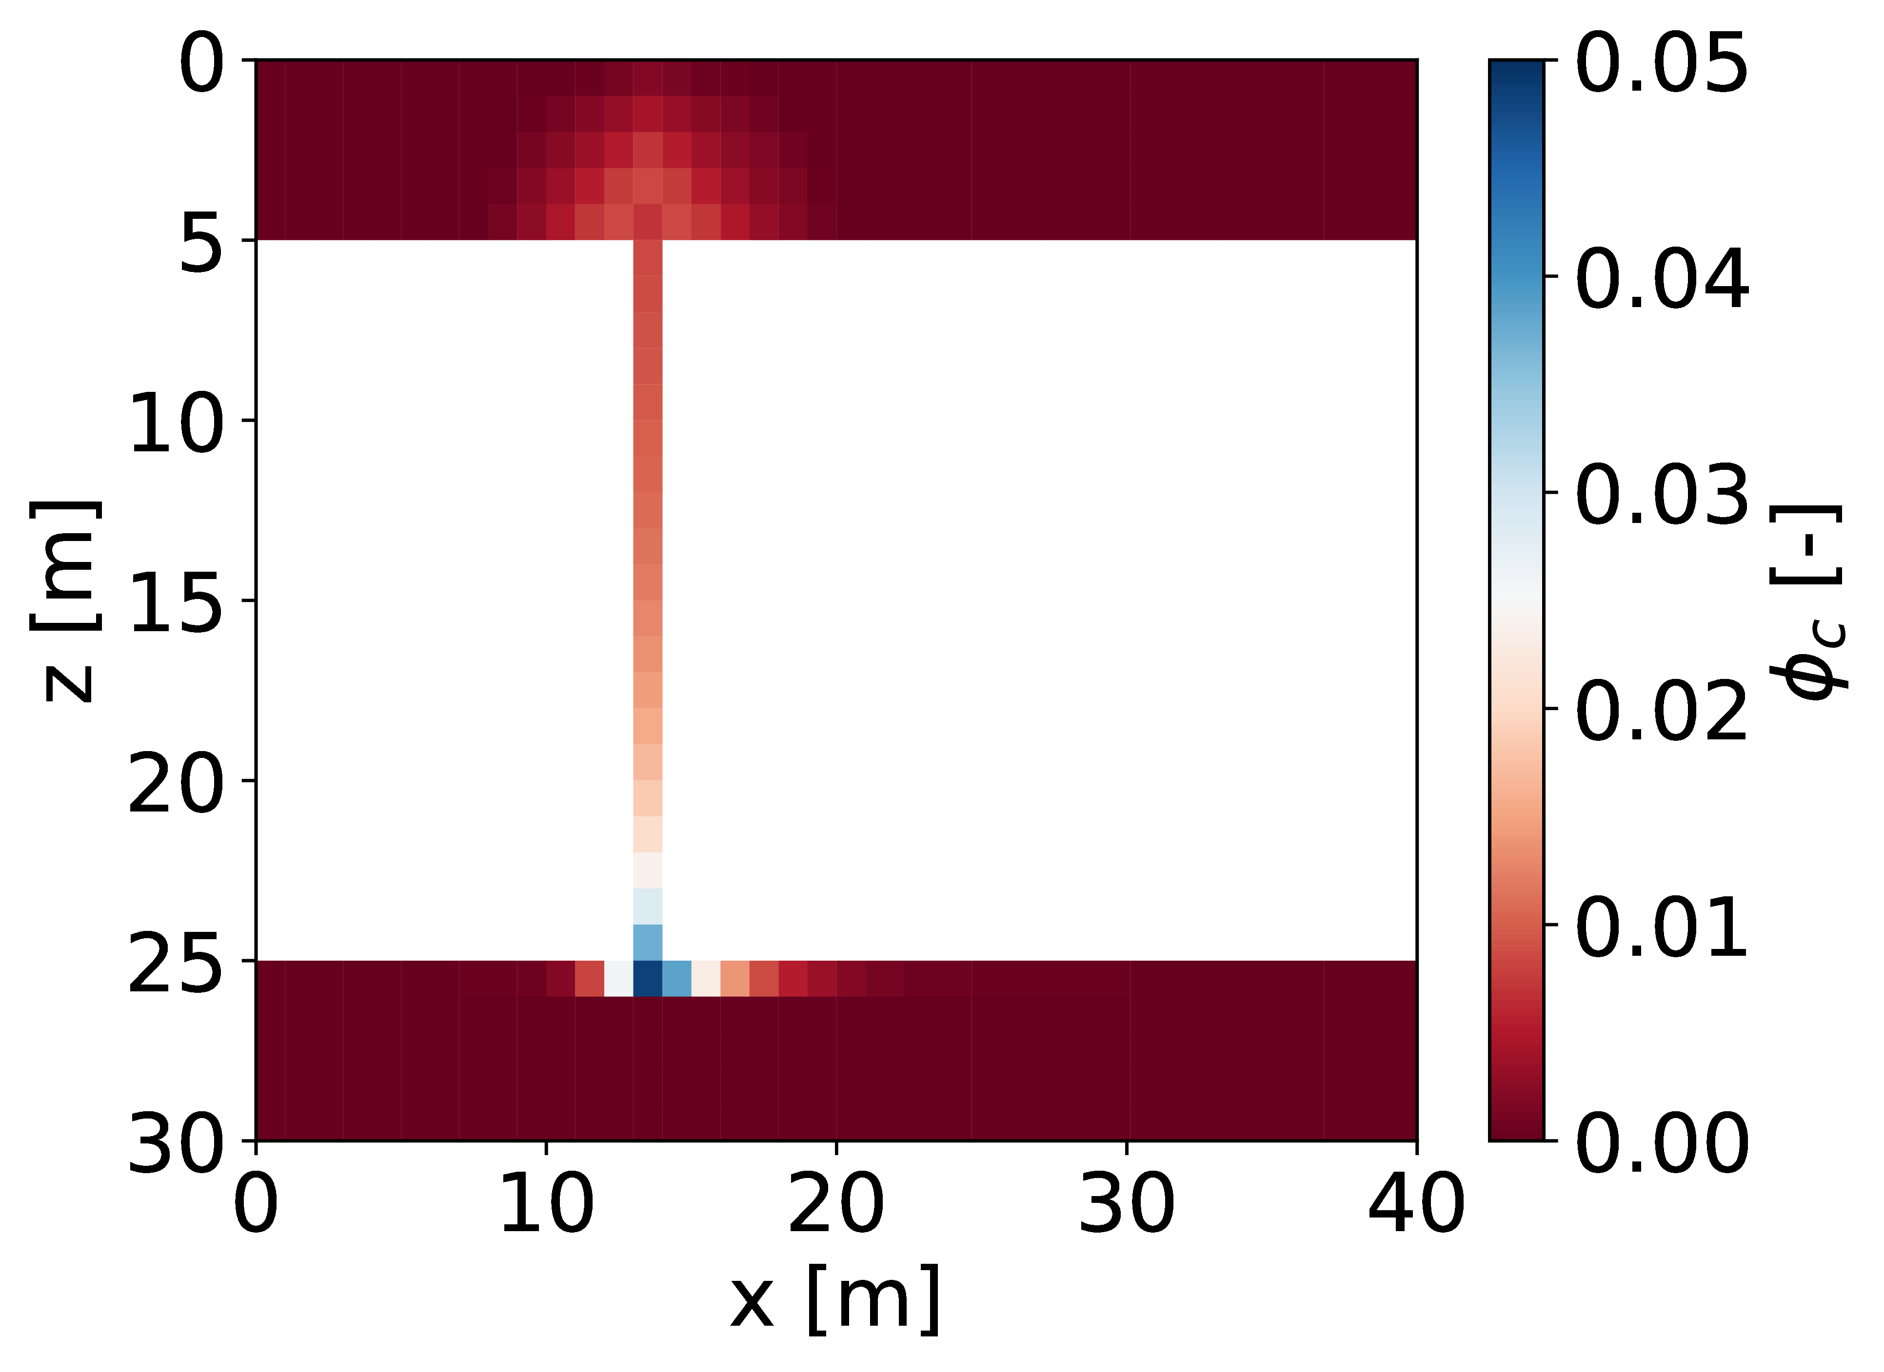
Test case 1
$a$ = 1m
$l_{x}$ = 13m
$l_{y}$ = 14m
When $φ_{c}→0.05$, permeability $→$ $≈$0D

Slide 8
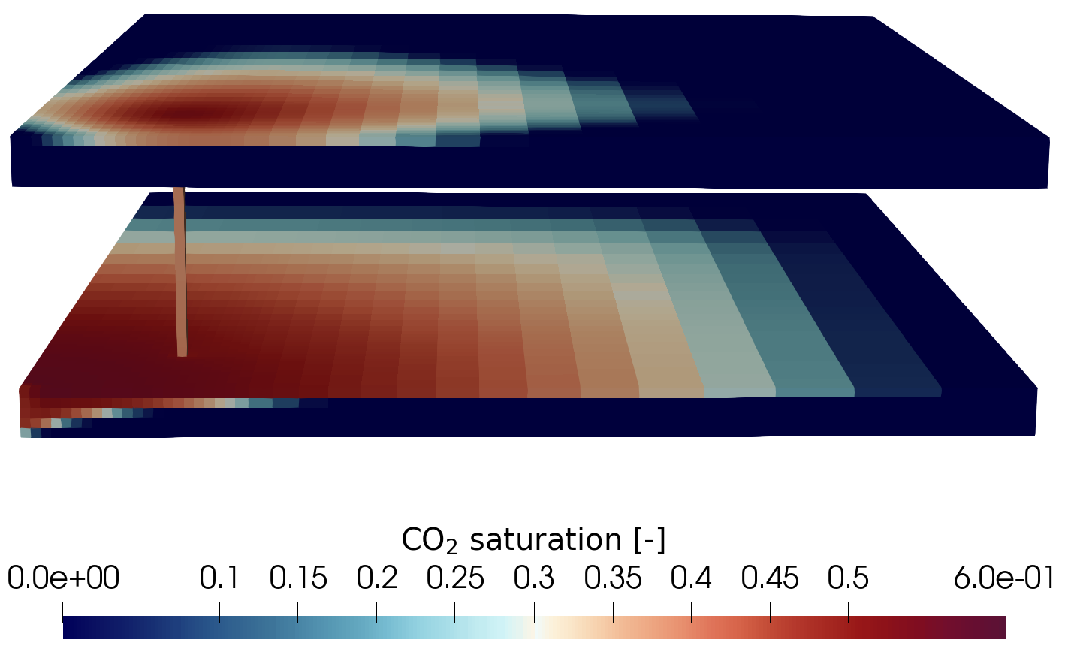
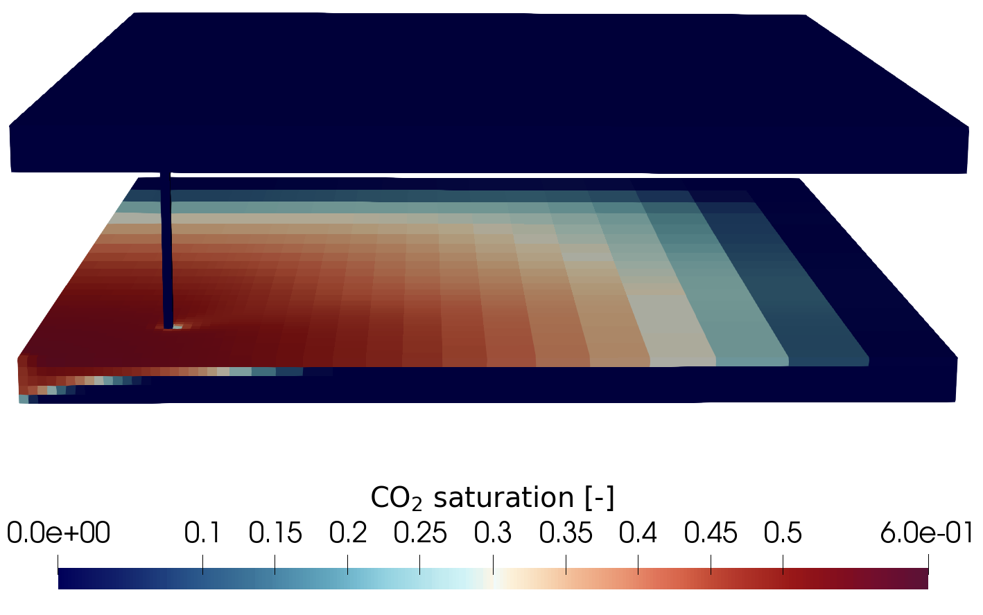
Test case 1
Before MICP:
4.3 % CO₂ leakage
After MICP:
6.67∙10⁻¹² % CO₂ leakage

Slide 9
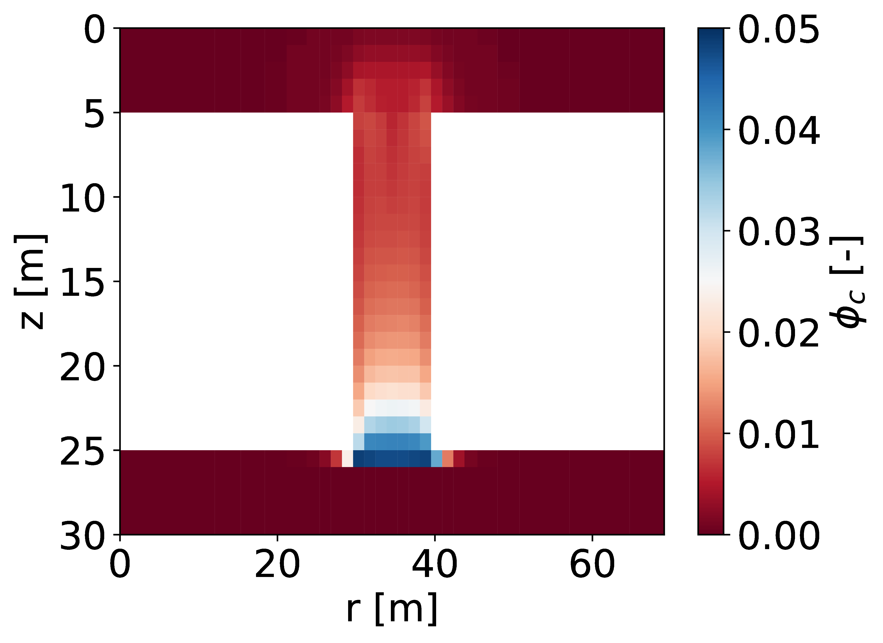
Test case 2
$a$ = 1m
$l_{x}$ = 11m
$l_{y}$ = 19m
When $φ_{c}→0.05$, permeability $→$ $≈$0D

Slide 10
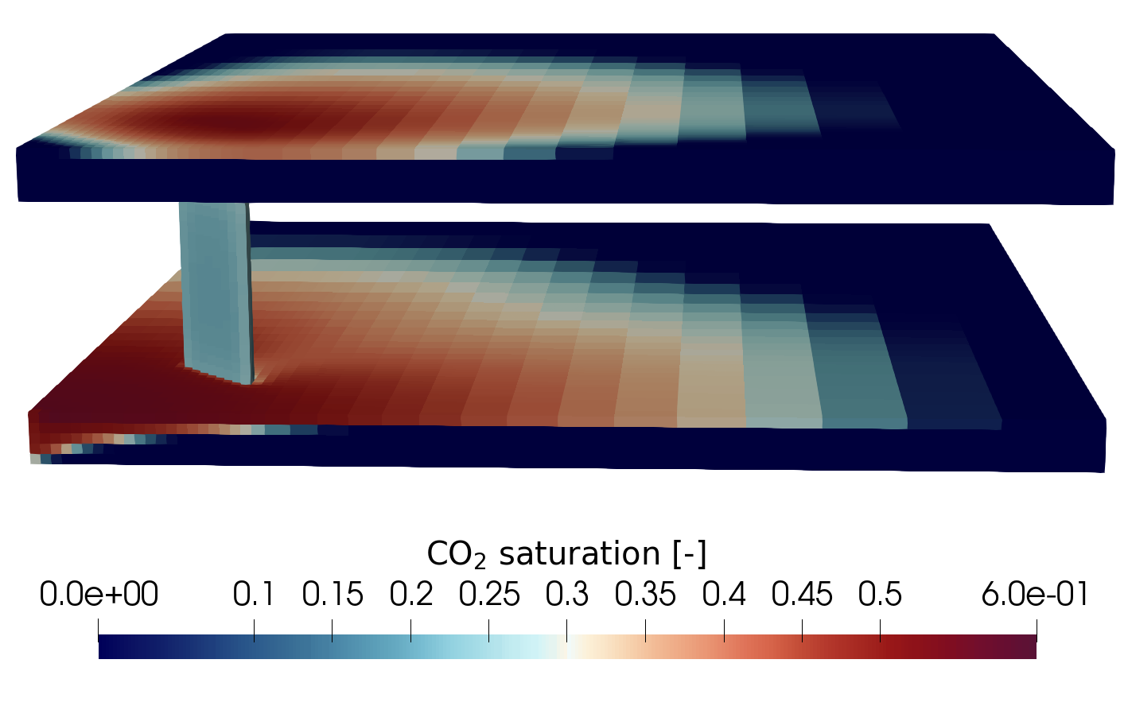
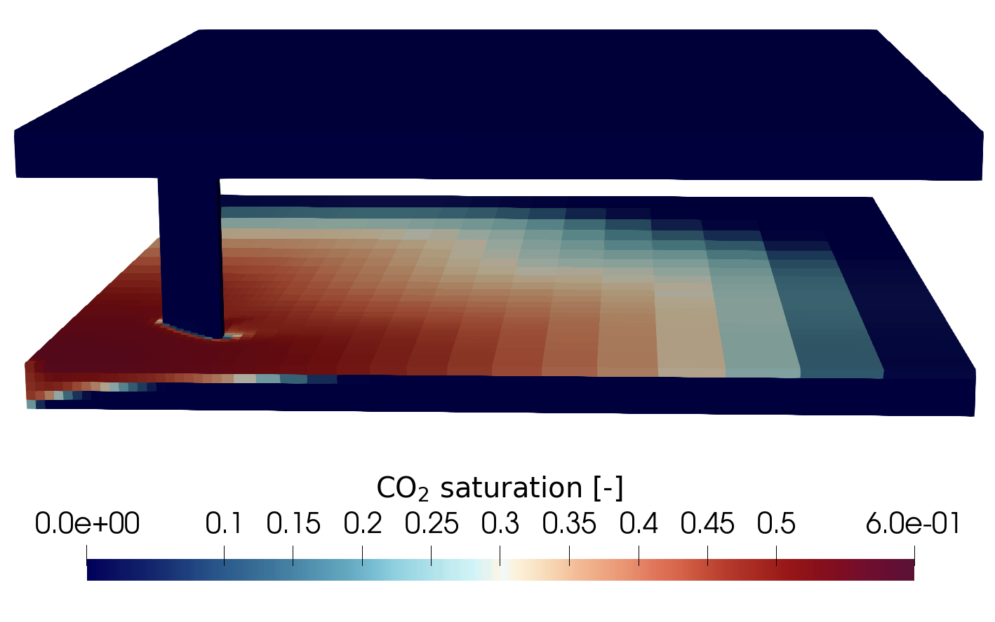
Test case 2
Before MICP:
7.04 % CO₂ leakage
After MICP:
1.28∙10⁻⁹ % CO₂ leakage

Slide 11
Summary
Field-scale optimization procedure for sealing leakage paths with MICP
OPM Flow simulator
EnOPT optimization method
Injection strategy for efficient sealing at the leakage location
Test cases showed that optimized MICP treatment effectively closed leakage paths for CO₂ through the caprock

Slide 12
Acknowledgements
The authors are grateful for the financial support from Research Council of Norway through the MICAP project, grant 268390.
Thank you for your attention!

