Slide 1
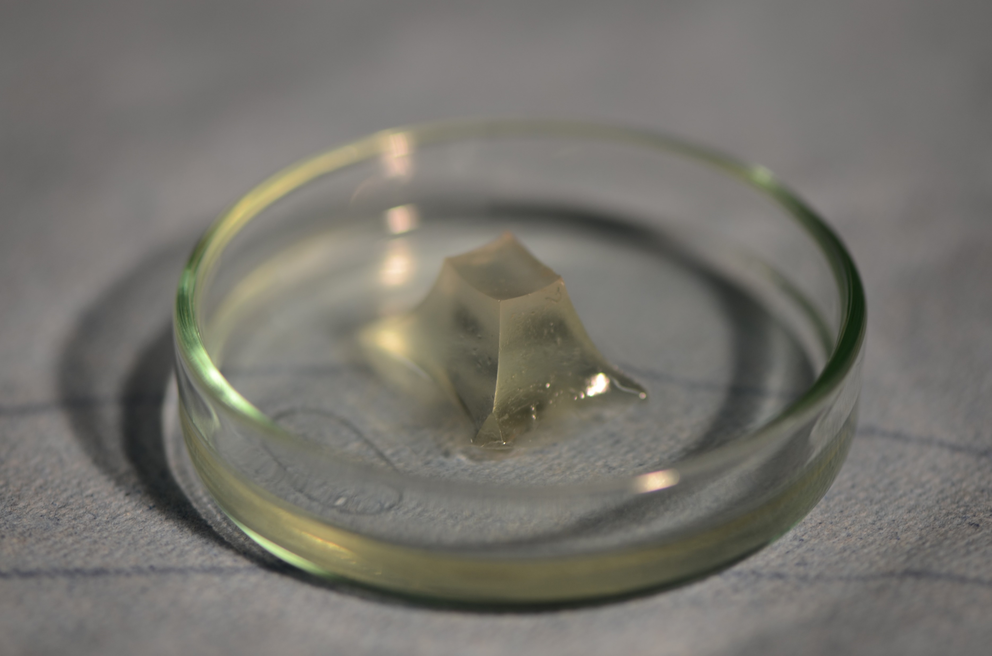
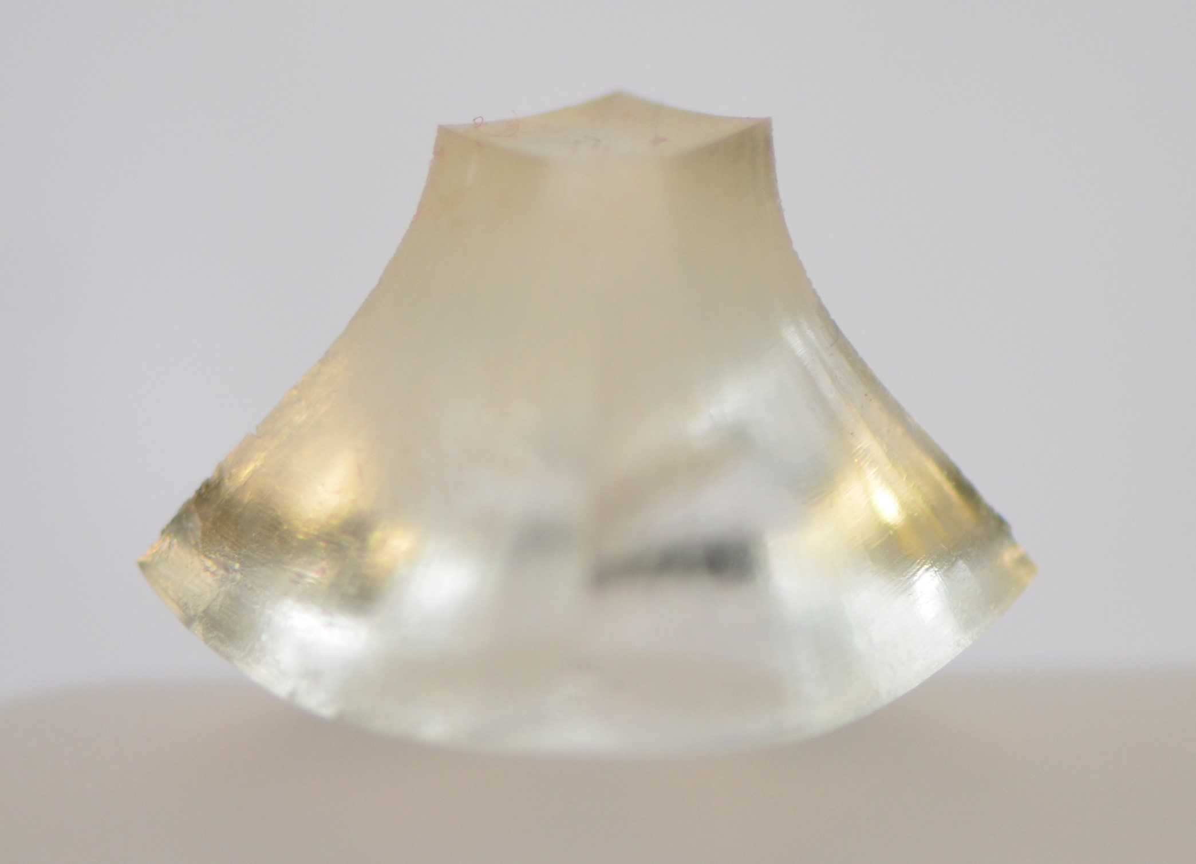
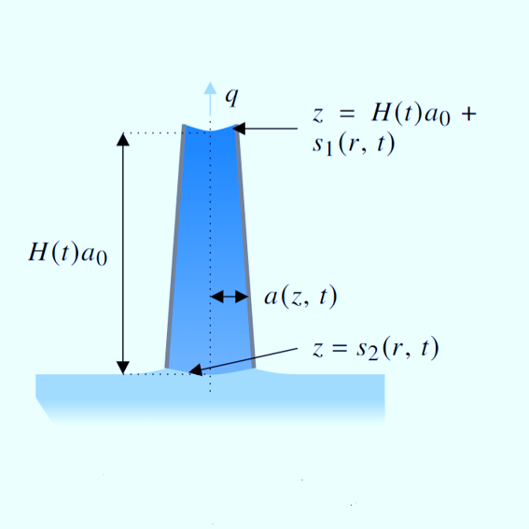
Multidirectional gel swelling and drying
A linear-elastic-nonlinear-swelling theory for hydrogels
Joseph Webber¹, Grae Worster¹ and Merlin Etzold²
¹ Institute of Theoretical Geophysics, Department of Applied Mathematics and Theoretical Physics, University of Cambridge, UK
² Department of Applied Mathematics and Theoretical Physics, University of Cambridge, UK
Interpore 2022 Abu Dhabi
MS04: Swelling and shrinking porous media
02 June 2022, 09:10 (GST)

Slide 2
Modelling super-absorbent polymers
Super-absorbent polymers (SAPs) are characterised by polymer fractions often as small as 1% by volume at equilibrium.
Therefore, large (>100%) swelling strains are involved in the transition from partially-dry to fully-swollen states.
LINEAR POROELASTICITY
Biot (1941), Doi (2009), Punter et al. (2020)
NONLINEAR (FREE-ENERGY) APPROACH
Flory & Rehner (1943a,b), Bertrand (2016)
Analytically-tractable; treats the gel as a linear-elastic material separating pore pressure from material elasticity.
But linear elasticity is only valid for small strains – to describe large swelling this is inadequate.
Derive a free-energy density from a microscopic understanding of the material.
But this requires an understanding of intermolecular interactions and doesn’t separate out the phases.
Image reproduced from Bertrand et al. (2016)
Notes:
Hydrogels comprise sometimes as little as 1% polymer by volume, and are formed from a hydrophilic polymer scaffold surrounded by adsorbed water molecules.
These materials behave elastically when swollen to a certain degree, but also have properties of porous media; water can flow through the interstices formed from the scaffold.
This has, in the past, led to many authors using classical linear poroelasticity. We treat the gel like a linear-elastic material which swells and dries by taking on or expelling water, and this water flow is driven by Darcy’s law throughout the structure. BUT large strains involved in swelling (see picture). Can’t model these with linear elasticity.
The other main approach is based around an understanding of the energetics of the polymer-water mixture. Derive a free-energy density and minimise this energy density to determine equations of motion. But we don’t necessarily want to know about interactions on the molecular scale, and prefer to work in the macroscopic state variables of linear poroelasticity. Can a compromise be sought?

Slide 3
Linear-elastic-nonlinear-swelling theory
Take the reference state for a gel to be the fully-swollen equilibrium, .
Label gel elements in this state by Lagrangian coordinates and introduce the displacement to represent a deformation.
The key idea underpinning our model is that deviatoric strains are small and thus we have linear elasticity in all but swelling strain.
Volume changes correspond to changes in polymer fraction since
Notes:
Start by considering a description of gel deformation: the goal is to separate deformation into its components – an isotropic part which is due to swelling and drying and a deviatoric part which we assume is ‘small’ in a certain sense, which we can linearise around.
Many different authors use different conventions for describing the reference state; either dry polymer or some “fully-swollen equilibrium”: we take the latter approach and measure displacements of individual gel elements from this state.
Assuming linearity ONLY in the deviatoric strains, we can Taylor-expand the expressions for inverse of a matrix and determinant to relate the isotropic part of the Cauchy strain tensor to changes in polymer fraction (arising from changes in volume of a gel element). The deviatoric part is assumed small.

Slide 4
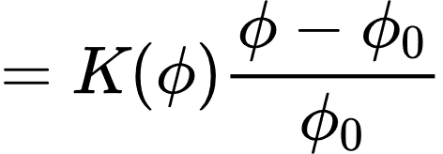
The constitutive relation and pressure
Treating the gel, when swollen to a certain degree, as a linear elastic material, the stress tensor is given by where P is the bulk pressure and is the shear modulus.
Allow for nonlinearities in polymer fraction, and therefore .
Separate into pervadic pressure (Peppin et al. 2005) and osmotic pressure , where the former is the pressure as measured by a transducer separated from the liquid by a partially-permeable membrane.
Notes:
Ignoring the slow (diffusively-dominated) swelling and drying effects, it is reasonable to treat a gel, swollen to a given degree, as a linear-elastic material. Since volumetric changes occur over much longer timescales, the instantaneous response is linear.
Therefore, the stress tensor must take the form –PI + 2(\mu_s)\epsilon, where P is a bulk pressure. But recall that we only linearise around the small deviatoric strains. Material properties likely change as polymer fraction does (drier gels are stiffer, for example), so allow the material properties to depend on polymer fraction phi.
Following other studies discussing two-phase mixtures, we separate the bulk pressure into a pervadic pressure – akin to a pore pressure of the water within the polymer scaffold – and an osmotic pressure arising from the hydrophilic nature of the polymer chains interacting with the water. This gives the constitutive relation shown, with the osmotic pressure sometimes written in the form in the box here, introducing an osmotic modulus K.

Slide 5
Gel dynamics
Dynamics are governed by the flow of water through the gel structure, with interstitial flow described by Darcy’s law, arising from gradients in pervadic pressure.
We have three equations from which a governing equation for the change of polymer fraction in time can be derived:
Polymer conservation
Water conservation
Cauchy’s momentum equation
Permeability
We henceforth consider the low-Péclet number limit where diffusive behaviour dominates advection.
advective term
Notes:
The pervadic pressure p is also known as the Darcy pressure; it is gradients in p which drive flow through the scaffold and therefore govern the dynamics of a hydrogel. In other models this is seen as a chemical potential; all end up resulting in equivalent dynamics.
Through a combination of water and polymer conservation, as well as Cauchy’s momentum equation which allows us to express gradients in p in terms of polymer fraction phi (using the constitutive relation we have just derived), an advection-diffusion equation can be derived governing the change in polymer fraction with respect to time.
For our purposes, it can be shown that the requirement of small deviatoric strains is equivalent to the low-Péclet number limit of this equation, ignoring the advective term and therefore we model gel dynamics as a nonlinear diffusive process.
The diffusive term on the right-hand side here illustrates the two driving behaviours – isotropic stresses arising from osmotic effects and deviatoric stresses arising from shearing strains.

Slide 6
Example: swelling of a spherical bead
This model shows how it is possible to accommodate large isotropic strains (and therefore swell to a great degree) without introducing large deviatoric strains (and therefore justifying our linearising assumption).
The radius here is set by polymer conservation
At the interface, continuity of normal stress sets polymer fraction
Notes:
As an example illustrating the utility of this model, we consider one of the simplest physical setups; a partially-dried bead swelling upon placement in water, as seen in one of the first slides.
Here, we swell from a polymer fraction eight times its equilibrium value to the equilibrium, and therefore introduce isotropic strains of around 200%; linear theory could not adequately describe this. However, it is shown that our LENS theory is capable of reproducing the swelling behaviour whilst never introducing large *deviatoric* strains; notice here that epsilon_rr is always less than around 10%.
Qualitatively, this behaviour agrees with experiments; the outer ‘skin’ swells to a greater degree, followed by water diffusing into the bulk of the gel, and then the outer layer continues to swell further and the process continues.

Slide 7
Boundary conditions and the shape of a gel
In order to solve the equation we have derived, we need boundary conditions, usually at the interface between gel and air/water/other media:
However, we don’t actually know the position of the boundary – in one-dimensional swelling problems, we can use polymer conservation. Need a different approach for general problems.
Can we find the displacement field given polymer fraction? Not immediately, all we know is .
Recall in linear elasticity that in the absence of any body force.
Continuity of normal stress
Continuity of tangential stress
Fixed evaporative flux
Impermeable boundaries
Notes:
It was hinted at in the example on the last slide that boundary conditions are key – in the case of the sphere, continuity of normal stress imposes a (time-varying) interfacial polymer fraction, and spherical symmetry ensures that radial gradients in polymer fraction are zero at the origin. In order to solve more general problems, there are a range of boundary conditions which can be imposed.
Alongside the normal and tangential stress conditions discussed in the last problem, we can impose conditions on the flux of interstitial water (e.g. in evaporation problems, or at impermeable boundaries).
This is all well and good – in the case of the spere it was easy to work out where the radial extent of the gel was by considering polymer conservation. In general we don’t know this, and therefore we can’t tell where the boundary is!
Major problem; overcome in linear elasticity by using the displacement field which is a biharmonic function, and then solving for the extents. Can’t do this here; can we find a displacement field given a polymer fraction field?

Slide 8
Boundary conditions and the shape of a gel
In the case of the hydrogels we are considering, the assumption of small deviatoric strain alongside Cauchy’s momentum equation in the absence of body forces implies that
Physically, this can be interpreted as a forcing due to curvatures in surfaces of constant polymer fraction.
Notes:
It turns out that our formulation does give an equation for the displacement field in the limit of small deviatoric strains. Akin to the biharmonic equation for pure linear elasticity, this equation describes the displacement forced by gradients in polymer fraction.
The right-hand side here can be loosely interpreted as arising from curvatures (the Laplacian) in surfaces of constant phi (the gradient) – clearer interpretation very welcome!
Can we put this to use in a problem where polymer conservation can’t be employed to describe the shape of a gel?

Slide 9
Drying of slender cylinders
Physical setup: cylinder of height and radius drying from its top surface only through a fixed evaporation flux .
Experiments show the formation of a curved interface on the top and bottom – can our model describe this?
Start with the assumption that and solve for the polymer fraction and shape.
Slenderness implies that
Can determine polymer fraction – seek the displacement field .
Notes:
One of the earliest experiments we have carried out considers a slender cylinder of gel which is initially fully-swollen, with its base immersed in water and allowed to dry in the air, acting somewhat like a wick drawing water up from the reservoir and evaporating into the surrounding air.
For the sake of simplicity, start by considering the case where the only evaporation occurs from the top surface. The assumption of slenderness, coupled with this simplified model, suggests that the polymer fraction will only depend on vertical position z.
Qualitatively, what do we expect? More shrinkage at the top, and experiments also show the formation of a convex base and a concave top: can we explain these physically? To do this, need to find the displacement field, and also solve for phi.

Slide 10
Drying of slender cylinders
(arising from )
Now require the deviatoric strain to be small, implying that
Zero tangential stress on the surface of the cylinder gives
Calculate the bulk pressure field using Cauchy’s momentum equation and impose zero normal stress on the surface to give
Notes:
Given phi (which we know how to get from the transport equation), use the displacement equation to seek the displacement field, working at leading order in the small deviatoric strains epsilon which scale like the (small) aspect ratio of the cylinder.
Solve the vertical component of the equation to get vertical displacement, then use the expression for the divergence of displacement to find the radial displacement. Applying the conditions of no tangential and normal stress and requiring small deviatoric strain all allows us to find the displacement field in full. Further details of this are provided in the paper.

Slide 11
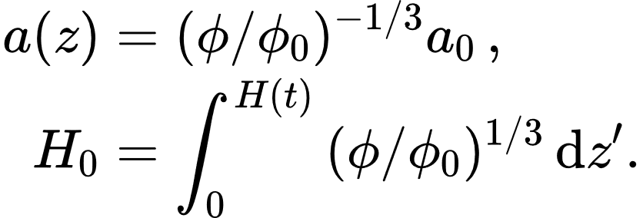
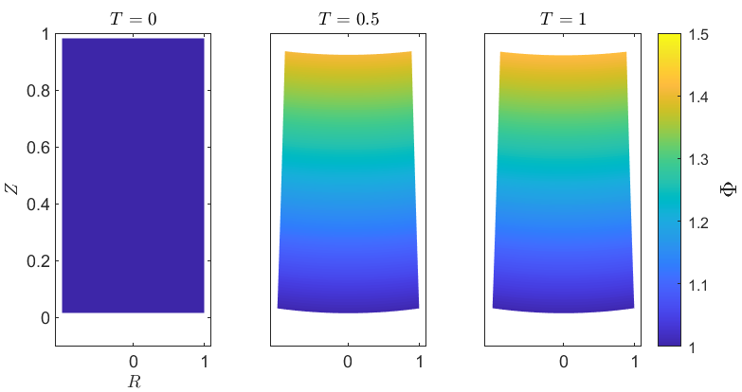
Drying of slender cylinders
Importantly, these results also show that the curvature of the top and bottom surfaces arises from gradients in polymer fraction.
These results match those of experiments which show the formation of a convex base and concave top.
Notes:
Altogether, the radial and vertical displacements therefore take the following form; this gives an explicit expression for the radius and an implicit expression for the height of the cylinder as it contracts.
Perhaps the most interesting result here is found in the ‘curvature’ term of the vertical displacement, which explains how the curved surfaces arise from gradients in polymer fraction. This replicates what’s seen in experiments, pictured here for a cuboid for illustration.
Notice also that numerics show an approach to a steady state, where the rate of water draw from the base matches evaporation, with a drier top and a more swollen base.

Slide 12
Drying of slender cylinders - comments
The same approach can be applied when drying from the sides only (and not the top) in order to deduce the displacement field. Note in this case that with .
In any case, we approach a steady state when the evaporative flux balances the flux of water drawn up from the base, as illustrated here.
These results agree with an alternative Lagrangian approach, where the cylinder is comprised of a stack of circular discs, drying isotropically and bending to accommodate differential swelling under classical plate theory.
Notes:
As an aside, the same approach can be applied when the sides of the cylinder are drying and the top is not. These two can be combined to give a general description of drying all over.
The video here shows the drying process when only the sides are exposed, and also illustrates the direction and magnitude of the interstitial flow field. Notice that a steady state is approached when this flow field becomes uniform, and the cylinder acts much like a drinking straw drawing water from its base.
We discussed on the last slide how curved interfaces form as a result of gradients in polymer fraction. For a physical description of how these arise, it is worth noting that the forced biharmonic displacement equation bears some resemblance to the equations for classical elastic plate theory. If we treat the cylinder as being formed from a stack of discs which are bonded to one another and dry isotropically, these equations result in exactly the same displacement field, with curvatures arising from adjacent slices matching radial strains.

Slide 13
Conclusions
Current approaches to modelling super-absorbent hydrogels are either analytically-intractable, and hide the physical processes underlying the swelling and drying, or do not consider the large strains accurately.
We have introduced a model which linearises around small deviatoric strains but allows for large isotropic strains to treat hydrogels as instantaneously linear-elastic whilst permitting a description of SAPs.
This model can also describe the displacement field in more complicated multidirectional problems, unlike classical poroelastic approaches, and agrees qualitatively with experiments.
Webber & Worster A linear-elastic-nonlinear-swelling theory for hydrogels. Part 1. Modelling of super-absorbent gels
Webber, Etzold & Worster A linear-elastic-nonlinear-swelling theory for hydrogels. Part 2. Displacement formulation
J. Fluid Mech. (to appear)
→ j.webber@damtp.cam.ac.uk
 @jwebber97
C-CLEAR NERC DTP
NE/S007164/1 reference 2436164
Notes:
(as it says on the slides)

