Slide 1
Supercritical Adsorption of CO₂ and CH₄ on Shales and Surrogate Porous Media
Humera Ansari, Martin Trusler, Geoffrey Maitland, Ronny Pini
humera.ansari10@imperial.ac.uk

Slide 2
Shale Gas Production
Rising production rates of shale gas worldwide
Global shale resources = 36,000 trillion cubic feet
Transition Fuel
Shale Gas Extraction
Fracking
Enhanced Shale Gas Recovery
Low recovery:
10 – 20%
Based on the New Albany Shale ^{[1]}
^{[2]}
CO₂
CH₄
CH₄
Shale
CO₂
^{[3]}
Improved CH₄ recovery
CO₂ sequestration
[1] Salehi et al., Oil and Gas Review, 7, 2009
[2] Edwards et al., Environmental Science & Technology, 49(15), 2015
[3] Ansari et al., Fuel, 301, 2021

Slide 3
Gas Storage in Shale
^{[1,2]}
Adsorbed Gas
Organic Matter
Clay Minerals
Free Gas
Large Pores
Natural Fractures
Dissolved Gas
Oil
Water
50% of GIP ^{[3]}
[1] Ma et al., Energy & Environmental Science, 14, 2021
[2] Loucks et al., Journal of Sedimentary Research, 79, 2009
[3] Rexer et al., Energy & Fuels, 27, 2013

Slide 4
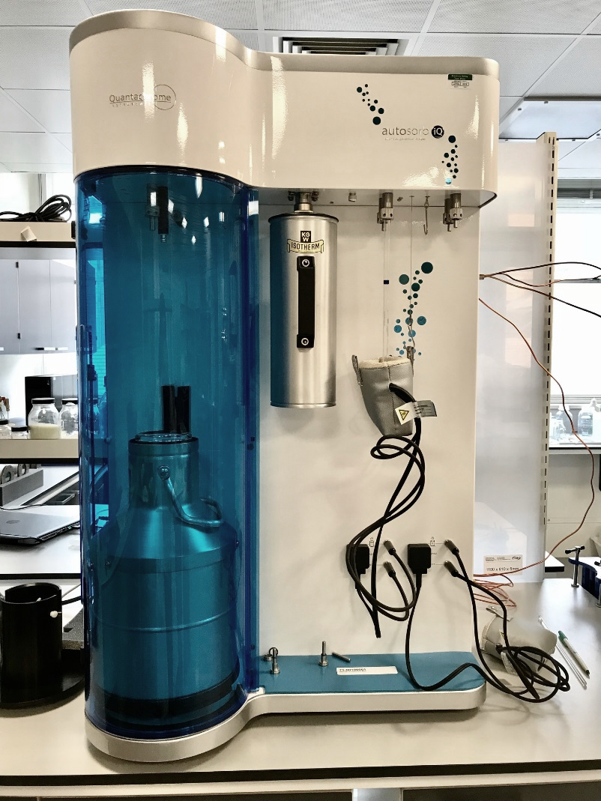
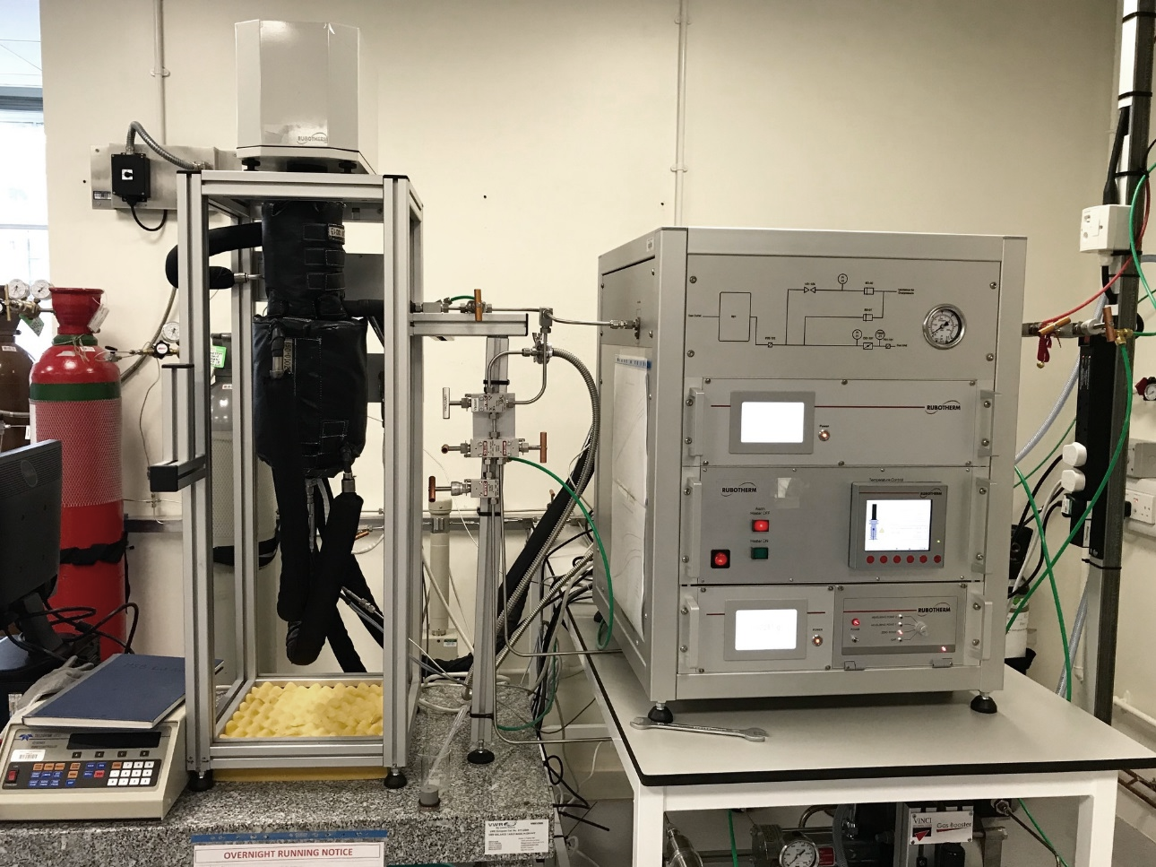
Adsorption Measurements
Subcritical Adsorption
Characterisation of the adsorbent
Supercritical Adsorption
Adsorption at subsurface conditions
Volumetric Measurement:
Quantachrome Autosorb iQ
Gravimetric Measurement:
Rubotherm Magnetic Suspension Balance
Pressure | Adsorbates
0 – 1 bar | Ar (87 K), N₂ (77 K) and CO₂ (273 K)
Pressure | Temperature
0 – 300 bar | 40°C

Slide 5
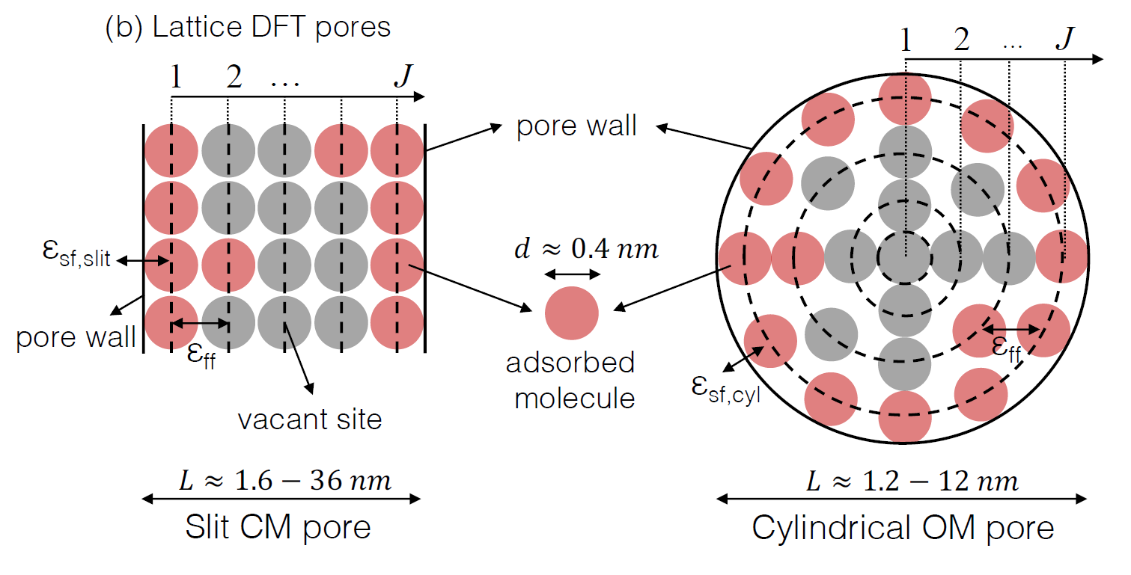
Adsorption Modelling: Lattice DFT Model
Pore space is discretised into lattice sites
Clay
Minerals
Organic
Matter
Slit pore^{[1]}
Cylindrical pore^{[2]}
Same number of molecules in each layer
Adsorption occurs on a flat surface
Number of molecules changes in each layer
Adsorption occurs on a curved surface
[1] Hwang et al., Microporous and Mesoporous Materials, 273, 2019
[2] Ansari et al., Microporous and Mesoporous Materials, 308, 2020

Slide 6
Use of Surrogate Materials
Ansari et al., Energy & Fuels, 36(7), 2022

Slide 7
Surrogate Materials
Mesoporous Carbon^{[1]}
Activated Carbon^{[1]}
Illite^{[2,3]}
HP Measurements
+
PSD
+
LDFT Model
Hybrid LDFT Model Parameters
[1] Ansari et al., Microporous and Mesoporous Materials, 308, 2020
[2] Hwang et al., Microporous and Mesoporous Materials, 273, 2019
[3] Ansari et al., Energy & Fuels, 36(7), 2022

Slide 8
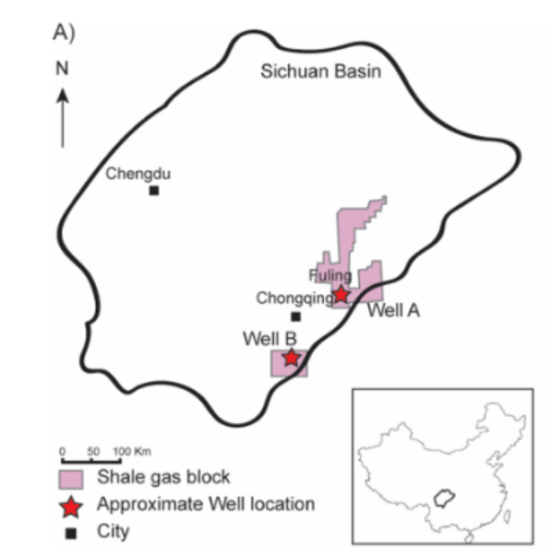
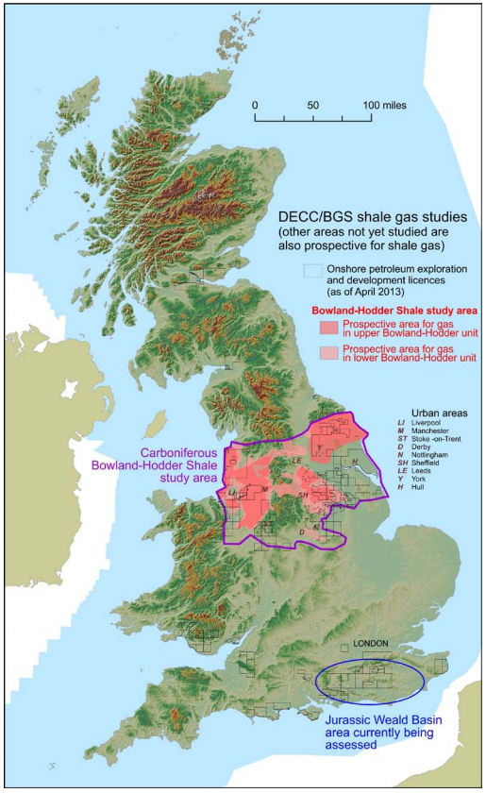
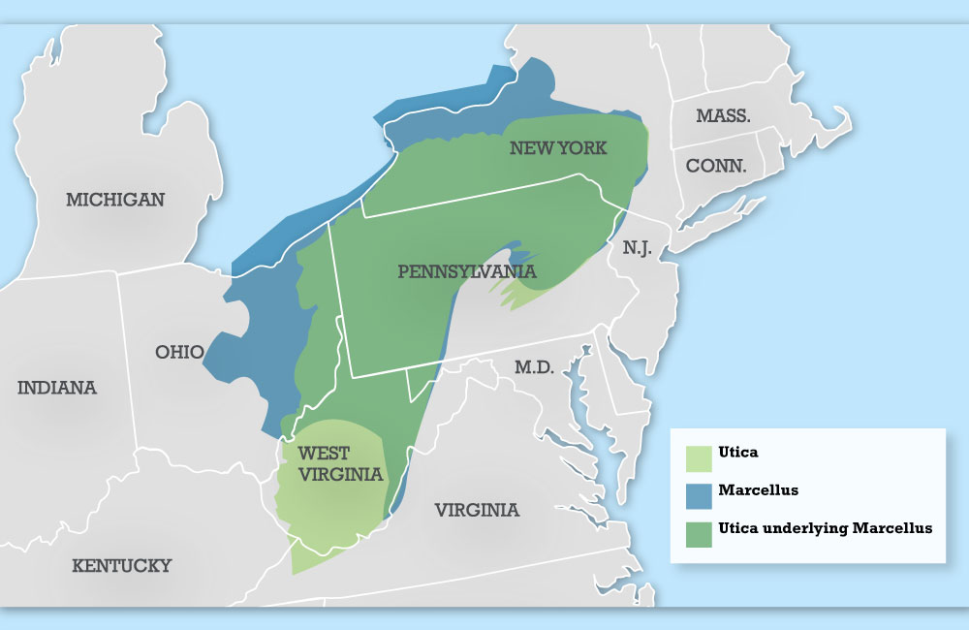
Shales
Longmaxi Shale
Bowland Shale
^{[1]}
^{[3]}
Shale | TOC [wt%] | Clay [wt%]
Longmaxi (LG4) | 7.8 | 21.0
Marcellus (ML) | 6.1 | 47.0
Bowland (B6) | 3.6 | 23.4
Bowland (B8) | 0.9 | 25.5
Marcellus Shale
^{[2]}
[1] Delle Piane et al., International Journal of Coal Geology, 2021. 103880
[2] Marcellus Coalition, 2020
[3] British Geological Survey

Slide 9
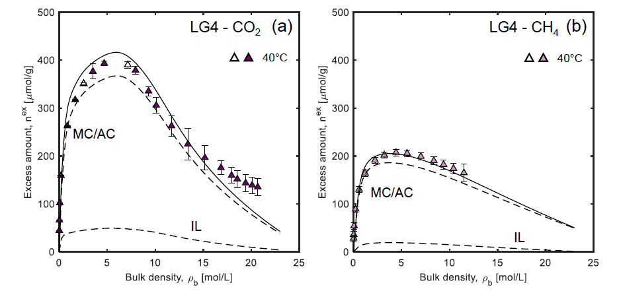
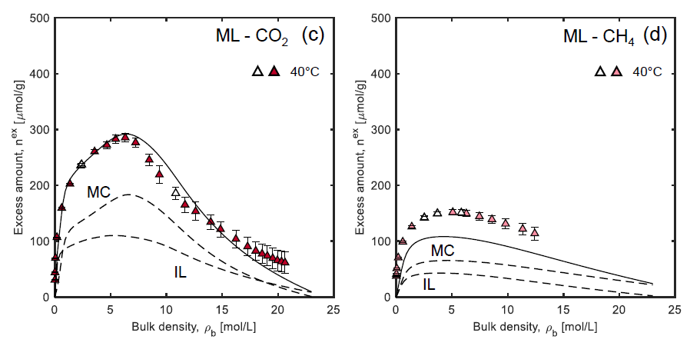
Adsorption on Shale
Longmaxi Shale
Marcellus Shale
Ratio of adsorption between LG4 and ML is similar to the ratio of TOC
CO₂/CH₄ ratio is > 2
Shale | TOC [wt%] | Clay [wt%]
LG4 | 7.8 | 21.0
ML | 6.1 | 47.0
LG4 model includes MC (60%) + AC (40%)
Carbon controls adsorption for LG4 and ML (ρ_{b} > 1 mol/L)
Ansari et al., Energy & Fuels, 36(7), 2022

Slide 10
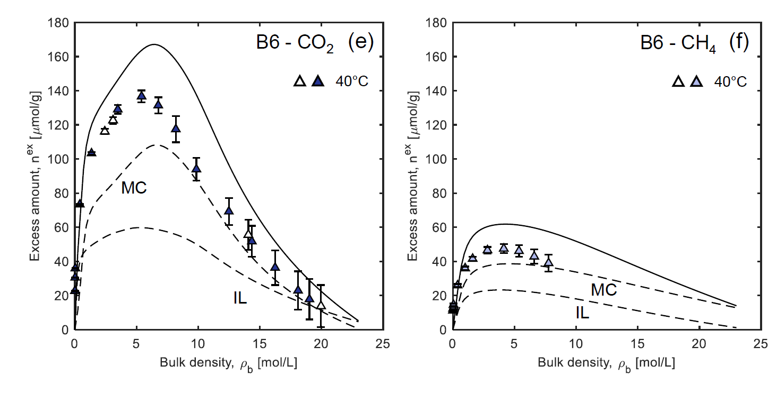
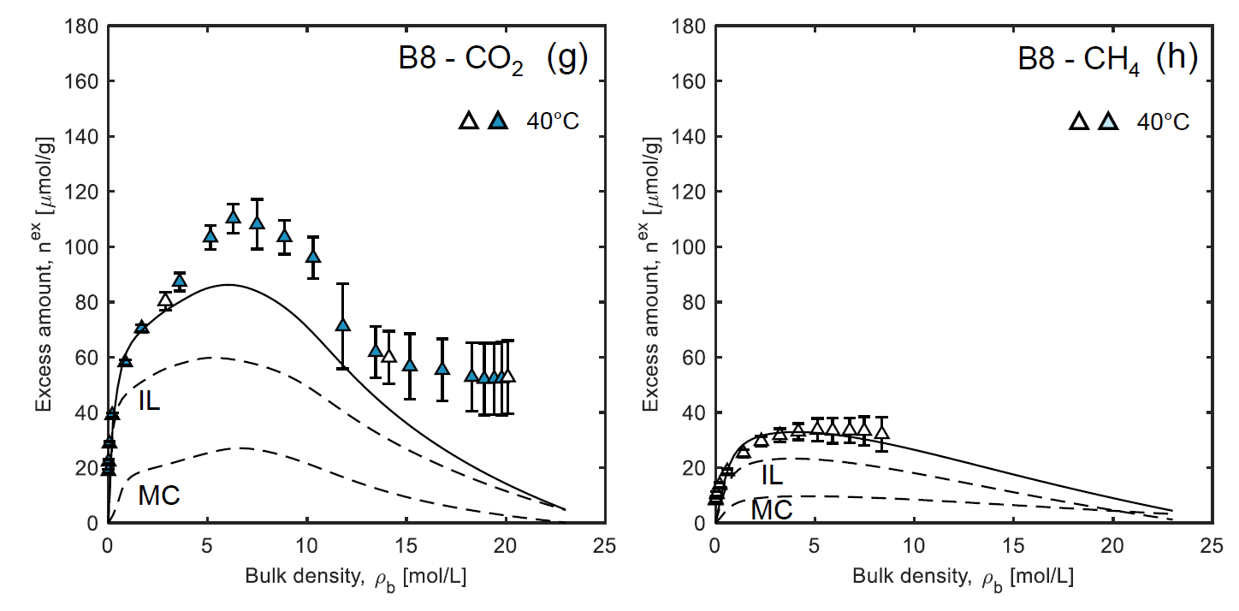
Adsorption on Shale
Bowland (organic-rich) Shale
Bowland (organic-lean) Shale
LG4 and ML adsorb more than the Bowland shales
CO₂/CH₄ ratio is > 3
Shale | TOC [wt%] | Clay [wt%]
B6 | 3.6 | 23.4
B8 | 0.9 | 25.5
Increased contribution of IL
B8 model includes a larger contribution of IL than MC
Ansari et al., Energy & Fuels, 36(7), 2022

Slide 11
Representative PSD for Shale
Shale | Experimental ν_{p}^{tot} [cm³/g] | Predicted ν_{p}^{tot} [cm³/g]
LG4 | 0.050 | 0.049
ML | 0.042 | 0.050
B6 | 0.020 | 0.028
B8 | 0.020 | 0.016
Pore volumes directly dependant on TOC
PSDs obtained based on kernels for either slit carbon pores or cylindrical silica pores (not both).
Three scaling factors:
w_{o} – TOC (wt%)
w_{c} – clay content (wt%)
t – fraction of AC
Ansari et al., Energy & Fuels, 36(7), 2022

Slide 12
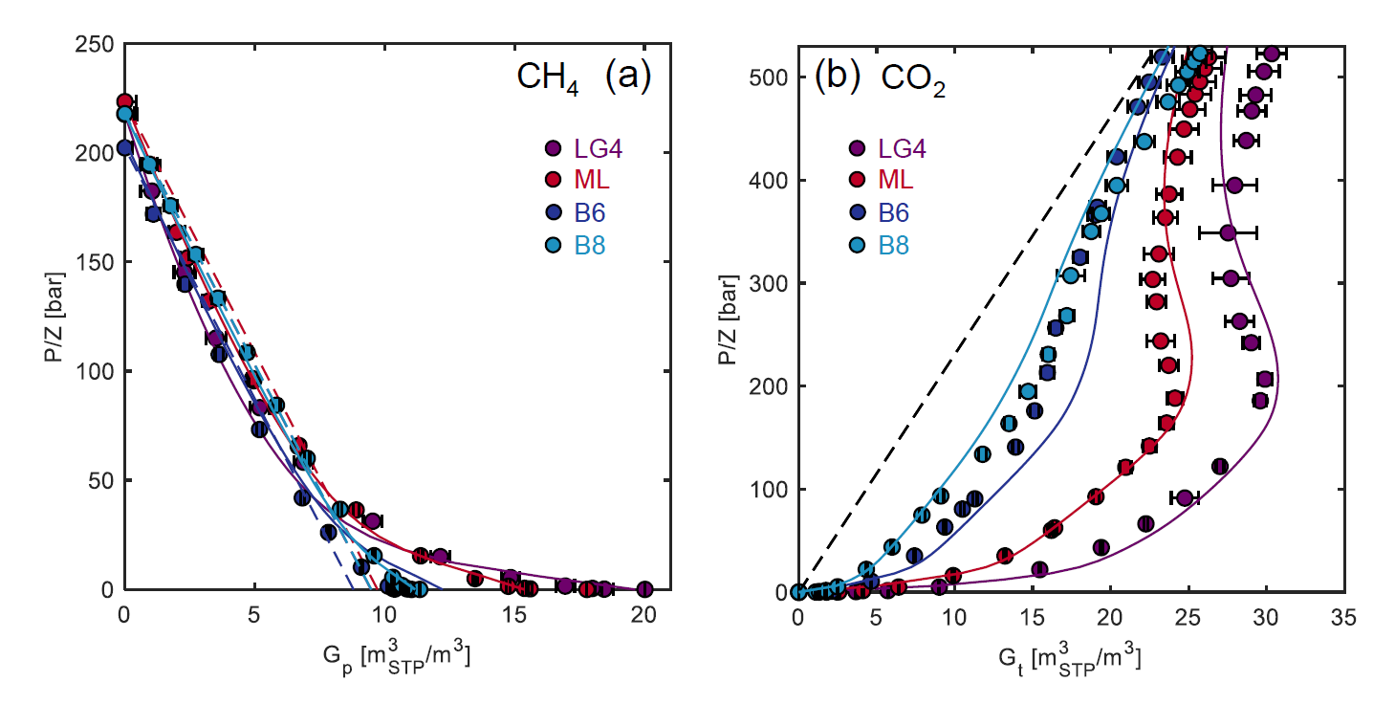
Gas-in-Place and CO₂ Storage Potential
Excess Adsorbed
Amount
$$G_{t}=\frac{1}{ρ_{sc}}\left(ϕρ_{b}+ρ_{sk}\left(1−ϕ\right)n_{ex}\right)$$
Volumetric Free Gas
Produced Volume:
$$G_{p}=G_{t,0}−G_{t}$$
Shale | OGIP [m³_{STP}/m³] | CO₂ Storage Potential [m³_{STP}/m³]
LG4 | 20.0 | 30.3
ML | 17.8 | 26.3
B6 | 11.0 | 23.3
B8 | 11.3 | 25.7
Ansari et al., Energy & Fuels, 36(7), 2022

Slide 13
Conclusions
Adsorption on shales is strongly dependent on TOC
Shale’s composition can be used to predict adsorption in shale, avoiding a heavy experimental burden
The validity of this approach extends from textural analysis to the quantification of the GIP
humera.ansari10@imperial.ac.uk

