Slide 1
Impact of compression on the properties of the diffusion layer of fuel cells
Asma Sharif
Supervise by :
Manuel Marcoux and Marc Prat
2 june 2022

Slide 2
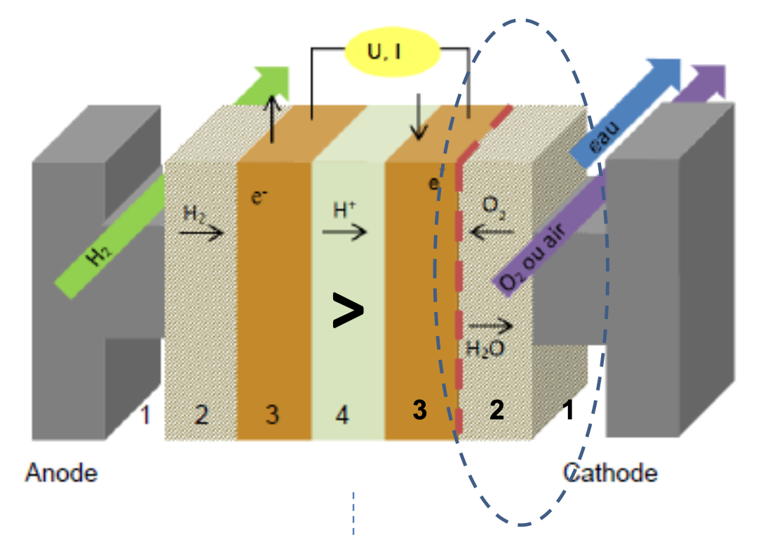
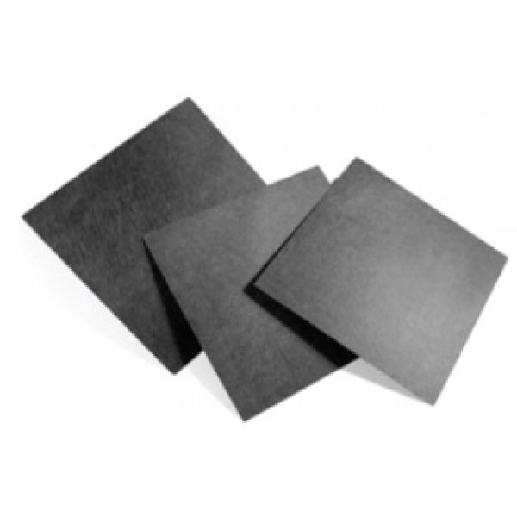
Contextualization :
Description of a unit cell :
Oxidation :
$$H_{2}→2H+2e^{−}$$
Reduction :
$O_{2}→$2$H_{2}$O + 4$H^{+}$
~10 cm
Gaz Diffusion Layer (GDL) :
Thin porous media
Hydrophobic with PTFE

Slide 3
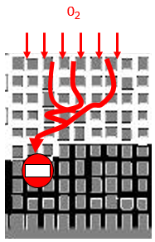
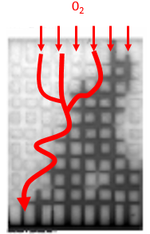
Loss of hydrophobicity :
The GDL are hydrophobic for a good mannagement of the water in the fuel cell and it is essential that it remains hydrophobic
Hydrophilic case :
Bloc invasion
No access to gas
Hydrophobic case :
The water is evacuated and leave an access for the transfer of gases
Functional
Ref : Influence des conditions de mouillage sur les déplacements quasi-statiques eau-air et l'évaporation en milieux poreux modèles : application à la gestion de l'eau dans les piles à combustibles PEMFC, Olivier Chapuis, IMFT 2006
Notes:
.

Slide 4
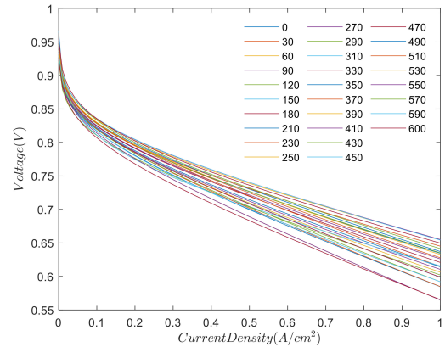
Performance loss :
Ref : Chunjuan Shen, Sichuan Xu, Yuan Gao Analysis of Fuel Cell Stack Performance Attenuation and Individual Cell Voltage Uniformity Based on the Durability Cycle Condition. Polymers 2021
Usage time
The performance decreases over time
Degradation due to compression by the GDL which alters its hydrophobic character ?

Slide 5
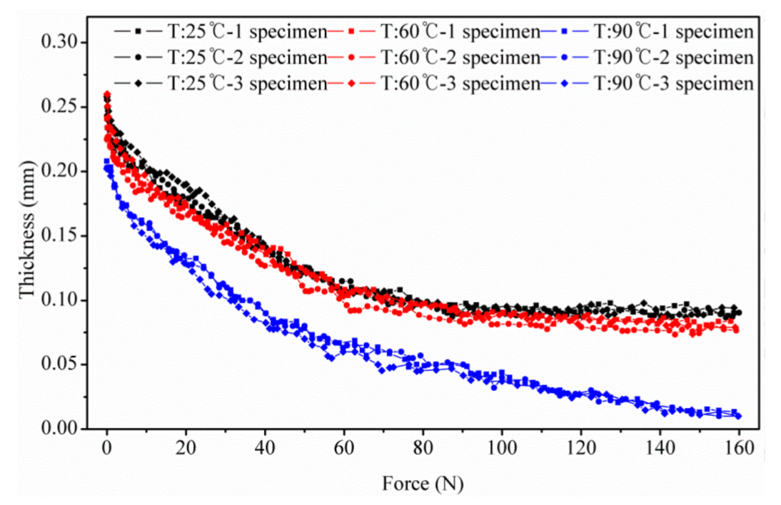
Compression aging :
Mechanical stress experienced by the fuel cell :
Vibration
Ampilement
Water circulation
Thermal expansion
The GDL are the most impacted
Impact of Compression and Temperature on GDL Thickness
Ref : An Investigation of the Compressive Behavior of Polymer Electrode Membrane Fuel Cell’s Gas Diffusion Layers under Different Temperatures, Yanqin Chen, Chao Jiang and Chongdu Cho, Polymers, 2018

Slide 6
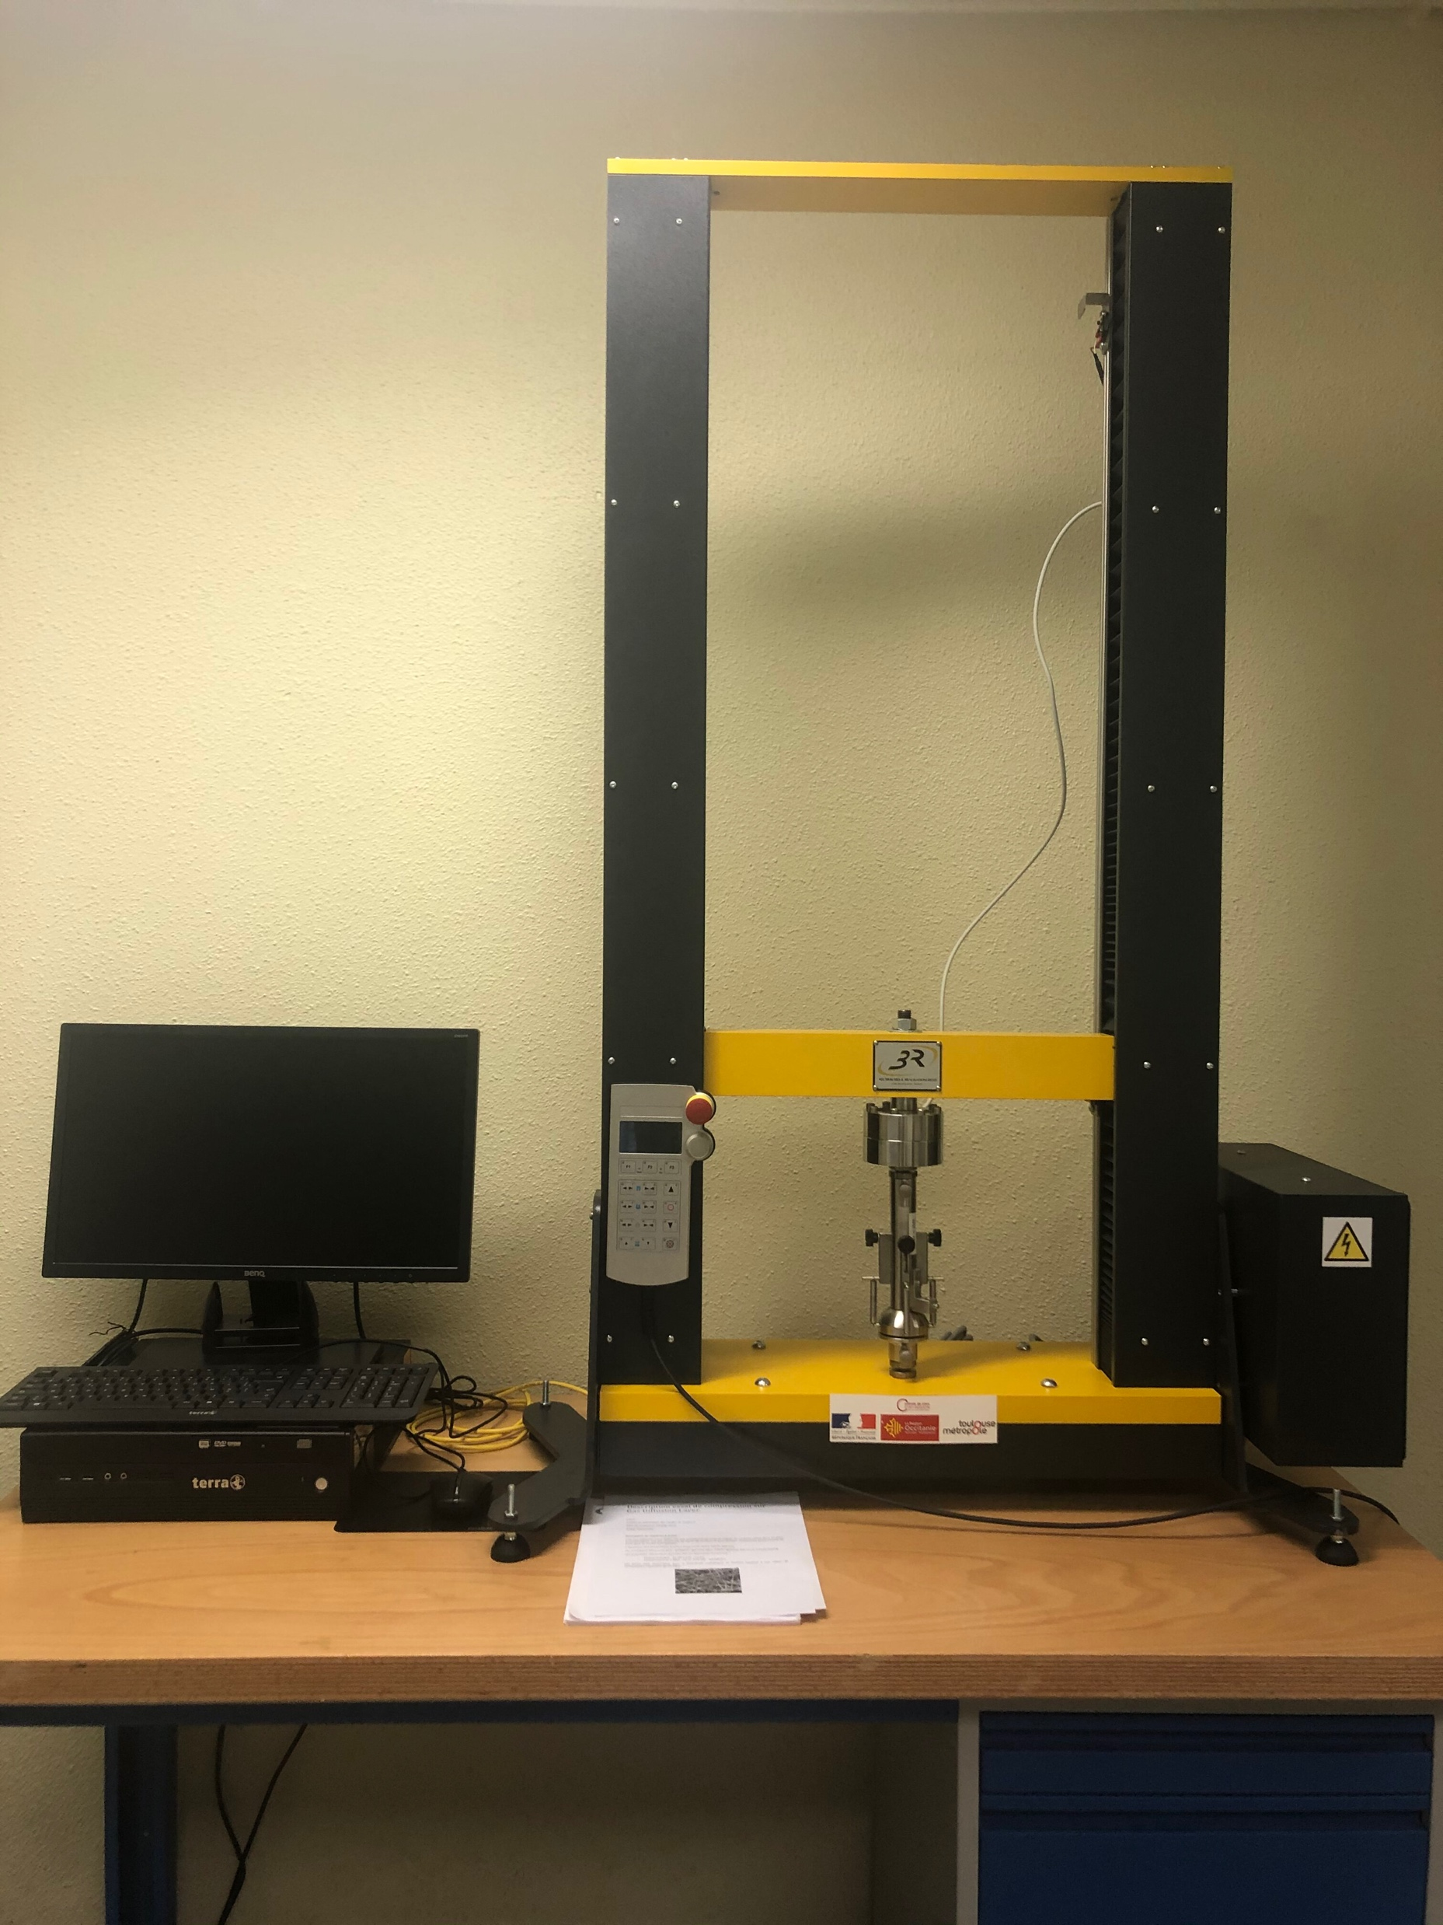
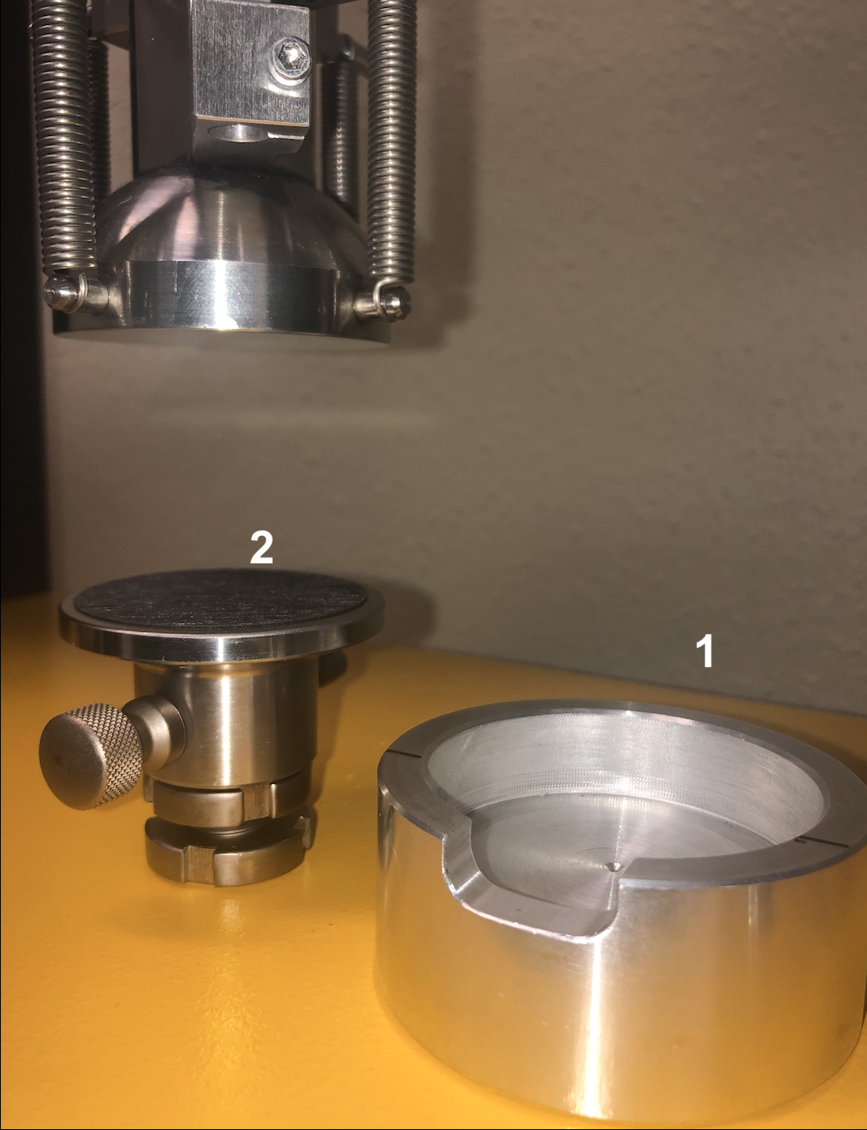
Compression aging :
Compression device :
Cork
Sample diametre 5cm
Cycles of compression and decompression, with a distance setpoint.
Force=f(Time)

Slide 7
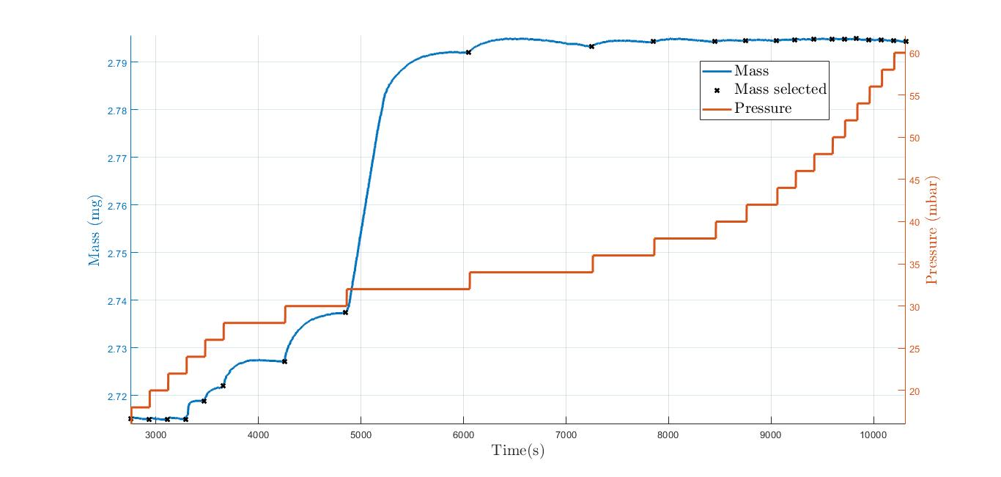
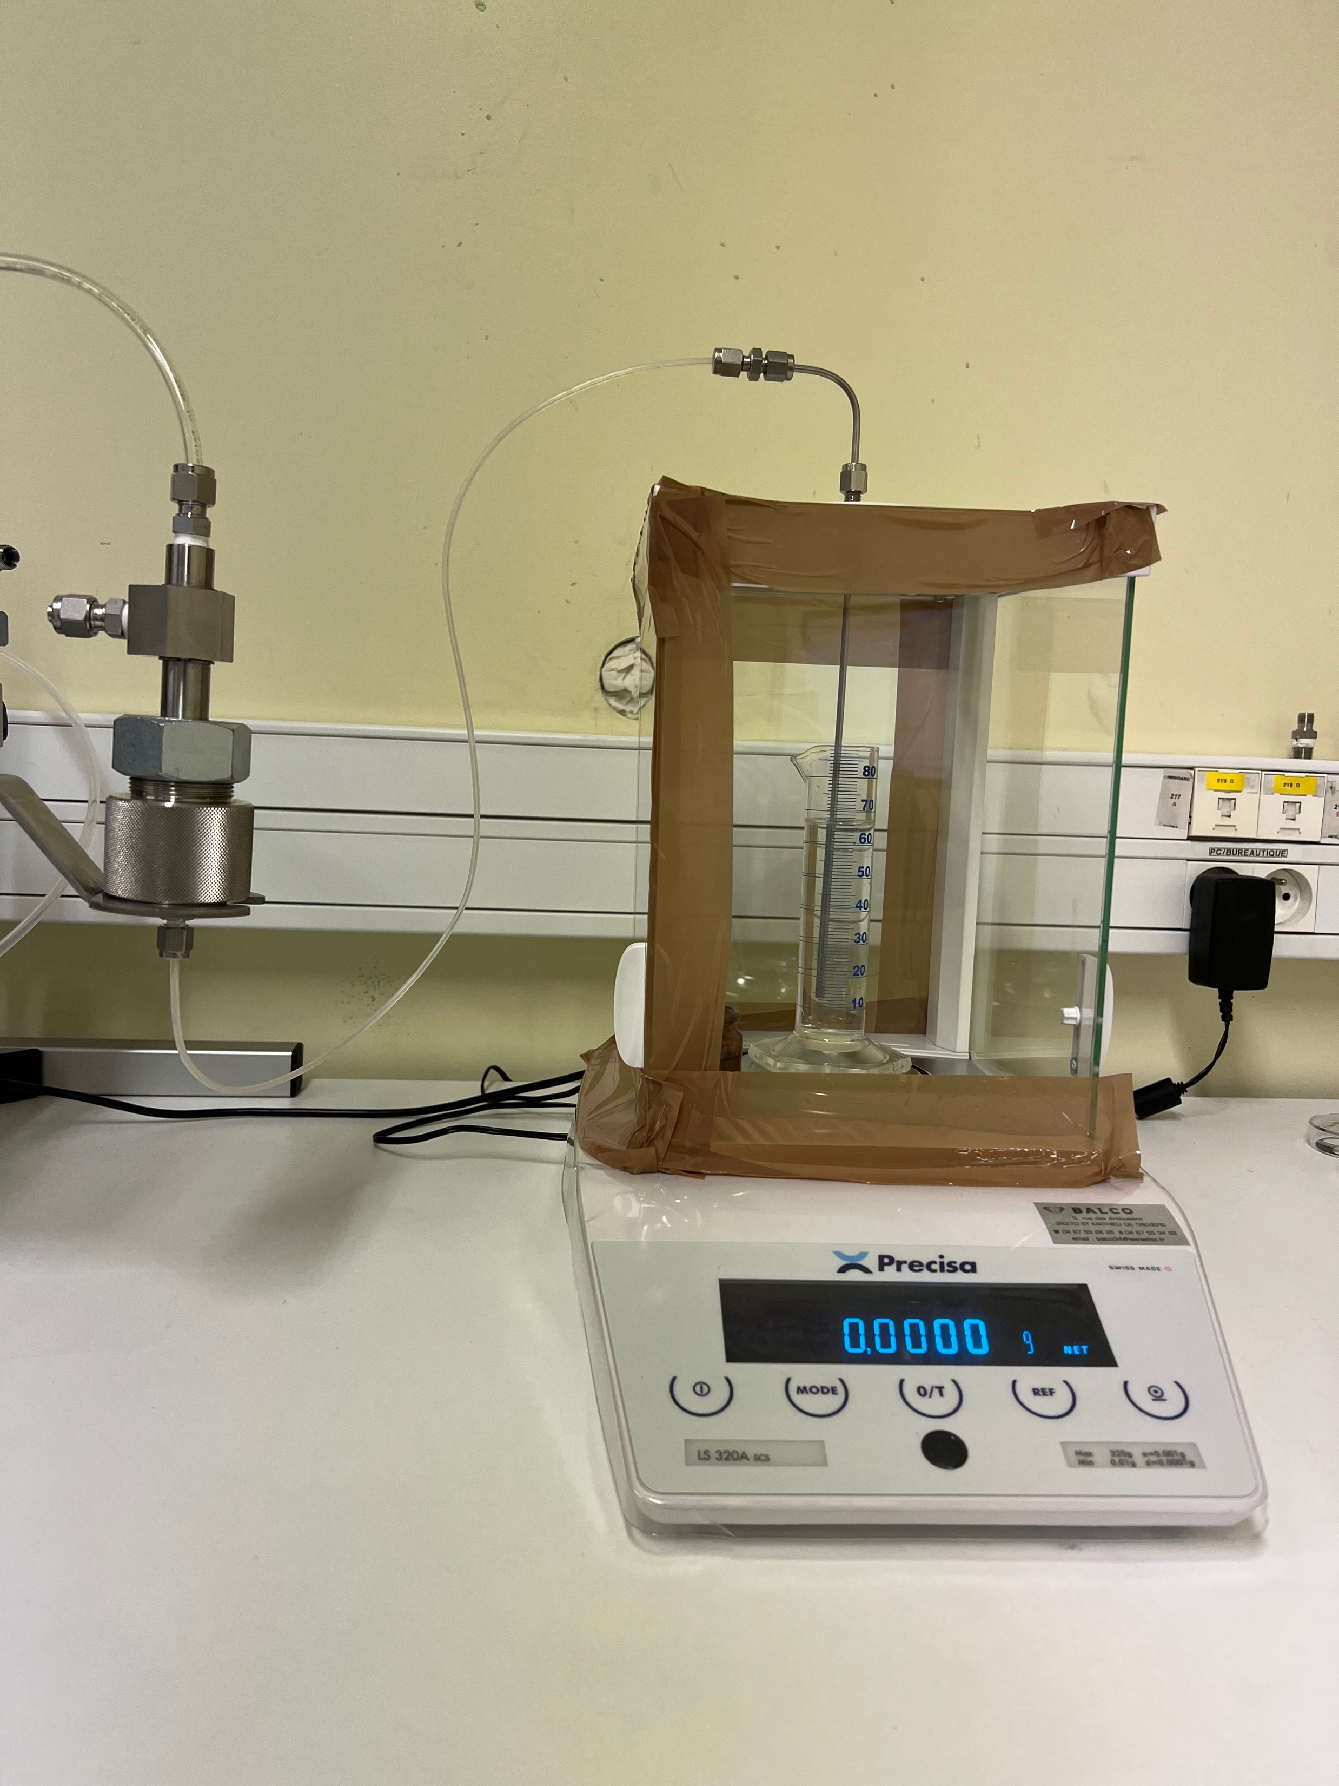
Liquid gas porosimetry ( n-dodecane/air) :
Drainage of dodecane-saturated GDL with air :
Example of result obtained with the porometer
Sample carrier
Balance

Slide 8
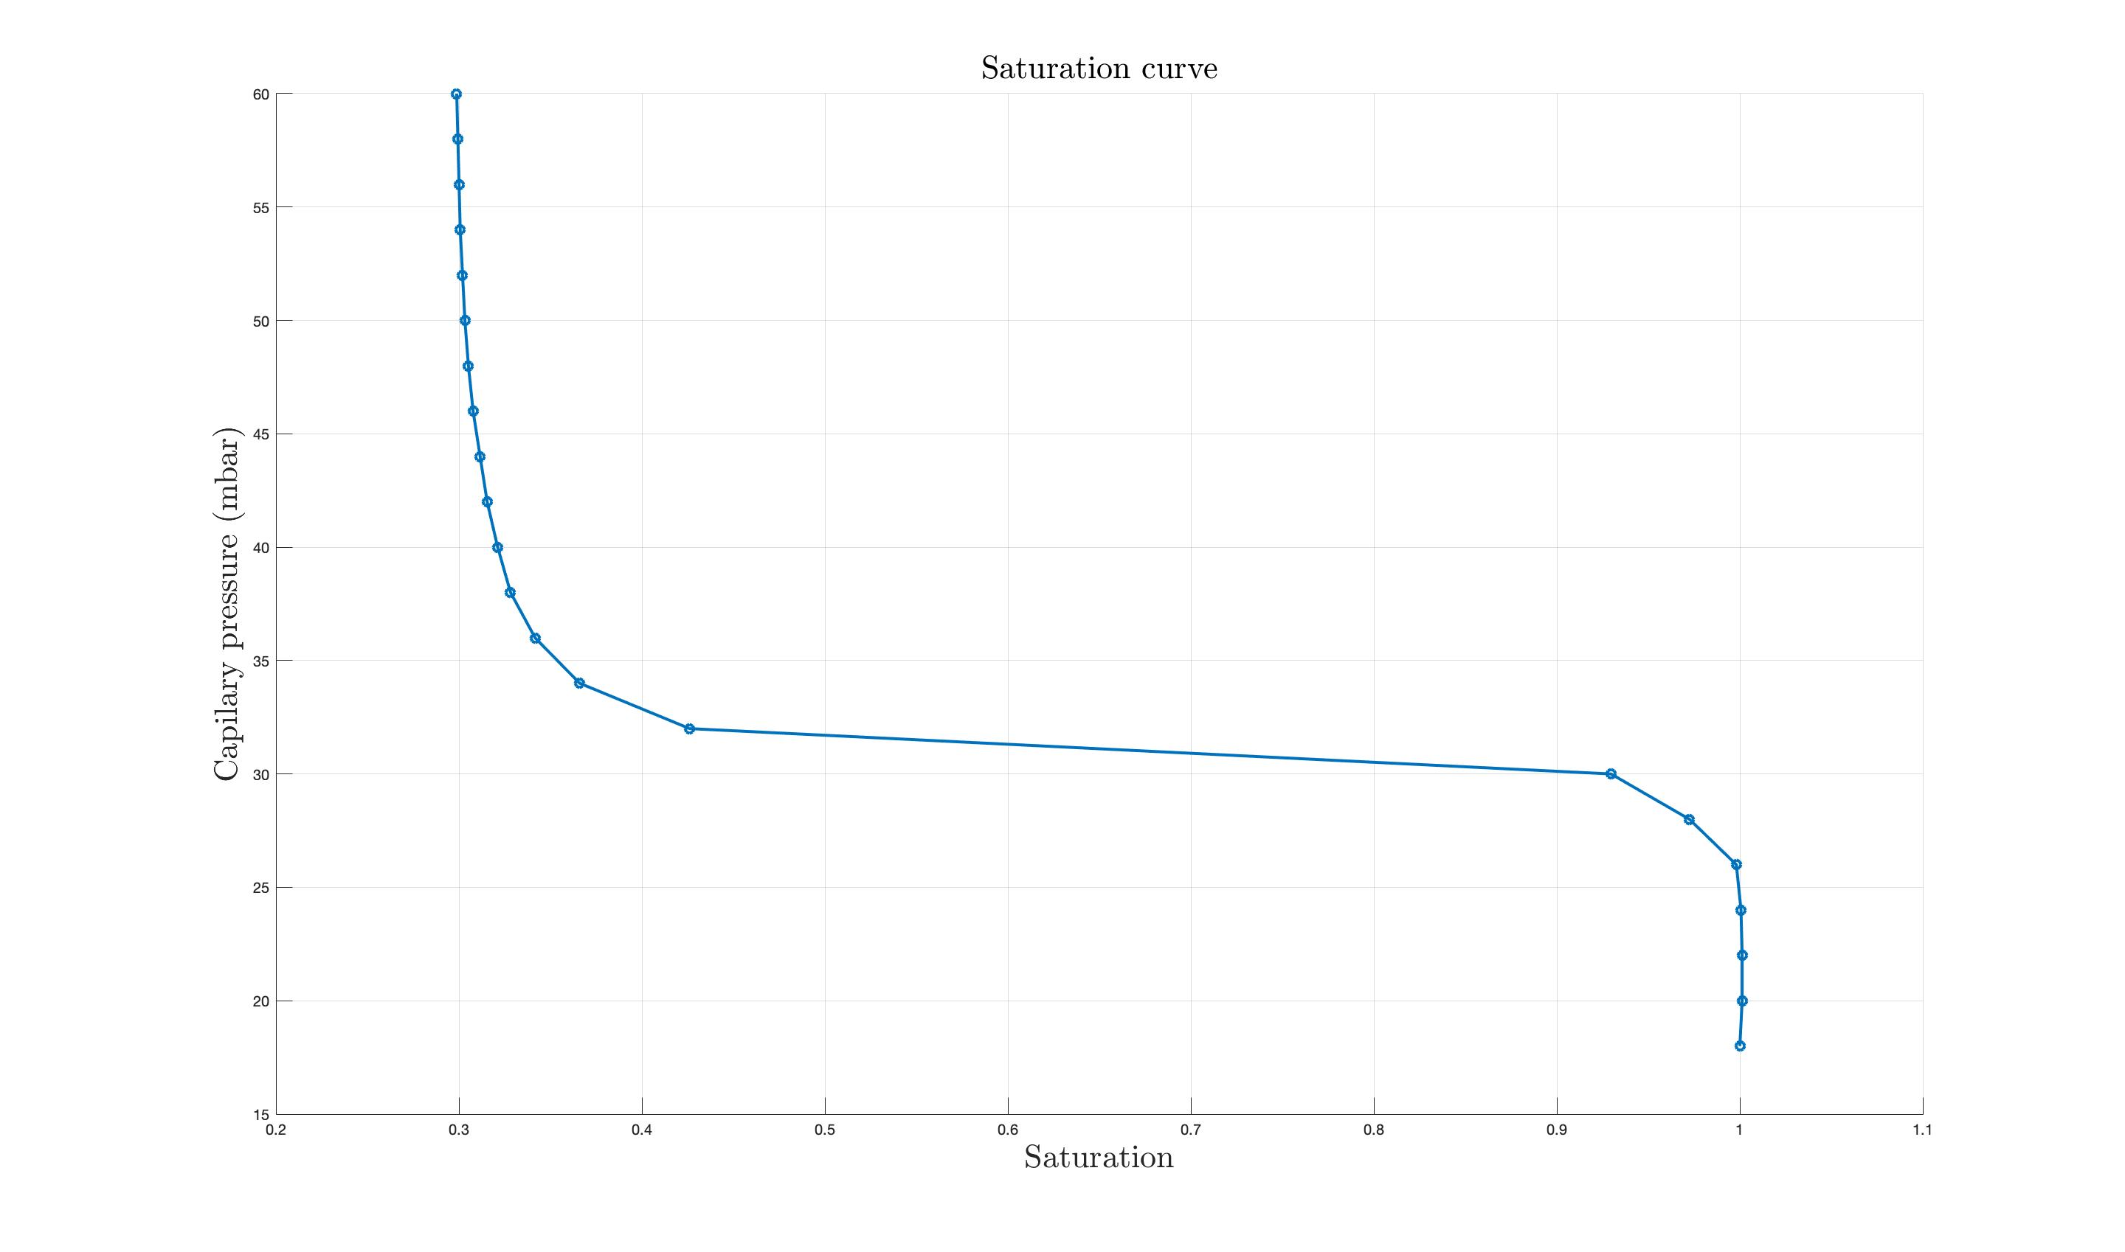
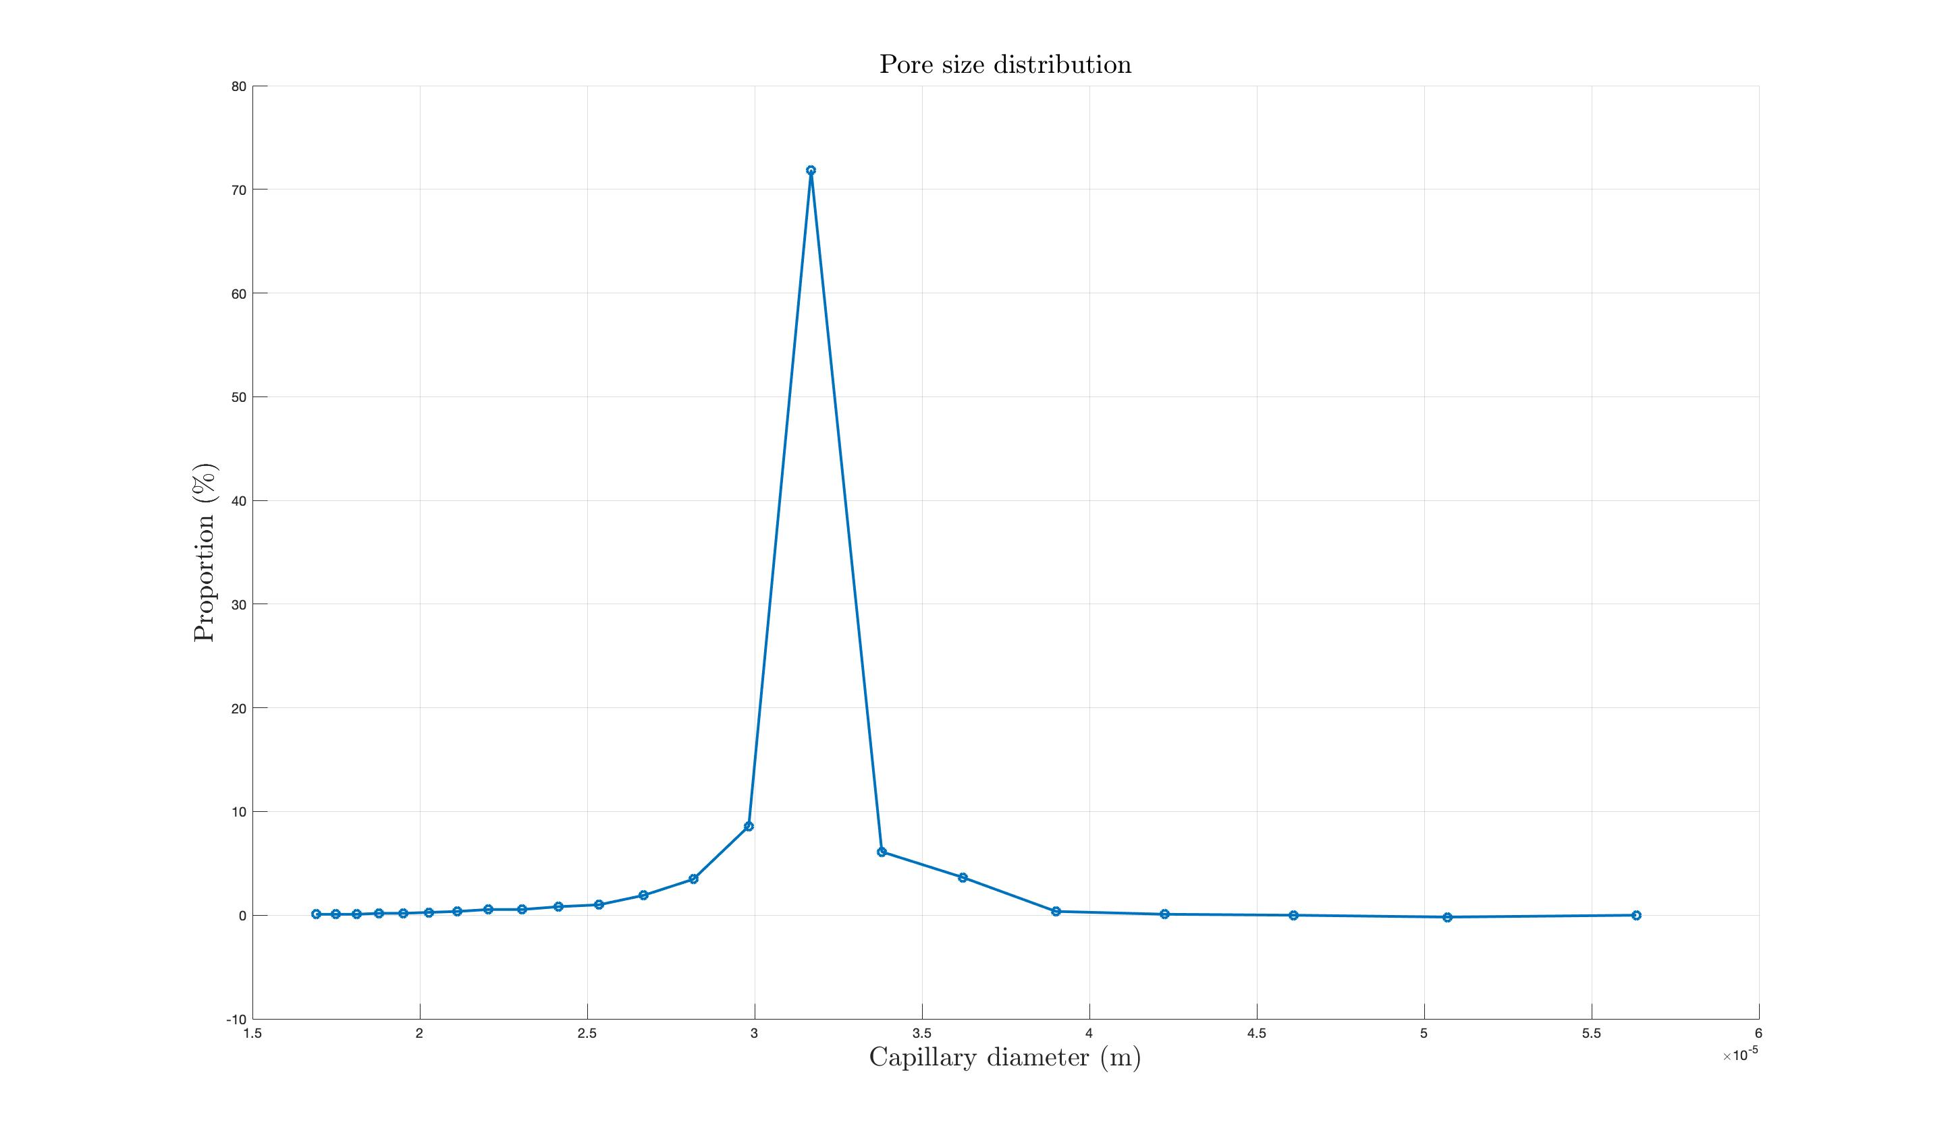
Liquid gas porosimetry ( n-dodecane/air) :
Saturation curve :
Pore size distribution :
Drainage of dodecane
$$P=\frac{4γcos⁡(θ)}{D}$$
Laplace's law :
Notes:
.

Slide 9
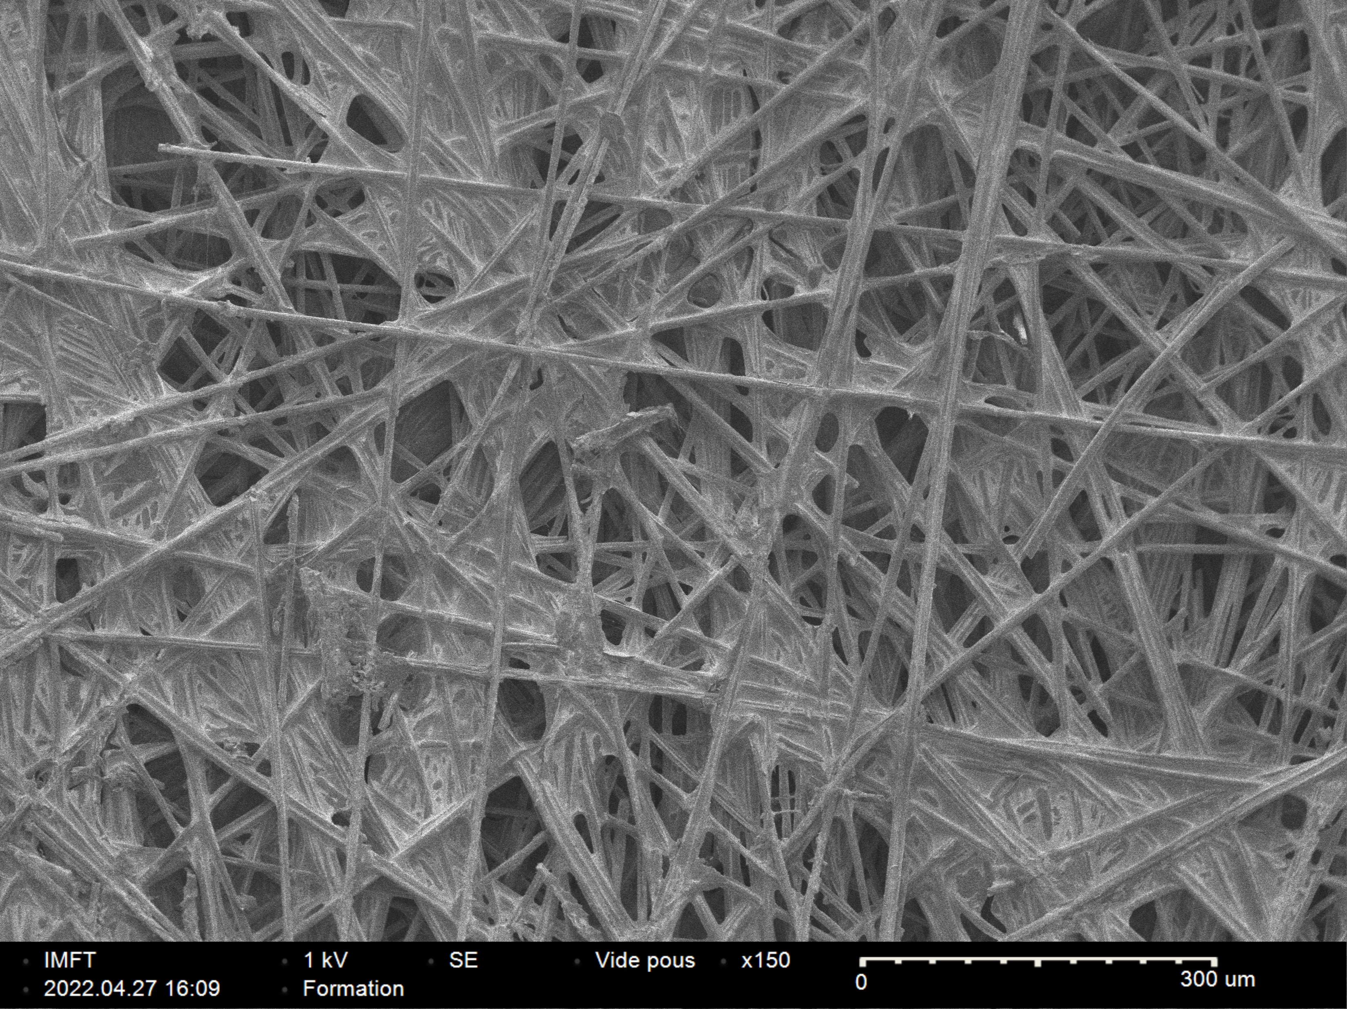
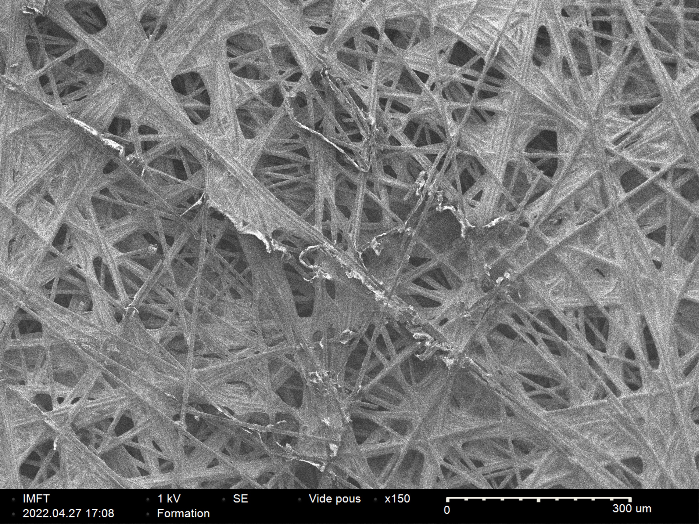
Toray Carbon Paper 120 :
After two weeks of aging :
New
Aged
Porosity : 78%
Substrate PTFE treatement : 5%

Slide 10
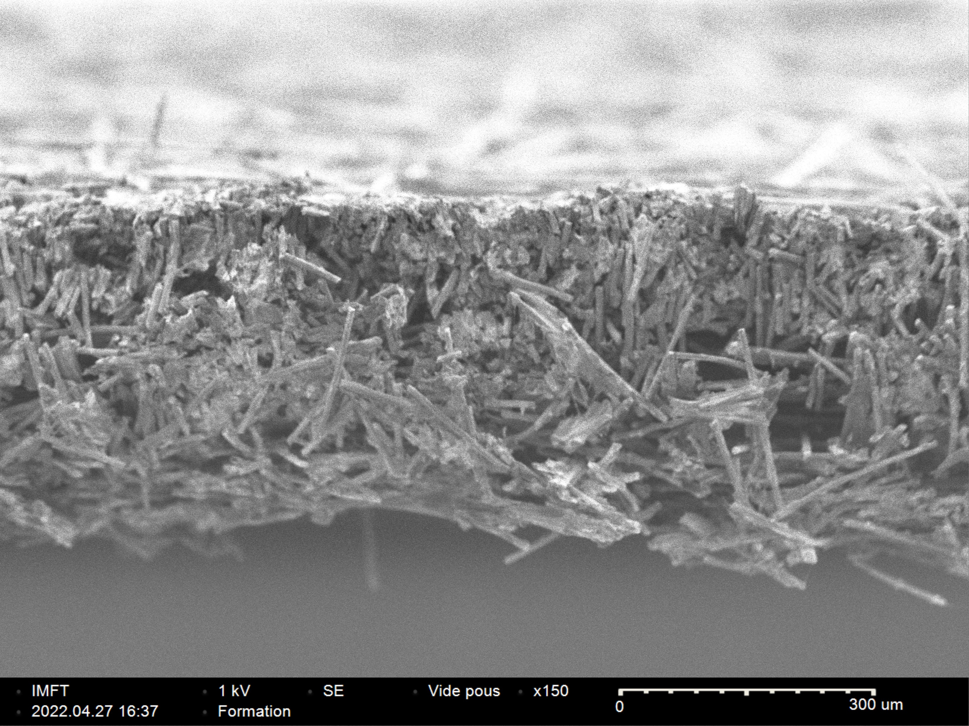
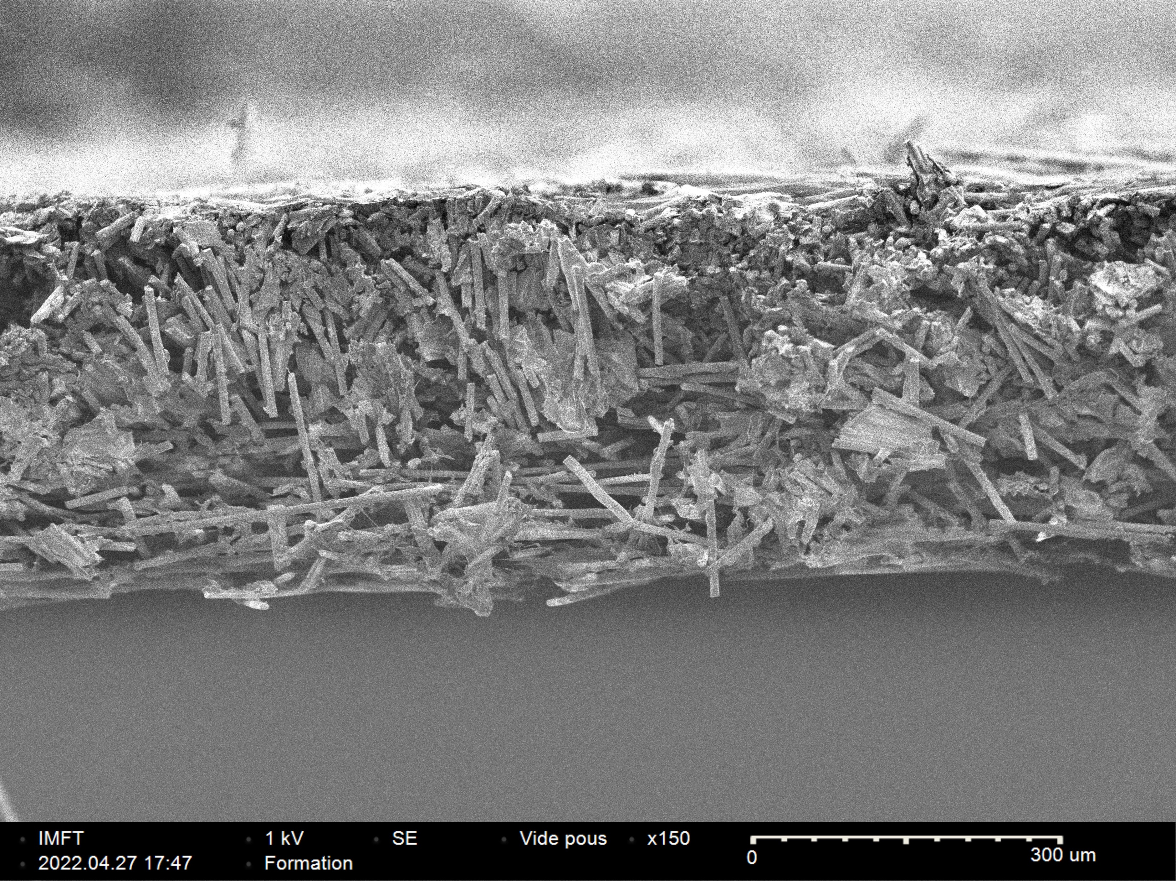
Toray Carbon Paper 120 :
Profile see :
New
Aged
Thickness =
399µm
374µm

Slide 11
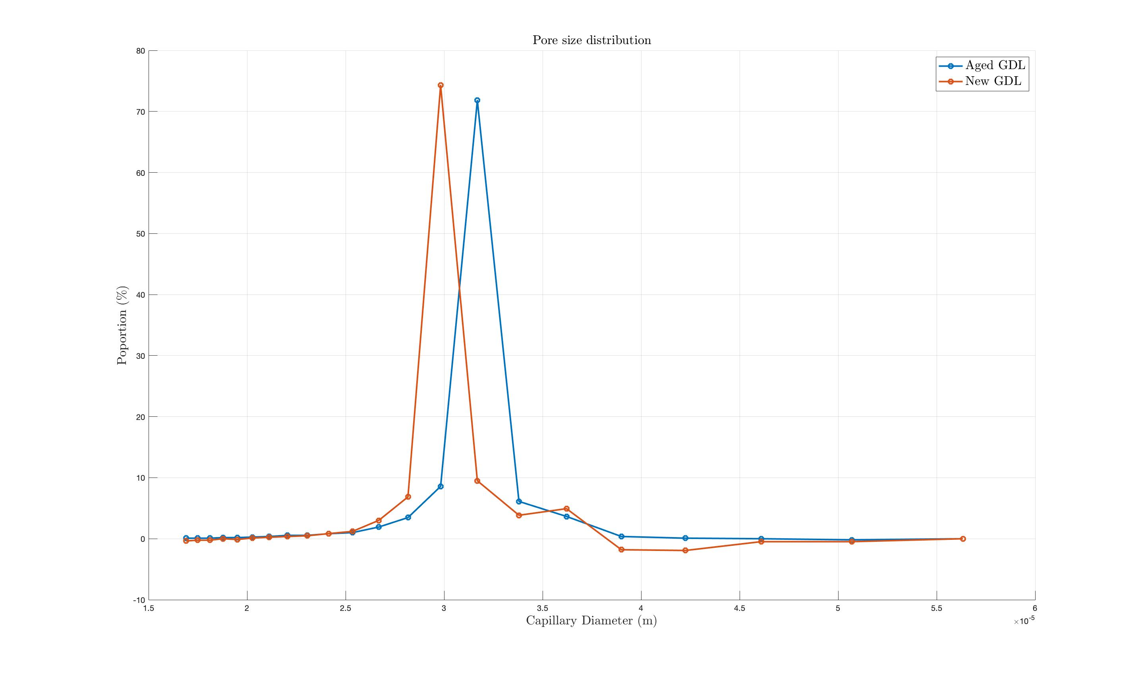
Liquid gas porosimetry ( n-dodecane/air) :
Results for toray tarbon paper 120 :
Modification of GDL morphology
After aging, larger pores and in smaller quantity
Notes:
.

Slide 12
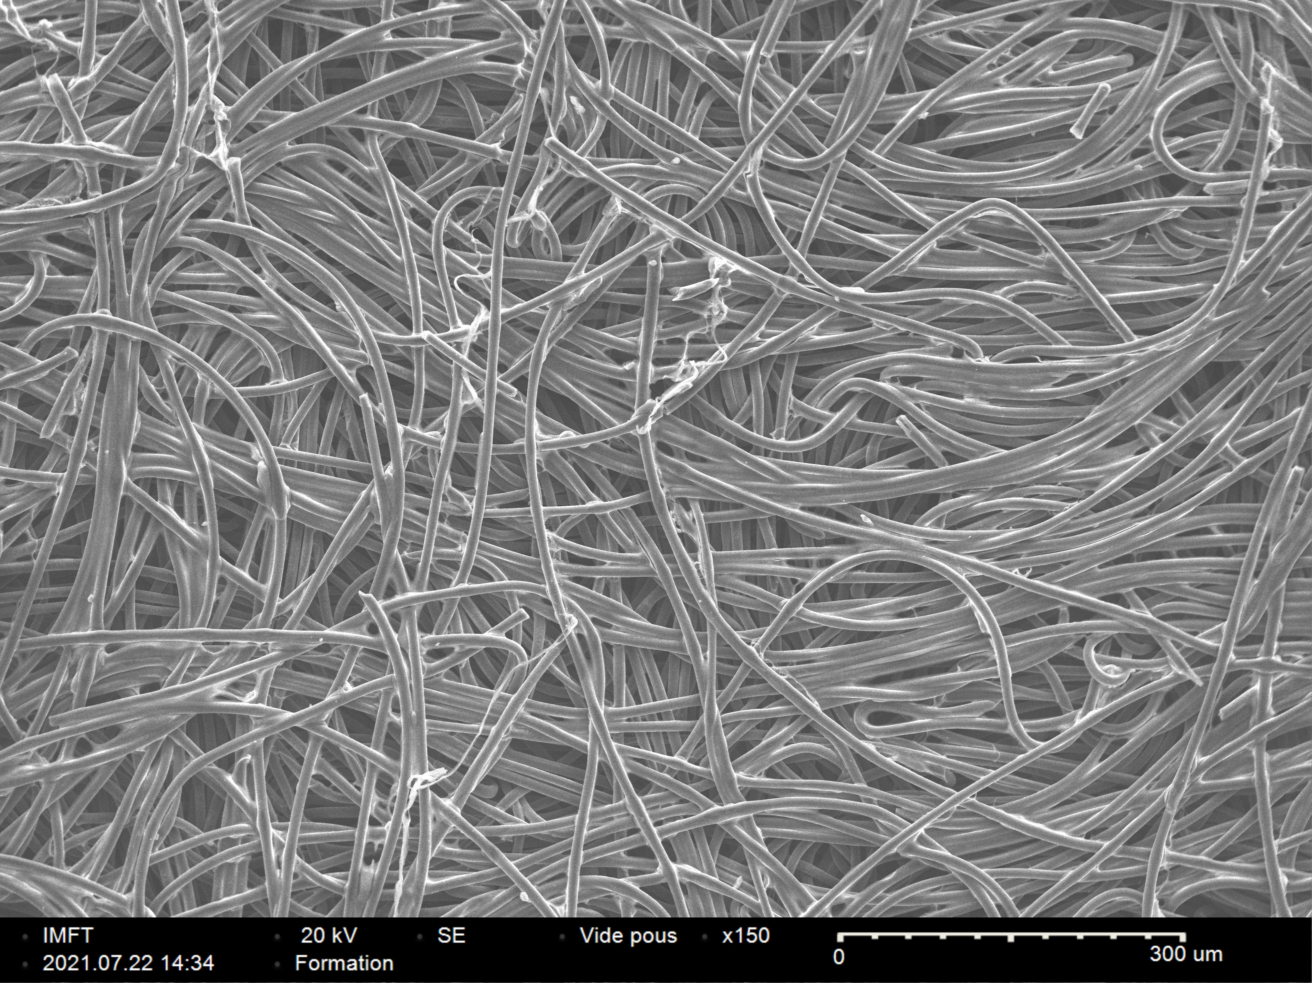
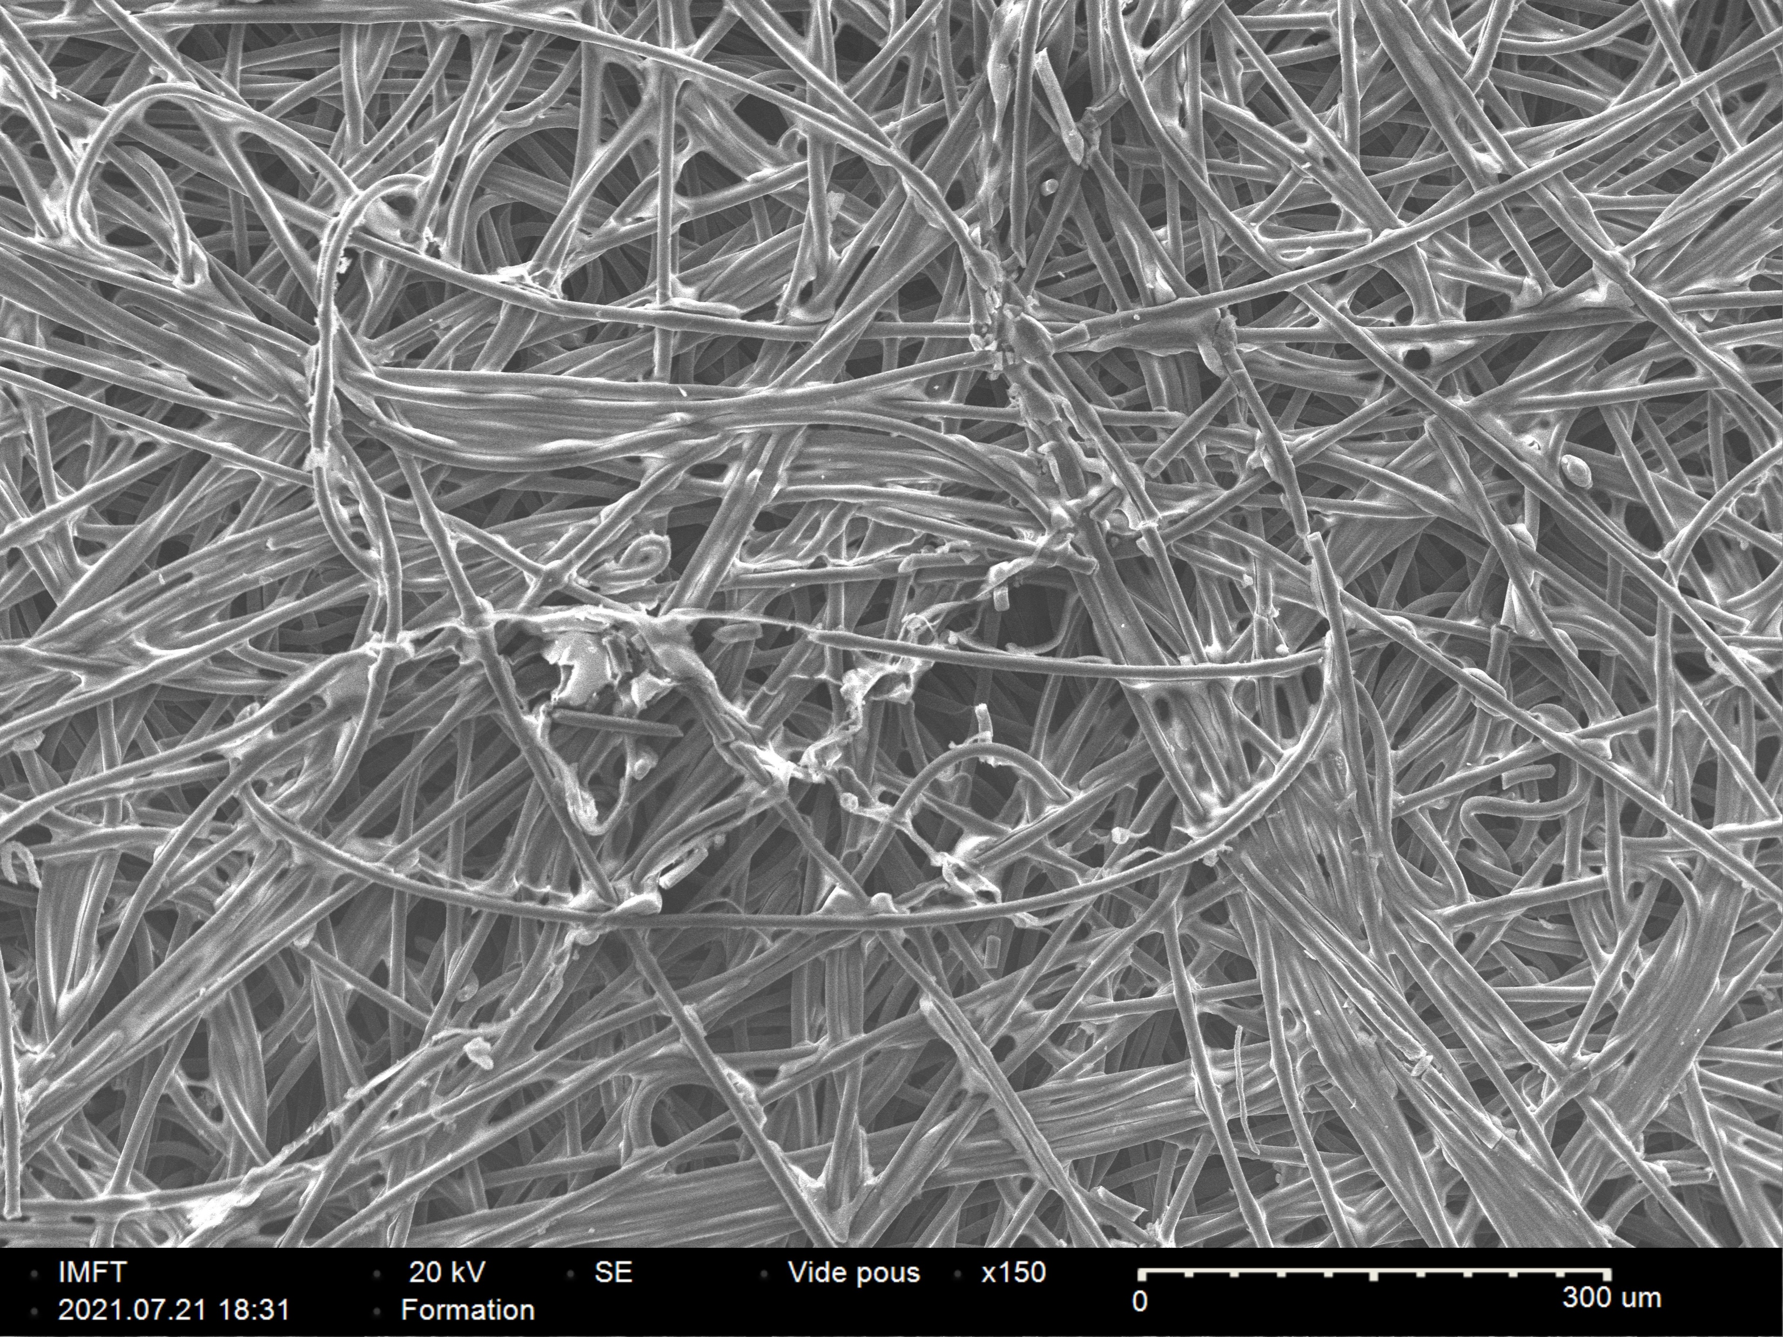
Freudenberg H2315T10A :
After two weeks of aging :
New
Aged
Porosity : 75.7%
Substrate PTFE treatement : 10%

Slide 13
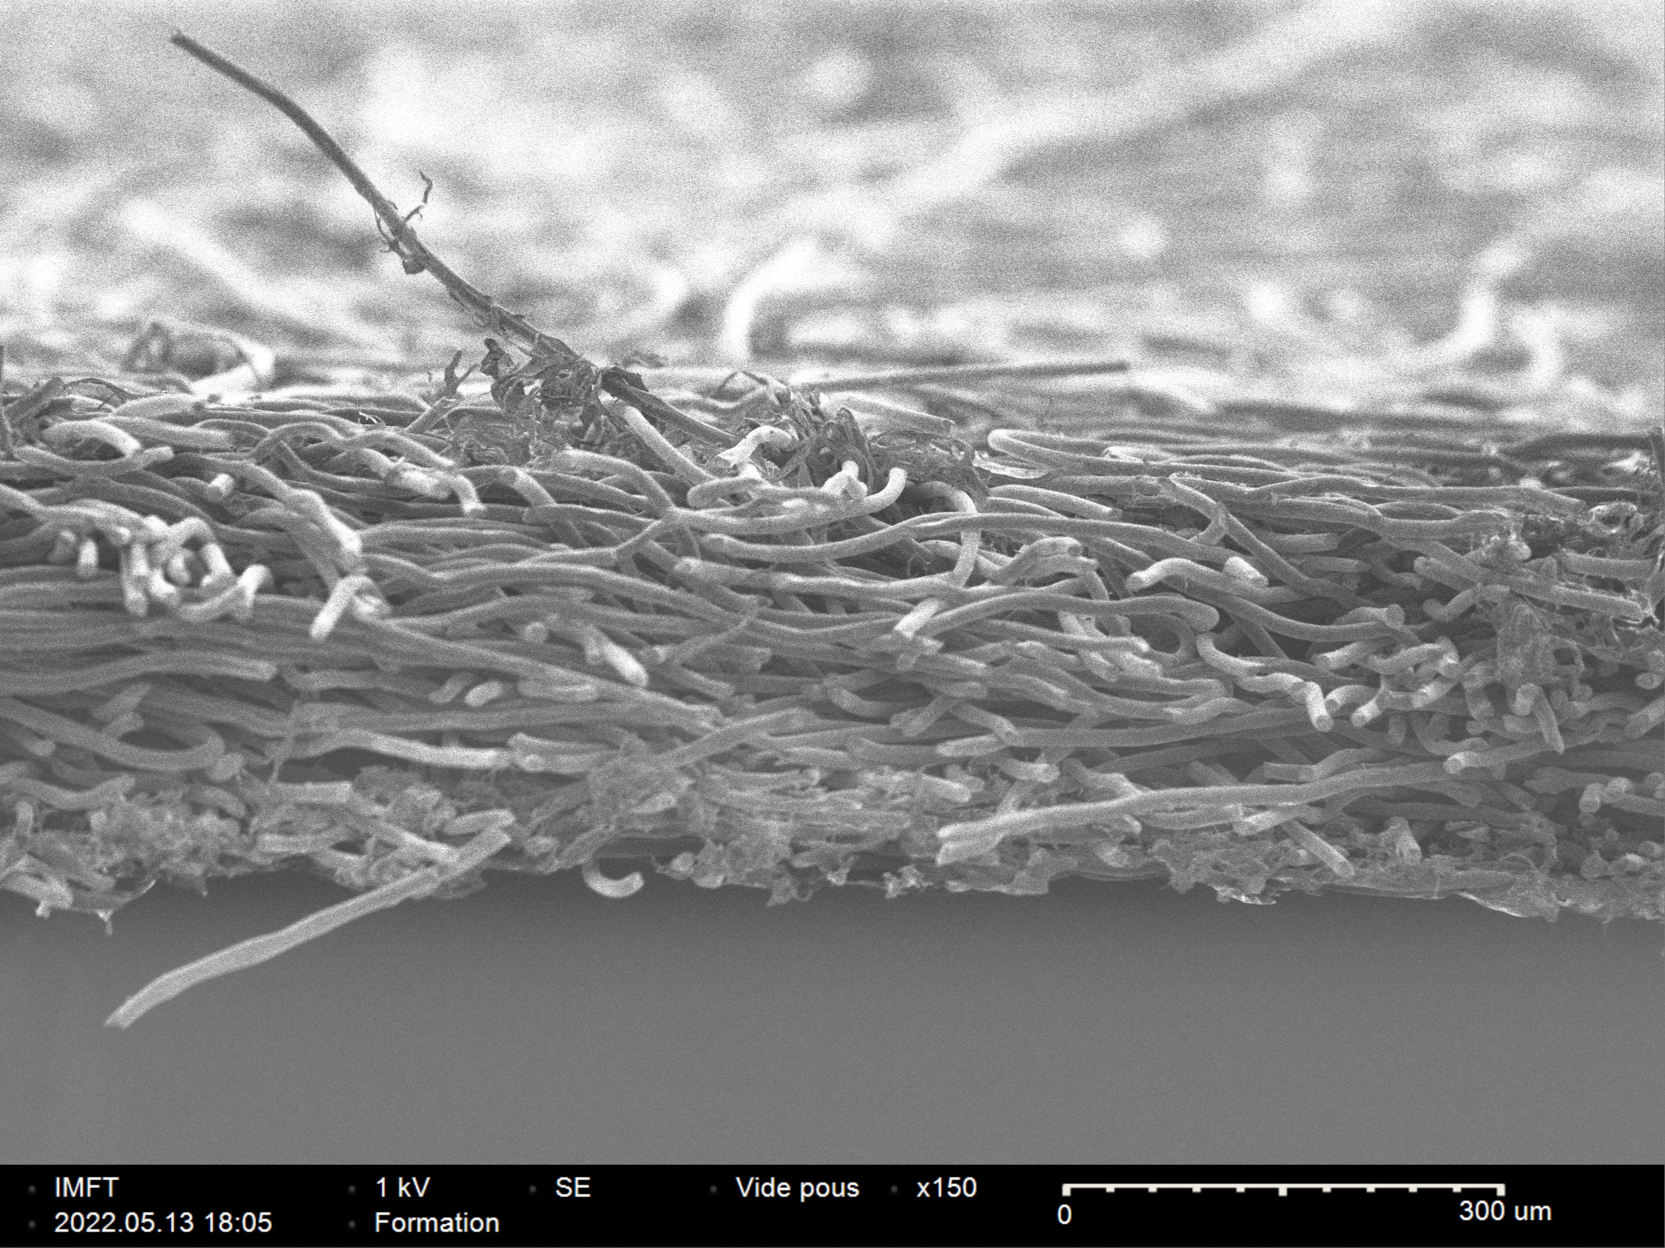
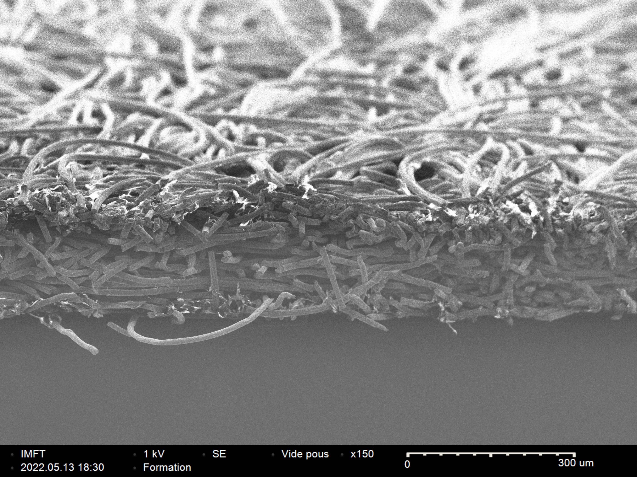
Freudenberg H2315T10 :
Seen in profile :
New
Aged
Thickness =
281µm
180µm

Slide 14
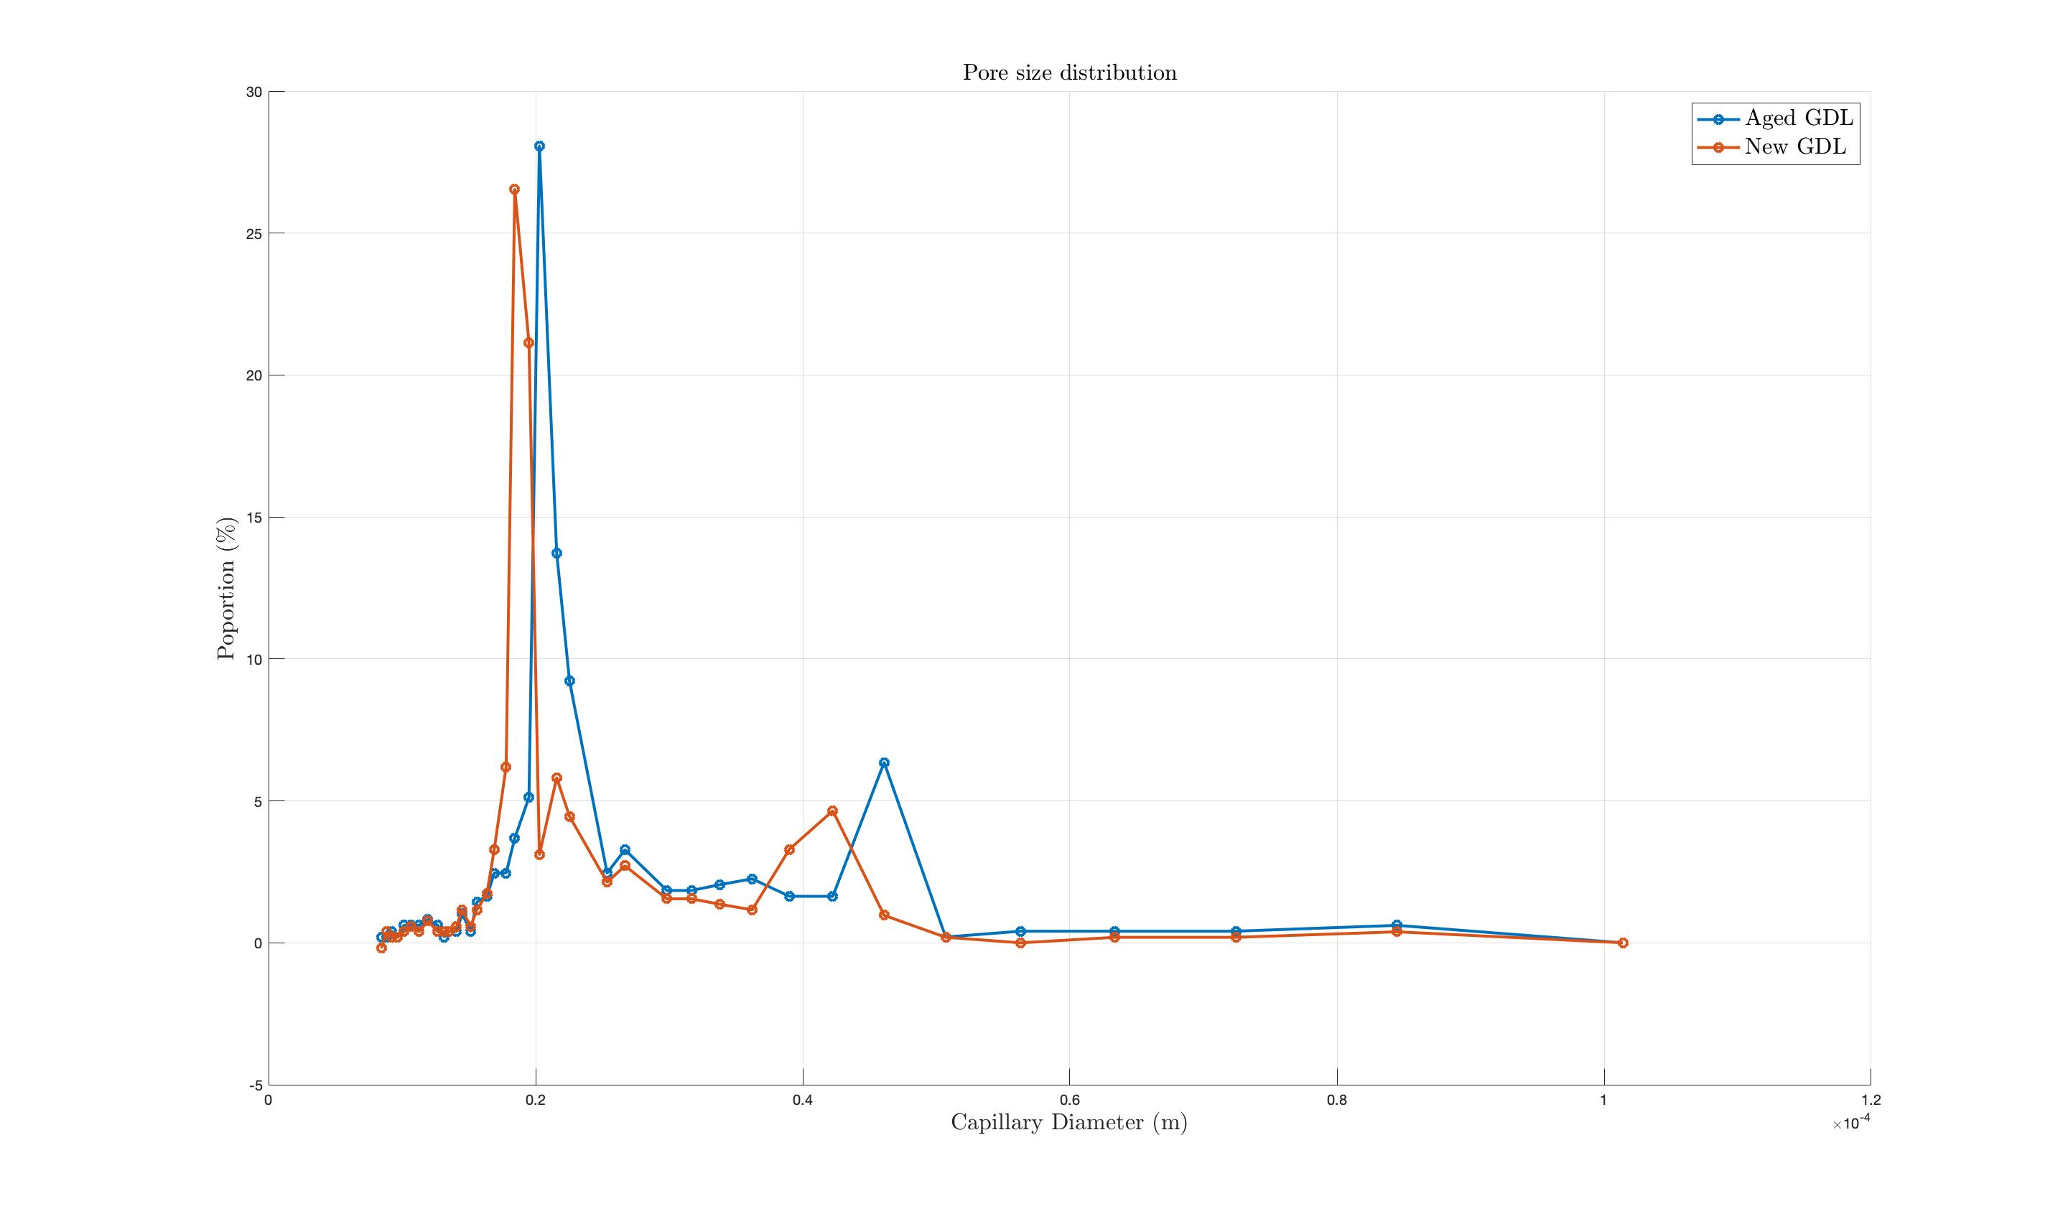
Liquid gas porosimetry ( n-dodecane/air) :
Results for freudenberg H2315T10A :
Modification of GDL morphology
After aging, larger pores and in greater quantity

Slide 15
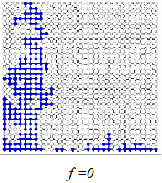
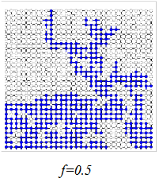
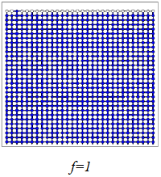
Conclusion and perspective :
The morphology of the GDL are modified :
For the GDL Toray :
New : Dmoy = 31.7µm
Aged : Dmoy = 33.8 µm
For the GDL Freudenberg :
New : Dmoy = 19.9µm
Aged : Dmoy = 21.6µm
Heterogeneous wettability applied to GDL
f = Proportion of hydrophilic pores
Variation of f after aging ?
Ref : Porométrie liquide-liquide, évaporométrie et simulations sur réseau de pores.
Othman Maalal, IMFT, 2021

