Slide 1
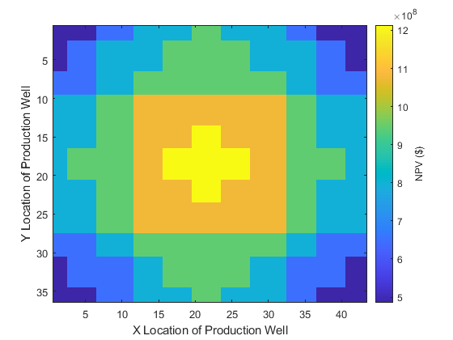
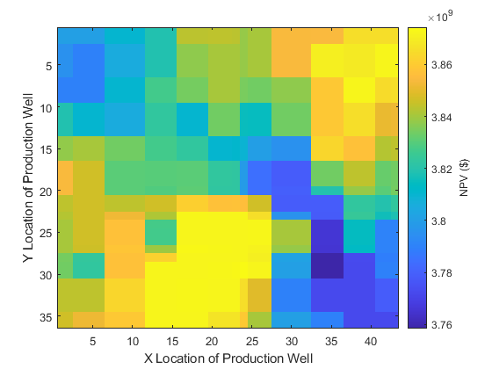
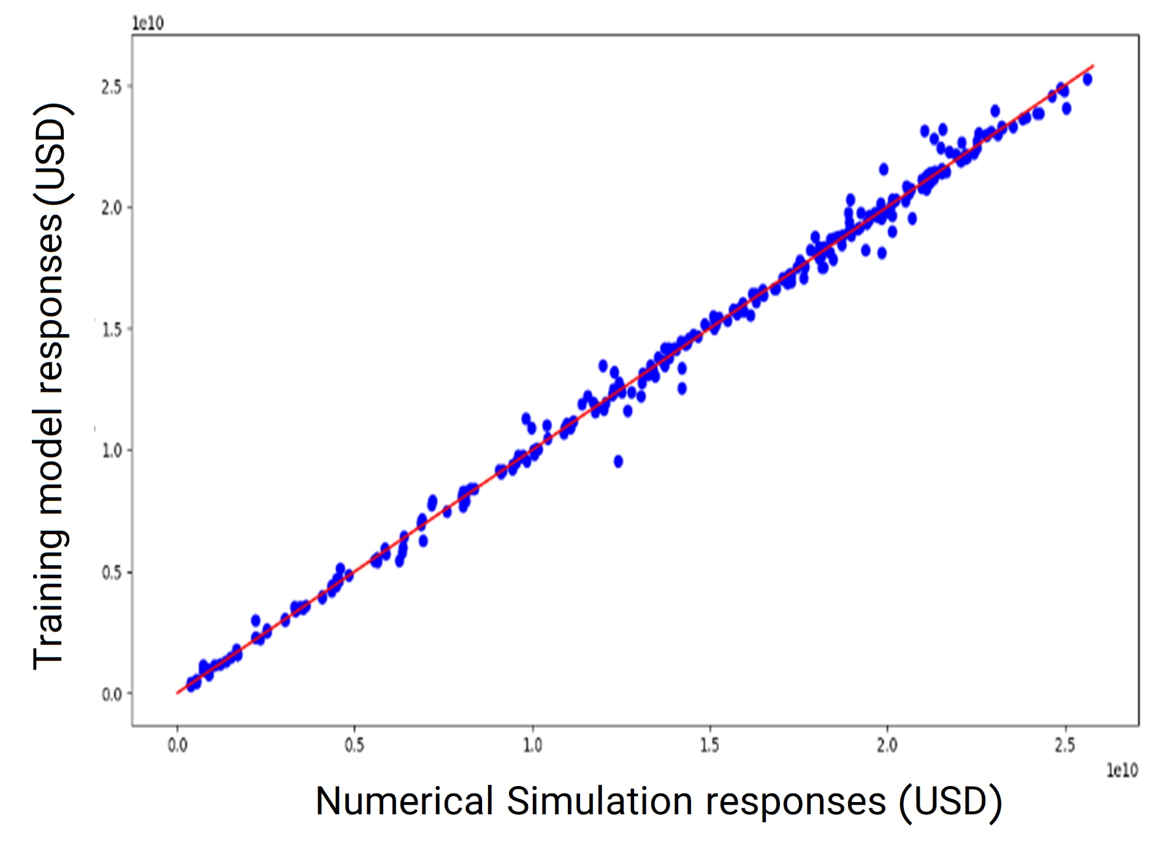
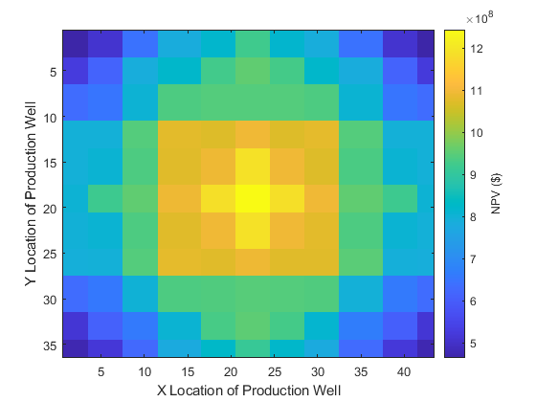
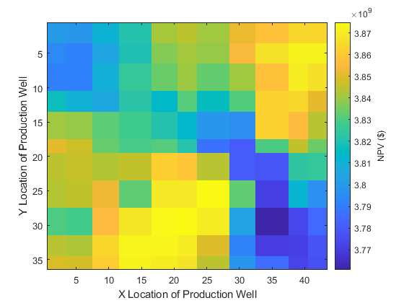
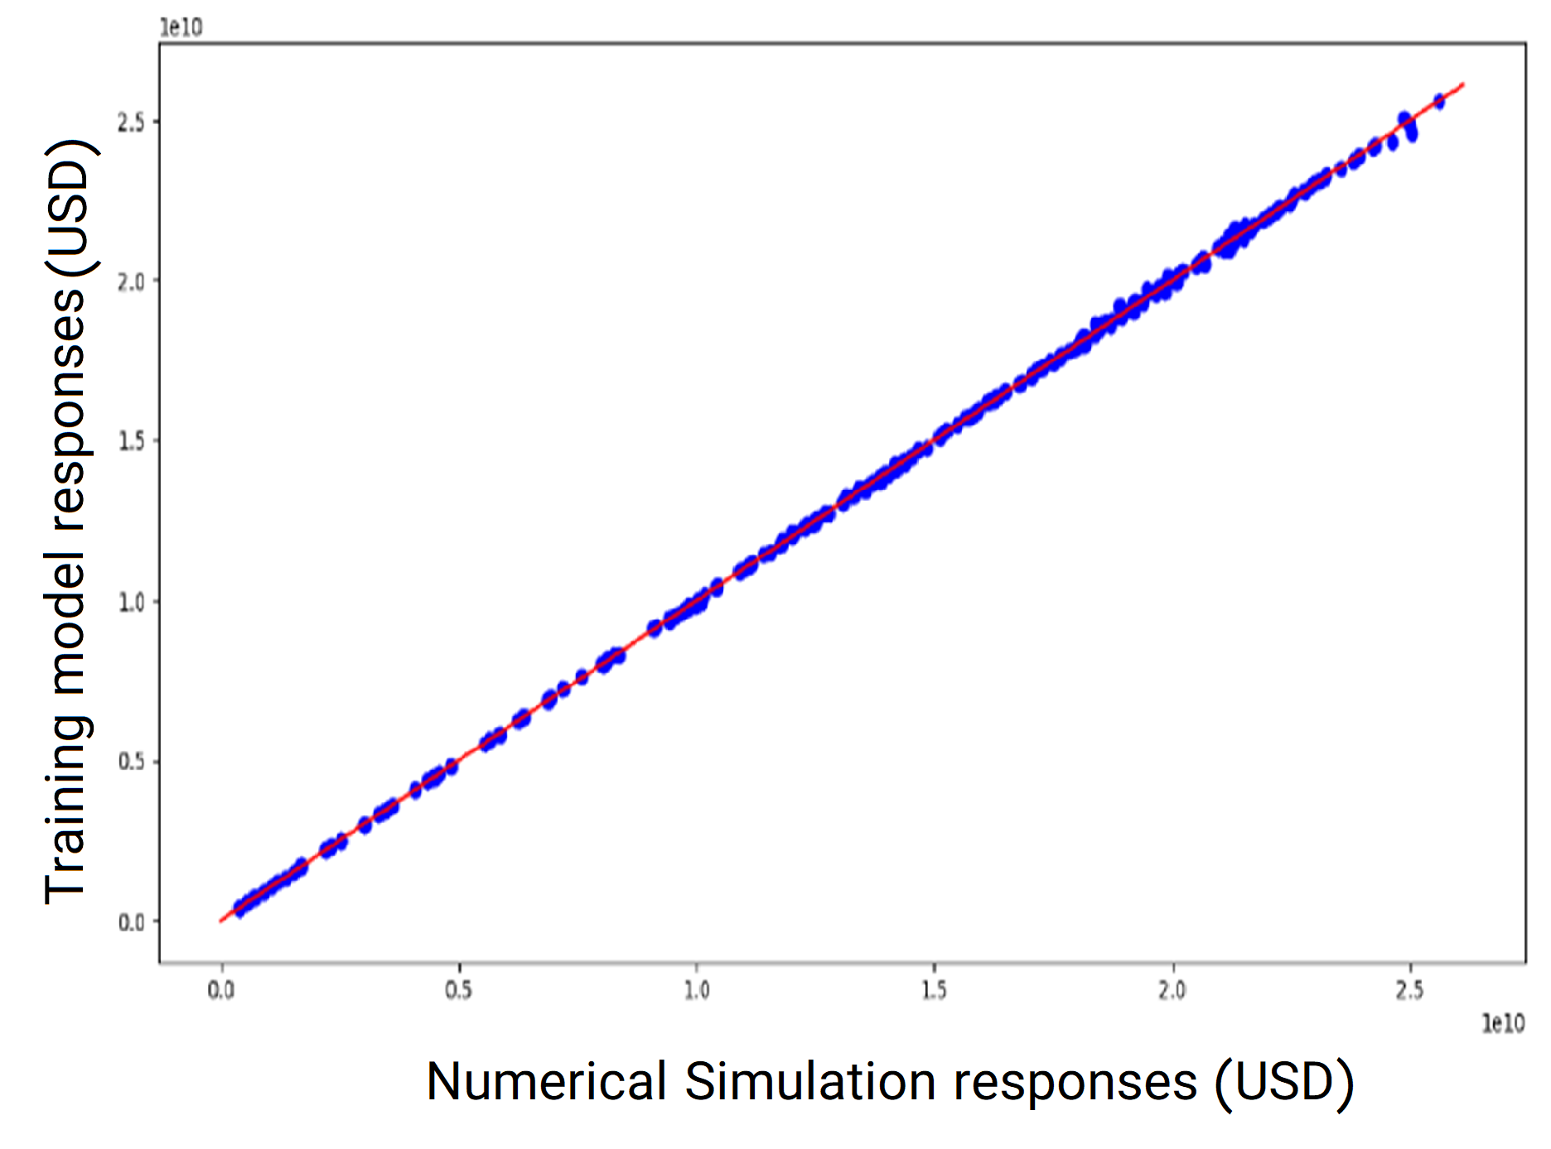
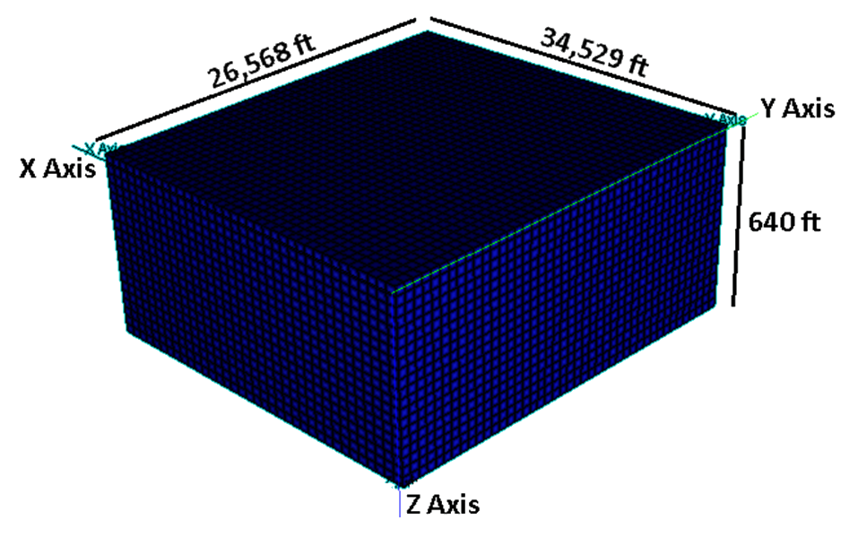
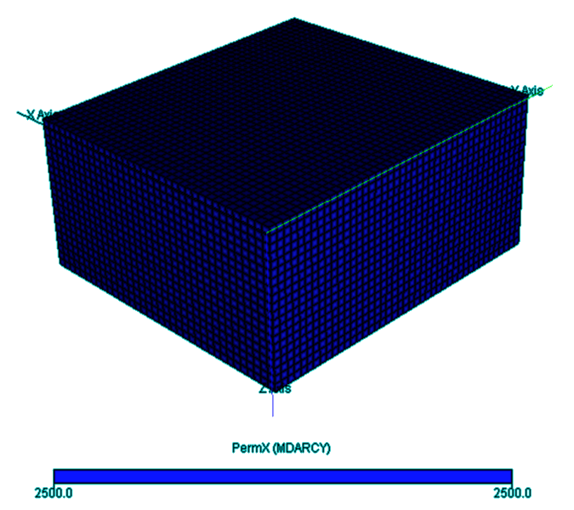
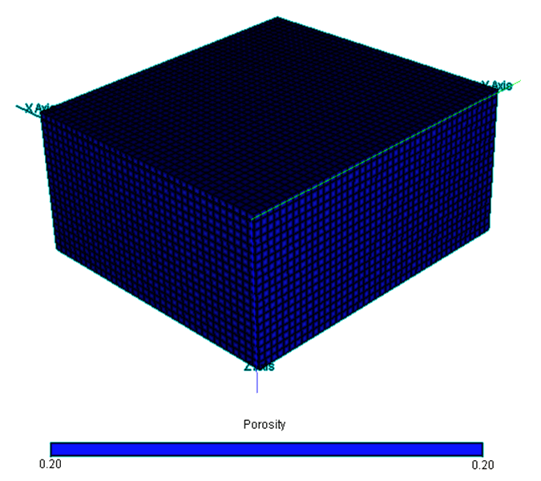
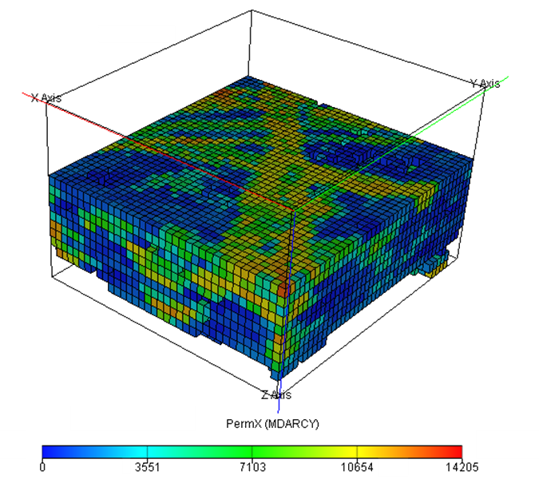
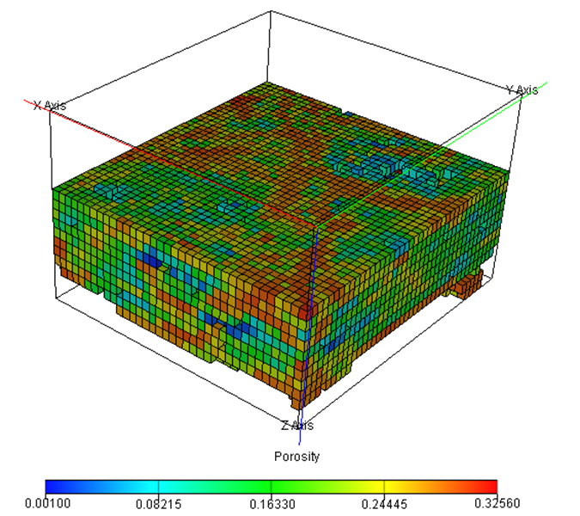
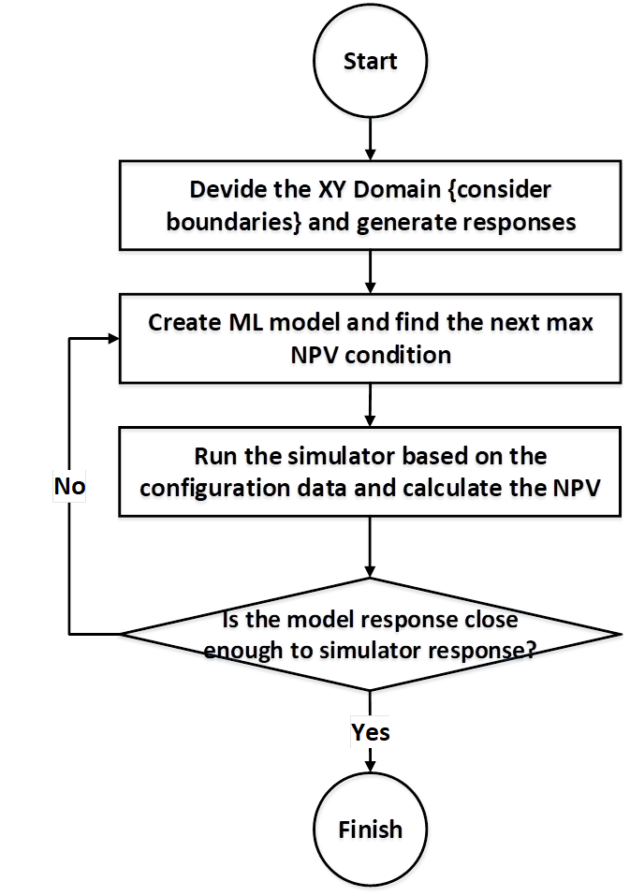
Introduction of an Integrated Workflow for Optimal Well Placement Using Machine Learning Methods
P. BakhtiariManesh¹, S. Sadeghnejad^{1,2*}, M. OstadHassan^{3,4}, S.M. Mousavi⁴
¹ Department of Petroleum Eng., Faculty of Chemical Engineering, Tarbiat Modares University, Tehran, Iran
² Geosciences Institute, Johannes Gutenberg-University, Mainz, Germany
³ Key laboratory of continental shale hydrocarbon accumulation and efficient development, Ministry of Education, Northeast Petroleum University, Daqing, China
⁴ Department of Petroleum Engineering, Amirkabir University of Technology, Tehran, Iran
Abstract
Results
Petroleum reservoir modeling procedure for production optimization is a complex problem and requires significant computational costs -rooted in reservoir simulation and post-processing. The advent of Artificial Intelligence -particularly supervised machine learning algorithms- in the petroleum industry is gained much popularity because of efficient functionality in terms of high dimensional data, computational cost and time. Several algorithms and methods were used to built models in order to assess the well placement problem in heterogeneous reservoir models [1,2]. The Extreme Gradient Boosting (xGBoost) and Light Gradient Boosting Machine (LightGBM) algorithms are then used to build intelligent models [3,5]. Three scenarios were defined to evaluate these two algorithms:
xGBoost Results
Scenario 1
Scenario 2
Scenario 3
Table 1: Description of optimization Scenarios.
Scenario | Description | Optimazation Parameters
1 | a homogeneous reservoir with just one production well | Production well Location
2 | a heterogeneous channelized reservoir with just one production well | Production well Location
3 | a heterogeneous channelized reservoir waterflood flooding | Production and Injection Well Locations
LightGBM Results
Objectives
Scenario 1
Scenario 2
Scenario 3
Evaluate the LightGBM and xGBoost algorithms in field optimization using Net Present Value (NPV) Function
Compare the performance of LightGBM and xGBoost
Reservoir Model
Fig. 5: Result of two xGBoost and LightGBM algorithms in three different scenarios. Scenario 1: The predicted NPVs of possible locations for production well in homogeneous reservoir.
Scenario 2: The predicted NPVs of possible locations for production well in heterogeneous reservoir.
Scenario 3: The predicted vs calculated NPVs of possible locations for production and injection wells.
Table 2: Reservoir Characterization and operational conditions in each scenarios.
Scenario | Permeability (mD) | Porosity (%) | OOIP ( × 10⁹ STB) | Production Rate (STB/Day) | Injection Rate (STB/Day)
1 | 2500 | 20 | 1.65 | 12000 | -
2 | 0 - 14205 | 0-32 | 8.14 | 11000 | -
3 | 0 - 14205 | 0-32 | 8.14 | 10000 | 10000
Table 3: Results of two different optimization algorithms.
Notice: The total number of possible locations for well placement is 43×36=1548.
Fig. 1: Reservoir dimensions. It has 30,960 (43×36×20) grids.
Scenario | R-squared (%) | K | Number of simulation runs
 | xGBoost | LightGBM
1 | 72.2 | 90.5 | 121
2 | 75.4 | 88.6 | 121
3 | 99.5 | 99.9 | 276
Conclusion
Light Gradient Boosting Machine and Extreme Gradient Boosting were the two machine learning approaches, which were used to predict the profit responses as a function of several variables. Three different scenarios were defined to facilitate this comparison.
Both algorithms show satisfying predictions.
the LGBM algorithm produces much more complex trees by following leaf wise split approach rather than a level-wise approach which is the main factor in achieving higher accuracy. However, it can sometimes lead to overfitting, which can be avoided by setting the controlling parameters.
In equal condition and number of simulation runs, LightGBM algorithms has shows more realistic distribution of responses.
Fig. 2 – permeability (Left) , and porosity (Right) distribution in the homogeneous non-channelized scenario
Fig. 3 – permeability (Left) , and porosity (Right) distribution in the channelized scenarios (Sliced layers 9-20)
References
Methodology
[1] Nwachukwu, A., et al., Fast evaluation of well placements in heterogeneous reservoir models using machine learning. Journal of Petroleum Science and Engineering, 2018. 163: p. 463-475.
[2] Mousavi, S.M., et al. Optimal Well Placement Using Machine Learning Methods: Multiple Reservoir Scenarios. in SPE Norway Subsurface Conference. 2020. Society of Petroleum Engineers.
[3] Jhaveri, S., et al. Success Prediction using Random Forest, CatBoost, XGBoost and AdaBoost for Kickstarter Campaigns. in 2019 3rd International Conference on Computing Methodologies and Communication (ICCMC). 2019. IEEE.
[4] Chen, T. and C. Guestrin. Xgboost: A scalable tree boosting system. in Proceedings of the 22nd acm sigkdd international conference on knowledge discovery and data mining. 2016.
[5] Ke, G., et al., Lightgbm: A highly efficient gradient boosting decision tree. Advances in neural information processing systems, 2017. 30: p. 3146-3154.
Acknowledgement
The second author (S. Sadeghnejad) gratefully acknowledges support from the Alexander von Humboldt Foundation for his visiting research at the Johannes Gutenberg University at Mainz (JGU), Germany.
Fig. 4: Methodology and Workflow.

