Slide 1
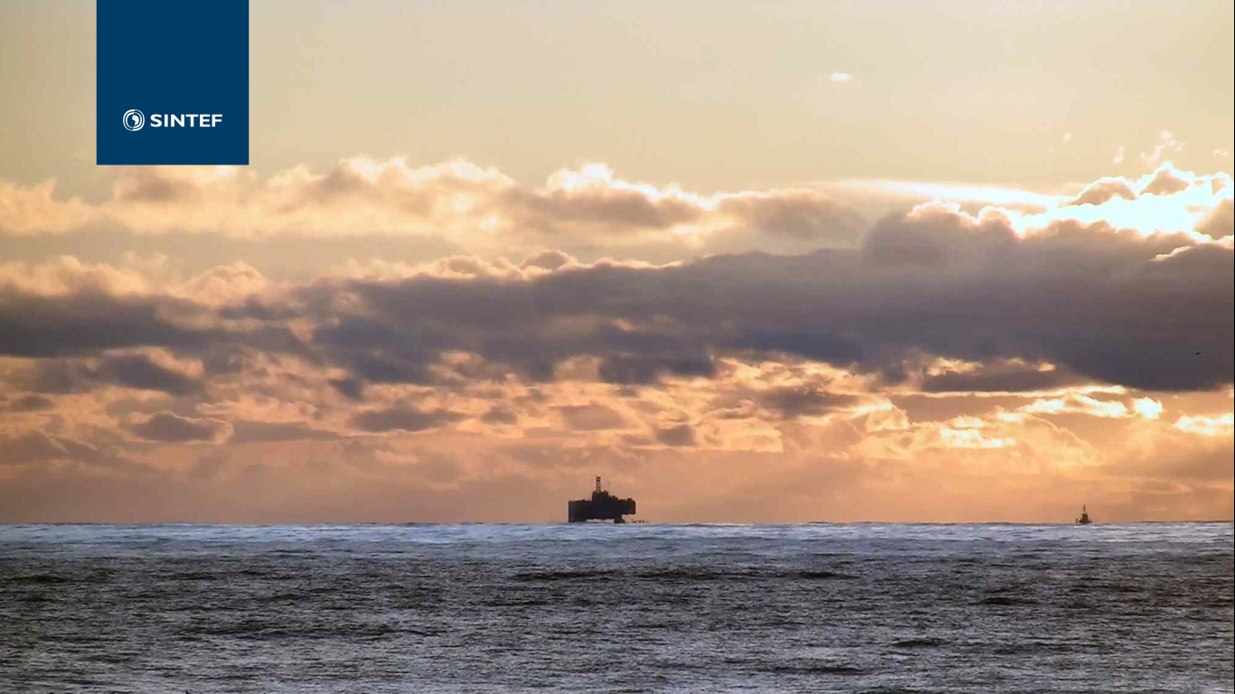
INTERPORE, New Orleans 14.05.2015
Lessons learned in the North Sea:
Closing the gaps in permanent well plugging
Malin Torsæter, PhD
Research Manager
SINTEF Industry, Dept. Petroleum

Slide 2
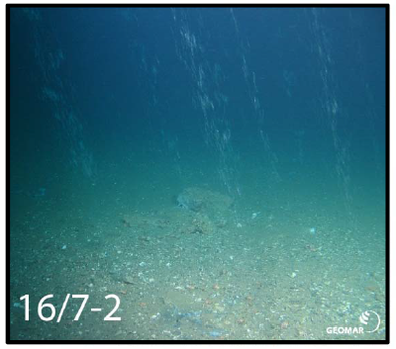
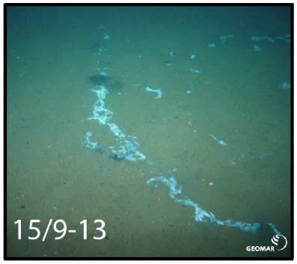
Motivation: Eternal leakage protection
"Permanently abandoned wells shall be plugged with an eternal perspective"
- NORSOK D-010
"The objective of P&A is to restore the integrity of the cap rock"
- Oil & Gas UK
Gas leakage
Bacterial mats
Vielstädte et al. (2017), Dealing with legacy wells: Implications from subsea leakage along abandoned North Sea gas wells. http://ieaghg.org/docs/11mon/Session11_Talk1_IEAGHG_lvielstaedte.pdf

Slide 3
What do we mean by "safe plug length"?
From:
Kuip et al, Energy Procedia 4 (2011) 5320–5326
Country | Min. plug length (m)
Denmark | 100 (or 50 + mech plug)
Norway | 100 (or 50 + mech plug)
Netherlands | 100 (or 50 + mech plug)
United Kingdom | 30
Australia | 60
Canada | 15
China | 30
Japan | 30
USA - API | 30
100 ft
100 m

Slide 4
Norway: P&A almost as expensive as drilling
P&A
25-60 days!

Slide 5
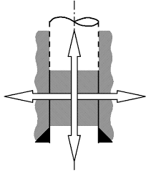
Log annular cement quality
Set plugs
Verify/monitor
Cut and pull pipes
(Remove steel/cement)
(Regain well access)
Main challenges
~ 80% of time
Use of expensive rigs:
Heavy lifting
Rotation based methods (cutting, milling)
Need for well control
Time consuming:
Plug all fluid bearing zones
Relatively long plug lengths
Extensive "tripping"

Slide 6
Learnings from P&A research in Norway

Slide 7
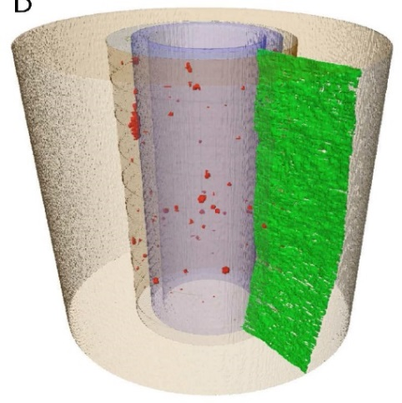
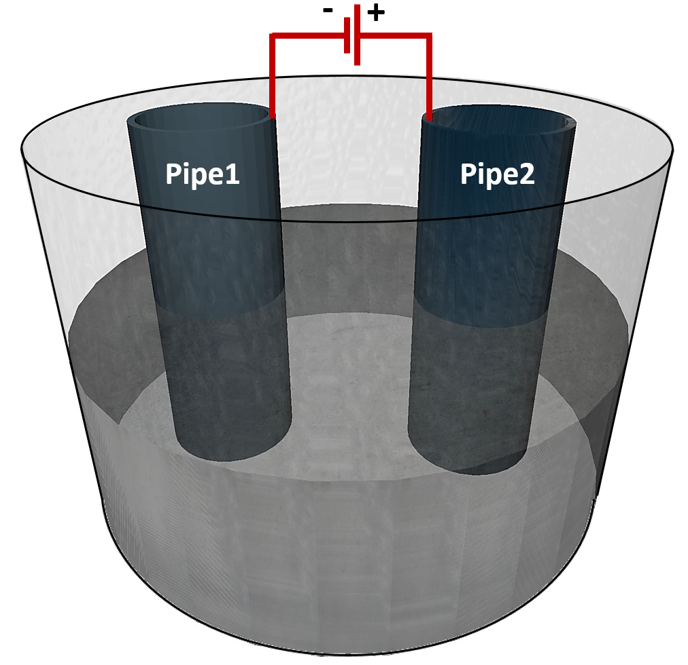
Low-hanging fruits: Save rig time
Save time on pipe cut & pull
Log through multiple steel tubulars
Physics: material/fluid impact on signals
Eliminate human log interpretation
→ machine learning
Explosives
Vibration
Temperature
Erosion
Corrosion
casing
Trans-mitter
ANNULUS
Lab study of signals
Slow signal in mud
Cooling by gas expansion can be used to fracture cement/rock.
Pipes corrode at +
Even stainless steel can be readily removed
Receivers
Fast signal along casing
A. Lavrov et al. (2016), AIMS Materials Science 3(3): 1199-1207.
J. Todorovic et al. (2016), Soc. of Petr. Eng., SPE 180052-MS

Slide 8
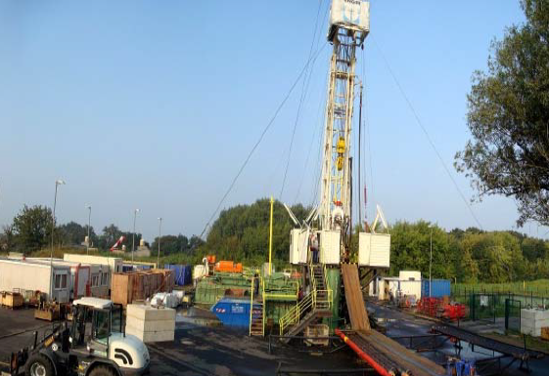
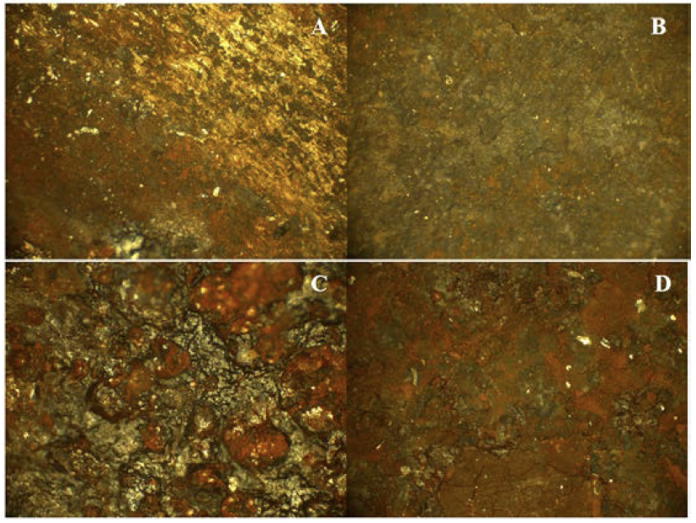
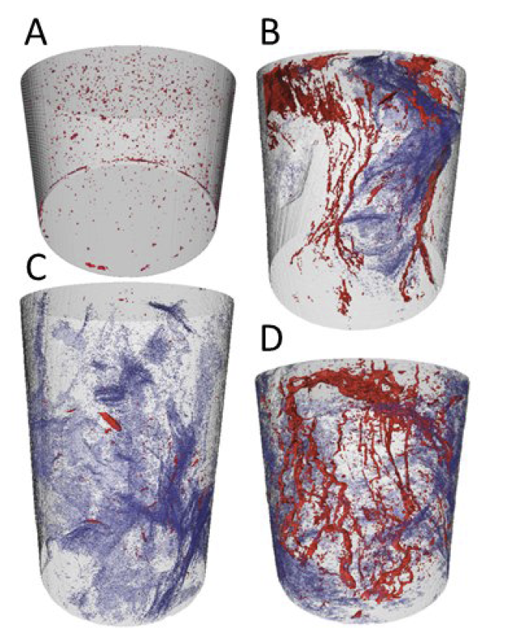
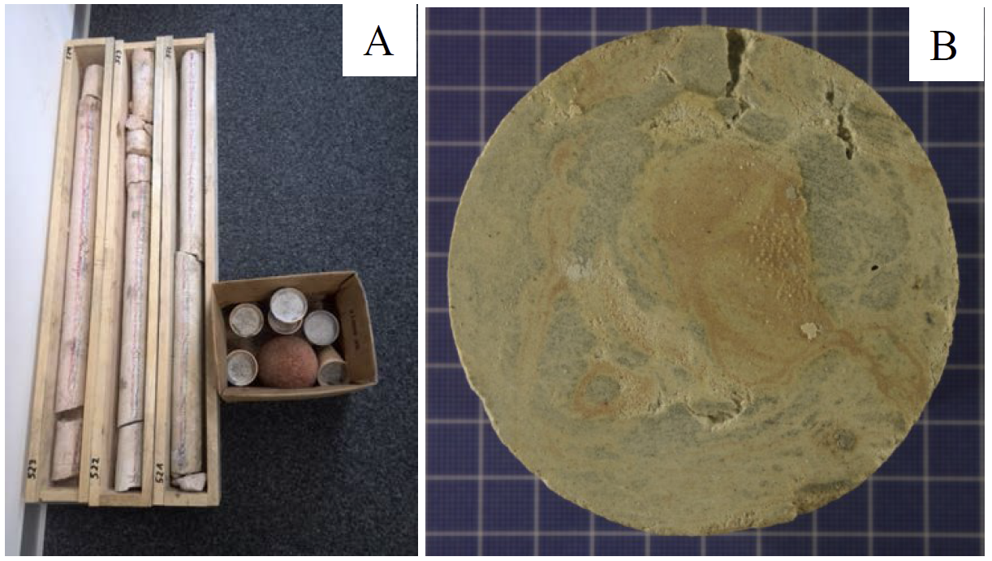
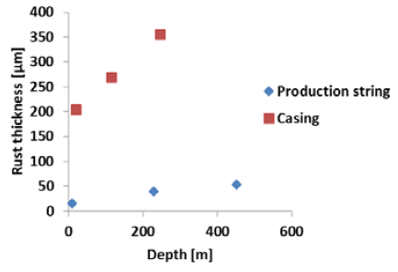
Well integrity: Material choice & placement
CO₂-injection in the period 2009-2013
Cement from well plug placed in 2013, cored in 2015
Microscopy study of pipes
Reference
521 m
Inside tubing
Outside tubing
Inside casing
Outside casing
tubing
casing
522 m
523 m
Pores
Contamination
Cement
K.Gawel et al., Study of materials retrieved from a Ketzin CO₂ monitoring well, Energy Procedia (2017)

Slide 9
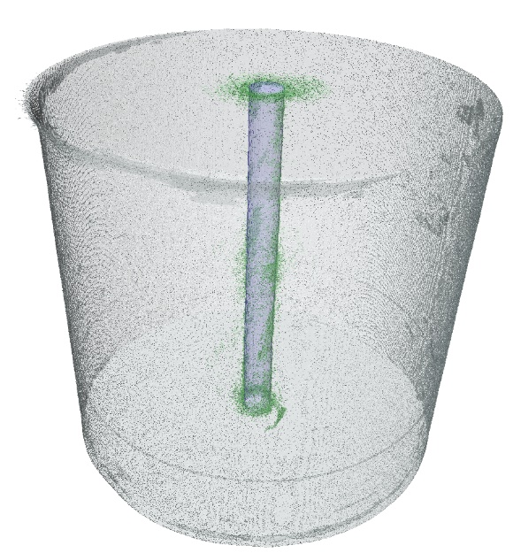
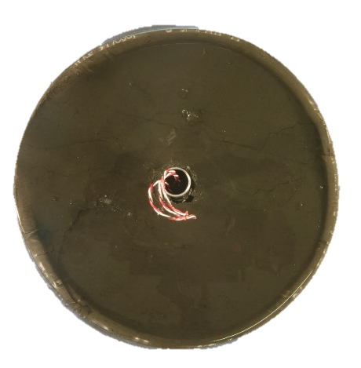
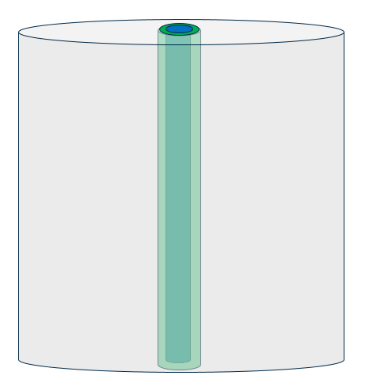
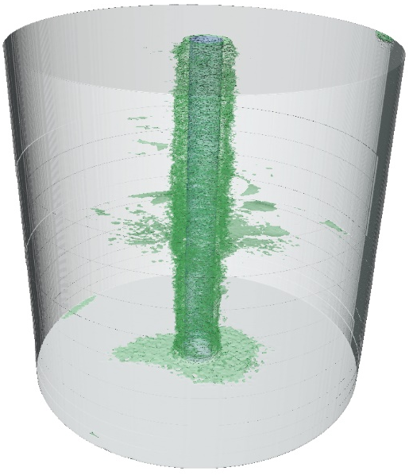
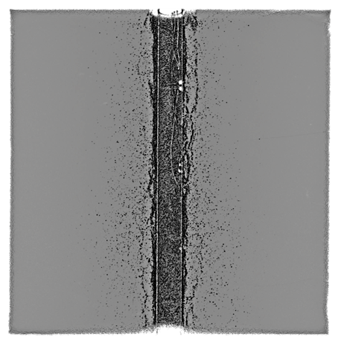
Nature's solution: shale as a barrier
Pores/cracks
Steel pipe
How can we plan to use shale as a barrier?
Can we facilitate shale creep/swelling?
Intact shale
Cylindrical shale sample creeping towards pipe
Good barrier!
Selected field shale
permeability
pressure
Poor barrier!
"Field proven" to last for a long time!
Outcrop shale
E. Fjær et al. (2016), How creeping shale may form a sealing barrier around a well, Am. Rock Mech. Assoc., ARMA 16-482.

Slide 10
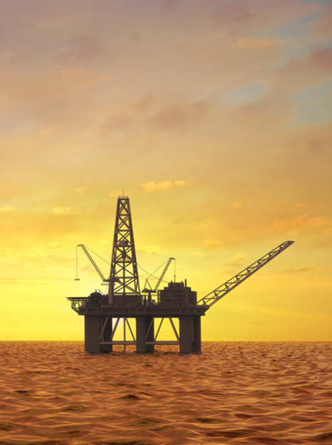
Way ahead
Thank you for your attention!
Norway is aiming high when it comes to well plugging & abandonment, both on the regulatory side and on R&D
A new plugging industry is foreseen
Global and long-lasting
We see a large potential for export of technology and services
Plugging the ~3000 wells in Norway will take 40 years
+/- 5000 wells to plug in UK North Sea
More than 1.8 million wells to plug globally

