Slide 1
Sensitivity studies of polymer injection applied to Ainsa Quarry1 outcrop
A. Fourno, J. Zarate Rada, N. Dubos-Sallee, V. Gervais,
O. Lerat, P.N.J. Rasolofosaon

Slide 2
OUTLINE
Introduction
The Ainsa outcrop
Facies Model
Motivation
Injection / Production constraints
Ainsa Fractured Model
Other hypotheses
Unconsolidated model
Permeable model
Conclusions

Slide 3
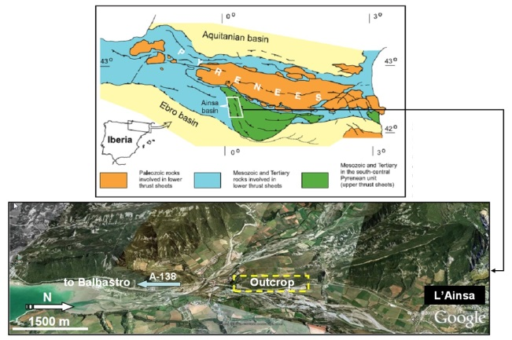
Ainsa Outcrop
Located in Spain (Southern Pyrenees)
Thickness 42m and Length 750m
Widely studied as a reference case for West Africa’s reservoirs

Slide 4
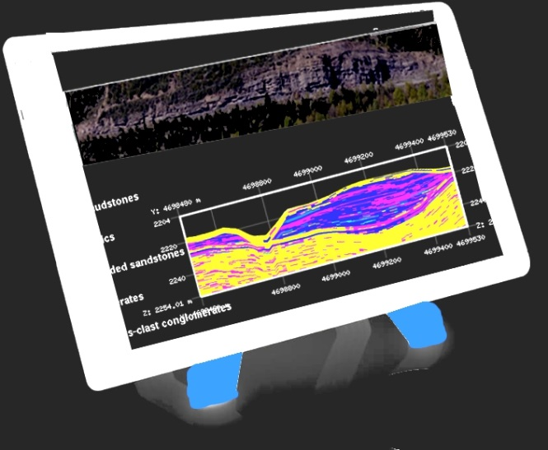
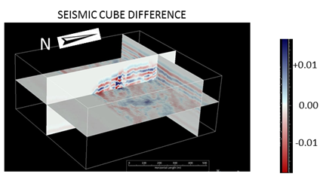
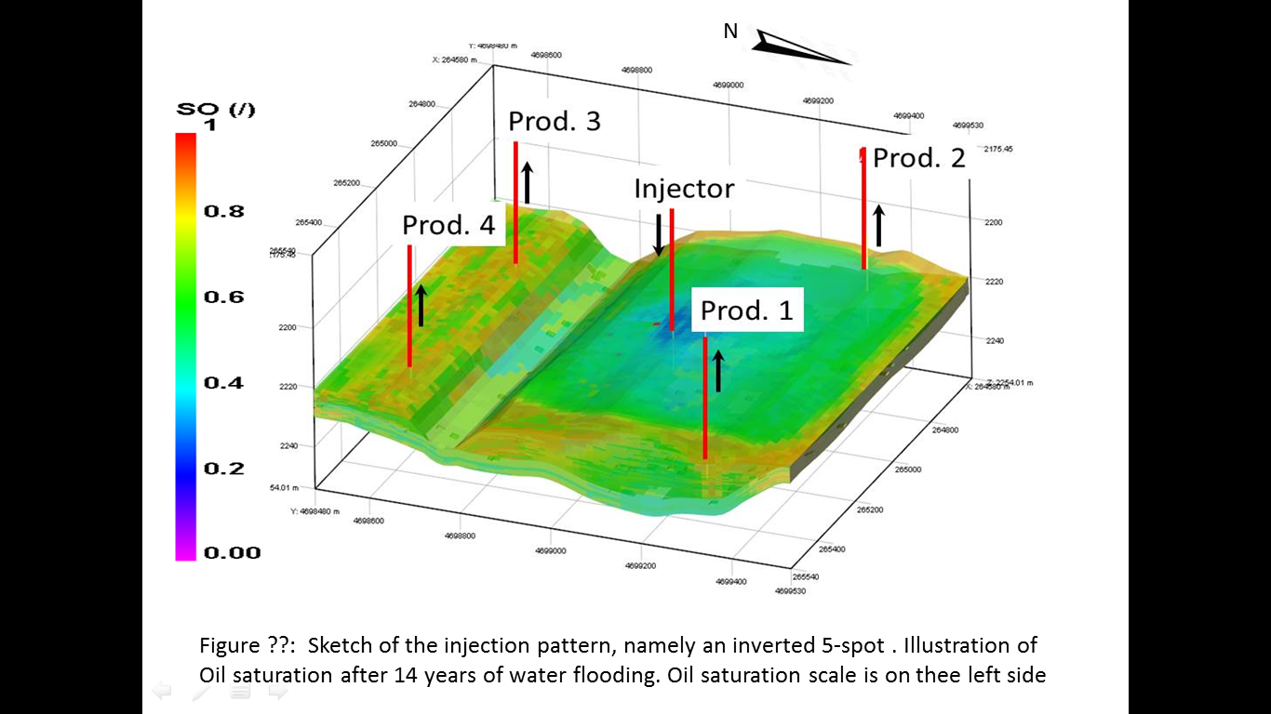
Ainsa Outcrop studies
Geologists
New learning
Geophysicists
Reservoir Engineers
https://www.smartanalog.fr/
http://www.ifp-school.com/jcms/r_23117/en/innovation-and-accomplishments

Slide 5
Facies Characterization
Geological model (Arbués et al., 2007)

Slide 6
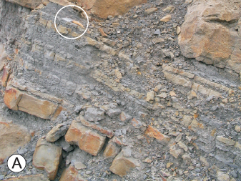
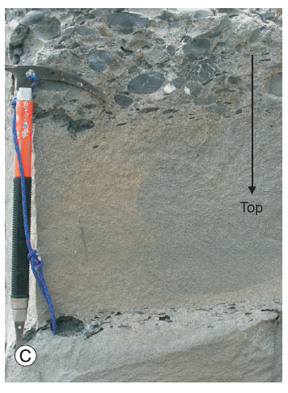
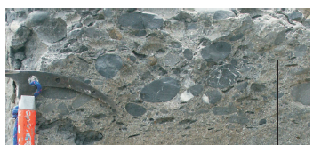
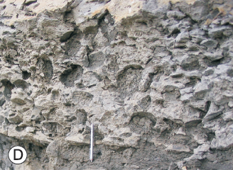
Geology and reservoir characteristics
Gravelly mudstones
Heterolithic packages and mudstone beds
Thick-bedded sandstones
Conglomerates
Mudstone-clastics conglomerates
From Arbués et al. 2007

Slide 7
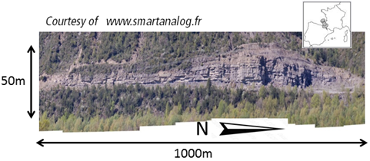
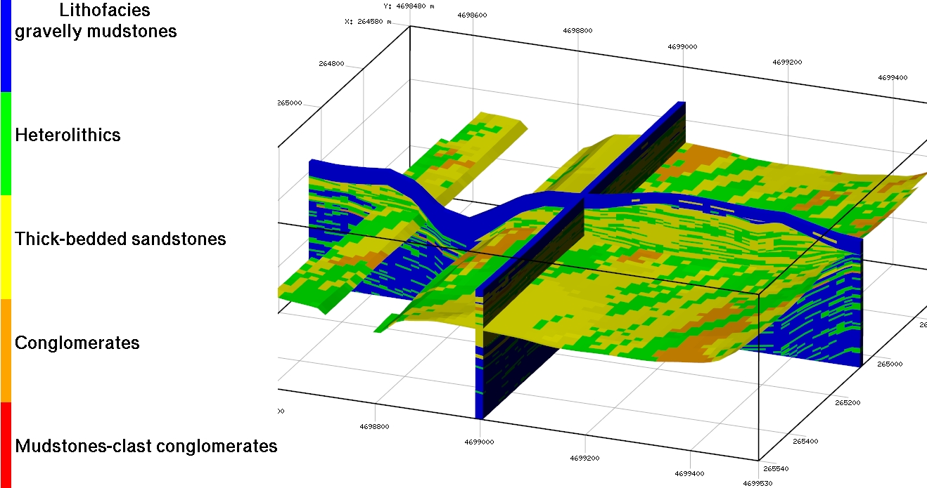
Ainsa outcrop: Facies MODEL
3D Reservoir Model
Jardin et al., 2010
O. Lerat, 2013
Model characteristics
64 cells in I (X length: 960 m)
70 cells in J (Y length: 1050 m)
145 cells in K (Z length: 50 m)

Slide 8
MOTIVATION
An outcrop is a visible exposure of bedrock or ancient superficial deposits on the surface of the Earth, [1]
→Gives information on facies distribution of a reservoir
→No information on petro-physical properties
Goal of this work: Evaluate/Understand polymer process impact considering realistic facies and permeability distributions
New learning
Reservoir Engineers
[1] Howell, J. V., 1960, Glossary of geology and related sciences. American Geological Institute, Washington, p. 207-208

Slide 9
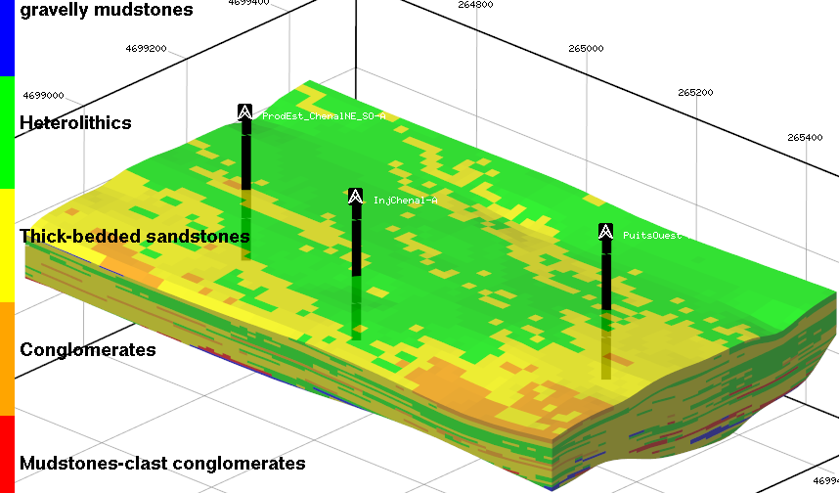
Water flood / polymer slug injection
Prod
Injector Well (INJ)
→Qmax = 600 m³/Day
→Pmax = 500Bar
If Pmax is achieved, injection is done
using a pressure control (Pmax fixed)
INJ
Prod
W 600m³/D
Water Flood scenario
04/14/16
04/14/30
W 600m³/D
W 600m³/D
Pol 1000 / 500 ppm
W 600m³/D
Polymer scenario
04/14/16
04/14/17
04/14/18
04/14/19
04/14/30

Slide 10
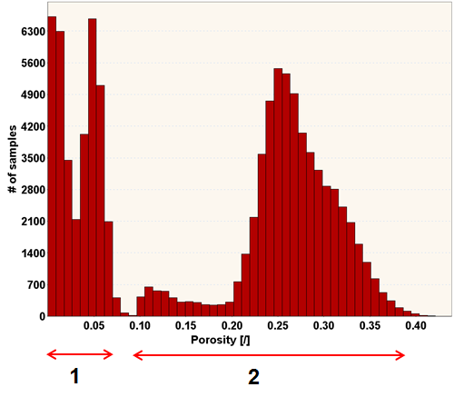
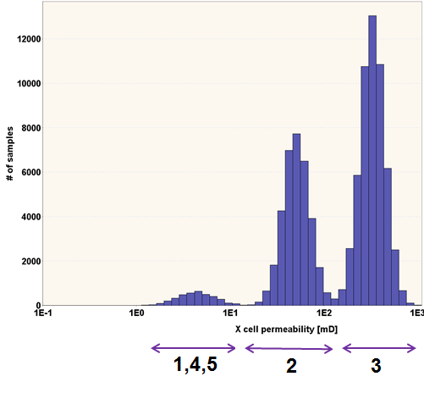
fractured model
Porosity
Gravelly mudstones (1)
Heterolithic packages
and mudstone beds (2)
Thick-bedded sandstones (3)
Mudstone-clastics conglomerates (4)
Conglomerates (5)
Permeability
1,4,5
2,3

Slide 11
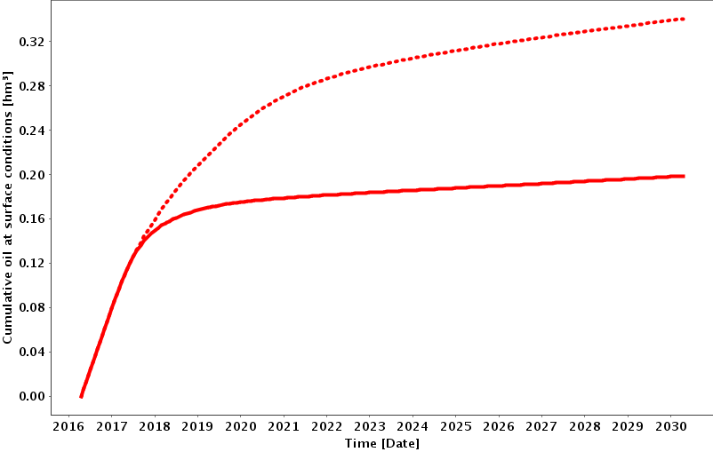
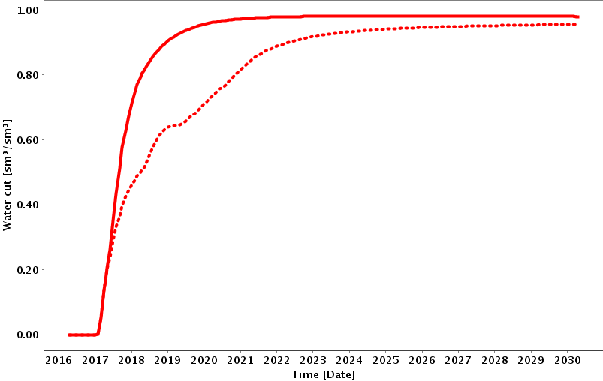
Fractured model: Water Flood / Polymer slug
Polymer scenario
Cumulated Oil curves:
→Polymer helps to better produce the reservoir
→For polymer scenario, oil production is still ongoing in 2030
→Whereas a few additional oil has been produced since 2019
for the water flood scenario.
88%
Cumulative oil (m³)
Water Flood scenario
Time (date)
Water Flood scenario
Water cut curves:
→Polymer helps to reduce the water production
Polymer scenario
Water cut (-)
Time (date)

Slide 12
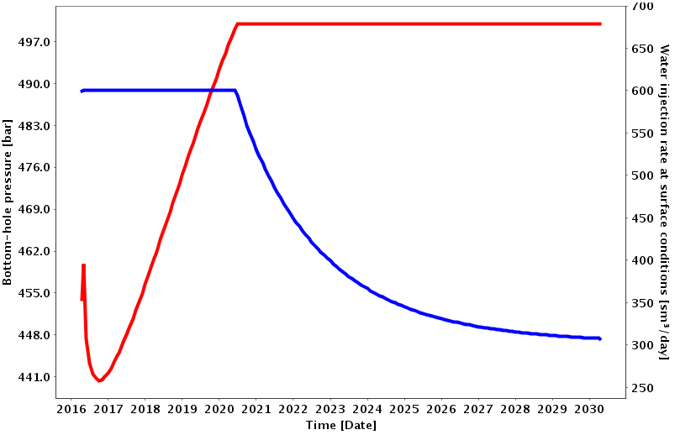
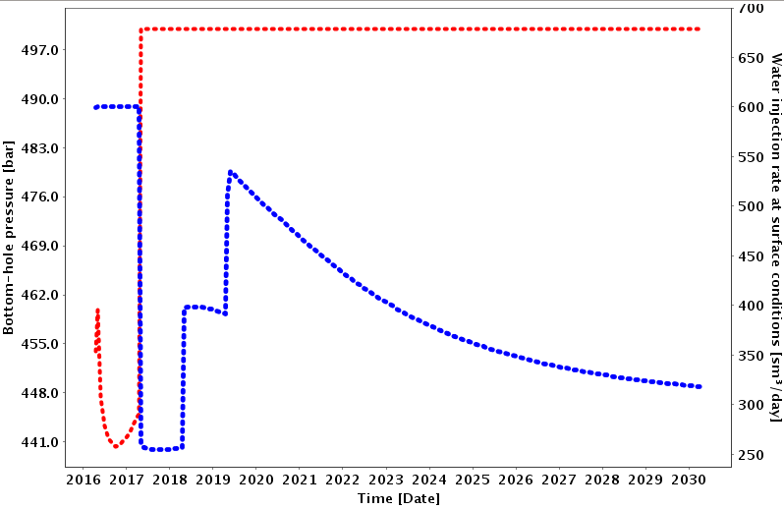
Fractured model: Polymer IMPACTS (from wells)
Water Flood scenario
Injector Pressure
Water Flood scenario:
→Early pressure decrease is due to producer well interferences
→Pmax is reached in 06/2020
→From this date, Injector well control evolved to a pressure control
→This induces a decrease of water injection rate
Bottom hole pressure (bar)
Water injection (m³/Day)
Injection Rate
Polymer scenario
Injector pressure
Polymer scenario:
→Early pressure decrease is due to producer interferences
→Pmax is reached as soon as polymer is injected.
→From polymer injection date (04/2017), injector well control evolved to a pressure control
→This induces a decrease of water injection rate
Bottom hole pressure (bar)
Water injection (m³/Day)
Injection Rate

Slide 13
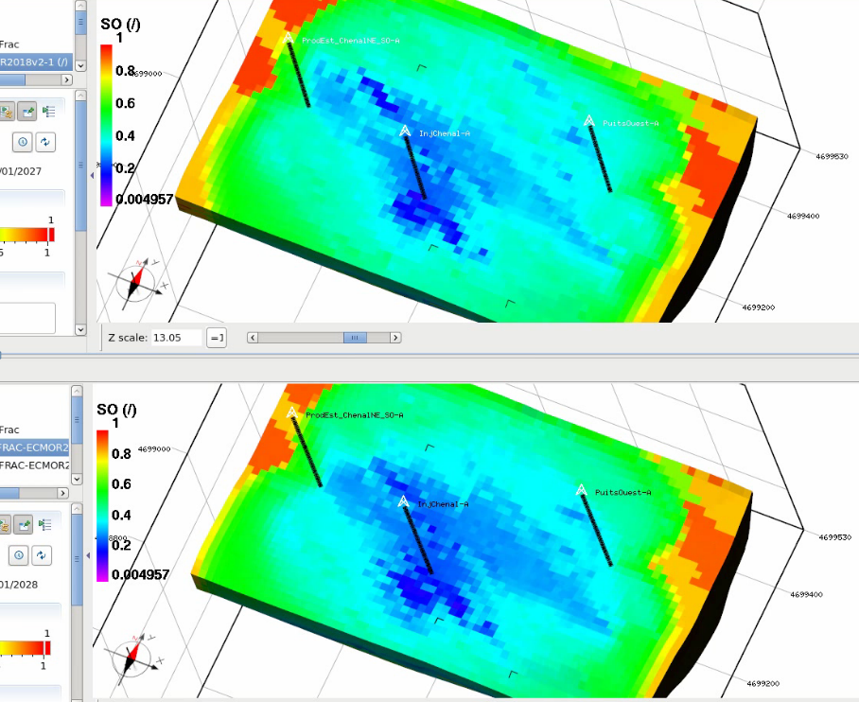
Fractured model: OIL SATURATION
Water Flood scenario
2026
W 600m³/D
04/14/16
04/14/30
Polymer scenario
2026
W 600m³/D
Pol 1000 / 500 ppm
W 600m³/D
04/14/16
04/14/17
04/14/18
04/14/19
04/14/30

Slide 14
Other hypotheses
What happens if fractured hypothesis is wrong
The outcrop data help to understand deposit facies distributions
but not the deposit porosity/permeability distributions
2 hypotheses are now considered :
→permeable reservoir (the reservoir is not a fractured reservoir)
→unconsolidated reservoir

Slide 15
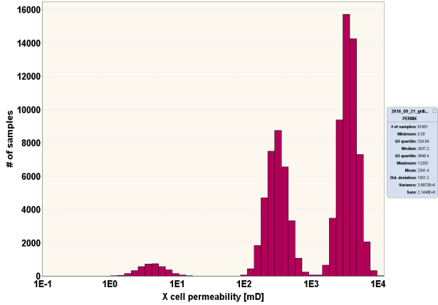
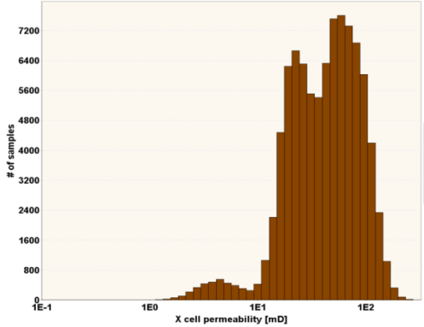
Other hypotheses
Unconsolidated reservoir permeability
Gravelly mudstones (1)
Heterolithic packages
and mudstone beds (2)
Thick-bedded sandstones (3)
Mudstone-clastics conglomerates (4)
Conglomerates (5)
2
3
Fractured reservoir permeability
1,4,5
Permeable reservoir permeability
2
3
1,4,5

Slide 16
UNCONSOLIDATED hypothesis
Unconsolidated reservoir permeability
Gravelly mudstones (1)
Heterolithic packages
and mudstone beds (2)
Thick-bedded sandstones (3)
Mudstone-clastics conglomerates (4)
Conglomerates (5)
2
3
Fractured reservoir permeability
1,4,5
Permeable reservoir permeability

Slide 17
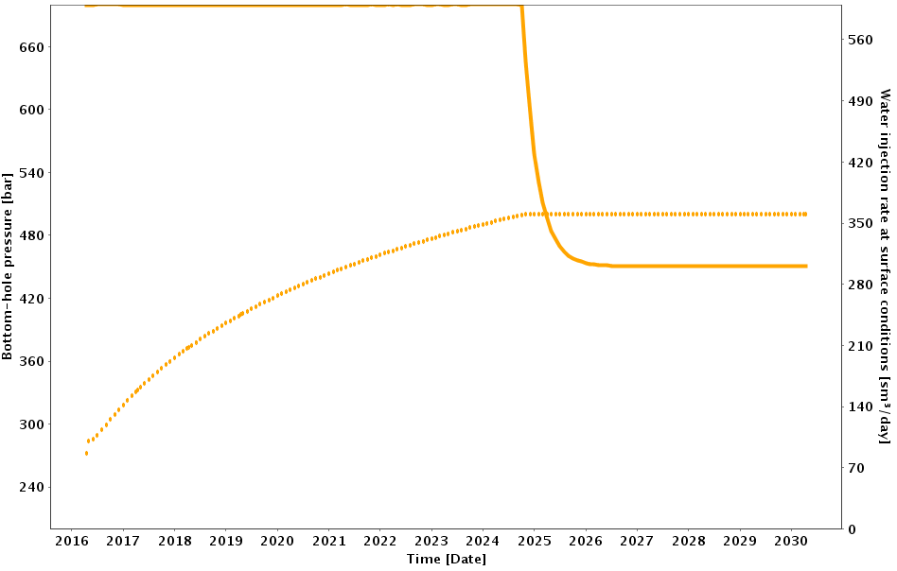
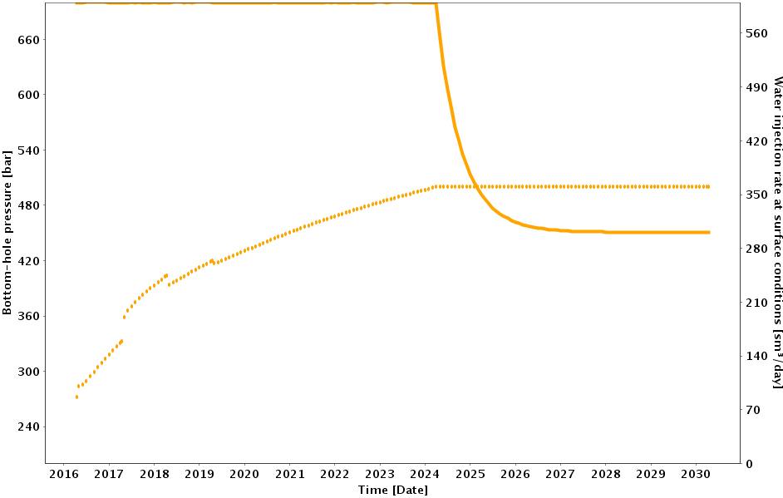
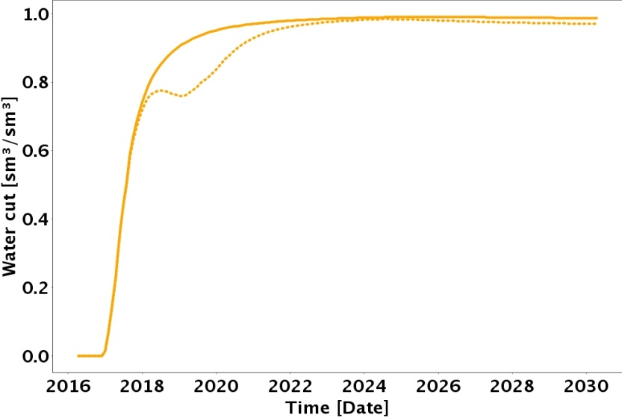
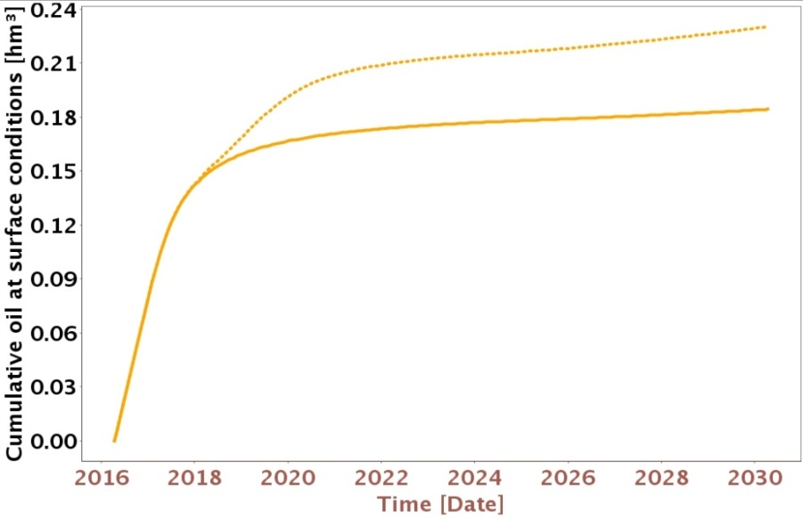
UNCONSOLIDATED hypothesis
As permeability is stronger polymer effect on Injector well is weak
→ This is a good news for well management
Bottom hole pressure (bar)
Water injection (m³/Day)
Bottom hole pressure (bar)
Water injection (m³/Day)
Water Flood scenario
Polymer scenario
Polymer is not so efficient to reduce water production
Nevertheless production increases of 22%
Water Flood scenario
Polymer scenario
Polymer scenario
22%
Water Flood scenario

Slide 18
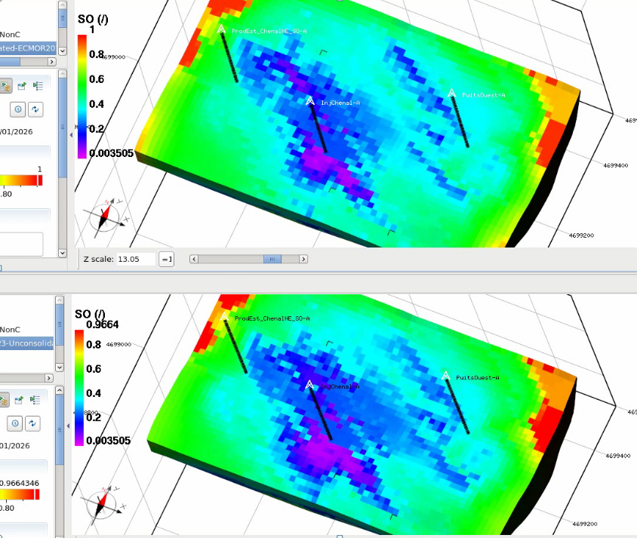
Unconsolidated hypothesis: OIL SATURATION
Water Flood
2026
W 600m³/D
04/14/16
04/14/30
Polymer Slug
2026
W 600m³/D
Pol 1000 / 500 ppm
W 600m³/D
04/14/16
04/14/17
04/14/18
04/14/19
04/14/30

Slide 19
Permeable hypothesis
Unconsolidated reservoir permeability
Gravelly mudstones (1)
Heterolithic packages
and mudstone beds (2)
Thick-bedded sandstones (3)
Mudstone-clastics conglomerates (4)
Conglomerates (5)
Fractured reservoir permeability
Permeable reservoir permeability
2
3
1,4,5

Slide 20
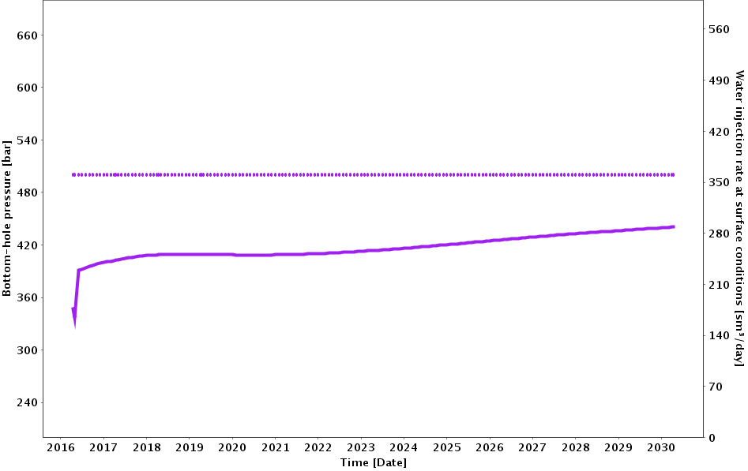
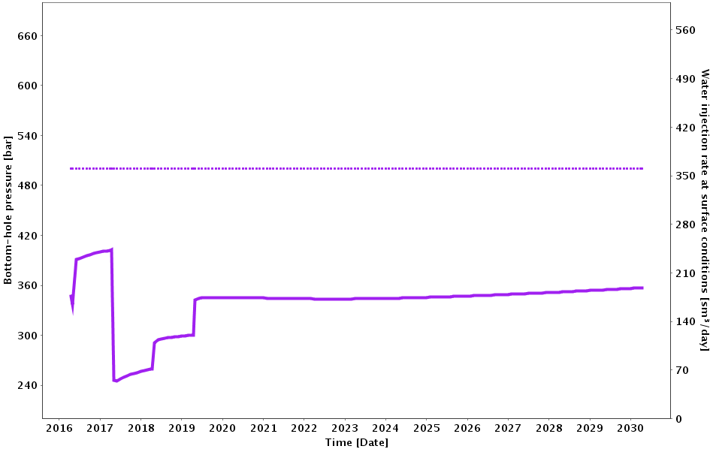
Permeable hypothesis
For both scenarios, Water injection is performed under a pressure constraint.
The use of polymer tends to strongly decrease the injection rate.
Water Flood scenario
Polymer scenario
Pmax = 500Bar
Pmax = 500Bar
Qinj~280 m3/Day
Qinj~200 m3/Day

Slide 21
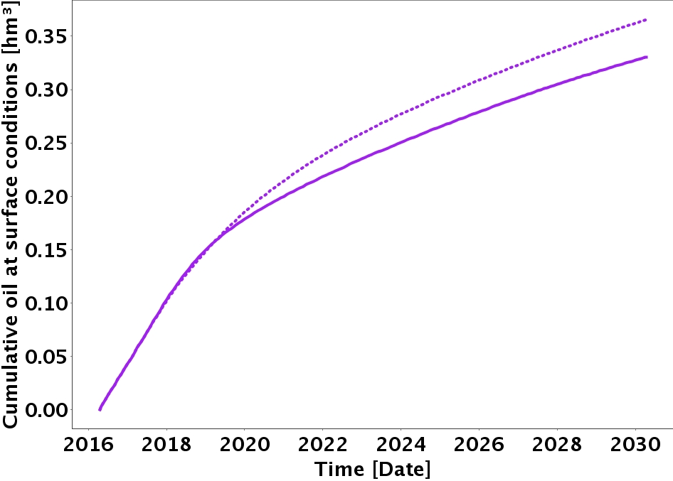
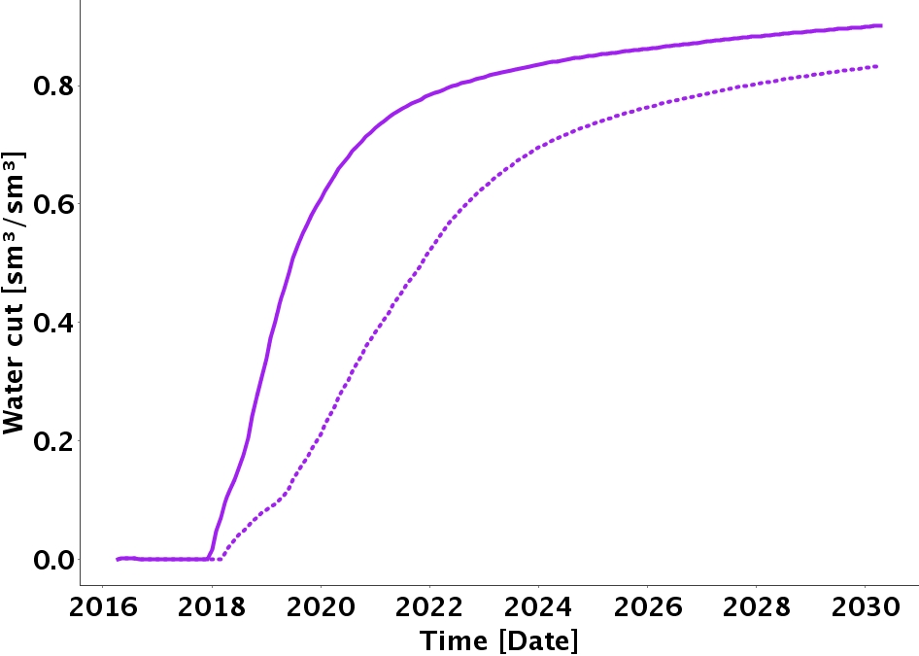
Permeable hypothesis
Polymer effect seems to be important considering the water cut :
→water production decreases
→a delay is observed to the water arrival time
Nevertheless, oil production slightly increases because :
→permeability is more homogeneous
→there is not a strong layering effect for both scenarios
Polymer scenario
Water Flood scenario
Polymer scenario
Water Flood scenario

Slide 22
Conclusions
As a result,
studied polymer is well adapted for fractured reservoir
Has a weak impact for permeable reservoir as this reservoir is more homogeneous
Obviously, polymer properties have to be chosen depending on :
permeabilities
heterogeneities
But not only :
→ Polymer has a strong impact on well management
Only reservoir simulations help :
To test facies properties hypothesis
To improve the polymer impact on production and well management

