Slide 1
In-situ visualization of microbial hydrogen consumption and growth in a porous medium using high-resolution PET-MRI
Institutt for fysikk og teknolog- Universitet i Bergen
Raymond Mushabe
(CSSR-UiB)
Bergit Brattekås, Na Liu, Geir Ersland, Nicole Dopffel
25th May 2023

Slide 2
Presentation outline
Hydrogen and porous media for the energy transition
Is it really possible to possible to utilise medical imaging methods for petrophysical studies?
Yes…
A scouting experiment with PET/MRI for in-situ saturation measurements
Bacteria studies relevant for underground hydrogen storage
PET-MRI general theory and methodology applied in porous media studies
Visualised results of biomass and hydrogen consumption in saline porous medium (sand)
MRI results (static)
PET results (dynamic)
Conclusions

Slide 3
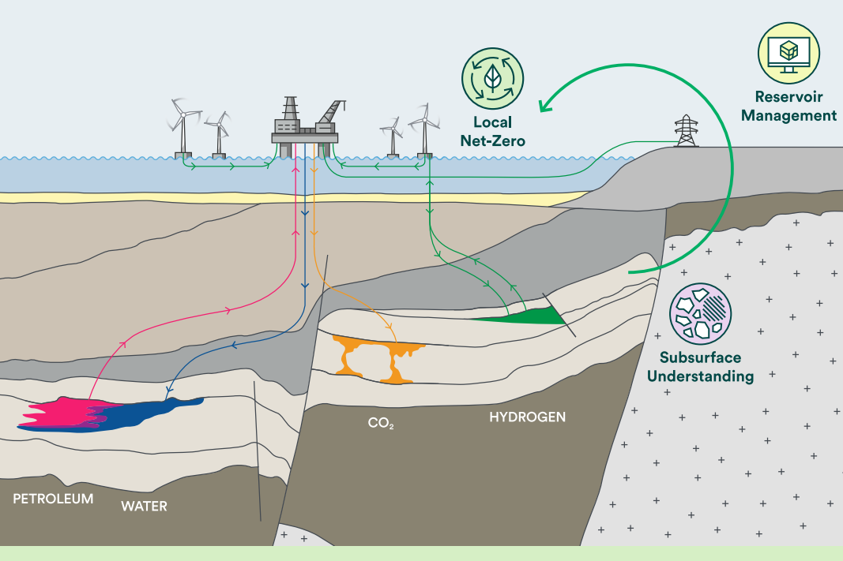
Porous media for energy transition
Why hydrogen storage in porous media?
Enormous volumes and well distributed worldwide – Not the sole reason.
Growing need to transition to renewable energy sources due to global warming and its adverse effects
Wind and solar power the leading sources for green energy – intermittent and unreliable supply
Hydrogen offers an alternative energy storage option – as an energy carrier
Hydrogen storage in aquifers and depleted hydrocarbon reservoirs
Contain large communities of microbes
Fig.1. Saline aquifers and depleted oil and gas reservoirs might be the most used underground storage sites because of their enormous volumes, wide availability, safety and existing infrastructure and technical know how. (CSSR focus on these two at the moment)

Slide 4
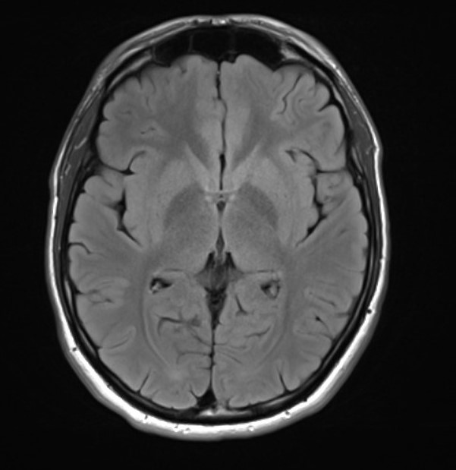
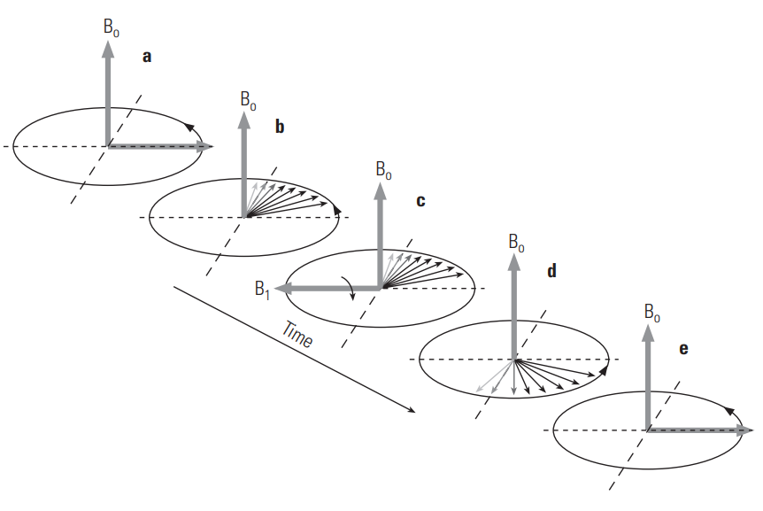
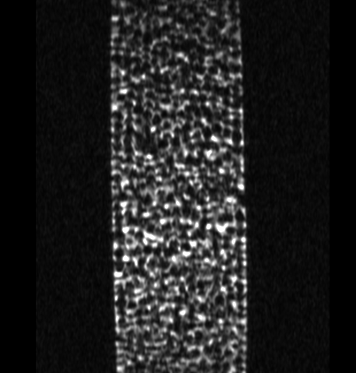
MRI PET functionality
Brain
MRI works based on proton spins that are dephased and realigned when introduced to a strong magnetic
T1 and T2 weighted images
a
PET is sensitive to positrons emitted by radioactive decay process of positron-emitting radionuclides
E.g. Fluorodeoxyglucose (18F-FDG) tracer
Recorded anhilation events for every pair captured positron of 511 keV travelling in opposite directions
Reconstructed statistical maps for the annihilation events, form which we can derive explicit measurements such as saturation
Rock grains
Water
b
Fig.2. b) brain image interviewFusion user manual
d) Brine saturated sand pack revealing water and sand grain regions (MRI images).
Fig.2.a. Illustration of MRI (a) and PET (b) working fundamentals. Ellis, D. V et.al (2007)

Slide 5
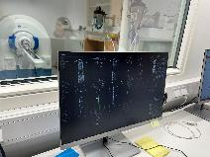
Experiment methodology
Sand pack | Value
Sandpack dimensions | 15 mm x 60 mm
Porosity | 45 %
Grain size | 0.5 mm
Bacteria srain | Oleidesulfovibrio alaskensis
MRI (Static)
Full sand pack image | 0.16 x 2.00 x 0.21 mm
Full sand pack | 0.12 x 0.6 x 0.23 mm
HR region specific | 0.07 x 0.6 x 0.07 mm
PET (Dynamic)
Tracer | 18F-FDG
Resolutions | 0.23 mm x 0.23 m x 0.23 m
c
b
Fig. 3. a) core and image resolutions. b) MRI and PET working space. c) Data receiving and reconstruction end.
a

Slide 6
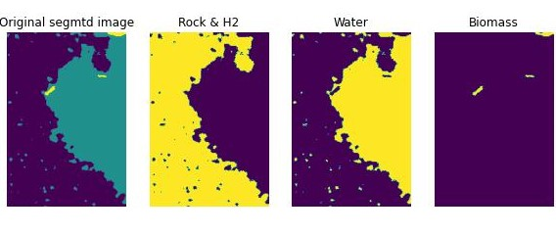
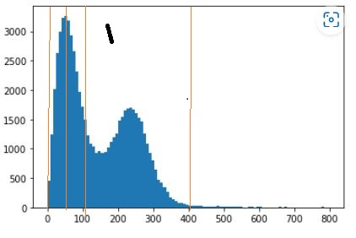
MRI results: Explicit phases
It was possible to identify and distinguish between phases through histogram analysis and thresholding of the pixel data
Hydrogen and rock as one signal
Water phase
Water component
Bacteria/biomass component
Noise or background signal
58%
40 %
2 %
Fig.4.a. Histogram distribution of signals from different components of the porous medium
Fig.4.b. Image segmentation based on histogram analysis of the pixel data. Bactreia growth after [ ] hours.

Slide 7
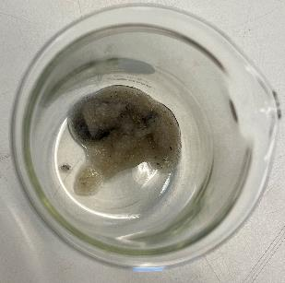
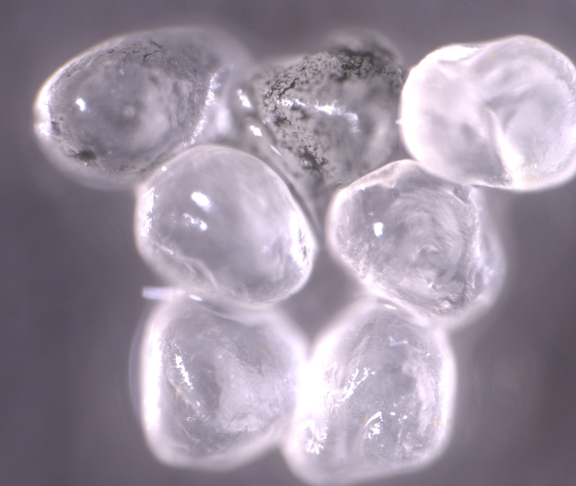
MRI results: Biomass accumulation
Biomass signal increased in area over time.
The initial signal
Section: 50 mm 12 mm x 0.23 mm
Biomass accumulation was also confirmed through microscopic analysis of the sand grains
0.2 hours
20.1 hours
30.1 hours
43.3 hours
c
0.5 mm
b
Fig.5.a. Biomass accumulation over time in the presence of hydrogen as the only source of food to the microbes. As shown in figures b) and c), the sand grain surfaces were later analysed under a high resolution Zeiss microscope for the biomass accumation. The dark regions is organic matter (biomass)

Slide 8
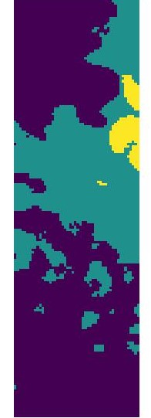
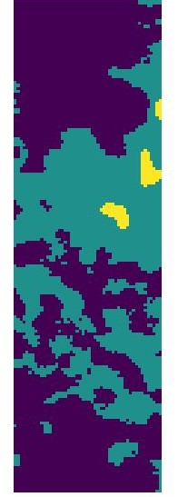
MRI results: Continuation…
Biomass signal increased in area over time.
This coincided with an equivalent reduction of the volume occupied by hydrogen
0.2 hours
1.1 hours
39.1 hours
Fig.6 Hydrogen consumption in the presence of active biomass accumulation (bacteria growth)

Slide 9
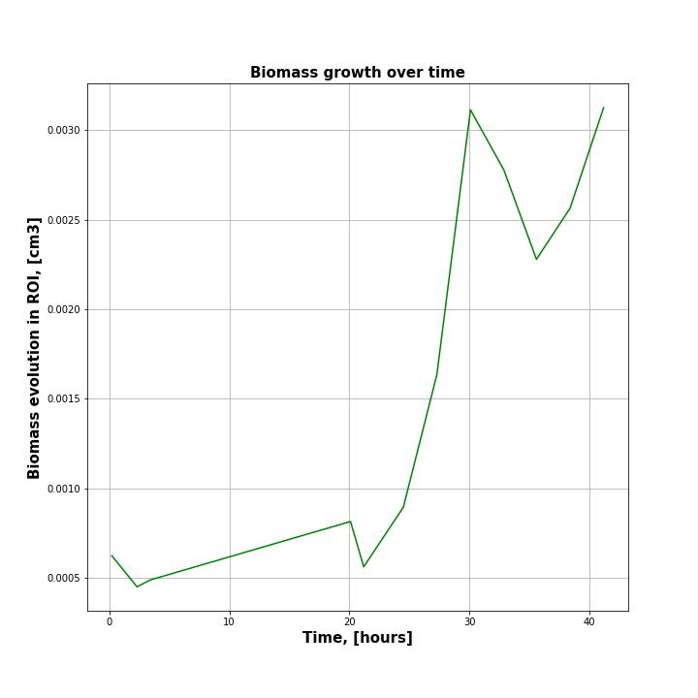
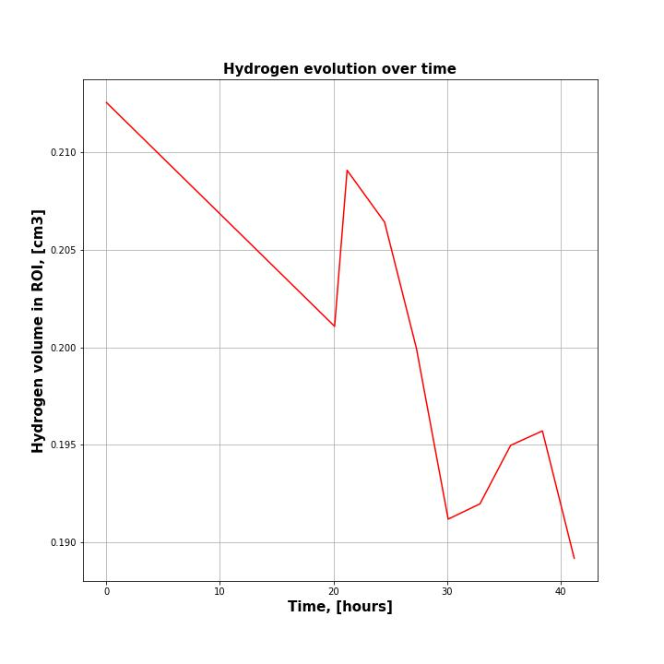
MRI results: Continuation…
Biomass signal increased in area over time.
This coincided with an equivalent reduction of the volume occupied by hydrogen
0.03%
-0.31 %
0.23%
Fig.7 Biomass accumulation (bacteria growth) conciding with reduction in hydrogen production

Slide 10
Biomass migration/redistribution
Over time, the biomass reduced in some areas of the core as it increased in others
This could be related to both localised food shortage or other physical parameters such as pH
It was at this stage that bacteria and biomass growth was confirmed in the sand pack saturated with 10% NaCl brine and hydrogen
PET image analysis investigated how this matter migration and growth affects fluid flow and distribution in

Slide 11
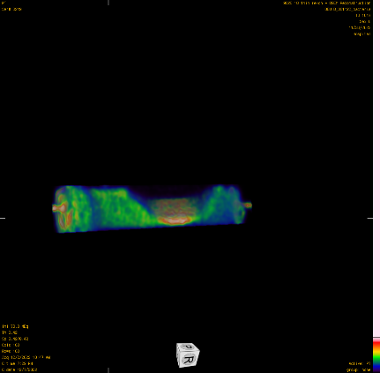
PET- Effect of biomass on fluid flow
Biomass accumulation and growth affected both fluid distribution and flow.
The PET signal (FDG-18) increased with time during flow around the bacteria saturated regions.
The accumulation of FDG-18 shows increase in water wittiness
Initial flow was piston like
30 min
Fig.8. 10 min 3D reconstruction of PET image slice at different times during flow. The orarange color coreesponds to the biomass occupied regions inside the sandpack.

Slide 12
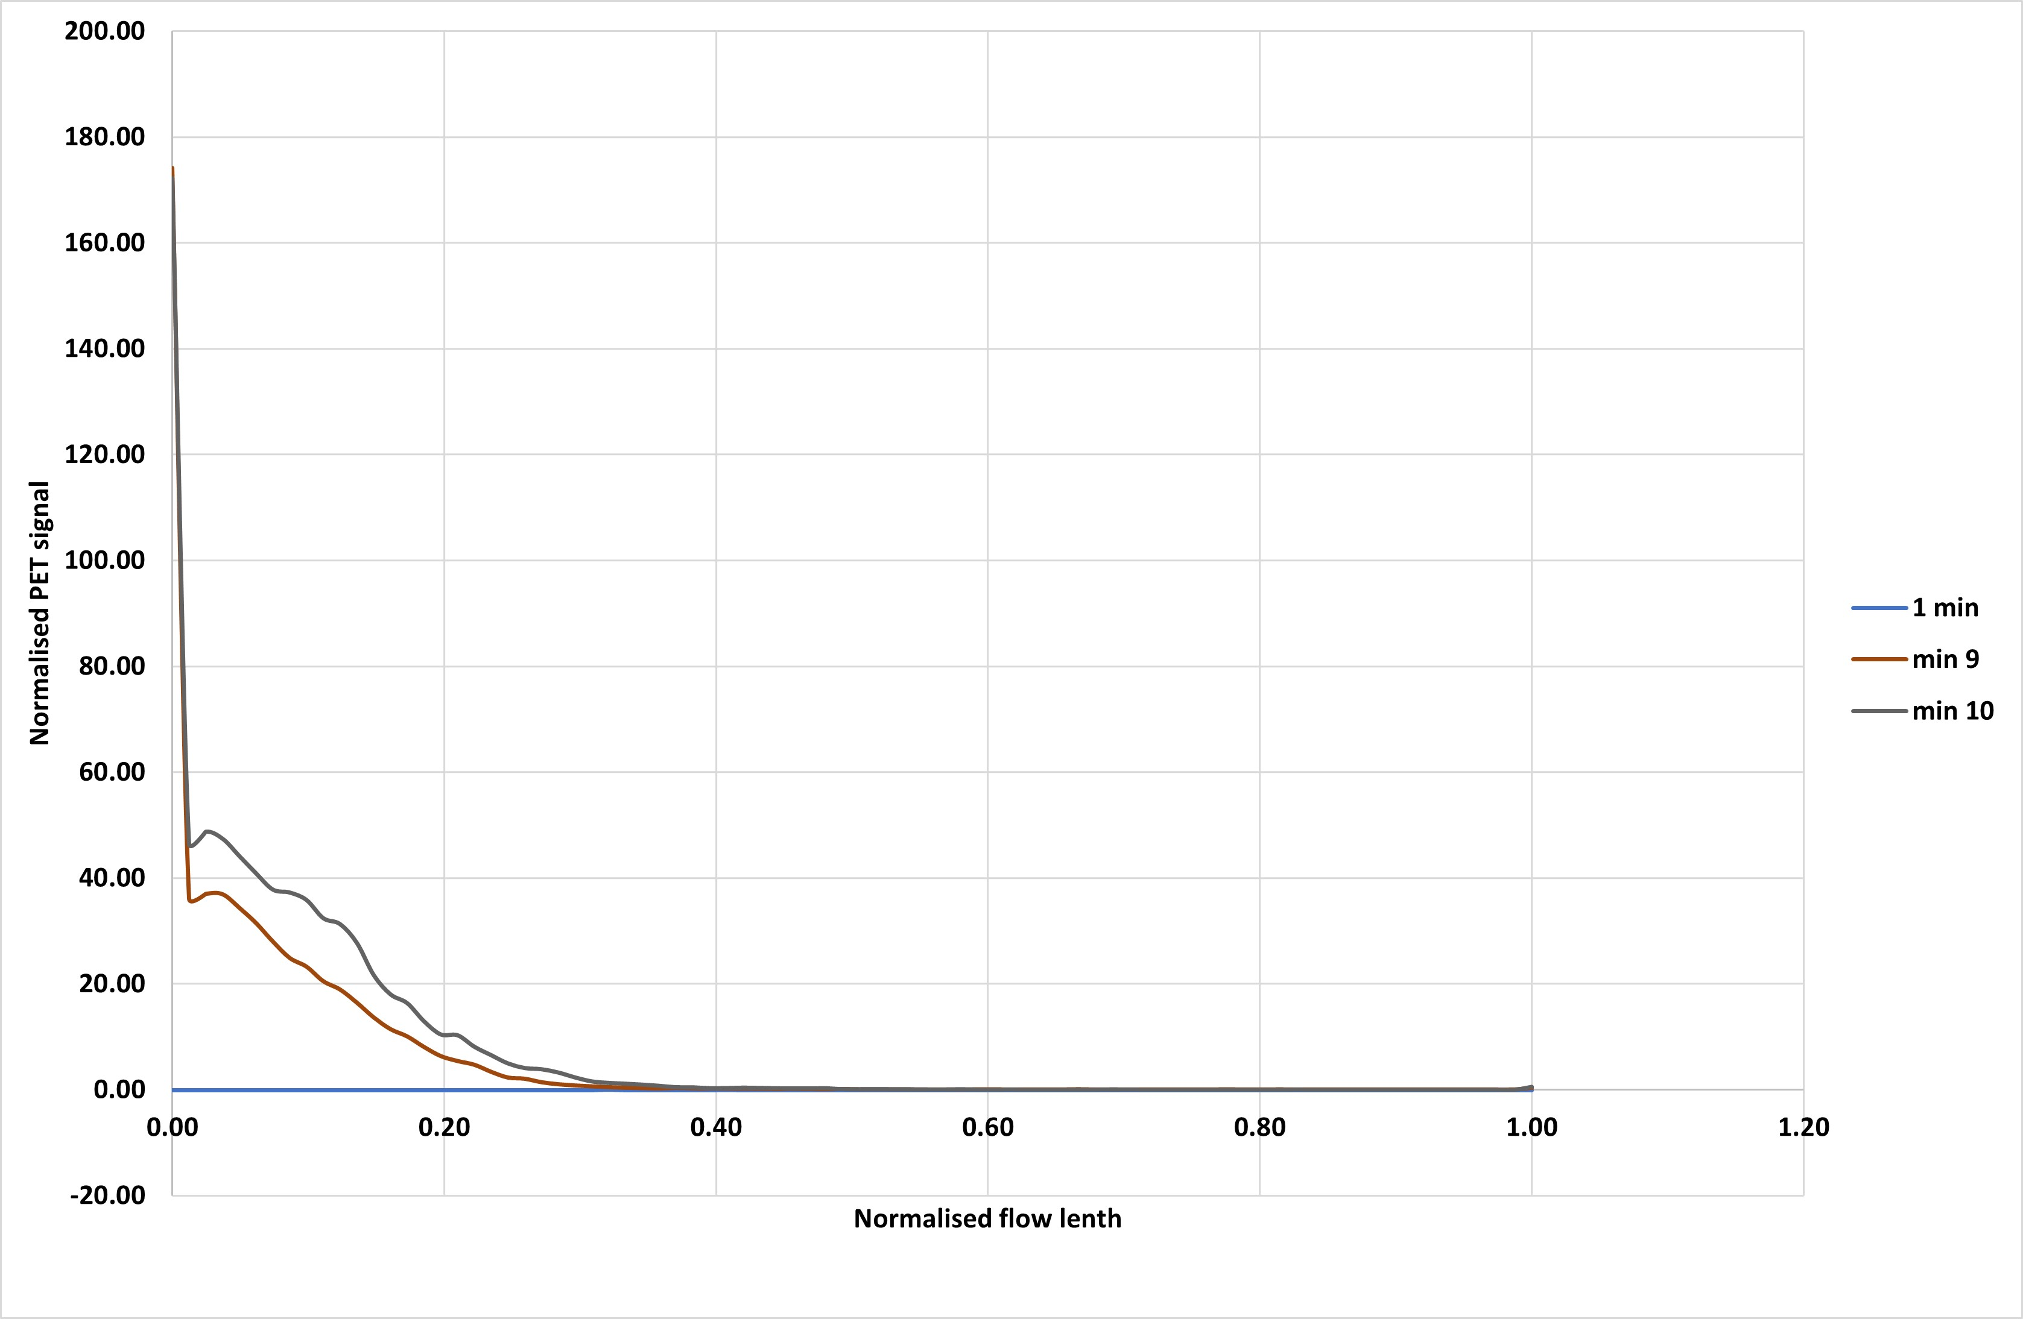
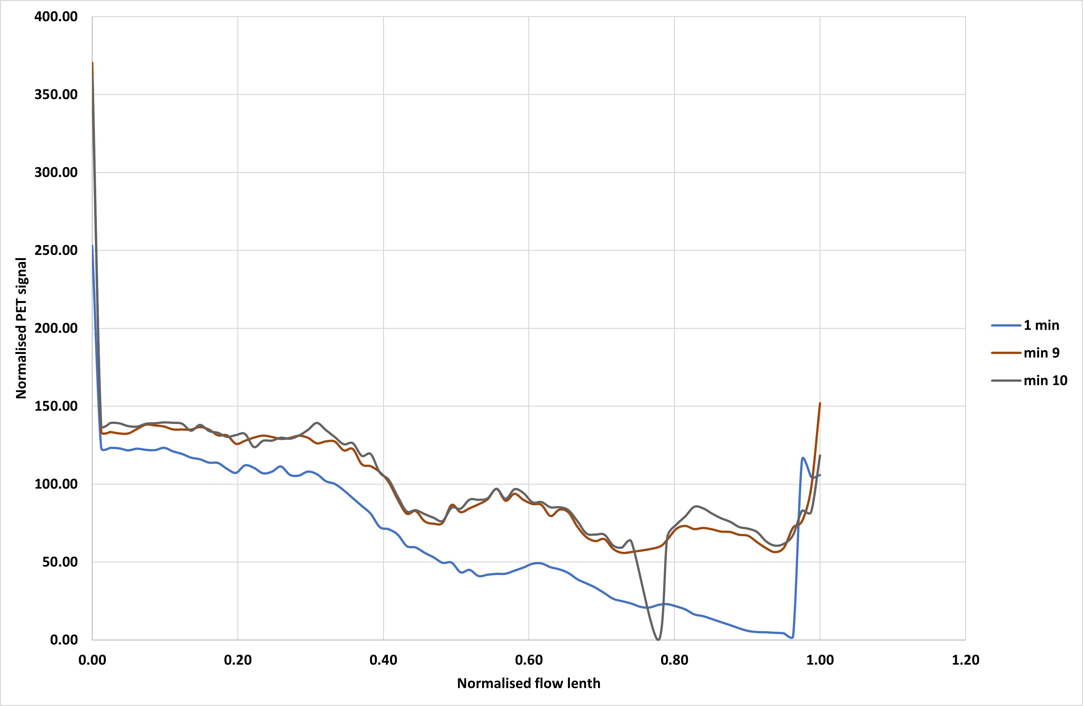
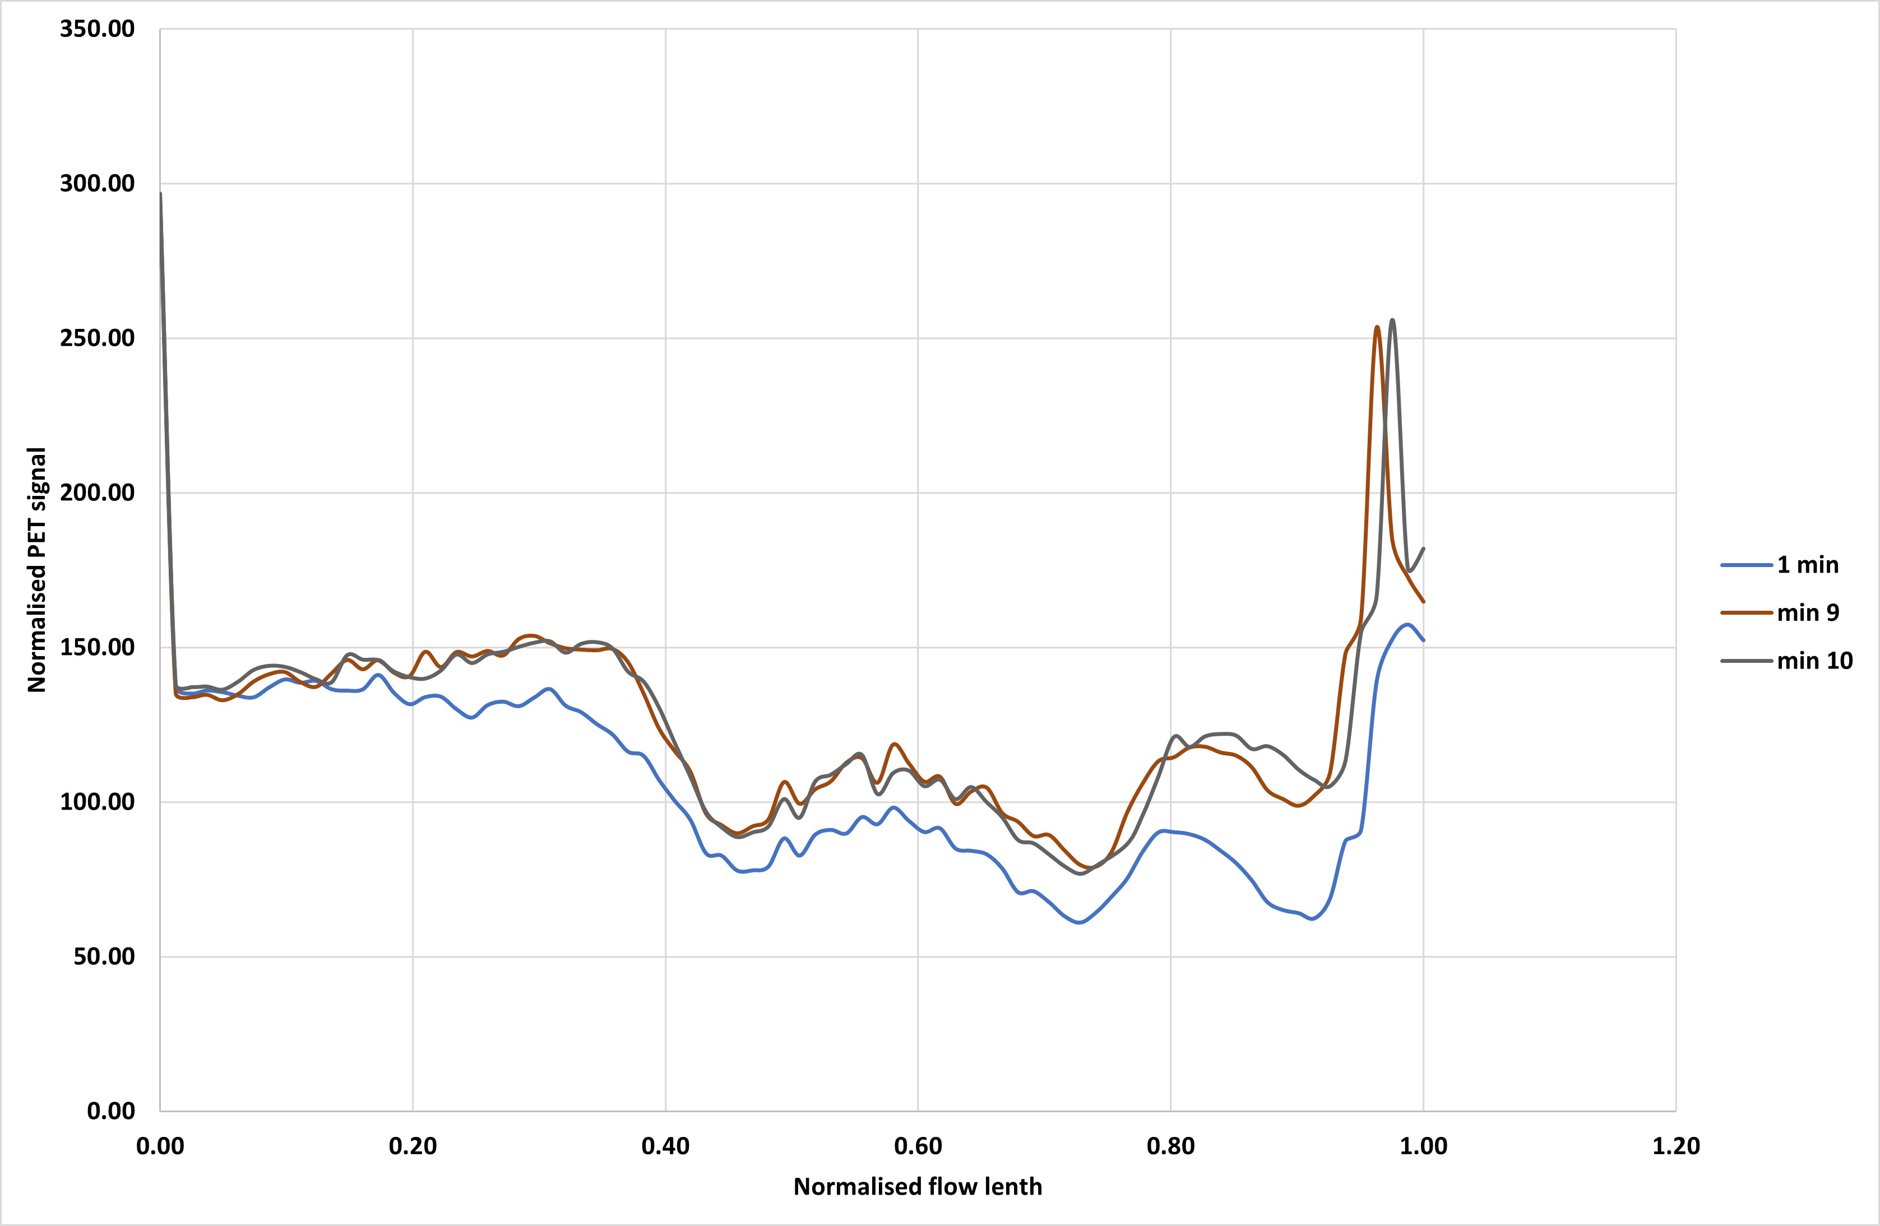
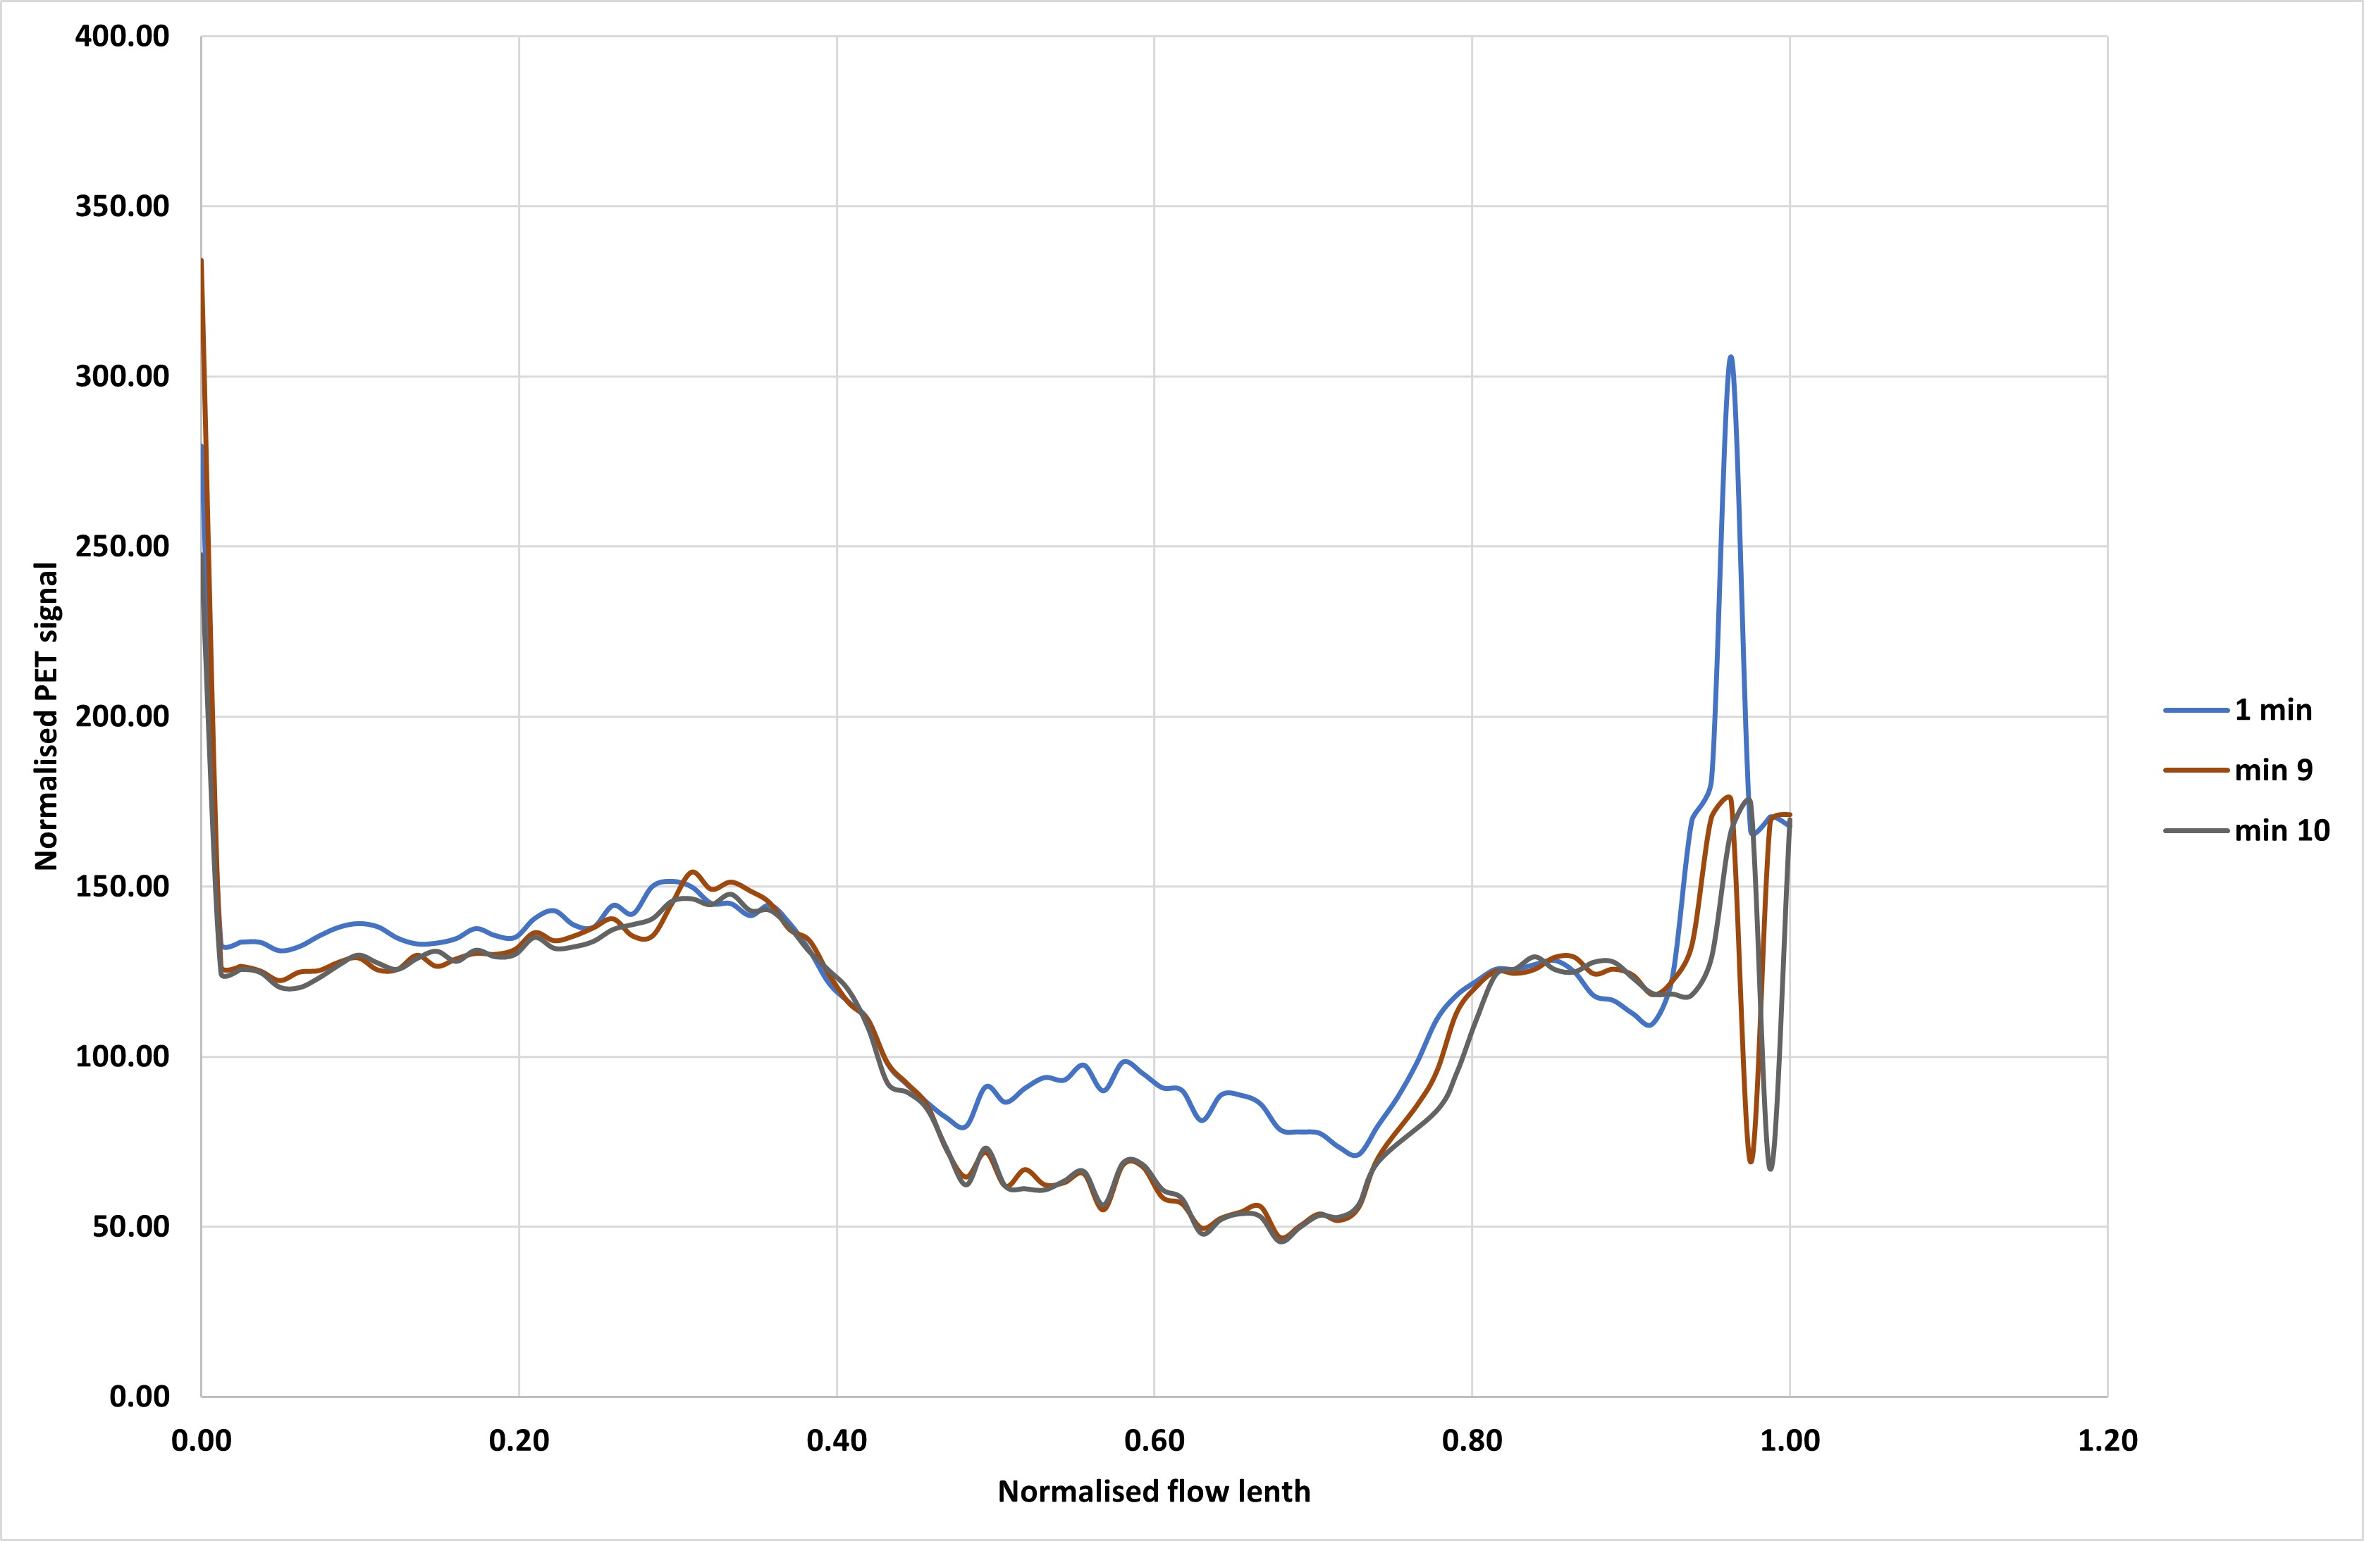
PET- Tracer absorption/accumulation
0 min
30 min
Fig. 9. Different regions of interest showing increasing tracer accumulation over time from a-b. In figure c, the accumulated tracer is eventually flushed out
a
c
40 min
50 min
b
d

Slide 13
Preliminary conclusion
Possible to visualise biomass and quantify phases with a PET/MRI combination
Observed biomass with high resolution MRI at different spatial resolutions – bacteria stain Oleidesulfovibrio alaskensis
General distribution of bacteria, water, hydrogen in a clean sand pack
Bacteria growth and accumulation
Bacteria migration over time
Fluid flow behaviour controlled by bacteria and hydrogen presence in the porous media. Rel perm and Pc measurements need to consider this when effect in future experiments
Bacteria seem to affect the wetting state in the presence of hydrogen and water
Relative residual hydrogen saturation

Slide 14
Last page
Department of Physics and Technology-University of Bergen
_____END____

