Slide 1
Multiscale Extended Finite Element Method for the Simulation of Contact – Frictional Behaviors of Fractures Under Compression
Fanxiang Xu
Hadi Hajibeygi
Bert Sluys
Delft University of Technology
May 25, 2023

Slide 2
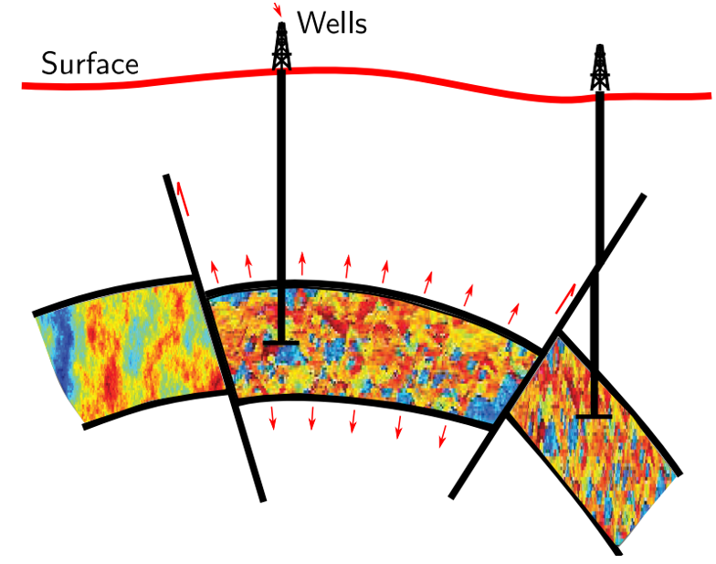
Simulation of Deformable Fractured Formation
Reservoirs are highly & densely fractured
Geo-mechanics is important on a bigger domain than reservoir itself
Fractures can slide & grow
Accurate & Efficient simulations are crucial !
$$[1]$$
[1]. Hajibeygi, H. (2021). Multiscale lecture notes.

Slide 3
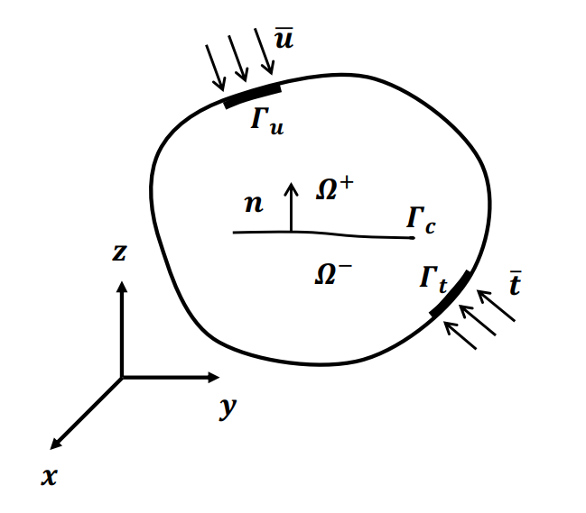
Governing Equations
Momentum balance (LEFM)
$∇∙σ+f=0$ on $Ω$
$σ∙\vec{n}=f_{c}$ on $Γ_{c}$
Contact – frictional law
No penetration
$g_{N}≥0$, $f_{c}≤0$, $g_{N}∙{ f}_{c}=0$
Coulomb’s law of friction
$$\left\|f_{cT}\right\|−μ_{f}\left\|f_{cN}\right\|\left\{\begin{matrix}=0 & slip \\ <0 & stick\end{matrix}\right.$$

Slide 4
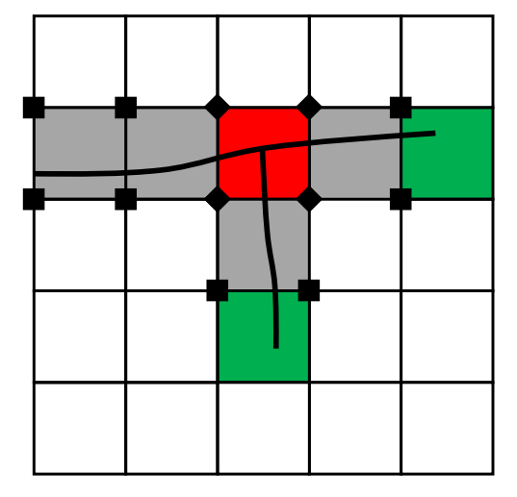
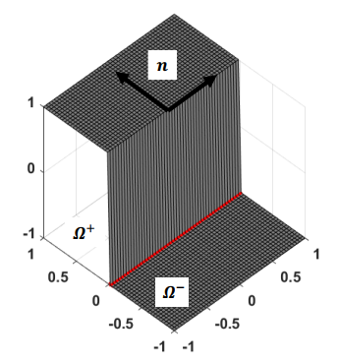
XFEM
Efficient in simulation of fractures
Structured grids
Extra DOFs in solution^{[1]}
$$u=\underset{standard FEM}{\underbrace{\sum_{i∈I}{u_{i}}N_{i}}}+ \underset{enrichment}{\underbrace{\sum_{j∈J}{a_{j}}N_{j}S\left(x\right)}}$$
Additional blocks
$$\left[\begin{matrix}K_{uu} & K_{ua} \\ K_{au} & K_{aa}\end{matrix}\right]\left[\begin{matrix}u \\ a\end{matrix}\right]=\left[\begin{matrix}f_{u} \\ f_{a}\end{matrix}\right]$$
[1]. Moës, N. et al. (1999). A finite element method for crack growth without remeshing.

Slide 5
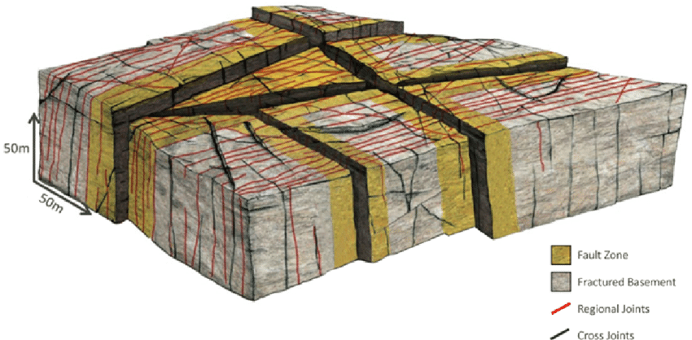
Compression + XFEM
Penalty method^{[1]} (Artificial high stiffness)
$${\left[\begin{matrix}K_{uu} & K_{ua} \\ K_{au} & K_{aa}+K_{con}\end{matrix}\right]}^{v}{\left[\begin{matrix}∆u \\ ∆a\end{matrix}\right]}^{v+1}={\left[\begin{matrix}f_{ext}^{u}−f_{int}^{u} \\ f_{ext}^{a}−f_{int}^{a}−f_{con}^{a}\end{matrix}\right]}^{v}$$
Too many extra DOFs for geoscience applications !
We propose multiscale XFEM (MS-XFEM)
$$[2]$$
[1]. Liu, F. et al.(2008). A contact algorithm for frictional crack propagation with the extended finite element method.
[2]. Bonter, D. et al. (2019). An integrated approach for fractured basement characterization: the Lancaster Field, a case study in the UK.

Slide 6
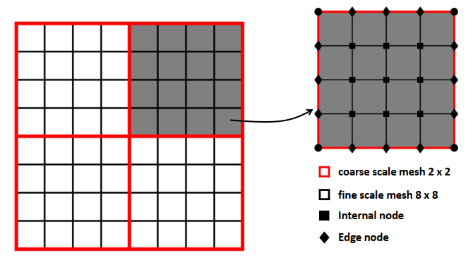
MS-XFEM
Solve the problem on the coarse scale mesh
Prolongation (Interpolate coarse scale solutions into fine scale)
$u^{f}=P∙u^{C}$
$P$ -- basis function matrix
$u^{C}$ -- coarse-scale solution
$u^{f}$ -- fine scale solution

Slide 7
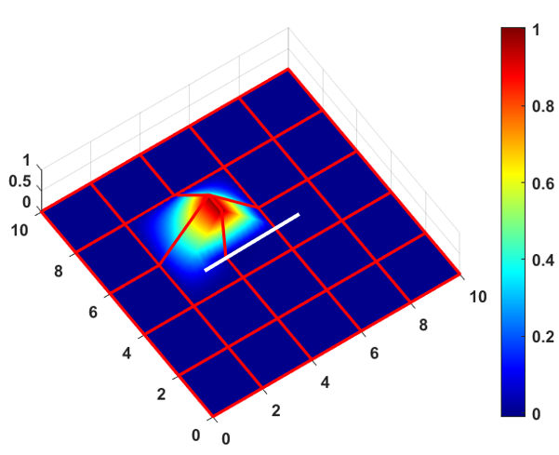
MS-XFEM
Compute on coarse scale mesh
$$u^{c}=P \underset{K_{c}^{−1}}{\underbrace{ {(R K_{f} P)}^{−1} }}∙\underset{f_{c}}{\underbrace{ (R∙f)}}$$
Restriction matrix $R=P^{T}$
No extra DOFs on coarse scale system
[1]. Xu, F. et al.(2021). Multiscale extended finite element method for deformable fractured porous media.

Slide 8
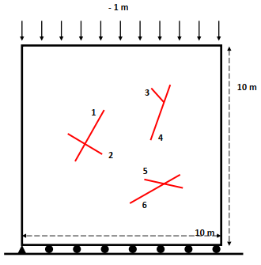
Test Case
Multiple cracks under compression
FS mesh: 50 x 50, MS mesh: 5 x 5
$E={10}^{6} Pa$ and $ν=0.3$
Frictional coefficient $μ_{f}=0.1$
Penalty parameters $[{10}^{8},{10}^{8}]$
Tolerance for residual: ${10}^{−8}$
Tolerance for displacement: ${10}^{−3}$
Tolerance for preconditioned GMRES: ${10}^{−2}$

Slide 9
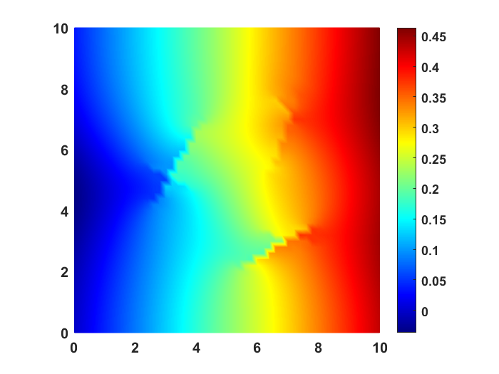
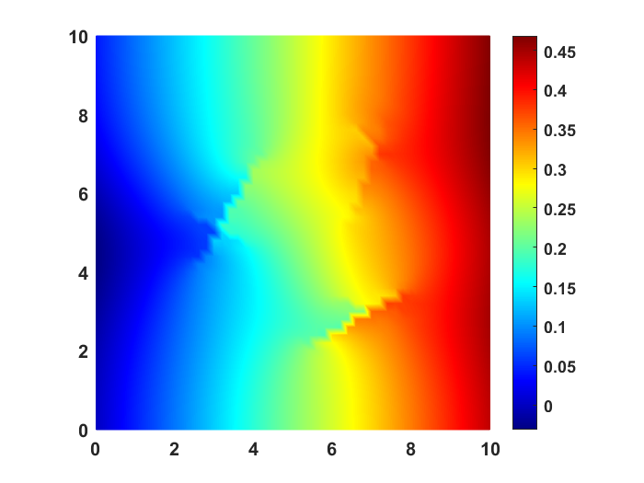
Test Case
MS-XFEM result is accurate
$d_{x}$ of fine scale ( 50 x 50 )
$d_{x}$ of MS-XFEM ( 5 x 5 )

Slide 10
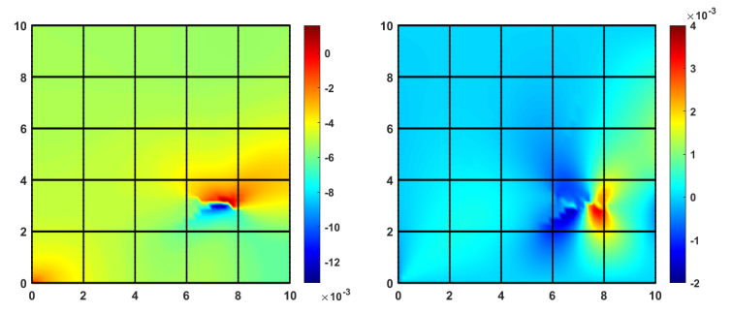
Test Case
MS-XFEM combined with GMRES can reduce errors greatly
Error plots show local peaks
Errors in x direction
Errors in y direction

Slide 11
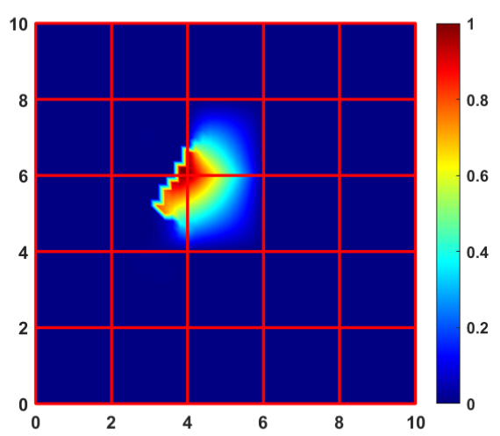
Test Case
Basis functions capture the discontinuities well

Slide 12
Conclusions
MS-XFEM is much better applicable for geoscience projects than XFEM
XFEM was used for local basis functions, FEM for coarse-scale system!
MS-XFEM was found accurate for simulation of contact-frictional behaviors under compressive stress

Slide 13
Thank You
f.xu-4@tudelft.nl

