Slide 1
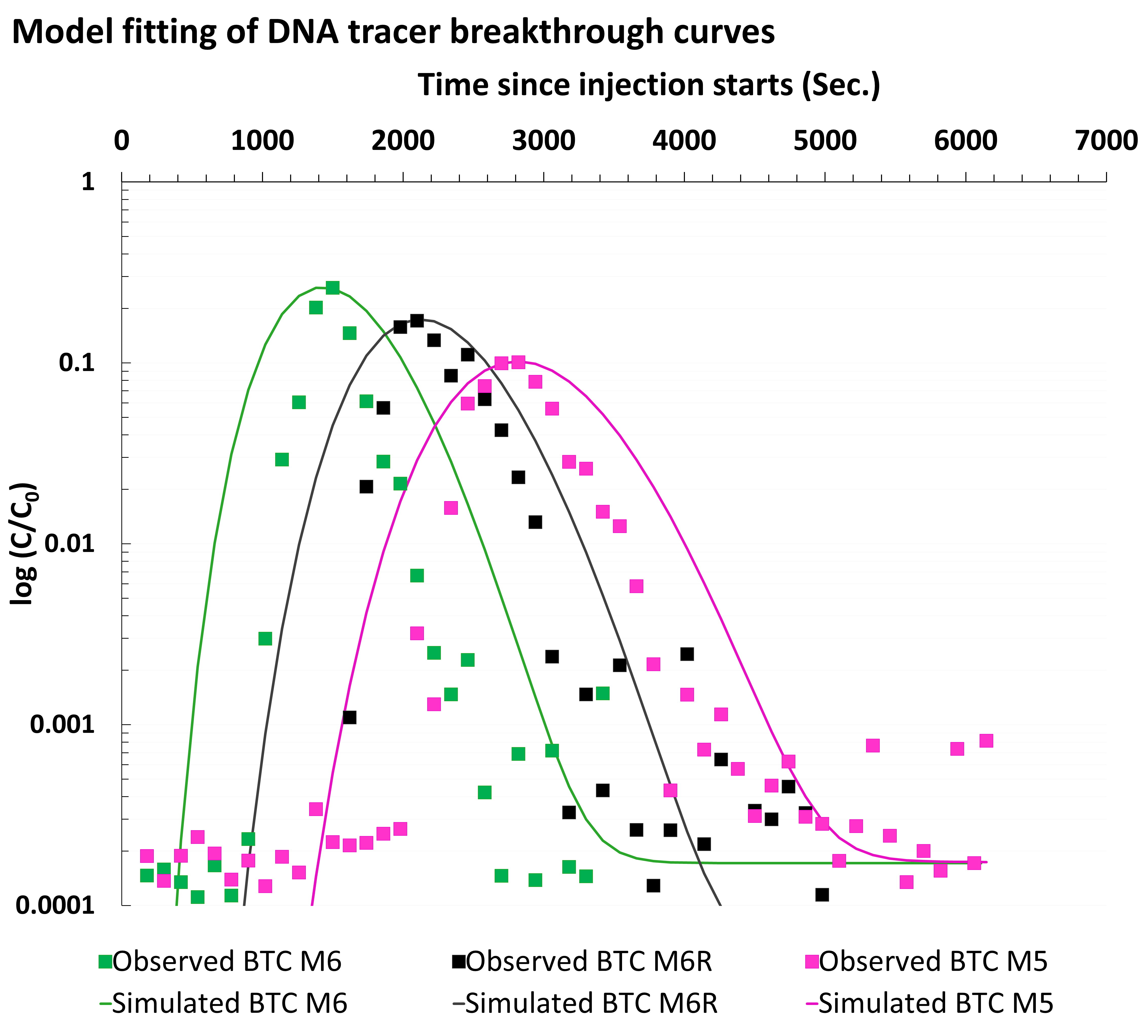
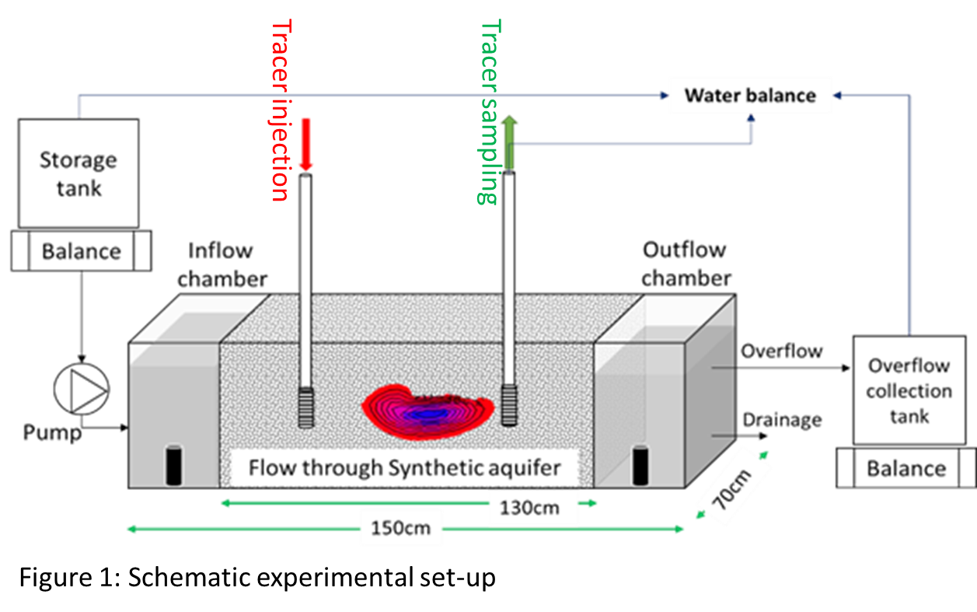
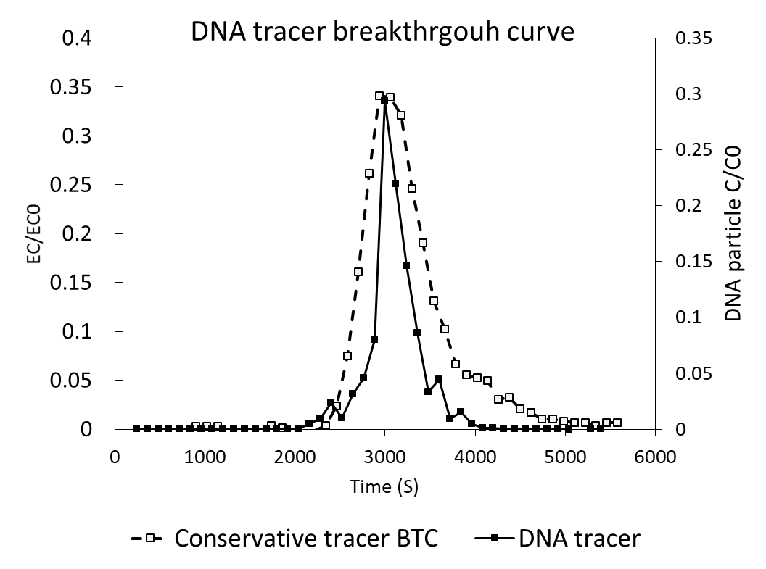
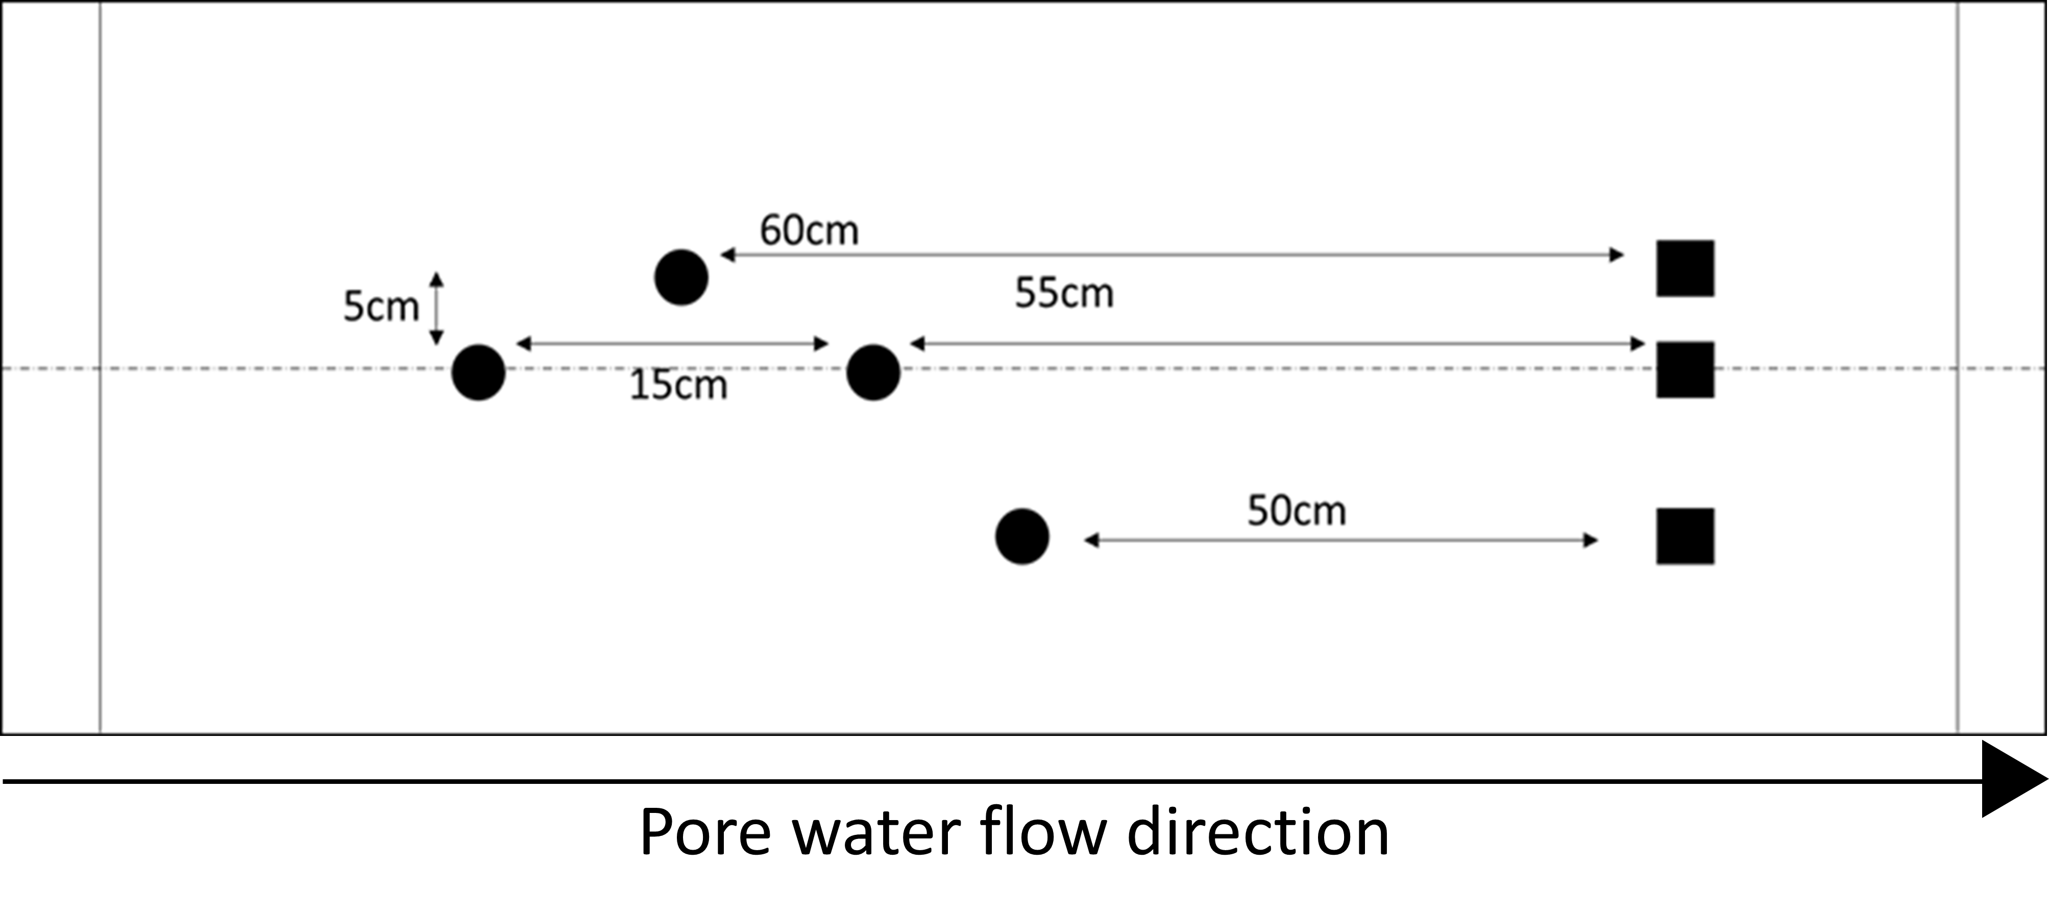
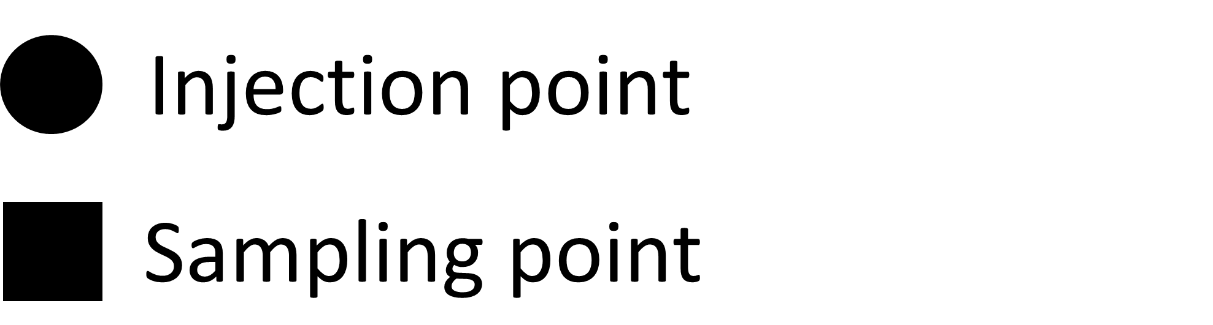
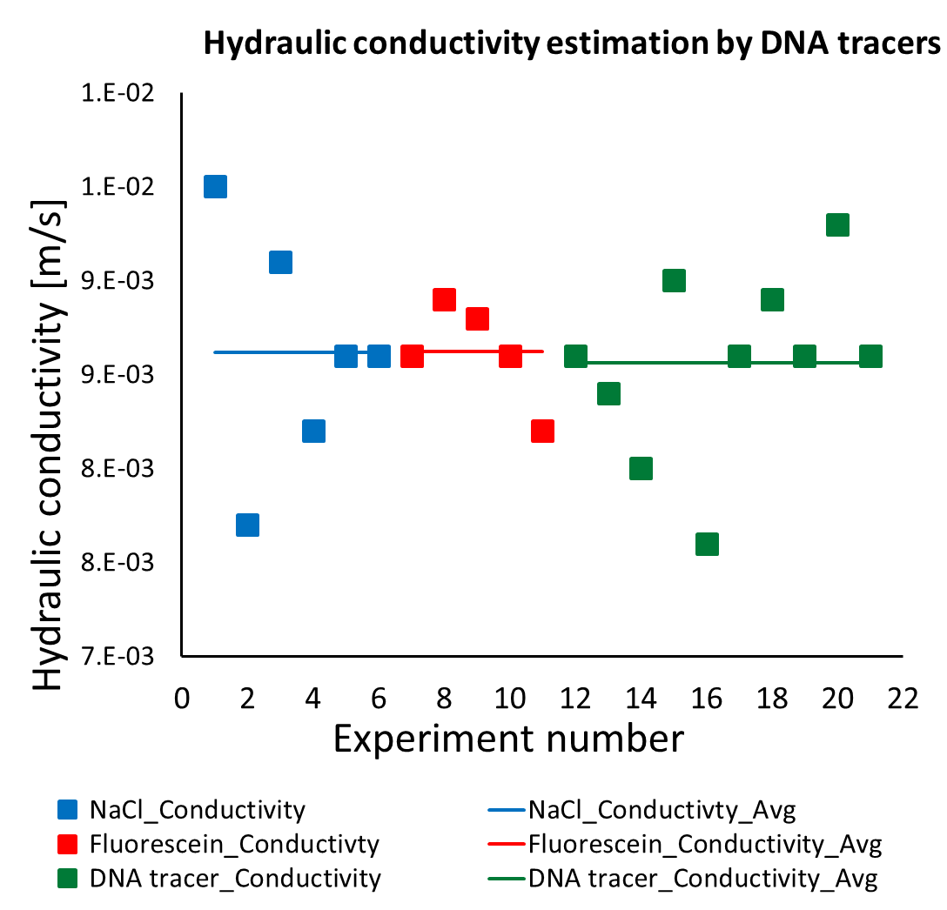
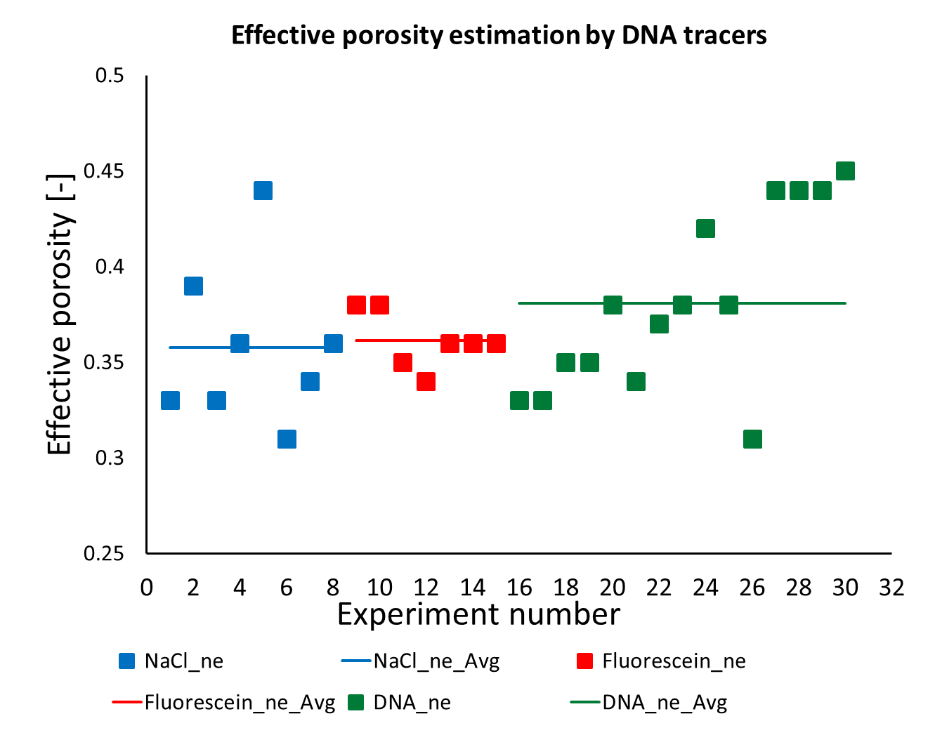
Use of DNA tracers for determining aquifer hydraulic properties in a 3-dimensional laboratory sand tank
Swagatam Chakraborty¹, Rayan Hamza Mohamed Elhaj², Chamath Arachchilage² , Jan Willem Foppen^{2,3}, Thom Bogaard³, and Jack Schijven⁴
https://www.tudelft.nl/citg/onderzoek/stories-of-science/water-met-een-streepjescode
Poster session 8, 3rd June 2021
¹Department of Earth Sciences, Faculty of Geosciences, Universiteit Utrecht, Utrecht, the Netherlands
²IHE-Delft, Institute for Water Education, Delft, the Netherlands
³Faculty of Civil Engineering and Geosciences, Delft University of Technology (TUDelft), Stevinweg 1, 2628 CN Delft, the Netherlands
⁴Department of Statistics, Informatics and Modelling, National Institute of Public Health and the Environment, P.O.Box 1, 3720 BA Bilthoven, the Netherlands
Introduction and objectives
DNA tracers
Traditional groundwater tracers (NaCl, dyes etc.) suffers from lack of distinctiveness, inability of multi-point, multi-plexed tracing, background noise concerns. We investigate recently developed DNA tracers as a potential alternative for groundwater and contaminant tracing. Precisely, here we present preliminary results oriented towards the objectives -
Potential of DNA microparticle tracers in determining porous media hydraulic parameters (hydraulic conductivity [K], effective porosity [n_{e}])
Comparison of three dimensional transport behaviour of DNA microparticle tracers with traditional conservative tracers
Silica encapsulated, magnetic core, double stranded DNA microparticle
Spherical (200-300nm); Zeta potential ca.-45mV - -50mV
Quantification: Quantitative Polymerase Chain Reaction (qPCR)
Set up and methodology
Set up
Homogeneous, silica sand
⌀ 500-700µm and 1200-1500µm
Water balance discrepancy < 2-3%
Method
Under controlled boundary conditions and steady state, known volume of DNA tracer suspensions are injection at a rate of 1.6ml/minute. The sample are collected at downgradient from several sampling points distributed both on and offset from principle flow line.
Several configurations of injection and sampling point experiments were subsequently carried out
Parameter estimation
(Hydraulic conductivity,
effective porosity)
Results
Conclusion
Hydraulic conductivity and effective porosity values and parameter value spaces obtained from DNA tracers are comparable to that conservative tracers
Parameter estimations for hydraulic conductivity and effective porosity were comparable to that of conservative tracers
However, transverse dispersive movement of DNA tracers differ from conservative tracer
DNA tracers are potential tracers for subsurface characterization in terms of hydraulic conductivity and effective porosity
 | Hydraulic conductivity [m/s] |  | Effective porosity [-]
Tracers | Average | Stdev | Average | Stdev
NaCl | 8.6E-03 | 6.4E-04 | 0.36 | 0.04
Fluorescein | 8.6E-03 | 2.7E-04 | 0.36 | 0.01
DNA tracers | 8.6E-03 | 4.9E-04 | 0.38 | 0.05
Future work
Determining longitudinal and transverse dispersion coefficients
Characterization in unconsolidated heterogeneous media
Acknowledgement
Traverse horizontal dispersive movement differs from conservative tracers
The authors acknowledge the invaluable supports from
STW-NWO (fund); NTNU (DNA tracer particles); Biolegio (Primers-qPCR);
Figure 2: Comparing Hydraulic conductivity and effective porosity values obtained from conservative and DNA tracers

